Slide 1
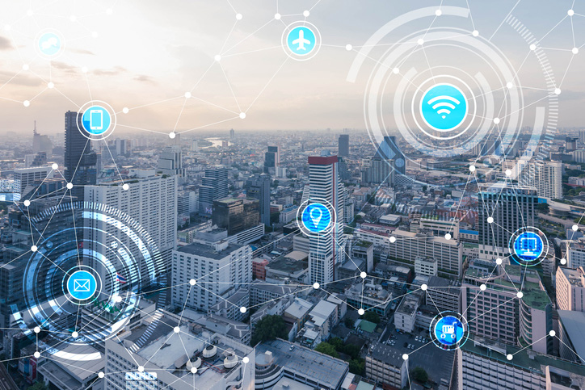
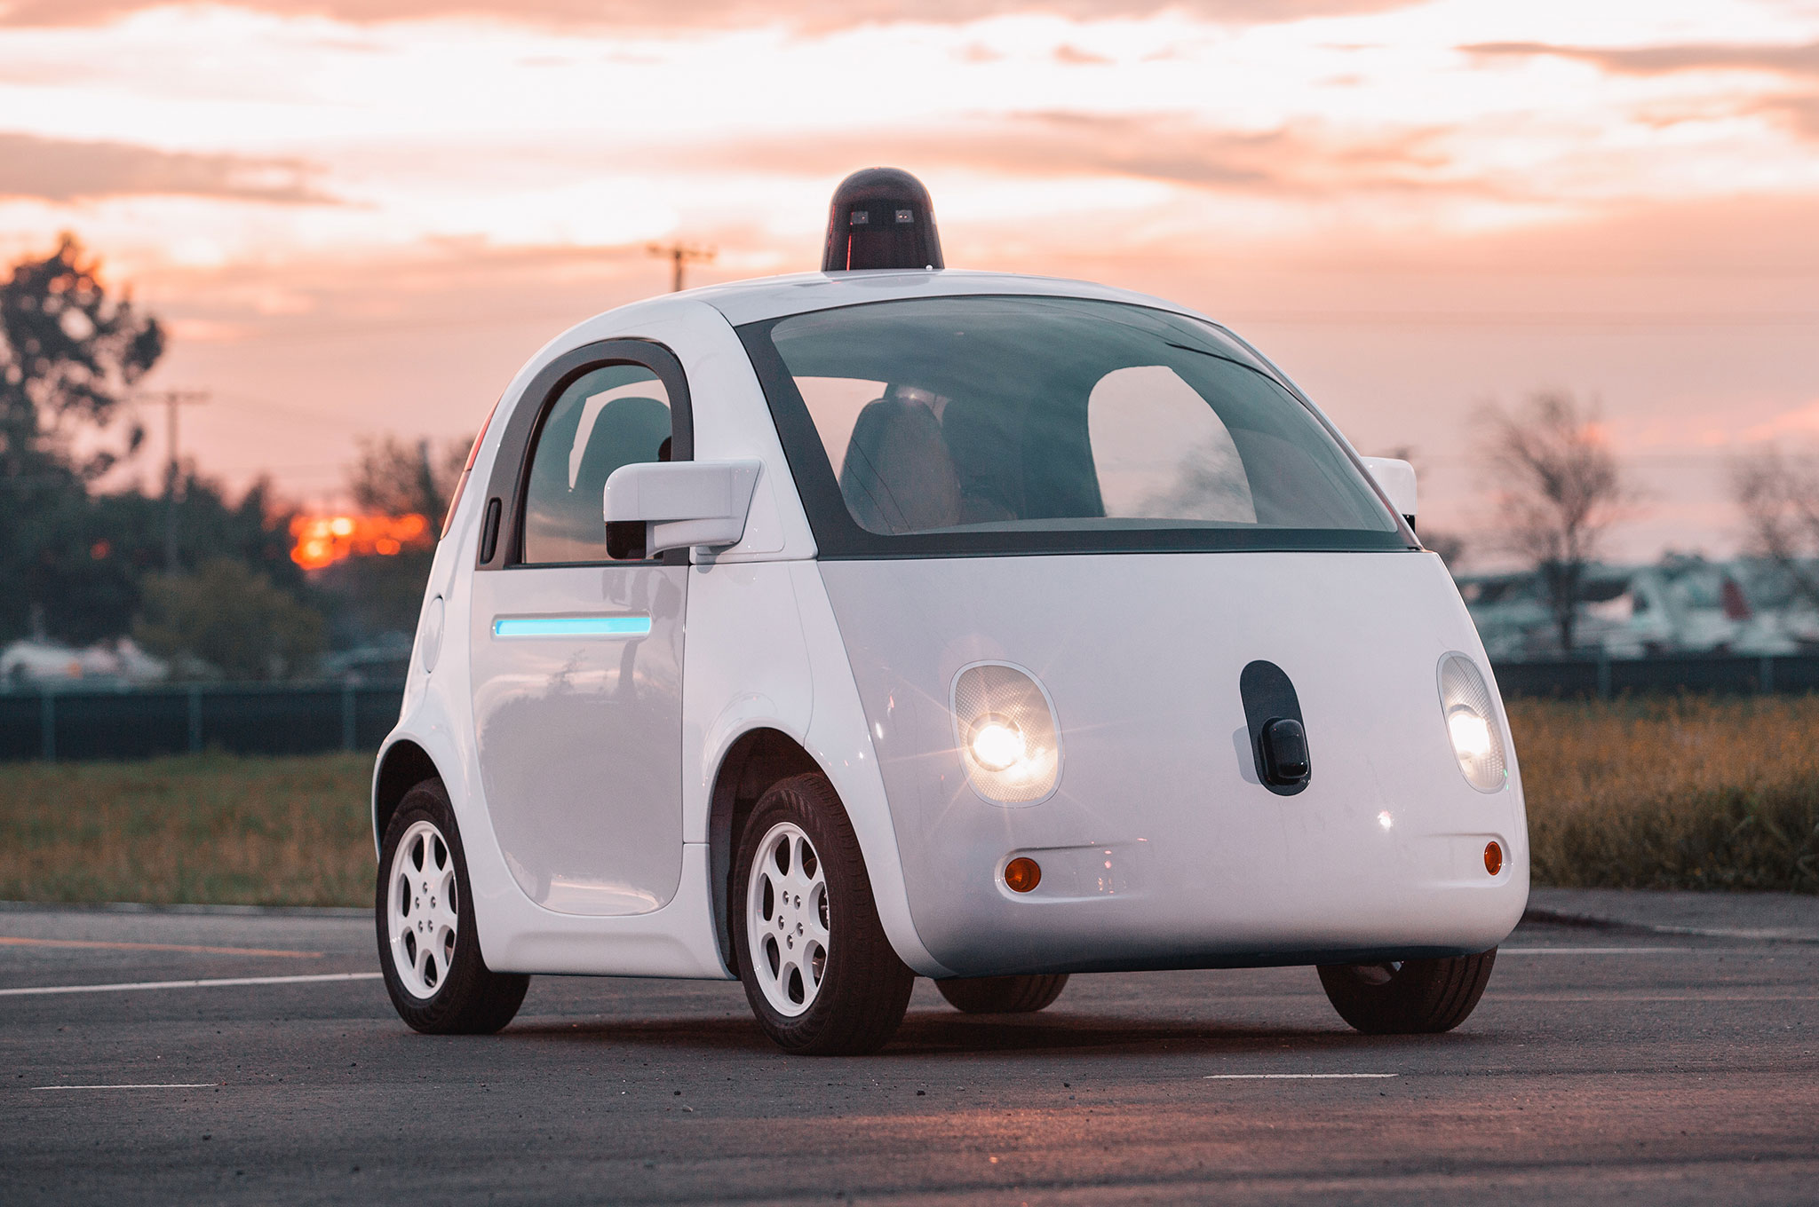
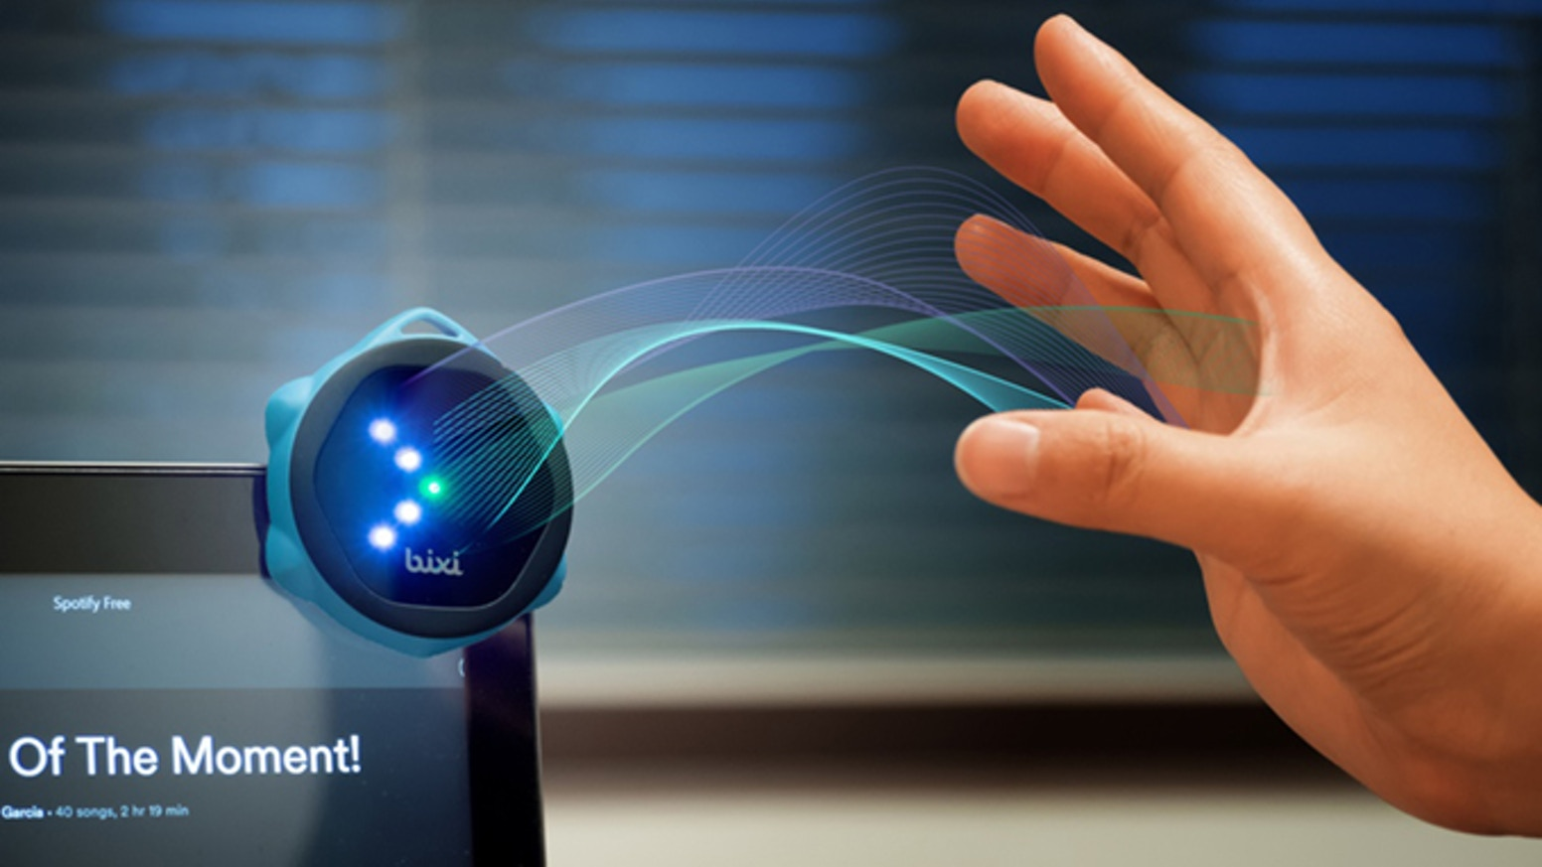
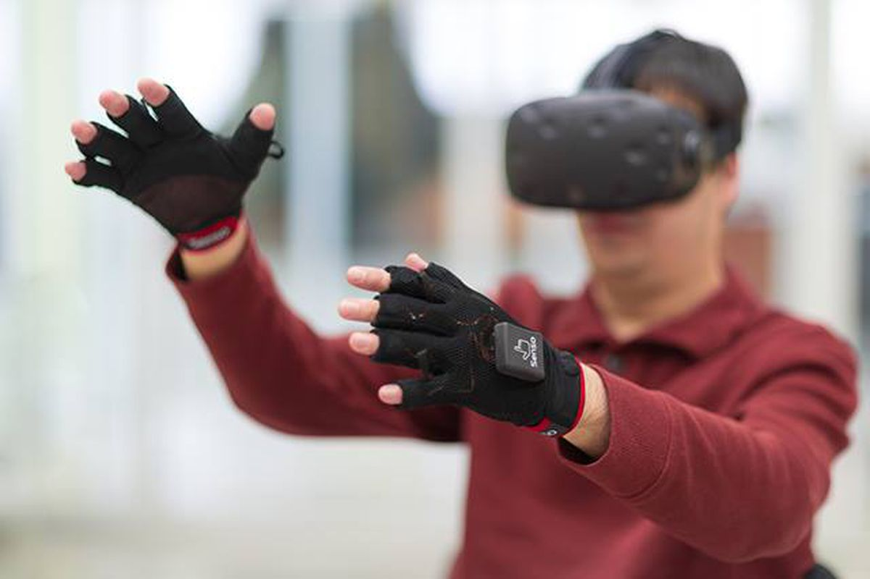

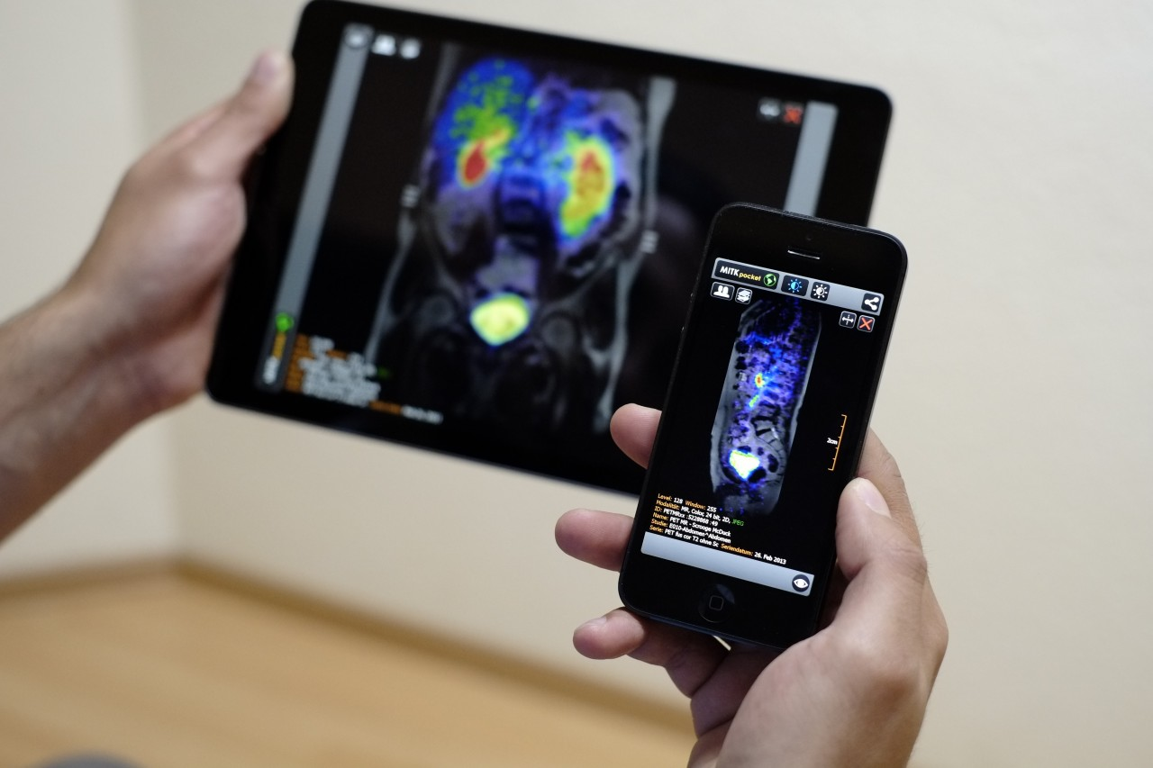
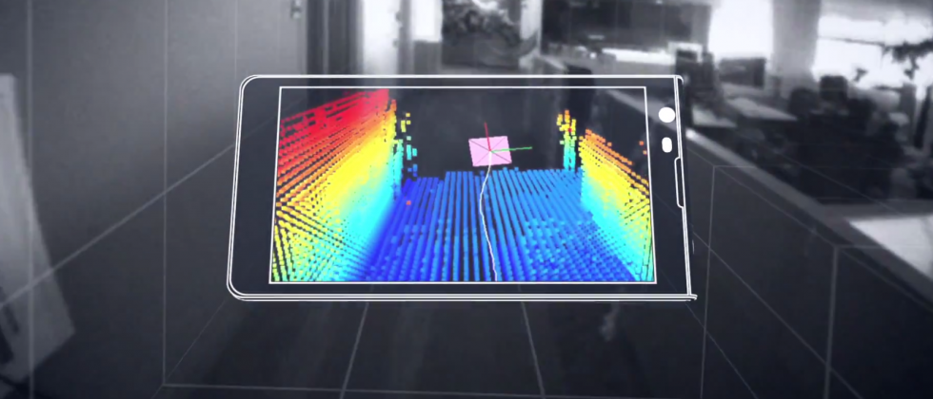
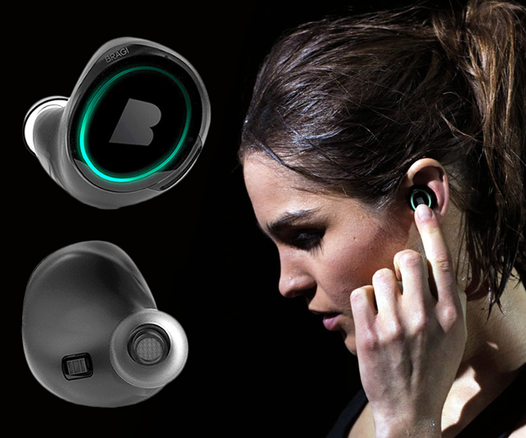
Wireless and Mobile Systems
for the IoT
CMSC 818W : Fall 2020
Lecture 2.1: Wave basics
Nirupam Roy
M-W 2:00-3:15pm
Online

Slide 2
This Zoom session is being recorded.

Slide 3
Waves

Slide 4
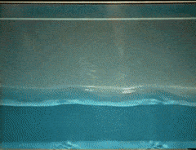
Waves: Transfer of energy, not mass

Slide 5
Sound
Visible light
Physical vibrations
WiFi signal
Ripples in water
Infrared
…
…

Slide 6
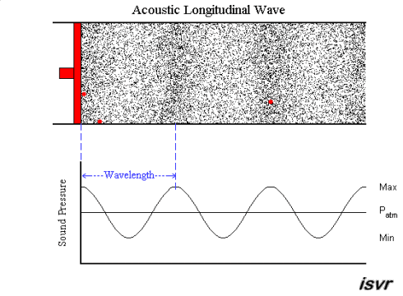
Mechanical Wave
Electromagnetic Wave
Sound
Visible light
Physical vibrations
WiFi signal
Ripples in water
Infrared
…
…

Slide 9
Waves made this possible

Slide 10
Waves made this possible

Slide 11
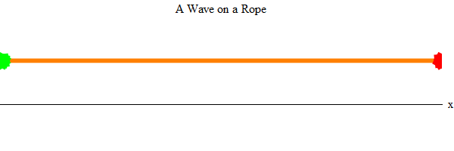
Waves properties:
Speed, frequency, amplitude, phase

Slide 12
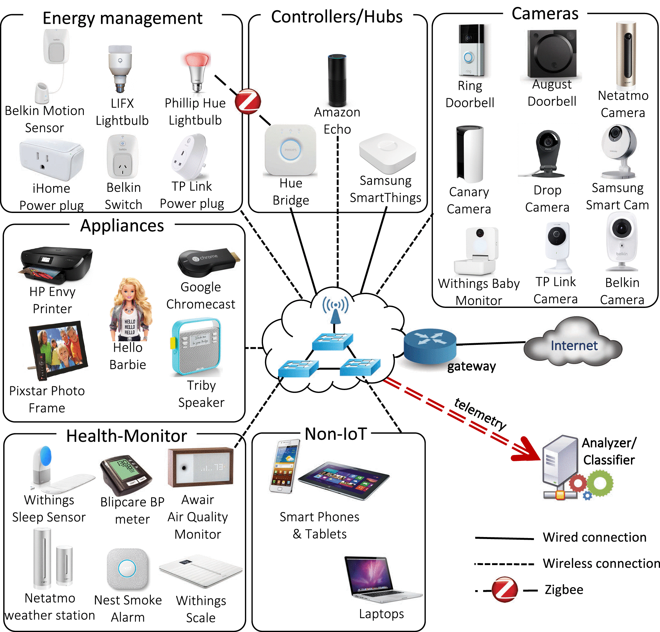
Waves made this possible

Slide 13
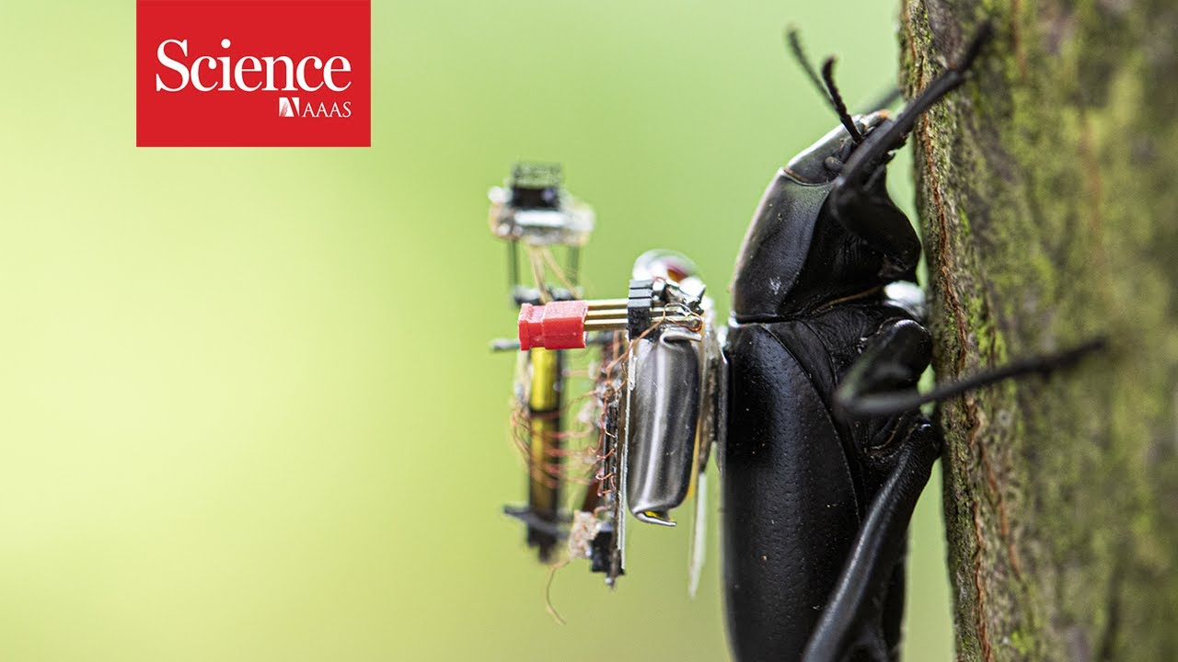
Waves made this possible

Slide 14

Waves in time and space

Slide 15
Waves in time and space
Temporal variation of the wave’s amplitude

Slide 16
Waves in time and space

Slide 17
Equation of waves in time and space

Slide 18
Equation of waves in time and space

Slide 19
Equation of waves in time and space

Slide 20
Equation of waves in time and space

Slide 21
Equation of waves in time and space

Slide 22
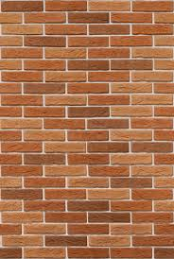
Reflection
Absorption
+
Reflection
echo

Slide 23
Reflection
Time = t1

Slide 24
Reflection
Time = t1
Absorption
+
Reflection

Slide 25
Reflection
Time = t1
Absorption
+
Reflection
echo
t2

Slide 26
Reflection
Time = t1
Absorption
+
Reflection
d
echo
t2
Sound travelled (2d) distance

Slide 27
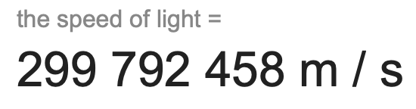
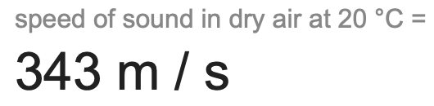
The speed of the wave is known

Slide 28
Reflection
Time = t1
Absorption
+
Reflection
d
echo
t2
Sound travelled (2d) distance
C.(t2-t1) = 2d

Slide 29
Reflection
Time = t1
Absorption
+
Reflection
d
Echolocation
echo
t2
Sound travelled (2d) distance
C.(t2-t1) = 2d

Slide 30
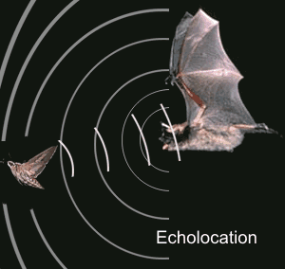
Echolocation in nature
Bat

Slide 31
Application: Contact tracing

Slide 32
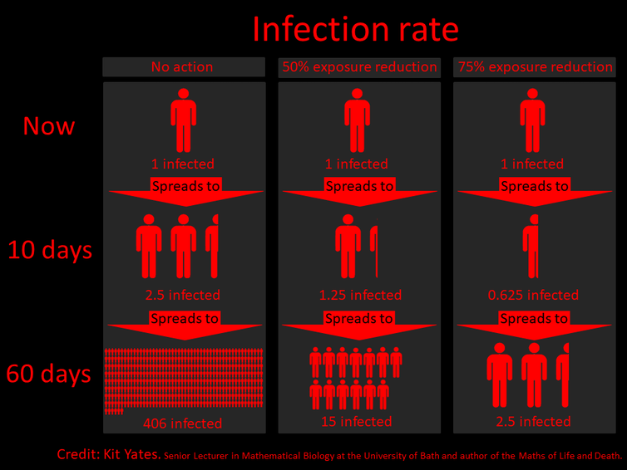

Slide 33
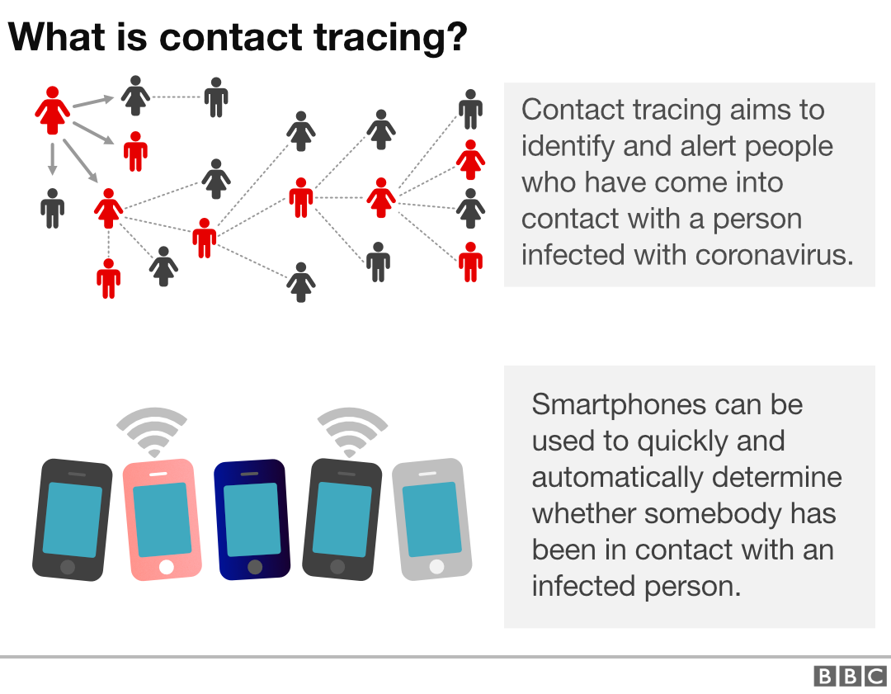
How to find the proximity between two smartphones?

Slide 34
A simple acoustic ranging technique
BeepBeep – SenSys 2007

Slide 35

Distance = d
Device A
Device B

Slide 36
Time = t1
Distance = d
Device A
Device B

Slide 37
Time = t1
Time = t2
Distance = d
Device A
Device B

Slide 38
Bluetooth/WiFi
Time = t1
Time = t1
Time = t2
Distance = d
Device A
Device B

Slide 39
Bluetooth/WiFi
Time = t1
Time = t1
Time = t2
Distance = d
Device A
Device B
d = C . (t2-t1)
C = speed of the wave
= ~340m/s for sound

Slide 40
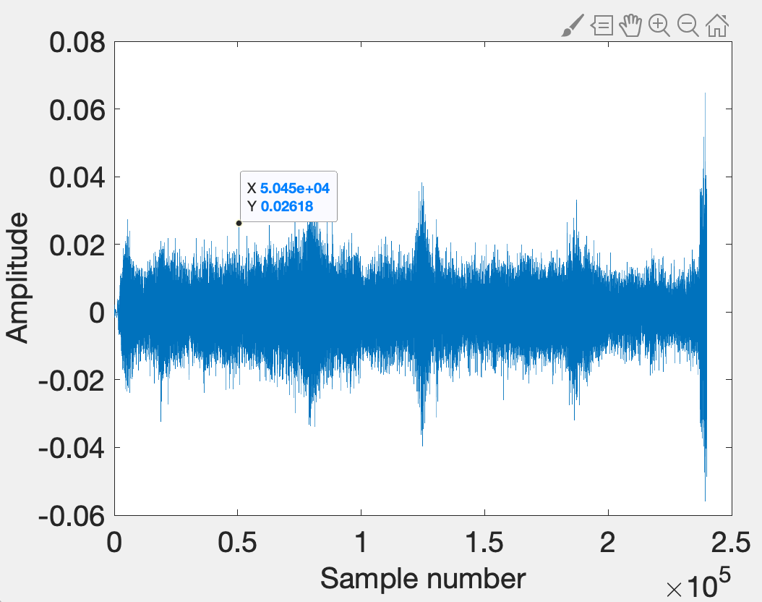

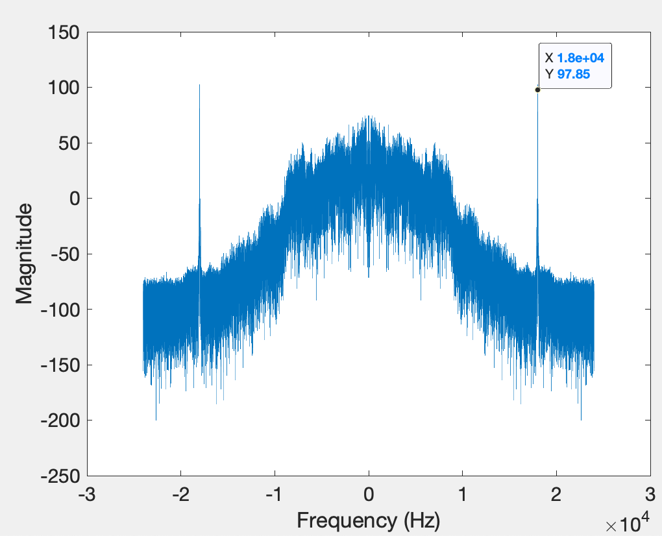
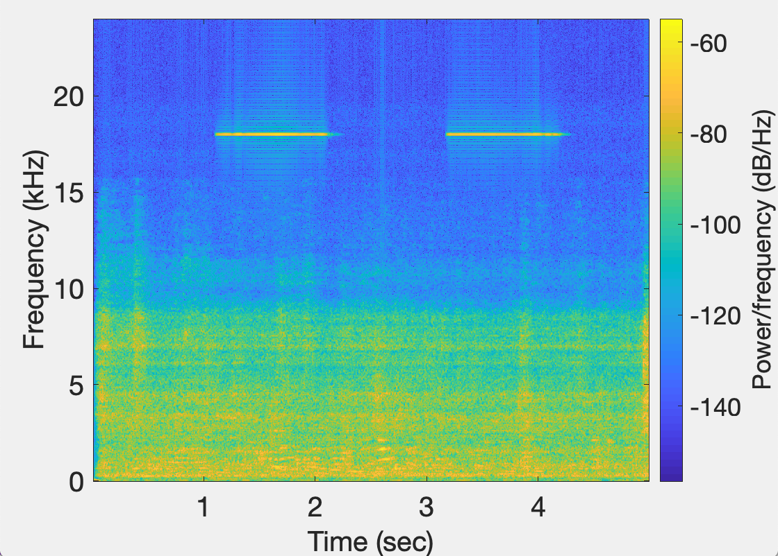
Time domain
signal
FFT Plot
Device A
STFT Plot

Slide 41
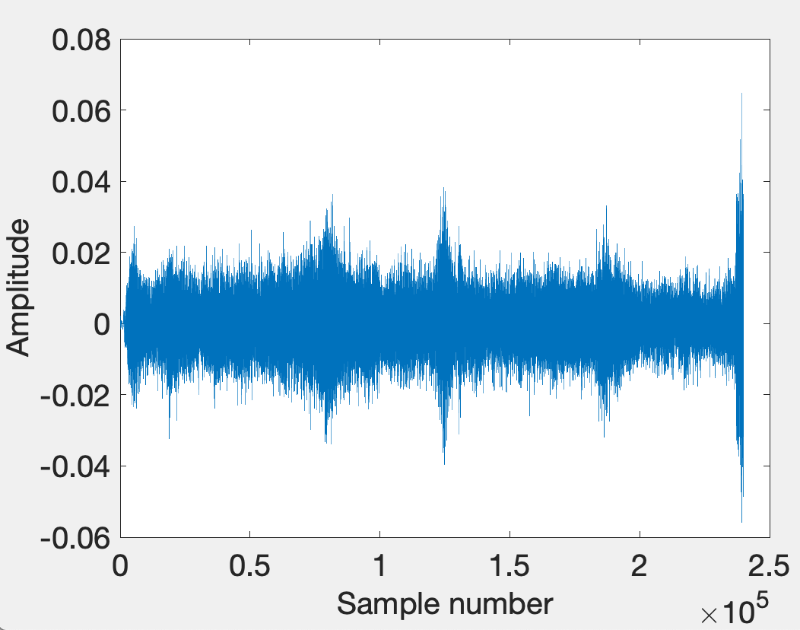
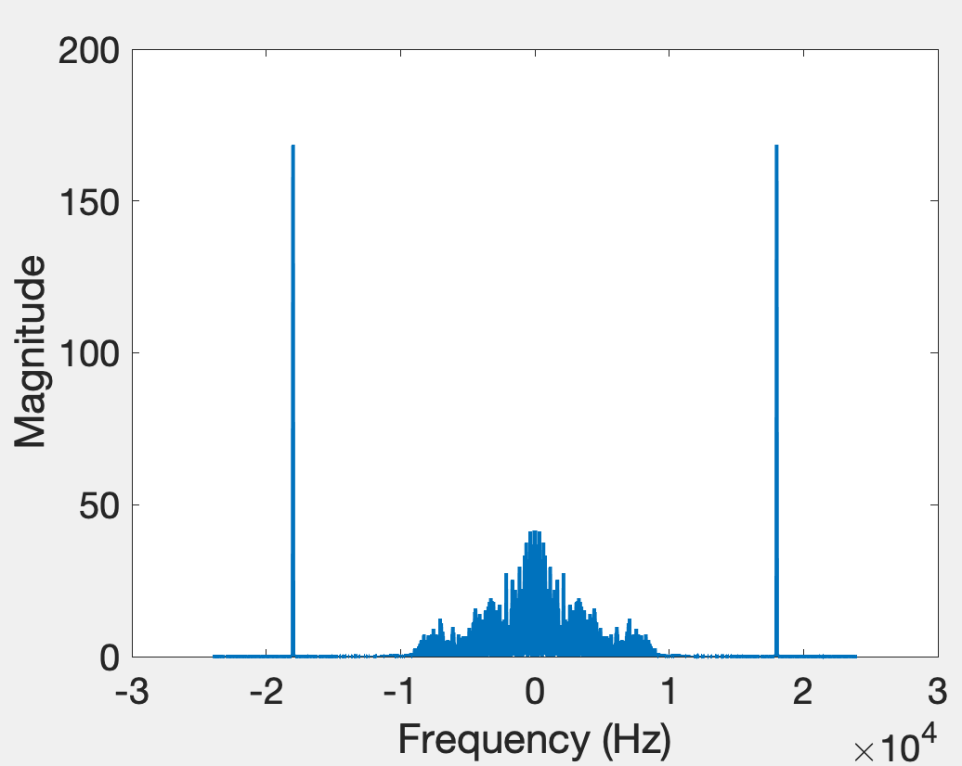
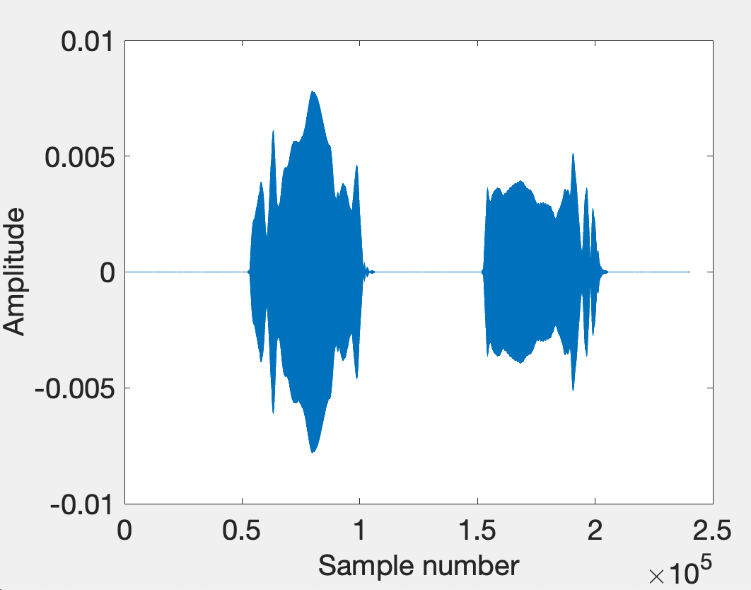
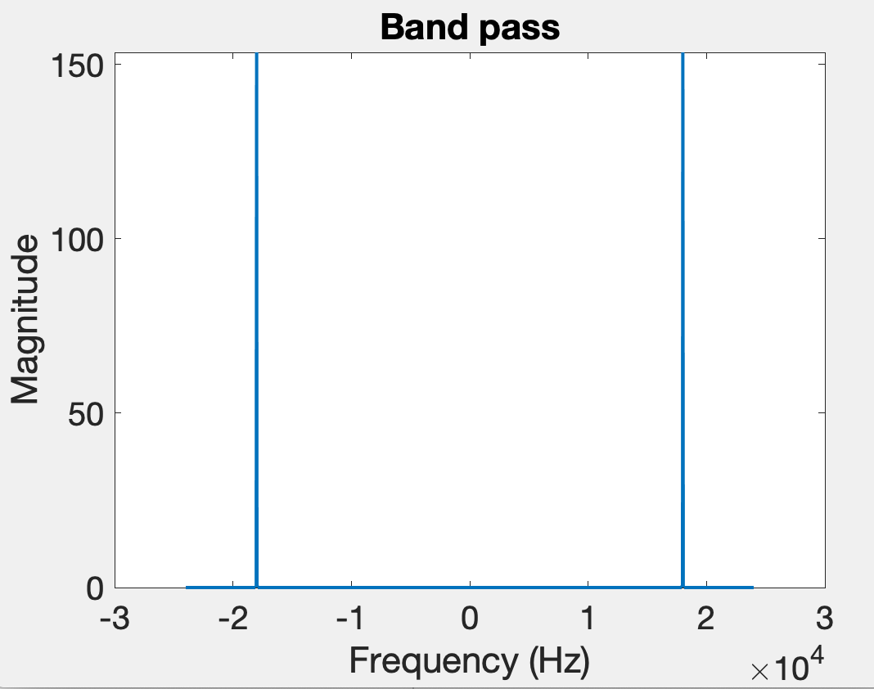
Time domain
Freq. domain
After bandpass filter

Slide 42
Bluetooth/WiFi
Time = t1
Time = t1
Time = t2
Distance = d
Problem: Clock synchronization
Device A
Device B
d = C . (t2-t1)

Slide 43
The root cause of inaccuracy
– three uncertainties
Clock synchronization uncertainty
time

Slide 44
The root cause of inaccuracy
– three uncertainties
Clock synchronization uncertainty
Sending uncertainty
time

Slide 45
Sound production and recording

Slide 46
Sound recording with microphone
Sound

Slide 47
Sound recording with microphone
Analog signal (voltage)
Sound
ADC
ADC = Analog-to-Digital Converter

Slide 48
Sound recording with microphone
Analog signal (voltage)
Sound
ADC
S6 S5 S4 S3 S2 S1 S0
Audio Sample Buffer
ADC = Analog-to-Digital Converter

Slide 49
Sound production with speaker
S6 S5 S4 S3 S2 S1 S0
Audio Sample Buffer

Slide 50
Sound production with speaker
S6 S5 S4 S3 S2 S1 S0
Analog signal (voltage)
Audio Sample Buffer
DAC
DAC = Digital-to-Analog Converter

Slide 51

Sound production with speaker
S6 S5 S4 S3 S2 S1 S0
Analog signal (voltage)
Audio Sample Buffer
DAC
Sound
DAC = Digital-to-Analog Converter

Slide 52
The root cause of inaccuracy
– three uncertainties
Clock synchronization uncertainty
Sending uncertainty
software issuing command
...
t0 = wall_clock();
write(sound_dev, signal);
...
time

Slide 53

The root cause of inaccuracy
– three uncertainties
Clock synchronization uncertainty
Sending uncertainty
software issuing command
...
t0 = wall_clock();
write(sound_dev, signal);
...
unknown delays (software, system, driver, hardware, …) ?
sound leaves
speaker
time

Slide 54
The root cause of inaccuracy
– three uncertainties
Clock synchronization uncertainty
Sending uncertainty
Receiving uncertainty
software issuing command
...
t0 = wall_clock();
write(sound_dev, signal);
...
unknown delays (software, system, driver, hardware, …) ?
sound leaves
speaker
time

Slide 55

The root cause of inaccuracy
– three uncertainties
Clock synchronization uncertainty
Sending uncertainty
Receiving uncertainty
software issuing command
...
t0 = wall_clock();
write(sound_dev, signal);
...
unknown delays (software, system, driver, hardware, …) ?
sound leaves
speaker
sound
reaches mic
time

Slide 56
The root cause of inaccuracy
– three uncertainties
Clock synchronization uncertainty
Sending uncertainty
Receiving uncertainty
software issuing command
...
t0 = wall_clock();
write(sound_dev, signal);
...
unknown delays (software, system, driver, hardware, …) ?
sound leaves
speaker
sound
reaches mic
unknown delays (hardware, interrupt, driver, scheduling, …) ?
time

Slide 57
The root cause of inaccuracy
– three uncertainties
Clock synchronization uncertainty
Sending uncertainty
Receiving uncertainty
software issuing command
software aware of arrival
...
t0 = wall_clock();
write(sound_dev, signal);
...
...
read(sound_dev, signal);
t1 = wall_clock();
...
unknown delays (software, system, driver, hardware, …) ?
sound leaves
speaker
sound
reaches mic
unknown delays (hardware, interrupt, driver, scheduling, …) ?
time

Slide 58



Beepbeep’s basic procedure
Device A emits a beep while both recording
Device B emits another beep while both continue recording
Both devices detect TOA of the two beeps and obtain respective ETOAs
Exchange ETOAs and calculate the distance
Device A
Device B
A’s recording
B’s recording
ETOA_{A}
ETOA_{B}
D_{AB}=|ETOA_{A}-ETOA_{B}|/2

Slide 59
Timeline
Device A
Device B

Slide 60

Timeline
Device A
Device B
1st Beep
t_{A0}

Slide 61
Timeline
Device A
Device B
1st Beep
t_{A0}
t_{A1}
t_{B1}

Slide 62

Timeline
Device A
Device B
1st Beep
t_{A0}
t_{A1}
t_{B1}
2nd Beep
t_{B2}

Slide 63
Timeline
Device A
Device B
1st Beep
t_{A0}
t_{A1}
t_{B1}
2nd Beep
t_{B2}
t_{B3}
t_{A3}

Slide 64
Timeline
Device A
Device B
1st Beep
t_{A0}
t_{A1}
t_{B1}
ETOA_{A}
2nd Beep
t_{B2}
t_{B3}
t_{A3}

Slide 65
Timeline
Device A
Device B
1st Beep
t_{A0}
t_{A1}
t_{B1}
ETOA_{B}
ETOA_{A}
2nd Beep
t_{B2}
t_{B3}
t_{A3}

Slide 66
Timeline
Device A
Device B
1st Beep
t_{A0}
t_{A1}
P
t_{B1}
ETOA_{B}
ETOA_{A}
2nd Beep
t_{B2}
t_{B3}
t_{A3}

Slide 67
Timeline
Device A
Device B
1st Beep
t_{A0}
t_{A1}
P
t_{B1}
ETOA_{B}
ETOA_{A}
2nd Beep
t_{B2}
t_{B3}
P
t_{A3}

Slide 68
Timeline
Device A
Device B
1st Beep
t_{A0}
t_{A1}
P
t_{B1}
ETOA_{B}
Q
ETOA_{A}
2nd Beep
t_{B2}
t_{B3}
P
t_{A3}

Slide 69
Timeline
Device A
Device B
1st Beep
t_{A0}
t_{A1}
P
t_{B1}
ETOA_{B}
Q
|ETOA_{A}-ETOA_{B}|
ETOA_{A}
2nd Beep
t_{B2}
= (P+Q+P) – (Q)
t_{B3}
P
t_{A3}

Slide 70
Timeline
Device A
Device B
1st Beep
t_{A0}
t_{A1}
P
t_{B1}
ETOA_{B}
Q
|ETOA_{A}-ETOA_{B}|
ETOA_{A}
2nd Beep
t_{B2}
= (P+Q+P) – (Q)
t_{B3}
P
= 2P
t_{A3}
= 2 (time of flight)

Slide 71
Fine-grained distance measurement

Slide 72
Equation of waves in time and space

Slide 73
Equation of waves in time and space

Slide 74
Equation of waves in time and space
Temporal variation of the wave’s amplitude

Slide 75
Equation of waves in time and space

Slide 76
Frequency, Amplitude, and Phase

Slide 77
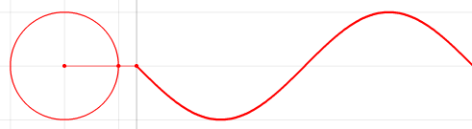


Frequency, Amplitude, and Phase
$$f cycles per second$$
$$2π angles per cycle$$
Time

Slide 78
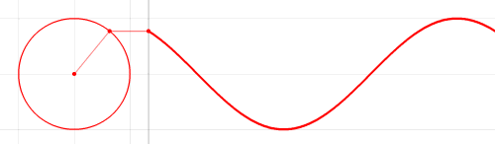
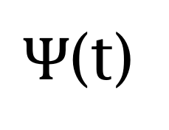
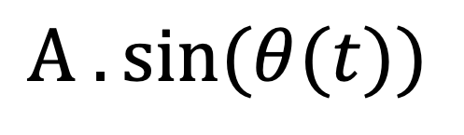


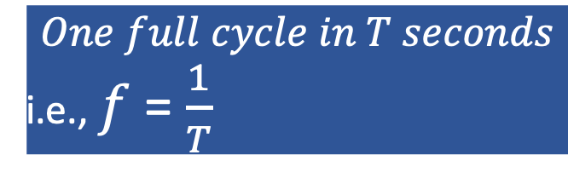
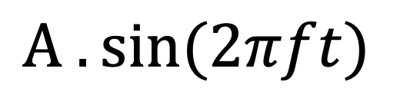
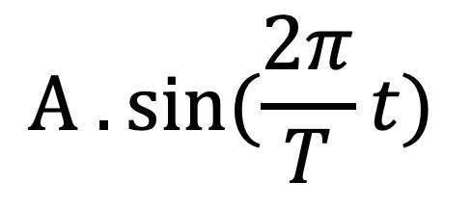

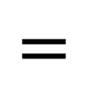
Frequency, Amplitude, and Phase
$$2π angles per cycle$$
$$f cycles per second$$
$$One full cycle in T seconds$$
i.e., $f$ = $\frac{1}{T}$
A
𝚹
Phase
time = t second
$Ψ$(t)
$$=$$
$$A . sin⁡(θ(t))$$
$$A . sin⁡(\frac{2π}{T}t)$$
$$=$$
$$A . sin⁡(2πft)$$
$$=$$

Slide 79
Equation of waves in time and space

Slide 80
Equation of waves in time and space

Slide 81
Equation of waves in time and space

Slide 82


Equation of waves in time and space
$$distance from the source (x)$$
$$space$$

Slide 83
Equation of waves in time and space
Amplitude here
$$distance from the source (x)$$
$$space$$
is a delayed version of
the amplitude here.

Slide 84
Equation of waves in time and space
Amplitude here
$$distance from the source (x)$$
$$space$$
is a delayed version of
the amplitude here.

Slide 85
Equation of waves in time and space
Amplitude here
The delay depends
on the distance.
$$distance from the source (x)$$
$$space$$
is a delayed version of
the amplitude here.

Slide 86


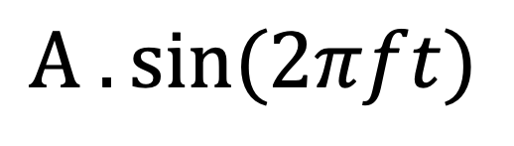
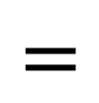
Equation of waves in time and space
Amplitude here
The delay depends
on the distance.
$$distance from the source (x)$$
$$space$$
is a delayed version of
the amplitude here.
$$A . sin⁡(\frac{2π}{T}t)$$
$Ψ$(t)
$$=$$
$$A . sin⁡(2πft)$$
$$=$$

Slide 87
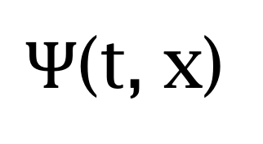
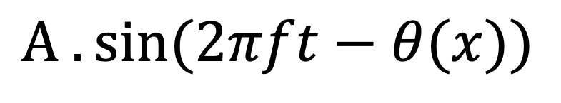
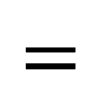
Equation of waves in time and space
Amplitude here
The delay depends
on the distance.
$$distance from the source (x)$$
$$space$$
is a delayed version of
the amplitude here.
$Ψ$(t, x)
$$=$$
$$A . sin⁡(2πft−θ(x))$$
Why is this negative?

Slide 88
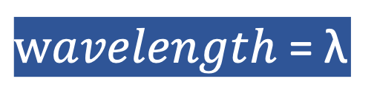
Equation of waves in time and space
$wavelength$ = λ
$$distance from the source (x)$$
$$space$$
$Ψ$(t, x)
$$=$$
$$A . sin⁡(2πft−θ(x))$$

Slide 89


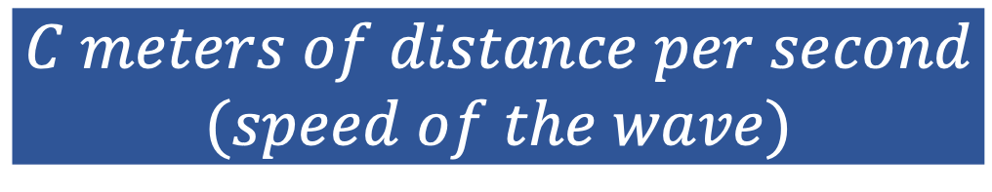
Equation of waves in time and space
$wavelength$ = λ
$$f number of cycles per second$$
$$C meters of distance per second$$
$$(speed of the wave)$$
$distance per cycle=\text{λ}$ = $C$/ $f$

