Slide 1
Wireless and Mobile Systems
for the IoT
CMSC 818W : Fall 2020
Lecture 2.3: Sensing in Time and Space – Part 2
Nirupam Roy
M-W 2:00-3:15pm
Online

Slide 2
This Zoom session is being recorded.

Slide 3
Assignment-1 deadline extension:
New deadline Sept 29th 11:59pm

Slide 4
Superimposition of sinusoids
Signal amplified
(perfect constructive interference)
$$sin⁡(2πft)$$
$$d=λ/2$$
$$\sin\left(2πft+\frac{2πd}{λ}\right)$$
= $\sin\left(2πft+π\right)$
= $− sin\left(2πft\right)$
Signal nullified
Signal nullified

Slide 5
Superimposition of sinusoids: Gain
Power gain due to the array structure
Distance from the center of the array
$$−λ/4$$
$$0$$
$$λ/4$$
$$d=λ/2$$
Constant phase difference of $\frac{2πd}{λ}$

Slide 6
Beamforming in 2D space
Approximation for ‘far field’
$$φ$$
Along this line
$d sin$($φ$)
$$φ$$
$$d$$
Combined signal = $\sin\left(2πft\right) + \sin\left(2πft+ \frac{2π d sin (φ)}{λ}\right)$
= $e^{j\left(2πft\right)}{ }+e^{j\left(2πft+ \frac{2π d sin(φ)}{λ}\right)}{ }$

Slide 7
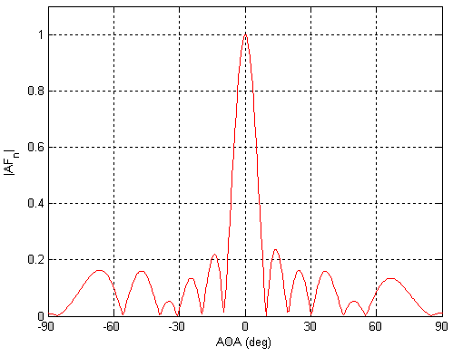

Slide 8
Beamforming in 2D space
$$φ$$
$$d$$
+
Combined signal
= $e^{j\left(2πft\right)}{ }+e^{j\left(2πft + \frac{2π d sin(φ)}{λ}\right)}{ }$

Slide 9
Uniform Linear Array (ULA)

Slide 10
Beamforming in 2D space
$d sin$($φ$)
$$E1$$
$$E2$$
$$E3$$
$$E4$$
…
N elements
$$d$$
$$d$$
$$d$$
Interelement distance = d

Slide 11
Beamforming in 2D space
$3d sin$($φ$)
$2d sin$($φ$)
$d sin$($φ$)
$$E1$$
$$E2$$
$$E3$$
$$E4$$
…
N elements
$$d$$
$$d$$
$$d$$
Interelement distance = d

Slide 12
Beamforming in 2D space
$3d sin$($φ$)
$2d sin$($φ$)
$d sin$($φ$)
$$E1$$
$$E2$$
$$E3$$
$$E4$$
…
N elements
$$d$$
$$d$$
$$d$$
Path difference with n^{th} element:
$\left(n−1\right)d sin$($φ$)
Phase difference with n^{th} element:
$\left(n−1\right)d sin$($φ$) 2Π/λ

Slide 13
$3d cos$($φ$)
$2d sin$($φ$)
Beamforming in 2D space
$d sin$($φ$)
$$E1$$
$$E2$$
$$E3$$
$$E4$$
…
N elements
$$d$$
$$d$$
$$d$$
Path difference with n^{th} element:
$\left(n−1\right)d sin$($φ$)
Phase difference with n^{th} element:
$\left(n−1\right)d sin$($φ$) 2Π/λ
Original signal:
$e^{j\left(2πft\right)}{ }$
Combined signal:

Slide 14
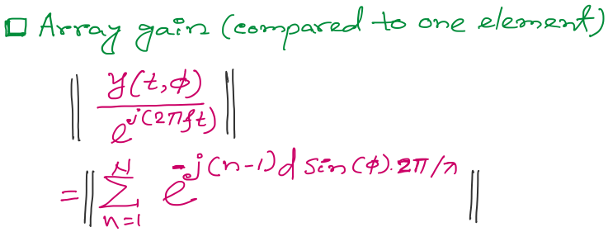
Beamforming in 2D space
f
Notes:
http://www.waves.utoronto.ca/prof/svhum/ece422/notes/15-arrays2.pdf

Slide 15
Beamforming in 2D space
Notes:
http://www.waves.utoronto.ca/prof/svhum/ece422/notes/15-arrays2.pdf

Slide 16
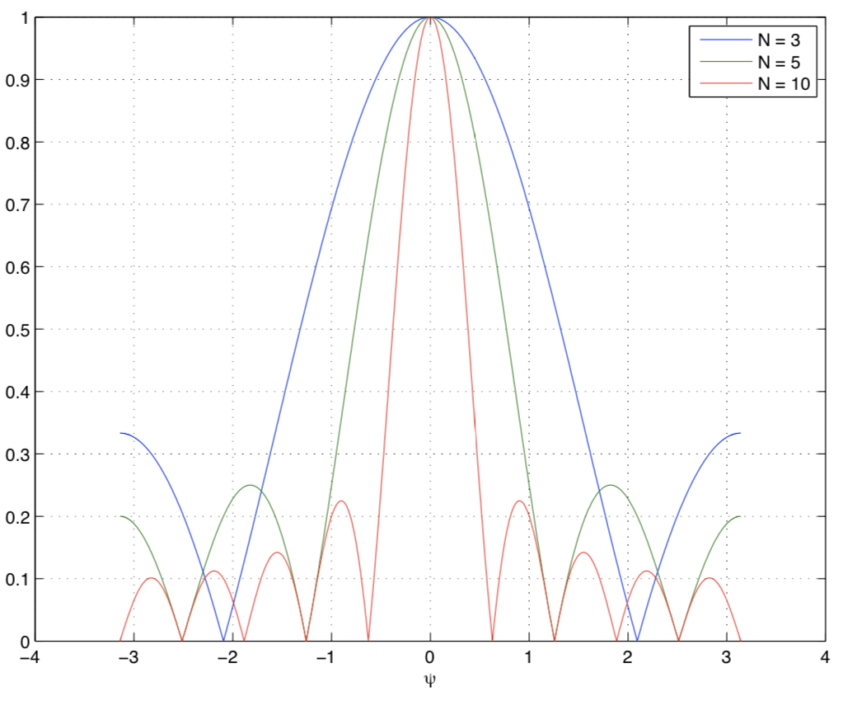
Beamforming in 2D space
Gain
-90 -60 -30 0 30 60 90
Angle
Notes:
http://www.waves.utoronto.ca/prof/svhum/ece422/notes/15-arrays2.pdf

Slide 17
Beamforming in 2D space
Notes:
http://www.waves.utoronto.ca/prof/svhum/ece422/notes/15-arrays2.pdf

Slide 18
Beamforming in 2D space: Broadside vs. Endfire

Slide 19
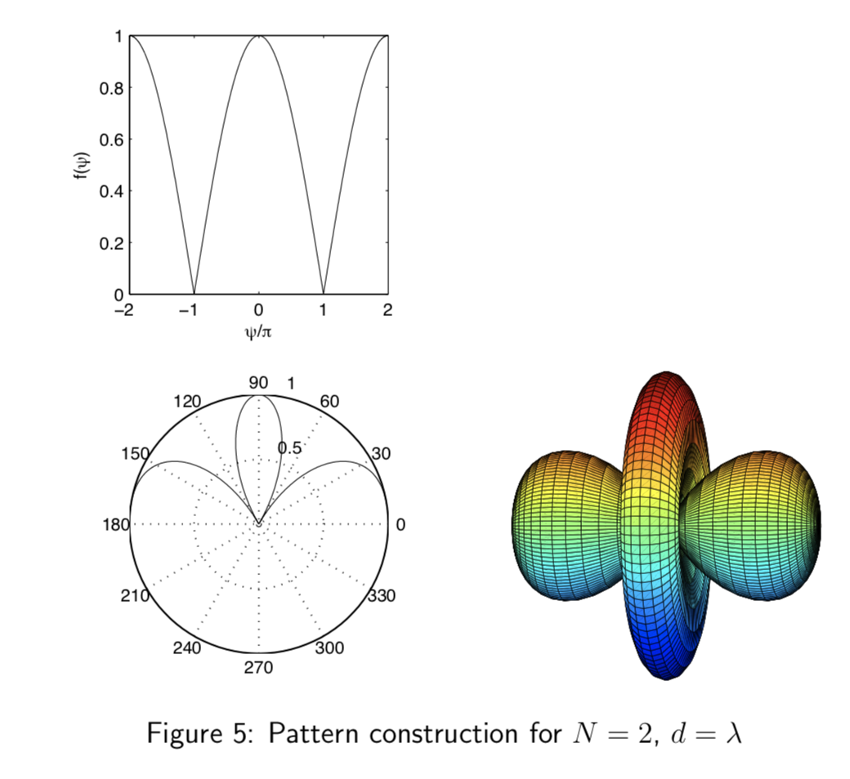
Beamforming in 2D space
Notes:
http://www.waves.utoronto.ca/prof/svhum/ece422/notes/15-arrays2.pdf

Slide 20
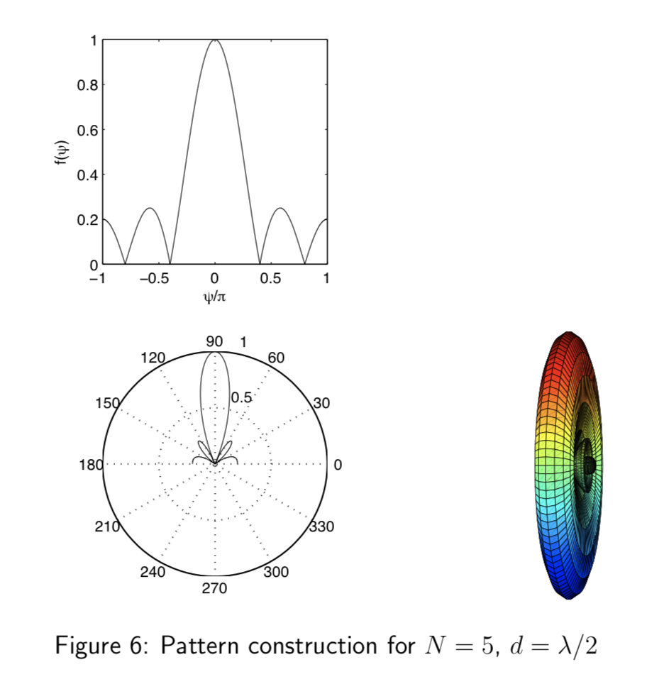
Beamforming in 2D space
Notes:
http://www.waves.utoronto.ca/prof/svhum/ece422/notes/15-arrays2.pdf

Slide 21
Beamforming in 2D space

Slide 22
Gain pattern calculation
Matlab demo

Slide 23
Beam-steering
Delay-sum beamformer or Phased array
Notes:
http://www.waves.utoronto.ca/prof/svhum/ece422/notes/15-arrays2.pdf

Slide 24
Beam-steering
Delay-sum beamformer or Phased array
Add additional phase:
$−\left(n−1\right)d sin$(𝚹_{s}) 2Π/λ
Notes:
http://www.waves.utoronto.ca/prof/svhum/ece422/notes/15-arrays2.pdf

Slide 25
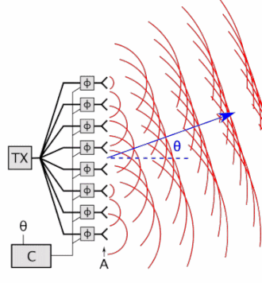
Beam-steering
Delay-sum beamformer or Phased array
Notes:
http://www.waves.utoronto.ca/prof/svhum/ece422/notes/15-arrays2.pdf

Slide 26
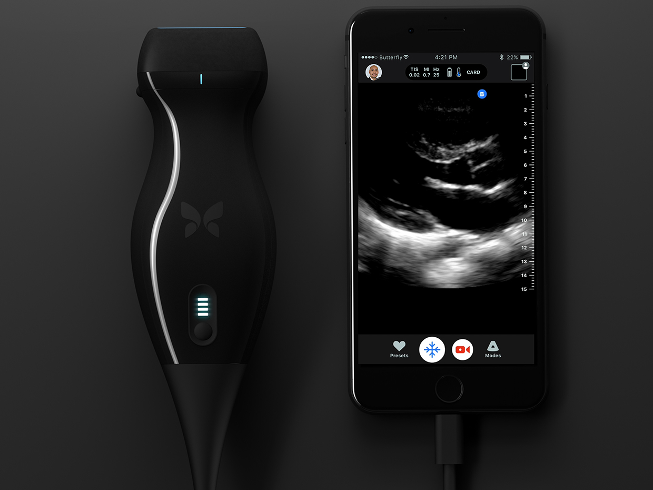
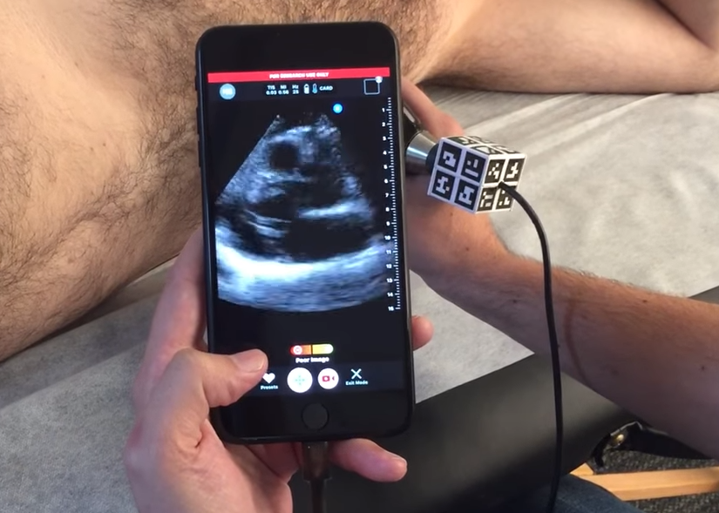

Slide 27
Angle-of-Arrival (AoA)
or
Direction-of-Arrival (DoA)

Slide 28
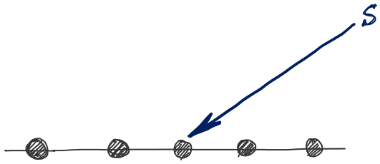
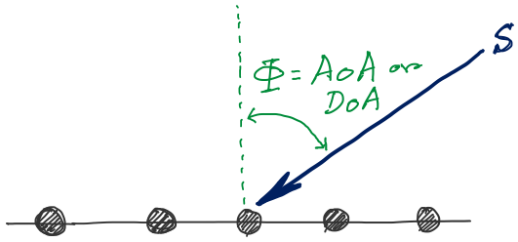
d
d
d
d
Notes:
http://www.waves.utoronto.ca/prof/svhum/ece422/notes/15-arrays2.pdf

Slide 29
DoA Estimation
$3d sin$($φ$)
$2d sin$($φ$)
$d sin$($φ$)
$$E1$$
$$E2$$
$$E3$$
$$E4$$
…
N elements
$$d$$
$$d$$
$$d$$
Interelement distance = d

Slide 30
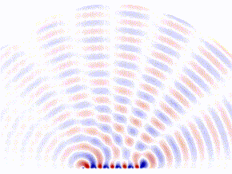
DoA Estimation: Beam-scanning
Scan the region with a steerable beam of the phased array.
DoA of the signal will show maximum received power.

Slide 31
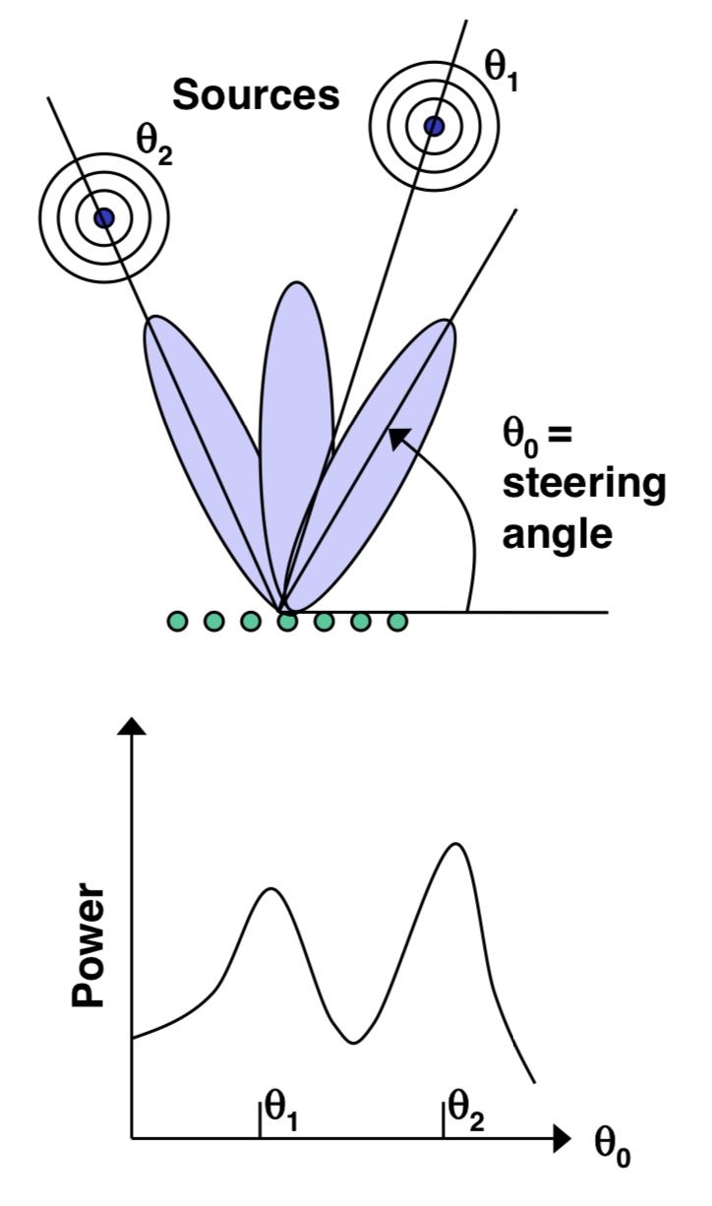
DoA Estimation: Beam-scanning

Slide 32
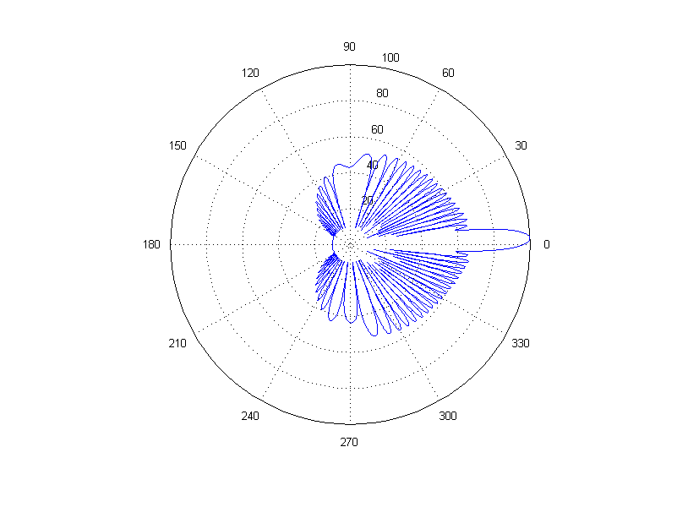
DoA Estimation: Beam-scanning
Number of elements = 30, wave length = 10cm, distance between elements = 6.5 cm
Notes:
http://www.waves.utoronto.ca/prof/svhum/ece422/notes/15-arrays2.pdf

Slide 33
Delay-sum DoA estimation

Slide 34
DoA Estimation: Delay-sum
Notes:
http://www.waves.utoronto.ca/prof/svhum/ece422/notes/15-arrays2.pdf

Slide 35
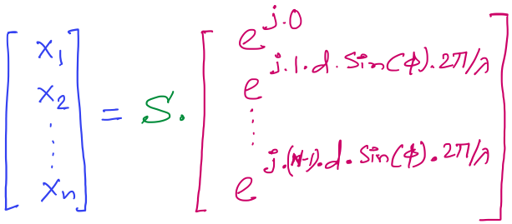
DoA Estimation: Delay-sum
Received signals in all elements:
Steering vector
Notes:
http://www.waves.utoronto.ca/prof/svhum/ece422/notes/15-arrays2.pdf

Slide 36
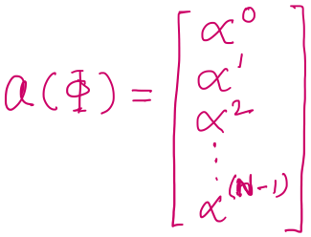
DoA Estimation: Delay-sum
Received signals in all elements:
Notes:
http://www.waves.utoronto.ca/prof/svhum/ece422/notes/15-arrays2.pdf

Slide 37
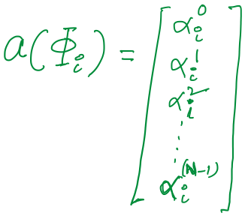
DoA Estimation: Delay-sum

Slide 38
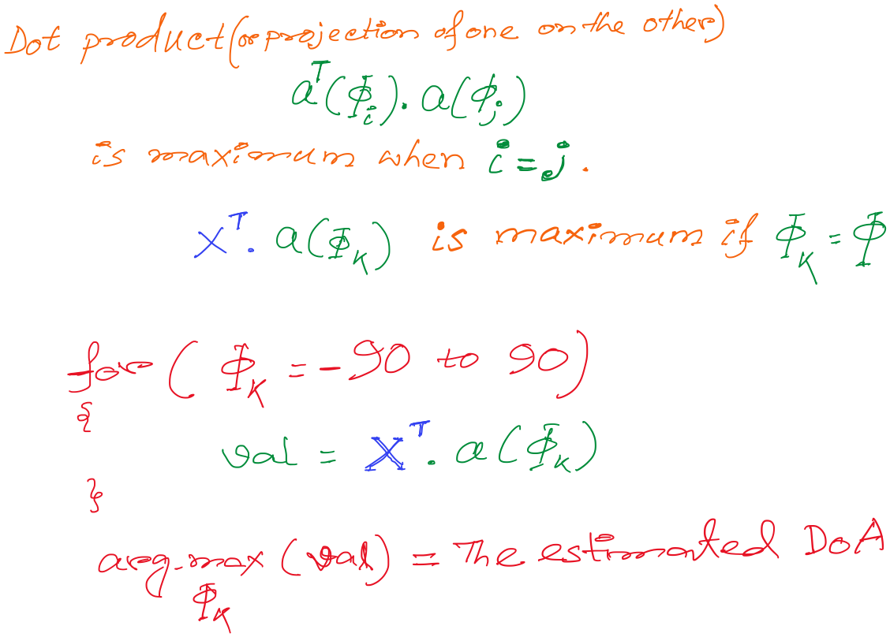
DoA Estimation: Delay-sum
How is this a “delay -sum” ?

Slide 39
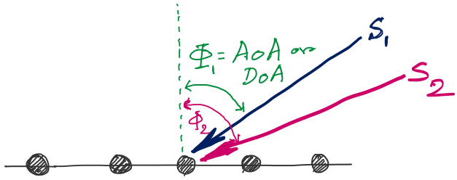
DoA Estimation
d
d
d
d
Notes:
http://www.waves.utoronto.ca/prof/svhum/ece422/notes/15-arrays2.pdf

Slide 40
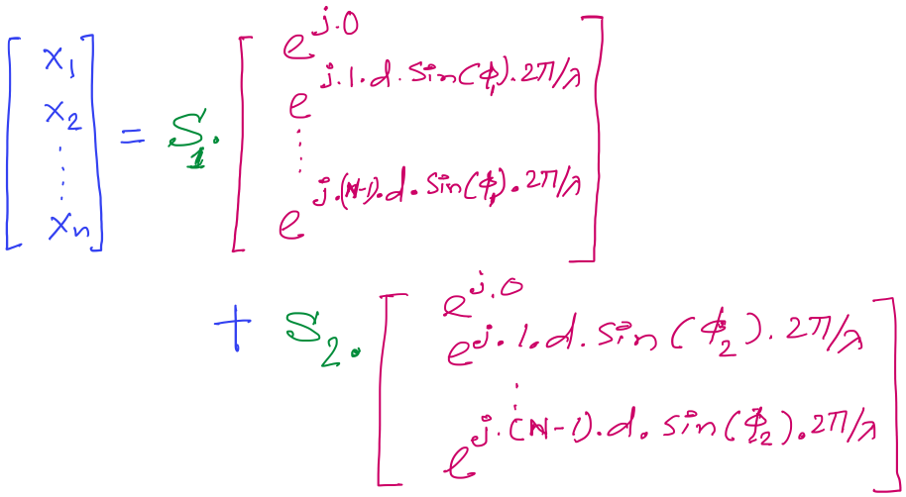
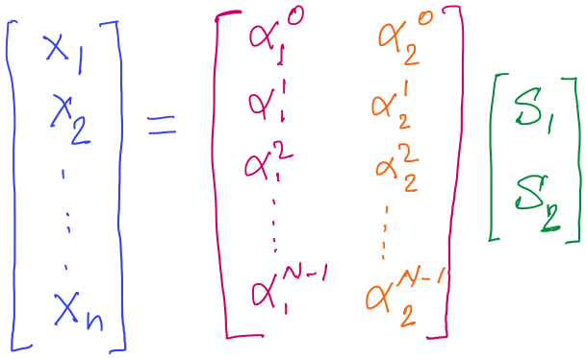
DoA Estimation

