Slide 1

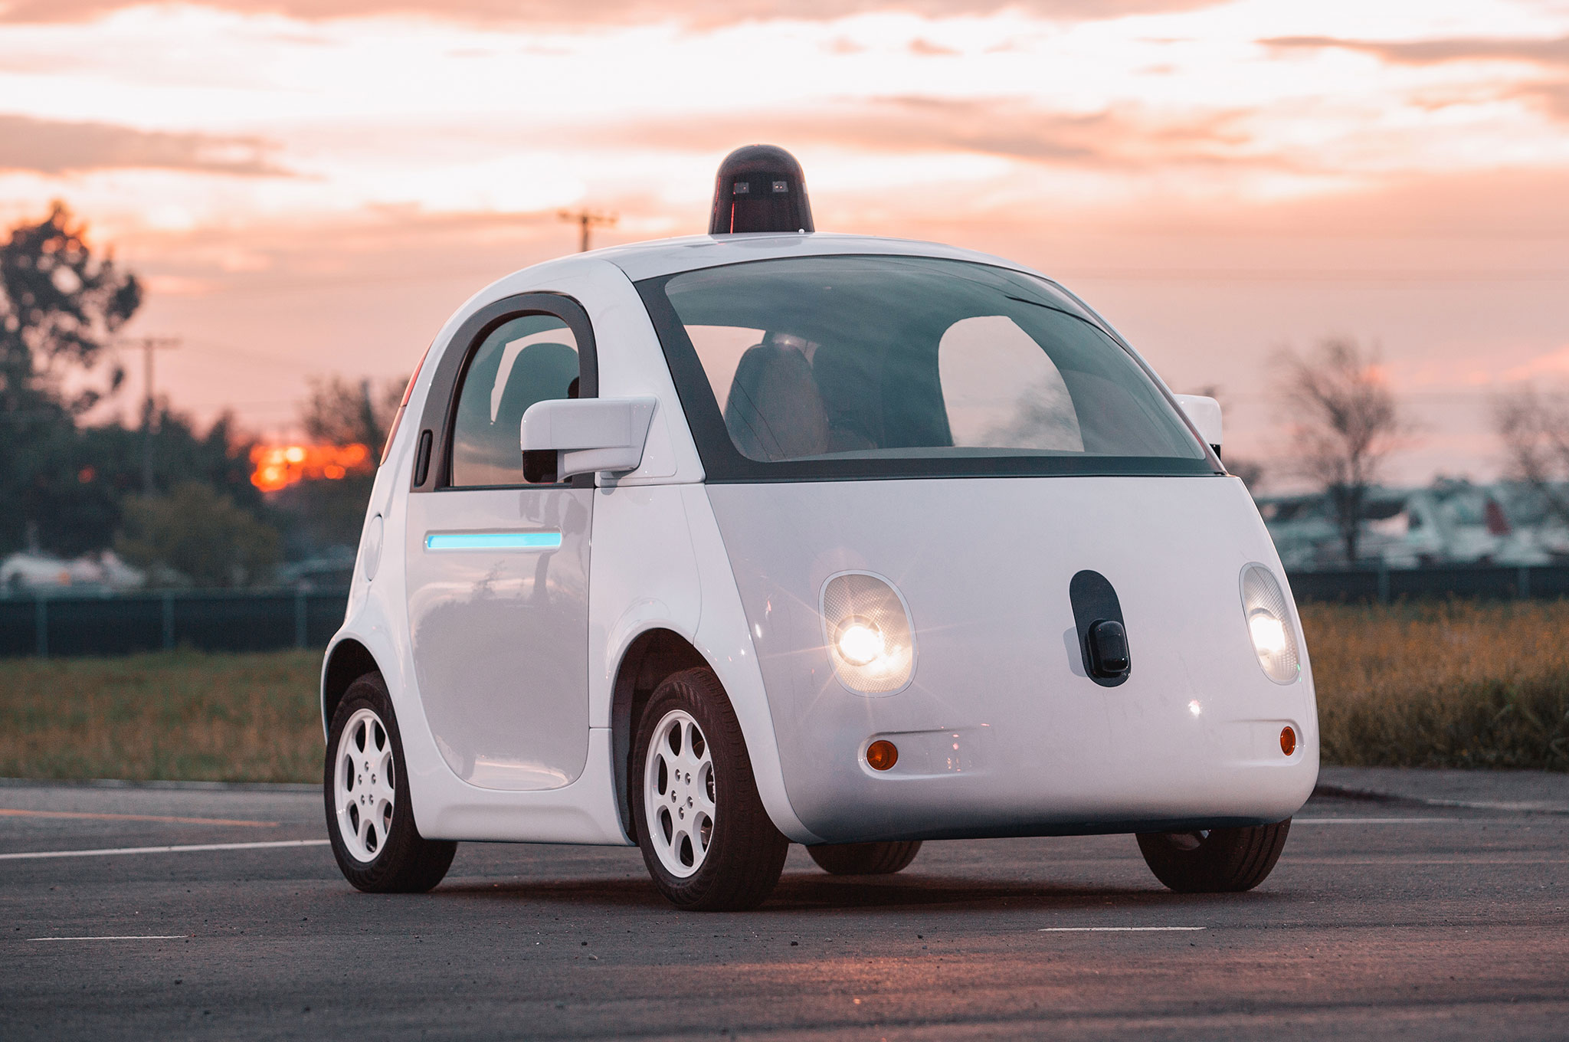
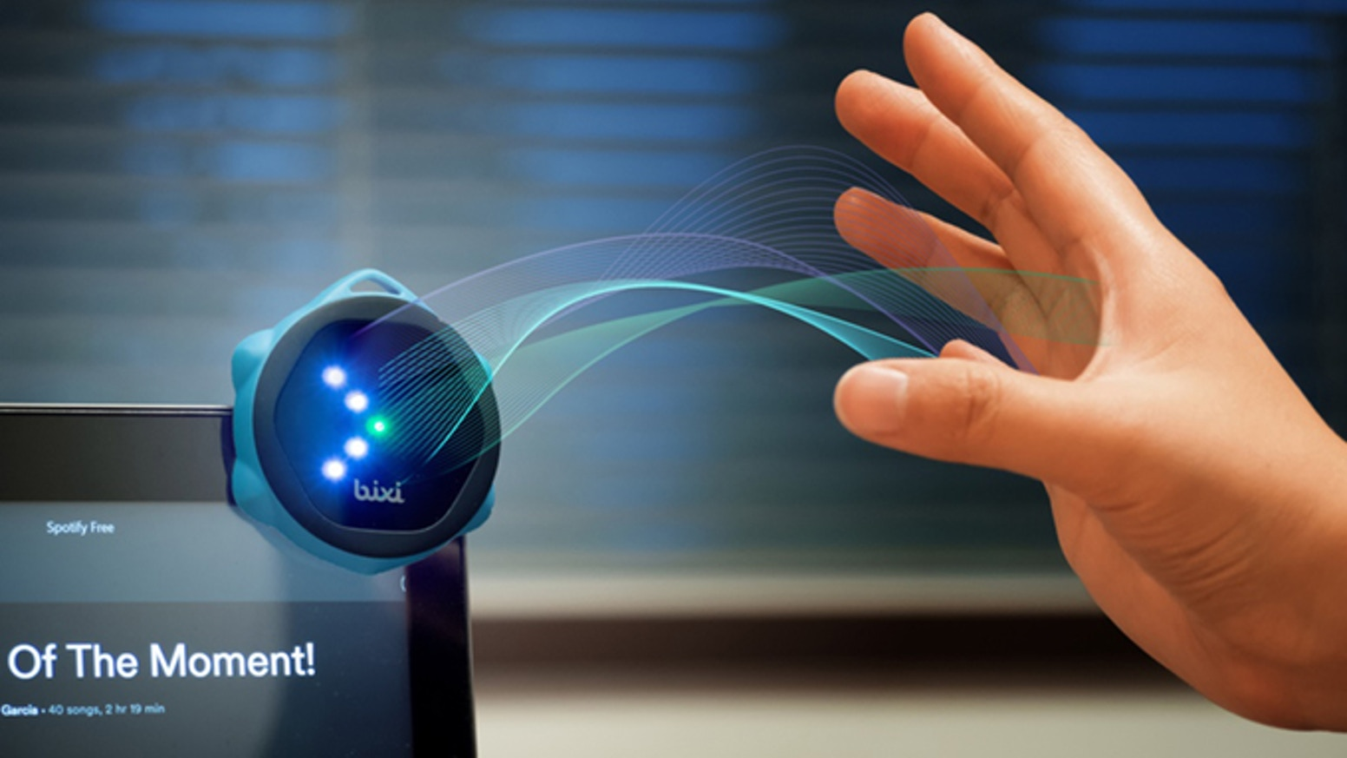
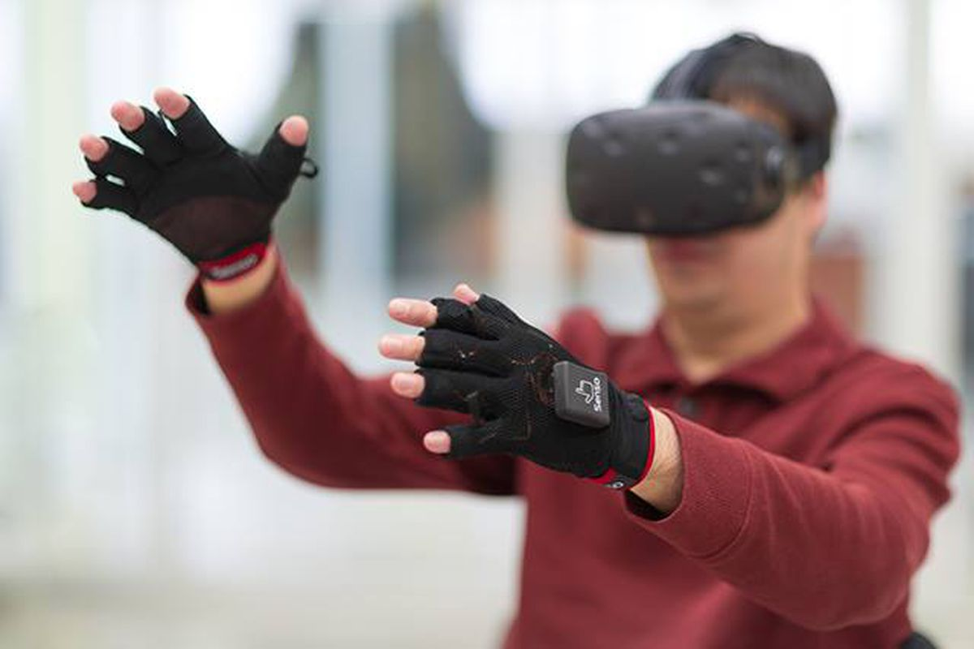

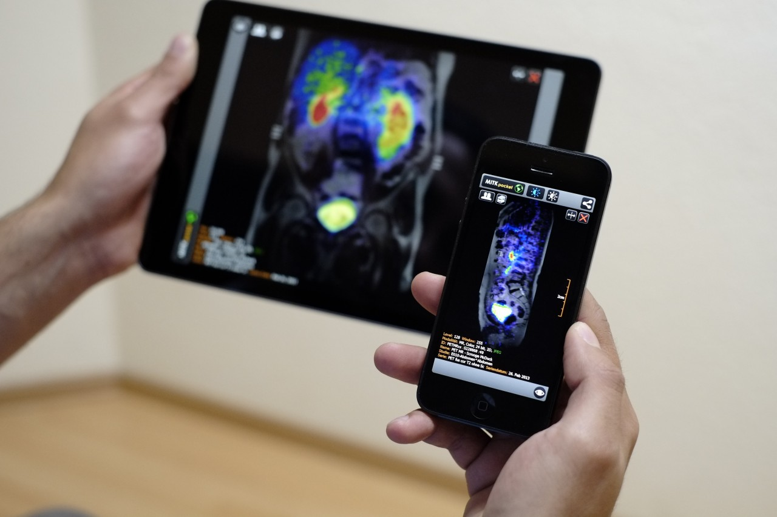
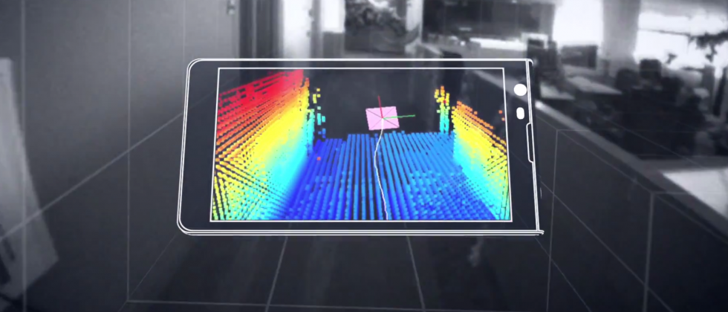
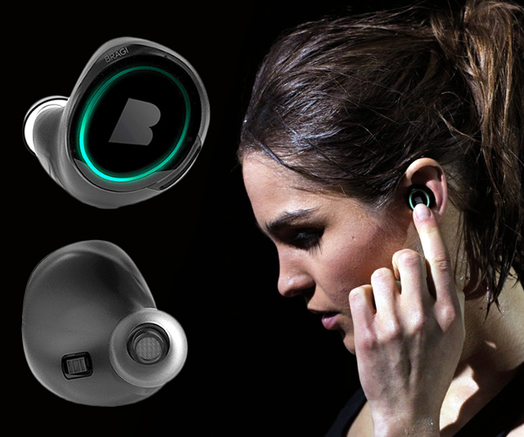
Wireless and Mobile Systems
for the IoT
CMSC 818W : Fall 2020
Lecture 2.4: Spatial sensing and ranging
Nirupam Roy
M-W 2:00-3:15pm
Online

Slide 2
This Zoom session is being recorded.

Slide 3
Angle-of-Arrival (AoA)
or
Direction-of-Arrival (DoA)

Slide 4
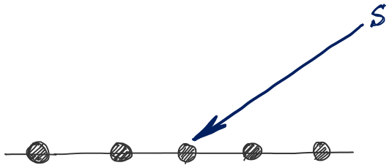
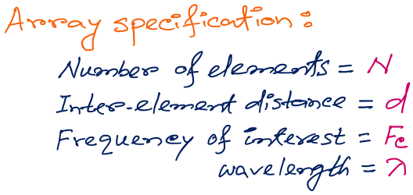
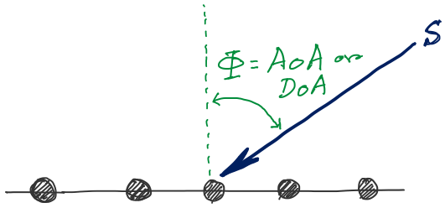
d
d
d
d
Notes:
http://www.waves.utoronto.ca/prof/svhum/ece422/notes/15-arrays2.pdf

Slide 5
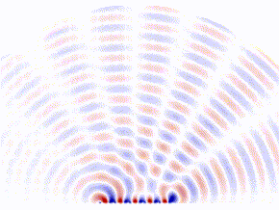
DoA Estimation: Beam-scanning
Scan the region with a steerable beam of the phased array.
DoA of the signal will show maximum received power.

Slide 6
Delay-sum DoA estimation

Slide 7
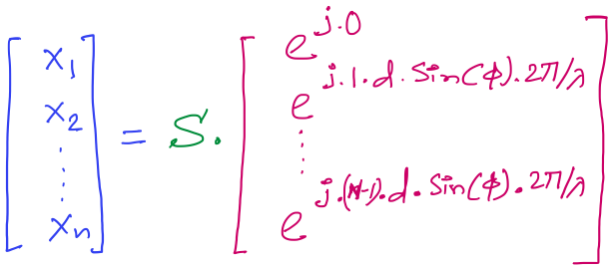

DoA Estimation: Delay-sum
Received signals in all elements:
Steering vector
Notes:
http://www.waves.utoronto.ca/prof/svhum/ece422/notes/15-arrays2.pdf

Slide 8
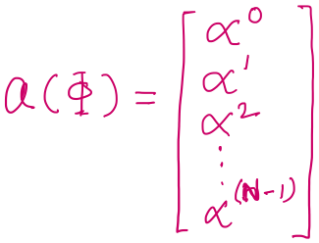

DoA Estimation: Delay-sum
Received signals in all elements:
Notes:
http://www.waves.utoronto.ca/prof/svhum/ece422/notes/15-arrays2.pdf

Slide 9
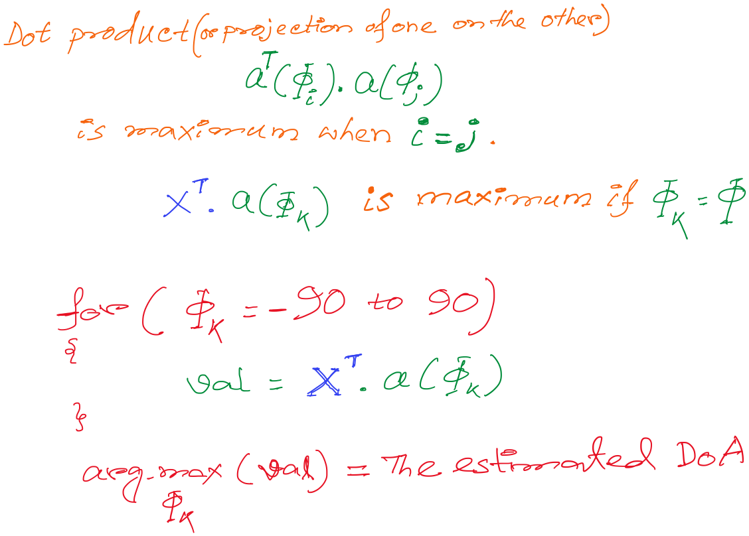
DoA Estimation: Delay-sum

Slide 10
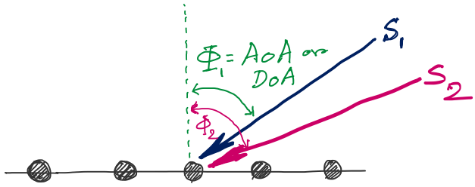
DoA Estimation: Multiple signals
f
d
d
d
d
Notes:
http://www.waves.utoronto.ca/prof/svhum/ece422/notes/15-arrays2.pdf

Slide 11
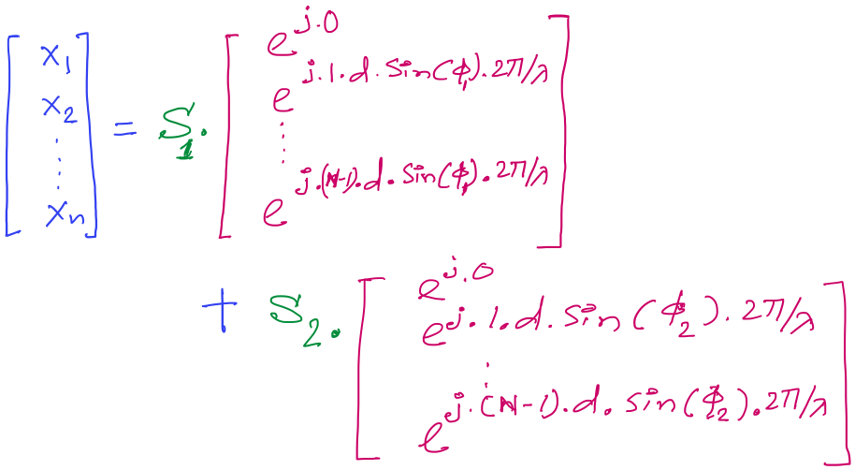
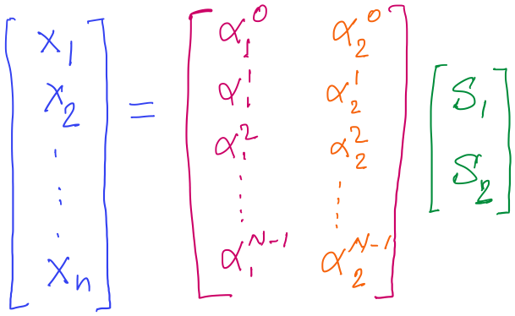
DoA Estimation

Slide 12
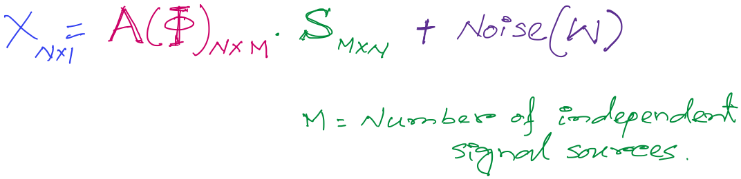
DoA Estimation
Mx1
Steering matrix

Slide 13
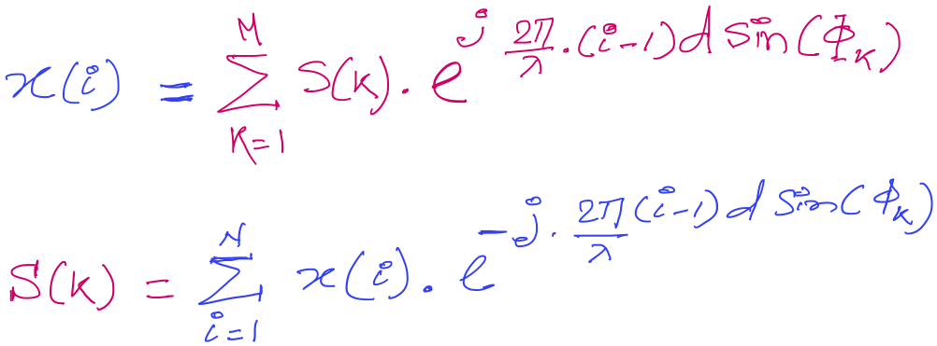
DoA Estimation

Slide 14
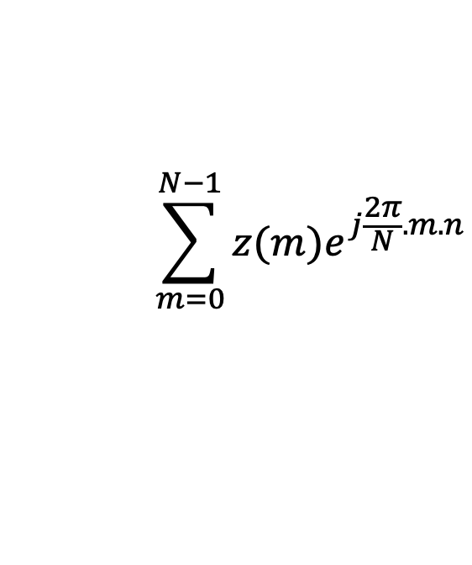
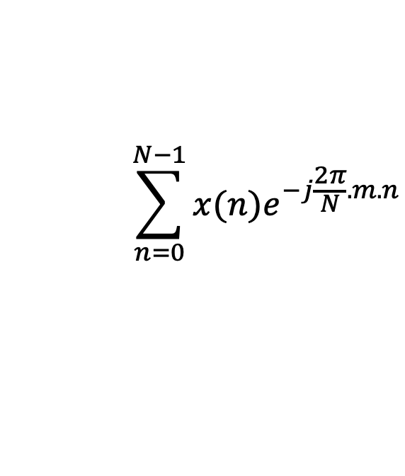
Discrete Fourier Transform
$$\sum_{n=0}^{N−1}{x(n)e^{−j\frac{2π}{N}.m.n}}$$
DFT:
z(m) =
$$\sum_{m=0}^{N−1}{z(m)e^{j\frac{2π}{N}.m.n}}$$
IDFT:
x(n) =

Slide 15














Discrete Fourier Transform
Frequency domain coefficients
$$e^{j0}$$
$$e^{j0.\frac{2π}{N}}$$
$$e^{j0.\frac{m.2π}{N}}$$
$$e^{j0.\frac{(N−1).2π}{N}}$$
$$e^{j0}$$
$$e^{j1.\frac{2π}{N}}$$
$$e^{j1.\frac{m.2π}{N}}$$
$$e^{j1.\frac{(N−1).2π}{N}}$$
+
$$e^{j2.\frac{2π}{N}}$$
+
$$e^{j2.\frac{m.2π}{N}}$$
+
$$e^{j2.\frac{(N−1).2π}{N}}$$
Z₀
$$e^{j0}$$
Z₁
…
Z_{m}
…
Z_{N-1}
…
…
…
…
$$e^{j(N−1).\frac{2π}{N}}$$
$$e^{j(N−1).\frac{m.2π}{N}}$$
$$e^{j(N−1).\frac{(N−1).2π}{N}}$$
$$e^{j0}$$
x[0]
x[1]
=
X =
x[2]
Time domain samples
…
x[N-1]

Slide 16
DoA Estimation : Classical FFT approach

Slide 17
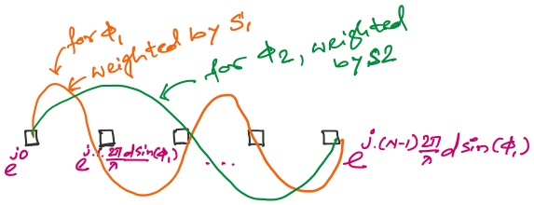
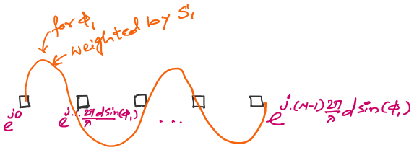
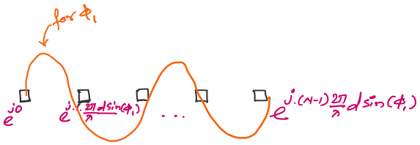

DoA Estimation : Classical FFT approach

Slide 18
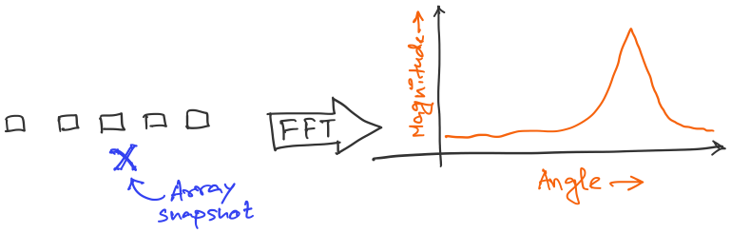
DoA Estimation : Classical FFT approach

Slide 19
DoA Estimation : Classical FFT approach
What is the minimum and maximum value of the inter-element distance (d)?
d
d
d
d

Slide 20
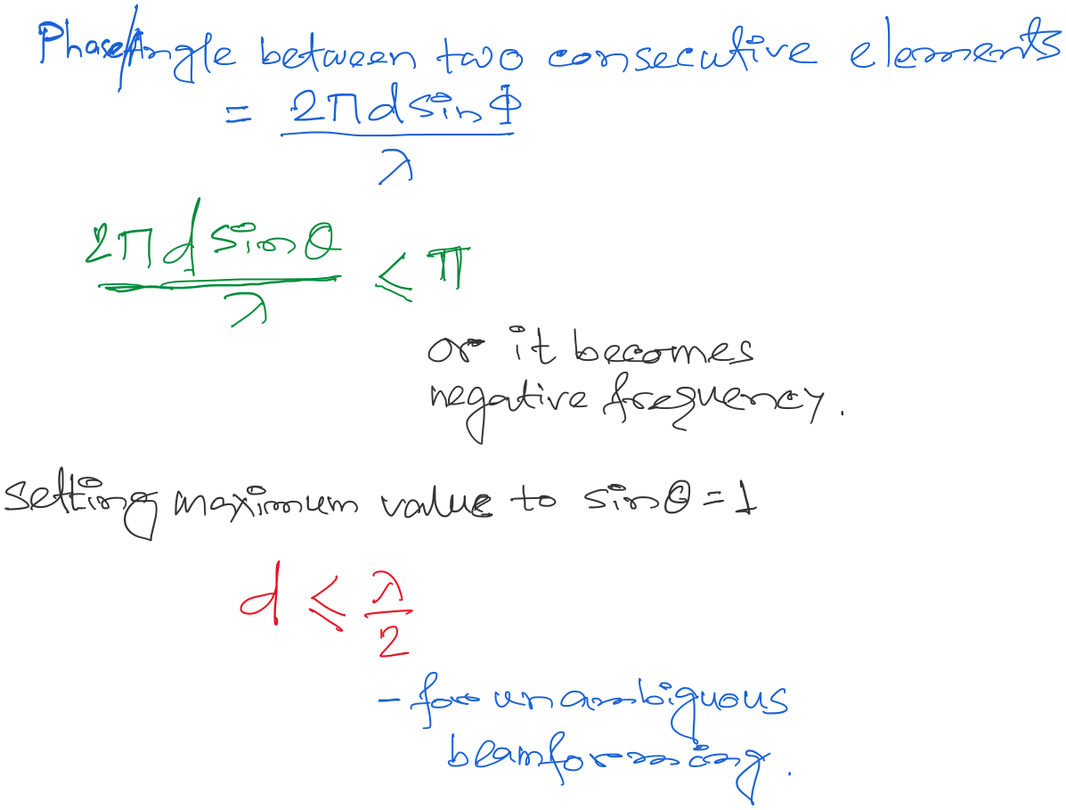
DoA Estimation : Classical FFT approach

Slide 21
Finding distance using waves

Slide 22
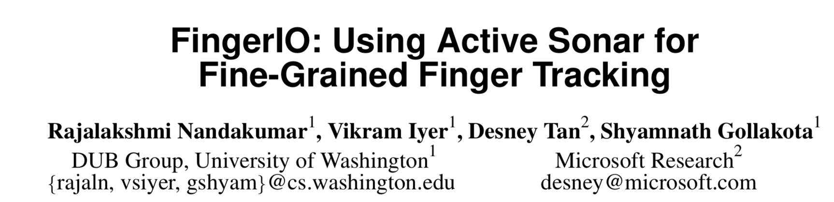

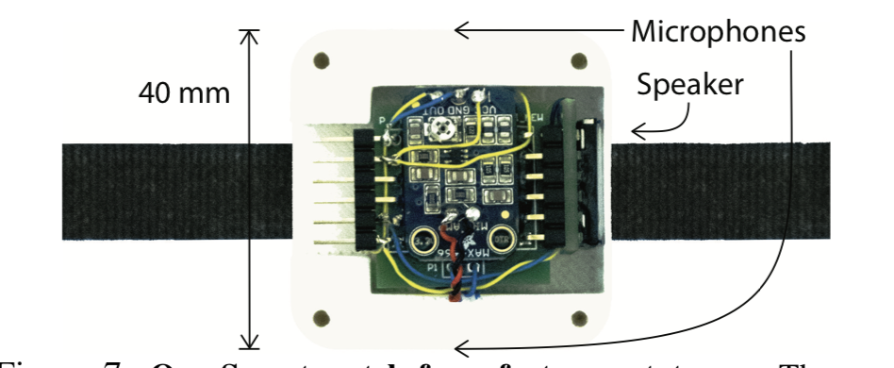
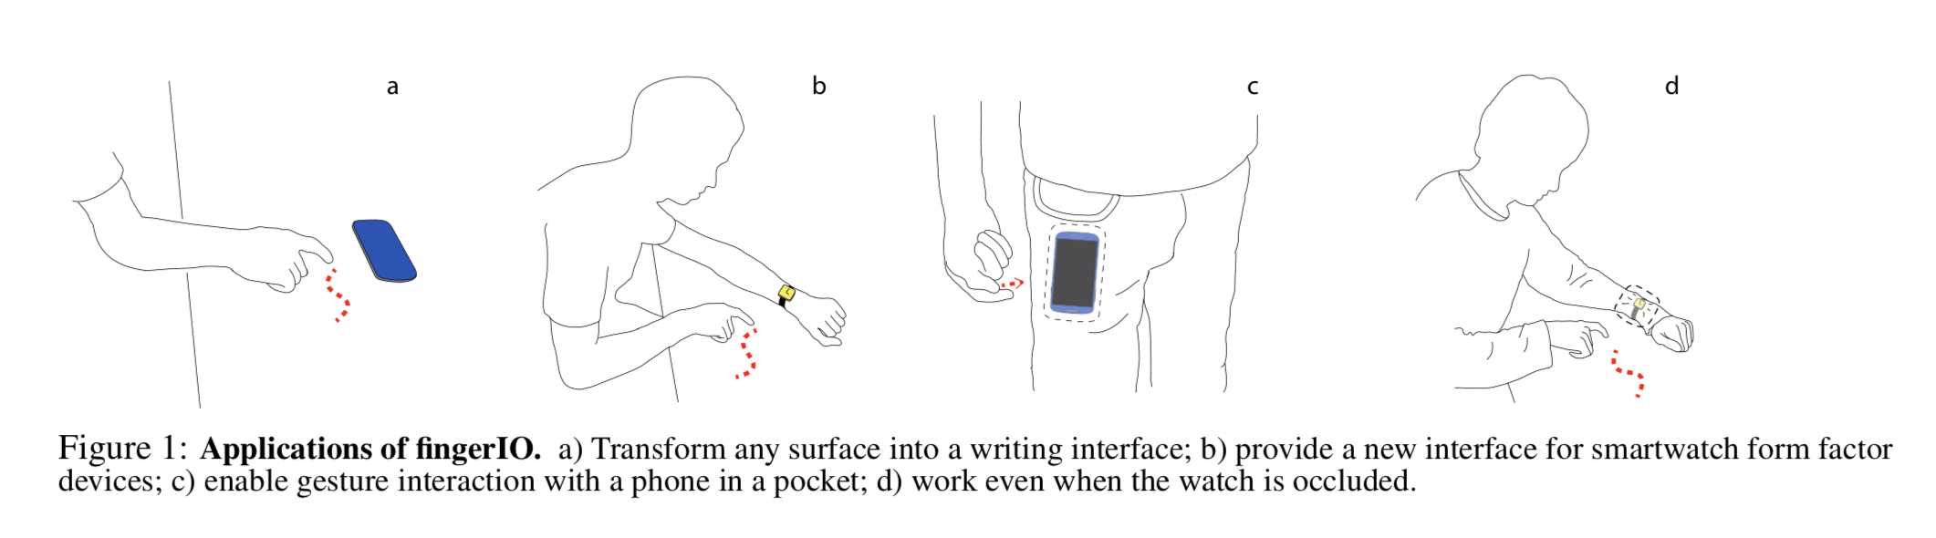

Slide 23
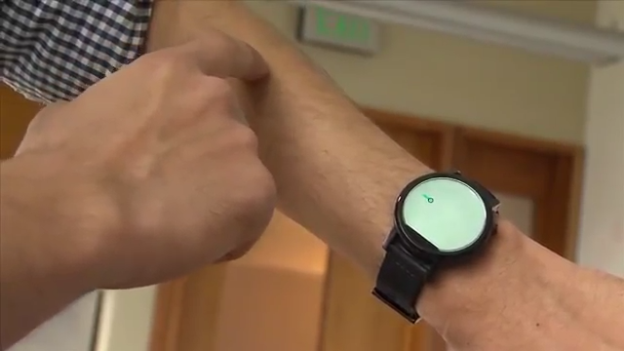

Slide 24
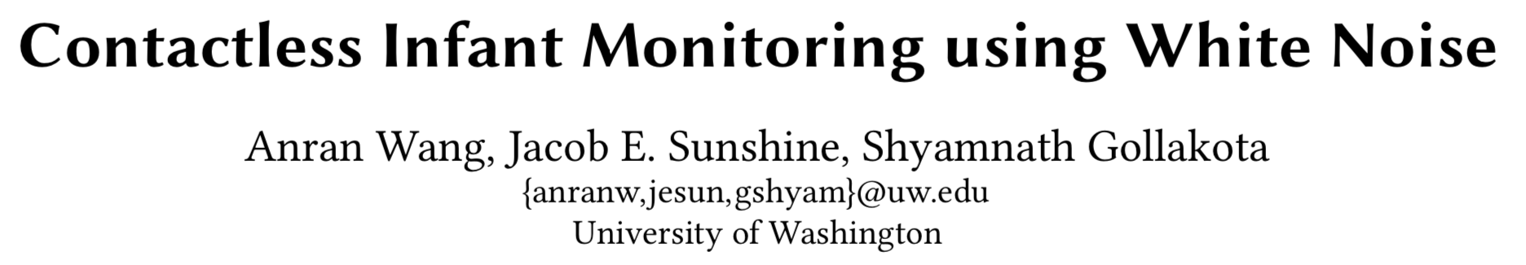
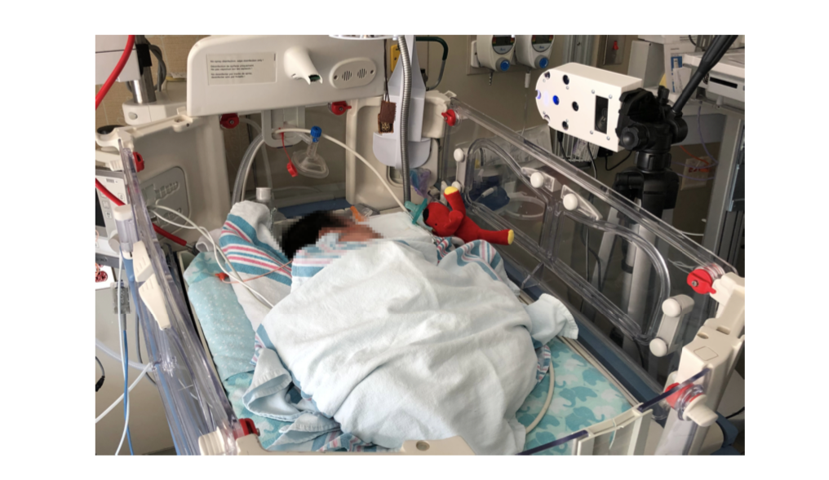

Slide 25
Finding distance using waves
(Ranging)

Slide 26
…
SONAR
(detection)
Depth/Image
Gesture

Slide 27
…
SONAR
(detection)
Depth/Image
Gesture
Finding distance using waves
(Ranging)

Slide 28
…
SONAR
(detection)
Depth/Image
Gesture
Finding distance using waves
(Ranging)
Speed
Amplitude
Frequency
Phase

Slide 29
1. Distance from the speed information
a. Techniques
b. Signal detection
2. Distance from the amplitude information
a. Absorption
b. Propagation loss
3. Distance from the frequency information
a. Doppler effect
b. A case study (Doppler + Triangulation)
4. Distance from the phase information
a. Overview
b. Impulse function, Impulse response, Convolution
c. A case study

Slide 30
1. Distance from the speed information
a. Techniques
b. Signal detection
2. Distance from the amplitude information
a. Absorption
b. Propagation loss
3. Distance from the frequency information
a. Doppler effect
b. A case study (Doppler + Triangulation)
4. Distance from the phase information
a. Overview
b. Impulse function, Impulse response, Convolution
c. A case study

Slide 31
Distance from the speed information
Dist. = (speed) X (time of travel)
Time of Arrival (ToA)
Signal source
observer

Slide 32
Distance from the speed information
Dist. = (speed) X (time of travel)
Time of Arrival (ToA)
Signal source
observer
Signal source
Time Difference of Arrival (TDoA)
observer 1
observer2

Slide 33
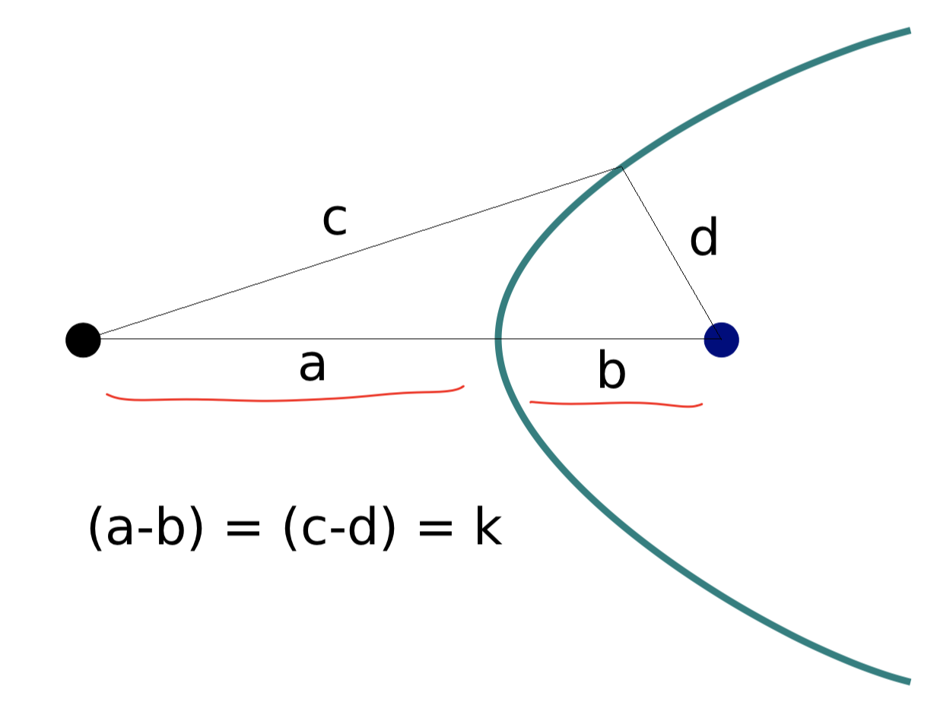
TDoA
a
b
Find the location of the wave source when (a-b) is known.

Slide 34
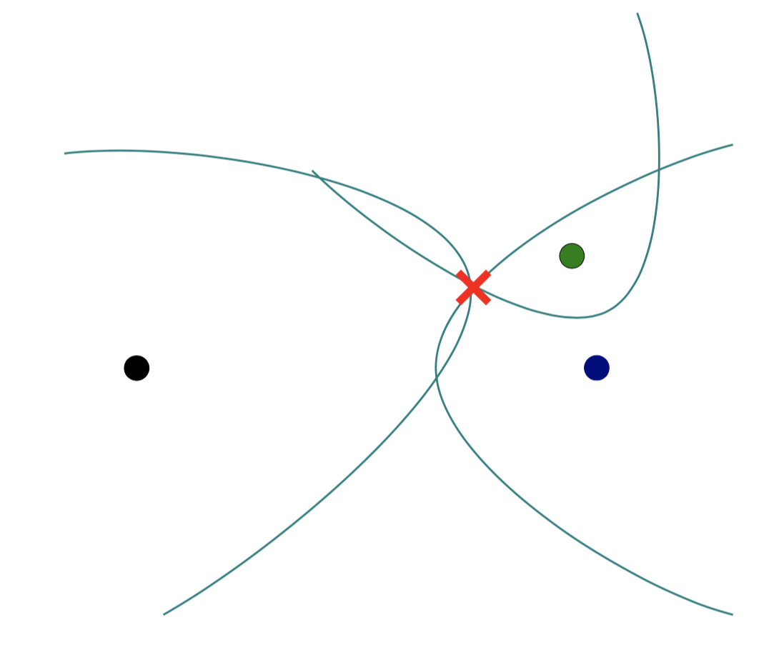
TDoA

Slide 35
Distance from the speed information
Dist. = (speed) X (time of travel)
Time of Arrival (ToA)
Signal source
observer
Signal source
Time Difference of Arrival (TDoA)
observer 1
observer2
Round-trip Time of Flight (RToF)
Signal source
+ observer
Reflector

Slide 36
Distance from the speed information
Dist. = (speed) X (time of travel)
Time of Arrival (ToA)
Signal source
observer
How to detect the signal at the receiver/observer?
Signal source
Time Difference of Arrival (TDoA)
observer 1
observer2
Round-trip Time of Flight (RToF)
Signal source
+ observer
Reflector

Slide 37
Signal detection
Amplitude
Time/Sample
Transmitter signal

Slide 38
Signal detection
Amplitude
Amplitude
Time/Sample
Time/Sample
Transmitter signal
Receiver signal

Slide 39
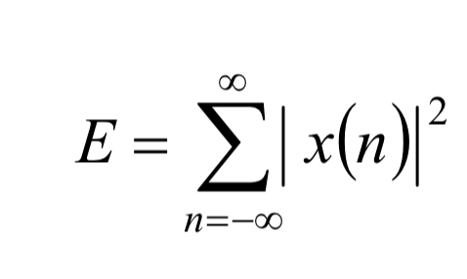
Signal detection
Amplitude
Amplitude
Time/Sample
Time/Sample
Transmitter signal
Receiver signal
Energy based signal detector
Energy of a discrete signal x(n),

Slide 40
Signal detection
Amplitude
Amplitude
Time/Sample
Time/Sample
Transmitter signal
Receiver signal

Slide 41
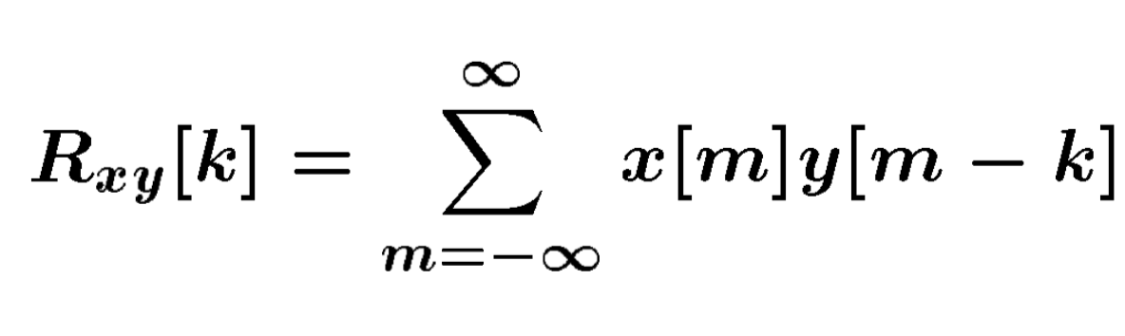
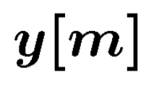
Signal detection
Received signal
Signal matching
Transmit signal template

Slide 42
Signal detection
Received signal
Signal matching
Transmit signal template
Correlation

Slide 43
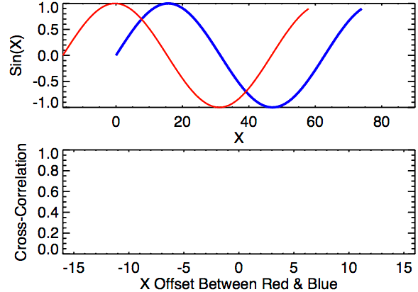
Signal detection
Correlation

Slide 44
Distance from the speed information
Dist. = (speed) X (time of travel)
Time of Arrival (ToA)
Signal source
observer
Time Difference of Arrival (TDoA)
Signal source
observer 1
observer2
Round-trip Time of Flight (RToF)
Signal source
+ observer
Reflector
Notes:
Slide 23: 20 minutes

Slide 45
1. Distance from the speed information
a. Techniques
b. Signal detection
2. Distance from the amplitude information
a. Absorption
b. Propagation loss
3. Distance from the frequency information
a. Doppler effect
b. A case study (Doppler + Triangulation)
4. Distance from the phase information
a. Overview
b. Impulse function, Impulse response, Convolution
c. A case study

Slide 46

Distance from the amplitude information
Amplitude
Time (sec)
$$AS . sin⁡(2πft)$$

Slide 47

Distance from the amplitude information
Dist. = d
Amplitude
Time (sec)
Amplitude
Time (sec)
$$AS . sin⁡(2πft)$$
$$AO . sin⁡(2πft)$$

Slide 48
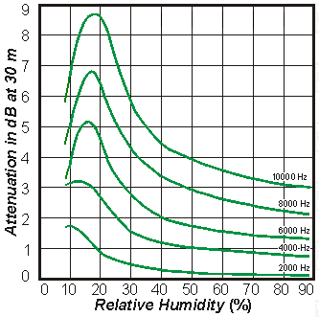
Distance from the amplitude information
Dist. = d
Amplitude
Time (sec)
Amplitude
Time (sec)
$$AS . sin⁡(2πft)$$
$$AO . sin⁡(2πft)$$
Attenuation due to atmospheric absorption and diffraction

Slide 49
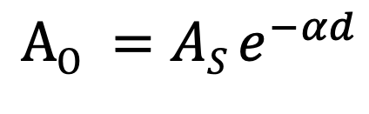
Distance from the amplitude information
Dist. = d
Amplitude
Time (sec)
Amplitude
Time (sec)
$$AS . sin⁡(2πft)$$
$$AO . sin⁡(2πft)$$
$$AO =AS e^{−αd}$$
α = attenuation coefficient
Depends on frequency and
environment ( temperature, humidity etc.)

Slide 50
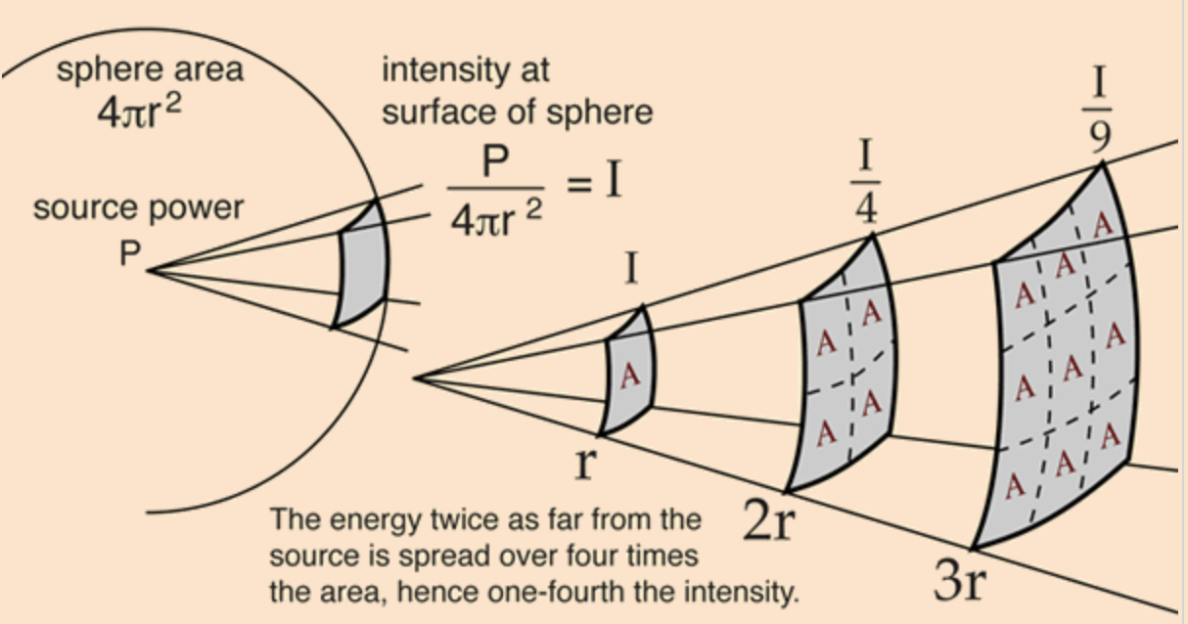
Distance from the amplitude information
Propagation loss

Slide 51
Distance from the amplitude information
Propagation loss
Notes:
Slide 30: 25 minutes

Slide 52
1. Distance from the speed information
a. Techniques
b. Signal detection
2. Distance from the amplitude information
a. Absorption
b. Propagation loss
3. Distance from the frequency information
a. Doppler effect
b. A case study (Doppler + Triangulation)
4. Distance from the phase information
a. Overview
b. Impulse function, Impulse response, Convolution
c. A case study

Slide 53
Distance from the frequency information
Motion of the sound source and/or the observer changes the frequency of the observed signal.
The change depends on the velocity of the source/observer.
This phenomena is known as Doppler effect or Doppler shift.

Slide 54
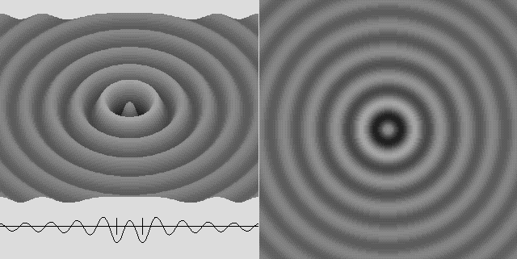
Doppler effect

Slide 55
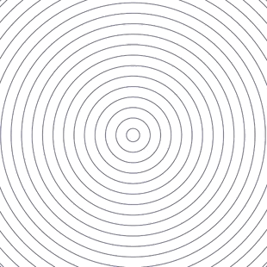
Doppler effect

Slide 56
Doppler effect

Slide 57
Doppler effect
Simple wave model: Stationary source

Slide 58
Doppler effect
Simple wave model: Stationary source
Time = t1

Slide 59
Doppler effect
Simple wave model: Stationary source
Time = t2

Slide 60
Doppler effect
Simple wave model: Stationary source
Time = t2

Slide 61
Doppler effect
Simple wave model: Stationary source
Time = t3

Slide 62
Doppler effect
Simple wave model: Stationary source
Time = t3

Slide 63
Doppler effect
Simple wave model: Stationary source
Wavelength = λ meters
Time = t3

Slide 64
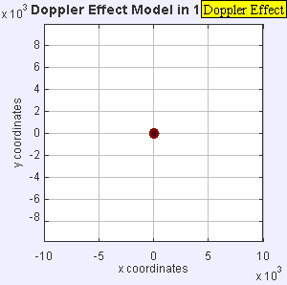
Doppler effect

Slide 65
Doppler effect
Simple wave model: Moving source

Slide 66
Doppler effect
Simple wave model: Moving source
Time = t1

Slide 67
Doppler effect
Simple wave model: Moving source
Time = t2

Slide 68
Doppler effect
Simple wave model: Moving source
Time = t2

Slide 69
Doppler effect
Simple wave model: Moving source
Time = t2

Slide 70
Doppler effect
Simple wave model: Moving source
Time = t3

Slide 71
Doppler effect
Simple wave model: Moving source
Time = t3

Slide 72
Doppler effect
Simple wave model: Moving source
Time = t3

Slide 73
Doppler effect
Simple wave model: Moving source
Actual wavelength = λ meters
Wavelength = λ₂ meters
Wavelength = λ₁ meters
Time = t3
Notes:
Slide 19: 2 minutes 30 seconds

Slide 74
Doppler effect
Simple wave model: Moving source
Actual wavelength = λ meters
Observer
Wavelength = λ₂ meters
Wavelength = λ₁ meters
Time = t3
Notes:
Slide 19: 2 minutes 30 seconds

Slide 75
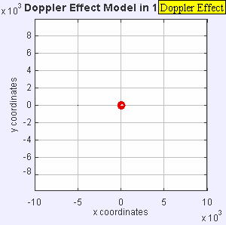
Doppler effect

Slide 76
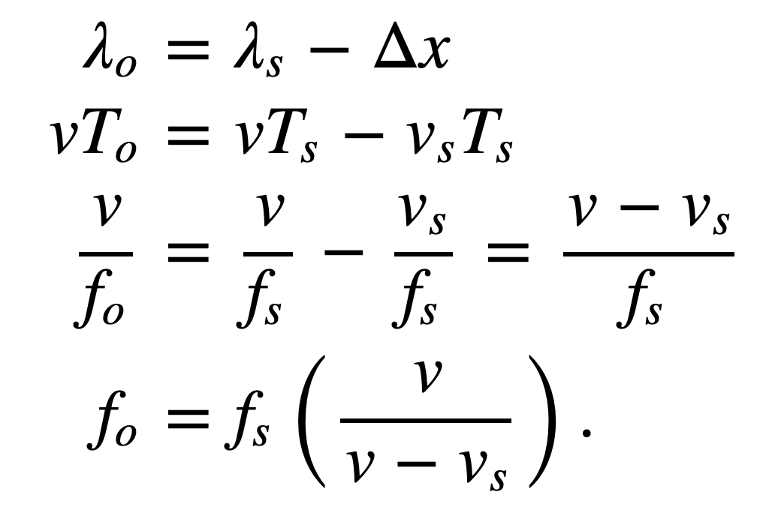
Doppler effect
Simple wave model: Moving source
Source moving towards the observer
v = Velocity of the signal (sound, light etc.)
v_{O} , T_{O} , f_{O} = Velocity of the observer and observed period and frequency
v_{S} , T_{S} , f_{S} = Velocity of the source and original period and frequency
Notes:
Slide 19: 2 minutes 30 seconds

Slide 77
Doppler effect
Simple wave model: Moving observer
Observer

Slide 78
Doppler effect
Simple wave model: Moving observer
t
t
Observer

Slide 79
Doppler effect
Simple wave model: Moving observer
t’ <t
t’ <t

Slide 80
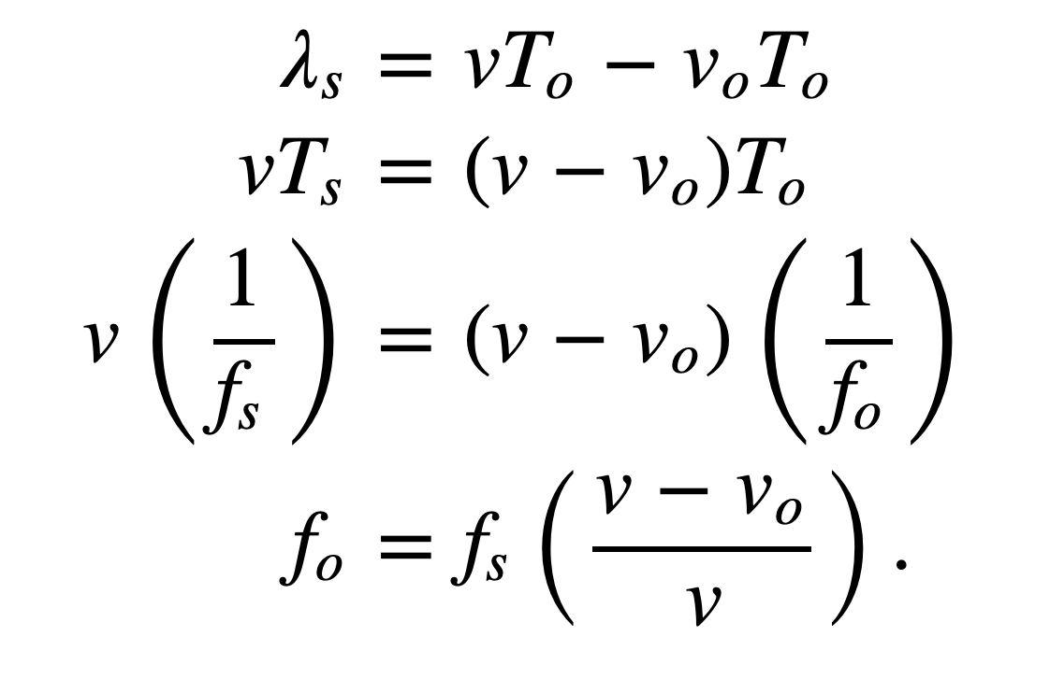
Doppler effect
Simple wave model: Moving observer
Observer moving towards the stationary source
+
+
+
+
v_{O} , T_{O} , f_{O} = Velocity of the observer and observed period and frequency
v_{S} , T_{S} , f_{S} = Velocity of the source and original period and frequency

Slide 81
Doppler effect
Simple wave model: Moving observer
Observer moving towards the stationary source
+
Doppler shift, Δf = f_{O}-f_{S} = f_{S} (v_{O}/v)
+
+
How will it change with signal’s velocity and frequency?
+
v_{O} , T_{O} , f_{O} = Velocity of the observer and observed period and frequency
v_{S} , T_{S} , f_{S} = Velocity of the source and original period and frequency

Slide 82
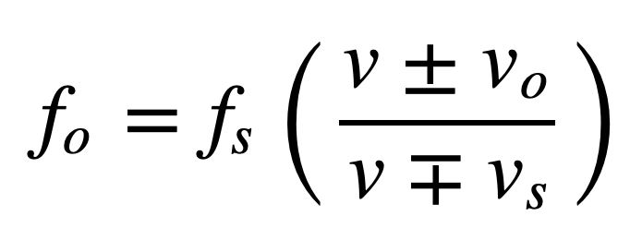
Doppler effect
Simple wave model: Moving observer
Both the source and the observer are moving
v_{O} , T_{O} , f_{O} = Velocity of the observer and observed period and frequency
v_{S} , T_{S} , f_{S} = Velocity of the source and original period and frequency
Notes:
Slide 58: 30 minutes

Slide 83
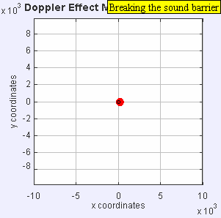
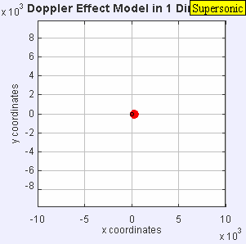
Doppler effect

Slide 84
Doppler effect

