Slide 1

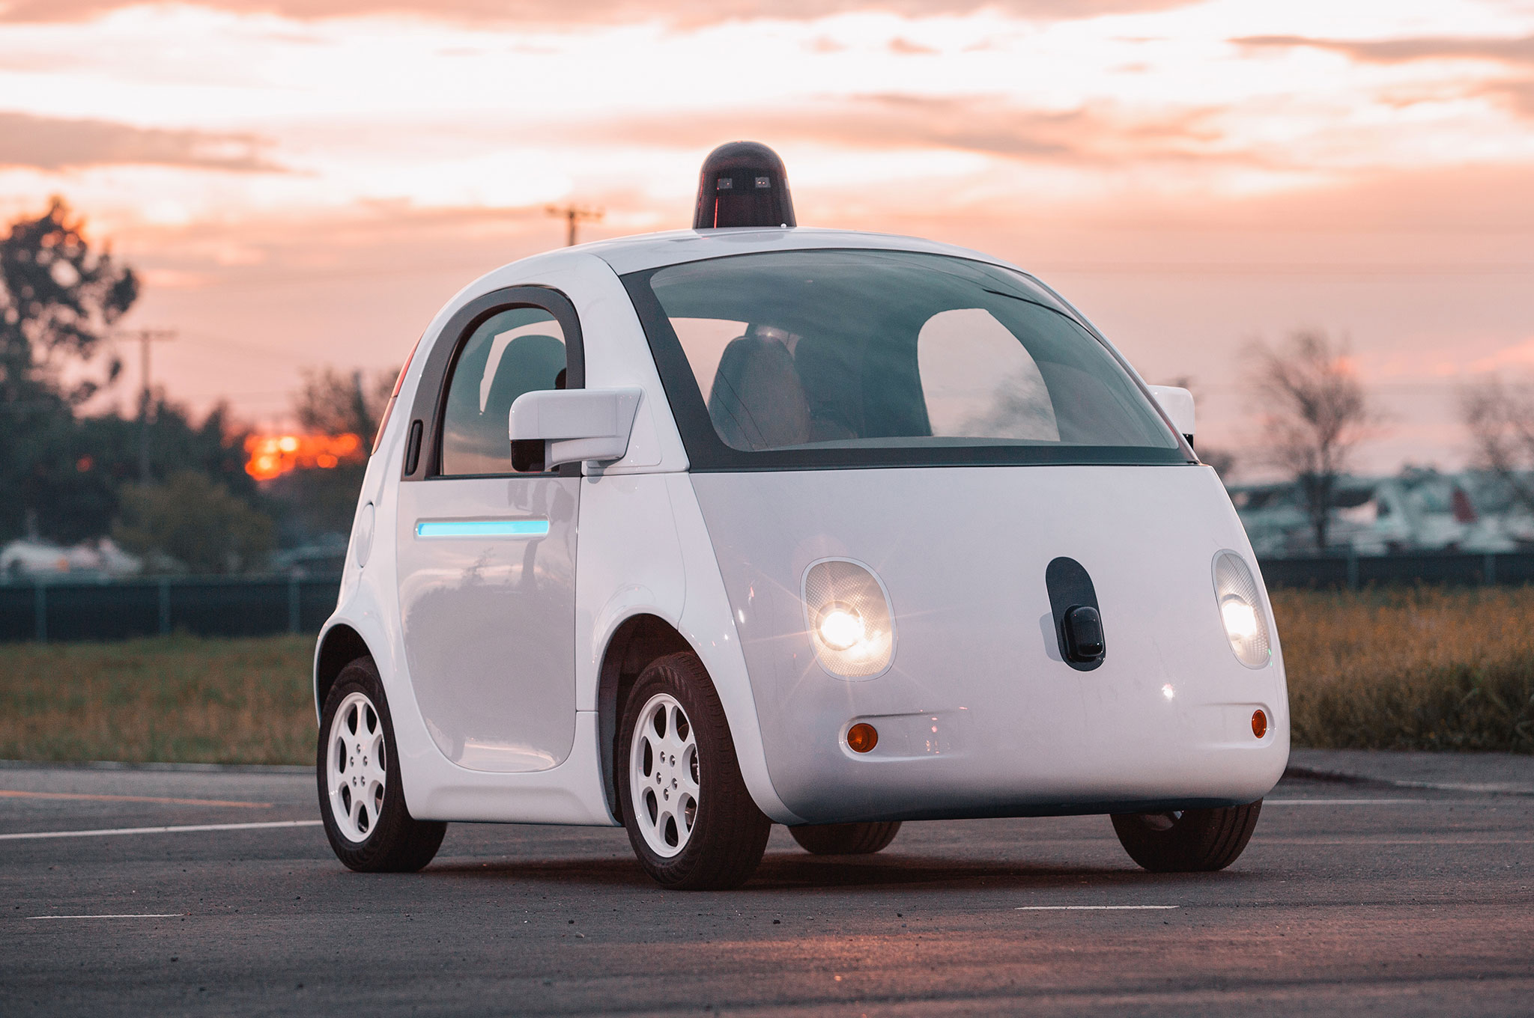
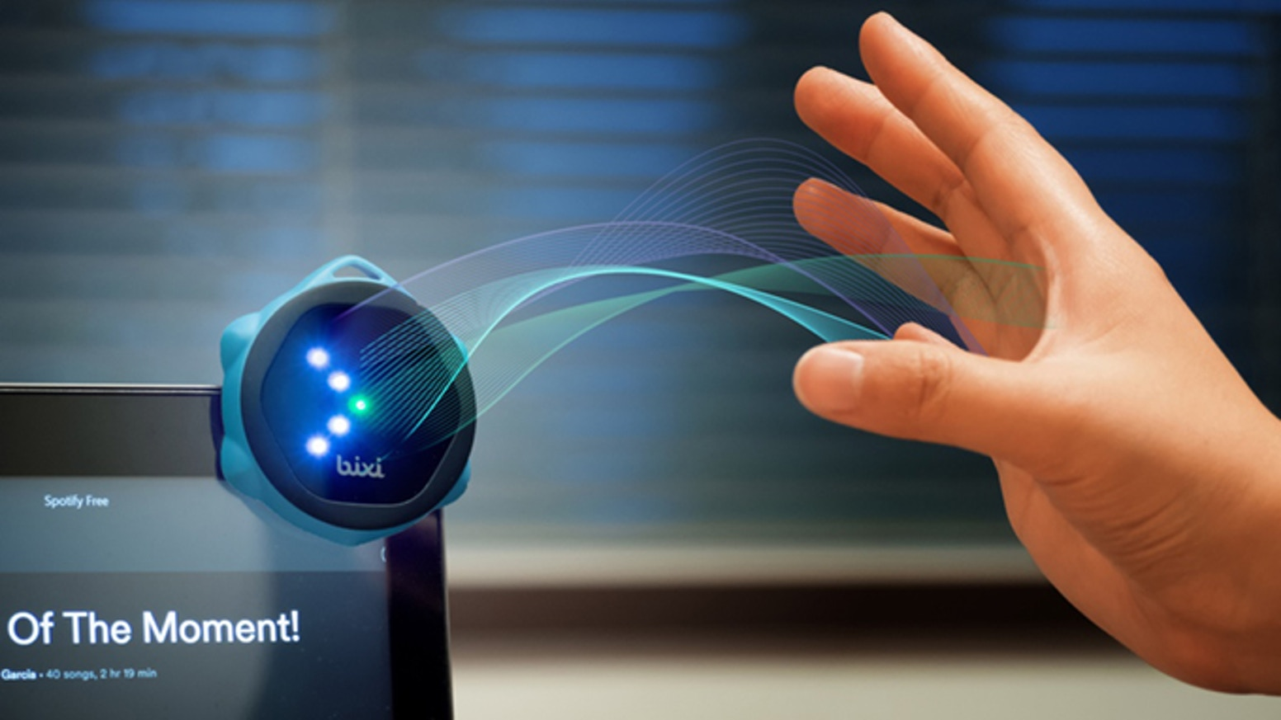
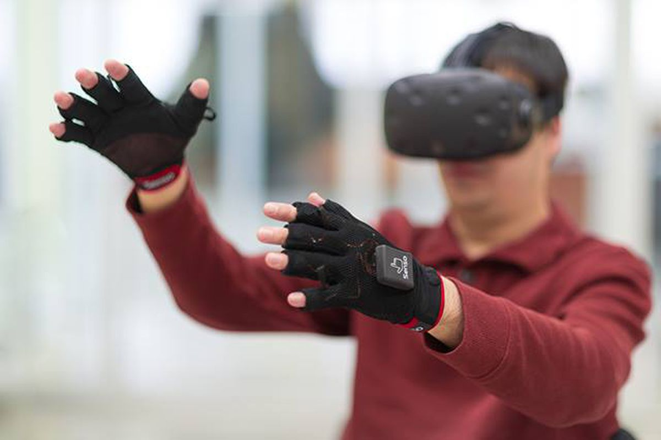

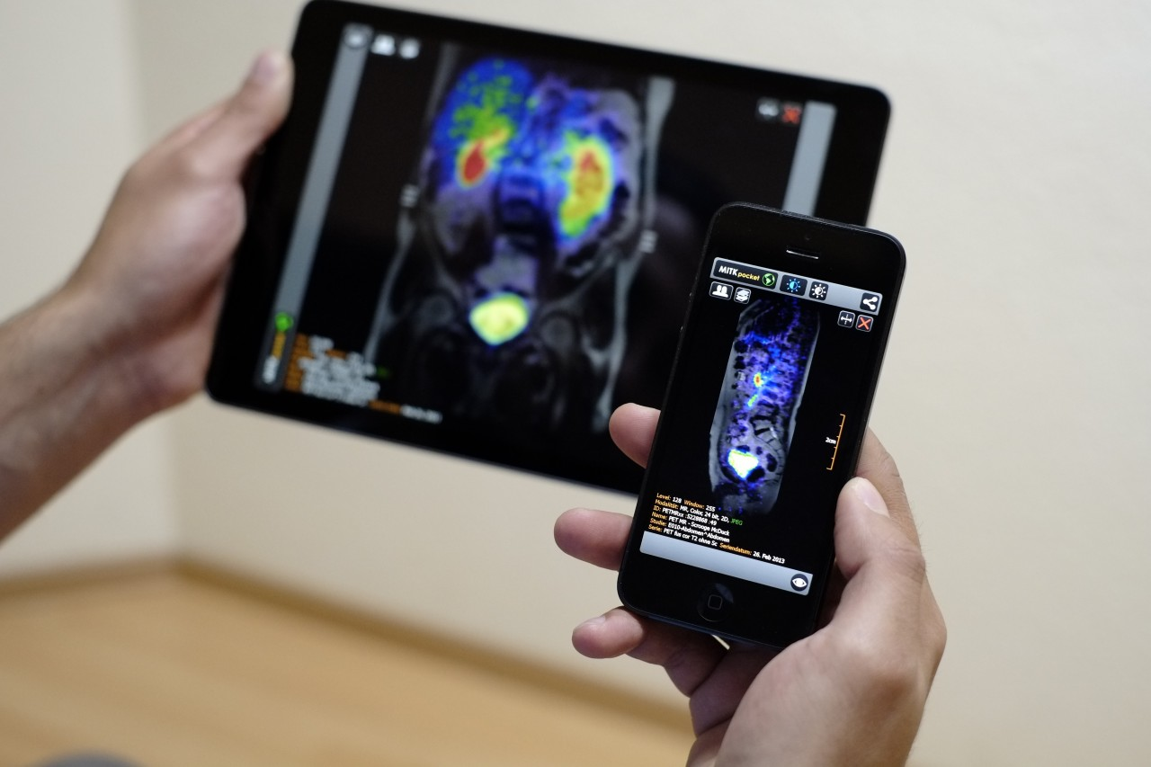
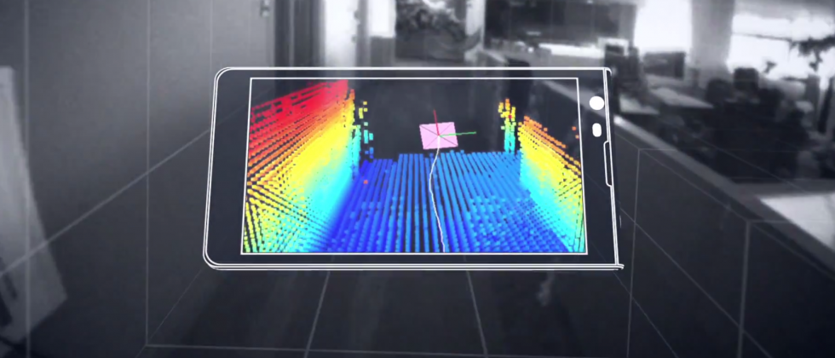
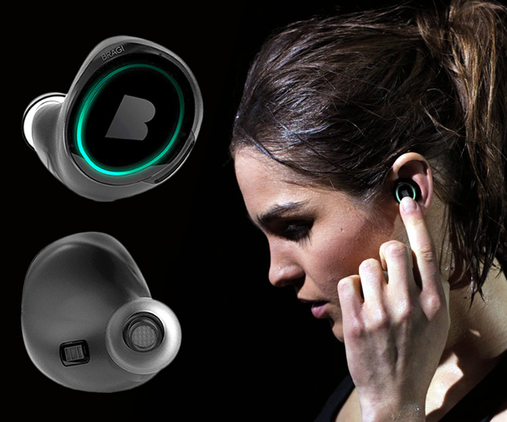
Wireless and Mobile Systems
for the IoT
CMSC 818W : Fall 2020
Lecture 3.1: Inertial Measurement Units (IMU) and sensor fusion
Nirupam Roy
M-W 2:00-3:15pm
Online

Slide 2
This zoom session is being recorded

Slide 5
Inertial Measurement Unit (IMU)
Accelerometer
Gyroscope
Magnetometer (compass)

Slide 6
Inertial Measurement Unit (IMU): Applications

Slide 7
Inertial Measurement Unit (IMU)
Accelerometer
Gyroscope
Magnetometer (compass)

Slide 8
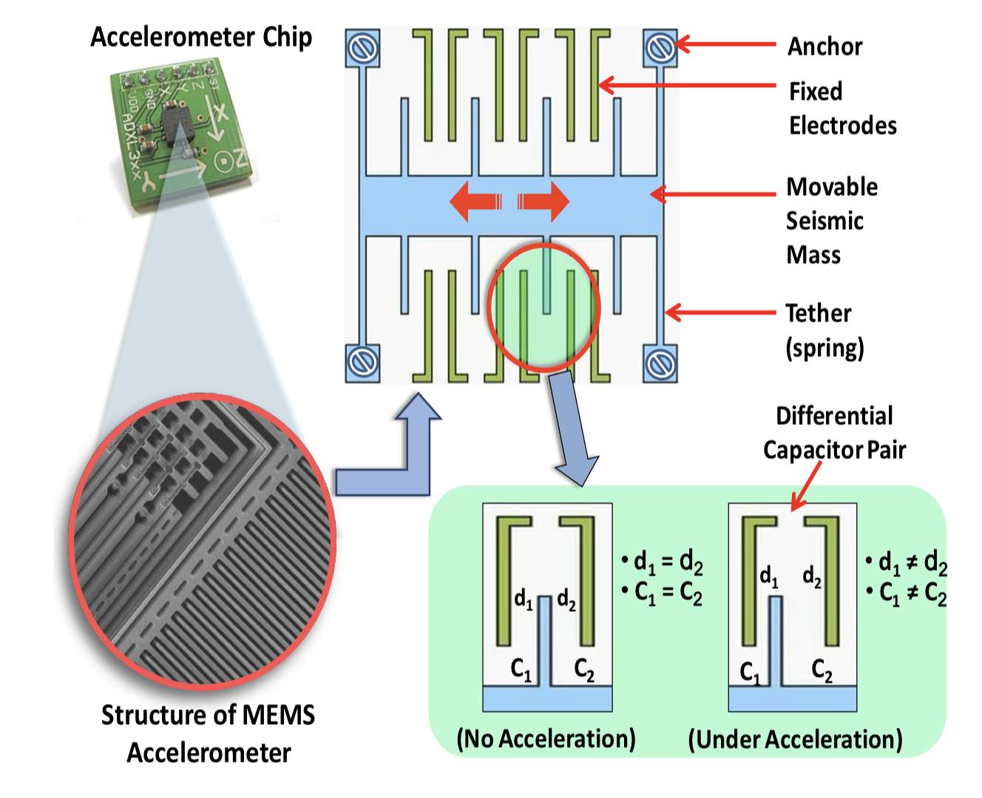
Accelerometer
Measures acceleration, not speed.
Measurements are proportional to the force. Why?

Slide 9
Accelerometer
Notes:
F = m.a = k.d (k= spring constant)
a = k.d/m, transformed the measurement of acceleration to the measurement of displacement

Slide 10
Accelerometer
Z
X
Y

Slide 11
Accelerometer
Gravity = 9.8 m/s²
What reading will you get when the device is in “free-fall”?
Old laptops had accelerometers in them. Why?

Slide 12
Accelerometer
Z
X
-Z
Y
gravity

Slide 13
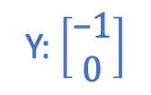
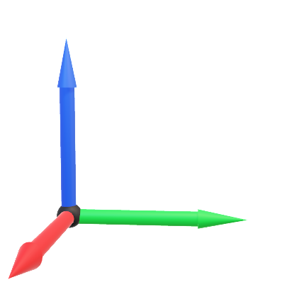
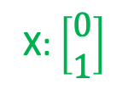

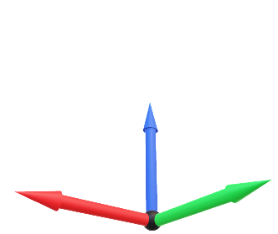
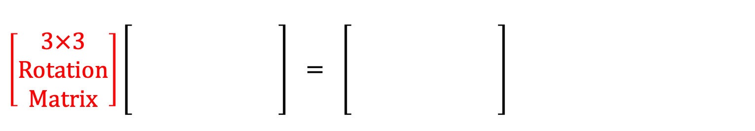
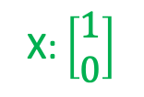
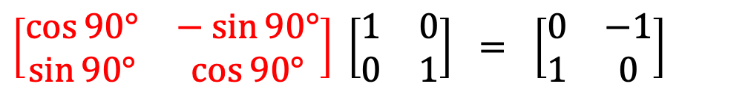
Accelerometer
One Prerequisite Slide: Rotation Matrices
Rotation is a function
Y: $\left[\begin{matrix}0 \\ 1\end{matrix}\right]$
90°
X: $\left[\begin{matrix}0 \\ 1\end{matrix}\right]$
Y: $\left[\begin{matrix}\text{−}1 \\ 0\end{matrix}\right]$
$${Rot}_{ 90°}\left( \right) = =$$
X: $\left[\begin{matrix}1 \\ 0\end{matrix}\right]$
Mathematically, rotation is a matrix
$$\left[\begin{matrix}\cos{90°} & − sin{90°} \\ \sin{90°} & \cos{90°}\end{matrix}\right] \left[\begin{matrix}1 & 0 \\ 0 & 1\end{matrix}\right] = \left[\begin{matrix}0 & −1 \\ 1 & 0\end{matrix}\right]$$
Same for 3D Rotation
$$\left[\begin{aligned}3×3 \\ Rotation \\ Matrix\end{aligned}\right]\left[\begin{aligned} \\ \\ \\ \end{aligned}\right] = \left[\begin{aligned} \\ \\ \\ \end{aligned}\right]$$

Slide 14
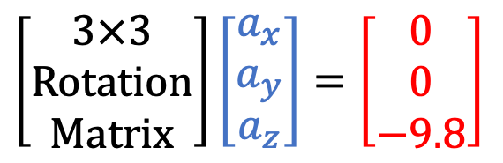
Accelerometer: Gravity vector
$$\left[\begin{aligned}3×3 \\ Rotation \\ Matrix\end{aligned}\right]\left[\begin{matrix}a_{x} \\ a_{y} \\ a_{z}\end{matrix}\right]=\left[\begin{matrix}0 \\ 0 \\ −9.8\end{matrix}\right]$$

Slide 15
Accelerometer
Z
linear acceleration
X
-Z
Y
gravity
Output = linear acceleration + gravity

Slide 16
Accelerometer Demo

Slide 17
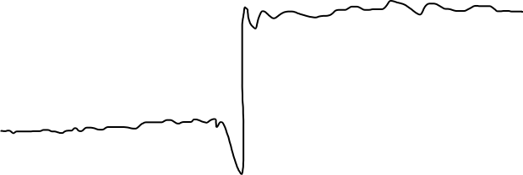
Accelerometer: Extracting gravity component
Accelerometer output
(any one of the axes)

Slide 18

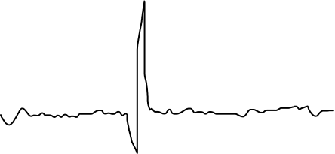
Accelerometer: Extracting gravity component
Accelerometer output
(any one of the axes)
Low frequency gravity signal
=
+
High frequency linear acceleration

Slide 19
Accelerometer: Extracting gravity component
Accelerometer output
(any one of the axes)
Low-pass filter
Low frequency gravity signal

Slide 20
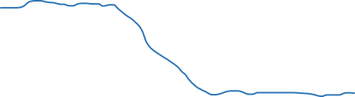
Accelerometer: Extracting gravity component
Accelerometer output
(any one of the axes)
Low-pass filter
Low frequency gravity signal
X
Y
Z

Slide 21
Accelerometer: Extracting gravity component
Z
X
-Z
Y
gravity

Slide 22
Accelerometer: Extracting gravity component
Z
X
-Z
Y
gravity

Slide 23
Accelerometer:: Extracting gravity component
Z
𝚹
X
Φ
-Z
Y
gravity

Slide 24
Accelerometer: Extracting gravity component
Accelerometer output
(any one of the axes)
Low-pass filter
Low frequency gravity signal
Do you see any
problem?

Slide 25
Inertial Measurement Unit (IMU)
Accelerometer
Gyroscope
Magnetometer (compass)

Slide 26
Gyroscope
Yaw
Roll
Pitch
Angular velocity around three axes

Slide 27
Gyroscope
Right hand rule

Slide 28
Gyroscope
Coriolis effect

Slide 29
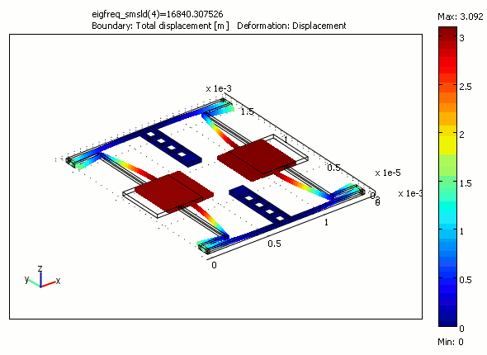
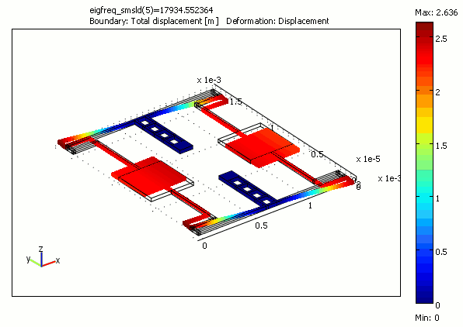
Gyroscope

Slide 30
Gyroscope Demo

Slide 31
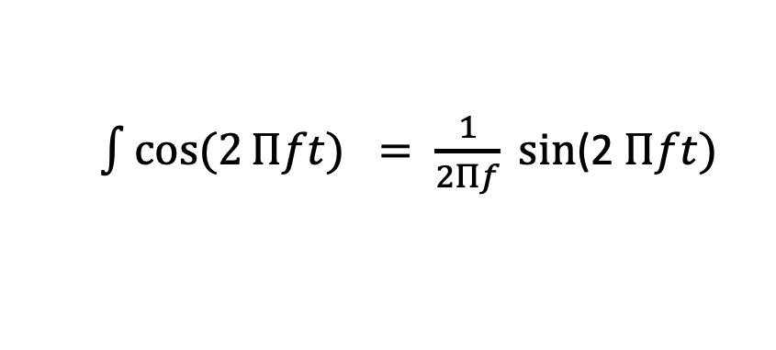
Gyroscope
Gyroscope data = angular velocity (radians or degrees per second)
⍵ = Δ𝚹/Δt
We need angle (𝚹)
Integrate the output,
𝚹 = 𝚹_{prev.} + ⍵. Δt
$\int{cos⁡(2}Πft) = \frac{1}{2Πf} sin$(2 $Πft)$

Slide 32
Gyroscope
Gyroscope data = angular velocity (radians or degrees per second)
⍵ = Δ𝚹/Δt
Calculated angle drifts over time

Slide 33
Accelerometer and Gyroscope Fusion
Z
X
Gravity vector

Slide 34
Accelerometer and Gyroscope Fusion
Z
Z
X
X
Gravity vector
Gravity vector

Slide 35
Accelerometer and Gyroscope Fusion
Z
Z
X
X
Gravity vector
Gravity vector

Slide 36
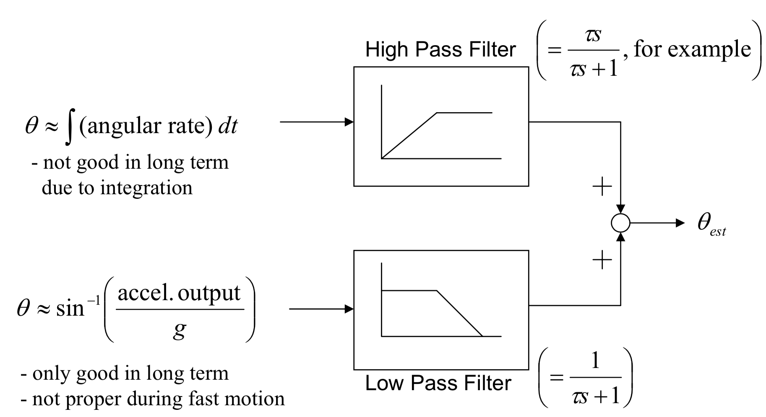
Accelerometer and Gyroscope Fusion
Complementary filter
Angle from gyro.
Angle from accel.
Angle from the gravity
vector

Slide 37
Inertial Measurement Unit (IMU)
Accelerometer
Gyroscope
Magnetometer (compass)

Slide 38
Magnetometer (the sensor behind the compass app)

Slide 39
Magnetometer (the sensor behind the compass app)
Z
Magnetic field vector
X
Y
Measures magnetic flux density (unit tesla)

Slide 40
Magnetometer Demo

Slide 41
Magnetometer (the sensor behind the compass app)
Gyroscope
Accelerometer
Tilt correction
Magnetometer
Azimuth angle
(Compass angle)

Slide 42
Axes V/S Degrees of freedom

