Slide 1
Wireless and Mobile Systems
for the IoT
CMSC 818W : Fall 2020
Lecture 3.2: Hidden Markov Model
Nirupam Roy
M-W 2:00-3:15pm
Online

Slide 2
Happy or sad?

Slide 3
Happy or sad?

Slide 4
Happy or sad?

Slide 5
Happy or sad?
Past experience
P (The dolphin is happy | Experience)

Slide 6
Inference from sensor data
Tracking arm motion

Slide 7
Inference from sensor data
Tracking arm motion
Partial information from sensors

Slide 8
Inference from sensor data
Tracking arm motion
Knowledge about the arm’s motion
(probabilistic models)
+
Partial information from sensors

Slide 9
Inference from sensor data
Tracking arm motion
Knowledge about the arm’s motion
(probabilistic models)
Arm’s gesture
and movement
tracking
+
Partial information from sensors

Slide 10
Probability refresher

Slide 11
A few basic probability rules
Joint probability: P (A, B) = P (B, A)
Likelihood of multiple events occurring simultaneously
Conditional probability: P (A|B) = P(A,B)/P(B)
Probability of an event, given another event has occurred
Marginal probability: P (B) = $\sum_{Ai}{P(B,Ai)}$

Slide 12
A few basic probability rules
Joint probability: P (A, B) = P (B, A)
Likelihood of multiple events occurring simultaneously
Conditional probability: P (A|B) = P(A,B)/P(B)
Probability of an event, given another event has occurred
Marginal probability: P (B) = $\sum_{Ai}{P(B,Ai)}$
A1
A2
A3
B

Slide 13
A few basic probability rules
Joint probability: P (A, B) = P (B, A)
Likelihood of multiple events occurring simultaneously
Conditional probability: P (A|B) = P(A,B)/P(B)
Probability of an event, given another event has occurred
Marginal probability: P (B) = $\sum_{Ai}{P(B,Ai)}$
Chain rule: P (A, B, C) = P(A|B,C) P(B,C) = P(A|B,C) P(B|C) P(C)

Slide 14
Bayes rule
Bayes rule: P (A_{i}|B) = $\frac{P\left(B|Ai\right)P(Ai)}{P(B)}$

Slide 15
Bayes rule
Likelihood
Posterior
Prior
Bayes rule: P (A_{i}|B) = $\frac{P\left(B|Ai\right)P(Ai)}{P(B)}$

Slide 16
Bayes rule
Likelihood
Posterior
Prior
Bayes rule: P (A_{i}|B) = $\frac{P\left(B|Ai\right)P(Ai)}{P(B)}$
= $\frac{P\left(B|Ai\right)P(Ai)}{\sum_{i}{P(B, Ai) }}$

Slide 17
Bayes rule
Likelihood
Posterior
Prior
Bayes rule: P (A_{i}|B) = $\frac{P\left(B|Ai\right)P(Ai)}{P(B)}$
= $\frac{P\left(B|Ai\right)P(Ai)}{\sum_{i}{P(B, Ai) }}$
= $\frac{P\left(B|Ai\right)P(Ai)}{\sum_{i}{P(B|Ai) P(Ai)}}$

Slide 18
Bayes rule
Likelihood
Posterior
Prior
Bayes rule: P (A_{i}|B) = $\frac{P\left(B|Ai\right)P(Ai)}{P(B)}$
= $\frac{P\left(B|Ai\right)P(Ai)}{\sum_{i}{P(B, Ai) }}$
= $\frac{P\left(B|Ai\right)P(Ai)}{\sum_{i}{P(B|Ai) P(Ai)}}$
Relates inverse representations of the probabilities concerning two events

Slide 19
Bayes rule
Healthy: A1
Diabetes: A2
Cancer: A3
Smoker: B
Likelihood
Posterior
Prior
Bayes rule: P (A_{i}|B) = $\frac{P\left(B|Ai\right)P(Ai)}{P(B)}$
= $\frac{P\left(B|Ai\right)P(Ai)}{\sum_{i}{P(B, Ai) }}$
= $\frac{P\left(B|Ai\right)P(Ai)}{\sum_{i}{P(B|Ai) P(Ai)}}$
Relates inverse representations of the probabilities concerning two events

Slide 20
Markov Model

Slide 21
Markov Model
Sunny
Sunny
Rainy
Sunny
Rainy
Rainy
t1 t2 t3 t4 t5 t6 (time)

Slide 22
Markov Model
Sunny
Sunny
Rainy
Sunny
Rainy
Rainy
t1 t2 t3 t4 t5 t6 (time)
Sunny
day
Rainy
day

Slide 23
Markov Model
Sunny
Sunny
Rainy
Sunny
Rainy
Rainy
t1 t2 t3 t4 t5 t6 (time)
P (sunny after rainy)
P (sunny after sunny)
P (rainy after rainy)
Sunny
day
Rainy
day
P (rainy after sunny)
Mth order Markov assumption: Current state depends on past M states

Slide 24
Markov Model
Sunny
Sunny
Rainy
Sunny
Rainy
Rainy
t1 t2 t3 t4 t5 t6 (time)
P (sunny after rainy)
P (sunny after sunny)
P (rainy after rainy)
The future depends on the present only, not on the past
Sunny
day
Rainy
day
P (rainy after sunny)

Slide 25
Markov Model
Sunny
Sunny
Rainy
Sunny
Rainy
Rainy
t1 t2 t3 t4 t5 t6 (time)
P (sunny after rainy)
P (sunny after sunny)
P (rainy after rainy)
Sunny
day
Rainy
day
P (rainy after sunny)

Slide 26
Markov Model
Sunny
Sunny
Rainy
Sunny
Rainy
Rainy
t1 t2 t3 t4 t5 t6 (time)
P (sunny after rainy)
P (sunny after sunny)
P (rainy after rainy)
Sunny
day
Rainy
day
Temp.
P (rainy after sunny)
Temp.
Humidity
Humidity
Wind
Wind

Slide 27
Hidden Markov Model

Slide 28
Hidden Markov Model: Toy robot localization example
Find location of the robot
(Hidden information)
Observations =
sensor measurement
S₁
S₂
S₃
…

Slide 29
Hidden Markov Model: Toy robot localization example
Prob
0
1
t=0

Slide 30
Hidden Markov Model: Toy robot localization example
Prob
0
1
t=1

Slide 31
Hidden Markov Model: Toy robot localization example
Prob
0
1
t=1

Slide 32
Hidden Markov Model: Toy robot localization example
Prob
0
1
t=2

Slide 33
Hidden Markov Model: Toy robot localization example
Prob
0
1
t=3

Slide 34
Hidden Markov Model: Toy robot localization example
Prob
0
1
t=4

Slide 35
Hidden Markov Model: Toy robot localization example
Prob
0
1
t=5

Slide 36
Hidden Markov Model: Toy robot localization example
State = location on the grid = S_{i}
S₁
S₂
S₃
…

Slide 37
Hidden Markov Model: Toy robot localization example
Observations =
sensor measurement = M_{i}
State = location on the grid = S_{i}
S₁
S₂
S₃
…

Slide 38
Hidden Markov Model: Toy robot localization example
Observations =
sensor measurement = M_{i}
State = location on the grid = S_{i}
S₁
S₂
S₃
…
Depends on the current state
only
(Emission)
S_{i}

Slide 39
Hidden Markov Model: Toy robot localization example
Observations =
sensor measurement = M_{i}
State = location on the grid = S_{i}
S₁
S₂
S₃
…
Depends on the current state
only
(Emission)
S_{i}
S_{i+1}
S_{i+2}
…
S_{i}
States change over time (Transition)

Slide 40
Hidden Markov Model: Definition
S₁
S₂
S₃
S₄
M₁
M₂
M₃
M₄

Slide 41
Hidden Markov Model: Definition
Hidden states
S₁
S₂
S₃
S₄
M₁
M₂
M₃
M₄

Slide 42
Hidden Markov Model: Definition
Hidden states
S₁
S₂
S₃
S₄
M₁
M₂
M₃
M₄
Observations

Slide 43
Hidden Markov Model: Definition
S₁
S₁
S₂
M₁
Transition
Emission

Slide 44
Hidden Markov Model: Definition
S₁
S₁
S₂
M₁
Transition
Emission
1st order Markov assumption:
Transition probability depends on the current state only.
Output independence assumption:
Output/Emission probability depends on the current state only.

Slide 45
Hidden Markov Model: Definition
Probability of a sequence of hidden states, given a sequence of observations

Slide 46
Hidden Markov Model: Definition
Probability of a sequence of hidden states, given a sequence of observations

Slide 47
Hidden Markov Model: Definition
Probability of a sequence of hidden states, given a sequence of observations

Slide 48
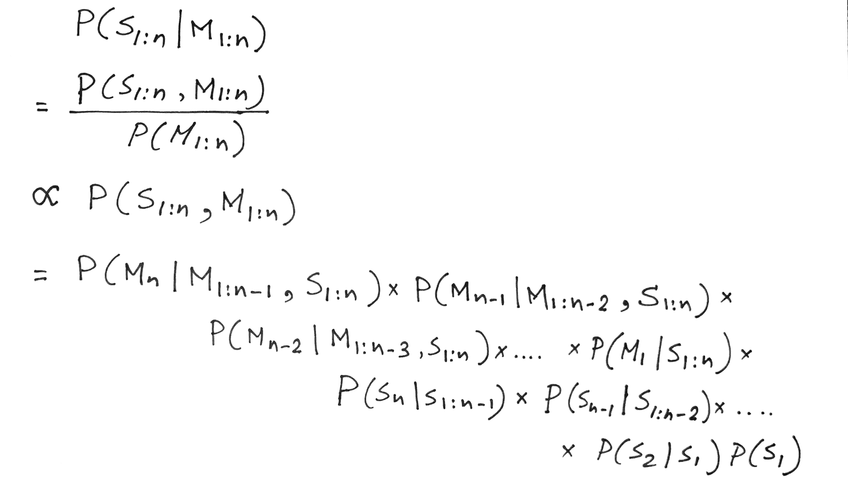
Hidden Markov Model: Definition
Chain rule

Slide 49
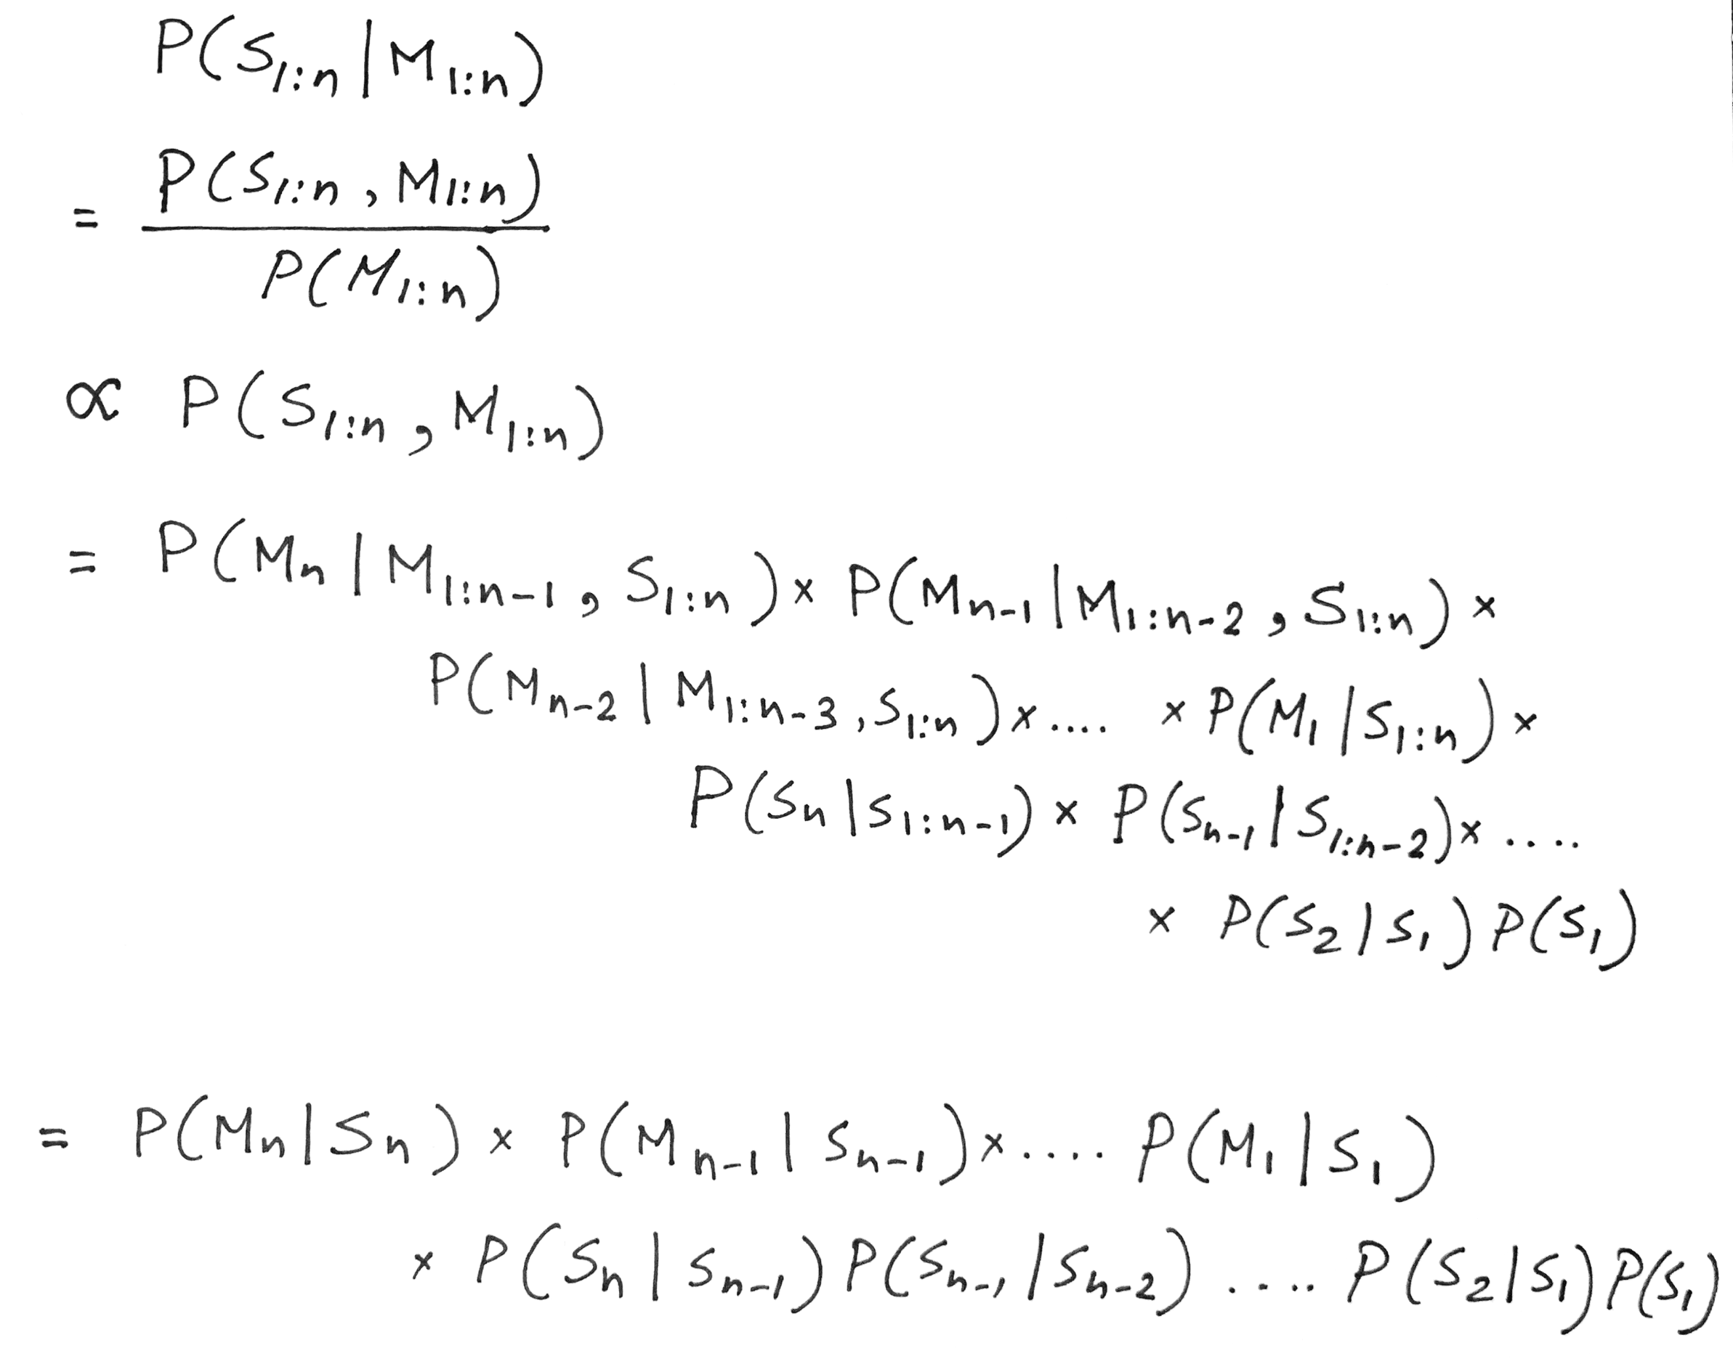
Hidden Markov Model: Definition
Observation depends on the current state only

Slide 50
Hidden Markov Model: Definition
Observation depends on the current state only
Future state depends on the current state only

Slide 51
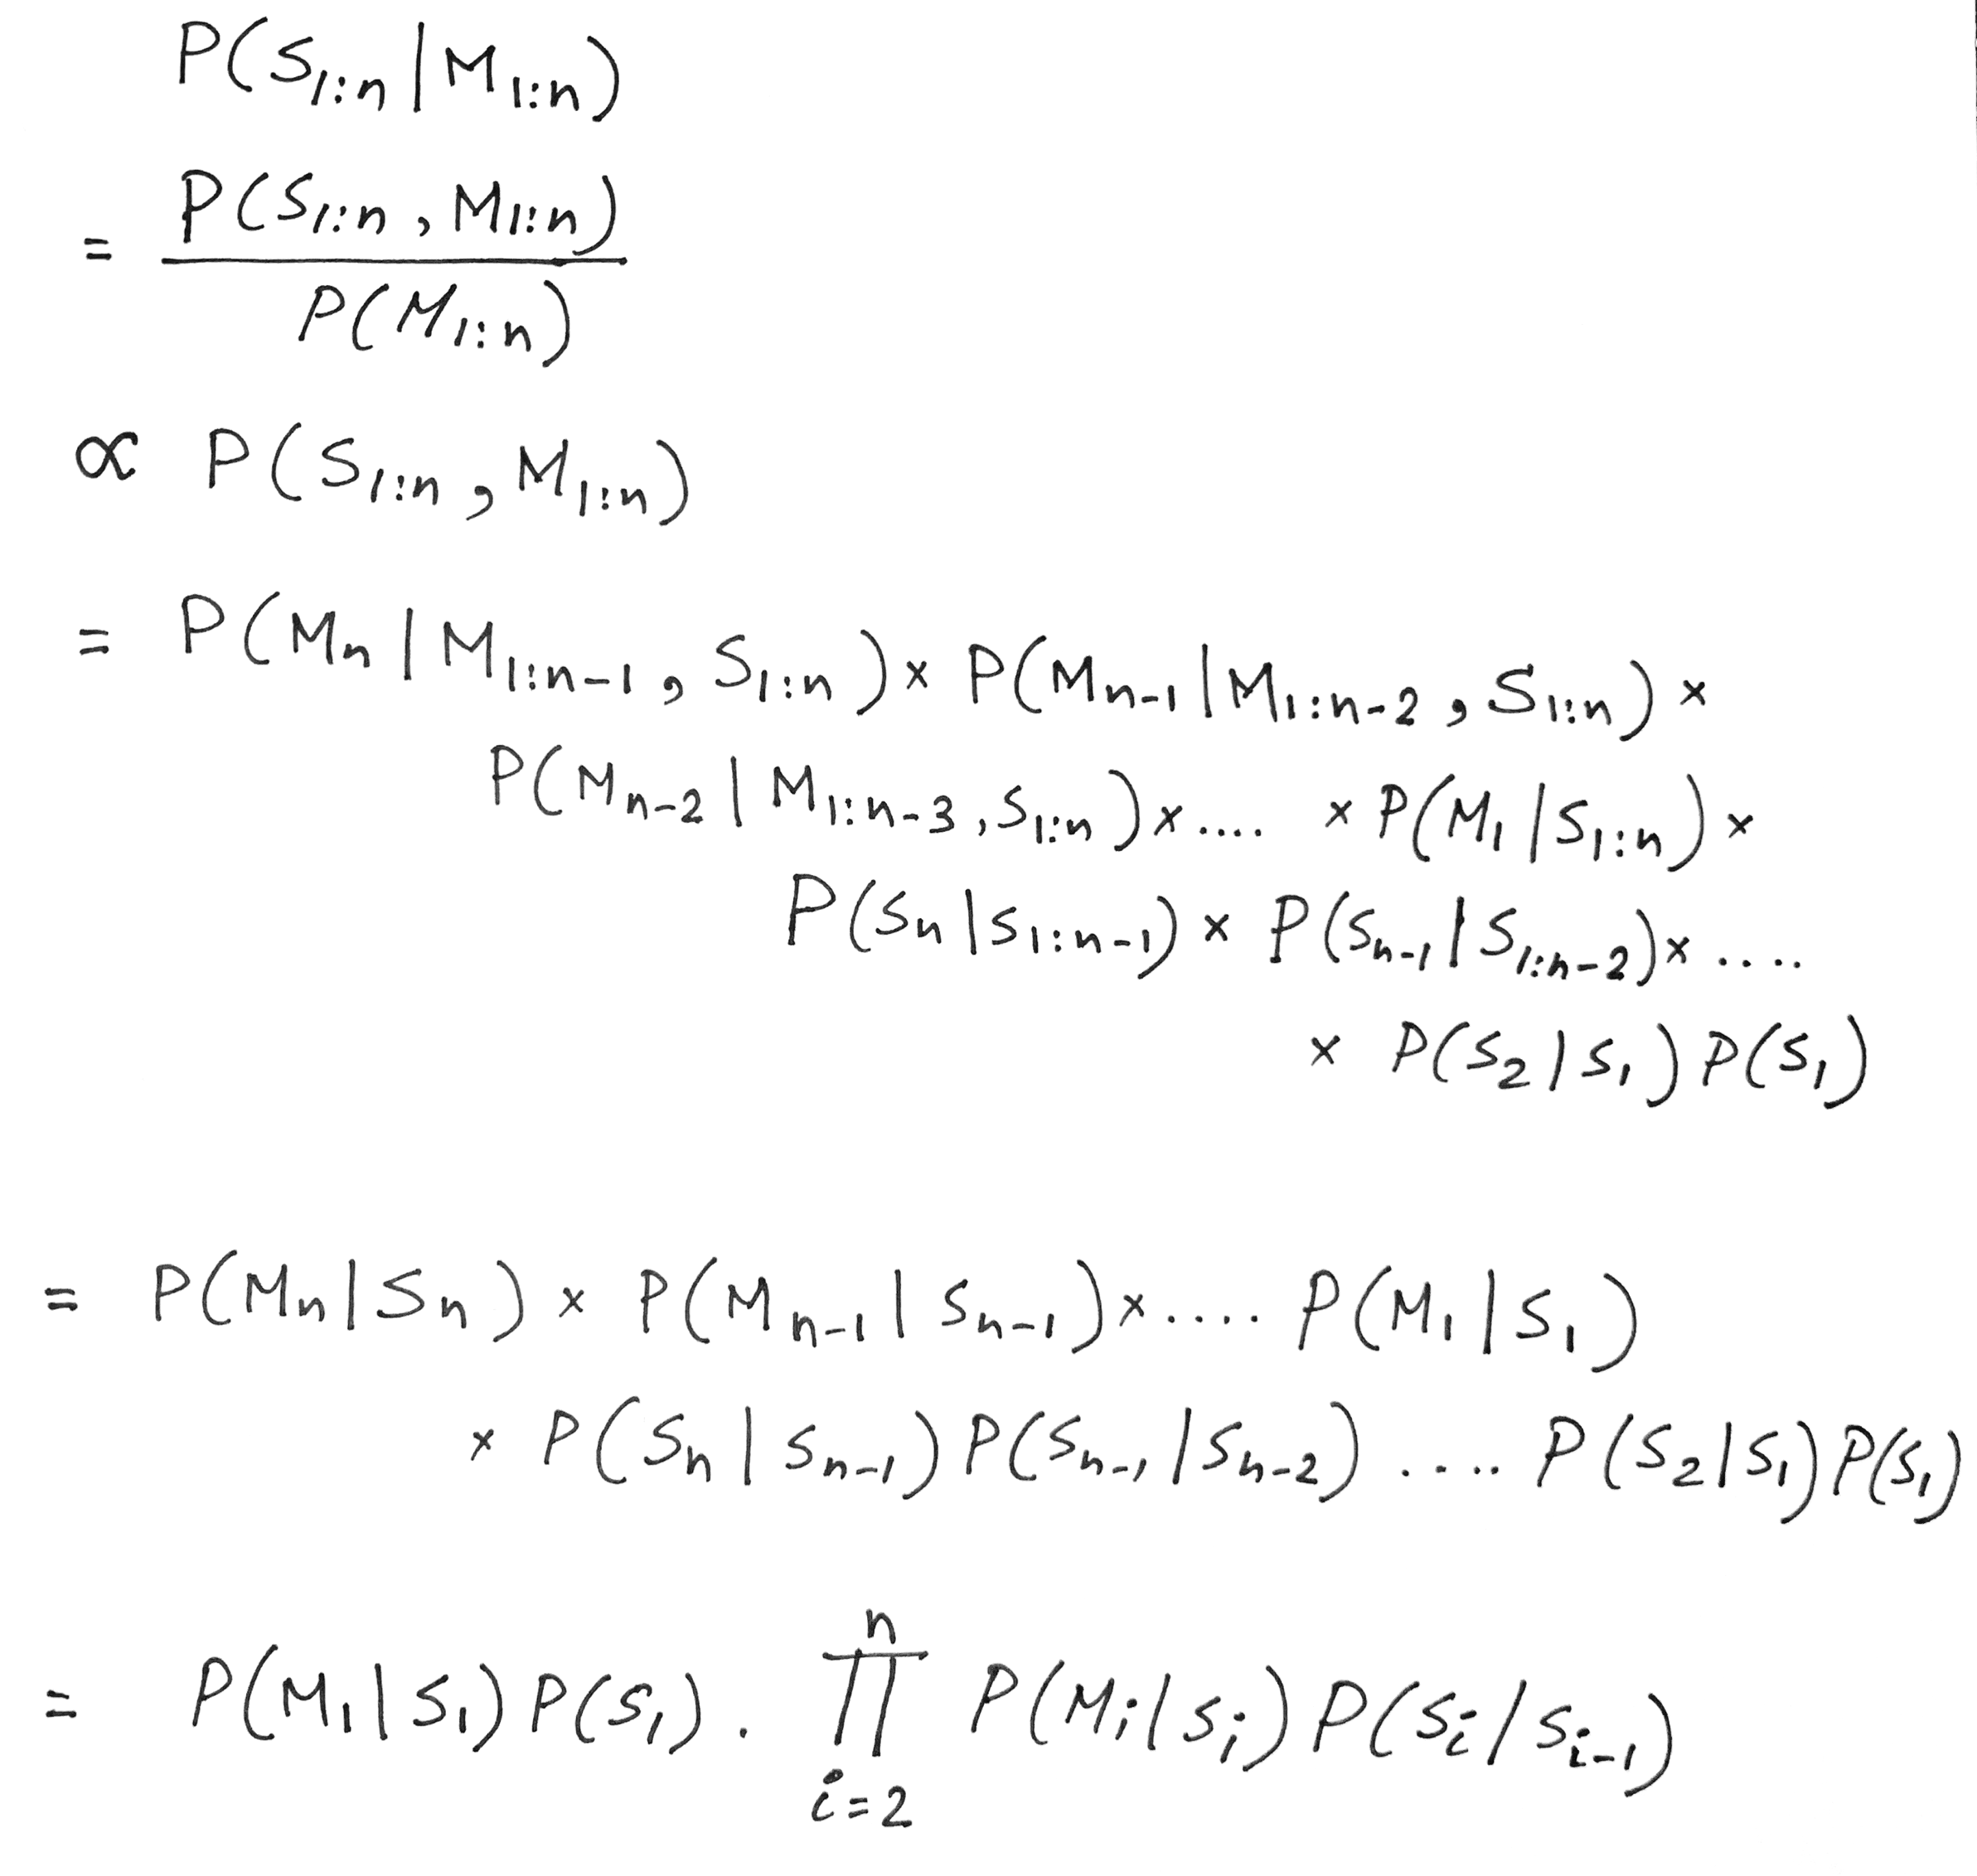
Hidden Markov Model: Definition

Slide 52
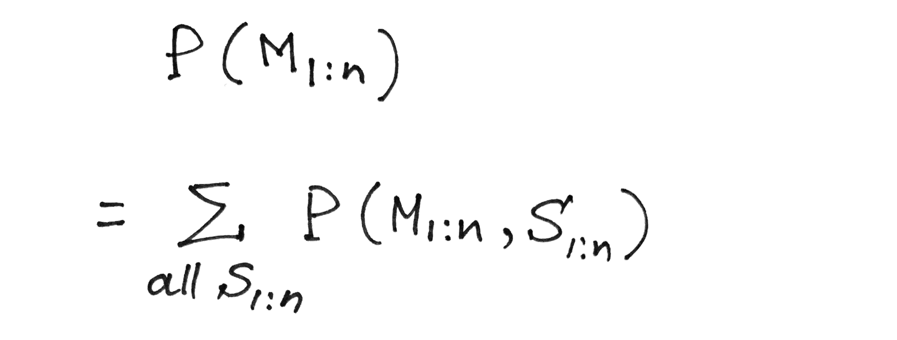
Hidden Markov Model: Definition
Probability of a given observation/measurement sequence
Marginal probability rule

Slide 53
Hidden Markov Model: Definition
Probability of a given observation/measurement sequence
Summation over all possible
combinations of hidden states

Slide 54
Hidden Markov Model: Definition
Probability of a given observation/measurement sequence
Summation over all possible
combinations of hidden states
For N hidden states and a sequence of T observations,
N^{T} different combinations

Slide 55
Hidden Markov Model: Definition
Forward-backward algorithm.
Viterbi algorithm

