Slide 1

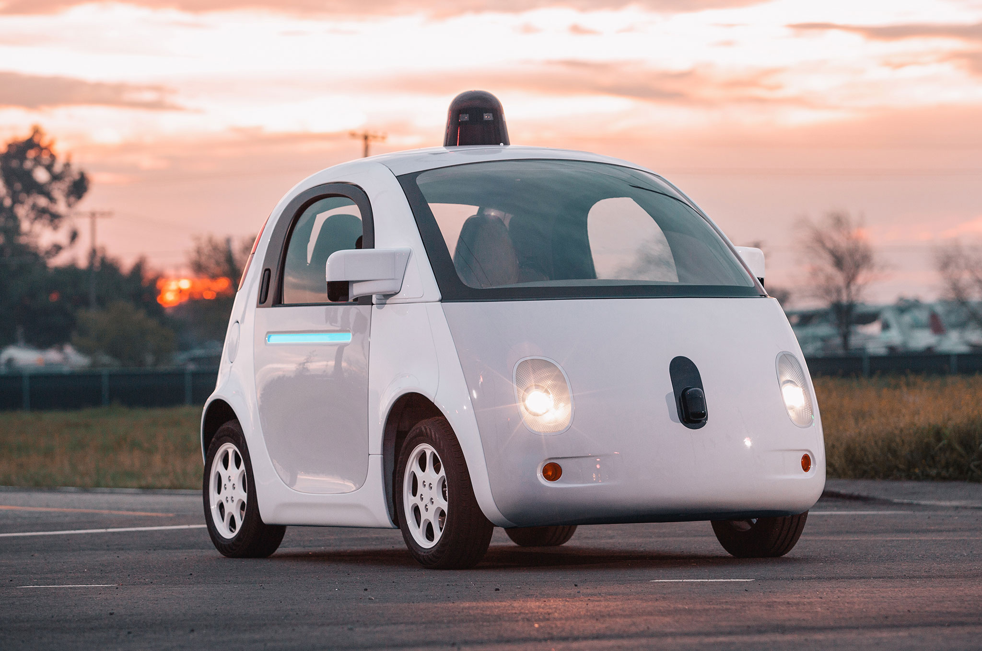

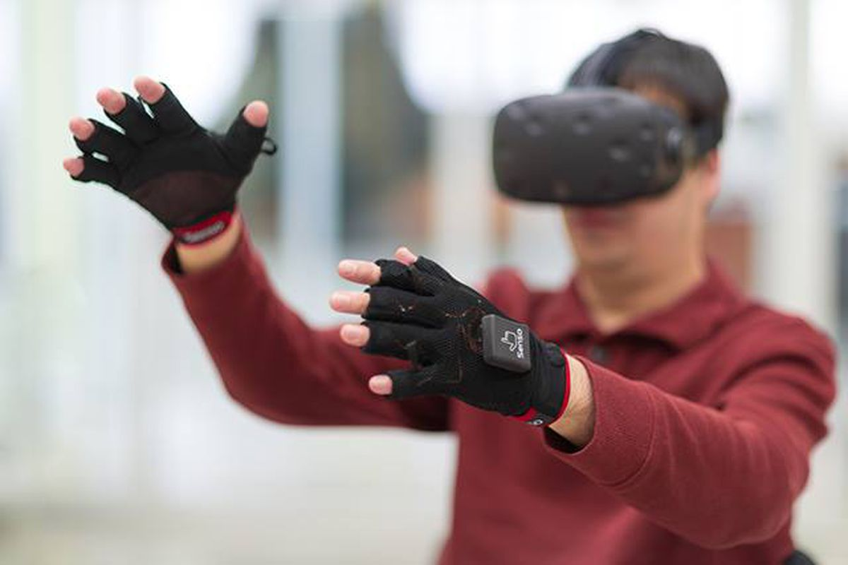

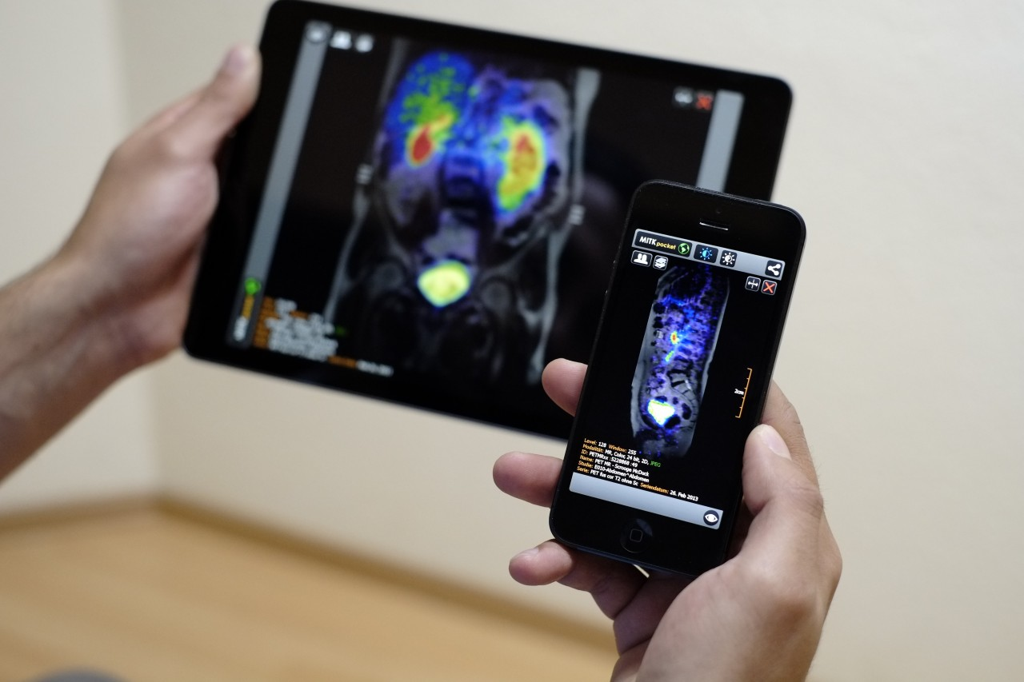
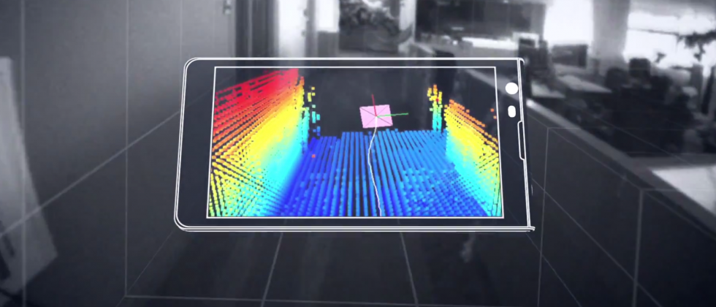

Wireless and Mobile Systems
for the IoT
CMSC 818W : Fall 2020
Lecture 4.3: GPS - I
Nirupam Roy
M-W 2:00-3:15pm
Online
This zoom session is being recorded.

Slide 2
Notes:
The nominal GPS configuration consists of a network of 24 satellites in high orbits around the Earth, but up to 30 or so satellites may be on station at any given time. Each satellite in the GPS constellation orbits at an altitude of about 20,000 km from the ground, and has an orbital speed of about 14,000 km/hour (the orbital period is roughly 12 hours - contrary to popular belief, GPS satellites are not in geosynchronous or geostationary orbits). The satellite orbits are distributed so that at least 4 satellites are always visible from any point on the Earth at any given instant (with up to 12 visible at one time).
Geostationary orbits are near the equator and hence does not provide enough coverage.

Slide 3
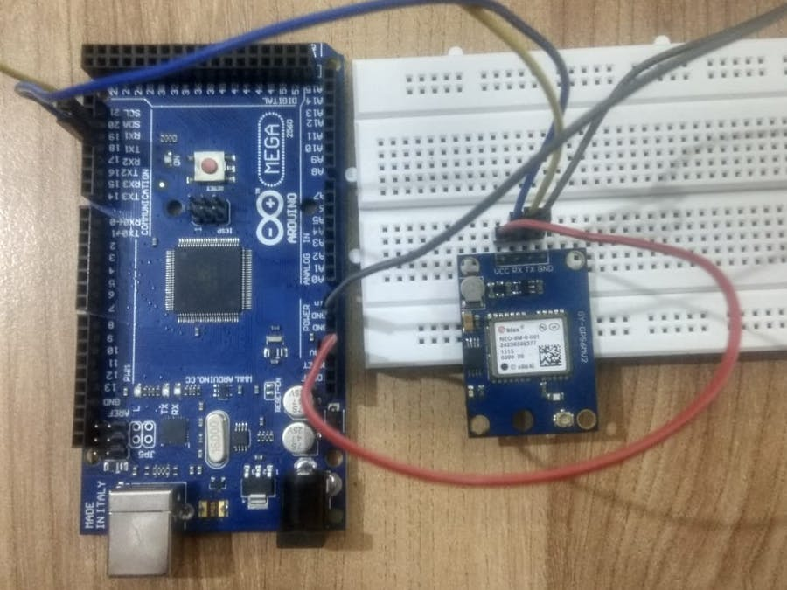

Slide 4
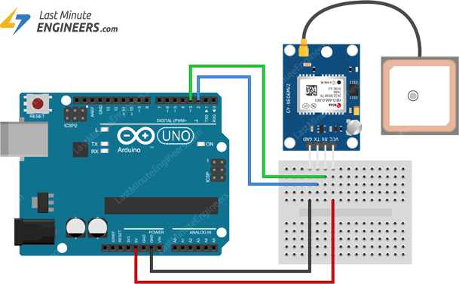

Slide 5
Global Navigation Satellite Systems:

Slide 6
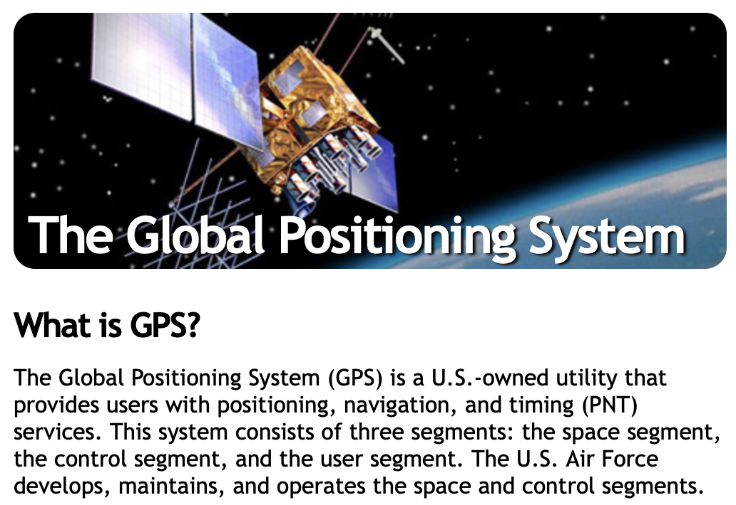
Global Navigation Satellite Systems:
https://www.gps.gov

Slide 7

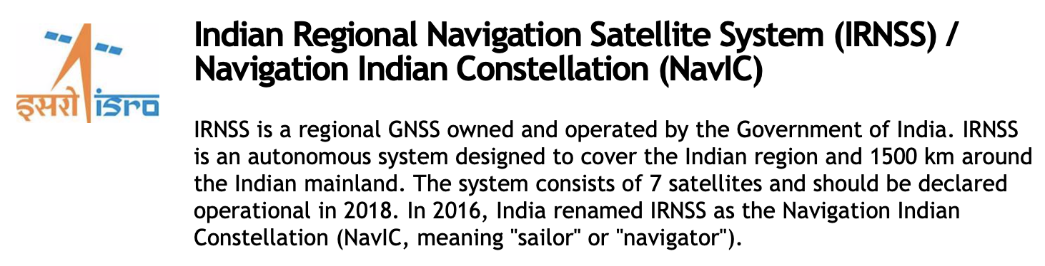

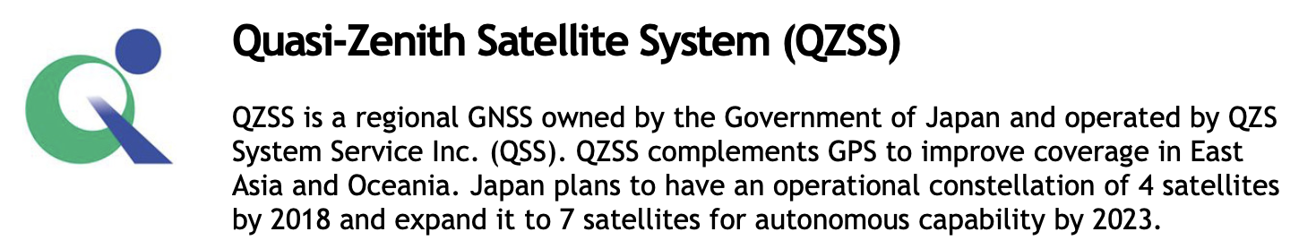

Global Navigation Satellite Systems:
Source: https://www.gps.gov

Slide 8
Location estimation

Slide 9
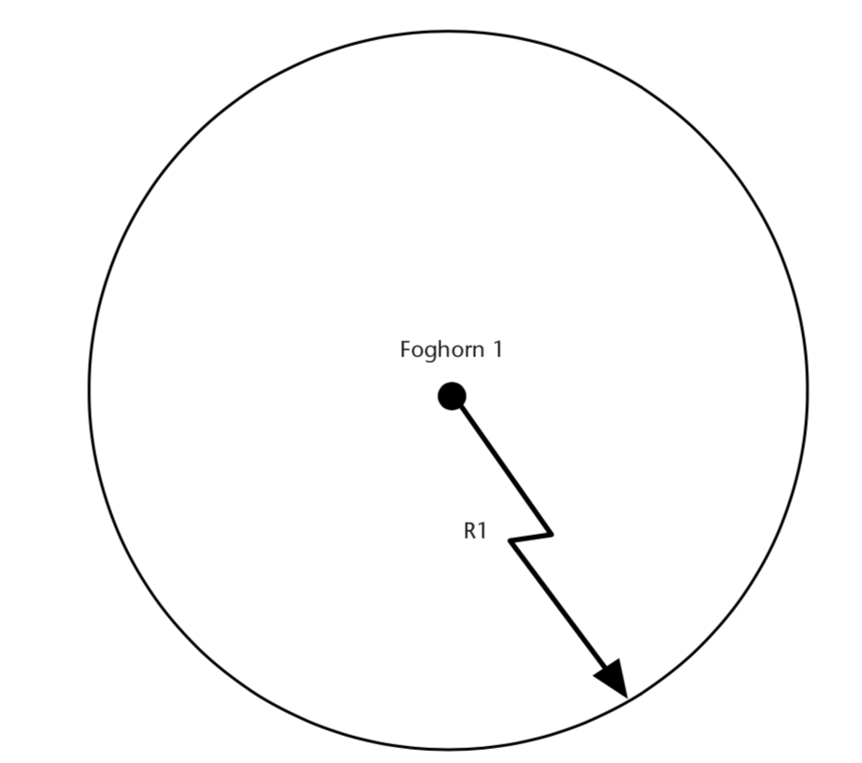
Ranging and localization
Ref: Understanding GPS Principles and Applications , 2nd Edition

Slide 10
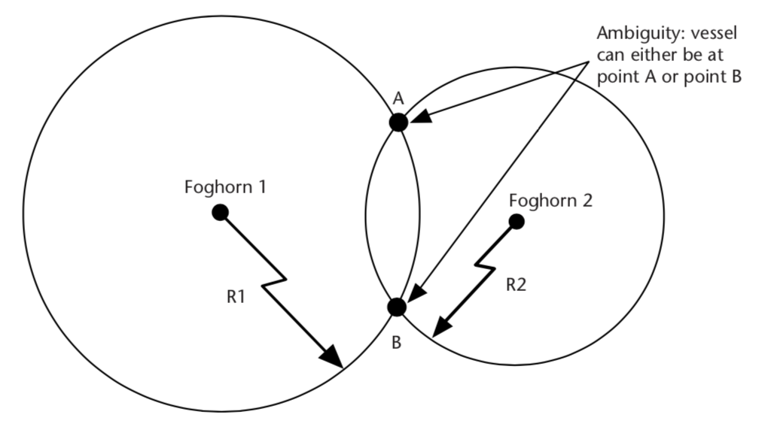
Ranging and localization
Ref: Understanding GPS Principles and Applications , 2nd Edition

Slide 11
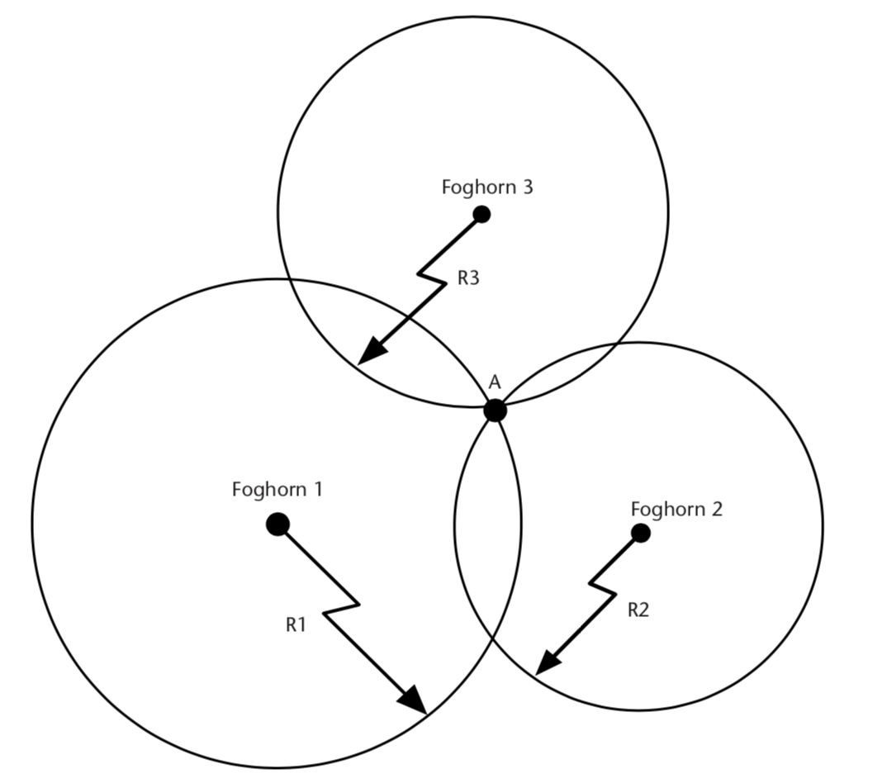
Ranging and localization
What if the clock is not synchronized?
Ref: Understanding GPS Principles and Applications , 2nd Edition

Slide 12
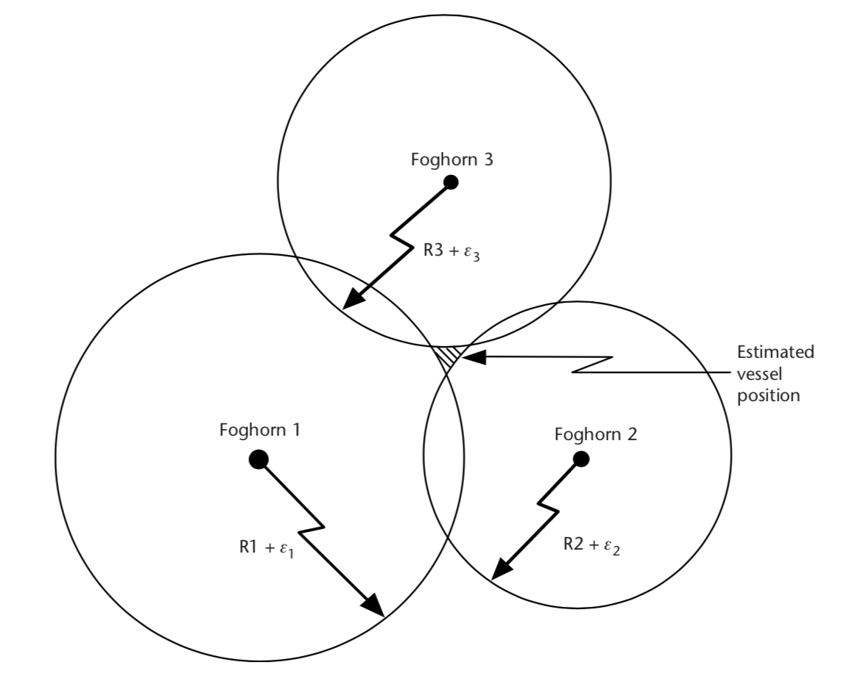
Independent measurement error
Ref: Understanding GPS Principles and Applications , 2nd Edition

Slide 13
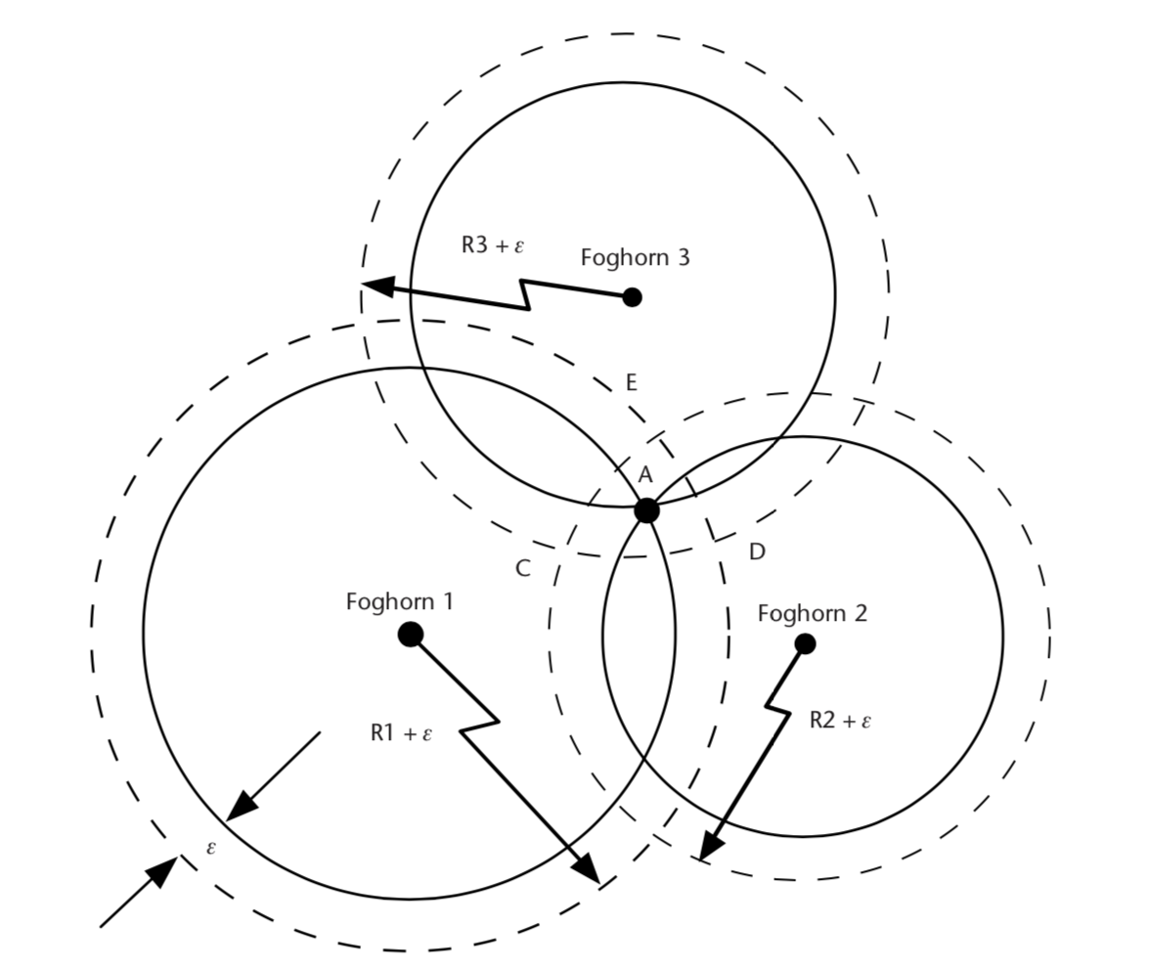
Ranging and localization: Common clock offset
Ref: Understanding GPS Principles and Applications , 2nd Edition

Slide 14
Triangulation vs Trilateration

Slide 15
Triangulation
base1
base2
𝚹₁
𝚹₂
𝚹₁
𝚹₂
observer

Slide 16
Trilateration
base1
base2
d
d’
observer

Slide 17
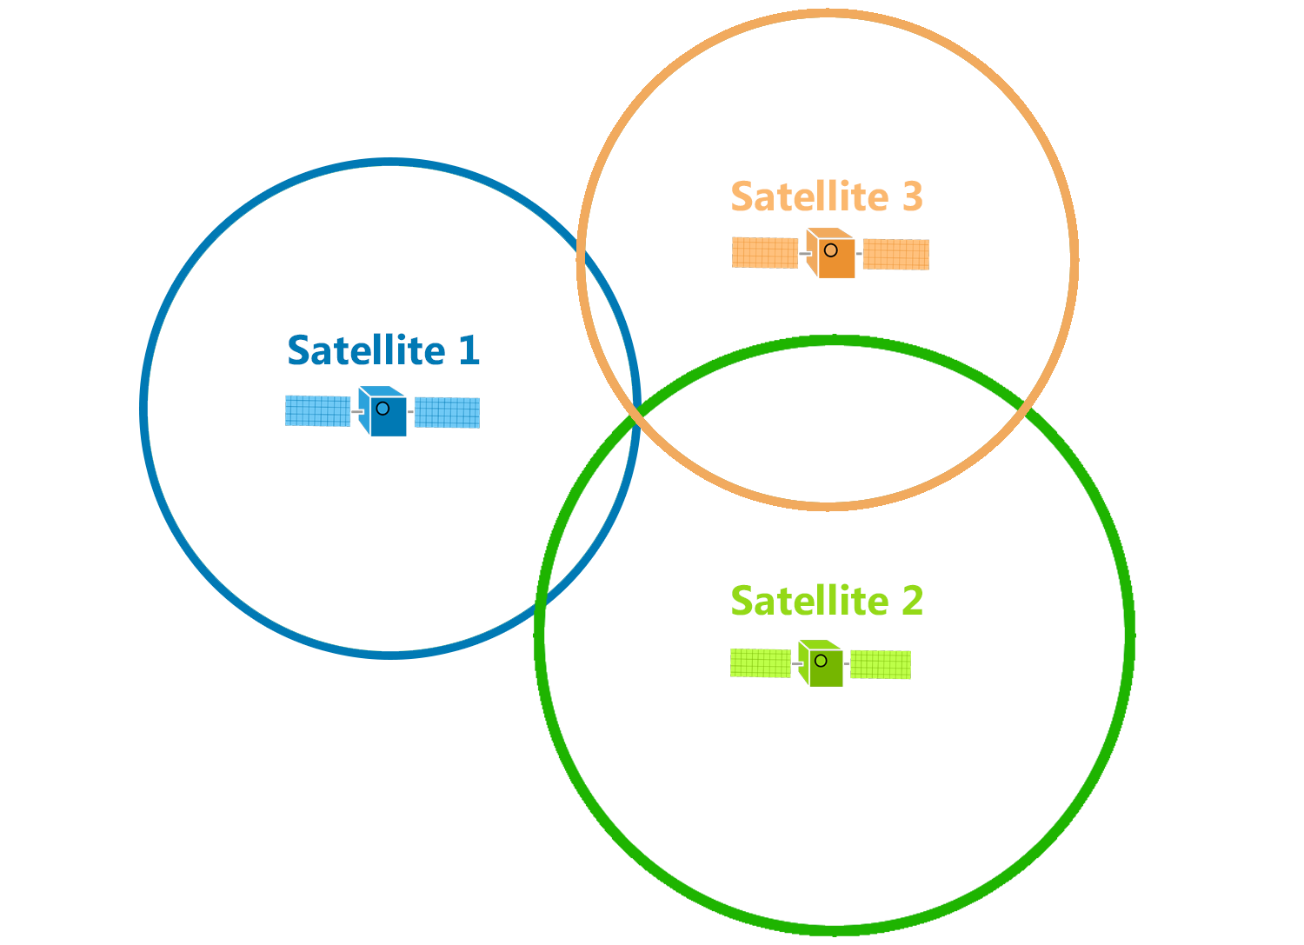
Trilateration
d

Slide 18
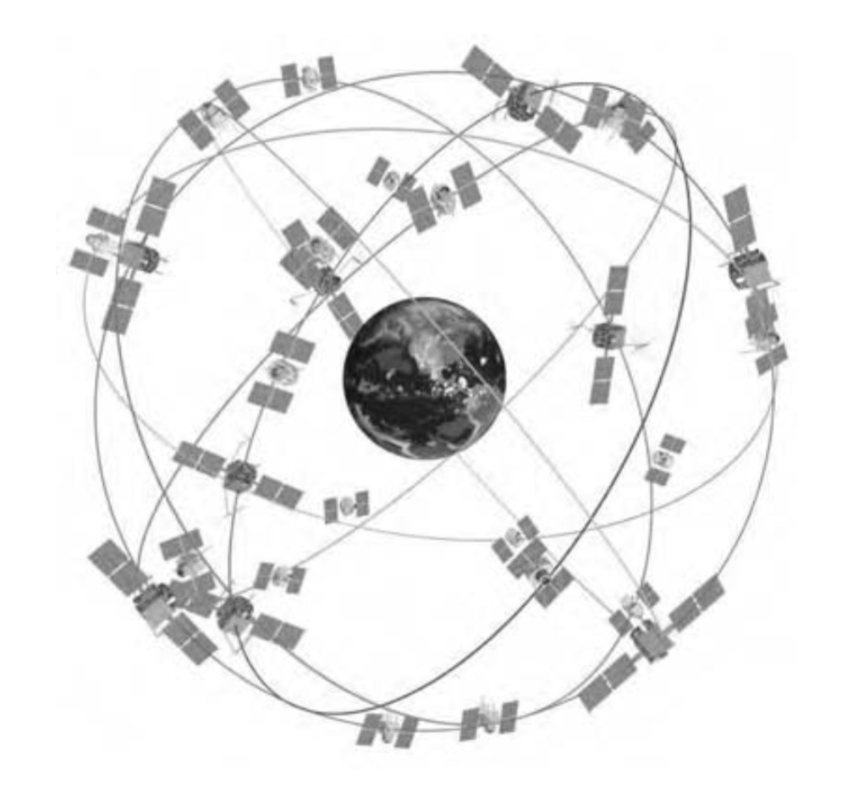
GPS Satellite Constellation
Baseline configuration
-- 24 satellites
-- 6 orbital planes, 4 satellites in each plane
-- 60° separation between planes
-- Orbital radius approx. 26,600 km
Geo-stationary ?
Notes:
https://www.gpsworld.com/origins-gps-part-1/
https://pdfs.semanticscholar.org/d6f5/812c9f91d68862cf3e2a8af6a3f9db14ba2b.pdf

Slide 19
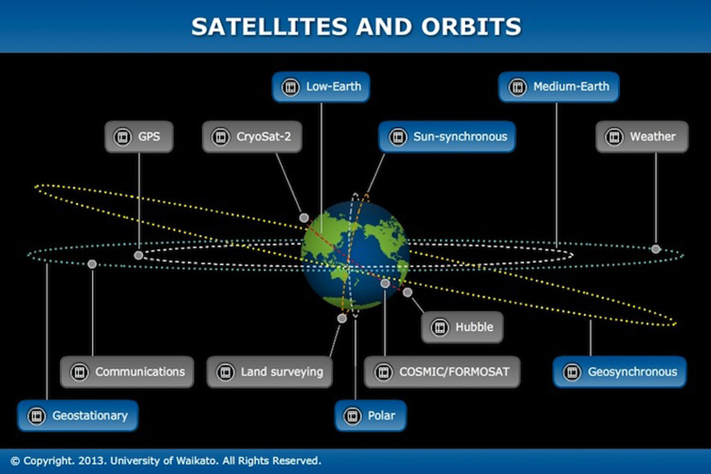
Satellite orbits

Slide 20
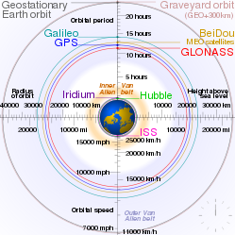
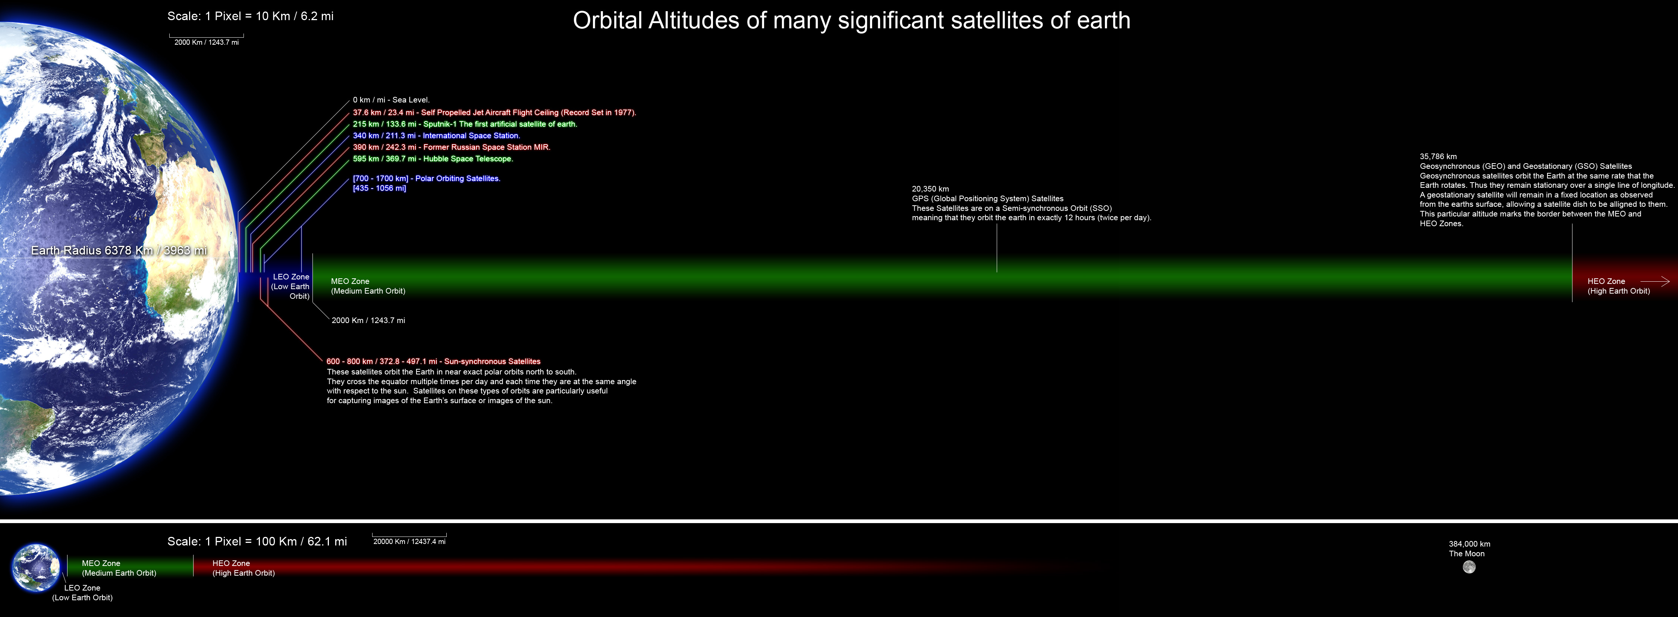
Satellite orbits

Slide 21
GPS Satellite Constellation
Baseline configuration
-- 24 satellites
-- 6 orbital planes, 4 satellites in each plane
-- 60° separation between planes
-- Orbital radius approx. 26,600 km
-- Orbital period 11h 58m (half day)
at a speed of around 14000km/s

Slide 22
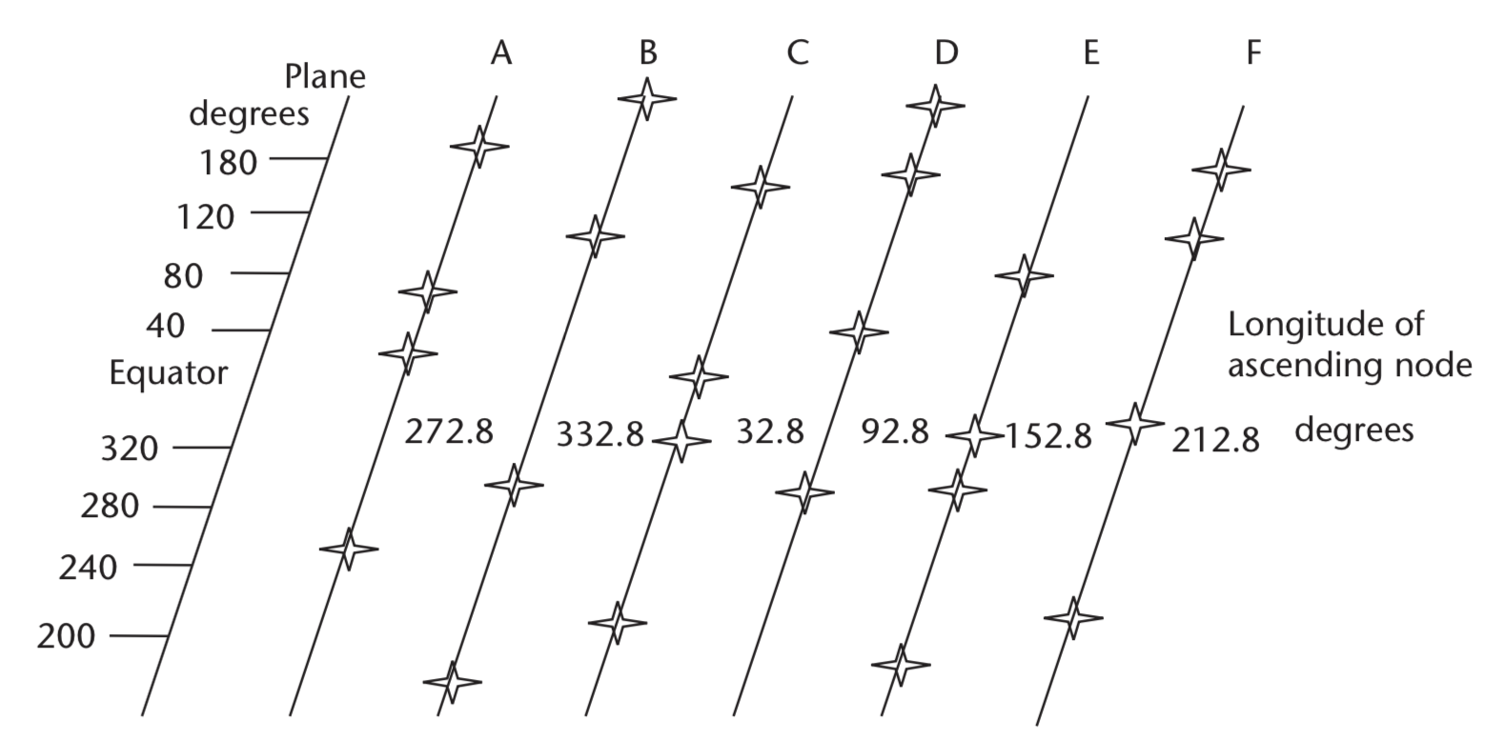
GPS Satellite Constellation
Planar projection of the constellation
( 0000h, July 1, 1993 UTC)
Notes:
The nominal GPS configuration consists of a network of 24 satellites in high orbits around the Earth, but up to 30 or so satellites may be on station at any given time. Each satellite in the GPS constellation orbits at an altitude of about 20,000 km from the ground, and has an orbital speed of about 14,000 km/hour (the orbital period is roughly 12 hours - contrary to popular belief, GPS satellites are not in geosynchronous or geostationary orbits). The satellite orbits are distributed so that at least 4 satellites are always visible from any point on the Earth at any given instant (with up to 12 visible at one time).
Geostationary orbits are near the equator and hence does not provide enough coverage.

Slide 23
GPS Satellite Constellation
At least 4 satellites are always visible from any point on the Earth at any given instant
Planar projection of the constellation
( 0000h, July 1, 1993 UTC)
Notes:
The nominal GPS configuration consists of a network of 24 satellites in high orbits around the Earth, but up to 30 or so satellites may be on station at any given time. Each satellite in the GPS constellation orbits at an altitude of about 20,000 km from the ground, and has an orbital speed of about 14,000 km/hour (the orbital period is roughly 12 hours - contrary to popular belief, GPS satellites are not in geosynchronous or geostationary orbits). The satellite orbits are distributed so that at least 4 satellites are always visible from any point on the Earth at any given instant (with up to 12 visible at one time).
Geostationary orbits are near the equator and hence does not provide enough coverage.

Slide 24
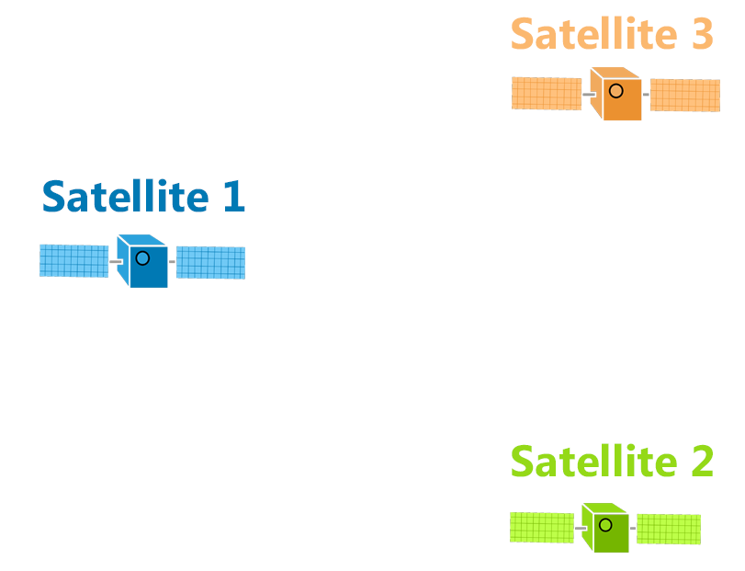
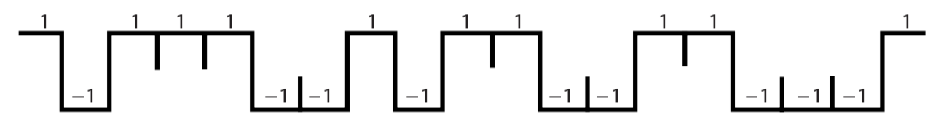
Pseudo-Random Noise (PRN) code
Each satellite is assigned a unique CDMA code.
PRN code (Coarse/Acquisition or C/A code)
Notes:
In 1928, Warren Marrison of Bell Telephone Laboratories developed the first quartz-crystal clock. With accuracies of up to 1 second in 30 years
Atomic clock:
Use of GPS clock: Wireless communication, TV broadcast, timestamping business transaction, frequency hopping

Slide 25
Signal detection
Amplitude
Amplitude
Time/Sample
Time/Sample
Transmitter signal
Receiver signal

Slide 26
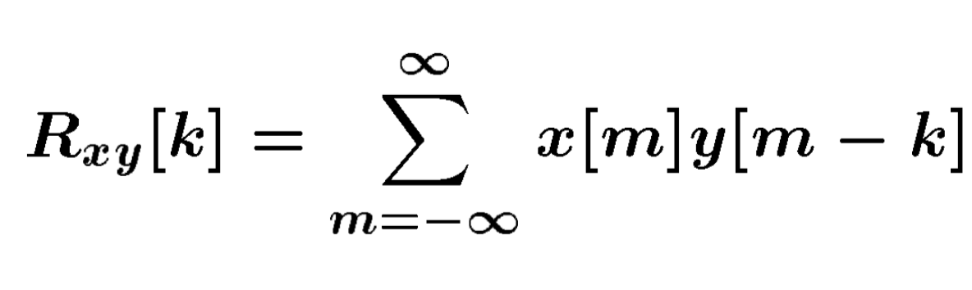
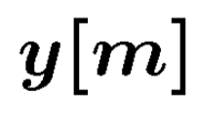
Signal detection
Received signal
Signal matching
Transmit signal template
Correlation

Slide 27
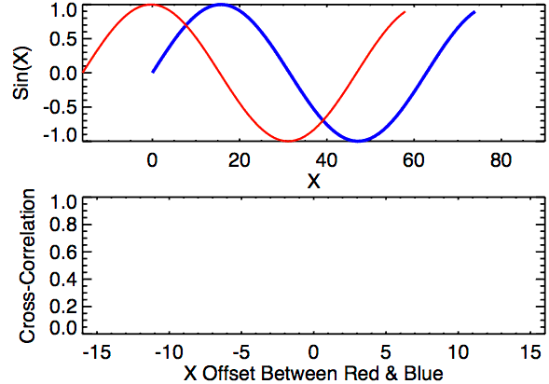
Signal detection
Correlation

Slide 28
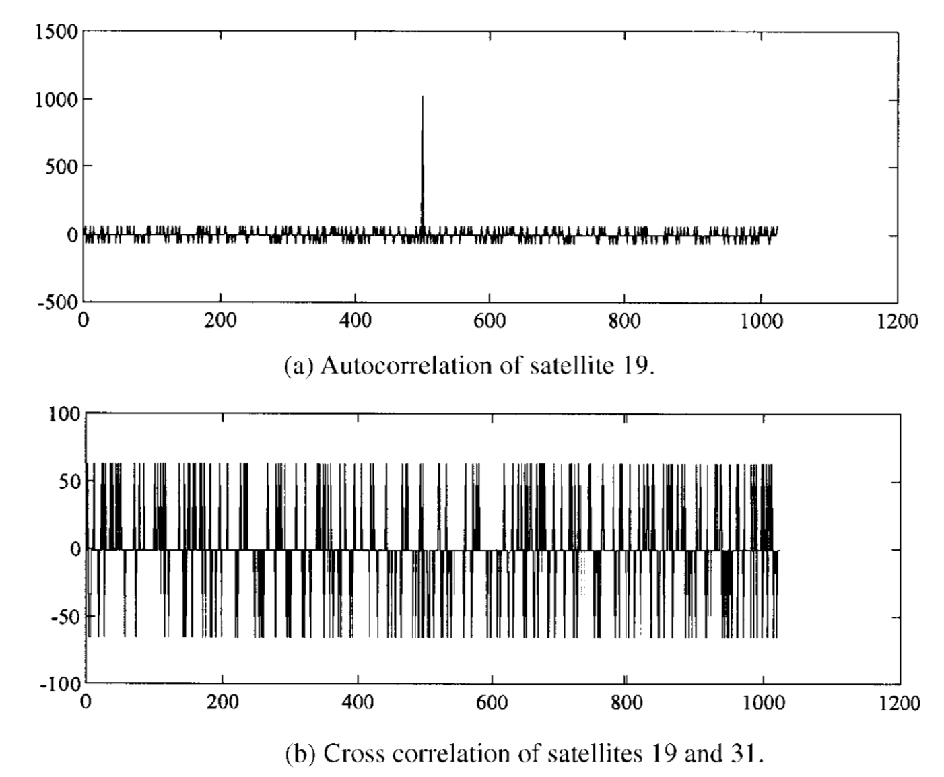
Pseudo-Random Noise (PRN) code
Notes:
In 1928, Warren Marrison of Bell Telephone Laboratories developed the first quartz-crystal clock. With accuracies of up to 1 second in 30 years
https://pdfs.semanticscholar.org/d6f5/812c9f91d68862cf3e2a8af6a3f9db14ba2b.pdf
Atomic clock:
Use of GPS clock: Wireless communication, TV broadcast, timestamping business transaction, frequency hopping

Slide 29
Propagation Delay
or
Time of Flight (ToF)

Slide 30
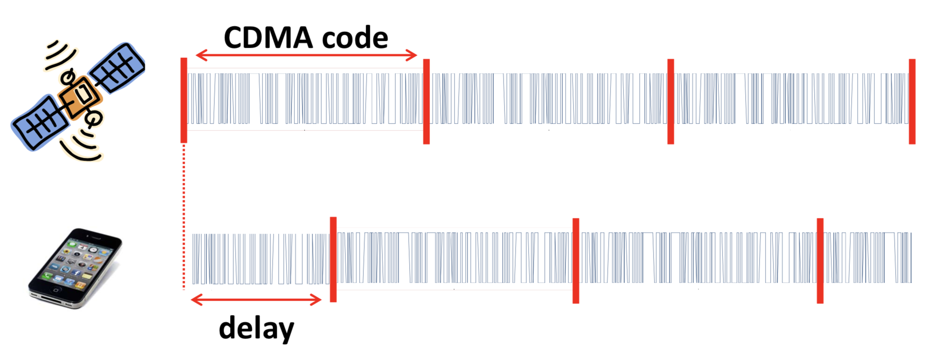
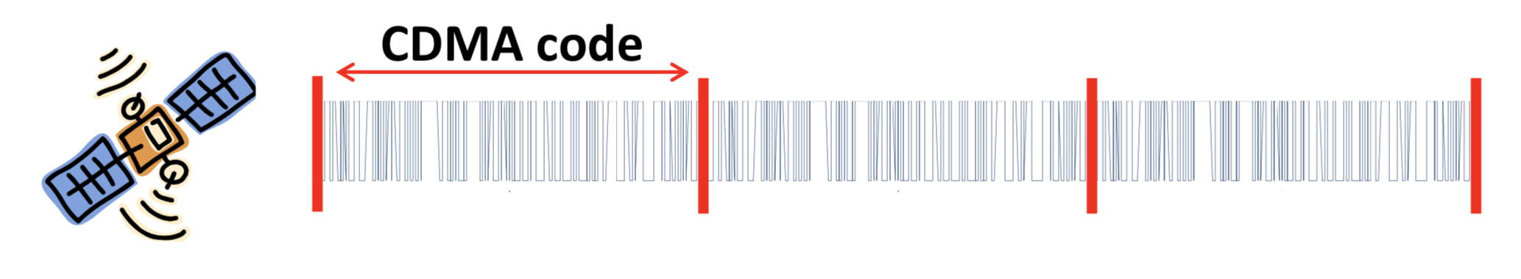
Time of Flight (ToF)
Known starting time of the code

Slide 31
Time of Flight (ToF)

Slide 32
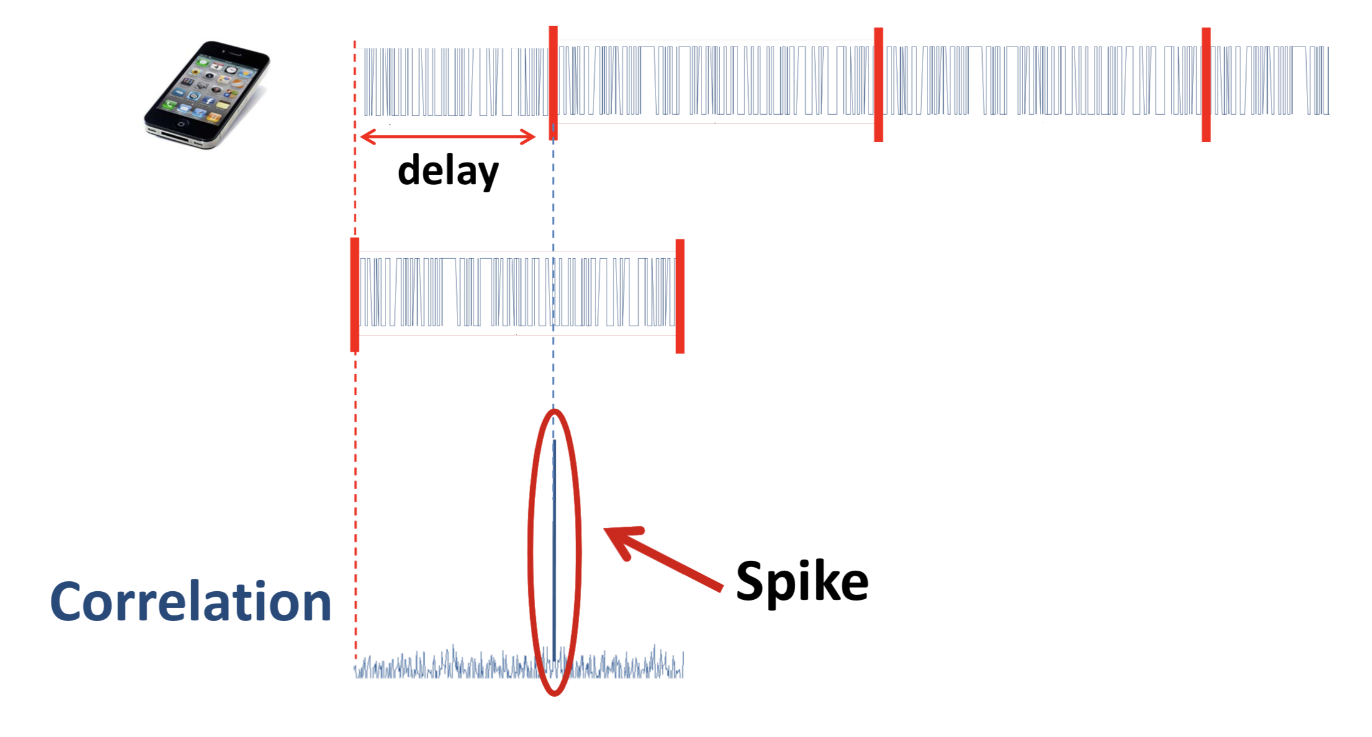
Time of Flight (ToF)

Slide 33
Time of Flight (ToF)
Δt

Slide 34
Range = propagation delay X speed of light
= Δt x C (C = speed of light, ~ 3x10⁸ m/s)

Slide 35
Time of Flight (ToF)
Starting time, t
Δt

Slide 36
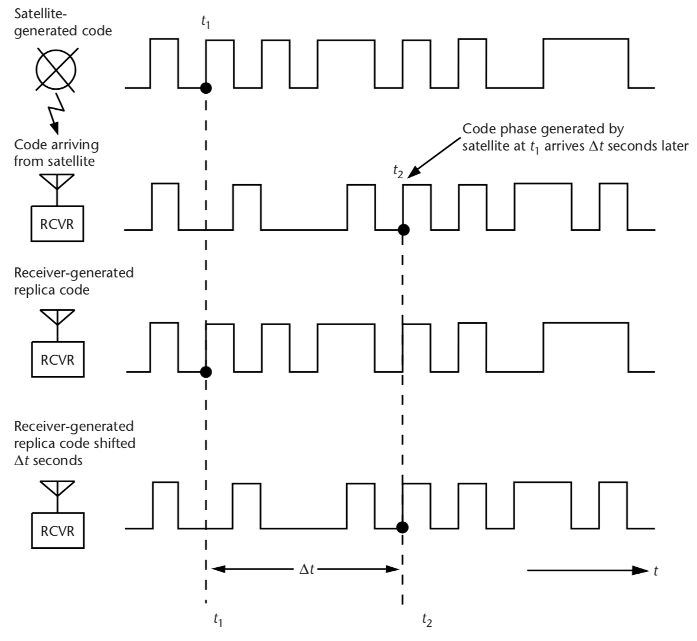
Time of Flight (ToF)

Slide 37
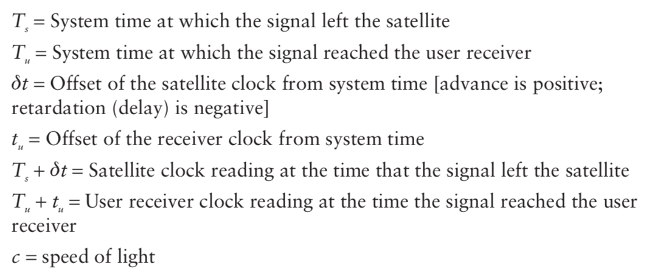
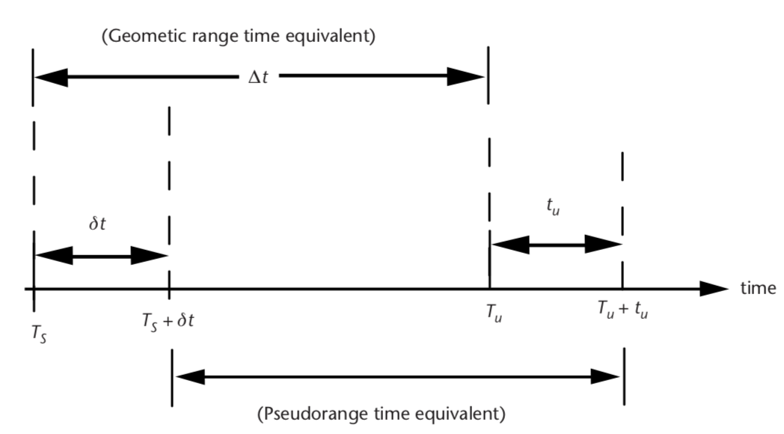
Time of Flight (ToF)
Can we rely on the clocks?

Slide 38
Clock
Mechanical clock: Oscillation of pendulum
Crystal clock: Electrical circuit that uses a piezoelectric crystal vibrating at a precise frequency.
(accuracy of 1 second in 30 years)
Atomic clock: Duration of 9,192,631,770 periods of the radiation from a Cesium 133 atom.
(accuracy of 1 second in more than 100 million years)
Notes:
In 1928, Warren Marrison of Bell Telephone Laboratories developed the first quartz-crystal clock. With accuracies of up to 1 second in 30 years
Atomic clock:
Use of GPS clock: Wireless communication, TV broadcast, timestamping business transaction, frequency hopping

Slide 39
Satellite clock and receiver clocks are not synchronized
Estimated propagation delay X speed of light
= Pseudo-Range

Slide 40
Calculating range
Pseudo-range from i^{th} satellite = 𝝆_{i}
Satellite’s location = (x_{i}, y_{i}, z_{i})
User’s true location = (x_{u}, y_{u}, z_{u})

Slide 41
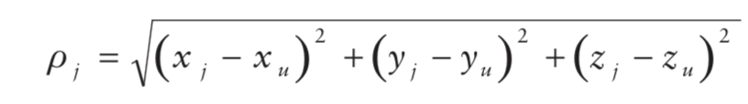
Calculating range
Pseudo-range from i^{th} satellite = 𝝆_{i}
Satellite’s location = (x_{i}, y_{i}, z_{i})
User’s true location = (x_{u}, y_{u}, z_{u})

Slide 42
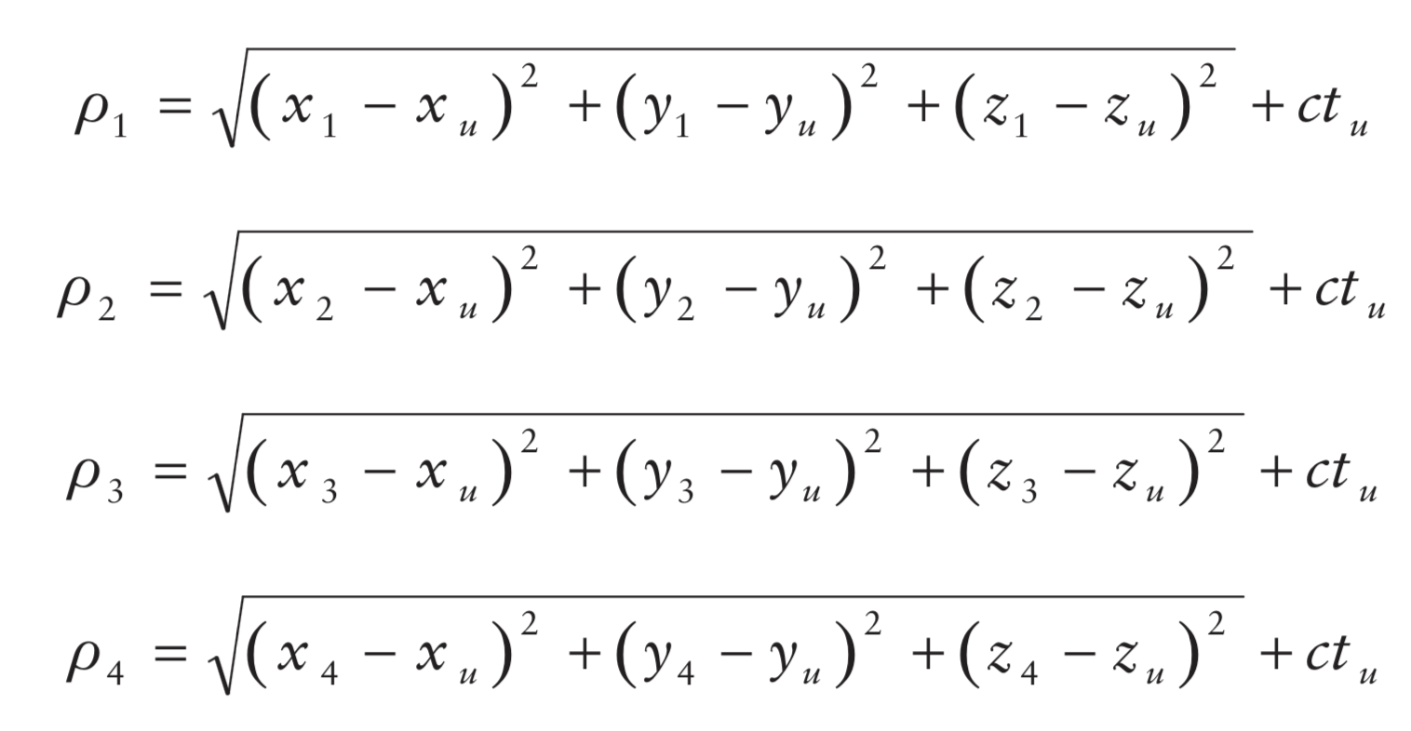
Calculating range
Pseudo-range from i^{th} satellite = 𝝆_{i}
Satellite’s location = (x_{i}, y_{i}, z_{i})
User’s true location = (x_{u}, y_{u}, z_{u})

Slide 43
Calculating range
Pseudo-range from i^{th} satellite = 𝝆_{i}
Satellite’s location = (x_{i}, y_{i}, z_{i})
User’s true location = (x_{u}, y_{u}, z_{u})
User’s time offset from satellite = t_{u}

Slide 44
Calculating range
Pseudo-range from i^{th} satellite = 𝝆_{i}
Satellite’s location = (x_{i}, y_{i}, z_{i})
User’s true location = (x_{u}, y_{u}, z_{u})
User’s time offset from satellite = t_{u}

