Slide 1
FingerIO: Using Active Sonar for Fine-Grained Finger Tracking
Rajalakshmi Nandakumar, Vikram Iyer, Desney Tan, Shyamnath Gollakota
Presented by:
Muhammed Zahid Ozturk & Biswaksen Patnaik
Nandakumar, Rajalakshmi, et al. "Fingerio: Using active sonar for fine-grained finger tracking." Proceedings of the 2016 CHI Conference on Human Factors in Computing Systems. 2016.
Notes:
Notes:
https://fingerio.cs.washington.edu/#faq
https://www.bilibili.com/video/av46595910/

Slide 2
Contactless Finger Tracking without Additional Hardware

Slide 3
Outline
Motivation
Related Work & Drawbacks
Key Ideas
  Using smartphone/smartwatch microphones as active sonars
  Estimating time of arrival precisely with special waveform design (OFDM)
Evaluation
Limitations and Future Directions

Slide 4
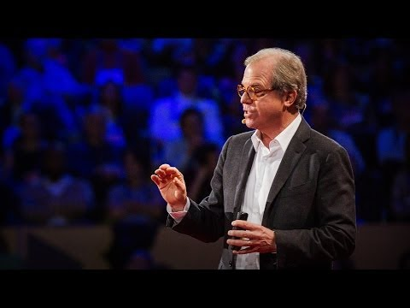
Motivation
Fun Fact!
Speaker: Nicholas Negroponte
Nicholas Negroponte (born December 1, 1943) is a Greek American architect. He is the founder and chairman Emeritus of Massachusetts Institute of Technology's Media Lab. Negroponte is the author of the 1995 bestseller Being Digital translated into more than forty languages.
Talk:30-year history of the future
TED 2014
How we thought of fingers on touch screens?
Notes:
Fun fact:
TED Talk:

Slide 5
Motivation
Can we achieve finger tracking for near device interaction with no finger instrumentation and no line of sight?
Notes:
Fun fact:
TED Talk:

Slide 6
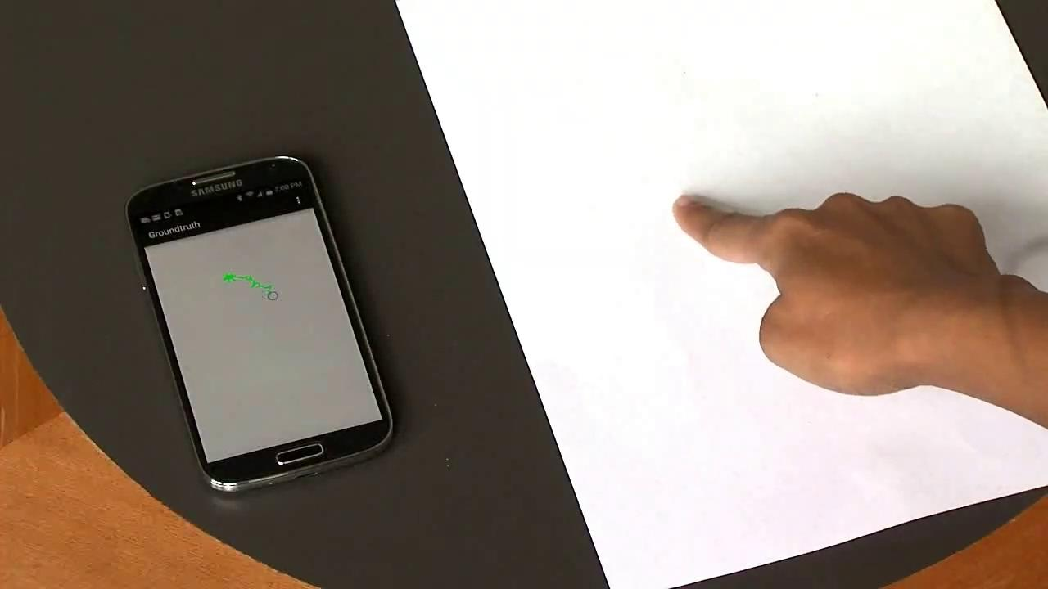

Motivation
Would it not be great if we could...
make almost anything an input surface? | move beyond tiny screens? | interact with occlusions?
Notes:
Fun fact:
TED Talk:

Slide 7
Related Work
Principle: Active Acoustic Localization
Determines the direction of device movement/localization using acoustic transmission.
Example: Whiteboard technology such as Mimio uses an active stylus with ultrasound and an anchor device placed at the corner of the board.
Drawbacks of systems developed:
Needs specific anchor devices. The uses instrumented devices to track.
Comparing Finger IO to similar devices, most need custom hardware.
Notes:
Fun fact:
TED Talk:

Slide 8
Related Work
Principle: Passive Acoustic Localization
Localization/gesture recognition using passive sounds created through interaction.
Example: “Localization of taps on surfaces…” uses piezo shock sensors to sense the sound propagation through material. Time delay of arrival helps in computation.
Advantages of FingerIO:
Achieves better tracking resolution on surface as well as air.
Notes:
Fun fact:
TED Talk:

Slide 9

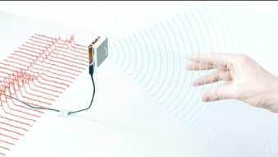
Related Work
Principle: RF-based Gesture systems
Uses radio signals for localization.
Example: Project Soli uses RF signals with a radar to perform gesture recognition. Records subtle finger gestures with ~60 GHz radar.
Drawbacks:
Requires custom hardware for processing GigaHertz bandwidth. It’s relatively power hungry. Finger IO on the other hand works on existing mobile devices.
Notes:
Fun fact:
TED Talk:

Slide 10
Key Ideas
Transforming mobile devices into active sonars
Achieving sub-centimeter tracking accuracy
Notes:
Fun fact:
TED Talk:

Slide 11
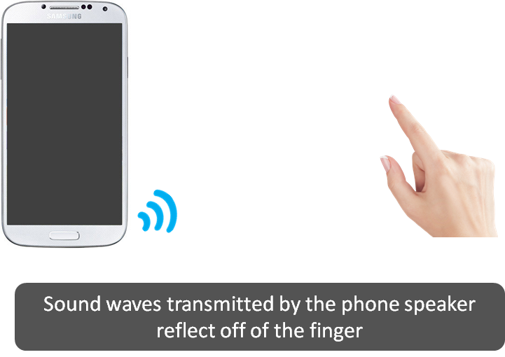
Transform the device into Active Sonar
Notes:
Fun fact:
TED Talk:

Slide 12
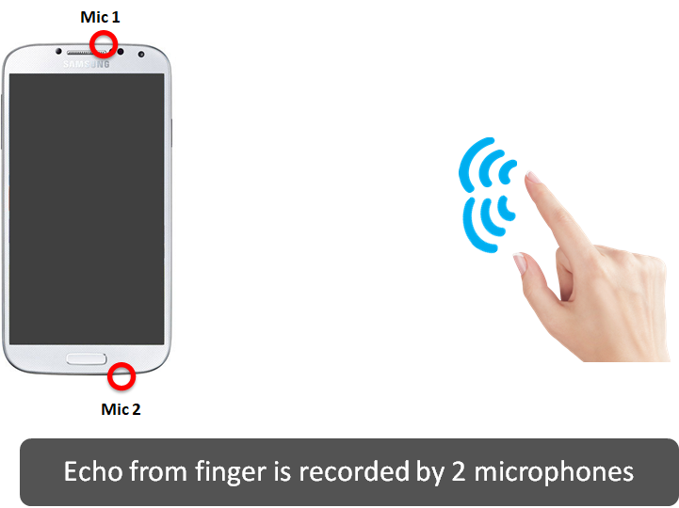
Transform the device into Active Sonar
Notes:
Fun fact:
TED Talk:

Slide 13
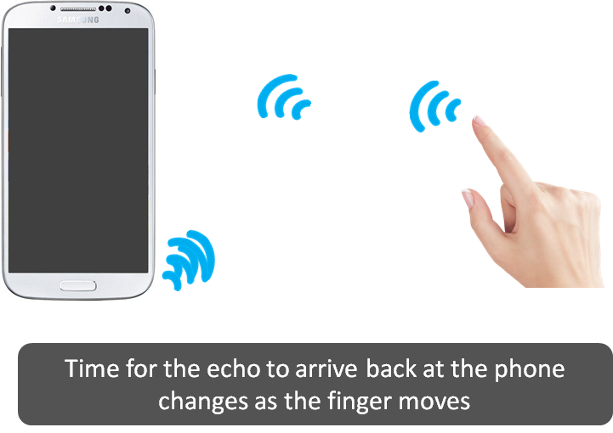
Transform the device into Active Sonar
Notes:
Fun fact:
TED Talk:

Slide 14
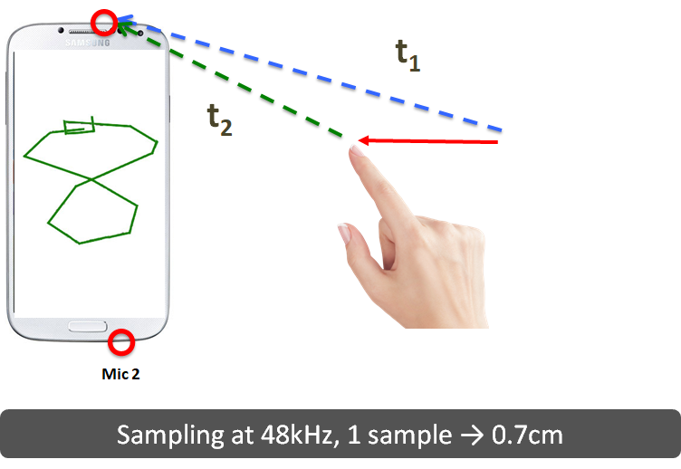
Transform the device into Active Sonar
Notes:
Fun fact:
TED Talk:

Slide 15
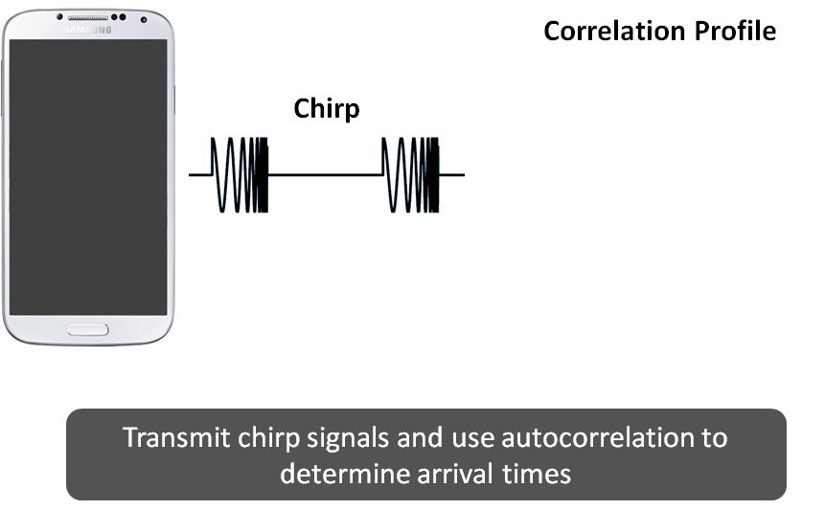
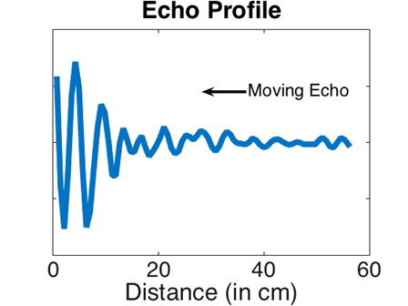
Measuring arrival time
Notes:
Fun fact:
TED Talk:

Slide 16
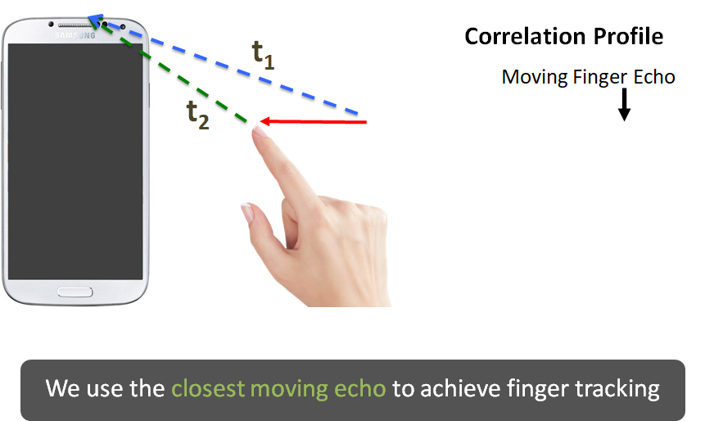
Finger Tracking
Notes:
Fun fact:
TED Talk:

Slide 17

Finger Tracking
Estimate echo arrival with 2-3 sample error - tracking accuracy of 3 cm
Notes:
Fun fact:
TED Talk:

Slide 18
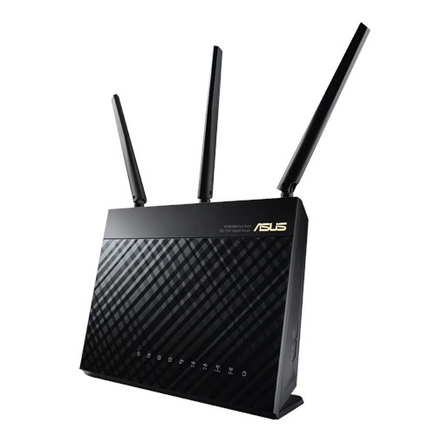

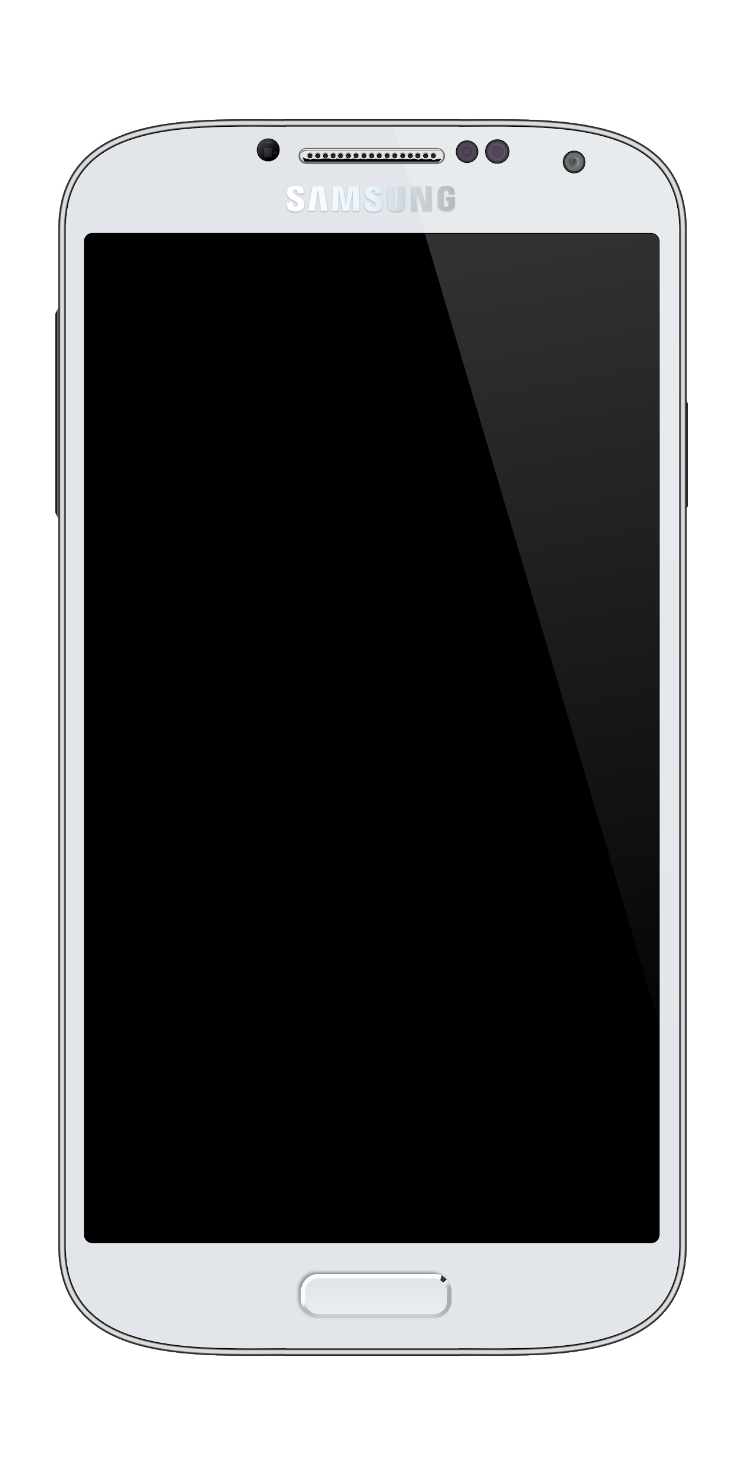

Synchronization in WiFi Networks
Transmitters and receivers do not share a common, synchronized clock
•
•
Receivers need to determine the start of a message to successfully decode

Slide 19
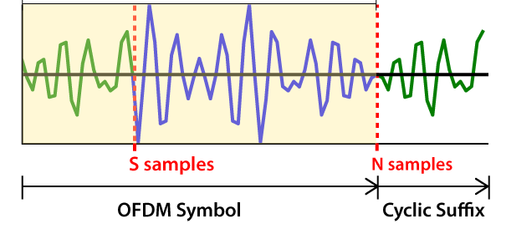
Fine-grained Timing Estimation Using Orthogonal Frequency Division Multiplexing (OFDM)
OFDM
Specific Waveform with the following properties
Fourier Transform amplitudes are the same up to certain delays.
Phase values show drifting, with proportional to delay.
Data Signal
Cyclic Suffix

Slide 20
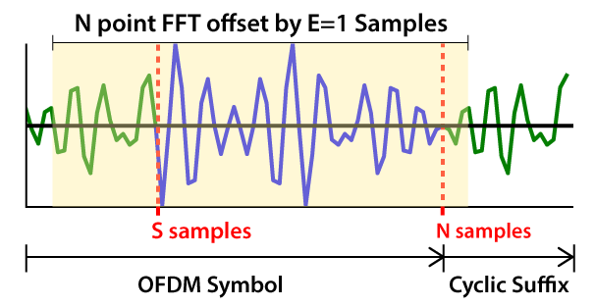
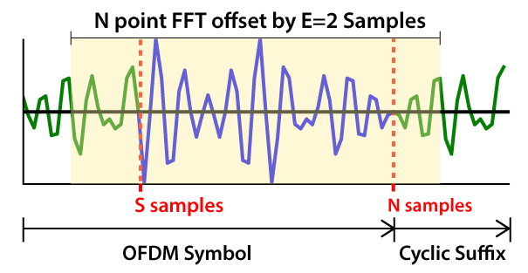
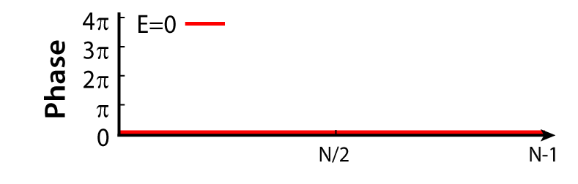
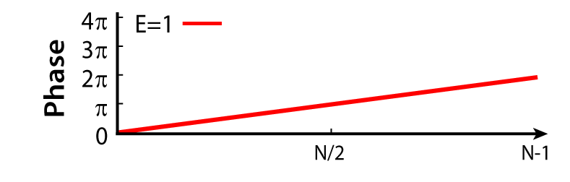
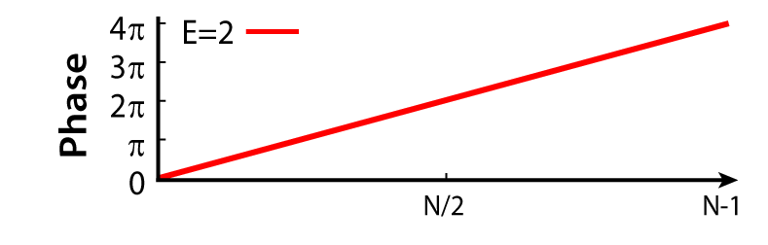
Fine-grained Timing Estimate Using OFDM
As shown, phase values can be used to estimate the exact delay

Slide 21
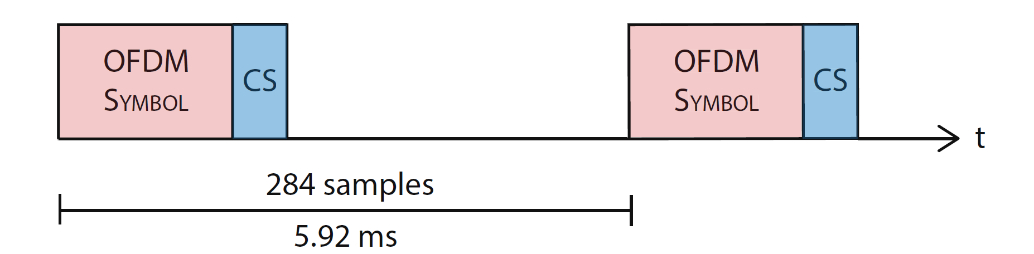
Pipeline
Transmit 18-20 kHz OFDM symbols, every 5.92 ms
Use correlation to get a coarse timing estimate - within 2-3 samples
Fine tune the timing estimate by using phase properties of OFDM - <1 cm accuracy
Apply triangulation to estimate location of the finger in 2D space, using distance estimates from both microphones

Slide 22
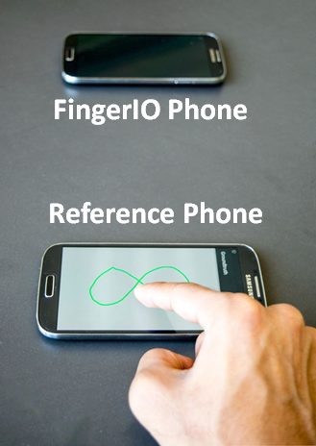
Evaluation
Data Collection and Performance Metrics - Phone
Data Collection
Random User Drawings
10 Users
3 Repetitions
Mic 1
Mic 2
Accuracy
0.8 cm (mean)
Operational Area
50 x 100 cm²
Ground Truth
Touchscreen of a Reference Phone

Slide 23
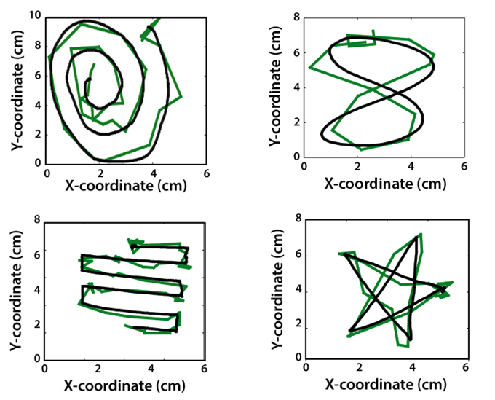
Evaluation
Example Drawings
Ground Truth
Black
FingerIO
Green,
downsampled x5

Slide 24
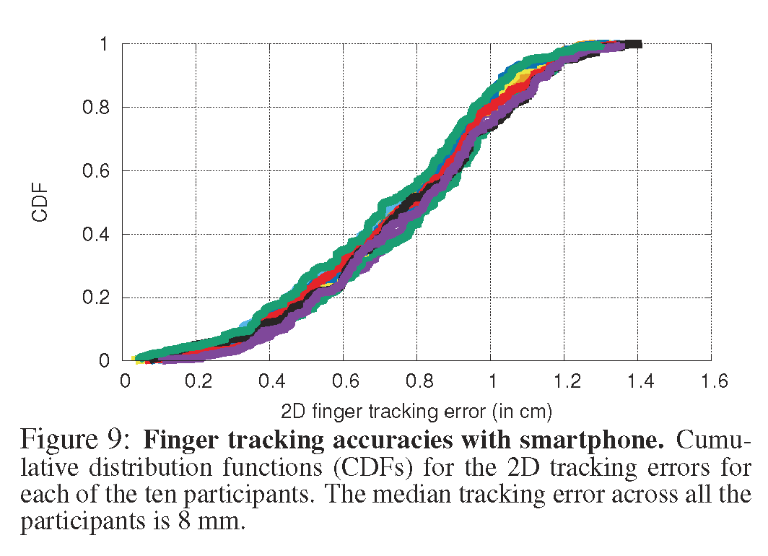
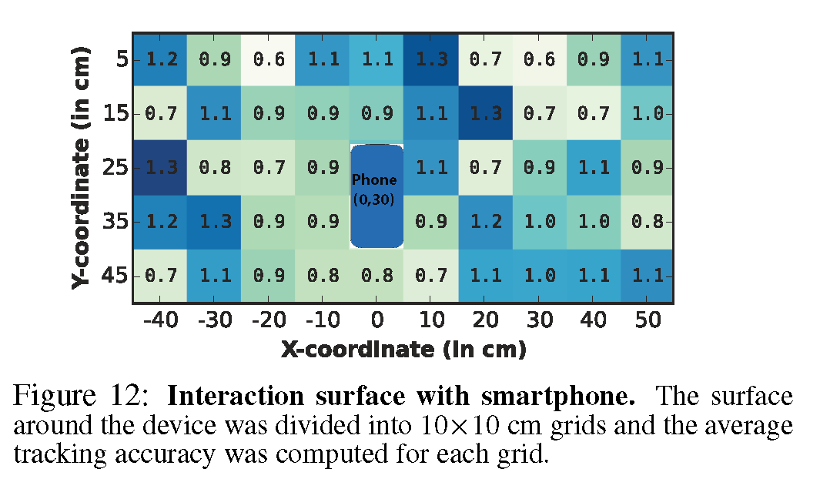
Evaluation
Performance Metrics

Slide 25
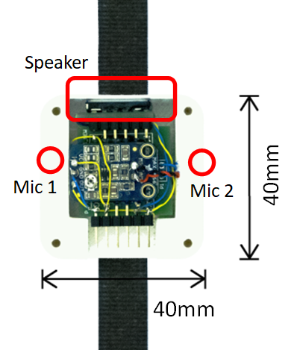
Evaluation
Performance Metrics - Smartwatch
Accuracy
1.2 cm
(was 0.8 cm)
Operational Area
25 x 50 cm²
(was 50 x 100 cm²)

Slide 26
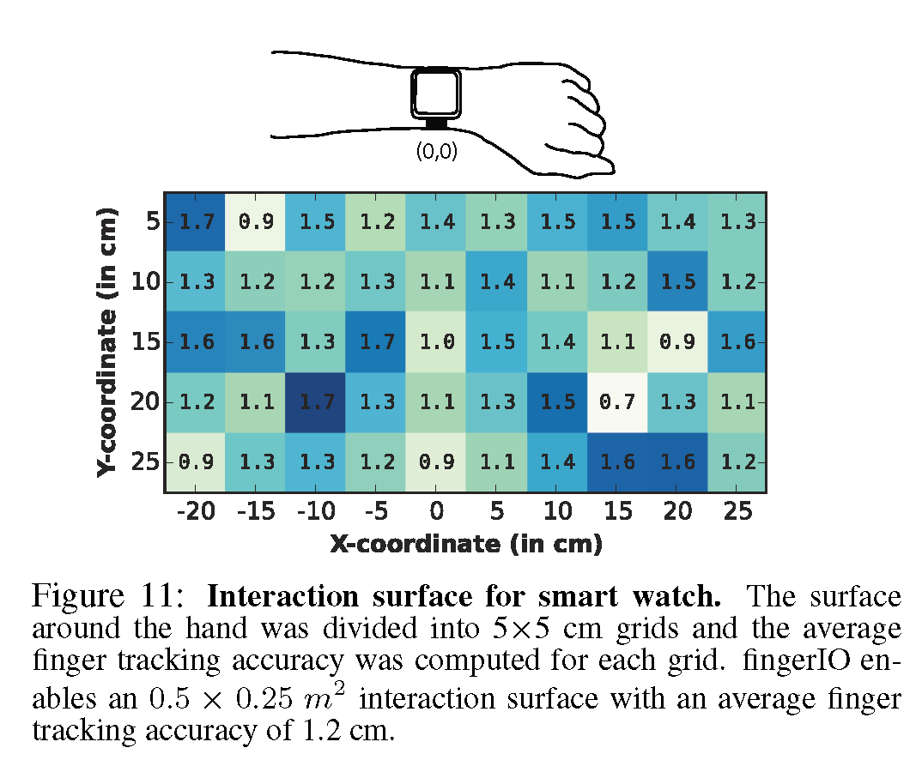
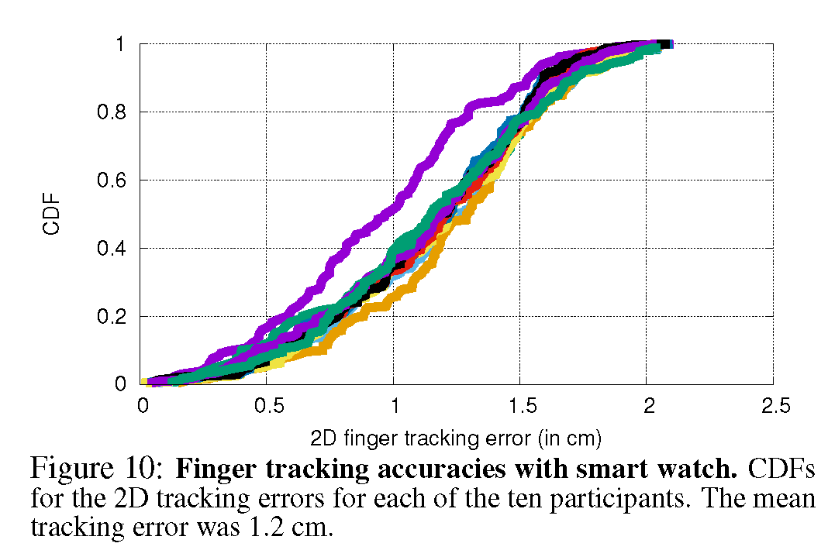
Evaluation
Performance Metrics

Slide 27
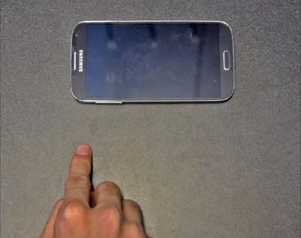
Evaluation
Unintended Motion
Data Collection
Random Motion
10 Users
1 min Motion
Results
0 False Detection (watch)
2 False Detection (phone)
5 cm

Slide 28
Limitations and Future Directions
Tracking 3D Motion
Possible Solution:
Additional Mic
Non-cursive Writing
(e.g. Lifting Fingers)
Power Consumption
Possible Solution:
Reducing Sampling Rate
Multiple Concurrent Motion
Possible Solution:
Better Algorithms
Tracking while in Motion
Possible Solution:
Motion Compensation with IMU
Area of Operation
Possible Solution:
Better Hardware

Slide 29
Conclusion
Track a finger with no instrumentation and no line of sight.
Introduce algorithms and techniques for active sonar without custom hardware
Enable exciting new directions for finger tracking research

