Slide 1
Contactless Infant Monitoring using White Noise
Anran Wang, Jacob E. Sunshine, Shyamnath Gollakota
University of Washington
Presented by: Callie Y. Kim, Diana Chou
Notes:
Hello everyone, today we will be presenting a paper about contactless infant monitoring using white noise.
My name is Diana and I am currently a master’s student in computer science. I will be presenting with Callie today.
Hi I’m Callie and I am also a master’s student in computer science.
Let’s get started!

Slide 2
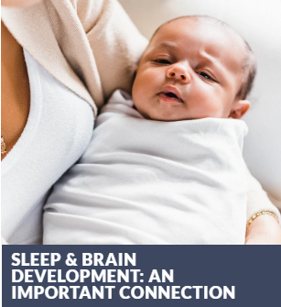
Motivation
Sleep is crucial for infant brain development
Infants are susceptible to devastating sleep anomalies, often caused by respiratory failure
Notes:
We’ll first talk about the motivation behind this paper.
We know that sleep plays an extremely important role in human health. It’s vitally important for the brain development in children, particularly infants.
Consumer sleep products that monitor the vital signs of infants have become increasingly popular with parents.
Monitors that track vital signs such as respiratory rates are often being used to monitor infants now because of their susceptibility to rare and devastating sleep anomalies.
In fact, the most frightening of these anomalies is Sudden Infant Death Syndrome (SIDS). SIDS is defined as the sudden death of a child less than one year of age usually occurring during sleep; it is the leading cause of death among children between one month to one year old in developed countries and respiratory failure is believed to be a part of the final common pathway.

Slide 3
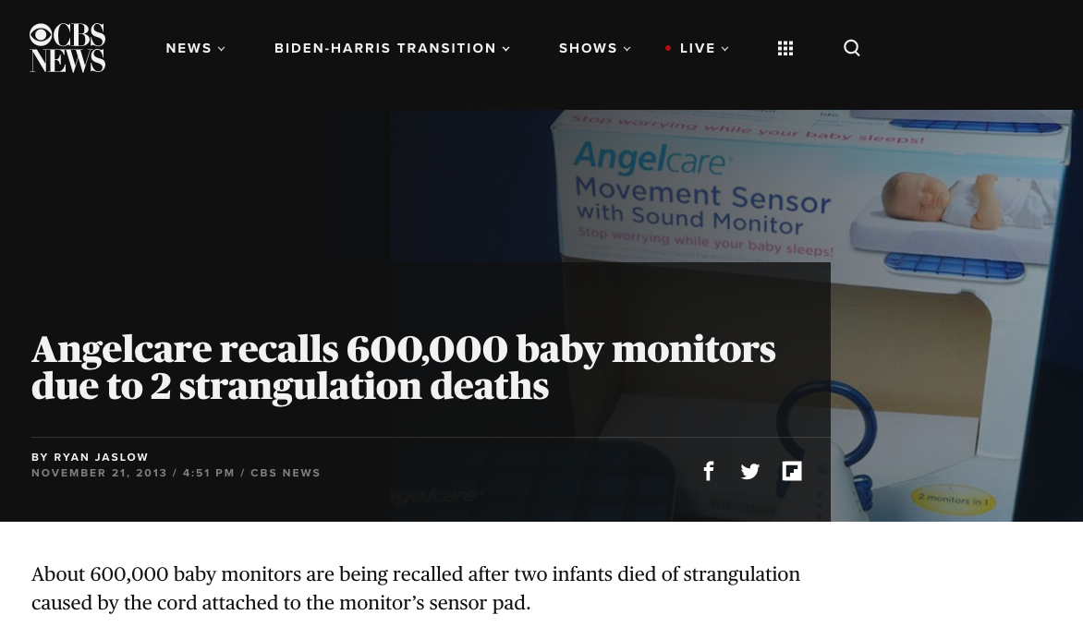
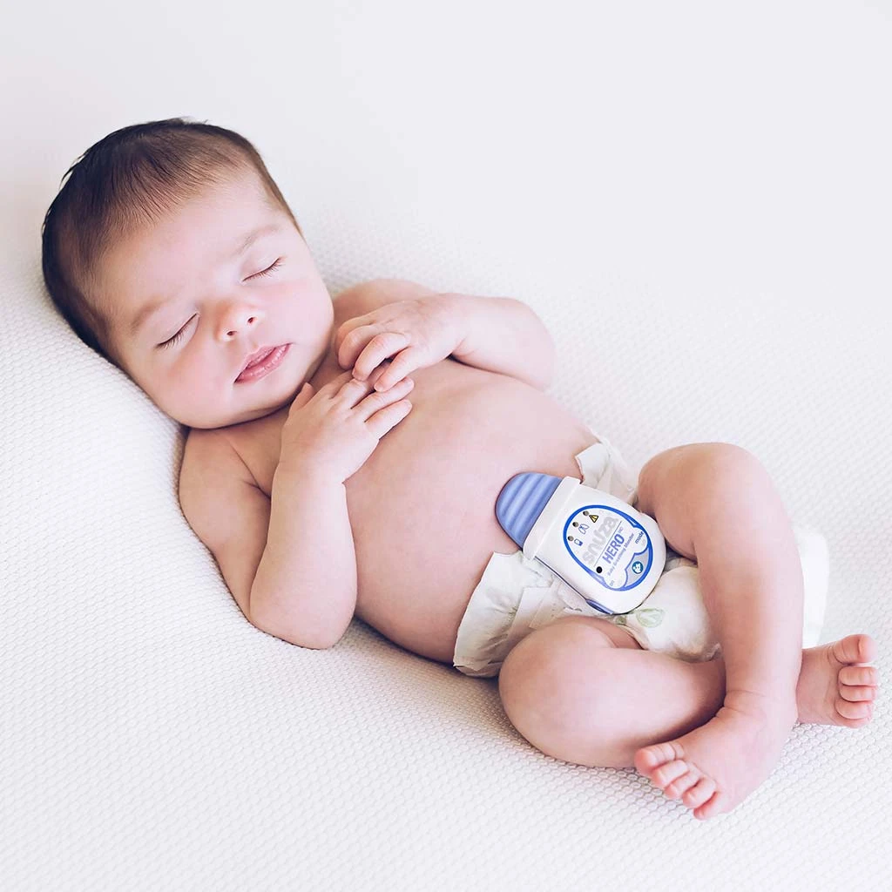
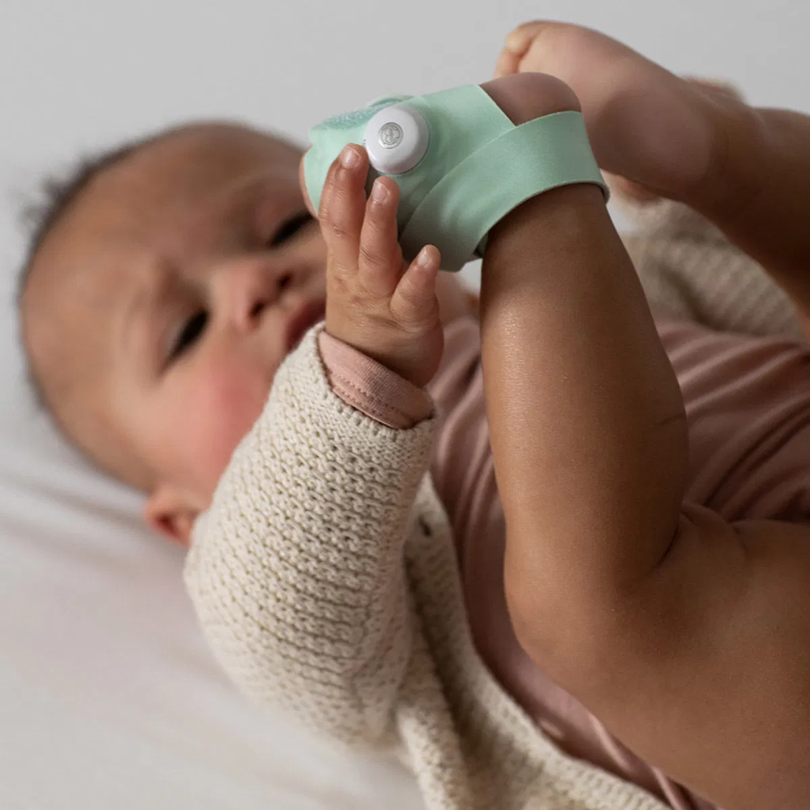
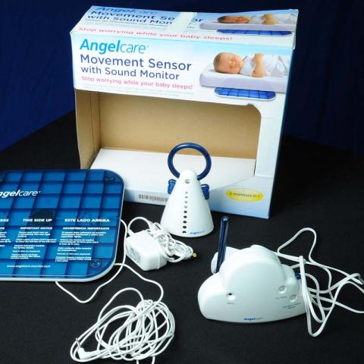
Snuza
Owlet Smart Sock
Angelcare
Current infant vital sign monitors are highly invasive. Critical cases have lead to severe complications including: rashes, burns, death from strangulation.
Notes:
Traditional solutions use wired sensors attached to babies, which can lead to issues such as skin burning and choking.
In fact, the product you see on the right, Angelcare, was reported to cause 2 strangulation deaths, and the company had to issue a recall on 600,000 baby monitors.

Slide 4
How can we enable contactless motion and respiratory monitoring in infants?
Notes:
So now we have a good idea on the motivation behind a newer and better system.
The question is… How can we enable contactless motion and respiratory monitoring in infants?

Slide 5
Contactless Monitoring
Increasing Popularity of Smart Speaker
Can smart speakers monitor infants?
Notes:
In the last several years, we’ve seen an increase in the adoption of smart speaker systems like Google Home, Amazon Echo, Apple HomePod, and more.
---Click---
So can we use these widely adapted devices as a monitoring medium?
Instead of solutions that require some kind of contact, we focus on a smart speaker system sitting at the bedside continuously monitoring infants extending the functionality of ubiquitous smart speakers.

Slide 6
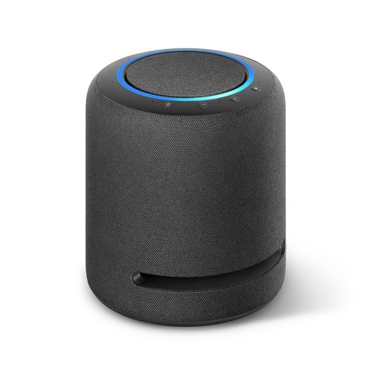
Contactless Monitoring
Concept: Transform Smart Speaker into Active Sonar System
7-microphone array
Speaker
Notes:
The high-level idea is to transform smart speakers into an active sonar system.
Smart speakers are essentially a multi-microphone array that pick up far-field noise and a speaker to emit sound.
Thus, the smart speaker can emit white noise which gets reflected off the infant’s body.
These reflections arrive at the microphone array of the device which are then processed to extract the infant’s body and minute chest motions.

Slide 7
Contactless Monitoring
Naive Solution: Use ApneaApp (https://apnea.cs.washington.edu)
Uses 18-20 kHz FMCW signals
Children and infants can hear up to 20 kHz
High frequency sound and long-term exposure
Can cause headaches, nausea, temporary hearing loss
Can track adult respiration, but not infants
Reflections and motion of the infants are weak
Respiratory rate is higher (30-60 BPM) than adults(<18 BPM)
Notes:
One naive solution is to use pre-existing sonar systems, such as the ApneaApp, which uses custom-designed signals between 18–20 kHz to track breathing in adults.
There’s a couple problems with this though.
Even though adults can’t hear it, these frequencies are actually audible to infants, and long-term exposure to these high frequency sounds can cause headache, nausea and even temporary hearing loss.
Also, these sonar systems are able to track respiration in adults, but not in infants, since their motions are weaker and breathing rates are higher.

Slide 8
Contactless Monitoring
Their Solution: Use White Noise on Smart Speakers
Use audible white noise instead of 18-20 kHz chirps
White noise machines are popular infant product
Used to help improve infant sleep quality
Use smart speakers instead of smartphones
Leverage multiple microphones to extract weak breathing motion
Notes:
So instead, an alternate solution is to use audible white noise on smart speakers, which are basically random signals.
White noise machines are actually gaining popularity in infant products, as they have been proven to help improve infant sleep quality.
The second spec of this solution is to use smart speakers instead of smartphones.
This allows to leverage multiple microphones to do beamforming and extract weak breathing motions.

Slide 9
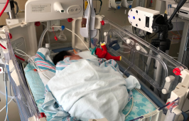
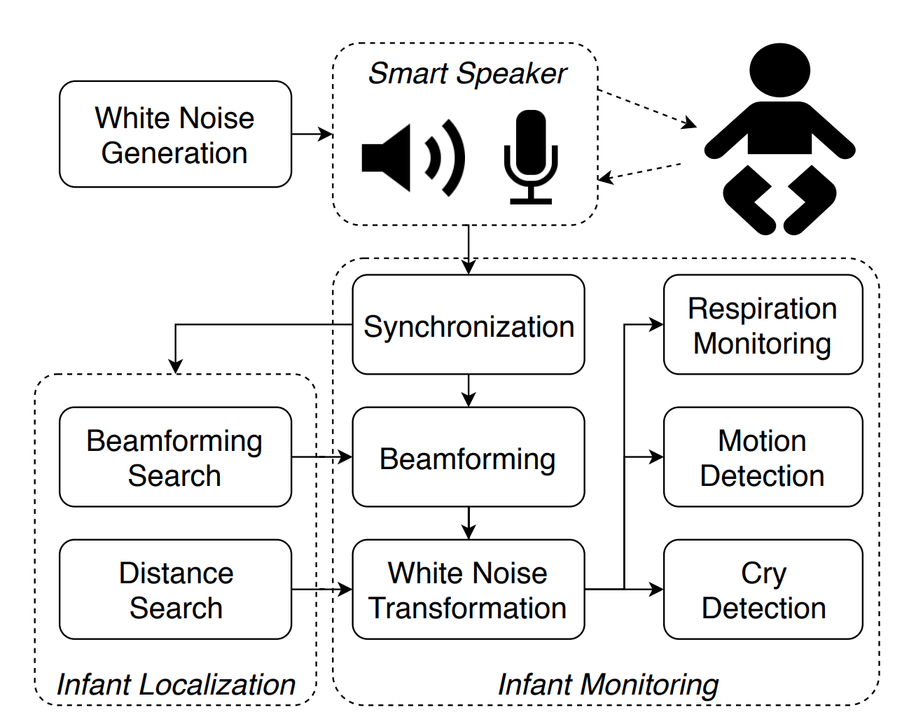
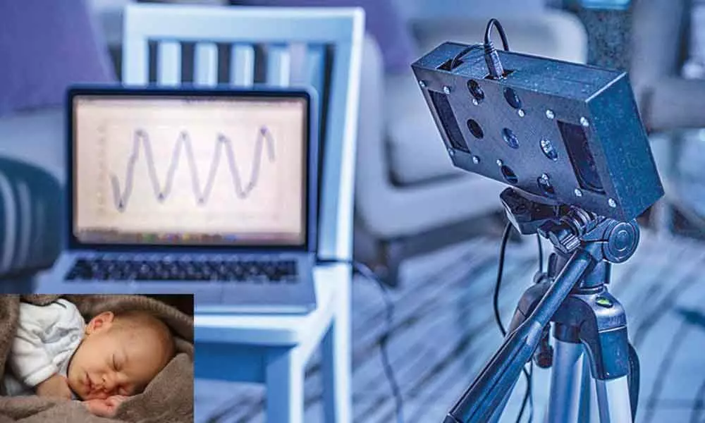
BreathJunior
“First smart speaker system that uses white noise to monitor infants’ breathing”
Notes:
The authors developed BreathJunior, the first smart speaker solution to contactlessly track infant respiration and motion, including both small motions like breathing and large motions such as babies moving around in their cribs.
This diagram shows a brief overview of the system architecture.
The speaker transmits white noise reflecting off the infant’s body and is received by the microphone array.
It uses beamforming algorithms to increase the signal strength of reflections from the infant’s chest and then transforms the reflections into five concurrent FMCW chirps.
The chirps are demodulated and decode the minute breathing motion by combining the information across the five chirps.
The system can also monitor body motion and detect audible baby sounds like crying using interference cancellation techniques.
In the following slides, we will describe the challenges and components of the receiver algorithm in more detail, and Callie will start by talking about the first challenge.

Slide 10
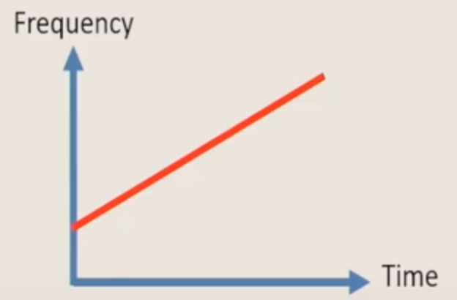
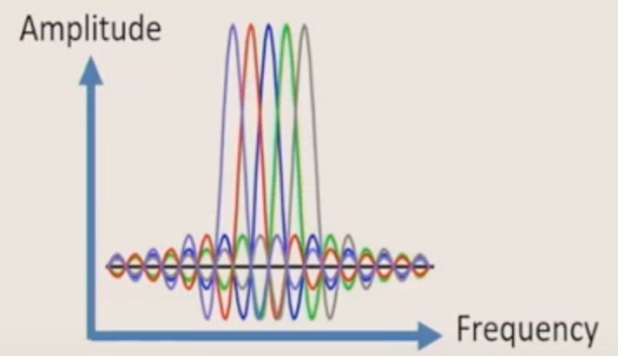
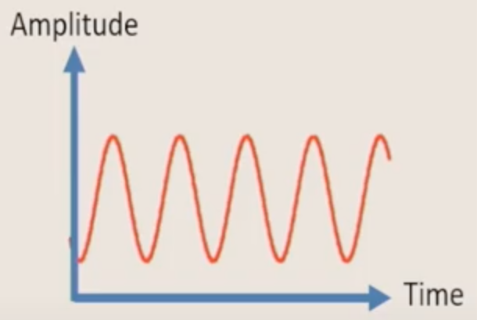
Challenge 1:
Extracting Motion Data from White Noise
Prior work uses structured signals
FMCW signal (chirp)
OFDM packet
Single carrier wave
Notes:
So the first challenge would be to extract motion data from white noise.
All prior work uses structured signals such as FMCW signal, OFDM packet and single carrier waves.
---------------------------------------------------------------------- Additional Info:
FMCW : Frequency-Modulated Continuous-Wave: An FMCW radar transmits a signal called a “chirp”. A chirp is a sinusoid whose frequency increases linearly with time.
OFDM : Orthogonal Frequency-Division Multiplexing : A type of digital transmission and a method of encoding digital data on multiple carrier frequencies
Frequency-Division Multiplexing : A technique by which the total bandwidth available in a communication medium is divided into a series of non-overlapping frequency bands, each of which is used to carry a separate signal.
Single carrier wave : A waveform that is modulated (modified) with an information-bearing signal for the purpose of conveying information.

Slide 11
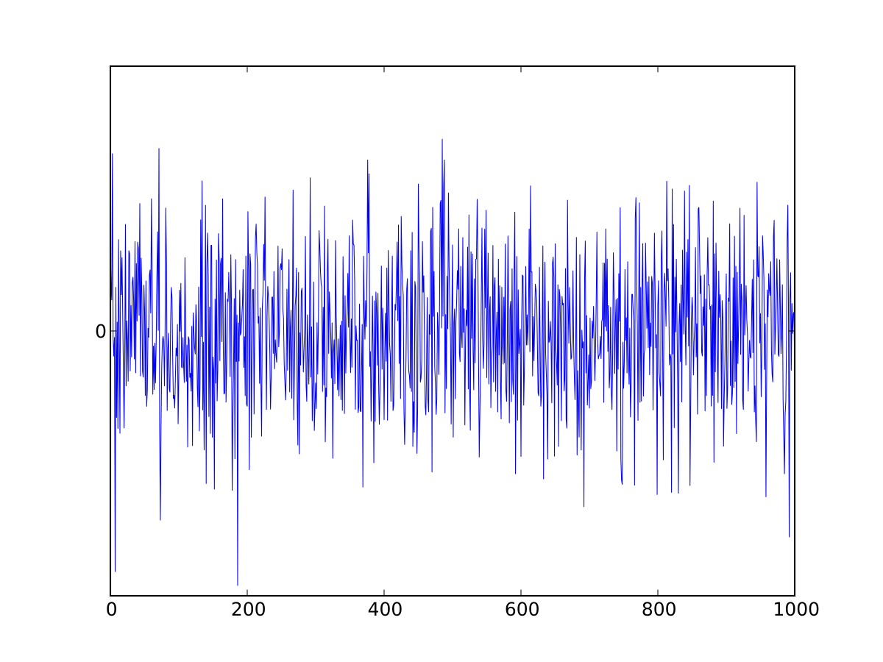
Challenge 1:
Extracting Motion Data from White Noise
White noise is random
Infants vs. Adults
Signal strength from breathing motions
Sampling rate
White noise signal intensity
Notes:
However, White noise is random in both the time and frequency domain. So how are we going to extract useful information from random white noise signals?
Also there are other small challenges that we need to keep in mind since our target users are infants.
First, the signal strength of the reflections corresponding to breathing motion is proportional to the surface area of the chest. Infants not only have a much smaller torso but their chest displacement due to breathing is also much smaller compared to adults.
Second, infants require a higher sampling rate as they breathe at a much higher rate compared to adults (2-3 times more).
Third, the white noise signal intensity should be low to minimize the risk of exceeding safe noise levels, yet at the same time the echoes still need to be detected reliably.

Slide 12
Idea:
Speaker transmits random white noise signal
Receiver transforms white noise into structured FMCW
≈
adjust
Notes:
First use a speaker to transmit the pseudo-random white noise.
---Click---
Twist is at the receiver side,
---Click---
we are going to transform the received white noise signal into a structured FMCW signal.
This is the process of how that happens.
The spectrum of the white noise has a flat amplitude, but the phase of each frequency components gives the white noise its randomness.
In contrast, if we see the spectrum on a whole FMCW chirp we also see that the amplitude is also approximately flat and we can approximate it as the same as white noise.
---Click---
The difference here is that the phase is symmetric and has a deterministic shape, which is not random.
---Click---
Therefore by adjusting the phase of the white noise the receiver can transform a white noise into a structured FMCW signal.

Slide 13
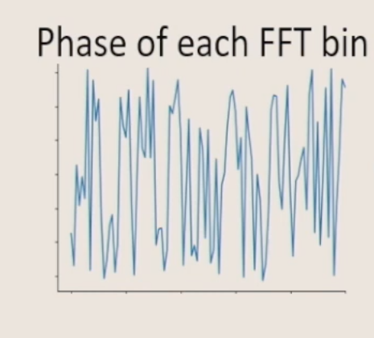
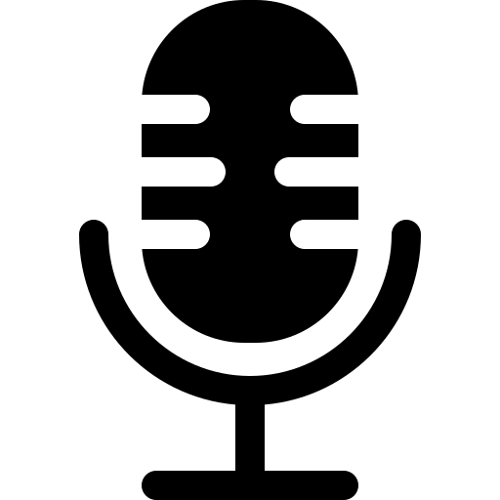
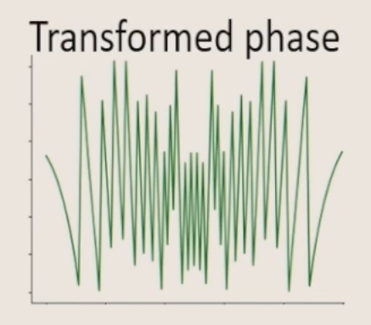
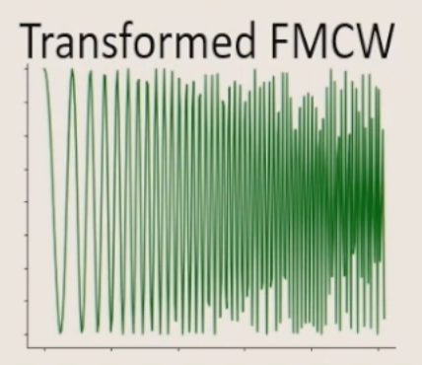
Idea:
Speaker transmits random white noise signal
Receiver transforms white noise into structured FMCW
+𝝋_{Δ}
FFT
Transformation preserves multipath/motion information
Apply FMCW decoding to extract motion/location information
White noise with random known phase 𝝋_{noise}
Calculate 𝝋_{Δ =} 𝝋_{FMCW -} 𝝋_{noise}
IFFT
Notes:
This is the whole pipeline.
First we transform the received white noise signal into a FMCW chirp. Then we extract breathing motion from the FMCW chirp. Finally, to improve the SNR we transform white noise into multiple concurrent FMCW chirps.
The speaker emits pseudo randomly generated signals with a known seed and the phase of the signal is known to us.
---Click---
The signal gets reflected back from the infants and received by the microphone.
---Click---
The microphone will take an FFT and then identify the phase of each frequency components.
---Click---
Finally we obtain the transformed FMCW signal by doing an inverse FFT.
---Click---
The key point here is that this transformation preserves multipath/motion information. Furthermore, now that we have the FMCW signal we can apply FMCW decoding to extract motion/location information.
---------------------------------------------------------------------- Additional Info:
fast Fourier transform (FFT) : Fourier analysis converts a signal from its original domain (often time or space) to a representation in the frequency domain and vice versa.

Slide 14
White Noise Generation at Speaker
Generate deterministic white noise using pseudo-random sequences with a known seed
Encode an impulse signal by shifting the phases of each of its frequency components by a random real sequence uniformly distributed in [0, 2π] => Follows Guassian white noise
In practice, generate the signal as a stream of blocks
use Mersenne Twister pseudo-random generator to generate different phase offsets ϕf for each block
perform IDFT to convert it back into the time-domain, which is then played through the speaker
Notes:
At the transmitter, we generate deterministic white noise using pseudo-random sequences with a known seed, such that it has a flat frequency response.
To do this, they encode an impulse signal by shifting the phases of each of its frequency components by a random real sequence uniformly distributed in [0, 2π].
The generated signal follows Gaussian white noise for two reasons. First, an impulse signal is flat in the frequency domain, and randomly changing the phase does not affect this. Second, the pseudo-random phase, denoted by ϕf , is independent and uniformly distributed in [0, 2π]. From the central limit theorem this makes it a white noise.
So in practice, they generate the signal as a stream of blocks, each of which has a constant duration. They use a duration of T = 0.2s and a sampling rate of 48000Hz and the frequency range is 1Hz to fmax = 24000Hz. We use a Mersenne Twister pseudo-random generator to generate fmaxT different phase offsets for each block, and perform IDFT to convert it back into the time-domain, which is then played through the speaker
---------------------------------------------------------------------- Additional Info:
The central limit theorem states that if you have a population with mean μ and standard deviation σ and take sufficiently large random samples from the population with replacement , then the distribution of the sample means will be approximately normally distributed.
Mersenne Twister pseudo-random generator. It is by far the most widely used general-purpose PRNG(pseudo-random generator)
IDFT : Inverse discrete Fourier transform : transforms N discrete-frequency samples to the same number of discrete-time sample

Slide 15
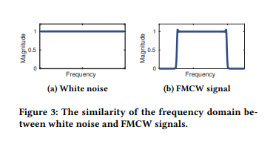
Decoding Breathing at Microphone
Array
Block-level Synchronization :
regenerate the transmitted block using the same seed, at the receiver side
cross-correlation
Transforming White Noise into Multi-FMCW :
generate a FMCW chirp template of duration T and perform DFT on this time window to get phases ψf
correct the phase of each frequency in the received white noise signal by ϕf − ψf
Notes:
Now we are going to talk about how to decode breathing at the microphone array.
Since speaker and all microphones share the same sampling clock they need to be synchronized once at the beginning.
The first step is to estimate the beginning of each transmitted white noise block as received by the microphone array.
Then they perform cross-correlation between the received signal using the center microphone in the array and the regenerated transmitted block.
By identifying the peak in the cross-correlation result they can determine the start of the first block in the received signal.
To transform the signal into an FMCW, we need to correct the phase of each frequency. We already know the phase ϕf we used in the transmitted white noise block so we need to compute the phase of the received white noise block which is ψf.
In order to do that, they first generate a FMCW chirp template and then perform a DFT on this time window to get FMCW (f ).This gives us the phases ψf of each of its frequency components.
---------------------------------------------------------------------- Additional Info: ψ psi
Then they identify the peak in the cross-correlation result which corresponds to the direct path from the speaker to the microphone. We use the location of this peak as the start of the first block in the received signal.
(EXTRA : Note that, we cannot extract respiration from cross correlation, because the sub-millimeter chest motion is much smaller than the granularity of a sample. Instead, we transform the pseudo-random white noise into FMCW signals at the receiver so that we can decode and extract the fine grained multipath profile using FFT efficiently.)

Slide 16
Decoding Breathing at Microphone
Array
3. Extracting breathing signal from FMCW.
perform traditional FMCW demodulation to extract the breathing signal
multiply the received FMCW chirp by a downchirp signal, eq 3
perform FFT on the signal
FFT bin corresponding to this distance :
extract the breathing signal by tracking the phase φi in this frequency bin
Notes:
After the signal is transformed to a FMCW chirp, we can perform traditional FMCW demodulation to extract the breathing signal. To do this, they first multiply the received FMCW chirp by a downchirp signal which is the equation 3
Next they perform an FFT on this signal, where each frequency bin corresponds to reflections at different distances so the phase of each frequency component of the demodulated signal is also a function of distance.
In other words, a tiny 1mm displacement will result in a significant radian phase difference (when f0 = 10000Hz), making it possible to track tiny motion.
Thus, if we knew the round-trip distance d between the infant and the microphone array (we will discuss this distance estimation in beamforming later), the FFT bin corresponding to this distance is fresp.
They extract the breathing signal by tracking the phase φi in this frequency bin for each demodulated chirp.
---------------------------------------------------------------------- Additional Info:
While this can be used to separate reflections from other environmental sources from that of the infant, it cannot be used to extract the minute breathing motion which has a resolution of a few millimeters (this is because of the resolution we get from Eq. 3 is limited by the bandwidth).
making it possible to track tiny motion, even if it is much less than the theoretical FMCW resolution limit (which is proportional to c/2B.)
EXTRA : Specifically, from Eq. 3, the phase of the FFT bin corresponding to the time-of-arrival tp is f0*tp − F/(2T)* (tp)^2.
Note that this phase sequence is confined to [−π, π], causing sharp transitions from π to −π or vice versa. To address this, we can simply compensate for the 2π phase shift by adding or subtracting a 2π when there is a more than π change between adjacent phase measurements.

Slide 17
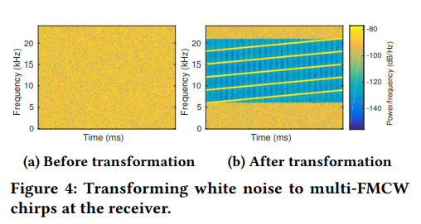
Decoding Breathing at Microphone
Array
4. Improving SNR with multi-FMCW chirps
Split band into 5 sub-bands, which are then transformed into five concurrent FMCW chirps independently
Excusion :
below 6kHz : environmental noise
above 21 kHz : low sensitivity
fuse the five phases of each FFT bin
Notes:
The authors wanted to improve SNR using multiple FMCW chirps, where SNR means a signal to noise ratio.
So they split the band between 6 kHz to 21 kHz into five sub-bands, which are then transformed into five concurrent FMCW chirps independently.
Chirp i has a starting frequency (f0 = 3000+3000i Hz) and bandwidth (F = 3000 Hz). They excluded below 6kHz because of environmental noise, and those above 21 kHz because of low sensitivity.
The spectrogram before and after transformation is shown in Figure on the right side.
Since the same frequency bin of each of the five demodulated chirps corresponds to a same time-of-arrival, they fuse the five phases of each FFT bin from each demodulated chirp to improve SNR.
They use this phase value to extract the minute breathing motion with sufficient SNR.
---------------------------------------------------------------------- Additional Info:
When transforming white noise to FMCW chirps, one approach is to transform white noise into a single large FMCW chirp that spans the whole frequency range of the white noise transmission.
A large band FMCW chirp has better spatial resolution because of more fine-grained frequency bins after demodulation and DFT.
However, even when using the whole 24kHz band, the resolution is limited to 1.4cm, which is still much larger than the movement of the chest of an infant.
On the other side, each FFT bin has less information and thus less SNR, making extracting respiration events difficult.
Signal-to-noise ratio is defined as the ratio of the power of a signal (meaningful input) to the power of background noise (meaningless or unwanted input)
A ratio higher than 1 indicates more signal than noise.
Recalling from Eq. 3 that the phase of a FFT bin corresponding to the same time-of-arrival is linear to the beginning frequency of the FMCW chirp. Hence, they average the φ across the five FMCW chirps as φ (avд) = Í5 i=1 φ (i) /(3000 + 3000i) Í5 i=1 1/(3000 + 3000i) (4) where φ (i) is the phase at the frequency bin corresponding to the respiration signal, fr esp , of the ith demodulated chirp.
By doing this, they trade-off resolution for SNR because each transformed chirp has less bandwidth. However, the same frequency bin of each of the five demodulated chirps corresponds to a same time-of-arrival.

Slide 18
Respiration, Motion and Cry Monitoring
Respiration rate monitoring :
apply a finite impulse response (FIR) filter
Breathing rate = number of zero crosses / 2
Apnea detection :
record the average amplitude A of the filtered phase signal
average amplitude (duration of 15 seconds) < βA => classify as apnea event
Notes:
From this phase data, they extract minute breathing as well as coarse infant motion information.
For Respiration rate monitoring,
they count the number of zero crosses for the filtered signal and divide it by two to compute breathing rate.
For Apnea detection,
When a duration of 15 seconds has an average amplitude less than β times A they classified it as an apnea event.
---------------------------------------------------------------------- Additional Info:
For Respiration rate monitoring, they applied a finite impulse response (FIR) filter onto the phase sequence with a pass-band of [0.4Hz, 1.1Hz] that corresponds to the normal range of an infant’s respiration rate.
apnea is a prolonged pause (more than 15 seconds) of the respiration.
They first record the average amplitude A of the filtered phase signal during the initial one-minute localization duration.
FIR filter : A finite impulse response (FIR) filter is a filter structure that can be used to implement almost any sort of frequency response digitally. They applied a finite impulse response (FIR) filter onto the phase sequence.
They empirically choose constant β using the infant simulator.

Slide 19
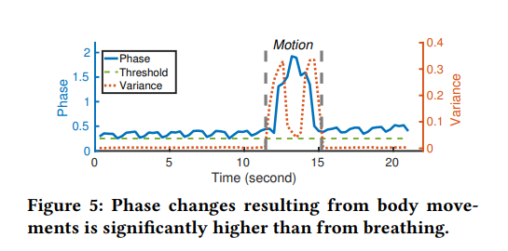
Respiration, Motion and Cry Monitoring
Motion detection :
the total variance within the last N phases exceeds a threshold
movement of legs and arms leads to interference to the respiration signals => No monitoring respiration during motion periods.
Crying and sound detection :
calculate the L2 norm difference between two adjacent chirps across time.
If the value exceeds a threshold, and it occurs frequently within a short time period => classify it as infant sounds.
Other sounds in the environment reduced in amplitude due to beamforming
Notes:
For Motion detection, the signal change due to movements of legs and hands is much larger than the movement from respiration.
If you see the graph on the right, it shows a large variance in the phase information with a peak.
So if the total variance within the last N phases exceeds a threshold, they classified it as body motion, whether the arm or leg.
Important point here is that because the positions of legs and hands are not far from the chest, their movement leads to interference to the respiration signals.
So the system does not monitor respiration during motion periods.
For crying and sound detection,
We know that infant crying sounds are typically loud in comparison to the white noise signal generated by their smart speaker
so they calculated the L2 norm of the difference between two adjacent transformed chirps.
Most of the sound from other people in the environment are reduced in amplitude due to the beamforming process described later.
Now, Diana will introduce the second Challenges.
---------------------------------------------------------------------- Additional Info:
They empirically choose the threshold using the simulator.
So they further improve sound detection by calculating the difference between two adjacent chirps across time.
The transformation procedure, while transforming white noise into chirps, will transform crying and other sounds into noise signals.
Hence, two adjacent chirps will be different, especially at low frequencies. We calculate the L2 norm of the difference between two adjacent transformed chirps.
If the value exceeds a threshold, and it occurs frequently within a short time period, the system would classify it as infant sounds.
Most of the sound from other people in the environment are reduced in amplitude due to the beamforming process described later.

Slide 20
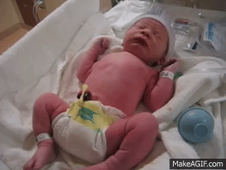
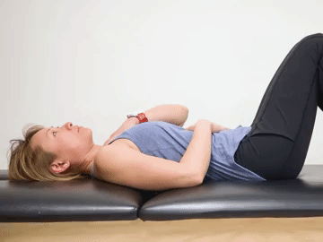
Challenge 2:
Extracting Minute Infant Breathing Motions
Notes:
The second challenge that needs to be addressed is how to extract minute breathing motions.
To demonstrate, here are two videos of the breathing patterns in an infant vs. an adult.
As you can see, not only is the size of the infant much smaller, but also the infant is breathing at a much higher rate.

Slide 21
Our solution: Perform beamforming at microphone array
Naive solution: Search every angle to maximize the breathing signal
𝞪 = ?
Notes:
So to extract this minute and fast raising motions our solution is to utilize much more microphones on the smart speaker to do acoustic beamforming.
The speaker emits the sound and we can add up the signal at the receiver side by multiple microphones to boost SNR. However, we first need to know the direction for beamforming.
A naive solution would be to search every angle to maximize the respiration signal strength.
---Click---

Slide 22
Our solution: Perform beamforming at microphone array
Naive solution: Search every angle to maximize the breathing signal
𝞪 = ?
Notes:
---Click---

Slide 23
Our solution: Perform beamforming at microphone array
Naive solution: Search every angle to maximize the breathing signal
𝞪 = ?
Notes:
---Click---

Slide 24
Our solution: Perform beamforming at microphone array
Naive solution: Search every angle to maximize the breathing signal
Ternary search that maximizes the respiration
signal strength in O(log(n)) steps
→ Run in real time on a Raspberry Pi
𝞪 = ?
→ computationally expensive!
Notes:
However, this is computationally inefficient as the search is linear to the number of angles and can not run on smart speakers in real time.
---Click---
The authors designed an efficient algorithm that maximizes the respiration signal strength in O(log(n)) steps, a divide and conquer algorithm using ternary search where n is the total number of angles in the search space. This can run in real time on Raspberry Pi.

Slide 25
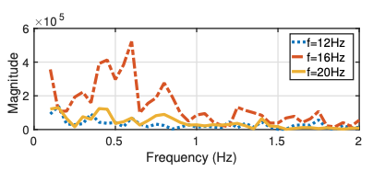
Initial Distance Computation
Find the most likely FFT bin that corresponds to respiratory motion
For each FFT bin f, perform another FFT over the complex values across all the chirps within the first minute of tracking
Calculate the SNR_{resp} for each bin f
Select the lowest frequency bin that has a peak SNR comparable with its neighboring frequency bins, and denote it as f_{resp}
Round-trip Distance = f_{resp}Tc F
The FFT of H_{f} over different FFT bins, f.
Notes:
Now we’ll explain how we perform receive beamforming on the microphone array to increase the SNR of the breathing reflections.
After computing an FFT on the FMCW chirps, we find the most likely FFT bin that corresponds to respiratory motion.
We store the complex value of each FFT bin, f of the demodulated chirp, H(i) .
For each FFT bin, we perform another FFT over the complex values across all the chirps within the first minute of tracking.
Then, calculate the SNR for each bin defined as the energy within 0.4Hz and 1Hz which corresponds to breathing rates of 20-60 breaths per minute divided by the energy above 1 Hz. This SNR is a good indicator of the quality of the respiration signal in FFT bin f .
We select the lowest frequency bin (meaning nearest to the microphone array), that has a peak SNR comparable with its neighboring frequency bins and denote it as f_resp
Thus, the round-trip distance between the infant and the smart speaker can then be estimated with the equation shown here.
Frequency bin (f_resp) times the white noise duration (Tc) divided by bandwidth (F).
This figure shows results from an experiment, and we can see that the FFT bin where f is equal to 16Hz, denoted by the red dash line, has the peak SNR with more energy between 0.4Hz and 1Hz.
---------------------------------------------------------------------- Additional Info:
FMCW : Frequency-Modulated Continuous-Wave:
SNR = Signal to Noise Ratio

Slide 26
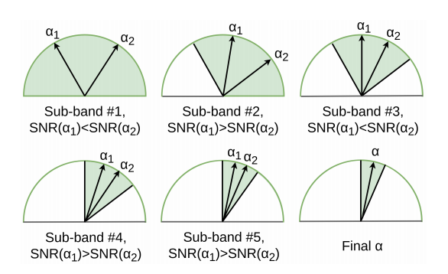
Receive Beamforming Algorithm
Go through the five multi-FMCW chirps from 6kHz to 21kHz ordered from low to high frequencies.
If SNR(α1) < SNR(α2) => narrow down the search scope to [α1,γr ]
If SNR(α1) > SNR(α2) => narrow down the angle search scope to [γl , α2]
Final α is the middle of the search scope
search scope becomes [α1,γr ]
search scope becomes [γl , α2 ]
Notes:
So now that we have an initial estimate of the distance, a receiver-side beamforming algorithm is used to suppress other reflections and increase the SNR of the weak reflections from the infant.
We go through the five multi-FMCW chirps from 6kHz to 21kHz ordered from low to high frequencies.
For each FMCW chirp, we maintain an angle scope, from gamma-left to gamma-right, which we initialize to [−π/2 to π/2] for the first FMCW chirp.
For the i-th FMCW chirp where i = 1 through 5, we sequentially set the beamforming angle alpha to two values of alpha1 = (2 * gammaleft + gammaright ) /3 and alpha2 = (gammaleft + 2*gammaright )/3.
At each of these two beamforming angles, we transform beamformed white noise into the demodulated FMCW signal.
We estimate the distance of the infant using the algorithm from the previous slide and calculate the SNR of the respiratory signal for the two angles, SNR(alpha1) and SNR(alpha2).
If SNR(alpha1) is less than SNR(alpha2), we narrow down the search scope to [alpha1, gammaright ]; otherwise, we narrow down the angle search scope to [gammaleft, alpha2].
We keep repeating this process at each increasing frequency until we reach the highest FMCW chirp, where we finalize alpha to be the middle of the search scope.
The steps of the algorithm are also illustrated in this figure, and we can see this adaptive beamforming method drastically increases the SNR.
---------------------------------------------------------------------- Additional Info:
FMCW : Frequency-Modulated Continuous-Wave:
SNR = Signal to Noise Ratio
Γl gamma left
Γr gamma right

Slide 27
Infant Localization and Beamforming
Calculate delays ∆i based on the angle α
Beamforming signal R(t) = Σ Ri(t − ∆i)
Beamforming angle search and distance estimation only done once at the beginning of the tracking process
Notes:
Since we know the angle α of the infant relative to the smart speaker, the delays ∆i could be calculated based on the angle, α, as, ∆i = ||Pi − P0 ||sin(α), where Pi is the location of the ith microphone.
We can then calculate the beamforming signal R(t) = Σ Ri(t − ∆i), where Ri(t) is the sample at time t received on microphone i.
This beamforming angle search and distance estimation is only done once at the beginning of the tracking process to compute the distance and angle of the infant with respect to the device. We use this distance and angle for the duration of infant monitoring.
---------------------------------------------------------------------- Additional Info:
If we lose the breathing or motion signal for more than 30 seconds, we re-initiate the search process to find the new distance/angle of the infant.
If neither the breathing nor the motion signal is found after the search, we can raise an alarm to the caregiver.

Slide 28
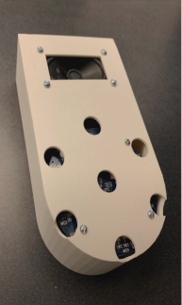
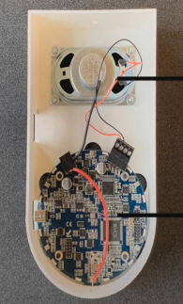
Implementation
$2 speaker transmitting at up to 59dB
MiniDSP 7-mic array
Notes:
Since commodity devices such as Amazon echo don’t give access to the microphone data, they built a smart speaker prototype using a cheap normal speaker and also a microphone array from MiniDSP which has seven embedded microphones.
---------------------------------------------------------------------- Additional Info:
The case was 3D-printed with plastic.
They play dynamically generated pseudo-random white noise and record the 7-channel recordings, using XT-Audio library [14]. We capture the acoustic signals at a sampling rate of 48kHz and 24 bits per sample.

Slide 29
Evaluation
Extensive evaluation in two setups:
Micro-benchmarks on $25,000 infant simulator : evaluate the effect of different parameters
Five new-born infants in Neonatal Intensive Care Unit (NICU) at UW Medical Center : verify the validity of the system
Notes:
To evaluate the effectiveness and accuracy of BreathJunior, the authors conducted extensive experiments in two setups.
First, with a tetherless newborn simulator to systematically evaluate the effect of different parameters.
And then with actual newborns. They recruited five infants at a Neo-natal Intensive Care Unit (NICU) and conducted a clinical study to verify the validity of their system.

Slide 30
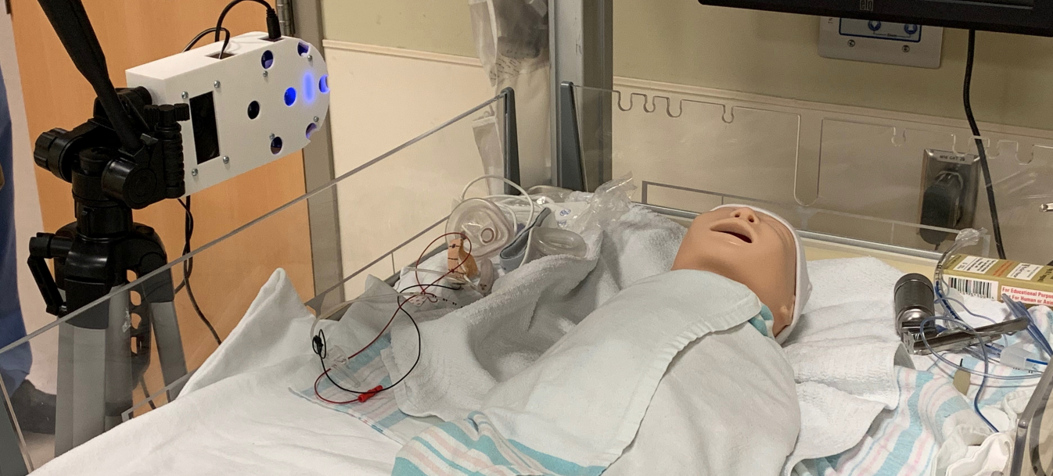
Parameters:
Distance (up to 0.7m)
Orientation (0°, 45°, 90°)
Position (top, left, right, bottom)
Sound pressure (50-59 dB (A))
Breathing rate and intensity
Interference of distant movement
Interference from ambient soundc
Key Results:
Respiratory rate within 5% / 10% at a distance of 0.5m / 0.7m
Works up to 65 BPM
Minimal degradation when wrapped with sleep sack
Evaluation with Infant Simulator
Notes:
Their first evaluation involved an infant simulator that was designed to train doctors practicing infant related operations. These simulators have of an anatomically realistic airway and support various breathing features such as the breathing rate and intensity. It can even control the crying and motion of their arms and legs.
The parameters that were evaluated included: distance, orientation, position, sound pressure, breathing rate and interference.
The key results to highlight is that the system works at a distance up to 0.7m and the error rate can be less than 10%. It can also detect up to 65 breaths per minute and the result is not affected when the infant is wrapped with a sleep sack.

Slide 31
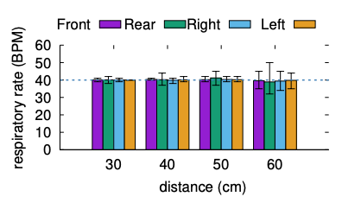
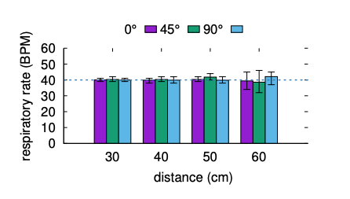
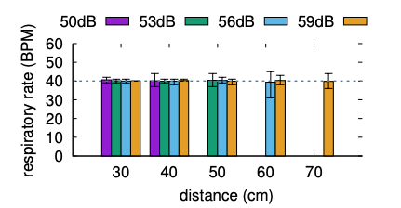
Accuracy
Respiration rate accuracy with different placement locations of the microphone array at 56 dB(A). Error bars represent the min-max interval.
Respiration rate accuracy with different angles of the microphone array at 56 dB(A).
Accuracy of computing respiratory rate with different at-ear sound pressures.
Notes:
These figures show the results when looking at distance, angles, and sound pressures. We can see:
On the left, we see variance in the measured breathing rate increases with distance.
In the middle we see there is no significant difference in the respiratory rate variance across the three orientations. This is because the microphone array is designed to be omni-directional to detect sound across all angles.
And on the right we see when white noise volume is increased,the breathing rate can be estimated with low variance from a distance of up to 70 cm. This is expected since the reflections from the breathing motion are stronger when the white noise volume is higher.

Slide 32
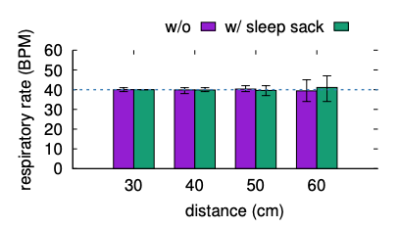
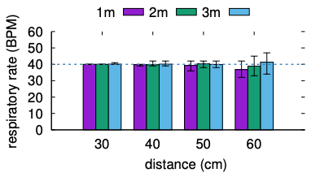
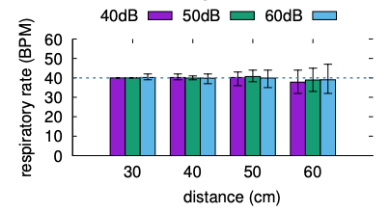
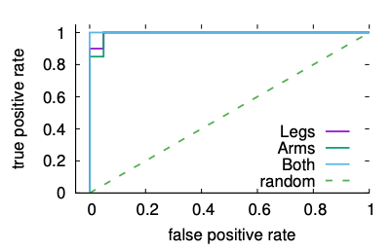
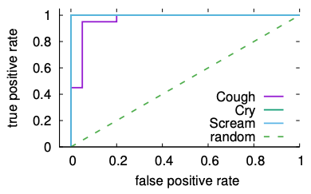
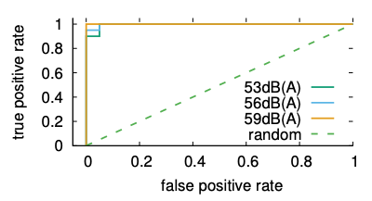
Additional Effects
With and without sleep sack.
Another moving adult at a distance.
Ambient interfering sound.
Apnea event detection ROC curves.
Motion detection ROC curves.
Sound detection ROC curves
Notes:
The authors also evaluate the effect of blankets and other interfering motion and environmental noise in the environment as well as the system’s ability to identify apnea events, body motion as well as audible sound.

Slide 33
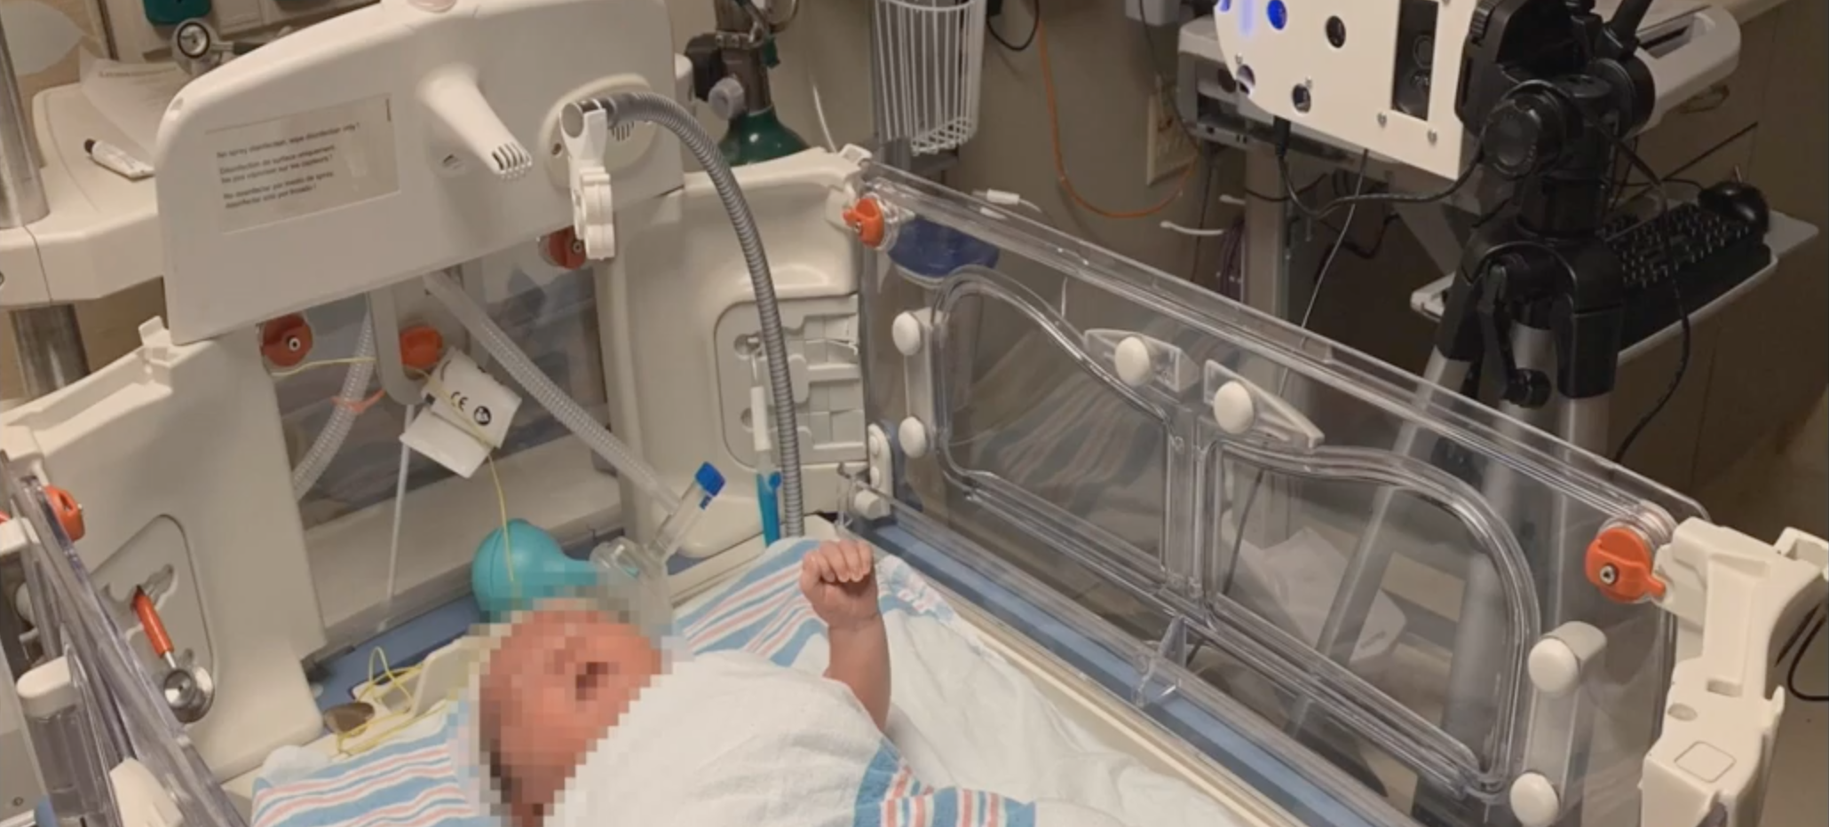
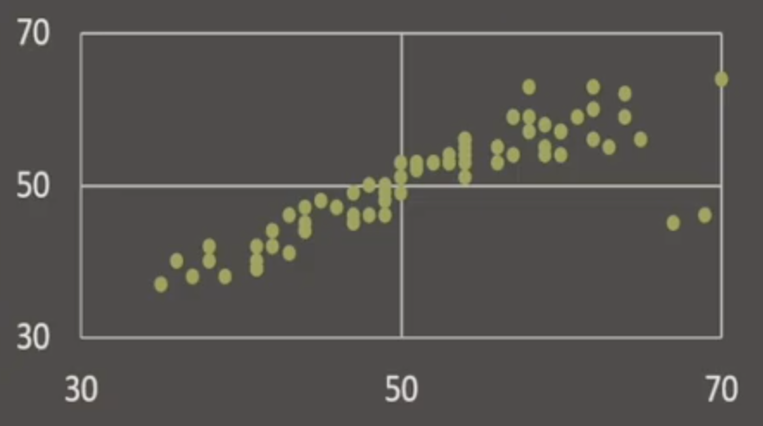
Five premature infants:
Weight: 3.5 kg - 4.5 kg
Age: < 45 days
Sleep sessions: 7
Total duration: 218 min
Key Results:
Interclass correlation: 0.938
Motion detected within 2 min
Crying detected within 1 min
Evaluation with Infants in NICU
Notes:
We then evaluated with actual infants. We did it in the Neonatal Intensive Care Unit (NICU) at UW Medical Center. The infants are in an incubator because they were born immature so they need to be monitored. We used that monitor data as the ground truth to compare with the results of our system.
We recruited 5 infants with the permission of their parents. The distribution was weight being 3.5 to 4.5 kilograms, age being less than 45 days old. We recorded a total of 218 minutes and we manually labeled them into periods of moving, crying and still. Our system can detect the restoration when the infant is still and with the high correlation between our result and the ground truth. Moreover, we show that our system can achieve higher motion and crying detection as well.

Slide 34
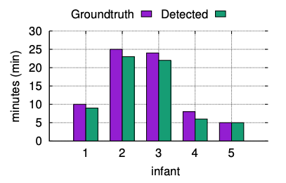
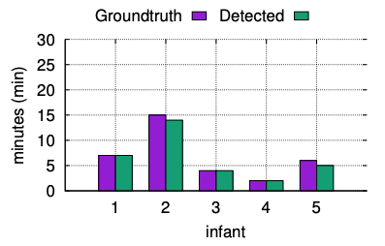
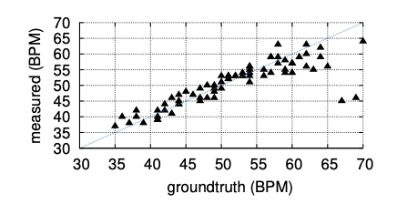
Figures
Comparison between respiratory rate from BreathJunior and groundtruth with infants at NICU.
Accuracy for detecting movement with infants at NICU.
Accuracy for detecting sound with infants at NICU.
Notes:
In all the figures, there is a high correlation between measured and groundtruth BPM.

Slide 35
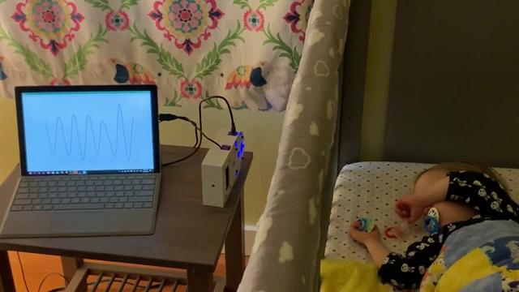
Video Demo
Notes:
Here’s a demo video of the smart speaker prototype monitoring the sleep of one of the researcher’s kids.
You can see the waveform on the screen and hear a weak white noise signal.
And now Callie will talk about our Insights from the paper.

Slide 36
Insights
Empirical parameters to detect apnea
Limited distribution due to low sample size
Not up to date evidence that white noise is safe for infants (1969, 2000 research)
Can not do both, motion detection and respiratory detection
Utilize more features of smart speakers
Notes:
Implementing the first contactless system that monitors infants using white noise is impressive.
However we have some doubts about this paper.
First is insufficient explanation about how they chose the empirical constant value when they tried to detect apnea and motion detection, it was limited to just one infant simulator. So further research could be evaluation different parameters using various infant simulators and improve validity.
Second is the low sample size which is 5 participants to validate their system. Also the breathing experiments were limited to a minimum infant weight of
3.5 kg. Evaluating the system with infants with lower weight would be valuable.
They provided significant related work as evidence that that there is no known negative consequences of white noise exposure. However, the paper cited were from 1969 and 2000 which as a long time ago. They might be different results concerning the effect of white noise recently.
Also the current system can not detect both motion and breathing at the same time.
Finally, we think that since they are trying to simulate their system using a smart speaker, further research could be done by utilizing features available in smart speaker to improve monitoring infants.
---Click---

Slide 37
Reference
MobiCom 2019 - Contactless Infant Monitoring using White Noise
https://www.youtube.com/watch?v=6nv6JG8IBQk
Anran Wang, Jacob E. Sunshine, and Shyamnath Gollakota. 2019. Contactless Infant Monitoring using White Noise. In The 25th Annual International Conference on Mobile Computing and Networking (MobiCom '19). Association for Computing Machinery, New York, NY, USA, Article 52, 1–16. DOI:https://doi.org/10.1145/3300061.3345453
Notes:
Here’s the reference to the paper and video demonstration.

Slide 38
Questions?
Notes:
---Click---
Does anyone have any questions? :)

