Slide 1

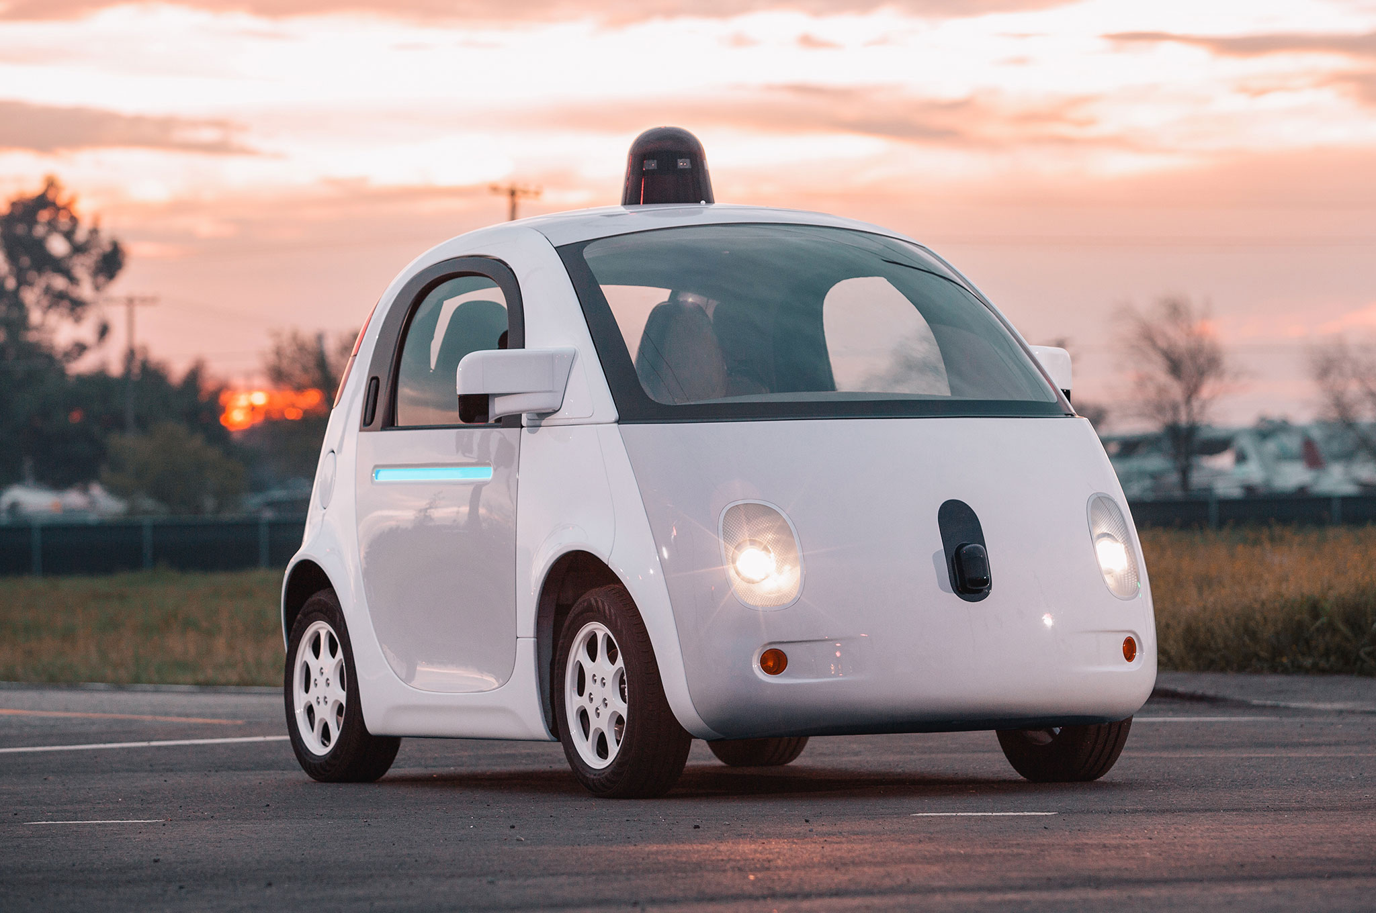



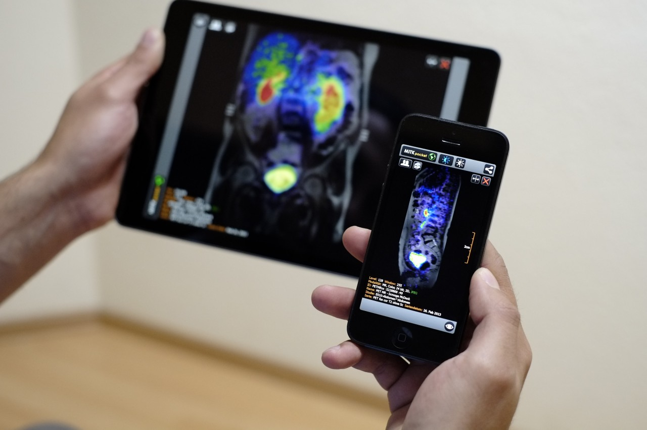
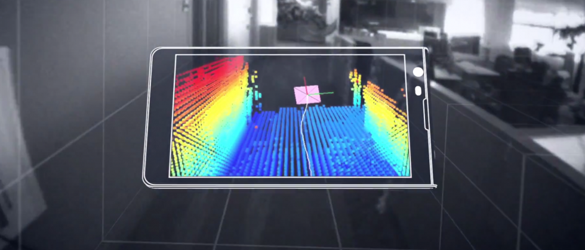
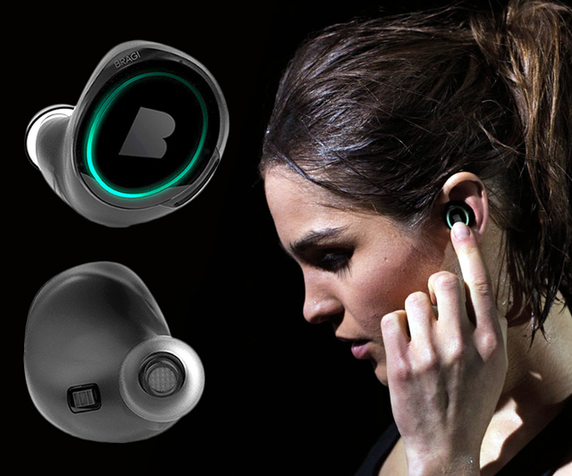
Wireless and Mobile Systems
for the IoT
CMSC 818W : Fall 2020
Midterm Review and Discussion
Nakul Garg
This zoom session is being recorded.

Slide 2
Take home exam.
Will be released at 9:00AM on November 11.
Due at 8:59AM on November 12.
The exam questions will be spread over almost all the topics discussed in the class so far.
Fundamental concepts/theories are important.
There will be no specific question from any paper
No programming

Slide 3
5 Sections
Multiple Choice Questions (10*2 points+ 2*2 bonus)
Measuring Signals (20 points)
Waves (20 points + 4 bonus points)
Indoor/Outdoor Localization (25 points + 2 bonus points)
Mixed Bag (15 points)

Slide 4
The following topics are particularly important
Sampling, Nyquist sampling rate, aliasing, calculating aliased frequency, Nyquist sampling rate for a frequency band
DFT spectrum of a real and complex signal
Upconversion and downconversion techniques in communication
Doppler frequency estimation
Superposition of signals, one dimensional beamforming
DoA estimation using antenna array
Beam-patterns of the Uniform Linear Array
Working principles of the IMU sensors, Local and global coordinate systems
Hidden Markov Model (HMM) – Viterbi Algorithm
Global Positioning System (GPS)

Slide 5
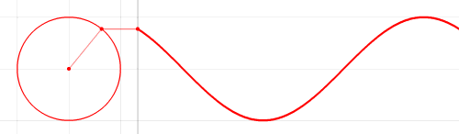
Frequency, Amplitude, and Phase
$$2π angles per cycle$$
$$f cycles per second$$
A
𝚹
Phase
time = t second
$$=$$
$$A . sin⁡(θ)$$
$$=$$
$$A . sin⁡(2πft)$$
$$A . sin⁡(2πft+φ)$$
-- with initial/additional phase ϕ

Slide 6
Time Domain and Frequency Domain
Time domain view
Frequency domain view

Slide 7
Time Domain and Frequency Domain
Fourier Transform
$$ej 2π4t$$
FFT
Amplitude
0
2
4
6
8
Frequency (Hz)
Time domain
Frequency domain
FFT = Fast Fourier Transform
IFFT = Inverse Fast Fourier Transform

Slide 8
Time Domain and Frequency Domain
Fourier Transform
FFT
$$\cos\left(2π4t\right)$$
Amplitude
$$ej 2πft$$
$$+$$
$$e_j 2πft$$
$$=$$
2
-6
-4
-2
0
2
4
6
8
Frequency (Hz)
Time domain
Frequency domain
FFT = Fast Fourier Transform
IFFT = Inverse Fast Fourier Transform

Slide 9
Discrete Fourier Transform
_{F}
…
DFT matrix,
=
f₀
f₁
…
f_{m}
f_{N-1}
_{Z}
Z₀
x[0]
X =
Fourier coefficients,
=
Z₁
Time series,
…
x[1]
Z_{m}
x[2]
…
…
Z_{N-1}
x[N-1]

Slide 10
Discrete Fourier Transform
_{X}
_{F}
_{Z}
=
_{X}
_{Z}
_{F}⁻¹
=
_{H}
_{X}
_{Z}
_{F}
=

Slide 11
The resolution and the highest frequency
Magnitude/Phase of z_{m}
-4
-3
-2
-1
m = 0
1
2
3
4
Frequency
Resolution
= minimum observable frequency difference =
$\frac{\text{f}\text{s}}{N}$

Slide 12
The resolution and the highest frequency
Magnitude/Phase of z_{m}
-4
-3
-2
-1
m = 0
1
2
3
4
Frequency
$−\frac{\text{f}\text{s}}{2}$
$\frac{\text{f}\text{s}}{2}$
Highest frequency =

Slide 13
The resolution and the highest frequency
How can we increase the resolution?
$$\frac{\text{f}\text{s}}{N}$$
= $\frac{\text{sample} \text{rate}}{\# of FFT points}$
How can we increase the range of the spectrum?
$[−\frac{\text{f}\text{s}}{2}$
, $\frac{\text{f}\text{s}}{2} ]$

Slide 14
Calculating the aliased frequency value for real signals
Sampling frequency = 10Hz
Nyquist frequency = 5Hz
Amplitude
Received
signal
Amplitude
0
2
4
6
8
0
2
4
6
8
Frequency (Hz)
Frequency (Hz)
f_{s} = Sampling frequency
f = Target frequency
f_{a} = Aliased(perceived) frequency
K = Non-negative integer
f_{a} = min(abs(K*f_{s} - f))

Slide 15
Downconversion
$$e^{j2πf1t}$$
$$e^{j2πf2t}$$
Amplitude
$${× e}^{−j2πf1t}$$
0
2
4
6
0
8
Frequency (kHz)

Slide 16
Downconversion
$${× e}^{−j2πf1t}$$
Amplitude
Frequency
down-conversion
Amplitude
0
2
4
6
8
0
2
4
6
8
Frequency (kHz)
Frequency (kHz)

Slide 17
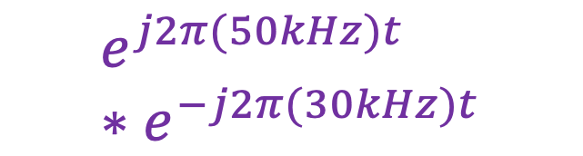

$$e^{j2π(50kHz)t}$$
$$e^{j2π(50kHz)t} ∗e^{−j2π(30kHz)t}$$
?
Amplitude
0
20
50
60
80
Frequency (kHz)

Slide 18
$$e^{j2π(50kHz)t}$$
$$e^{j2π(50kHz)t} ∗e^{−j2π(30kHz)t}$$
Amplitude
Amplitude
0
20
50
60
80
0
20
50
60
80
Frequency (kHz)
Frequency (kHz)

Slide 19
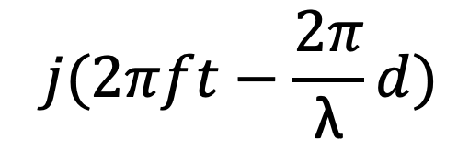

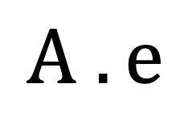



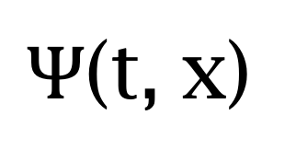
Equation of waves in time and space
$wavelength$ = λ
$$distance from the source (d)$$
$$space$$
$$⁡j(2πft−\frac{2π}{\text{λ}}d)$$
$$A . e$$
$Ψ$(t, x)
$$=$$

Slide 20


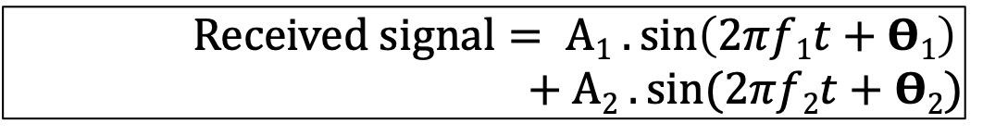
Superimposition of sinusoids
$$A1 . sin⁡(2πf1t+Θ1)$$
Amplitude
Amplitude
$$A2 . sin⁡(2πf2t+Θ2)$$
$Received signal= A1 .\sin\left(2πf1t+Θ1\right)$ $+A2 . sin⁡(2πf2t+Θ2)$

Slide 21
Beamforming in 2D space
Approximation for ‘far field’
$$φ$$
$d sin$($φ$)
$$?$$
$$φ$$
$$d$$

Slide 22
Beamforming in 2D space
Approximation for ‘far field’
$$φ$$
Along this line
$d sin$($φ$)
$$φ$$
$$d$$
Combined signal = $\sin\left(2πft\right) + \sin\left(2πft+ \frac{2π d sin (φ)}{λ}\right)$
= $e^{j\left(2πft\right)}{ }+e^{j\left(2πft+ \frac{2π d sin(φ)}{λ}\right)}{ }$

Slide 23
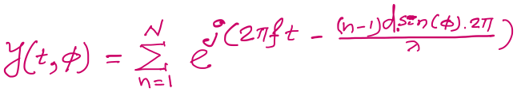






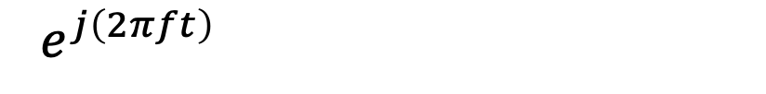
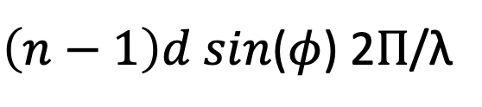
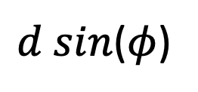

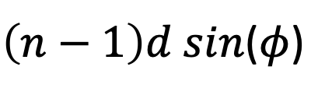
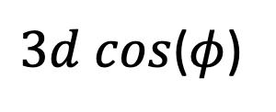
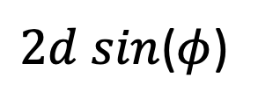

$3d cos$($φ$)
$2d sin$($φ$)
Beamforming in 2D space
$d sin$($φ$)
$$E1$$
$$E2$$
$$E3$$
$$E4$$
…
N elements
$$d$$
$$d$$
$$d$$
Path difference with n^{th} element:
$\left(n−1\right)d sin$($φ$)
Phase difference with n^{th} element:
$\left(n−1\right)d sin$($φ$) 2Π/λ
Original signal:
$e^{j\left(2πft\right)}{ }$
Combined signal:

Slide 24
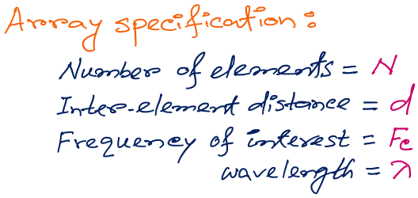
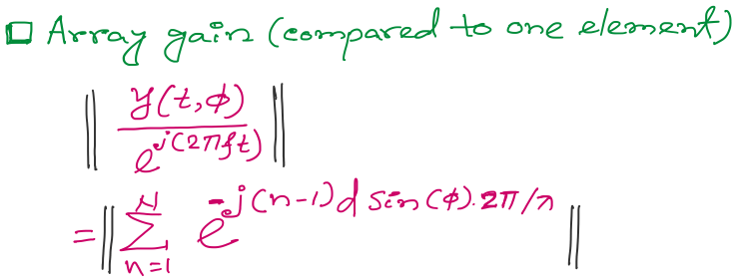
Beamforming in 2D space
f
Notes:
http://www.waves.utoronto.ca/prof/svhum/ece422/notes/15-arrays2.pdf

Slide 25

Beamforming in 2D space
Notes:
http://www.waves.utoronto.ca/prof/svhum/ece422/notes/15-arrays2.pdf

Slide 26
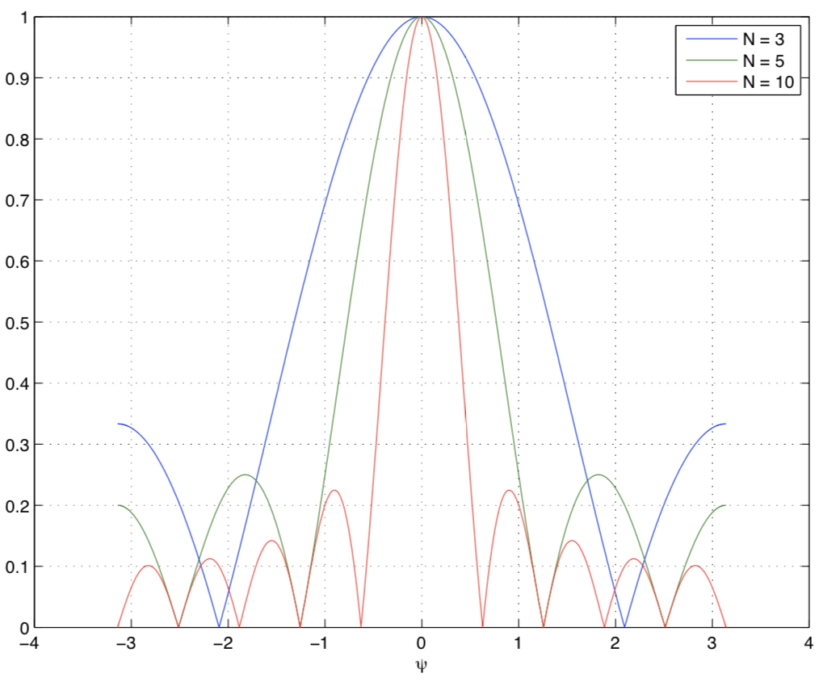
Beamforming in 2D space
Gain
-90 -60 -30 0 30 60 90
Angle
Notes:
http://www.waves.utoronto.ca/prof/svhum/ece422/notes/15-arrays2.pdf

Slide 27
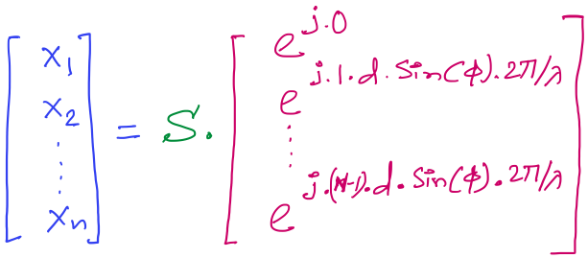

DoA Estimation: Delay-sum
Received signals in all elements:
Steering vector
Notes:
http://www.waves.utoronto.ca/prof/svhum/ece422/notes/15-arrays2.pdf

Slide 28
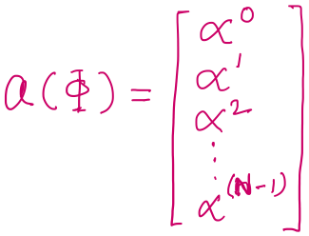

DoA Estimation: Delay-sum
Received signals in all elements:
Notes:
http://www.waves.utoronto.ca/prof/svhum/ece422/notes/15-arrays2.pdf

Slide 29
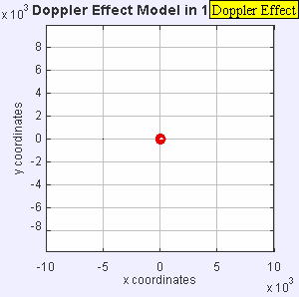
Doppler effect

Slide 30
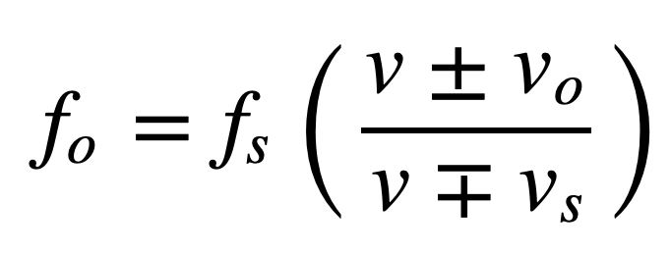
Doppler effect
Simple wave model: Moving observer
Both the source and the observer are moving
v_{O} , T_{O} , f_{O} = Velocity of the observer and observed period and frequency
v_{S} , T_{S} , f_{S} = Velocity of the source and original period and frequency
Notes:
Slide 58: 30 minutes

Slide 31
A fire truck emits an 880Hz siren. As the truck approaches an observer on the sidewalk, he perceives the pitch to be 950Hz. Approximately what frequency does he hear after the truck passes and is moving away? Assume the truck's velocity remains constant, and that the velocity of sound in air is 340m/s.

Slide 32
A fire truck emits an 880Hz siren. As the truck approaches an observer on the sidewalk, he perceives the pitch to be 950Hz. Approximately what frequency does he hear after the truck passes and is moving away? Assume the truck's velocity remains constant, and that the velocity of sound in air is 340m/s.
950 = 880(340/340−v)
v = 25 m/s
f = 880(340/340+25) = 820Hz
Answer = f = 820Hz

Slide 33
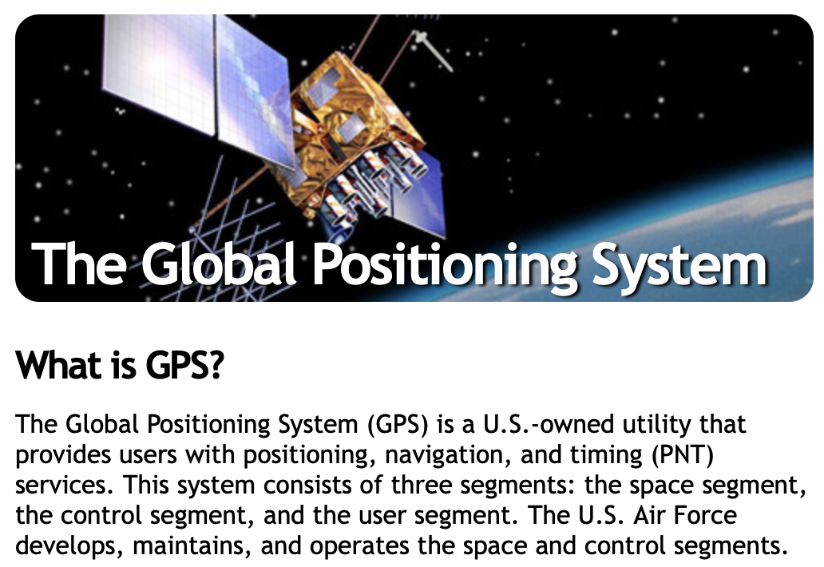
Global Navigation Satellite Systems:
https://www.gps.gov

Slide 34
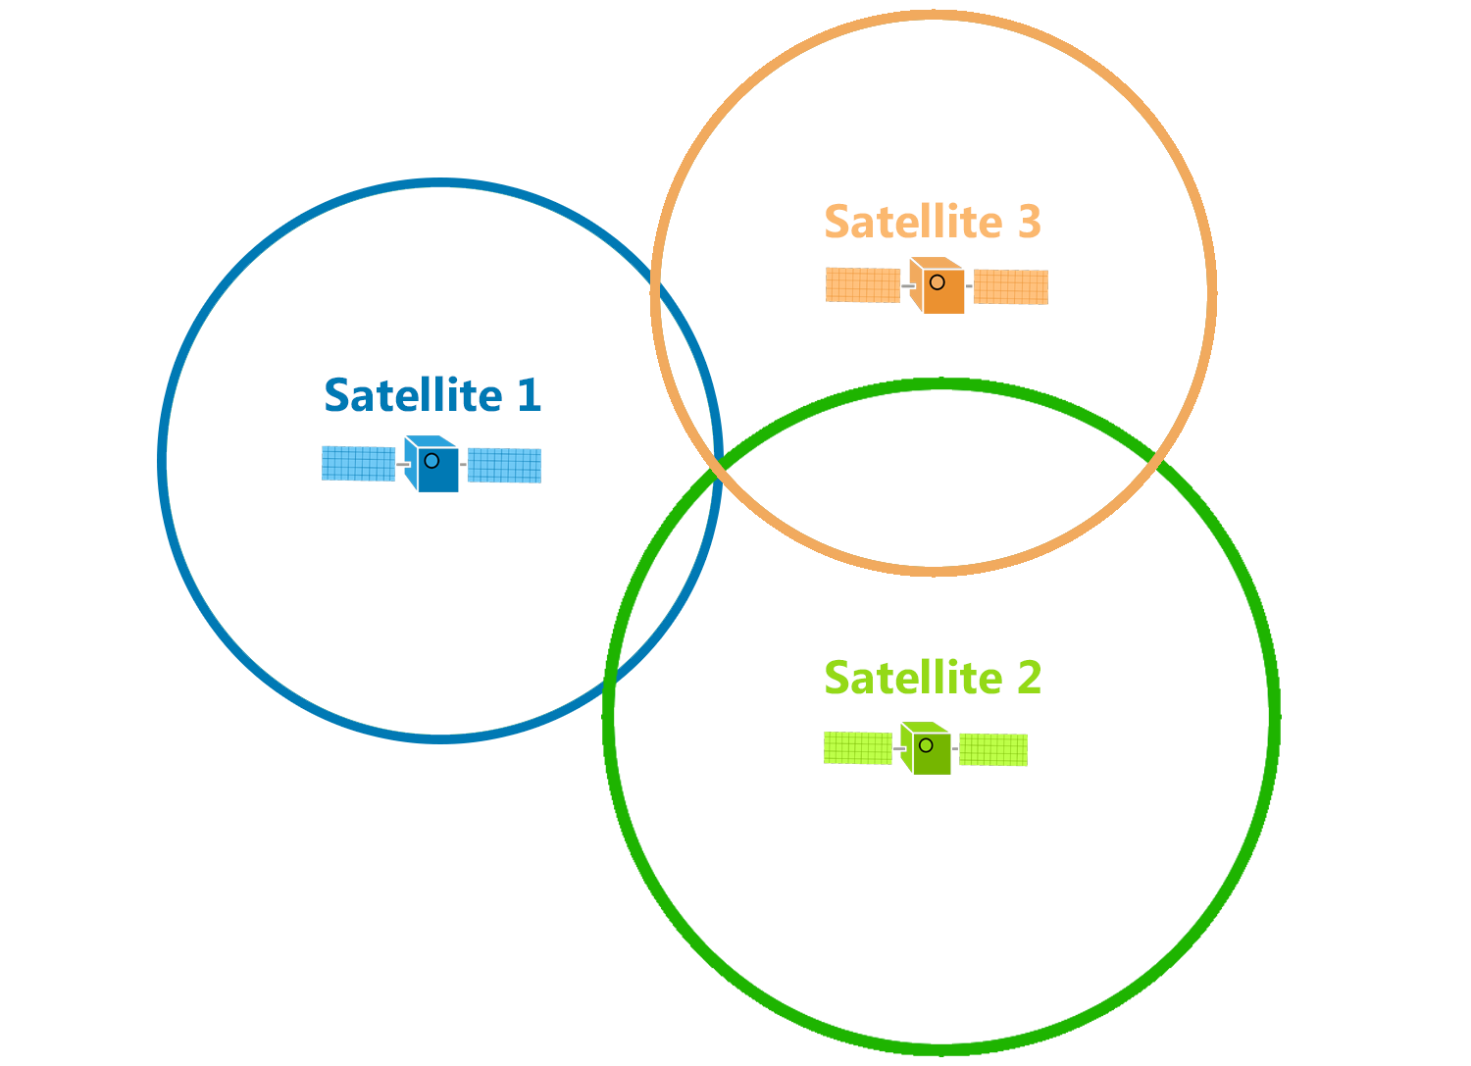
Trilateration
d

Slide 35
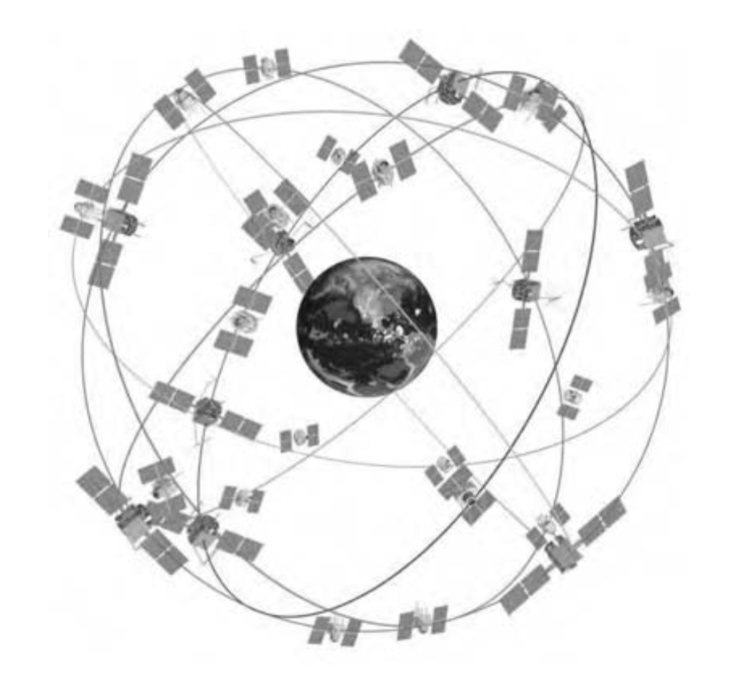
GPS Satellite Constellation
Baseline configuration
-- 24 satellites
-- 6 orbital planes, 4 satellites in each plane
-- 60° separation between planes
-- Orbital radius approx. 26,600 km
-- Orbital period 11h 58m (half day)
at a speed of around 14000km/s

Slide 36
A simple gesture recognition example
Start
End
St
No
Call
Call
Near
Far
Near
Far

Slide 37
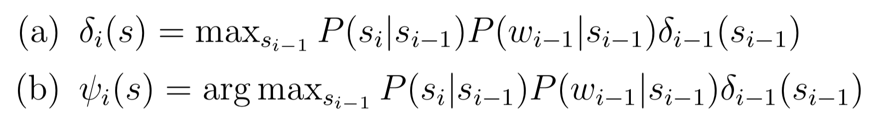

Viterbi Algorithm
Save two parameters per iteration, per state:
Recursion
$$Initialize, δ0\left(Start\right)=1$$
Example: $S=\left\{Start, Call, NoCall, End\right\},ω=\{St, Near, Far\}$

