Slide 1

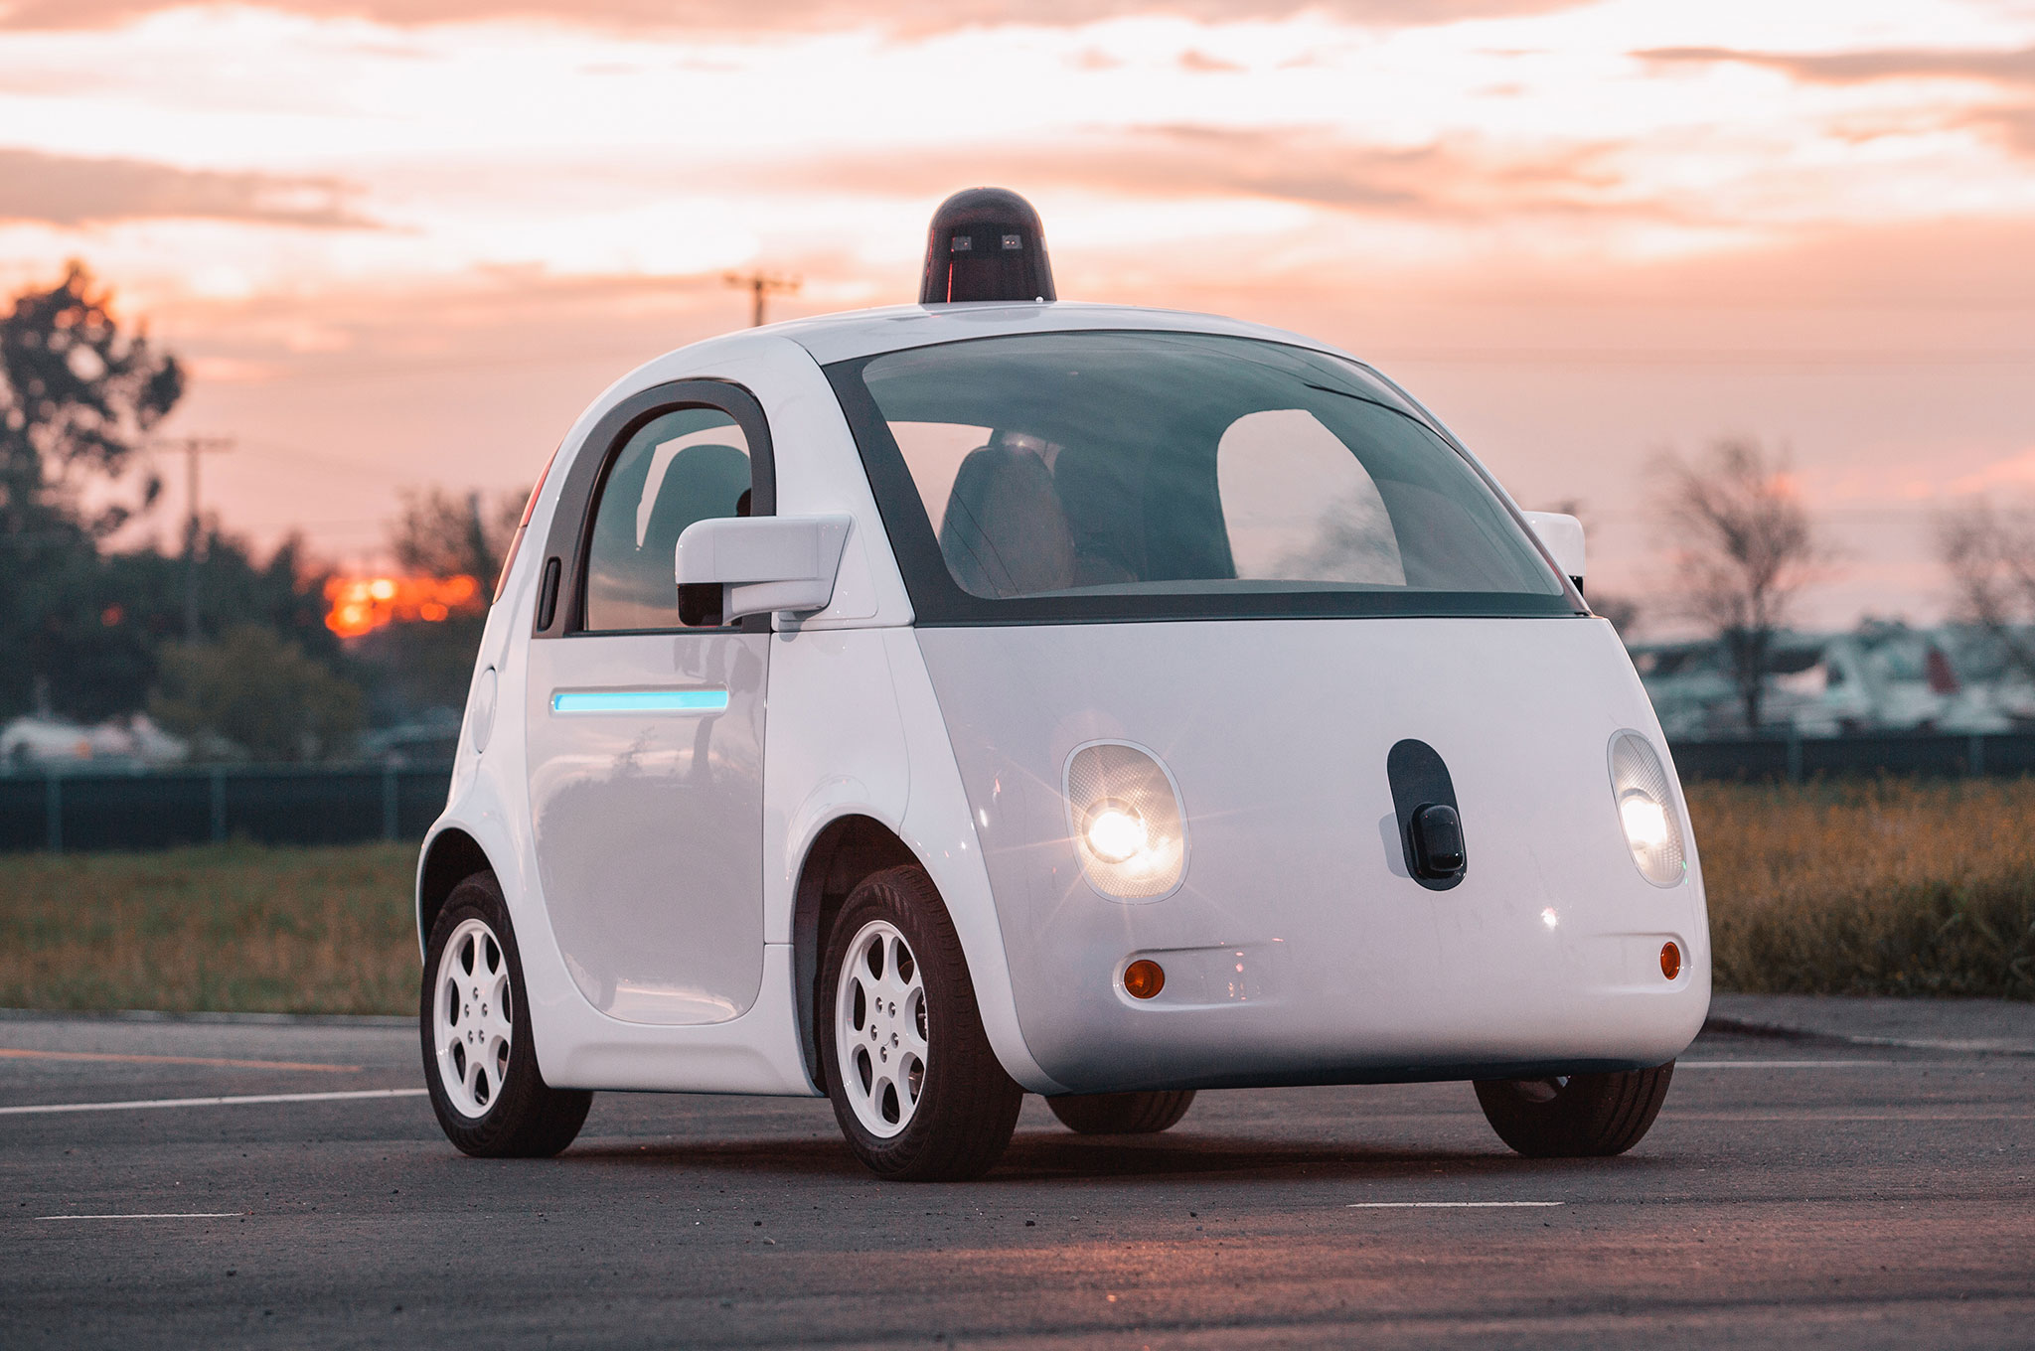

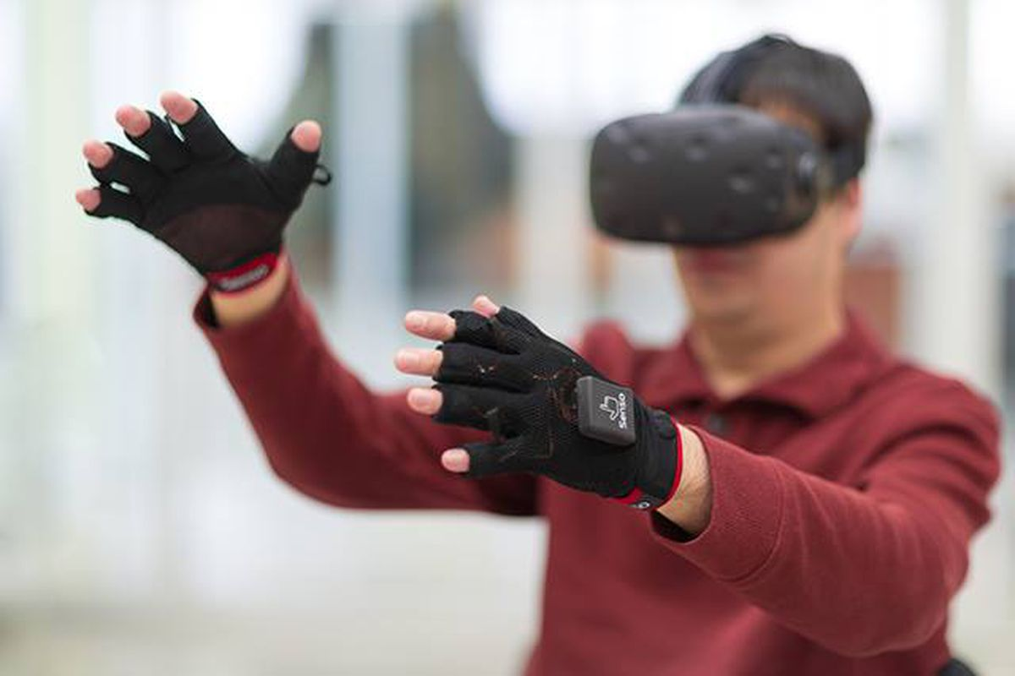

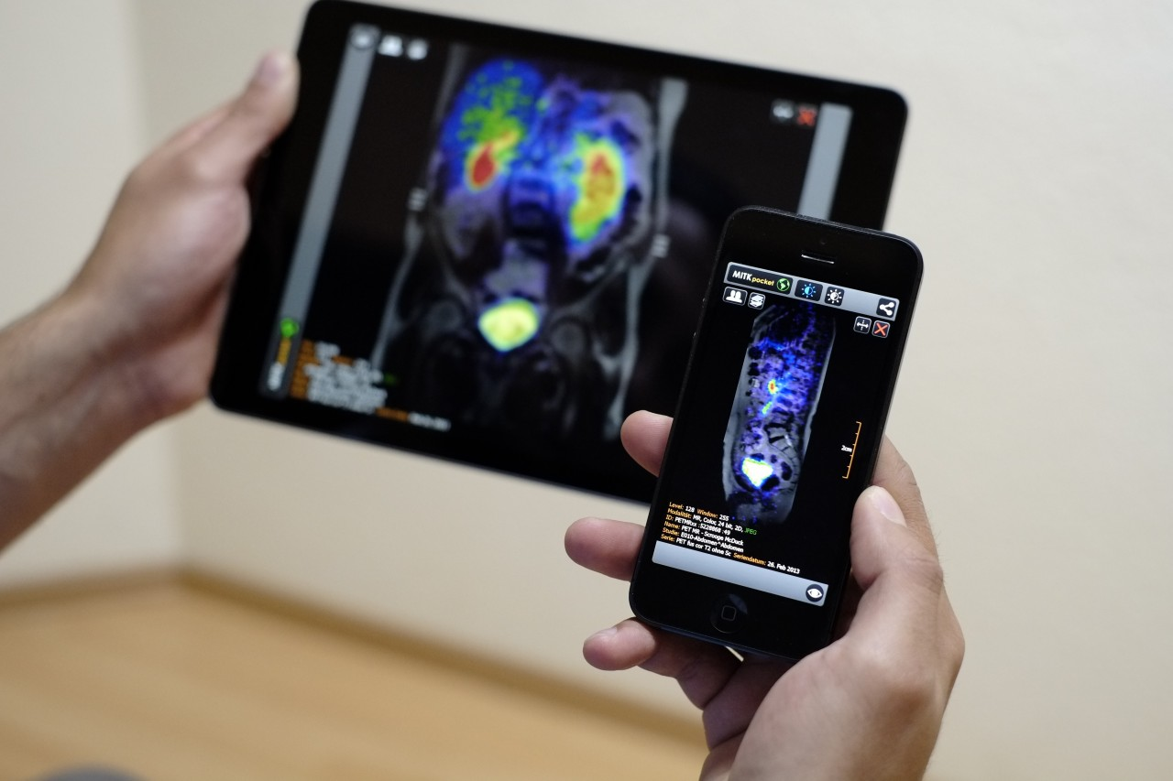
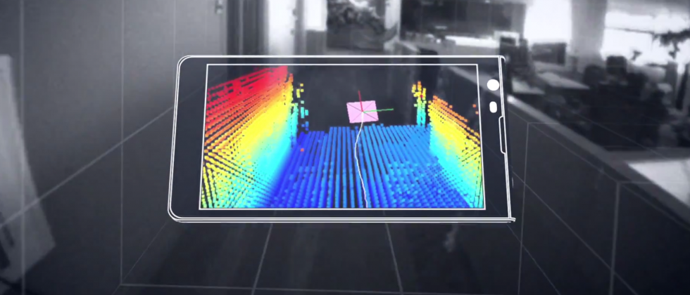
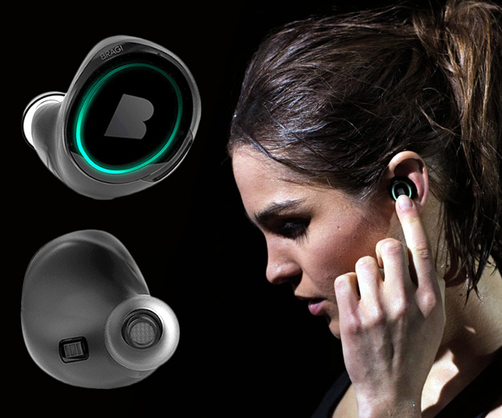
Wireless and Mobile Systems
for the IoT
CMSC 715 : Fall 2021
Lecture 1.3: Mathematical Foundations
for Signal Analysis (Part 2)
Nirupam Roy
M-W 2:00-3:15pm
CHM 1224

Slide 2
1. No in-person class on Wednesday Sept 15th.
2. We will release a lecture video.
3. The first assignment will be released on Sept 16th.
Due on Sept 29th.
4. Follow the timeline on the course website.

Slide 3
Where do we stand?
Diverse application: Security, Mobile Health, Machine perception, IoT networks, …
Computing + networking
Computing on physical cues
Sensing + Computing
Math. For visualizing
and manipulating signals
Sensor abstraction

Slide 4
Where do we stand?
More abstract computing
Diverse application: Security, Mobile Health, Machine perception, IoT networks, …
Computing + networking
More physical sensing
Computing on physical cues
Sensing + Computing
Math. For visualizing
and manipulating signals
Sensor abstraction

Slide 5
Where do we stand?
Diverse application: Security, Mobile Health, Machine perception, IoT networks, …
Computing + networking
We are here
Computing on physical cues
Sensing + Computing
Math. For visualizing
and manipulating signals
Sensor abstraction

Slide 6
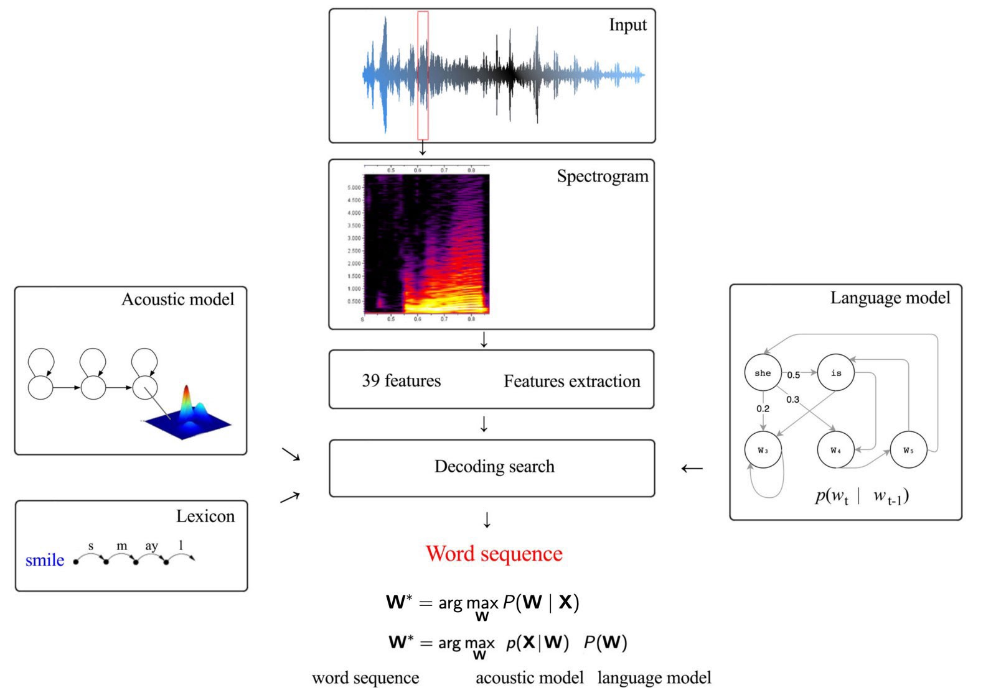
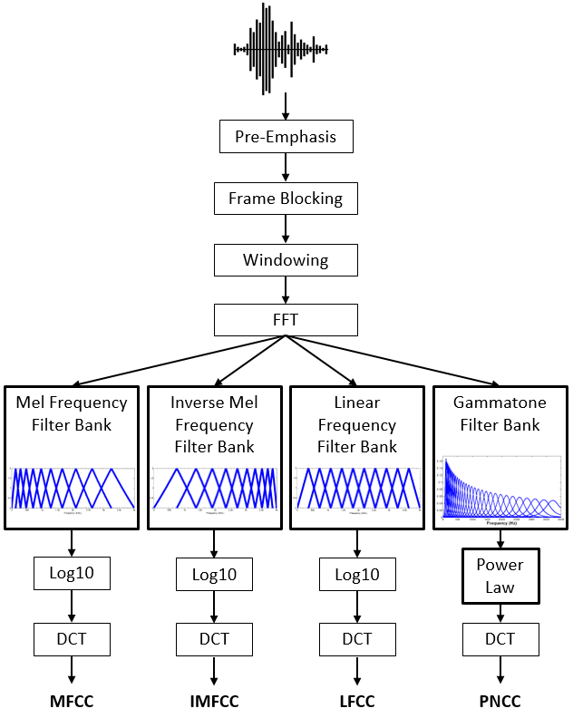
Why learn about Frequency domain?

Slide 7
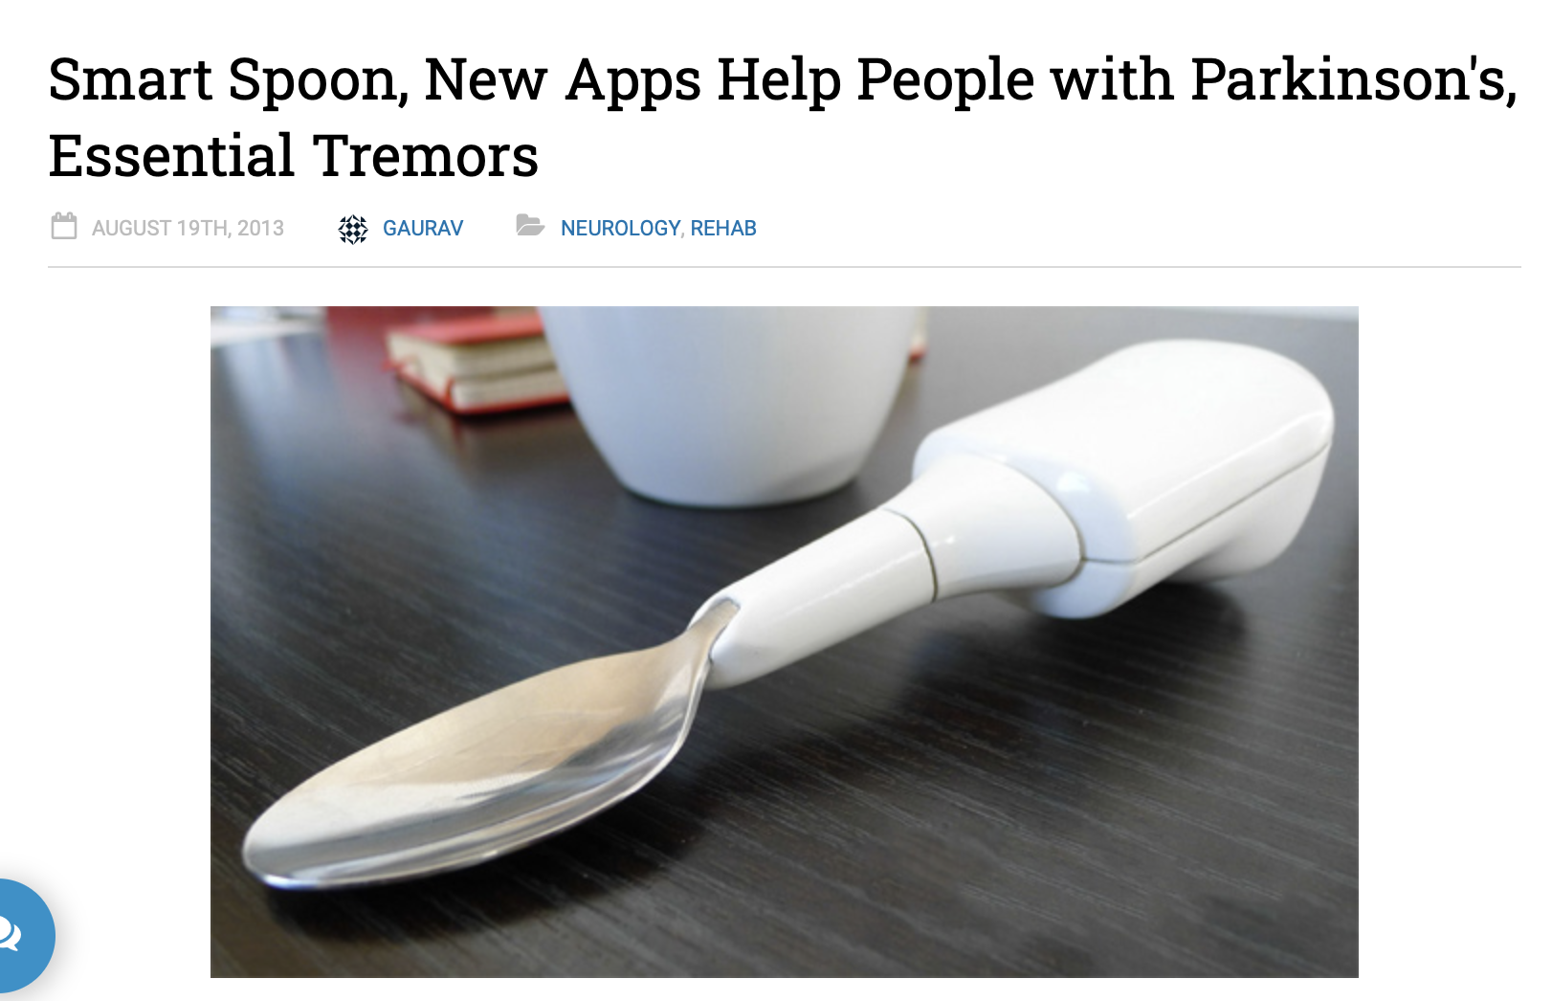
Why learn about Frequency domain?

Slide 8

Why learn about Frequency domain?

Slide 9
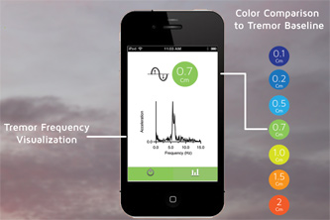
Why learn about Frequency domain?

Slide 10
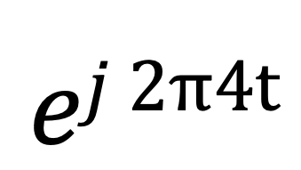
Time Domain and Frequency Domain
Fourier Transform
$$ej 2π4t$$
FFT
Amplitude
0
2
4
6
8
Frequency (Hz)
Time domain
Frequency domain
FFT = Fast Fourier Transform
IFFT = Inverse Fast Fourier Transform

Slide 11





Time Domain and Frequency Domain
Fourier Transform
FFT
$$\cos\left(2π4t\right)$$
Amplitude
$$ej 2πft$$
$$+$$
$$e_j 2πft$$
$$=$$
2
-6
-4
-2
0
2
4
6
8
Frequency (Hz)
Time domain
Frequency domain
FFT = Fast Fourier Transform
IFFT = Inverse Fast Fourier Transform

Slide 12
Matlab demo
function fft_test()
freq = 200;
sampleRate = 1000;
time_ticks = 0:1/sampleRate:1;
realSignal = sin(2*pi*freq*time_ticks);
plot_fft(realSignal, sampleRate);
complexSignal = exp(j*2*pi*freq*time_ticks);
plot_fft(complexSignal, sampleRate);
end

Slide 13
Calculating
Discrete Fourier Transform (DFT)

Slide 14
Discrete Fourier Transform
…
0
1
2
3
4
5
6
N-1
Sample number
X = [ ]
x[0], x[1], x[2], x[3], x[4], … x[N-1]

Slide 15
Discrete Fourier Transform
…
0
1
2
3
4
5
6
N-1
Sample number
X = [ ]
x[0], x[1], x[2], x[3], x[4], … x[N-1]

Slide 16





Discrete Fourier Transform
…
0
1
2
3
4
5
6
N-1
Sample number
$$e^{j2.\frac{2π}{N}}$$
$$e^{j1.\frac{2π}{N}}$$
$$\frac{2π}{N}$$
$$e^{j0.\frac{2π}{N}}$$
$$e^{j(N−1).\frac{2π}{N}}$$

Slide 17



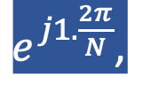
Discrete Fourier Transform
…
0
1
2
3
4
5
6
N-1
Sample number
= [ ]
Freq f₁
$$e^{j0.\frac{2π}{N}},$$
$e^{j1.\frac{2π}{N}}$,
$$e^{j2.\frac{2π}{N}},$$
…
$${,e}^{j(N−1).\frac{2π}{N}}$$
$$e^{j2.\frac{2π}{N}}$$
$$e^{j1.\frac{2π}{N}}$$
$$\frac{2π}{N}$$
$$e^{j0.\frac{2π}{N}}$$
$$e^{j(N−1).\frac{2π}{N}}$$

Slide 18

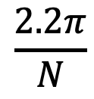


Discrete Fourier Transform
…
0
1
2
3
4
5
6
N-1
Sample number
$$e^{j1.\frac{2.2π}{N}}$$
$$\frac{2.2π}{N}$$
$$e^{j0.\frac{2.2π}{N}}$$
$$e^{j(N−1).\frac{2.2π}{N}}$$

Slide 19

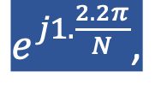


Discrete Fourier Transform
…
0
1
2
3
4
5
6
N-1
Sample number
= [ ]
Freq f₂
$$e^{j0.\frac{2.2π}{N}},$$
$e^{j1.\frac{2.2π}{N}}$,
$$e^{j2.\frac{2.2π}{N}},$$
…
$${,e}^{j(N−1).\frac{2.2π}{N}}$$
$$e^{j1.\frac{2.2π}{N}}$$
$$\frac{2.2π}{N}$$
$$e^{j0.\frac{2.2π}{N}}$$
$$e^{j(N−1).\frac{2.2π}{N}}$$

Slide 20
Discrete Fourier Transform
…
0
1
2
3
4
5
6
N-1
Sample number
What is the MINIMUM number of cycles
observable in this model?

Slide 21

Discrete Fourier Transform
…
0
1
2
3
4
5
6
N-1
Sample number
$$0$$

Slide 22



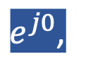
Discrete Fourier Transform
…
0
1
2
3
4
5
6
N-1
Sample number
= [ ]
Freq f₀
$$e^{j0},$$
$e^{j0}$,
$$e^{j0},$$
…
$${,e}^{j0}$$
$$0$$

Slide 23





Discrete Fourier Transform
…
0
1
2
3
4
5
6
N-1
Sample number
= [ ]
Freq f₁
$$e^{j0.\frac{2π}{N}},$$
$e^{j1.\frac{2π}{N}}$,
$$e^{j2.\frac{2π}{N}},$$
…
$${,e}^{j(N−1).\frac{2π}{N}}$$
$$e^{j2.\frac{2π}{N}}$$
$$e^{j1.\frac{2π}{N}}$$
$$\frac{2π}{N}$$
$$e^{j0.\frac{2π}{N}}$$
$$e^{j(N−1).\frac{2π}{N}}$$

Slide 24
Discrete Fourier Transform
…
0
1
2
3
4
5
6
N-1
Sample number
What is the MAXIMUM number of cycles
observable in this model?

Slide 25
Discrete Fourier Transform
…
0
1
2
3
4
5
6
N-1
Sample number
What happens when the ball rotates exactly N times?
$$0$$
We can uniquely observe up to (N-1) number of cycles.

Slide 26


Discrete Fourier Transform
Freq f₀
n=0
$$e^{j0}$$
n=1
$$e^{j0}$$
n=2
$$e^{j0}$$
…
…
n=N-1
$$e^{j0}$$

Slide 27
Discrete Fourier Transform
Number of cycles
…
…
Freq f₀
Freq f₁
Freq f_{m}
Freq f_{N-1}
n=0
$$e^{j0}$$
n=1
$$e^{j0}$$
Sample number
n=2
$$e^{j0}$$
…
…
n=N-1
$$e^{j0}$$

Slide 28












Discrete Fourier Transform
Number of cycles
…
…
Freq f₀
Freq f₁
Freq f_{m}
Freq f_{N-1}
n=0
$$e^{j0}$$
$$e^{j0.\frac{2π}{N}}$$
$$e^{j0.\frac{m.2π}{N}}$$
$$e^{j0.\frac{(N−1).2π}{N}}$$
n=1
$$e^{j0}$$
$$e^{j1.\frac{2π}{N}}$$
$$e^{j1.\frac{m.2π}{N}}$$
$$e^{j1.\frac{(N−1).2π}{N}}$$
Sample number
…
…
$$e^{j2.\frac{(N−1).2π}{N}}$$
$$e^{j2.\frac{2π}{N}}$$
$$e^{j2.\frac{m.2π}{N}}$$
n=2
$$e^{j0}$$
…
…
…
…
…
$$e^{j(N−1).\frac{2π}{N}}$$
$$e^{j(N−1).\frac{m.2π}{N}}$$
$$e^{j(N−1).\frac{(N−1).2π}{N}}$$
n=N-1
$$e^{j0}$$

Slide 29














Discrete Fourier Transform
$$e^{j0}$$
$$e^{j0.\frac{2π}{N}}$$
$$e^{j0.\frac{m.2π}{N}}$$
$$e^{j0.\frac{(N−1).2π}{N}}$$
$$e^{j0}$$
$$e^{j1.\frac{2π}{N}}$$
$$e^{j1.\frac{m.2π}{N}}$$
$$e^{j1.\frac{(N−1).2π}{N}}$$
+
$$e^{j2.\frac{2π}{N}}$$
+
$$e^{j2.\frac{m.2π}{N}}$$
+
$$e^{j2.\frac{(N−1).2π}{N}}$$
Z₀
$$e^{j0}$$
Z₁
…
Z_{m}
…
Z_{N-1}
…
…
…
…
$$e^{j(N−1).\frac{2π}{N}}$$
$$e^{j(N−1).\frac{m.2π}{N}}$$
$$e^{j(N−1).\frac{(N−1).2π}{N}}$$
$$e^{j0}$$

Slide 30














Discrete Fourier Transform
$$e^{j0}$$
$$e^{j0.\frac{2π}{N}}$$
$$e^{j0.\frac{m.2π}{N}}$$
$$e^{j0.\frac{(N−1).2π}{N}}$$
$$e^{j0}$$
$$e^{j1.\frac{2π}{N}}$$
$$e^{j1.\frac{m.2π}{N}}$$
$$e^{j1.\frac{(N−1).2π}{N}}$$
+
$$e^{j2.\frac{2π}{N}}$$
+
$$e^{j2.\frac{m.2π}{N}}$$
+
$$e^{j2.\frac{(N−1).2π}{N}}$$
Z₀
$$e^{j0}$$
Z₁
…
Z_{m}
…
Z_{N-1}
…
…
…
…
$$e^{j(N−1).\frac{2π}{N}}$$
$$e^{j(N−1).\frac{m.2π}{N}}$$
$$e^{j(N−1).\frac{(N−1).2π}{N}}$$
$$e^{j0}$$

Slide 31
Discrete Fourier Transform
$$e^{j0}$$
$$e^{j0.\frac{2π}{N}}$$
$$e^{j0.\frac{m.2π}{N}}$$
$$e^{j0.\frac{(N−1).2π}{N}}$$
$$e^{j0}$$
$$e^{j1.\frac{2π}{N}}$$
$$e^{j1.\frac{m.2π}{N}}$$
$$e^{j1.\frac{(N−1).2π}{N}}$$
+
$$e^{j2.\frac{2π}{N}}$$
+
$$e^{j2.\frac{m.2π}{N}}$$
+
$$e^{j2.\frac{(N−1).2π}{N}}$$
Z₀
$$e^{j0}$$
Z₁
…
Z_{m}
…
Z_{N-1}
…
…
…
…
$$e^{j(N−1).\frac{2π}{N}}$$
$$e^{j(N−1).\frac{m.2π}{N}}$$
$$e^{j(N−1).\frac{(N−1).2π}{N}}$$
$$e^{j0}$$
=
…
0
1
2
3
4
5
6
N-1
Sample number

Slide 32
Discrete Fourier Transform
Frequency domain coefficients
$$e^{j0}$$
$$e^{j0.\frac{2π}{N}}$$
$$e^{j0.\frac{m.2π}{N}}$$
$$e^{j0.\frac{(N−1).2π}{N}}$$
$$e^{j0}$$
$$e^{j1.\frac{2π}{N}}$$
$$e^{j1.\frac{m.2π}{N}}$$
$$e^{j1.\frac{(N−1).2π}{N}}$$
+
$$e^{j2.\frac{2π}{N}}$$
+
$$e^{j2.\frac{m.2π}{N}}$$
+
$$e^{j2.\frac{(N−1).2π}{N}}$$
Z₀
$$e^{j0}$$
Z₁
…
Z_{m}
…
Z_{N-1}
…
…
…
…
$$e^{j(N−1).\frac{2π}{N}}$$
$$e^{j(N−1).\frac{m.2π}{N}}$$
$$e^{j(N−1).\frac{(N−1).2π}{N}}$$
$$e^{j0}$$
x[0]
x[1]
=
X =
x[2]
Time domain samples
…
x[N-1]

Slide 33
Discrete Fourier Transform
_{F}
…
DFT matrix,
=
f₀
f₁
…
f_{m}
f_{N-1}

Slide 34
Discrete Fourier Transform
_{F}
…
DFT matrix,
=
f₀
f₁
…
f_{m}
f_{N-1}
_{Z}
Z₀
Fourier coefficients,
=
Z₁
…
Z_{m}
…
Z_{N-1}

Slide 35
Discrete Fourier Transform
_{F}
…
DFT matrix,
=
f₀
f₁
…
f_{m}
f_{N-1}
_{Z}
Z₀
x[0]
X =
Fourier coefficients,
=
Z₁
Time series,
…
x[1]
Z_{m}
x[2]
…
…
Z_{N-1}
x[N-1]

Slide 36
Discrete Fourier Transform
_{X}
_{F}
_{Z}
=
_{X}
_{Z}
_{F}⁻¹
=
_{H}
_{X}
_{Z}
_{F}
=

Slide 37
Discrete Fourier Transform
_{X}
_{F}
_{Z}
=
_{X}
_{Z}
_{F}⁻¹
=
_{H}
_{X}
_{Z}
_{F}
=
*
f₀
*
f₁
…
*
f_{m}
…
*
f_{N-1}

Slide 38
Discrete Fourier Transform
_{X}
_{F}
_{Z}
=
IDFT
_{X}
_{Z}
_{F}⁻¹
=
DFT
_{H}
_{X}
_{Z}
_{F}
=
*
f₀
x[0]
Z₀
*
Z₁
f₁
x[1]
…
=
…
*
x[2]
Z_{m}
f_{m}
…
…
…
Z_{N-1}
*
x[N-1]
f_{N-1}

Slide 39
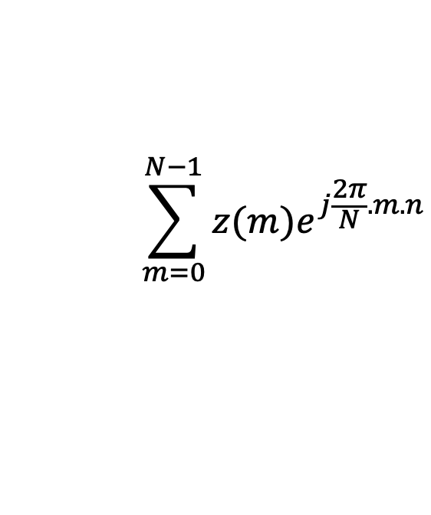
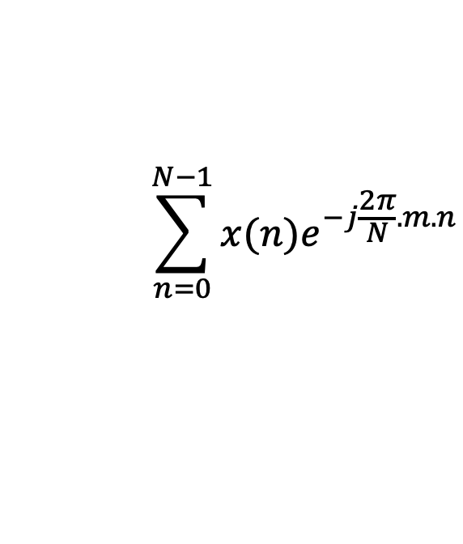
Discrete Fourier Transform
$$\sum_{n=0}^{N−1}{x(n)e^{−j\frac{2π}{N}.m.n}}$$
DFT:
z(m) =
$$\sum_{m=0}^{N−1}{z(m)e^{j\frac{2π}{N}.m.n}}$$
IDFT:
x(n) =

Slide 40
Preserving energy in time and frequency domain

Slide 41
Preserving energy in time and frequency domain
Is IDFT( DFT(x) ) = x ?

Slide 42

Preserving energy in time and frequency domain
Is IDFT( DFT(x) ) = x ?
*
_{X ?}
_{X}
_{F F}
=
*
_{N.X}
_{X}
_{F F}
=
_{F}
$$\frac{1}{\sqrt{N}}$$
…
DFT matrix,
=
f₀
f₁
…
f_{m}
f_{N-1}

Slide 43
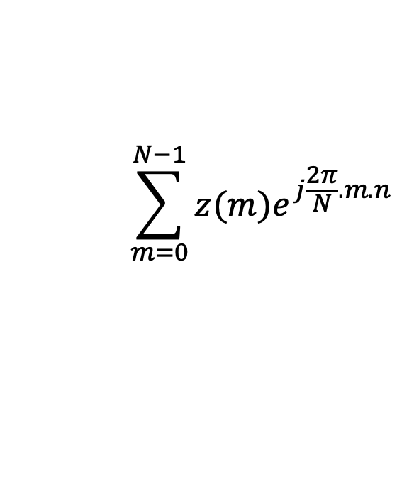
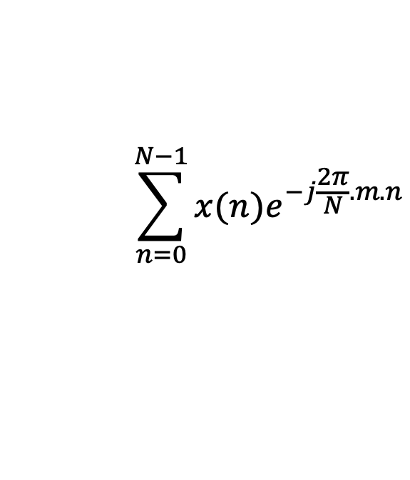


Discrete Fourier Transform
$$\sum_{n=0}^{N−1}{x(n)e^{−j\frac{2π}{N}.m.n}}$$
z(m) =
$$\frac{1}{\sqrt{N}}$$
DFT:
$$\sum_{m=0}^{N−1}{z(m)e^{j\frac{2π}{N}.m.n}}$$
x(n) =
$$\frac{1}{\sqrt{N}}$$
IDFT:

Slide 44
Plotting
DFT spectrum

Slide 45
Plotting the DFT spectrum
Magnitude
|z_{m}|
m = 0
1
2
3
4
…
Frequency
N-2
N-1

Slide 46
Plotting the DFT spectrum
Magnitude
|z_{m}|
m = 0
1
2
3
4
…
Frequency
N-2
N-1
Phase
⦨ z_{m}
m = 0
1
2
3
4
…
Frequency
N-2
N-1

Slide 47

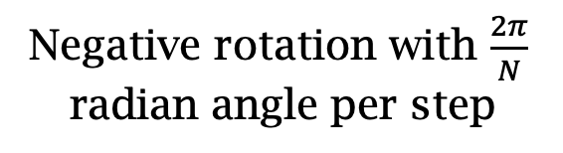

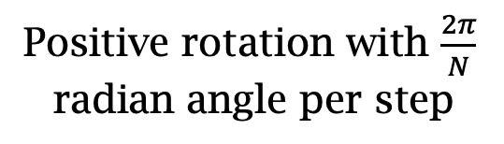
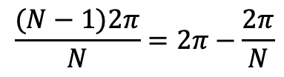
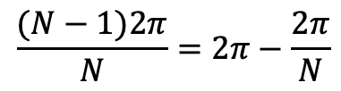
The Curious Case of “Negative frequency”
$$\frac{(N−1)2π}{N}=2π−\frac{2π}{N}$$
$$\frac{2π}{N}$$
$$\frac{2π}{N}$$
$$\frac{(N−1)2π}{N}=2π−\frac{2π}{N}$$
Positive rotation with $\frac{2π}{N}$ radian angle per step
Negative rotation with $\frac{2π}{N}$ radian angle per step

Slide 48
The Curious Case of “Negative frequency”
m = 0
1
2
3
4
…
Frequency
N-2
N-1
+
+
+
-
-
-

Slide 49
The Curious Case of “Negative frequency”
-4
-3
-2
-1
m = 0
1
2
3
4
Frequency

Slide 50
The Curious Case of “Negative frequency”
Magnitude
|z_{m}|
-4
-3
-2
-1
m = 0
1
2
3
4
Frequency
Real signal’s magnitude spectrum is symmetric.
Why?

Slide 51
The Curious Case of “Negative frequency”
Magnitude
|z_{m}|
-4
-3
-2
-1
m = 0
1
2
3
4
Frequency
Complex signal’s magnitude spectrum may or may not be symmetric.
Why?

Slide 52
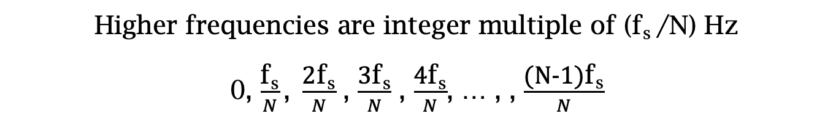
Estimating the real-world frequencies
Sampling frequency = f_{s} (i.e., f_{s} samples per second)
Slowest frequency ($\frac{2π}{N}$ radians per step) = N samples per rotation
= (N/ f_{s}) seconds per rotation
Therefore, the slowest frequency = (f_{s} /N) Hz
Higher frequencies are integer multiple of (f_{s} /N) Hz
0, $\frac{\text{f}\text{s}}{N}\text{, }\frac{\text{2}\text{f}\text{s}}{N}$ , $\frac{\text{3}\text{f}\text{s}}{N}$ , $\frac{\text{4}\text{f}\text{s}}{N}$, … , , $\frac{\text{(}\text{N}\text{−1)}\text{f}\text{s}}{N}$

Slide 53

The resolution and the highest frequency
Magnitude/Phase of z_{m}
-4
-3
-2
-1
m = 0
1
2
3
4
Frequency
Resolution
= minimum observable frequency difference =
$\frac{\text{f}\text{s}}{N}$
What if the actual frequency falls in between two frequency bins?

Slide 54
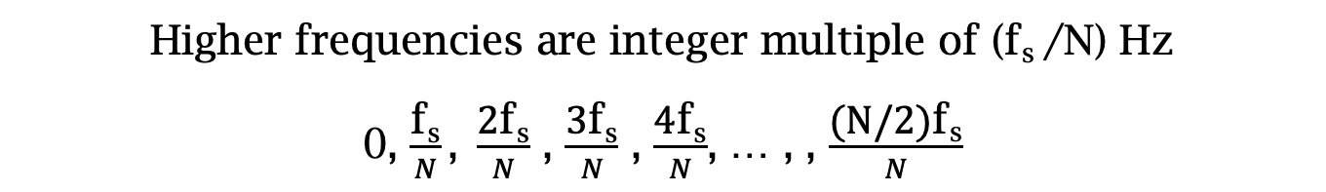
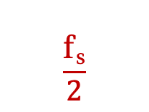

Estimating the real-world frequencies
Sampling frequency = f_{s} (i.e., f_{s} samples per second)
Slowest frequency ($\frac{2π}{N}$ radians per step) = N samples per rotation
= (N/ f_{s}) seconds per rotation
Therefore, the slowest frequency = (f_{s} /N) Hz
Higher frequencies are integer multiple of (f_{s} /N) Hz
0, $\frac{\text{f}\text{s}}{N}\text{, }\frac{\text{2}\text{f}\text{s}}{N}$ , $\frac{\text{3}\text{f}\text{s}}{N}$ , $\frac{\text{4}\text{f}\text{s}}{N}$, … , , $\frac{\text{(}\text{N}\text{/2)}\text{f}\text{s}}{N}$
$$\frac{\text{f}\text{s}}{2}$$
- $\frac{\text{f}\text{s}}{N}\text{, }\text{−}\frac{\text{2}\text{f}\text{s}}{N}$ , - $\frac{\text{3}\text{f}\text{s}}{N}$ , - $\frac{\text{4}\text{f}\text{s}}{N}$, … , , - $\frac{\text{(}\text{N}\text{/2)}\text{f}\text{s}}{N}$

Slide 55
The resolution and the highest frequency
Magnitude/Phase of z_{m}
-4
-3
-2
-1
m = 0
1
2
3
4
Frequency
Resolution
= minimum observable frequency difference =
$\frac{\text{f}\text{s}}{N}$
What if the actual frequency falls in between two frequency bins?

Slide 56
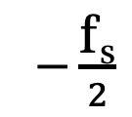
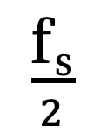
The resolution and the highest frequency
Magnitude/Phase of z_{m}
-4
-3
-2
-1
m = 0
1
2
3
4
Frequency
$−\frac{\text{f}\text{s}}{2}$
$\frac{\text{f}\text{s}}{2}$
Highest frequency =

Slide 57
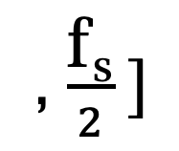
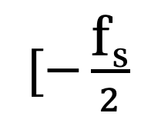
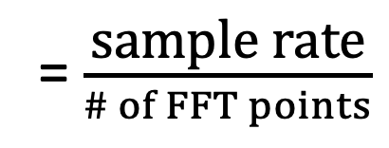
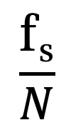
The resolution and the highest frequency
How can we increase the resolution?
$$\frac{\text{f}\text{s}}{N}$$
= $\frac{\text{sample} \text{rate}}{\# of FFT points}$
How can we increase the range of the spectrum?
$[−\frac{\text{f}\text{s}}{2}$
, $\frac{\text{f}\text{s}}{2} ]$

Slide 58
Time resolution v/s Frequency resolution

Slide 59
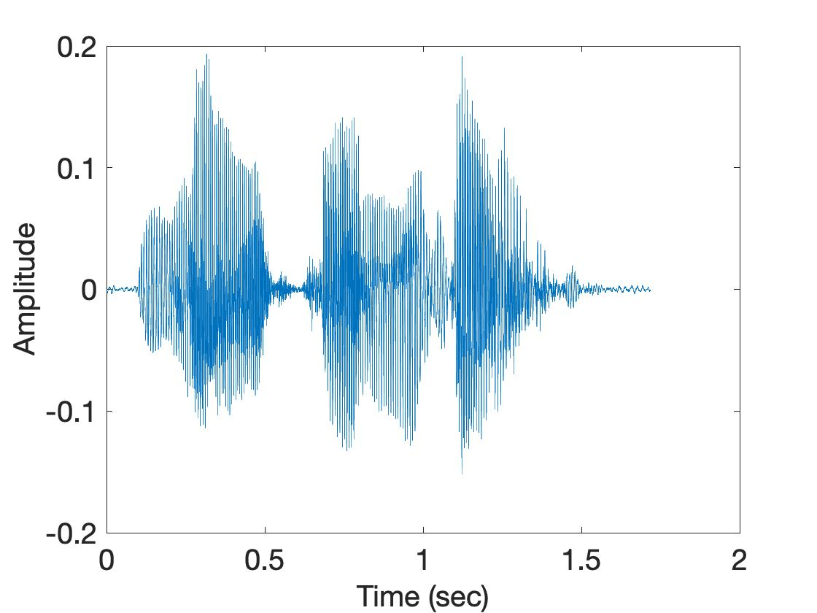
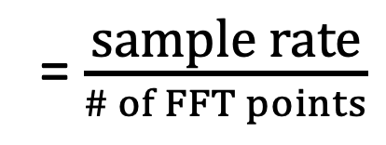
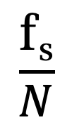
Time resolution v/s Frequency resolution
U
M
D
[
[
DFT
DFT
$$\frac{\text{f}\text{s}}{N}$$
= $\frac{\text{sample} \text{rate}}{\# of FFT points}$
How can we increase the frequency resolution?
How can we increase the time resolution?

Slide 60
Aliasing

Slide 61
Sampling theorem
Amplitude
Time (sec)
0.00
0.25
0.50
0.75
1.00
1.25
Amplitude
Time (sec)
0.00
0.25
0.50
0.75
1.00
1.25
Aliasing: Two signals become indistinguishable after sampling

Slide 62
Time domain samples
Amplitude
Time (sec)
0.00
0.25
0.50
0.75
1.00
1.25
FFT
Amplitude
-6
-4
-2
0
2
4
6
8
Frequency (Hz)
Frequency domain

Slide 63
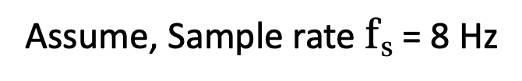
Aliasing: Different frequencies, same name!!
Magnitude/Phase of z_{m}
-4
-3
-2
-1
m = 0
1
2
3
4
Frequency
Assume, Sample rate $\text{f}\text{s}$ = 8 Hz
For a COMPLEX signal, what value will we see if the actual frequency is:
a) 3 Hz
b) -2 Hz
c) 6 Hz
d) -5 Hz
e) 4 Hz and -4Hz

Slide 64
Magnitude/Phase of z_{m}
-4
-3
-2
-1
m = 0
1
2
3
4
Frequency
5
6
7
8

Slide 65
Magnitude/Phase of z_{m}
-4
-3
-2
-1
m = 0
1
2
3
4
Frequency
5
6
7
8

Slide 66
Magnitude/Phase of z_{m}
-4
-3
-2
-1
m = 0
1
2
3
4
Frequency
0
- F_{s}/4
F_{s}/4
F_{s}/2

Slide 67
Aliasing: Different frequencies, same name!!
Magnitude/Phase of z_{m}
-4
-3
-2
-1
m = 0
1
2
3
4
Frequency
Assume, Sample rate $\text{f}\text{s}$ = 8 Hz
For a COMPLEX signal, what value will we see if the actual frequency is:
a) 3 Hz
b) -2 Hz
c) 6 Hz
d) -5 Hz
e) 4 Hz and -4Hz

Slide 68
Aliasing: Different frequencies, same name!!
Magnitude/Phase of z_{m}
-4
-3
-2
-1
m = 0
1
2
3
4
Frequency
Assume, Sample rate $\text{f}\text{s}$ = 8 Hz
For a REAL signal, what value will we see if the actual frequency is:
a) 3 Hz
b) -2 Hz
c) 6 Hz
d) -5 Hz
e) 4 Hz and -4Hz

Slide 69
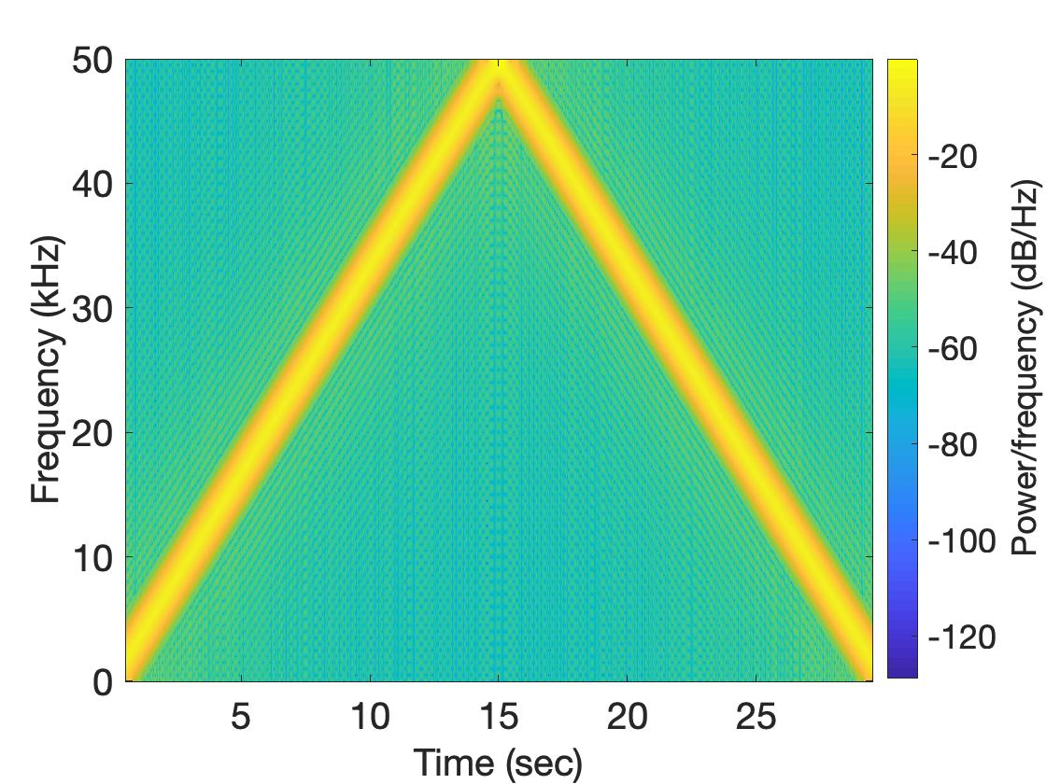
Aliasing: Spectrogram of increasing frequency

Slide 70
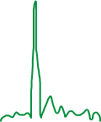

Calculating the aliased frequency value for real signals
Sampling frequency = 10Hz
Nyquist frequency = 5Hz
Amplitude
0
2
4
6
8
Frequency (Hz)

Slide 71

Calculating the aliased frequency value for real signals
Sampling frequency = 10Hz
Nyquist frequency = 5Hz
Amplitude
Received
signal
Amplitude
0
2
4
6
8
0
2
4
6
8
Frequency (Hz)
Frequency (Hz)

Slide 72
Calculating the aliased frequency value for real signals
Sampling frequency = 10Hz
Nyquist frequency = 5Hz
Amplitude
Received
signal
Amplitude
0
2
4
6
8
0
2
4
6
8
Frequency (Hz)
Frequency (Hz)
f_{s} = Sampling frequency
f = Target frequency
f_{a} = Aliased(perceived) frequency
K = Non-negative integer
f_{a} = min(abs(K*f_{s} - f))

Slide 73
Aliasing: A real life scenario
Nyquist frequency
Amplitude
10k
20k
30k
40k
50k
60k
70k
80k
90k
100k
Frequency spectrum
Notes:
to amplify the signal power …
Now, this signal typically contains many more frequencies than the sampling system can handle …

Slide 74
Aliasing: A real life scenario
Nyquist frequency
Amplitude
10k
20k
30k
40k
50k
60k
70k
80k
90k
100k
Frequency spectrum
Notes:
to amplify the signal power …
Now, this signal typically contains many more frequencies than the sampling system can handle …

Slide 75
Aliasing: A real life scenario
Nyquist frequency
Amplitude
10k
20k
30k
40k
50k
60k
70k
80k
90k
100k
Frequency spectrum
We need a “Low-pass filter”
to remove unwanted high frequency signals
Notes:
to amplify the signal power …
Now, this signal typically contains many more frequencies than the sampling system can handle …

Slide 76
Anti-aliasing filter
Nyquist frequency
Amplitude
10k
20k
30k
40k
50k
60k
70k
80k
90k
100k
Frequency spectrum
Sensor
ADC
Anti-aliasing
Filter
Notes:
to amplify the signal power …
Now, this signal typically contains many more frequencies than the sampling system can handle …

Slide 77
Anti-aliasing filter
Nyquist frequency
Amplitude
10k
20k
30k
40k
50k
60k
70k
80k
90k
100k
Frequency spectrum
Sensor
ADC
Anti-aliasing
Filter
Notes:
Hence, a low pass filter…

Slide 78
Anti-aliasing filter
Anti-aliasing
filter
Amplitude
10k
20k
30k
40k
50k
60k
70k
80k
90k
100k
Frequency spectrum
Sensor
ADC
Anti-aliasing
Filter
Notes:
removes the unwanted frequencies above 24 kHz …
And ultimately, this filtered signal is sampled by an ADC to generate digital sound samples

Slide 79
Anti-aliasing filter

Slide 80
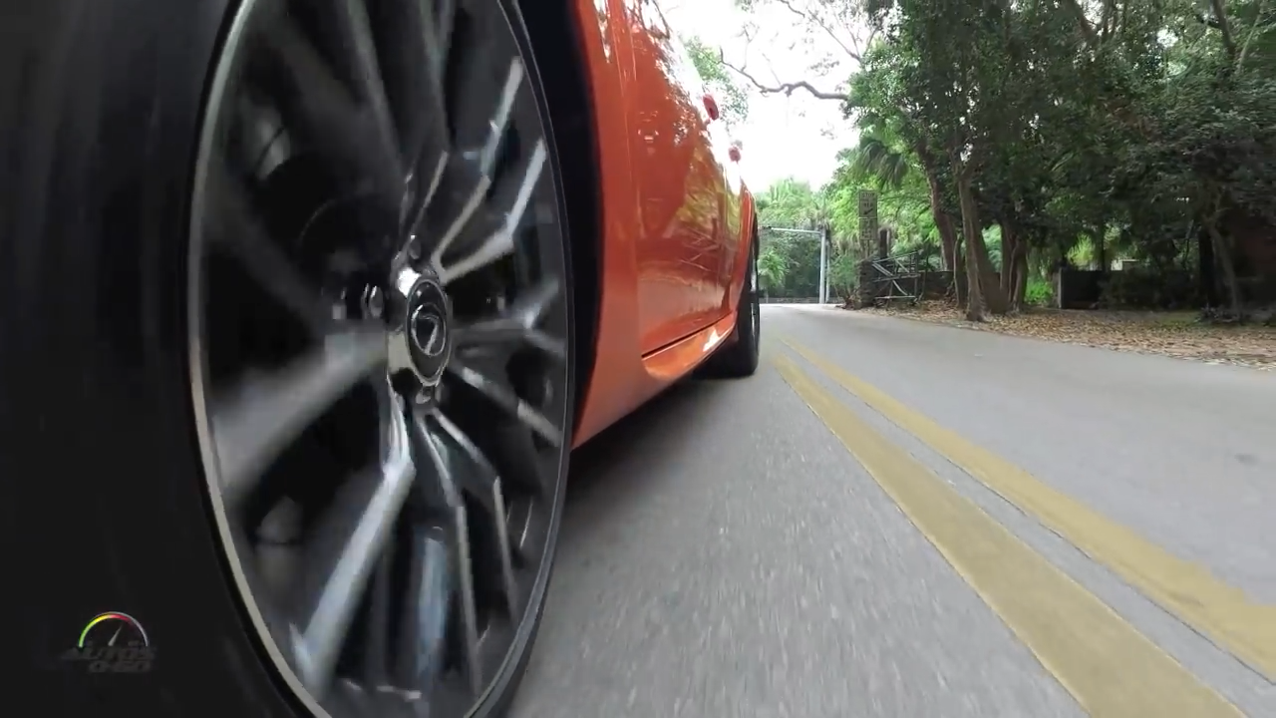
Aliasing in real life
https://www.youtube.com/watch?v=B8EMI3_0TO0

Slide 81
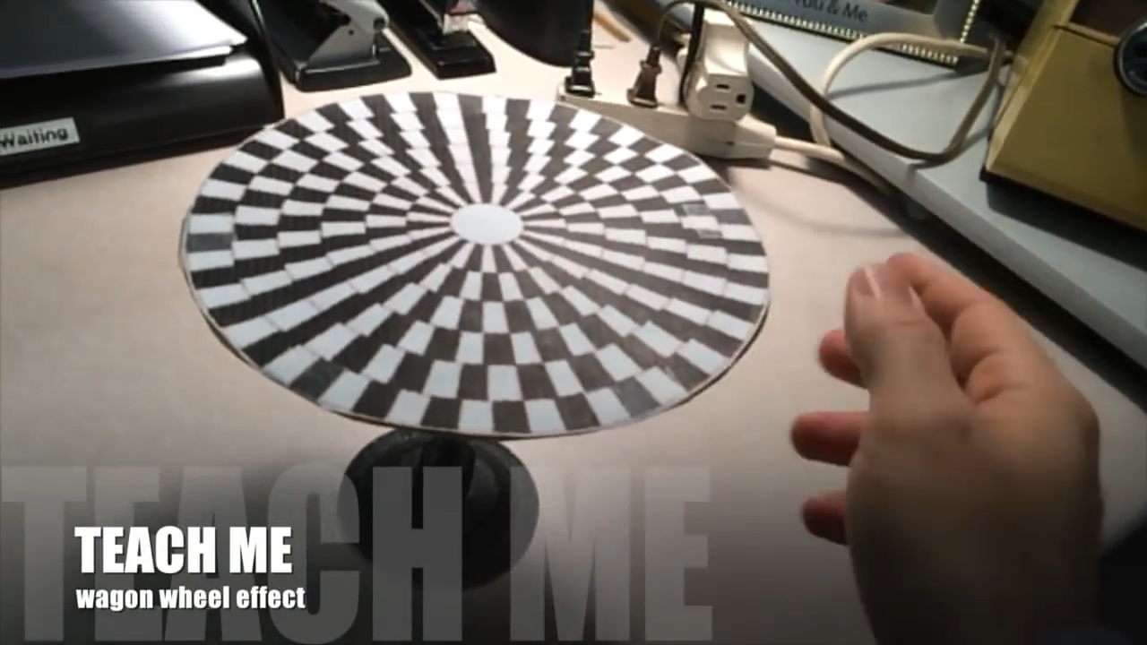
Aliasing in real life
https://www.youtube.com/watch?v=QOwzkND_ooU

