Slide 1
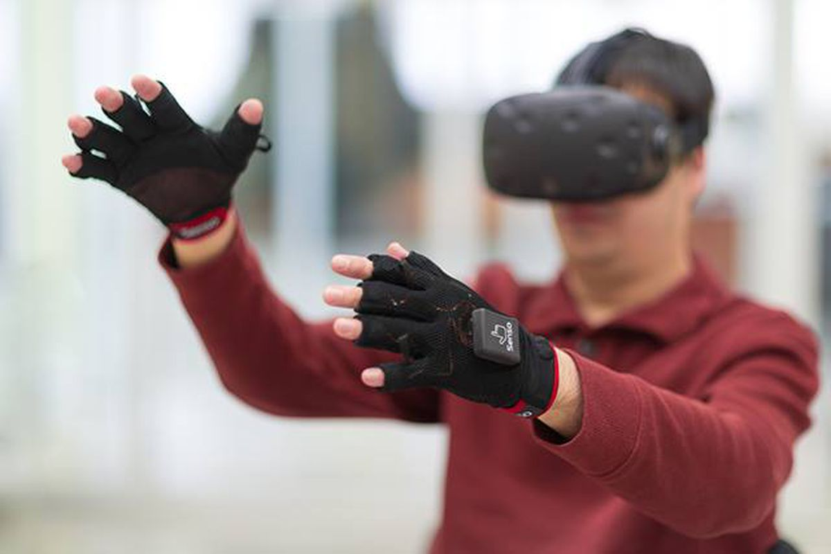
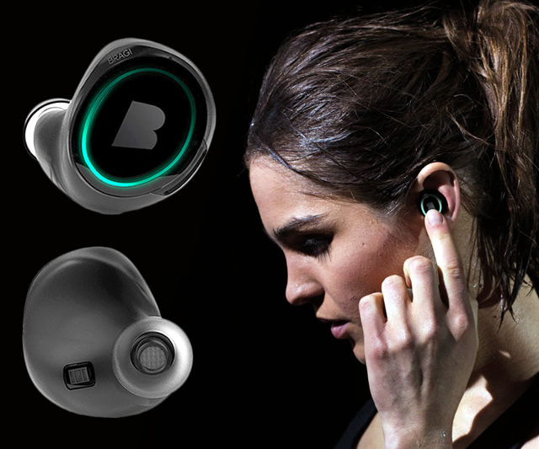
Wireless and Mobile Systems
for the IoT
CMSC 715 : Fall 2021
Lecture 1.4: Properties of the Discrete Fourier Transform
and visualizing DFT coefficients
Nirupam Roy
M-W 2:00-3:15pm
CHM 1224

Slide 2
Time Domain and Frequency Domain
Fourier Transform
$$ej 2π4t$$
FFT
Amplitude
0
2
4
6
8
Frequency (Hz)
Time domain
Frequency domain
FFT = Fast Fourier Transform
IFFT = Inverse Fast Fourier Transform

Slide 3
Time Domain and Frequency Domain
Fourier Transform
FFT
$$\cos\left(2π4t\right)$$
Amplitude
$$ej 2πft$$
$$+$$
$$e_j 2πft$$
$$=$$
2
-6
-4
-2
0
2
4
6
8
Frequency (Hz)
Time domain
Frequency domain
FFT = Fast Fourier Transform
IFFT = Inverse Fast Fourier Transform

Slide 4
Matlab demo
function fft_test()
freq = 200;
sampleRate = 1000;
time_ticks = 0:1/sampleRate:1;
realSignal = sin(2*pi*freq*time_ticks);
plot_fft(realSignal, sampleRate);
complexSignal = exp(j*2*pi*freq*time_ticks);
plot_fft(complexSignal, sampleRate);
end

Slide 5
A few more ideas…
1) Filtering frequencies
1) Filtering frequencies
2) Multiplying frequency with frequency
3) Sampling a band of frequencies

Slide 6
Matlab demo code

Slide 7
A few more ideas…
1) Filtering frequencies
2) Multiplying frequency with frequency
3) Sampling a band of frequencies

Slide 8
Multiplying two frequencies
Magnitude/Phase of z_{m}
-4
-3
-2
-1
m = 0
1
2
3
4
Frequency
Two signals with frequencies f1 and f2 are multiplied:
$$ej 2π f1 t$$
$$ej 2π f2 t$$
$$ej 2πf1 t$$
$$+$$
$$e_j 2πf1t$$
$$ej 2πf2 t$$
$$+$$
$$e_j 2πf2t$$
2
2

Slide 9
Matlab demo code

Slide 10
A few more ideas…
1) Filtering frequencies
2) Multiplying frequency with frequency
3) Sampling a band of frequencies

Slide 11
Sample Rate for a Frequency band
$$e^{j2πf1t}$$
$$e^{j2πf2t}$$
Amplitude
$${× e}^{−j2πf1t}$$
0
2
4
6
0
8
Frequency (kHz)
What should be the sample rate?

Slide 12
Sample Rate for a Frequency band
$${× e}^{−j2πf1t}$$
Amplitude
Frequency
down-conversion
Amplitude
0
2
4
6
8
0
2
4
6
8
Frequency (kHz)
Frequency (kHz)
What should be the sample rate?
Generally, bandwidth of the signal determines the sample rate.

Slide 13
Programming Assignment #1

Slide 14
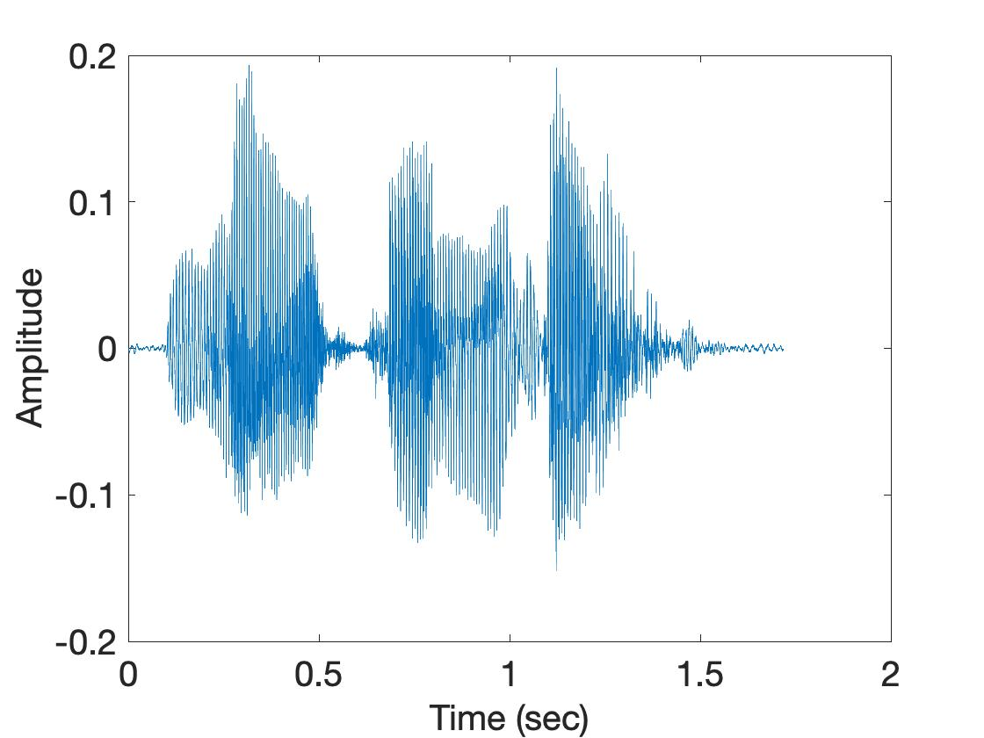
Short-time Fourier Transform (STFT)
U
M
D
[
[
[
DFT of overlapping windows
of samples
(Spectrogram/STFT)
[
DFT
DFT
DFT
DFT

Slide 15
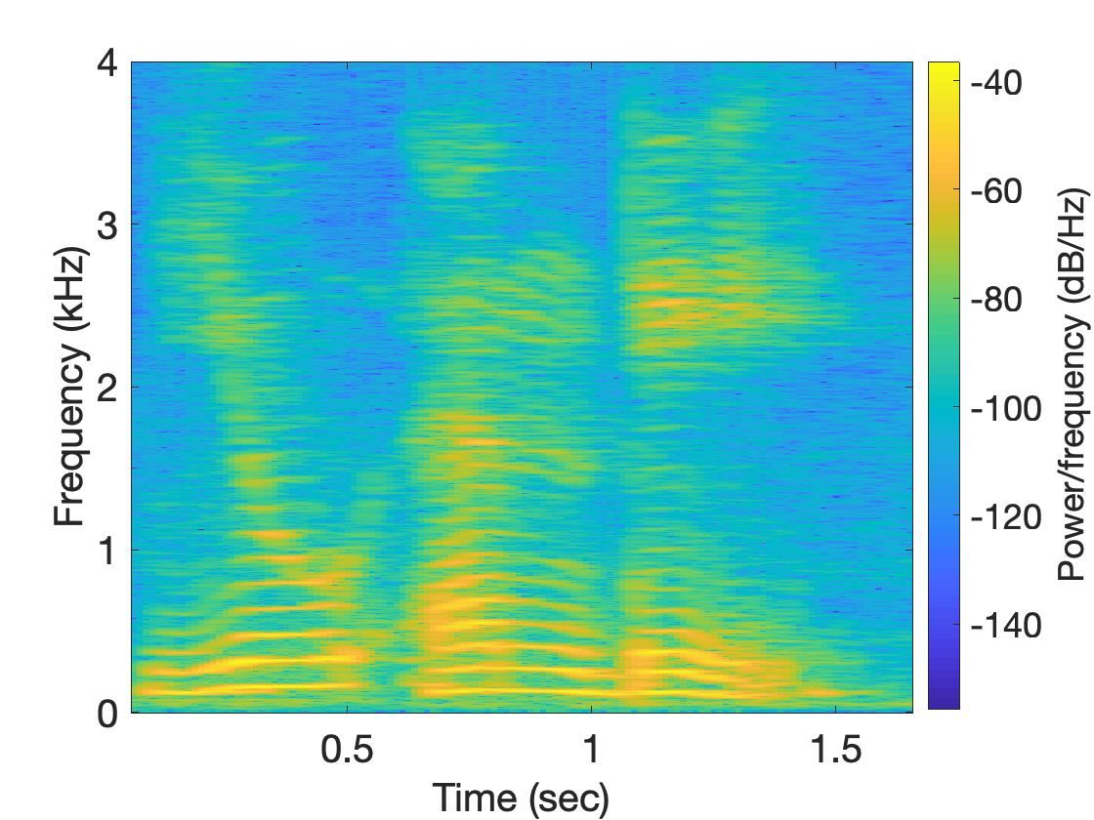
Short-time Fourier Transform (STFT)
U
M
D

Slide 16
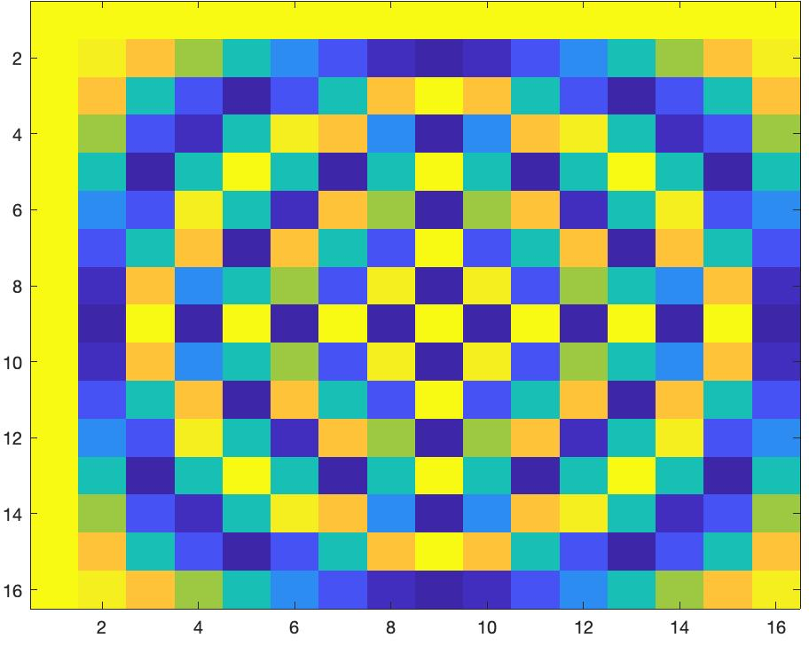
Short-time Fourier Transform (STFT)
*
_{X}
_{Z}
_{F}
=
_{F}
=
_{Matlab function: dftm(N)}
_{X}
=

Slide 17
Short-time Fourier Transform (STFT)
*
_{X}
_{Z}
_{F}
=
_{F}
_{N}
=
_{Matlab function: dftm(N)}
_{N}
_{abs(Z)}
_{X}
_{8N}
=

Slide 18
Short-time Fourier Transform (STFT)
?
_{x}
₌

