Slide 1
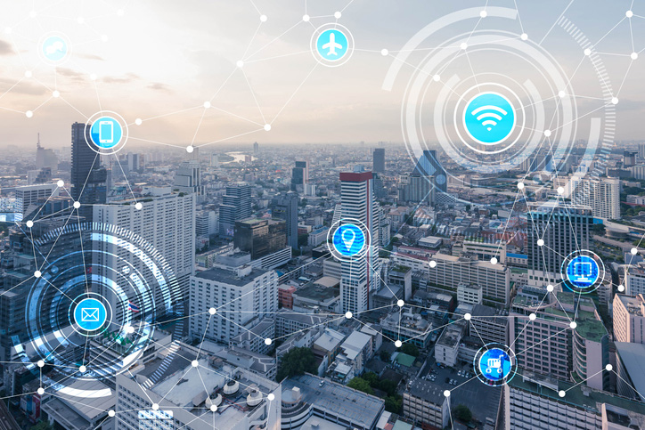
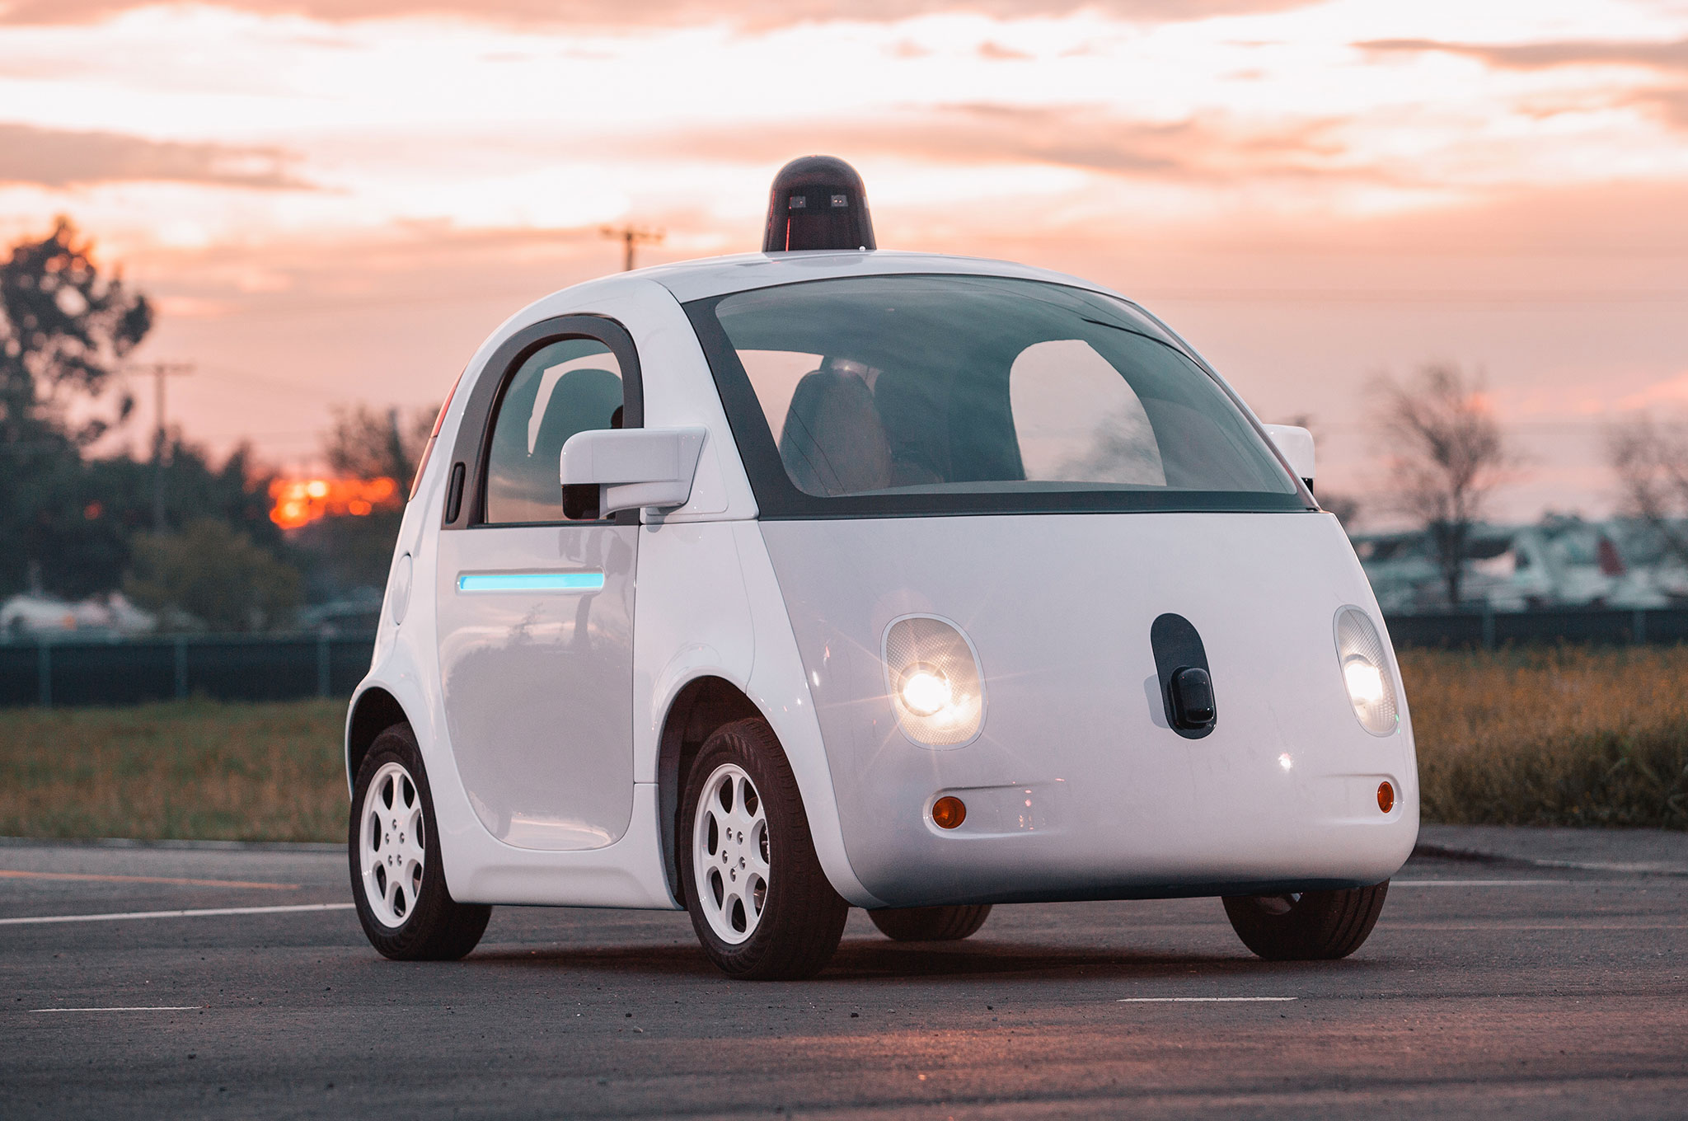
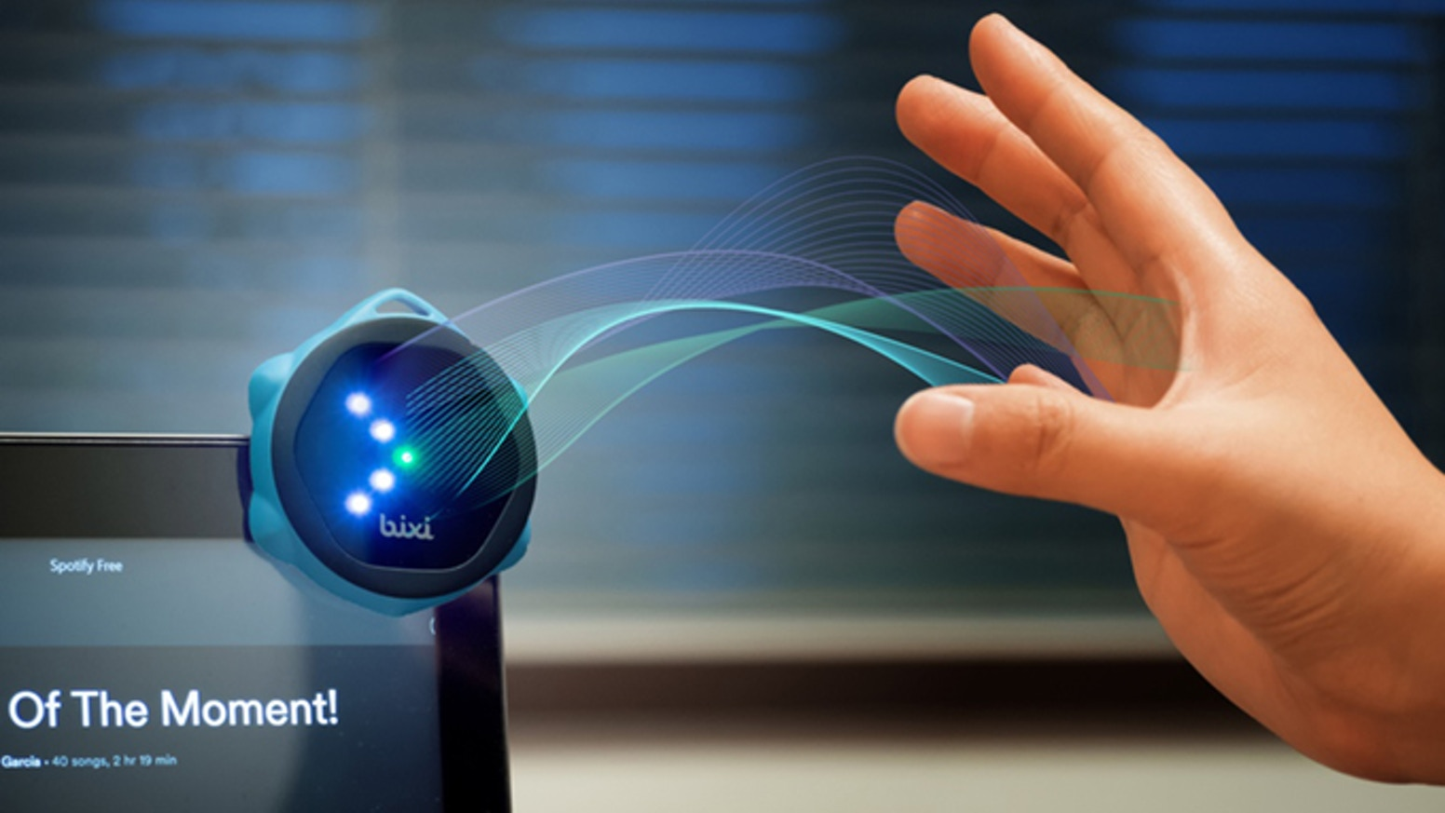
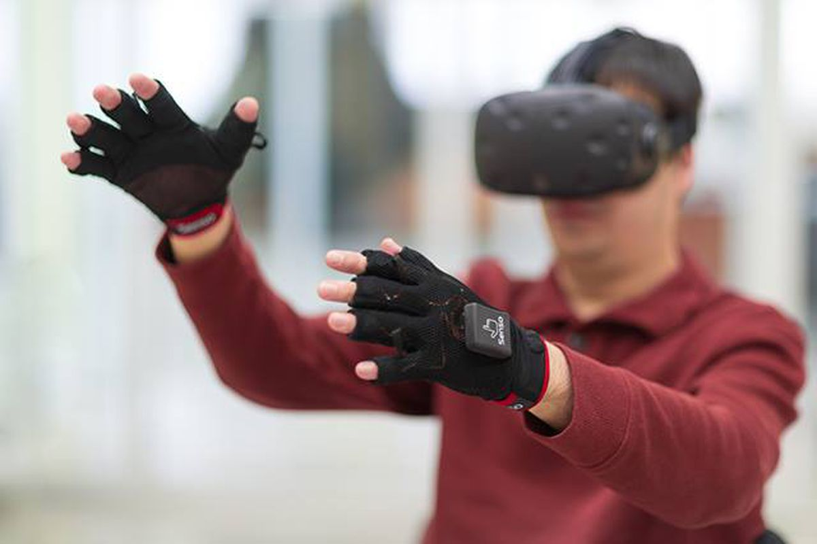

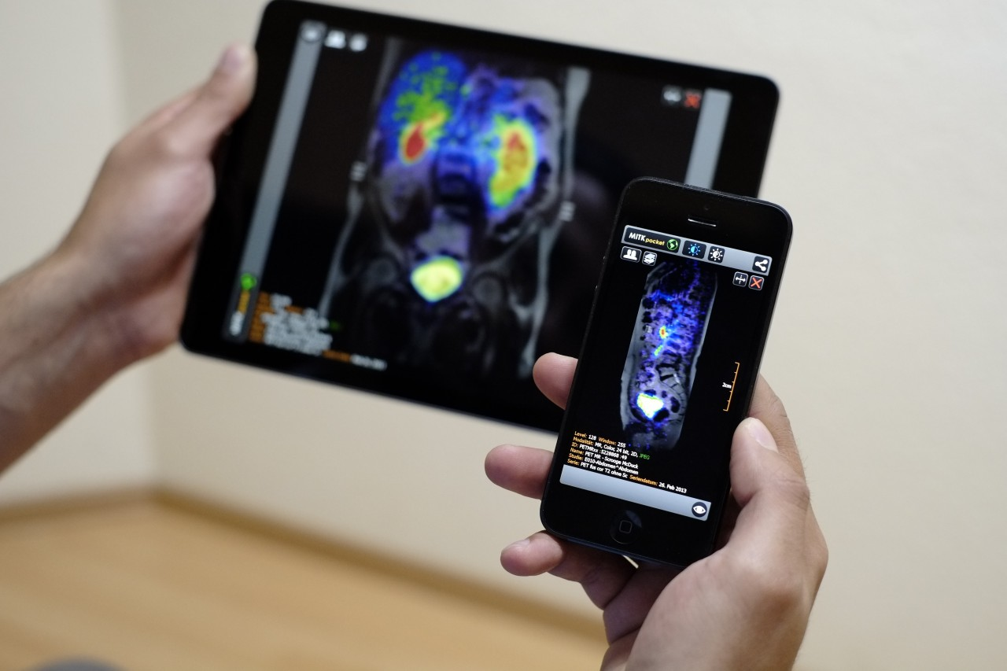
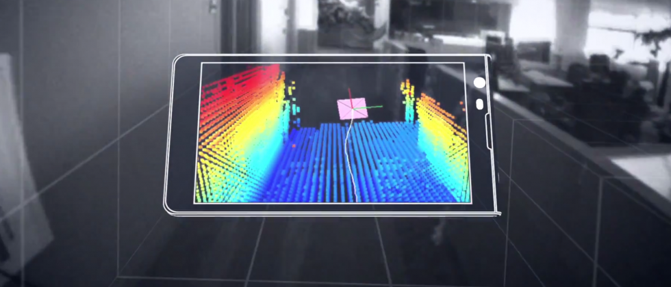
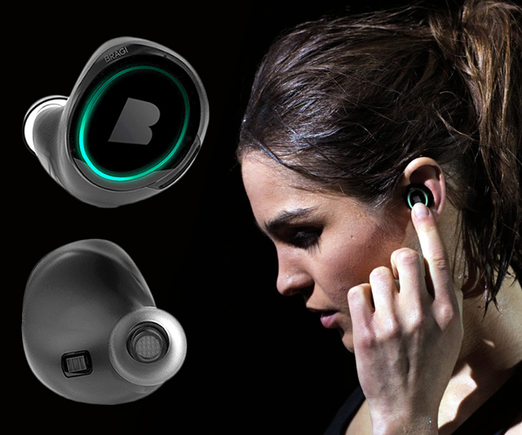
Wireless and Mobile Systems
for the IoT
CMSC 715 : Fall 2021
Lecture 2.1: Wave basics
Nirupam Roy
M-W 2:00-3:15pm
CHM 1224

Slide 2
Waves

Slide 3
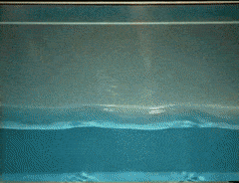
Waves: Transfer of energy, not mass

Slide 4
Sound
Visible light
Physical vibrations
WiFi signal
Ripples in water
Infrared
…
…

Slide 5
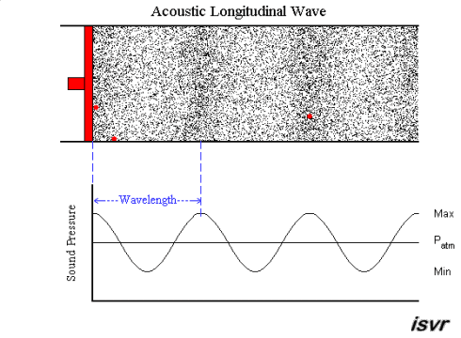
Mechanical Wave
Electromagnetic Wave
Sound
Visible light
Physical vibrations
WiFi signal
Ripples in water
Infrared
…
…

Slide 8
Waves made this possible

Slide 9
Waves made this possible

Slide 10
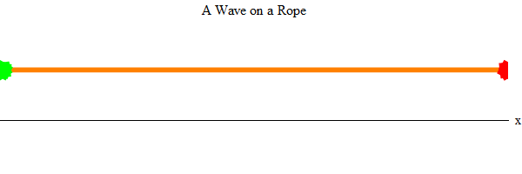
Waves properties:
frequency, amplitude, phase + speed

Slide 11
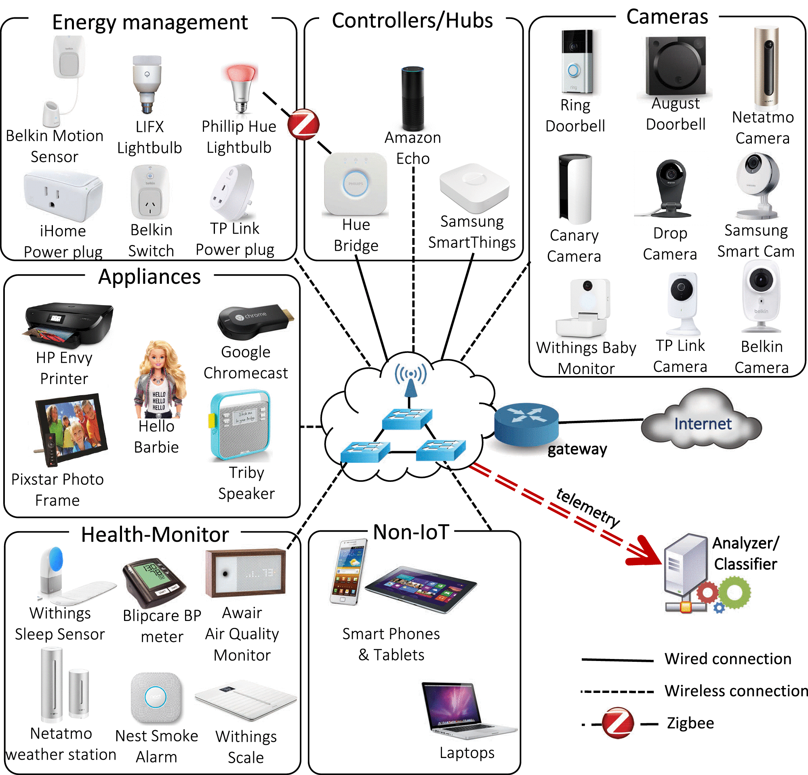
Waves made this possible

Slide 12
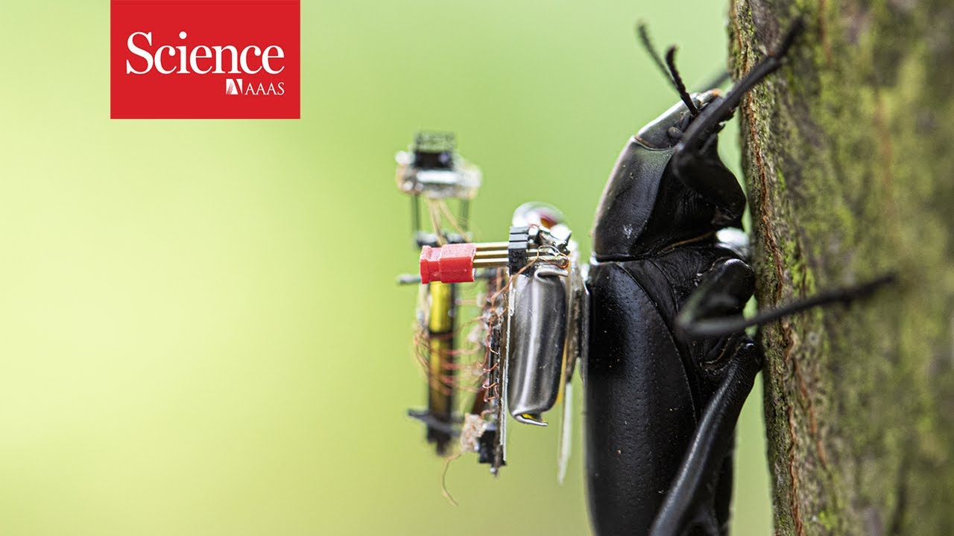
Waves made this possible

Slide 13

Waves in time and space

Slide 14
Waves in time and space
Temporal variation of the wave’s amplitude

Slide 15
Waves in time and space

Slide 16
Waves in time and space

Slide 17
Waves in time and space

Slide 18
Waves in time and space

Slide 19
Waves in time and space

Slide 20
Waves in time and space

Slide 21
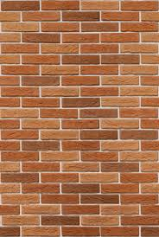
Reflection
Absorption
+
Reflection
echo

Slide 22
Reflection
Time = t1

Slide 23
Reflection
Time = t1
Absorption
+
Reflection

Slide 24
Reflection
Time = t1
Absorption
+
Reflection
echo
t2

Slide 25
Reflection
Time = t1
Absorption
+
Reflection
d
echo
t2
Sound travelled (2d) distance

Slide 26
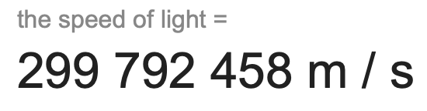
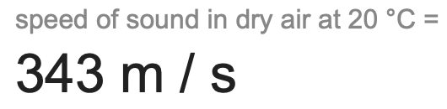
The speed of the wave is known

Slide 27
Reflection
Time = t1
Absorption
+
Reflection
d
echo
t2
Sound travelled (2d) distance
C.(t2-t1) = 2d

Slide 28
Reflection
Time = t1
Absorption
+
Reflection
d
Echolocation
echo
t2
Sound travelled (2d) distance
C.(t2-t1) = 2d

Slide 29
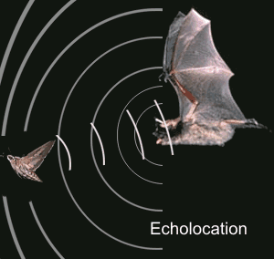
Echolocation in nature
Bat

Slide 30
Application: Contact tracing

Slide 31
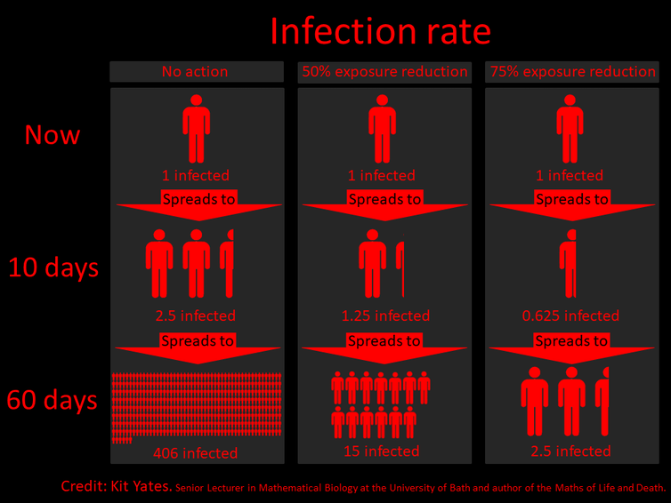

Slide 32
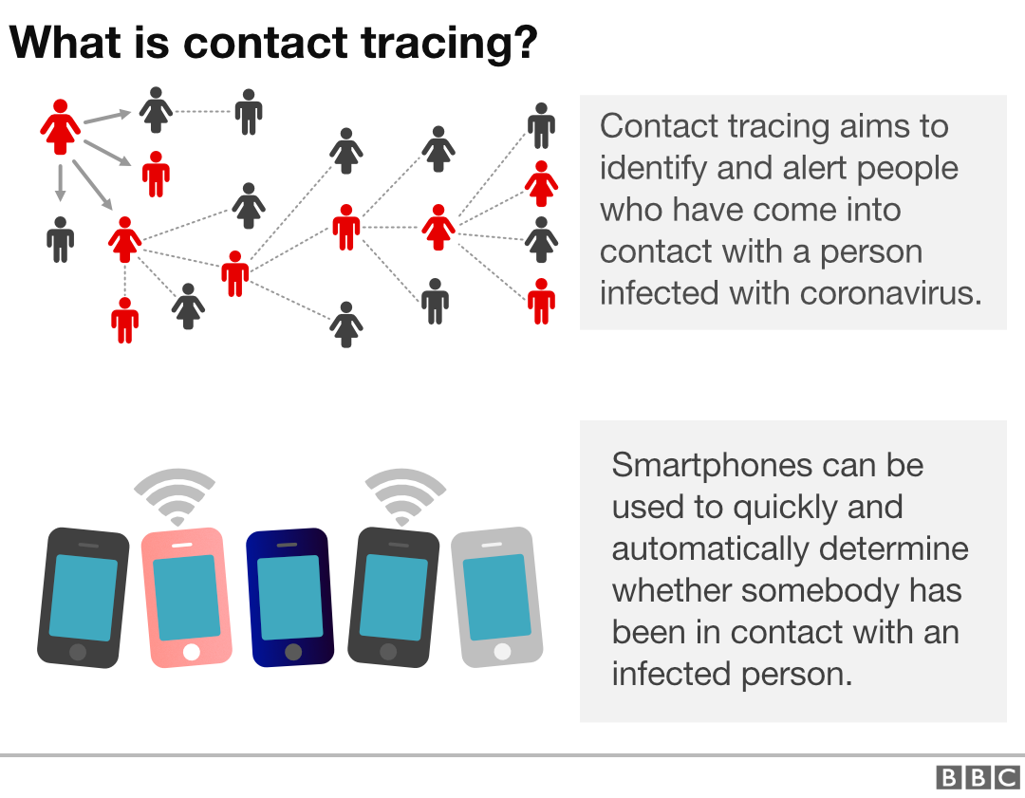
How to find the proximity between two smartphones?

Slide 33
A simple acoustic ranging technique
BeepBeep – SenSys 2007

Slide 34

Distance = d
Device A
Device B

Slide 35
Time = t1
Distance = d
Device A
Device B

Slide 36
Time = t1
Time = t2
Distance = d
Device A
Device B

Slide 37
Bluetooth/WiFi
Time = t1
Time = t1
Time = t2
Distance = d
Device A
Device B

Slide 38
Bluetooth/WiFi
Time = t1
Time = t1
Time = t2
Distance = d
Device A
Device B
d = C . (t2-t1)
C = speed of the wave
= ~340m/s for sound

Slide 39
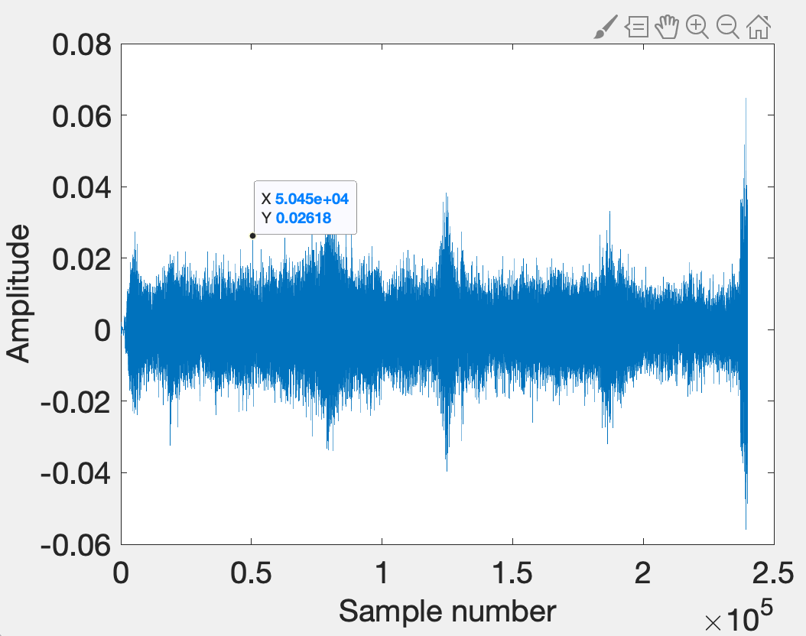

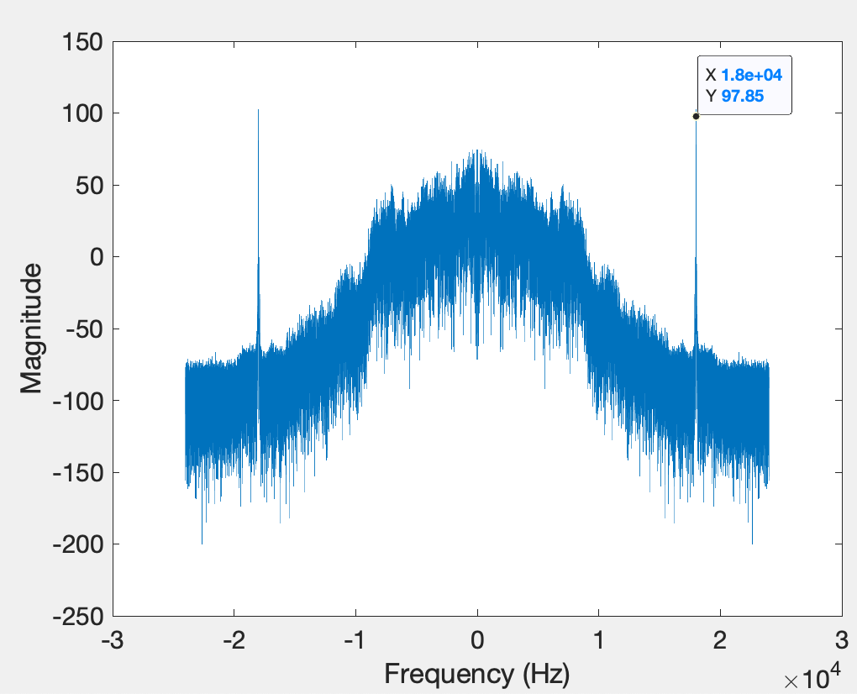
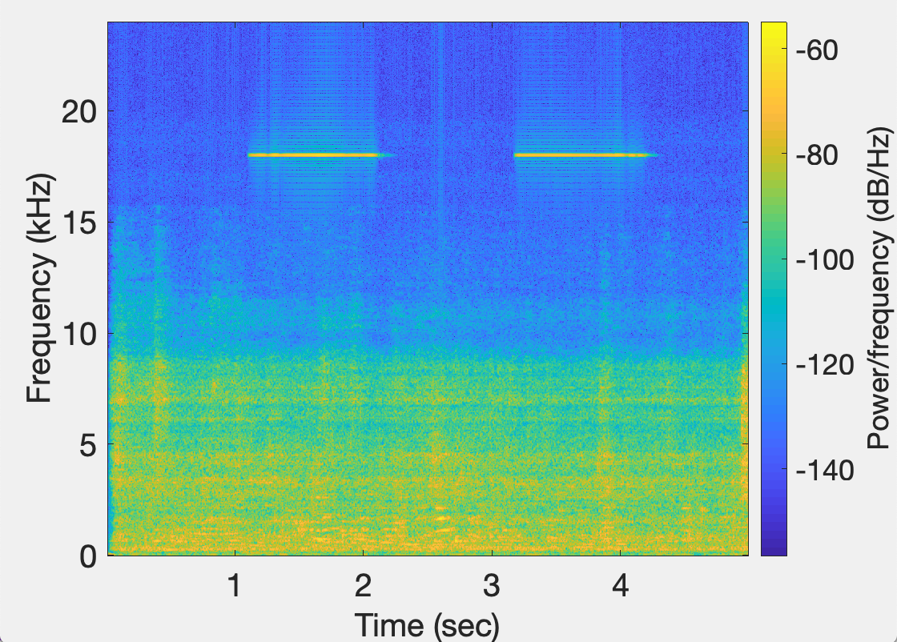
Time domain
signal
FFT Plot
Device A
STFT Plot

Slide 40
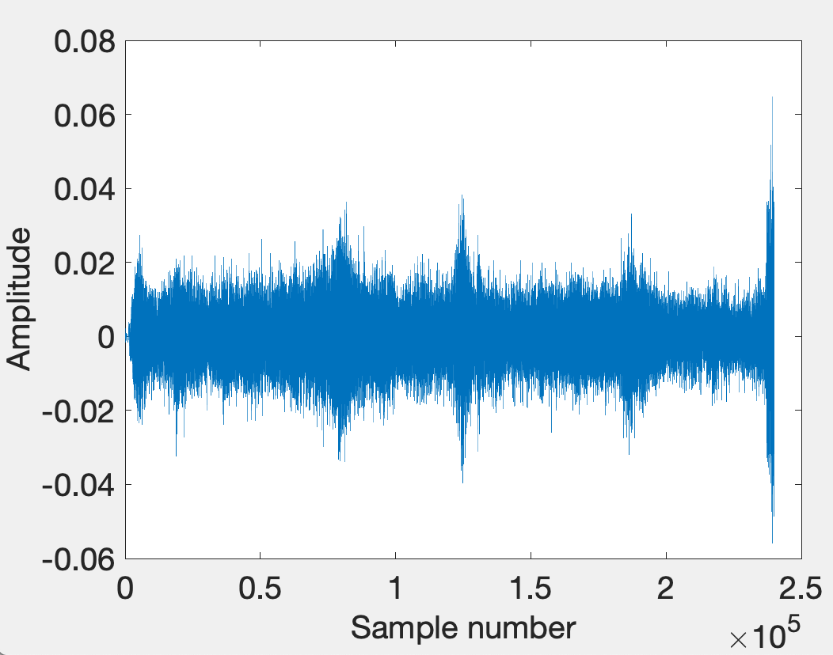
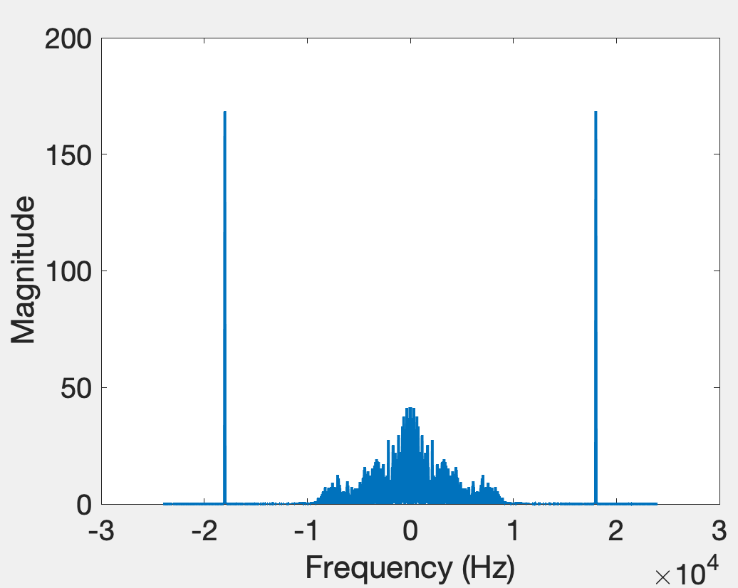
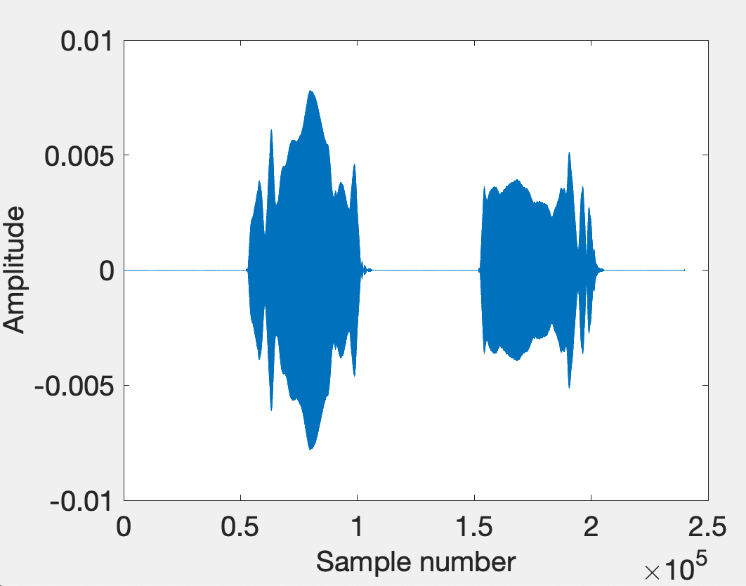
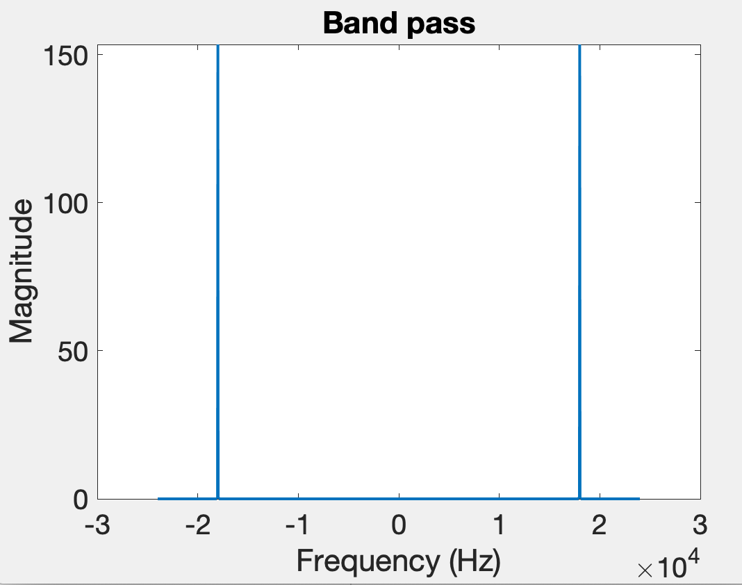
Time domain
Freq. domain
After bandpass filter

Slide 41
Bluetooth/WiFi
Time = t1
Time = t1
Time = t2
Distance = d
Problem: Synchronization
Device A
Device B
d = C . (t2-t1)

Slide 42
The root cause of inaccuracy
– three uncertainties
Clock synchronization uncertainty
time

Slide 43
The root cause of inaccuracy
– three uncertainties
Clock synchronization uncertainty
Sending uncertainty
time

Slide 44
The root cause of inaccuracy
– three uncertainties
Clock synchronization uncertainty
Sending uncertainty
Receiving uncertainty
time

Slide 45
Sound production and recording

Slide 46
Sound recording with microphone
Sound

Slide 47
Sound recording with microphone
Analog signal (voltage)
Sound
ADC
ADC = Analog-to-Digital Converter

Slide 48
Sound recording with microphone
Analog signal (voltage)
Sound
ADC
S6 S5 S4 S3 S2 S1 S0
Audio Sample Buffer
ADC = Analog-to-Digital Converter

Slide 49
Sound production with speaker
S6 S5 S4 S3 S2 S1 S0
Audio Sample Buffer

Slide 50
Sound production with speaker
S6 S5 S4 S3 S2 S1 S0
Analog signal (voltage)
Audio Sample Buffer
DAC
DAC = Digital-to-Analog Converter

Slide 51

Sound production with speaker
S6 S5 S4 S3 S2 S1 S0
Analog signal (voltage)
Audio Sample Buffer
DAC
Sound
DAC = Digital-to-Analog Converter

Slide 52
The root cause of inaccuracy
– three uncertainties
Clock synchronization uncertainty
Sending uncertainty
software issuing command
...
t0 = wall_clock();
write(sound_dev, signal);
...
time

Slide 53

The root cause of inaccuracy
– three uncertainties
Clock synchronization uncertainty
Sending uncertainty
software issuing command
...
t0 = wall_clock();
write(sound_dev, signal);
...
unknown delays (software, system, driver, hardware, …) ?
sound leaves
speaker
time

Slide 54
The root cause of inaccuracy
– three uncertainties
Clock synchronization uncertainty
Sending uncertainty
Receiving uncertainty
software issuing command
...
t0 = wall_clock();
write(sound_dev, signal);
...
unknown delays (software, system, driver, hardware, …) ?
sound leaves
speaker
time

Slide 55

The root cause of inaccuracy
– three uncertainties
Clock synchronization uncertainty
Sending uncertainty
Receiving uncertainty
software issuing command
...
t0 = wall_clock();
write(sound_dev, signal);
...
unknown delays (software, system, driver, hardware, …) ?
sound leaves
speaker
sound
reaches mic
time

Slide 56
The root cause of inaccuracy
– three uncertainties
Clock synchronization uncertainty
Sending uncertainty
Receiving uncertainty
software issuing command
...
t0 = wall_clock();
write(sound_dev, signal);
...
unknown delays (software, system, driver, hardware, …) ?
sound leaves
speaker
sound
reaches mic
unknown delays (hardware, interrupt, driver, scheduling, …) ?
time

Slide 57
The root cause of inaccuracy
– three uncertainties
Clock synchronization uncertainty
Sending uncertainty
Receiving uncertainty
software issuing command
software aware of arrival
...
t0 = wall_clock();
write(sound_dev, signal);
...
...
read(sound_dev, signal);
t1 = wall_clock();
...
unknown delays (software, system, driver, hardware, …) ?
sound leaves
speaker
sound
reaches mic
unknown delays (hardware, interrupt, driver, scheduling, …) ?
time

Slide 58



Beepbeep’s basic procedure
Device A emits a beep while both recording
Device B emits another beep while both continue recording
Both devices detect TOA of the two beeps and obtain respective ETOAs
Exchange ETOAs and calculate the distance
Device A
Device B
A’s recording
B’s recording
ETOA_{A}
ETOA_{B}
D_{AB}=|ETOA_{A}-ETOA_{B}|/2

Slide 59
Timeline
Device A
Device B

Slide 60

Timeline
Device A
Device B
1st Beep
t_{A0}

Slide 61
Timeline
Device A
Device B
1st Beep
t_{A0}
t_{A1}
t_{B1}

Slide 62

Timeline
Device A
Device B
1st Beep
t_{A0}
t_{A1}
t_{B1}
2nd Beep
t_{B2}

Slide 63
Timeline
Device A
Device B
1st Beep
t_{A0}
t_{A1}
t_{B1}
2nd Beep
t_{B2}
t_{B3}
t_{A3}

Slide 64
Timeline
Device A
Device B
1st Beep
t_{A0}
t_{A1}
t_{B1}
ETOA_{A}
2nd Beep
t_{B2}
t_{B3}
t_{A3}

Slide 65
Timeline
Device A
Device B
1st Beep
t_{A0}
t_{A1}
t_{B1}
ETOA_{B}
ETOA_{A}
2nd Beep
t_{B2}
t_{B3}
t_{A3}

Slide 66
Timeline
Device A
Device B
1st Beep
t_{A0}
t_{A1}
P
t_{B1}
ETOA_{B}
ETOA_{A}
2nd Beep
t_{B2}
t_{B3}
t_{A3}

Slide 67
Timeline
Device A
Device B
1st Beep
t_{A0}
t_{A1}
P
t_{B1}
ETOA_{B}
ETOA_{A}
2nd Beep
t_{B2}
t_{B3}
P
t_{A3}

Slide 68
Timeline
Device A
Device B
1st Beep
t_{A0}
t_{A1}
P
t_{B1}
ETOA_{B}
Q
ETOA_{A}
2nd Beep
t_{B2}
t_{B3}
P
t_{A3}

Slide 69
Timeline
Device A
Device B
1st Beep
t_{A0}
t_{A1}
P
t_{B1}
ETOA_{B}
Q
|ETOA_{A}-ETOA_{B}|
ETOA_{A}
2nd Beep
t_{B2}
= (P+Q+P) – (Q)
t_{B3}
P
t_{A3}

Slide 70
Timeline
Device A
Device B
1st Beep
t_{A0}
t_{A1}
P
t_{B1}
ETOA_{B}
Q
|ETOA_{A}-ETOA_{B}|
ETOA_{A}
2nd Beep
t_{B2}
= (P+Q+P) – (Q)
t_{B3}
= 2P
P
t_{A3}
= 2 (time of flight)

Slide 71
Fine-grained distance measurement
Equation of waves in time and space

Slide 72
Equation of waves in time and space

Slide 73
Equation of waves in time and space
Temporal variation of the wave’s amplitude

Slide 74
Equation of waves in time and space

Slide 75
Frequency, Amplitude, and Phase

Slide 76
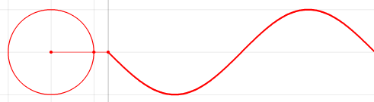


Frequency, Amplitude, and Phase
Time
$$f cycles per second$$
$$2π angles per cycle$$

Slide 77
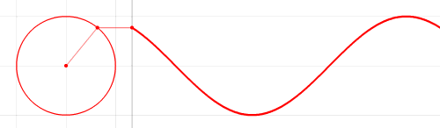
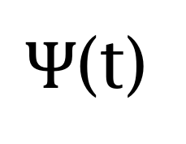
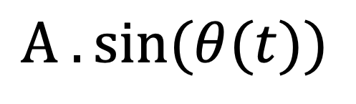


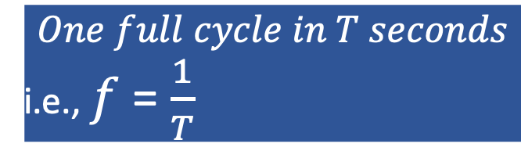
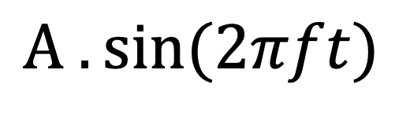
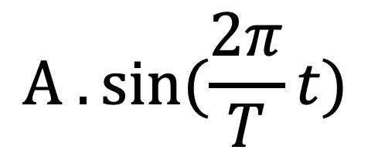

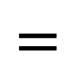
Frequency, Amplitude, and Phase
$$2π angles per cycle$$
$$f cycles per second$$
$$One full cycle in T seconds$$
i.e., $f$ = $\frac{1}{T}$
A
𝚹
Phase
time = t second
$Ψ$(t)
$$=$$
$$A . sin⁡(θ(t))$$
$$A . sin⁡(\frac{2π}{T}t)$$
$$=$$
$$A . sin⁡(2πft)$$
$$=$$

Slide 78
Equation of waves in time and space

Slide 79
Equation of waves in time and space

Slide 80
Equation of waves in time and space

Slide 81


Equation of waves in time and space
$$distance from the source (x)$$
$$space$$

Slide 82
Equation of waves in time and space
Amplitude here
$$distance from the source (x)$$
$$space$$
is a delayed version of
the amplitude here.

Slide 83
Equation of waves in time and space
Amplitude here
$$distance from the source (x)$$
$$space$$
is a delayed version of
the amplitude here.

Slide 84
Equation of waves in time and space
Amplitude here
The delay depends
on the distance.
$$distance from the source (x)$$
$$space$$
is a delayed version of
the amplitude here.

Slide 85


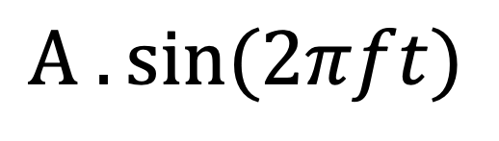
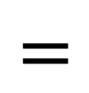
Equation of waves in time and space
Amplitude here
The delay depends
on the distance.
$$distance from the source (x)$$
$$space$$
is a delayed version of
the amplitude here.
$$A . sin⁡(\frac{2π}{T}t)$$
$Ψ$(t)
$$=$$
$$A . sin⁡(2πft)$$
$$=$$

Slide 86
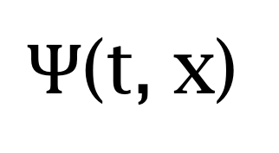
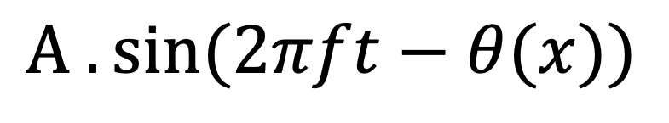
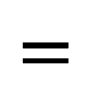
Equation of waves in time and space
Amplitude here
The delay depends
on the distance.
$$distance from the source (x)$$
$$space$$
is a delayed version of
the amplitude here.
$Ψ$(t, x)
$$=$$
$$A . sin⁡(2πft−θ(x))$$
Why is this negative?

Slide 87
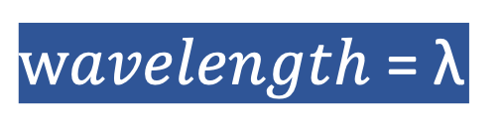
Equation of waves in time and space
$wavelength$ = λ
$$distance from the source (x)$$
$$space$$
$Ψ$(t, x)
$$=$$
$$A . sin⁡(2πft−θ(x))$$

Slide 88


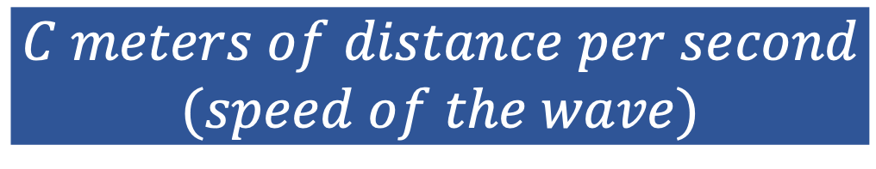
Equation of waves in time and space
$wavelength$ = λ
$$f number of cycles per second$$
$$C meters of distance per second$$
$$(speed of the wave)$$
$distance per cycle=\text{λ}$ = $C$/ $f$

