Slide 1
Wireless and Mobile Systems
for the IoT
CMSC 715 : Fall 2021
Lecture 2.3: Sensing in Time and Space – Part 2
Nirupam Roy
M-W 2:00-3:15pm
CHM 1224

Slide 2
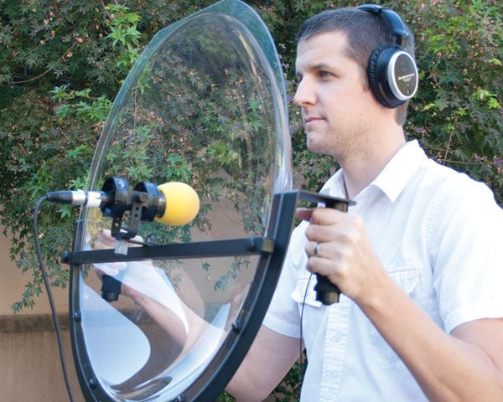
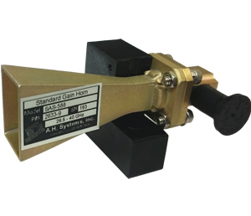
Directionality of signals: Physical guiding

Slide 3
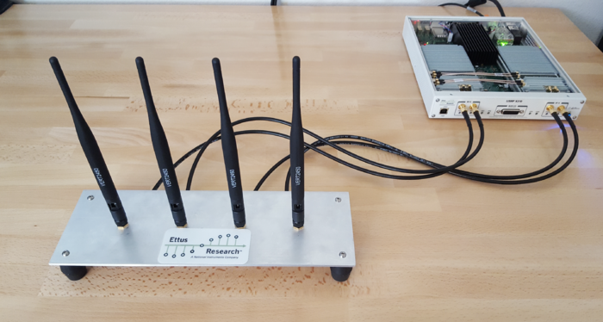
Directionality of signals: Array of sensors

Slide 4
Superimposition

Slide 5
Superimposition of sinusoids
Signal amplified
(perfect constructive interference)
$$sin⁡(2πft)$$
$$d=λ/2$$
$$\sin\left(2πft+\frac{2πd}{λ}\right)$$
= $\sin\left(2πft+π\right)$
= $− sin\left(2πft\right)$
Signal nullified
Signal nullified

Slide 6
Superimposition of sinusoids: Gain
Power gain due to the array structure
Distance from the center of the array
$$−λ/4$$
$$0$$
$$λ/4$$
$$d=λ/2$$
Constant phase difference of $\frac{2πd}{λ}$

Slide 7
Sensing with an Array

Slide 8
Sensing with an Array

Slide 9
Sensing with an Array

Slide 10
Sensing with an Array
Extra path delay
== additional phase

Slide 11
Sensing with an Array
Extra path delay
== additional phase
+
Received combined signal

Slide 12
Sensing with an Array
Extra path delay
== additional phase
+
Received combined signal

Slide 13
Sensing with an Array
Extra path delay
== additional phase
+
Received combined signal

Slide 14
Sensing with an Array
$$φ$$
Extra path delay
== additional phase
+
Received combined signal

Slide 15
Sensing with an Array
Approximation for ‘far field’

Slide 16
Sensing with an Array
Approximation for ‘far field’
Extra path delay
== additional phase

Slide 17
Sensing with an Array
Approximation for ‘far field’
$$φ$$
$d sin$($φ$)
$$d$$
+
Received combined signal

Slide 18
Sensing with an Array
Approximation for ‘far field’
$$φ$$
Along this line
$d sin$($φ$)
$$d$$
= $e^{j\left(2πft\right)}{ }+e^{j\left(2πft+ \frac{2π d sin(φ)}{λ}\right)}{ }$
Combined signal

Slide 19
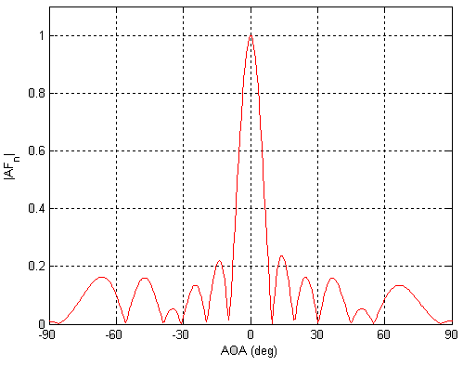
Sensing with an Array: Spatial gain
$$φ$$

Slide 20
Sensing with an Array
$$φ$$
$$d$$
+
Combined signal
= $e^{j\left(2πft\right)}{ }+e^{j\left(2πft + \frac{2π d sin(φ)}{λ}\right)}{ }$

Slide 21
Uniform Linear Array (ULA)

Slide 22
Beamforming in 2D space
$d sin$($φ$)
$$E1$$
$$E2$$
$$E3$$
$$E4$$
…
N elements
$$d$$
$$d$$
$$d$$
Interelement distance = d

Slide 23
Beamforming in 2D space
$3d sin$($φ$)
$2d sin$($φ$)
$d sin$($φ$)
$$E1$$
$$E2$$
$$E3$$
$$E4$$
…
N elements
$$d$$
$$d$$
$$d$$
Interelement distance = d

Slide 24
Beamforming in 2D space
$3d sin$($φ$)
$2d sin$($φ$)
$d sin$($φ$)
$$E1$$
$$E2$$
$$E3$$
$$E4$$
…
N elements
$$d$$
$$d$$
$$d$$
Path difference with n^{th} element:
$\left(n−1\right)d sin$($φ$)
Phase difference with n^{th} element:
$\left(n−1\right)d sin$($φ$) 2Π/λ

Slide 25
Beamforming in 2D space
$3d sin$($φ$)
$2d sin$($φ$)
$d sin$($φ$)
$$E1$$
$$E2$$
$$E3$$
$$E4$$
…
N elements
$$d$$
$$d$$
$$d$$
Interelement distance = d
Path difference with n^{th} element:
$\left(n−1\right)d sin$($φ$)
Phase difference with n^{th} element:
$\left(n−1\right)d sin$($φ$) 2Π/λ

Slide 26
$3d cos$($φ$)
$2d sin$($φ$)
Beamforming in 2D space
$d sin$($φ$)
$$E1$$
$$E2$$
$$E3$$
$$E4$$
…
N elements
$$d$$
$$d$$
$$d$$
Path difference with n^{th} element:
$\left(n−1\right)d sin$($φ$)
Phase difference with n^{th} element:
$\left(n−1\right)d sin$($φ$) 2Π/λ
Signal at 1st sensor:
$e^{j\left(2πft\right)}{ }$
Combined signal:

Slide 27
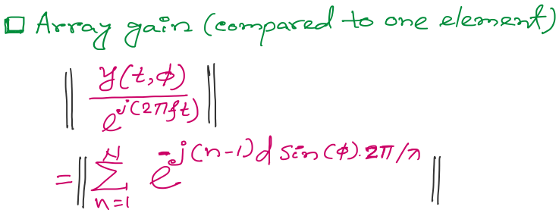
Beamforming in 2D space
f
Notes:
http://www.waves.utoronto.ca/prof/svhum/ece422/notes/15-arrays2.pdf

Slide 28
Beamforming in 2D space
Notes:
http://www.waves.utoronto.ca/prof/svhum/ece422/notes/15-arrays2.pdf

Slide 29
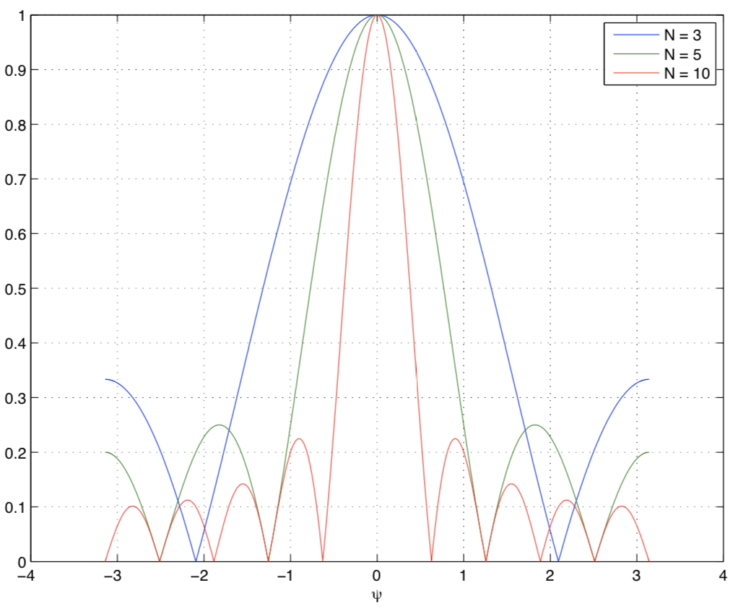
Beamforming in 2D space
Gain
-90 -60 -30 0 30 60 90
Angle
Notes:
http://www.waves.utoronto.ca/prof/svhum/ece422/notes/15-arrays2.pdf

Slide 30
Beamforming in 2D space
Notes:
http://www.waves.utoronto.ca/prof/svhum/ece422/notes/15-arrays2.pdf

Slide 31
Beamforming in 2D space: Broadside vs. Endfire

Slide 32
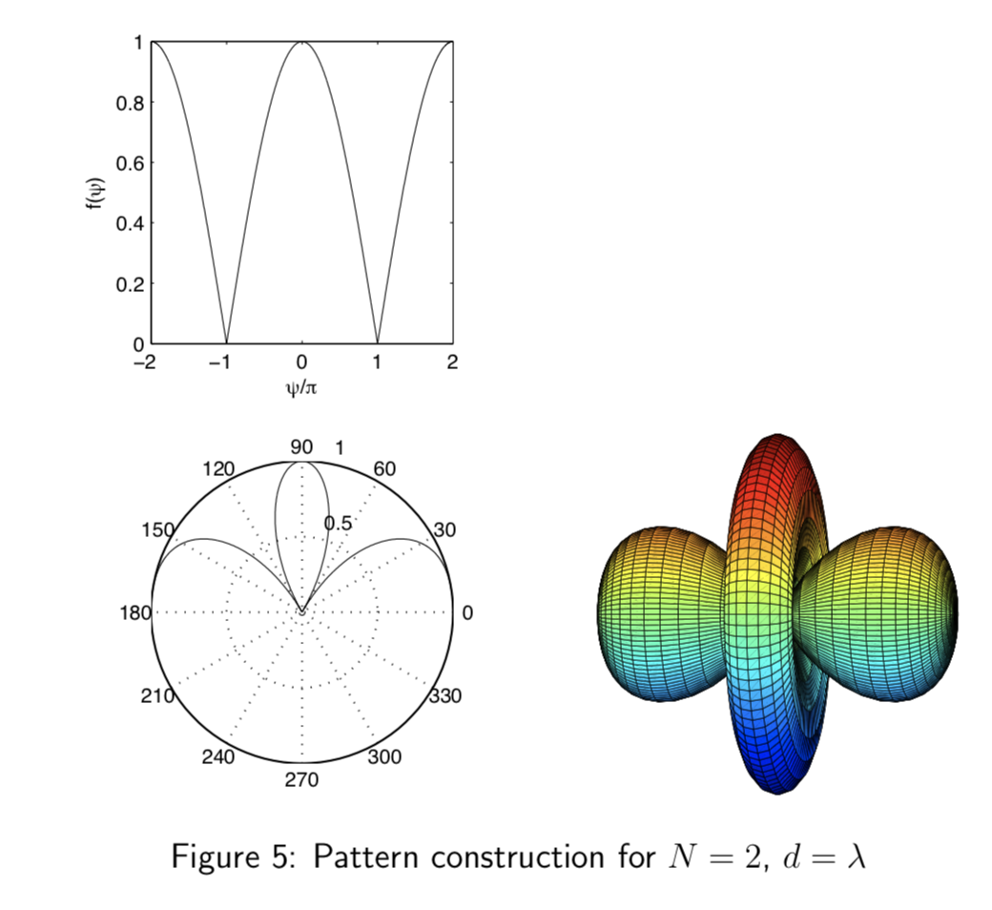
Beamforming in 2D space
Notes:
http://www.waves.utoronto.ca/prof/svhum/ece422/notes/15-arrays2.pdf

Slide 33
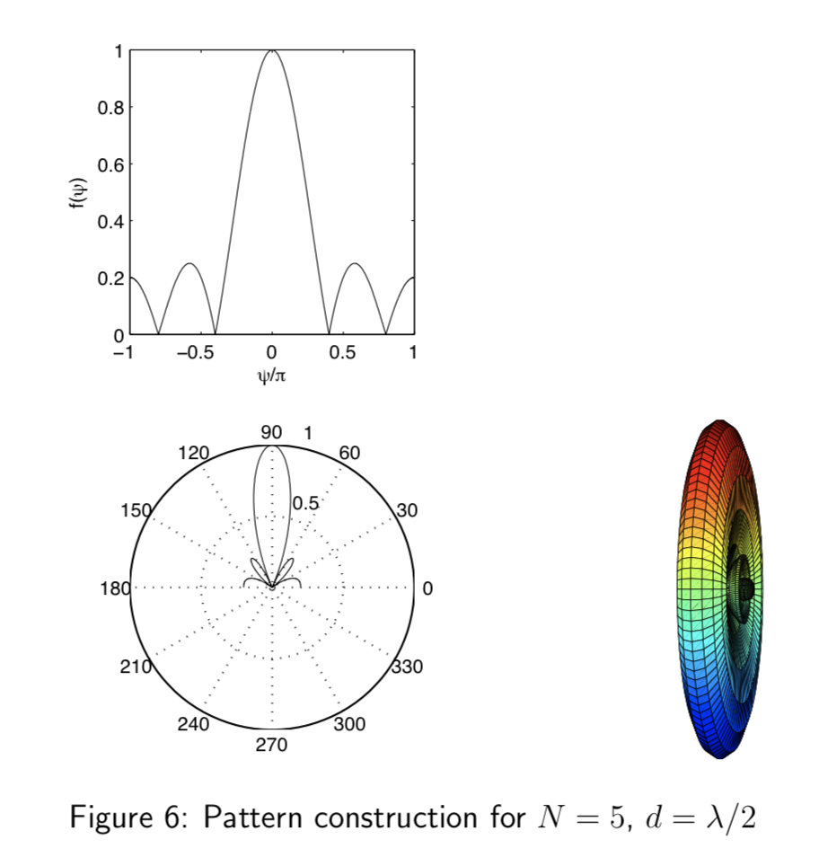
Beamforming in 2D space
Notes:
http://www.waves.utoronto.ca/prof/svhum/ece422/notes/15-arrays2.pdf

Slide 34
Beamforming in 2D space

Slide 35
Sensing with an Array
$$φ$$
$$d$$
Extra phase-1
Extra phase-2
+
Combined signal

Slide 36
Sensing with an Array
$$φ$$
$$d$$
Extra phase-1
Extra phase-2
= $e^{jΘ2}{ }$
= $e^{jΘ1}{ }$
+
= $e^{j\left(2πft\right)}{ }+e^{j\left(2πft + \frac{2π d sin(φ)}{λ}\right)}{ }$

Slide 37
Sensing with an Array
$$φ$$
$$d$$
Extra phase-1
Extra phase-2
= $e^{jΘ2}{ }$
= $e^{jΘ1}{ }$
+
= $e^{j\left(2πft+Θ1\right)}{ }+e^{j\left(2πft + \frac{2π d sin(φ)}{λ}+Θ2\right)}{ }$

Slide 38
Beam-steering
Delay-sum beamformer or Phased array
Notes:
http://www.waves.utoronto.ca/prof/svhum/ece422/notes/15-arrays2.pdf

Slide 39
Beam-steering
Phased array
Add additional phase:
$−\left(n−1\right)d sin$(𝚹_{s}) 2Π/λ
Notes:
http://www.waves.utoronto.ca/prof/svhum/ece422/notes/15-arrays2.pdf

Slide 40
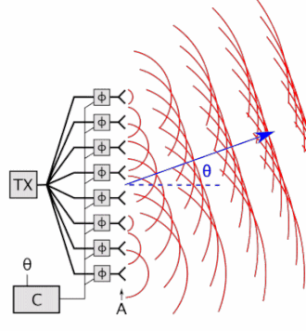
Beam-steering
Delay-sum beamformer or Phased array
Notes:
http://www.waves.utoronto.ca/prof/svhum/ece422/notes/15-arrays2.pdf

Slide 41
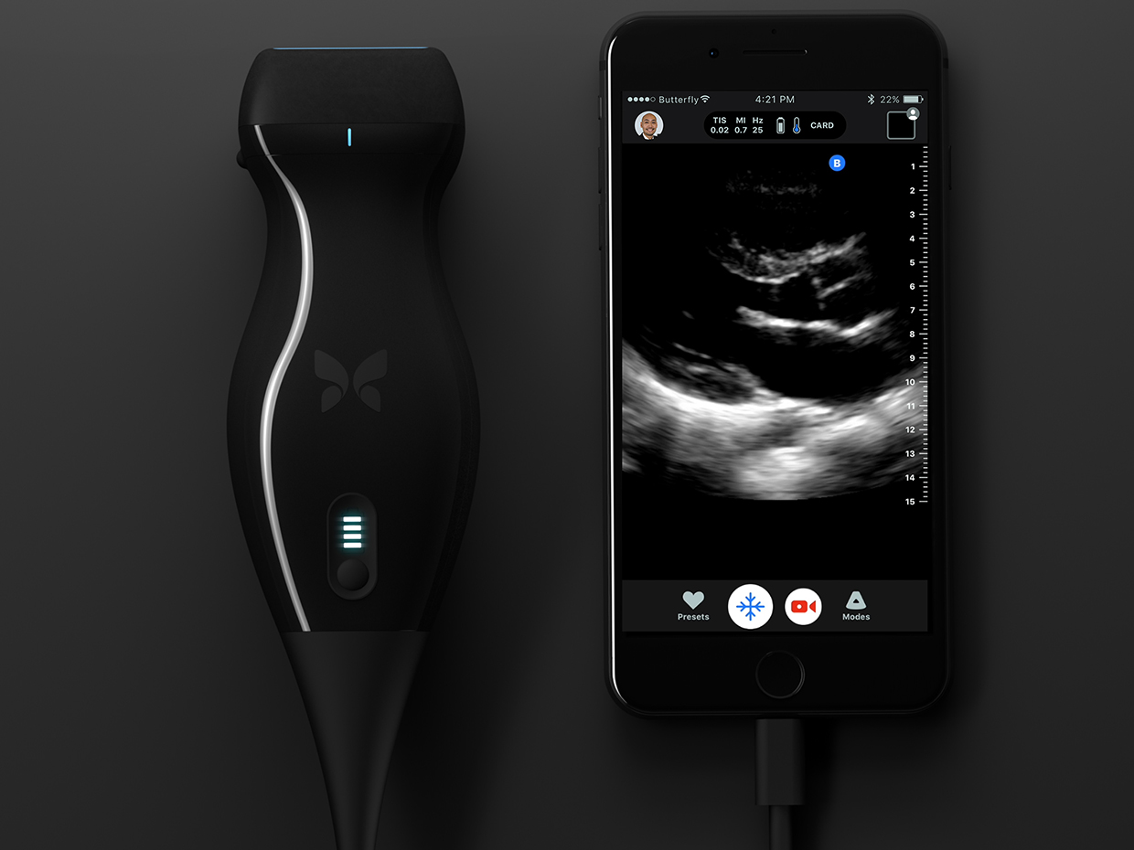
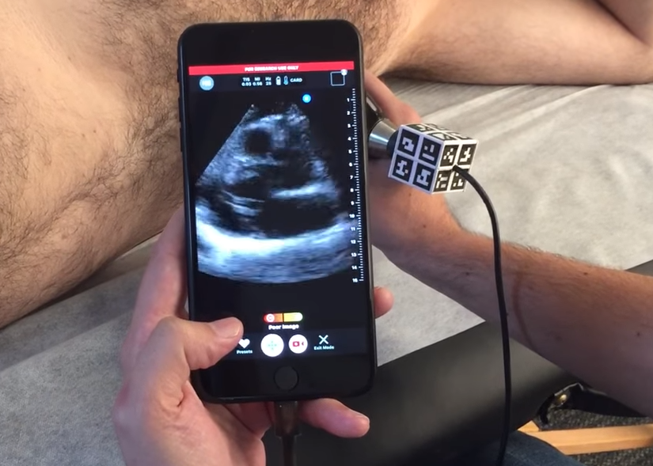

Slide 42
Gain pattern calculation
Matlab demo
The demo is released as a video

