Slide 1

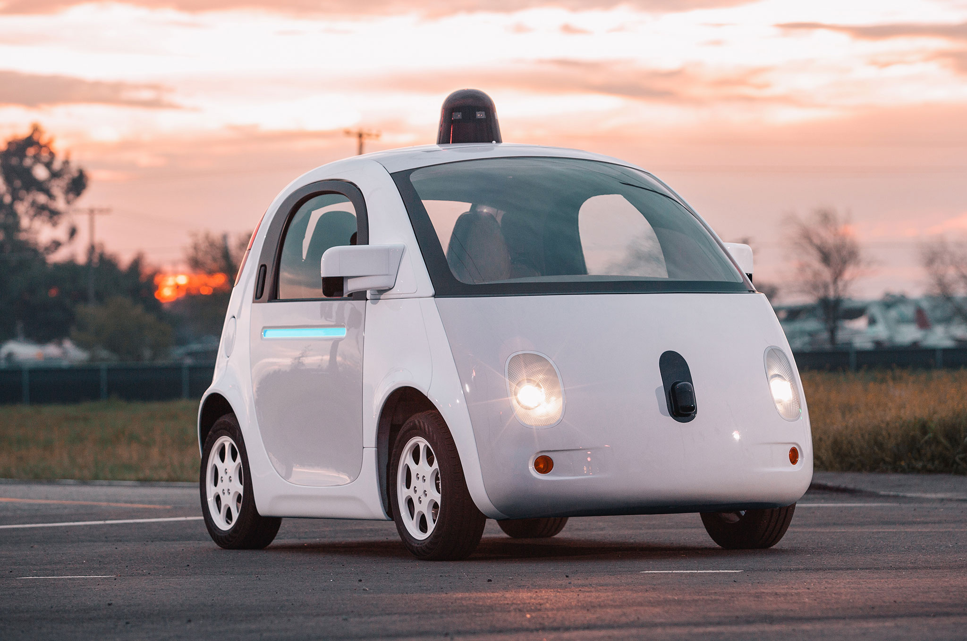
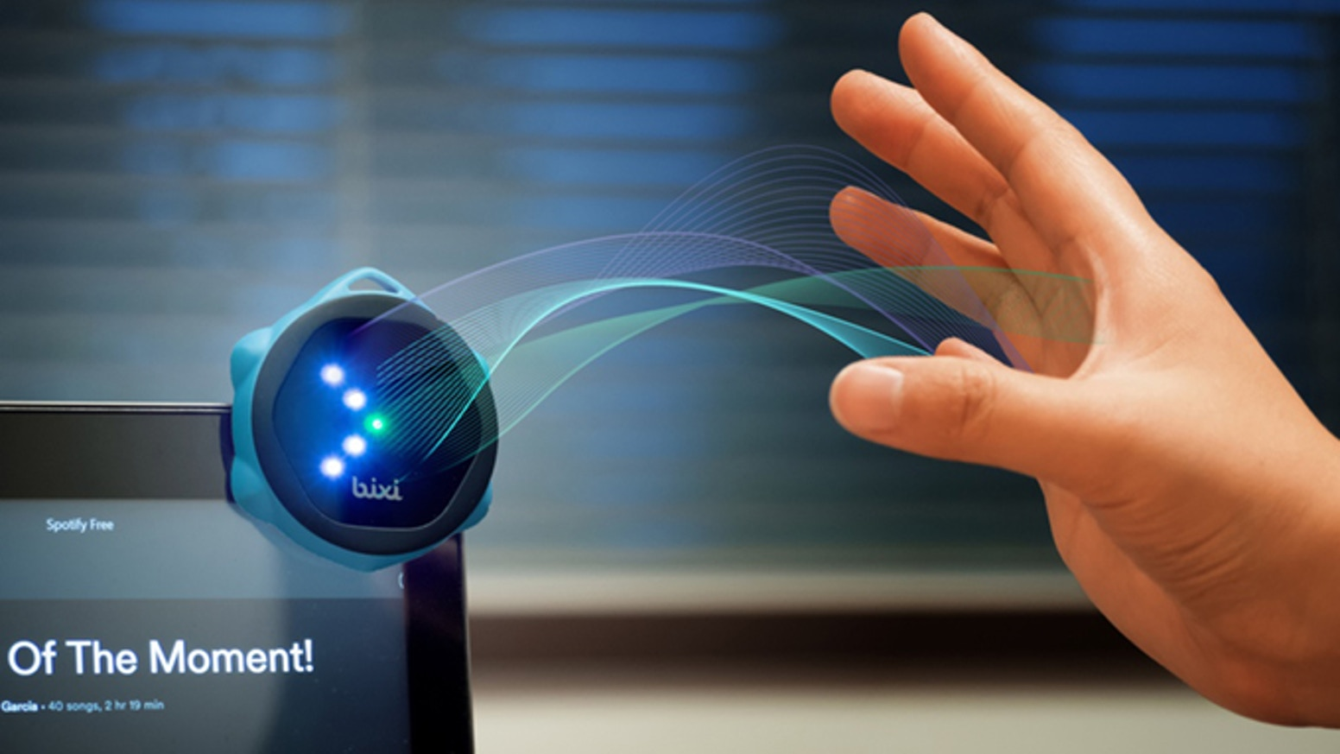
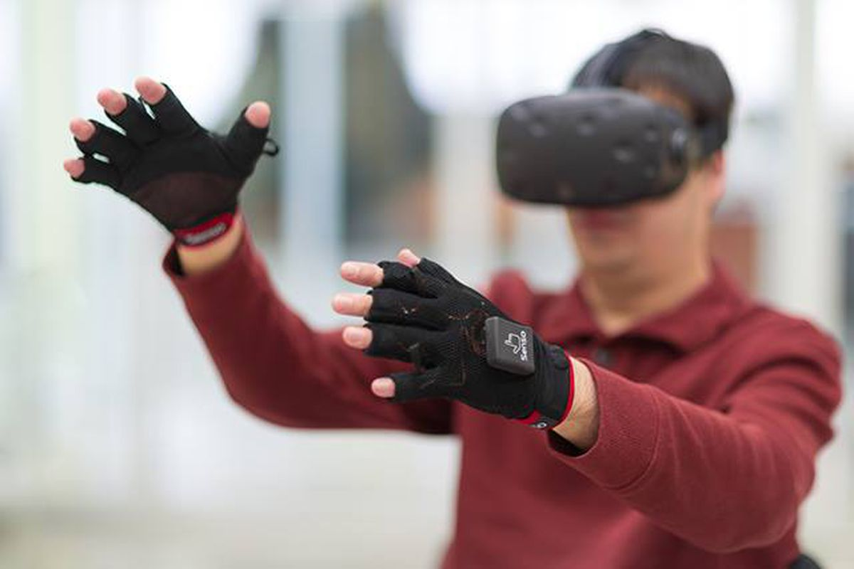

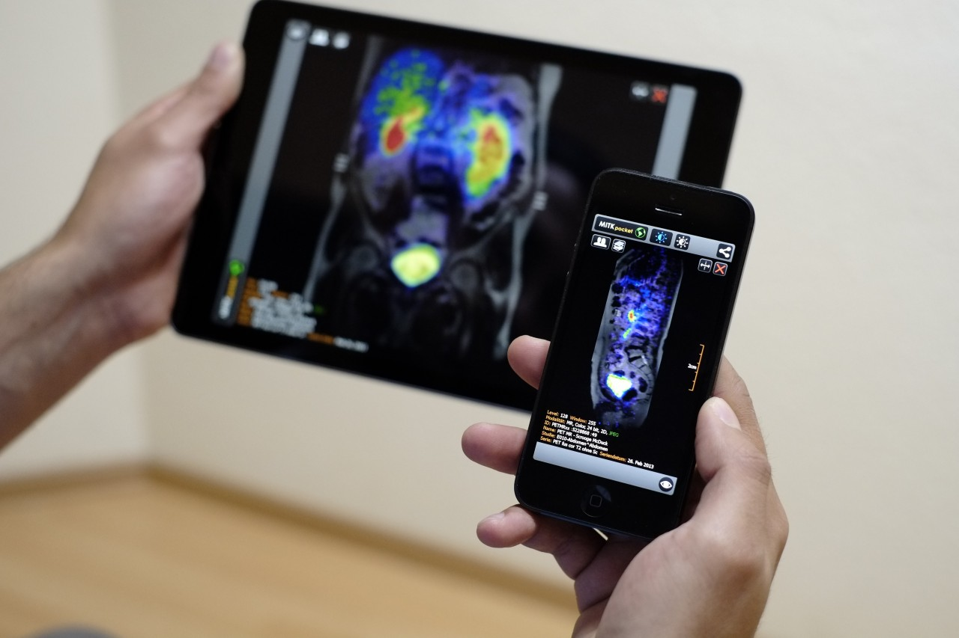
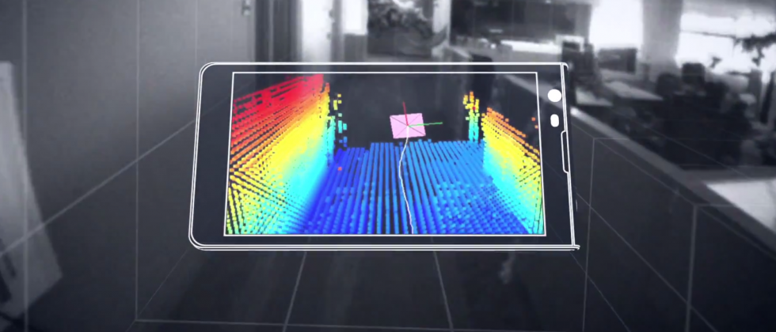
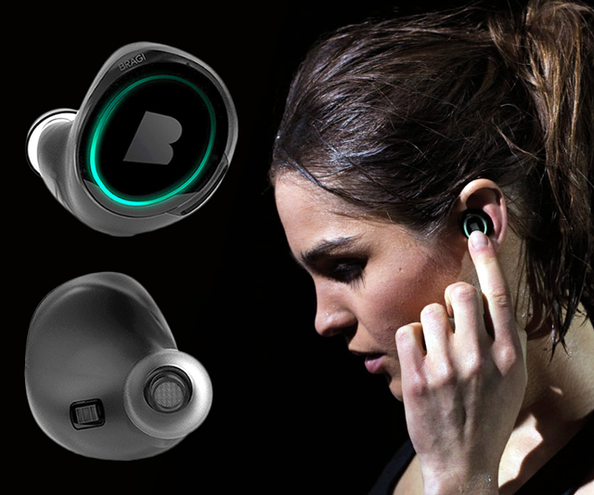
Wireless and Mobile Systems
for the IoT
CMSC 715 : Fall 2021
Lecture 2.4: Spatial sensing and ranging
Nirupam Roy
M-W 2:00-3:15pm
CHM 1224

Slide 2
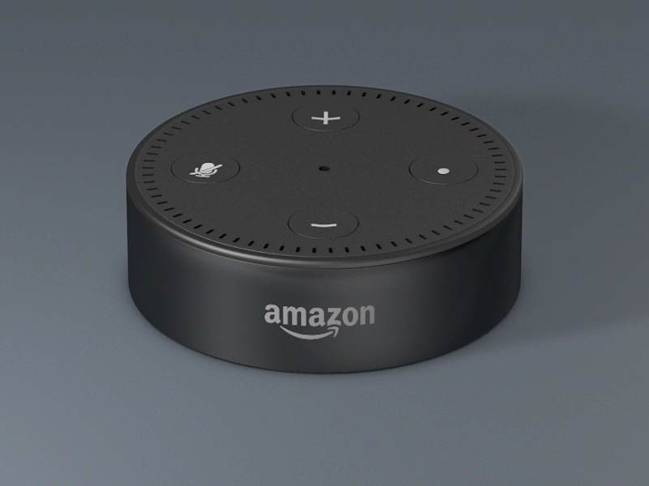

Slide 3
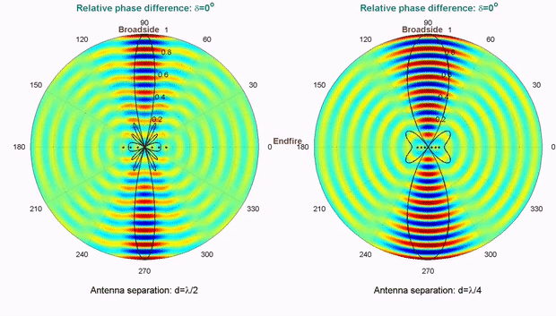
Computationally controlling beam direction

Slide 4
Angle-of-Arrival (AoA)
or
Direction-of-Arrival (DoA)

Slide 5
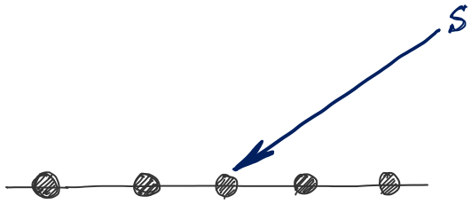
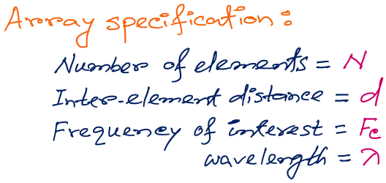
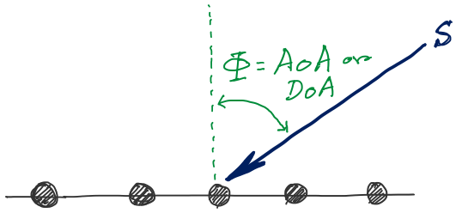
d
d
d
d
Notes:
http://www.waves.utoronto.ca/prof/svhum/ece422/notes/15-arrays2.pdf

Slide 6

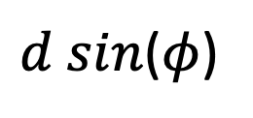




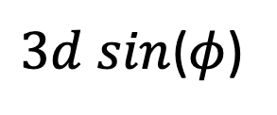


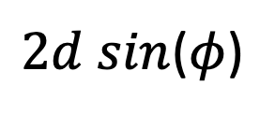
DoA Estimation
$3d sin$($φ$)
$2d sin$($φ$)
$d sin$($φ$)
$$E1$$
$$E2$$
$$E3$$
$$E4$$
…
N elements
$$d$$
$$d$$
$$d$$
Interelement distance = d

Slide 7
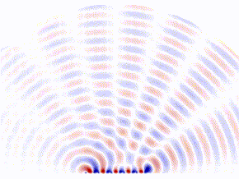
DoA Estimation: Beam-scanning
Scan the region with a steerable beam of the phased array.
DoA of the signal will show maximum received power.

Slide 8
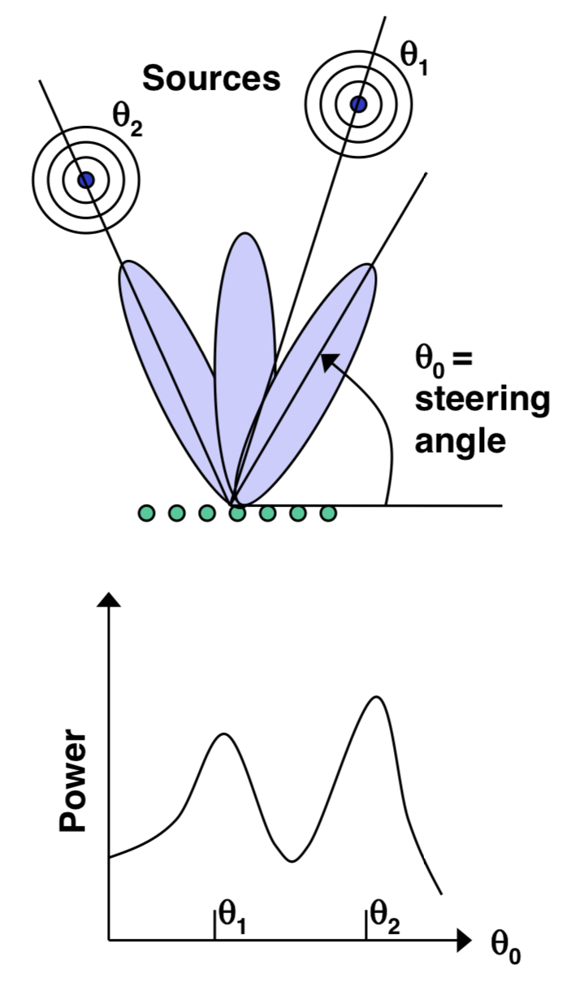
DoA Estimation: Beam-scanning

Slide 9
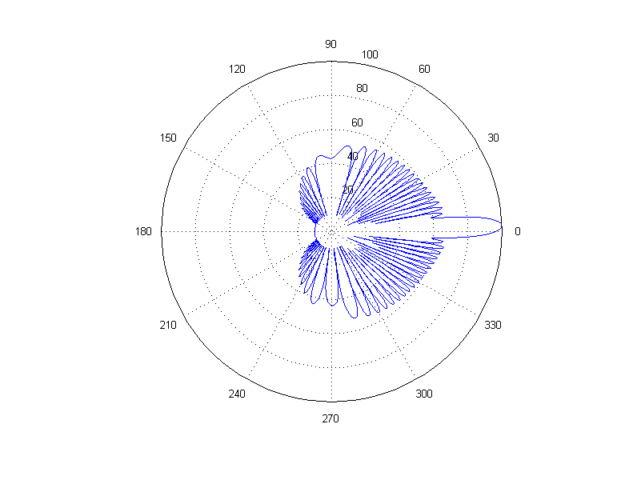
DoA Estimation: Beam-scanning
Number of elements = 30, wave length = 10cm, distance between elements = 6.5 cm
Notes:
http://www.waves.utoronto.ca/prof/svhum/ece422/notes/15-arrays2.pdf

Slide 10
Delay-sum DoA estimation

Slide 11
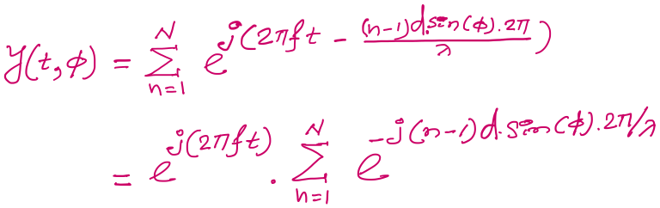

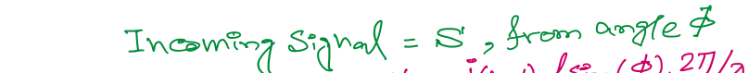
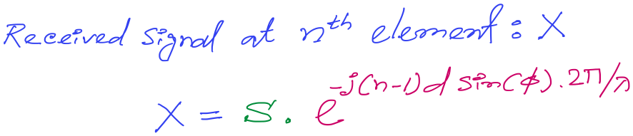
DoA Estimation: Delay-sum
Notes:
http://www.waves.utoronto.ca/prof/svhum/ece422/notes/15-arrays2.pdf

Slide 12
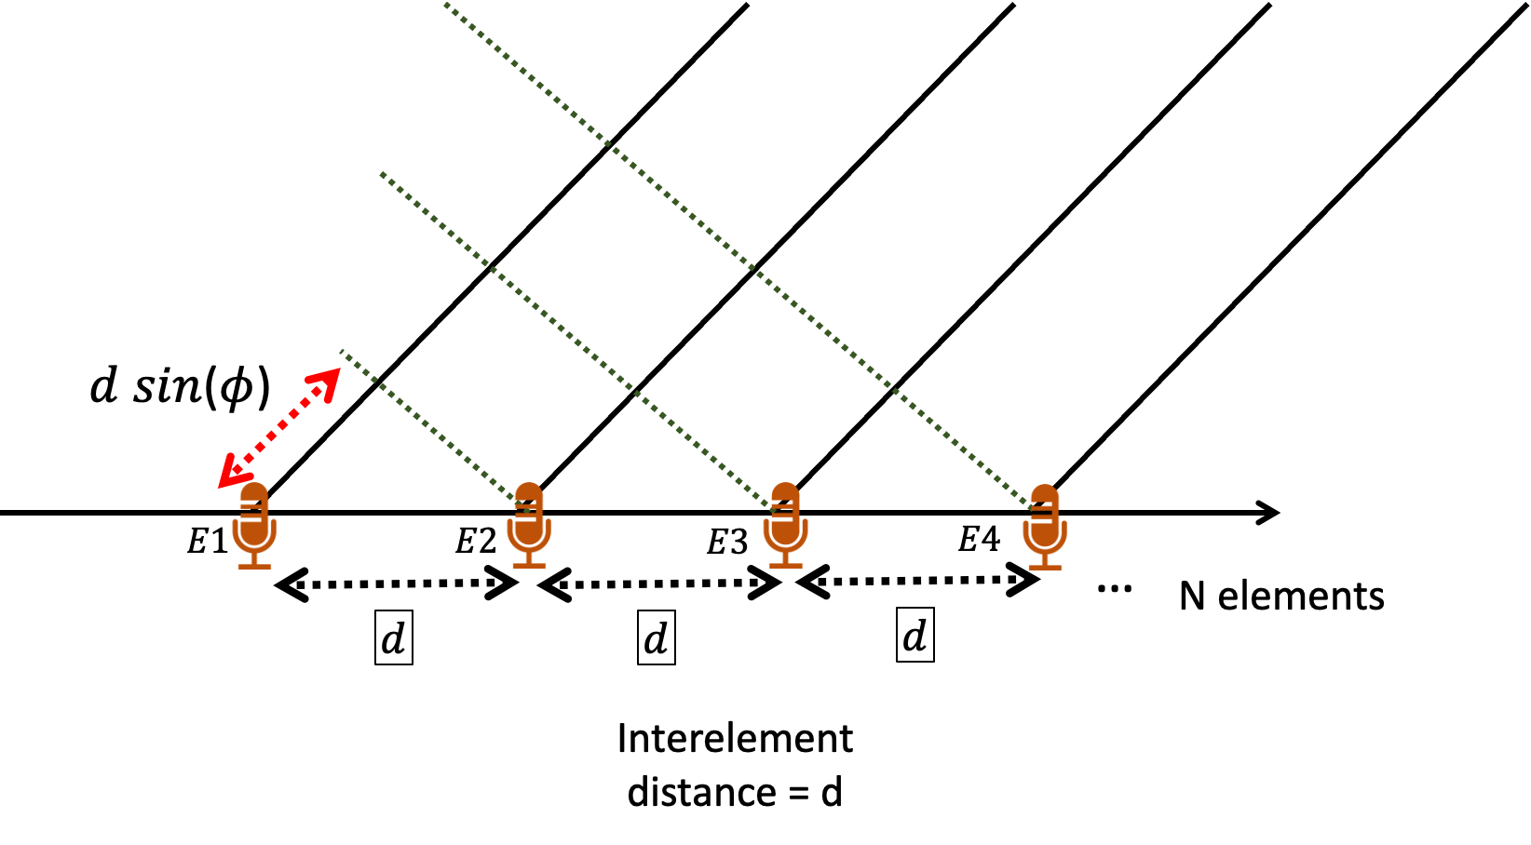
DoA Estimation: Delay-sum
For 3rd mic, n == 3
Notes:
http://www.waves.utoronto.ca/prof/svhum/ece422/notes/15-arrays2.pdf

Slide 13
DoA Estimation: Delay-sum
Notes:
http://www.waves.utoronto.ca/prof/svhum/ece422/notes/15-arrays2.pdf

Slide 14
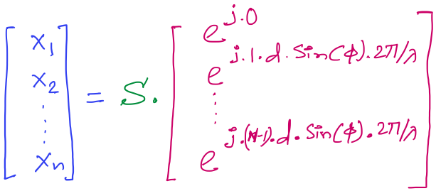

DoA Estimation: Delay-sum
Received signals in all elements:
…
Steering vector
Notes:
http://www.waves.utoronto.ca/prof/svhum/ece422/notes/15-arrays2.pdf

Slide 15
DoA Estimation: Delay-sum
Received signals in all elements:
…
Steering vector
Notes:
http://www.waves.utoronto.ca/prof/svhum/ece422/notes/15-arrays2.pdf

Slide 16
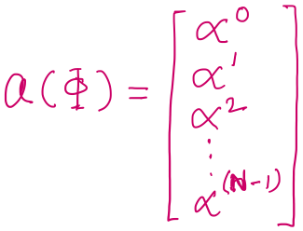

DoA Estimation: Delay-sum
Received signals in all elements:
Notes:
http://www.waves.utoronto.ca/prof/svhum/ece422/notes/15-arrays2.pdf

Slide 17
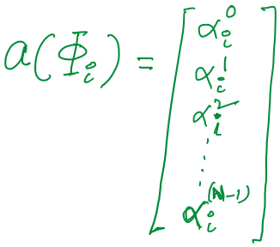

DoA Estimation: Delay-sum

Slide 18
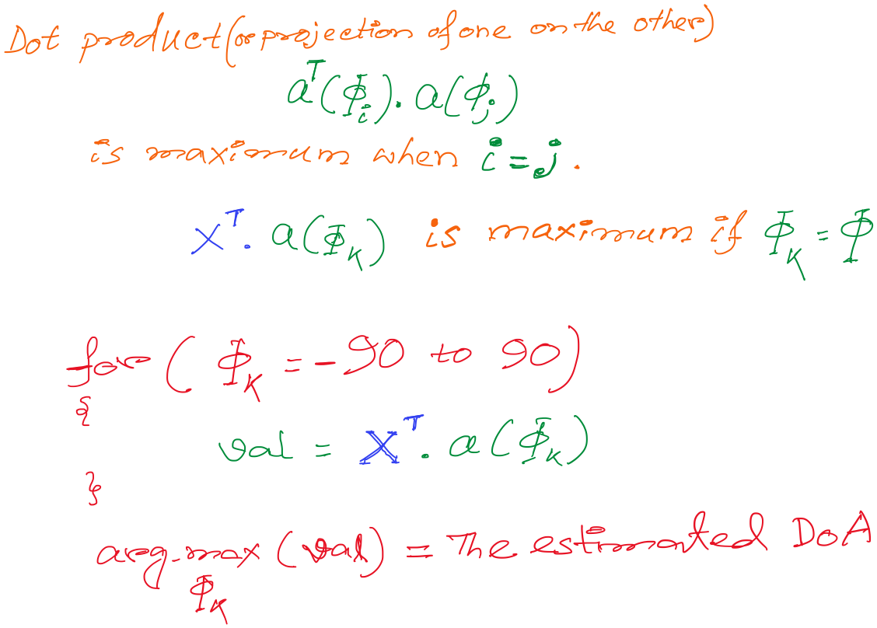
DoA Estimation: Delay-sum

Slide 19
DoA Estimation: Delay-sum

Slide 20
DoA Estimation: Delay-sum
How is this a “delay -sum” ?

Slide 21
DoA Estimation: Delay-sum
How is this a “delay -sum” ?

Slide 22
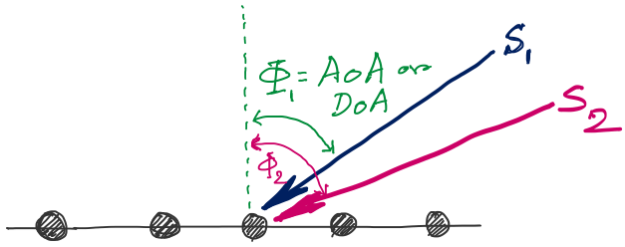
DoA Estimation
d
d
d
d
Notes:
http://www.waves.utoronto.ca/prof/svhum/ece422/notes/15-arrays2.pdf

Slide 23
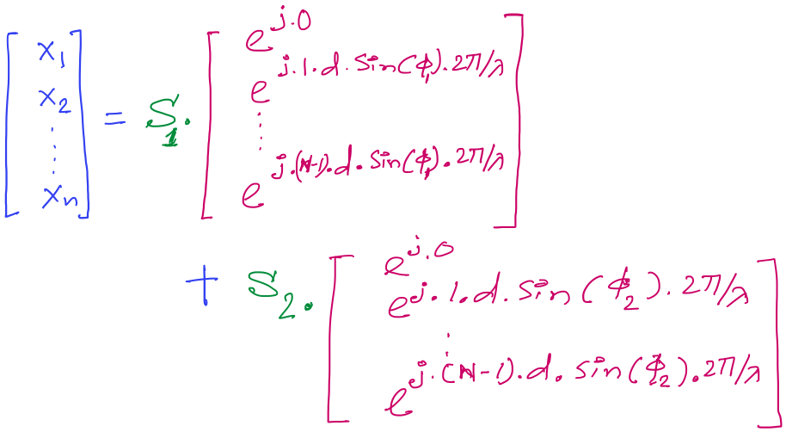
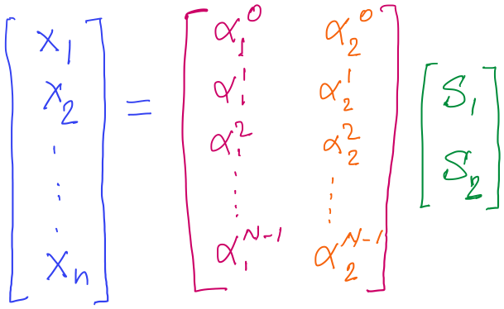
DoA Estimation

Slide 24
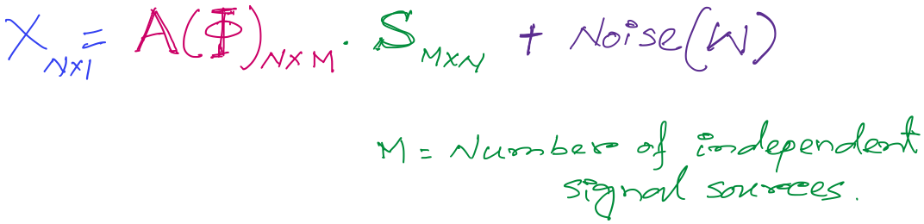
DoA Estimation
Mx1
Steering matrix

Slide 25
A different approach to DoA estimation

Slide 26
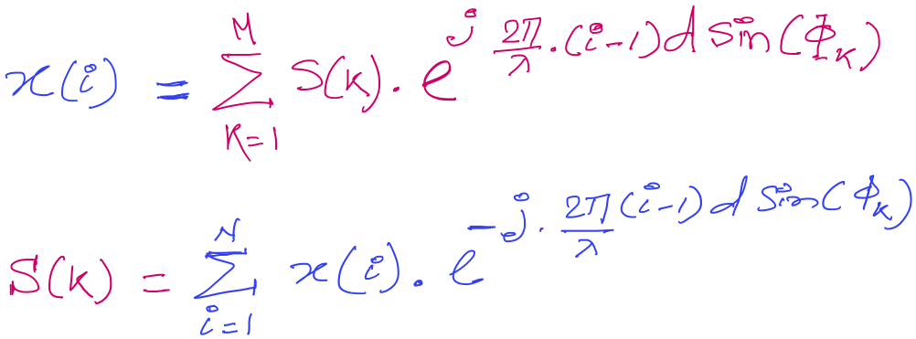
DoA Estimation

Slide 27
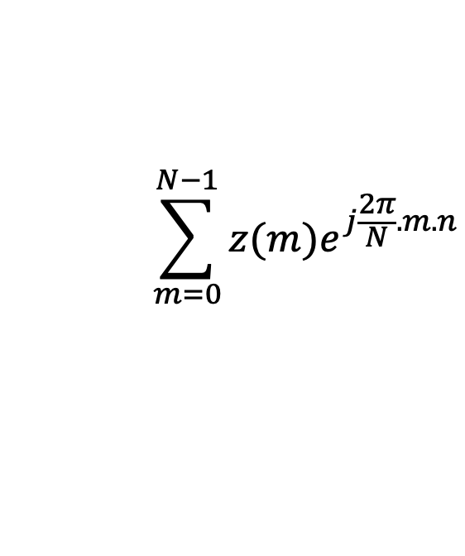
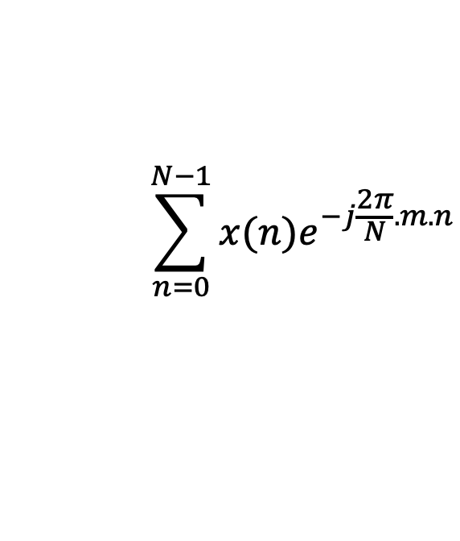
Discrete Fourier Transform
$$\sum_{n=0}^{N−1}{x(n)e^{−j\frac{2π}{N}.m.n}}$$
DFT:
z(m) =
$$\sum_{m=0}^{N−1}{z(m)e^{j\frac{2π}{N}.m.n}}$$
IDFT:
x(n) =

Slide 28














Discrete Fourier Transform
Frequency domain coefficients
$$e^{j0}$$
$$e^{j0.\frac{2π}{N}}$$
$$e^{j0.\frac{m.2π}{N}}$$
$$e^{j0.\frac{(N−1).2π}{N}}$$
$$e^{j0}$$
$$e^{j1.\frac{2π}{N}}$$
$$e^{j1.\frac{m.2π}{N}}$$
$$e^{j1.\frac{(N−1).2π}{N}}$$
+
$$e^{j2.\frac{2π}{N}}$$
+
$$e^{j2.\frac{m.2π}{N}}$$
+
$$e^{j2.\frac{(N−1).2π}{N}}$$
Z₀
$$e^{j0}$$
Z₁
…
Z_{m}
…
Z_{N-1}
…
…
…
…
$$e^{j(N−1).\frac{2π}{N}}$$
$$e^{j(N−1).\frac{m.2π}{N}}$$
$$e^{j(N−1).\frac{(N−1).2π}{N}}$$
$$e^{j0}$$
x[0]
x[1]
=
X =
x[2]
Time domain samples
…
x[N-1]

Slide 29
DoA Estimation : Classical FFT approach

Slide 30
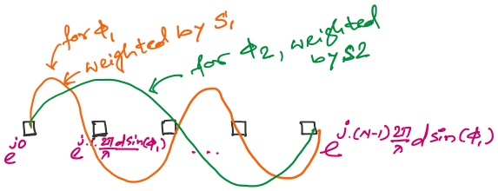
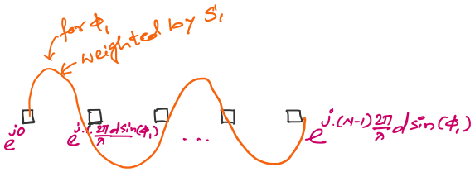
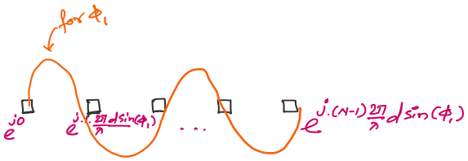

An observation on the spatial samples

Slide 31
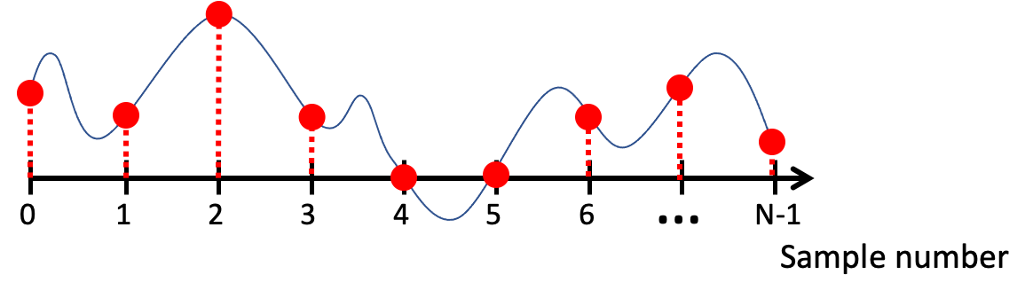
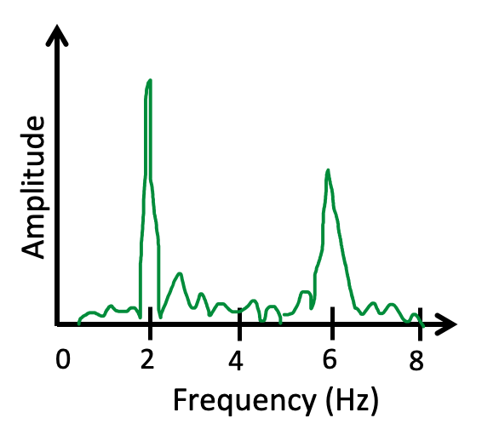
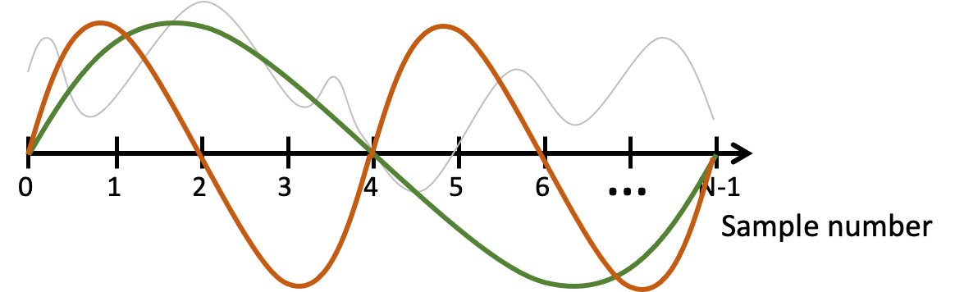
FFT
Arbitrary signals can be represented as a combination of sinusoids

Slide 32
FFT
Arbitrary signals can be represented as a combination of sinusoids
Agnostic of the type of signal or sampling details

Slide 33
FFT
Arbitrary signals can be represented as a combination of sinusoids

Slide 34
FFT
Arbitrary signals can be represented as a combination of sinusoids

Slide 35
DoA Estimation : Classical FFT approach

Slide 36
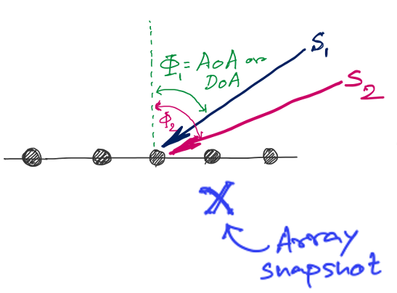
DoA Estimation : Classical FFT approach
FFT
Amplitude
0
4
8
12
16
Frequency (Hz) ??

Slide 37
Discrete Fourier Transform
…
0
1
2
3
4
5
6
N-1
Sample number
X = [ ]
x[0], x[1], x[2], x[3], x[4], … x[N-1]

Slide 38
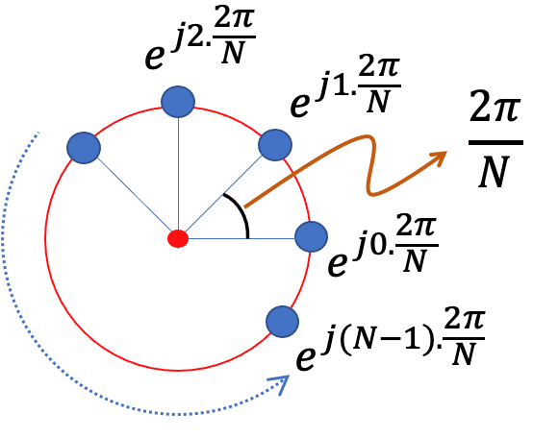
Discrete Fourier Transform
…
0
1
2
3
4
5
6
N-1
Sample number
Slowest frequency goes $\frac{2π}{N}$ radians per step.

Slide 39
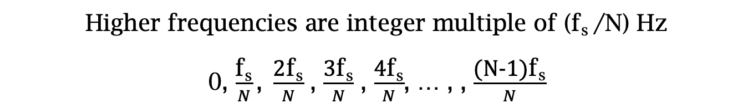
Estimating the real-world frequencies
Sampling frequency = f_{s} (i.e., f_{s} samples per second)
Slowest frequency ($\frac{2π}{N}$ radians per step) = N samples per rotation
= (N/ f_{s}) seconds per rotation
Therefore, the slowest frequency = (f_{s} /N) Hz
Higher frequencies are integer multiple of (f_{s} /N) Hz
0, $\frac{\text{f}\text{s}}{N}\text{, }\frac{\text{2}\text{f}\text{s}}{N}$ , $\frac{\text{3}\text{f}\text{s}}{N}$ , $\frac{\text{4}\text{f}\text{s}}{N}$, … , , $\frac{\text{(}\text{N}\text{−1)}\text{f}\text{s}}{N}$

Slide 40
Discrete Fourier Transform
…
0
1
2
3
4
5
6
N-1
Sample number
Slowest frequency goes $\frac{2π}{N}$ radians per step.

Slide 41
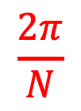
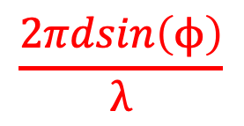

Discrete Fourier Transform
…
0
1
2
3
4
5
6
N-1
Sample number
$$\frac{2π}{N}$$
$$\frac{2πdsin\left(ϕ\right)}{λ}$$
$$=$$

Slide 42
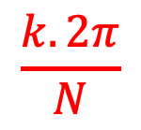
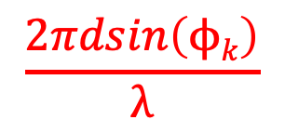

Discrete Fourier Transform
…
0
1
2
3
4
5
6
N-1
Sample number
$$\frac{k.2π}{N}$$
$$\frac{2πdsin\left(ϕk\right)}{λ}$$
$$=$$

Slide 43

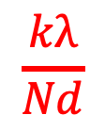
Discrete Fourier Transform
…
0
1
2
3
4
5
6
N-1
Sample number
$$\frac{kλ}{Nd}$$
$$ϕk$$
$$=$$
asin( )

Slide 44
DoA Estimation : Classical FFT approach
What is the minimum and maximum value of the inter-element distance (d)?
d
d
d
d

Slide 45
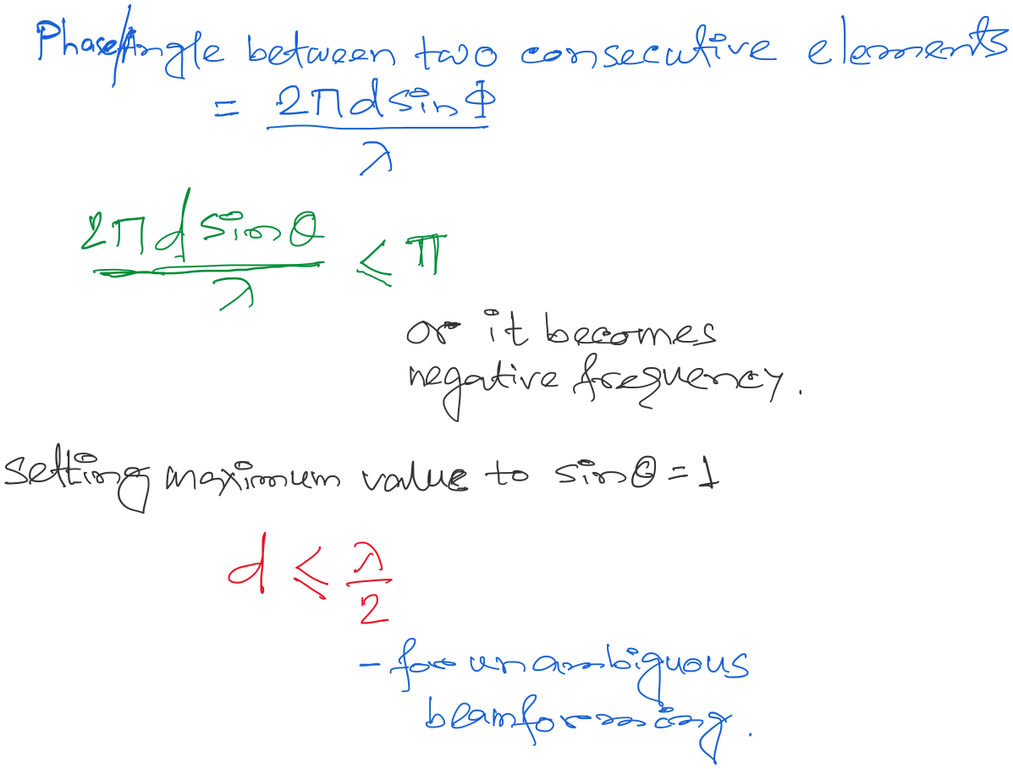
DoA Estimation : Classical FFT approach

Slide 46
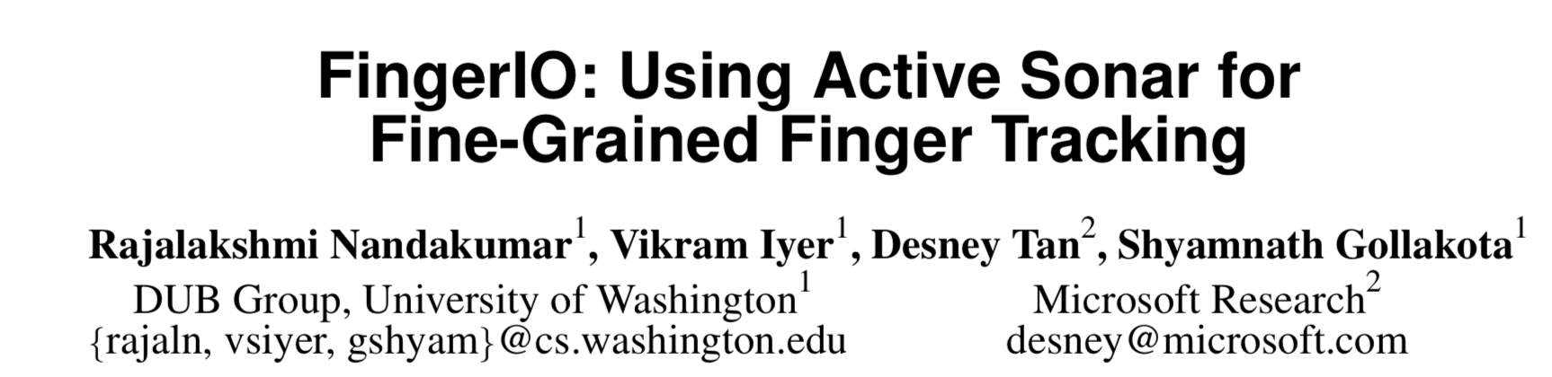

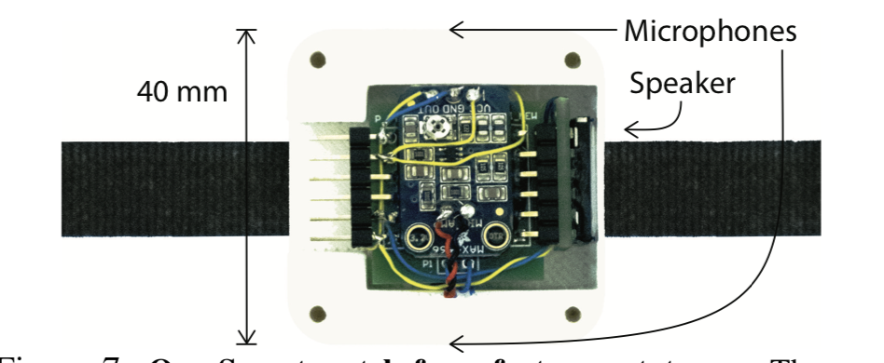
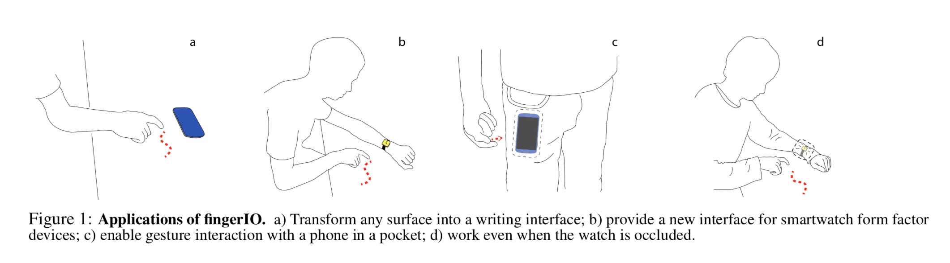

Slide 47


Slide 48
Extra Slide for reference
(not presented in class)

Slide 49
Finding distance using waves

Slide 50



Slide 51
Finding distance using waves
(Ranging)

Slide 52
…
SONAR
(detection)
Depth/Image
Gesture

Slide 53
…
SONAR
(detection)
Depth/Image
Gesture
Finding distance using waves
(Ranging)

Slide 54
…
SONAR
(detection)
Depth/Image
Gesture
Finding distance using waves
(Ranging)
Speed
Amplitude
Frequency
Phase

Slide 55
1. Distance from the speed information
a. Techniques
b. Signal detection
2. Distance from the amplitude information
a. Absorption
b. Propagation loss
3. Distance from the frequency information
a. Doppler effect
b. A case study (Doppler + Triangulation)
4. Distance from the phase information
a. Overview
b. Impulse function, Impulse response, Convolution
c. A case study

Slide 56
1. Distance from the speed information
a. Techniques
b. Signal detection
2. Distance from the amplitude information
a. Absorption
b. Propagation loss
3. Distance from the frequency information
a. Doppler effect
b. A case study (Doppler + Triangulation)
4. Distance from the phase information
a. Overview
b. Impulse function, Impulse response, Convolution
c. A case study

Slide 57
Distance from the speed information
Dist. = (speed) X (time of travel)
Time of Arrival (ToA)
Signal source
observer

Slide 58
Distance from the speed information
Dist. = (speed) X (time of travel)
Time of Arrival (ToA)
Signal source
observer
Signal source
Time Difference of Arrival (TDoA)
observer 1
observer2

Slide 59

TDoA
a
b
Find the location of the wave source when (a-b) is known.

Slide 60

TDoA

Slide 61
Distance from the speed information
Dist. = (speed) X (time of travel)
Time of Arrival (ToA)
Signal source
observer
Signal source
Time Difference of Arrival (TDoA)
observer 1
observer2
Round-trip Time of Flight (RToF)
Signal source
+ observer
Reflector

Slide 62
Distance from the speed information
Dist. = (speed) X (time of travel)
Time of Arrival (ToA)
Signal source
observer
How to detect the signal at the receiver/observer?
Signal source
Time Difference of Arrival (TDoA)
observer 1
observer2
Round-trip Time of Flight (RToF)
Signal source
+ observer
Reflector

Slide 63
Signal detection
Amplitude
Time/Sample
Transmitter signal

Slide 64
Signal detection
Amplitude
Amplitude
Time/Sample
Time/Sample
Transmitter signal
Receiver signal

Slide 65

Signal detection
Amplitude
Amplitude
Time/Sample
Time/Sample
Transmitter signal
Receiver signal
Energy based signal detector
Energy of a discrete signal x(n),

Slide 66
Signal detection
Amplitude
Amplitude
Time/Sample
Time/Sample
Transmitter signal
Receiver signal

Slide 67


Signal detection
Received signal
Signal matching
Transmit signal template

Slide 68
Signal detection
Received signal
Signal matching
Transmit signal template
Correlation

Slide 69

Signal detection
Correlation

Slide 70
Distance from the speed information
Dist. = (speed) X (time of travel)
Time of Arrival (ToA)
Signal source
observer
Time Difference of Arrival (TDoA)
Signal source
observer 1
observer2
Round-trip Time of Flight (RToF)
Signal source
+ observer
Reflector
Notes:
Slide 23: 20 minutes

Slide 71
1. Distance from the speed information
a. Techniques
b. Signal detection
2. Distance from the amplitude information
a. Absorption
b. Propagation loss
3. Distance from the frequency information
a. Doppler effect
b. A case study (Doppler + Triangulation)
4. Distance from the phase information
a. Overview
b. Impulse function, Impulse response, Convolution
c. A case study

Slide 72

Distance from the amplitude information
Amplitude
Time (sec)
$$AS . sin⁡(2πft)$$

Slide 73

Distance from the amplitude information
Dist. = d
Amplitude
Time (sec)
Amplitude
Time (sec)
$$AS . sin⁡(2πft)$$
$$AO . sin⁡(2πft)$$

Slide 74

Distance from the amplitude information
Dist. = d
Amplitude
Time (sec)
Amplitude
Time (sec)
$$AS . sin⁡(2πft)$$
$$AO . sin⁡(2πft)$$
Attenuation due to atmospheric absorption and diffraction

Slide 75

Distance from the amplitude information
Dist. = d
Amplitude
Time (sec)
Amplitude
Time (sec)
$$AS . sin⁡(2πft)$$
$$AO . sin⁡(2πft)$$
$$AO =AS e^{−αd}$$
α = attenuation coefficient
Depends on frequency and
environment ( temperature, humidity etc.)

Slide 76

Distance from the amplitude information
Propagation loss

Slide 77
Distance from the amplitude information
Propagation loss
Notes:
Slide 30: 25 minutes

Slide 78
1. Distance from the speed information
a. Techniques
b. Signal detection
2. Distance from the amplitude information
a. Absorption
b. Propagation loss
3. Distance from the frequency information
a. Doppler effect
b. A case study (Doppler + Triangulation)
4. Distance from the phase information
a. Overview
b. Impulse function, Impulse response, Convolution
c. A case study

Slide 79
Distance from the frequency information
Motion of the sound source and/or the observer changes the frequency of the observed signal.
The change depends on the velocity of the source/observer.
This phenomena is known as Doppler effect or Doppler shift.

Slide 80

Doppler effect

Slide 81

Doppler effect

Slide 82
Doppler effect

Slide 83
Doppler effect
Simple wave model: Stationary source

Slide 84
Doppler effect
Simple wave model: Stationary source
Time = t1

Slide 85
Doppler effect
Simple wave model: Stationary source
Time = t2

Slide 86
Doppler effect
Simple wave model: Stationary source
Time = t2

Slide 87
Doppler effect
Simple wave model: Stationary source
Time = t3

Slide 88
Doppler effect
Simple wave model: Stationary source
Time = t3

Slide 89
Doppler effect
Simple wave model: Stationary source
Wavelength = λ meters
Time = t3

Slide 90

Doppler effect

Slide 91
Doppler effect
Simple wave model: Moving source

Slide 92
Doppler effect
Simple wave model: Moving source
Time = t1

Slide 93
Doppler effect
Simple wave model: Moving source
Time = t2

Slide 94
Doppler effect
Simple wave model: Moving source
Time = t2

Slide 95
Doppler effect
Simple wave model: Moving source
Time = t2

Slide 96
Doppler effect
Simple wave model: Moving source
Time = t3

Slide 97
Doppler effect
Simple wave model: Moving source
Time = t3

Slide 98
Doppler effect
Simple wave model: Moving source
Time = t3

Slide 99
Doppler effect
Simple wave model: Moving source
Actual wavelength = λ meters
Wavelength = λ₂ meters
Wavelength = λ₁ meters
Time = t3
Notes:
Slide 19: 2 minutes 30 seconds

Slide 100
Doppler effect
Simple wave model: Moving source
Actual wavelength = λ meters
Observer
Wavelength = λ₂ meters
Wavelength = λ₁ meters
Time = t3
Notes:
Slide 19: 2 minutes 30 seconds

Slide 101

Doppler effect

Slide 102

Doppler effect
Simple wave model: Moving source
Source moving towards the observer
v = Velocity of the signal (sound, light etc.)
v_{O} , T_{O} , f_{O} = Velocity of the observer and observed period and frequency
v_{S} , T_{S} , f_{S} = Velocity of the source and original period and frequency
Notes:
Slide 19: 2 minutes 30 seconds

Slide 103
Doppler effect
Simple wave model: Moving observer
Observer

Slide 104
Doppler effect
Simple wave model: Moving observer
t
t
Observer

Slide 105
Doppler effect
Simple wave model: Moving observer
t’ <t
t’ <t

Slide 106

Doppler effect
Simple wave model: Moving observer
Observer moving towards the stationary source
+
+
+
+
v_{O} , T_{O} , f_{O} = Velocity of the observer and observed period and frequency
v_{S} , T_{S} , f_{S} = Velocity of the source and original period and frequency

Slide 107
Doppler effect
Simple wave model: Moving observer
Observer moving towards the stationary source
+
Doppler shift, Δf = f_{O}-f_{S} = f_{S} (v_{O}/v)
+
+
How will it change with signal’s velocity and frequency?
+
v_{O} , T_{O} , f_{O} = Velocity of the observer and observed period and frequency
v_{S} , T_{S} , f_{S} = Velocity of the source and original period and frequency

Slide 108

Doppler effect
Simple wave model: Moving observer
Both the source and the observer are moving
v_{O} , T_{O} , f_{O} = Velocity of the observer and observed period and frequency
v_{S} , T_{S} , f_{S} = Velocity of the source and original period and frequency
Notes:
Slide 58: 30 minutes

Slide 109


Doppler effect

Slide 110
Doppler effect

