Slide 1
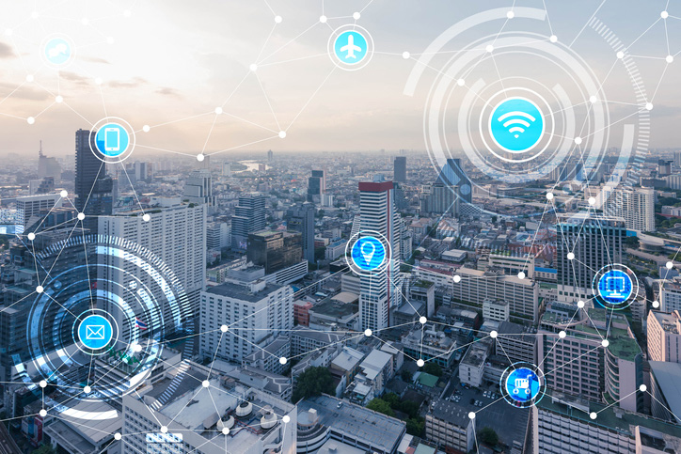
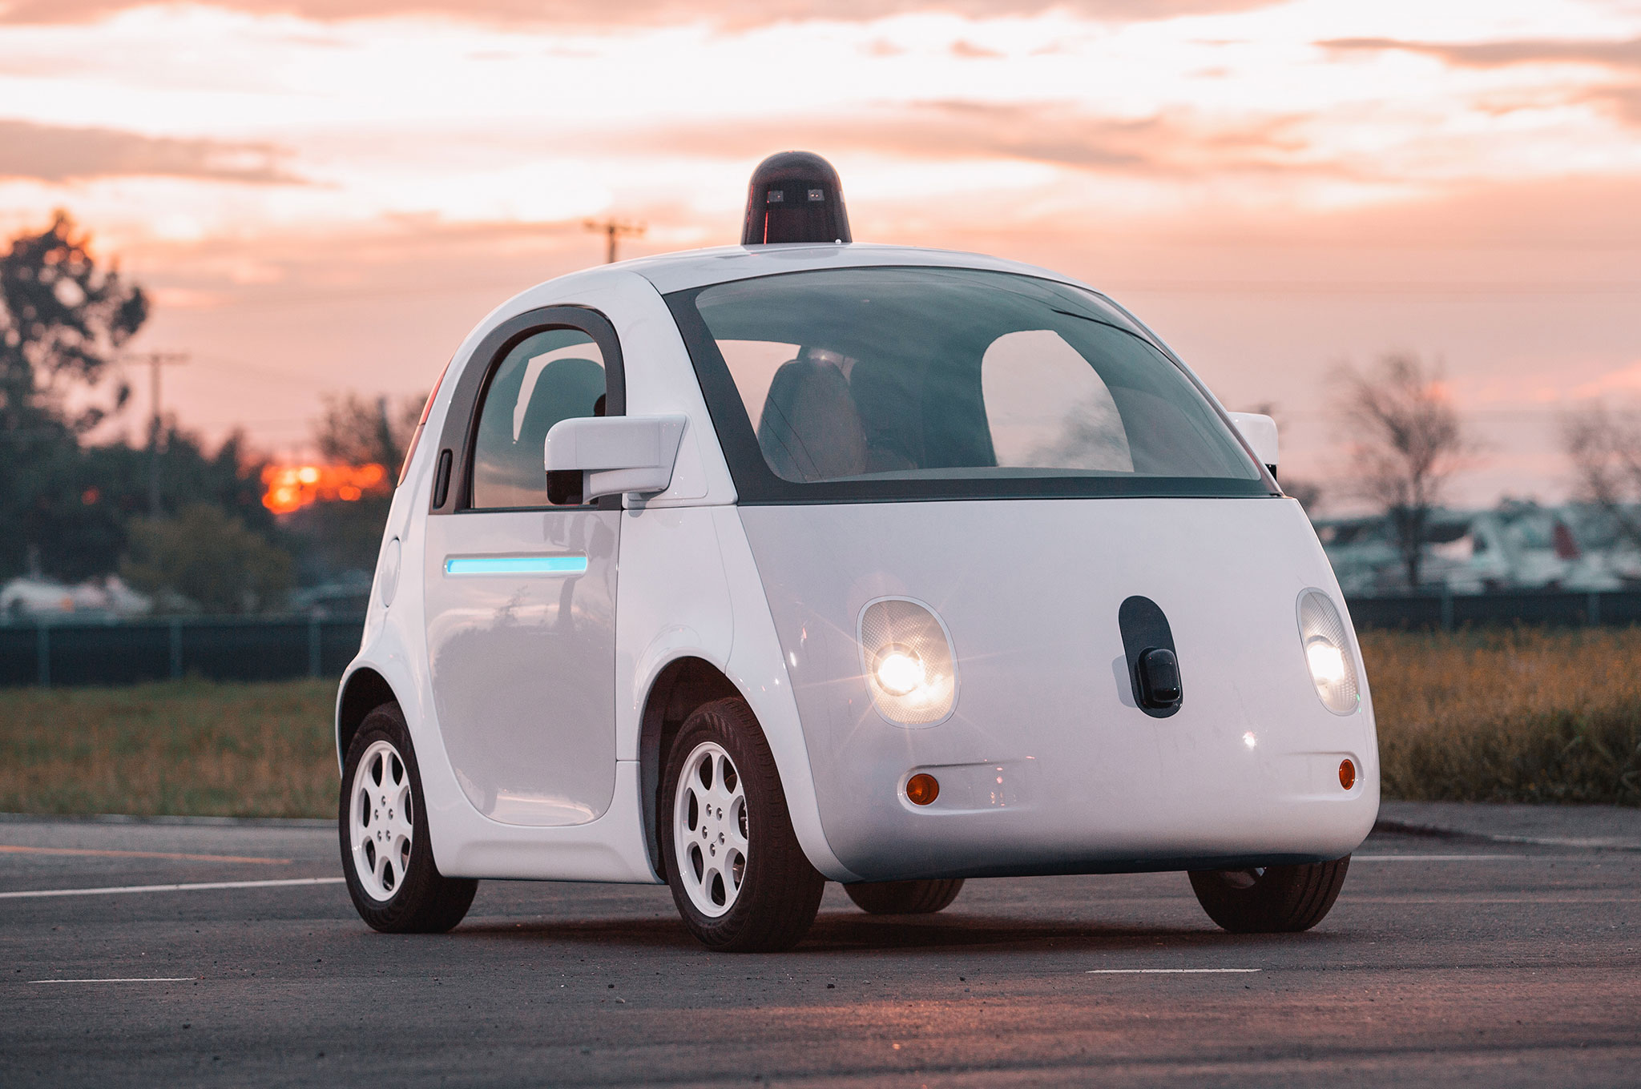
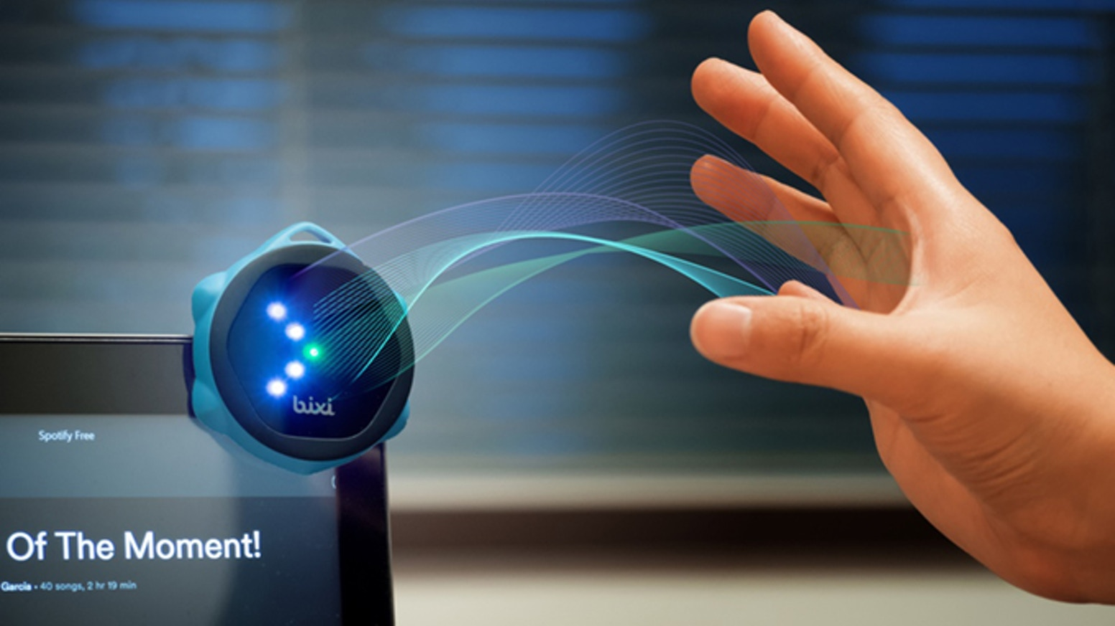
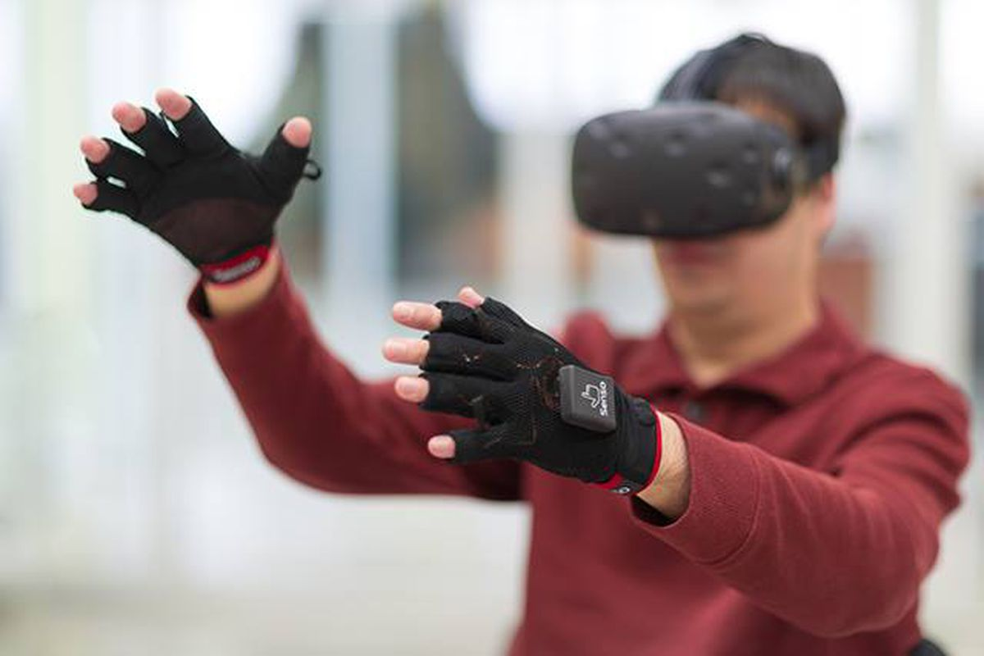

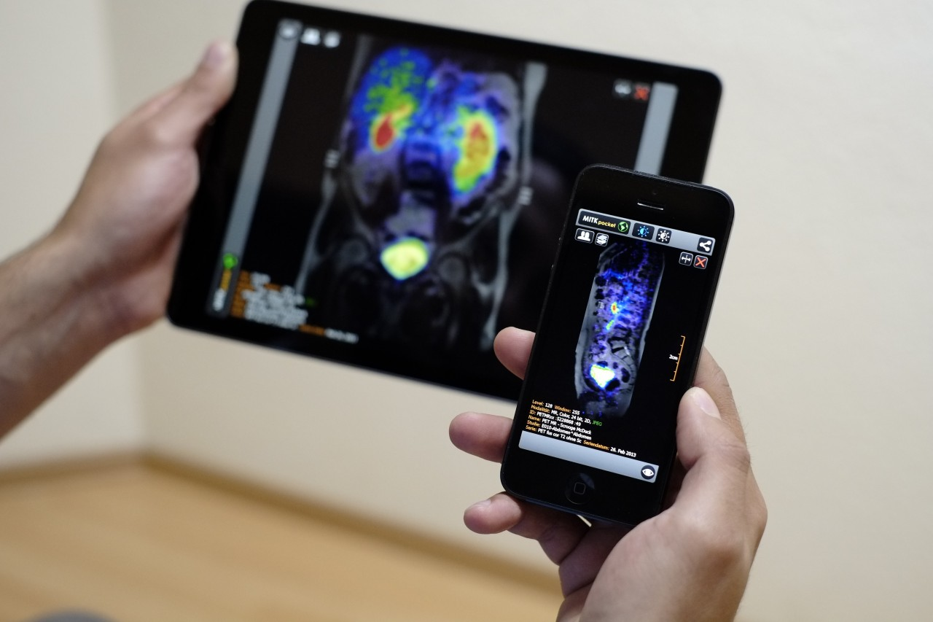
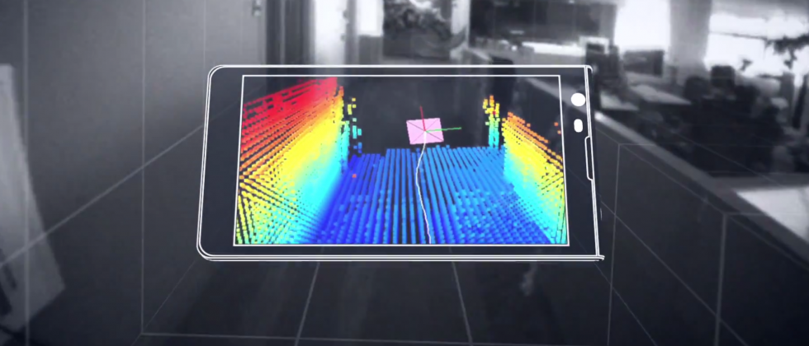
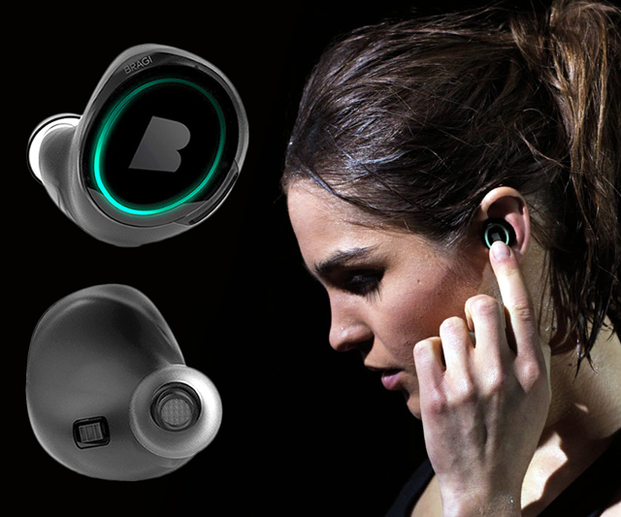
Wireless and Mobile Systems
for the IoT
CMSC 715 : Fall 2021
Lecture 3.2: Machine Learning for IoT
Nirupam Roy
M-W 2:00-3:15pm
CHM 1224

Slide 2
Class project: Rules
The class project == 40% of the total grade.
Demonstrate your understanding of the core theories and capability to transform them into real-world solutions.
You can pick a project idea from the following list, or may improvise an idea from the list, or may work on your own idea.
Project must conform to the philosophy of this course, "wireless and mobile systems for the IoT." (Recommend in-person discussions with the instructor to ensure that your project qualifies.)

Slide 3
Class project: Rules
Team of two. Need the instructor's permission for any other team sizes.
More than one team may pick the same project idea, must work independently.
Your final project report should contain no more than six (6) pages, including all figures and references.

Slide 4
Class project: Rules
Final project report must contain the following sections:
  Introduction (includes an overview of the project and the motivation)
  System Design (describes the methods and implementation details)
  Evaluation (evaluates the developed system with experimental results and plots)
5% of the project grades as a bonus for submitting a working demo of the project.
Each student will be graded separately.
We can help.

Slide 5
Class project: Ideas
A list of project ideas is given here:
http://www.cs.umd.edu/class/fall2021/cmsc715/projectIdeas.html

Slide 6
Markov Model
Sunny
Sunny
Rainy
Sunny
Rainy
Rainy
t1 t2 t3 t4 t5 t6 (time)
P (sunny after rainy)
P (sunny after sunny)
P (rainy after rainy)
Sunny
day
Rainy
day
Temp.
P (rainy after sunny)
Temp.
Humidity
Humidity
Wind
Wind

Slide 7
Hidden Markov Model: Definition
Hidden states
S₁
S₁
S₂
S₃
S₄
S₁
S₂
M₁
M₁
M₂
M₃
M₄
Transition
Emission
Observations
1st order Markov assumption:
Transition probability depends on the current state only.
Output independence assumption:
Output/Emission probability depends on the current state only.

Slide 8
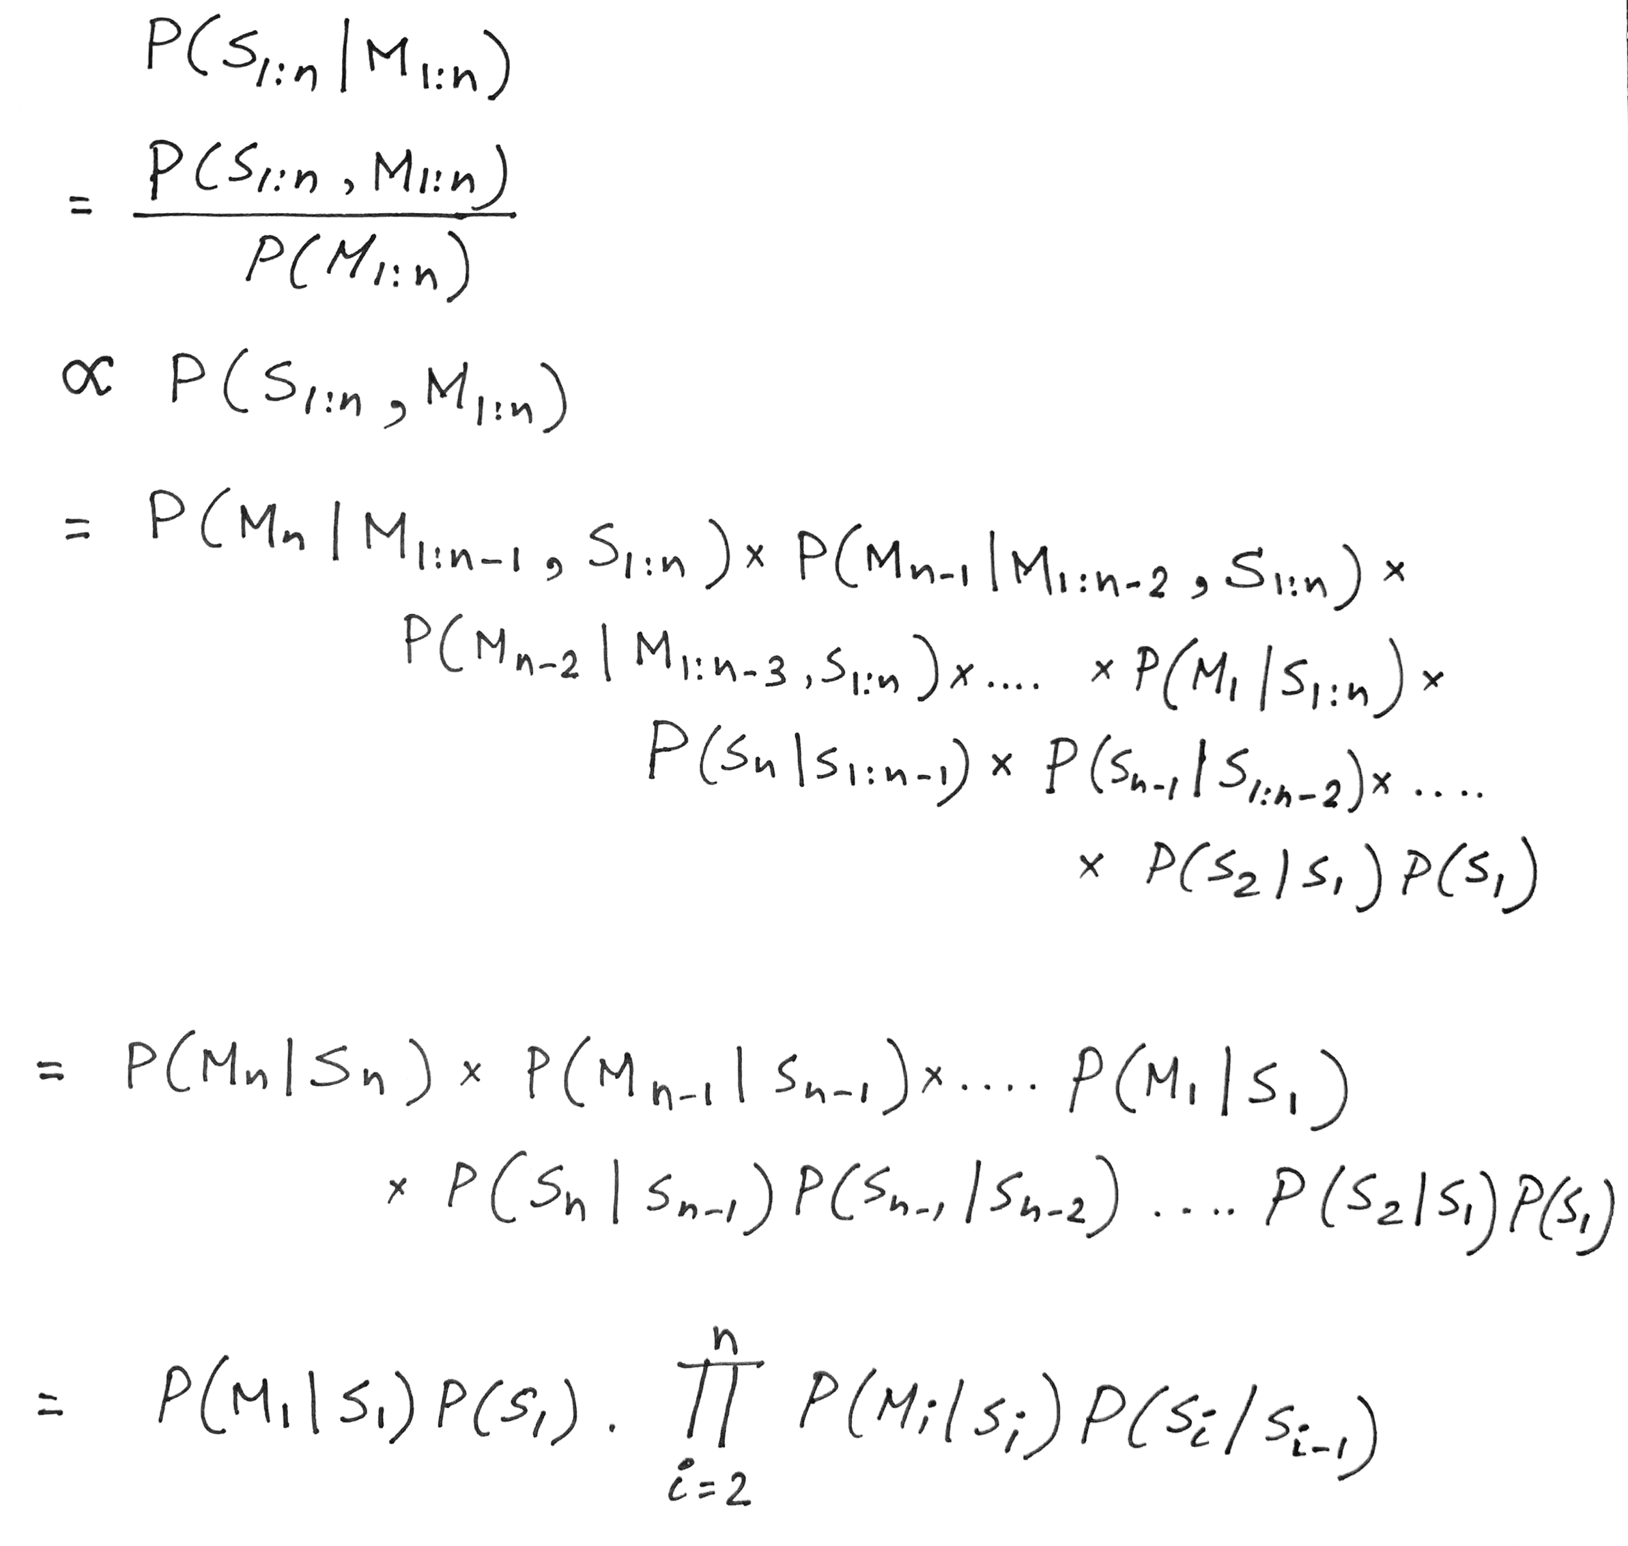
Hidden Markov Model: Definition
For N hidden states and a sequence of T observations, N^{T} different combinations

Slide 9
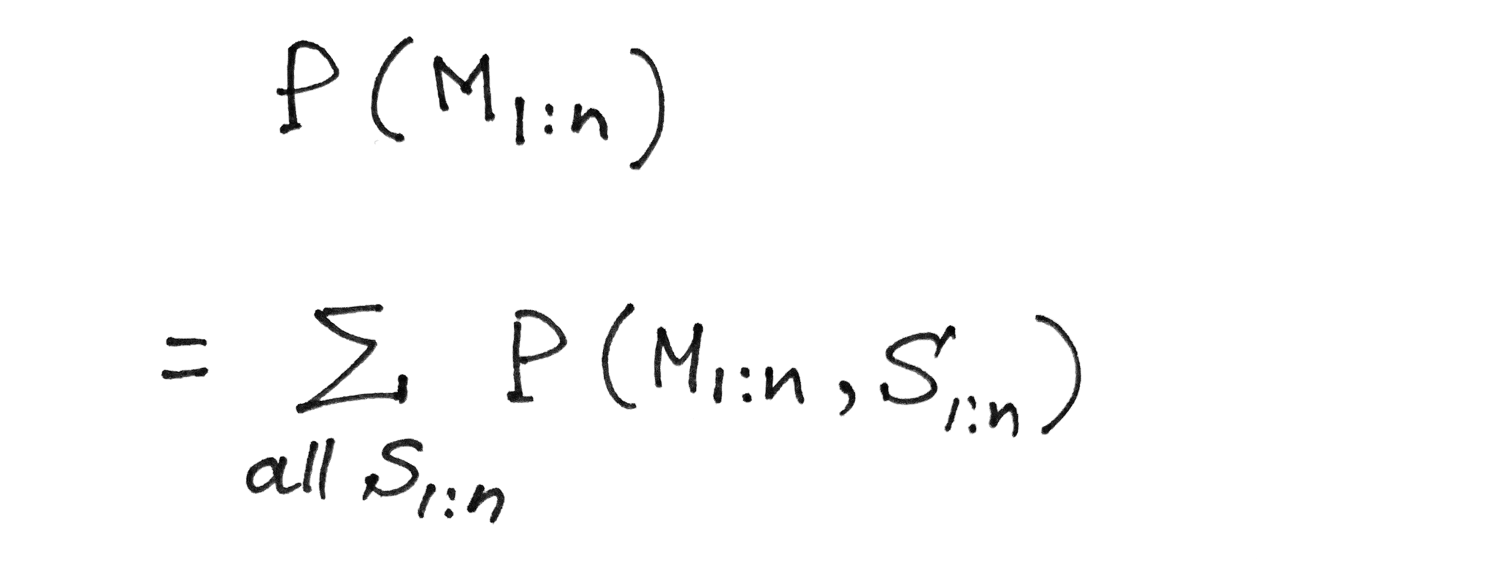
Hidden Markov Model: Definition
Probability of a given observation/measurement sequence
Marginal probability rule

Slide 10
Hidden Markov Model: Definition
Probability of a given observation/measurement sequence
Summation over all possible
combinations of hidden states

Slide 11
Hidden Markov Model: Definition
Probability of a given observation/measurement sequence
Summation over all possible
combinations of hidden states
For N hidden states and a sequence of T observations,
N^{T} different combinations

Slide 12
Hidden Markov Model: Definition
Forward-backward algorithm.
Viterbi algorithm

Slide 13
Problems solved by HMM
1) Likelihood:
  Determine the likelihood of an observation sequence.
2) Decoding:
  Given an observation sequence, determine the best sequence of hidden states.
[Viterbi algorithm]
[Forward-backward algorithm]
[Baum-Welch algorithm]
3) Learning:
  Given an observation sequence and a sequence of states, learn the HMM parameters:
  i) Transition probabilities
  ii) Emission probabilities

Slide 14
Problems solved by HMM
1) Likelihood:
  Determine the likelihood of an observation sequence.
2) Decoding:
  Given an observation sequence, determine the best sequence of hidden states.
[Viterbi algorithm]
[Forward-backward algorithm]
[Baum-Welch algorithm]
3) Learning:
  Given an observation sequence and a sequence of states, learn the HMM parameters:
  i) Transition probabilities
  ii) Emission probabilities

Slide 15
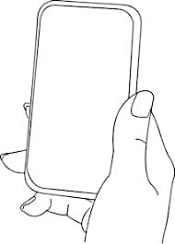
A simple gesture recognition example
States:
Observations:
No
Call
Call
Near
Far
Notes:
http://www.davidsbatista.net/assets/documents/posts/2017-11-11-hmm_viterbi_mini_example.pdf

Slide 16
A simple gesture recognition example
Start
End
St
No
Call
Call
Near
Far
Near
Far

Slide 17
A simple gesture recognition example
 | Call | NoCall | End
Start | 0.7 | 0.3 | 0
Call | 0.2 | 0.7 | 0.1
NoCall | 0.7 | 0.2 | 0.1
 | St | Near | Far
Start | 1 | 0 | 0
Call | 0 | 0.7 | 0.3
NoCall | 0 | 0.4 | 0.6
State transition
probabilities
Emission
probabilities

Slide 18
A simple gesture recognition example
Emission states are: Near, Far, Far
What is the hidden state sequence?

Slide 19
A simple gesture recognition example
i = 1 2 3
Call
Call
Call
Start
End
No
Call
No
Call
No
Call
St
Near
Far
Far

Slide 20
Hidden Markov Model: Definition

Slide 21
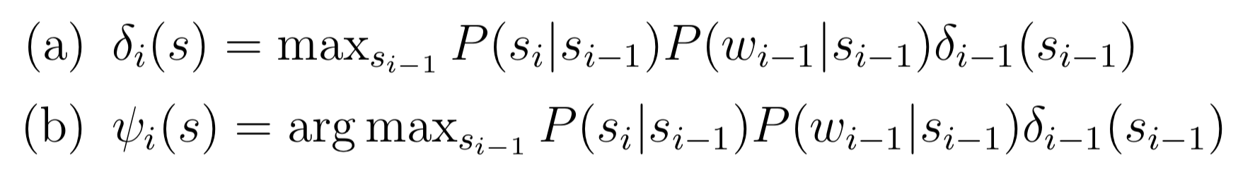

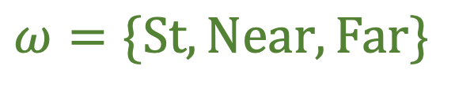

A simple gesture recognition example
Save two parameters per iteration, per state:
Recursion
$$Initialize, δ0\left(Start\right)=1$$
$$S=\{Start, Call, NoCall, End\}$$
$$ω=\{St, Near, Far\}$$
[Ref] http://www.davidsbatista.net/assets/documents/posts/2017-11-11-hmm_viterbi_mini_example.pdf

Slide 22
A simple gesture recognition example
i = 1 2 3
Call
Call
Call
Start
End
No
Call
No
Call
No
Call
St
Near
Far
Far

Slide 23




A simple gesture recognition example
i = 1
 | Call | NoCall | End
Start | 0.7 | 0.3 | 0
Call | 0.2 | 0.7 | 0.1
NoCall | 0.7 | 0.2 | 0.1
Call
State transition probabilities
Start
$$δ0\left(Start\right)=1$$
 | St | Near | Far
Start | 1 | 0 | 0
Call | 0 | 0.7 | 0.3
NoCall | 0 | 0.4 | 0.6
No
Call
St
Near
Emission probabilities

Slide 24




A simple gesture recognition example
i = 1 2
Call
Call
Start
No
Call
No
Call
Near
Far

Slide 25





A simple gesture recognition example
i = 1 2 3
0.14406
Call
Call
Call
0.0043
Start
0.343
0.04116
End
No
Call
No
Call
No
Call
Near
Far
Far

Slide 26
A simple gesture recognition example
i = 1 2 3
Call
Call
Call
The values of delta and psi are not correct on this slide. Please refer to the calculation shown at the following link.
http://www.cs.umd.edu/class/fall2020/cmsc818w/course_materials/slides/Viterbi_solution.pdf
Start
End
No
Call
No
Call
No
Call
Near
Far
Far

Slide 27
A simple gesture recognition example
i = 1 2 3
0.14406
Call
Call
Call
0.0043
Start
0.343
0.04116
End
No
Call
No
Call
No
Call
Near
Far
Far

Slide 28
A simple gesture recognition example
i = 1 2 3
0.14406
Call
Call
Call
0.0043
Start
0.343
0.04116
End
No
Call
No
Call
No
Call
Near
Far
Far

Slide 29
A simple gesture recognition example
i = 1 2 3
0.14406
Call
Call
Call
For complete step by step solution of this example visit:
http://www.cs.umd.edu/class/fall2021/cmsc715/course_materials/slides/Viterbi_solution.pdf
0.0043
Start
0.343
0.04116
End
No
Call
No
Call
No
Call
Viterbi sequence: < Call, NoCall, Call >
P( <Call, NoCall, Call > | <Near, Far, Far>) = 0.0043
Near
Far
Far

Slide 30
Sample applications of statistical inference in IoT

Slide 31
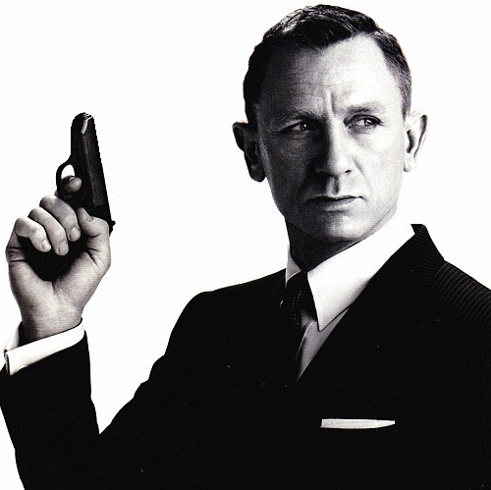
MoLe
Motion Leaks through Smartwatch Sensors
He Wang
Ted Tsung-Te Lai
Romit Roy Choudhury
UIUC
MobiCom’15 Presentation

Slide 32
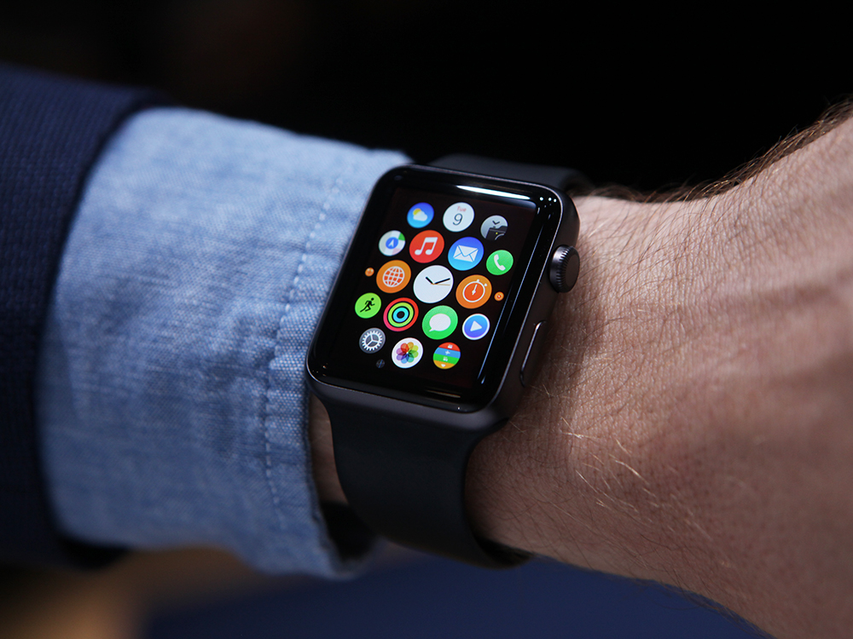
Your Watch Knows About You
More Than You Think?

Slide 33
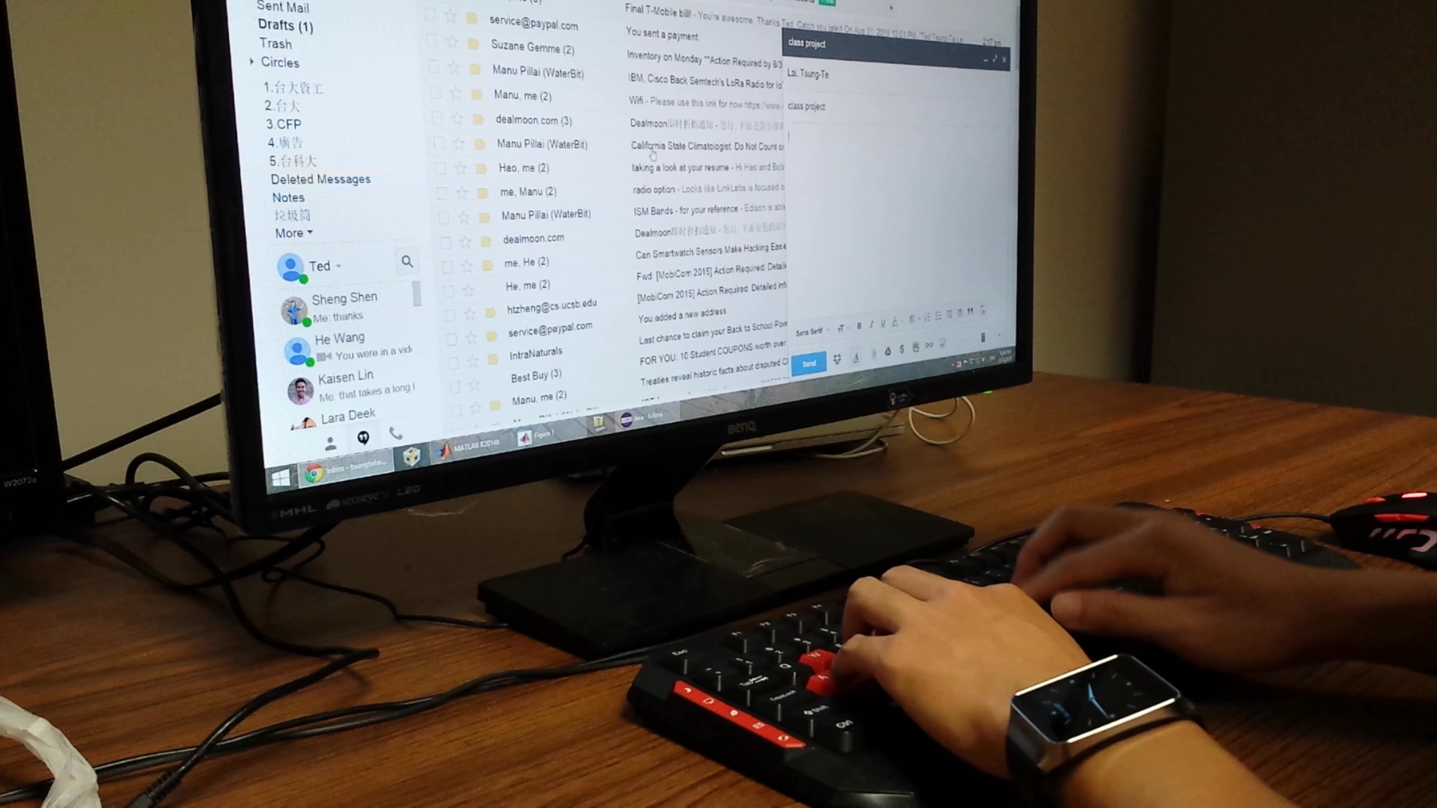
Watch = Spy? Monitor Typing in Background?

Slide 34
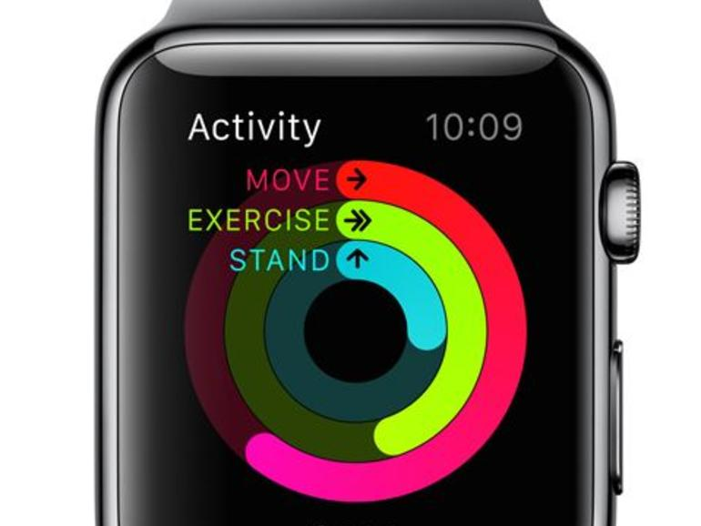
Watch motion sensor to infer input words?

Slide 35
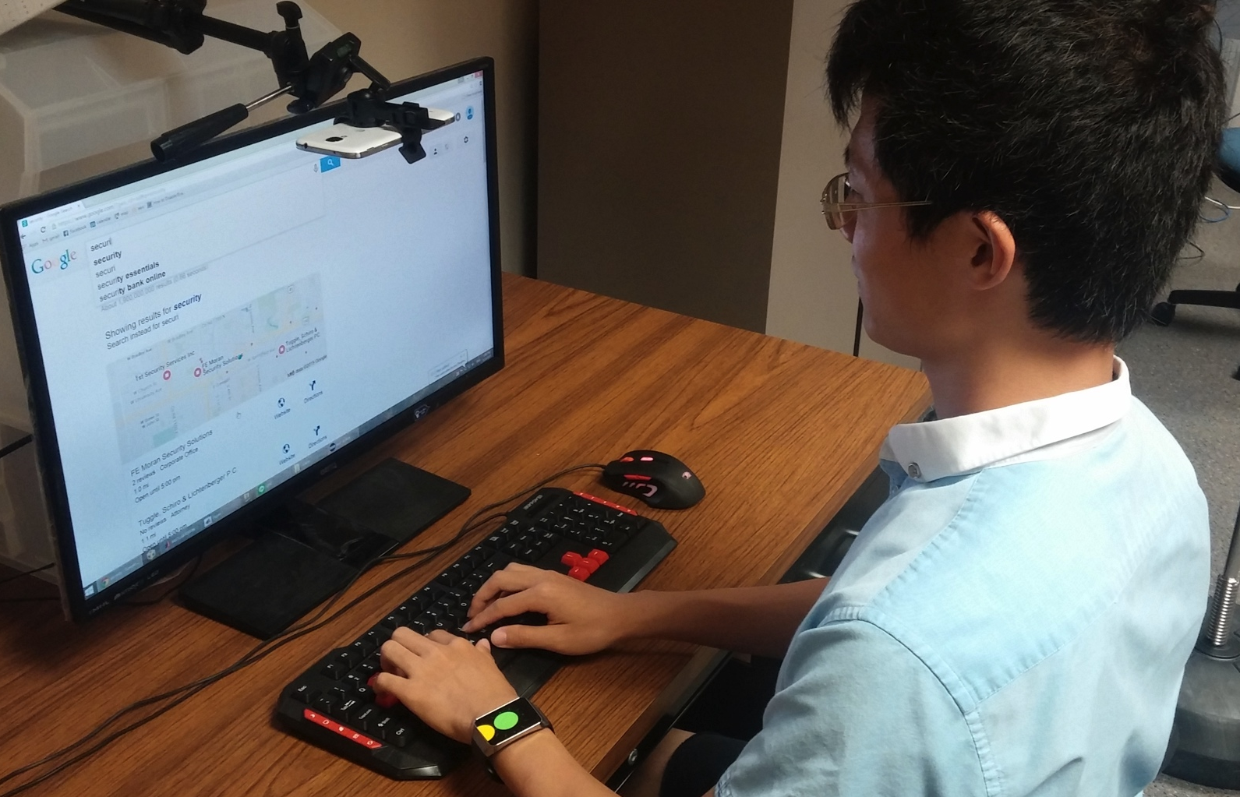
Understand Human Typing

Slide 36
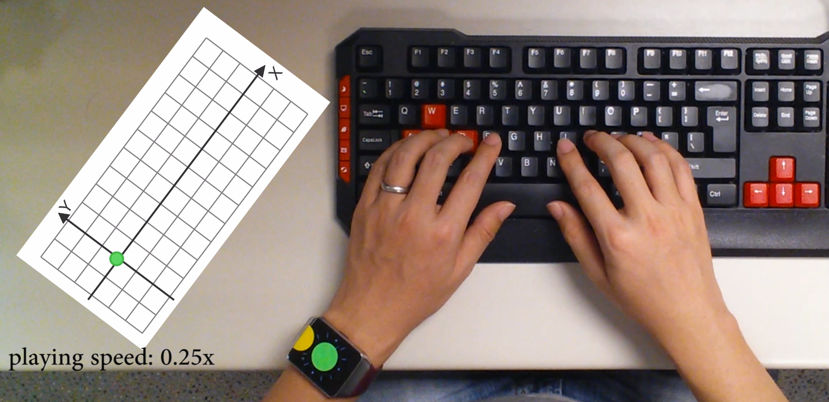
Correlation Between Watch Movement and keystrokes
watch
movement
groundtruth

Slide 37
Design Challenges
Noisy sensor data
Watch location ≠ keystroke
Information from the other hand is missing

Slide 38

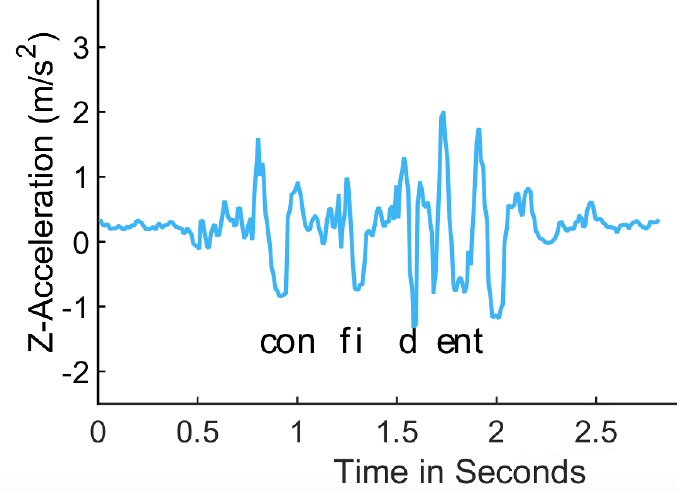
Keystroke Time
Use z-acceleration to infer keystroke time
true positive
false positive
Z-acceleration

Slide 39
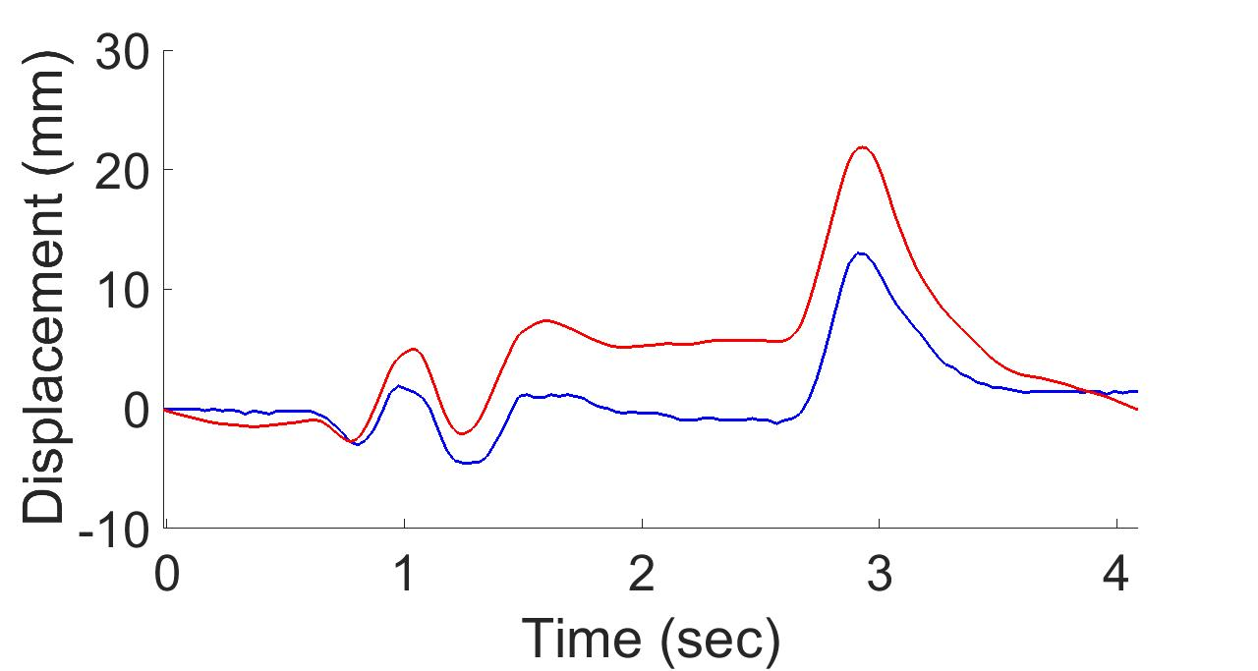
Watch Displacement
Use Android linear acceleration to estimate watch displacement
Android API
ground truth

Slide 40
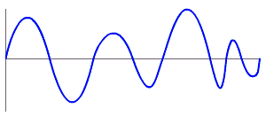
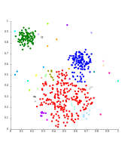
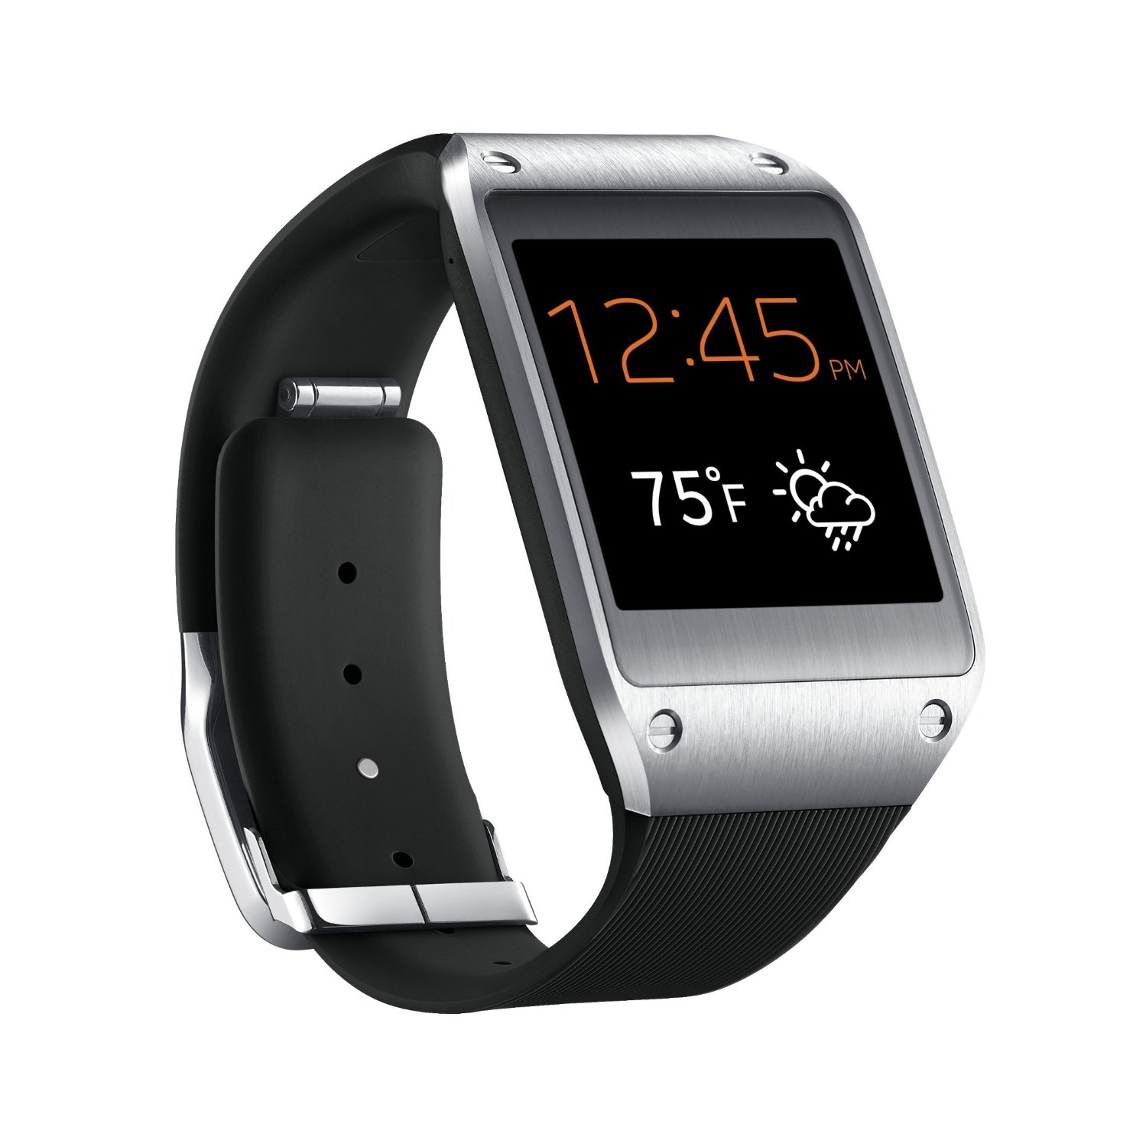
MoLe Architecture
Keystroke
Detector
Time
Location
User Data

Slide 41
Design Challenges
Noisy sensor data
Watch location ≠ keystroke
Information from the other hand is missing

Slide 42
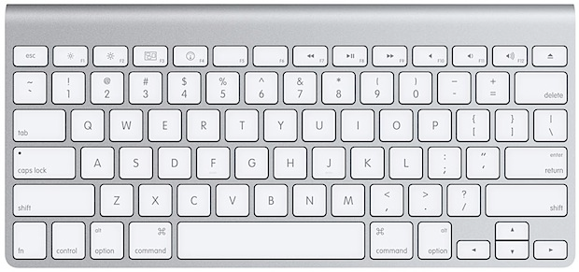
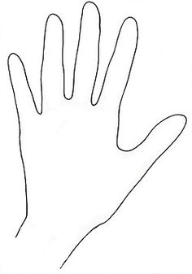
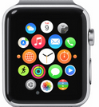
Watch Location ≠ Keystroke
Y Displacement
0
-10
20
X Displacement
Y Displacement (mm)
10
0
-10
-10 0 10 20
X Displacement (mm)

Slide 43
Watch Location ≠ Keystroke
Groundtruth location
20
Y Displacement (mm)
10
0
c
-10
-10 0 10 20
X Displacement (mm)

Slide 44
Watch Location ≠ Keystroke
Groundtruth location
20
Y Displacement (mm)
10
c
0
c
-10
-10 0 10 20
X Displacement (mm)

Slide 45
Watch Location ≠ Keystroke
Groundtruth location
20
Y Displacement (mm)
10
0
x
c
-10
-10 0 10 20
X Displacement (mm)

Slide 46
Watch Location ≠ Keystroke
Groundtruth location
20
Y Displacement (mm)
10
c
x
0
x
c
-10
-10 0 10 20
X Displacement (mm)

Slide 47
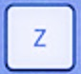
Watch Location ≠ Keystroke
Groundtruth location
20
Y Displacement (mm)
10
0
x
z
c
-10
-10 0 10 20
X Displacement (mm)

Slide 48
Watch Location ≠ Keystroke
Groundtruth location
20
Y Displacement (mm)
10
z
c
cluster
x
0
x
z
c
-10
-10 0 10 20
X Displacement (mm)

Slide 49
Watch Location ≠ Keystroke
Groundtruth location
20
q
Y Displacement (mm)
r
10
w
e
a
d
s
f
0
b
t
x
g
z
c
v
-10
-10 0 10 20
X Displacement (mm)

Slide 50
Watch Location ≠ Keystroke
Unlabeled keystrokes
20
Y Displacement (mm)
10
0
-10
-10 0 10 20
X Displacement (mm)

Slide 51
MoLe Architecture
Keystroke
Detector
Time
Location
User Data

Slide 52
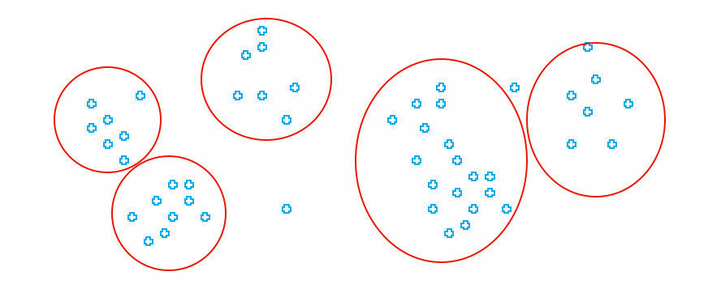
MoLe Architecture
Attacker Training Data
Attacker Point Cloud
a b c d
Keystroke
Detector
Point
Cloud
Fitting
Time
Location
Unlabeled Point Cloud
User Data

Slide 53
Design Challenges
Noisy sensor data
Watch location ≠ keystroke
Information from the other hand is missing

Slide 54
Right Hand Keystrokes Are Missing

Slide 55
MoLe Architecture
Attacker Training Data
Attacker Point Cloud
a b c d
Keystroke
Detector
Point
Cloud
Fitting
Time
Location
Unlabeled Point Cloud
User Data

Slide 56

MoLe Architecture
Attacker Training Data
Rank of Word_{i}
Attacker Point Cloud
a b c d
Keystroke
Detector
Point
Cloud
Fitting
Bayesian
Inference
P(O|W_{i})
Time
Location
Word W_{i}
Unlabeled Point Cloud
Observation ( O )
User Data
Dictionary

Slide 57
Outline
Motivation & Challenge
MoLe
  Keystroke detectors
  Point cloud fitting
  Bayesian inference
Evaluation
Limitations
Conclusion

Slide 58
MoLe Architecture
Attacker Training Data
Rank of Word_{i}
Attacker Point Cloud
a b c d
Keystroke
Detector
Point
Cloud
Fitting
Bayesian
Inference
P(O|W_{i})
Time
Location
Word W_{i}
Unlabeled Point Cloud
Observation ( O )
User Data
Dictionary

Slide 59
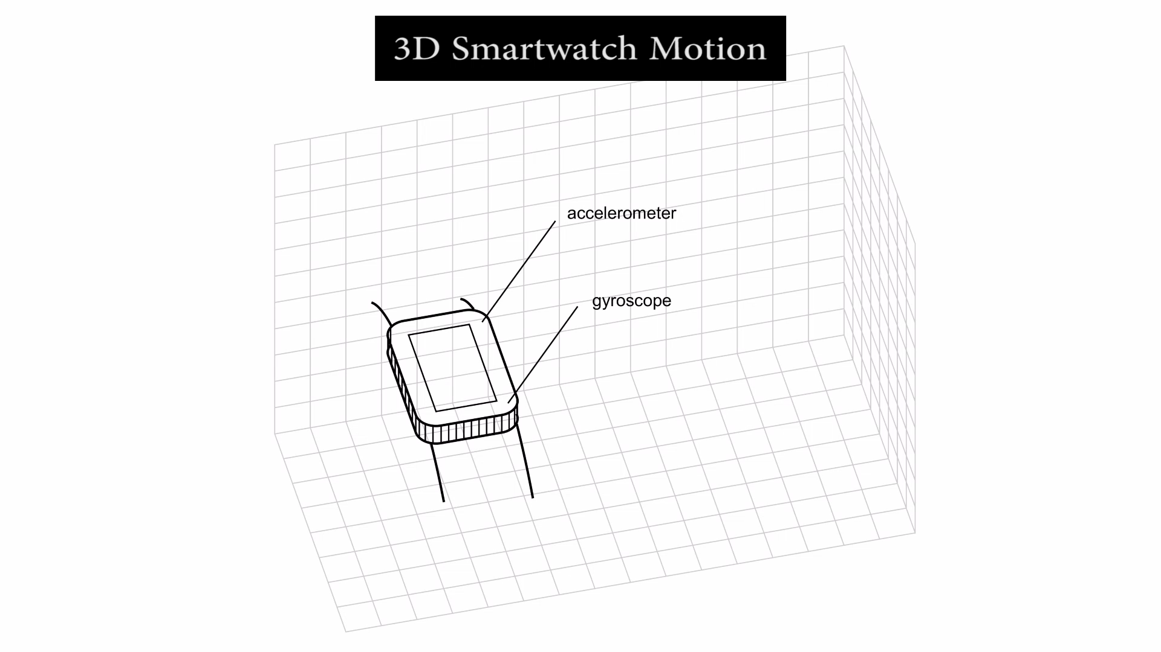
Keystroke Detector

Slide 60
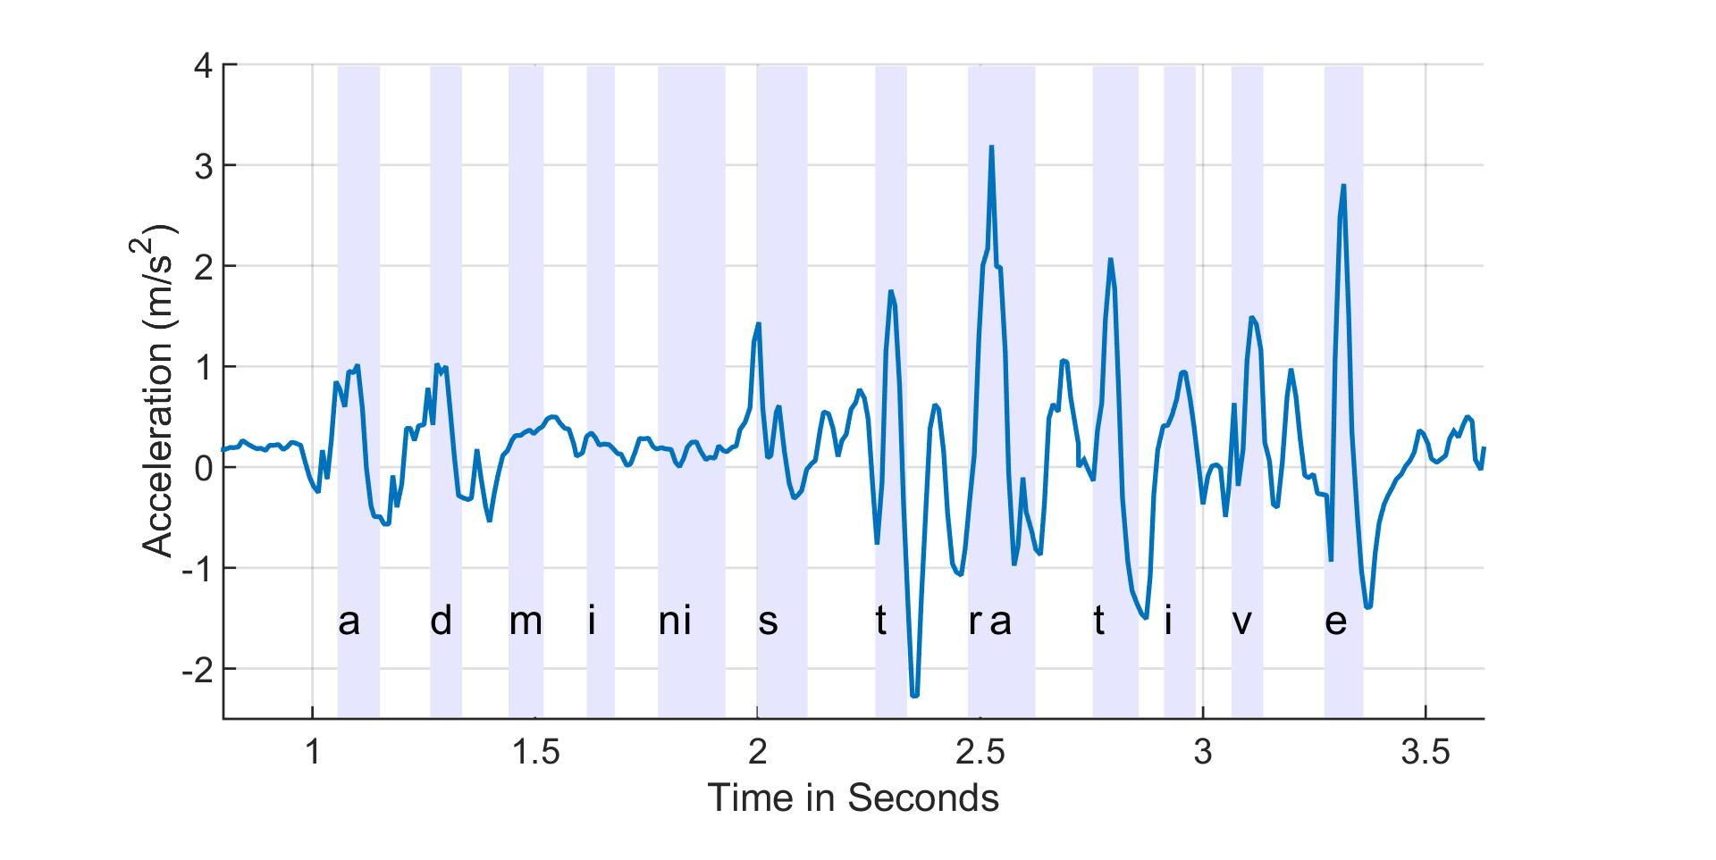
Keystroke Detector - Time
Z-acceleration
z-axis linear acceleration

Slide 61
Keystroke Detector - Time
Peak detection generates errors
z-axis linear acceleration
true detection
false detection

Slide 62
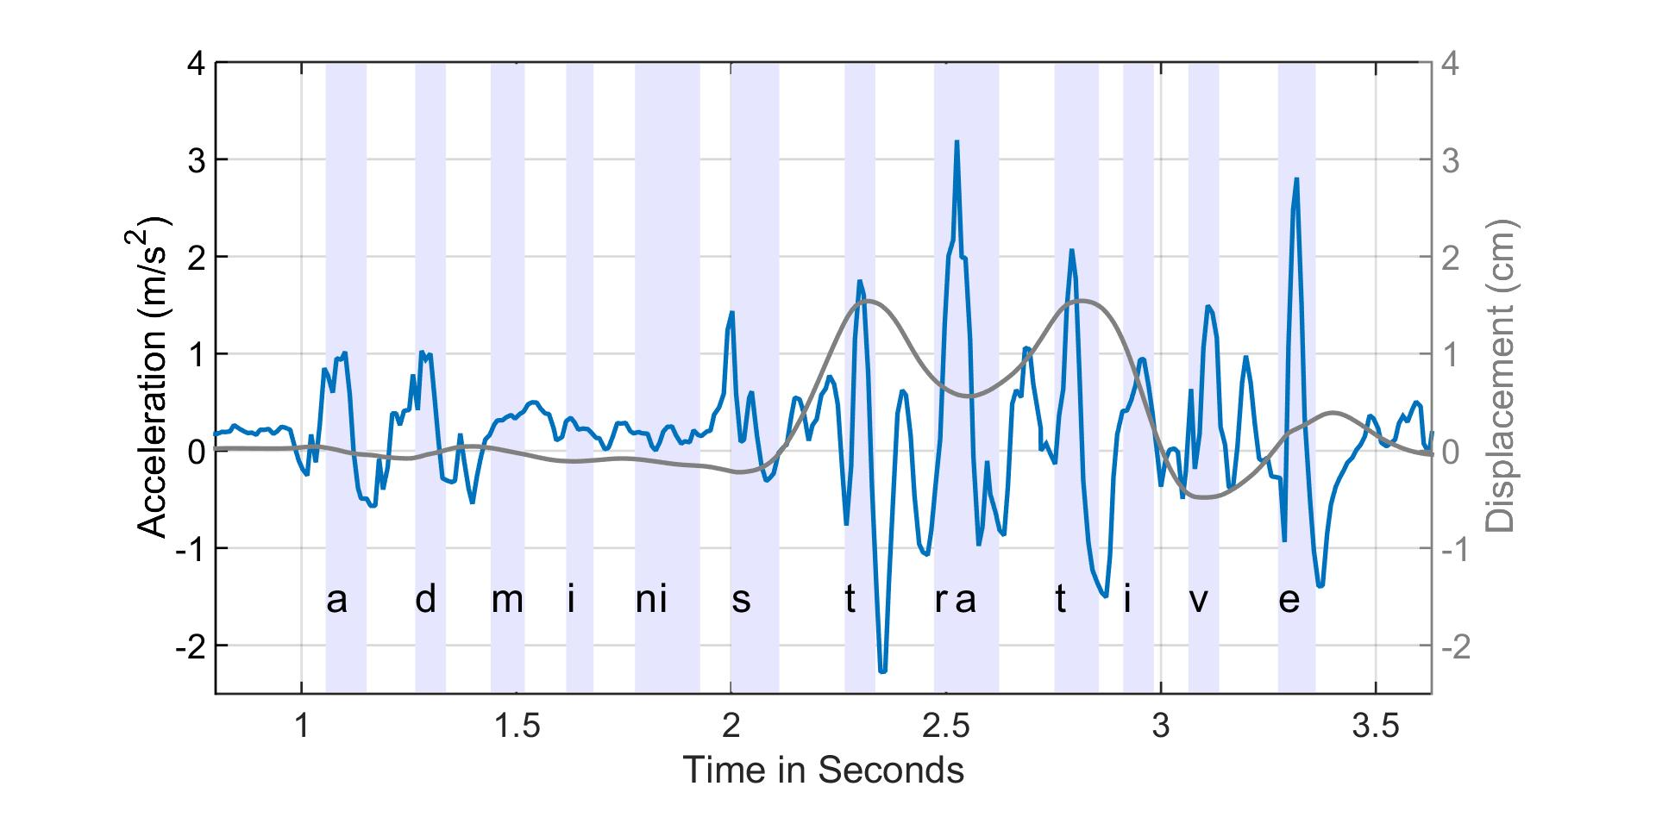
Keystroke Detector - Time
Peak detection generates errors
z-axis linear acceleration
x-axis displacement
true detection
false detection

Slide 63
Keystroke Detector - Time
Use a low threshold peak detection to generate candidates
z-axis linear acceleration
candidates

Slide 64
Keystroke Detector - Time
Apply bagged decision tree to classify keystrokes
z-axis linear acceleration
keystroke
non-keystroke

Slide 65
Keystroke Detector - Time
True positive False positive

Slide 66
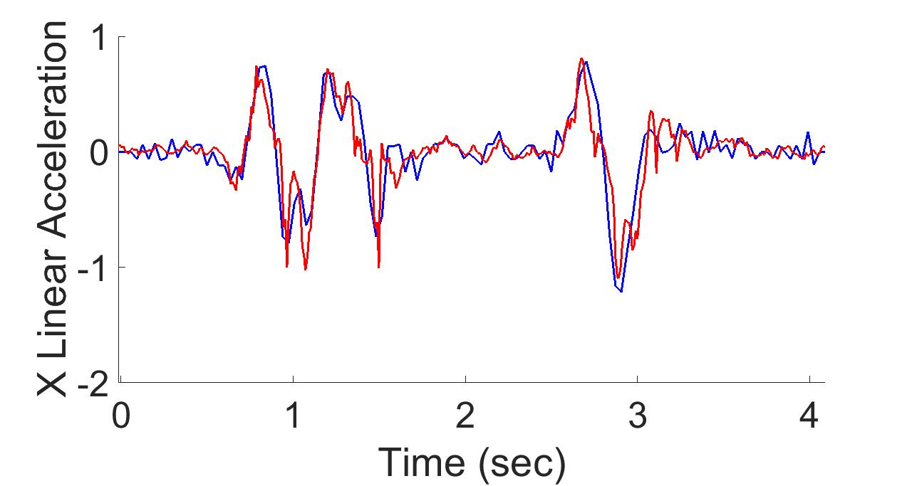
Keystroke Detector - Displacement
ground truth
Android API
double integral with mean removal

Slide 67
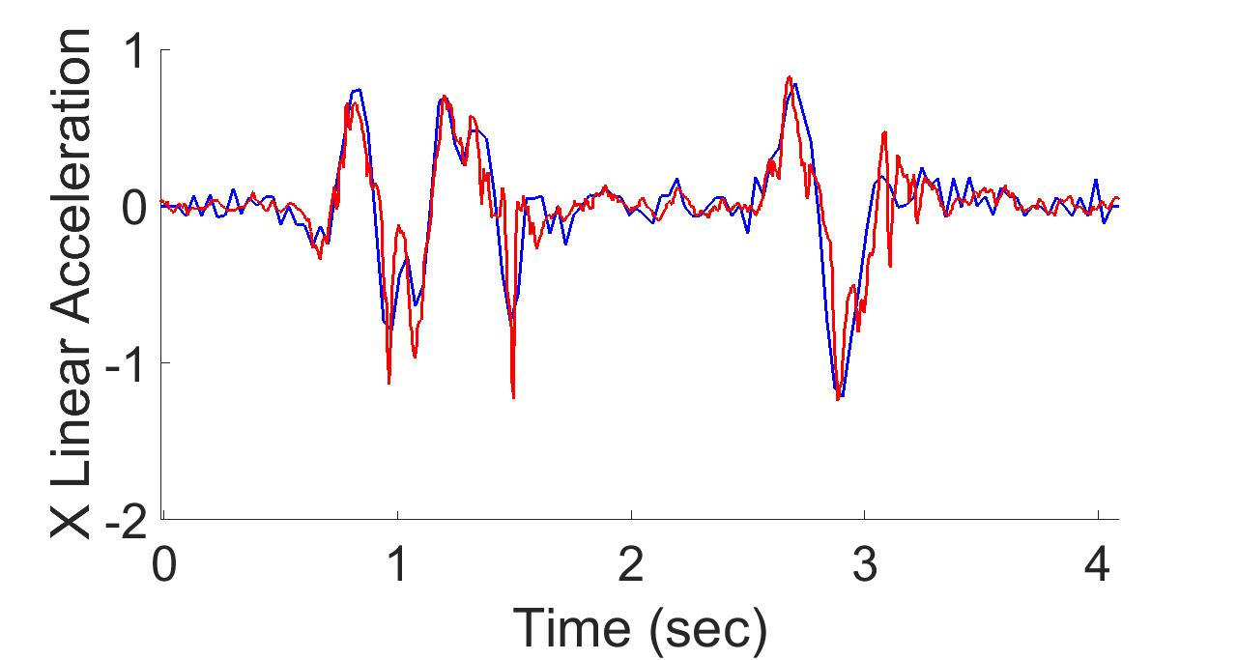
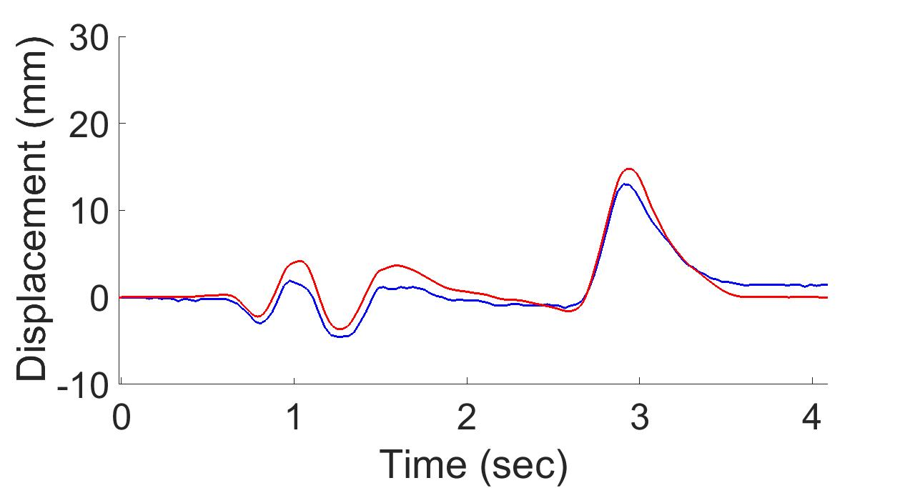
Keystroke Detector - Displacement
ground truth
MoLe
- use gyro to estimate and remove gravity
(with Kalman filter)
double integral with mean removal

Slide 68
Keystroke Detector - Displacement
Mole median error < 1.5mm
Android median error < 2.5mm

Slide 69
MoLe Architecture
Attacker Training Data
Rank of Word_{i}
Attacker Point Cloud
a b c d
Keystroke
Detector
Point
Cloud
Fitting
Bayesian
Inference
P(O|W_{i})
Time
Location
Word W_{i}
Unlabeled Point Cloud
Observation ( O )
User Data
Dictionary

Slide 70
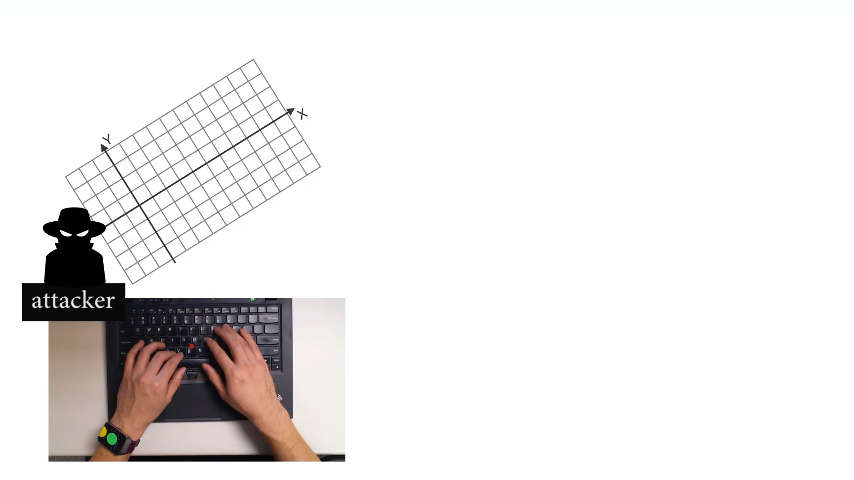
Point Cloud Fitting

Slide 71
Point Cloud Fitting
attacker training data
20
Y Displacement (mm)
Q
10
W
0
A
T
X
-10
-10 0 10 20
X Displacement (mm)

Slide 72
Point Cloud Fitting
user data (unlabeled)
attacker training data
20
Y Displacement (mm)
Q
10
W
0
A
T
X
-10
-10 0 10 20
X Displacement (mm)

Slide 73
Point Cloud Fitting
user data (unlabeled)
attacker training data
20
Y Displacement (mm)
Find convex hulls and centroids
10
0
-10
-10 0 10 20
X Displacement (mm)

Slide 74
Point Cloud Fitting
user data (unlabeled)
attacker training data
20
Y Displacement (mm)
Q
Find convex hulls and centroids
Rotate and scale
10
W
0
A
T
X
-10
-10 0 10 20
X Displacement (mm)

Slide 75
MoLe Architecture
Attacker Training Data
Rank of Word_{i}
Attacker Point Cloud
a b c d
Keystroke
Detector
Point
Cloud
Fitting
Bayesian
Inference
P(O|W_{i})
Time
Location
Word W_{i}
Unlabeled Point Cloud
Observation ( O )
User Data
Dictionary

Slide 76


Bayesian Inference
Input “confident”
Observed
watch motion
MoLe output list
Rank | word guess
1 | confident
2 | consider
3 | commander
… | …
4999 | are
5000 | is
Compute
likelihood
word₁
word₂
word₃
…
word₄₉₉₉
word₅₀₀₀

Slide 77
Bayesian Inference
prob of observation
W_{i}: Candidate word_{i} in dictionary
O: Motion observation

Slide 78
Bayesian Inference
word frequency
W_{i}: Candidate word_{i} in dictionary
O: Motion observation

Slide 79
Bayesian Inference
Likelihood function
W_{i}: Candidate word_{i} in dictionary
O: Motion observation

Slide 80
Observations
Number of keystrokes
Location of keystrokes
Time interval between keystrokes

Slide 81
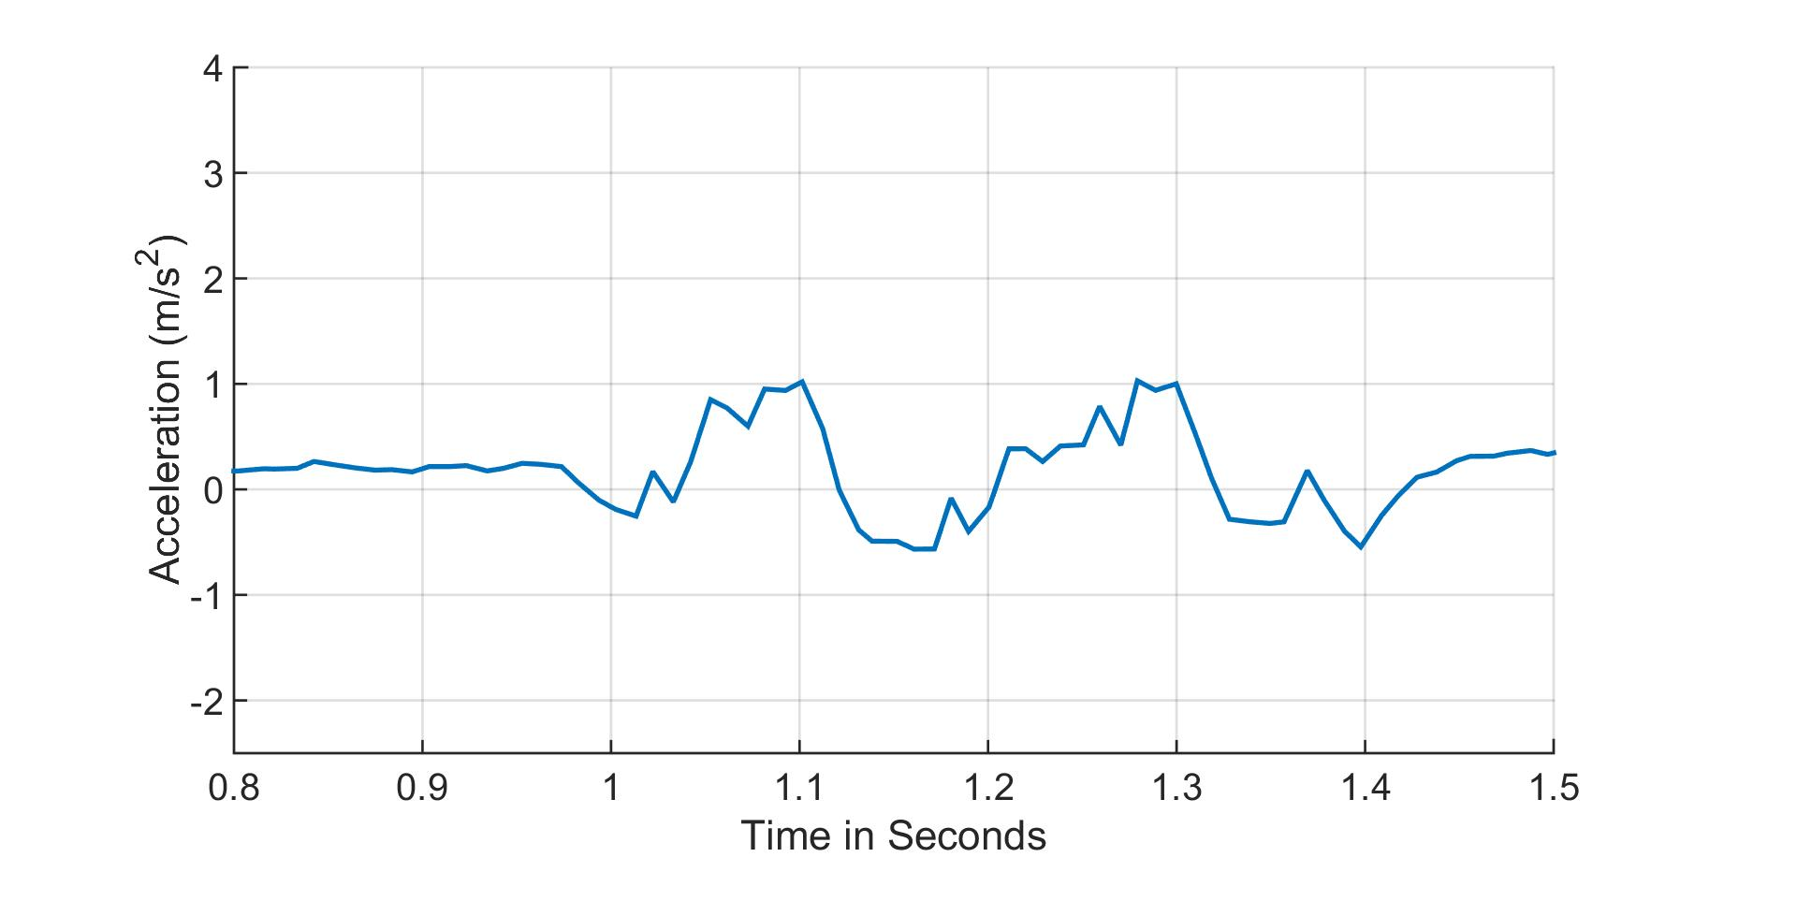
Observation 1: Number of Keystrokes
likely
the (2)
fine (2)
2 keystrokes
detected
unlikely
administrative (9)
comprehensive (7)
keystroke

Slide 82
Observation 2: Location of Keystrokes
Point cloud (after fitting with training data)
20
Y Displacement (mm)
10
0
-10
-10 0 10 20
X Displacement (mm)

Slide 83
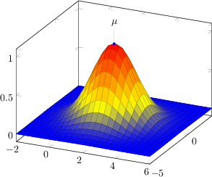
Observation 2: Location of Keystrokes
Model each keystroke location as Gaussian distribution
Point cloud (after fitting with training data)
20
q
Y Displacement (mm)
r
10
w
e
a
d
s
f
0
b
t
x
g
v
c
z
-10
-10 0 10 20
X Displacement (mm)

Slide 84
Observation 2: Location of Keystrokes
Model each keystroke location as Gaussian distribution
Point cloud (after fitting with training data)
20
q
Detected keystroke location
Y Displacement (mm)
r
10
w
e
a
d
s
f
0
b
t
x
g
v
c
z
-10
-10 0 10 20
X Displacement (mm)

Slide 85
Observation 2: Location of Keystrokes
Model each keystroke location as Gaussian distribution
Point cloud (after fitting with training data)
20
q
Detected keystroke location
Y Displacement (mm)
r
10
w
e
a
d
s
f
0
b
t
x
g
v
c
z
-10
-10 0 10 20
X Displacement (mm)

Slide 86
Observation 2: Location of Keystrokes
v->a
Location of v and r is different
20
Y Displacement (mm)
10
r->a
r->a
0
v->a
-10
-10 0 10 20
X Displacement (mm)

Slide 87
Observation 3: Time Interval
z-axis linear acceleration
keystroke
87

Slide 88
Observation 3: Time Interval
z-axis linear acceleration
keystroke
0.6 sec
88

Slide 89
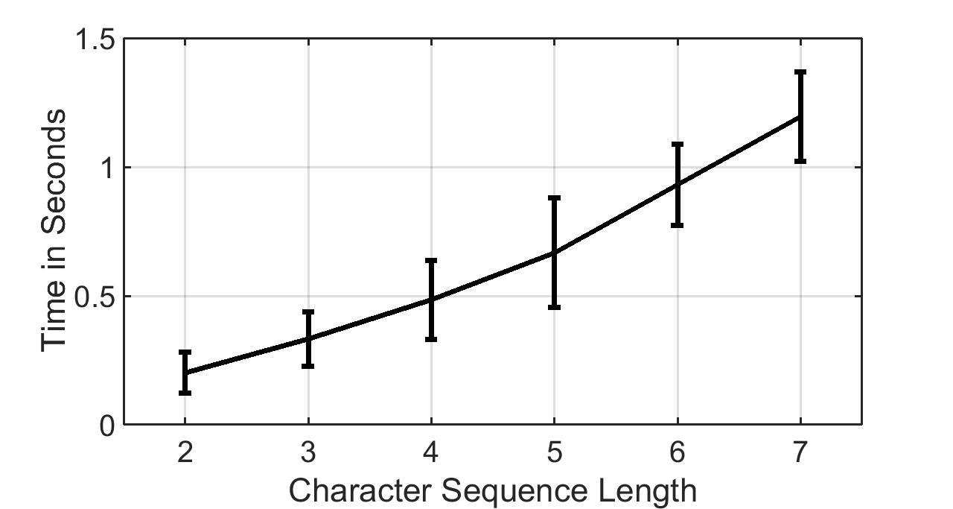
Observation 3: Time Interval
LL LRL LRRL LRRRL LRRRRL LRRRRRL

Slide 90
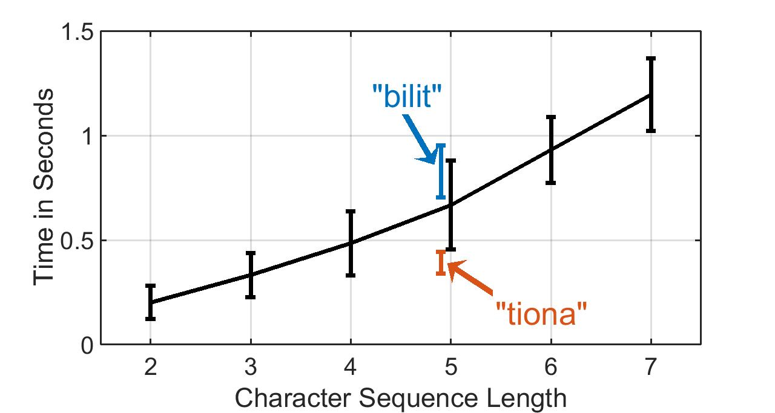
Observation 3: Time Interval

Slide 91
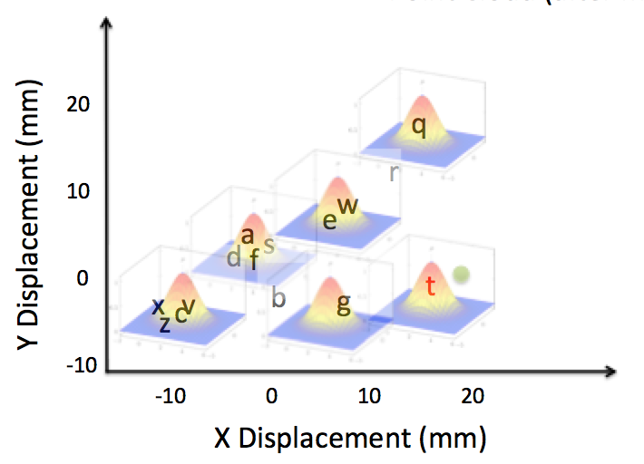
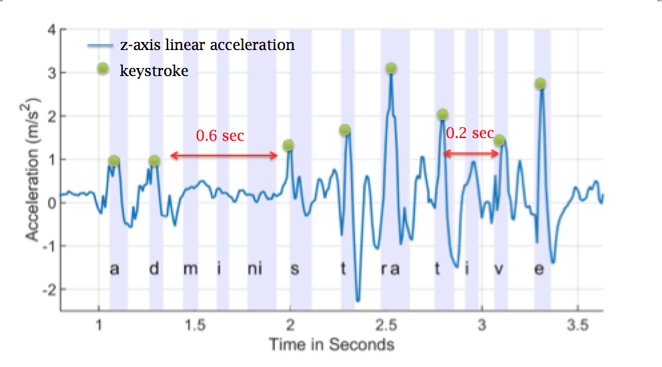
Bayesian Inference
The probability of the observed motion given word_{i}
Number of keystrokes
Location distribution
Time interval distribution

Slide 92
Outline
Motivation & Challenge
MoLe
Evaluation
Limitations
Conclusion

Slide 93
Experimental Setup
Samsung Galaxy Gear Live with Android Wear
  Sample accl and gyro at 200Hz
  Off-line Matlab analysis
8 Participants
  5 native speakers, 3 non-native speakers
  300 words for each subject, 2400 words total
  Words are randomly selected from 5000 most frequently used words
2 labeled point clouds (training data)
  2 persons collect offline data with Top-500 longest words

Slide 94
Evaluation Metrics
How well can Mole guess each word?
Observation improvements
Recovery via human observation

Slide 95
Rank CDF
Median rank = 24, 30 percentile rank = 5 (out of 5000 words)
When word length > 6, median rank = 10

Slide 96
Avg Rank Across Users
With perfect key press detection
median rank = 6, 30 percentile rank = 1

Slide 97
Evaluation Metrics
How well can Mole guess each word?
Observation improvements
Recovery via human observation

Slide 98
Observation Improvements
340
49
24

Slide 99
Evaluation Metrics
How well can Mole guess each word?
Observation improvements
Recovery via human observation

Slide 100
Can you guess the sentence?
Rank | W1 | W2 | W3 | W4 | W5 | W6 | W7 | w8
1 | motor | pistol | profound | technology | angel | those | that | disappear
2 | monitor | list | journalism | remaining | spray | today | tight | discourse
3 | them | but | originally | telephone | super | third | tightly | secondary
4 | the | lost | original | meanwhile | fire | through | thirty | adviser
5 | then | most | profile | headline | shore | towel | truth | discover

Slide 101
Can you guess the sentence?
“The most profound technologies are those that disappear”
- Mark Weiser, 1991
Rank | W1 | W2 | W3 | W4 | W5 | W6 | W7 | w8
1 | motor | pistol | profound | technology | angel | those | that | disappear
2 | monitor | list | journalism | remaining | spray | today | tight | discourse
3 | them | but | originally | telephone | super | third | tightly | secondary
4 | the | lost | original | meanwhile | fire | through | thirty | adviser
5 | then | most | profile | headline | shore | towel | truth | discover
are

Slide 102
Outline
Motivation & Challenge
MoLe
Evaluation
Limitations
Conclusion

Slide 103
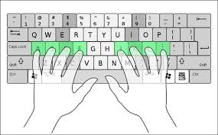
Limitations
Single word only
  Unable to detect space (could be right or left thumb)
English words only
  Digits and non-English words are not applicable
Required standard typing method

Slide 104
Outline
Motivation & Challenge
MoLe
Evaluation
Limitations
Conclusion

Slide 105
Conclusion
Mole: Motion Leaks through Smartwatch sensor
Identify leaks when using watch motion sensors to infer input words
Type a word W with length > 6, MoLe can shortlist 10 words (rank 10) on average that includes W

Slide 106
Extra slides

Slide 107
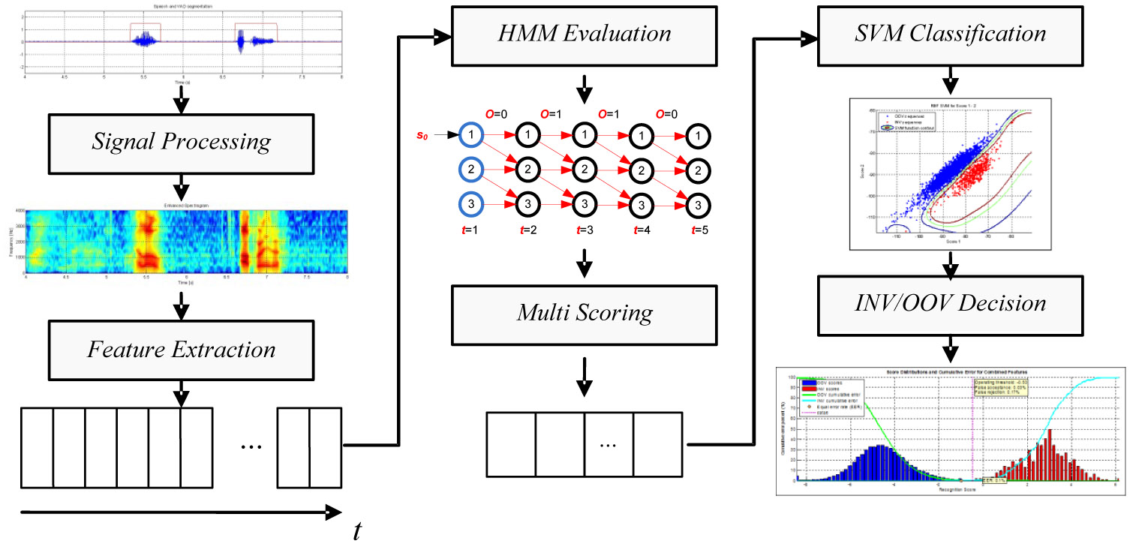

Slide 108
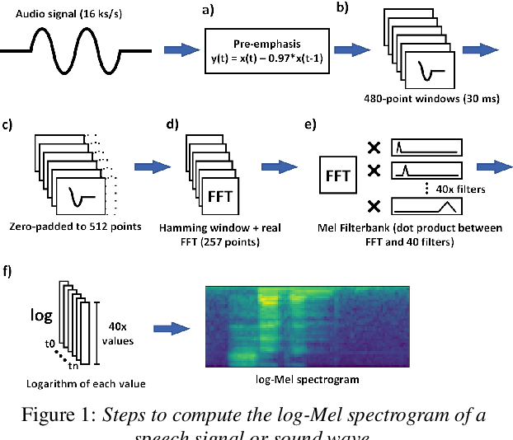

Slide 109
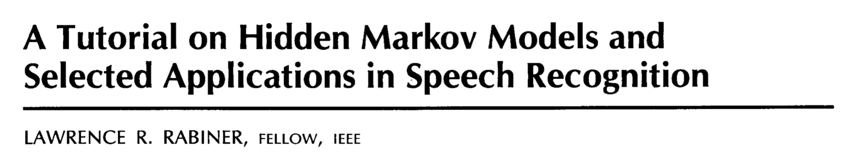

Slide 110
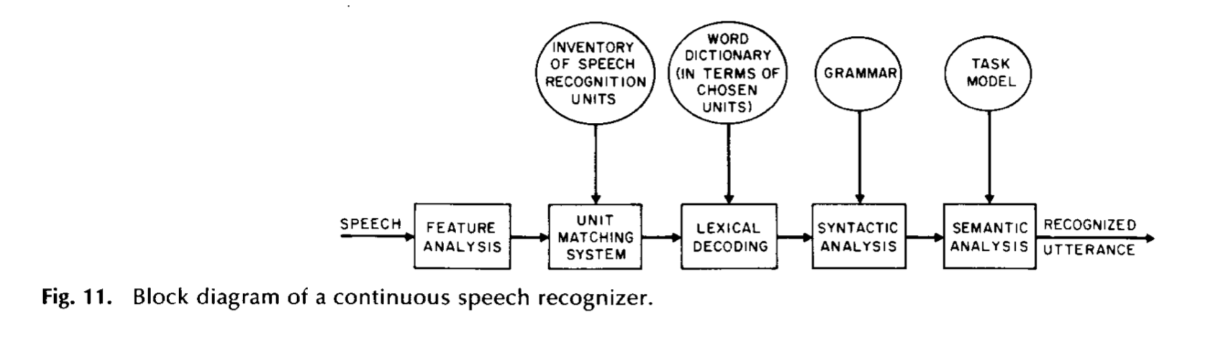

Slide 111
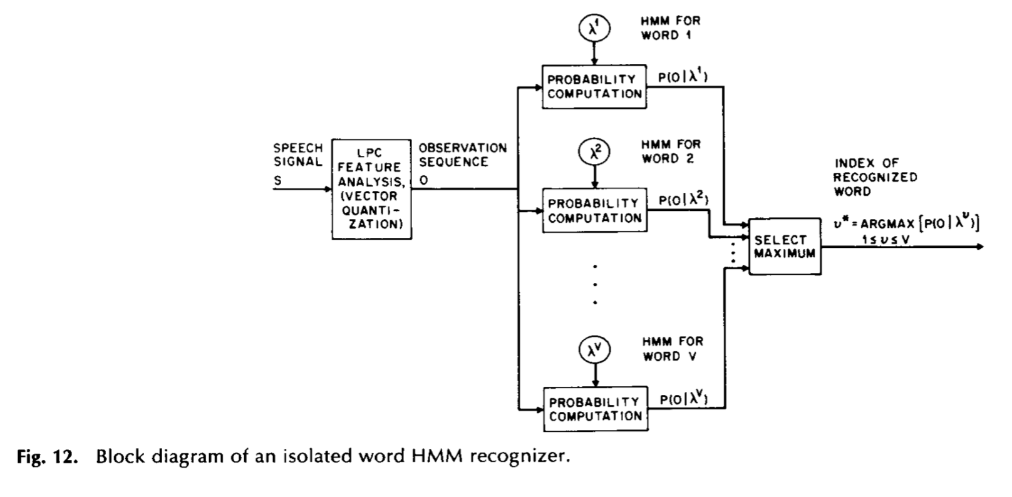

Slide 112
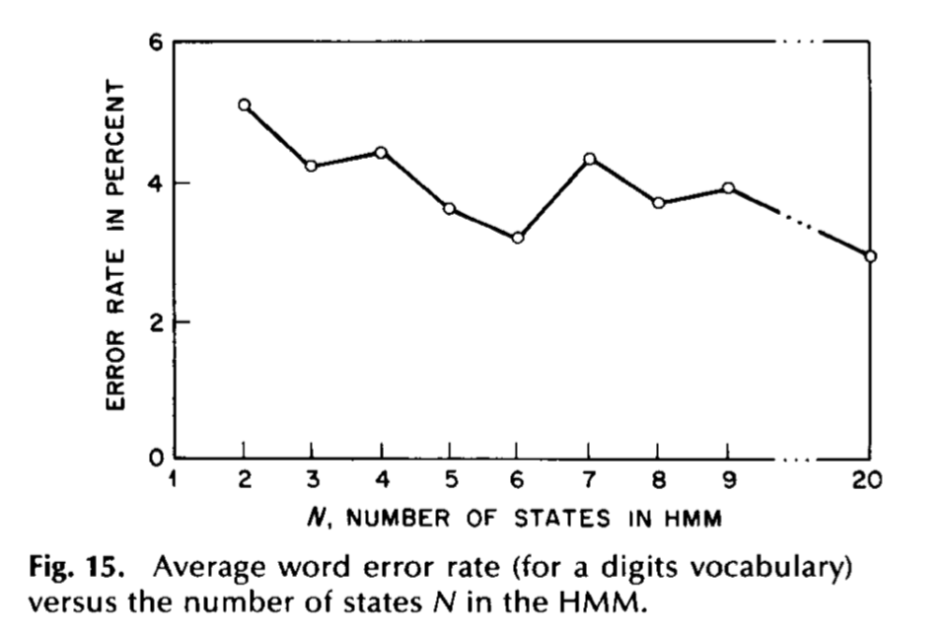

Slide 113
An Application of HMM and Viterbi Algorithm
Ref: https://www.ri.cmu.edu/pub_files/pub3/yang_jie_1994_1/yang_jie_1994_1.pdf

Slide 114
An Application of HMM and Viterbi Algorithm
Approach:
1) Define meaningful gestures
2) Describe each gesture in terms of an HMM
3) Collect base data
4) Find parameters of the HMM through base data
5) Estimate gestures with the HMM model

Slide 115
https://jonathan-hui.medium.com/speech-recognition-gmm-hmm-8bb5eff8b196

