Slide 1
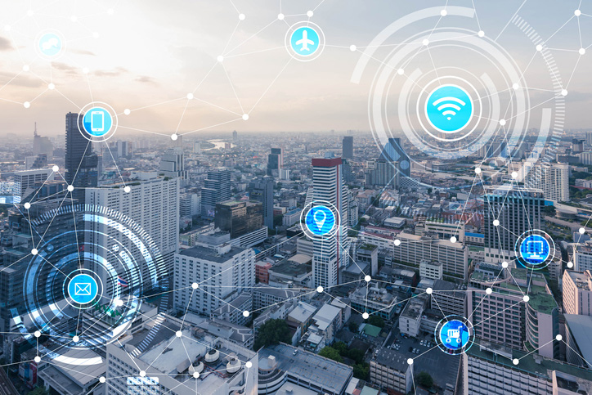
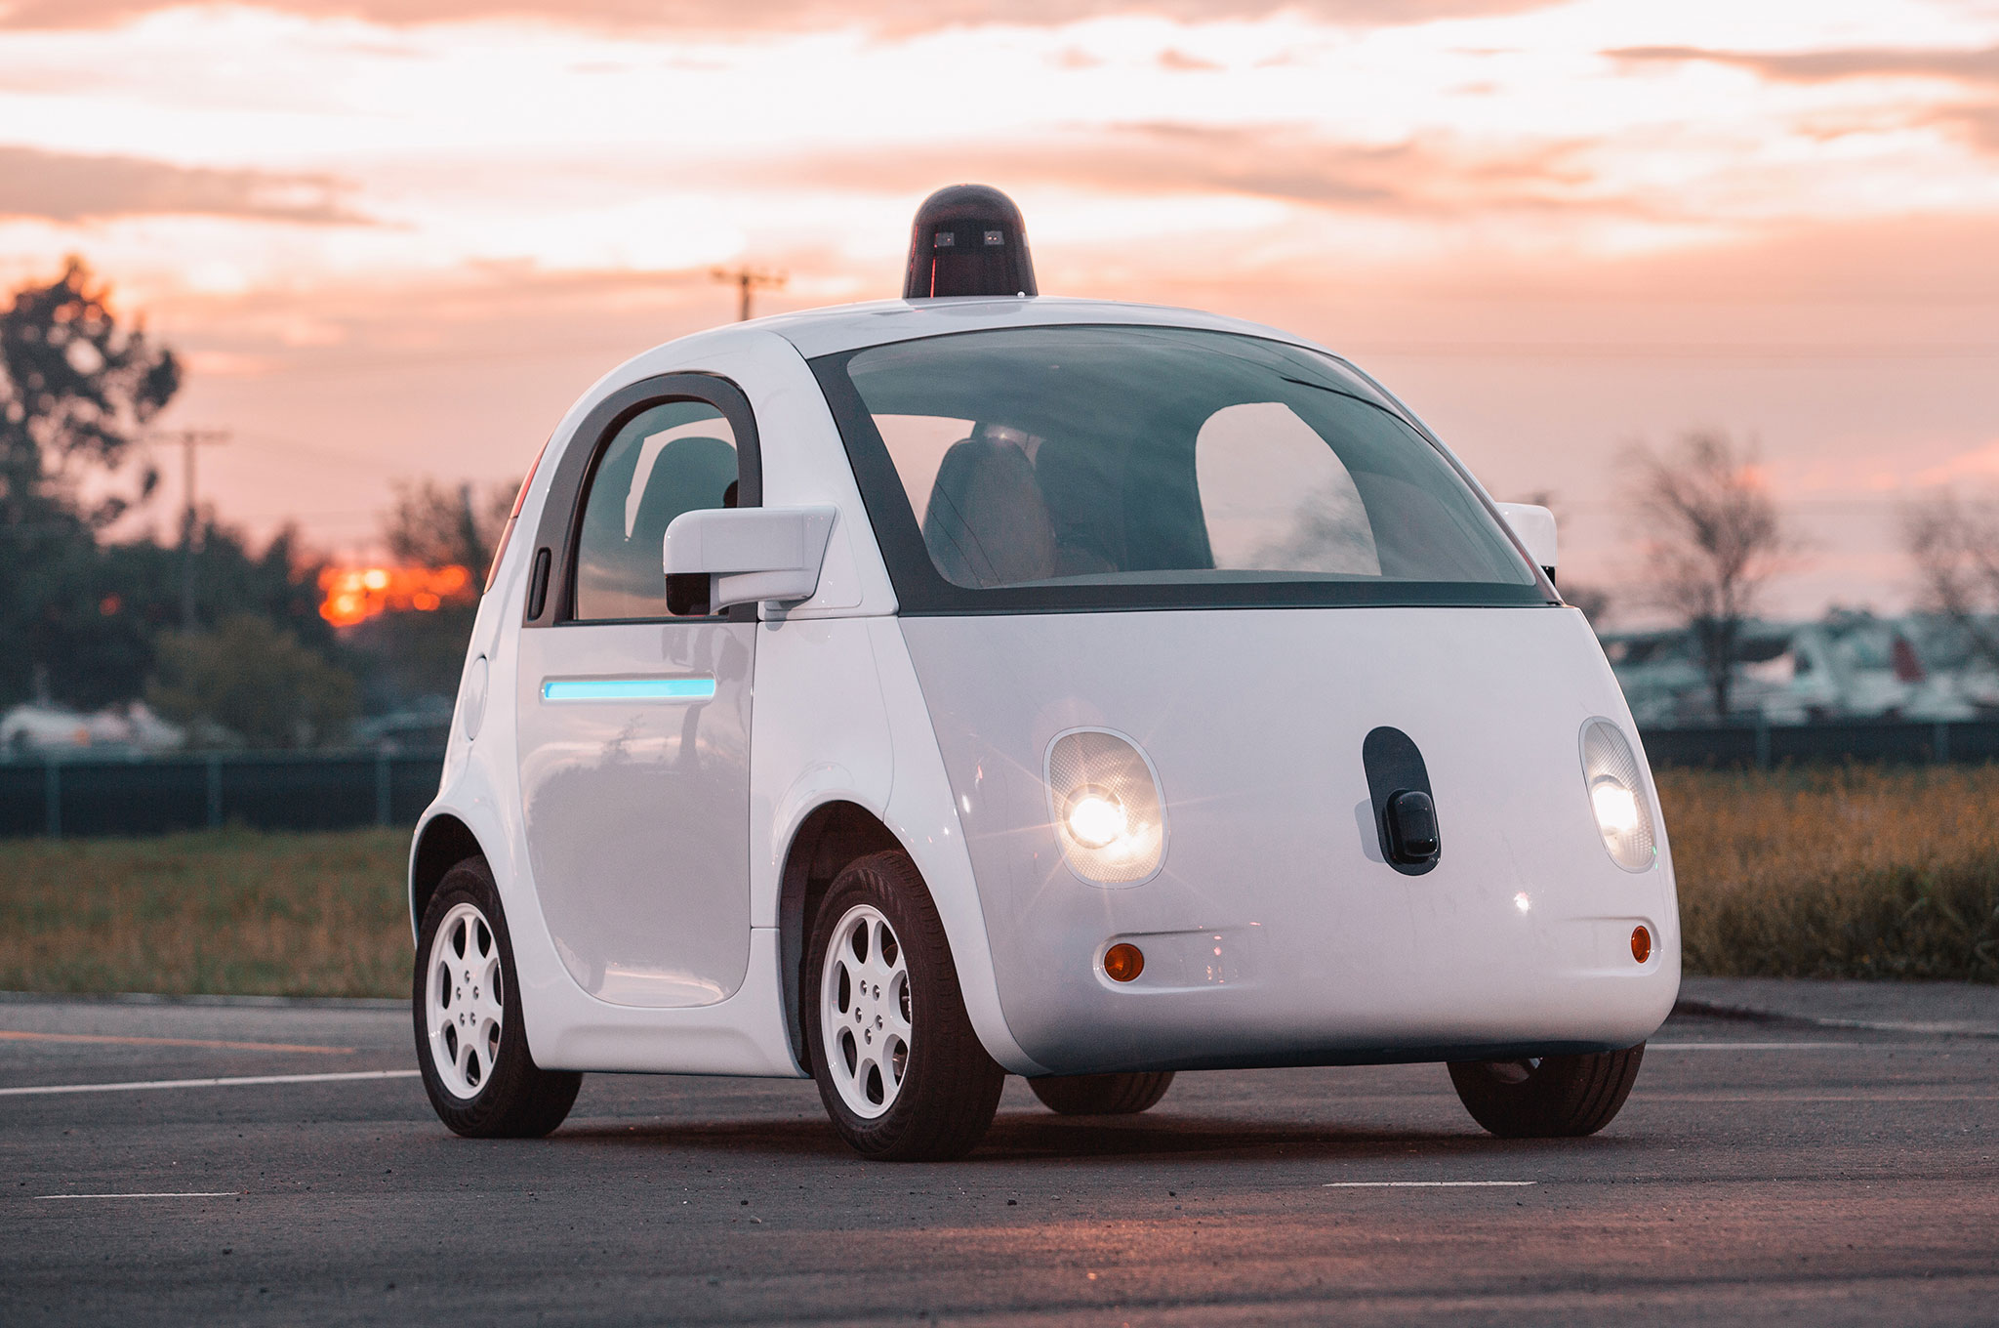

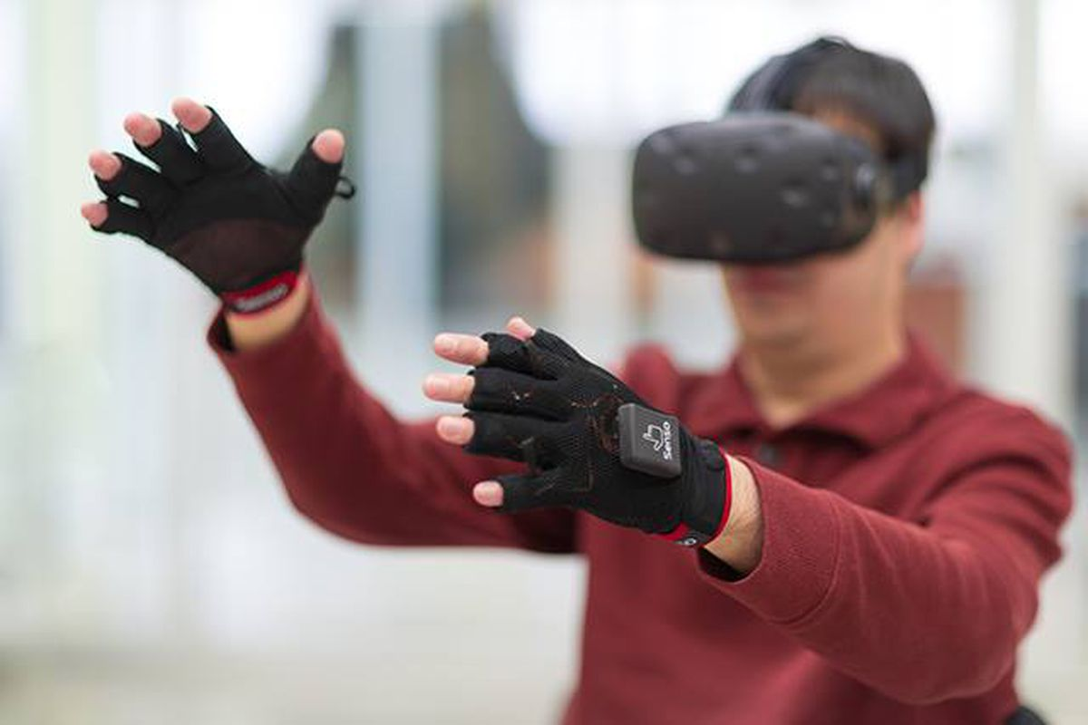

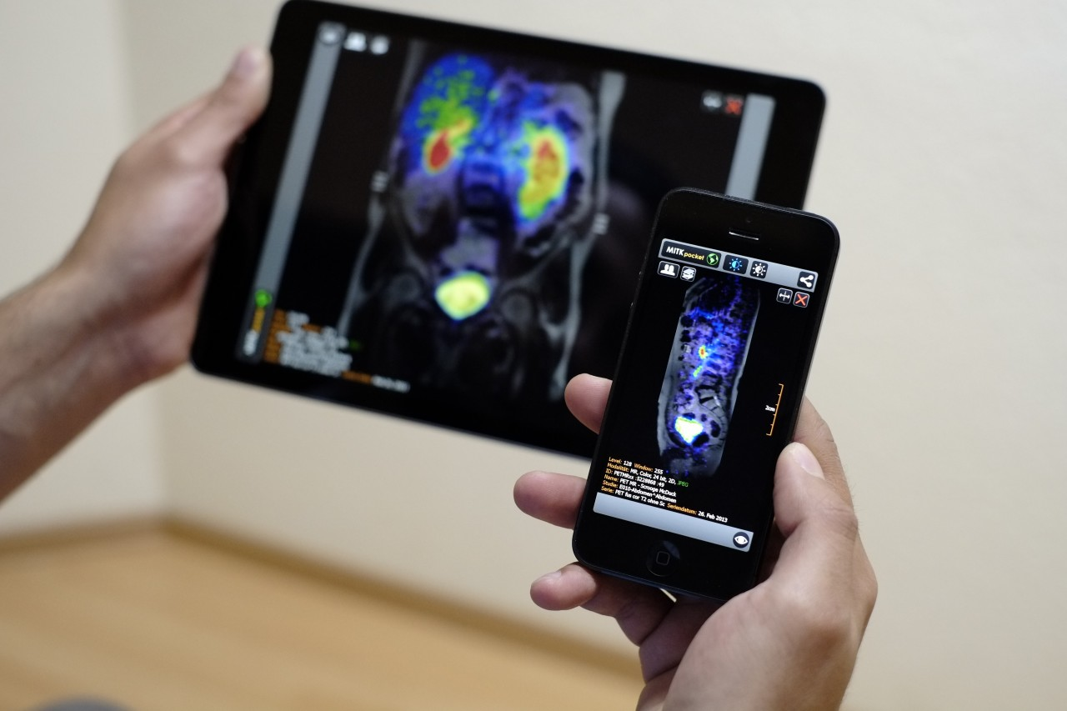
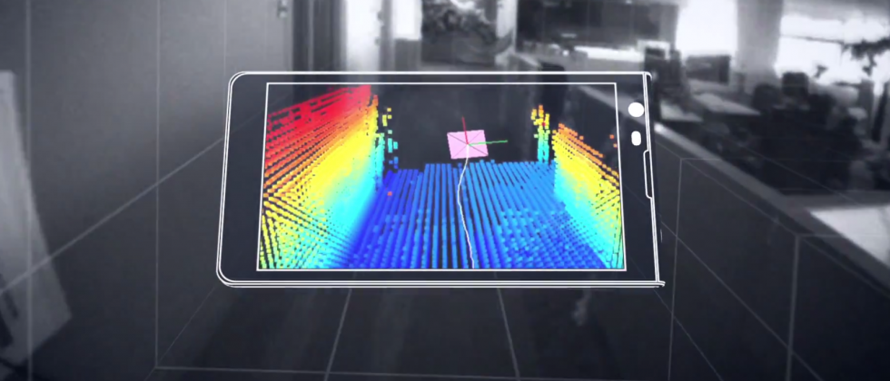
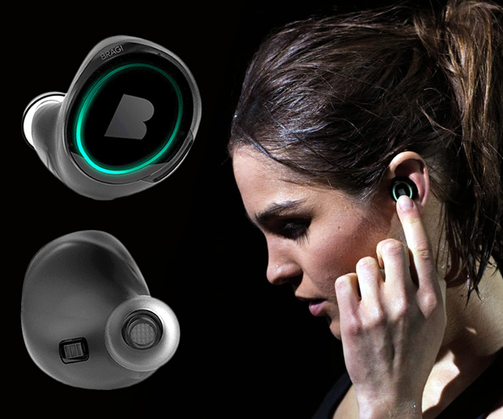
Wireless and Mobile Systems
for the IoT
CMSC 715 : Fall 2021
Lecture 3.5: Deep Learning for IoT- Part 3
Nirupam Roy
M-W 2:00-3:15pm
CHM 1224

Slide 2
Sensing + Machine learning: New opportunities

Slide 3
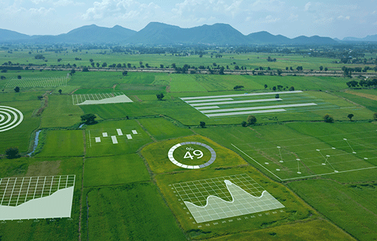
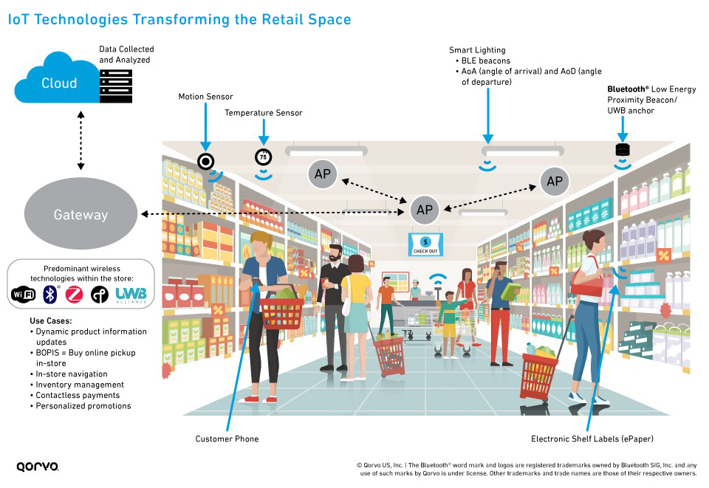
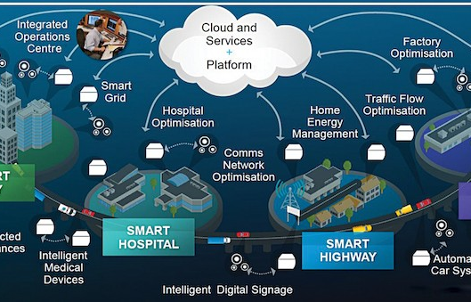
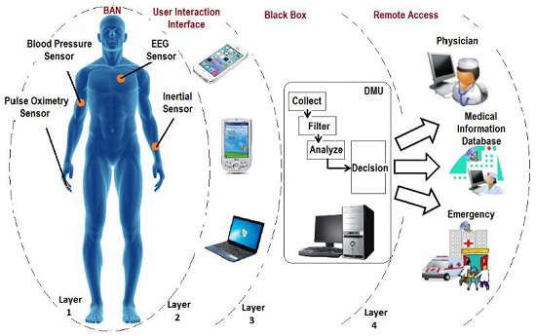
Sensing + Machine learning: Applications space

Slide 4
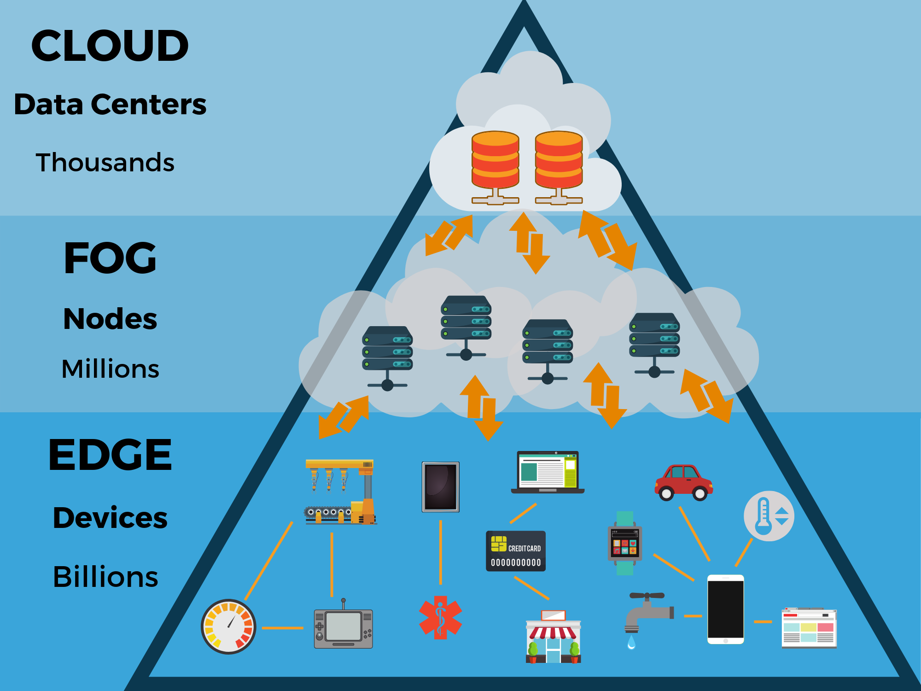

Slide 5
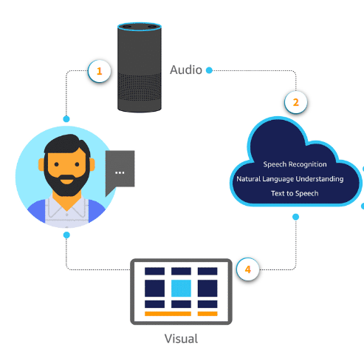
Computing on the cloud

Slide 6
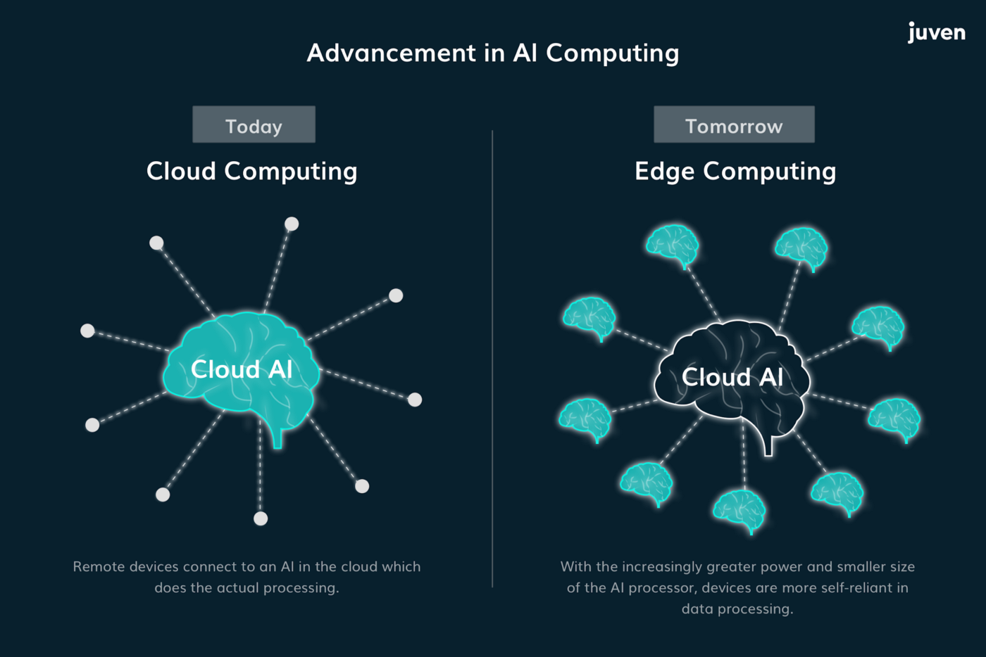

Slide 7
Computing on the cloud

Slide 8

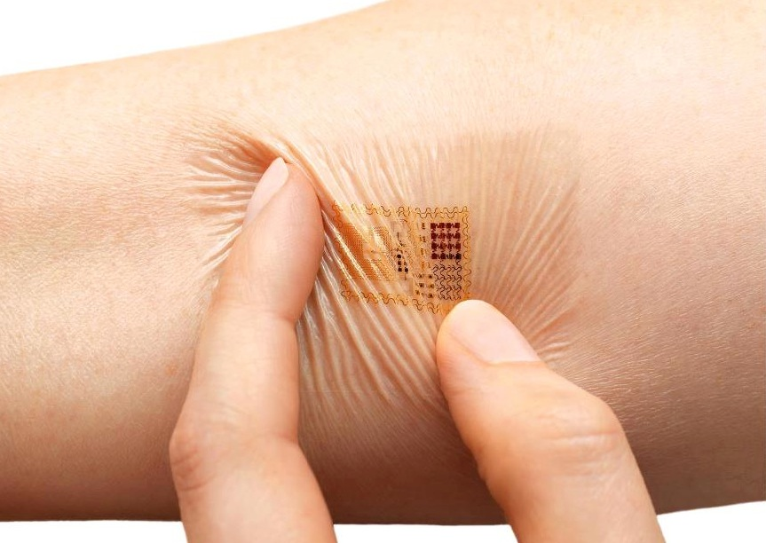
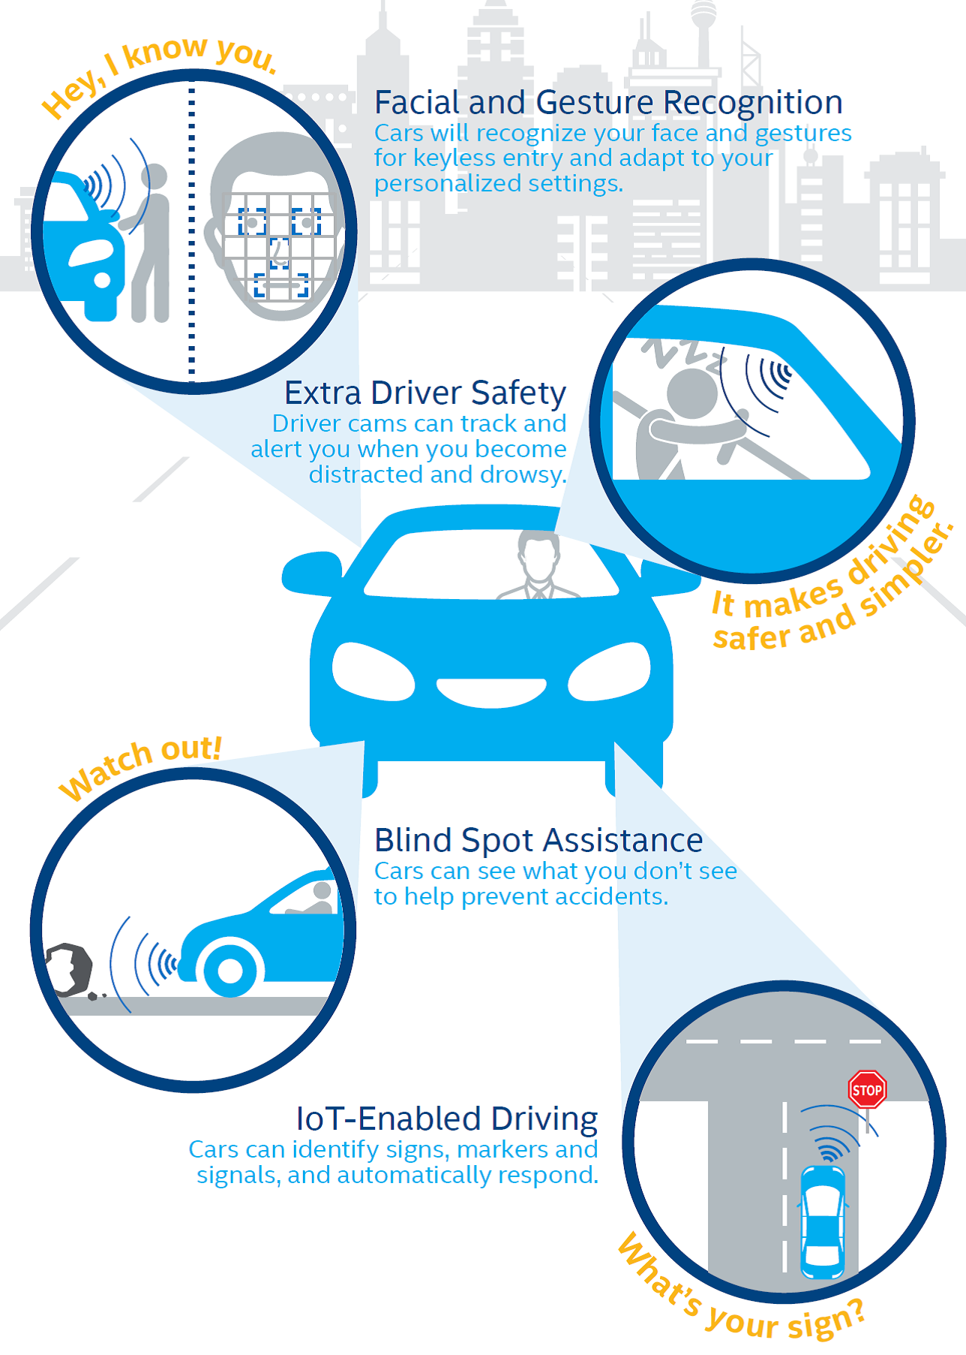
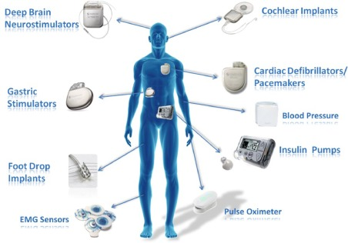
Computing on the cloud: Challenges

Slide 9
Computing on the cloud: Challenges
1. Latency –Data transmission to the cloud typically introduces longer latency than data processing on the embedded device. Real-time applications are latency sensitive.
2. Unreliable data transmissions – When the network connectivity is unreliable or even nonexistent, it is often impractical to stream data from sensors that generate large amounts of raw data, such as cameras, accelerometers, or microphones.
3. Energy efficiency – Microcontroller-based devices are inherently designed to perform extremely low-power computations, so they can operate for a long time on a small power budget.
4. Low cost – The expansion of IoT applications in many industrial segments was driven by the low cost and high volumes of microprocessors and supporting embedded hardware, and this trend is likely to continue.

Slide 10
Computing on the cloud: Challenges
5. Privacy – Privacy is always a concern when personal or other highly sensitive data is handled outside of the device. This is particularly true if data is sent to the cloud, as data can be lost or stolen.
6. Autonomy – Small embedded devices can contribute to the increased autonomy of the system they belong to, by generating independent, data-driven local decisions that can be shared only within the system.

Slide 11
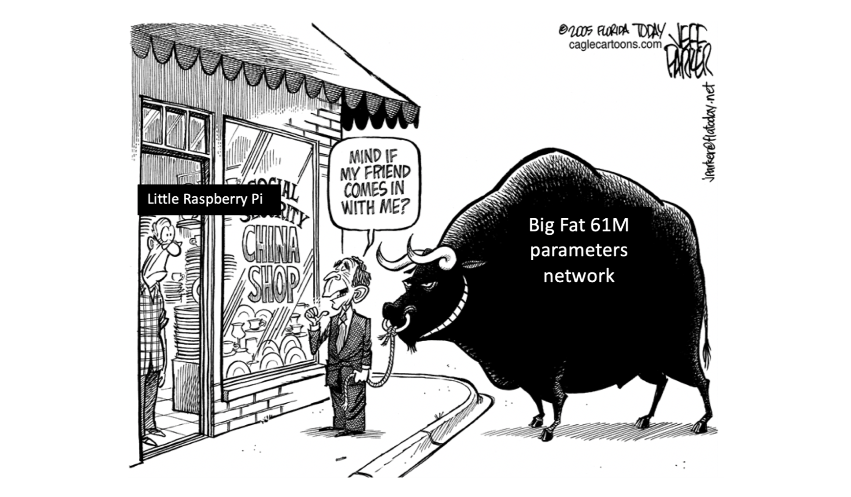

Slide 12
Deep Learning refresher

Slide 13
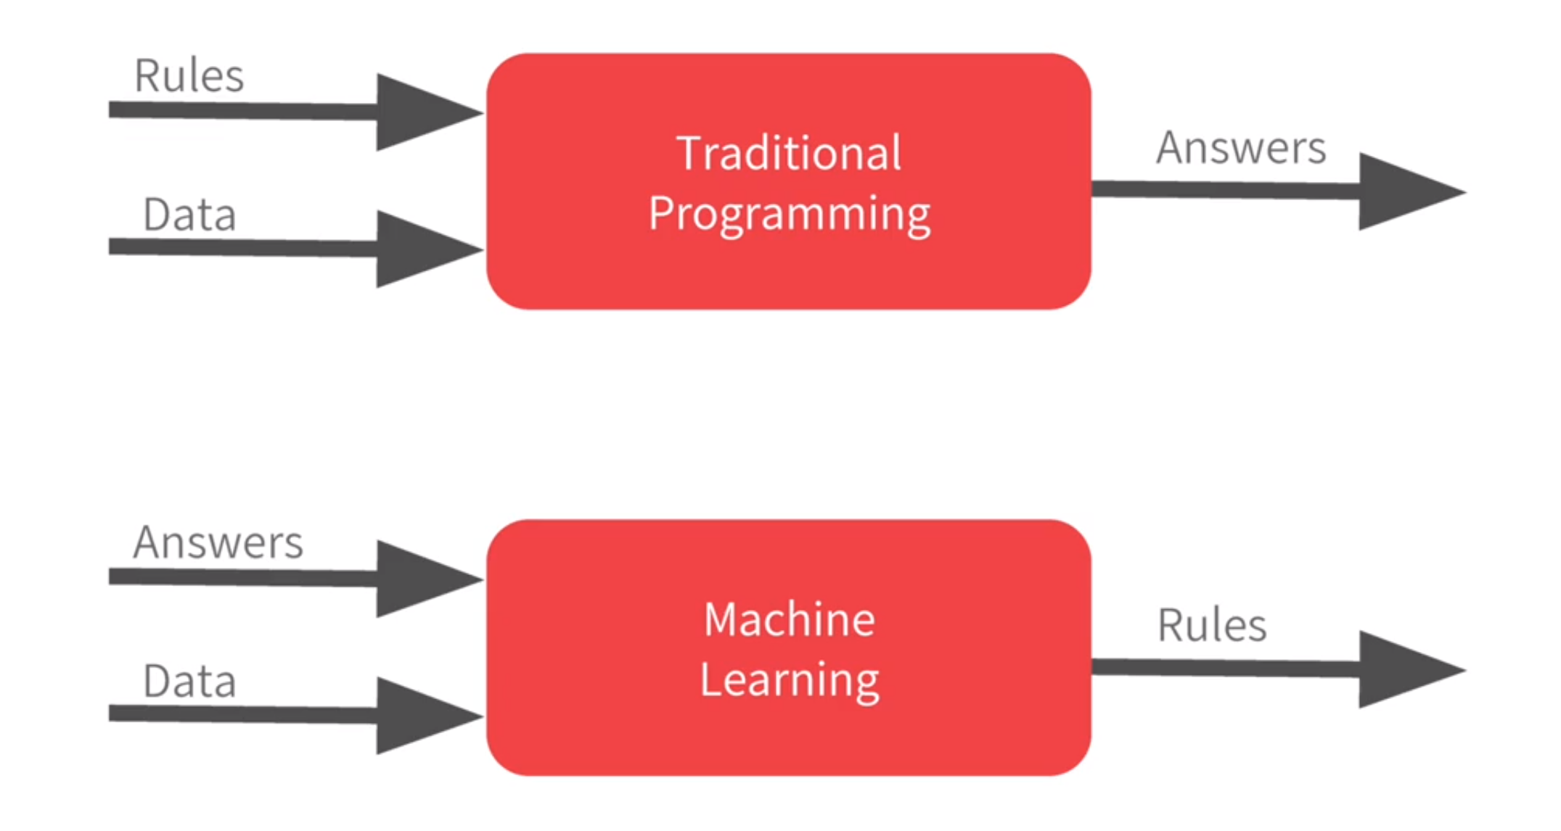
Machine learning: A new way to program computers

Slide 14
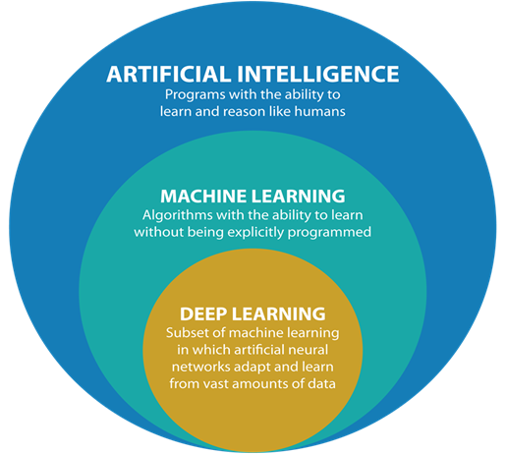
Machine Learning and Deep Learning

Slide 15
A computing systems inspired by the biological neural networks.

Slide 16
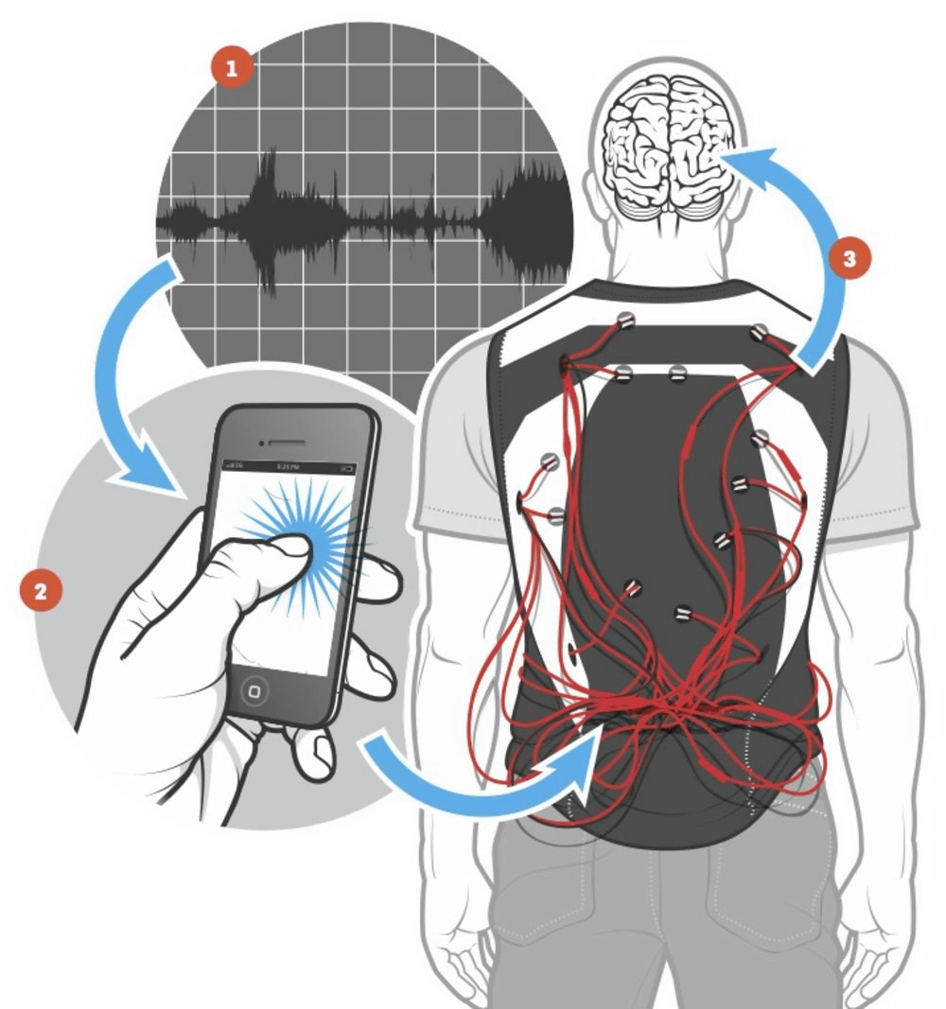
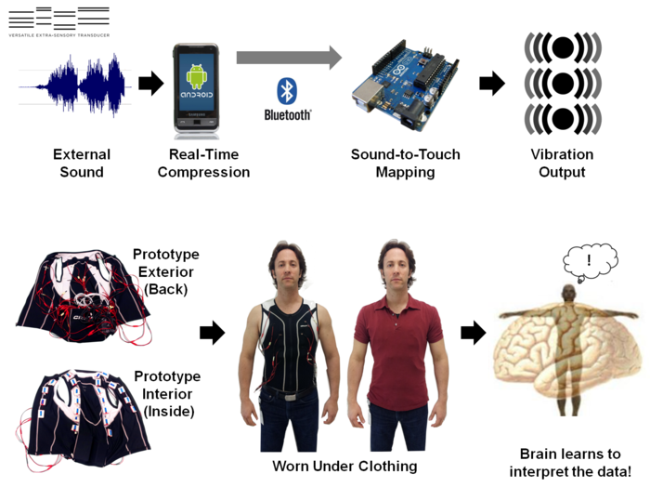
How does ’natural’ neural network work?
Sensory substitution experiment by David Eagleman

Slide 17
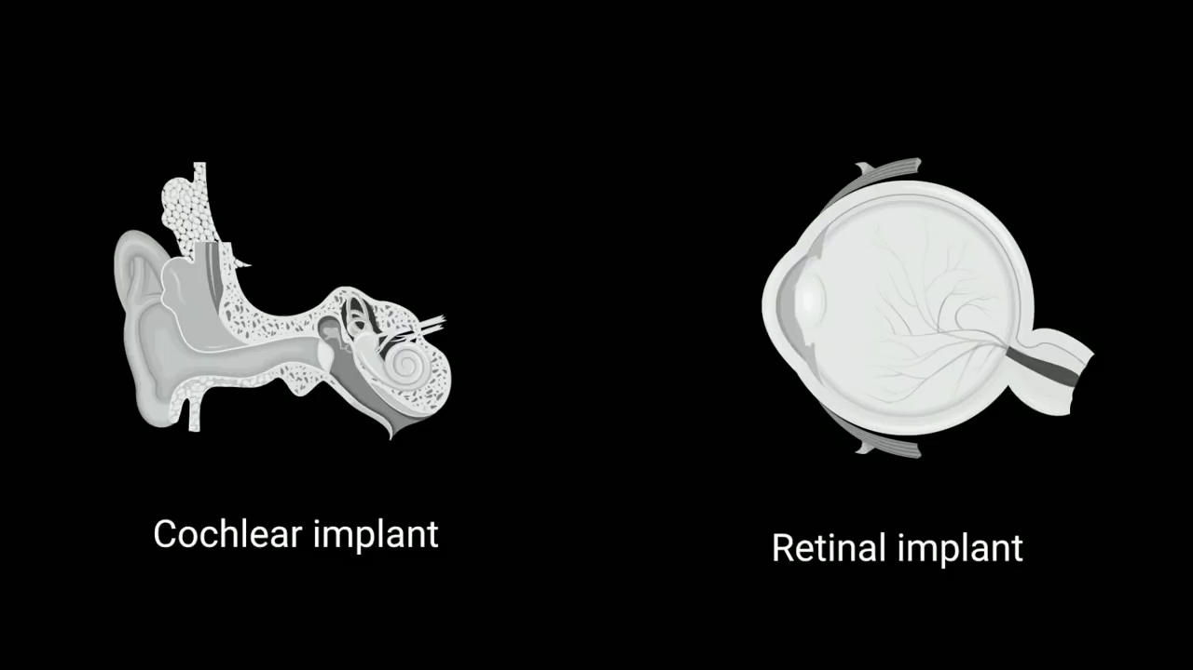
How does ’natural’ neural network work?

Slide 18
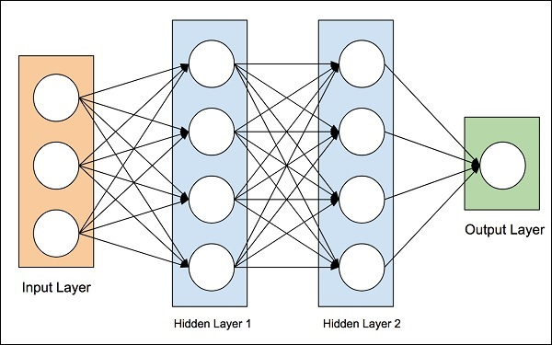
Neural network
Notes:
PC: https://www.hebergementwebs.com/machine-learning-tutorial/machine-learning-artificial-neural-networks

Slide 19
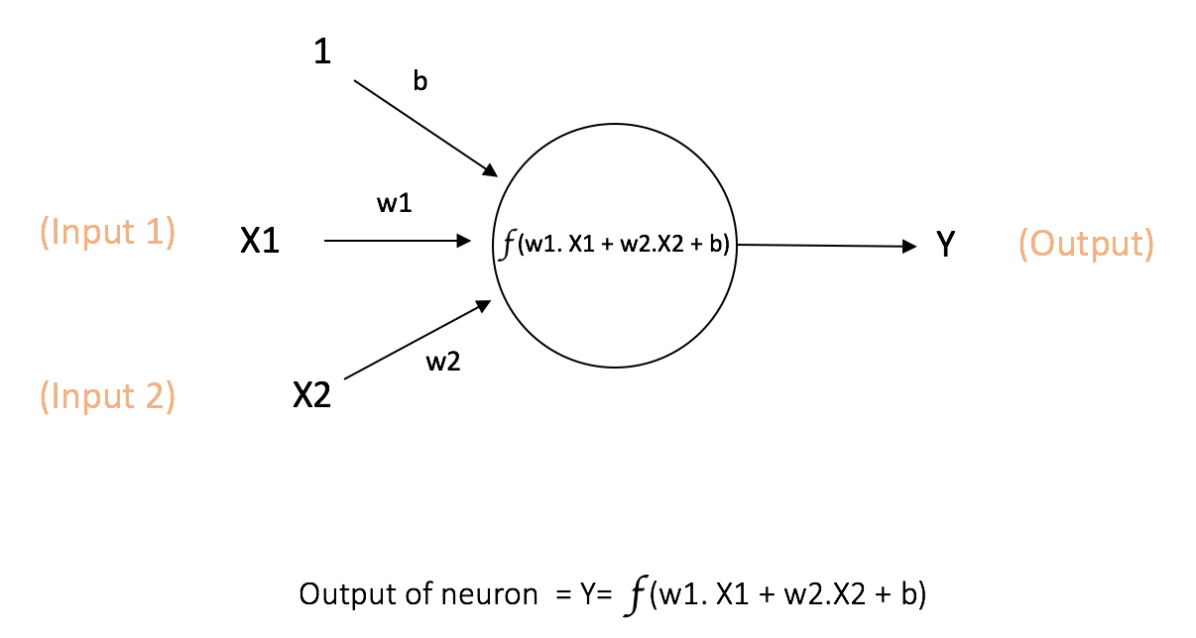
Notes:
PC: https://www.kdnuggets.com/2016/11/quick-introduction-neural-networks.html

Slide 20
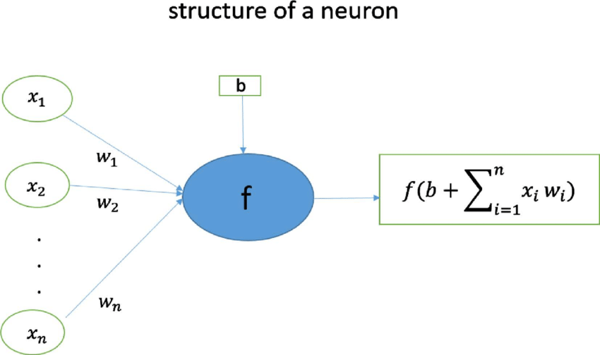
Structure of a neuron

Slide 21
Structure of a neuron
How to take decision/process information using neurons?

Slide 22
Neural network
Why is this popular now?
Notes:
PC: https://www.hebergementwebs.com/machine-learning-tutorial/machine-learning-artificial-neural-networks

Slide 23
Forward and Back Propagation

Slide 24
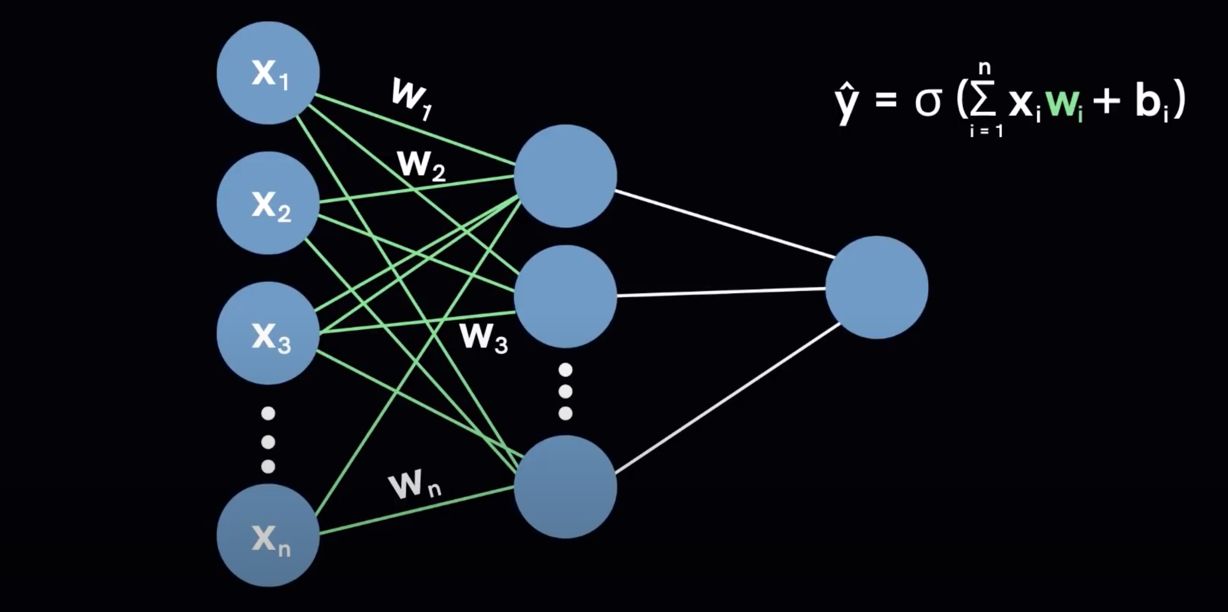
Forward propagation
Notes:
https://www.youtube.com/watch?v=VyWAvY2CF9c

Slide 25
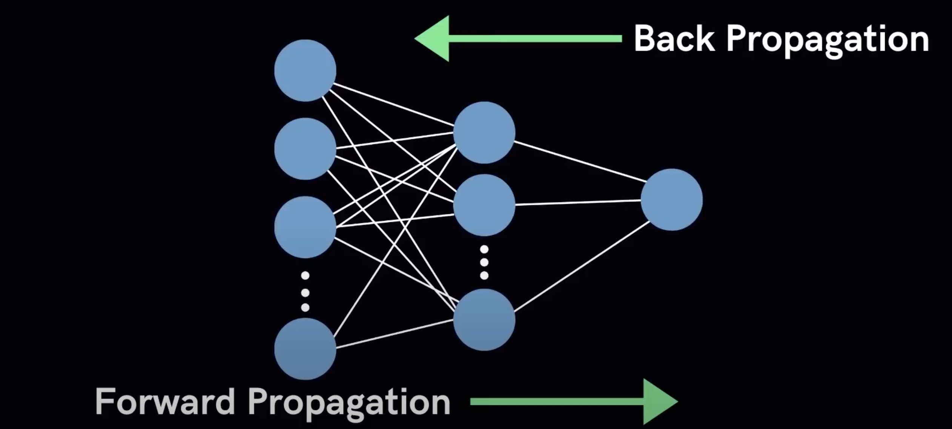
Back propagation

Slide 26
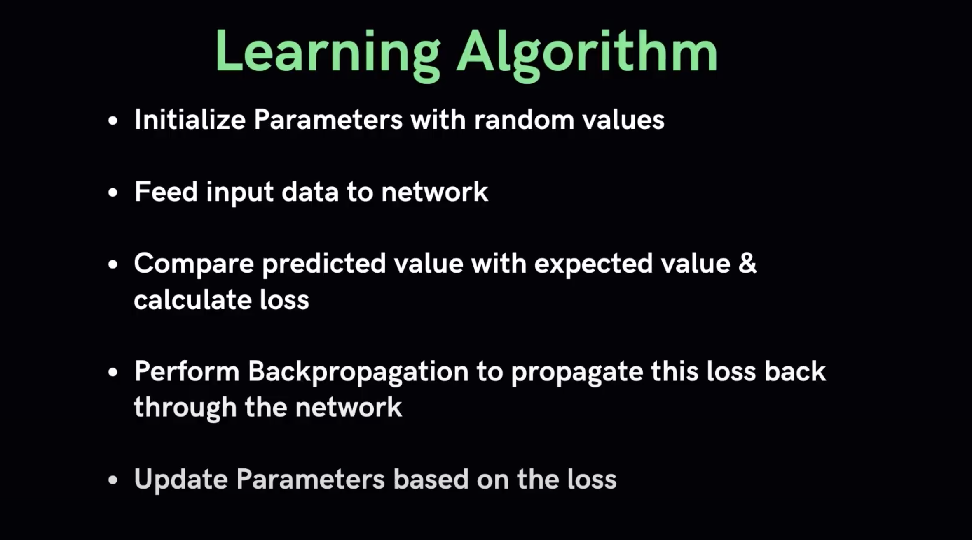
Notes:
https://www.youtube.com/watch?v=VyWAvY2CF9c

Slide 27
Deep learning terminologies
1. Activation function
2. Loss function
3. Optimizers
4. Parameters & Hyperparameters
… and a few others

Slide 28
Deep learning terminologies
1. Activation function
Notes:
Does not model every situation

Slide 29
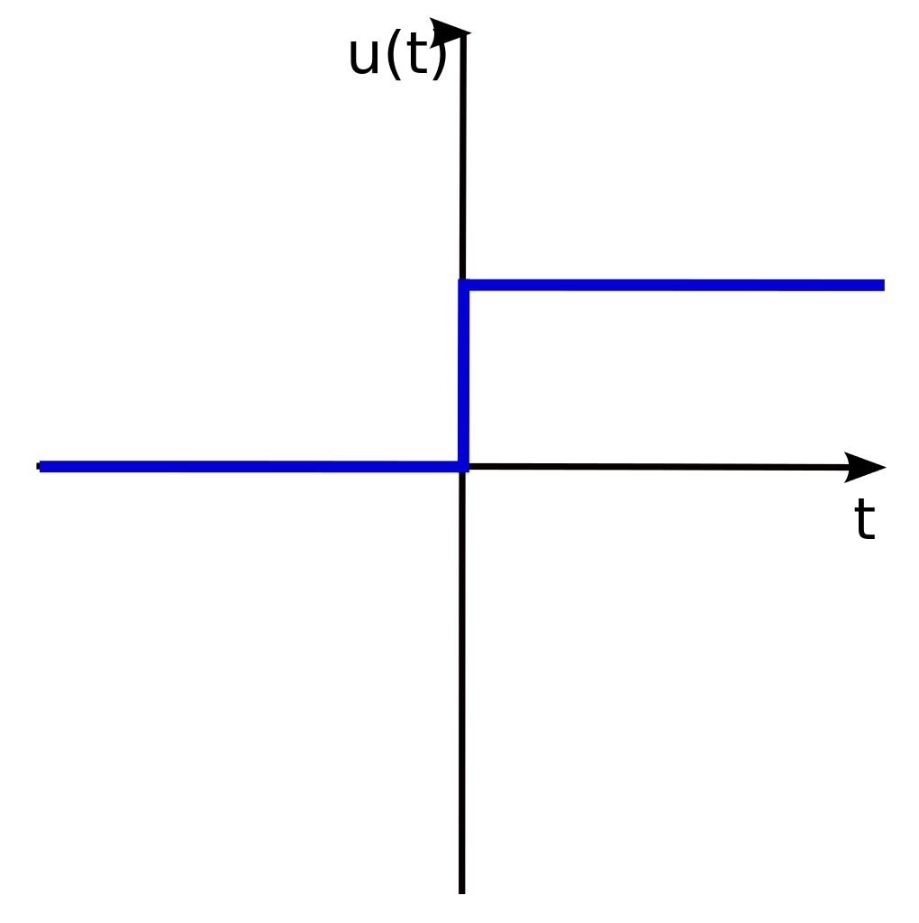
Deep learning terminologies
1. Activation function
a. Step function
Notes:
Does not model every situation

Slide 30
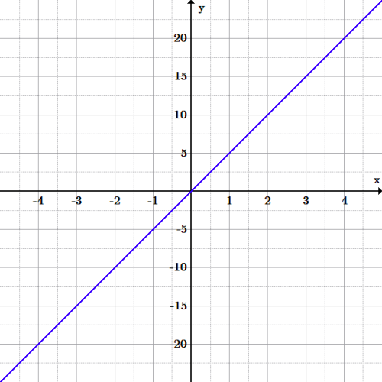
Deep learning terminologies
1. Activation function
b. Linear function

Slide 31
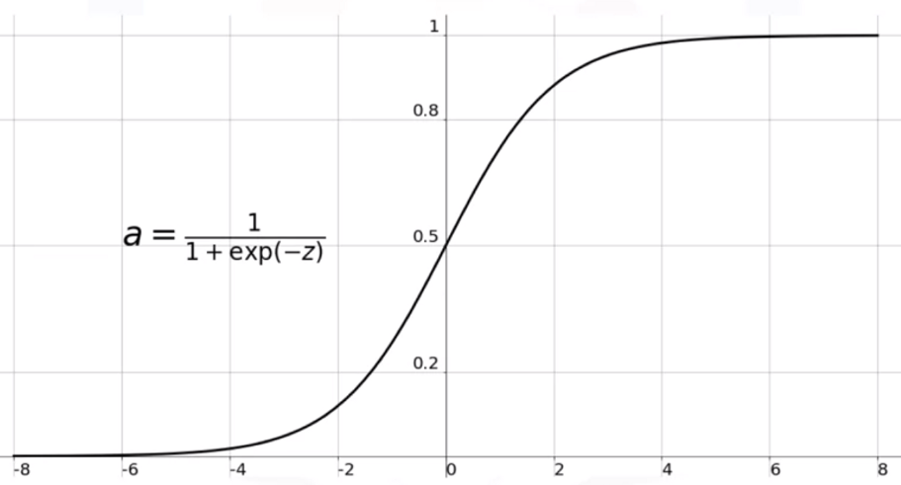
Deep learning terminologies
1. Activation function
c. Sigmoid function

Slide 32
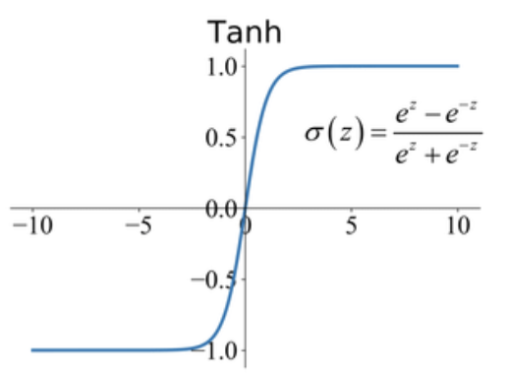
Deep learning terminologies
1. Activation function
d. tanh function

Slide 33
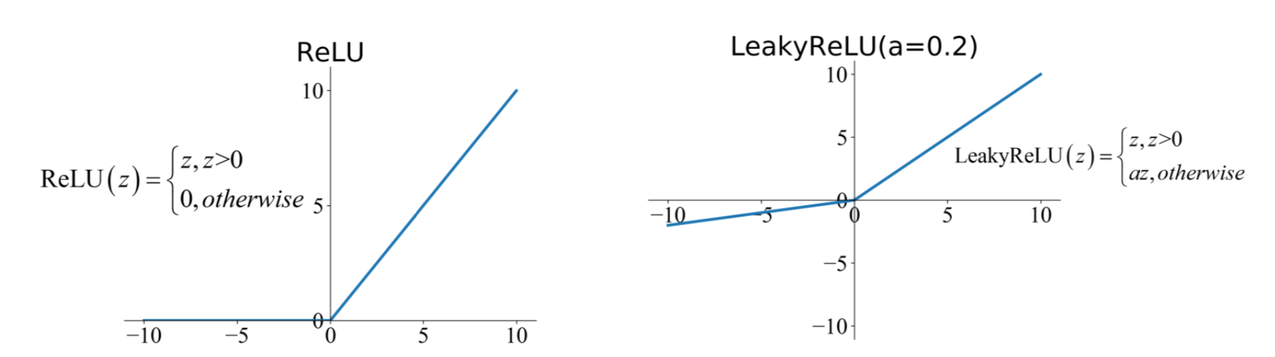
Deep learning terminologies
1. Activation function
e. ReLU (Rectified Linear Unit) function

Slide 34
Deep learning terminologies
1. Activation function
e. ReLU (Rectified Linear Unit) function

Slide 35
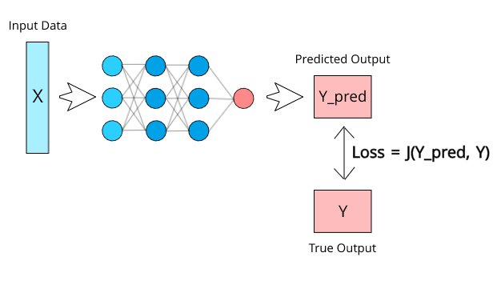
Deep learning terminologies
2. Loss function
Notes:
Ref: https://medium.com/deep-learning-demystified/loss-functions-explained-3098e8ff2b27

Slide 36
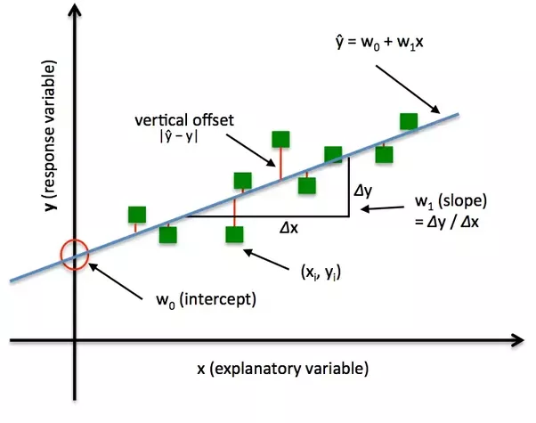
Deep learning terminologies
2. Loss function
Notes:
Ref: https://algorithmia.com/blog/introduction-to-loss-functions

Slide 37
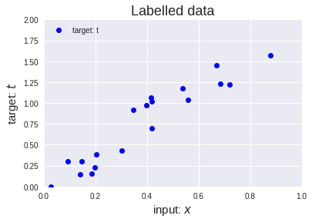
Deep learning terminologies
3. Optimizer
y = x.p
Notes:
https://medium.com/onfido-tech/machine-learning-101-be2e0a86c96a

Slide 38
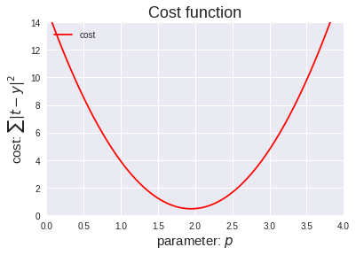
Deep learning terminologies
3. Optimizer
y = x.p
Notes:
https://medium.com/onfido-tech/machine-learning-101-be2e0a86c96a

Slide 39
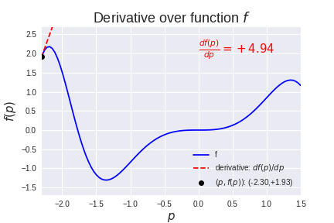
Deep learning terminologies
3. Optimizer
Notes:
Source: https://medium.com/onfido-tech/machine-learning-101-be2e0a86c96a

Slide 40
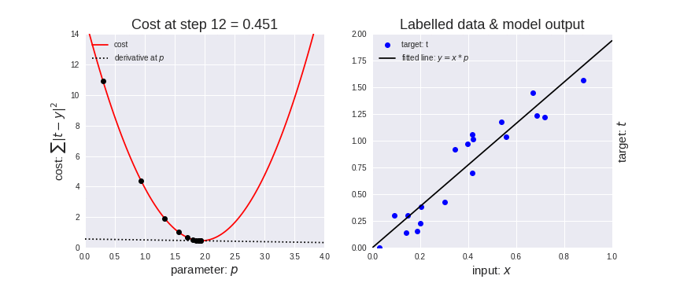
Deep learning terminologies
3. Optimizer
Notes:
https://medium.com/onfido-tech/machine-learning-101-be2e0a86c96a

Slide 41
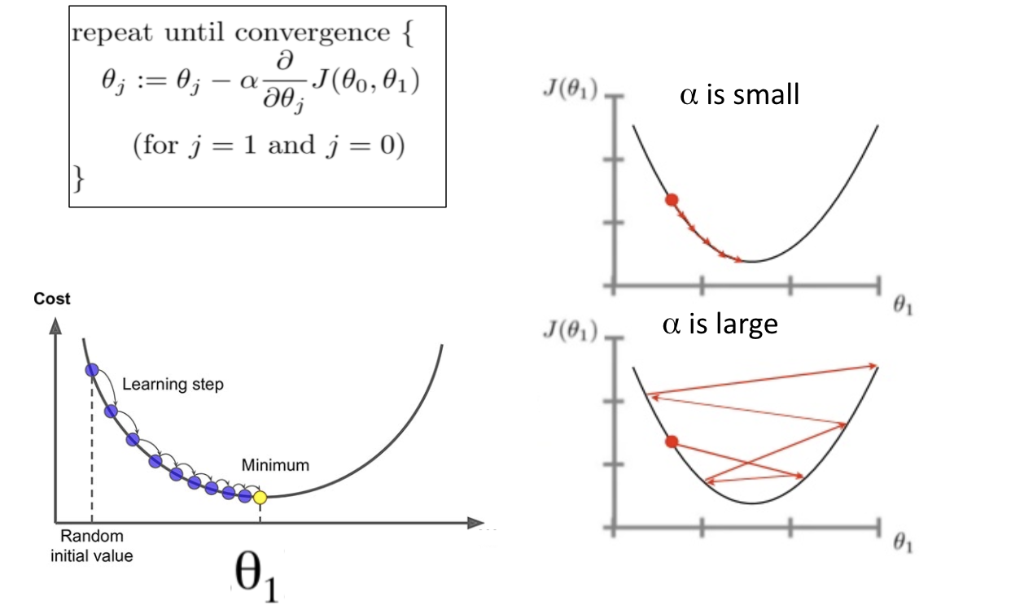
Deep learning terminologies
3. Optimizer: Gradient Descent
Notes:
Ref: https://www.analyticsvidhya.com/blog/2019/08/detailed-guide-7-loss-functions-machine-learning-python-code/

Slide 42
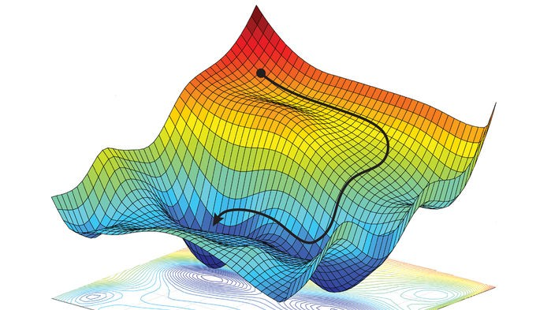
Deep learning terminologies
3. Optimizer
Notes:
Ref: https://www.analyticsvidhya.com/blog/2019/08/detailed-guide-7-loss-functions-machine-learning-python-code/

Slide 43
Deep learning terminologies
4. Parameters and Hyperparameters
a. Parameters:
-Values can be estimated from data.
-Generally, not set manually by the designer.
-e.g., weights and biases
Notes:
Ref: https://www.analyticsvidhya.com/blog/2019/08/detailed-guide-7-loss-functions-machine-learning-python-code/

Slide 44
Deep learning terminologies
4. Parameters and Hyperparameters
a. Parameters:
-Values can be estimated from data.
-Generally, not set manually by the designer.
-e.g., weights and biases
b. Hyperparameters:
-Configuration variables.
-Can not be estimated from the data.
-e.g., Learning rates, activation functions
Notes:
Ref: https://www.analyticsvidhya.com/blog/2019/08/detailed-guide-7-loss-functions-machine-learning-python-code/

Slide 45
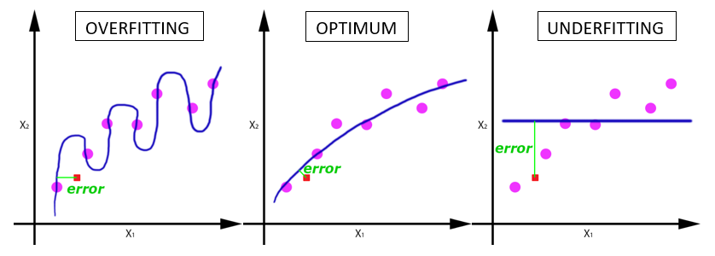
Deep learning terminologies
5. Epoch, Batches, Batch size, Iteration
a. Epoch:
-Entire dataset is passed (forward and backward) through the network.
-Why do we need multiple epochs?
How to find the right number of epochs?
Notes:
Ref: https://www.analyticsvidhya.com/blog/2019/08/detailed-guide-7-loss-functions-machine-learning-python-code/

Slide 46
Deep learning terminologies
5. Epoch, Batches, Batch size, Iteration
a. Epoch:
-Entire dataset is passed (forward and backward) through the network.
b. Batch/Batch size:
-Large data set is divided into smaller chunks or batches of specific size.
Notes:
Ref: https://www.analyticsvidhya.com/blog/2019/08/detailed-guide-7-loss-functions-machine-learning-python-code/

Slide 47
Deep learning terminologies
5. Epoch, Batches, Batch size, Iteration
a. Epoch:
-Entire dataset is passed (forward and backward) through the network.
b. Batch/Batch size:
-Large data set is divided into smaller chunks or batches of specific size.
c. Iteration:
-Number of batches required to complete one epoch.
Notes:
Ref: https://www.analyticsvidhya.com/blog/2019/08/detailed-guide-7-loss-functions-machine-learning-python-code/

Slide 48
Deep learning terminologies
5. Epoch, Batches, Batch size, Iteration
a. Epoch:
-Entire dataset is passed (forward and backward) through the network.
A dataset of 1000 training examples is divided into batches of 200 examples.
It will take 5 iterations to complete 1 epoch.
b. Batch/Batch size:
-Large data set is divided into smaller chunks or batches of specific size.
c. Iteration:
-Number of batches required to complete one epoch.
Notes:
Ref: https://www.analyticsvidhya.com/blog/2019/08/detailed-guide-7-loss-functions-machine-learning-python-code/

Slide 49
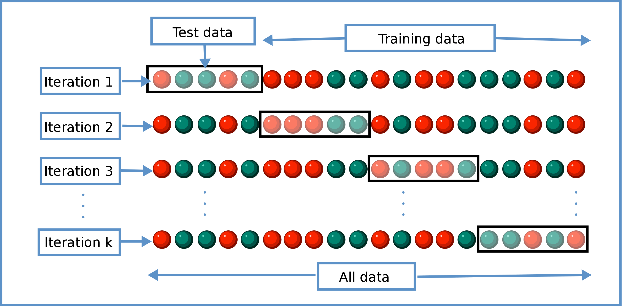
Deep learning terminologies
6. Cross-validation
Notes:
PC: https://en.wikipedia.org/wiki/Cross-validation_(statistics)

Slide 50
Types of learning problems
1. Supervised
a. Classification
b. Regression
2. Unsupervised
a. Clustering
b. Association
3. Reinforcement

Slide 51
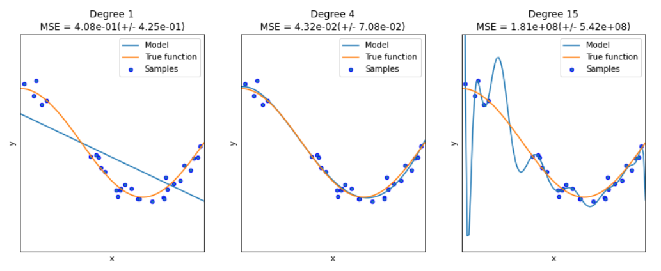
Dealing with overfitting

Slide 52
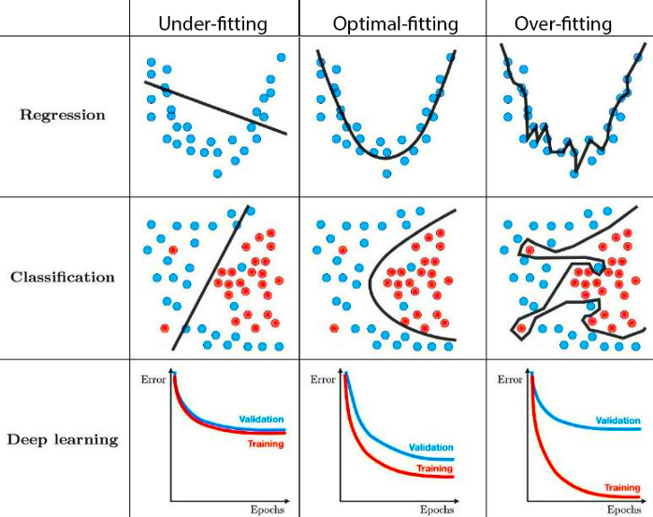
Challenges: Underfitting & Overfitting
Notes:
PC: https://towardsdatascience.com/techniques-for-handling-underfitting-and-overfitting-in-machine-learning-348daa2380b9

Slide 53
Dealing with underfitting
a. Increase model complexity
b. Use more epochs for training
c. Shuffle data per epoch
Notes:
https://towardsdatascience.com/techniques-for-handling-underfitting-and-overfitting-in-machine-learning-348daa2380b9

Slide 54
Dealing with overfitting
a. Increase training dataset
Regularization
a. Dropout
b. Augmentation
c. Early stopping
Notes:
https://towardsdatascience.com/techniques-for-handling-underfitting-and-overfitting-in-machine-learning-348daa2380b9

Slide 55
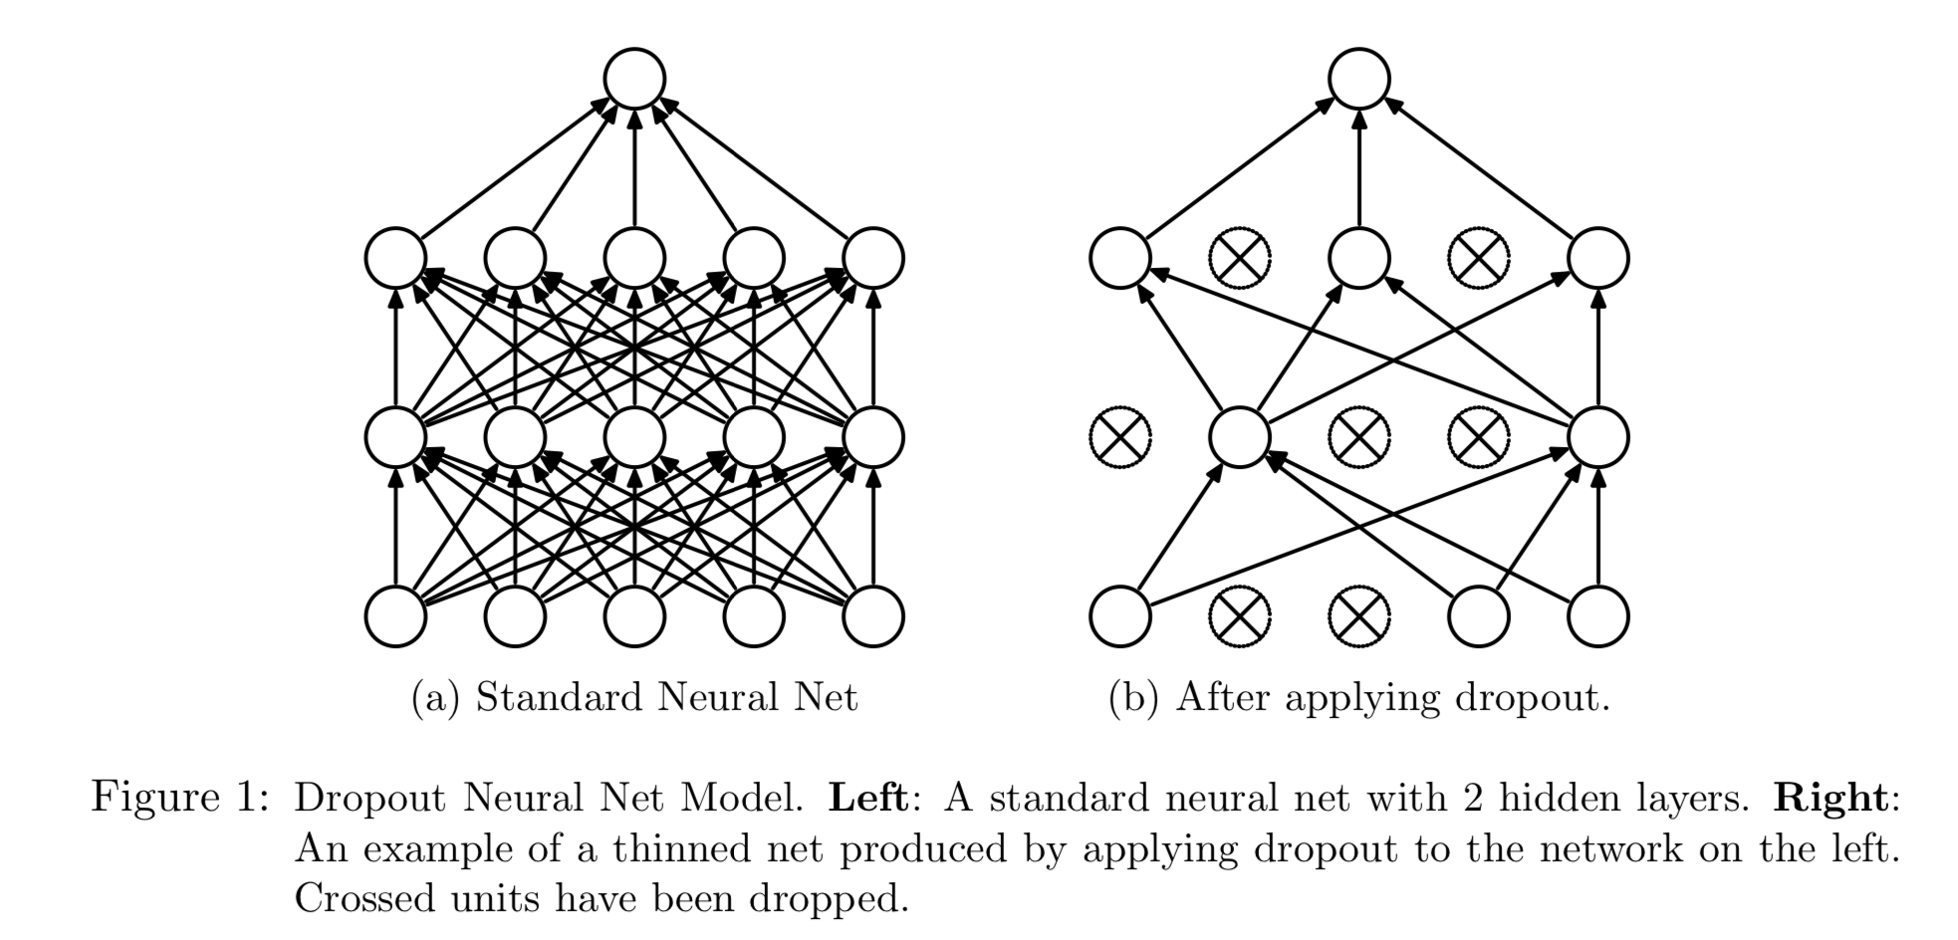
Dealing with overfitting
a. Dropout
Ref: Dropout: A Simple Way to Prevent Neural Networks from Overfitting
https://www.cs.toronto.edu/~hinton/absps/JMLRdropout.pdf
Notes:
DropConnect

Slide 56
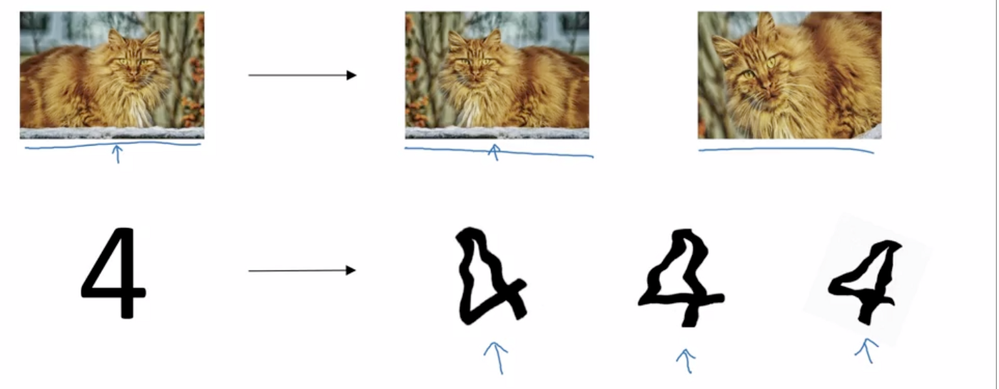
Dealing with overfitting
b. Augmentation
Notes:
https://medium.com/@dhartidhami/regularization-in-deep-learning-2065b7c889e5

Slide 57
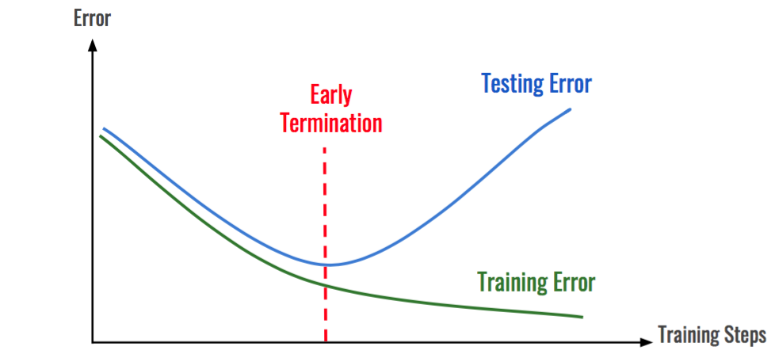
Dealing with overfitting
c. Early stopping

Slide 58
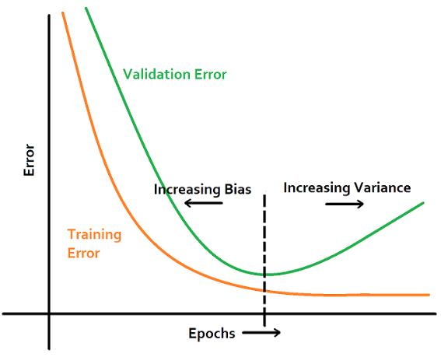

Slide 59
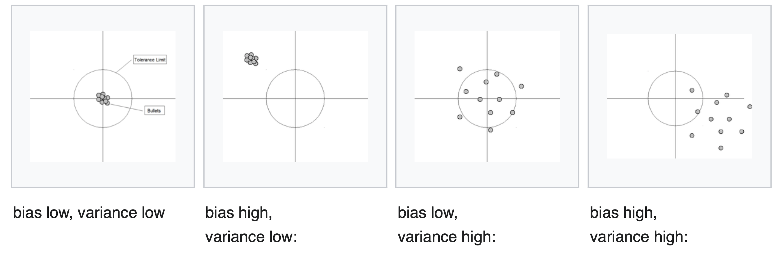

Slide 60
Deep learning on Mobile/Embedded devices: Challenges
Ref: https://www.edx.org/professional-certificate/harvardx-tiny-machine-learning

Slide 61
Microprocessor vs Microcontroller

Slide 62

Microprocessor vs Microcontroller

Slide 63

Microprocessor vs Microcontroller
Microcontroller

Slide 64

Microprocessor vs Microcontroller
Ref: https://www.edx.org/professional-certificate/harvardx-tiny-machine-learning

Slide 65


Slide 66

Microprocessor vs Microcontroller
Floating point operation
Ref: https://www.edx.org/professional-certificate/harvardx-tiny-machine-learning

Slide 67
Microprocessor vs Microcontroller
Floating point operation
Ref: https://www.edx.org/professional-certificate/harvardx-tiny-machine-learning

Slide 68

Microprocessor vs Microcontroller
Floating point operation
Ref: https://www.edx.org/professional-certificate/harvardx-tiny-machine-learning

Slide 69
Microprocessor vs Microcontroller
Floating point operation
Ref: https://www.edx.org/professional-certificate/harvardx-tiny-machine-learning

Slide 70

Microprocessor vs Microcontroller
Floating point operation
Ref: https://www.edx.org/professional-certificate/harvardx-tiny-machine-learning

Slide 71

CPU vs GPU
Notes:
https://www.analyticsvidhya.com/blog/2020/09/why-gpus-are-more-suited-for-deep-learning/

Slide 72

CPU vs GPU for parallel operations
Notes:
https://eli.thegreenplace.net/2018/backpropagation-through-a-fully-connected-layer/

Slide 73

CPU vs GPU
Notes:
https://www.analyticsvidhya.com/blog/2020/09/why-gpus-are-more-suited-for-deep-learning/

Slide 74

Compression of deep learning models
(TinyML example)
Notes:
https://tutorials.one/tiny-machine-learning/

Slide 75

a. Pruning

Slide 76

b. Quantization

Slide 77

c. Knowledge distillation

