Slide 1
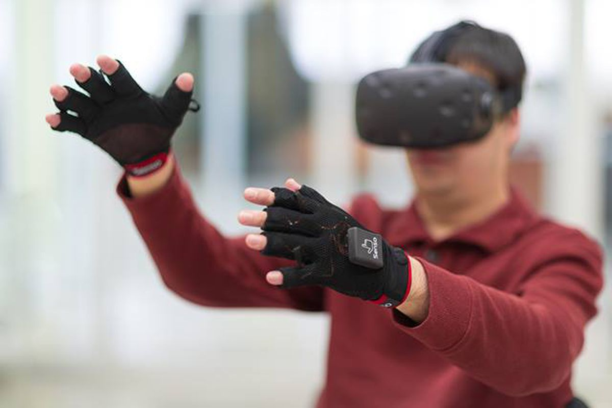
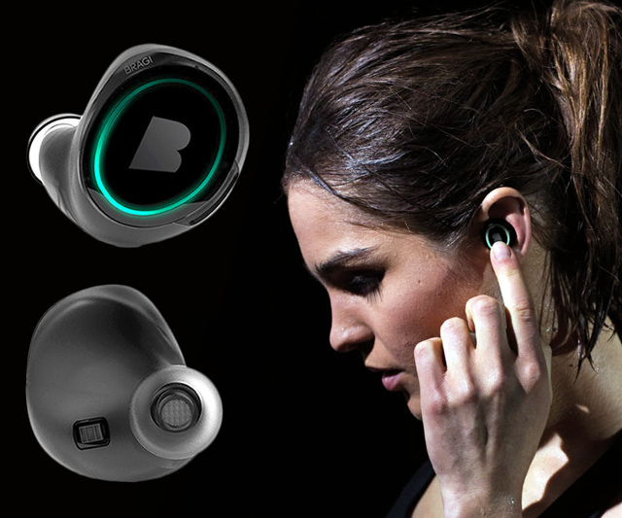
Wireless and Mobile Systems
for the IoT
CMSC 715 : Fall 2021
Lecture 3.6: Deep Learning for IoT- Part 4
Nirupam Roy
M-W 2:00-3:15pm
CHM 1224

Slide 2
Announcement: Spot selection for class presentations
We will release the slots for paper presentation today (Oct 25) right after the class at 3:30PM.
You should use shared document to sign up for a date and time slot to present.
Time slots will be assigned on first come, first served basis. Please add your team member's name in front of the available slot. Do not overwrite or delete any existing team's name.
After the slot selection, we will select papers based on your interests.

Slide 3
Deep Learning refresher

Slide 4
b₁
i₁
w₁
h₁
w₅
w₂
O₁
b₂
w₃
w₆
i₂
w₄
h₂
Input layer
Hidden layer
Output layer
Ref: https://hmkcode.com/ai/backpropagation-step-by-step/

Slide 5
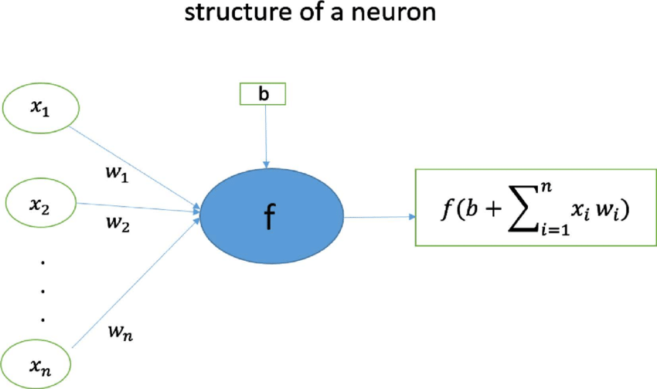
Structure of a neuron

Slide 6
b₁
i₁
w₁
h₁
w₅
w₂
O₁
b₂
w₃
w₆
i₂
w₄
h₂
For simplicity:
Set bias terms to zero.
Activation function: f(z) = z

Slide 7
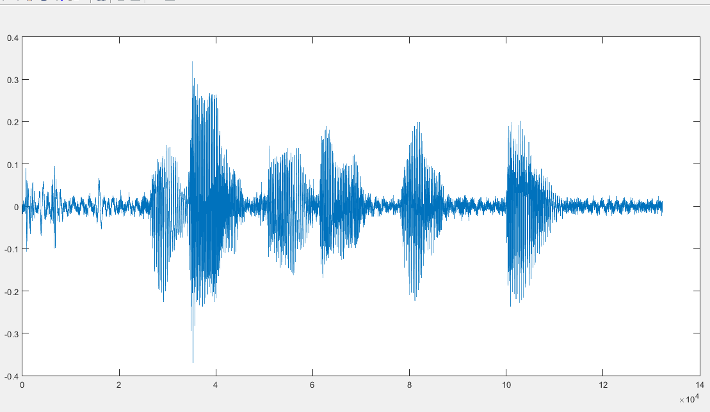
Forward propagation
i₁
w₁
h₁
w₅
w₂
[4.5, 0.8, 2.2, 9.1]
O₁
w₃
w₆
i₂
w₄
h₂
Prediction
Loss = ½(Actual output - prediction)²
Optimization: Adjust parameters to minimize loss

Slide 8
Back propagation
i₁
w₁
h₁
w₅
w₂
O₁
w₃
w₆
i₂
w₄
h₂
Prediction
Loss = ½(Actual output - prediction)²
Optimization: Adjust parameters to minimize loss

Slide 9
i₁
w₁
h₁
w₅
w₂
O₁
w₃
w₆
i₂
w₄
h₂
An example:
Input: i₁=2, i₂=3
Actual output = 1

Slide 10
2
w₁
h₁
w₅
w₂
O₁
w₃
w₆
Actual output = 1
3
w₄
h₂
An example:
Input: i₁=2, i₂=3
Actual output = 1

Slide 11
Start with random parameters
2
w₁
h₁
w₅
w₂
O₁
w₃
w₆
Actual output = 1
3
w₄
h₂

Slide 12
Start with random parameters
2
0.11
h₁
0.21
0.14
O₁
0.12
0.15
Actual output = 1
3
h₂
0.08
Forward propagation:
0.11
0.12
[
2
3
]
=
[
0.85
0.48
]
0.21
0.08

Slide 13
Start with random parameters
2
0.11
0.85
0.21
0.14
O₁
0.12
0.15
Actual output = 1
3
0.48
0.08
Forward propagation:
h₁
h₂
0.14
O₁
0.11
0.12
=
[
]
[
2
3
]
=
[
0.85
0.48
]
0.191
0.21
0.08
0.15

Slide 14
Start with random parameters
2
0.11
0.85
0.21
0.14
O₁
0.12
0.15
Actual output = 1
3
0.48
0.08
Error/Loss calculation:
O₁
Actual output = 1
1/2(
0.191
-
1
)²
=
0.327

Slide 15
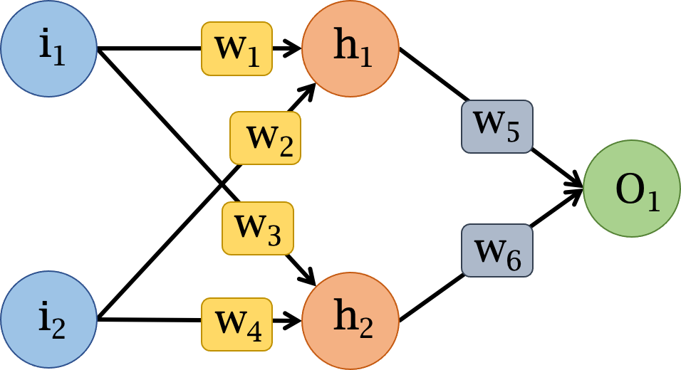

Slide 20
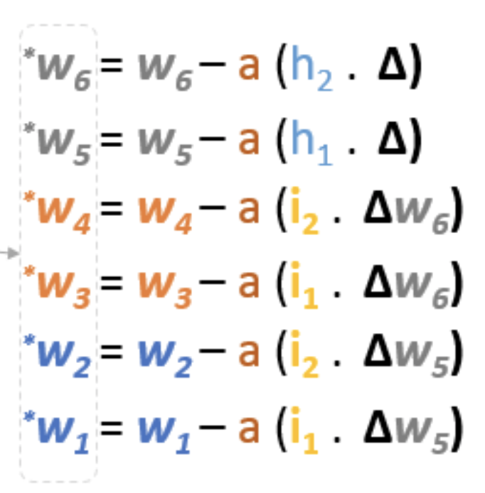
Ref: https://hmkcode.com/ai/backpropagation-step-by-step/

Slide 21
i₁
w₁
h₁
w₅
w₂
O₁
w₃
w₆
i₂
w₄
h₂

Slide 22
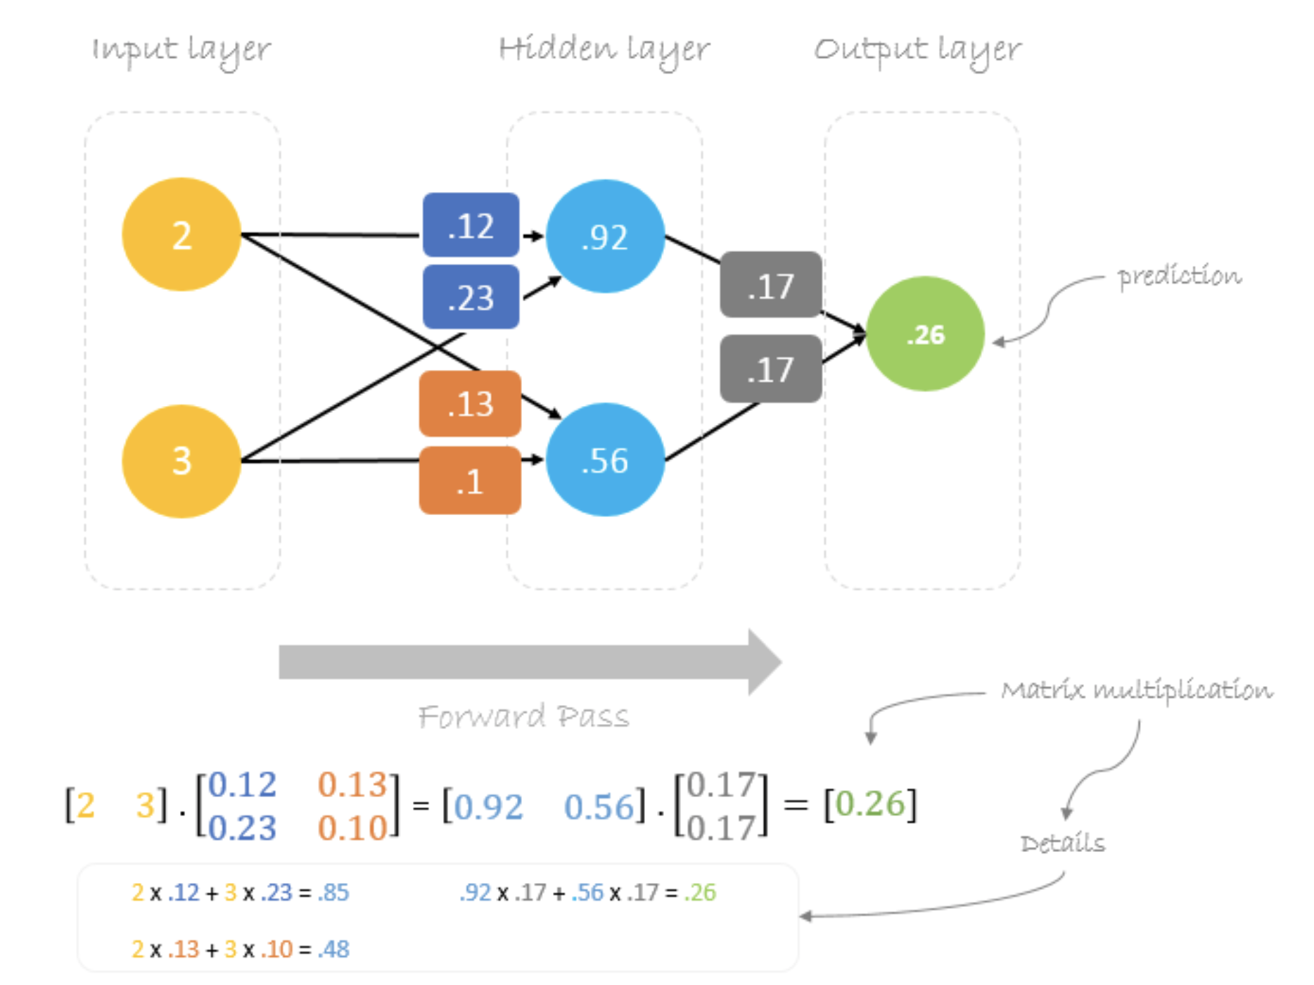

Slide 23
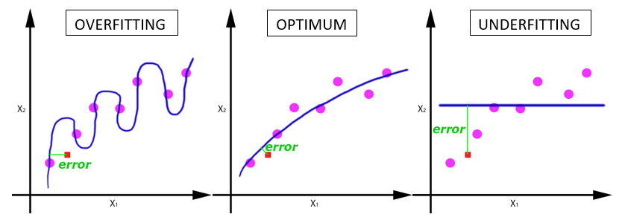
Deep learning terminologies
5. Epoch, Batches, Batch size, Iteration
a. Epoch:
-Entire dataset is passed (forward and backward) through the network.
-Why do we need multiple epochs?
How to find the right number of epochs?
Notes:
Ref: https://www.analyticsvidhya.com/blog/2019/08/detailed-guide-7-loss-functions-machine-learning-python-code/

Slide 24
Deep learning terminologies
5. Epoch, Batches, Batch size, Iteration
a. Epoch:
-Entire dataset is passed (forward and backward) through the network.
b. Batch/Batch size:
-Large data set is divided into smaller chunks or batches of specific size.
Notes:
Ref: https://www.analyticsvidhya.com/blog/2019/08/detailed-guide-7-loss-functions-machine-learning-python-code/

Slide 25
Deep learning terminologies
5. Epoch, Batches, Batch size, Iteration
a. Epoch:
-Entire dataset is passed (forward and backward) through the network.
b. Batch/Batch size:
-Large data set is divided into smaller chunks or batches of specific size.
c. Iteration:
-Number of batches required to complete one epoch.
Notes:
Ref: https://www.analyticsvidhya.com/blog/2019/08/detailed-guide-7-loss-functions-machine-learning-python-code/

Slide 26
Deep learning terminologies
5. Epoch, Batches, Batch size, Iteration
a. Epoch:
-Entire dataset is passed (forward and backward) through the network.
A dataset of 1000 training examples is divided into batches of 200 examples.
It will take 5 iterations to complete 1 epoch.
b. Batch/Batch size:
-Large data set is divided into smaller chunks or batches of specific size.
c. Iteration:
-Number of batches required to complete one epoch.
Notes:
Ref: https://www.analyticsvidhya.com/blog/2019/08/detailed-guide-7-loss-functions-machine-learning-python-code/

Slide 27
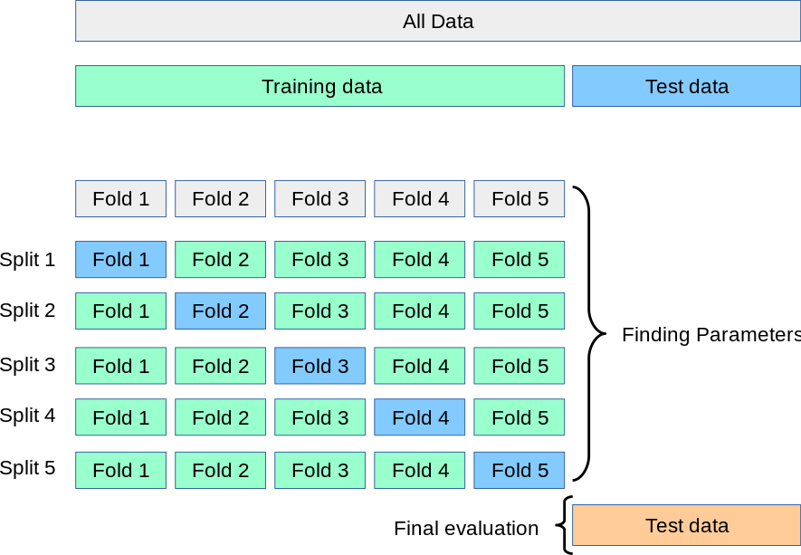
Deep learning terminologies
6. Cross-validation
Notes:
PC: https://en.wikipedia.org/wiki/Cross-validation_(statistics)

Slide 28
Types of learning problems
1. Supervised
a. Classification
b. Regression
2. Unsupervised
a. Clustering
b. Association
3. Reinforcement

Slide 29
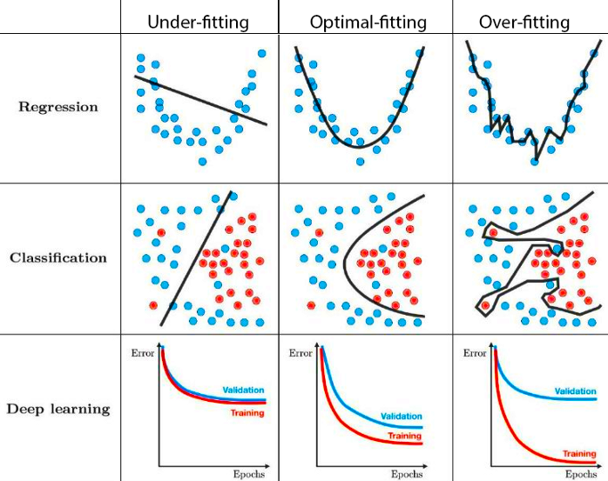
Challenges: Underfitting & Overfitting
Notes:
PC: https://towardsdatascience.com/techniques-for-handling-underfitting-and-overfitting-in-machine-learning-348daa2380b9

Slide 30
Dealing with underfitting
a. Increase model complexity
b. Use more epochs for training
c. Shuffle data per epoch
Notes:
https://towardsdatascience.com/techniques-for-handling-underfitting-and-overfitting-in-machine-learning-348daa2380b9

Slide 31
Dealing with overfitting
a. Increase training dataset
Regularization
a. Dropout
b. Augmentation
c. Early stopping
Notes:
https://towardsdatascience.com/techniques-for-handling-underfitting-and-overfitting-in-machine-learning-348daa2380b9

Slide 32
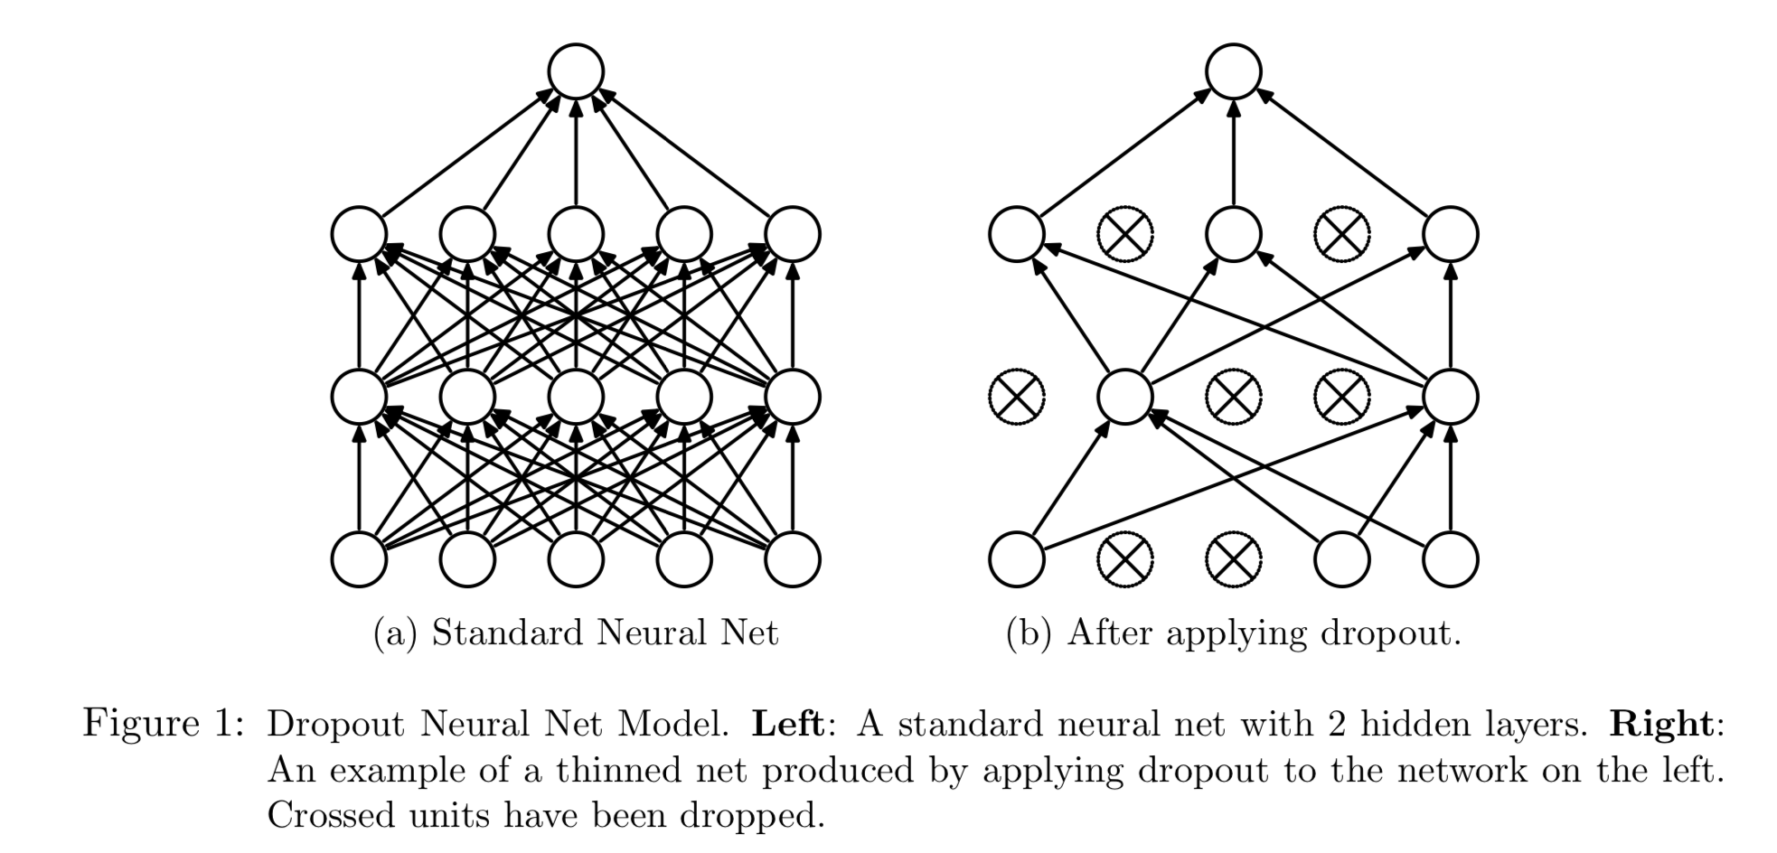
Dealing with overfitting
a. Dropout
Ref: Dropout: A Simple Way to Prevent Neural Networks from Overfitting
https://www.cs.toronto.edu/~hinton/absps/JMLRdropout.pdf
Notes:
DropConnect

Slide 33
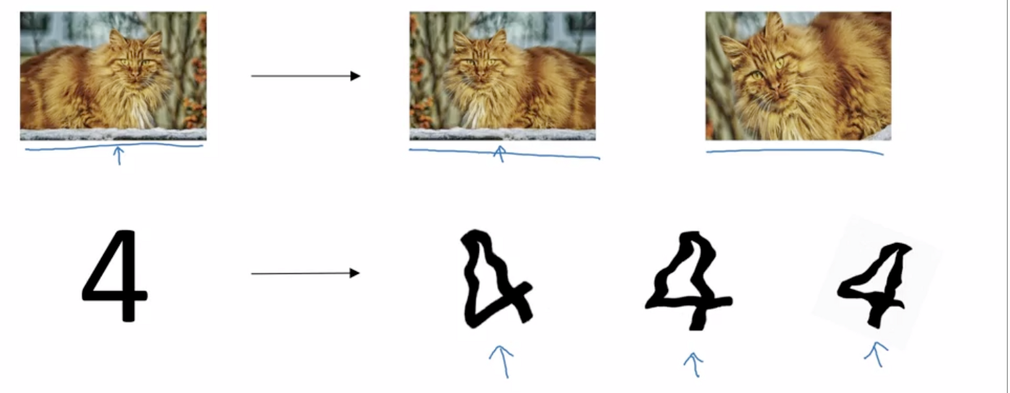
Dealing with overfitting
b. Augmentation
Notes:
https://medium.com/@dhartidhami/regularization-in-deep-learning-2065b7c889e5

Slide 34
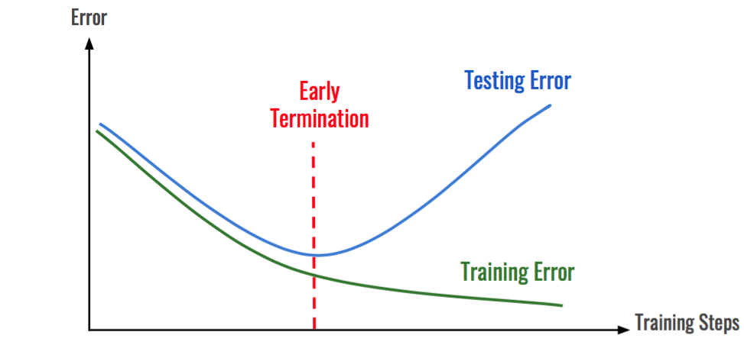
Dealing with overfitting
c. Early stopping

Slide 35
Deep learning on Mobile/Embedded devices: Challenges
Ref: https://www.edx.org/professional-certificate/harvardx-tiny-machine-learning

Slide 36
Microprocessor vs Microcontroller

Slide 37
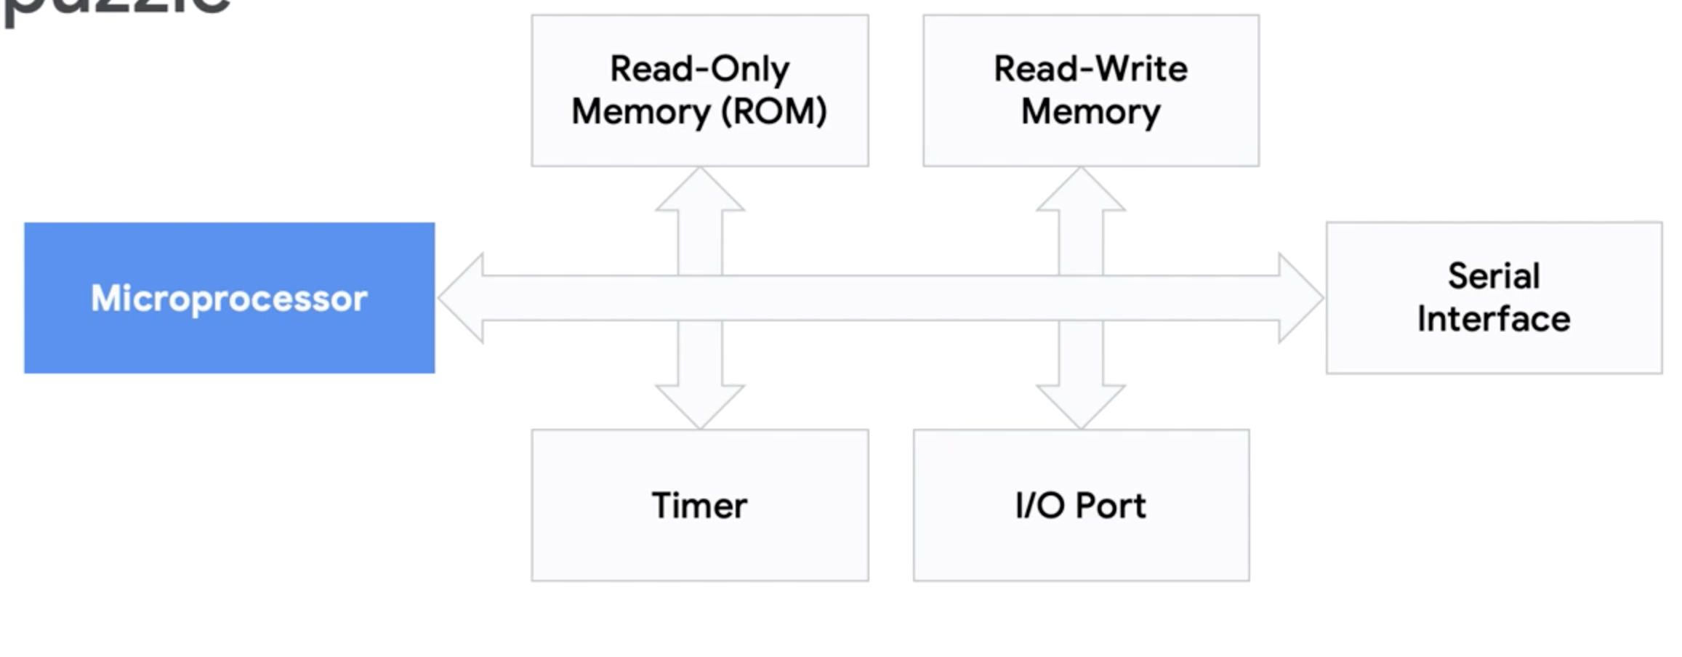
Microprocessor vs Microcontroller

Slide 38
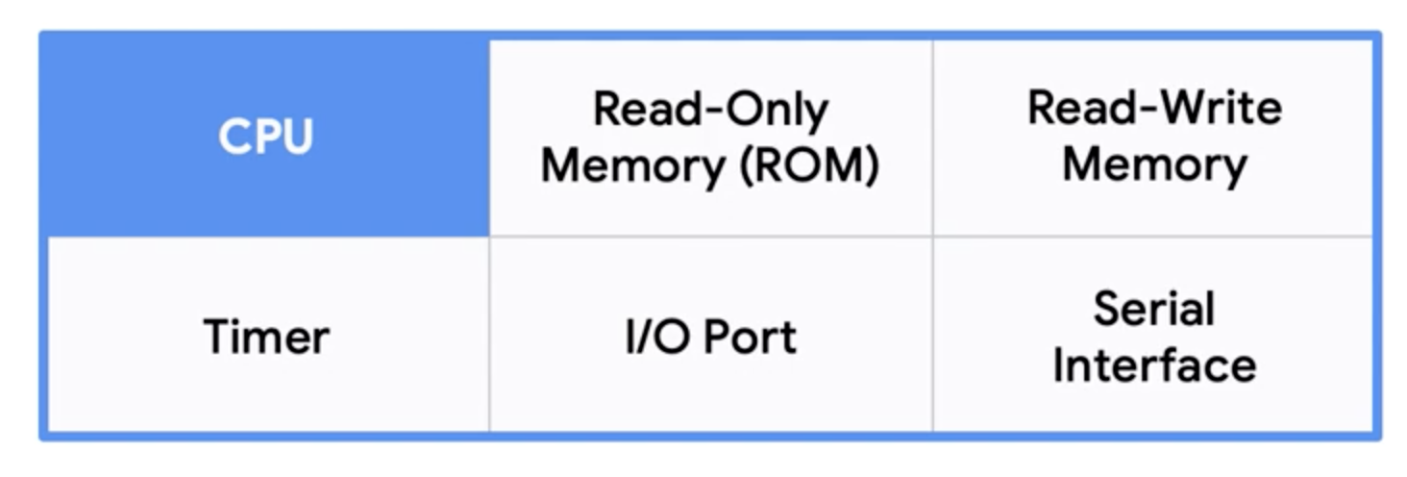
Microprocessor vs Microcontroller
Microcontroller

Slide 39
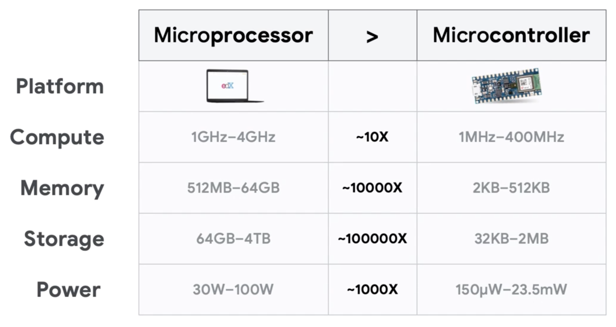
Microprocessor vs Microcontroller
Ref: https://www.edx.org/professional-certificate/harvardx-tiny-machine-learning

Slide 40
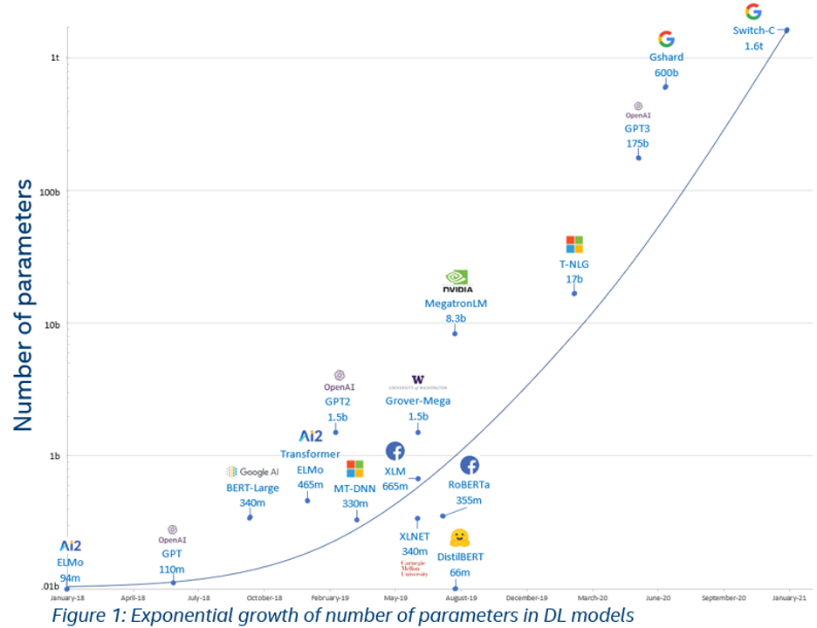

Slide 41
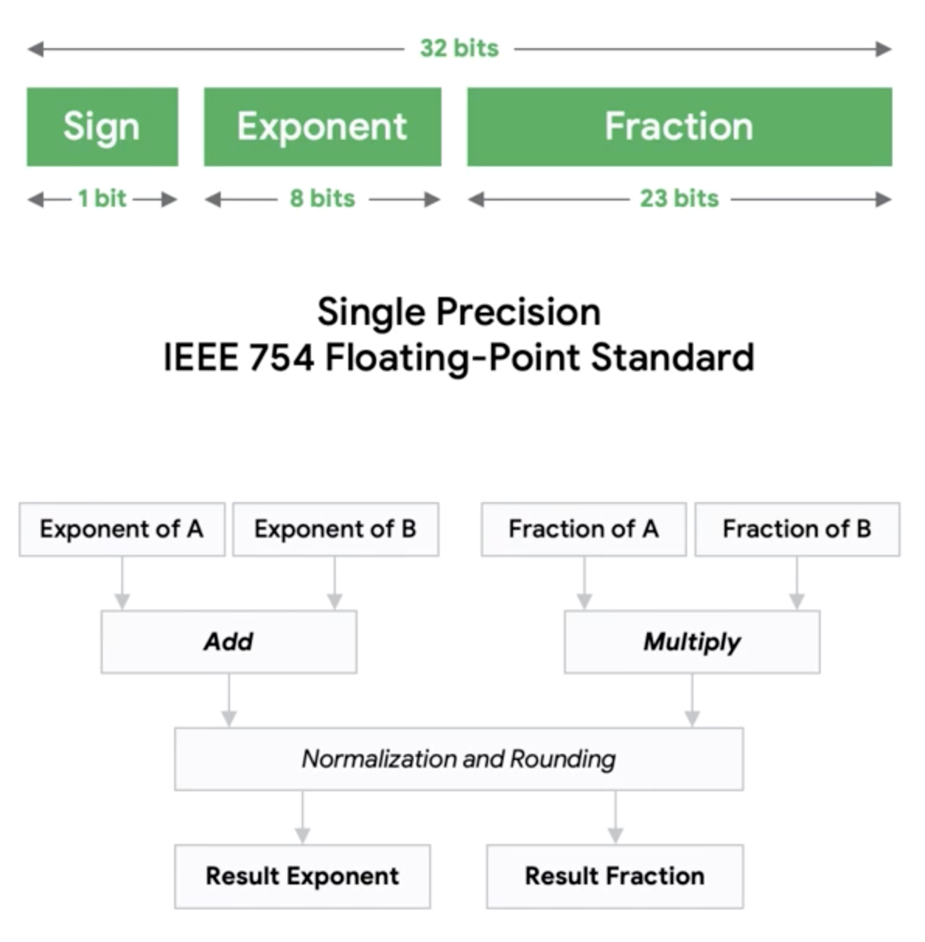
Microprocessor vs Microcontroller
Floating point operation
Ref: https://www.edx.org/professional-certificate/harvardx-tiny-machine-learning

Slide 42
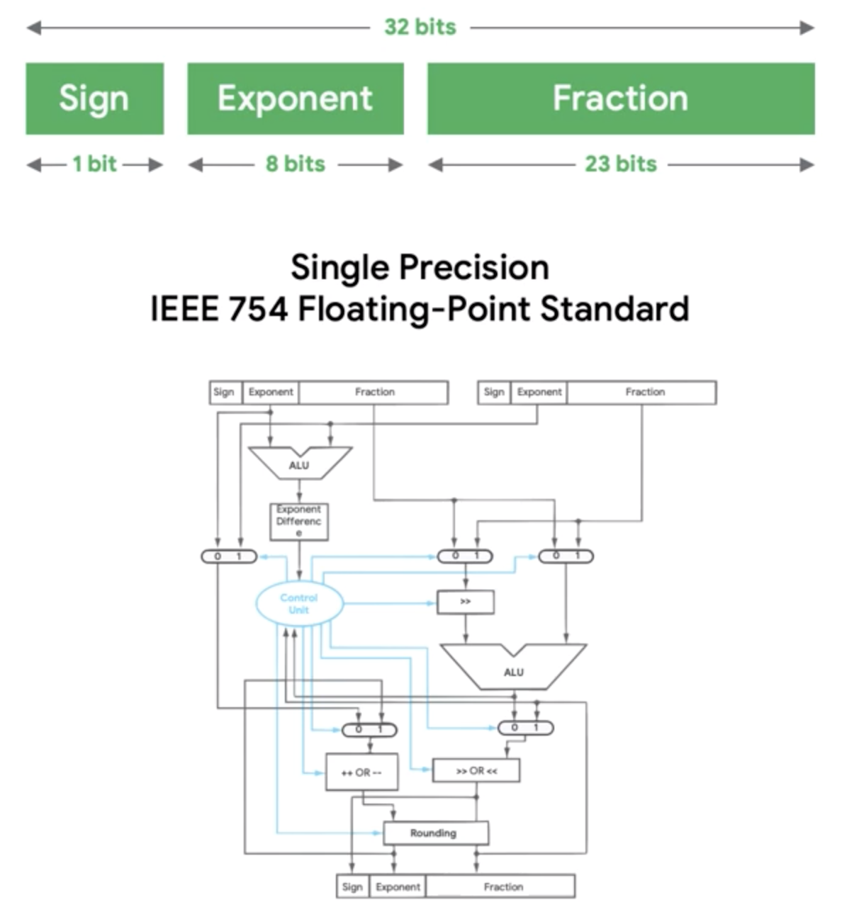
Microprocessor vs Microcontroller
Floating point operation
Ref: https://www.edx.org/professional-certificate/harvardx-tiny-machine-learning

Slide 43
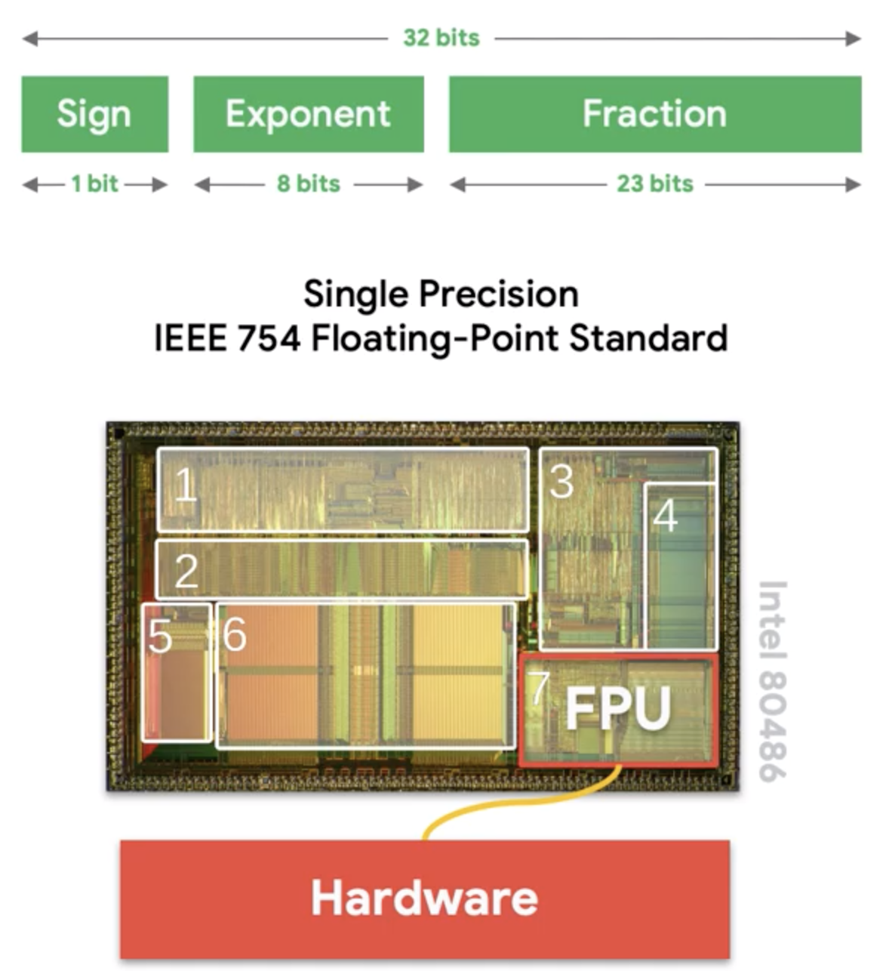
Microprocessor vs Microcontroller
Floating point operation
Ref: https://www.edx.org/professional-certificate/harvardx-tiny-machine-learning

Slide 44
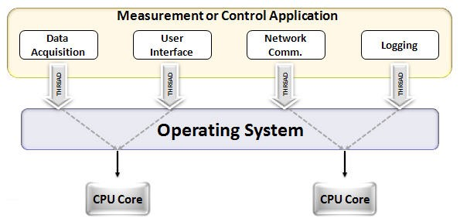
CPU vs GPU
Notes:
https://www.analyticsvidhya.com/blog/2020/09/why-gpus-are-more-suited-for-deep-learning/

Slide 45
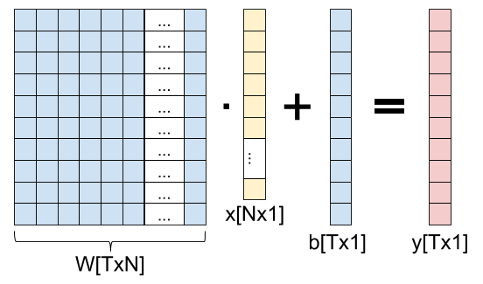
CPU vs GPU for parallel operations
Notes:
https://eli.thegreenplace.net/2018/backpropagation-through-a-fully-connected-layer/

Slide 46
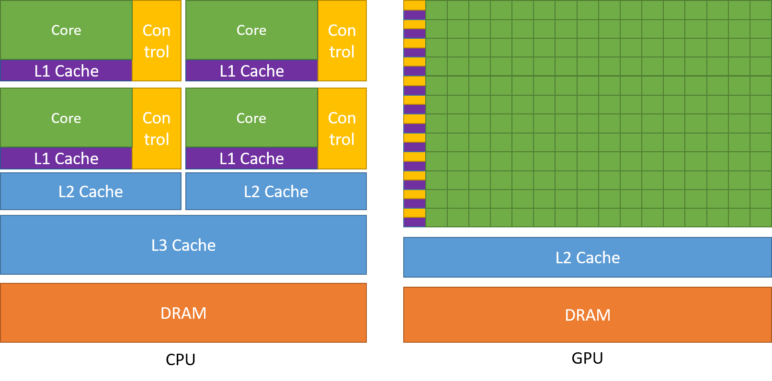
CPU vs GPU
Notes:
https://www.analyticsvidhya.com/blog/2020/09/why-gpus-are-more-suited-for-deep-learning/

Slide 47
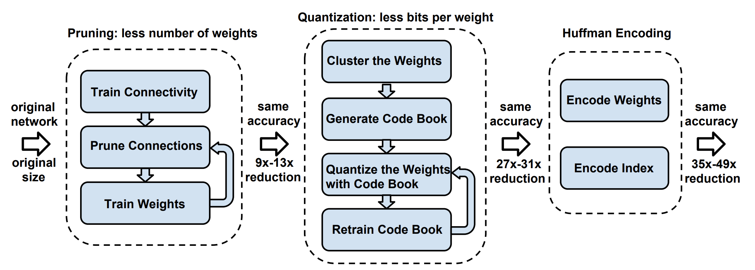
Compression of deep learning models
(TinyML example)
Notes:
https://tutorials.one/tiny-machine-learning/

Slide 48
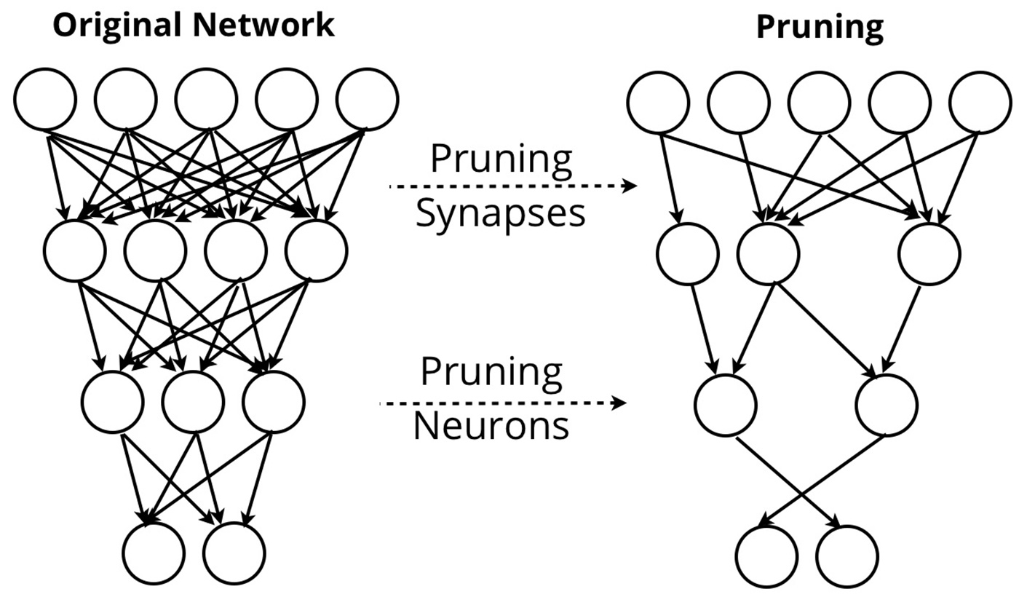
a. Pruning

Slide 49
b. Quantization

Slide 50
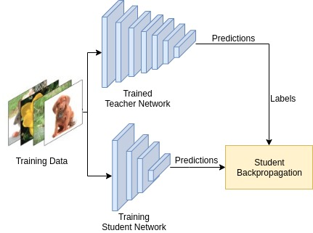
c. Knowledge distillation
Notes:
Paper ref: https://arxiv.org/pdf/2006.05525.pdf

Slide 51
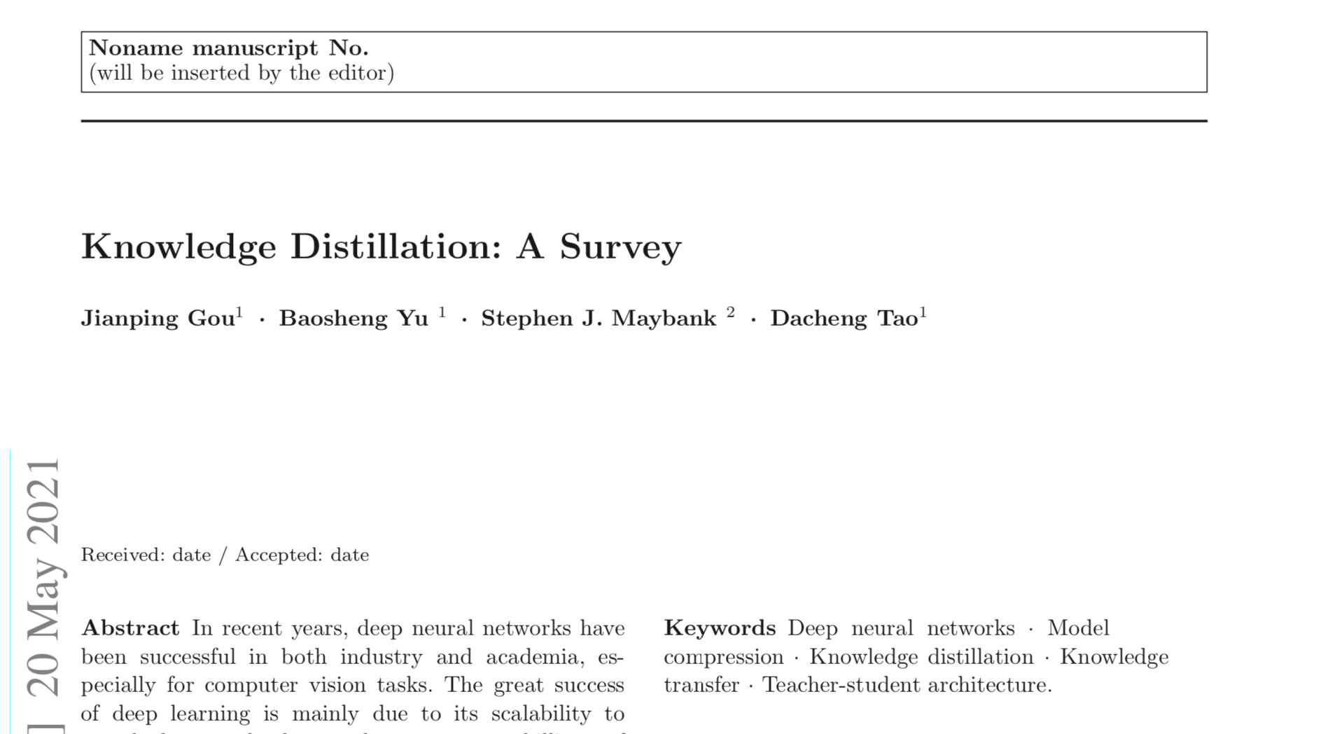
c. Knowledge distillation
Notes:
Paper ref: https://arxiv.org/pdf/2006.05525.pdf

