Slide 1
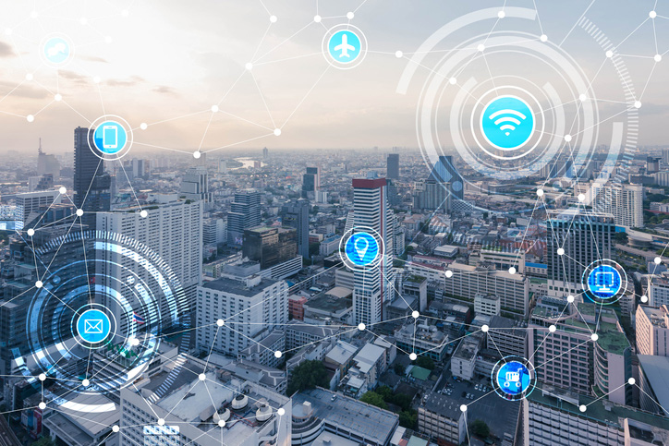
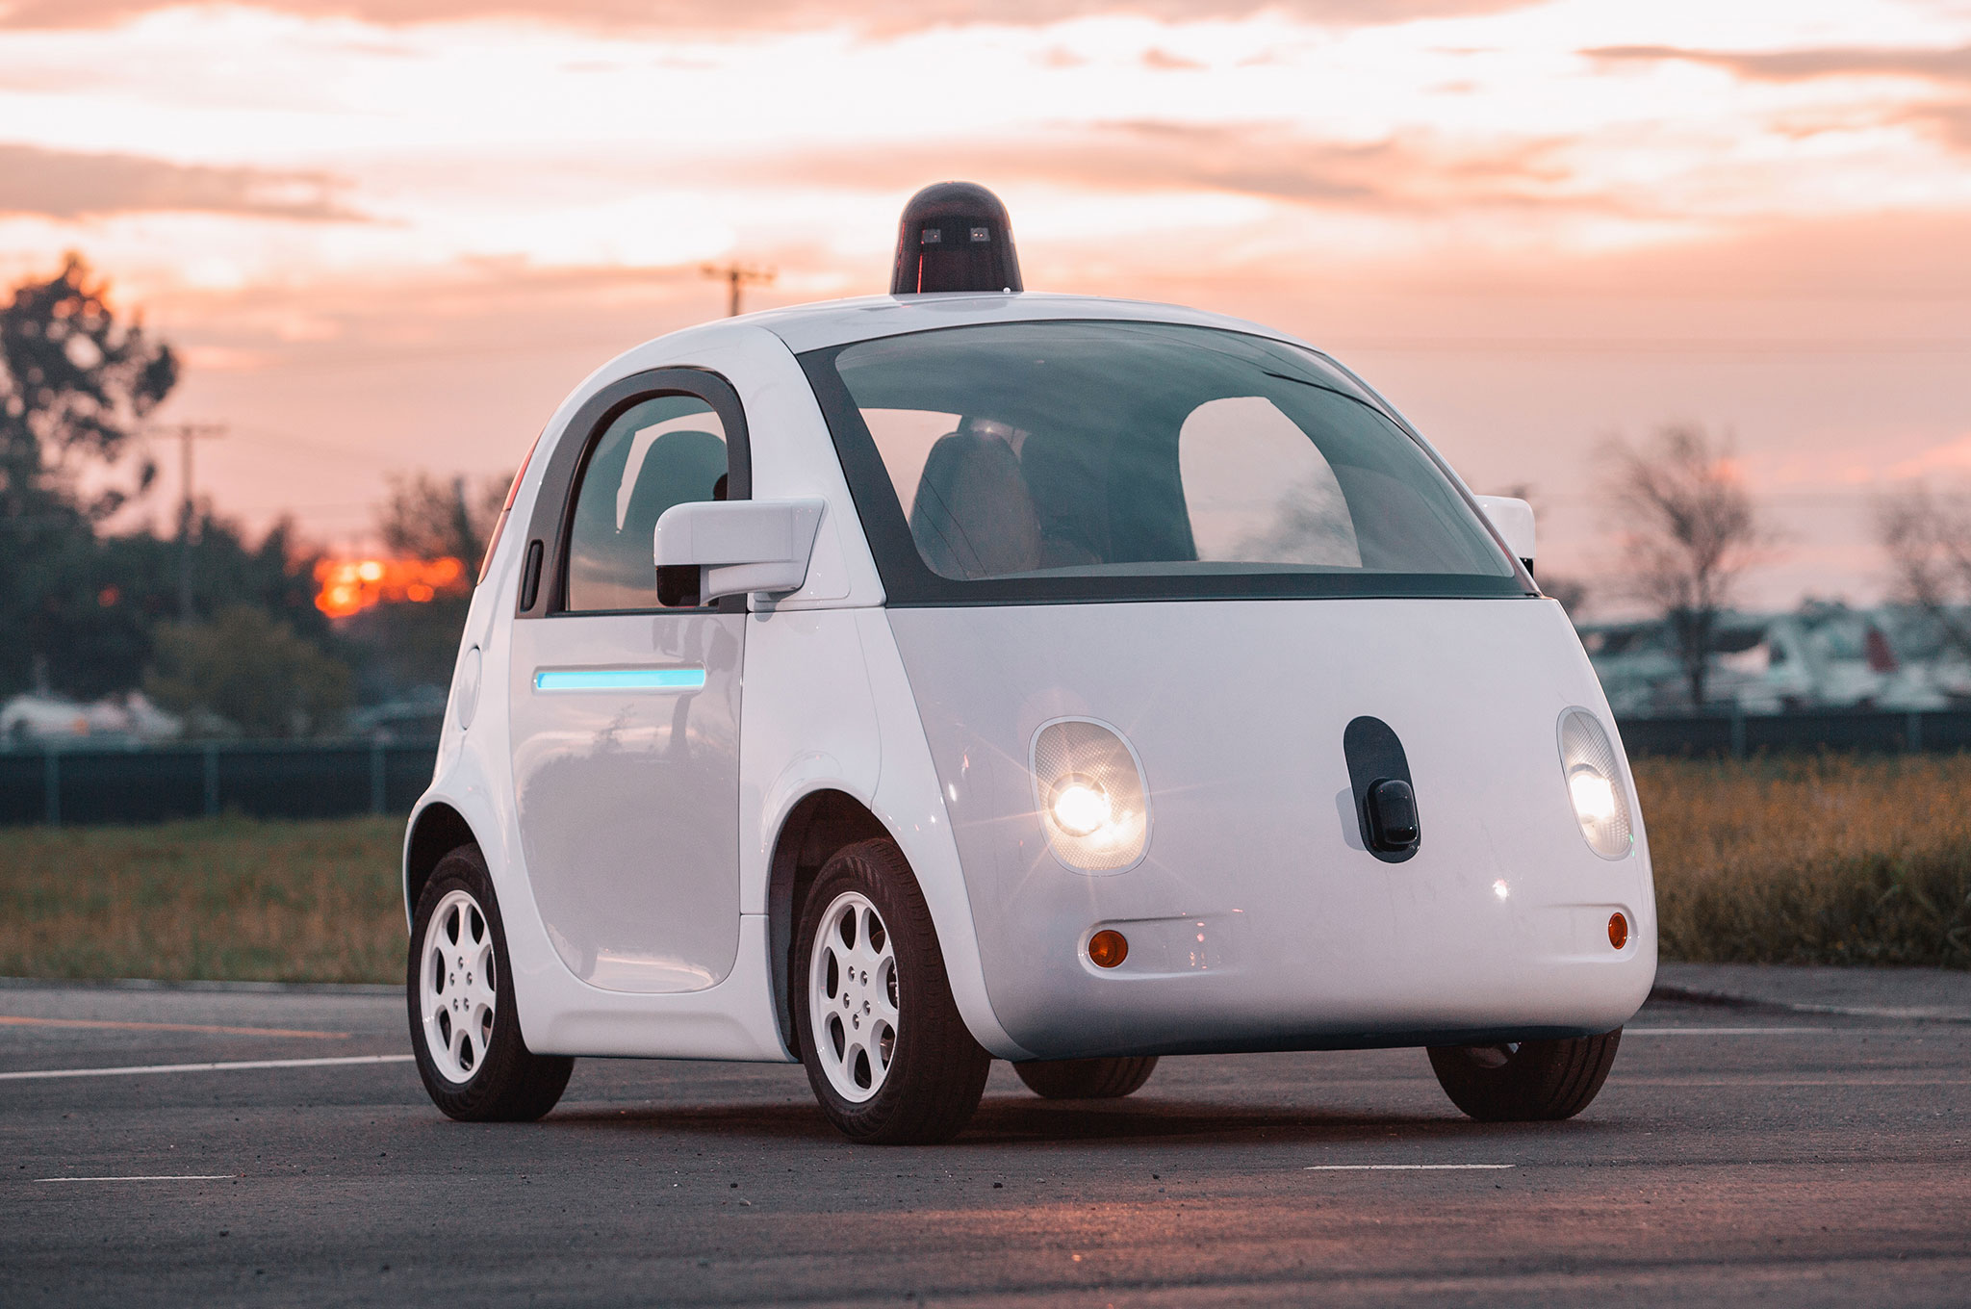
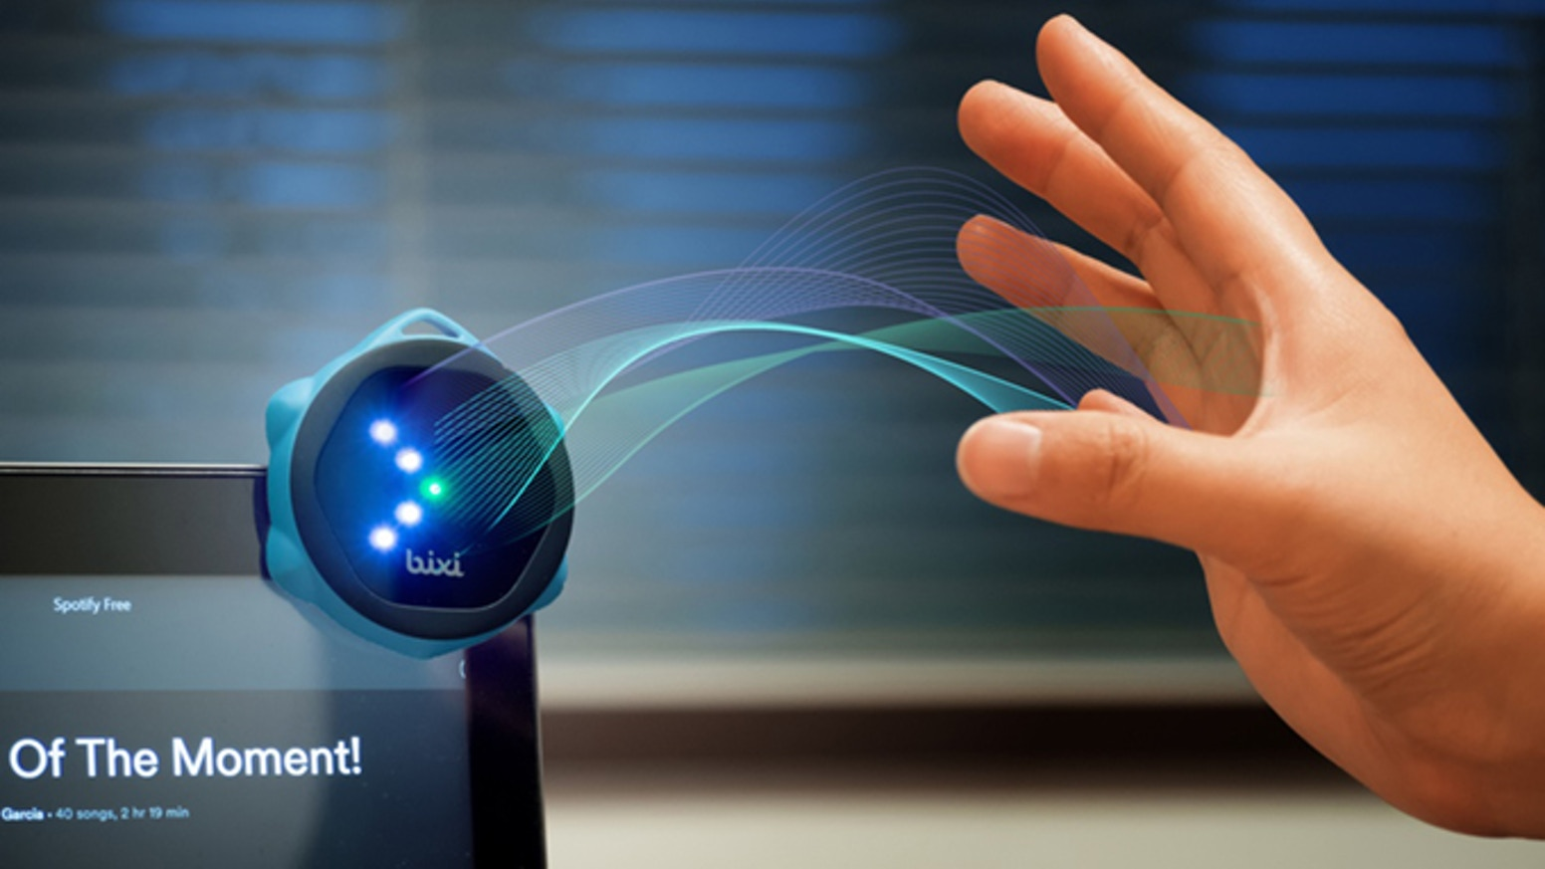
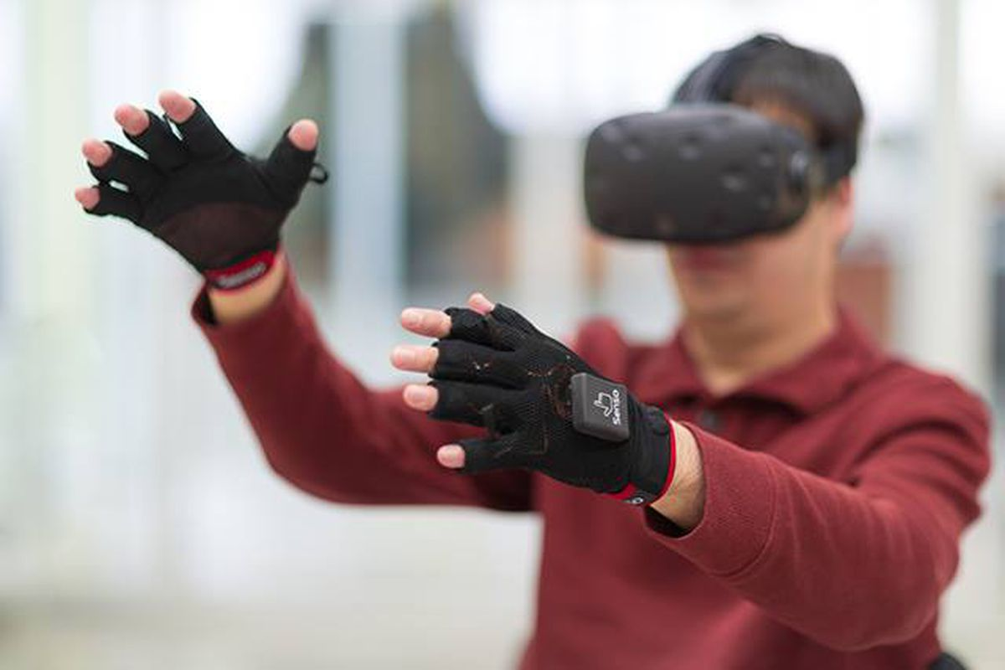

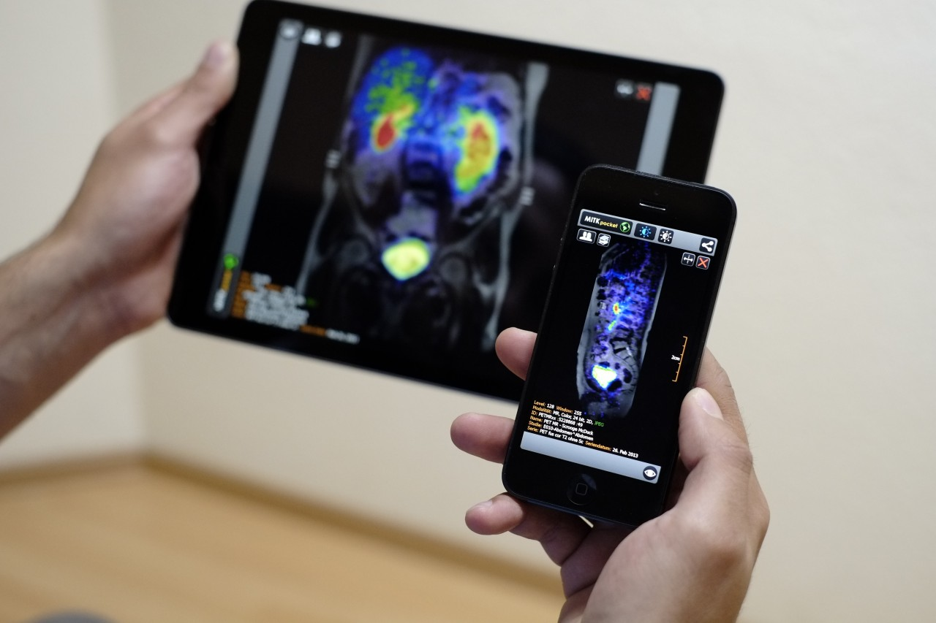
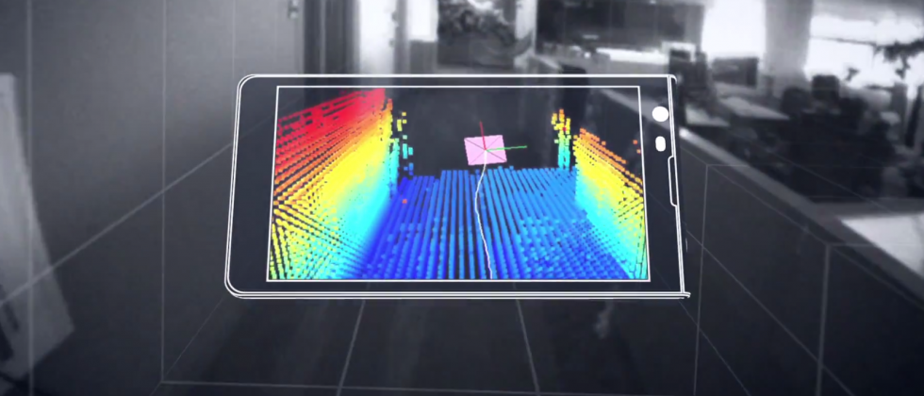
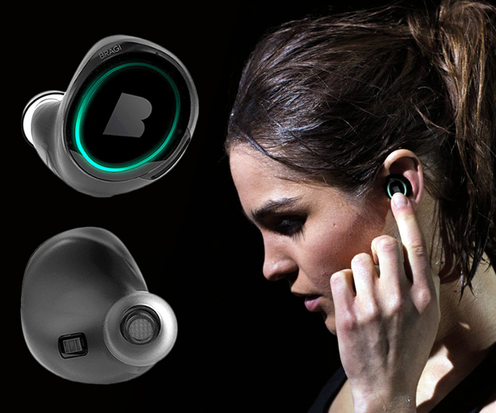
Wireless and Mobile Systems
for the IoT
CMSC 715 : Fall 2021
Lecture 5.2:
Wireless Networks for IoT – Part 2
Nirupam Roy
M-W 2:00-3:15pm
CHM 1224

Slide 2
Wireless Networking
1
Inherently multi-access
2
Higher error-rate
3
Limited access to power
4
Varying topology

Slide 3
Wireless Networking
Wireless network == WiFi ?
WiFi
Bluetooth, ZigBee, …
Cellular

Slide 4
Wireless Networking
Wired network
Base station/
Access point
Collision domain

Slide 5
Wireless Networking
A
B

Slide 6
Wireless Networking
CSMA-CA: CSMA-Collision Avoidance
A
B
C
Hidden terminal problem

Slide 7
Wireless Networking
CSMA-CA: CSMA-Collision Avoidance
RTS = Request To Send
A
B
CTS = Clear To Send

Slide 8
Wireless Networking
CSMA-CA: CSMA-Collision Avoidance
A
B
C
RTS

Slide 9
Wireless Networking
CSMA-CA: CSMA-Collision Avoidance
A
B
C
CTS

Slide 10
Wireless Networking
CSMA-CA: CSMA-Collision Avoidance
A
B
RTS
C
RTS
What if the RTS packets collided?

Slide 11
Wireless Networking
CSMA-CA: CSMA-Collision Avoidance
Exponential Back-off
Exponential Back-off
A
B
RTS
C
RTS
What if the RTS packets collided?

Slide 12
Wireless Networking
A
B
C
D
Exposed terminal problem

Slide 13
Wireless Sensor Networks
Infrastructure
network
Mesh
network
Ad-hoc
network

Slide 14
Today’s talk
1. Networks
2. Wireless networks
3. Wireless sensor networks
4. Low-power wireless sensor networks

Slide 15
Wireless Sensor Networks

Slide 16
Wireless Sensor Networks
Wireless Sensor Networks (WSN) == Wireless Ad-hoc Networks?
Large number of sensor
Densely deployed
Prone to failure
Highly dynamic topology
Limited power, computational capabilities, and memory
Nodes may not have global addresses
Notes:
WSN overview and comparison: http://shodhganga.inflibnet.ac.in/bitstream/10603/77730/12/12_chapter_02.pdf

Slide 17
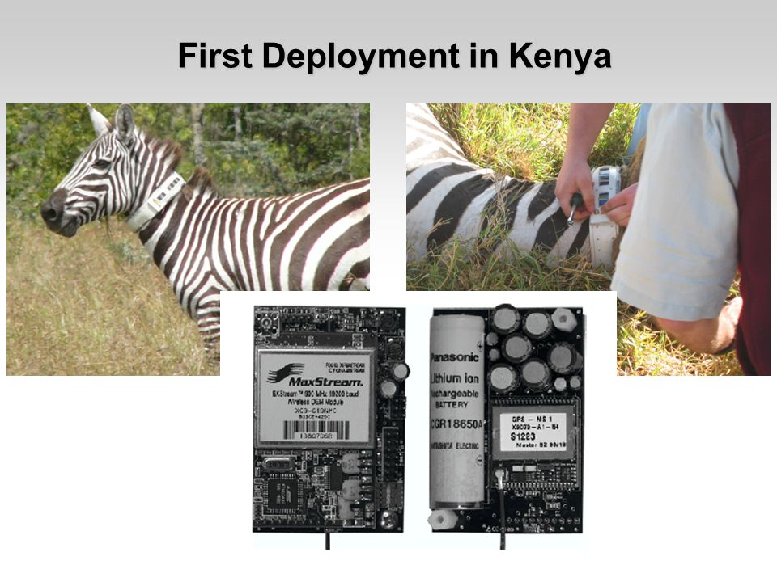
ZebraNet: An application of sensor networks

Slide 18
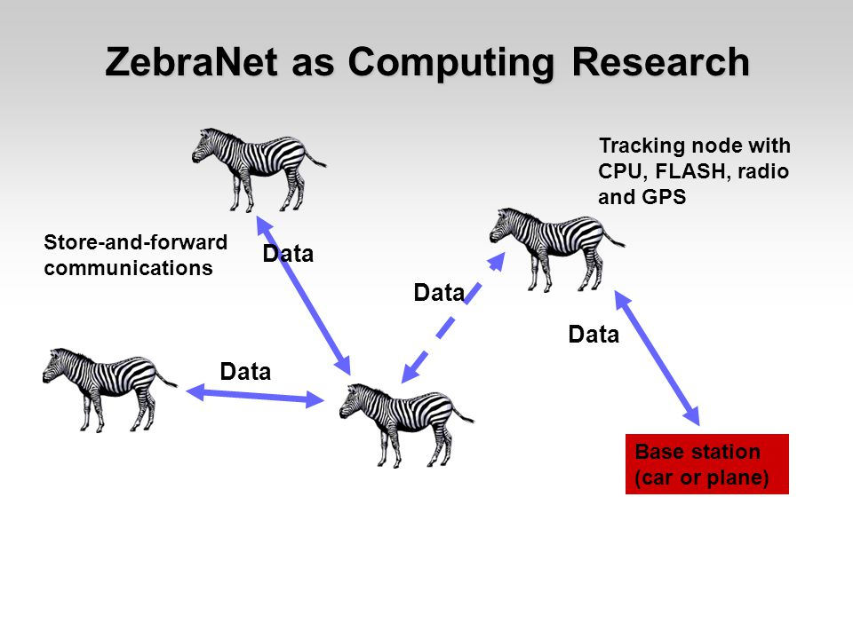

Slide 19
Wireless Sensor Networks

Slide 20
Today’s talk
1. Networks
2. Wireless networks
3. Wireless sensor networks
4. Low-power, long-range wireless sensor networks

Slide 21
Types of Networks
PAN
LAN
MAN
WAN
Personal Area Network
Local Area Network
Metropolitan Area Network
Wide Area Network
Notes:
BAN = Body area network

Slide 22
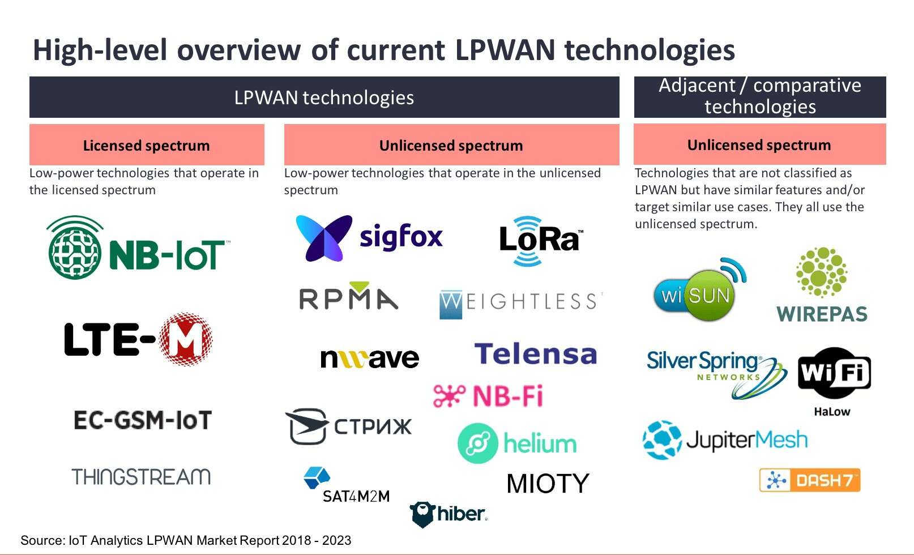
LPWAN: Low Power Wide Area Network

Slide 23
LPWAN: Low Power Wide Area Network

Slide 24
LPWAN: Low Power Wide Area Network
LoRaWAN

Slide 25
LoRa-WAN: A Low-Power Wide Area Network

Slide 26
LoRa-WAN: A Low-Power Wide Area Network

Slide 27
LoRa-WAN: A Low-Power Wide Area Network

Slide 28
LoRa (Long Range)
LoRa Node
LoRa Gateway

Slide 29
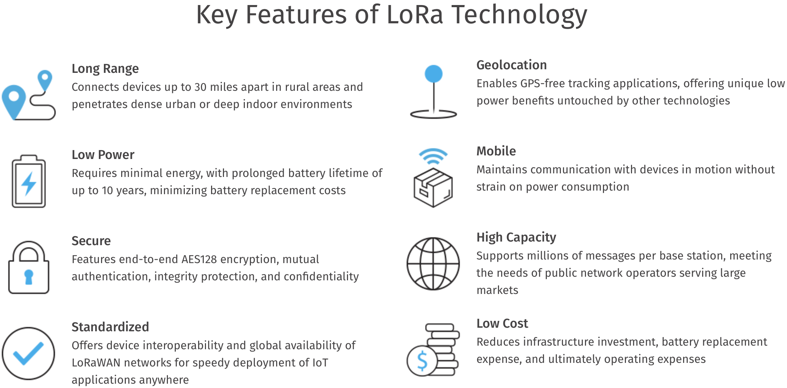
LoRa (Long Range)

Slide 30
LoRa: Stack

Slide 31
LoRa: PHY Layer

Slide 32
LoRa (Long Range)
Shannon-Hartley theorem for channel capacity:
∝

Slide 33
LoRa (Long Range)
Spread spectrum communication: Transmission

Slide 34
LoRa (Long Range)
Spread spectrum communication: Transmission

Slide 35
LoRa (Long Range)
Spread spectrum communication: Transmission

Slide 36
LoRa (Long Range)
Spread spectrum communication: Reception

Slide 37
LoRa (Long Range)
Spread spectrum communication: Reception

Slide 38
LoRa (Long Range)
Spread spectrum: The intuition
XOR code
Amplitude
Amplitude
Frequency
Frequency
…for matching code
XOR code

Slide 39
LoRa (Long Range)
Spread spectrum: The intuition
XOR code
Amplitude
Amplitude
Frequency
Frequency
…for different codes
Or any other signal
XOR code

Slide 40
LoRa (Long Range)
Spread spectrum: The intuition
Narrowband interference
XOR code
Amplitude
Amplitude
Frequency
Frequency
Wideband interference

Slide 41
LoRa (Long Range)
Spread spectrum: The intuition
Received signal
Narrowband interference
Signal-to-Noise
Ratio (SNR)
XOR code
Amplitude
Amplitude
Frequency
Frequency
Wideband interference
XOR code

Slide 42
LoRa (Long Range)
Chirp spread spectrum communication

Slide 43
LoRa (Long Range)
Chirp spread spectrum communication
Sine signal
Sine sweep or Chirp
Amplitude
Amplitude
Time (sec)
Time (sec)
Frequency
Frequency
Time (sec)
Time (sec)

Slide 44
LoRa (Long Range)
Chirp spread spectrum communication
Frequency
Frequency
Time (sec)
Time (sec)
Chirps at different phases
= LoRa symbols for data
Frequency
Time (sec)

Slide 45
LoRa (Long Range)
Modulation

Slide 46
LoRa (Long Range)
Modulation

Slide 47
LoRa (Long Range)
Communication bandwidth

Slide 48
LoRa (Long Range)
Communication bandwidth
Overall bandwidth

Slide 49
LoRa (Long Range)
Demodulation:
What happens when we multiply two chirps with phase difference?

Slide 50
LoRa (Long Range)
Demodulation:
Taken from the slides by Thomas Telkamp

Slide 51
LoRa (Long Range)
Demodulation:

Slide 52
LoRa (Long Range)
Demodulation:
Taken from the slides by Thomas Telkamp

Slide 53
LoRa (Long Range)
Demodulation:
Taken from the slides by Thomas Telkamp

Slide 54
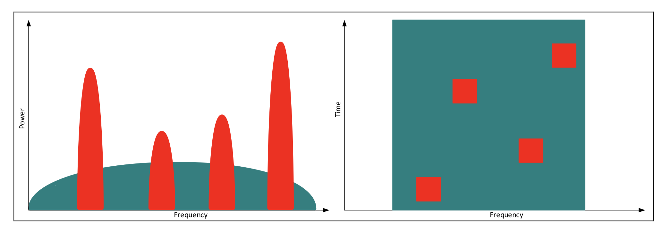
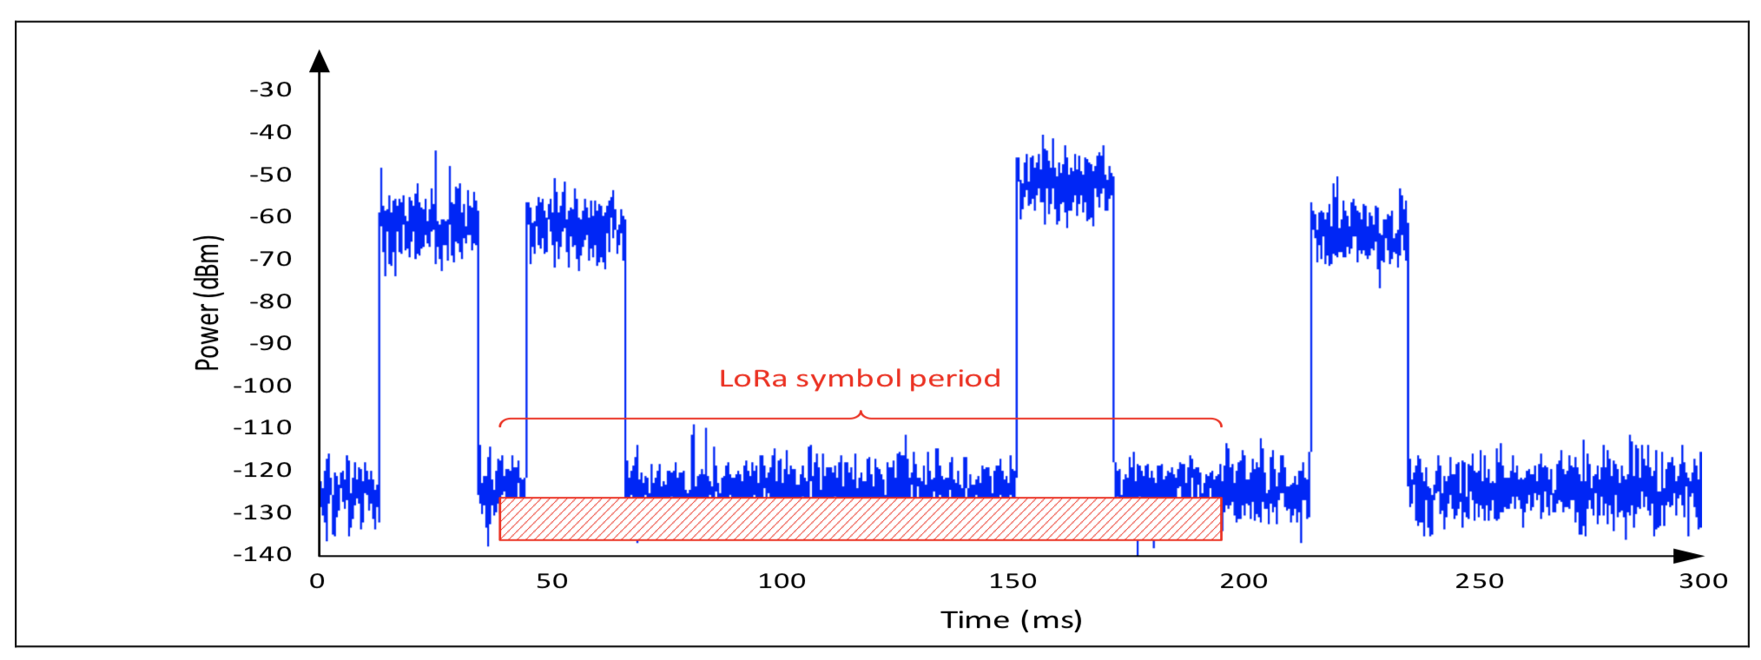
LoRa (Long Range)
Wide-band signal with narrow-band interferences

Slide 55
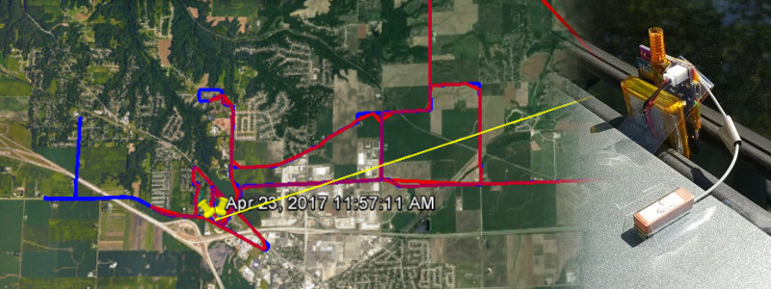
LoRa (Long Range)

