Slide 1

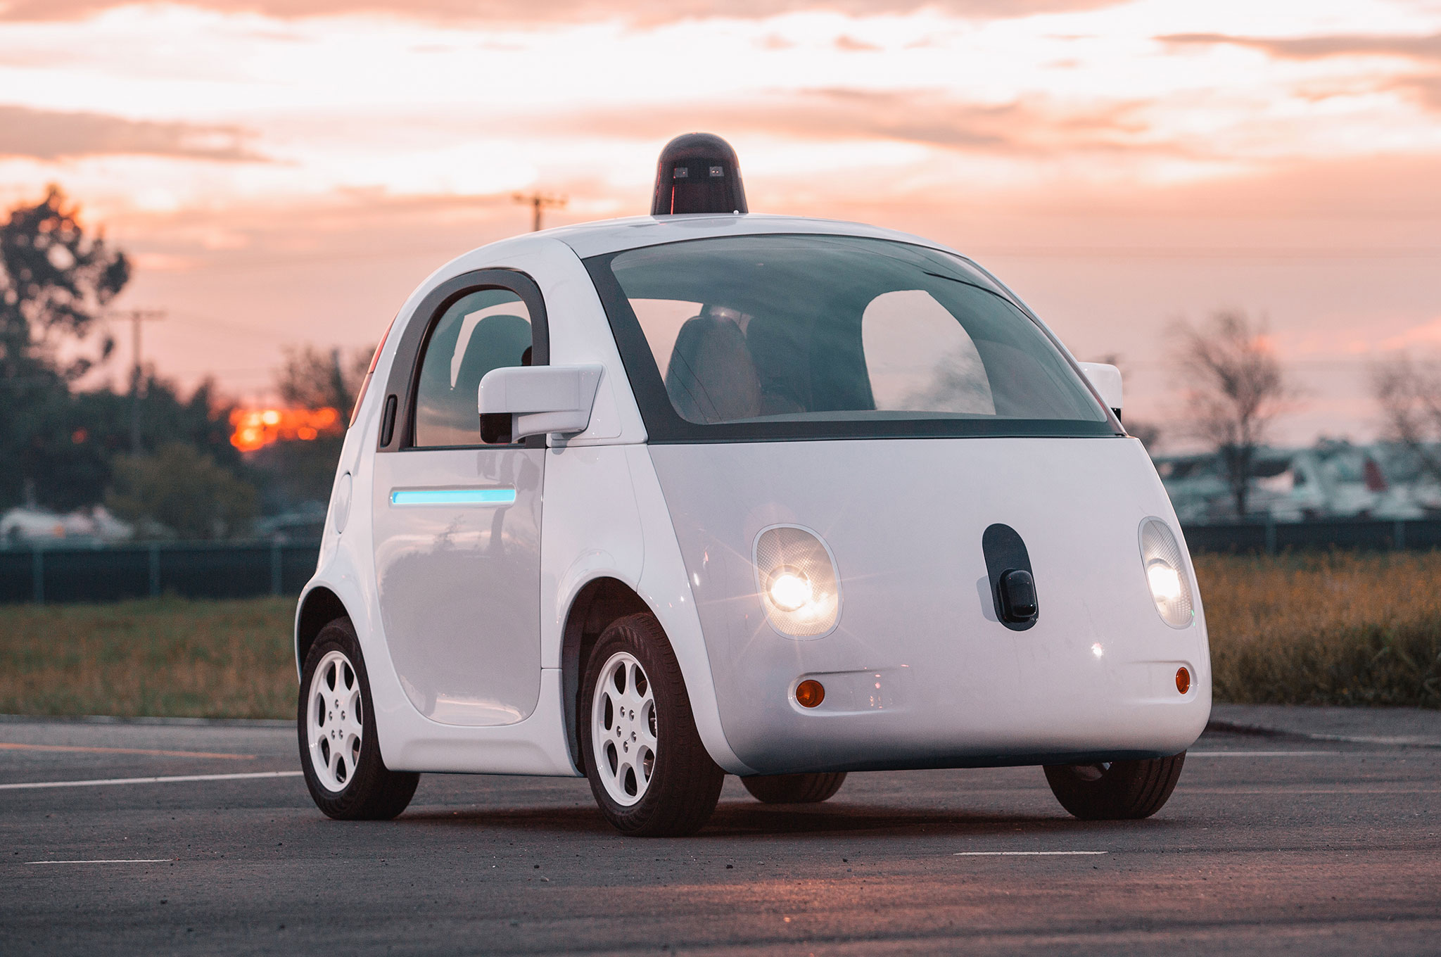

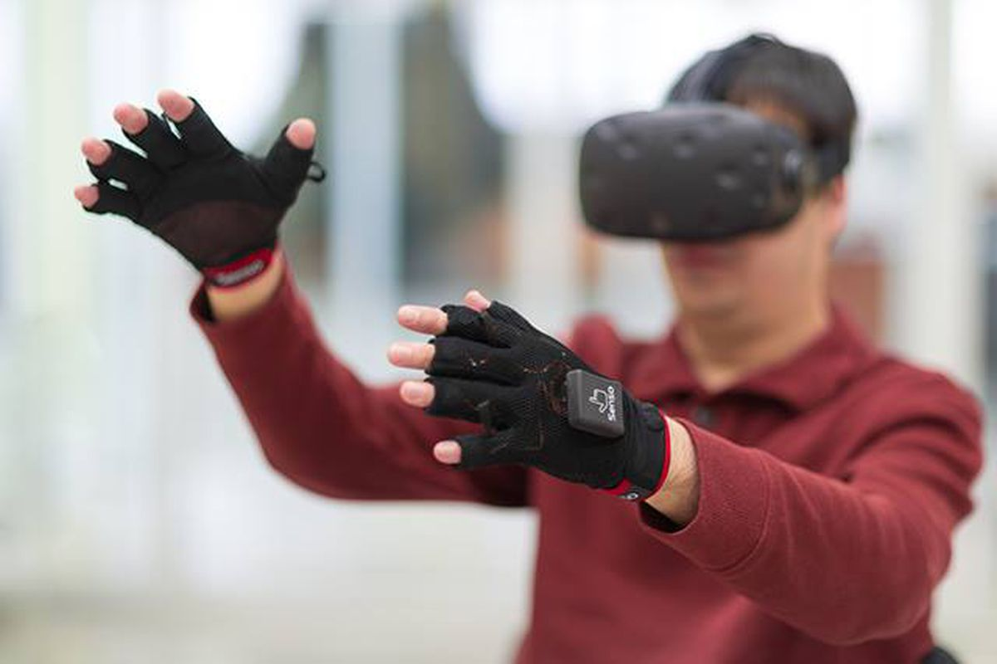
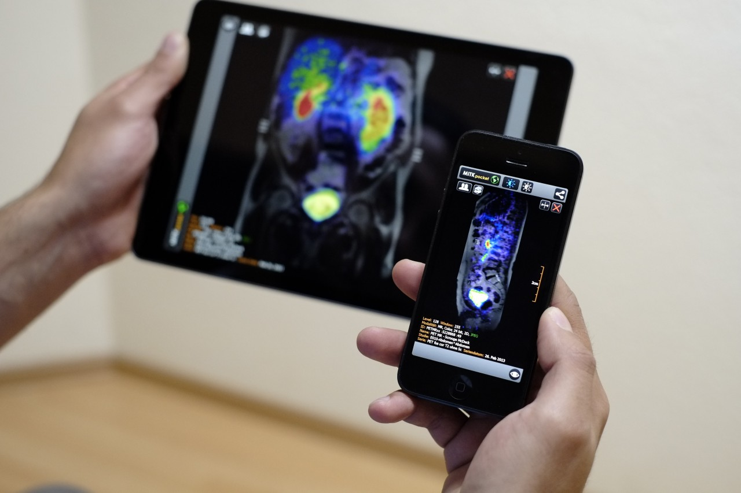
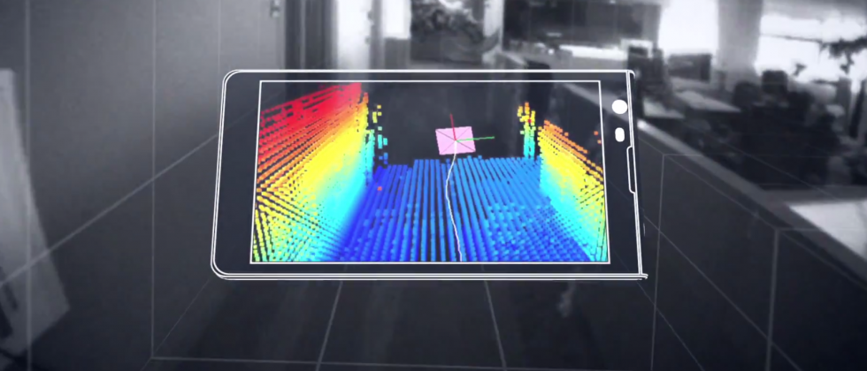
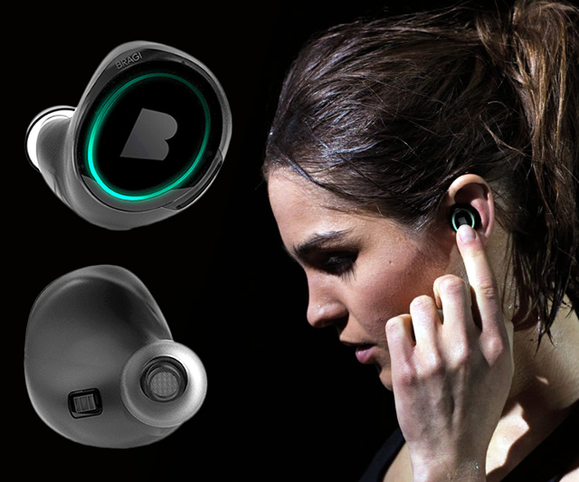
Wireless and Mobile Systems
for the IoT
CMSC 715 : Fall 2021
Midterm Review and Discussion
November 1st, 2021
Nakul Garg

Slide 2
November 3, 02:00 PM
The exam questions will be spread over the topics taught so far (up to lecture 4.1).
Fundamental concepts/theories are important.
There will be no specific question from any paper
No programming

Slide 3
3 Sections
Multiple Choice Questions
Short answer type questions
Problem solving
There maybe some Bonus questions

Slide 4
The following topics are particularly important
Sensor fundamentals, Local/global coordinate systems, frequency and phase of a signal
Time & Frequency domain representation, Analog to Digital conversion, Sampling theorem, Aliasing, Complex representation of a signal
Positive and negative frequencies, Discrete Fourier Transform (DFT), Aliasing in different types of signals
Frequency bands, multiplication of frequency
Time-space propagation of signals (waves), reflection and echolocation, using waves for proximity sensing and ranging (distance finding)
Space-time equation of waves, superposition of waves, Sensing with multiple sensors, Spatial filtering/beamforming
Directional sensing with the sensor array, uniform linear array (ULA)
The direction of arrival estimation, signal localization
Markov model, Hidden Markov Model, Viterbi decoding
Bayesian inference, Deep learning overview, Challenges of computing on Embedded devices, Adapting deep learning for embedded sensing and inference systems.
Indoor localization techniques: fingerprinting, ranging from multiple signal sources, pedestrian dead reckoning (using inertial sensors in mobile devices), Combination of dead reckoning with other localization techniques (indoor signatures or GPS signal).

Slide 5
Today’s focus
Sensor fundamentals, Local/global coordinate systems, frequency and phase of a signal
Time & Frequency domain representation, Analog to Digital conversion, Sampling theorem, Aliasing, Complex representation of a signal
Positive and negative frequencies, Discrete Fourier Transform (DFT), Aliasing in different types of signals
Frequency bands, multiplication of frequency
Time-space propagation of signals (waves), reflection and echolocation, using waves for proximity sensing and ranging (distance finding)
Space-time equation of waves, superposition of waves, Sensing with multiple sensors, Spatial filtering/beamforming
Directional sensing with the sensor array, uniform linear array (ULA)
The direction of arrival estimation, signal localization
Markov model, Hidden Markov Model, Viterbi decoding
Bayesian inference, Deep learning overview, Challenges of computing on Embedded devices, Adapting deep learning for embedded sensing and inference systems.
Indoor localization techniques: fingerprinting, ranging from multiple signal sources, pedestrian dead reckoning (using inertial sensors in mobile devices), Combination of dead reckoning with other localization techniques (indoor signatures or GPS signal).

Slide 6
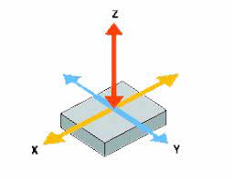
Location estimated by double-integrating the accelerometer data drifts from the ground truth because
Location can not be estimated from accelerometer data
Single integration is sufficient for location estimation
Double-integration reduces high frequency noise
Double-integration amplifies low frequency noise

Slide 7
Location estimated by double-integrating the accelerometer data drifts from the ground truth because
Location can not be estimated from accelerometer data
Single integration is sufficient for location estimation
Double-integration reduces high frequency noise
Double-integration amplifies low frequency noise

Slide 8

You can use the magnetometer sensor of a smartphone to find the global walking direction of the user if you know:
The orientation of the smartphone
The walking speed of the user
The exact value of the gravity at that location
The location of the magnetic north pole

Slide 9
You can use the magnetometer sensor of a smartphone to find the global walking direction of the user if you know:
The orientation of the smartphone
The walking speed of the user
The exact value of the gravity at that location
The location of the magnetic north pole

Slide 10
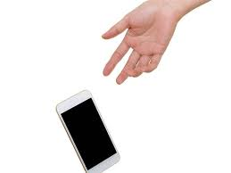
Dropping a smartphone may damage it. You are planning to develop an airbag system for smartphones that will inflate in the event of a fall to protect the phone. The key challenge of this system is to detect the fall before the smartphone hits the ground. Explain how you can detect the fall of the smartphone using its sensors.

Slide 11
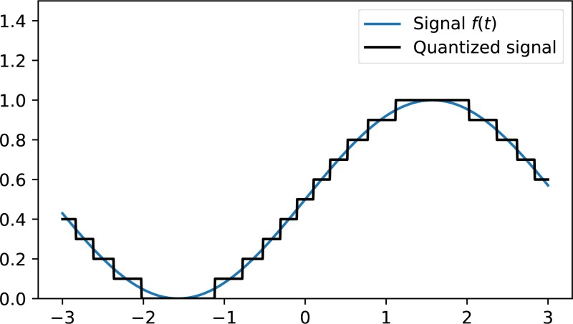
A signal is bandlimited to 1000 Hz. What bit rate is obtained in the digital domain if we use the minimum possible sampling rate and a 6-bit A/D converter?

Slide 12
A signal is bandlimited to 1000 Hz. What bit rate is obtained in the digital domain if we use the minimum possible sampling rate and a 6-bit A/D converter?
Minimum sampling rate = 2000Hz
Bitrate = 2000*6 bits/second

Slide 13
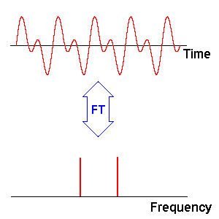
The DFT magnitudes of a signal are always symmetric around half of the sampling frequency. Is this statement correct? Why?
Yes
No
🤷‍♂️

Slide 14
The DFT magnitudes of a signal are always symmetric around half of the sampling frequency. Is this statement correct? Why?
Yes
No
🤷‍♂️

Slide 15
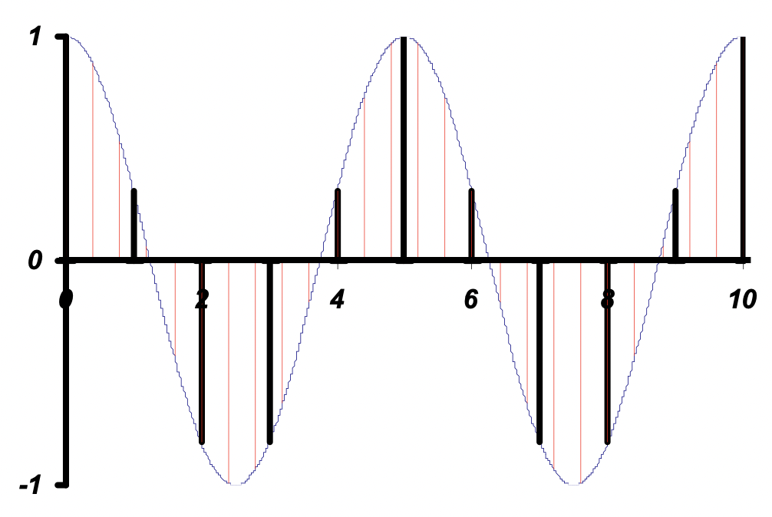
How many samples are enough to represent a 10 second long 40Hz sinusoid time signal?

Slide 16
How many samples are enough to represent a 10 second long 40Hz sinusoid time signal?
Nyquist rate = 80 Hz
Number of samples in 10 seconds = 80*10

Slide 17
What is the frequency resolution in Hz of a signal x(t) sampled at 5 Hz over a time interval of 3 s
0.33
1
3
15

Slide 18
What is the frequency resolution in Hz of a signal x(t) sampled at 5 Hz over a time interval of 3 s
0.33
1
3
15

Slide 19
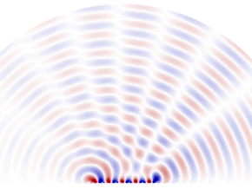
What are the advantages of using microphone array for spatial filtering over a mechanically steerable directional microphone?

Slide 20
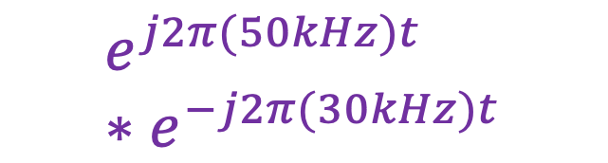

$$e^{j2π(50kHz)t}$$
$$e^{j2π(50kHz)t} ∗e^{−j2π(30kHz)t}$$
?
Amplitude
0
20
50
60
80
Frequency (kHz)

Slide 21
$$e^{j2π(50kHz)t}$$
$$e^{j2π(50kHz)t} ∗e^{−j2π(30kHz)t}$$
Amplitude
Amplitude
0
20
50
60
80
0
20
50
60
80
Frequency (kHz)
Frequency (kHz)

Slide 22
Calculating the aliased frequency value for real signals
Sampling frequency = 10Hz
Nyquist frequency = 5Hz
Amplitude
Received
signal
Amplitude
0
2
4
6
8
0
2
4
6
8
Frequency (Hz)
Frequency (Hz)
f_{s} = Sampling frequency
f = Target frequency
f_{a} = Aliased(perceived) frequency
K = Non-negative integer
f_{a} = min(abs(K*f_{s} - f))

Slide 23

Sampled at 140kHz
$$e^{j2π(60kHz)t}$$
Amplitude
?
0
40
50
60
70
Amplitude
Frequency (kHz)
Sampled at 100kHz
0
40
50
60
70
Frequency (kHz)
Amplitude
?
0
40
50
60
70
Frequency (kHz)

Slide 24
Sampled at 140kHz
$$e^{j2π(60kHz)t}$$
Amplitude
0
40
50
60
70
Amplitude
Frequency (kHz)
Sampled at 100kHz
0
40
50
60
70
Frequency (kHz)
Amplitude
?
0
40
50
60
70
Frequency (kHz)

Slide 25
Sampled at 140kHz
$$e^{j2π(60kHz)t}$$
Amplitude
0
40
50
60
70
Amplitude
Frequency (kHz)
Sampled at 100kHz
0
40
50
60
70
Frequency (kHz)
Amplitude
0
40
50
60
70
Frequency (kHz)

Slide 26
Solved example of Viterbi

