Slide 1
Challenges & Solutions in Action Segmentation
Eadom Dessalene

Slide 2
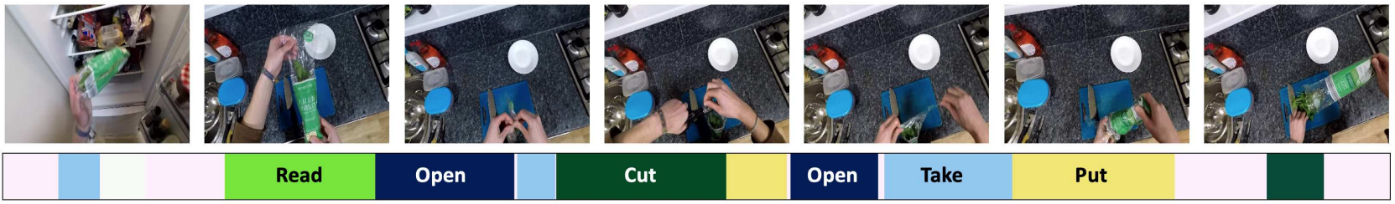
Task
Given a long, untrimmed video, the goal is to simultaneously segment the video by time and predict each segment with a corresponding action category.
  While video classification has shown great progress with the success of deep neural networks, temporally locating and recognizing action segments has proven to be far more challenging

Slide 3
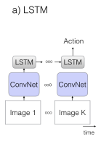
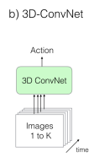
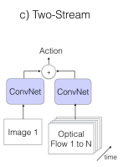
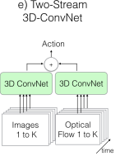
Generic Approaches
It is tempting to treat this as an “action recognition” problem extended in the temporal domain (and without assumption of temporal boundary annotations), using architectures proposed for action recognition.
  Simply use features extracted by CNNs over every frame and apply a standard sequence prediction model over those features

Slide 4
Challenges
These approaches typically don’t work at a satisfactory level, on top of the other problems listed below:
  Challenge 1 : Space-time Tradeoffs (videos are long)
  Challenge 2 : Dense annotations are often unobtainable
  Challenge 3 : Regressing action boundaries is difficult
  Challenge 4 : Lack of sub-symbolic label structure
  Challenge 5 : Dominance of ‘background’ class of action

Slide 5
Challenge #1
Naïve approaches such as relying on the extension over time of large ConvNets (i.e. VGG16) yield an explosion in the number of model parameters and make training intractable
To get around this, typical proposals involve customized high-level temporal models over pre-trained CNN features, allowing for the capturing of long-range dependencies across frames while keeping training tractable.

Slide 6
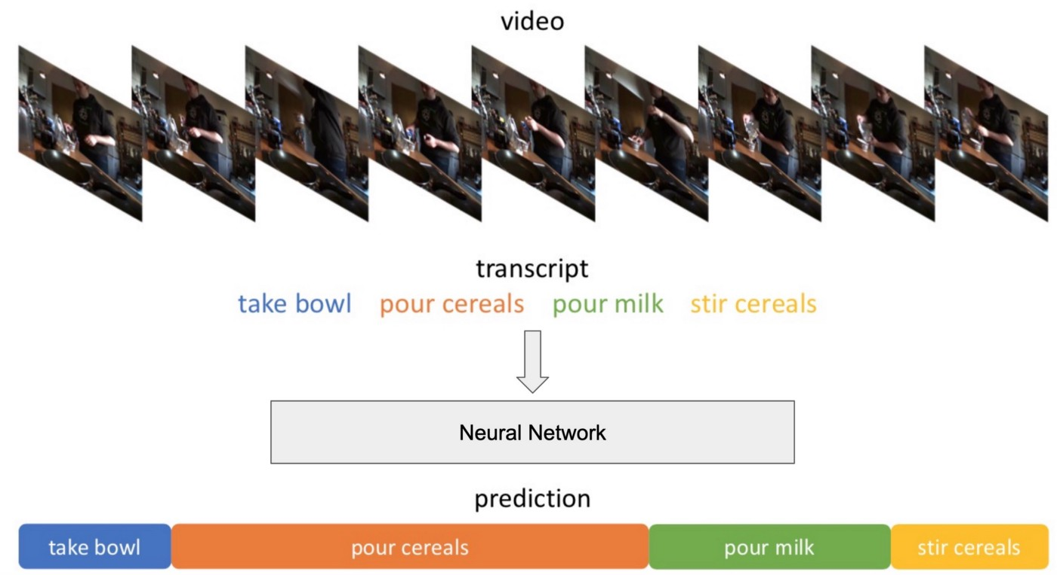
Challenge #2
Dense annotations are difficult to obtain
  Videos are 30+ minutes long requiring fully exhaustive annotation
  Beginning and ending of actions are ambiguous
  Impossible to enforce mutual exclusivity of action with common ontologies
Alternative is the weakly supervised action segmentation problem
  Often involves weak action labels in the form of an action order, or transcript, an ordered list of actions occurring in the video as supervision
  Even weaker form of supervision – set-supervised training, where ground truth is a set of actions present, without ordering.
  However, model requires frame-wise labels for supervision.

Slide 7
Challenge #3
Visual features change continuously over time in video, but their corresponding labels change suddenly.
  Frames around temporal boundaries of are typically where errors most commonly occur.
This commonly results in oversegmentation errors – producing continuously fluctuating action class predictions, lacking smooth consistency in predictions
Oversegmentation
Ground Truth

Slide 8
Challenge # 4
Action segmentation involve an actor performing high-level activities
  Actors perform actions at various levels of abstraction, yet datasets sidestep the issue of abstraction of action. Datasets commonly mix action labels such as “make salad” and “cut lettuce” .
  If multiple actions apply to a given segment, annotators will commonly select the one that saves them the most work.

Slide 9
Challenge #5
Background class (where nothing is happening) tends to dominate class labels (varying from 30% to 50% of all action labels)
  These are long, unconstrained videos. There are many possible reasons as to why a segment would be assigned a background class label.
    Actor could be performing actions outside the window of observation (very common when multiple views aren’t available)
    Actor could be resting or performing a cognitive action (thinking, staring, etc)

Slide 10
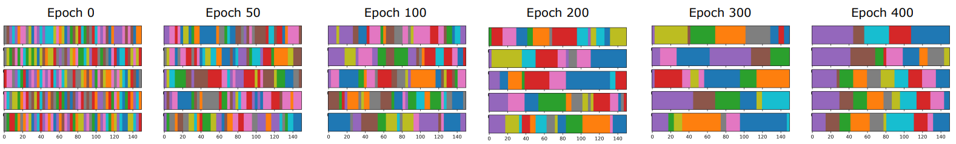
Unsupervised Action Segmentation for Instructional Videos
Goal of this approach is to discover atomic actions from instructional videos in unsupervised fashion using differentiable constraints. Their method works with a fixed k-the number of actions per task.
  They introduce an approach of learning by ‘self-labeling’ videos. They generate self supervisory labels that best satisfy their constraints via ranking several candidate sequences.
  Their rank function incorporates the following constraints:
    Given a sequence of actions, ensure every of the k actions appears at least once
    Ensure each atomic action has similar duration across different videos
    Ensure each atomic action is consistent across videos
Approach proposes solutions to Challenges #2 and #4

Slide 11
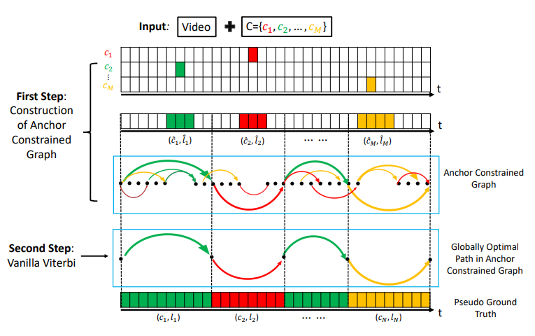
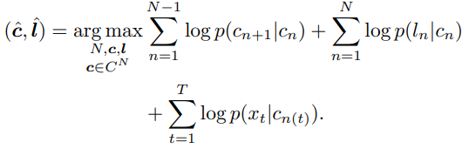
Anchor-Constrained Viterbi for Set-Supervised Action Segmentation
Tackles the set-supervised problem, representing all legal action segmentations of a training video by distinct paths in a directed video segmentation graph. The goal is to identify the highest-scoring valid path where every action occurs at least once.
First step involves estimating scores of all actions from the ground truth set over all frames. For each action they assign an anchor.
Second step involves approximating a globally optimal action segmentation by running the Viterbi algorithm over the densely connected video graph (nodes are frames, edges are actions).
Addresses Challenges #1 and #2

Slide 12
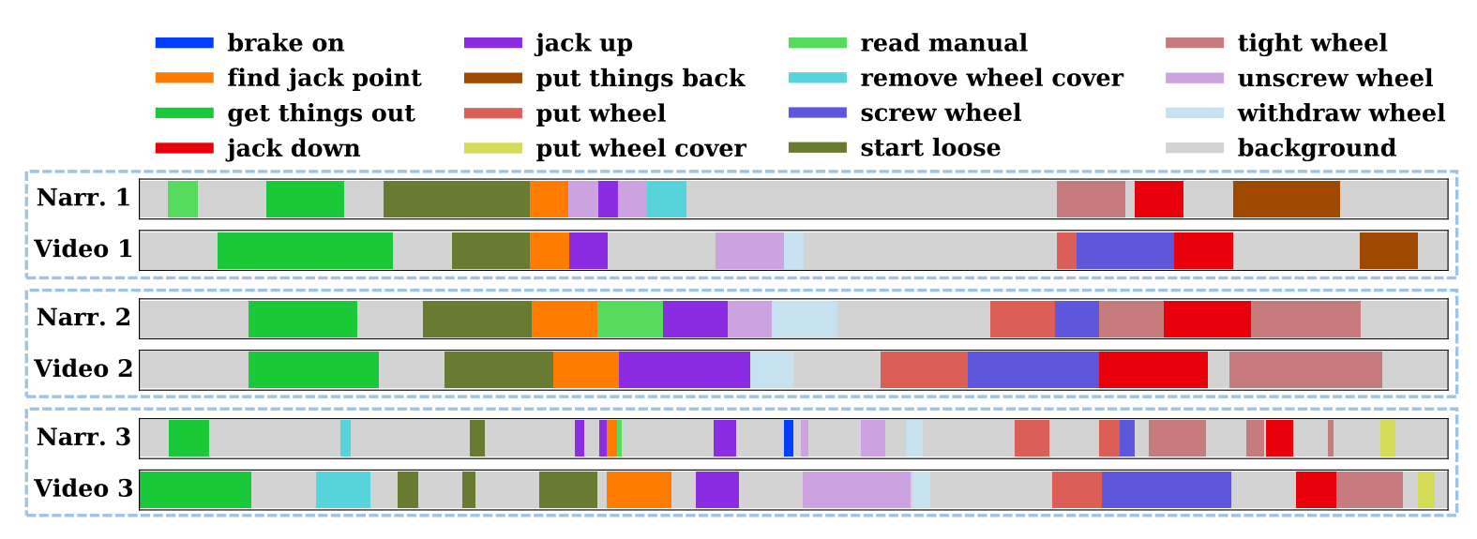
Learning to Segment Actions from Visual and Language Instructions via Differentiable Weak Sequence Alignment
Addresses the problem of unsupervised localization of task-relevant actions in instructional videos using both visual and language instructions.
  Motivated by the observation that sequences of actions associated with visual and linguistic modalities exhibit an ordered one-to-one correspondence with most actions – some actions are absent in the other modality.

Slide 13


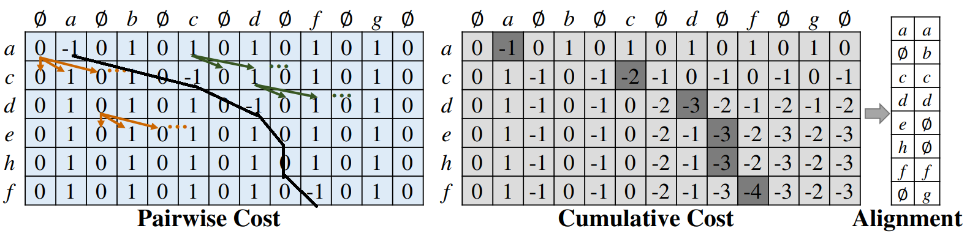
Learning to Segment Actions from Visual and Language Instructions via Differentiable Weak Sequence Alignment (Continued)
Proposes a differentiable weak sequence alignment (DWSA) method that finds ordered one-to-one matching between sequences while allowing some items to stay unmatched, using dynamic programming.
Toy example shown below with symbolic sequences
and

Slide 14
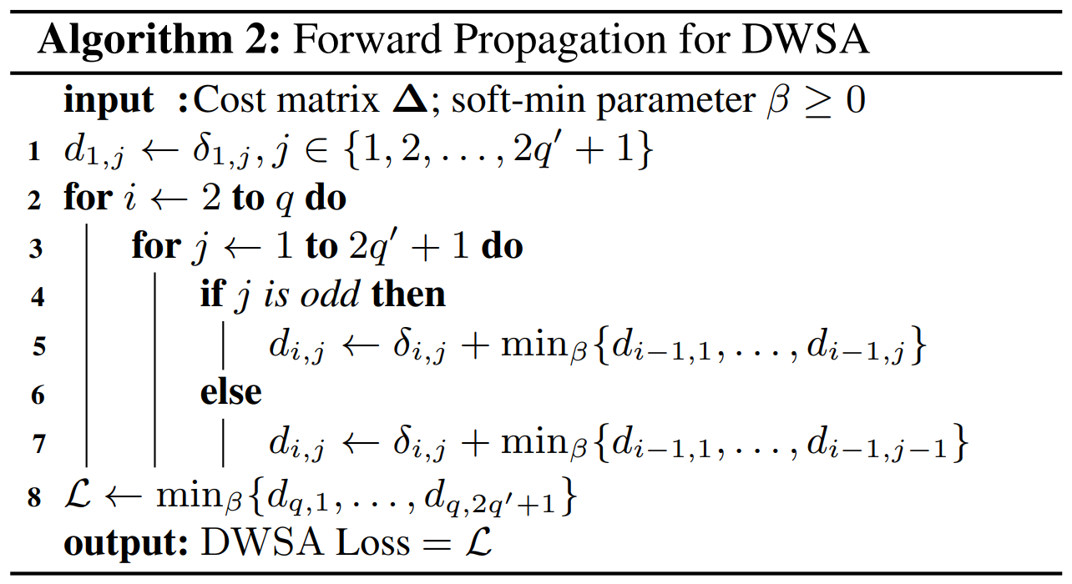
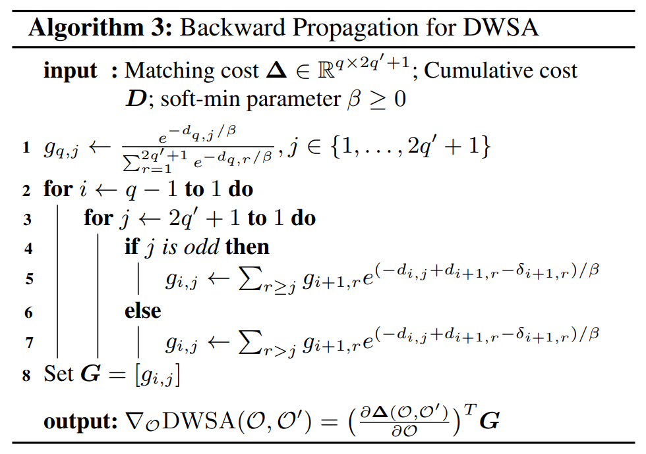
Learning to Segment Actions from Visual and Language Instructions via Differentiable Weak Sequence Alignment (Continued)
Addresses Challenges #2 and #5

Slide 15
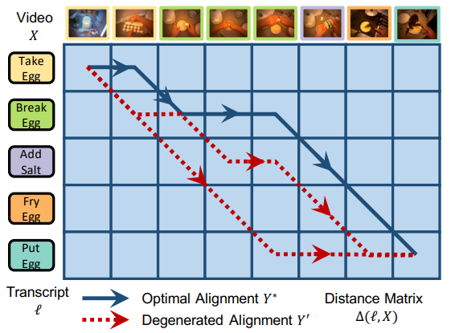
D3TW: Discriminative Differentiable Dynamic Time Warping for Weakly Supervised Action Alignment and Segmentation
Addresses weakly supervised action segmentation in videos
Given a distance function between frames and action labels, D3TW attempts to find the best possible path producing an alignment between the transcript and video.
Learns the distance function using a novel contrastive loss based on ‘negative’ and ‘positive’ transcripts
Addresses Challenges #1 and #2

Slide 16
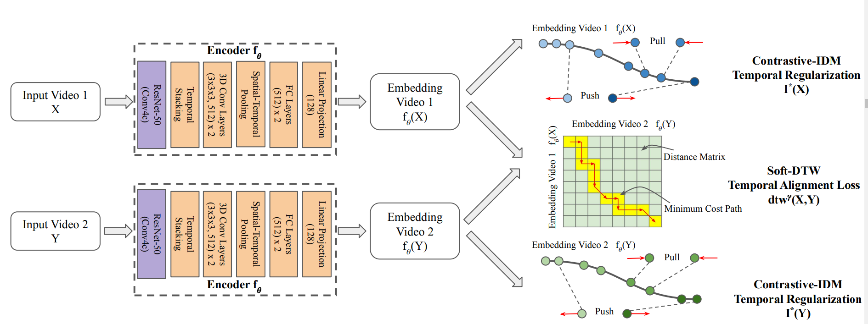
Learning by Aligning Videos in Time
Proposes a self-supervised method for learning video representations that align videos in time. This work aims at learning good representations for action segmentation.
Introduces a temporal alignment loss, aligning videos in the embedding space with dynamic programming.
Also proposes a temporal regularization, encouraging different frames to be mapped to different points in embedding space.

Slide 17
Others
Cross-task weakly supervised learning from instructional videos
  Proposes an action segmentation method over video leveraging temporal constraints learned from narration and a list of steps.
  Uses dynamic programming to solve for a temporal alignment between narration and video
  Penalizes action predictions that occur outside the constraint regions existent in narration
Hierarchical Modeling for Task Recognition and Action Segmentation in Weakly-Labeled Instructional Videos
  Presents a novel top-down weakly supervised action segmentation approach, where the predicted high-level task is used to constrain the inference of fine-grained action sequences.

Slide 18
References
[1] Piergiovanni, A. J., et al. "Unsupervised Action Segmentation for Instructional Videos." arXiv preprint arXiv:2106.03738 (2021).
[2] Li, Jun, and Sinisa Todorovic. "Anchor-Constrained Viterbi for Set-Supervised Action Segmentation." Proceedings of the IEEE/CVF Conference on Computer Vision and Pattern Recognition. 2021.
[3] Shen, Yuhan, Lu Wang, and Ehsan Elhamifar. "Learning To Segment Actions From Visual and Language Instructions via Differentiable Weak Sequence Alignment." Proceedings of the IEEE/CVF Conference on Computer Vision and Pattern Recognition. 2021.
[4] Chang, Chien-Yi, et al. "D3tw: Discriminative differentiable dynamic time warping for weakly supervised action alignment and segmentation." Proceedings of the IEEE/CVF Conference on Computer Vision and Pattern Recognition. 2019.
[5] Haresh, Sanjay, et al. "Learning by Aligning Videos in Time." Proceedings of the IEEE/CVF Conference on Computer Vision and Pattern Recognition. 2021.
[6] Zhukov, Dimitri, et al. "Cross-task weakly supervised learning from instructional videos." Proceedings of the IEEE/CVF Conference on Computer Vision and Pattern Recognition. 2019.
[7] Ghoddoosian, Reza, Saif Sayed, and Vassilis Athitsos. "Hierarchical Modeling for Task Recognition and Action Segmentation in Weakly-Labeled Instructional Videos." arXiv preprint arXiv:2110.05697 (2021).

