Slide 1

Differentiable convex optimization layers in neural networks
Sahil Singla
Department of Computer Science
University of Maryland
Notes:
Hello everyone, Myself Sahil. I am a PhD student in the computer science department. I will be talking about the paper “Differentiable convex optimization layers in neural networks”.

Slide 2
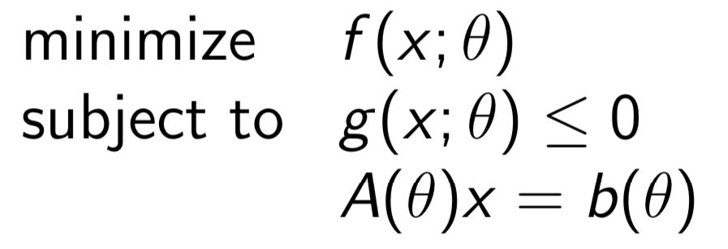
Convex optimization
x ∈ R^{n} is the variable
𝛳 ∈ R^{m} is the parameter
f and g are convex (curve upwards)
find x that minimizes f while satisfying the constraints
Notes:
This is an optimization problem. In an optimization problem, the goal is to find a value for a variable x that minimizes the cost function, while also satisfying some constraints. The variable x might represent a decision, weights in a machine learning model, or a design of a physical device.
Notice that the optimization problem is parametrized by a vector \theta. This vector determines the shape of the objective function and the constraints. Unfortunately, most optimization problems are computationally intractable. Convex optimization problems are the subset of optimization problems that can be easily solved.

Slide 3
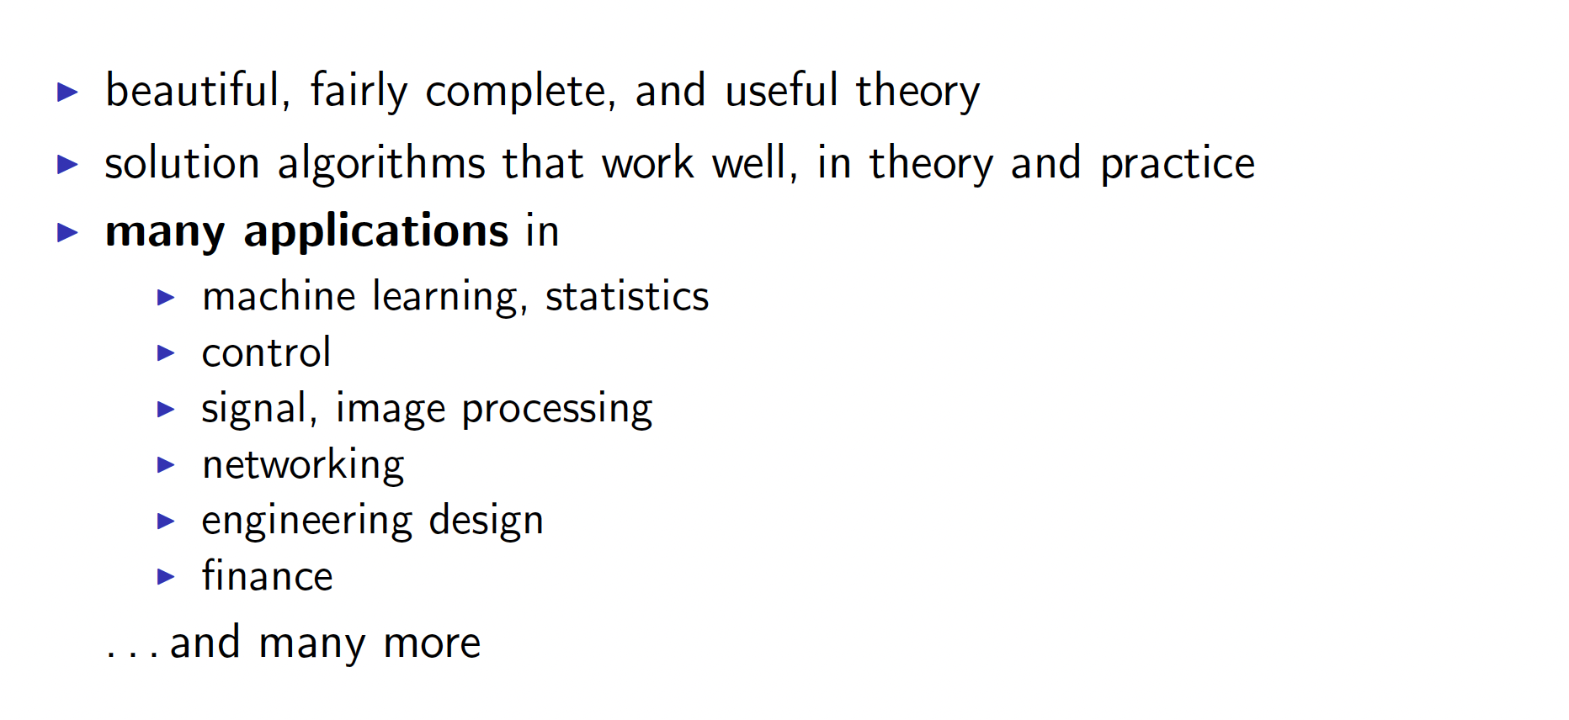
Why convex optimization?
Notes:
Convex optimization has a lot of properties that makes it a useful tool. It has a beautiful, fairly complete and useful theory.
The solution algorithms work well in theory and practice.
Moreover, it has many applications in machine learning, statistics, control, signal and image processing, engineering desgn, finance and many more.

Slide 4
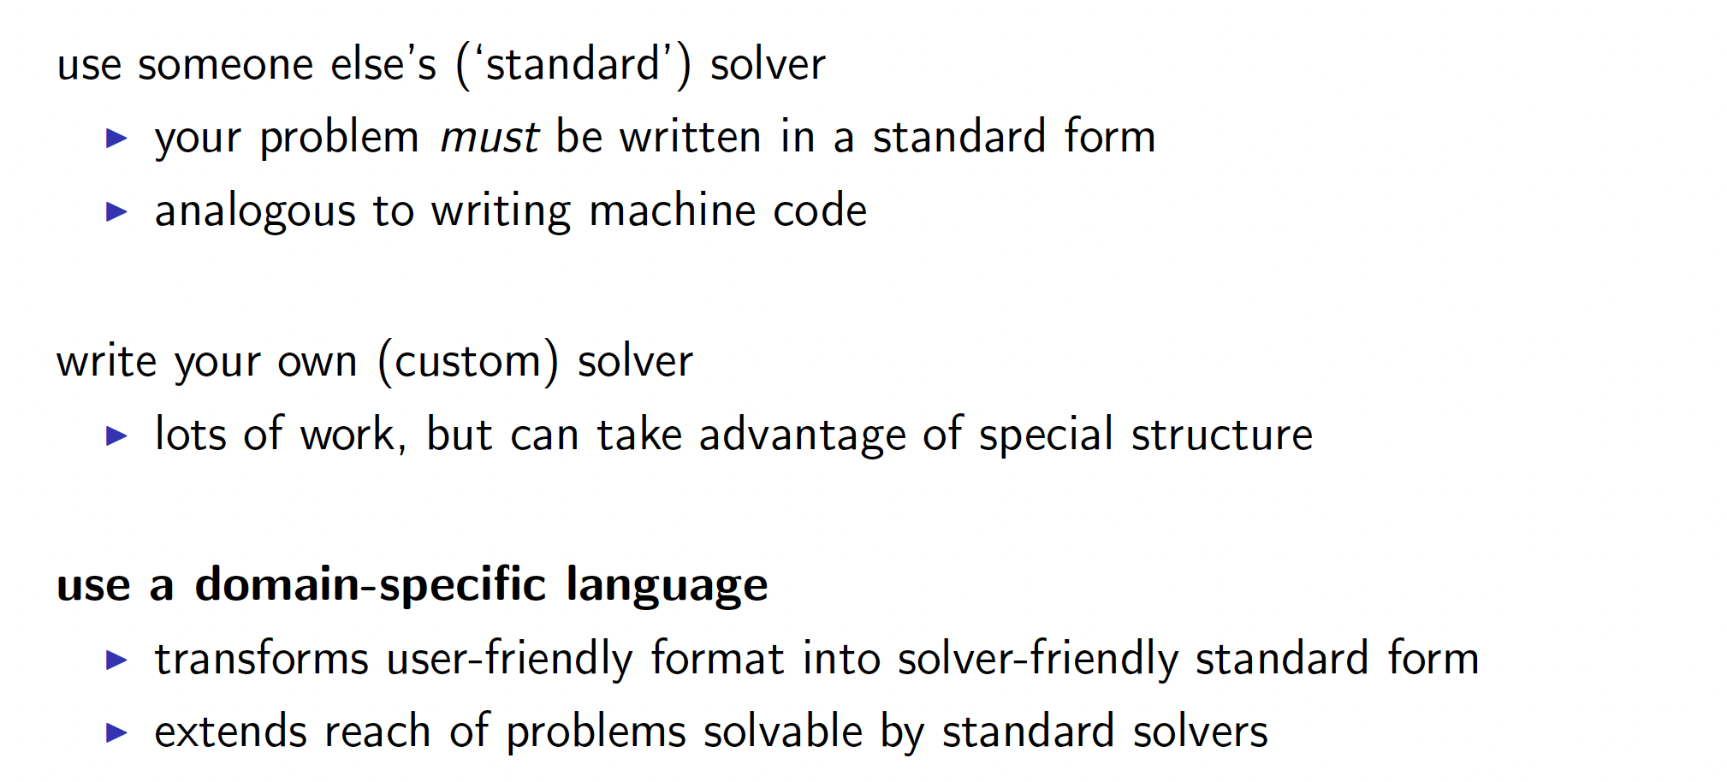
How do you solve a convex optimization?
Notes:
To solve convex optimization problems, there are many standard solvers available. However, they require that the problem be written in a standard form.
An alternative is that you can write your own custom solver. It takes more work but you can take advantage of the special problem structure.
Or you can use a domain specific language that transforms user friendly format into a solver friendly form. It extends the reach of problems solvable by standard solvers.

Slide 5
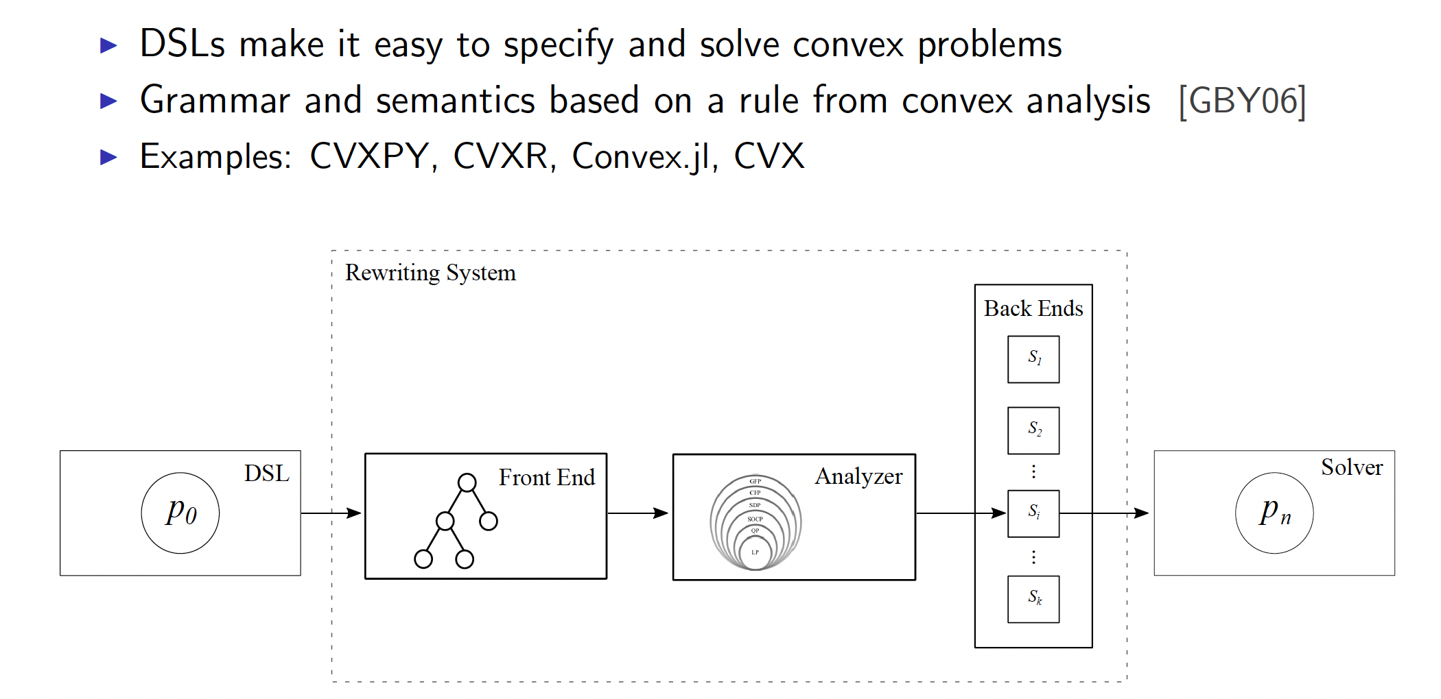
Domain-specific languages (DSLs)
CVXPY, CVXR, Convex.jI, CVX are all software packages in different languages with the
same underlying solvers that are open source
Notes:
DSLs make it easy to specify and solve convex problems. Grammar and semantics is based on rules from convex analysis. Example libraries are CVXPY, CVXR, Convex.JI and CVX.
All these libraries are frontends for different languages with the same underlying solvers that are all open source.
Here is a diagram showing the same. The problem is specified using a DSL. The library first constructs a syntax tree, analyzes it and converts it into a standard form that is then solved by a solver.

Slide 6
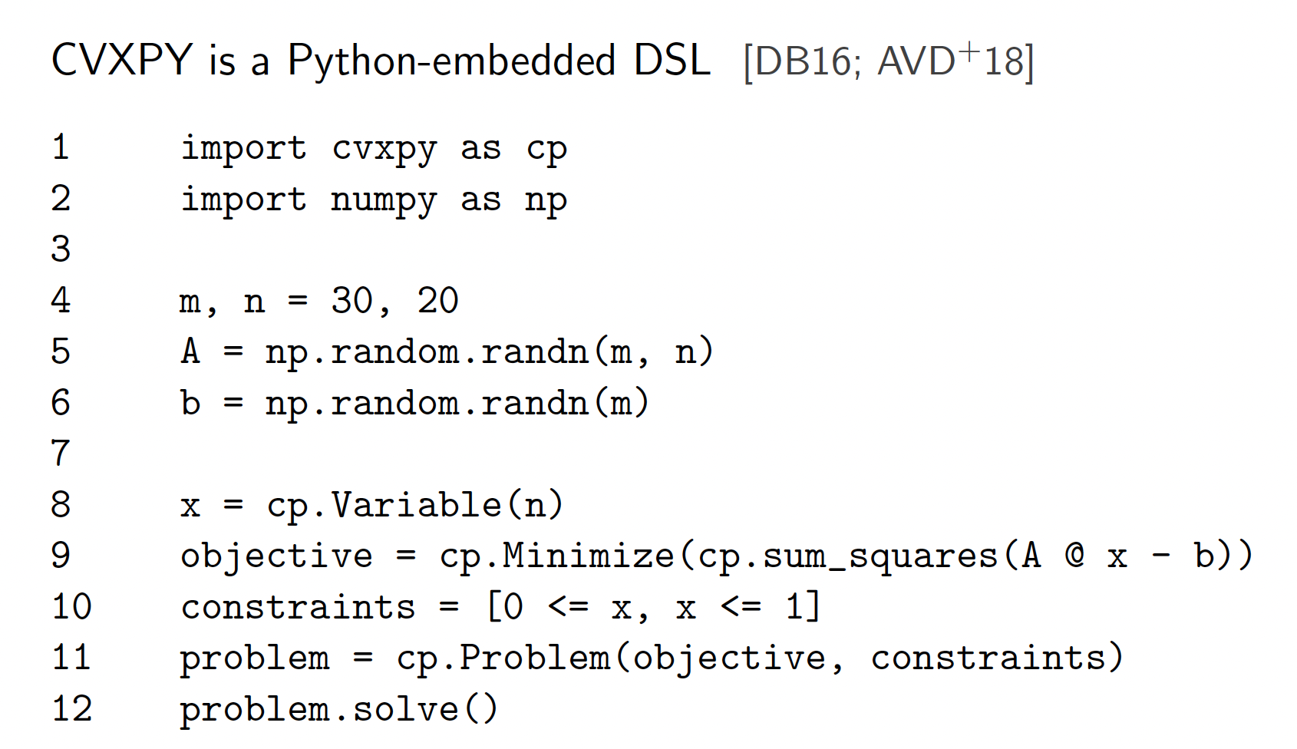
Example
In this talk, we will be primarily discussing CVXPY, but concepts are
applicable generally
Notes:
In this talk, we will be primarily discussing about CVXPY, but the concepts are general and applicable to any convex optimization library.
Cvxpy is a python embedded DSL. Here is a simple code example where we are trying to minimize the sum of squares of the vector (Ax – b), subject to each x between 0 and 1.

Slide 7
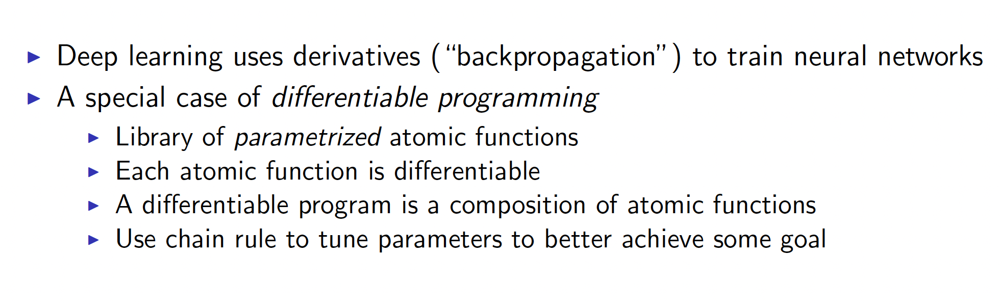
How does this apply for neural networks?
Notes:
So how does this apply to neural networks. Since deep learning uses derivatives i.e backpropagation to train neural networks,
It can be considered as a special case of differentiable programming.

Slide 8
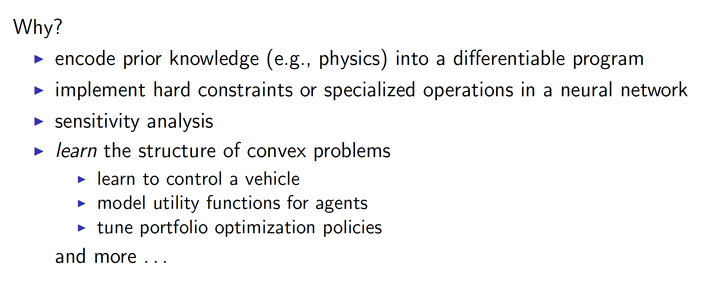
Analytically differentiating through CVXPY
Notes:
Now, why do we want to analytically differentiate through the output of cvxpy.
One reason could be to encode prior knowledge as is often the case in physics into a differentiable program.
Another could be that we want to implement hard constraints of specialized operations in a neural network.
Yet another reason could be to perform sensitivity analysis i.e how the output solution changes when the parameters of the convex problem are slightly changed.
Or we may want to learn the structure of convex problems in tasks such as how to control a vehicle, model utility functions for agents in reinforcement learning or tune portfolio optimization policies.

Slide 9
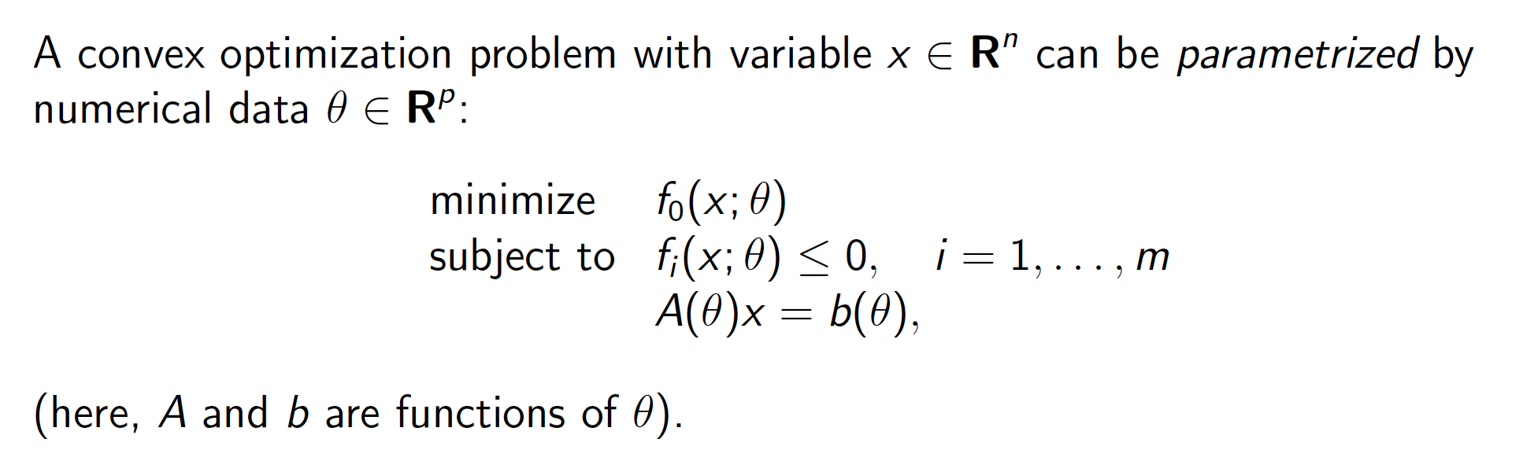
Parametrized convex optimization problems
Notes:
Here is an example of a convex optimization problem.

Slide 10
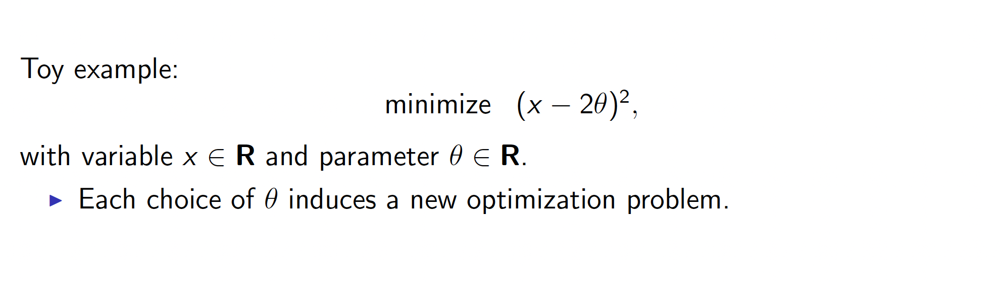
Parametrized convex optimization problems
Notes:
Consider this toy example where we want to minimize x – 2 \theta squared
Each choice of theta induces a new optimization problem.

Slide 11
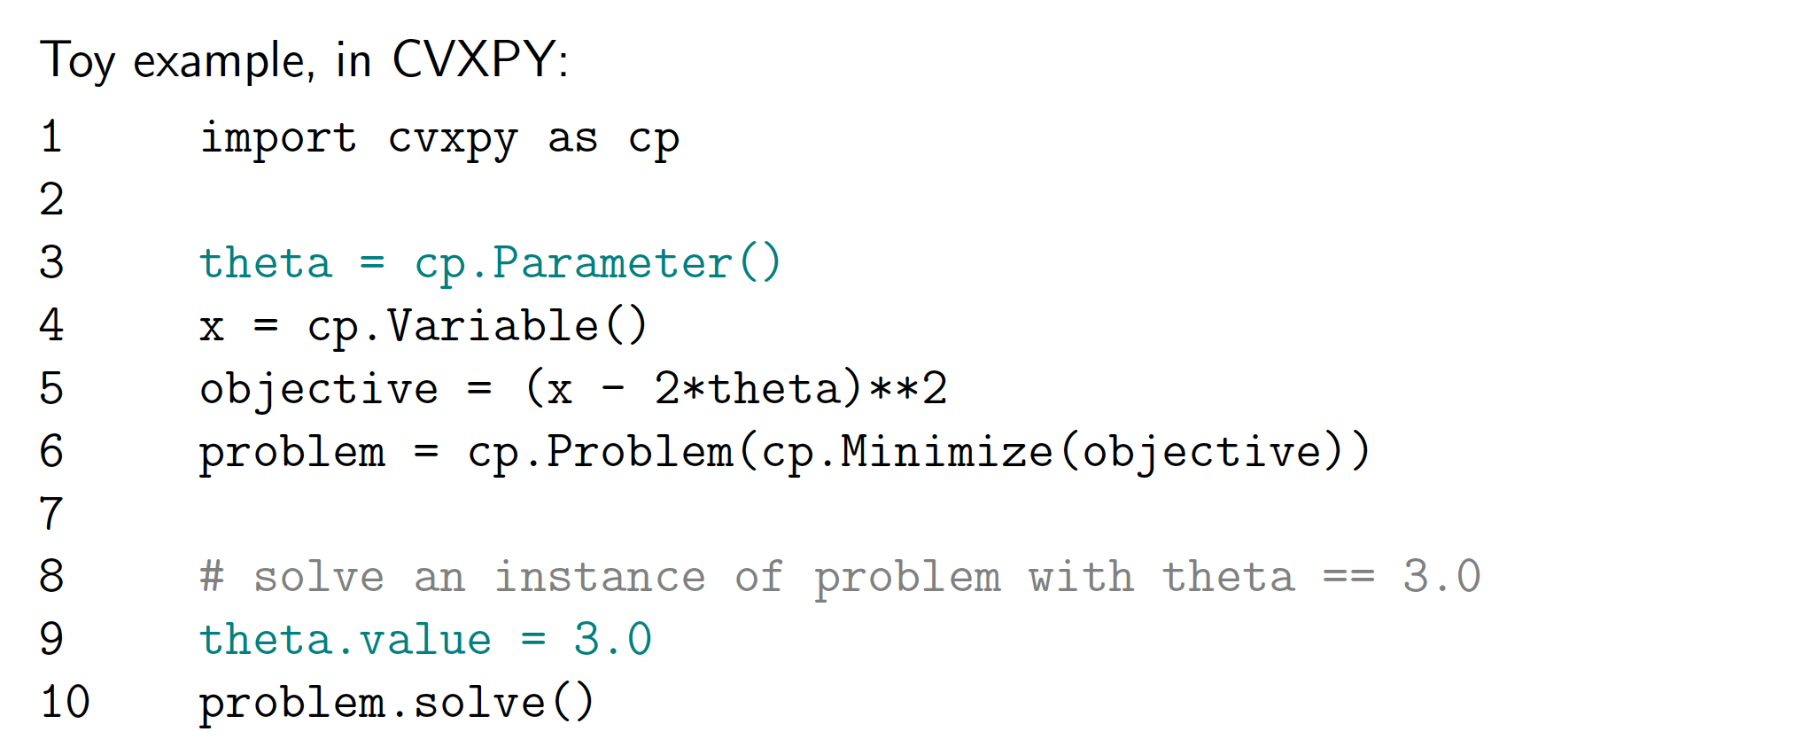
Parametrized convex optimization problems
Notes:
Here is the code for this simple problem in CVXPY.

Slide 12
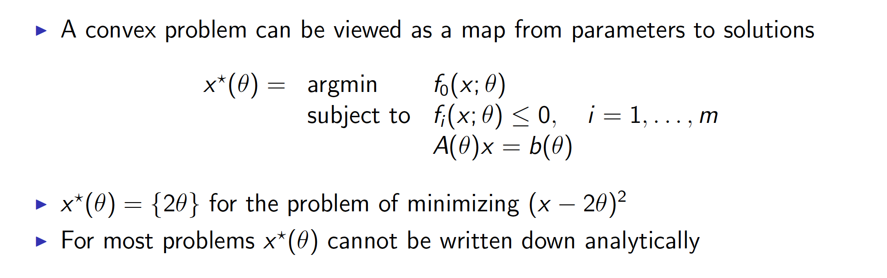
Solution mapping of a convex optimization problem
Notes:
A convex optimization problem can be viewed as a map from parameters to solutions.
In this case the solution is rather simple. We know 2 theta is the solution for this problem of minimizing (x – 2 theta) squared.
However, for most problems the solution cannot be written down analytically.

Slide 13
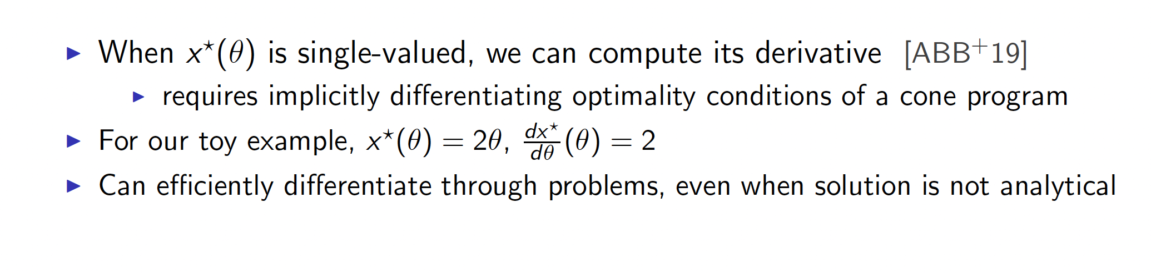
Derivative of the solution map of a convex problem
Notes:
However, when the solution is single valued, we can compute the derivative. It requires implicitly differentiating through the optimality conditions of a cone program.
In the toy example, the derivative is simply two.
Now, let us discuss how we can efficiently differentiate through problems even when the solution is not analytical.

Slide 14
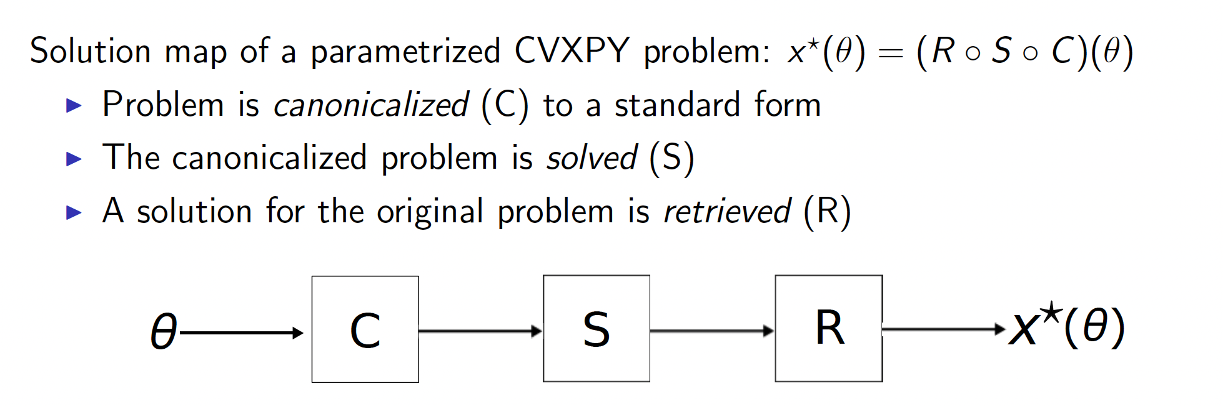
Differentiating through CVXPY
Notes:
The solution map of a parametrized CVXPY problem can be written as a composition of 3 functions: R, S and C.
The optimization problem is first canonicalized to a standard form using the mapping C.
The canonicalized problem is solved. This is called the function S.
Next, the solution for the original problem is retrieved which we call the function R.
Here is a diagram showing these steps.

Slide 15
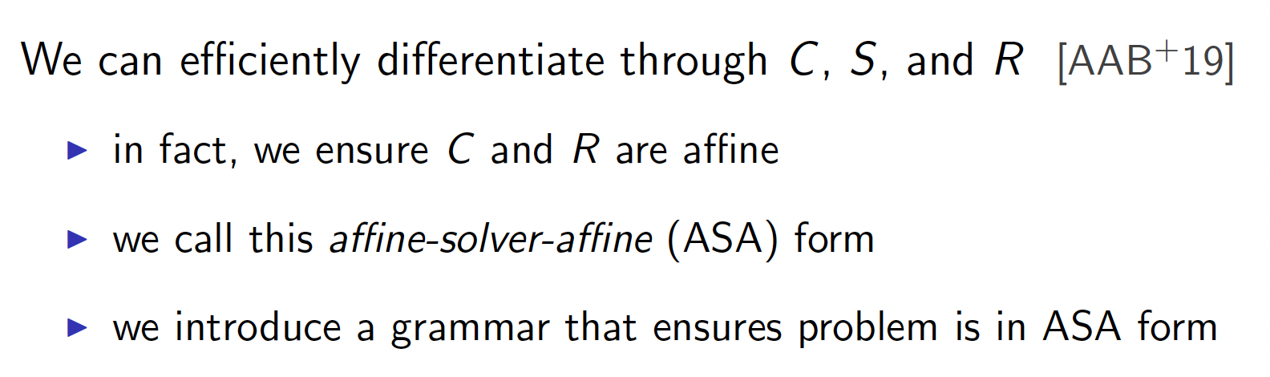
Differentiating through CVXPY
Notes:
It turns out that we can efficiently differentiate through C, S and R.
In fact, we can ensure that C and R are affine so that differentiation through them is trivial.
This is called the affine-solver-affine form.
They also introduce a grammar in the paper that ensures that the problem is in ASA form.

Slide 16
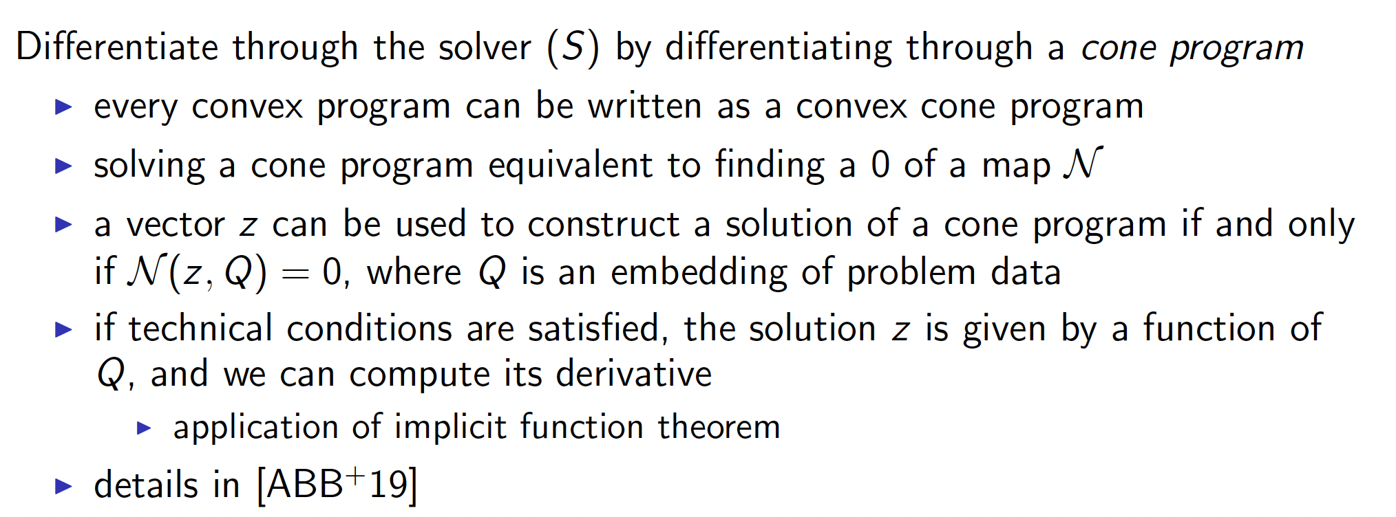
Differentiating through CVXPY
Notes:
The question remains, how do you differentiate through the solver S.
It turns out that every convex program can be written as a convex cone program.
Solving a cone program is equivalent to finding a zero of a map called N.
A vector z can be used to construct a solution of a cone program if and only if N(z, Q) is zero where Q is the embedding of problem data.
If the technical conditions are satisfied, the solution z is given by a function of Q and we can compute its derivative by directly using the implicit function theorem.

Slide 17
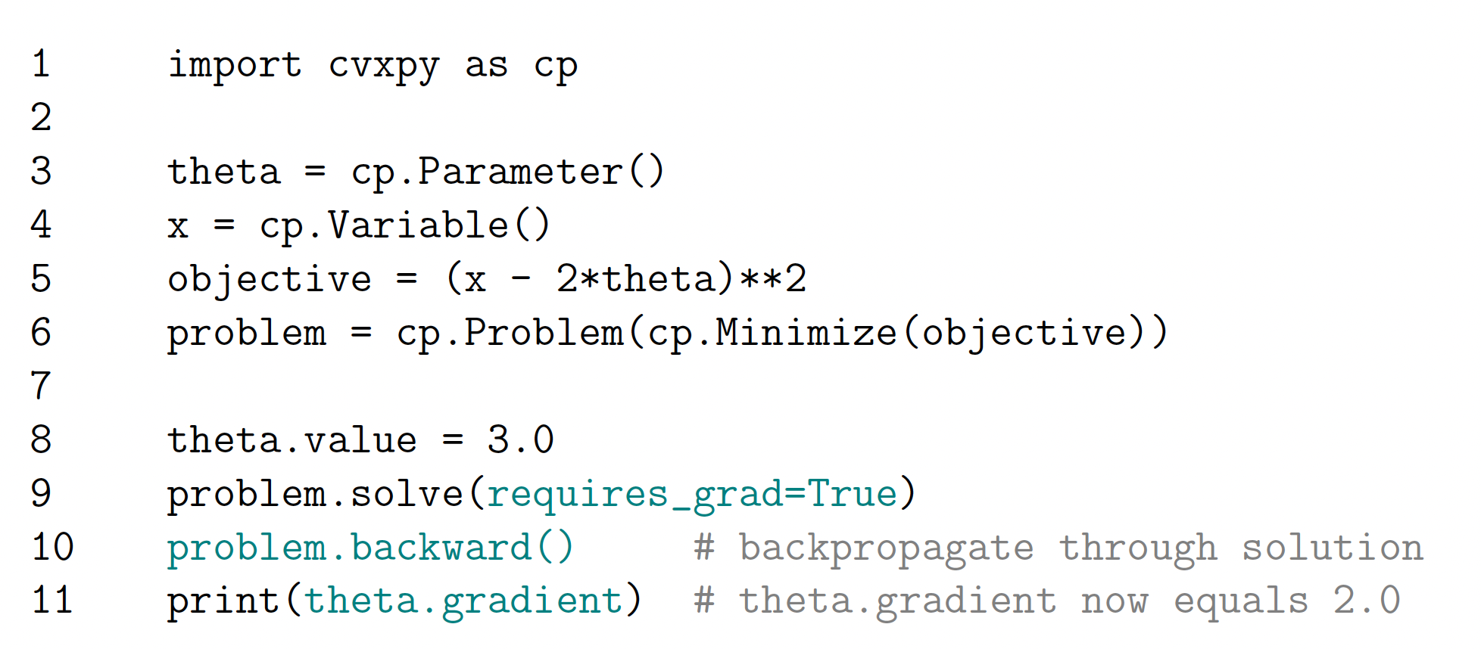
Differentiating through CVXPY
Notes:
As a result, differentiating through cvxpy can be done easily by adding the following lines of code (shown in green).

Slide 18
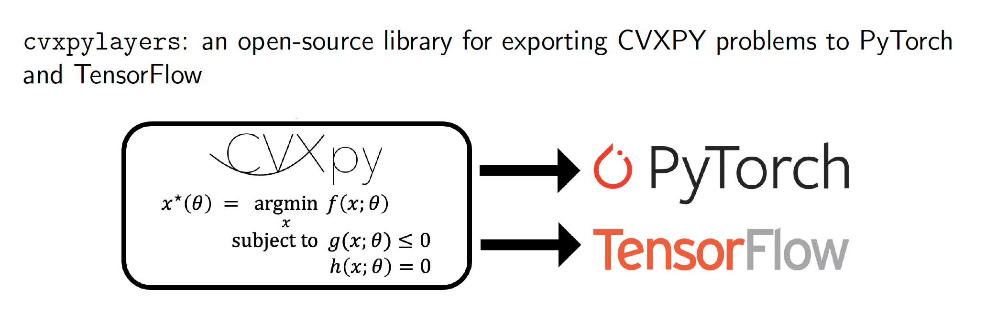
Exporting to PyTorch and TensorFlow
Notes:
They introduce the library cvxpylayers which is an opensource library for exporting cvxpy problems to pytorch and tensorflow.

Slide 19
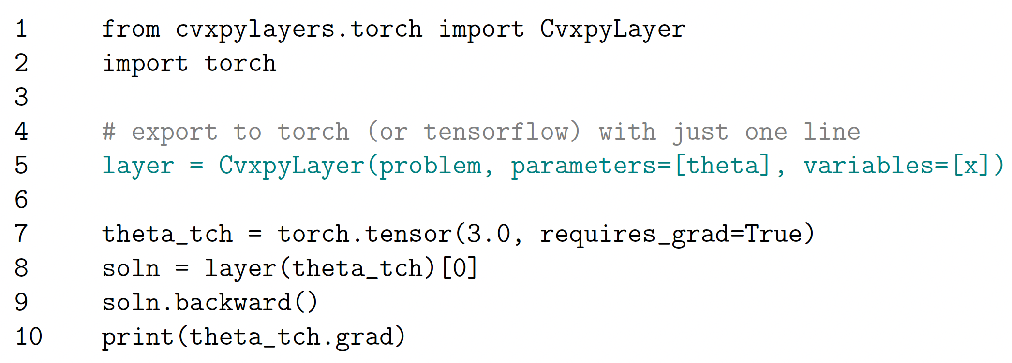
Exporting to PyTorch and TensorFlow
Notes:
Here is a sample code using pytorch. The line in green shows a cvxpy layer. You feed the problem, the parameters whose gradient we want to compute and the variables we want to optimize over.

Slide 20
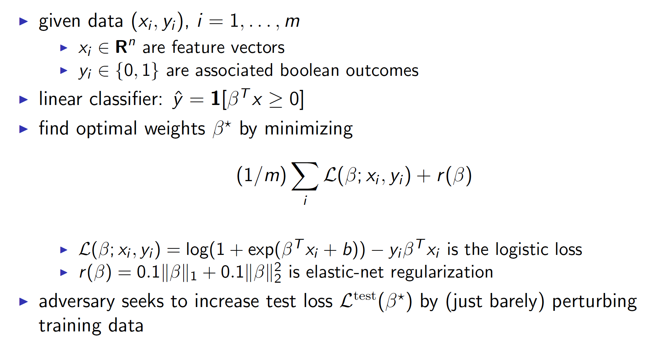
Example: Data poisoning attack
Notes:
Now, let us consider an example. Given data points x_i and y_i where x_i are the feature vectors and y_i are the associated Boolean outcomes. We want to learn a binary linear classifier by minimizing the loss function.
Here, L is the logistic loss for binary classification and r(beta) is the elastic net regularization. Notice that this is a convex optimization problem.

Slide 21
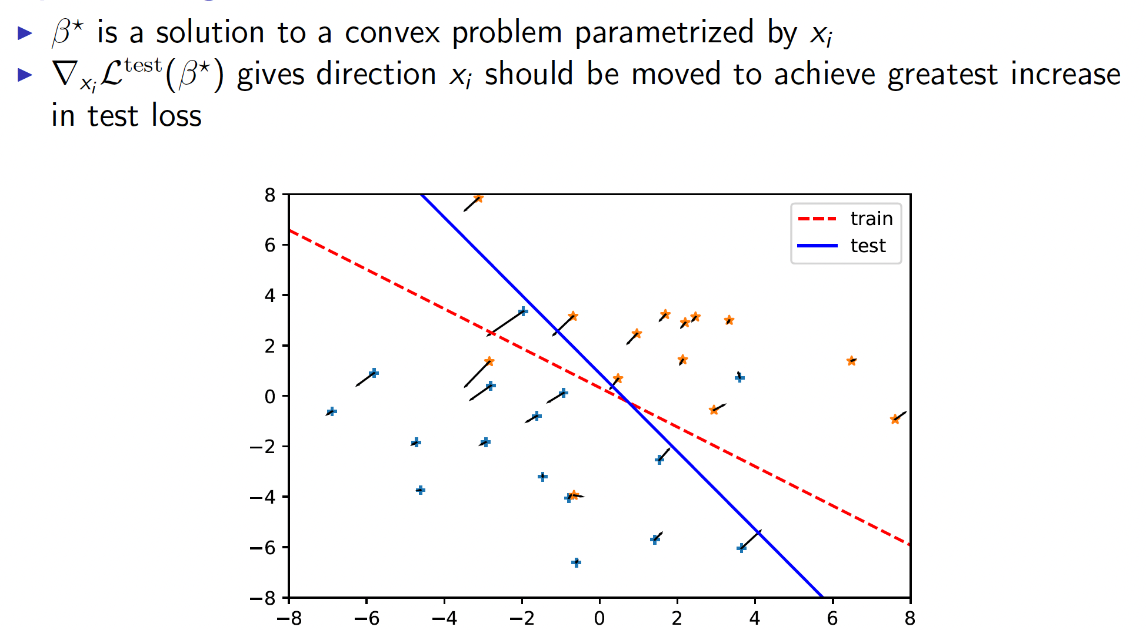
Example: Data poisoning attack
Notes:
We have an adversary who wants to increase test loss by just barely perturbing the training data.
Now, we can consider Beta star to be the solution to a convex problem parametrized by x_i
Then by differentiating the solution to the optimization problem we can get the direction in which x_i should be moved to achieve the greatest increase in test loss.

Slide 22
Example: Data poisoning attack
Notes:
Here is a figure showing directions discovered by the software in which various data points can be perturbed to maximally increase the test loss.

Slide 23
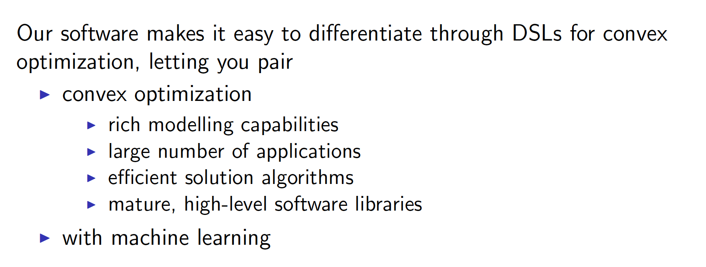
Summary
Notes:
In summary the software makes it easy to differentiate through DSLs for convex optimization, letting you pair
The rich modelling capabilities, applications, efficient solution algorithms for convex optimization
with machine learning

