Slide 1


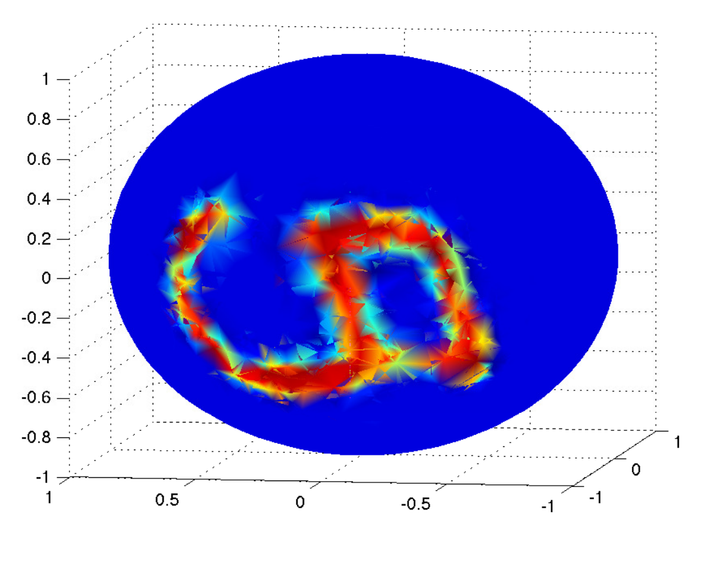
Graph Neural Network on Computer Vision
Howard Hua
Oct 29, 2021
MNIST image on the 3D sphere
(Bruna et al., ICLR, 2014)

Slide 2
Why are graph useful in Vision?
Solve problem that previously were too challenging
  Data Density (Diez & Sepulcre, Nature Communications, 2019)
  Data Distribution (Yin, Junbo and Shen, CVPR2020, LiDAR-Based..)
  Nature of the Data (Mitrokhin, Hua, CVPR2020, Learning Visual..)
More flexibility
  Neighbourhood assignment (Wang, Sun, et.al, acm, Dynamic Graph CNN for Learning on Point Clouds)
  Feature aggregate operation (Li Zhang, CIKM 2020, A Feature-Importance…)
  Learnable feature aggregator (Veličković, Cucurull, ICLR2018, GAT )
  Learnable Graph Convolutional Layer, (Gao, Wang, SIGKDD, Large-Scale Learnable..)
New perspectives
  Graph of superpixels (Liang et al., ECCV, 2016)
  Graph of skeleton joints (Yan et al., AAAI, 2018)
  Graph of bounding boxes (Wang & Gupta, ECCV, 2018)

Slide 3
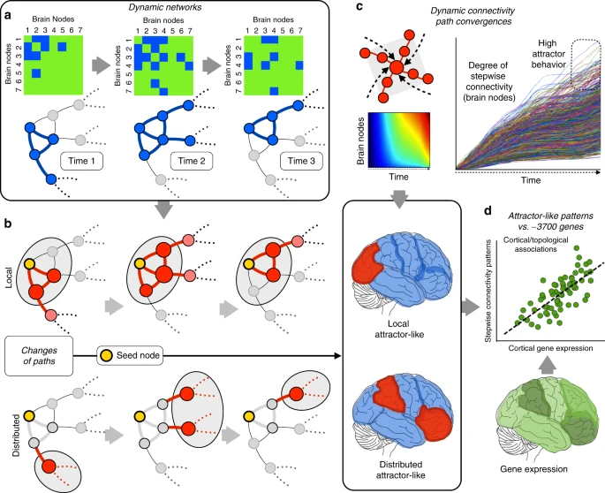
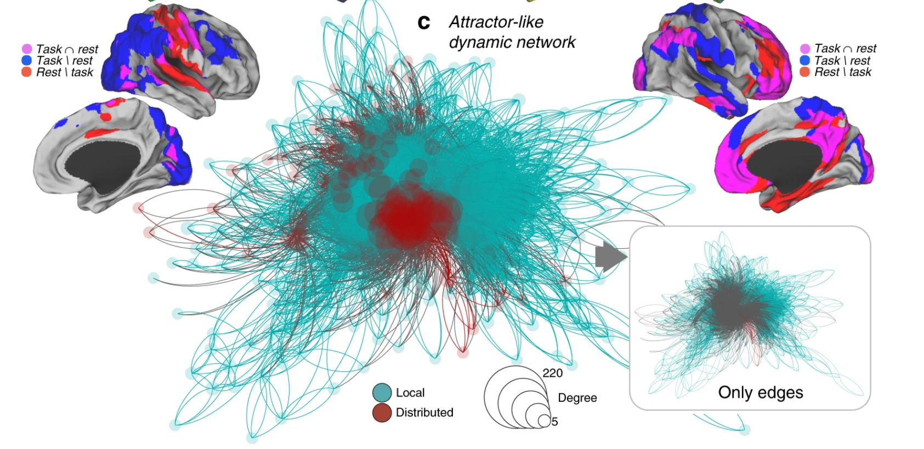
Challenging Problem: Data Density
Solve problem that previously were too challenging
  Data Density (Diez & Sepulcre, Nature Communications, 2019, Neurogenetic profiles delineate large-scale connectivity dynamics of the human brain)
Brain Atlas Connectivity Problem-Huge size!
Learn Connectivity properties
by modifying edges

Slide 4
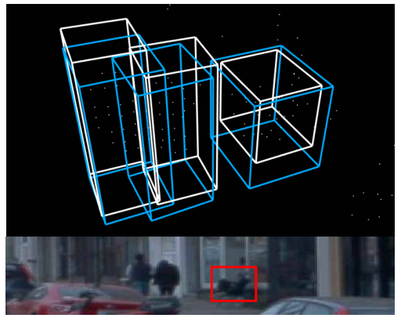
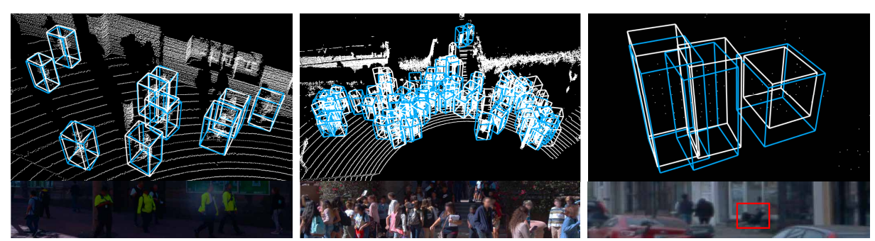
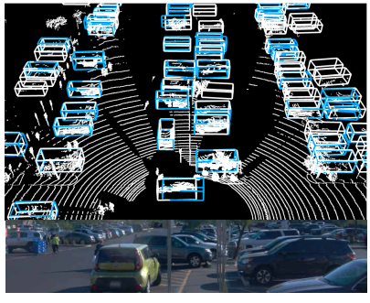
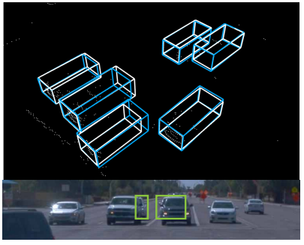
Challenging Problem: Data Distribution
Solve problem that previously were too challenging
b. Data Distribution (Yuning Chai, Pei Sun, CVPR2021, To the Point:
Efficient 3D Object Detection in the Range Image with Graph Convolution Kernels)
Sparse Data
Uneven Distribution (higher density close by, …)
Frustrum, Cylinder, Pillars, etc.
Discretize Data (have to discard datapoints in voxels)
Far away object picked up!
White:GroundTruth Blue:Inference

Slide 5
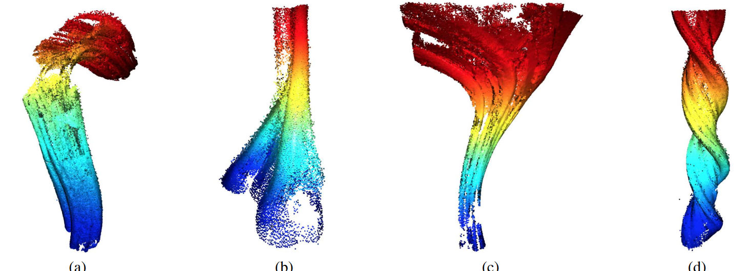
Challenging Problem: Nature of the Data
Solve problem that previously were too challenging
c. Nature of the Data (Mitrokhin, Hua, CVPR2020, Learning Visual Motion Segmentation
Using Event Surfaces)
Some data won’t allow for discretization,
Some data are just more convenient as graphs.

Slide 6
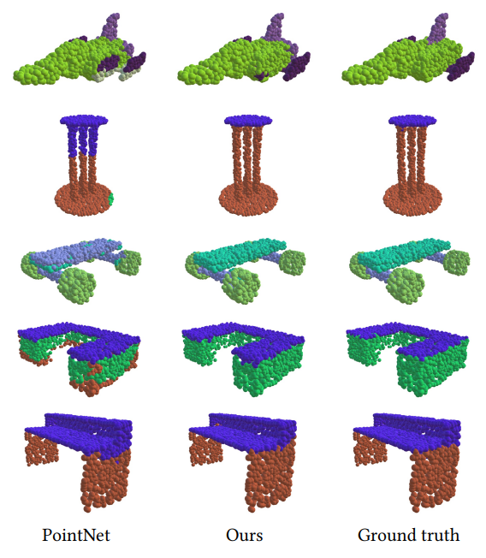
More Flexibility: Neighbour Assignment
Solve problem that previously were too challenging
More flexibility
  Neighbourhood (edge) assignment (Yue Wang, Yongbin Sun, et.al, acm transaction on graphics, 2019, Dynamic Graph CNN for Learning on Point Clouds)
Dynamic connectivity by edges each layer
you can edit the graph at each layer - drop nonessential points? Like PointNet?

Slide 7
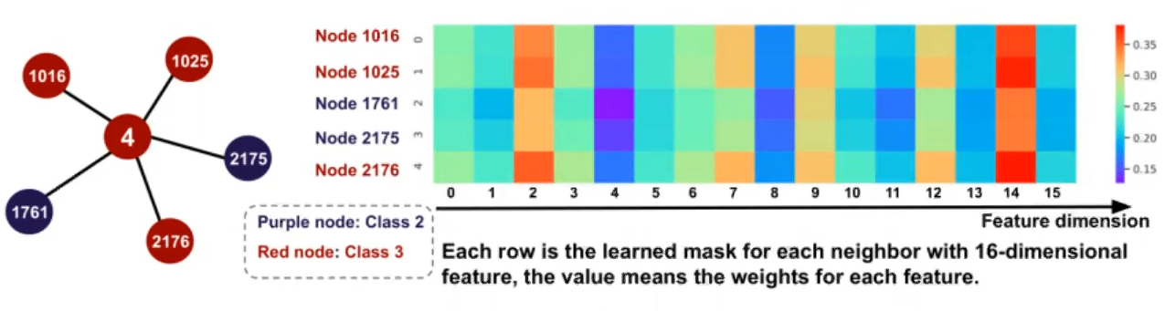
More Flexibility: Feature/Aggregation/Layer
Solve problem that previously were too challenging
More flexibility
  Flexible feature aggregate operation. The feature not only can be aggregated node-wise, but also feature channel wise? (Li Zhang, CIKM 2020, A Feature-Importance-Aware and Robust Aggregator for GCN)
  Learnable feature aggregator (Petar Veličković, Guillem Cucurull, ICLR2018, Graph Attention Networks)
  Learnable Graph Convolutional Layer, (Hongyang Gao, Zhengyang Wang, ACM SIGKDD , 2018, Large-Scale Learnable Graph Convolutional Networks)

Slide 8
Why are graph useful in Vision?
Solve problem that previously were too challenging
  Data Density (Diez & Sepulcre, Nature Communications, 2019)
  Data Distribution (Yin, Junbo and Shen, CVPR2020, LiDAR-Based..)
  Nature of the Data (Mitrokhin, Hua, CVPR2020, Learning Visual..)
More flexibility
  Edge assignment (Wang, Sun, et.al, acm, Dynamic Graph CNN for Learning on Point Clouds)
  Feature aggregate operation (Li Zhang, CIKM 2020, A Feature-Importance…)
  Learnable feature aggregator (Veličković, Cucurull, ICLR2018, GAT )
  Learnable Graph Convolutional Layer, (Gao, Wang, SIGKDD, Large-Scale Learnable..)
New perspectives (later in this talk)
  Graph of superpixels (Liang et al., ECCV, 2016)
  Graph of skeleton joints (Yan et al., AAAI, 2018)
  Graph of bounding boxes (Wang & Gupta, ECCV, 2018)

Slide 9
Comparisons between ConvNets and GNN
Traditional ConvNets | Graph Based Methods
Invariances: By sharing convolutional filters, pooling operations. | Invariance: Permutation invariant by sharing aggregator operator
Locality: Nearby pixels often resembles some semantic concepts, large filters, pooling, etc. | Locality: User can define the adjacency matrix, connect pixels spatially with more flexibility.
Compositionality: Implicity exploited by stacked convolutional layers and pooling | Compositionality: Directed edges, Label/embeddings on edge, label propagation, etc.

Slide 10
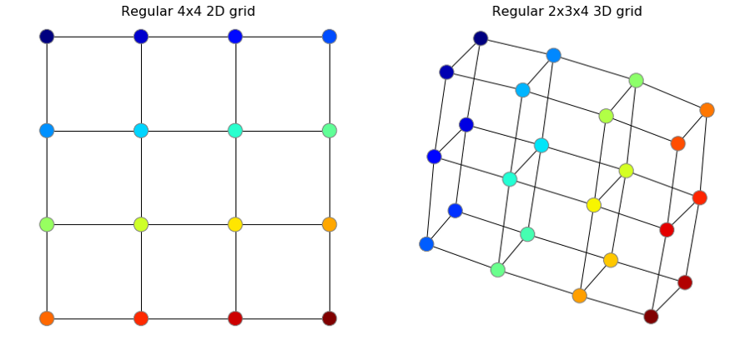
Brief Recap On CNN to GNN
We define a regular two or three dimensional grid as the filter. In GNN, we define this as a set of connected neighbours.
The grid will be the same for all training and testing in ConvNet, but will be different in GNN - different adjacencies
The grid goes over all possible locations on an image (left ->right, top-> bottom), while GNN iterate all nodes.
Regular 4x4 2D convolutional kernel,
and those points converted into graph representation

Slide 11
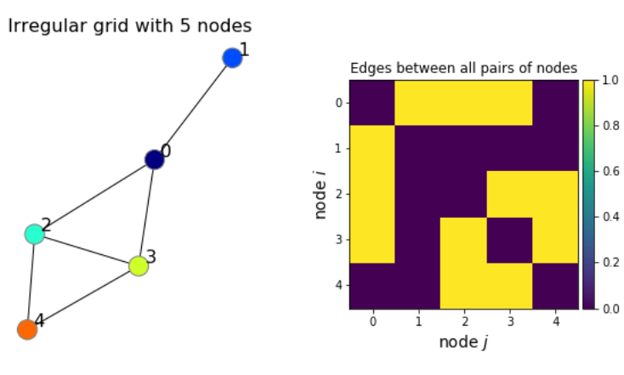
Convolution on images in terms of graphs
GNN:
We define what are the nodes:
  Pixels
  Superpixels
  semantic areas (BBox, Regions, Instances)
  Pointcloud (Lidar, etc.)
We define a strategy to generate adjacency matrix
  Radius
  Directed/Undirected
  Number of K-N-N
Aggregate features, times weight
Activation, Output

Slide 12
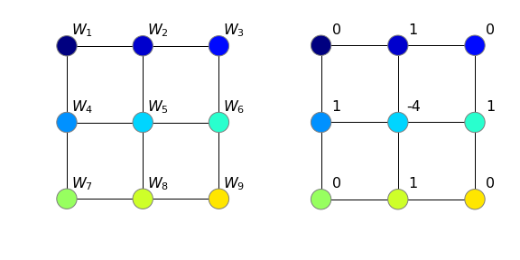
Brief Recap On CNN to GNN
ConvNets:
When we perform convolution, we slide this filter over all possible locations
We compute the dot product between the values on the grid and the values of the filter:
W: X₁W₁+X₂W₂+…+X₉W₉
An Edge detector on the 2d grid

Slide 13
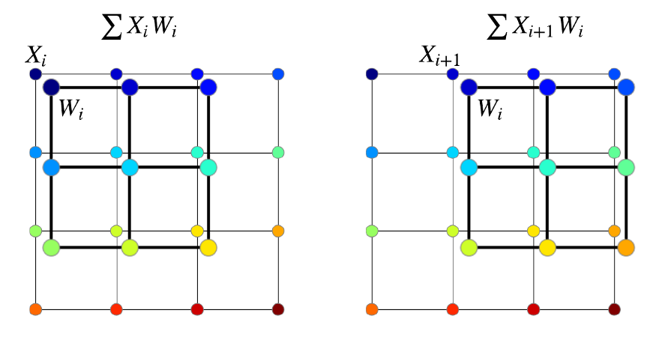
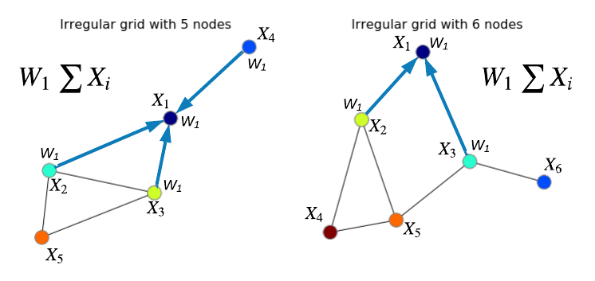
Convolution on images in terms of graphs
Dot product summarizes a 3x3 matrix into a single value.
Dot product is not permutation-invariant, so we need to flip and rotate the images as augmentations
We also have pooling which is permutation-invariant
(max/sum pooling)
Dot-product is the aggregator here, while GNN has aggregator that works on graph!
2D convolution
on a regular grid
Graph convolution

Slide 14
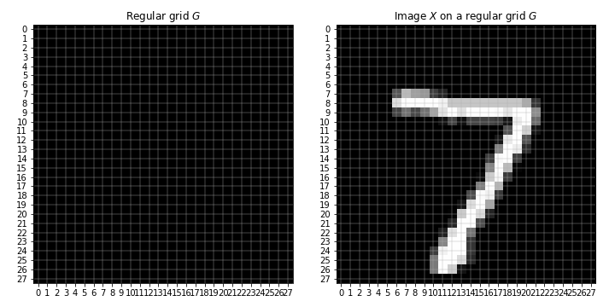
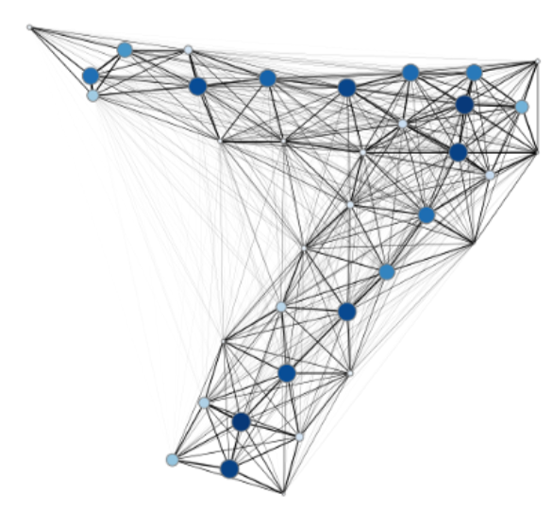
Almost anything can be turned into graphs
An image from the MNIST dataset on the left and an example of its graph representation on the right. Darker and larger nodes on the right correspond to higher pixel intensities. (Fey et al., CVPR, 2018)

Slide 15
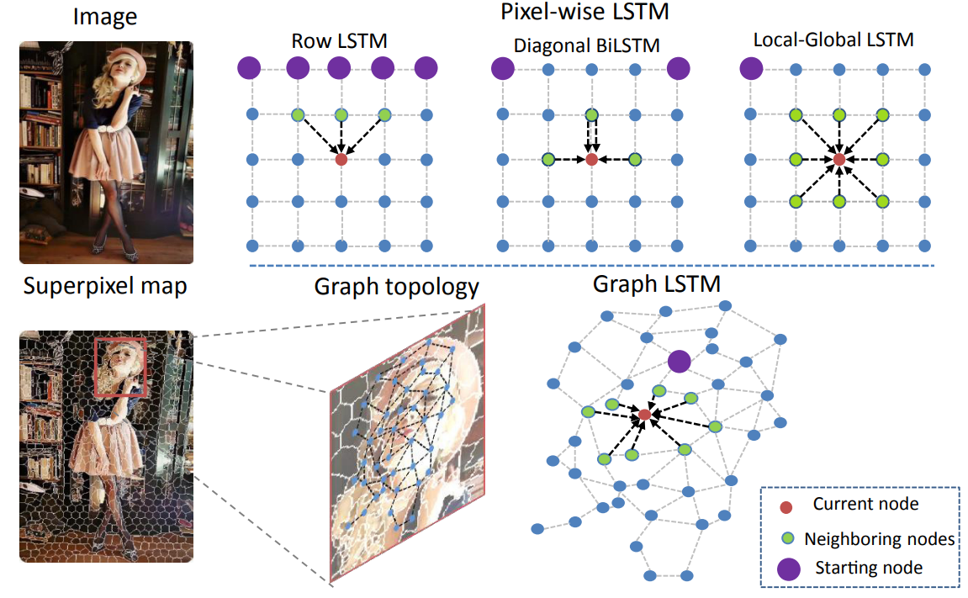
Semantic Object Parsing with Graph LSTM
Video Sequence sem. seg. task
Fully Supervised
Superpixel as a semantically consistent node, and adaptively construct an undirected graph for each image, where the spatial relations of the superpixels are naturally used as edges.
Confidence-driven scheme to update the hidden and memory states of nodes progressively till all nodes are updated.
time: 0.5s (w/o superpixeling)
Up to +10% IOU over LSTM-CNN

Slide 16
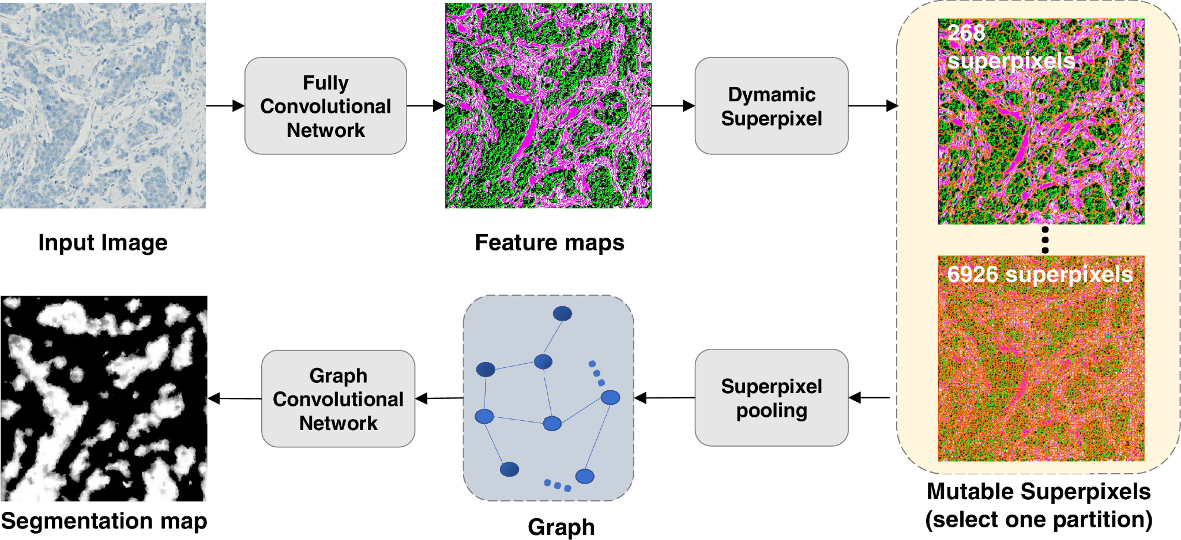
Joint fully convolutional and graph convolutional networks for weakly-supervised segmentation of pathology images
Image sem. seg. task
weakly-supervised
FCN feature extractors
-> superpixels -> GNN
-> supervised by image level labels
Ablation study:
GNN vs no GNN: +10% (up to +~30% DICE coeff. for some difficult ones.)
Finer control over regions.
Fully supervised U-Net is +~5% DICE coeff.
7. Super Pixeling takes ~2.5 s for 1024x1024, FCN and GCN both below 0.01 s. Traditional U-Net is slower.
8. Traditional U-Net self supervised is -~20% worse in DICE coefficient

Slide 17
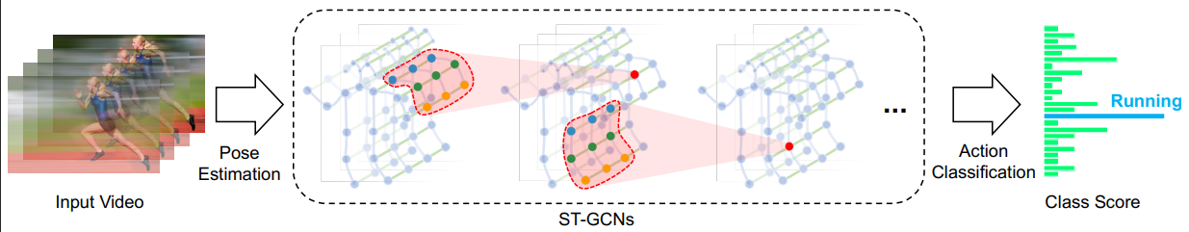
Spatial Temporal Graph Convolutional Networks for Skeleton-Based Action Recognition
Learns a time sequence of skeleton graphs, each node corresponds to a joint.
Pose algorithms extracts the joint coordinates from a sequence of frames.
Human body structures and time are build into edges. Whereas the 2D CNN based methods uses input as pixel intensity vectors on a 2D grid.
Edges on the same frame could either be spatially or intuitively connected.
on RGB-D dataset, outperforms CNN based methods (temporal CNN too) by ~1%-~3%.

Slide 18
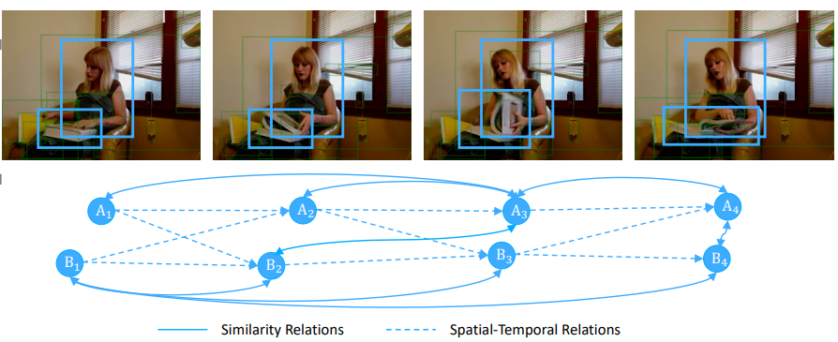
Videos as Space-Time Region Graphs
Represent videos as space-time region graphs with nodes as region proposals.
Similarity relations: regions which have similar appearance or semantic connections.
Spatial-Temporal relations: Objects which overlap in space and close in time.
The region proposal nodes are then classified into semantic labels for B-Boxes.
GNN here serves as a intermediate to learn the temporal and similarity relations.
Average Precision (AP) improves +~5% by ablation study.
Method:
Conventional feature extractor, then RoIAlign
Extracted region proposal, fed into GNNs as nodes
Edges created using aforementioned relations
Pooling over all nodes to get classifications

Slide 19
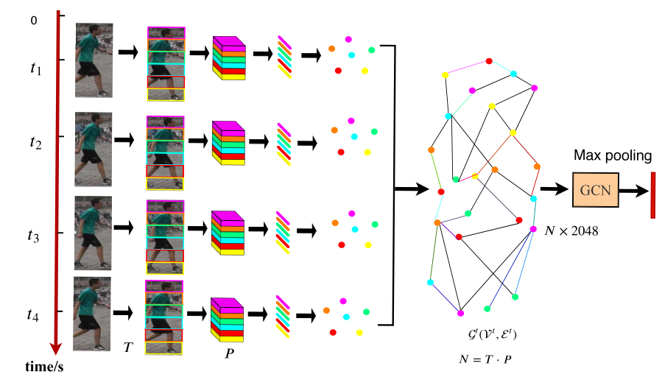
Spatial-Temporal Graph Convolutional Network for Video-based Person Re-identification
GCN provides complementary information between frames to combat occlusion.
CNN Feature extractor; Two GCN branches a spatial one and a temporal one.
Spatial branch only extracts structural info like human body
Temporal branch only carries discriminative cues from adjacent frames.
The temporal branch horizontally partition the image into patches as nodes, and learn with 4 adjacent frames.
meanAP score +~3% versus no spatial or temporal branch.
4. Triplet loss to train both branches and a global branch
end to end.
5. Spatial branch learns patches within frames.

Slide 20
Takeaway
Pixels in images, videos, and point clouds are not naturally statistical data points, we need to improvise methods to convert them to statistical meaningful data points, such as bounding box, feature distributions, regions of interests, etc.
GNNs in vision often employ learning on both spatial and temporal information.
GNNs are faster and more efficient. No empty voxels or grids.
We have flexibility on edge configurations. However, current results suggests that quantity matters more than quality for edge configurations. More research needed.
Since we are handcrafting features or categories of features, explainability is often better when using GNNs. Most operations could be very intuitive.
It is easier to take advantage of the temporal factor and doing so produce significant improvements, e.g. on consecutive frames, object trajectories, temporal relations.
However, step 1 could be time consuming depending on your implementation (superpixel, for example).

Slide 21
References
Anton Mitrokhin, Zhiyuan Hua, CVPR2020, Learning Visual Motion Segmentation Using Event Surfaces
Boris Knyazev, Medium, 2019, Tutorial on Graph Neural Networks for Computer Vision and Beyond
Bruna et al., ICLR, 2014, Spectral Networks and Locally Connected Networks on Graphs
Diez & Sepulcre, Nature Communications, 2019, Neurogenetic profiles delineate large-scale connectivity dynamics of the human brain
Fey et al., CVPR, 2018 SplineCNN: Fast Geometric Deep Learning with Continuous B-Spline Kernels
Hongyang Gao, Zhengyang Wang, ACM SIGKDD , 2018, Large-Scale Learnable Graph Convolutional Networks
Jun Zhang, Zhiyuan Hua, Medical Image Analysis, 2021, Joint fully convolutional and graph convolutional networks for weakly-supervised segmentation of pathology images
Li Zhang, CIKM 2020, A Feature-Importance-Aware and Robust Aggregator for GCN
Liang et al., ECCV, 2016, Semantic Object Parsing with Graph LSTM
Petar Veličković, Guillem Cucurull, ICLR2018, Graph Attention Networks
Wang & Gupta, ECCV, 2018, Videos as Space-Time Region Graphs
Yuning Chai, Pei Sun, CVPR2021, To the Point: Efficient 3D Object Detection in the Range Image with Graph Convolution Kernels
Yue Wang, Yongbin Sun, et.al, acm transaction on graphics, 2019, Dynamic Graph CNN for Learning on Point Clouds
Yan et al., AAAI, 2018, Spatial Temporal Graph Convolutional Networks for Skeleton-Based Action Recognition

