Slide 1
Neural Differentiable Rendering
Preliminary to Learning Robust Feature Representations for Video Recognition by Paired Data Generation
Divya Kothandaraman
18 Nov 2021

Slide 2
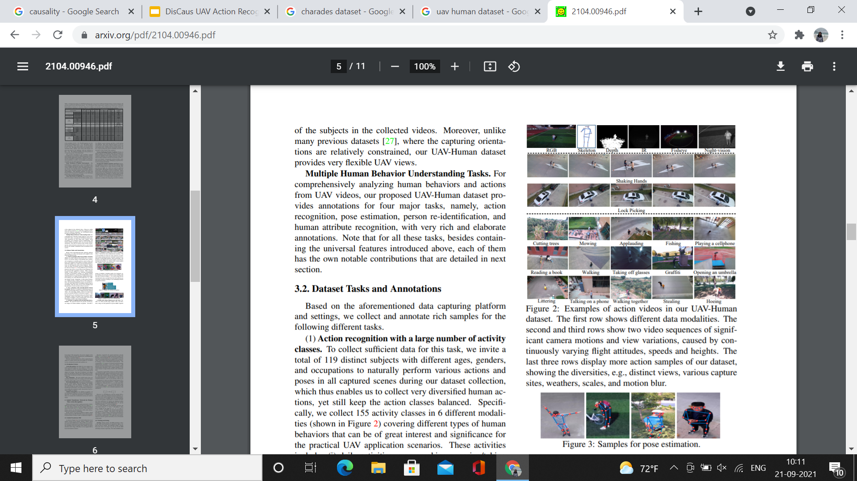
Problem Statement
Generate two videos:
Agent 1 + BG2
Agent 2 + BG 1
MODEL
Interpretation 1: Separate out ‘actor’ and ‘background’ !
Actor should include context relevant to actor (e.g. human agent swimming in water)
Interpretation 2: Disentangle features most relevant to action prediction and least relevant to action prediction
2 random videos from the dataset

Slide 3
Proposed Idea
Object 1
Image 1
Object Background Disentanglement
BG 1
Image 2
Object 2
Differentiable programming component
BG 2
Encoder
Feature maps

Slide 4
Proposed Idea
Also use the network to generate (or reconstruct) Object 1 + BG1 and Object 2 + BG2
Object 1
Decoder
Object 1 + BG2
BG 2
Losses:
Pixel wise MSE loss for reconstruction
Contrastive loss for swapped reconstructed videos (Siamese network)
Additional (frozen) action recognition network to predict desired activity, which backpropagates to this encoder-decoder structure
Shared weights
Object 2
Decoder
Object 2 + BG1
BG 1

Slide 5
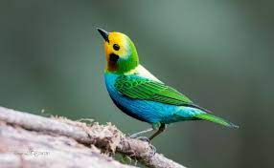
Attribute Control is Key for Rendering
Object
Background
Pose
Shape
Color
Niemeyer, M., & Geiger, A. (2021). Giraffe: Representing scenes as compositional generative neural feature fields. In Proceedings of the IEEE/CVF Conference on Computer Vision and Pattern Recognition (pp. 11453-11464).
Notes:
In recent years, the computer vision community has made great strides towards highly-realistic image generation. In particular, Generative Adversarial Networks (GANs) emerged as a powerful class of generative models. They are able to synthesize photorealistic images at resolutions of 1024 x 1024 pixels and beyond. Despite these successes, synthesizing realistic 2D images is not the only aspect required in applications of generative models. The generation process should also be controllable in a simple and consistent manner. Definitions of disentanglement vary, but commonly refer to being able to control an attribute of interest, e.g. object shape, size, or pose, without changing other attributes. Most approaches, however, do not consider the compositional nature of scenes and operate in the 2D domain, ignoring that our world is three-dimensional. This often leads to entangled representations and control mechanisms are not built-in, but need to be discovered in the latent space a posteriori. These properties, however, are crucial for successful applications, e.g. a movie production where complex object trajectories need to be generated in a consistent manner.

Slide 6
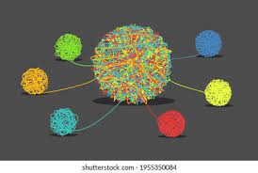
Compositional Scene Representations
Neural Network
Shape
Object
Background
Represent as compositional neural feature fields
Color
Pose
Niemeyer, M., & Geiger, A. (2021). Giraffe: Representing scenes as compositional generative neural feature fields. In Proceedings of the IEEE/CVF Conference on Computer Vision and Pattern Recognition (pp. 11453-11464).
Notes:
One way to perform this disentanglement is to represent these attributes as compositional neural feature fields. Given an input scene, an encoder can be used to derive entangled feature representations, which can then be represented as compositional neural feature fields to derive each attribute.

Slide 7
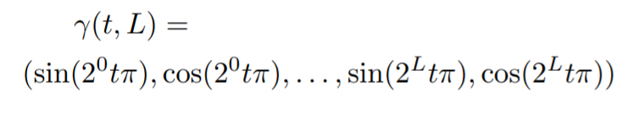
Compositional Neural Feature Fields: Preliminaries
Neural Radiance Fields:
Continuous function f
Maps 3D point x(R³) and viewing direction d(S²) -> volume density σ(R⁺) and RGB color value c(R³)
Pre-defined positional encoding applied element-wise to each component of x and d
Niemeyer, M., & Geiger, A. (2021). Giraffe: Representing scenes as compositional generative neural feature fields. In Proceedings of the IEEE/CVF Conference on Computer Vision and Pattern Recognition (pp. 11453-11464).
Notes:
A radiance field is a continuous function f which maps a 3D point x ∈ R 3 and a viewing direction d ∈ S 2 to a volume density σ ∈ R + and an RGB color value c ∈ R 3 . A key observation is that the low dimensional input x and d needs to be mapped to higher-dimensional features to be able to represent complex signals when f is parameterized with a neural network. More specifically, a pre-defined positional encoding is applied element-wise to each component of x and d: (equation). where t is a scalar input, e.g. a component of x or d, and L the number of frequency octaves. In the context of generative models, we observe an additional benefit of this representation: It introduces an inductive bias to learn 3D shape representations in canonical orientations which otherwise would be arbitrary.

Slide 8
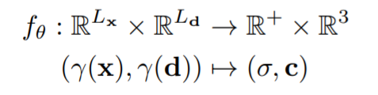
Compositional Neural Feature Fields: Preliminaries
Neural Radiance Fields
Parameterize f with a multi-layer perceptron (MLP)
Niemeyer, M., & Geiger, A. (2021). Giraffe: Representing scenes as compositional generative neural feature fields. In Proceedings of the IEEE/CVF Conference on Computer Vision and Pattern Recognition (pp. 11453-11464).
Notes:
Following a landmark paper on implicit shape representations, Neural Radiance Fields (NeRFs) can be learnt by parameterizing f with a multi-layer perceptron (MLP). where θ indicate the network parameters and Lx, Ld the output dimensionalities of the positional encodings.

Slide 9
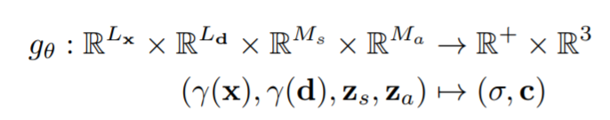
Compositional Neural Feature Fields: Preliminaries
Generative Neural Radiance Fields (GRAF)
Generative model for Neural Radiance Fields
Condition MLPs on appearance and shape codes z_{s}, z_{a} (in N(0,I))
Niemeyer, M., & Geiger, A. (2021). Giraffe: Representing scenes as compositional generative neural feature fields. In Proceedings of the IEEE/CVF Conference on Computer Vision and Pattern Recognition (pp. 11453-11464).
Notes:
While the previous equation fits θ to multiple posed images of a single scene, another idea is a generative model for Neural Radiance Fields (GRAF) that is trained from unposed image collections. To learn a latent space of NeRFs, they condition the MLP on shape and appearance codes zs, za ∼ N (0, I). where Ms, Ma are the dimensionalities of the latent codes.

Slide 10
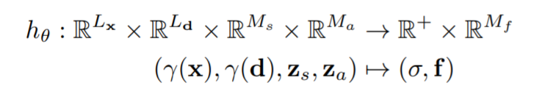
Compositional Neural Feature Fields: Preliminaries
Combination of neural and volume rendering:
Replace color representation c with a more generic feature f to represent object as Generative Neural Feature Fields
Niemeyer, M., & Geiger, A. (2021). Giraffe: Representing scenes as compositional generative neural feature fields. In Proceedings of the IEEE/CVF Conference on Computer Vision and Pattern Recognition (pp. 11453-11464).
Notes:
The direction that this paper explores is a more efficient combination of volume and neural rendering. They replace GRAF’s formulation for the three-dimensional color output c with a more generic Mf -dimensional feature f and represent objects as Generative Neural Feature Fields

Slide 11
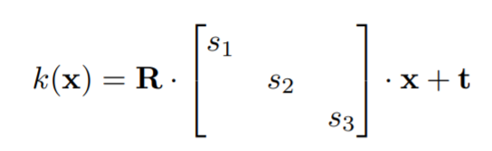
Compositional Neural Feature Fields
Limitation of NeRF and GRAF: Entire scene is represented by a single model
But the goal is disentanglement! Need more control
Each object (background considered as an object): feature field + affine transformation
T = {s,t,R}; transform point to scene space as:
Niemeyer, M., & Geiger, A. (2021). Giraffe: Representing scenes as compositional generative neural feature fields. In Proceedings of the IEEE/CVF Conference on Computer Vision and Pattern Recognition (pp. 11453-11464).
Notes:
A key limitation of NeRF and GRAF is that the entire scene is represented by a single model. As we are interested in disentangling different entities in the scene, we need control over the pose, shape and appearance of individual objects (we consider the background as an object as well). We therefore represent each object using a separate feature field in combination with an affine transformation. where s, t ∈ R 3 indicate scale and translation parameters, and R ∈ SO(3) a rotation matrix. Using this representation, it transforms points from object to scene space as per the equation.

Slide 12
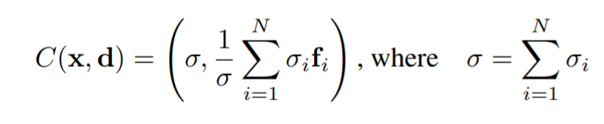
Compositional Neural Feature Fields
Scenes -> Compositions
Recall: Feature field maps 3D point x(R³) and viewing direction d(S²) -> volume density σ(R⁺) and RGB color value c(R³)
How do you combine them all? Natural choice is to average densities at each point
Niemeyer, M., & Geiger, A. (2021). Giraffe: Representing scenes as compositional generative neural feature fields. In Proceedings of the IEEE/CVF Conference on Computer Vision and Pattern Recognition (pp. 11453-11464).
Notes:
Hence, scenes are described as compositions of N entities where the first N − 1 are the objects in the scene and the last represents the background. There are two cases: First, N is fixed across the dataset such that the images always contain N − 1 objects plus the background. Second, N is varied across the dataset. In practice, the same representation is used for the background as for objects except that we fix the scale and translation parameters sN , tN to span the entire scene, and to be centered at the scene space origin. To define the composition operator C, let’s recall that a feature field of a single entity h i θi predicts a density σi ∈ R + and a feature vector fi ∈ RMf for a given point x and viewing direction d. When combining non-solid objects, a natural choice for the overall density at x is to sum up the individual densities and to use the density-weighted mean to combine all features at (x, d).

Slide 13
Compositional Neural Feature Fields
Limitation: Object placement matters (averaging operation)
Reality: Object in video 1 and video 2 may not be exactly aligned! Can’t just swap and average.
Neural Differentiable Rendering to the rescue!
Notes:
What are the limitations? For direct averaging as described in the previous slide, the placement of the moving object in both videos under consideration must be exact aligned. However, this is not true in practice, we cannot just swap and average. What is the solution? Neural Differentiable Rendering to the rescue!

Slide 14
Neural Differentiable Rendering
Neural Rendering: Deep image or video generation approaches that enable explicit or implicit control of scene properties such as illumination, camera parameters, pose, geometry, appearance, and semantic structure.
Reconstruction + Rendering
Computer Graphics Modules
Explicit vs Implicit control
Multimodal synthesis
Control
Generality
Tewari, A., Fried, O., Thies, J., Sitzmann, V., Lombardi, S., Sunkavalli, K., ... & Zollhöfer, M. (2020, May). State of the art on neural rendering. In Computer Graphics Forum (Vol. 39, No. 2, pp. 701-727).
Notes:
Neural rendering brings the promise of addressing both reconstruction and rendering by using deep networks to learn complex mappings from captured images to novel images. Neural rendering combines physical knowledge, e.g., mathematical models of projection, with learned components to yield new and powerful algorithms for controllable image generation. Neural Rendering can defined as Deep image or video generation approaches that enable explicit or implicit control of scene properties such as illumination, camera parameters, pose, geometry, appearance, and semantic structure. One taxonomy of neural rendering approaches is as follows: • Control: What do we want to control and how do we condition the rendering on the control signal? • CG Modules: Which computer graphics modules are used and how are they integrated into a neural rendering pipeline? • Explicit or Implicit Control: Does the method give explicit control over the parameters or is it done implicitly by showing an example of what we expect to get as output? • Multi-modal Synthesis: Is the method trained to output multiple optional outputs, given a specific input? • Generality: Is the rendering approach generalized over multiple scenes/objects?

Slide 15
Retaining Realism on the Natural Image Manifold
Generative approaches:
Not photo-realistic
Generates by random sampling of latent vector space
Cannot manipulate visual content in a user-controlled manner!
Zhu, J. Y., Krähenbühl, P., Shechtman, E., & Efros, A. A. (2016, October). Generative visual manipulation on the natural image manifold. In European conference on computer vision (pp. 597-613). Springer, Cham.
Notes:
Several recent papers have shown visually impressive results sampling random images drawn from the natural image manifold. However, two reasons prevent these advances from being useful in practical applications at this time. First, the generated images, while good, are still not quite photo-realistic (plus there are practical issues in making them high resolution). Second, these generative models are set up to produce images by sampling a latent vector-space, typically at random. So, these methods are not able to create and manipulate visual content in a user-controlled fashion.

Slide 16
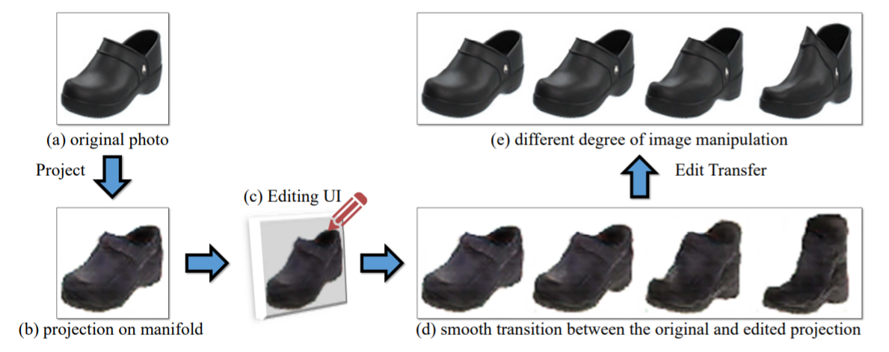
Retaining Realism on the Natural Image Manifold
Use GAN to learn the manifold of natural images but not for generation.
Zhu, J. Y., Krähenbühl, P., Shechtman, E., & Efros, A. A. (2016, October). Generative visual manipulation on the natural image manifold. In European conference on computer vision (pp. 597-613). Springer, Cham.
Notes:
The generative adversarial neural network can be used to just learn the manifold of natural images, and not employ it for image generation. Instead, it can be used as a constraint on the output of various image manipulation operations, to make sure the results lie on the learned manifold at all times. This idea enables the network to reformulate several editing operations, specifically color and shape manipulations, in a natural and data-driven way. The model automatically adjusts the output keeping all edits as realistic as possible.
Overview of the approach. First, the original photo is projected onto (a) onto a lowdimensional latent vector representation (b) by regenerating it using GAN. Next, the network modifies the color and shape of the generated image (d) using various brush tools (c) (for example, dragging the top of the shoe). Finally, they apply the same amount of geometric and color changes to the original photo to achieve the final result

Slide 17
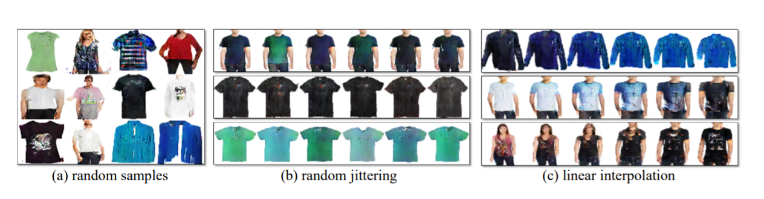
Retaining Realism on the Natural Image Manifold
GAN as a manifold approximation
Produces high quality samples
Euclidean distance -> perceptually meaningful visual similarity
Zhu, J. Y., Krähenbühl, P., Shechtman, E., & Efros, A. A. (2016, October). Generative visual manipulation on the natural image manifold. In European conference on computer vision (pp. 597-613). Springer, Cham.
Notes:
Given a real photo, we first project it onto our approximation of the image manifold by finding the closest latent feature vector z of the GAN to the original image. Then, this paper presents a realtime method for gradually and smoothly updating the latent vector z so that it generates the desired image that both satisfies the user’s edits (e.g., a scribble or a warp) and stays close to the natural image manifold.
GAN as a manifold approximation. (a) Randomly generated examples from a GAN, trained on the shirts dataset; (b) random jittering: each row shows a random sample from a GAN (the first one at the left), and its variants produced by adding Gaussian noise to z in the latent space; (c) interpolation: each row shows two randomly generated images (first and last), and their smooth interpolations in the latent space.

Slide 18
Retaining Realism on the Natural Image Manifold
Real photo
Project to approximation of image manifold
Update latent vector
Find closest latent vector of the GAN to the original image
Satisfy user edits, as well as stay close to real manifold
Zhu, J. Y., Krähenbühl, P., Shechtman, E., & Efros, A. A. (2016, October). Generative visual manipulation on the natural image manifold. In European conference on computer vision (pp. 597-613). Springer, Cham.
Notes:
A real photo x R lies, by definition, on the ideal image manifold M. However for an approximate manifold M˜ , the goal here is to find a generated image x ∗ ∈ M˜ close to x R in some distance metric L(x1, x2). Our goal is to reconstruct the original photo x R using the generative model G by minimizing the reconstruction error, where L(x1, x2) = kC(x1) − C(x2)k 2 in some differentiable feature space C. With the image x R 0 projected onto the manifold M˜ as x0 = G(z0) via the projection methods just described, we can start modifying the image on that manifold. We update the initial projection x0 by simultaneously matching the user intentions while staying on the manifold, close to the original image x0. Each editing operation is formulated as a constraint fg(x) = vg on a local part of the output image x.

Slide 19
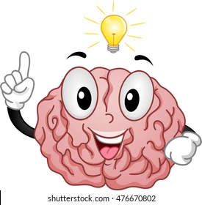
Neural Scene Representation and Rendering
Three legs of a table?
Can learn with limited data!
Learning to see
Sketch a room’s layout or imagine another perspective by just seeing a part!
Eslami, S. A., Rezende, D. J., Besse, F., Viola, F., Morcos, A. S., Garnelo, M., ... & Hassabis, D. (2018). Neural scene representation and rendering. Science, 360(6394), 1204-1210.
Notes:
Our brains draw on prior knowledge to reason and to make inferences that go far beyond the patterns of light that hit our retinas. For example, when entering a room for the first time, you instantly recognise the items it contains and where they are positioned. If you see three legs of a table, you will infer that there is probably a fourth leg with the same shape and colour hidden from view. Even if you can’t see everything in the room, you’ll likely be able to sketch its layout, or imagine what it looks like from another perspective. Today, state-of-the-art visual recognition systems are trained using large datasets of annotated images produced by humans. Acquiring this data is a costly and time-consuming process, requiring individuals to label every aspect of every object in each scene in the dataset. As a result, often only a small subset of a scene’s overall contents is captured, which limits the artificial vision systems trained on that data.

Slide 20
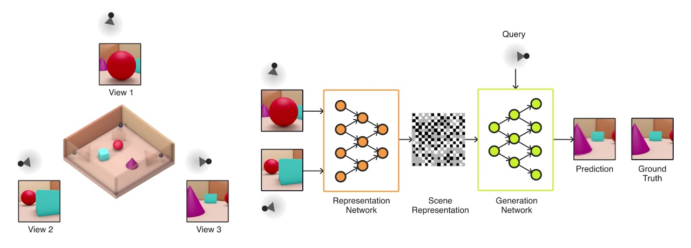
Generative Query Network
Describes the underlying scene
Query unknown
Captures important elements - object positions, room layout etc
Predicts the scene from a previously unobserved viewpoint.
Understands how viewpoints manifest as pixels
Eslami, S. A., Rezende, D. J., Besse, F., Viola, F., Morcos, A. S., Garnelo, M., ... & Hassabis, D. (2018). Neural scene representation and rendering. Science, 360(6394), 1204-1210.
Notes:
Generative Query Network (GQN), a framework within which machines learn to perceive their surroundings by training only on data obtained by themselves as they move around scenes. The GQN model is composed of two parts: a representation network and a generation network. The representation network takes the agent's observations as its input and produces a representation (a vector) which describes the underlying scene. The generation network then predicts (‘imagines’) the scene from a previously unobserved viewpoint. The representation network does not know which viewpoints the generation network will be asked to predict, so it must find an efficient way of describing the true layout of the scene as accurately as possible. It does this by capturing the most important elements, such as object positions, colours and the room layout, in a concise distributed representation. During training, the generator learns about typical objects, features, relationships and regularities in the environment. This shared set of ‘concepts’ enables the representation network to describe the scene in a highly compressed, abstract manner, leaving it to the generation network to fill in the details where necessary. For instance, the representation network will succinctly represent ‘blue cube’ as a small set of numbers and the generation network will know how that manifests itself as pixels from a particular viewpoint.

Slide 21
Generative Query Network: Benefits
Can image previously unobserved scenes from new viewpoints
Can learn to count, localize and and classify objects without any object level labels
Can represent, measure and reduce uncertainty
Robust, data efficient reinforcement learning
Eslami, S. A., Rezende, D. J., Besse, F., Viola, F., Morcos, A. S., Garnelo, M., ... & Hassabis, D. (2018). Neural scene representation and rendering. Science, 360(6394), 1204-1210.
Notes:
The GQN’s generation network can ‘imagine’ previously unobserved scenes from new viewpoints with remarkable precision. When given a scene representation and new camera viewpoints, it generates sharp images without any prior specification of the laws of perspective, occlusion, or lighting. The generation network is therefore an approximate renderer that is learned from data. The GQN’s representation network can learn to count, localise and classify objects without any object-level labels. Even though its representation can be very small, the GQN’s predictions at query viewpoints are highly accurate and almost indistinguishable from ground-truth. The GQN can represent, measure and reduce uncertainty. It is capable of accounting for uncertainty in its beliefs about a scene even when its contents are not fully visible, and it can combine multiple partial views of a scene to form a coherent whole. The GQN’s representation allows for robust, data-efficient reinforcement learning. When given GQN’s compact representations, state-of-the-art deep reinforcement learning agents learn to complete tasks in a more data-efficient manner compared to model-free baseline agents, as shown in the figure below.

Slide 22
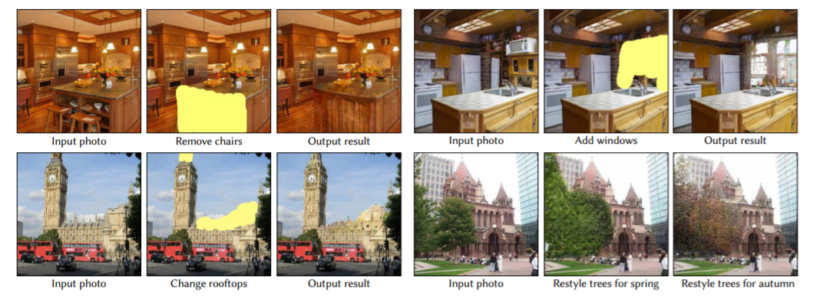
Generative Image Prior
Bau, D., Strobelt, H., Peebles, W., Wulff, J., Zhou, B., Zhu, J. Y., & Torralba, A. (2020). Semantic photo manipulation with a generative image prior. arXiv preprint arXiv:2005.07727.
Notes:
This method enables several new interactive photo manipulations in which a user edits a photo with high-level concepts rather than pixel colors. The deep generative model can synthesize new content that follows both the user’s intention and the natural image statistics. Top: Given simple user strokes, it can automatically synthesize and manipulate different objects while adjusting the surrounding context to match. Bottom: The users can edit the visual appearance of objects directly, such as changing the appearance of rooftops or trees. Photos from the LSUN dataset

Slide 23
Generative Image Prior
Issues with GAN generation:
Cannot precisely reproduce input image
Post manipulation pixels do not fit the original image
Adapt image prior learnt by GANs to image statistics on an individual image
Bau, D., Strobelt, H., Peebles, W., Wulff, J., Zhou, B., Zhu, J. Y., & Torralba, A. (2020). Semantic photo manipulation with a generative image prior. arXiv preprint arXiv:2005.07727.
Notes:
Two technical challenges have prevented generative models from being applied to natural photograph manipulation. First, it is extremely difficult to find a latent code z to reproduce a given photograph x with a deep generative model. The reconstructed image G(z) roughly captures the visual content of the input image x, but visual details are obviously different from the original photo. Second, after manipulation, the newly synthesized pixels from generative models are often incompatible with the existing content from the real image, which makes stitching the new content into the context of the original image challenging.
The key idea is to learn an image-specific generative model G ′ ≈ G, that produces a near-exact solution for our input image x, so that x ≈ G ′ (z) outside the edited region of the image. We construct our image-specific G ′ to share the same semantic representations as of the original G. Importantly, our image-specific G ′ produces new visual content, consistent with the original photo while reflecting semantic manipulations.

Slide 24
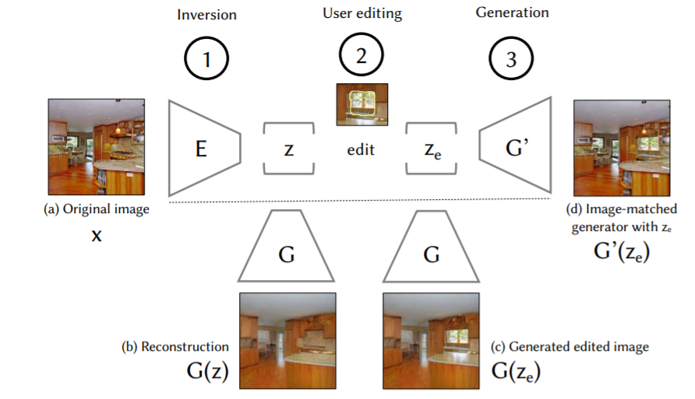
Generative Image Prior
Bau, D., Strobelt, H., Peebles, W., Wulff, J., Zhou, B., Zhu, J. Y., & Torralba, A. (2020). Semantic photo manipulation with a generative image prior. arXiv preprint arXiv:2005.07727.
Notes:
Here is an overview of the method. To perform a semantic edit on an image x, the method take three steps. (1) It first computes a latent vector z = E(x) representing x. (2) Next, it applies a semantic vector space operation ze = edit(z) in the latent space; this could add, remove, or alter a semantic concept in the image. (3) Finally, it regenerates the image from the modified ze . Unfortunately, as can be seen in (b), usually the input image x cannot be precisely generated by the generator G, so (c) using the generator G to create the edited image G(xe ) will result in the loss of many attributes and details of the original image (a). Therefore to generate the image there is a new last step: (d) it learns an image-specific generator G ′ which can produce x ′ e = G ′ (ze ) that is faithful to the original image x in the unedited regions

Slide 25
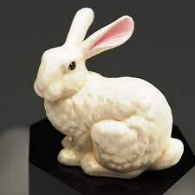
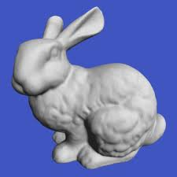
Image Guided Neural Object Rendering
Combines the benefits of image-based rendering and GAN based image synthesis!
Inaccuracies
Coarse
View dependent appearance effects
Issues with
Image based shape reconstruction
Rerendering
Thies, J., Zollhöfer, M., Theobalt, C., Stamminger, M., & Nießner, M. (2020). Image-guided neural object rendering. In 8th International Conference on Learning Representations. OpenReview. net.
Notes:
In recent years, large progress has been made in 3D shape reconstruction of objects from photographs or depth streams. However, highly realistic re-rendering of such objects, e.g., in a virtual environment, is still very challenging. The reconstructed surface models and color information often exhibit inaccuracies or are comparably coarse. Many objects also exhibit strong view-dependent appearance effects, such as specularities. These effects not only frequently cause errors already during image-based shape reconstruction, but are also hard to reproduce when re-rendering an object from novel viewpoints.

Slide 26
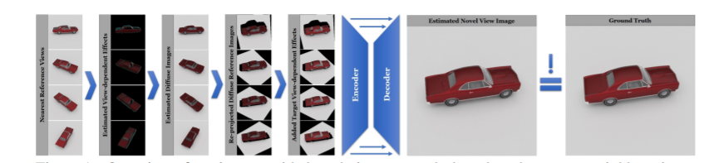
Image Guided Neural Object Rendering
Reconstruction using multi-view stereo
Self-supervised training
Trained in a Siamese way - removes view-dependent effect
CompositionNet -> projected kNN to final output
Resolves reprojection errors & fills gaps
Thies, J., Zollhöfer, M., Theobalt, C., Stamminger, M., & Nießner, M. (2020). Image-guided neural object rendering. In 8th International Conference on Learning Representations. OpenReview. net.
Notes:
In contrast, the approach in this paper explicitly handles view-dependent effects to output photo-realistic images and videos. It is a neural rendering approach that combines image-based rendering and the advances in deep learning. As input, we capture a short video of an object to reconstruct the geometry using multi-view stereo. Given this 3D reconstruction and the set of images of the video, it can train in a self-supervised manner. The core of the approach is a neural network called EffectsNet which is trained in a Siamese way to estimate view-dependent effects, for example, specular highlights or reflections. This allows it to remove view-dependent effects from the input images, resulting in images that contain view-independent appearance information of the object. This view-independent information can be projected into a novel view using the reconstructed geometry, where new view-dependent effects can be added. CompositionNet, a second network, composites the projected K nearest neighbor images to a final output. Since CompositionNet is trained to generate photo-realistic output images, it is resolving reprojection errors as well as filling regions where no image content is available.

Slide 27
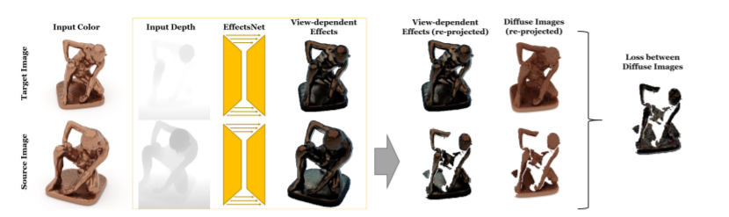
Image Guided Neural Object Rendering
Training EffectsNet:
Self-supervised siamese training
View, depth map -> view-dependent effects
Reproject -> diffuse color (subtraction)
Thies, J., Zollhöfer, M., Theobalt, C., Stamminger, M., & Nießner, M. (2020). Image-guided neural object rendering. In 8th International Conference on Learning Representations. OpenReview. net.
Notes:
A main contribution of this work is a convolutional neural network that learns the disentanglement of view-dependent and view-independent effects in a self-supervised manner. Since the training data consists of a series of images taken from different viewing directions, assuming constant illumination, the reflected radiance of two corresponding points in two different images only differs by the view-dependent effects. The self-supervised training procedure is based on a Siamese network that gets a pair of randomly selected images from the training set as input. The task of the network is to extract view-dependent lighting effects from an image, based on the geometric information from the proxy geometry. In a Siamese scheme, two random images from the training set are chosen and fed into the network to predict the view-dependent effects based on the current view and the respective depth map. After re-projecting the source image to the target image space it computes the diffuse color via subtraction. The network is optimized by minimizing the difference between the two diffuse images in the valid region.

Slide 28
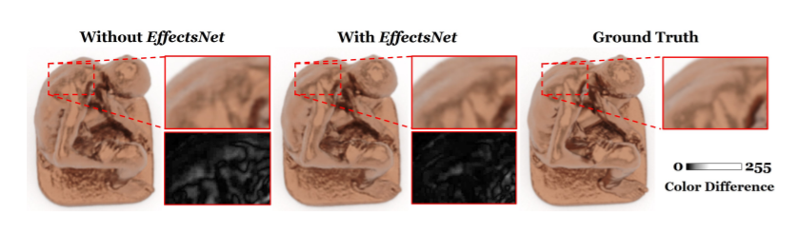
Image Guided Neural Object Rendering
Specular highlights not smooth without EffectsNet
Visually consistent temporal animation of view-dependent effects
Thies, J., Zollhöfer, M., Theobalt, C., Stamminger, M., & Nießner, M. (2020). Image-guided neural object rendering. In 8th International Conference on Learning Representations. OpenReview. net.
Notes:
Since the EffectsNet is a core component of the algorithm, here is a comparison of the technique with and without EffectsNet using synthetic data. The full pipeline results in smoother specular highlights and sharper details. Without EffectsNet the specular highlights are not as smooth as the ground truth. Besides, the EffectsNet leads to a visually consistent temporal animation of the view-dependent effects. The close-ups show the color difference w.r.t. ground truth. On the test set the MSE without EffectsNet is 2.6876 versus 2.3864 with EffectsNet.

Slide 29
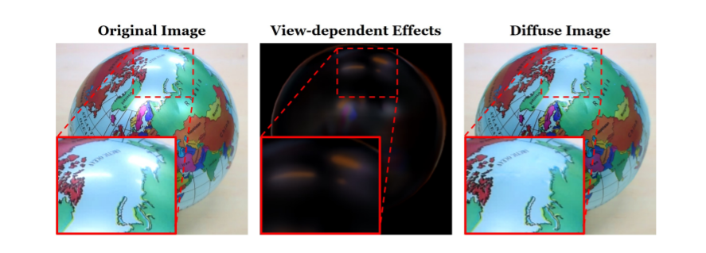
Image Guided Neural Object Rendering
Prediction and removal of view-dependent effects of a highly specular real object
Thies, J., Zollhöfer, M., Theobalt, C., Stamminger, M., & Nießner, M. (2020). Image-guided neural object rendering. In 8th International Conference on Learning Representations. OpenReview. net.
Notes:
Prediction and removal of view-dependent effects of a highly specular real object. This experiment is conducted on real data. In this slide, the effectiveness of EffectsNet to estimate the specular effects in an image is shown. The globe has a specular surface and reflects the ceiling lights. These specular highlights are estimated and removed from the original image of the object which results in a diffuse image of the object.

Slide 30
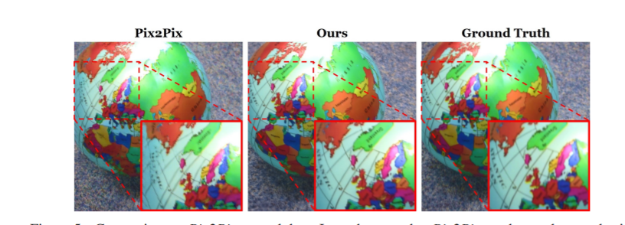
Image Guided Neural Object Rendering
Artifacts in Pix2Pix resolved by EffectsNet!
Thies, J., Zollhöfer, M., Theobalt, C., Stamminger, M., & Nießner, M. (2020). Image-guided neural object rendering. In 8th International Conference on Learning Representations. OpenReview. net.
Notes:
Comparison to Pix2Pix on real data. It can be seen that Pix2Pix can be used to synthesize novel views. The close-up shows the artifacts that occur with Pix2Pix and are resolved by this approach leading to higher fidelity results.

Slide 31
References
Niemeyer, M., & Geiger, A. (2021). Giraffe: Representing scenes as compositional generative neural feature fields. In Proceedings of the IEEE/CVF Conference on Computer Vision and Pattern Recognition (pp. 11453-11464).
Tewari, A., Fried, O., Thies, J., Sitzmann, V., Lombardi, S., Sunkavalli, K., ... & Zollhöfer, M. (2020, May). State of the art on neural rendering. In Computer Graphics Forum (Vol. 39, No. 2, pp. 701-727).
Zhu, J. Y., Krähenbühl, P., Shechtman, E., & Efros, A. A. (2016, October). Generative visual manipulation on the natural image manifold. In European conference on computer vision (pp. 597-613). Springer, Cham.
Eslami, S. A., Rezende, D. J., Besse, F., Viola, F., Morcos, A. S., Garnelo, M., ... & Hassabis, D. (2018). Neural scene representation and rendering. Science, 360(6394), 1204-1210.
Bau, D., Strobelt, H., Peebles, W., Wulff, J., Zhou, B., Zhu, J. Y., & Torralba, A. (2020). Semantic photo manipulation with a generative image prior. arXiv preprint arXiv:2005.07727.
Thies, J., Zollhöfer, M., Theobalt, C., Stamminger, M., & Nießner, M. (2020). Image-guided neural object rendering. In 8th International Conference on Learning Representations. OpenReview. Net.

