Slide 1
Variational Quantum Algorithm
Kaiyan Shi, Haowei Deng
Notes:
Differentiable Programming on quantum computers
joint start, joint ending
the flow is there
comparison

Slide 2
Concept Review
A qubit can be described by 2-d vector:
$$α\left|0\right\rangle +β\left|1\right\rangle =\left[\begin{matrix}α \\ β\end{matrix}\right]$$
The state of an $n$-qubit system can be represented by $2^{n}$-dim vector.
The space of such states is a $2^{n}$-dim Hilbert space.
Unitary transformation $U:\left|φ\right\rangle →U\left|φ\right\rangle .$
How a state time-evolve under a Hamiltonian? Schrödinger’s equation
$$i\frac{d}{dt}\left|ψ\left(t\right)\right\rangle =H\left(t\right)\left|ψ\left(t\right)\right\rangle .$$

Slide 3
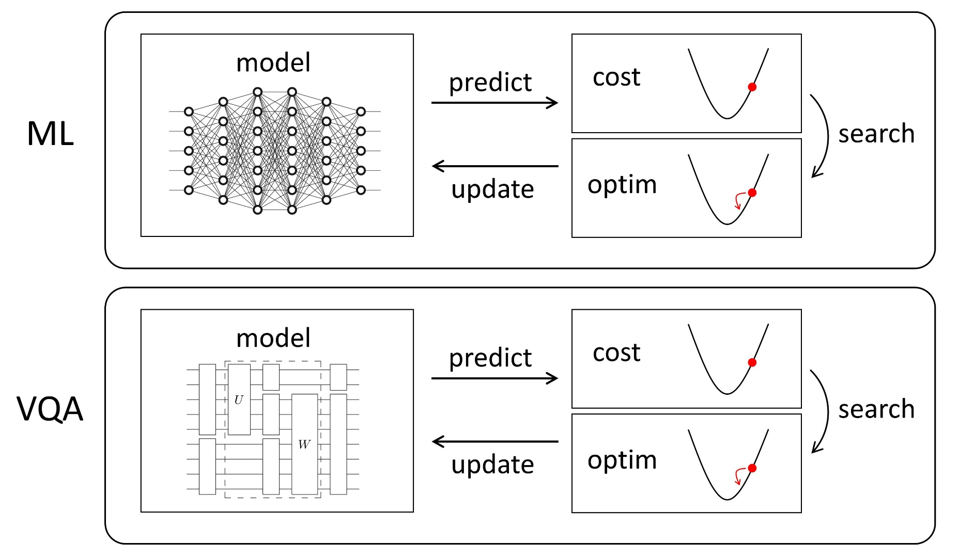
Variational Quantum Algorithm (VQA)
In classical machine learning, we have:
The model in ML can be a neural network running on a classical computer.
In VQA, the model is a quantum circuit running on the quantum computer.

Slide 4
Variational Quantum Algorithm (VQA)
A simple VQA example
Suppose the $n$-qubits quantum system’s initial state is $\left|φ_{0}\right\rangle$ and we want to construct a unitary circuit $U$ which can transfer $\left|φ_{0}\right\rangle$ to target $\left|φ_{1}\right\rangle .$ $\left|φ_{0}\right\rangle$ and $\left|φ_{1}\right\rangle$ can be represented by $2^{n}$-dim vector. Let
$$\left|φ\left(θ\right)\right\rangle =U(θ_{1},…,θ_{m})\left|φ_{0}\right\rangle .$$
We need to figure out the parameters $θ_{1},…,θ_{m}$ which make $\left|φ\left(θ\right)\right\rangle =\left|φ_{1}\right\rangle$.
Analogy: Consider a robot control problem. Suppose we have a robot at (0,0) and we want to drive it to a target position $(x_{t},y_{t})$. The position of the robot can also be represented by a 2-dim vector.
Suppose the driver is parametrized by: The angle $θ$ between the moving direction and the x-axis and the driving distance $r$. So the robot will be moved to position $\left(x,y\right)=(rcos(θ),rsin(θ))$.
We need to figure out $θ, r$ to move the robot to the target position $(x_{t},y_{t})$.

Slide 5
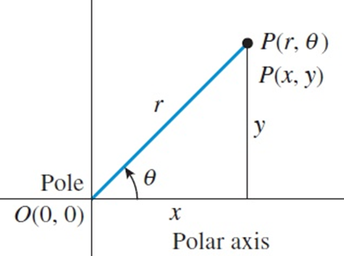
Variational Quantum Algorithm (VQA)
Cost Function: In robot control problem, when the robot is in $\left(x,y\right),$ we can use its distance from the target position as the cost function which we want to minimize
$$D =\sqrt{{(x_{t}−x)}^{2}+{(y_{t}−y)}^{2}}$$
In VQA, when our circuit generate a state $\left|φ\left(θ\right)\right\rangle$ , we also want to evaluate $\left|φ\left(θ\right)\right\rangle$’s distance from our target state $\left|φ_{1}\right\rangle . The d$istance can be calculated as
$$D^{′}=1−⟨φ_{1}\left|φ\left(θ\right)\right\rangle$$
$⟨ψ_{1}\left|φ\left(θ\right)\right\rangle$ is the inner product of $\left|φ\left(θ\right)\right\rangle$ and $\left|φ_{1}\right\rangle$
In VQA, we need to tune $θ_{1},…,θ_{m}$ to minimize this distance $D^{′}$

Slide 6
Variational Quantum Algorithm (VQA)
 | Robot Control Problem | VQA
Position /State | (0,0)$→(x_{t},y_{t})$ | $\left|φ_{0}\right\rangle →\left|φ_{1}\right\rangle$
Parameter | $$r,θ$$ | $$θ_{1},…,θ_{m}$$
Intermediate state | $$\left(x,y\right)=$$ $$(rcos(θ),rsin(θ))$$ | $$\left|φ\left(θ\right)\right\rangle$$
Cost Function | $$\sqrt{{(x_{t}−x)}^{2}+{(y_{t}−y)}^{2}}$$ | $$1−⟨φ_{1}\left|φ\left(θ\right)\right\rangle$$
Steps for this example VQA:
Run $U(θ_{1},…,θ_{m})$ on quantum computer and get $\left|φ\left(θ\right)\right\rangle$
Evaluate $D′$, the distance between $\left|φ\left(θ\right)\right\rangle$ and $\left|φ_{1}\right\rangle$.
Calculate the gradients of $θ_{1},…,θ_{m}$ and tune them.

Slide 7
Variational Quantum Algorithm (VQA)
Why we need quantum computer?
In application (i.e. quantum chemical simulation), $n$ can be very large. Using classical model to simulate the evolution of a $2^{n}$-dim vector ($\left|φ_{0}\right\rangle ,$ $\left|φ_{1}\right\rangle , \left|φ\left(θ\right)\right\rangle$ ) has $O(2^{n})$ complexity. Quantum computer can do this in $O(poly(n))$.
This example is exactly Variational Quantum Eigensolver (VQE), one of the most promising applications of quantum computing
Circuit – based VQE
Pulse – based VQE

Slide 8
Variational Quantum Eigensolver

Slide 9
Variational Quantum Eigensolver (VQE) [PA14]
What is VQE?
a hybrid quantum-classical algorithm
aim to find the lowest eigenvalue of a given Hamiltonian
Why VQE?
beneficial for (quantum) systems whose dimension of the problem space grows exponentially
applicable on Noisy Intermediate-Scale Quantum (NISQ) devices
current devices have a lot of noise and have restriction in circuit depth
a lot of quantum algorithms are not applicable
usage in quantum chemistry, one of the most promising applications of quantum computing
Connection with Differentiable Programming
optimizer requires gradient calculation

Slide 10
VQE Diagram Illustration
A hybrid quantum-classical algorithm
where differentiable programming might makes effects

Slide 11
Variational Quantum Eigensolver (VQE)
Problem (Core Task): Solve the ground state (energy) of any molecular Hamiltonian $\hat{H}$.
Input: Some molecular Hamiltonian $\hat{H}$
Approach:
Prepare a parameterized wave function ansatz on a quantum computer.
Adopt classical optimization methods (e.g. gradient descent) to adjust θ to minimize the expectation value
Output:
Minimized expectation value, expected to be the ground state enegy
, expected to be the ground state
Theoretical foundation of VQE: Rayleign-Ritz variational principle
Notes:
draw analogy
input, what
s the assumption

Slide 12
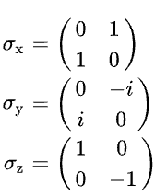
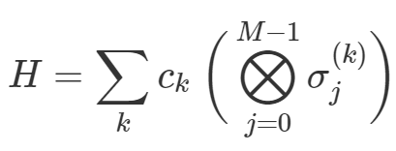
Variational Quantum Eigensolver (VQE)
Problem (Reduced Task): Finding the smallest eigenvalue $λ_{min}$ of a discretized Hamiltonian $H$ and its corresponding eigenvector .
Input: Some discretized Hamiltonian $H$
Approach:
Prepare a parameterized ansatz on a quantum computer.
Adopt classical optimization methods (e.g. gradient descent) to adjust θ to minimize the expectation value
Output:
Minimized expectation value, expected to be $λ_{min}$
, ecpected to be
Tranformation from $\hat{H}$ to$H$ :
The corresponding Hamiltonian $H$ of $\hat{H}$ should be expressed as a weighted sum of Pauli spin operators $\{σ_{x},σ_{y},σ_{z}\}$ such that the information can be processed on a quantum computer,
where $σ_{j}^{(k)}∈\{I,σ_{x},σ_{y},σ_{z}\}$ and $M$ stands for qubit number.
Notes:
Discretized Hamiltonian H construction: We use a minimal basis set to represent the molecular orbitals, whose number corresponds to the number of qubits needed. Furthermore, we use the Jordan-Wigner transformation to perform the fermionic-to-qubit mapping of the Hamiltonian.
How to transform the problem from 4 to 5?
X,Y,Z?

Slide 13
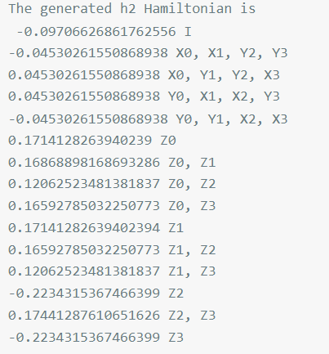
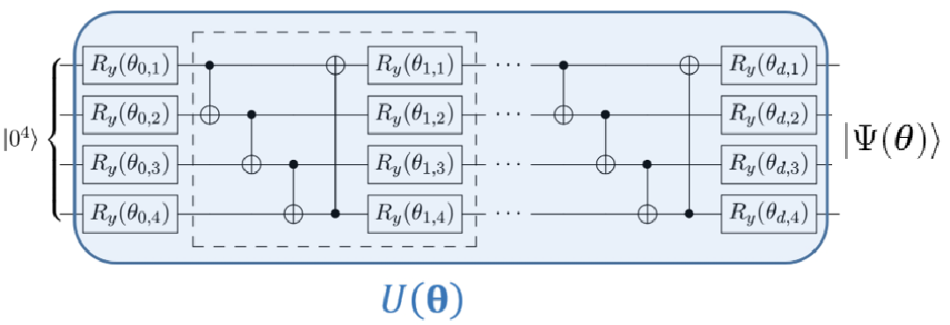
VQE Example - Hydrogen Molecule $H_{2}$
Construct $H$ for $H_{2}$ from exisiting packages like openfermion:
Build a quantum neural network QNN to prepare the wave function ansatz
Setting loss function to be minimized is the expectation value,
This is a $4$-qubit quantum circuit template with $D$ layers.
The dotted frame in the figure denotes a single layer.
Exemplary circuit, $R_{y}$ can be replaced with $R_{x}, R_{z}$ etc.
Notes:
In the approximation of$H_{2}$, we have four spin orbitals, which defines the number of qubits.
Define Rx, Ry, Rz
it’s similar for x and z

Slide 14
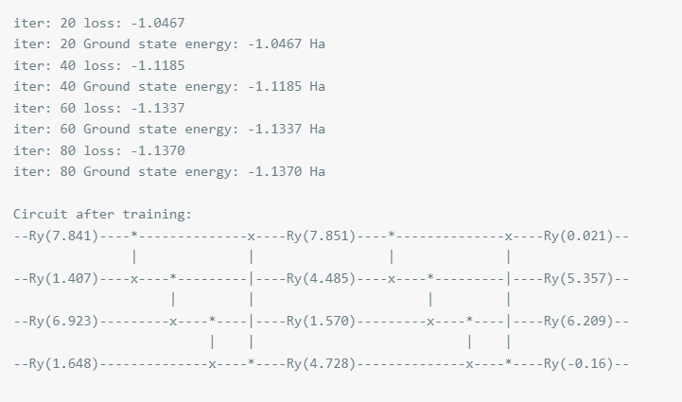
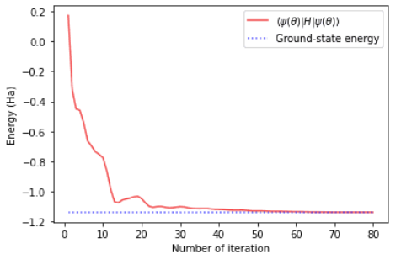
VQE Example - Hydrogen Molecule $H_{2}$
Set up the parameters of the model and start training the quantum neural network

Slide 15
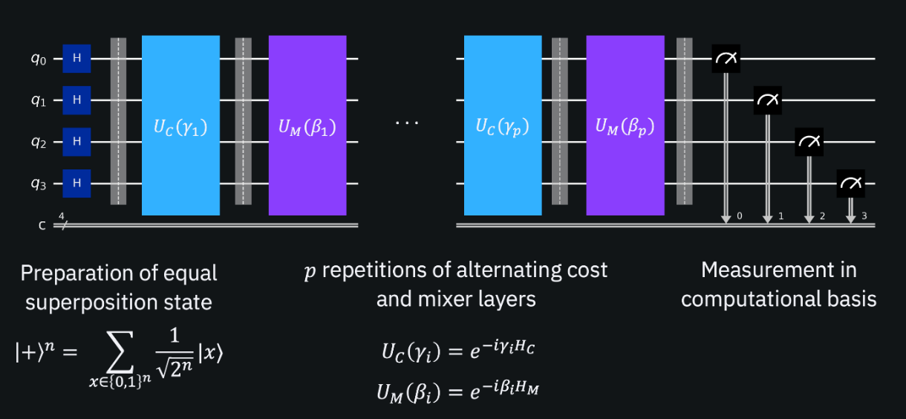
VQE and QAOA
From my understanding, those Hamiltonians are interchangable.
VQE, QAOA $∈$ VQA
Application
QAOA: combinatorial optimization
VQE: quantum chemistry
target Hamiltonian comes from molecular Hamiltonian.
Circuit
QAOA: related to the target Hamiltonian $H$
VQE: customized circuit, can be independent of $H$
QAOA circuit can also be used.
QAOA circuit
Notes:
connection, why maxcut works

Slide 16
VQE Diagram Illustration
A hybrid quantum-classical algorithm
where differentiable programming might makes effects

Slide 17
Calculating gradient using quantum circuits
Qiskit Gradient Framework
Automatic differentiation - Backpropagation
Not clear how intermediate derivatives could be stored and reused inside of a quantum computation
No computing graph
To get the gradient of a quantum program, the key idea is to construct some new programs to compute the gradients of the original one.
Automatic differentiation
Numerical Differentiation
Symbolic Differentiation
Notes:
Transition from VQE to gradients: why use quantum circuits to calculate gradient
quantum - parameter shift
challenges for quantum 串起来
只能用circuit去求
Natural gradient:
Direct quantum analogue of the Natural Gradient in the statistics literature, and reduces to it in a certain limit.
Avoid gradient descent in the parameter space altogether
Perform the gradient descent in the distribution space
The benefits provided by the Quantum Natural Gradient are complementary to those of existing stochastic optimization methods such as Adam.
AD: since the intermediate quantum states cannot be measured without impacting the overall computation

Slide 18
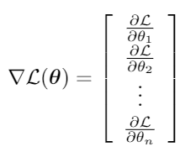
Calculating gradient using quantum circuits
Loss function is
where $θ= [θ_{1}, θ_{2},...,θ_{n}]$ is a list of trainable parameters in the circuit.
Goal is to find
Notes:
接下来三种方法

Slide 19
Finite Difference Method
Numerical Differentiation
Main Idea
The error of the derivative of a function $f(x)$ tends to zero as $h$ tends to zero:
By choosing a sufficiently small $h$, we can get a good approximation of the derivative.
For example, for the central finite difference method, the gradient of the loss fnction is
Advantage
no need to build extra circuits or using extra qubits
Disadvantage
only get an estimation of the gradient
high errors of near-term quantum devices
Notes:
advantage: simply loop through the parameter list, shift specific parameter in the original circuit and evaluate the objective function over and over again
diagrams of implementation on circuits

Slide 20
Parameter Shift Rules
Original parameter shift rule
restriction: $U(θ)$ is a single-parameter gate.
restriction: $U(θ)$ can be written as $e^{−iaθG}$, where $G$ has two unique eigenvalues $λ_{1}$ and $λ_{2}$.
parameter-shift rule to find its gradient
where $r = \frac{a}{2}(λ_{2} − λ_{1}).$
Advantage
no need to build extra circuits or using extra qubits as well
analytical gradient
Disadvantage
restrictions
Notes:
how shift occurs
how do we do the shifts
diagrams of implementation on circuits

Slide 21
Parameter Shift Rules Diagram Illustration
In the diagram
$μ = θ$
$s = \frac{π}{4r}$
The “parameter shift rule” in the larger context of hybrid optimization.
A quantum node can compute derivatives of its outputs with respect to gate parameters by running the original circuit twice, but with a shift in the parameter in question.

Slide 22
Parameter Shift Rules
History of Parameter-Shift Rules:
Two eigenvalues [LJ17, MK18, Schuld19]
Three eigenvalues [WD21, KJAA21]
More complicated gate structure - two eigenvalues
stochastic parameter-shift rule [BLG21]
Equidistant eigenvalues [VJD18]
General parameter-shift rules [WD21, IART21]
Overview of existing and new parameter-shift rules for first-order univariate derivatives as Venn diagram on the space of quantum gates.[WD21]
Notes:
R unique positive eigenvalue differences

Slide 23
Parameter Shift Rules
History of Parameter-Shift Rules:
General parameter-shift rules [WD21, IART21]
[WD21] derives new, general parameter-shift rules for single-parameter quantum gates. It also combines the general rule with the stochastic parameter-shift rule, to extend the framework to multi-parameter quantum gates.
Overview of existing and new parameter-shift rules for first-order univariate derivatives as Venn diagram on the space of quantum gates.[WD21]
Notes:
R unique positive eigenvalue differences

Slide 24
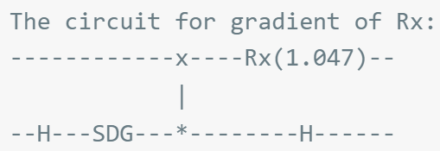
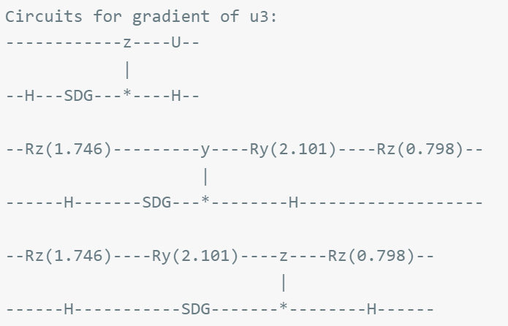
Linear Combiantion of Unitaries
Write $U(θ)$ as $U_{1}(θ_{1})U_{2}(θ_{2})...U_{m}(θ_{m})$
where $U_{i}(θ_{i})$ is one of the one-qubit (e.x. $R_{z}$) and two-qubit gates (e.x. ${CR}_{z}$) and $m$ is the total number of parameterized gates in the circuit $U(θ)$
Get gradient of inividual parameter
Single-qubit gate gradient, e.x. $R_{x}$, $R_{y}$, $R_{z}$
Single-qubit gate gradient, e.x. $U3(θ,Φ,λ)$
some symbolic differentiation

Slide 25
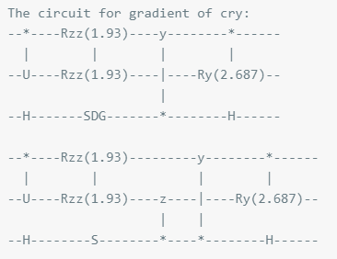
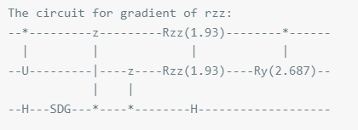
Linear Combiantion of Unitaries
Get gradient of inividual parameter
Two-qubit gate gradient - control rotation gates e.x. ${CR}_{x}$
Two-qubit gate gradient - rotation gates e.x. $R_{xx}$
cannot be represented using one circuit
Notes:
CRx, Rxx

Slide 26
Gradient Review
Numerical Differentiation
Finite Difference Method
pros: no need to build extra circuits or using extra qubits
cons: estimation of gradients, high errors
Symbolic Differentiation
pros: analytic and exact & cons: exhaustive, not always computable
Automatic Differentiation
Parameter-Shift Rule
pros: no need for extra circuits, exact and analytic & cons: ?
Linear Combinations of Unitaries
pros: the most general
cons: needs ancilla qubit, takes long time to run on complex circuits

Slide 27
Pulse-Based Variational Quantum Eigensolver

Slide 28
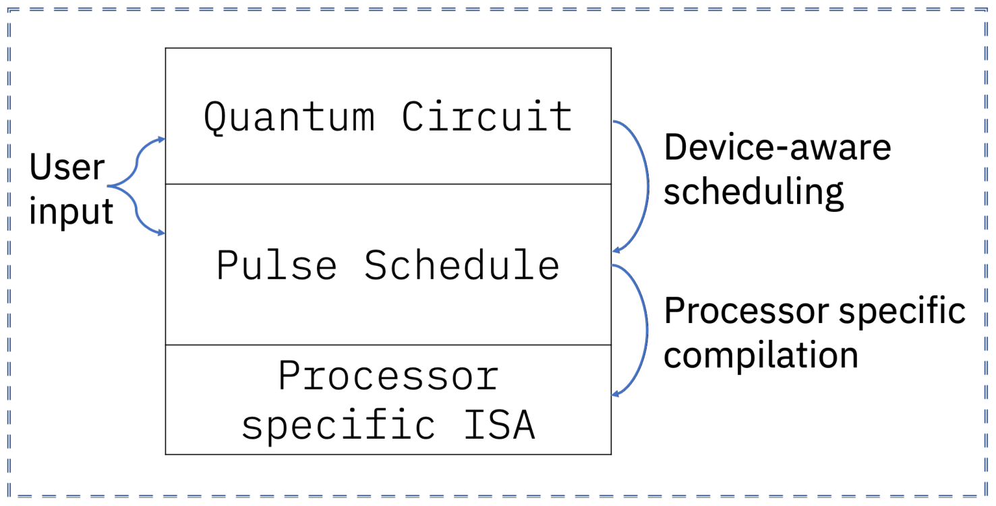
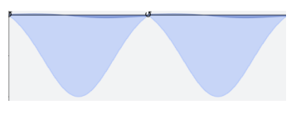
Quantum Pulse Scedule
Drive
Analog Pulse
Qubits
An analog pulse is a control signal that can control the state of qubits in a quantum computer. The effect of each pulse depends on its shape, frequency and amplitude.
The envisioned quantum program representations and compilation procedures. Circuits are built and optimized first, and then are scheduled into pulse programs by using calibrated native gate definitions.
Recent framework enables advanced users to control the quantum system at the pulse level.

Slide 29
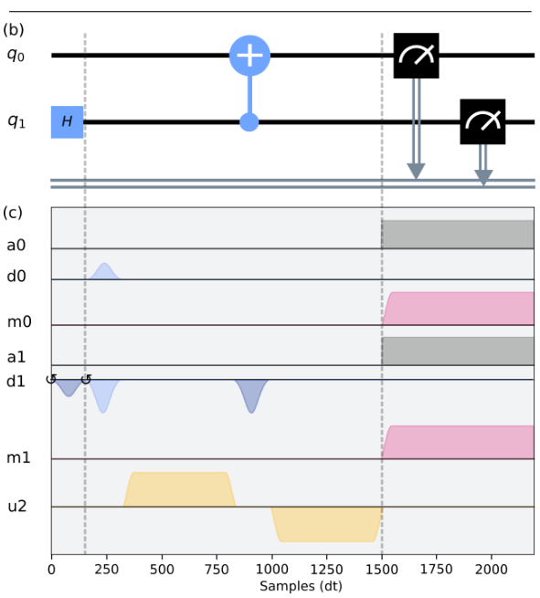
Quantum Pulse Scedule
Gates in a quantum circuit are decomposed into several corresponding pulses.
i.e. Bell state circuit and its corresponding pulse sequence.

Slide 30
Pulse-based VQE
Unlike the classical VQE which optimizes the rotation parameters of the single-qubit gates from the logical quantum circuit, pulse-based VQE directly takes the pulse parameters as the optimization parameters to find the minimal loss value

Slide 31
Pulse-based VQE
To implement pulse-based VQE, we need to translate the logical quantum circuit into a pulse-based quantum circuit, i.e., the logical rotating gates $R_{x} (θ)$and $R_{y}(θ)$are replaced by the corresponding control pulses on X and Y channels respectively with variable amplitudes - which we call pulse-based gates:

Slide 32
Why Pulse-Based Optimization
The quantum circuit model hides the underlying physical implementation of gates and measurements on a quantum computer.
Pulse-Based optimization focuses on the program closer to the hardware than circuit-level optimization.
Extracting the highest performance out of quantum hardware requires the ability to craft a pulse-level instruction schedule, which cannot be done within the standard circuit model [PANY2020].
Quantum Optimal Control: Control the quantum system with highly efficient means (i.e. with analog pulse).

Slide 33
Quantum Optimal Control
In quantum control we look to prepare some specific quantum state, effect some state-to-state transfer, or effect some transformation (or gate) on a quantum system. A quantum state can be represented by a vector in the $2^{n}$-dim Hilbert space.
i.e. $\frac{1}{\sqrt{2}}(\left|00\right\rangle +|11⟩)\text{.}$
Suppose we want to effect a state-to-state transfer
$\left|φ_{0}\right\rangle →\left|φ_{1}\right\rangle$
Analogy: Recall the robot control problem. We have a robot at (0,0) and we want to drive it to a target position. The position of the robot can also be represented by a 2-dim vector.

Slide 34
Quantum Optimal Control
We can use the analog pulse as control signal to drive the state from $\left|φ_{0}\right\rangle$to$\left|φ_{1}\right\rangle$.
So this leads to a question: given a specific quantum system with known time-independent dynamics generator and set of externally controllable fields for which the interaction can be described by control dynamics generators:
What is the shape of the control pulse required to achieve?
GRadient Ascent Pulse Engineering (GRAPE) has been proposed to solve this problem.

Slide 35
GRadient Ascent Pulse Engineering (GRAPE)
In robot control problem, we usually have some dynamics generators to make the robot move.
For quantum system, the dynamics generators of the system are Hamiltonians $H\left(t\right)$. The dynamics of the system are governed by Schrödinger equation
$$i\frac{d}{dt}\left|φ\left(t\right)\right\rangle =H\left(t\right)\left|φ\left(t\right)\right\rangle$$
The combined Hamiltonian for the system is given by
Pulse
where $H_{0}$is the drift Hamiltonian and the $H_{j}$ are the control Hamiltonians. The $u_{j}$ are time varying amplitude functions for the specific control.
Gradient ascent algorithm can be used to determine a set of $u_{j}$ that will drive our system from $\left|φ_{0}\right\rangle$to$\left|φ_{1}\right\rangle$.

Slide 36
GRadient Ascent Pulse Engineering (GRAPE)
In the hardware implementation, Time allowed for the system to evolve T is split into M timeslots (typically these are of equal duration). The combined Hamiltonian can then be approximated as
$k$ is a timeslot index and $t_{k}$ is the evolution time at the start of the timeslot where $t$ locates, and $u_{jk}$ is the amplitude of control $j$ throughout timeslot $k$. Then the time evolution operator $X$ within timeslot $k$ can be calculated as
The evolution up to timeslot $t_{k}$ is
If the objective is state-to-state transfer, then $X_{0}=\left|φ_{0}\right\rangle$ and $X_{targ}=\left|φ_{1}\right\rangle$

Slide 37
GRadient Ascent Pulse Engineering (GRAPE)
A figure of merit or fidelity $f_{PSU}$ is some measure of how close the evolution $X(T)$ is to the target $X_{targ}$ , based on the control amplitudes $u_{jk}$ in the timeslots. It can be calculated by
Where $d$ is the dimension of the system.
As there are now $N×M$ variables ($u_{jk}$ in ) and the fidelity $f$ to
maximize, then the problem becomes a finite multi-variable optimization problem, and we can
solve this problem with gradient method.
How can we get the gradient for $u_{jk}$ ?

Slide 38
Evaluate the Gradient in Pulse-level Control
 | Circuit-Level | Pulse-Level
Numerical Differentiation | High errors of near-term quantum devices can make it unfeasible
Automatic Differentiation through backpropagation | Need to store and reuse the intermediate derivatives. Hard in quantum computing since measurement will impact the overall computation.
New Strategy | Parameter-shift rule Linear combination rule
?
Can we apply these rules to Pulse-level control directly?
Notes:
difference between circuit or pulse, more!
reword 27 & 28

Slide 39
Evaluate the Gradient in Pulse-level Control
 | Circuit-Level | Pulse-Level
New Strategy | Parameter-shift rule Linear combination rule
?
Can we apply these rules to Pulse-level control directly?
Key idea of the new strategy to calculate the gradient of a quantum circuit:
Construct an appropriate new circuit and run this new circuit on the same input state. The result (a scalar) is the gradient of the original circuit.
For pulse-level, the prior works calculate the gradient through classical computer. We also want to construct a corresponding pulse sequence that can calculate the gradient of the original pulse sequence.
Notes:
difference between circuit or pulse, more!
reword 27 & 28

Slide 40
Evaluating the Gradient in Pulse-level Control
Naive way: divide the evolution time $T$ into lots of timeslot which have the same duration $dT$. The amplitude for each control Hamiltonian in each timeslot is constant and can be regarded as a quantum gate. Circuit-level techniques(i.e. parameter shift, Linear combination ) can be applied directly.
T
dT
Drawback: Not scalable. The number of timeslot $dT$ which the evolution time $T$ divided into is usually very large(much larger than a equivalent quantum circuit).
Need a better rule to calculate the pulse sequence’s gradient.

Slide 41
Reference
[WD21] Wierichs, David, et al. "General parameter-shift rules for quantum gradients." arXiv preprint arXiv:2107.12390 (2021).
[VJD18] Vidal, Javier Gil, and Dirk Oliver Theis. "Calculus on parameterized quantum circuits." arXiv preprint arXiv:1812.06323 (2018).
[IART21] Izmaylov, Artur F., Robert A. Lang, and Tzu-Ching Yen. "Analytic gradients in variational quantum algorithms: Algebraic extensions of the parameter-shift rule to general unitary transformations." arXiv preprint arXiv:2107.08131 (2021).
[WD21] Wierichs, David, et al. "General parameter-shift rules for quantum gradients." arXiv preprint arXiv:2107.12390 (2021).
[PA14] Peruzzo, Alberto, et al. "A variational eigenvalue solver on a photonic quantum processor." Nature communications 5.1 (2014): 1-7.
[LJ17] Li, Jun, et al. "Hybrid quantum-classical approach to quantum optimal control." Physical review letters 118.15 (2017): 150503.
[MK18] Mitarai, Kosuke, et al. "Quantum circuit learning." Physical Review A 98.3 (2018): 032309.
[Schuld19] Schuld, Maria, et al. "Evaluating analytic gradients on quantum hardware." Physical Review A 99.3 (2019): 032331.

Slide 42
Reference
[KJAA21] Kottmann, Jakob S., Abhinav Anand, and Alán Aspuru-Guzik. "A feasible approach for automatically differentiable unitary coupled-cluster on quantum computers." Chemical Science 12.10 (2021): 3497-3508.
[BLG21] Banchi, Leonardo, and Gavin E. Crooks. "Measuring analytic gradients of general quantum evolution with the stochastic parameter shift rule." Quantum 5 (2021): 386.
[PANY2020]. Optimized Quantum Compilation for Near-Term Algorithms with OpenPulse

