Slide 1
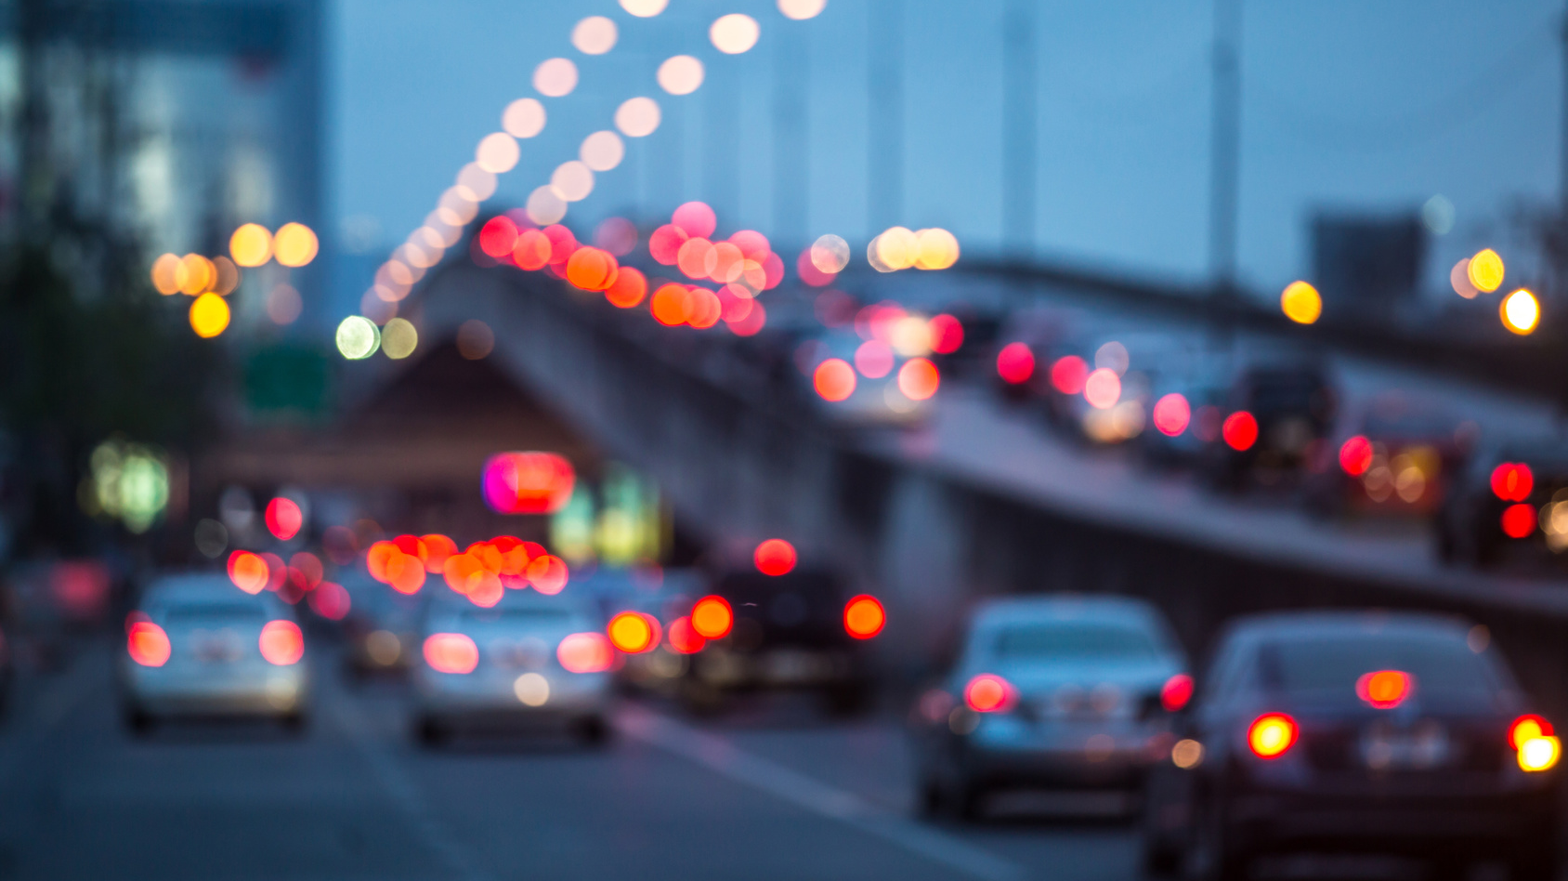
Differentiable Traffic Simulation (Student Led Lecture)
Sanghyun Son

Slide 2
Different Approaches for Traffic Simulation
Microscopic
Macroscopic
Mesoscopic
approach

Slide 3
Microscopic Approach
Each vehicle and its dynamics are modeled individually.
Enables detailed simulation, which is much more precise when simulating heavily congested conditions, or complex geometric configurations.
Use the family of car-following, lane changing, and gap acceptance models to model the individual vehicle’s behavior.
Barceló, Jaume, et al. "Microscopic traffic simulation: A tool for the design, analysis and evaluation of intelligent transport systems." Journal of intelligent and robotic systems 41.2 (2005): 173-203.
Lopez, Pablo Alvarez, et al. "Microscopic traffic simulation using sumo." 2018 21st International Conference on Intelligent Transportation Systems (ITSC). IEEE, 2018.

Slide 4
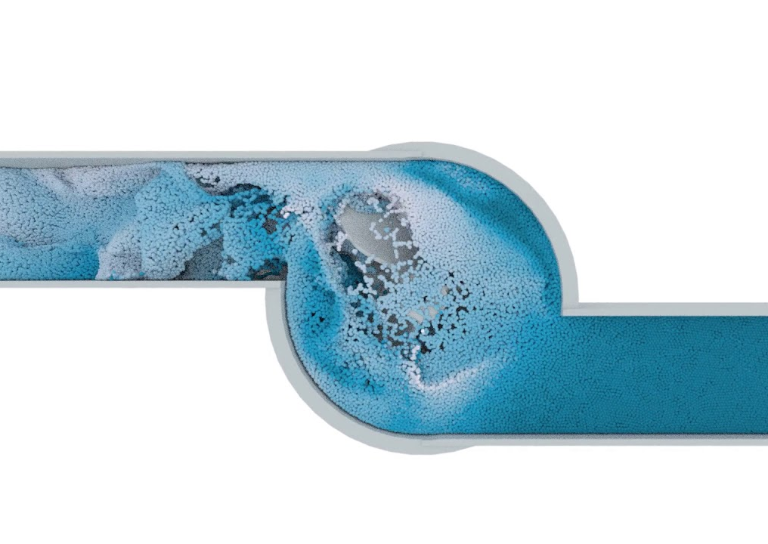
Macroscopic Approach
Represent traffic as a compressible fluid with flow characteristics, such as density and flow.
Mainly use PDE to describe the relationships between the flow characteristics and solve it to simulate the traffic.
Each vehicle can be seen as a sampled particle in the traffic flow.
Computationally efficient and scalable.
Hueper, Jan, et al. "Macroscopic modeling and simulation of freeway traffic flow." IFAC Proceedings Volumes 42.15 (2009): 112-116.

Slide 6
Macroscopic Models
Describe the state of a single lane.
The state ($q$) is defined on two different dimensions: space ($x$) and time ($t$). State = $q(x,t)$
Definition of state differs from model to model, but there are three basic terms commonly used for the definition.

Slide 7
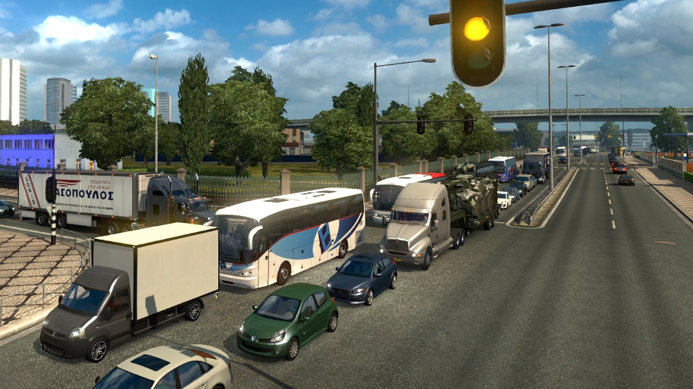
State
Density ($ρ$): Number of vehicles per unit length of the roadway.
Flux ($q$): Number of vehicles passing a reference point per unit of time.
Speed ($v$): Distance covered by a vehicle per unit time.
Notes:
Observed relationship on the right. It is fundamental because it is somehow implemented in all macroscopic traffic theories.

Slide 8
Fundamental Diagram
Starting point of the hydrodynamic (macroscopic) theory of traffic flow simulation.
The qualitative behavior of the flux-density relation.
It is fundamental in the sense that it is somehow implemented in every traffic theory.
Brenneis, A., et al. "Comparison of one and two-equation models for traffic flow calculations." Fluid Dynamics Conference. 1995.
Notes:
Observed relationship on the right. It is fundamental because it is somehow implemented in all macroscopic traffic theories.

Slide 9
History of Macroscopic Traffic Models
LWR
PW
ARZ
TWO-equation model
Add momentum equation to LWR model.
Assume isotropic relationship between vehicles.
ONE-Equation model
Based on conservation of mass:
$$\frac{∂ρ}{∂t}+\frac{∂(ρv)}{∂x}=0, v=V(ρ)$$
Two-equation model
Replace momentum with relative flow.
Assume anisotropic relationship between vehicles.
Brenneis, A., et al. "Comparison of one and two-equation models for traffic flow calculations." Fluid Dynamics Conference. 1995.
Notes:
© Copyright PresentationGO.com – The free PowerPoint and Google Slides template library

Slide 10
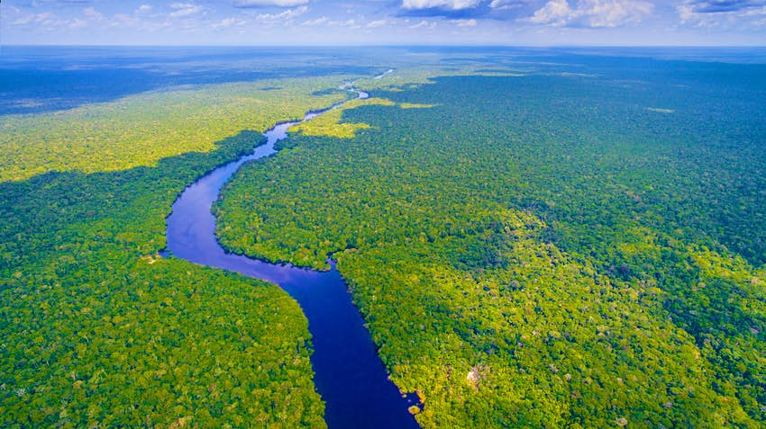
LWR Model
$$\frac{∂ρ}{∂t}+\frac{∂(ρv)}{∂x}=0, v=V(ρ)$$
Based on the conservation of mass.
Scalar, nonlinear PDE describing the motion of traffic in terms of density.
Can describe simple behaviors, such as traffic jam and shockwave.
Cannot reproduce more complex phenomena, as it only uses density to determine speed and flux. i.e. All traffic at a given density has same velocity.
Lighthill, Michael James, and Gerald Beresford Whitham. "On kinematic waves II. A theory of traffic flow on long crowded roads." Proceedings of the Royal Society of London. Series A. Mathematical and Physical Sciences 229.1178 (1955): 317-345

Slide 11
PW Model
$$\frac{∂ρ}{∂t}+\frac{∂(ρv)}{∂x}=0,$$
$$\frac{∂v}{∂t}+v\frac{∂v}{∂x}=−\frac{V−V\left(ρ\right)}{τ_{0}}−\frac{{c_{0}}^{2}}{ρ}\frac{∂ρ}{∂x}$$
Direct application of gas dynamics model.
Added momentum equation to LWR model.
$τ_{0}$ denotes the relaxation term, and ${c_{0}}^{2}$ denotes a parameter related to driver anticipation.
Can describe more complex behaviors than LWR model.
Can give non-realistic results, such as negative speed, because it does not modify isotropic nature of gas particles. i.e. Vehicles are more affected by other vehicles in front of them than those behind them.
Payne, Harold J. "Model of freeway traffic and control." Mathematical Model of Public System (1971): 51-61.

Slide 12
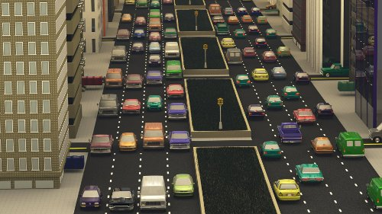
ARZ Model
$$\frac{∂ρ}{∂t}+\frac{∂(ρv)}{∂x}=0,$$
$$\frac{∂(v−V\left(ρ\right))}{∂t}+v\frac{∂(v−V\left(ρ\right))}{∂x}=−\frac{v−V\left(ρ\right)}{τ_{0}}$$
Modify momentum equation to eliminate non-realistic behaviors of PW model.
Correct anisotropic behavior of vehicles.
When written in conservative form, mass and relative flow are conserved.
Considered to be the most widely used macroscopic traffic model and has many extensions.
Still has some limitations, such as heavy reliance on initial condition in accelerating a vehicle.
Aw, A. A. T. M., and Michel Rascle. "Resurrection of" second order" models of traffic flow." SIAM journal on applied mathematics 60.3 (2000): 916-938.

Slide 13
Related Work (1)
Sewall, Jason, et al. "Continuum traffic simulation."
Computer Graphics Forum. Vol. 29. No. 2.
Oxford, UK: Blackwell Publishing Ltd, 2010.

Slide 14
ARZ Model: Conservative Form
State of a lane is defined as
$$q(x, t)= \left({ρ(x, t) \atop y(x, t)}\right)$$
$ρ$ = Density (≒ Mass)
$y$ = Relative flow (≒ Momentum)
Sewall, Jason, et al. "Continuum traffic simulation." Computer Graphics Forum. Vol. 29. No. 2. Oxford, UK: Blackwell Publishing Ltd, 2010.

Slide 15
ARZ Model: Conservative Form
$$q_{t}+ {f(q)}_{x}=0$$
$f\left(q\right)=uq$ = Flux Function
States that density and relative flow is conserved across the entire lane.

Slide 16
Solution: Finite Volume Method

Slide 17
Solution: Finite Volume Method
$$q_{0}$$
$$q_{1}$$
$$q_{2}$$
$$q_{3}$$
$$q_{4}$$
Divide the lane into multiple cells, and store $q$ state values for each of them.

Slide 18
Solution: Finite Volume Method
$$t=T$$
$$⋮$$
States of a later time step depend on the previous states. The update amount is determined by the flux function.
$$t=1$$
$$t=0$$
Leveque, Finite Volume Methods for Hyperbolic Problems, 2002

Slide 19
Solution: Finite Volume Method
$$t=1$$
? | ?
Waves. Slope equals to speed.
$$t=0$$
ARZ system is a hyperbolic PDE, which admits wave analysis.
The discontinuity at the previous step is propagated in the form of waves to the next time step.
The “speeds” of the two waves are determined by two eigenvalues of the matrix $A$, which represents the flux function. i.e. ${f(q)}_{x}=Aq_{x}.$
The states are conserved as far as it does not cross the wave. However, when it crosses the wave, state value changes and the amounts of change are determined by the two eigenvectors of the matrix $A.$
Leveque, Finite Volume Methods for Hyperbolic Problems, 2002

Slide 20
Solution: Finite Volume Method
$$t=1$$
? | ?
Difference is eigenvector of $A$.
$$t=0$$
The discontinuity at the previous step is propagated in the form of waves to the next time step.
The “speed” of the wave is determined by the eigenvalues of the matrix $A$, which represents the flux function. i.e. ${f(q)}_{x}=Aq_{x}.$
The states are conserved as far as it does not cross the wave. However, when it crosses the wave, state value changes and the amount of change is determined by the eigenvectors of the matrix $A.$
Leveque, Finite Volume Methods for Hyperbolic Problems, 2002

Slide 21
Solution: Finite Volume Method
$$t=1$$
$$t=0$$
By identifying the properties of the waves, we can identify the contribution of state values from the last time step.
Aggregate the different state values and average them to compute state values of next time step.
Since eigenvalues and eigenvectors of the matrix $A$ determine the properties of the waves, and the matrix $A$ is determined by the state values from the last time step in differentiable way, we can differentiate this whole process of solving hyperbolic PDE system.
Leveque, Finite Volume Methods for Hyperbolic Problems, 2002

Slide 22
Forward Simulation: Single Vehicle
Based on the FVM solution, we can run macroscopic forward traffic simulation.

Slide 23
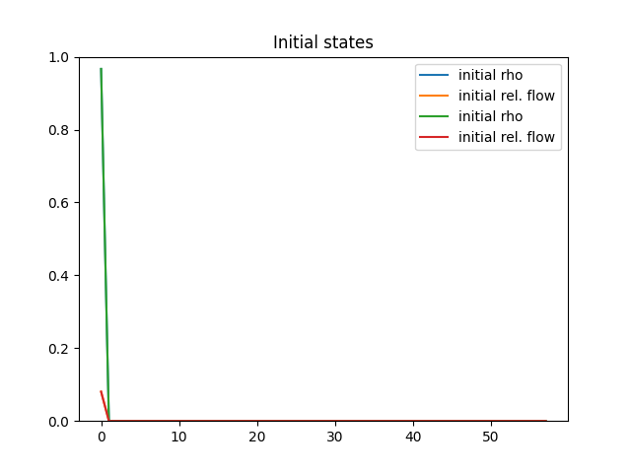
Forward Simulation: Single Vehicle

Slide 24
Forward Simulation: Multiple Vehicles

Slide 25
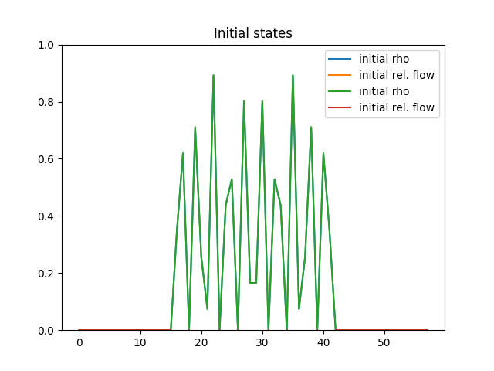
Forward Simulation: Multiple Vehicles

Slide 26
Related Work (2)
Sewall, Jason, David Wilkie, and Ming C. Lin.
"Interactive hybrid simulation of large-scale traffic."
Proceedings of the 2011 SIGGRAPH Asia Conference. 2011.

Slide 27
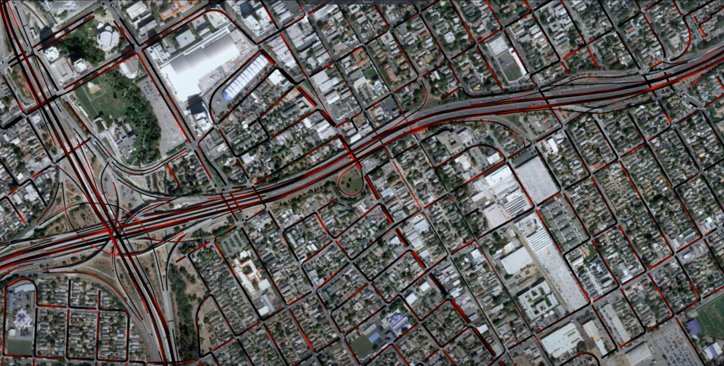
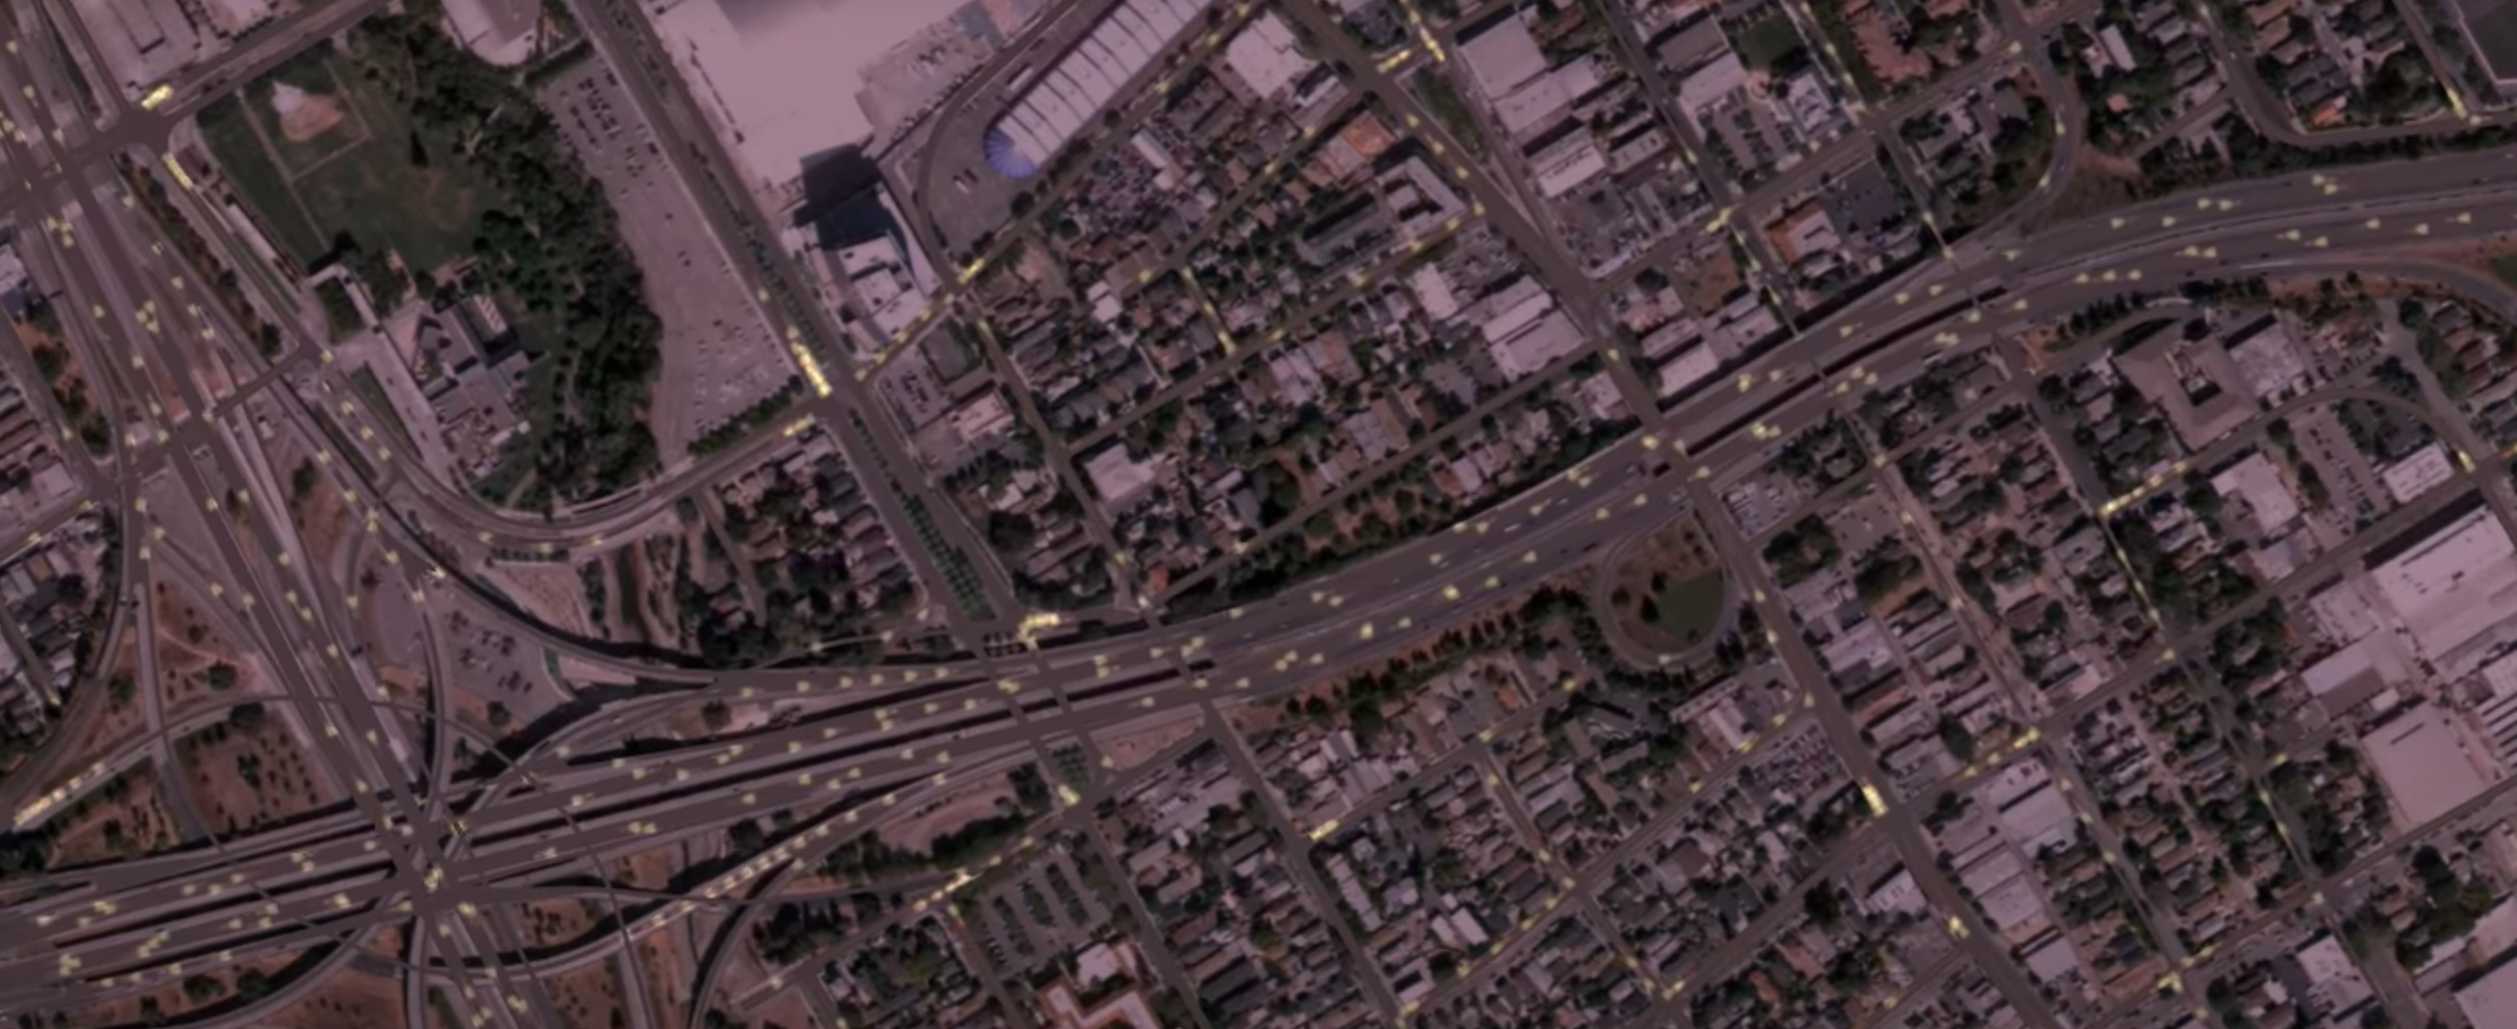
Hybrid Simulation
Mixture of macro and micro traffic simulation.
Main contribution is in suggesting a way to move back and forth between the two different approaches.
A conversion method to translate two different traffic representations.
An intermediate cell to connect two different kinds of lanes.

Slide 28
Conversion (Micro to Macro)
Just same as what we have seen before.
For given set of discrete vehicles and cells, compute portion of each cell that is occupied by the vehicles.
Intuitive, and easy.

Slide 29
Conversion (Macro to Micro)
Not very intuitive as before.
Basically, we can think this process as a sampling process, using the density of each cell as a probability to draw a discrete vehicle.
Use Poisson process to sample the vehicles based on the density distribution of the cells.

Slide 30
Poisson Process: Homogeneous
Per unit time, an event occurs at a random rate $λ$, which is constant value.
Let $x$ be a random variable that represents the time interval between two events. Then the probability density function of $x$ is defined as $p\left(x\right)= λe^{−λx}$.
If we have a uniform random variable $U$, we can represent the random variable $x$ as $\frac{−\ln{U}}{λ}$.

Slide 31
Poisson Process: Inhomogeneous
Per unit time, an event occurs at a random rate $λ(x)$, which is determined by density of a cell.
Then the probability density function of $x$ is defined as $p\left(x\right)= λ(τ+x)e^{−(Λ\left(τ+x\right)−Λ\left(τ\right))}$. Here $τ$ is the position of the last vehicle and $Λ\left(x\right)=\int_{0}^{x}{λ(t)}dt$.
If we have a uniform random variable $U$, we can represent the random variable $x$ as $Λ^{−1}\left(Λ\left(τ\right)−\ln{U}\right)−τ$.

Slide 32
Poisson Process: Inhomogeneous
Entire algorithm now looks like below. 1. Compute $Λ\left(τ\right)$ for the current $τ$ value. 2. Determine the value of uniform random variable $U$. 3. Compute $Λ\left(τ\right)−\ln{U}$, and then find a value $x$ that satisfies $Λ\left(x\right)=Λ\left(τ\right)−\ln{U}$. 4. Our next vehicle would locate at $τ+x.$
The figure shows that more vehicles are instantiated at the cells with higher density.

Slide 33
Flux Capacitors
It is not translating between different representations: it connects two different lanes with different representations.
They inserted a flux capacitor cells in between the different kinds of lanes, so that flux from macro cells become discrete vehicles and discrete vehicles from micro change to flow smoothly.

Slide 34
Thank you.

