Slide 1
Pontryagin Differentiable Programming and Multi-agent Collision Avoidance
Senthil Hariharan Arul
CMSC 838B Presentation

Slide 2
Contents
Optimal Control Problem
Pontryagin’s Maximum Principle
Pontryagin Differentiable Programming*
Multi-agent Collision Avoidance
*Jin, W., Wang, Z., Yang, Z., & Mou, S. (2020). Pontryagin Differentiable Programming: An End-to-End Learning and Control Framework. ArXiv, abs/1912.12970.

Slide 3
Optimal Control Problem

Slide 4
Optimal Control Problem
Optimal control theory deals with finding a control for a dynamical system such that an objective function is minimized.
Examples:
Send a rocket (system) to the moon with minimal fuel consumption (objective)
Robot reaching a goal position in minimum time

Slide 5
Optimal Control Problem 1/2
Consider the following system,
Dynamics: $\dot{x}=f\left(x,u\right)$,
Initial condition: $x\left(0\right){=x}_{o}$,
Action set: $u\left(t\right)∈\text{𝒰}$.
The optimal control problem is to compute an optimal trajectory for the system w.r.t a objective function, from the its initial state to its final state.

Slide 6
Optimal Control Problem 2/2
A typical objective function is minimizes the terminal cost and stage cost over a time horizon T.
The optimal control is the sequence of $u\left(t\right) ∀t∈\left[0,T\right]$ that minimizes objective $J$.
The output of OCP is the set of optimal control and optimal state over the
time horizon. $ξ=\{x_{0:T }, u_{0:T}\}$
$$J=ψ\left(x\left(T\right)\right)+\int_{0}^{T}{L\left(x\left(t\right), u\left(t\right)\right) dt}$$
Terminal Cost
Stage Cost

Slide 7
Pontryagin’s Maximum Principle

Slide 8
Pontryagin's Maximum Principle (PMP) 1/2
PMP presents a necessary condition that must hold on a optimal trajectory.
Consider a function H (Hamiltonian) which is a weighted sum of the stage cost and system dynamics.
$$H\left(x\left(t\right), u\left(t\right), λ\left(t\right), t\right)=λ^{T}\left(t\right)∗f\left(x\left(t\right),u\left(t\right)\right)+L\left(x\left(t\right),u\left(t\right)\right)$$
Here the vector $λ$ is called to Lagrange multiplier.

Slide 9
Pontryagin’s Maximum Principle (PMP) 2/2
Pontryagin’s maximum principle gives a necessary condition that optimal state trajectory $x^{∗}$, optimal control $u^{∗}$ must satisfy.
The corresponding Lagrange multiplier $λ^{∗}$ maximize the Hamiltonian, i.e.,
And the following PMP condition are satisfied,
$H\left(x^{∗}\left(t\right), u^{∗}\left(t\right), λ^{∗}\left(t\right), t\right)≥H\left(x^{∗}\left(t\right), u\left(t\right), λ^{∗}\left(t\right), t\right) ∀ t∈[0,T]$.
$\dot{x}\left(t\right)={ H}_{λ}\left(x^{∗}\left(t\right), u^{∗}\left(t\right), λ\left(t\right), t\right)$
$−\dot{λ}\left(t\right)={ H}_{x}\left(x^{∗}\left(t\right), u^{∗}\left(t\right), λ\left(t\right), t\right)$
$\frac{∂H}{∂u}=0$
$λ\left(T\right)= \frac{∂ψ}{∂x}\left(x\left(T\right)\right)$.

Slide 10
Pontryagin Differentiable Programming*
*Jin, W., Wang, Z., Yang, Z., & Mou, S. (2020). Pontryagin Differentiable Programming: An End-to-End Learning and Control Framework. ArXiv, abs/1912.12970.

Slide 11
Pontryagin Differential Programming 1/2
Consider the following system (in discrete time) $Σ(θ)$
Dynamics: $x_{t+1}=f\left(x_{t},u_{t}\right)$
Control Policy: $u_{t}=u\left(t,x_{t},θ\right)$
The control policy is parameterized by a tunable set $θ$, could be the weights of a network.
Loss function (or objective):
$$L\left(ξ_{θ}, θ\right)=\sum_{t=0}^{T−1}{c_{t}\left(x_{t}^{θ},u_{t}^{θ}\right)+l_{f}(x_{T}^{θ})}$$
Here, $c_{t}$ is instantaneous cost at state $x_{t}$, and $l_{f}$ is the terminal cost.

Slide 12
Pontryagin Differential Programming 2/2
Parameter tuning through gradient descent
$$θ_{k+1}=θ_{k}−η_{k}\frac{dL}{dθ}{\left.​\right|}_{θ_{k}}$$
We know $ξ=\{x_{0:T }^{∗}, u_{0:T}^{∗}\}$, thus the derivate of loss w.r.t $θ$ can be written as
$$\frac{dL}{dθ}{\left.​\right|}_{θ_{k}}=\frac{∂L}{∂ξ}{\left.​\right|}_{ξ_{θ_{k}}}\frac{∂ξ}{∂θ}{\left.​\right|}_{θ_{k}}+\frac{∂L}{∂θ}{\left.​\right|}_{θ_{k}}$$
In the backward pass $\frac{∂L}{∂ξ}$ and $\frac{∂L}{∂θ}$ are easily computed from the loss function. The main challenge is to compute $\frac{∂ξ}{∂θ}$.

Slide 13
Computing $\frac{∂ξ}{∂θ}$

Slide 14
Computing $\frac{∂ξ}{∂θ}$ 1/4
$\frac{∂ξ}{∂θ}$ is analytically solved using Differential PMP and auxiliary control system.
The Hamiltonian in this case is written as $H\left(t\right)=c_{t}\left(x_{t},u_{t};θ\right)+f{\left(x_{t}, u_{t};θ\right)}^{′}λ_{t+1}$
PMP conditions:
(1) $x_{t+1}^{θ}= \frac{∂H_{t}}{∂λ_{t+1}^{θ}}=f\left(x_{t}, u_{t};θ\right)$
(2) $λ_{t}^{θ}=\frac{∂H_{t}}{∂x_{t}^{θ}}$
(3) $0=\frac{∂H_{t}}{∂u_{t}^{θ}}$
(4) $λ_{T}^{θ}=\frac{∂h}{∂x_{T}^{θ}}$

Slide 15
Computing $\frac{∂ξ}{∂θ}$ 2/4
$\frac{∂ξ}{∂θ}$ is analytically solved using Differential PMP and auxiliary control system.
Differentiating PMP conditions w.r.t $θ$:
(1) $\frac{∂x_{t+1}^{θ}}{∂θ}=F_{t}\frac{∂x_{t}^{θ}}{∂θ}+G_{t}\frac{∂u_{t}^{θ}}{∂θ}+E_{t}$
(2) $\frac{∂λ_{t}^{θ}}{∂θ}=H_{t}^{xx}\frac{∂x_{t}^{θ}}{∂θ}+H_{t}^{xu}\frac{∂u_{t}^{θ}}{∂θ}+F^{′}\frac{∂λ_{t+1}^{θ}}{∂θ}+H_{t}^{xe}$
(3) $0=H_{t}^{ux}\frac{∂x_{t}^{θ}}{∂θ}+H_{t}^{uu}\frac{∂u_{t}^{θ}}{∂θ}+G_{t}^{′}\frac{∂λ_{t+1}^{θ}}{∂θ}+H_{t}^{ue}$
(4) $\frac{∂λ_{T}^{θ}}{∂θ}=H_{T}^{xx}\frac{∂x_{T}^{θ}}{∂θ}+H_{T}^{xe}$

Slide 16
Computing $\frac{∂ξ}{∂θ}$ 3/4
We observe that the differential PMP equation are similar to the original PMP equations.
Thus, the can be assumed to be the PDP equations for an auxiliary control system given by
$$X_{t}=\frac{∂x_{t}}{∂θ} and U_{t}=\frac{∂u_{t}}{∂θ}$$

Slide 17
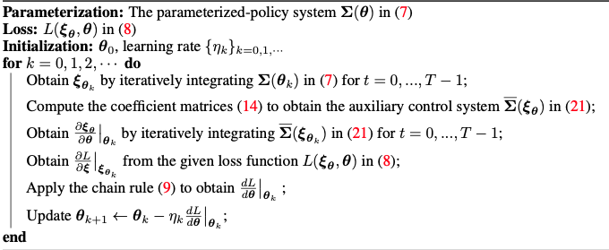
Computing $\frac{∂ξ}{∂θ}$ 4/4
$\frac{∂ξ}{∂θ}$ can be computed by iteratively integrating and is the PMP solution to the auxiliary control system.
Illustration of the parameter tuning through analytical gradients and auxiliary control system
Algorithm

Slide 18
Results
Rocket landing as an optimal control problem

Slide 19
Collision Avoidance

Slide 20
Collision Avoidance 1/2
The formulation for multi-agent collision avoidance is similar to OCP with an addition “collision avoidance” constraint.
Objective Function: $L\left(ξ_{θ}, θ\right)=\sum_{t=0}^{T−1}{c_{t}\left(x_{i,t}^{θ},u_{i,t}^{θ}\right)+l_{f}(x_{T}^{θ})}$
Dynamics: $x_{i,t+1}=f\left(x_{i,t},u_{i.t}\right)$
Collision Avoidance: $A\left(x_{i,t}\right)∩A\left(x_{j,t}\right)=∅$
Control Policy: $u_{t}=u\left(t,x_{t},θ\right)$
i.e. the agents boundary do not overlap at any time instant

Slide 21
Collision Avoidance 2/2
Prior Work
Two popular decentralized collision avoidance methods
Optimal Reciprocal Collision Avoidance (ORCA)
Buffered Voronoi Cell (BVC)
Note: ORCA and BVC are navigation methods based on computational geometry. They are introduced as my proposed final project would be compared with them.

Slide 22
ORCA*
For any two agent A and B:
Constructs a set of relative velocities that can cause collision between the agents
Assumes each agent takes equal responsibility to avoid collision
Considers a single integrator dynamics for each agent (Velocity control)
A convex subset of collision-free relative velocities are used to compute collision-free velocity
*Van Den Berg, J., Guy, S. J., Lin, M., & Manocha, D. (2011). Reciprocal n-body collision avoidance. In Robotics research(pp. 3-19). Springer, Berlin, Heidelberg.

Slide 23
ORCA
Consider 2 circular agents A and B,
Positions: $P_{a}, P_{b}$
Velocities: $V_{a}, V_{b}$
Bounding Radius: $r_{a}, r_{b}$
Collision-Free Condition
$$\left\|P_{ab}+V_{ab}t\right\|<r_{ab}$$
Rearranging, we get
$$\left\|V_{ab}−(−\frac{P_{ab}}{t})\right\|<\frac{r_{ab}}{t}$$
Which is the equation for a disc/circle with center at $−\frac{P_{ab}}{t}$ and radius $\frac{r_{ab}}{t}$
Then, relative position and velocity are given by
Relative Position: $P_{ab}=P_{a}−P_{b}$
Relative Velocity: $V_{ab}=V_{a}−V_{b}$
Sum of Radii: $r_{ab}=r_{a}+r_{b}$

Slide 24
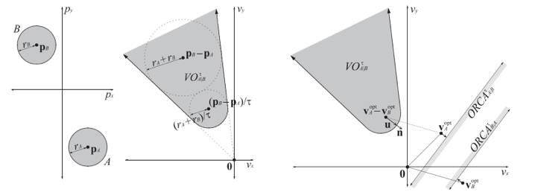
ORCA
Image Source: ORCA GAMMA UNC http://gamma.cs.unc.edu/ORCA/

Slide 25
Buffered Voronoi Cell*
Each agent continually computes its buffered voronoi cell (BVC)
Plans a path within BVC
The path can be planned using the OCP method presented previously
Guarantees collision avoidance for single integrator dynamics
Buffered?
The voronoi region shrunken by a distance equal to agent radius
A representative scenario with 5 agents
*Zhou, D., Wang, Z., Bandyopadhyay, S., & Schwager, M. (2017). Fast, on-line collision avoidance for dynamic vehicles using buffered voronoi cells. IEEE Robotics and Automation Letters, 2(2), 1047-1054.

Slide 26
Thank you Questions?

