Slide 1
Cloth Parameter Estimation
Why and How
Will Smith Chambers, Oct 19, 2021

Slide 2
Why do we care about Parameter Estimation?

Slide 3
Virtual Shopping
VITON: An Image-Based Virtual Try-on Network Xinton Han, Zuxuan Wu

Slide 4
Virtual Reality
uswitch.com

Slide 5
Medical simulations
mdanderson.org

Slide 6
Where are we today?

Slide 7
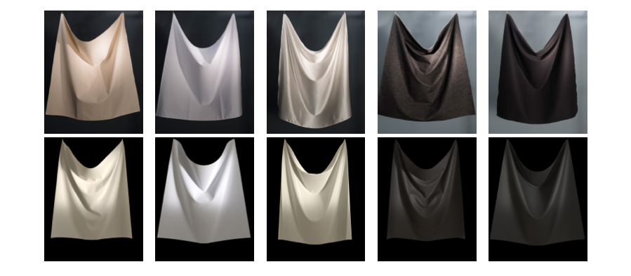
Data Driven, non ML
Clyde, Teran, Tamstorf 2017
Doesn’t generalize very well

Slide 8
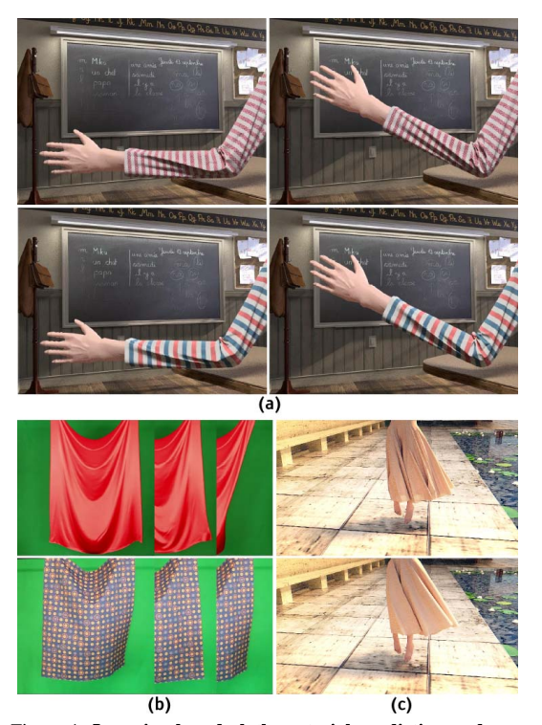
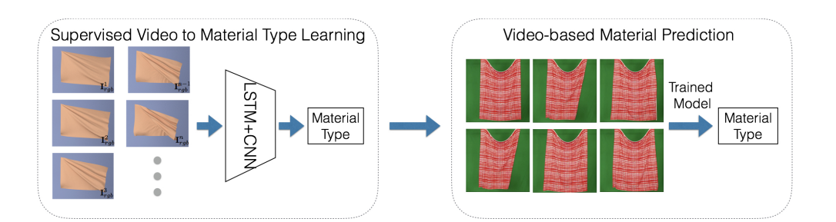
Neural Net Methods
Very reliant on Pixel data, tricky to get good data
Shan Yang, Junbang Liang, Ming C Lin 2017

Slide 9
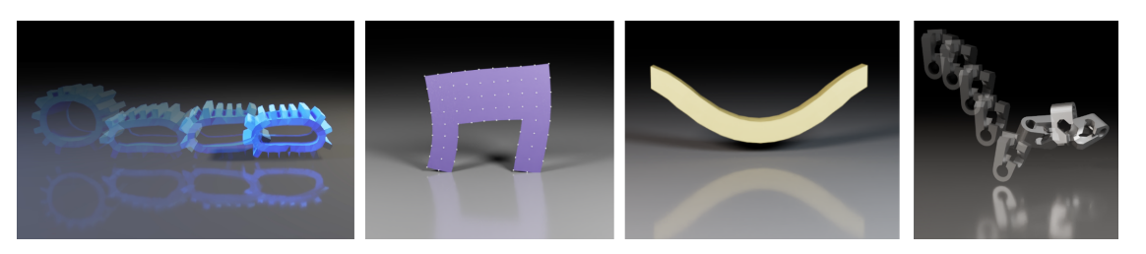
Differentiable Physics Simulation
Murthy, Macklin, Golemo, Voleti, Petrini, Weiss, Considine, Parent-Levesque, Xie, Erlebne, Paull, Shkurti, Nowrousesahrai, Fidler - Differentiable for system identification and visuomotor control

Slide 10
My contribution:
Better Differentiable Rendering

Slide 11
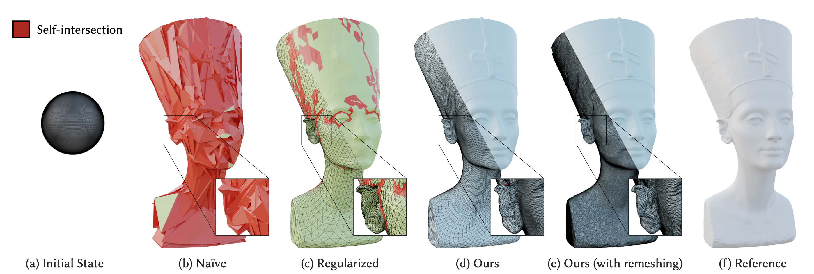
Optimize vertex and material properties to look right.
Baptiste Nicolet, Alec Jacobson, Wenzel Jakob, 2021

Slide 12
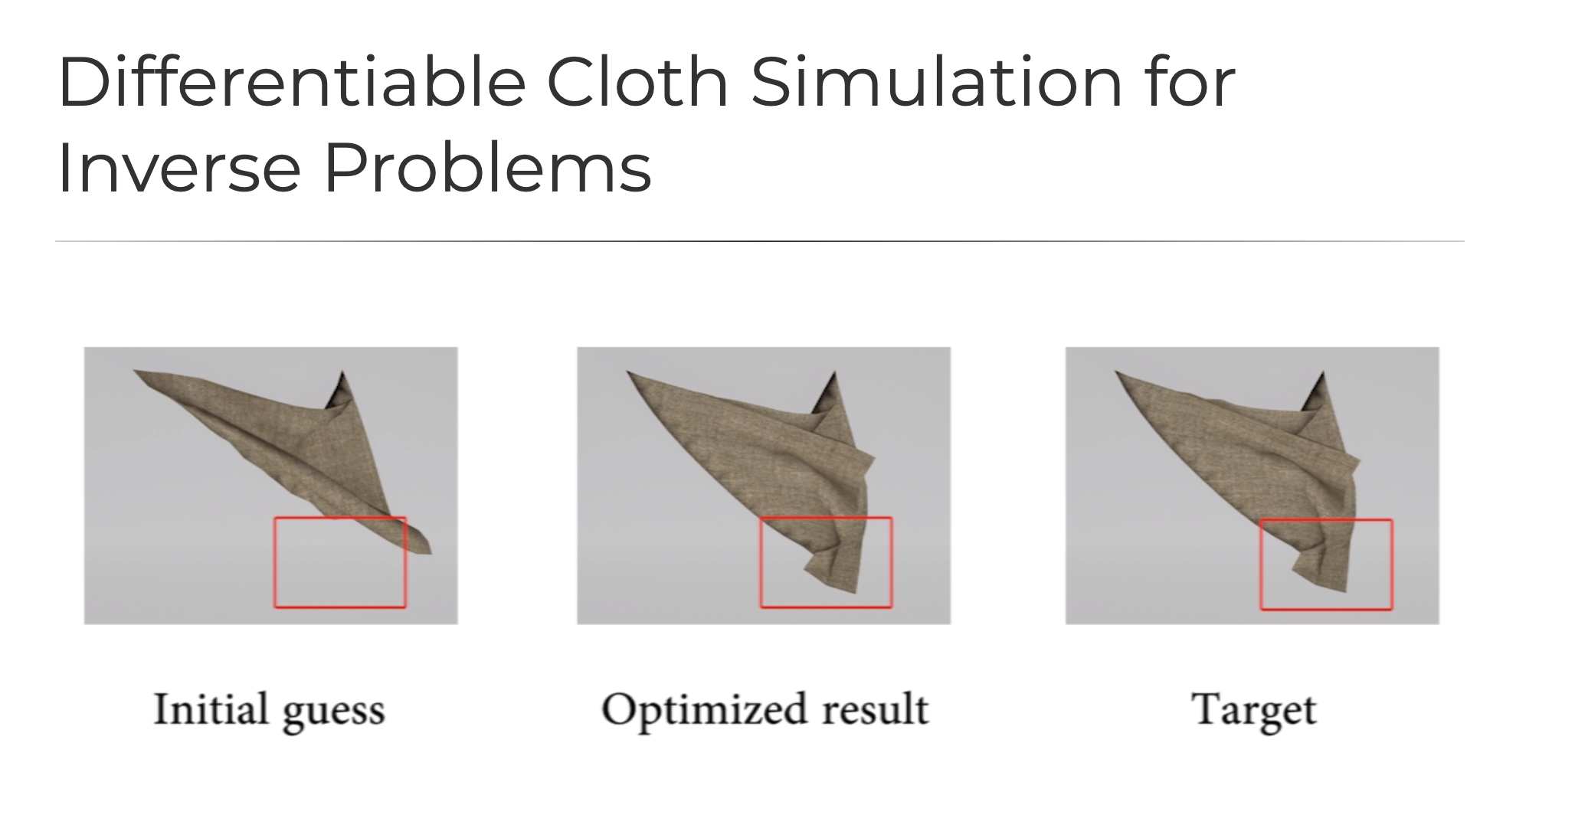
Differentiable cloth simulation
Junbang Liang, Ming C Lin, Vladlen Koltun

Slide 13
Challenges
Implement high detail mesh recovery inverse renderer
Use Differentiable cloth simulator to solve for material parameters

Slide 14
Backup Plan: Implement just parameter estimation from meshes

Slide 15
Nov 20th goal
Implement Parameter estimation from 3D meshes
Have plausible implementation trajectory for inverse renderer

Slide 16
Dec 10th goal
Have mesh data recovered from inverse renderer flowing into parameter finding pipeline

Slide 17
Long term: Optimize/expand
First: Achieve end to end cloth parameter finding solution
Generalize to soft bodies
Generalize to real world video
Generalize to more difficult real-world media (smoke)

Slide 18
Related Work
David Clyde, Joseph Teran, Rasmus Tamstorf 2017 - Modeling and Data Driven Parameter Estimation for Woven Fabrics
Shan Yang, Junbang Liang, Ming C Lin 2017 - Learning Based Cloth Material Recovery From Video
Junbang Liang, Ming C Lin, Vladlen Koltun 2019 - Differentiable Cloth Simulation for Inverse Problems
Baptiste Nicolet, Alec Jacobson, Wenzel Jakob, 2021 - Large Steps in Inverse Rendering of Geometry
Rama Krishna Kandukuri, Jan ZAchterhold, Michael Moller, Jorg Stuckler - Learning to Identify Physical Parameters from Video Using Differentiable Physics
Miguel Jaques, Michael Burke, Timothy Hospedales - Physics as inverse Graphics
Murthy, Macklin, Golemo, Voleti, Petrini, Weiss, Considine, Parent-Levesque, Xie, Erlebne, Paull, Shkurti, Nowrousesahrai, Fidler - Differentiable for system identification and visuomotor control

Slide 19
Done, questions?

