Slide 1

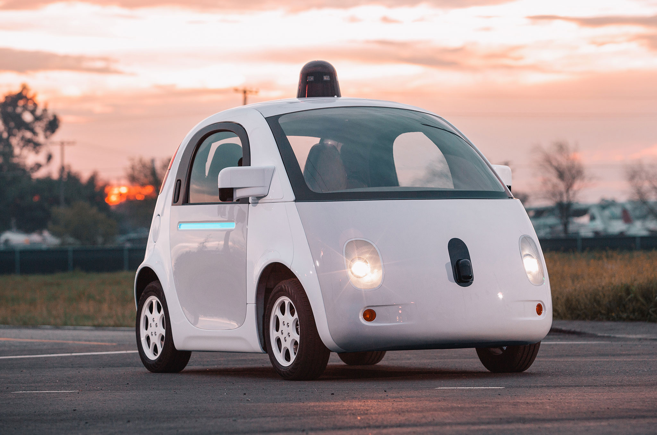

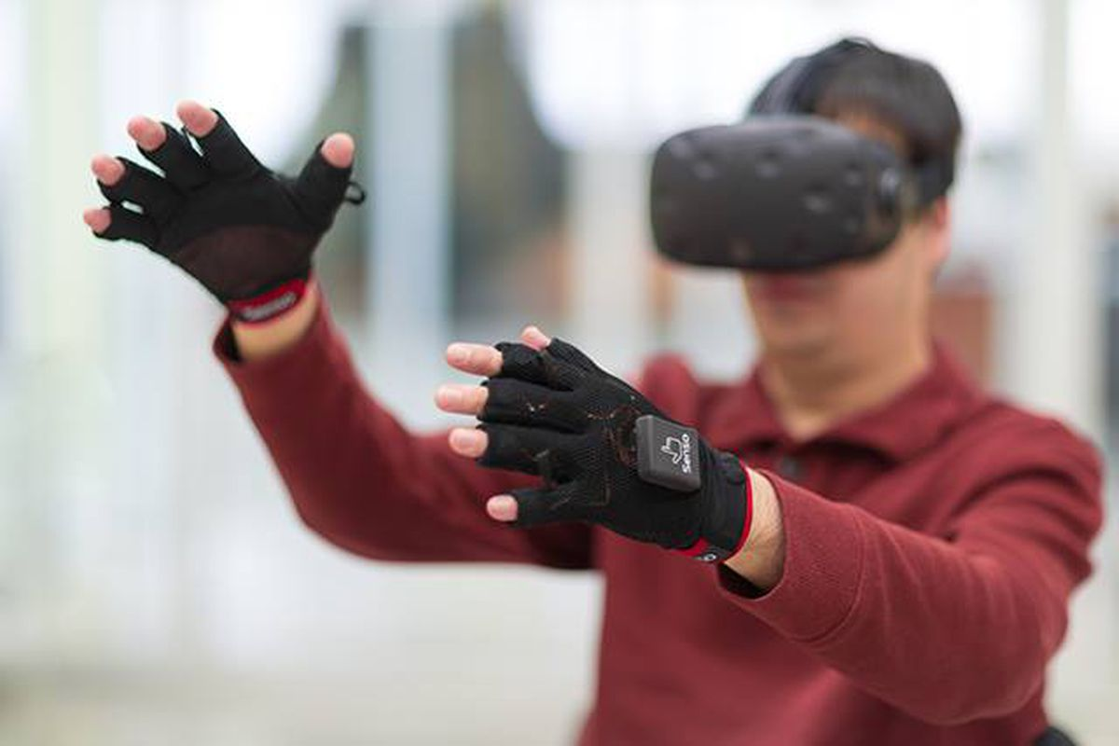

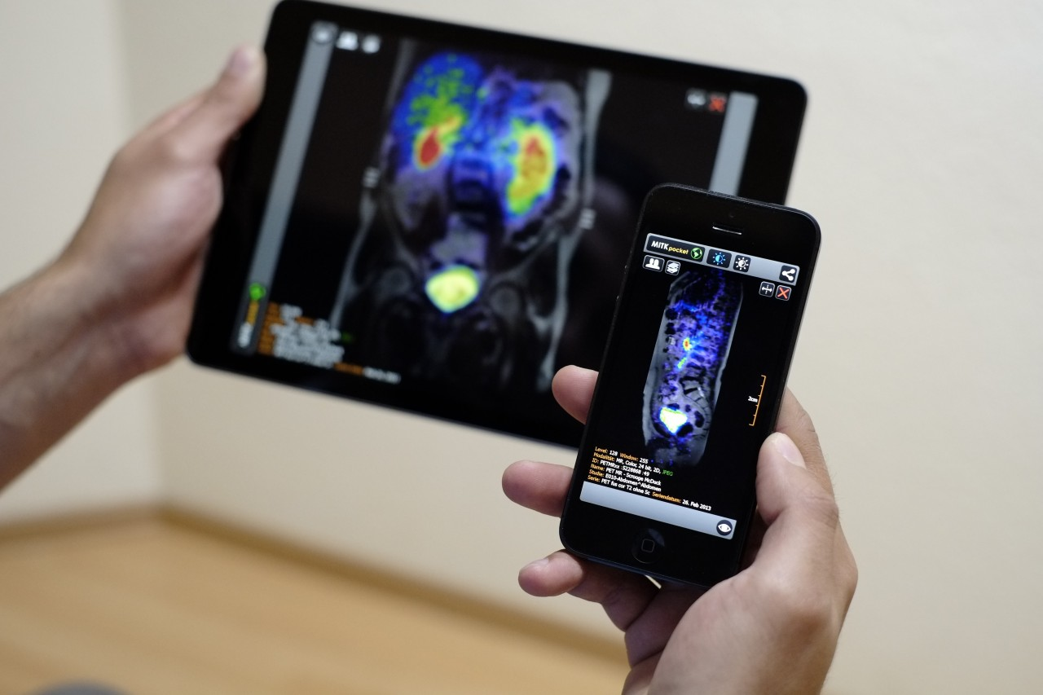
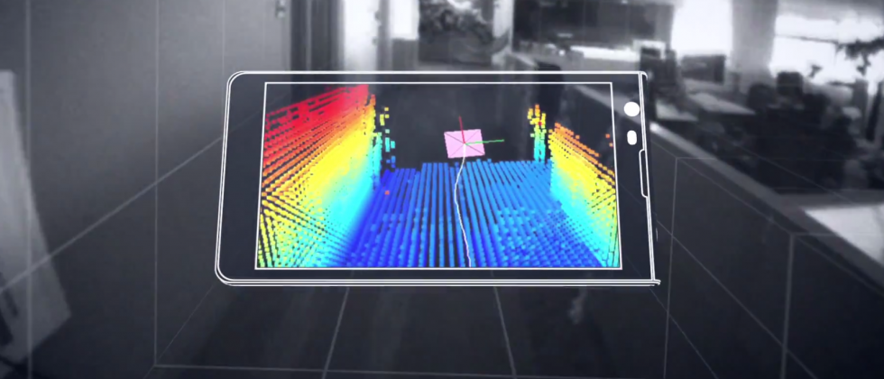
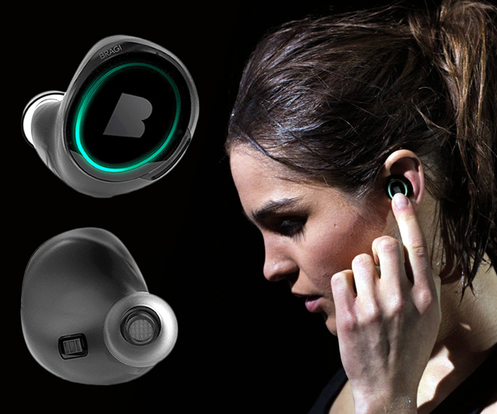
Wireless and Mobile Systems
for the IoT
CMSC 715 : Fall 2022
Lecture 1.2: Mathematical Foundations
for Signal Analysis
Nirupam Roy
Tu-Th 12:30-1:45pm
CSI 3120

Slide 2
Time and Frequency domain view

Slide 3
The concept of the Fourier series
Amplitude
Time (sec)
0.00
0.25
0.50
0.75
1.00
1.25
Amplitude
Time (sec)
0.00
0.25
0.50
0.75
1.00
1.25

Slide 4
Frequency components change over time
Amplitude
Time (sec)
0.00
0.25
0.50
0.75
1.00
1.25
FFT
A set of
frequencies

Slide 5
Frequency components change over time
Amplitude
Time (sec)
0.00
0.25
0.50
0.75
1.00
1.25
FFT

Slide 6
Frequency components change over time
Amplitude
Time (sec)
0.00
0.25
0.50
0.75
1.00
1.25
FFT
FFT

Slide 7
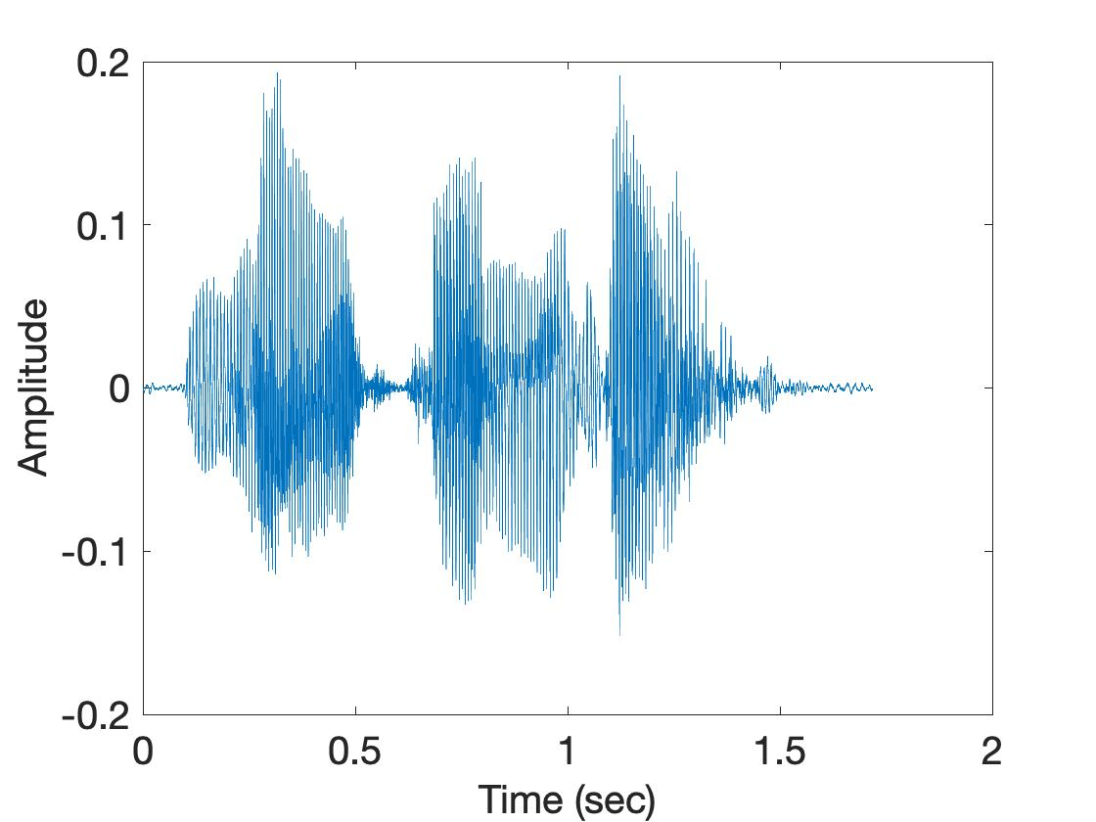
Frequency components change over time
U
M
D

Slide 8
Spectrogram
U
M
D
[
[
[
FFT of overlapping windows
of samples
(Spectrogram)
[
FFT
FFT
FFT
FFT

Slide 9
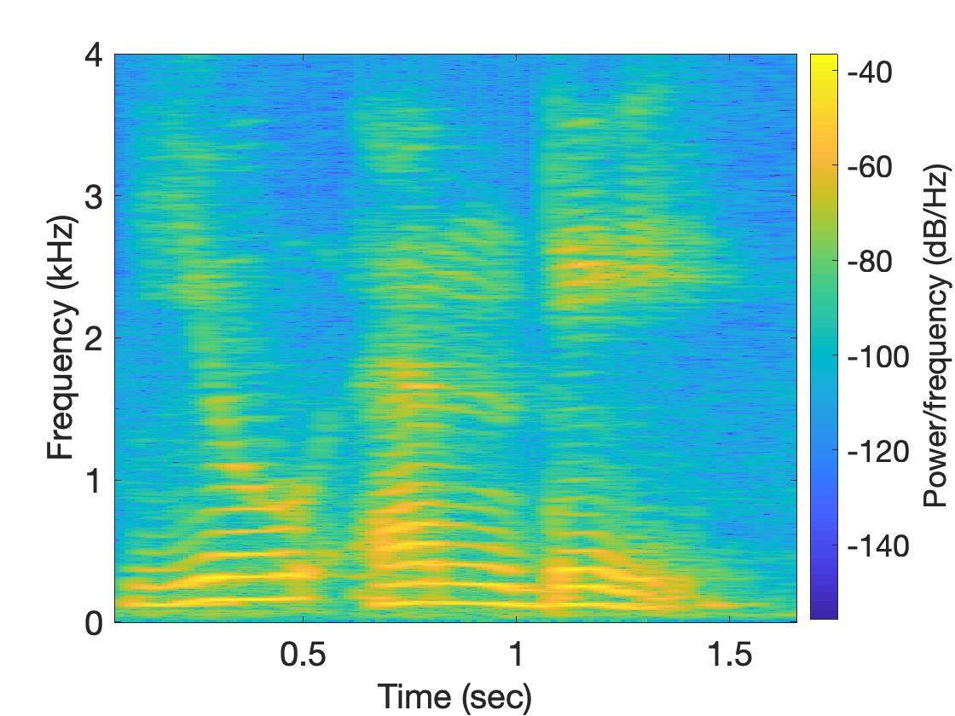
Spectrogram
U
M
D

Slide 10
Why do we need
the frequency domain view?

Slide 11

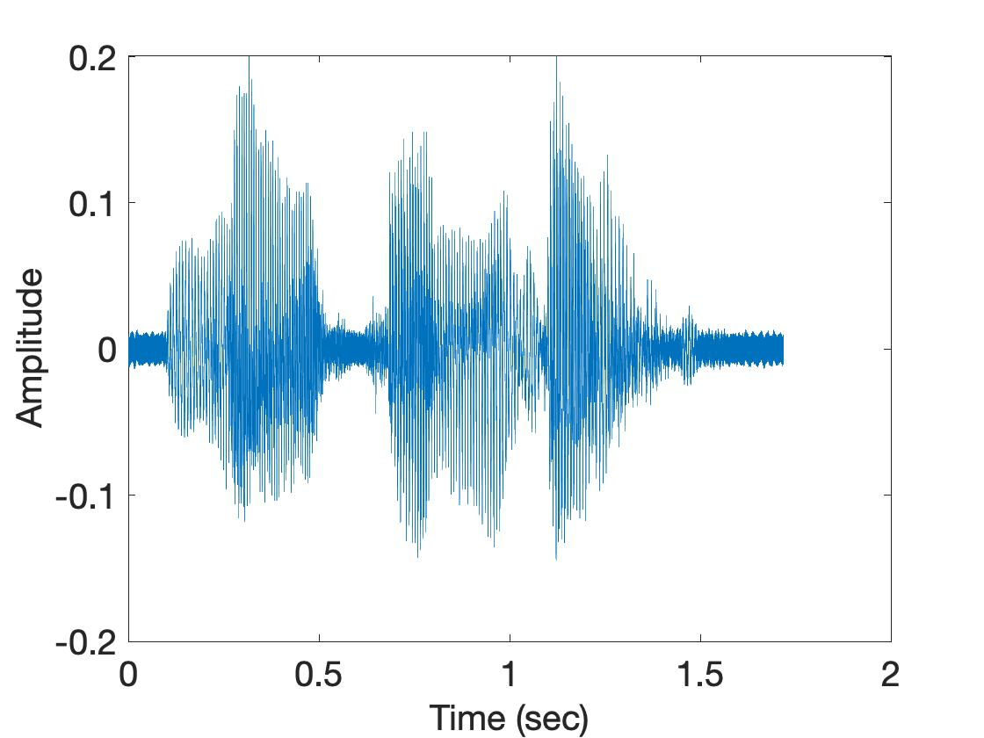
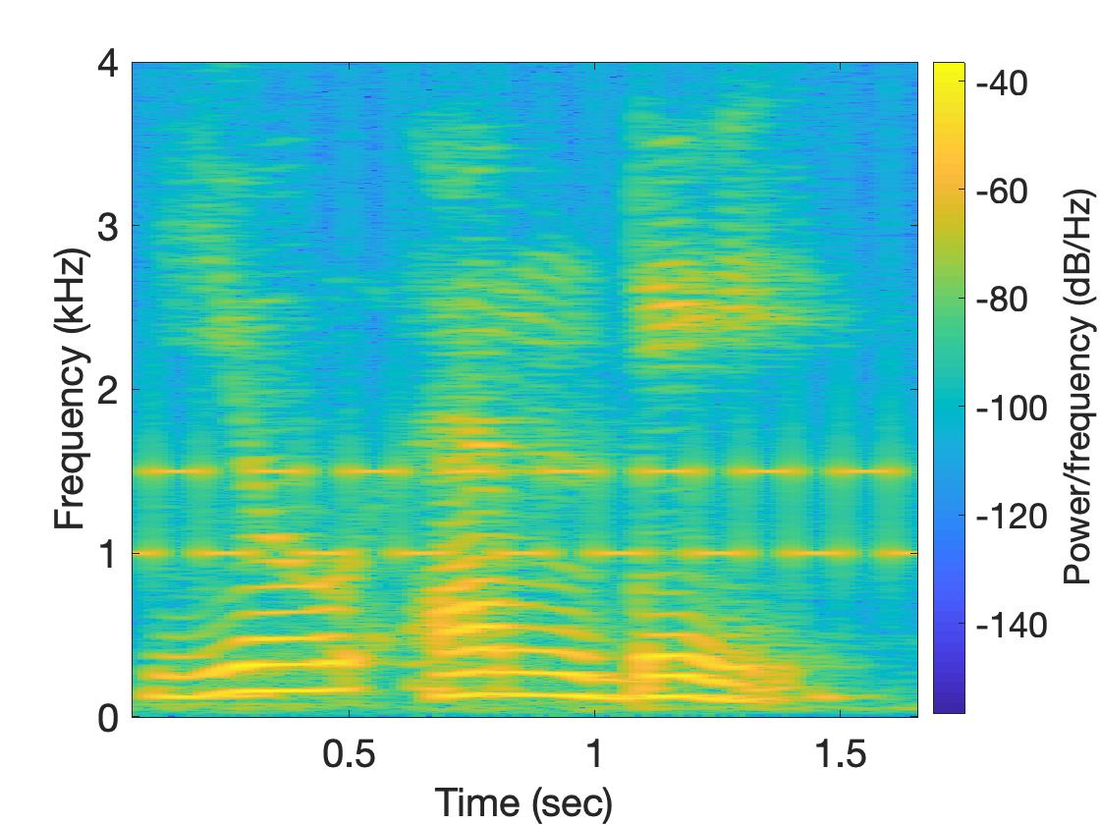
Why do we need the frequency domain view?
Sound
Sound + Noise
Time
domain
Freq.
domain

Slide 12
Analog
Digital
Physical signal
(voice)
Spectrogram plot
on computer
FFT
Time varying voltage
signal
A collection of numbers

Slide 13
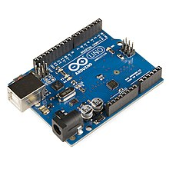
SENSOR
Analog
Analog
A structure or material
That reacts to the physical phenomenon
A circuit that converts the reaction to measurable electrical signal (e.g. voltage)
A physical phenomenon
We want to measure
Interpretation of the signal, storing the data
Digital

Slide 14
Analog
Digital
Physical signal
(voice)
Spectrogram plot
on computer
FFT
Time varying voltage
signal
A collection of numbers
?

Slide 15
Analog
Digital
Physical signal
(voice)
Spectrogram plot
on computer
FFT
Time varying voltage
signal
A collection of numbers
ADC
Analog-to-Digital Converter

Slide 16
Sampling theorem
Amplitude
Time (sec)
0.00
0.25
0.50
0.75
1.00
1.25

Slide 17
Sampling theorem
Amplitude
Time (sec)
0.00
0.25
0.50
0.75
1.00
1.25
Amplitude
Time (sec)
0.00
0.25
0.50
0.75
1.00
1.25
[ 0.34 0.22 0.09 0.21 0.30 0.08 0.09 ]

Slide 18
Sampling theorem
Amplitude
Time (sec)
0.00
0.25
0.50
0.75
1.00
1.25
T = Sampling interval
f_{s}= 1/T = Sample rate (or sampling frequency)
Clock

Slide 19
1-dimensional sampling

Slide 20
1-dimensional sampling
Y
V_{y}
V_{x}
X

Slide 21
1-dimensional sampling
2-dimensional sampling

Slide 22
1-dimensional sampling
2-dimensional sampling
3-dimensional sampling

Slide 23
Sampling theorem
Amplitude
Time (sec)
0.00
0.25
0.50
0.75
1.00
1.25
Amplitude
Time (sec)
0.00
0.25
0.50
0.75
1.00
1.25

Slide 24
Sampling theorem
Amplitude
Time (sec)
0.00
0.25
0.50
0.75
1.00
1.25
Aliasing: Two signals become indistinguishable
after sampling
Amplitude
Time (sec)
0.00
0.25
0.50
0.75
1.00
1.25

Slide 25
Aliasing
Amplitude
Time (sec)
0.00
0.25
0.50
0.75
1.00
1.25
Amplitude
Time (sec)
0.00
0.25
0.50
0.75
1.00
1.25

Slide 26
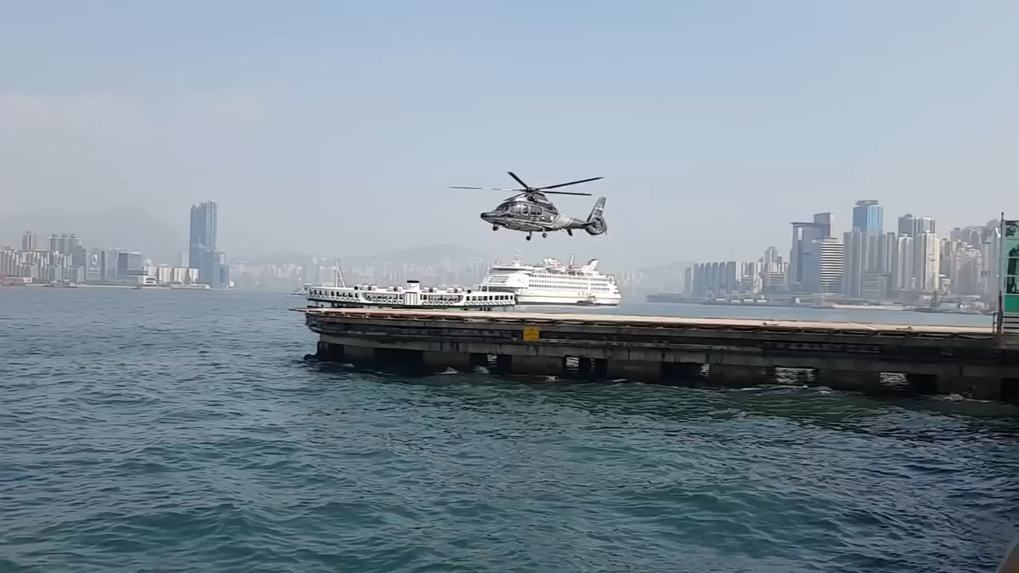
Aliasing

Slide 27
How to find a good sample rate?

Slide 28
How to find a good sample rate?
Nyquist-Shannon sampling theorem:
In order to uniquely represent a signal F(t) by a set of samples, the sampling rate must be more than twice the highest frequency component present in F(t).
If sample rate is f_{s} and maximum frequency we want to
record is f_{max} , then
f_{s} > 2f_{max}

Slide 29
Amplitude
Time (sec)
0.00
0.25
0.50
0.75
1.00
1.25
Nyquist frequency = Maximum alias-free frequency for a given sample rate.
Nyquist rate = Lower bound of sample rate for a signal

Slide 30
Aliasing
f_{max} = 12 Hz
Amplitude
0
4
8
12
16
Frequency (Hz)

Slide 31
Commonly, the maximum frequency in human voice is 4 kHz, what sample rate will you use in your audio recorder?
Is there any limit on the maximum sample rate you can use?

Slide 32
Mathematical model for a signal

Slide 33
Mathematical abstractions

Slide 34
Mathematical abstractions
… we use them everyday to
understand our world

Slide 35
A few examples
What is a number?
What is a negative number?
What do they model?
Any other example?

Slide 36
Model for a signal (frequency, amplitude, and phase)

Slide 37


Model for a signal (frequency, amplitude, and phase)
$$A . sin⁡(θ)$$
$$A . cos⁡(θ)$$

Slide 38


Model for a signal (frequency, amplitude, and phase)
$$A . sin⁡(θ)$$
$$A . cos⁡(θ)$$
Why not use the sinusoid as the model ?

Slide 39
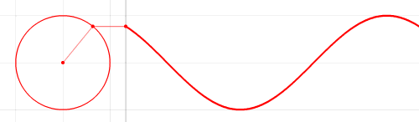

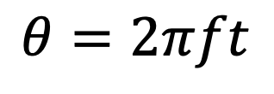



Model for a signal (frequency, amplitude, and phase)
1
$$sin⁡(θ)$$
𝚹
$$cos⁡(θ)$$
$$f cycles per second$$
$$θ=2πft$$
$$2π angles per cycle$$

Slide 40





Frequency, Amplitude, and Phase
$$2π angles per cycle$$
$$f cycles per second$$
A
𝚹
Phase
time = t second
$$=$$
$$A . sin⁡(θ)$$
$$=$$
$$A . sin⁡(2πft)$$
$$A . sin⁡(2πft+φ)$$
-- with initial/additional phase ϕ

Slide 41
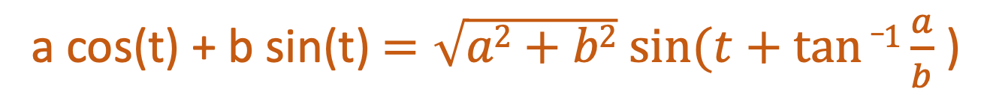
Why do we need both Sine and Cosine ?
A sine function with phase shift can be written as a weighted combination of sine and cosine:
a cos(t) + b sin(t) $=\sqrt{a2+b2} sin⁡(t+tan⁡_1\frac{a}{b}$ )

Slide 42
Model for a signal (frequency, amplitude, and phase)
1
$$sin⁡(θ)$$
𝚹
$$cos⁡(θ)$$
How can we incorporate both Sine and Cosine in the equation?

Slide 43

Model for a signal (frequency, amplitude, and phase)
1
$$sin⁡(θ)$$
𝚹
$$cos⁡(θ)$$
1.
$$\cos\left(θ\right)+sin⁡(θ)$$

Slide 44

Model for a signal (frequency, amplitude, and phase)
1
$$sin⁡(θ)$$
𝚹
$$cos⁡(θ)$$
1.
$$\cos\left(θ\right)+sin⁡(θ)$$
2.
$$<cos\left(θ\right), \sin\left(θ\right)>$$

Slide 45

Model for a signal (frequency, amplitude, and phase)
1
$$sin⁡(θ)$$
𝚹
$$cos⁡(θ)$$
1.
$$\cos\left(θ\right)+sin⁡(θ)$$
2.
$$<cos\left(θ\right), \sin\left(θ\right)>$$
3.
$$\cos\left(θ\right)+j \sin\left(θ\right)$$

Slide 46
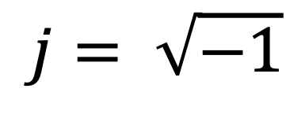
Complex numbers
Imaginary
$$j= \sqrt{−1}$$

Slide 47
Complex numbers

Slide 48
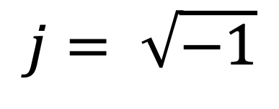
Complex numbers
Imaginary
$$j= \sqrt{−1}$$

Slide 49
Complex numbers and Natural exponential
j
j

Slide 50
Complex numbers and Natural exponential
…

Slide 51
Complex numbers and Natural exponential
…
…

Slide 52
Complex numbers and Natural exponential
…
…
…

Slide 53
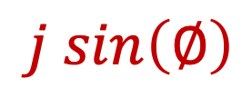

Complex numbers and Natural exponential
…
…
…
$$\cos\left(∅\right)$$
$$j sin\left(∅\right)$$
Euler’s formula

Slide 54

Complex numbers and Natural exponential
$$e^{j∅}=\cos{∅+j sin∅}$$

Slide 55
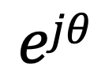
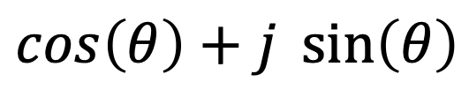

Model for a signal (frequency, amplitude, and phase)
$$\cos\left(θ\right)+j \sin\left(θ\right)$$
$$=$$
$$ejθ$$

Slide 56
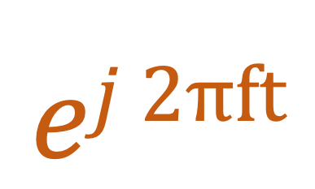

Model for a signal (frequency, amplitude, and phase)
$$ej 2πft$$
$$\cos\left(θ\right)+j \sin\left(θ\right)$$
$$=$$
$$ejθ$$
$$=$$

Slide 57
Model for a signal (frequency, amplitude, and phase)
$$ej 2πft$$
$$\cos\left(θ\right)+j \sin\left(θ\right)$$
$$=$$
$$ejθ$$
$$=$$

Slide 58
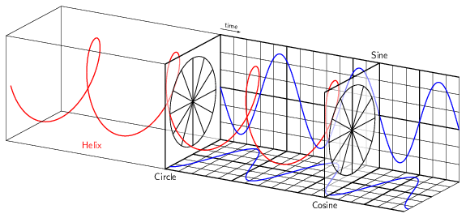
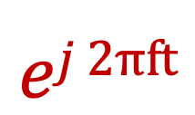
Model for a signal (frequency, amplitude, and phase)
$$ej 2πft$$

Slide 59
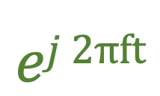
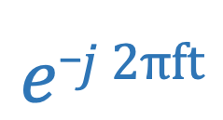
Model for a signal (frequency, amplitude, and phase)
$$ej 2πft$$
$$e_j 2πft$$

Slide 60

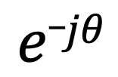


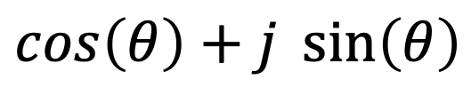

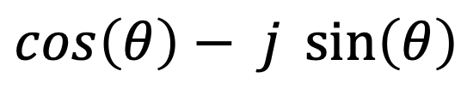

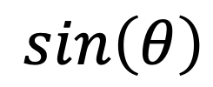
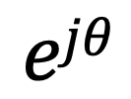

Model for a signal (frequency, amplitude, and phase)
$$ejθ$$
$$=$$
$$\cos\left(θ\right)+j \sin\left(θ\right)$$
$$e_jθ$$
$$=$$
$$\cos\left(θ\right)− j \sin\left(θ\right)$$
How about real sinusoids?
$$\cos\left(θ\right)$$
$$=$$
$$?$$
$$\sin\left(θ\right)$$
$$=$$
$$?$$

Slide 61

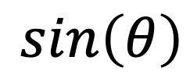



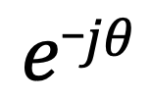
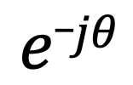
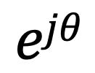
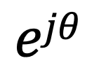
Presenting real signal with the complex model
$$ejθ$$
$$=$$
$$\cos\left(θ\right)+j \sin\left(θ\right)$$
$$e_jθ$$
$$=$$
$$\cos\left(θ\right)− j \sin\left(θ\right)$$
$$ejθ$$
$$+$$
$$e_jθ$$
$$\cos\left(θ\right)$$
$$=$$
2
$$ejθ$$
$$−$$
$$e_jθ$$
$$\sin\left(θ\right)$$
$$=$$
2j

Slide 62
Presenting real signal with the complex model

Slide 63
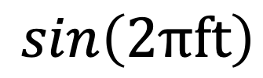
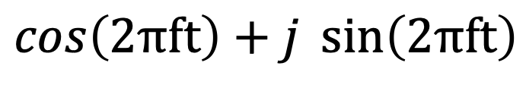


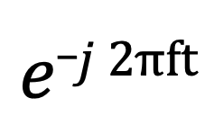
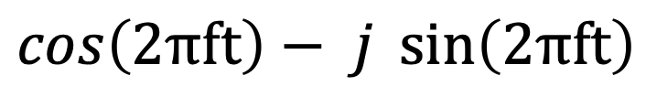
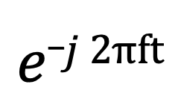
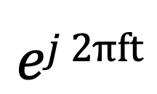
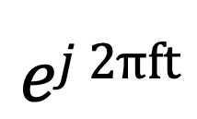
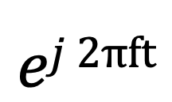
Presenting real signal with the complex model
$$ej 2πft$$
$$=$$
$$\cos\left(2πft\right)+j \sin\left(2πft\right)$$
$$e_j 2πft$$
$$=$$
$$\cos\left(2πft\right)− j \sin\left(2πft\right)$$
$$ej 2πft$$
$$+$$
$$e_j 2πft$$
$$\cos\left(2πft\right)$$
$$=$$
2
$$ej 2πft$$
$$−$$
$$e_j 2πft$$
$$\sin\left(2πft\right)$$
$$=$$
2j

Slide 64
Time Domain and Frequency Domain
Fourier Transform
FFT
Amplitude
Amplitude
IFFT
0.00
0.25
0.50
0
2
4
6
8
Time
Frequency (Hz)
Time domain
Frequency domain
FFT = Fast Fourier Transform
IFFT = Inverse Fast Fourier Transform

Slide 65
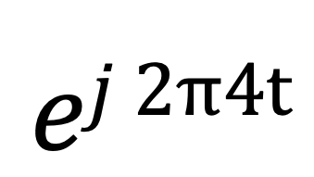
Time Domain and Frequency Domain
Fourier Transform
$$ej 2π4t$$
FFT
Amplitude
0
2
4
6
8
Frequency (Hz)
Time domain
Frequency domain
FFT = Fast Fourier Transform
IFFT = Inverse Fast Fourier Transform

Slide 66

Time Domain and Frequency Domain
Fourier Transform
FFT
?
$$\cos\left(2π4t\right)$$
Amplitude
0
2
4
6
8
Frequency (Hz)
Time domain
Frequency domain
FFT = Fast Fourier Transform
IFFT = Inverse Fast Fourier Transform

Slide 67




Time Domain and Frequency Domain
Fourier Transform
FFT
?
$$\cos\left(2π4t\right)$$
Amplitude
$$ej 2π4t$$
$$+$$
$$e_j 2π4t$$
$$=$$
2
0
2
4
6
8
Frequency (Hz)
Time domain
Frequency domain
FFT = Fast Fourier Transform
IFFT = Inverse Fast Fourier Transform

Slide 68
Time Domain and Frequency Domain
Fourier Transform
FFT
$$\cos\left(2π4t\right)$$
Amplitude
$$ej 2π4t$$
$$+$$
$$e_j 2π4t$$
$$=$$
2
-6
-4
-2
0
2
4
6
8
Frequency (Hz)
Time domain
Frequency domain
FFT = Fast Fourier Transform
IFFT = Inverse Fast Fourier Transform

Slide 69

Time Domain and Frequency Domain
Fourier Transform
FFT
$$\cos\left(2π4t\right)$$
Amplitude
$$ej 2π4t$$
$$+$$
$$e_j 2π4t$$
$$=$$
2
-6
-4
-2
0
2
4
6
8
Frequency (Hz)
Time domain
Frequency domain
FFT = Fast Fourier Transform
IFFT = Inverse Fast Fourier Transform

Slide 70
Matlab demo
function fft_test()
freq = 200;
sampleRate = 1000;
time_ticks = 0:1/sampleRate:1;
realSignal = sin(2*pi*freq*time_ticks);
plot_fft(realSignal, sampleRate);
complexSignal = exp(j*2*pi*freq*time_ticks);
plot_fft(complexSignal, sampleRate);
end

