Slide 1
Wireless and Mobile Systems
for the IoT
CMSC 715 : Fall 2022
Lecture 1.4: Properties of the Discrete Fourier Transform
and visualizing DFT coefficients
Nirupam Roy
Tu-Th 12:30-1:45pm
CSI 3120

Slide 2
Plotting
DFT spectrum

Slide 3
Plotting the DFT spectrum
Magnitude
|z_{m}|
m = 0
1
2
3
4
…
Frequency
N-2
N-1

Slide 4
Plotting the DFT spectrum
Magnitude
|z_{m}|
m = 0
1
2
3
4
…
Frequency
N-2
N-1
Phase
⦨ z_{m}
m = 0
1
2
3
4
…
Frequency
N-2
N-1

Slide 5
The Curious Case of “Negative frequency”
$$\frac{(N−1)2π}{N}=2π−\frac{2π}{N}$$
$$\frac{2π}{N}$$
$$\frac{2π}{N}$$
$$\frac{(N−1)2π}{N}=2π−\frac{2π}{N}$$
Positive rotation with $\frac{2π}{N}$ radian angle per step
Negative rotation with $\frac{2π}{N}$ radian angle per step

Slide 6
The Curious Case of “Negative frequency”
m = 0
1
2
3
4
…
Frequency
N-2
N-1
+
+
+
-
-
-

Slide 7
The Curious Case of “Negative frequency”
-4
-3
-2
-1
m = 0
1
2
3
4
Frequency

Slide 8
The Curious Case of “Negative frequency”
Magnitude
|z_{m}|
-4
-3
-2
-1
m = 0
1
2
3
4
Frequency
Real signal’s magnitude spectrum is symmetric.
Why?

Slide 9
The Curious Case of “Negative frequency”
Magnitude
|z_{m}|
-4
-3
-2
-1
m = 0
1
2
3
4
Frequency
Complex signal’s magnitude spectrum may or may not be symmetric.
Why?

Slide 10
Estimating the real-world frequencies
Sampling frequency = f_{s} (i.e., f_{s} samples per second)
Slowest frequency ($\frac{2π}{N}$ radians per step) = N samples per rotation
= (N/ f_{s}) seconds per rotation
Therefore, the slowest frequency = (f_{s} /N) Hz
Higher frequencies are integer multiple of (f_{s} /N) Hz
0, $\frac{\text{f}\text{s}}{N}\text{, }\frac{\text{2}\text{f}\text{s}}{N}$ , $\frac{\text{3}\text{f}\text{s}}{N}$ , $\frac{\text{4}\text{f}\text{s}}{N}$, … , , $\frac{\text{(}\text{N}\text{−1)}\text{f}\text{s}}{N}$

Slide 11
The resolution and the highest frequency
Magnitude/Phase of z_{m}
-4
-3
-2
-1
m = 0
1
2
3
4
Frequency
Resolution
= minimum observable frequency difference =
$\frac{\text{f}\text{s}}{N}$
What if the actual frequency falls in between two frequency bins?

Slide 12
Estimating the real-world frequencies
Sampling frequency = f_{s} (i.e., f_{s} samples per second)
Slowest frequency ($\frac{2π}{N}$ radians per step) = N samples per rotation
= (N/ f_{s}) seconds per rotation
Therefore, the slowest frequency = (f_{s} /N) Hz
Higher frequencies are integer multiple of (f_{s} /N) Hz
0, $\frac{\text{f}\text{s}}{N}\text{, }\frac{\text{2}\text{f}\text{s}}{N}$ , $\frac{\text{3}\text{f}\text{s}}{N}$ , $\frac{\text{4}\text{f}\text{s}}{N}$, … , , $\frac{\text{(}\text{N}\text{/2)}\text{f}\text{s}}{N}$
$$\frac{\text{f}\text{s}}{2}$$
- $\frac{\text{f}\text{s}}{N}\text{, }\text{−}\frac{\text{2}\text{f}\text{s}}{N}$ , - $\frac{\text{3}\text{f}\text{s}}{N}$ , - $\frac{\text{4}\text{f}\text{s}}{N}$, … , , - $\frac{\text{(}\text{N}\text{/2)}\text{f}\text{s}}{N}$

Slide 13
The resolution and the highest frequency
Magnitude/Phase of z_{m}
-4
-3
-2
-1
m = 0
1
2
3
4
Frequency
Resolution
= minimum observable frequency difference =
$\frac{\text{f}\text{s}}{N}$
What if the actual frequency falls in between two frequency bins?

Slide 14
The resolution and the highest frequency
Magnitude/Phase of z_{m}
-4
-3
-2
-1
m = 0
1
2
3
4
Frequency
$−\frac{\text{f}\text{s}}{2}$
$\frac{\text{f}\text{s}}{2}$
Highest frequency =

Slide 15
The resolution and the highest frequency
How can we increase the resolution?
$$\frac{\text{f}\text{s}}{N}$$
= $\frac{\text{sample} \text{rate}}{\# of FFT points}$
How can we increase the range of the spectrum?
$[−\frac{\text{f}\text{s}}{2}$
, $\frac{\text{f}\text{s}}{2} ]$

Slide 16
Time resolution v/s Frequency resolution

Slide 17
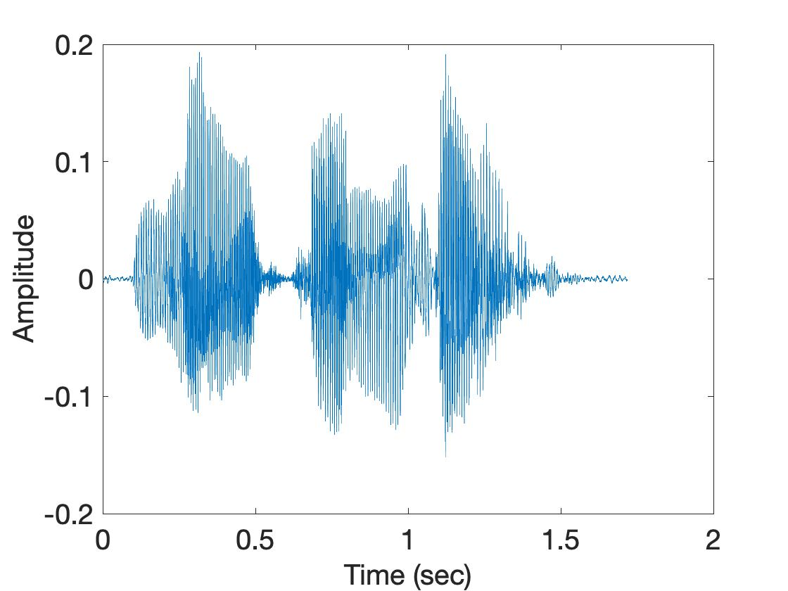
Time resolution v/s Frequency resolution
U
M
D
[
[
DFT
DFT
$$\frac{\text{f}\text{s}}{N}$$
= $\frac{\text{sample} \text{rate}}{\# of FFT points}$
How can we increase the frequency resolution?
How can we increase the time resolution?

Slide 18
Aliasing

Slide 19
Sampling theorem
Amplitude
Time (sec)
0.00
0.25
0.50
0.75
1.00
1.25
Amplitude
Time (sec)
0.00
0.25
0.50
0.75
1.00
1.25
Aliasing: Two signals become indistinguishable after sampling

Slide 20
Time domain samples
Amplitude
Time (sec)
0.00
0.25
0.50
0.75
1.00
1.25
FFT
Amplitude
-6
-4
-2
0
2
4
6
8
Frequency (Hz)
Frequency domain

Slide 21
Aliasing: Different frequencies, same name!!
Magnitude/Phase of z_{m}
-4
-3
-2
-1
m = 0
1
2
3
4
Frequency
Assume, Sample rate $\text{f}\text{s}$ = 8 Hz
For a COMPLEX signal, what value will we see if the actual frequency is:
a) 3 Hz
b) -2 Hz
c) 6 Hz
d) -5 Hz
e) 4 Hz and -4Hz

Slide 22
Magnitude/Phase of z_{m}
-4
-3
-2
-1
m = 0
1
2
3
4
Frequency
5
6
7
8

Slide 23
Magnitude/Phase of z_{m}
-4
-3
-2
-1
m = 0
1
2
3
4
Frequency
5
6
7
8

Slide 24
Magnitude/Phase of z_{m}
-4
-3
-2
-1
m = 0
1
2
3
4
Frequency
0
- F_{s}/4
F_{s}/4
F_{s}/2

Slide 25
Magnitude/Phase of z_{m}
-4
-3
-2
-1
m = 0
1
2
3
4
Frequency
0
-1
1
- 2
2
-3
3
4
-4

Slide 26
Aliasing: Different frequencies, same name!!
Magnitude/Phase of z_{m}
-4
-3
-2
-1
m = 0
1
2
3
4
Frequency
Assume, Sample rate $\text{f}\text{s}$ = 8 Hz
For a COMPLEX signal, what value will we see if the actual frequency is:
a) 3 Hz
b) -2 Hz
c) 6 Hz
d) -5 Hz
e) 4 Hz and -4Hz

Slide 27
Aliasing: Different frequencies, same name!!
Magnitude/Phase of z_{m}
-4
-3
-2
-1
m = 0
1
2
3
4
Frequency
Assume, Sample rate $\text{f}\text{s}$ = 8 Hz
For a REAL signal, what value will we see if the actual frequency is:
a) 3 Hz
b) -2 Hz
c) 6 Hz
d) -5 Hz
e) 4 Hz and -4Hz

Slide 28
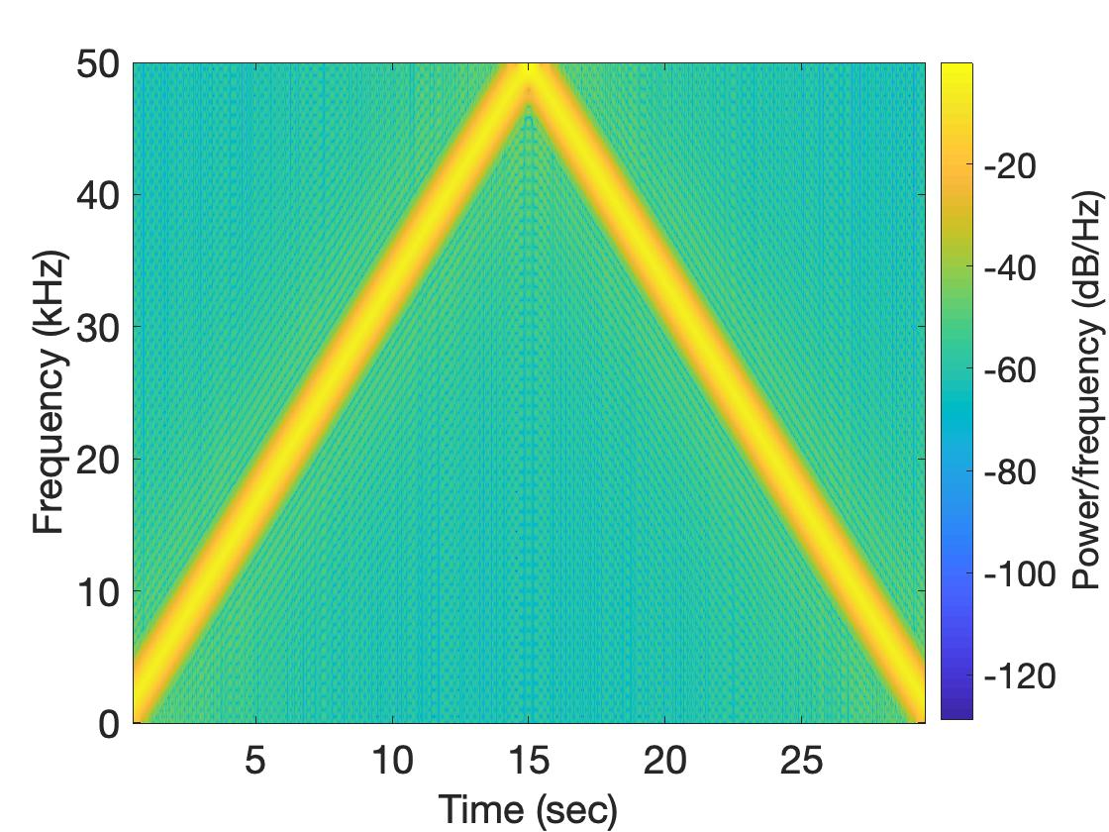
Aliasing: Spectrogram of increasing frequency

Slide 29
Calculating the aliased frequency value for real signals
Sampling frequency = 10Hz
Nyquist frequency = 5Hz
Amplitude
0
2
4
6
8
Frequency (Hz)

Slide 30
Calculating the aliased frequency value for real signals
Sampling frequency = 10Hz
Nyquist frequency = 5Hz
Amplitude
Received
signal
Amplitude
0
2
4
6
8
0
2
4
6
8
Frequency (Hz)
Frequency (Hz)

Slide 31
Calculating the aliased frequency value for real signals
Sampling frequency = 10Hz
Nyquist frequency = 5Hz
Amplitude
Received
signal
Amplitude
0
2
4
6
8
0
2
4
6
8
Frequency (Hz)
Frequency (Hz)
f_{s} = Sampling frequency
f = Target frequency
f_{a} = Aliased(perceived) frequency
K = Non-negative integer
f_{a} = min(abs(K*f_{s} - f))

Slide 32
Aliasing: A real life scenario
Nyquist frequency
Amplitude
10k
20k
30k
40k
50k
60k
70k
80k
90k
100k
Frequency spectrum
Notes:
to amplify the signal power …
Now, this signal typically contains many more frequencies than the sampling system can handle …

Slide 33
Aliasing: A real life scenario
Nyquist frequency
Amplitude
10k
20k
30k
40k
50k
60k
70k
80k
90k
100k
Frequency spectrum
Notes:
to amplify the signal power …
Now, this signal typically contains many more frequencies than the sampling system can handle …

Slide 34
Aliasing: A real life scenario
Nyquist frequency
Amplitude
10k
20k
30k
40k
50k
60k
70k
80k
90k
100k
Frequency spectrum
We need a “Low-pass filter”
to remove unwanted high frequency signals
Notes:
to amplify the signal power …
Now, this signal typically contains many more frequencies than the sampling system can handle …

Slide 35
Anti-aliasing filter
Nyquist frequency
Amplitude
10k
20k
30k
40k
50k
60k
70k
80k
90k
100k
Frequency spectrum
Sensor
ADC
Anti-aliasing
Filter
Notes:
to amplify the signal power …
Now, this signal typically contains many more frequencies than the sampling system can handle …

Slide 36
Anti-aliasing filter
Nyquist frequency
Amplitude
10k
20k
30k
40k
50k
60k
70k
80k
90k
100k
Frequency spectrum
Sensor
ADC
Anti-aliasing
Filter
Notes:
Hence, a low pass filter…

Slide 37
Anti-aliasing filter
Anti-aliasing
filter
Amplitude
10k
20k
30k
40k
50k
60k
70k
80k
90k
100k
Frequency spectrum
Sensor
ADC
Anti-aliasing
Filter
Notes:
removes the unwanted frequencies above 24 kHz …
And ultimately, this filtered signal is sampled by an ADC to generate digital sound samples

Slide 38
Anti-aliasing filter

Slide 39
Aliasing in real life
https://www.youtube.com/watch?v=B8EMI3_0TO0

Slide 40
Aliasing in real life
https://www.youtube.com/watch?v=QOwzkND_ooU

Slide 41
A few more ideas…
1) Filtering frequencies
1) Filtering frequencies
2) Multiplying frequency with frequency
3) Sampling a band of frequencies

Slide 42
Matlab demo code

Slide 43
A few more ideas…
1) Filtering frequencies
2) Multiplying frequency with frequency
3) Sampling a band of frequencies

Slide 44
Multiplying two frequencies
Magnitude/Phase of z_{m}
-4
-3
-2
-1
m = 0
1
2
3
4
Frequency
Two signals with frequencies f1 and f2 are multiplied:
$$ej 2π f1 t$$
$$ej 2π f2 t$$
$$ej 2πf1 t$$
$$+$$
$$e_j 2πf1t$$
$$ej 2πf2 t$$
$$+$$
$$e_j 2πf2t$$
2
2

Slide 45
Matlab demo code

Slide 46
A few more ideas…
1) Filtering frequencies
2) Multiplying frequency with frequency
3) Sampling a band of frequencies

Slide 47
Sample Rate for a Frequency band
$$e^{j2πf1t}$$
$$e^{j2πf2t}$$
Amplitude
$${× e}^{−j2πf1t}$$
0
2
4
6
0
8
Frequency (kHz)
What should be the sample rate?

Slide 48
Sample Rate for a Frequency band
$${× e}^{−j2πf1t}$$
Amplitude
Frequency
down-conversion
Amplitude
0
2
4
6
8
0
2
4
6
8
Frequency (kHz)
Frequency (kHz)
What should be the sample rate?
Generally, bandwidth of the signal determines the sample rate.

Slide 49
Programming Assignment #1

Slide 50
Short-time Fourier Transform (STFT)
U
M
D
[
[
[
DFT of overlapping windows
of samples
(Spectrogram/STFT)
[
DFT
DFT
DFT
DFT

Slide 51
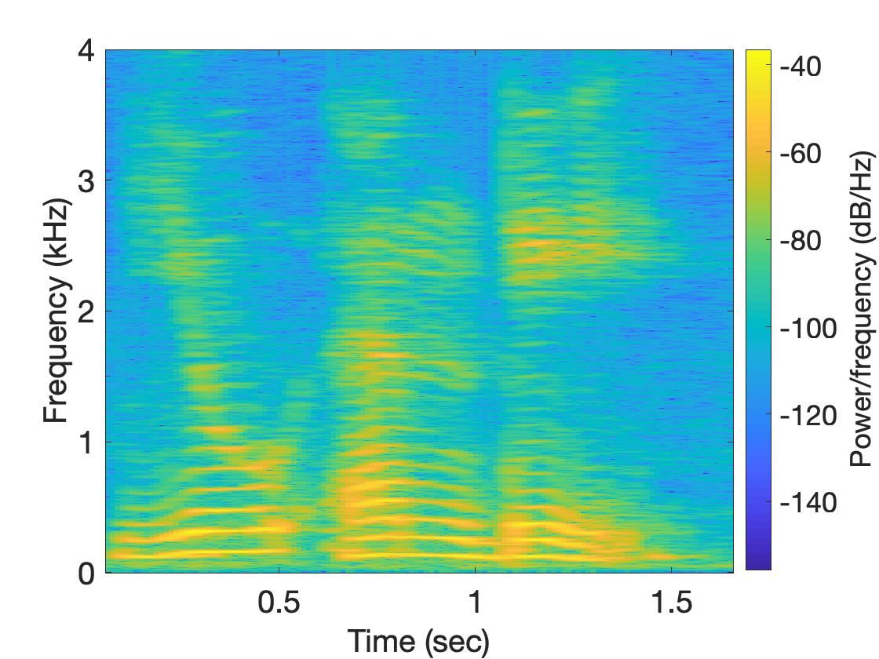
Short-time Fourier Transform (STFT)
U
M
D

Slide 52
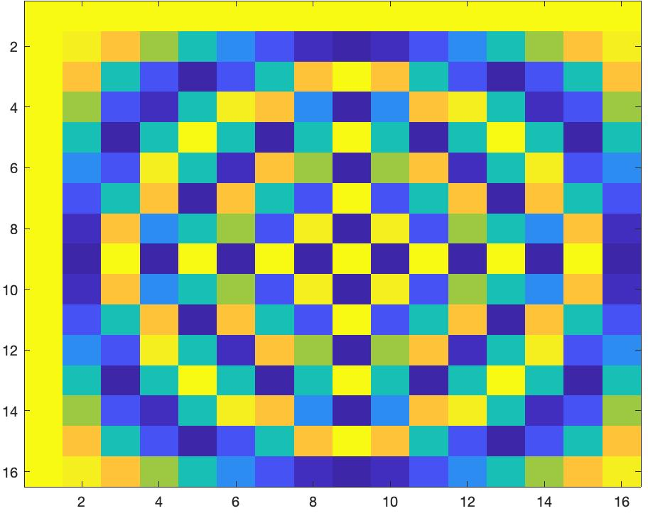
Short-time Fourier Transform (STFT)
*
_{X}
_{Z}
_{F}
=
_{F}
=
_{Matlab function: dftm(N)}
_{X}
=

Slide 53
Short-time Fourier Transform (STFT)
*
_{X}
_{Z}
_{F}
=
_{F}
_{N}
=
_{Matlab function: dftm(N)}
_{N}
_{abs(Z)}
_{X}
_{8N}
=

Slide 54
Short-time Fourier Transform (STFT)
?
_{x}
₌

Slide 55
Extra Slides

Slide 56
Time Domain and Frequency Domain
Fourier Transform
$$ej 2π4t$$
FFT
Amplitude
0
2
4
6
8
Frequency (Hz)
Time domain
Frequency domain
FFT = Fast Fourier Transform
IFFT = Inverse Fast Fourier Transform

Slide 57
Time Domain and Frequency Domain
Fourier Transform
FFT
$$\cos\left(2π4t\right)$$
Amplitude
$$ej 2πft$$
$$+$$
$$e_j 2πft$$
$$=$$
2
-6
-4
-2
0
2
4
6
8
Frequency (Hz)
Time domain
Frequency domain
FFT = Fast Fourier Transform
IFFT = Inverse Fast Fourier Transform

Slide 58
Matlab demo
function fft_test()
freq = 200;
sampleRate = 1000;
time_ticks = 0:1/sampleRate:1;
realSignal = sin(2*pi*freq*time_ticks);
plot_fft(realSignal, sampleRate);
complexSignal = exp(j*2*pi*freq*time_ticks);
plot_fft(complexSignal, sampleRate);
end

Slide 59
A few more ideas…
1) Filtering frequencies
1) Filtering frequencies
2) Multiplying frequency with frequency
3) Sampling a band of frequencies

Slide 60
Matlab demo code

Slide 61
A few more ideas…
1) Filtering frequencies
2) Multiplying frequency with frequency
3) Sampling a band of frequencies

Slide 62
Multiplying two frequencies
Magnitude/Phase of z_{m}
-4
-3
-2
-1
m = 0
1
2
3
4
Frequency
Two signals with frequencies f1 and f2 are multiplied:
$$ej 2π f1 t$$
$$ej 2π f2 t$$
$$ej 2πf1 t$$
$$+$$
$$e_j 2πf1t$$
$$ej 2πf2 t$$
$$+$$
$$e_j 2πf2t$$
2
2

Slide 63
Matlab demo code

Slide 64
A few more ideas…
1) Filtering frequencies
2) Multiplying frequency with frequency
3) Sampling a band of frequencies

Slide 65
Sample Rate for a Frequency band
$$e^{j2πf1t}$$
$$e^{j2πf2t}$$
Amplitude
$${× e}^{−j2πf1t}$$
0
2
4
6
0
8
Frequency (kHz)
What should be the sample rate?

Slide 66
Sample Rate for a Frequency band
$${× e}^{−j2πf1t}$$
Amplitude
Frequency
down-conversion
Amplitude
0
2
4
6
8
0
2
4
6
8
Frequency (kHz)
Frequency (kHz)
What should be the sample rate?
Generally, bandwidth of the signal determines the sample rate.

Slide 67
Programming Assignment #1

Slide 68
Short-time Fourier Transform (STFT)
U
M
D
[
[
[
DFT of overlapping windows
of samples
(Spectrogram/STFT)
[
DFT
DFT
DFT
DFT

Slide 69
Short-time Fourier Transform (STFT)
U
M
D

Slide 70
Short-time Fourier Transform (STFT)
*
_{X}
_{Z}
_{F}
=
_{F}
=
_{Matlab function: dftm(N)}
_{X}
=

Slide 71
Short-time Fourier Transform (STFT)
*
_{X}
_{Z}
_{F}
=
_{F}
_{N}
=
_{Matlab function: dftm(N)}
_{N}
_{abs(Z)}
_{X}
_{8N}
=

Slide 72
Short-time Fourier Transform (STFT)
?
_{x}
₌

