Slide 1
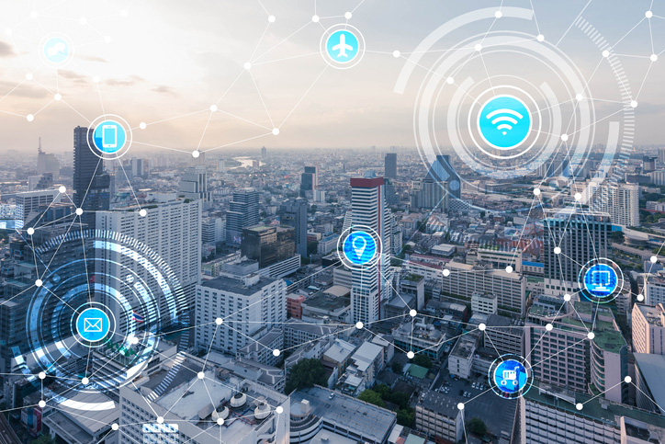
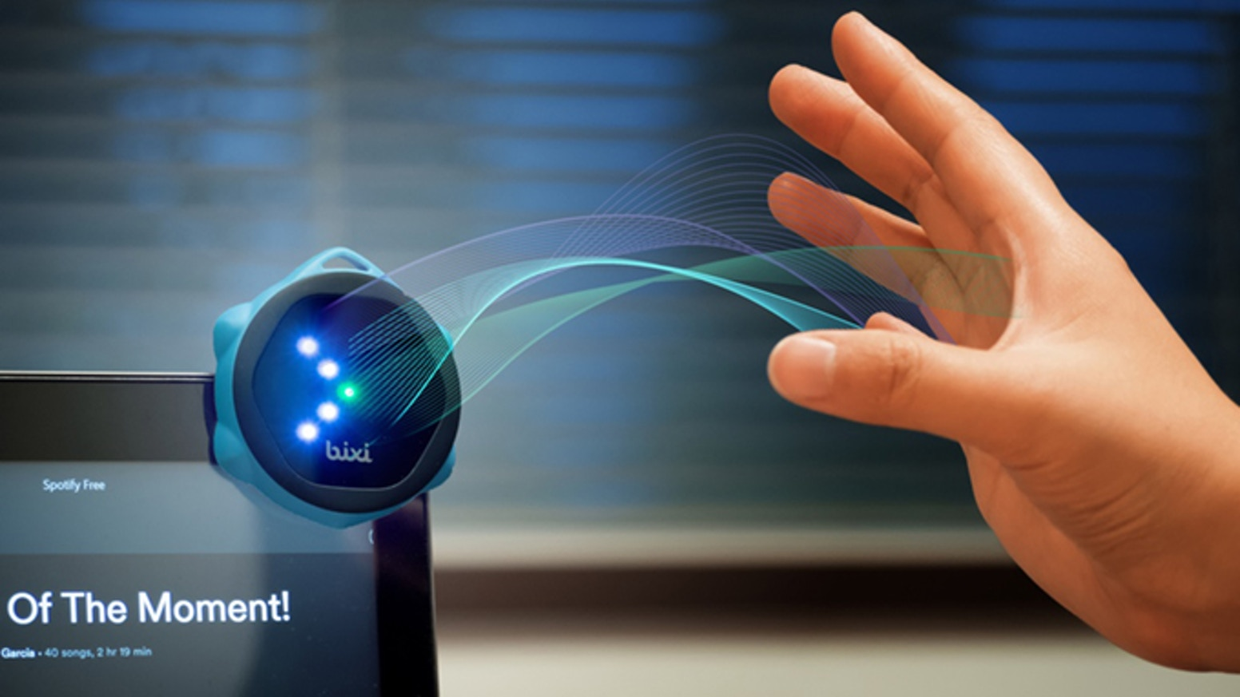
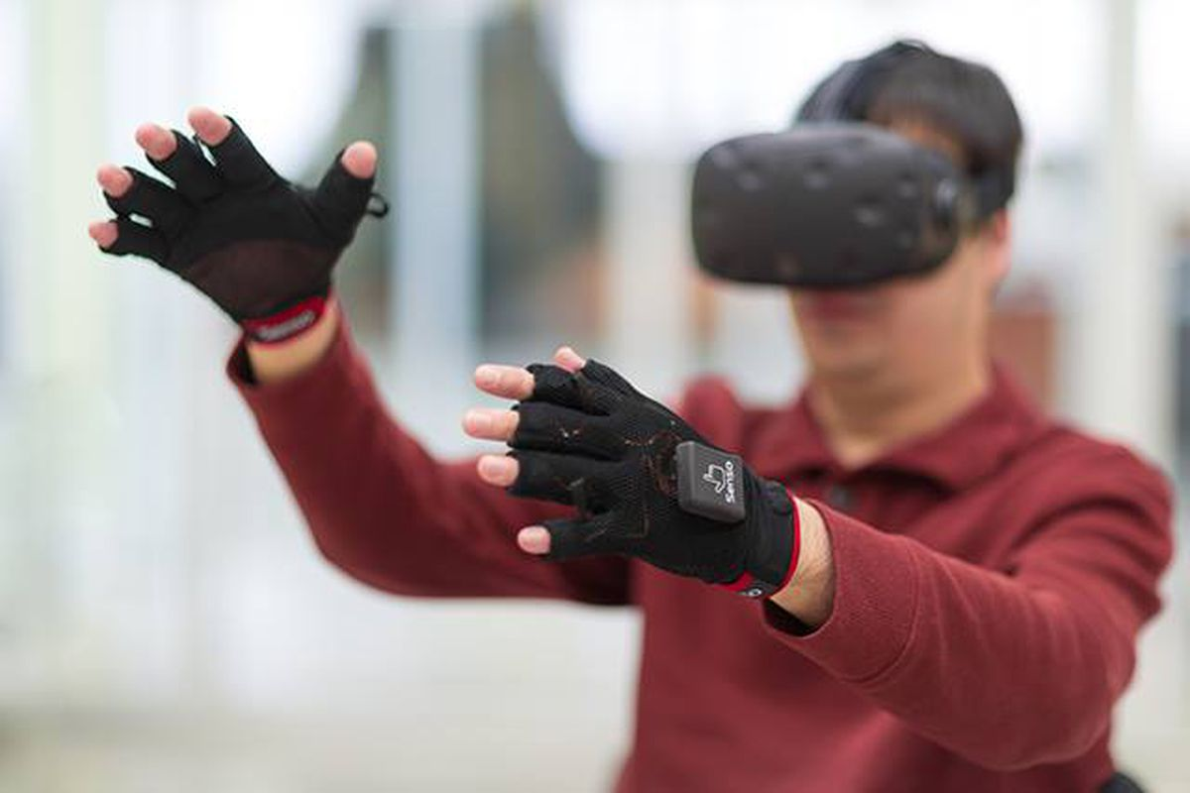
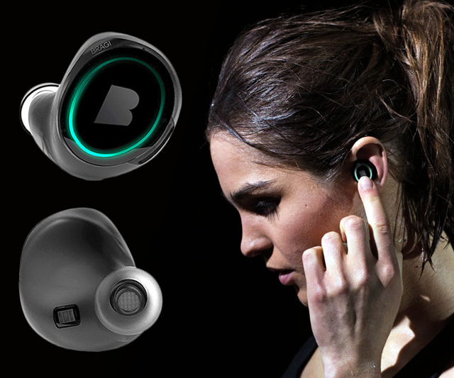
Wireless and Mobile Systems
for the IoT
CMSC 715 : Fall 2022
Lecture 2.1: Wave basics
Nirupam Roy
Tu-Th 12:30-1:45pm
CSI 3120

Slide 2
Anti-aliasing filter (cont…)

Slide 3
Anti-aliasing filter
Nyquist frequency
Amplitude
10k
20k
30k
40k
50k
60k
70k
80k
90k
100k
Frequency spectrum
Sensor
ADC
Anti-aliasing
Filter
Notes:
Hence, a low pass filter…

Slide 4
Anti-aliasing filter
Anti-aliasing
filter
Amplitude
10k
20k
30k
40k
50k
60k
70k
80k
90k
100k
Frequency spectrum
Sensor
ADC
Anti-aliasing
Filter
Notes:
removes the unwanted frequencies above 24 kHz …
And ultimately, this filtered signal is sampled by an ADC to generate digital sound samples

Slide 5
Aliasing in real life

Slide 6
Aliasing in real life
https://www.youtube.com/watch?v=B8EMI3_0TO0

Slide 7
Aliasing in real life
https://www.youtube.com/watch?v=QOwzkND_ooU

Slide 8
A few more ideas…
1) Filtering frequencies
1) Filtering frequencies
2) Multiplying frequency with frequency
3) Sampling a band of frequencies

Slide 9
Matlab demo code

Slide 10
A few more ideas…
1) Filtering frequencies
2) Multiplying frequency with frequency
3) Sampling a band of frequencies

Slide 11
Multiplying two frequencies
Magnitude/Phase of z_{m}
-4
-3
-2
-1
m = 0
1
2
3
4
Frequency
Two signals with frequencies f1 and f2 are multiplied:
$$ej 2π f1 t$$
$$ej 2π f2 t$$
$$ej 2πf1 t$$
$$+$$
$$e_j 2πf1t$$
$$ej 2πf2 t$$
$$+$$
$$e_j 2πf2t$$
2
2

Slide 12
Matlab demo code

Slide 13
A few more ideas…
1) Filtering frequencies
2) Multiplying frequency with frequency
3) Sampling a band of frequencies

Slide 14
Sample Rate for a Frequency band
$$e^{j2πf1t}$$
$$e^{j2πf2t}$$
Amplitude
$${× e}^{−j2πf1t}$$
0
2
4
6
0
8
Frequency (kHz)
What should be the sample rate?

Slide 15
Sample Rate for a Frequency band
$${× e}^{−j2πf1t}$$
Amplitude
Frequency
down-conversion
Amplitude
0
2
4
6
8
0
2
4
6
8
Frequency (kHz)
Frequency (kHz)
What should be the sample rate?
Generally, bandwidth of the signal determines the sample rate.

Slide 16
Programming Assignment #1

Slide 17
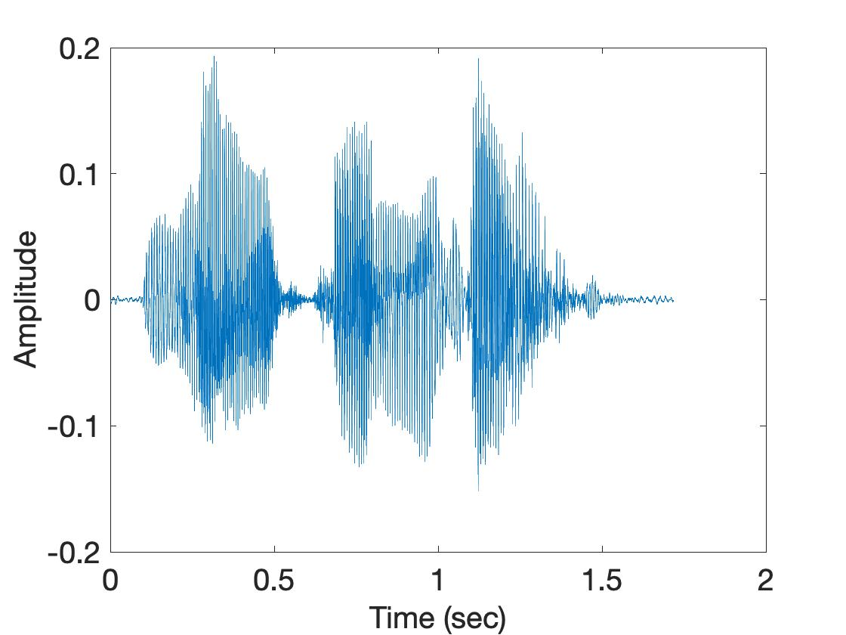
Short-time Fourier Transform (STFT)
U
M
D
[
[
[
DFT of overlapping windows
of samples
(Spectrogram/STFT)
[
DFT
DFT
DFT
DFT

Slide 18
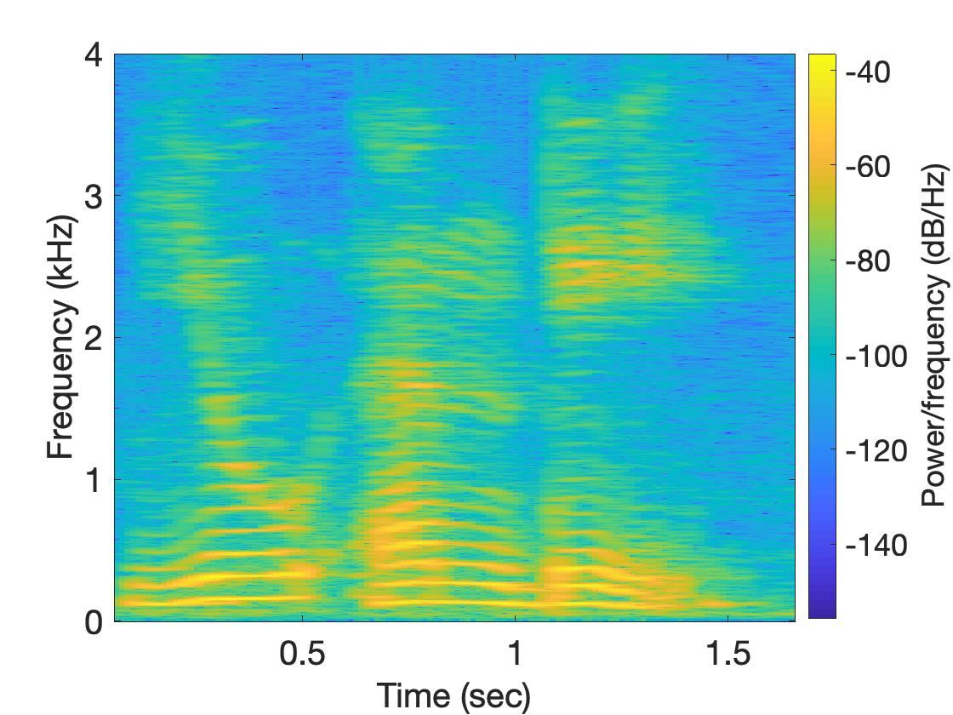
Short-time Fourier Transform (STFT)
U
M
D

Slide 19
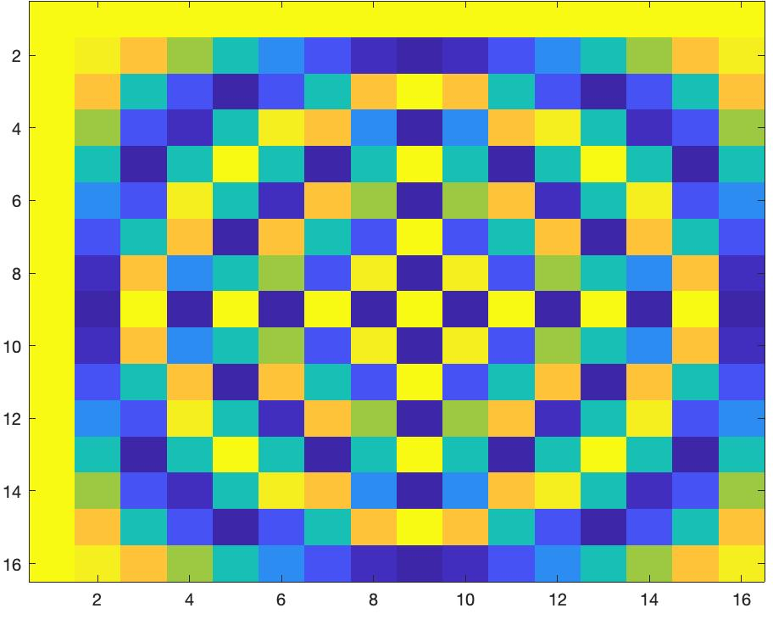
Short-time Fourier Transform (STFT)
*
_{X}
_{Z}
_{F}
=
_{F}
=
_{Matlab function: dftm(N)}
_{X}
=

Slide 20
Short-time Fourier Transform (STFT)
*
_{X}
_{Z}
_{F}
=
_{F}
_{N}
=
_{Matlab function: dftm(N)}
_{N}
_{abs(Z)}
_{X}
_{8N}
=

Slide 21
Short-time Fourier Transform (STFT)
?
_{x}
₌

Slide 22
Waves

Slide 23
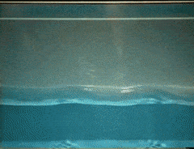
Waves: Transfer of energy, not mass

Slide 24
Sound
Visible light
Physical vibrations
WiFi signal
Ripples in water
Infrared
…
…

Slide 25
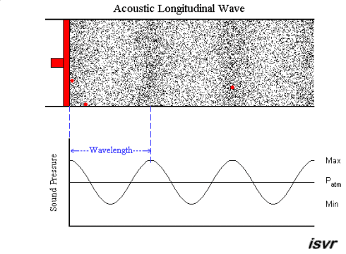
Mechanical Wave
Electromagnetic Wave
Sound
Visible light
Physical vibrations
WiFi signal
Ripples in water
Infrared
…
…

Slide 28
Waves made this possible

Slide 29
Waves made this possible

Slide 30
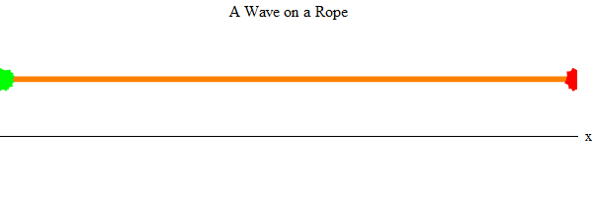
Waves properties:
frequency, amplitude, phase + speed

Slide 31
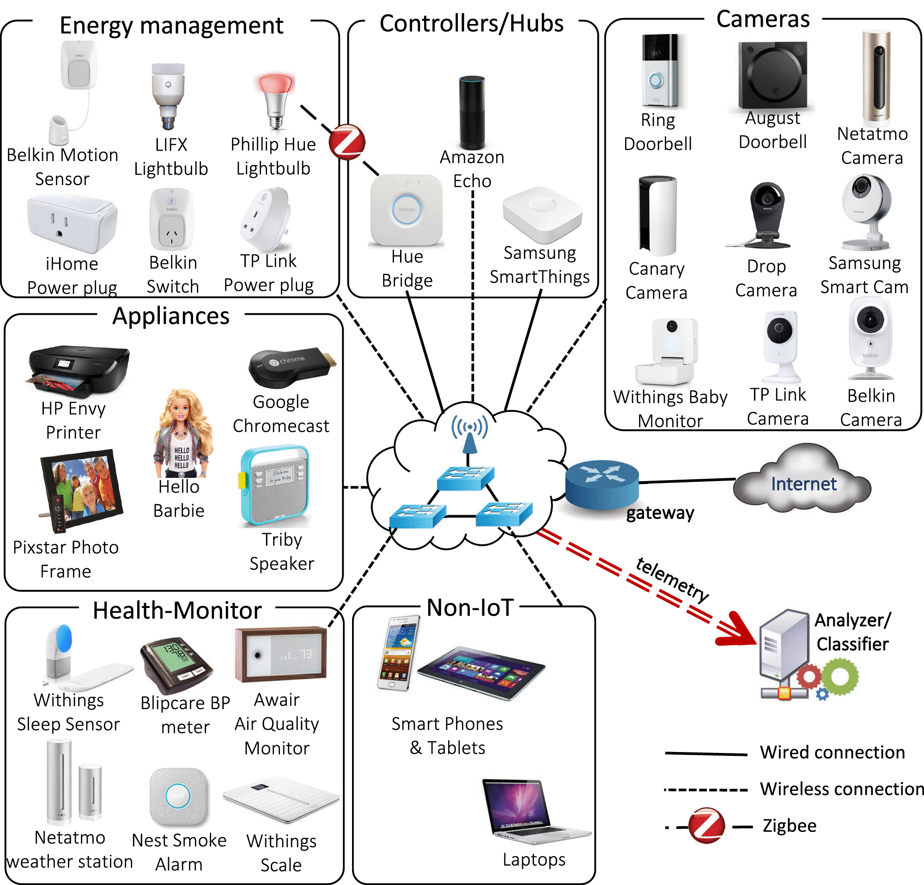
Waves made this possible

Slide 32
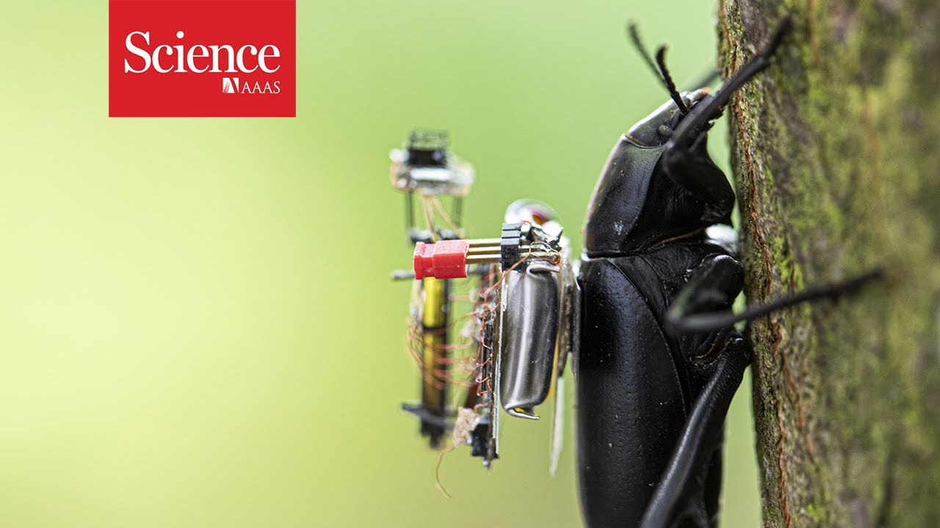
Waves made this possible

Slide 33
Waves in time and space

Slide 34
Waves in time and space
Temporal variation of the wave’s amplitude

Slide 35
Waves in time and space

Slide 36
Waves in time and space

Slide 37
Waves in time and space

Slide 38
Waves in time and space

Slide 39
Waves in time and space

Slide 40
Waves in time and space

Slide 41
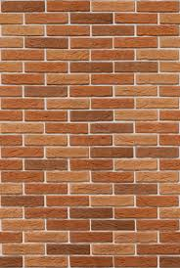
Reflection
Absorption
+
Reflection
echo

Slide 42
Reflection
Time = t1

Slide 43
Reflection
Time = t1
Absorption
+
Reflection

Slide 44
Reflection
Time = t1
Absorption
+
Reflection
echo
t2

Slide 45
Reflection
Time = t1
Absorption
+
Reflection
d
echo
t2
Sound travelled (2d) distance

Slide 46
The speed of the wave is known

Slide 47
Reflection
Time = t1
Absorption
+
Reflection
d
echo
t2
Sound travelled (2d) distance
C.(t2-t1) = 2d

Slide 48
Reflection
Time = t1
Absorption
+
Reflection
d
Echolocation
echo
t2
Sound travelled (2d) distance
C.(t2-t1) = 2d

Slide 49
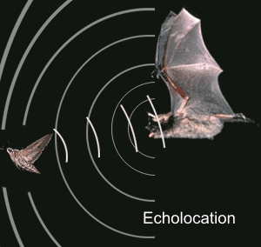
Echolocation in nature
Bat

Slide 50
Application: Contact tracing

Slide 52
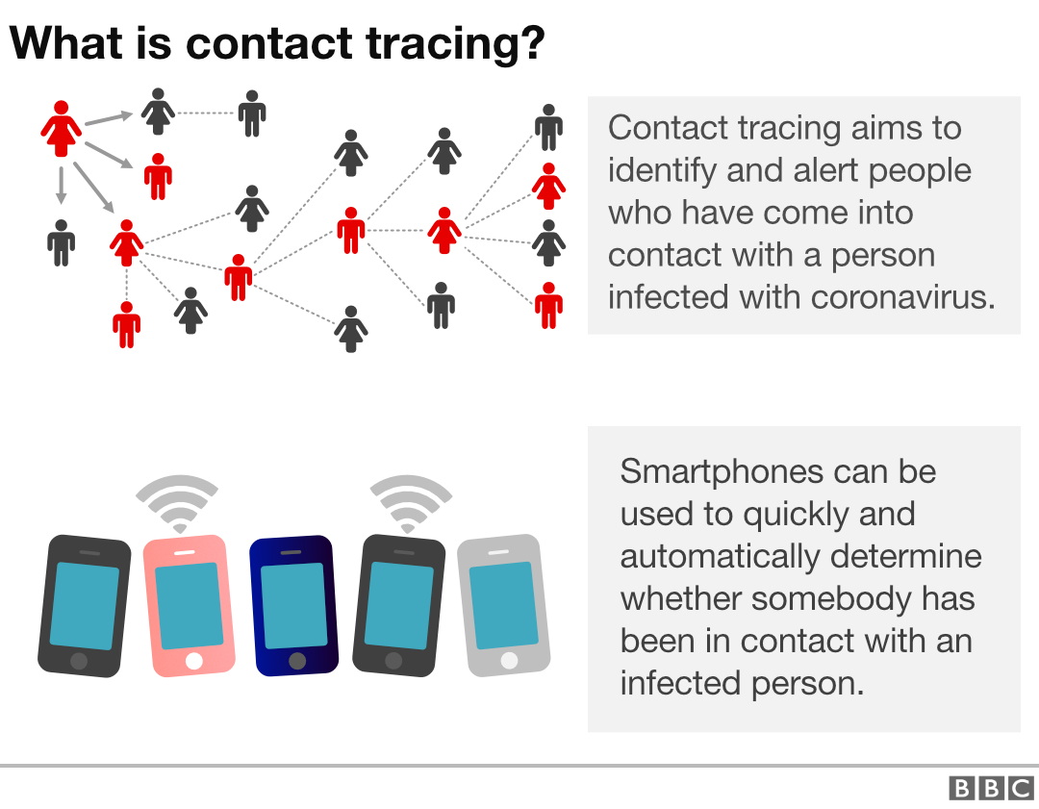
How to find the proximity between two smartphones?

