Slide 1

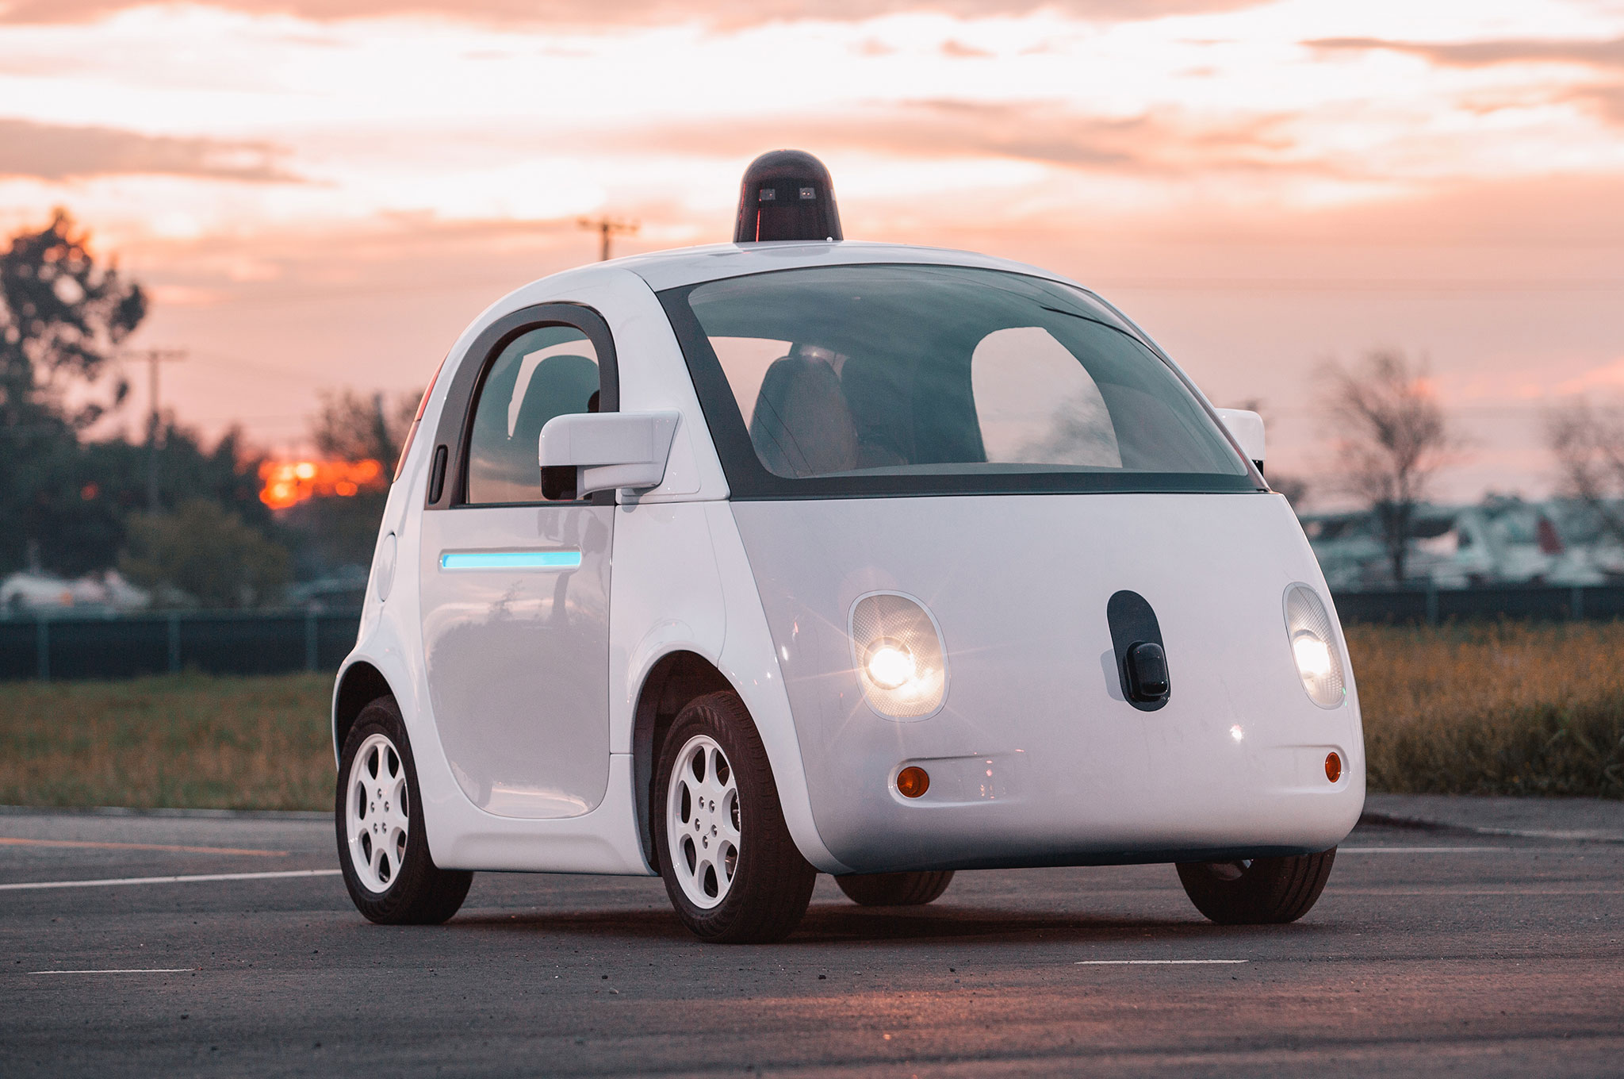
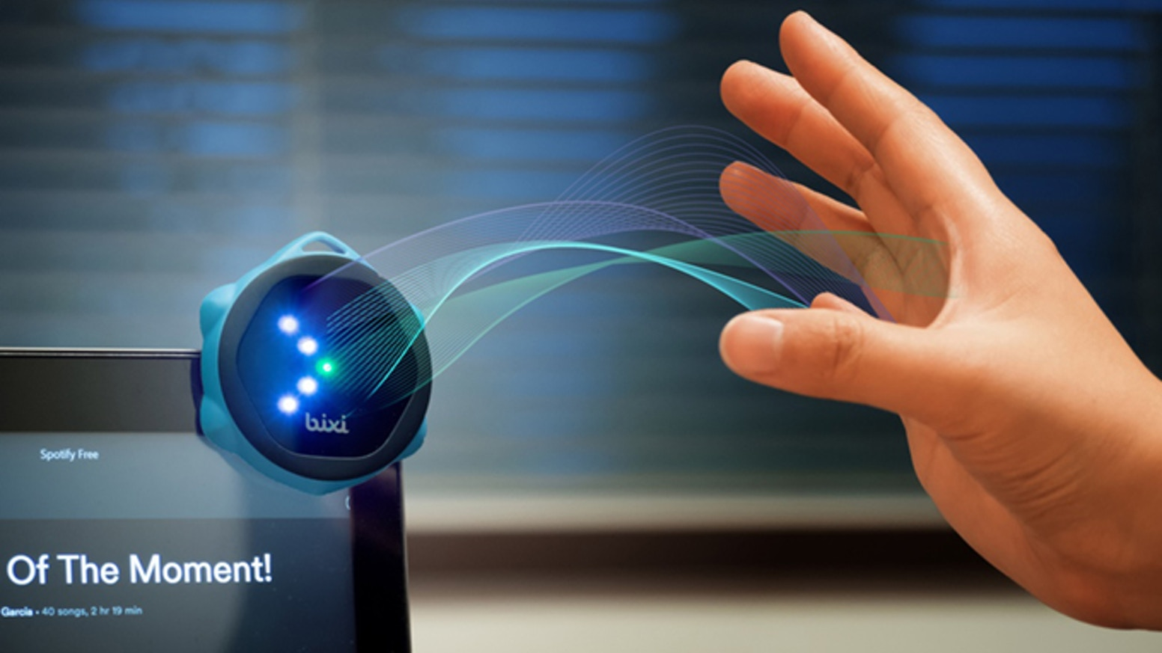
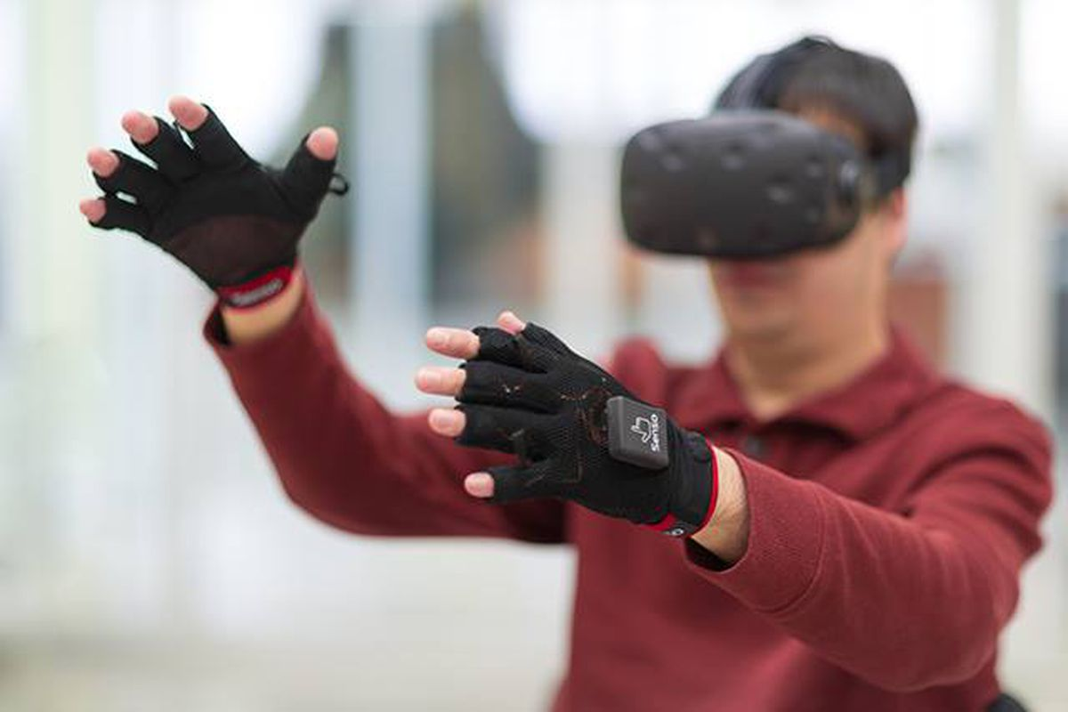

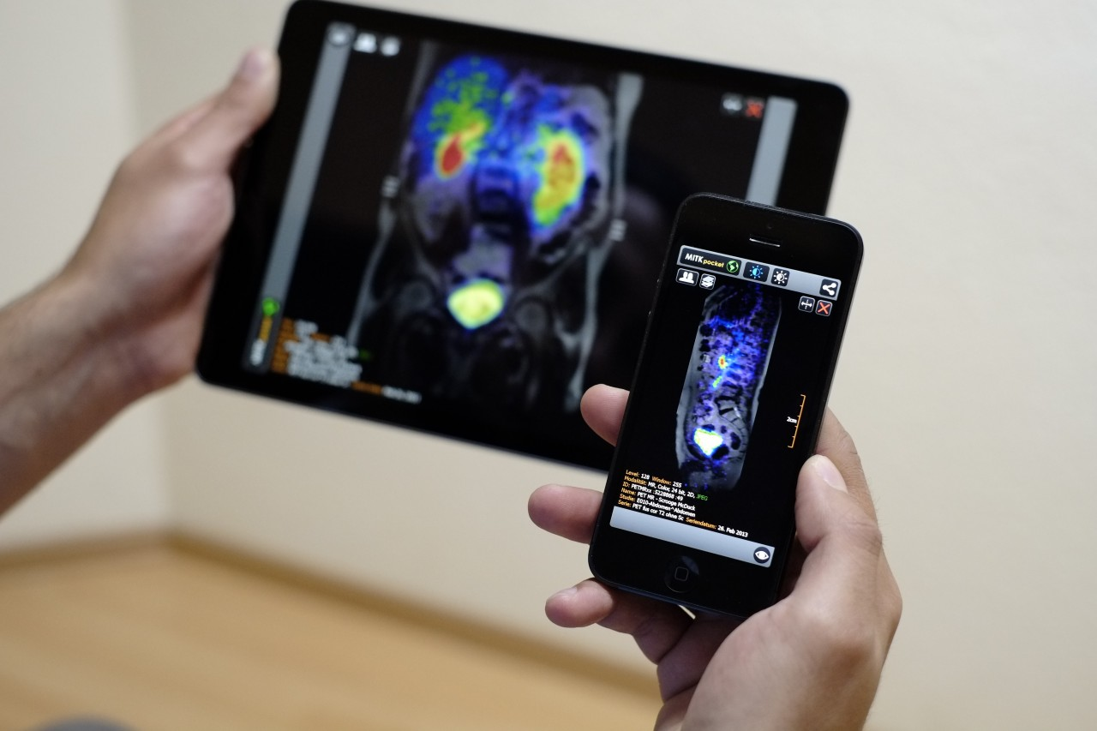
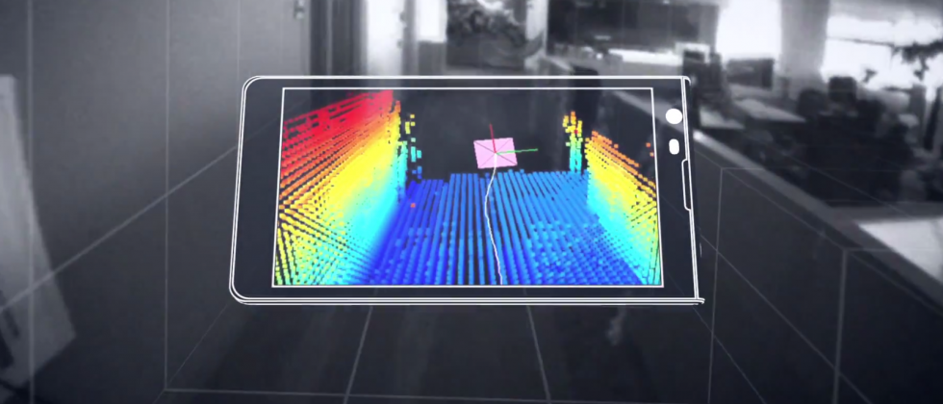
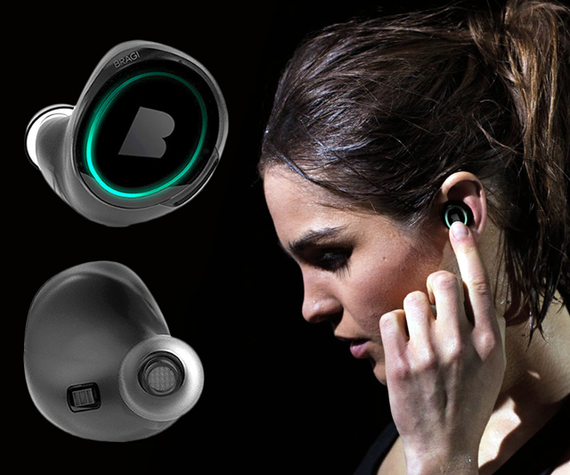
Wireless and Mobile Systems
for the IoT
CMSC 715 : Fall 2022
Lecture 2.4: Spatial Sensing and Ranging
Nirupam Roy
Tu-Th 12:30-1:45pm
CSI 3120 (temporary location CSI 2118)

Slide 2
Beamforming in 2D space

Slide 3
Beamforming in 2D space
Approximation for ‘far field’
$$φ$$
$$?$$
$$d$$

Slide 4
Beamforming in 2D space
Approximation for ‘far field’
$$φ$$
$d sin$($φ$)
$$?$$
$$φ$$
$$d$$

Slide 5
Beamforming in 2D space
Approximation for ‘far field’
$$φ$$
Along this line
$d sin$($φ$)
$$φ$$
$$d$$
Combined signal = $\sin\left(2πft\right) + \sin\left(2πft+ \frac{2π d sin (φ)}{λ}\right)$
= $e^{j\left(2πft\right)}{ }+e^{j\left(2πft+ \frac{2π d sin(φ)}{λ}\right)}{ }$

Slide 6
Beamforming in 2D space
Approximation for ‘far field’
Parameters: d, $φ$, $λ$ (or f)
Does the gain depend on the distance from the array?
$$φ$$
Along this line
$d sin$($φ$)
$$φ$$
$$d$$
Combined signal = $\sin\left(2πft\right) + \sin\left(2πft+ \frac{2π d sin (φ)}{λ}\right)$
= $e^{j\left(2πft\right)}{ }+e^{j\left(2πft+ \frac{2π d sin(φ)}{λ}\right)}{ }$

Slide 7
Beamforming in 2D space
Directional gain of an array

Slide 8
Beamforming in 2D space

Slide 9
Beamforming in 2D space
$$φ$$
$$d$$

Slide 10
Beamforming in 2D space
$$φ$$
$$d$$
+
Combined signal
= $e^{j\left(2πft\right)}{ }+e^{j\left(2πft + \frac{2π d sin(φ)}{λ}\right)}{ }$

Slide 11
Sensing with an Array

Slide 12
Sensing with an Array

Slide 13
Sensing with an Array

Slide 14
Sensing with an Array
Extra path delay
== additional phase

Slide 15
Sensing with an Array
Extra path delay
== additional phase
+
Received combined signal

Slide 16
Sensing with an Array
Extra path delay
== additional phase
+
Received combined signal

Slide 17
Sensing with an Array
Extra path delay
== additional phase
+
Received combined signal

Slide 18
Sensing with an Array
$$φ$$
Extra path delay
== additional phase
+
Received combined signal

Slide 19
Sensing with an Array
Approximation for ‘far field’

Slide 20
Sensing with an Array
Approximation for ‘far field’
Extra path delay
== additional phase

Slide 21
Sensing with an Array
Approximation for ‘far field’
$$φ$$
$d sin$($φ$)
$$d$$
+
Received combined signal

Slide 22
Sensing with an Array
Approximation for ‘far field’
$$φ$$
Along this line
$d sin$($φ$)
$$d$$
= $e^{j\left(2πft\right)}{ }+e^{j\left(2πft+ \frac{2π d sin(φ)}{λ}\right)}{ }$
Combined signal

Slide 23
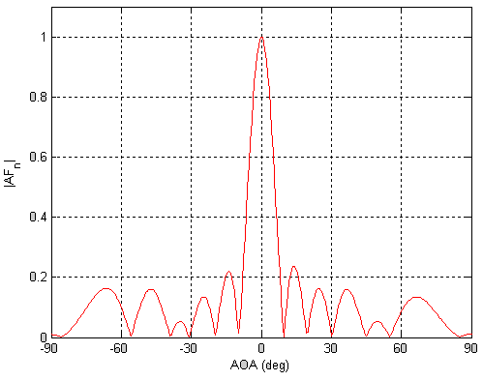
Sensing with an Array: Spatial gain
$$φ$$

Slide 24
Sensing with an Array
$$φ$$
$$d$$
+
Combined signal
= $e^{j\left(2πft\right)}{ }+e^{j\left(2πft + \frac{2π d sin(φ)}{λ}\right)}{ }$

Slide 25
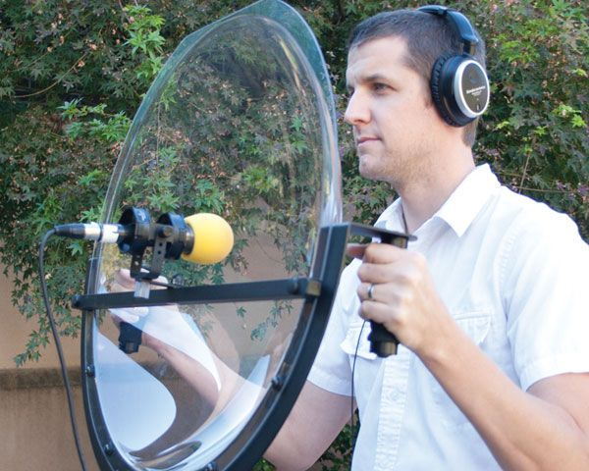
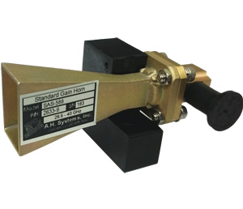
Directionality of signals: Physical guiding

Slide 26
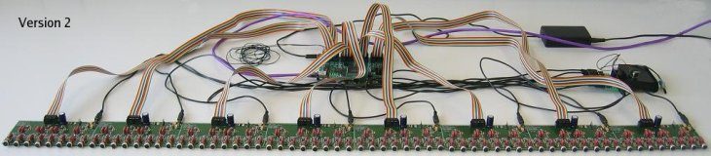
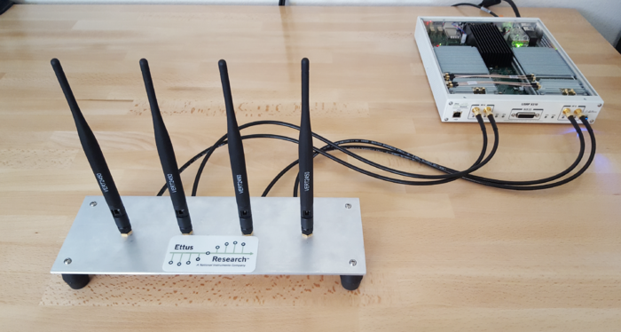
Directionality of signals: Array of sensors

Slide 27
Uniform Linear Array (ULA)

Slide 28
Beamforming in 2D space
$d sin$($φ$)
$$E1$$
$$E2$$
$$E3$$
$$E4$$
…
N elements
$$d$$
$$d$$
$$d$$
Interelement distance = d

Slide 29
Beamforming in 2D space
$3d sin$($φ$)
$2d sin$($φ$)
$d sin$($φ$)
$$E1$$
$$E2$$
$$E3$$
$$E4$$
…
N elements
$$d$$
$$d$$
$$d$$
Interelement distance = d

Slide 30
Beamforming in 2D space
$3d sin$($φ$)
$2d sin$($φ$)
$d sin$($φ$)
$$E1$$
$$E2$$
$$E3$$
$$E4$$
…
N elements
$$d$$
$$d$$
$$d$$
Path difference with n^{th} element:
$\left(n−1\right)d sin$($φ$)
Phase difference with n^{th} element:
$\left(n−1\right)d sin$($φ$) 2Π/λ

Slide 31
Beamforming in 2D space
$3d sin$($φ$)
$2d sin$($φ$)
$d sin$($φ$)
$$E1$$
$$E2$$
$$E3$$
$$E4$$
…
N elements
$$d$$
$$d$$
$$d$$
Interelement distance = d
Path difference with n^{th} element:
$\left(n−1\right)d sin$($φ$)
Phase difference with n^{th} element:
$\left(n−1\right)d sin$($φ$) 2Π/λ

Slide 32
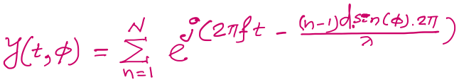

$3d cos$($φ$)
$2d sin$($φ$)
Beamforming in 2D space
$d sin$($φ$)
$$E1$$
$$E2$$
$$E3$$
$$E4$$
…
N elements
$$d$$
$$d$$
$$d$$
Path difference with n^{th} element:
$\left(n−1\right)d sin$($φ$)
Phase difference with n^{th} element:
$\left(n−1\right)d sin$($φ$) 2Π/λ
Signal at 1st sensor:
$e^{j\left(2πft\right)}{ }$
Combined signal:

Slide 33
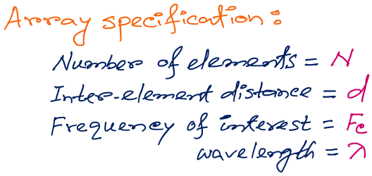
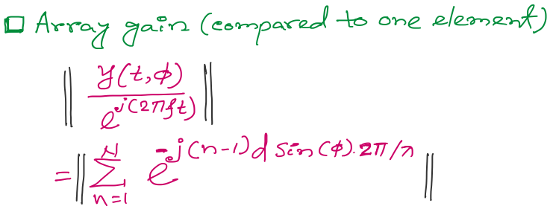
Beamforming in 2D space
f
Notes:
http://www.waves.utoronto.ca/prof/svhum/ece422/notes/15-arrays2.pdf

Slide 34
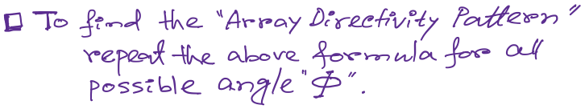
Beamforming in 2D space
Notes:
http://www.waves.utoronto.ca/prof/svhum/ece422/notes/15-arrays2.pdf

Slide 35
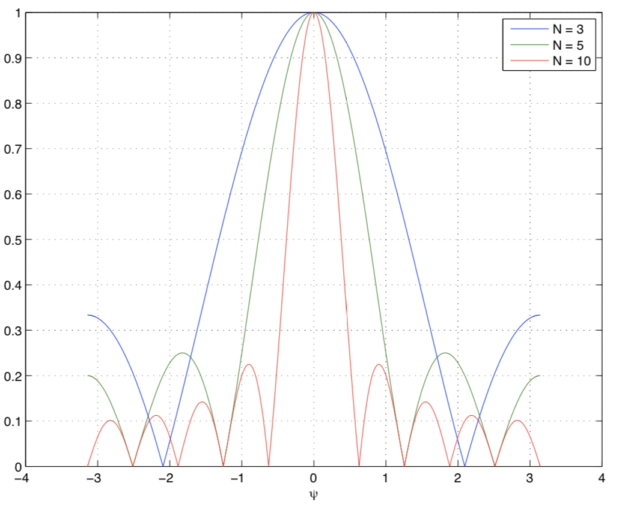
Beamforming in 2D space
Gain
-90 -60 -30 0 30 60 90
Angle
Notes:
http://www.waves.utoronto.ca/prof/svhum/ece422/notes/15-arrays2.pdf

Slide 36
Beamforming in 2D space
Notes:
http://www.waves.utoronto.ca/prof/svhum/ece422/notes/15-arrays2.pdf

Slide 37
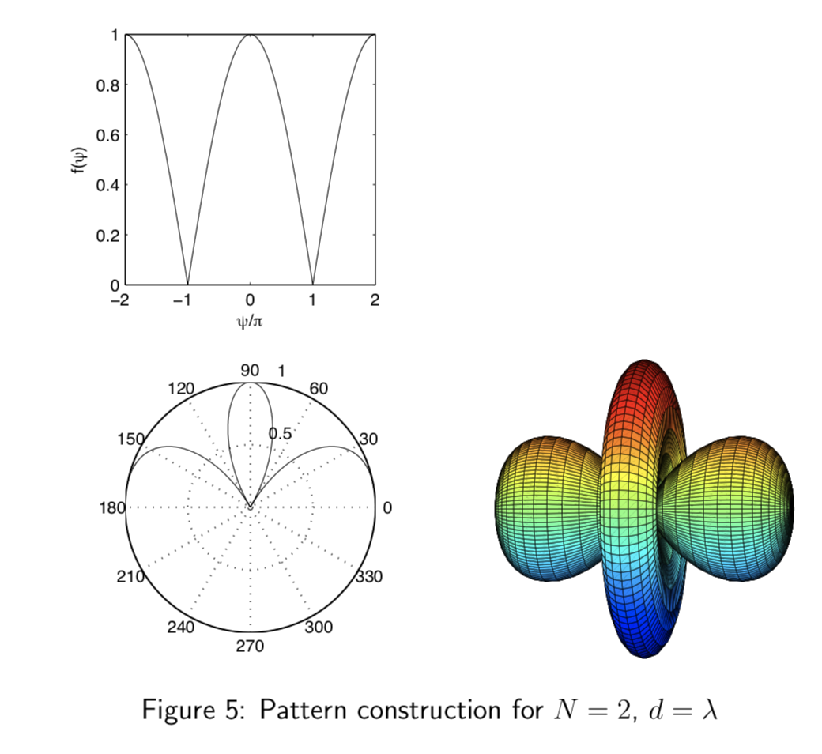
Beamforming in 2D space
Notes:
http://www.waves.utoronto.ca/prof/svhum/ece422/notes/15-arrays2.pdf

Slide 38
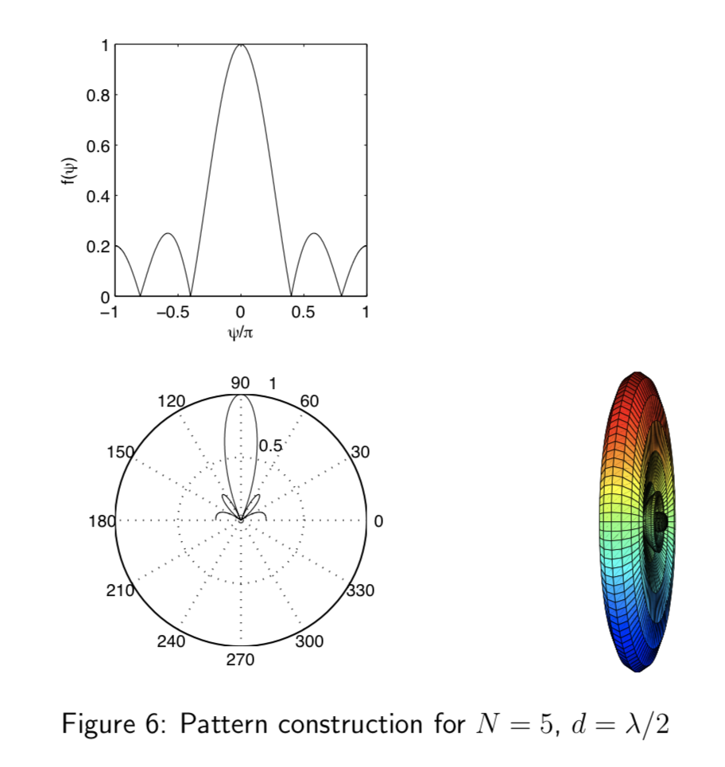
Beamforming in 2D space
Notes:
http://www.waves.utoronto.ca/prof/svhum/ece422/notes/15-arrays2.pdf

Slide 39
Beamforming in 2D space

Slide 40
Sensing with an Array
$$φ$$
$$d$$
Extra phase-1
Extra phase-2
+
Combined signal

Slide 41
Sensing with an Array
$$φ$$
$$d$$
Extra phase-1
Extra phase-2
= $e^{jΘ2}{ }$
= $e^{jΘ1}{ }$
+
= $e^{j\left(2πft\right)}{ }+e^{j\left(2πft + \frac{2π d sin(φ)}{λ}\right)}{ }$

Slide 42
Sensing with an Array
$$φ$$
$$d$$
Extra phase-1
Extra phase-2
= $e^{jΘ2}{ }$
= $e^{jΘ1}{ }$
+
= $e^{j\left(2πft+Θ1\right)}{ }+e^{j\left(2πft + \frac{2π d sin(φ)}{λ}+Θ2\right)}{ }$

Slide 43
Beam-steering
Delay-sum beamformer or Phased array
Notes:
http://www.waves.utoronto.ca/prof/svhum/ece422/notes/15-arrays2.pdf

Slide 44
Beam-steering
Phased array
Add additional phase:
$−\left(n−1\right)d sin$(𝚹_{s}) 2Π/λ
Notes:
http://www.waves.utoronto.ca/prof/svhum/ece422/notes/15-arrays2.pdf

Slide 45
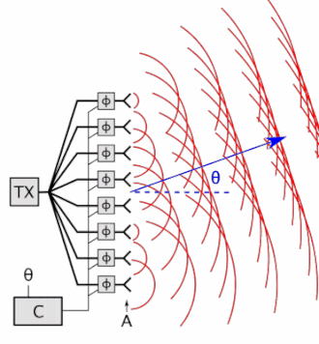

Beam-steering
Delay-sum beamformer or Phased array
Notes:
http://www.waves.utoronto.ca/prof/svhum/ece422/notes/15-arrays2.pdf

Slide 46
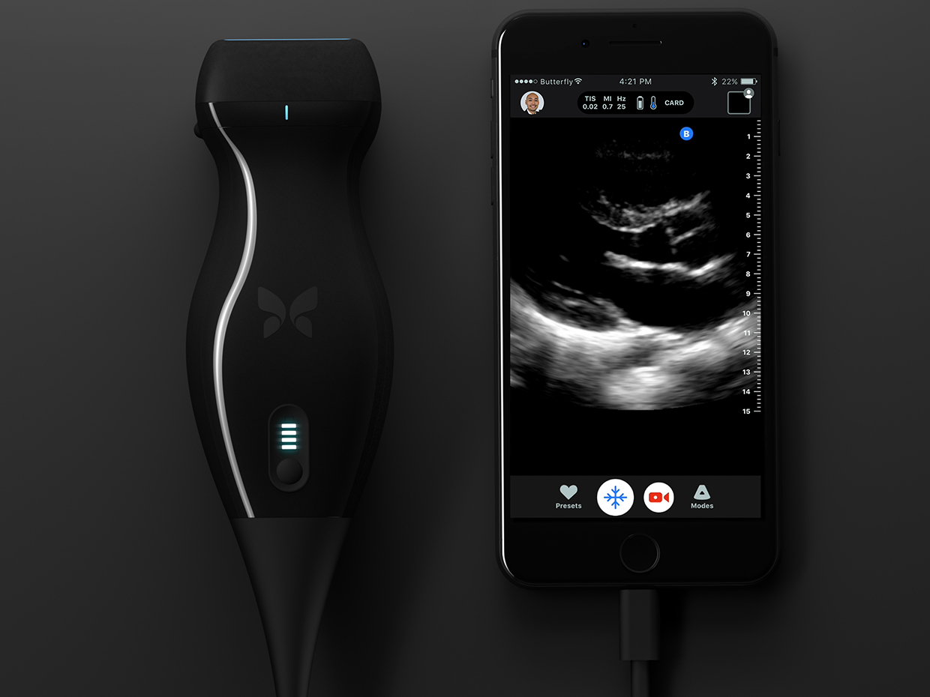
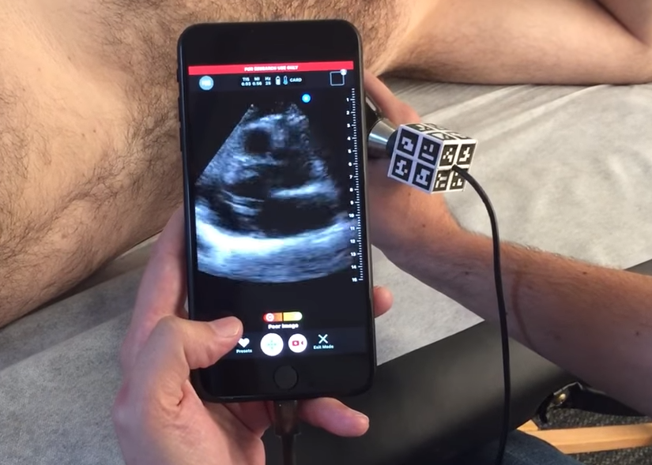

Slide 47
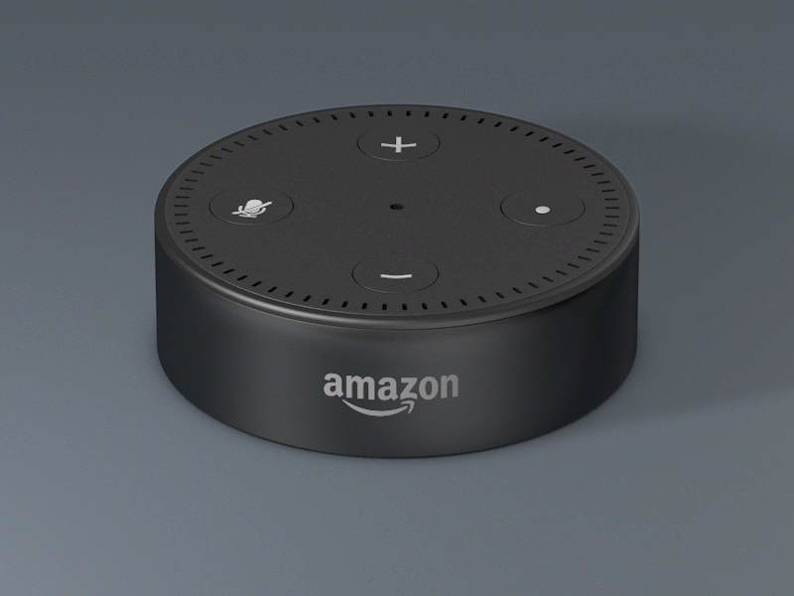

Slide 48
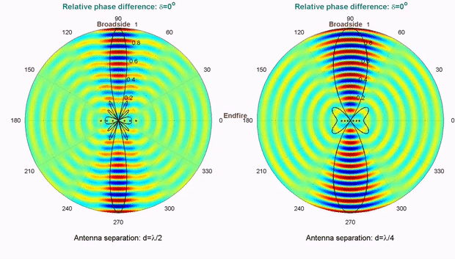
Computationally controlling beam direction

Slide 49
Extra Slide for reference
(not taught in class)

Slide 50
Finding distance using waves

Slide 51
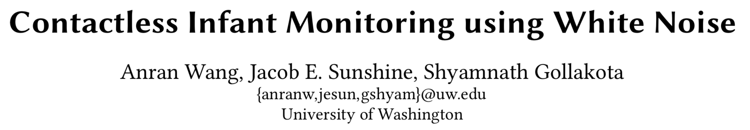
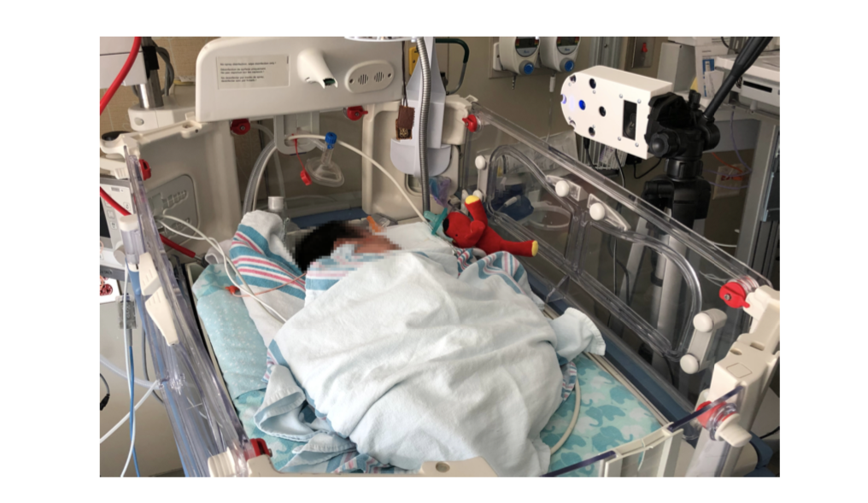

Slide 52
Finding distance using waves
(Ranging)

Slide 53
…
SONAR
(detection)
Depth/Image
Gesture

Slide 54
…
SONAR
(detection)
Depth/Image
Gesture
Finding distance using waves
(Ranging)

Slide 55
…
SONAR
(detection)
Depth/Image
Gesture
Finding distance using waves
(Ranging)
Speed
Amplitude
Frequency
Phase

Slide 56
1. Distance from the speed information
a. Techniques
b. Signal detection
2. Distance from the amplitude information
a. Absorption
b. Propagation loss
3. Distance from the frequency information
a. Doppler effect
b. A case study (Doppler + Triangulation)
4. Distance from the phase information
a. Overview
b. Impulse function, Impulse response, Convolution
c. A case study

Slide 57
1. Distance from the speed information
a. Techniques
b. Signal detection
2. Distance from the amplitude information
a. Absorption
b. Propagation loss
3. Distance from the frequency information
a. Doppler effect
b. A case study (Doppler + Triangulation)
4. Distance from the phase information
a. Overview
b. Impulse function, Impulse response, Convolution
c. A case study

Slide 58
Distance from the speed information
Dist. = (speed) X (time of travel)
Time of Arrival (ToA)
Signal source
observer

Slide 59
Distance from the speed information
Dist. = (speed) X (time of travel)
Time of Arrival (ToA)
Signal source
observer
Signal source
Time Difference of Arrival (TDoA)
observer 1
observer2

Slide 60
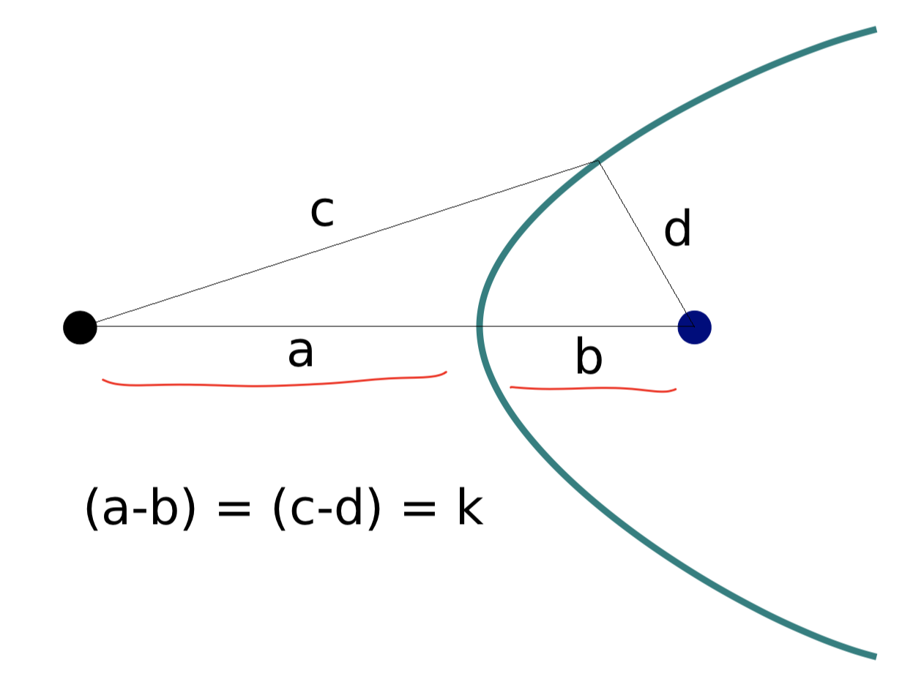
TDoA
a
b
Find the location of the wave source when (a-b) is known.

Slide 61
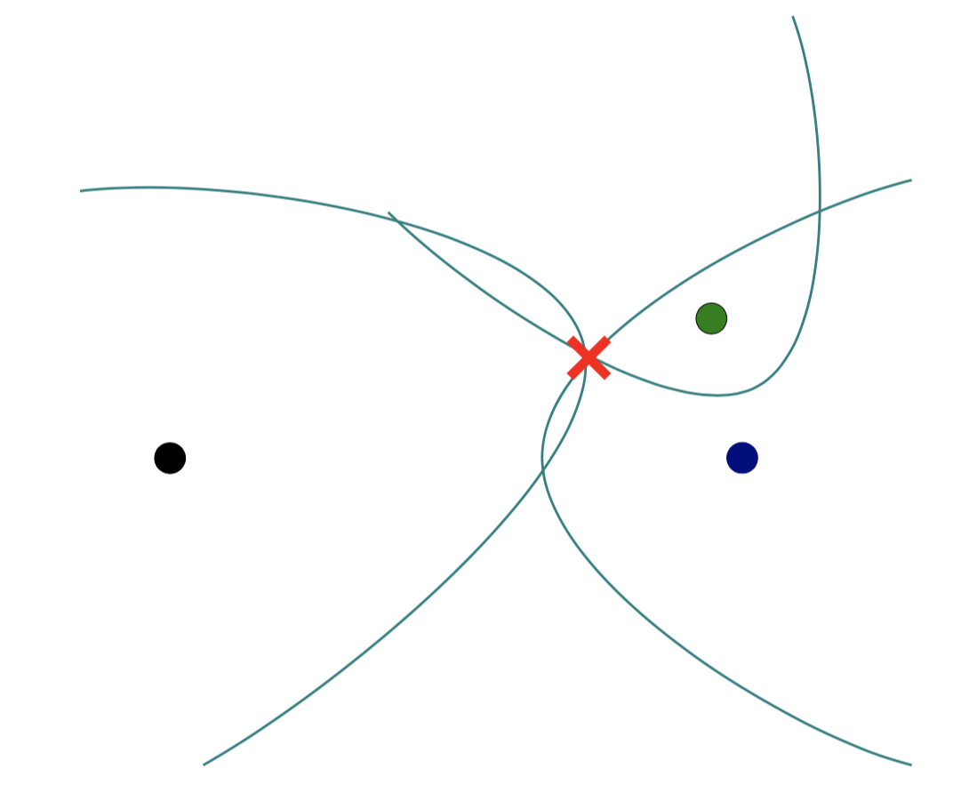
TDoA

Slide 62
Distance from the speed information
Dist. = (speed) X (time of travel)
Time of Arrival (ToA)
Signal source
observer
Signal source
Time Difference of Arrival (TDoA)
observer 1
observer2
Round-trip Time of Flight (RToF)
Signal source
+ observer
Reflector

Slide 63
Distance from the speed information
Dist. = (speed) X (time of travel)
Time of Arrival (ToA)
Signal source
observer
How to detect the signal at the receiver/observer?
Signal source
Time Difference of Arrival (TDoA)
observer 1
observer2
Round-trip Time of Flight (RToF)
Signal source
+ observer
Reflector

Slide 64
Signal detection
Amplitude
Time/Sample
Transmitter signal

Slide 65
Signal detection
Amplitude
Amplitude
Time/Sample
Time/Sample
Transmitter signal
Receiver signal

Slide 66
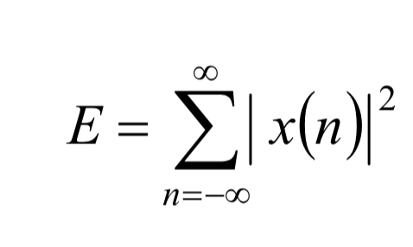
Signal detection
Amplitude
Amplitude
Time/Sample
Time/Sample
Transmitter signal
Receiver signal
Energy based signal detector
Energy of a discrete signal x(n),

Slide 67
Signal detection
Amplitude
Amplitude
Time/Sample
Time/Sample
Transmitter signal
Receiver signal

Slide 68
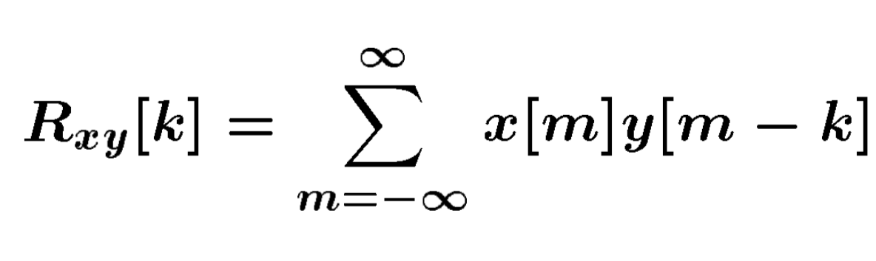
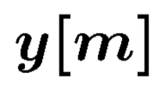
Signal detection
Received signal
Signal matching
Transmit signal template

Slide 69
Signal detection
Received signal
Signal matching
Transmit signal template
Correlation

Slide 70
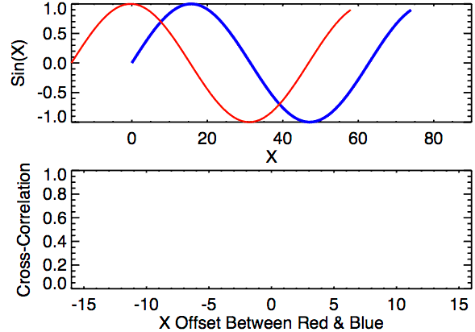
Signal detection
Correlation

Slide 71
Distance from the speed information
Dist. = (speed) X (time of travel)
Time of Arrival (ToA)
Signal source
observer
Time Difference of Arrival (TDoA)
Signal source
observer 1
observer2
Round-trip Time of Flight (RToF)
Signal source
+ observer
Reflector
Notes:
Slide 23: 20 minutes

Slide 72
1. Distance from the speed information
a. Techniques
b. Signal detection
2. Distance from the amplitude information
a. Absorption
b. Propagation loss
3. Distance from the frequency information
a. Doppler effect
b. A case study (Doppler + Triangulation)
4. Distance from the phase information
a. Overview
b. Impulse function, Impulse response, Convolution
c. A case study

Slide 73

Distance from the amplitude information
Amplitude
Time (sec)
$$AS . sin⁡(2πft)$$

Slide 74

Distance from the amplitude information
Dist. = d
Amplitude
Time (sec)
Amplitude
Time (sec)
$$AS . sin⁡(2πft)$$
$$AO . sin⁡(2πft)$$

Slide 75
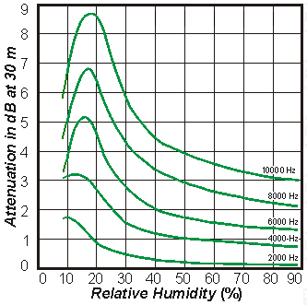
Distance from the amplitude information
Dist. = d
Amplitude
Time (sec)
Amplitude
Time (sec)
$$AS . sin⁡(2πft)$$
$$AO . sin⁡(2πft)$$
Attenuation due to atmospheric absorption and diffraction

Slide 76
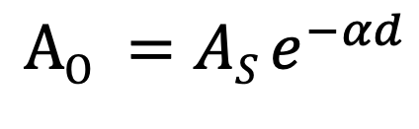
Distance from the amplitude information
Dist. = d
Amplitude
Time (sec)
Amplitude
Time (sec)
$$AS . sin⁡(2πft)$$
$$AO . sin⁡(2πft)$$
$$AO =AS e^{−αd}$$
α = attenuation coefficient
Depends on frequency and
environment ( temperature, humidity etc.)

Slide 77
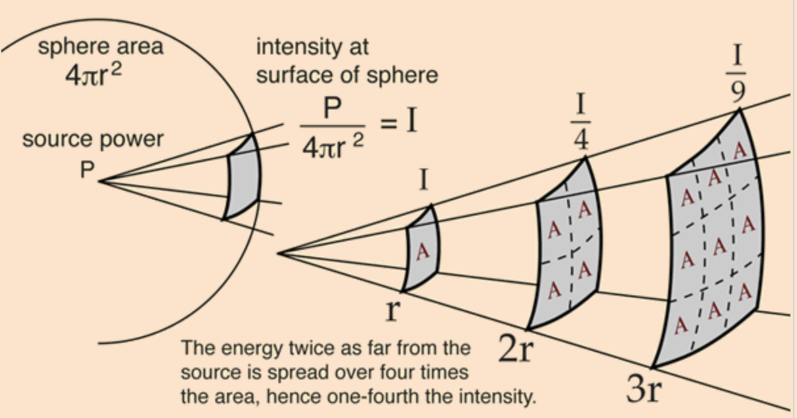
Distance from the amplitude information
Propagation loss

Slide 78
Distance from the amplitude information
Propagation loss
Notes:
Slide 30: 25 minutes

Slide 79
1. Distance from the speed information
a. Techniques
b. Signal detection
2. Distance from the amplitude information
a. Absorption
b. Propagation loss
3. Distance from the frequency information
a. Doppler effect
b. A case study (Doppler + Triangulation)
4. Distance from the phase information
a. Overview
b. Impulse function, Impulse response, Convolution
c. A case study

Slide 80
Distance from the frequency information
Motion of the sound source and/or the observer changes the frequency of the observed signal.
The change depends on the velocity of the source/observer.
This phenomena is known as Doppler effect or Doppler shift.

Slide 81
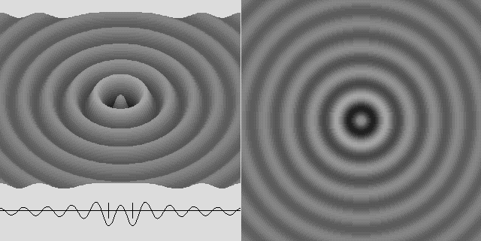
Doppler effect

Slide 82

Doppler effect

Slide 83
Doppler effect

Slide 84
Doppler effect
Simple wave model: Stationary source

Slide 85
Doppler effect
Simple wave model: Stationary source
Time = t1

Slide 86
Doppler effect
Simple wave model: Stationary source
Time = t2

Slide 87
Doppler effect
Simple wave model: Stationary source
Time = t2

Slide 88
Doppler effect
Simple wave model: Stationary source
Time = t3

Slide 89
Doppler effect
Simple wave model: Stationary source
Time = t3

Slide 90
Doppler effect
Simple wave model: Stationary source
Wavelength = λ meters
Time = t3

Slide 91
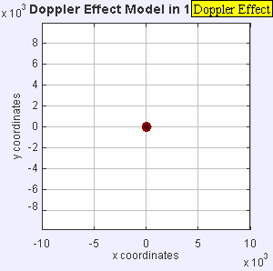
Doppler effect

Slide 92
Doppler effect
Simple wave model: Moving source

Slide 93
Doppler effect
Simple wave model: Moving source
Time = t1

Slide 94
Doppler effect
Simple wave model: Moving source
Time = t2

Slide 95
Doppler effect
Simple wave model: Moving source
Time = t2

Slide 96
Doppler effect
Simple wave model: Moving source
Time = t2

Slide 97
Doppler effect
Simple wave model: Moving source
Time = t3

Slide 98
Doppler effect
Simple wave model: Moving source
Time = t3

Slide 99
Doppler effect
Simple wave model: Moving source
Time = t3

Slide 100
Doppler effect
Simple wave model: Moving source
Actual wavelength = λ meters
Wavelength = λ₂ meters
Wavelength = λ₁ meters
Time = t3
Notes:
Slide 19: 2 minutes 30 seconds

Slide 101
Doppler effect
Simple wave model: Moving source
Actual wavelength = λ meters
Observer
Wavelength = λ₂ meters
Wavelength = λ₁ meters
Time = t3
Notes:
Slide 19: 2 minutes 30 seconds

Slide 102
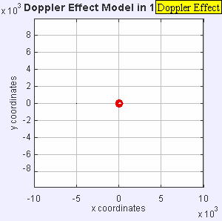
Doppler effect

Slide 103
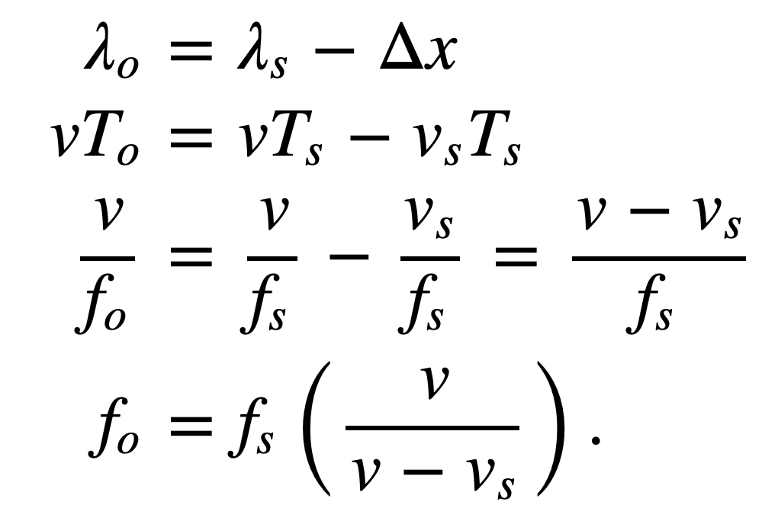
Doppler effect
Simple wave model: Moving source
Source moving towards the observer
v = Velocity of the signal (sound, light etc.)
v_{O} , T_{O} , f_{O} = Velocity of the observer and observed period and frequency
v_{S} , T_{S} , f_{S} = Velocity of the source and original period and frequency
Notes:
Slide 19: 2 minutes 30 seconds

Slide 104
Doppler effect
Simple wave model: Moving observer
Observer

Slide 105
Doppler effect
Simple wave model: Moving observer
t
t
Observer

Slide 106
Doppler effect
Simple wave model: Moving observer
t’ <t
t’ <t

Slide 107
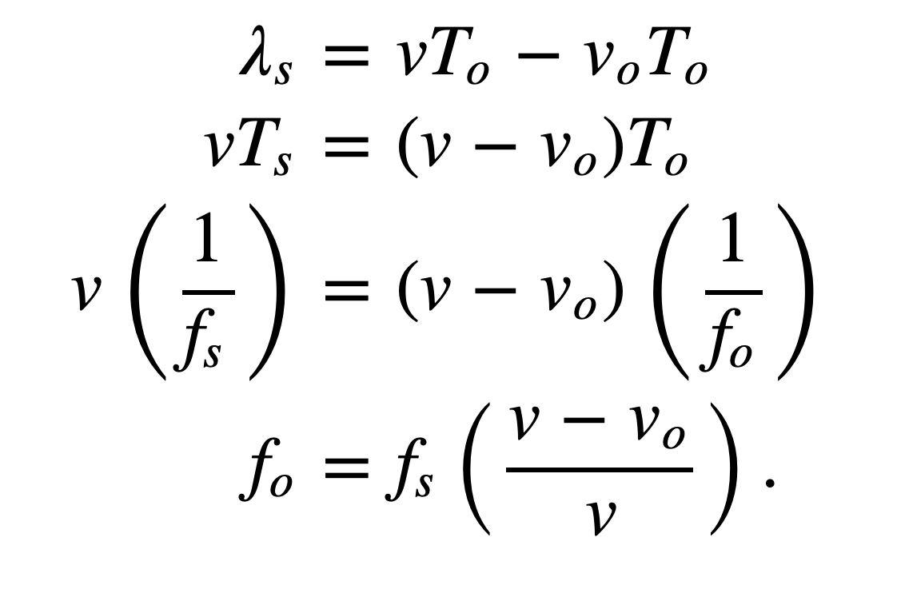
Doppler effect
Simple wave model: Moving observer
Observer moving towards the stationary source
+
+
+
+
v_{O} , T_{O} , f_{O} = Velocity of the observer and observed period and frequency
v_{S} , T_{S} , f_{S} = Velocity of the source and original period and frequency

Slide 108
Doppler effect
Simple wave model: Moving observer
Observer moving towards the stationary source
+
Doppler shift, Δf = f_{O}-f_{S} = f_{S} (v_{O}/v)
+
+
How will it change with signal’s velocity and frequency?
+
v_{O} , T_{O} , f_{O} = Velocity of the observer and observed period and frequency
v_{S} , T_{S} , f_{S} = Velocity of the source and original period and frequency

Slide 109
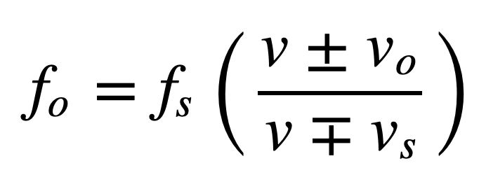
Doppler effect
Simple wave model: Moving observer
Both the source and the observer are moving
v_{O} , T_{O} , f_{O} = Velocity of the observer and observed period and frequency
v_{S} , T_{S} , f_{S} = Velocity of the source and original period and frequency
Notes:
Slide 58: 30 minutes

Slide 110
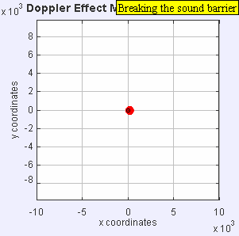
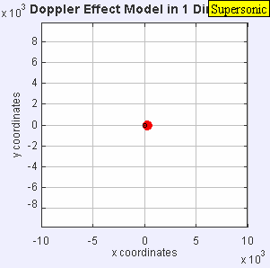
Doppler effect

Slide 111
Doppler effect

