Slide 1

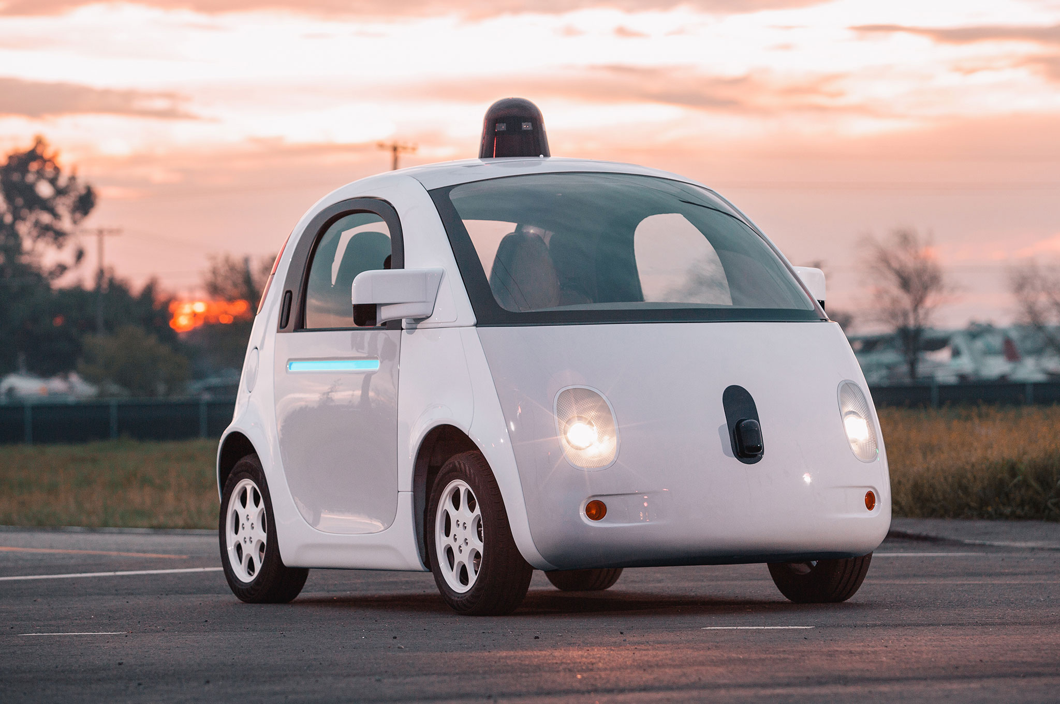
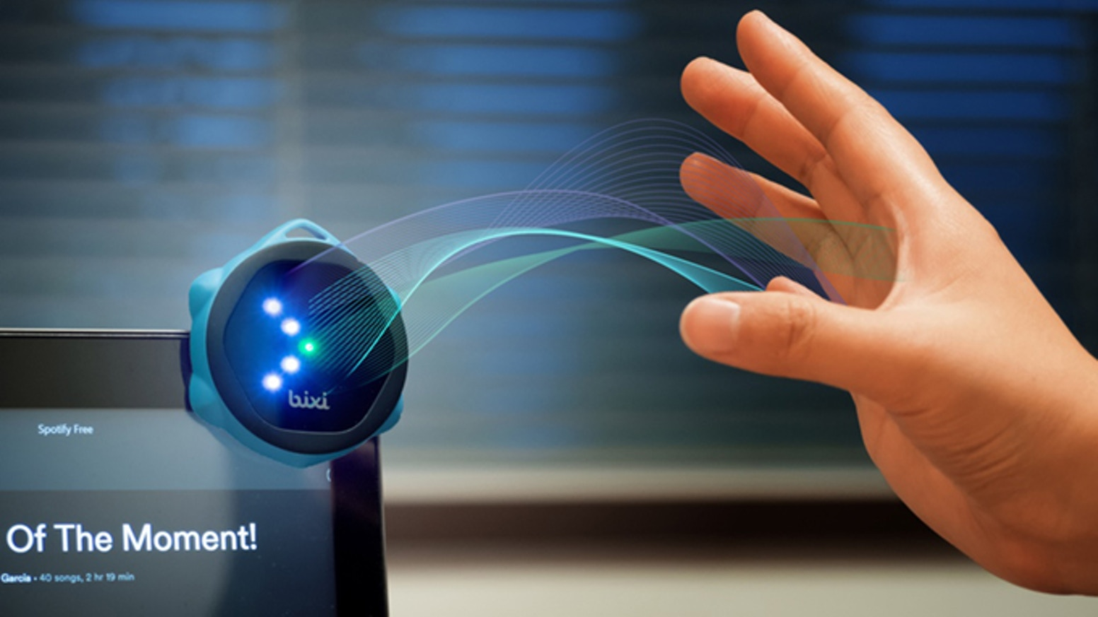
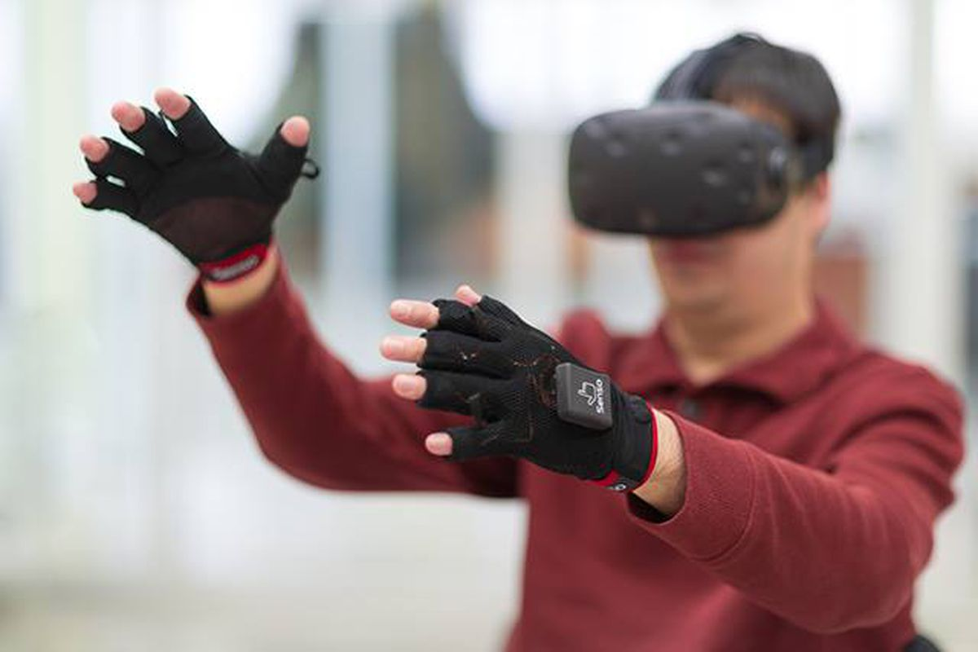

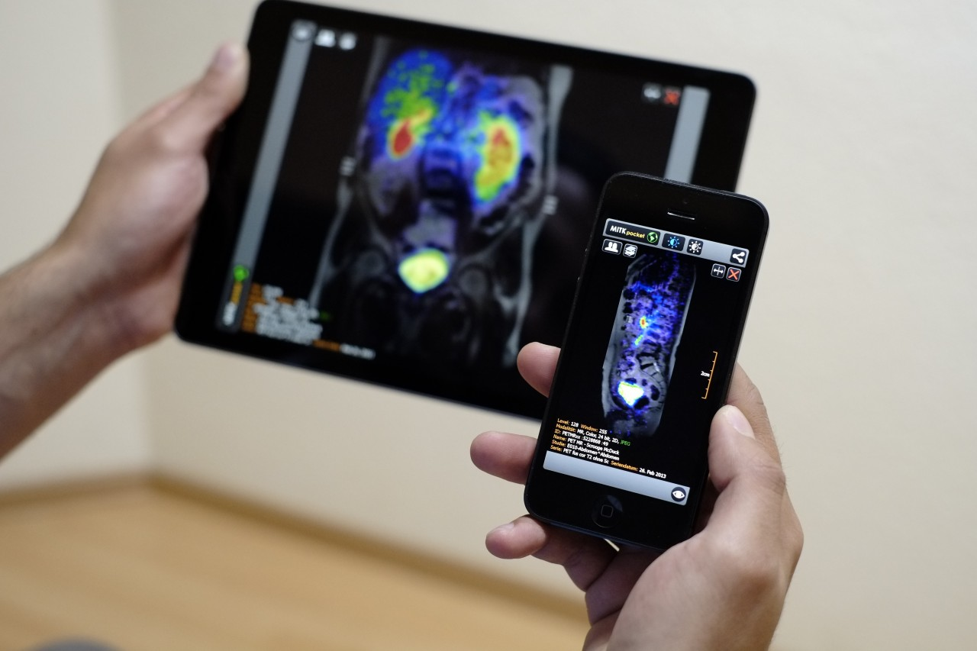
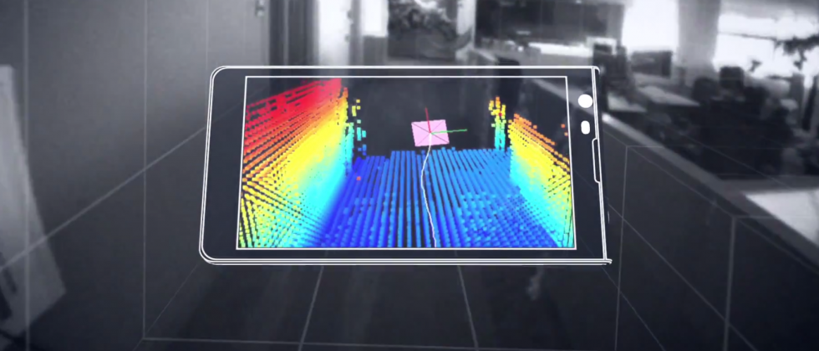
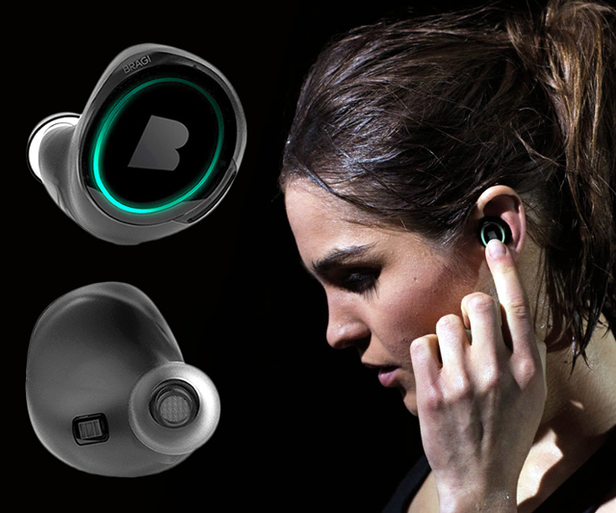
Wireless and Mobile Systems
for the IoT
CMSC 715 : Fall 2022
Lecture 2.5: Direction of arrival (Cont…)
Nirupam Roy
Tu-Th 12:30-1:45pm
CSI 3120 (temporary location CSI 2118)

Slide 2
Angle-of-Arrival (AoA)
or
Direction-of-Arrival (DoA)

Slide 3
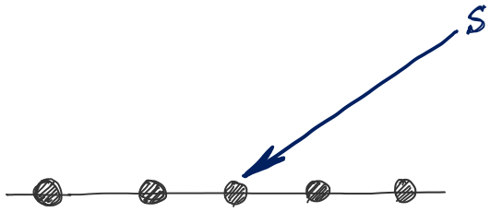
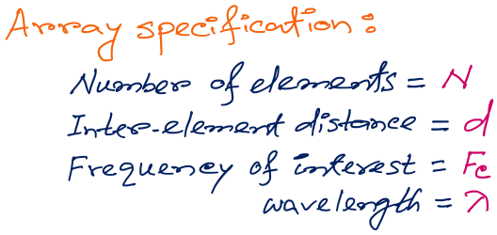
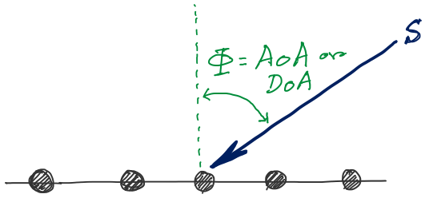
d
d
d
d
Notes:
http://www.waves.utoronto.ca/prof/svhum/ece422/notes/15-arrays2.pdf

Slide 4

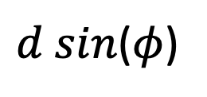




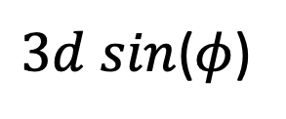


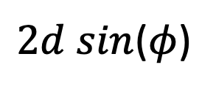
DoA Estimation
$3d sin$($φ$)
$2d sin$($φ$)
$d sin$($φ$)
$$E1$$
$$E2$$
$$E3$$
$$E4$$
…
N elements
$$d$$
$$d$$
$$d$$
Interelement distance = d

Slide 5
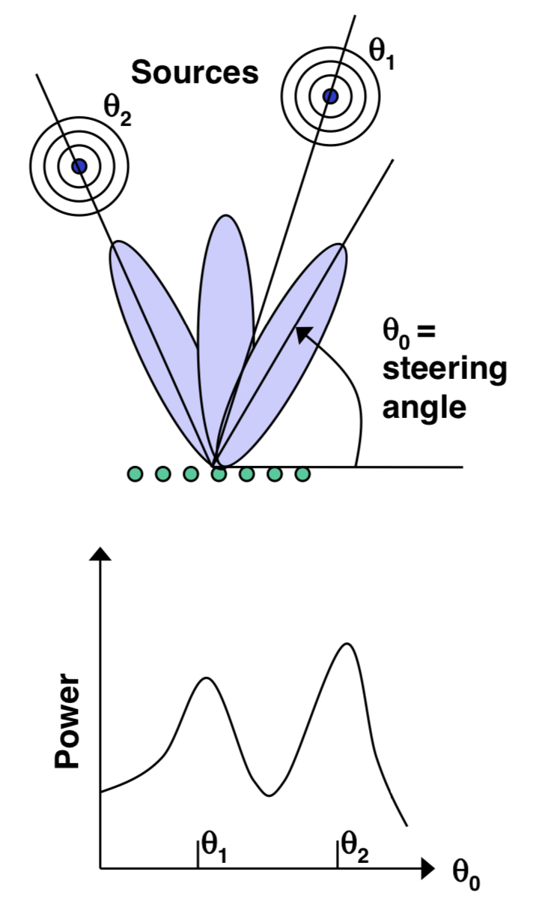
DoA Estimation: Beam-scanning

Slide 6
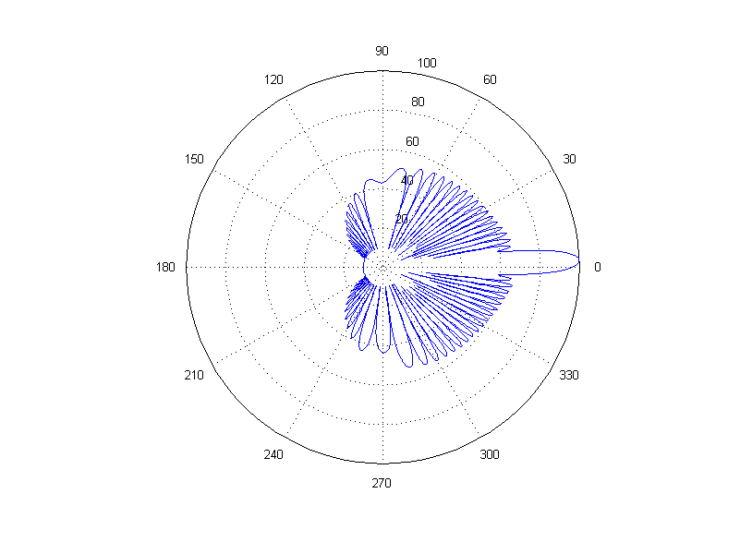
DoA Estimation: Beam-scanning
Number of elements = 30, wave length = 10cm, distance between elements = 6.5 cm
Notes:
http://www.waves.utoronto.ca/prof/svhum/ece422/notes/15-arrays2.pdf

Slide 7
Delay-sum DoA estimation

Slide 8
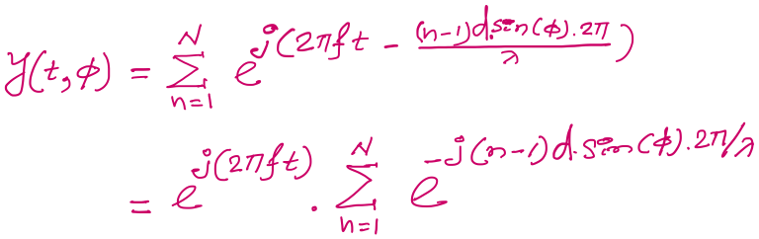

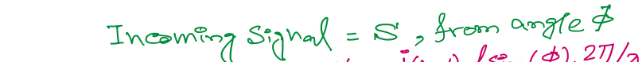
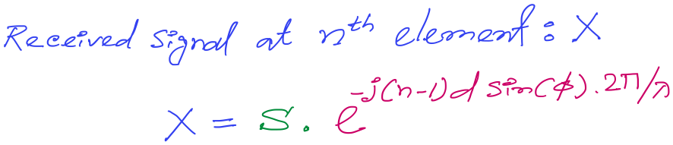
DoA Estimation: Delay-sum
Notes:
http://www.waves.utoronto.ca/prof/svhum/ece422/notes/15-arrays2.pdf

Slide 9
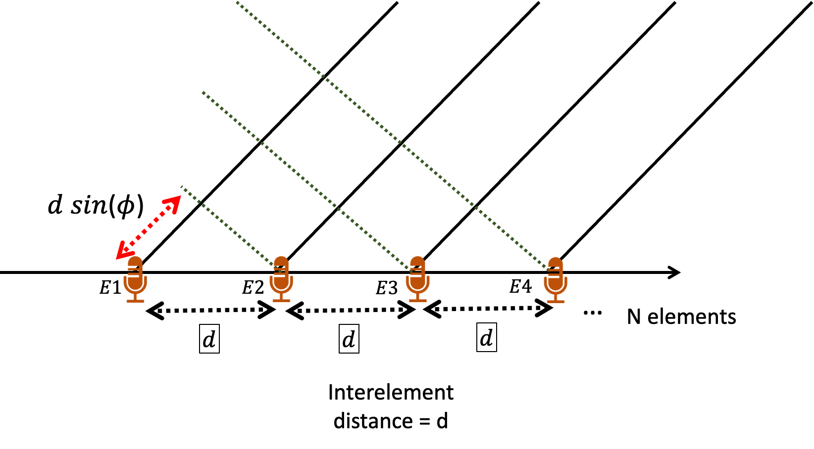
DoA Estimation: Delay-sum
For 3rd mic, n == 3
Notes:
http://www.waves.utoronto.ca/prof/svhum/ece422/notes/15-arrays2.pdf

Slide 10
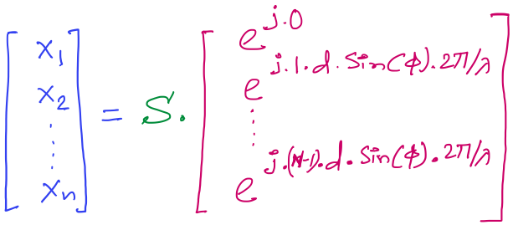

DoA Estimation: Delay-sum
Received signals in all elements:
…
Note: Here the samples from individual sensors are collected separately and simultaneously, not added together.
Steering vector
Notes:
http://www.waves.utoronto.ca/prof/svhum/ece422/notes/15-arrays2.pdf

Slide 11
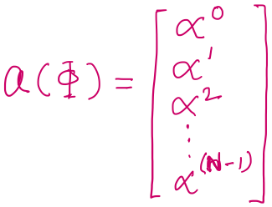

DoA Estimation: Delay-sum
Received signals in all elements:
Notes:
http://www.waves.utoronto.ca/prof/svhum/ece422/notes/15-arrays2.pdf

Slide 12
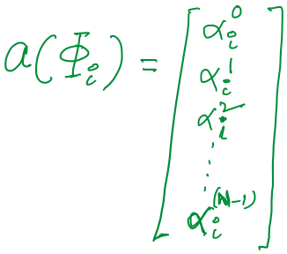

DoA Estimation: Delay-sum

Slide 13
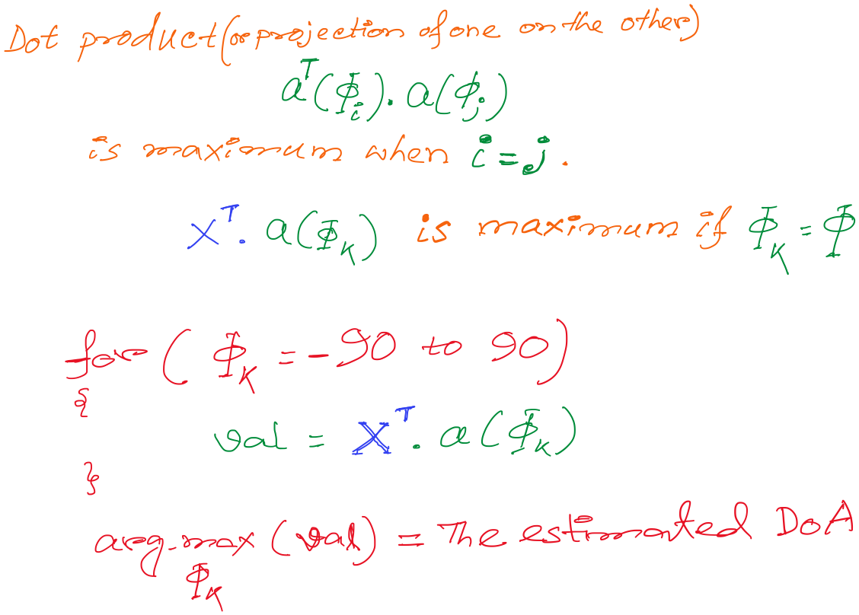
DoA Estimation: Delay-sum

Slide 14
DoA Estimation: Delay-sum

Slide 15
DoA Estimation: Delay-sum
How is this a “delay -sum” ?

Slide 16
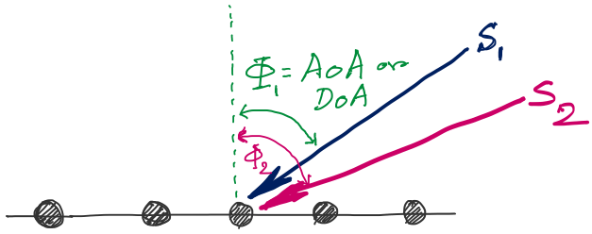
DoA Estimation
d
d
d
d
Notes:
http://www.waves.utoronto.ca/prof/svhum/ece422/notes/15-arrays2.pdf

Slide 17
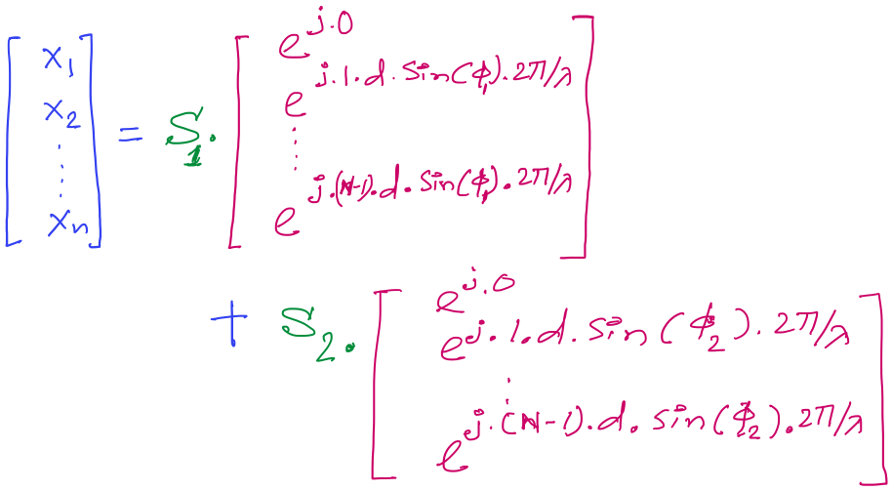
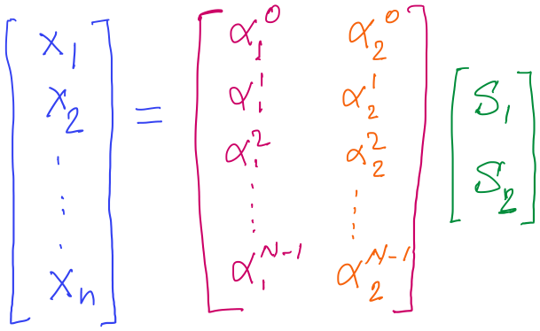
DoA Estimation

Slide 18
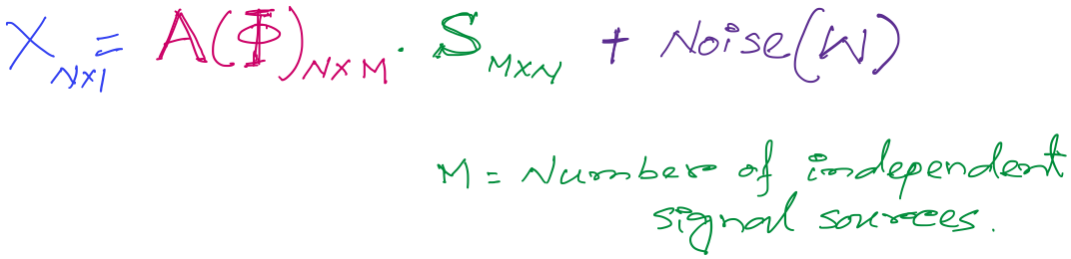
DoA Estimation
Mx1
Steering matrix

Slide 19
A different approach to DoA estimation

Slide 20
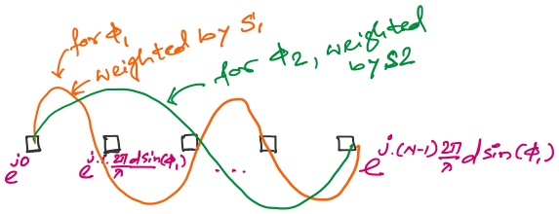
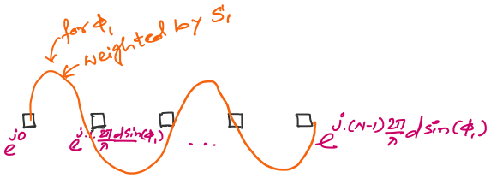
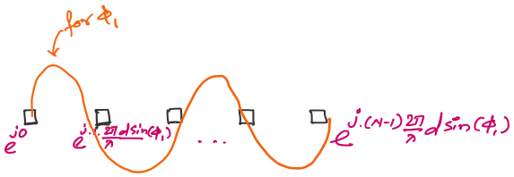

An observation on the spatial samples

Slide 21
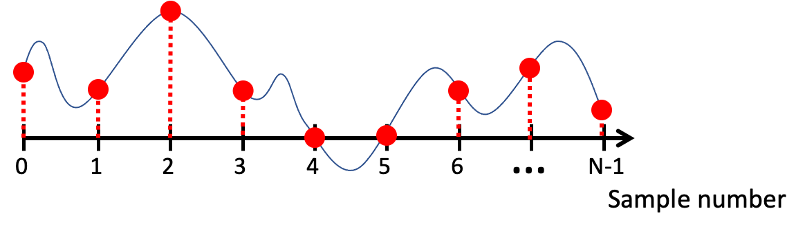
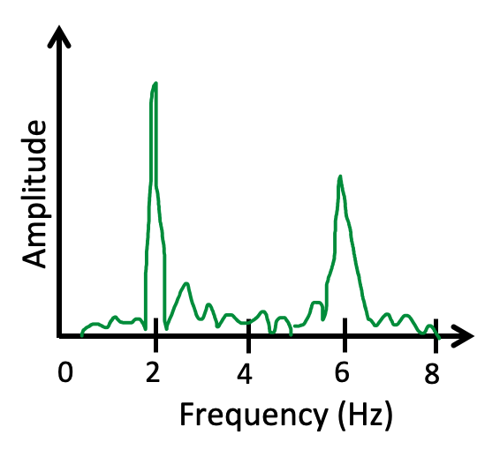
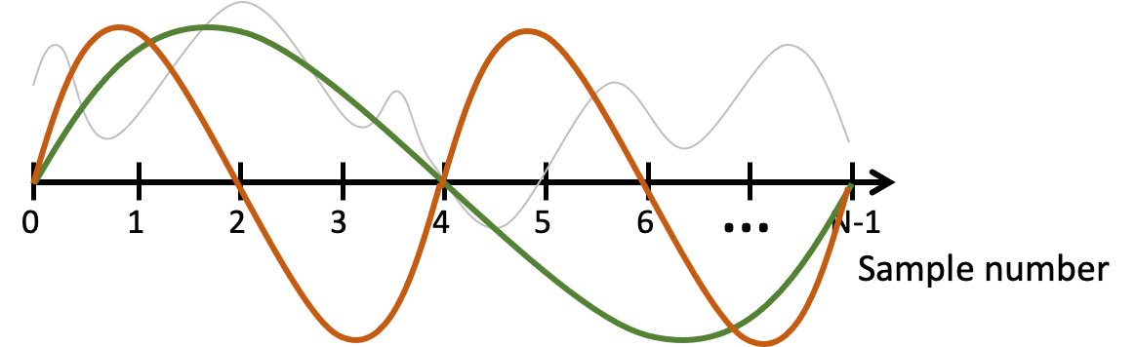
FFT
Arbitrary signals can be represented as a combination of sinusoids

Slide 22
FFT
Arbitrary signals can be represented as a combination of sinusoids
Agnostic of the type of signal or sampling details

Slide 23
FFT
Arbitrary signals can be represented as a combination of sinusoids

Slide 24
FFT
Arbitrary signals can be represented as a combination of sinusoids

Slide 25
DoA Estimation : Classical FFT approach

Slide 26
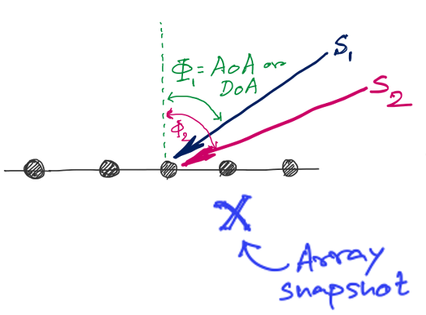
DoA Estimation : Classical FFT approach
FFT
Amplitude
0
4
8
12
16
Frequency (Hz) ??

Slide 27
Discrete Fourier Transform
…
0
1
2
3
4
5
6
N-1
Sample number
X = [ ]
x[0], x[1], x[2], x[3], x[4], … x[N-1]

Slide 28
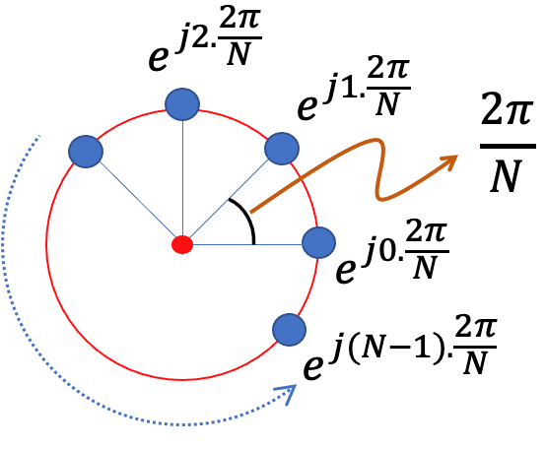
Discrete Fourier Transform
…
0
1
2
3
4
5
6
N-1
Sample number
Slowest frequency goes $\frac{2π}{N}$ radians per step.

Slide 29
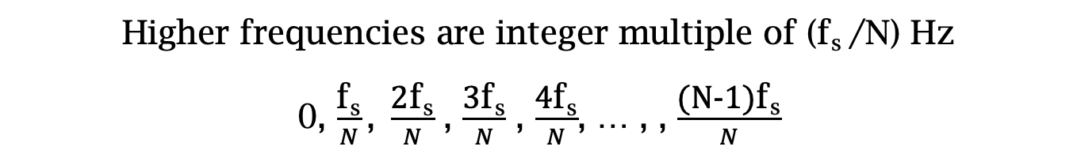
Estimating the real-world frequencies
Sampling frequency = f_{s} (i.e., f_{s} samples per second)
Slowest frequency ($\frac{2π}{N}$ radians per step) = N samples per rotation
= (N/ f_{s}) seconds per rotation
Therefore, the slowest frequency = (f_{s} /N) Hz
Higher frequencies are integer multiple of (f_{s} /N) Hz
0, $\frac{\text{f}\text{s}}{N}\text{, }\frac{\text{2}\text{f}\text{s}}{N}$ , $\frac{\text{3}\text{f}\text{s}}{N}$ , $\frac{\text{4}\text{f}\text{s}}{N}$, … , , $\frac{\text{(}\text{N}\text{−1)}\text{f}\text{s}}{N}$

Slide 30
Discrete Fourier Transform
…
0
1
2
3
4
5
6
N-1
Sample number
Slowest frequency goes $\frac{2π}{N}$ radians per step.

Slide 31
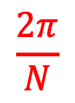
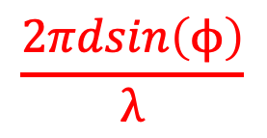

Discrete Fourier Transform
…
0
1
2
3
4
5
6
N-1
Sample number
$$\frac{2π}{N}$$
$$\frac{2πdsin\left(ϕ\right)}{λ}$$
$$=$$

Slide 32
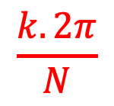
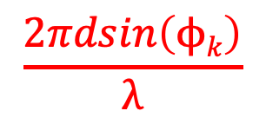

Discrete Fourier Transform
…
0
1
2
3
4
5
6
N-1
Sample number
$$\frac{k.2π}{N}$$
$$\frac{2πdsin\left(ϕk\right)}{λ}$$
$$=$$

Slide 33

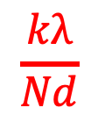
Discrete Fourier Transform
…
0
1
2
3
4
5
6
N-1
Sample number
$$\frac{kλ}{Nd}$$
$$ϕk$$
$$=$$
asin( )

Slide 34
DoA Estimation : Classical FFT approach
What is the minimum and maximum value of the inter-element distance (d)?
d
d
d
d

Slide 35
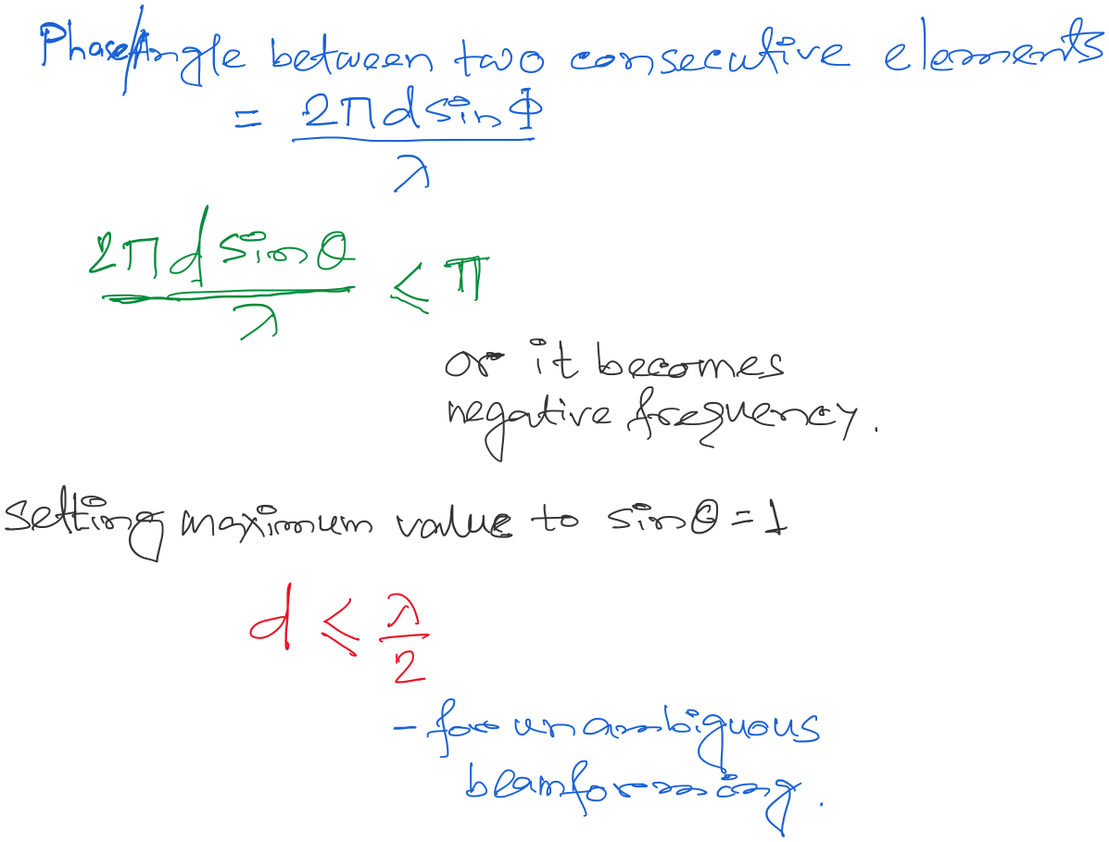
DoA Estimation : Classical FFT approach

Slide 36
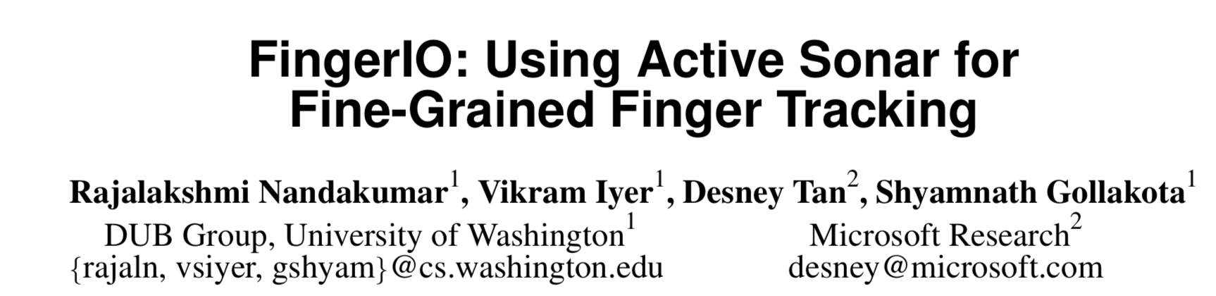

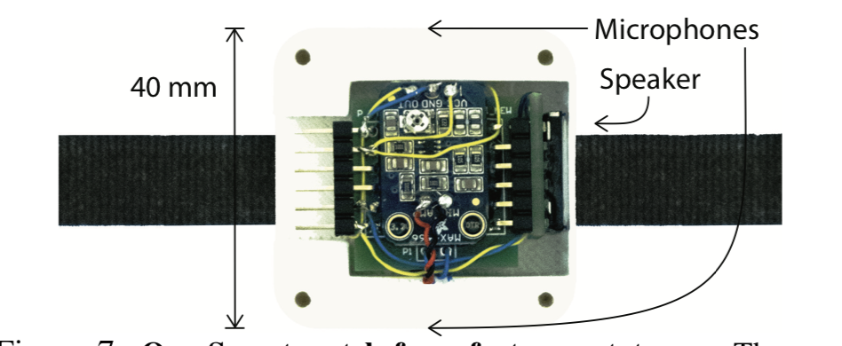
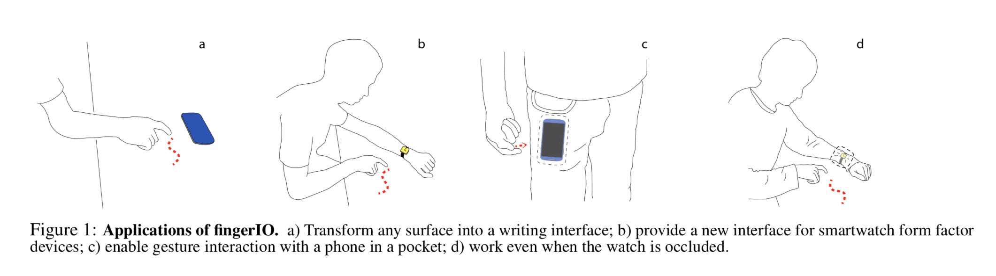

Slide 37
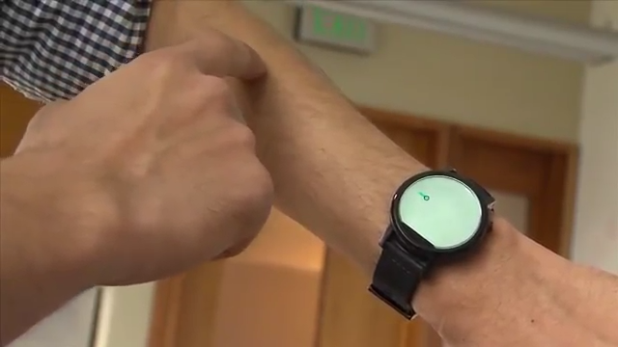

Slide 38
Announcements
Assignment-1 scores are out. Congratulations!
Papers for class presentations are released.
Prepare a list of choices and wait for the FCFS
slot selection on Friday 12noon.
3) Assignment-2 will be released today.

Slide 39
Extra slides
(not covered in lecture)

Slide 40
Hint for assignment-2: Signal detection
Amplitude
Time/Sample
Transmitter signal

Slide 41
Hint for assignment-2: Signal detection
Amplitude
Amplitude
Time/Sample
Time/Sample
Transmitter signal
Receiver signal

Slide 42
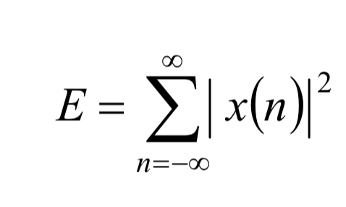
Hint for assignment-2: Signal detection
Amplitude
Amplitude
Time/Sample
Time/Sample
Transmitter signal
Receiver signal
Energy based signal detector
Energy of a discrete signal x(n),

Slide 43
Signal detection
Amplitude
Amplitude
Time/Sample
Time/Sample
Transmitter signal
Receiver signal

Slide 44
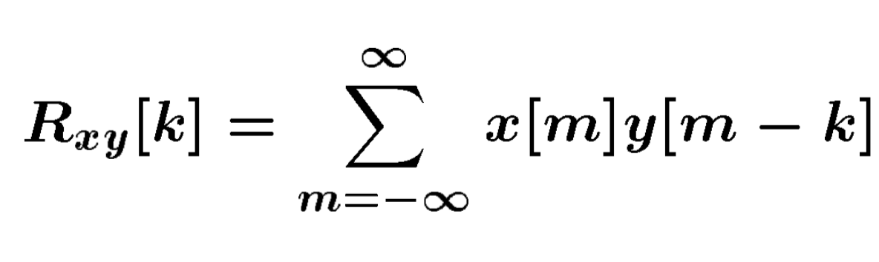
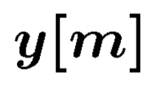
Signal detection
Received signal
Signal matching
Transmit signal template

Slide 45
Signal detection
Received signal
Signal matching
Transmit signal template
Correlation

Slide 46
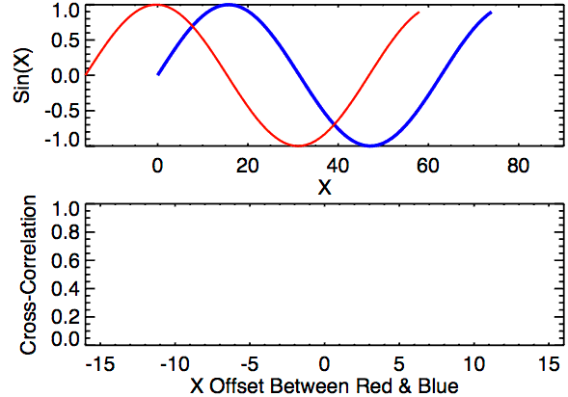
Signal detection
Correlation

Slide 47
Extra Slide for reference
(not presented in class)

Slide 48
Finding distance using waves

Slide 49
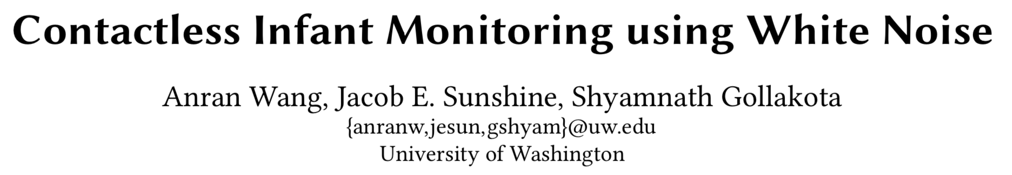


Slide 50
Finding distance using waves
(Ranging)

Slide 51
…
SONAR
(detection)
Depth/Image
Gesture

Slide 52
…
SONAR
(detection)
Depth/Image
Gesture
Finding distance using waves
(Ranging)

Slide 53
…
SONAR
(detection)
Depth/Image
Gesture
Finding distance using waves
(Ranging)
Speed
Amplitude
Frequency
Phase

Slide 54
1. Distance from the speed information
a. Techniques
b. Signal detection
2. Distance from the amplitude information
a. Absorption
b. Propagation loss
3. Distance from the frequency information
a. Doppler effect
b. A case study (Doppler + Triangulation)
4. Distance from the phase information
a. Overview
b. Impulse function, Impulse response, Convolution
c. A case study

Slide 55
1. Distance from the speed information
a. Techniques
b. Signal detection
2. Distance from the amplitude information
a. Absorption
b. Propagation loss
3. Distance from the frequency information
a. Doppler effect
b. A case study (Doppler + Triangulation)
4. Distance from the phase information
a. Overview
b. Impulse function, Impulse response, Convolution
c. A case study

Slide 56
Distance from the speed information
Dist. = (speed) X (time of travel)
Time of Arrival (ToA)
Signal source
observer

Slide 57
Distance from the speed information
Dist. = (speed) X (time of travel)
Time of Arrival (ToA)
Signal source
observer
Signal source
Time Difference of Arrival (TDoA)
observer 1
observer2

Slide 58

TDoA
a
b
Find the location of the wave source when (a-b) is known.

Slide 59

TDoA

Slide 60
Distance from the speed information
Dist. = (speed) X (time of travel)
Time of Arrival (ToA)
Signal source
observer
Signal source
Time Difference of Arrival (TDoA)
observer 1
observer2
Round-trip Time of Flight (RToF)
Signal source
+ observer
Reflector

Slide 61
Distance from the speed information
Dist. = (speed) X (time of travel)
Time of Arrival (ToA)
Signal source
observer
How to detect the signal at the receiver/observer?
Signal source
Time Difference of Arrival (TDoA)
observer 1
observer2
Round-trip Time of Flight (RToF)
Signal source
+ observer
Reflector

Slide 62
Signal detection
Amplitude
Time/Sample
Transmitter signal

Slide 63
Signal detection
Amplitude
Amplitude
Time/Sample
Time/Sample
Transmitter signal
Receiver signal

Slide 64
Signal detection
Amplitude
Amplitude
Time/Sample
Time/Sample
Transmitter signal
Receiver signal
Energy based signal detector
Energy of a discrete signal x(n),

Slide 65
Signal detection
Amplitude
Amplitude
Time/Sample
Time/Sample
Transmitter signal
Receiver signal

Slide 66
Signal detection
Received signal
Signal matching
Transmit signal template

Slide 67
Signal detection
Received signal
Signal matching
Transmit signal template
Correlation

Slide 68
Signal detection
Correlation

Slide 69
Distance from the speed information
Dist. = (speed) X (time of travel)
Time of Arrival (ToA)
Signal source
observer
Time Difference of Arrival (TDoA)
Signal source
observer 1
observer2
Round-trip Time of Flight (RToF)
Signal source
+ observer
Reflector
Notes:
Slide 23: 20 minutes

Slide 70
1. Distance from the speed information
a. Techniques
b. Signal detection
2. Distance from the amplitude information
a. Absorption
b. Propagation loss
3. Distance from the frequency information
a. Doppler effect
b. A case study (Doppler + Triangulation)
4. Distance from the phase information
a. Overview
b. Impulse function, Impulse response, Convolution
c. A case study

Slide 71

Distance from the amplitude information
Amplitude
Time (sec)
$$AS . sin⁡(2πft)$$

Slide 72

Distance from the amplitude information
Dist. = d
Amplitude
Time (sec)
Amplitude
Time (sec)
$$AS . sin⁡(2πft)$$
$$AO . sin⁡(2πft)$$

Slide 73

Distance from the amplitude information
Dist. = d
Amplitude
Time (sec)
Amplitude
Time (sec)
$$AS . sin⁡(2πft)$$
$$AO . sin⁡(2πft)$$
Attenuation due to atmospheric absorption and diffraction

Slide 74

Distance from the amplitude information
Dist. = d
Amplitude
Time (sec)
Amplitude
Time (sec)
$$AS . sin⁡(2πft)$$
$$AO . sin⁡(2πft)$$
$$AO =AS e^{−αd}$$
α = attenuation coefficient
Depends on frequency and
environment ( temperature, humidity etc.)

Slide 75

Distance from the amplitude information
Propagation loss

Slide 76
Distance from the amplitude information
Propagation loss
Notes:
Slide 30: 25 minutes

Slide 77
1. Distance from the speed information
a. Techniques
b. Signal detection
2. Distance from the amplitude information
a. Absorption
b. Propagation loss
3. Distance from the frequency information
a. Doppler effect
b. A case study (Doppler + Triangulation)
4. Distance from the phase information
a. Overview
b. Impulse function, Impulse response, Convolution
c. A case study

Slide 78
Distance from the frequency information
Motion of the sound source and/or the observer changes the frequency of the observed signal.
The change depends on the velocity of the source/observer.
This phenomena is known as Doppler effect or Doppler shift.

Slide 79

Doppler effect

Slide 80

Doppler effect

Slide 81
Doppler effect

Slide 82
Doppler effect
Simple wave model: Stationary source

Slide 83
Doppler effect
Simple wave model: Stationary source
Time = t1

Slide 84
Doppler effect
Simple wave model: Stationary source
Time = t2

Slide 85
Doppler effect
Simple wave model: Stationary source
Time = t2

Slide 86
Doppler effect
Simple wave model: Stationary source
Time = t3

Slide 87
Doppler effect
Simple wave model: Stationary source
Time = t3

Slide 88
Doppler effect
Simple wave model: Stationary source
Wavelength = λ meters
Time = t3

Slide 89

Doppler effect

Slide 90
Doppler effect
Simple wave model: Moving source

Slide 91
Doppler effect
Simple wave model: Moving source
Time = t1

Slide 92
Doppler effect
Simple wave model: Moving source
Time = t2

Slide 93
Doppler effect
Simple wave model: Moving source
Time = t2

Slide 94
Doppler effect
Simple wave model: Moving source
Time = t2

Slide 95
Doppler effect
Simple wave model: Moving source
Time = t3

Slide 96
Doppler effect
Simple wave model: Moving source
Time = t3

Slide 97
Doppler effect
Simple wave model: Moving source
Time = t3

Slide 98
Doppler effect
Simple wave model: Moving source
Actual wavelength = λ meters
Wavelength = λ₂ meters
Wavelength = λ₁ meters
Time = t3
Notes:
Slide 19: 2 minutes 30 seconds

Slide 99
Doppler effect
Simple wave model: Moving source
Actual wavelength = λ meters
Observer
Wavelength = λ₂ meters
Wavelength = λ₁ meters
Time = t3
Notes:
Slide 19: 2 minutes 30 seconds

Slide 100

Doppler effect

Slide 101

Doppler effect
Simple wave model: Moving source
Source moving towards the observer
v = Velocity of the signal (sound, light etc.)
v_{O} , T_{O} , f_{O} = Velocity of the observer and observed period and frequency
v_{S} , T_{S} , f_{S} = Velocity of the source and original period and frequency
Notes:
Slide 19: 2 minutes 30 seconds

Slide 102
Doppler effect
Simple wave model: Moving observer
Observer

Slide 103
Doppler effect
Simple wave model: Moving observer
t
t
Observer

Slide 104
Doppler effect
Simple wave model: Moving observer
t’ <t
t’ <t

Slide 105

Doppler effect
Simple wave model: Moving observer
Observer moving towards the stationary source
+
+
+
+
v_{O} , T_{O} , f_{O} = Velocity of the observer and observed period and frequency
v_{S} , T_{S} , f_{S} = Velocity of the source and original period and frequency

Slide 106
Doppler effect
Simple wave model: Moving observer
Observer moving towards the stationary source
+
Doppler shift, Δf = f_{O}-f_{S} = f_{S} (v_{O}/v)
+
+
How will it change with signal’s velocity and frequency?
+
v_{O} , T_{O} , f_{O} = Velocity of the observer and observed period and frequency
v_{S} , T_{S} , f_{S} = Velocity of the source and original period and frequency

Slide 107

Doppler effect
Simple wave model: Moving observer
Both the source and the observer are moving
v_{O} , T_{O} , f_{O} = Velocity of the observer and observed period and frequency
v_{S} , T_{S} , f_{S} = Velocity of the source and original period and frequency
Notes:
Slide 58: 30 minutes

Slide 108


Doppler effect

Slide 109
Doppler effect

