Slide 1
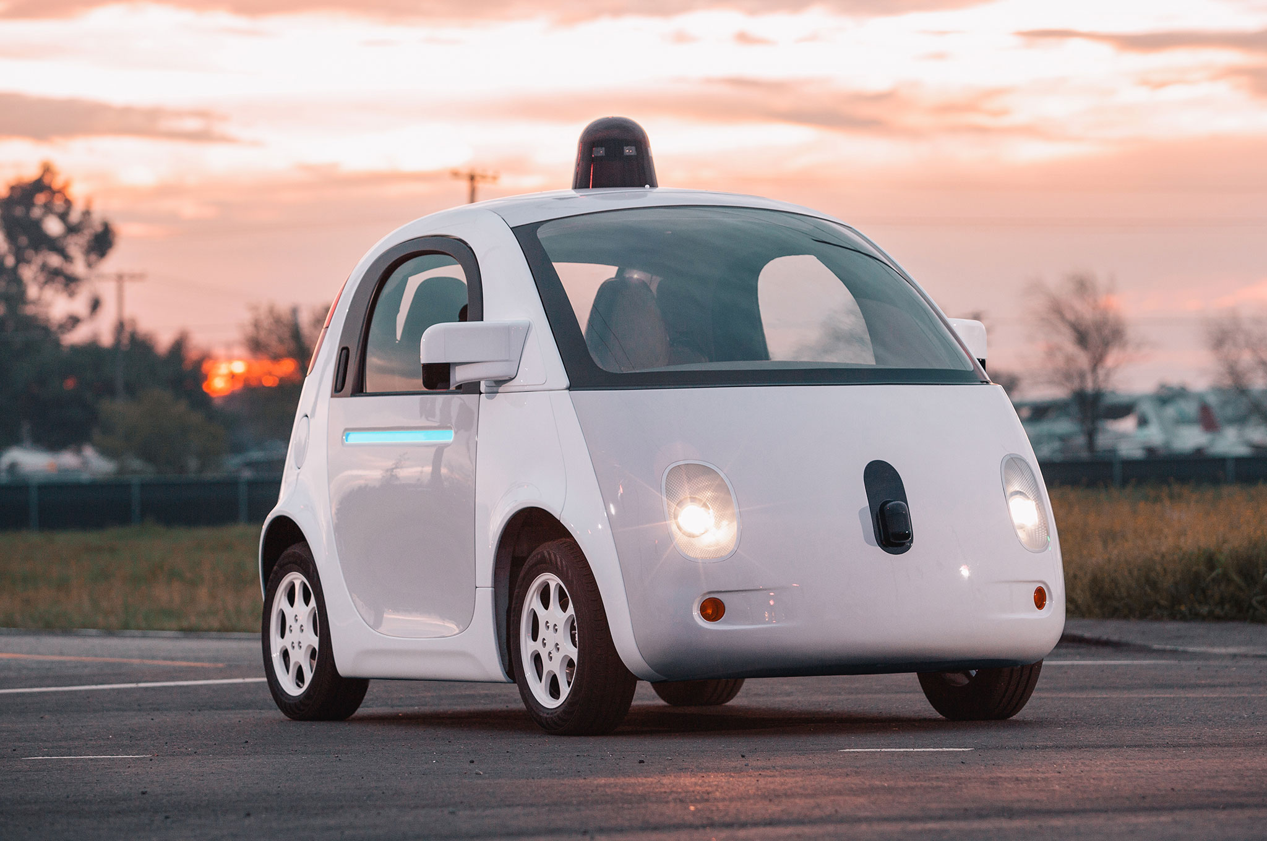
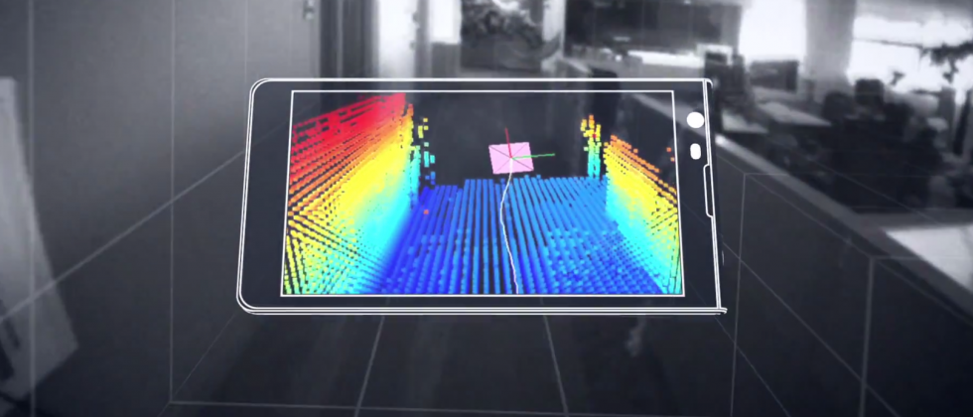
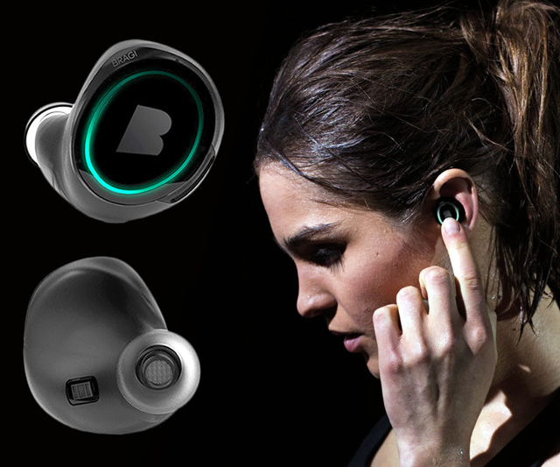
Wireless and Mobile Systems
for the IoT
CMSC 715 : Fall 2022
Lecture 3.2: Machine Learning for IoT
Nirupam Roy
Tu-Th 12:30-1:45pm
CSI 3120 (temporary location CSI 2118)

Slide 2
Form a team of 2 for Assignment-3 and class project.
Collect Embedded_ML kit from the TA Nakul by Oct 19th.

Slide 3
Class project: Rules
The class project == 30% of the total grade.
Demonstrate your understanding of the core theories and capability to transform them into real-world solutions.
You can pick a project idea from the following list, or may improvise an idea from the list, or may work on your own idea.
Project must conform to the philosophy of this course, "wireless and mobile systems for the IoT." (Recommend in-person discussions with the instructor to ensure that your project qualifies.)

Slide 4
Class project: Rules
Team of two. Need the instructor's permission for any other team sizes.
More than one team may pick the same project idea, must work independently.
Your final project report should contain no more than six (6) pages, including all figures and references.

Slide 5
Class project: Rules
Final project report must contain the following sections:
Introduction (includes an overview of the project and the motivation)
System Design (describes the methods and implementation details)
Evaluation (evaluates the developed system with experimental results and plots)
-- A template is provided.
5% of the project grades as a bonus for submitting a working demo of the project.
Each student will be graded separately.
We can help.

Slide 6
Class project: Ideas
A list of project ideas is given here:
http://www.cs.umd.edu/class/fall2022/cmsc715/projectIdeas.html

Slide 7
Markov Model
Sunny
Sunny
Rainy
Sunny
Rainy
Rainy
t1 t2 t3 t4 t5 t6 (time)
P (sunny after rainy)
P (sunny after sunny)
P (rainy after rainy)
Sunny
day
Rainy
day
Temp.
P (rainy after sunny)
Temp.
Humidity
Humidity
Wind
Wind

Slide 8
Hidden Markov Model: Definition
Hidden states
S₁
S₁
S₂
S₃
S₄
S₁
S₂
M₁
M₁
M₂
M₃
M₄
Transition
Emission
Observations
1st order Markov assumption:
Transition probability depends on the current state only.
Output independence assumption:
Output/Emission probability depends on the current state only.

Slide 9
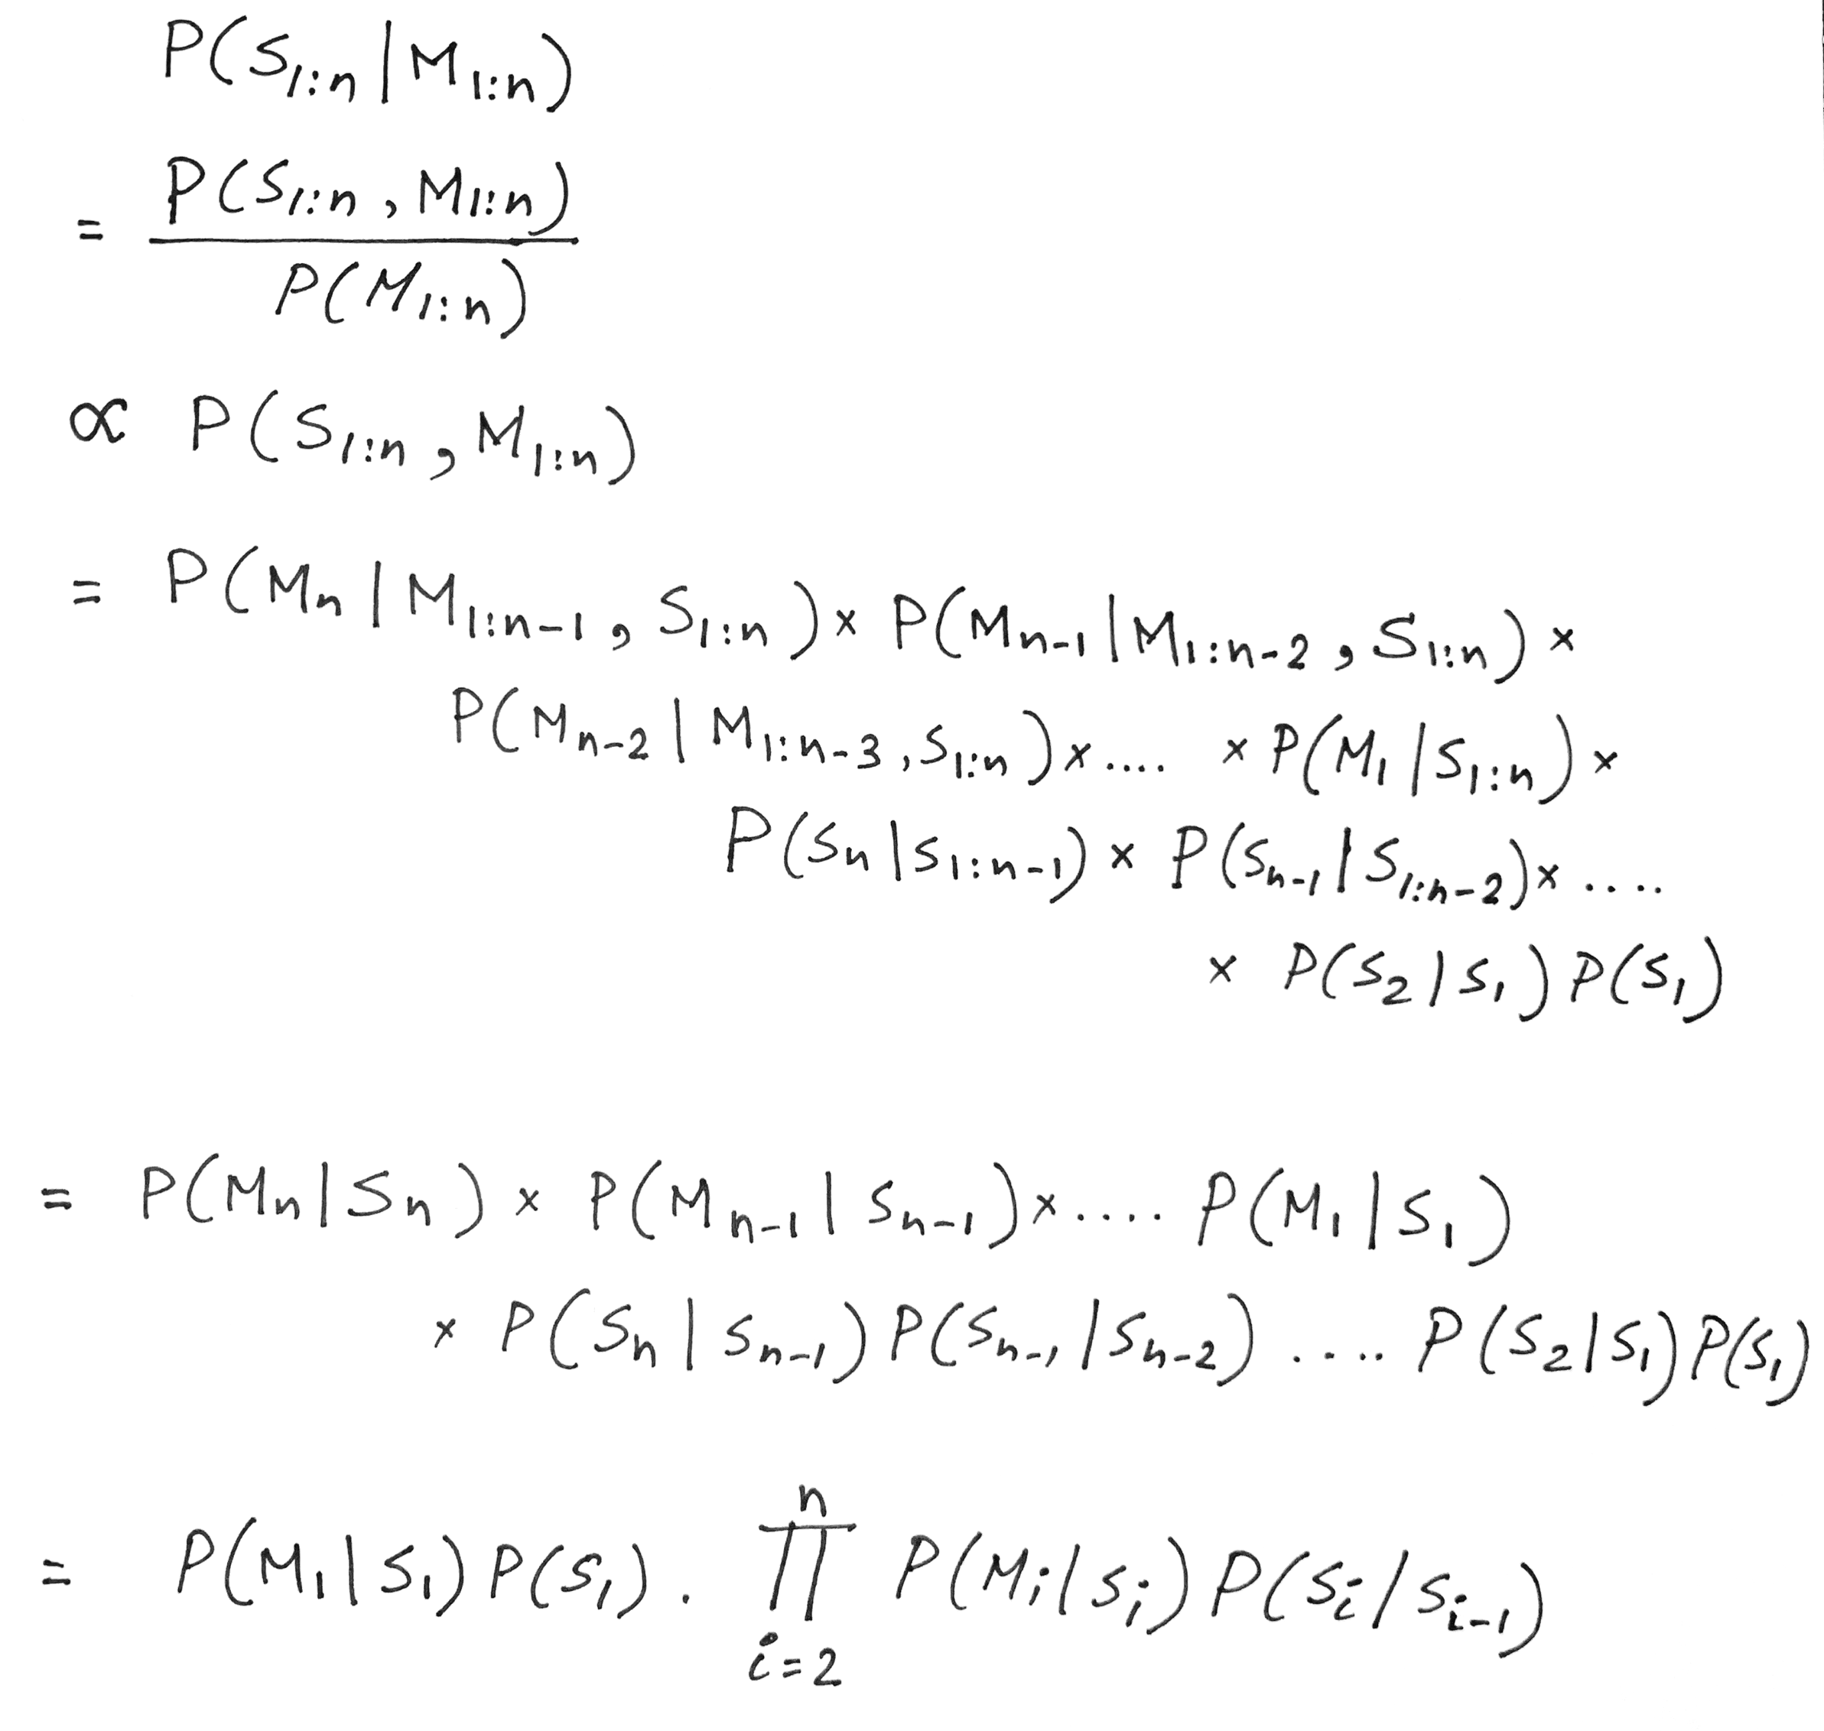
Hidden Markov Model: Definition
For N hidden states and a sequence of T observations, N^{T} different combinations

Slide 10
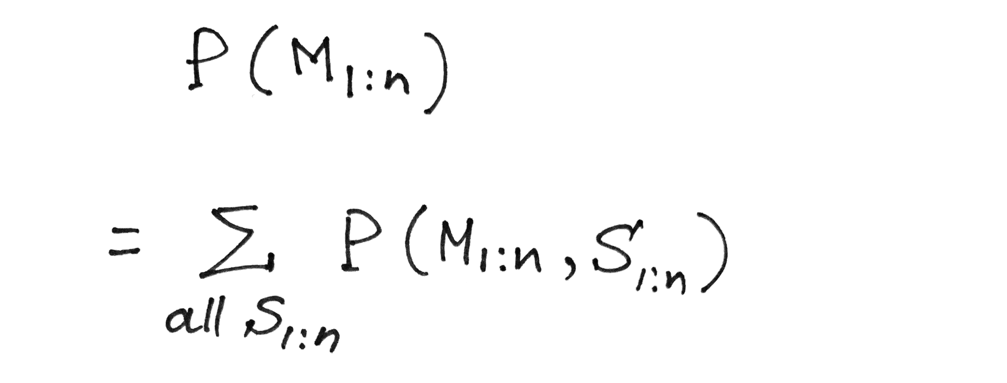
Hidden Markov Model: Definition
Probability of a given observation/measurement sequence
Marginal probability rule

Slide 11
Hidden Markov Model: Definition
Probability of a given observation/measurement sequence
Summation over all possible
combinations of hidden states

Slide 12
Hidden Markov Model: Definition
Probability of a given observation/measurement sequence
Summation over all possible
combinations of hidden states
For N hidden states and a sequence of T observations,
N^{T} different combinations

Slide 13
Hidden Markov Model: Definition
Forward-backward algorithm.
Viterbi algorithm

Slide 14
Problems solved by HMM
1) Likelihood:
Determine the likelihood of an observation sequence.
2) Decoding:
Given an observation sequence, determine the best sequence of hidden states.
[Viterbi algorithm]
[Forward-backward algorithm]
[Baum-Welch algorithm]
3) Learning:
Given an observation sequence and a sequence of states, learn the HMM parameters:
i) Transition probabilities
ii) Emission probabilities

Slide 15
Problems solved by HMM
1) Likelihood:
Determine the likelihood of an observation sequence.
2) Decoding:
Given an observation sequence, determine the best sequence of hidden states.
[Viterbi algorithm]
[Forward-backward algorithm]
[Baum-Welch algorithm]
3) Learning:
Given an observation sequence and a sequence of states, learn the HMM parameters:
i) Transition probabilities
ii) Emission probabilities

Slide 16
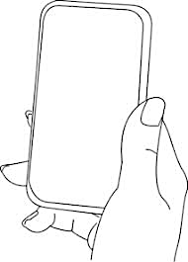
A simple gesture recognition example
States:
Observations:
No
Call
Call
Near
Far
Notes:
http://www.davidsbatista.net/assets/documents/posts/2017-11-11-hmm_viterbi_mini_example.pdf

Slide 17
Extra slides
(Not taught in class)

Slide 18
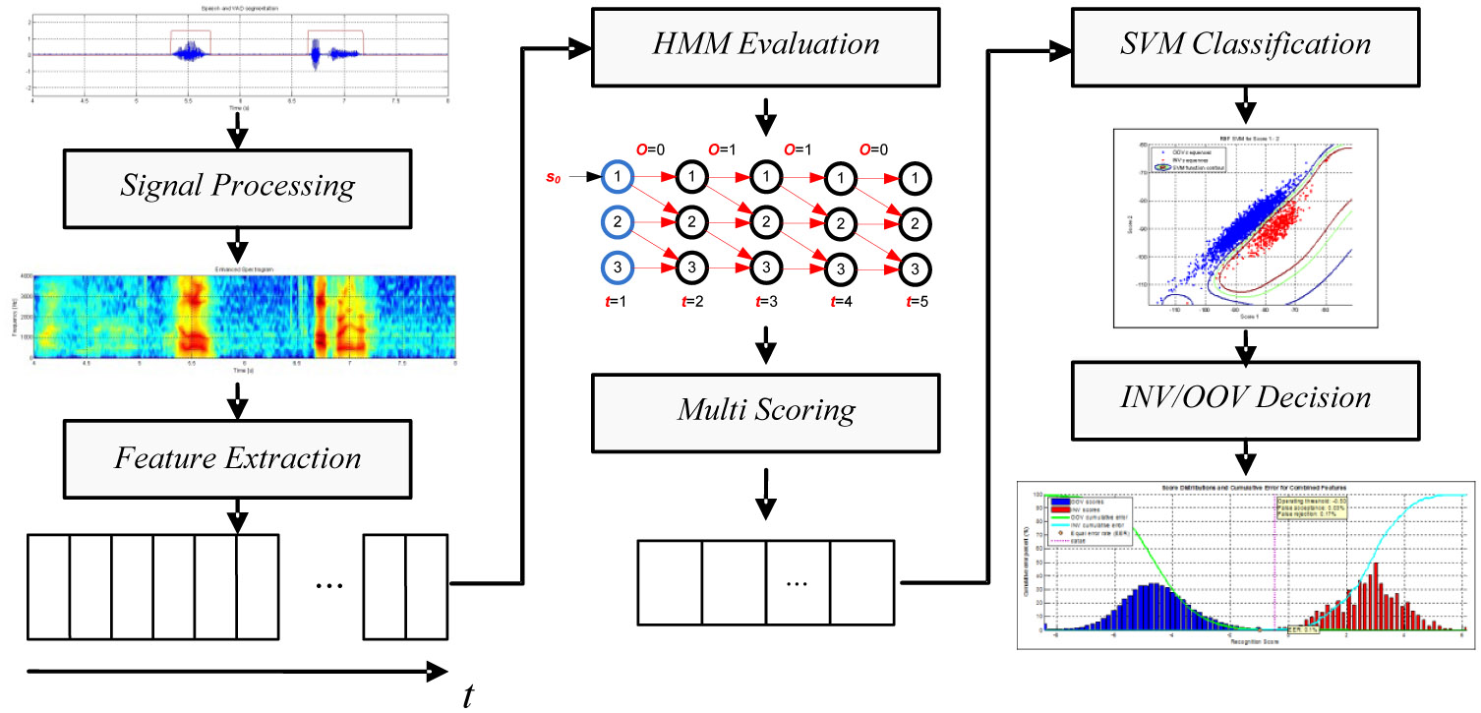

Slide 19
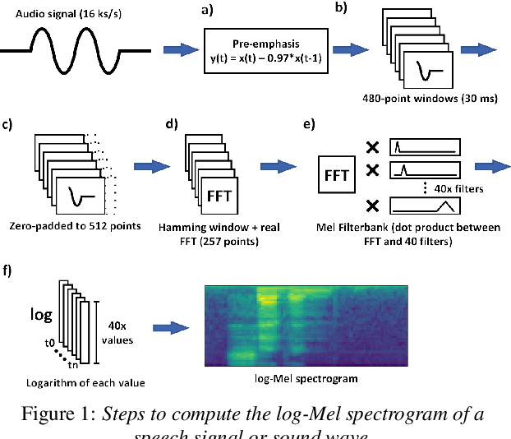

Slide 22
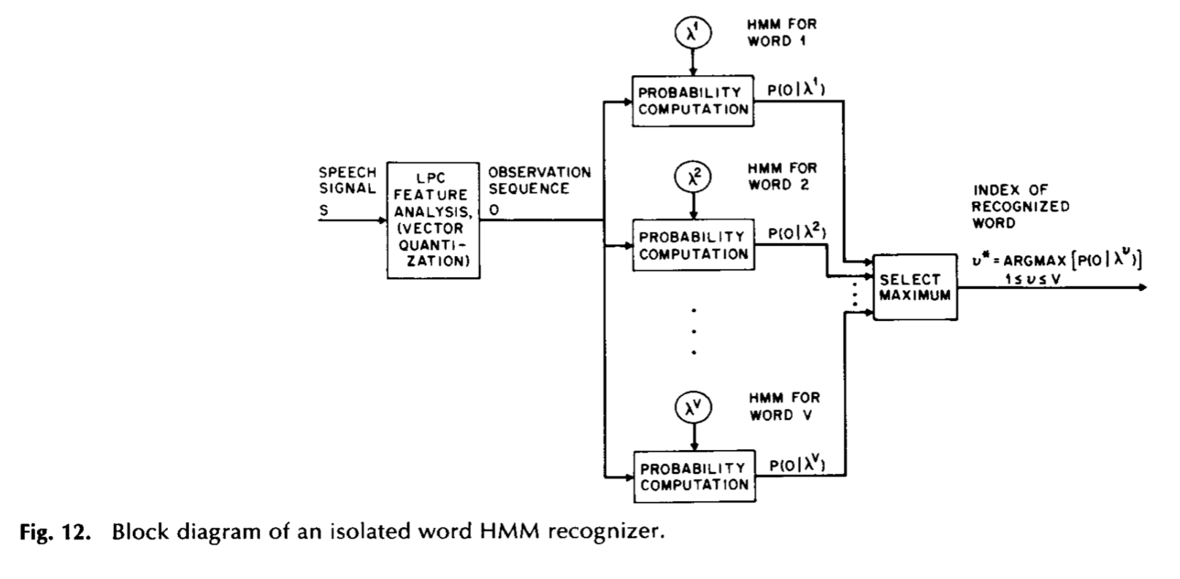

Slide 23
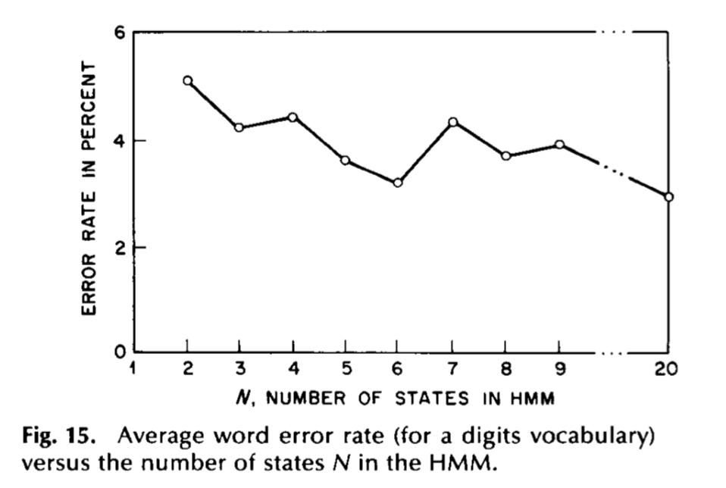

Slide 24
An Application of HMM and Viterbi Algorithm
Ref: https://www.ri.cmu.edu/pub_files/pub3/yang_jie_1994_1/yang_jie_1994_1.pdf

Slide 25
An Application of HMM and Viterbi Algorithm
Approach:
1) Define meaningful gestures
2) Describe each gesture in terms of an HMM
3) Collect base data
4) Find parameters of the HMM through base data
5) Estimate gestures with the HMM model

Slide 26
https://jonathan-hui.medium.com/speech-recognition-gmm-hmm-8bb5eff8b196

