Slide 1

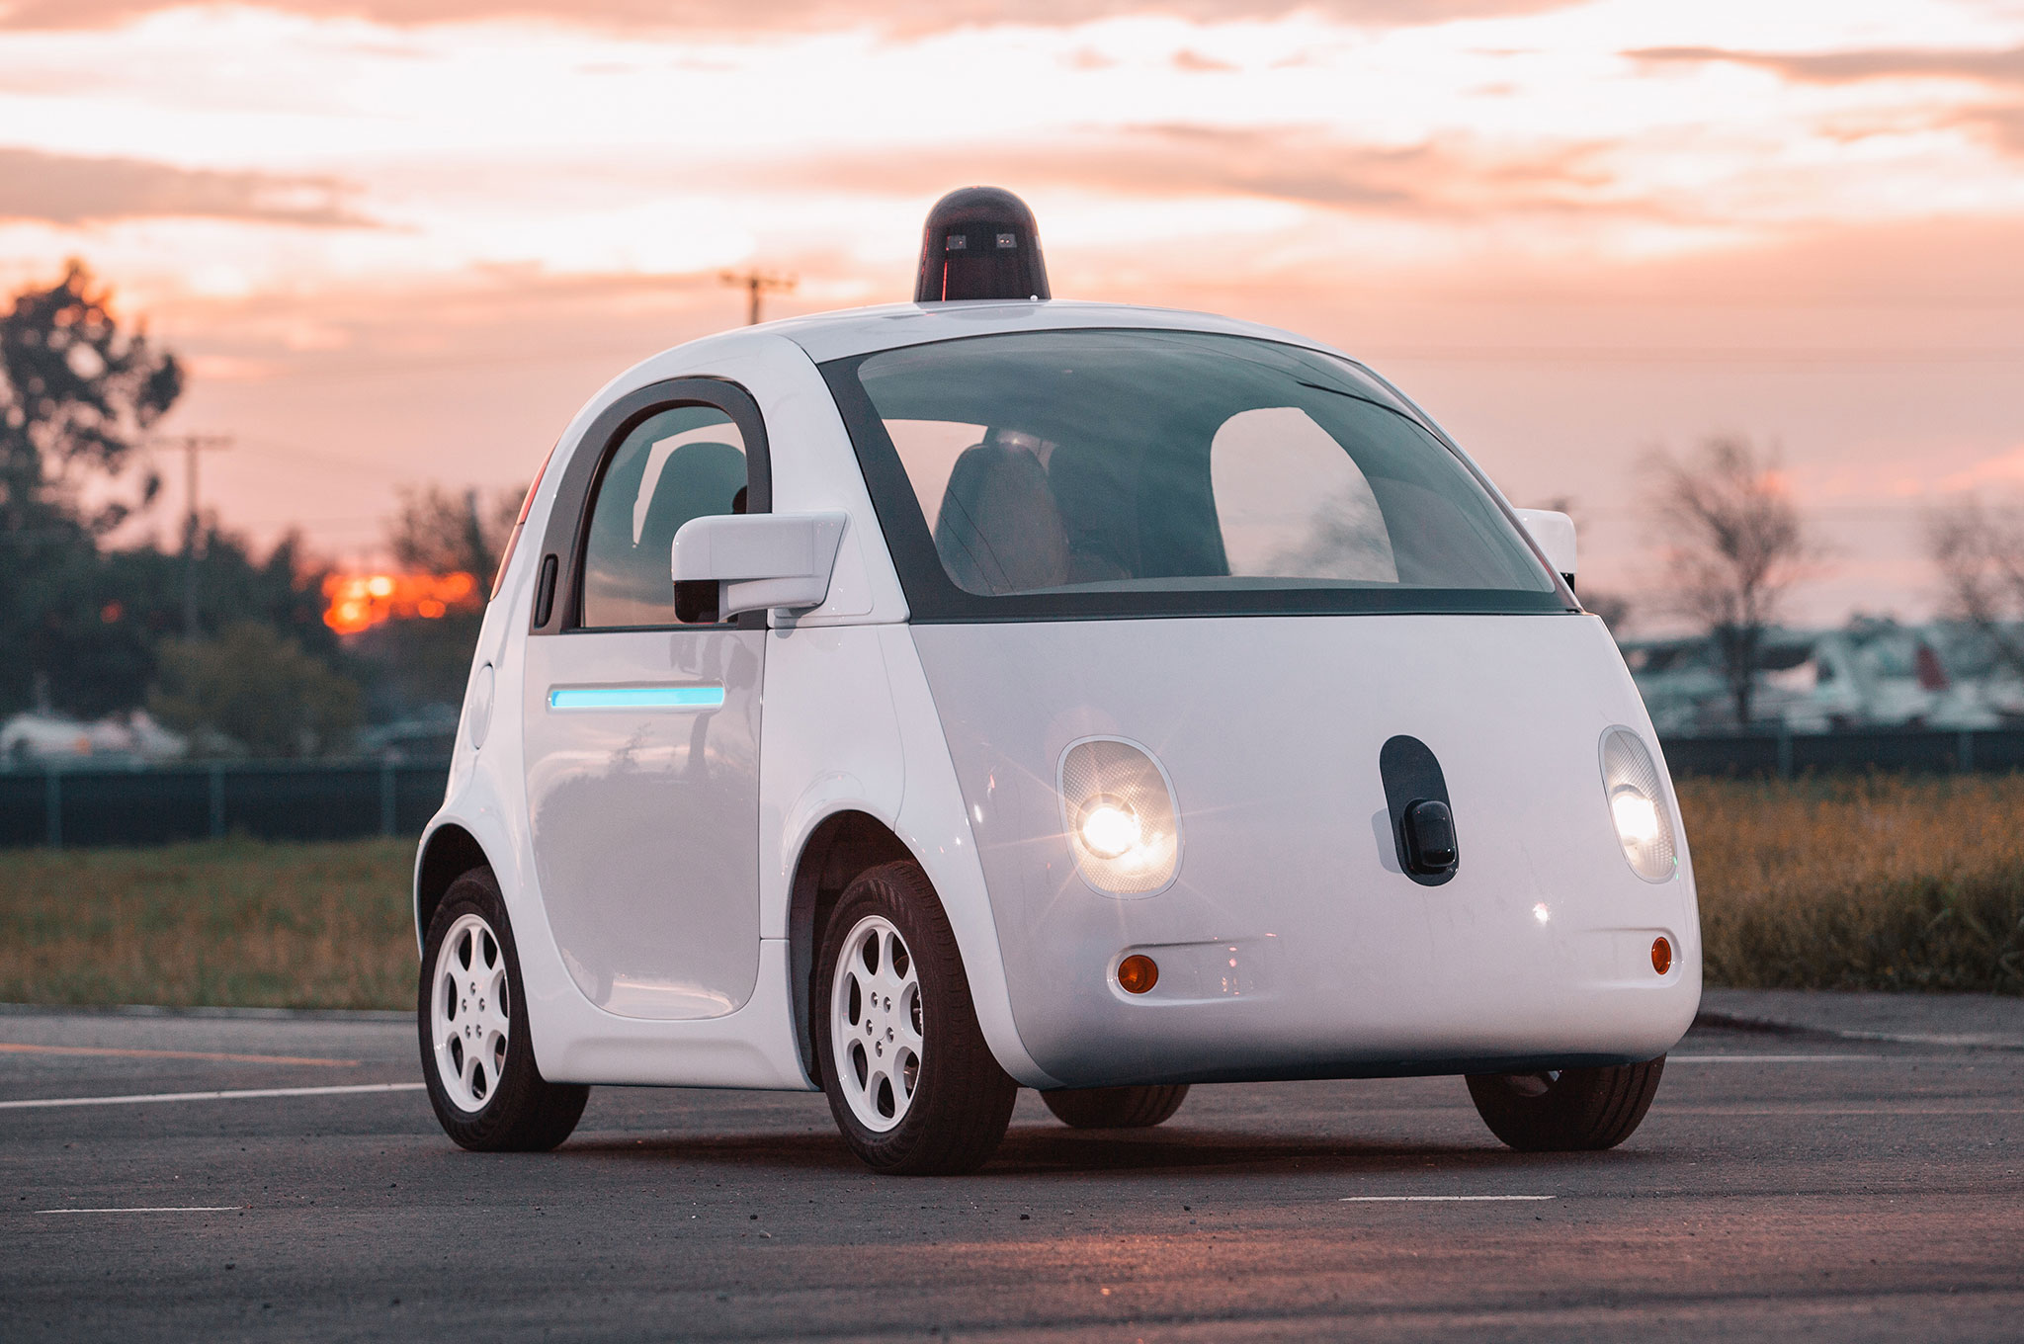

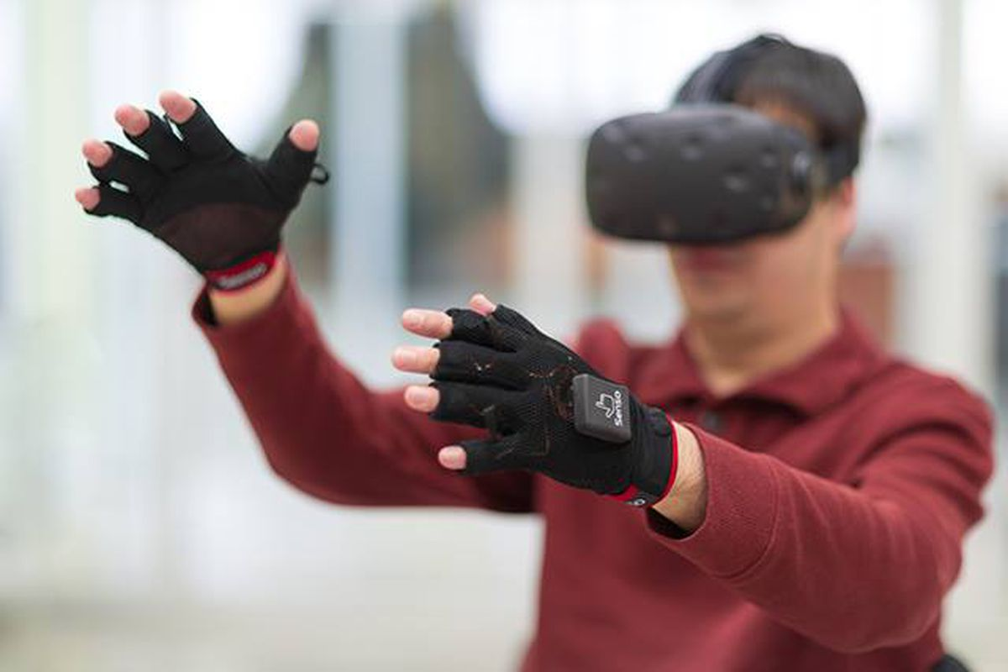

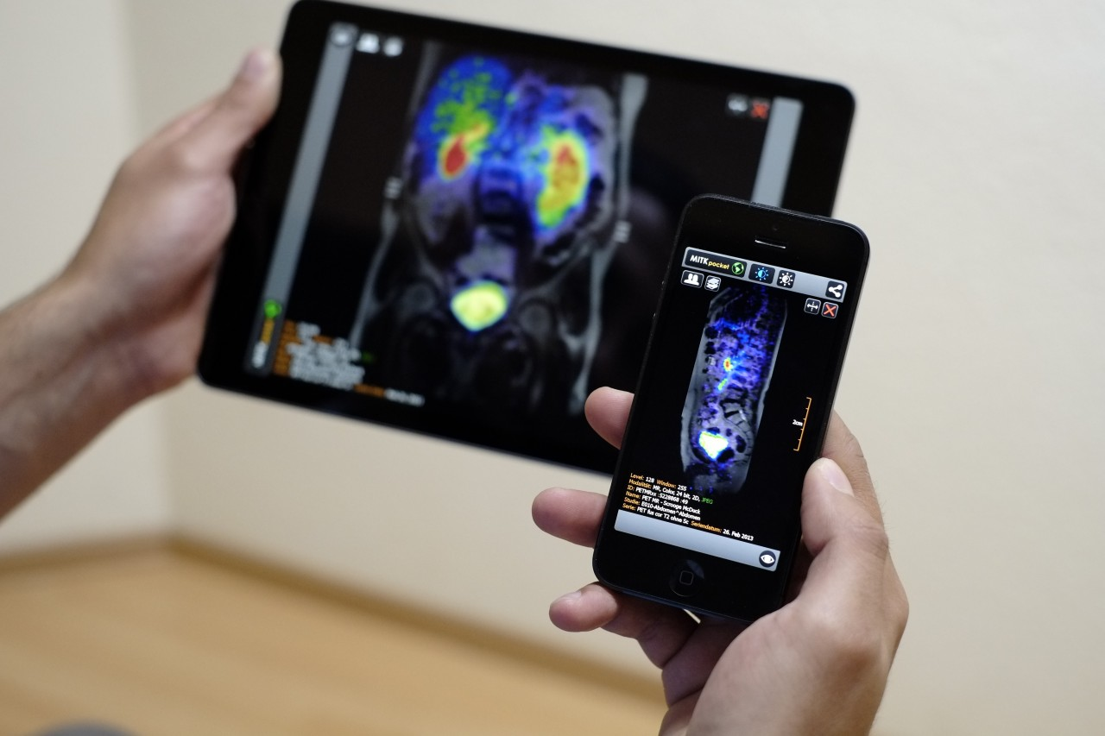
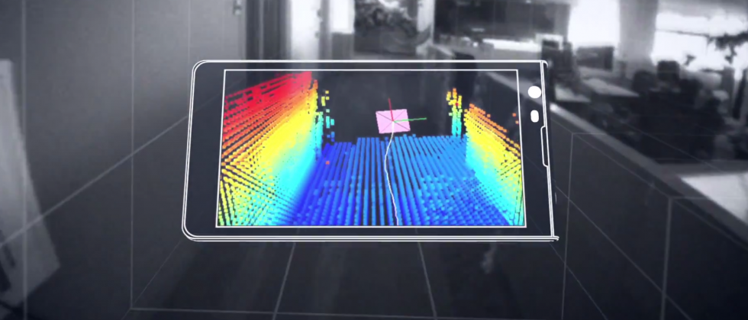
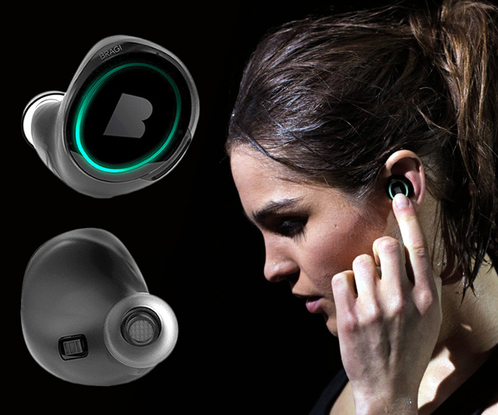
Wireless and Mobile Systems
for the IoT
CMSC 715 : Fall 2022
Lecture 3.4: Machine Learning
and Statistical Inference for IoT
Nirupam Roy
Tu-Th 12:30-1:45pm
CSI 3120 (temporary location CSI 2118)

Slide 2
Sample applications of statistical inference in IoT

Slide 3

MoLe
Motion Leaks through Smartwatch Sensors
He Wang
Ted Tsung-Te Lai
Romit Roy Choudhury
UIUC
MobiCom’15 Presentation

Slide 4
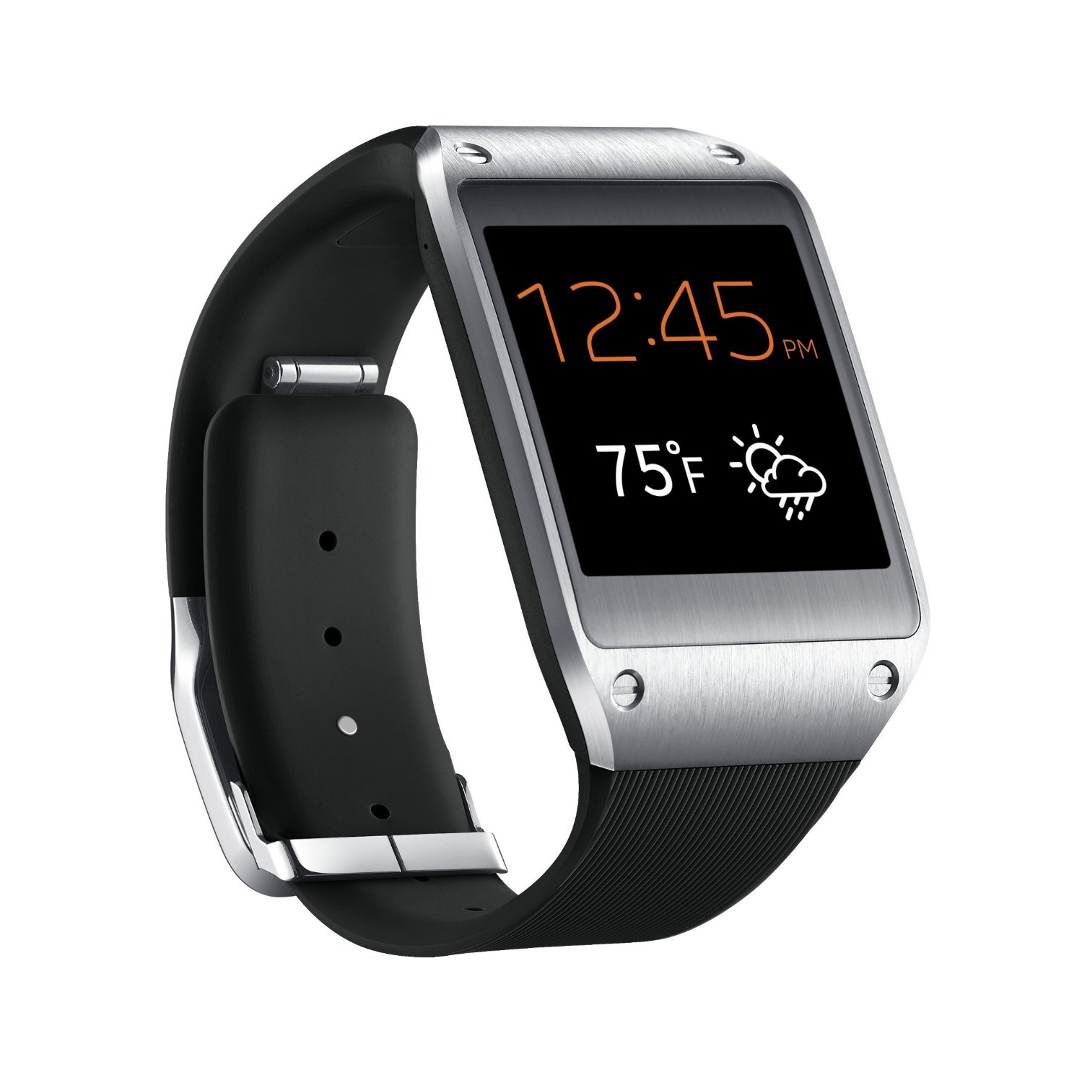
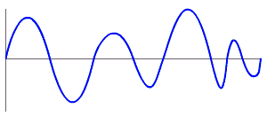
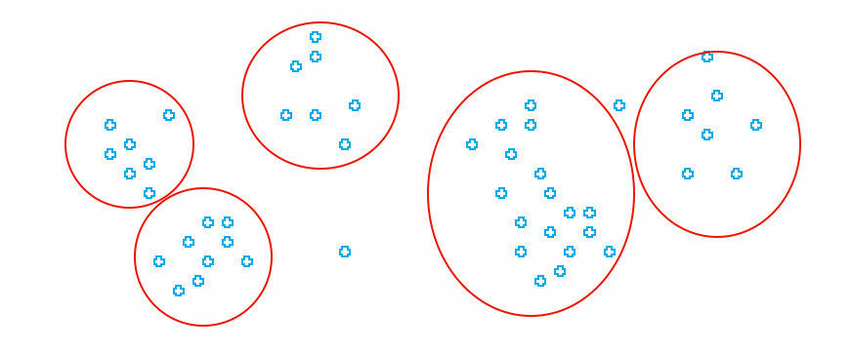
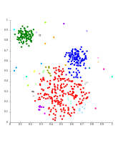

MoLe Architecture
Attacker Training Data
Rank of Word_{i}
Attacker Point Cloud
a b c d
Keystroke
Detector
Point
Cloud
Fitting
Bayesian
Inference
P(O|W_{i})
Time
Location
Word W_{i}
Unlabeled Point Cloud
Observation ( O )
User Data
Dictionary

Slide 5
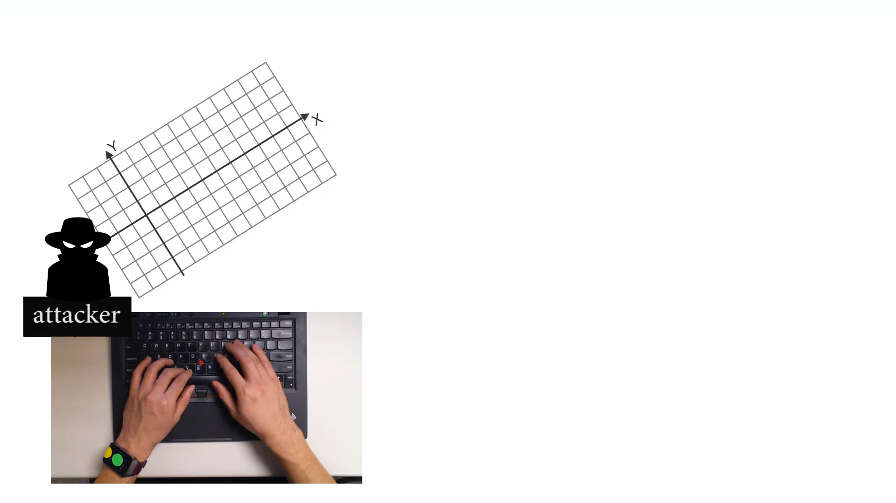
Point Cloud Fitting

Slide 6
Point Cloud Fitting
attacker training data
20
Y Displacement (mm)
Q
10
W
0
A
T
X
-10
-10 0 10 20
X Displacement (mm)

Slide 7
Point Cloud Fitting
user data (unlabeled)
attacker training data
20
Y Displacement (mm)
Q
10
W
0
A
T
X
-10
-10 0 10 20
X Displacement (mm)

Slide 8
Point Cloud Fitting
user data (unlabeled)
attacker training data
20
Y Displacement (mm)
Find convex hulls and centroids
10
0
-10
-10 0 10 20
X Displacement (mm)

Slide 9
Point Cloud Fitting
user data (unlabeled)
attacker training data
20
Y Displacement (mm)
Q
Find convex hulls and centroids
Rotate and scale
10
W
0
A
T
X
-10
-10 0 10 20
X Displacement (mm)

Slide 10
MoLe Architecture
Attacker Training Data
Rank of Word_{i}
Attacker Point Cloud
a b c d
Keystroke
Detector
Point
Cloud
Fitting
Bayesian
Inference
P(O|W_{i})
Time
Location
Word W_{i}
Unlabeled Point Cloud
Observation ( O )
User Data
Dictionary

Slide 11


Bayesian Inference
Input “confident”
Observed
watch motion
MoLe output list
Rank | word guess
1 | confident
2 | consider
3 | commander
… | …
4999 | are
5000 | is
Compute
likelihood
word₁
word₂
word₃
…
word₄₉₉₉
word₅₀₀₀

Slide 12
Bayesian Inference
prob of observation
W_{i}: Candidate word_{i} in dictionary
O: Motion observation

Slide 13
Bayesian Inference
word frequency
W_{i}: Candidate word_{i} in dictionary
O: Motion observation

Slide 14
Bayesian Inference
Likelihood function
W_{i}: Candidate word_{i} in dictionary
O: Motion observation

Slide 15
Observations
Number of keystrokes
Location of keystrokes
Time interval between keystrokes

Slide 16
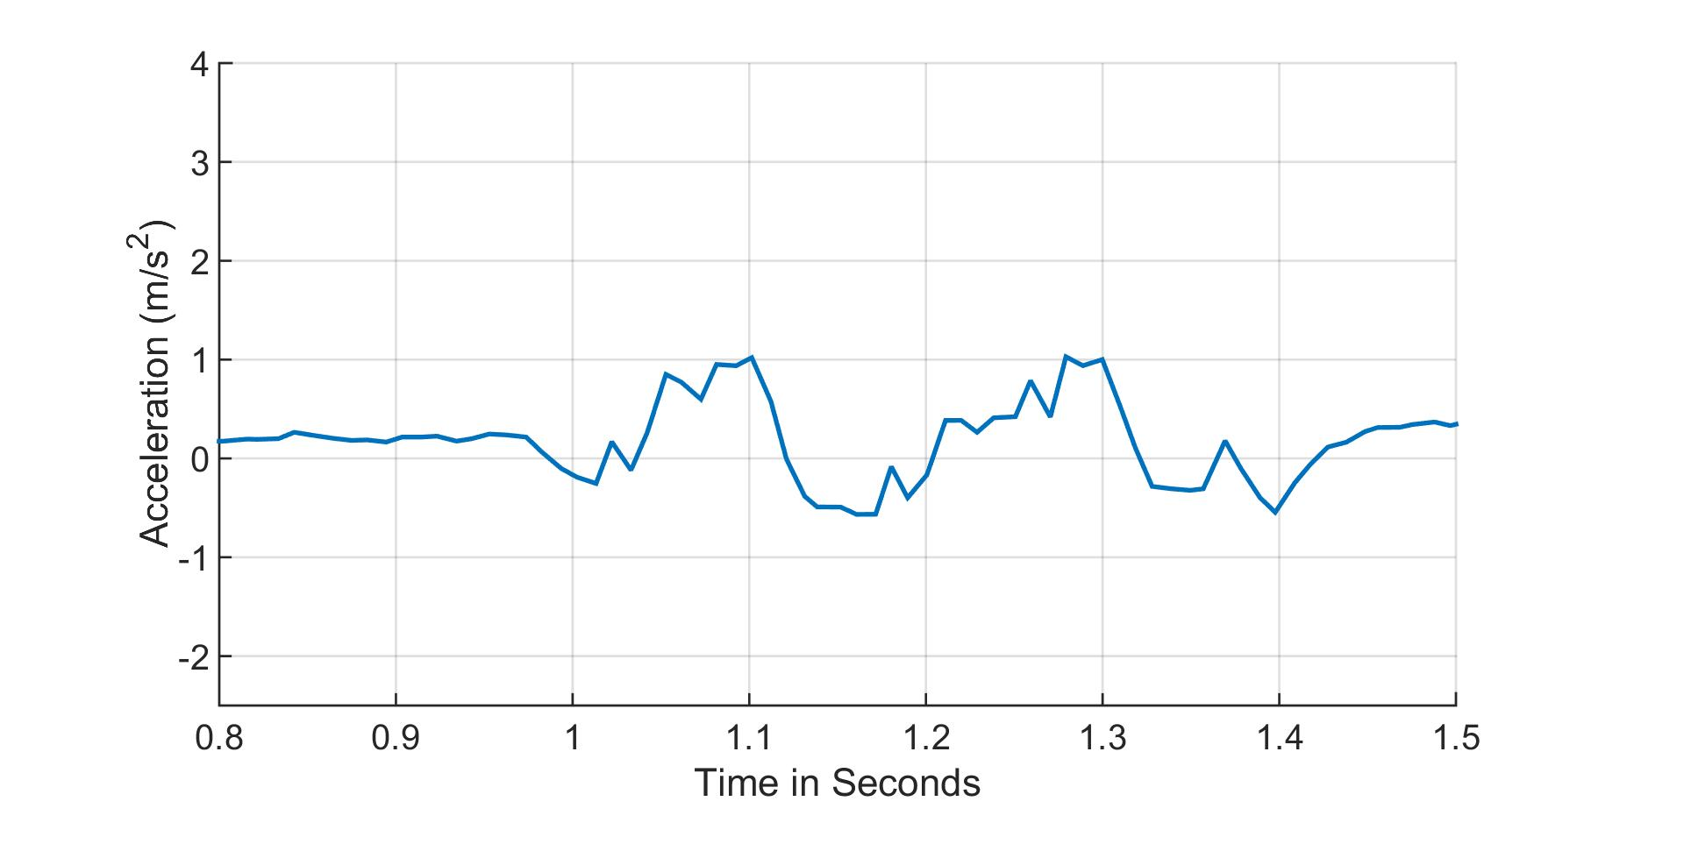
Observation 1: Number of Keystrokes
likely
the (2)
fine (2)
2 keystrokes
detected
unlikely
administrative (9)
comprehensive (7)
keystroke

Slide 17
Observation 2: Location of Keystrokes
Point cloud (after fitting with training data)
20
Y Displacement (mm)
10
0
-10
-10 0 10 20
X Displacement (mm)

Slide 18
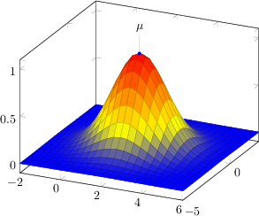
Observation 2: Location of Keystrokes
Model each keystroke location as Gaussian distribution
Point cloud (after fitting with training data)
20
q
Y Displacement (mm)
r
10
w
e
a
d
s
f
0
b
t
x
g
v
c
z
-10
-10 0 10 20
X Displacement (mm)

Slide 19
Observation 2: Location of Keystrokes
Model each keystroke location as Gaussian distribution
Point cloud (after fitting with training data)
20
q
Detected keystroke location
Y Displacement (mm)
r
10
w
e
a
d
s
f
0
b
t
x
g
v
c
z
-10
-10 0 10 20
X Displacement (mm)

Slide 20
Observation 2: Location of Keystrokes
Model each keystroke location as Gaussian distribution
Point cloud (after fitting with training data)
20
q
Detected keystroke location
Y Displacement (mm)
r
10
w
e
a
d
s
f
0
b
t
x
g
v
c
z
-10
-10 0 10 20
X Displacement (mm)

