Slide 1

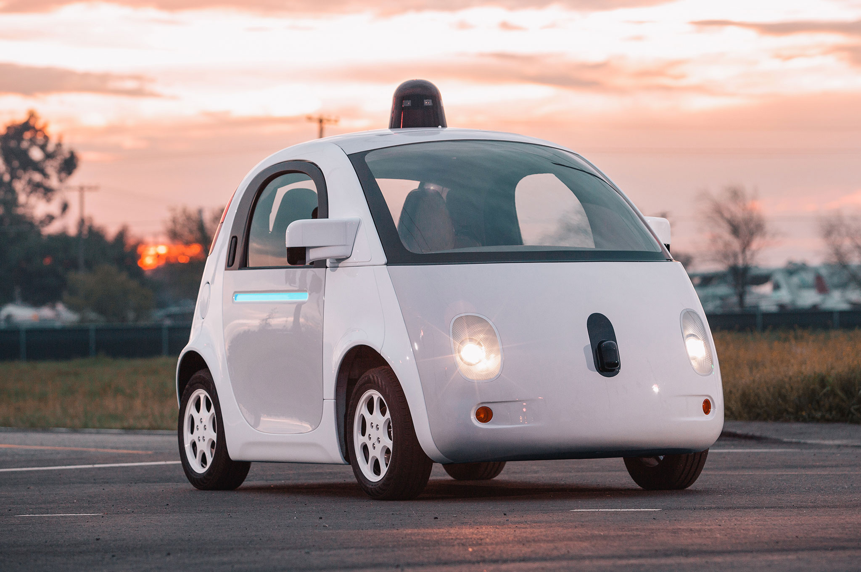
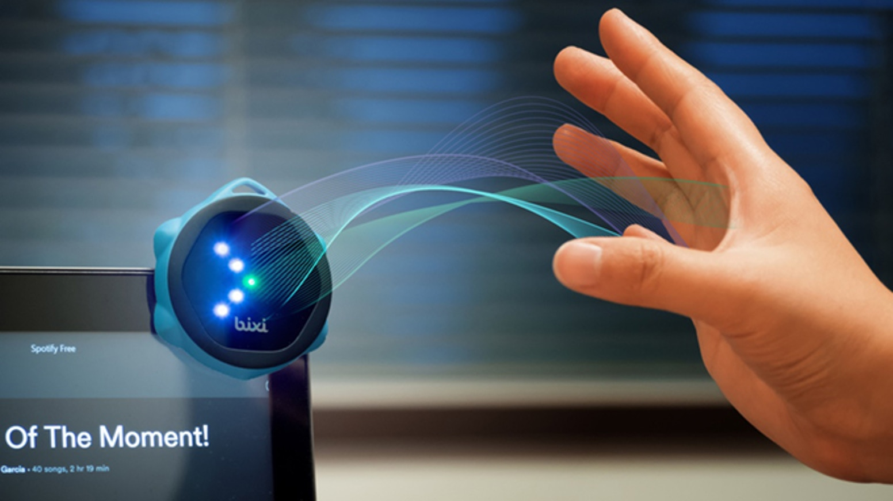
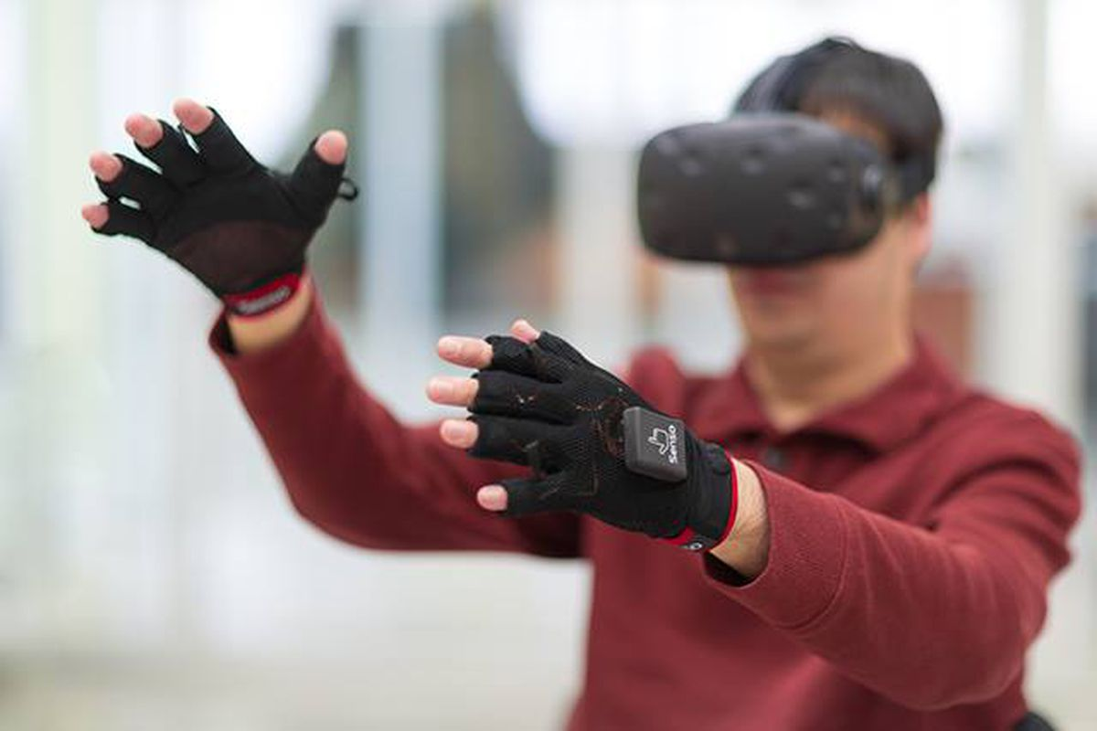

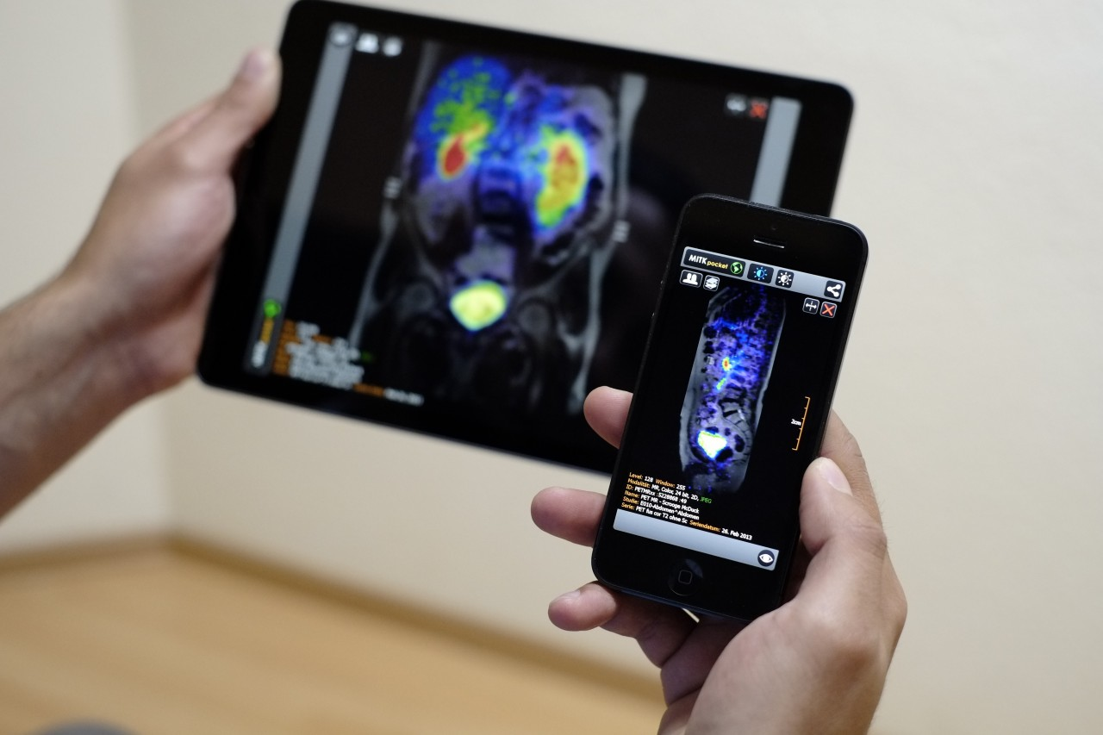
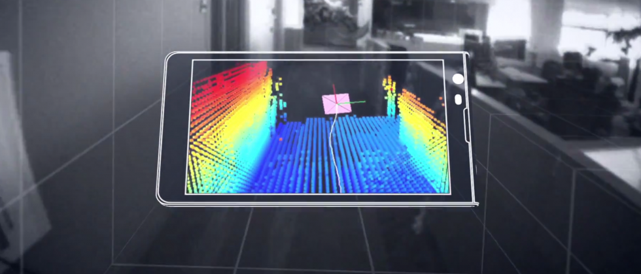
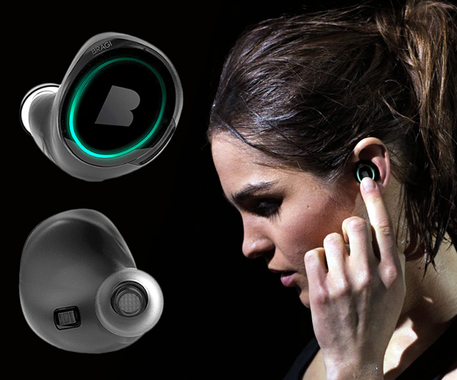
Wireless and Mobile Systems
for the IoT
CMSC 715 : Fall 2022
Lecture 3.5: Machine Learning and
Statistical Inference for IoT
Nirupam Roy
Tu-Th 12:30-1:45pm
CSI 3120 (temporary location CSI 2118)

Slide 2

MoLe
Motion Leaks through Smartwatch Sensors
Sample applications of statistical inference in IoT
He Wang
Ted Tsung-Te Lai
Romit Roy Choudhury
UIUC
MobiCom’15 Presentation

Slide 3
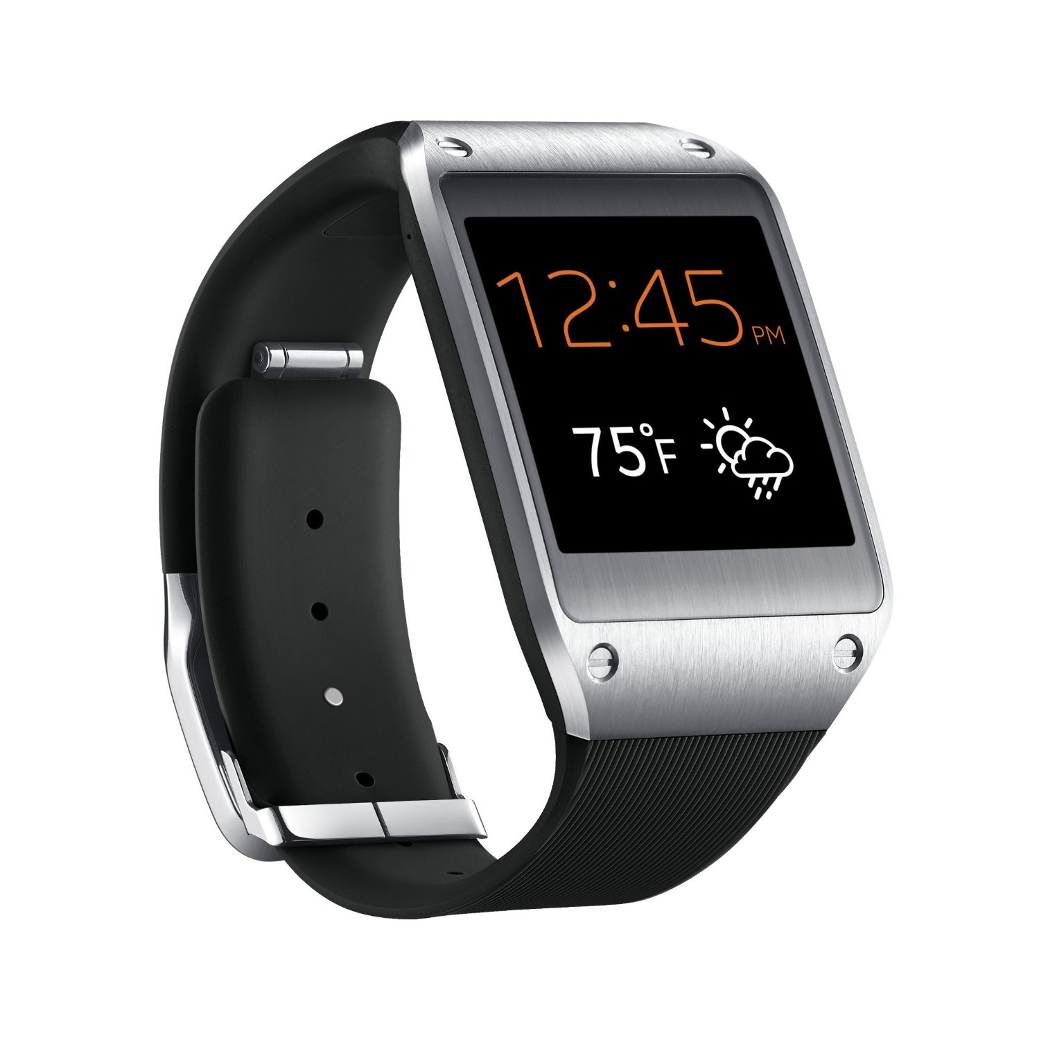
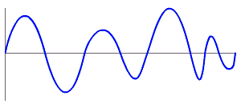
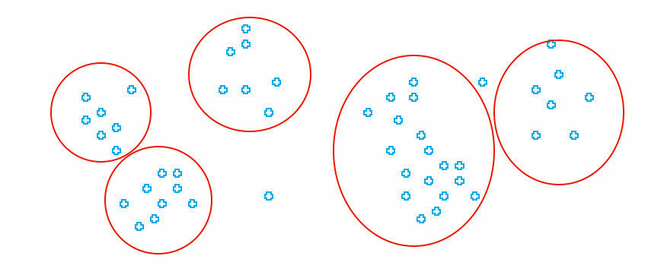
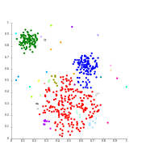

MoLe Architecture
Attacker Training Data
Rank of Word_{i}
Attacker Point Cloud
a b c d
Keystroke
Detector
Point
Cloud
Fitting
Bayesian
Inference
P(O|W_{i})
Time
Location
Word W_{i}
Unlabeled Point Cloud
Observation ( O )
User Data
Dictionary

Slide 4
Bayesian Inference
Likelihood function
W_{i}: Candidate word_{i} in dictionary
O: Motion observation

Slide 5
Observations
Number of keystrokes
Location of keystrokes
Time interval between keystrokes

Slide 6
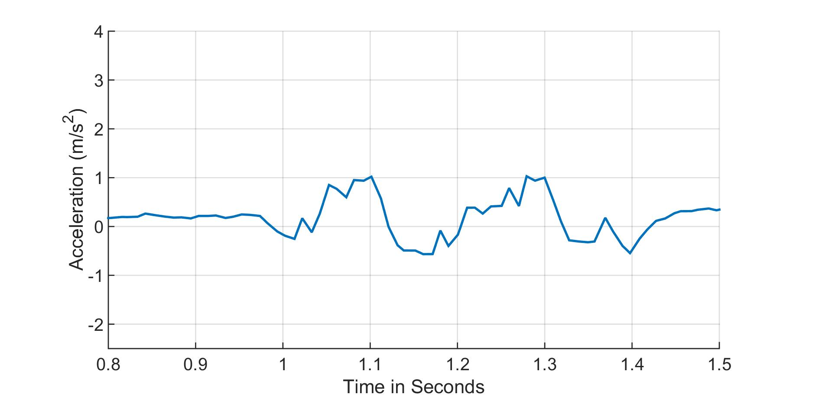
Observation 1: Number of Keystrokes
likely
the (2)
fine (2)
2 keystrokes
detected
unlikely
administrative (9)
comprehensive (7)
keystroke

Slide 7
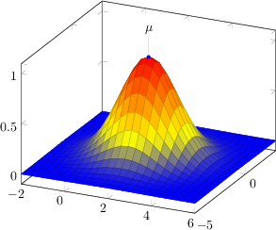
Observation 2: Location of Keystrokes
Model each keystroke location as Gaussian distribution
Point cloud (after fitting with training data)
20
q
Detected keystroke location
Y Displacement (mm)
r
10
w
e
a
d
s
f
0
b
t
x
g
v
c
z
-10
-10 0 10 20
X Displacement (mm)

Slide 8
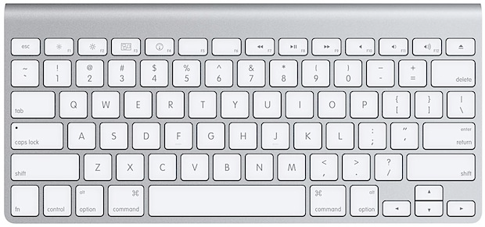
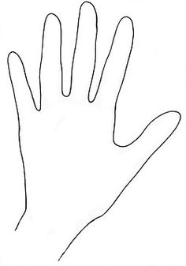
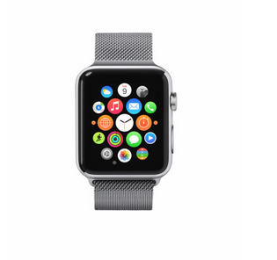
Observation 2: Location of Keystrokes
v->a
Location of v and r is different
20
Y Displacement (mm)
10
r->a
r->a
0
v->a
-10
-10 0 10 20
X Displacement (mm)

Slide 9
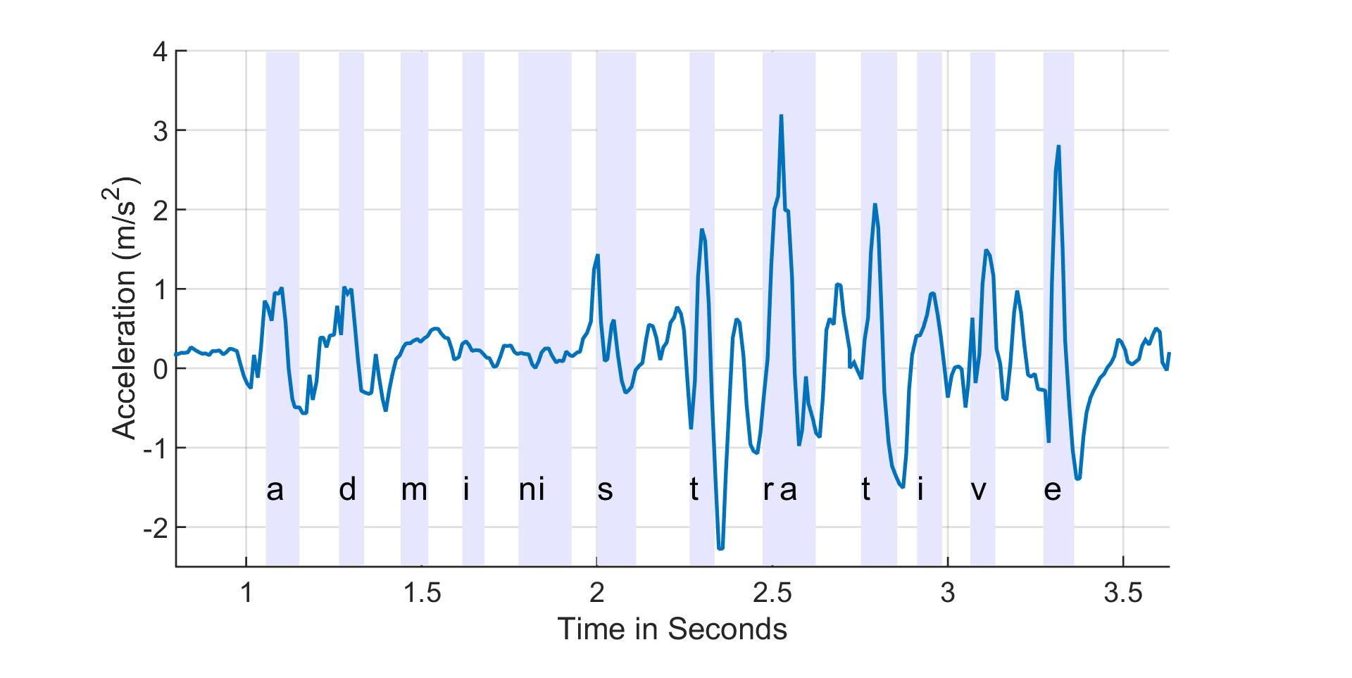
Observation 3: Time Interval
z-axis linear acceleration
keystroke
9

Slide 10
Observation 3: Time Interval
z-axis linear acceleration
keystroke
0.6 sec
10

Slide 11
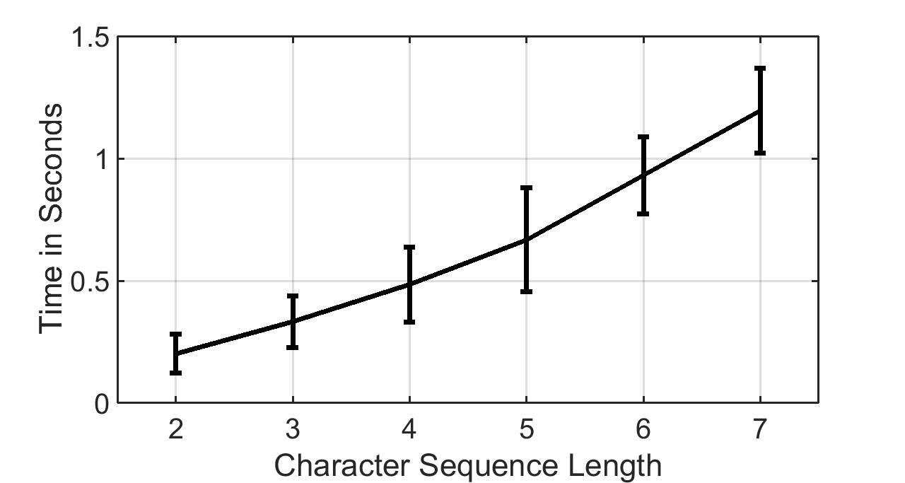
Observation 3: Time Interval
LL LRL LRRL LRRRL LRRRRL LRRRRRL

Slide 12
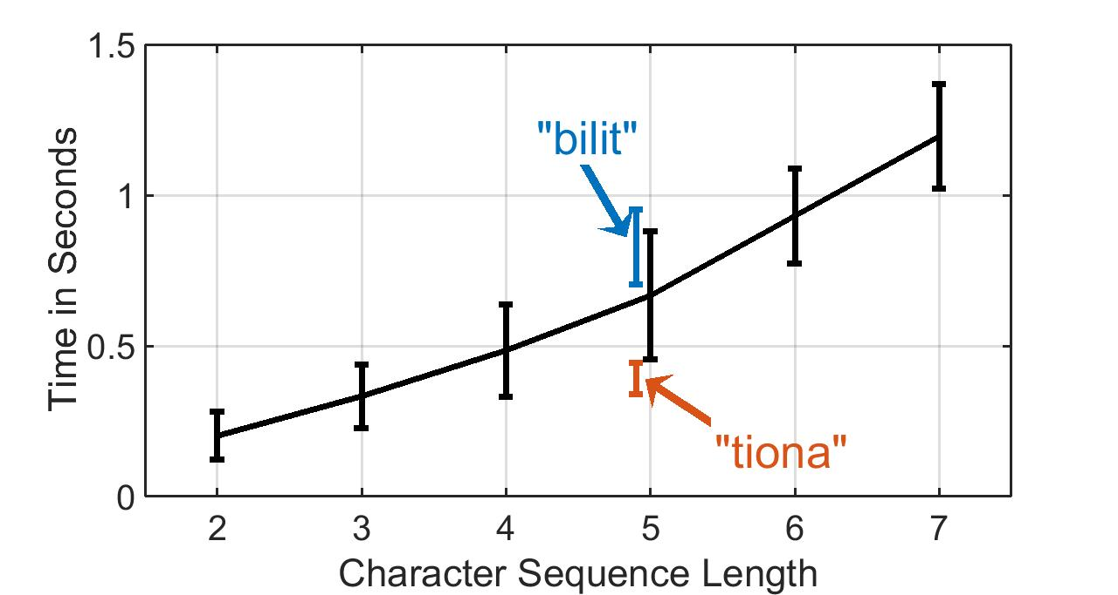
Observation 3: Time Interval

Slide 13

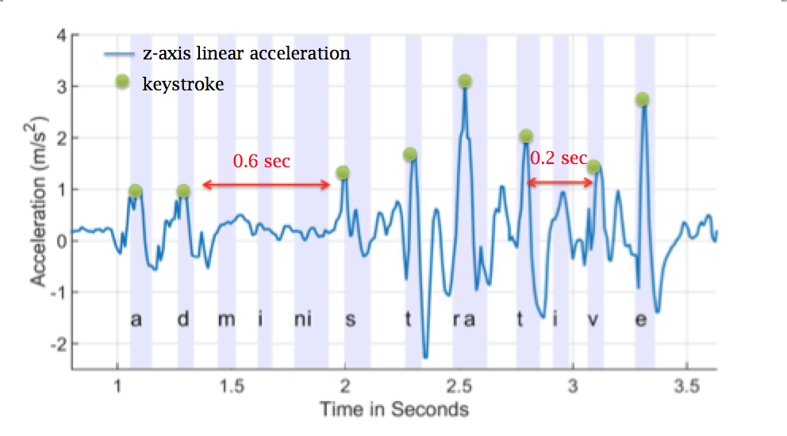
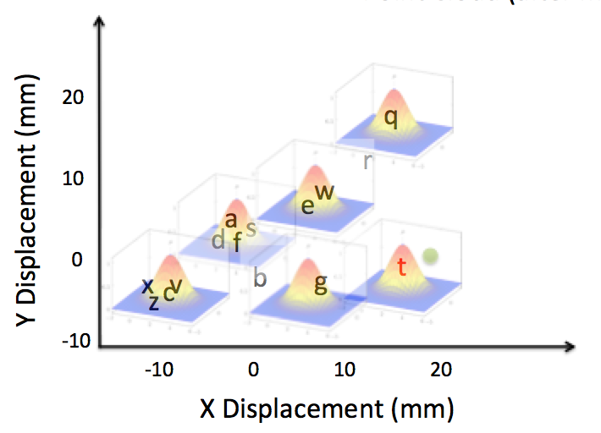
Bayesian Inference
The probability of the observed motion given word_{i}
Number of keystrokes
Number of keystrokes
Location distribution
Location distribution
Time interval distribution
Time interval distribution

Slide 14
Outline
Motivation & Challenge
MoLe
Evaluation
Limitations
Conclusion

Slide 15
Experimental Setup
Samsung Galaxy Gear Live with Android Wear
  Sample accl and gyro at 200Hz
  Off-line Matlab analysis
8 Participants
  5 native speakers, 3 non-native speakers
  300 words for each subject, 2400 words total
  Words are randomly selected from 5000 most frequently used words
2 labeled point clouds (training data)
  2 persons collect offline data with Top-500 longest words

Slide 16
Evaluation Metrics
How well can Mole guess each word?
Observation improvements
Recovery via human observation

Slide 17
Rank CDF
Median rank = 24, 30 percentile rank = 5 (out of 5000 words)
When word length > 6, median rank = 10

Slide 18
Avg Rank Across Users
With perfect key press detection
median rank = 6, 30 percentile rank = 1

Slide 19
Evaluation Metrics
How well can Mole guess each word?
Observation improvements
Recovery via human observation

Slide 20
Observation Improvements
340
49
24

Slide 21
Evaluation Metrics
How well can Mole guess each word?
Observation improvements
Recovery via human observation

Slide 22
Can you guess the sentence?
Rank | W1 | W2 | W3 | W4 | W5 | W6 | W7 | w8
1 | motor | pistol | profound | technology | angel | those | that | disappear
2 | monitor | list | journalism | remaining | spray | today | tight | discourse
3 | them | but | originally | telephone | super | third | tightly | secondary
4 | the | lost | original | meanwhile | fire | through | thirty | adviser
5 | then | most | profile | headline | shore | towel | truth | discover

Slide 23
Can you guess the sentence?
“The most profound technologies are those that disappear”
- Mark Weiser, 1991
Rank | W1 | W2 | W3 | W4 | W5 | W6 | W7 | w8
1 | motor | pistol | profound | technology | angel | those | that | disappear
2 | monitor | list | journalism | remaining | spray | today | tight | discourse
3 | them | but | originally | telephone | super | third | tightly | secondary
4 | the | lost | original | meanwhile | fire | through | thirty | adviser
5 | then | most | profile | headline | shore | towel | truth | discover
are

Slide 24
Outline
Motivation & Challenge
MoLe
Evaluation
Limitations
Conclusion

Slide 25
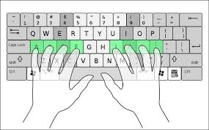
Limitations
Single word only
  Unable to detect space (could be right or left thumb)
English words only
  Digits and non-English words are not applicable
Required standard typing method

Slide 26
Outline
Motivation & Challenge
MoLe
Evaluation
Limitations
Conclusion

Slide 27
Conclusion
Mole: Motion Leaks through Smartwatch sensor
Identify leaks when using watch motion sensors to infer input words
Type a word W with length > 6, MoLe can shortlist 10 words (rank 10) on average that includes W

Slide 28
Statistical inference vs. Machine Learning

Slide 29
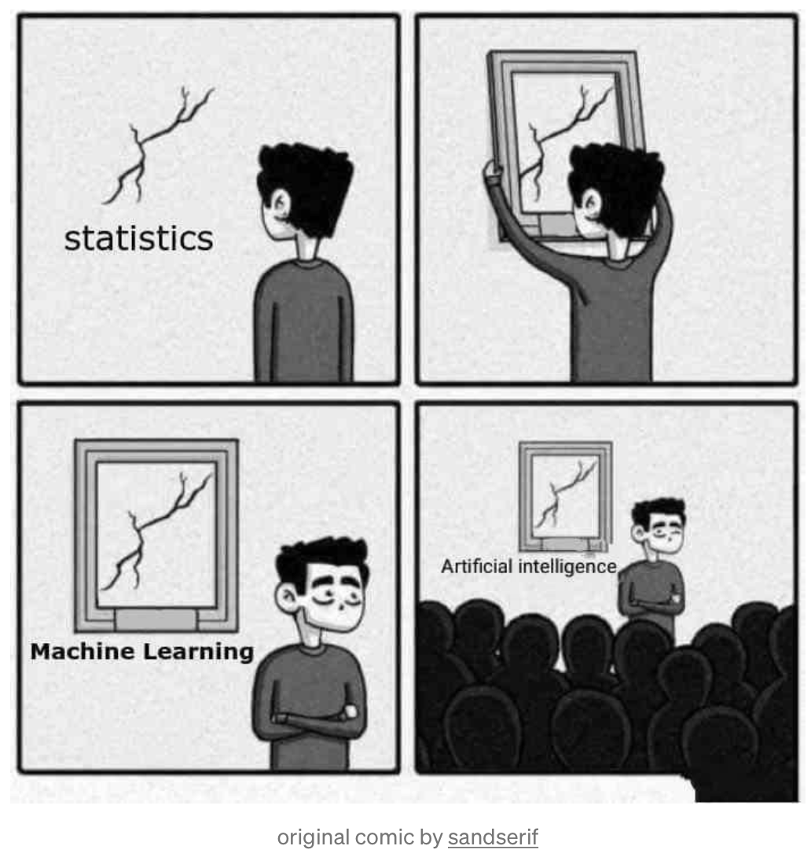
Statistical inference vs. Machine Learning
Debate?

Slide 30
Statistical inference vs. Machine Learning
Debate?
“Machine Learning vs. Statistics”
https://www.svds.com/machine-learning-vs-statistics/
“No, Machine Learning is not just glorified Statistics”
https://towardsdatascience.com/no-machine-learning-is-not-just-glorified-statistics-26d3952234e3

Slide 31
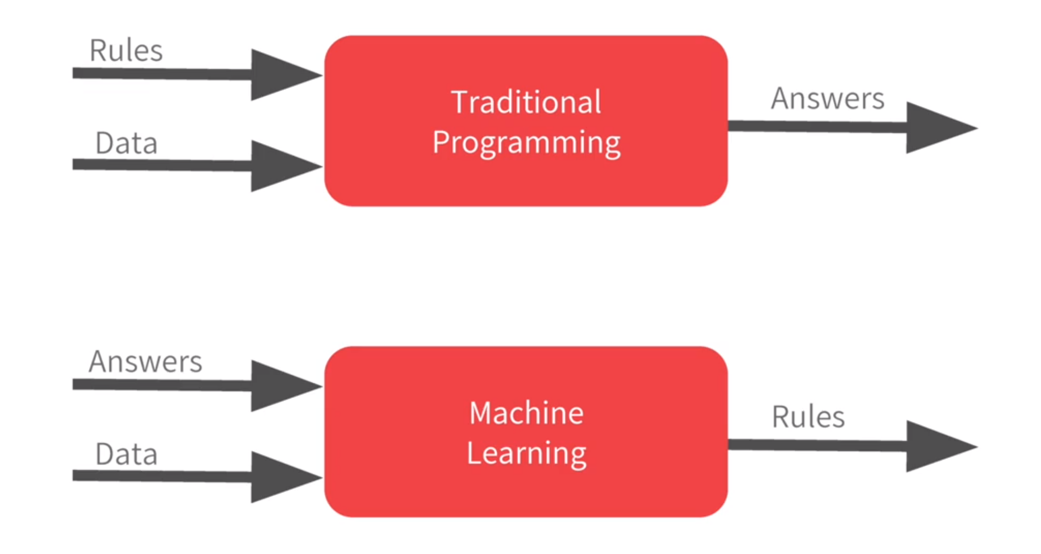
Machine learning: A new way to program computers

Slide 32
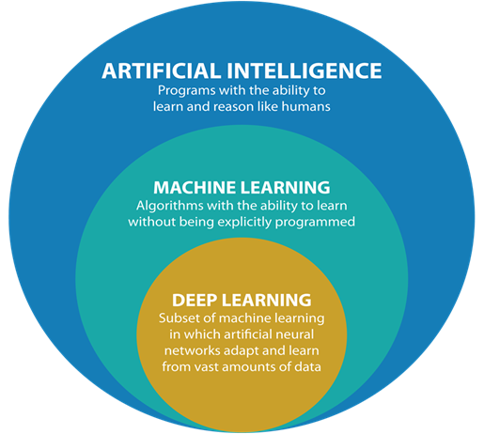
Machine learning: A new way to program computers

