Slide 1
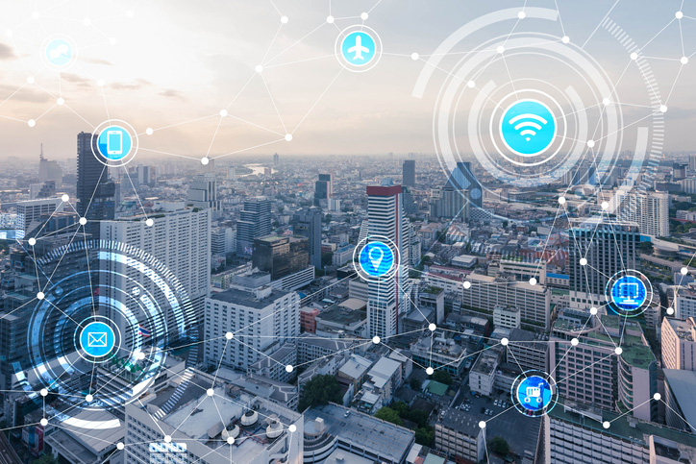
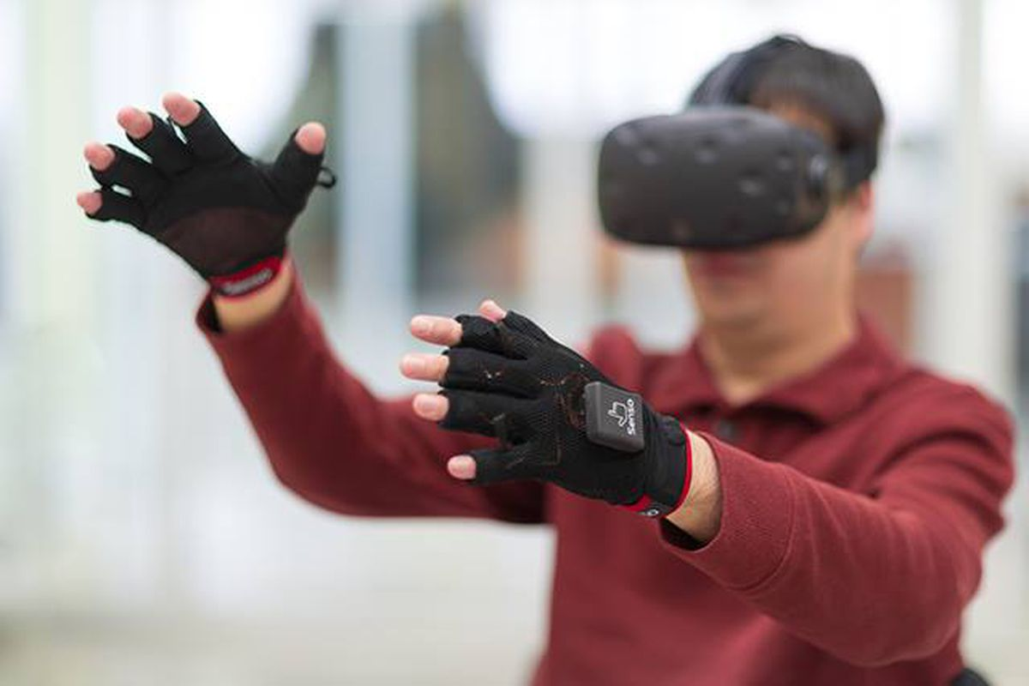
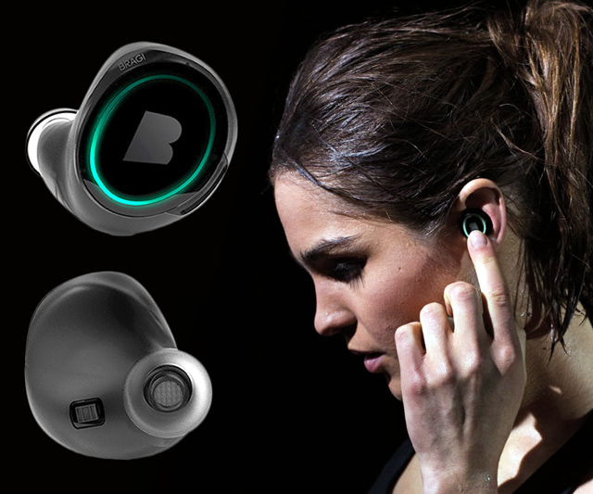
Wireless and Mobile Systems
for the IoT
CMSC 715 : Fall 2022
Lecture 3.8: Deep Learning in IoT
Nirupam Roy
Tu-Th 12:30-1:45pm
CSI 3120 (temporary location CSI 2118)

Slide 2
Sensing + Machine learning: New opportunities

Slide 3
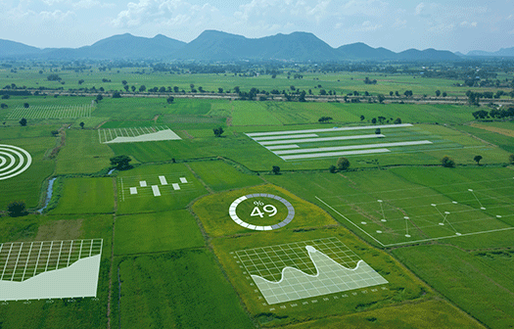
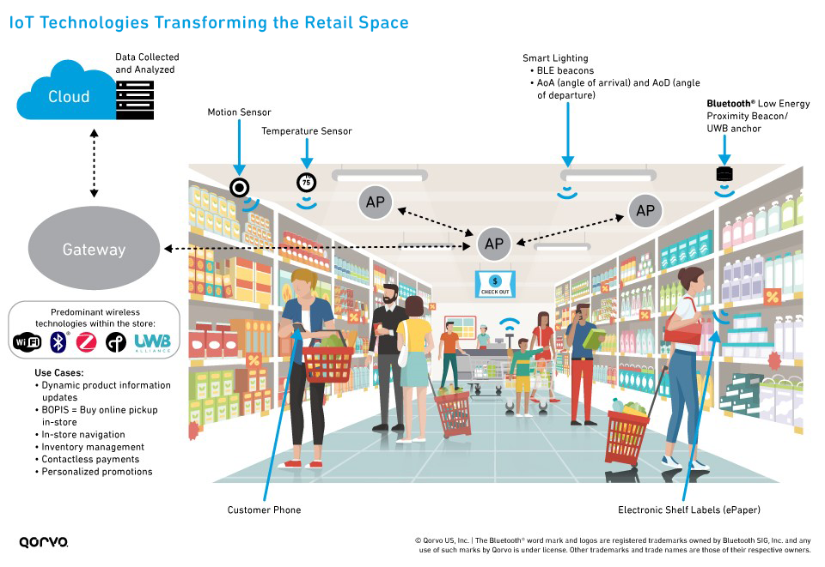
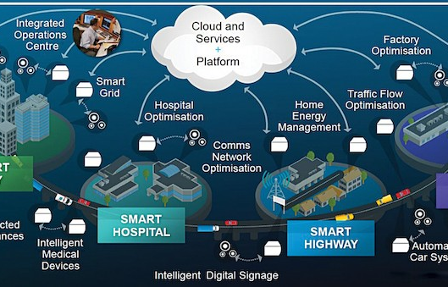
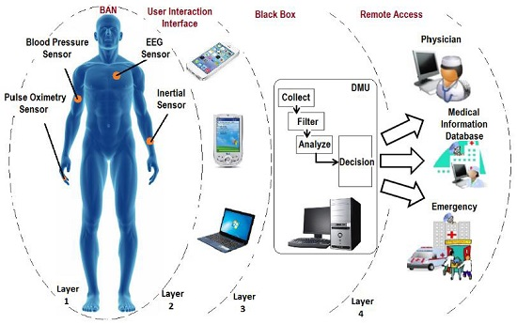
Sensing + Machine learning: Applications space

Slide 4
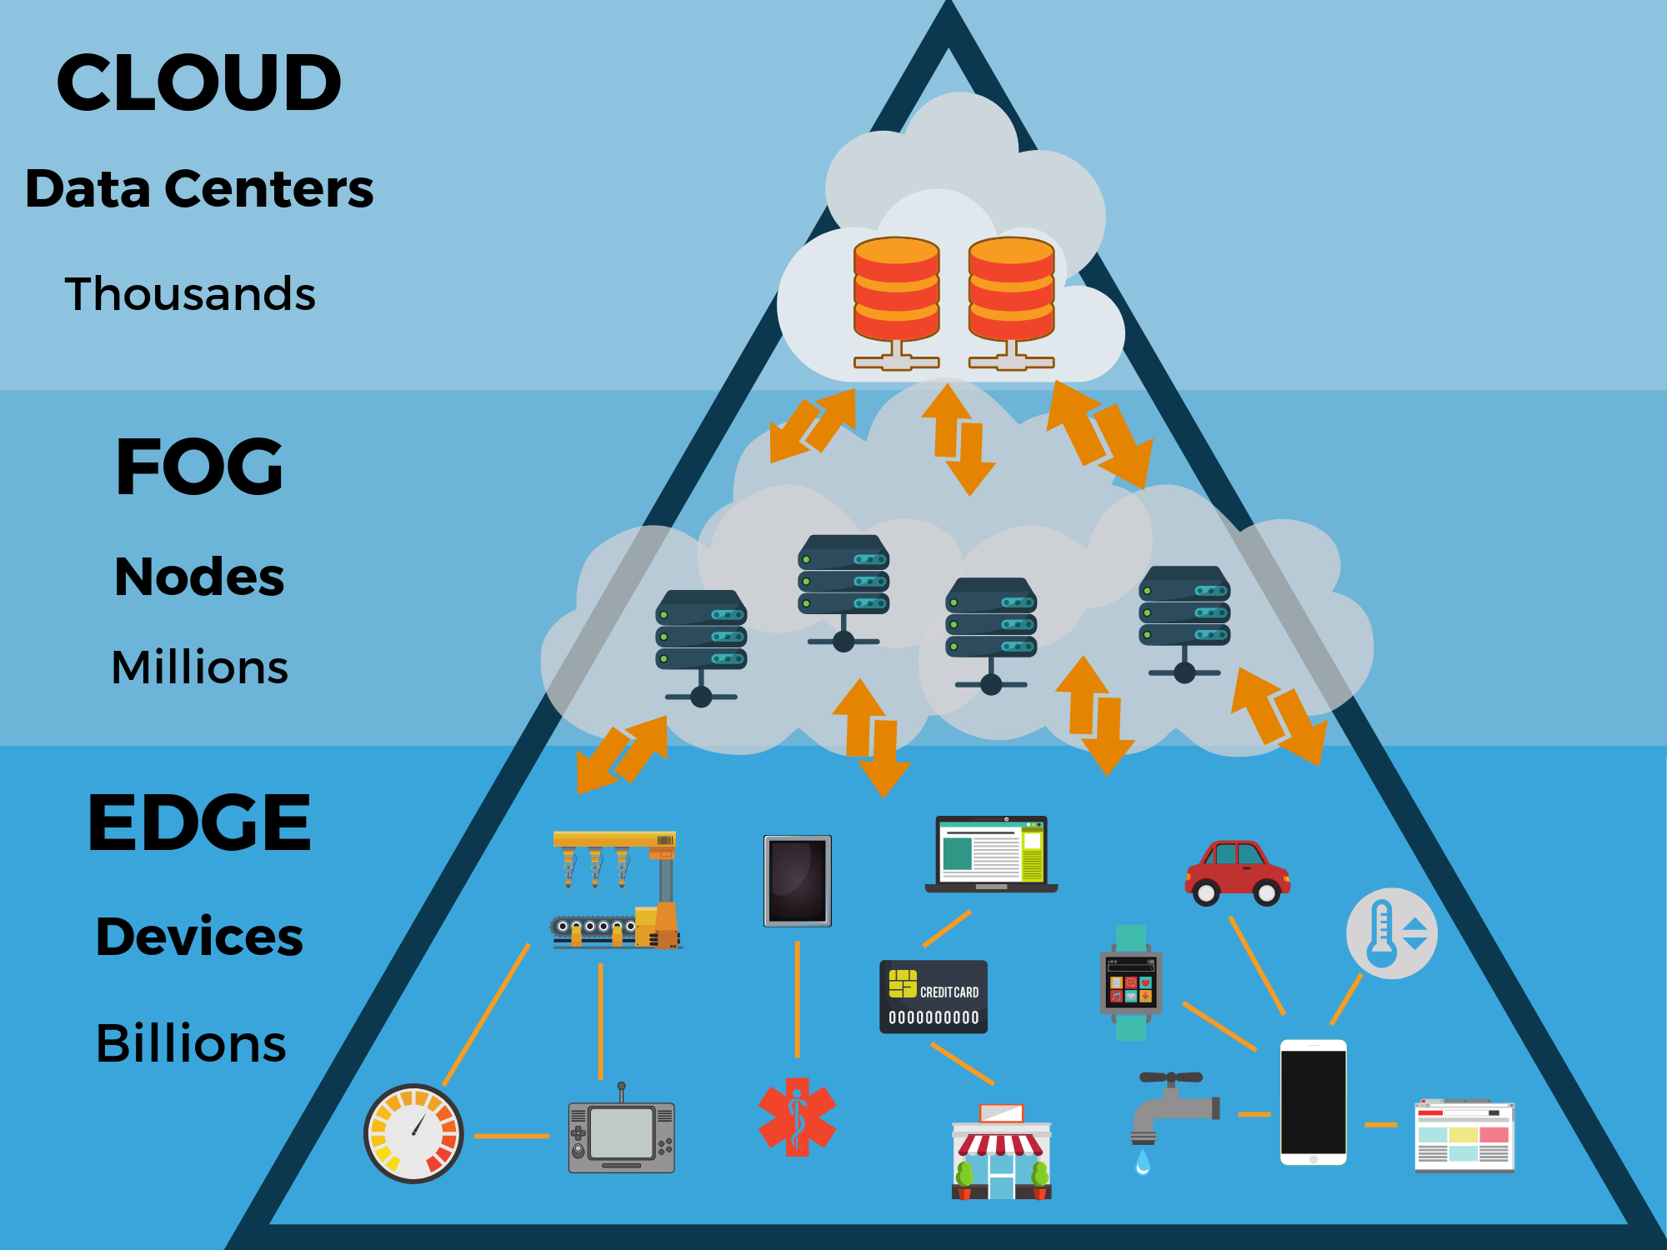

Slide 5
Computing on the cloud

Slide 6
Computing on the cloud

Slide 7
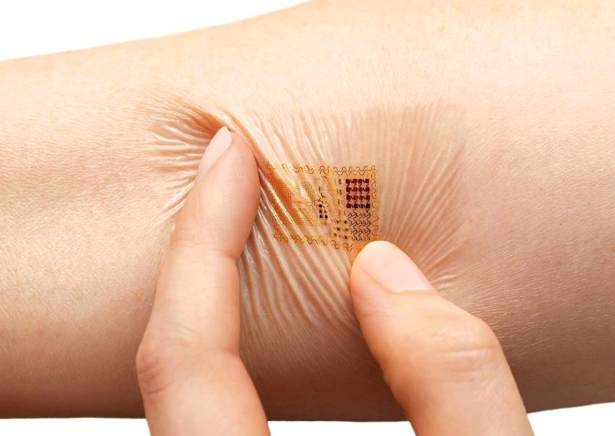
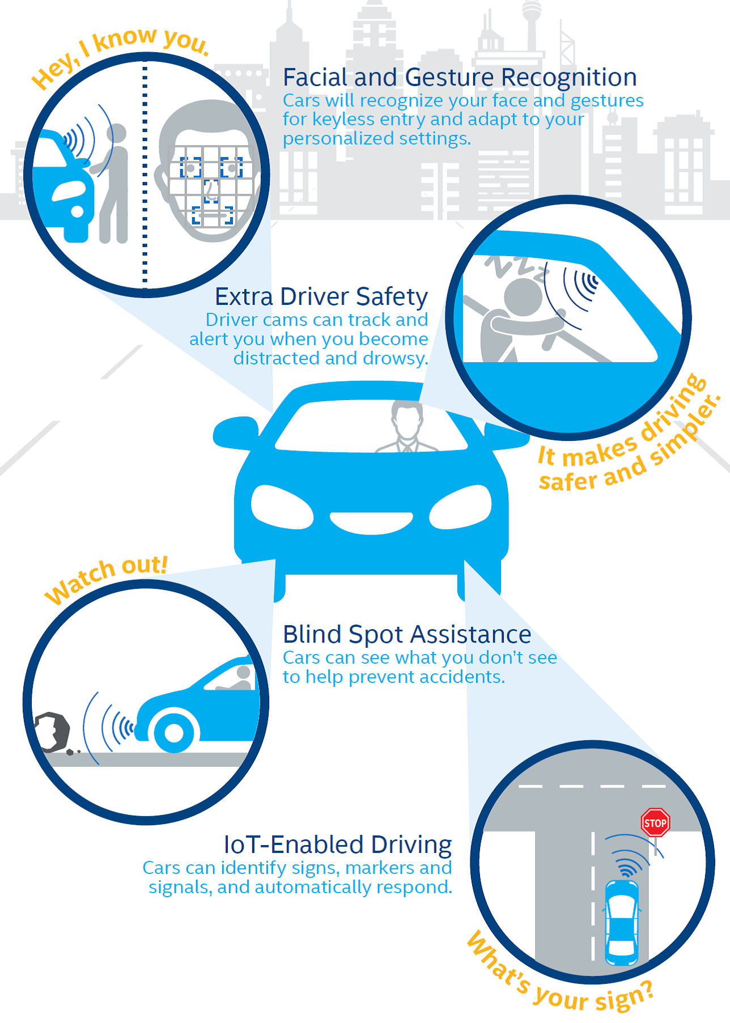
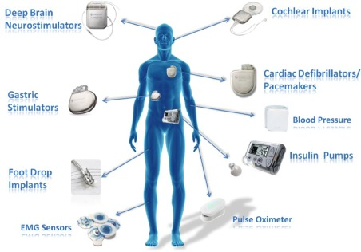
Computing on the cloud: Challenges

Slide 8
Computing on the cloud: Challenges
1. Latency –Data transmission to the cloud typically introduces longer latency than data processing on the embedded device. Real-time applications are latency sensitive.
2. Unreliable data transmissions – When the network connectivity is unreliable or even nonexistent, it is often impractical to stream data from sensors that generate large amounts of raw data, such as cameras, accelerometers, or microphones.
3. Energy efficiency – Microcontroller-based devices are inherently designed to perform extremely low-power computations, so they can operate for a long time on a small power budget.
4. Low cost – The expansion of IoT applications in many industrial segments was driven by the low cost and high volumes of microprocessors and supporting embedded hardware, and this trend is likely to continue.

Slide 9
Computing on the cloud: Challenges
5. Privacy – Privacy is always a concern when personal or other highly sensitive data is handled outside of the device. This is particularly true if data is sent to the cloud, as data can be lost or stolen.
6. Autonomy – Small embedded devices can contribute to the increased autonomy of the system they belong to, by generating independent, data-driven local decisions that can be shared only within the system.

Slide 11
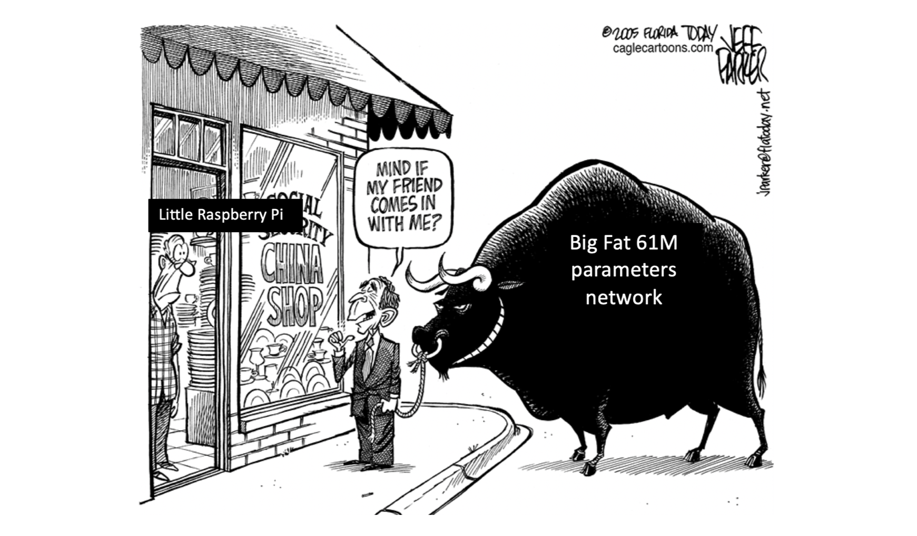

Slide 12
Deep learning on Mobile/Embedded devices: Challenges
Ref: https://www.edx.org/professional-certificate/harvardx-tiny-machine-learning

Slide 13
Microprocessor vs Microcontroller

Slide 14
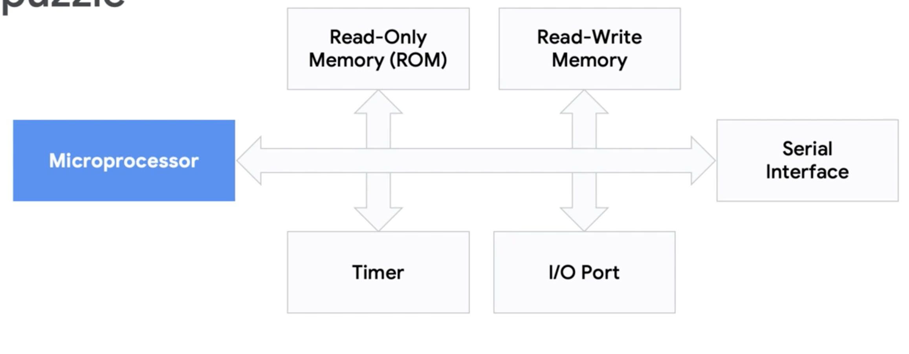
Microprocessor vs Microcontroller

Slide 15
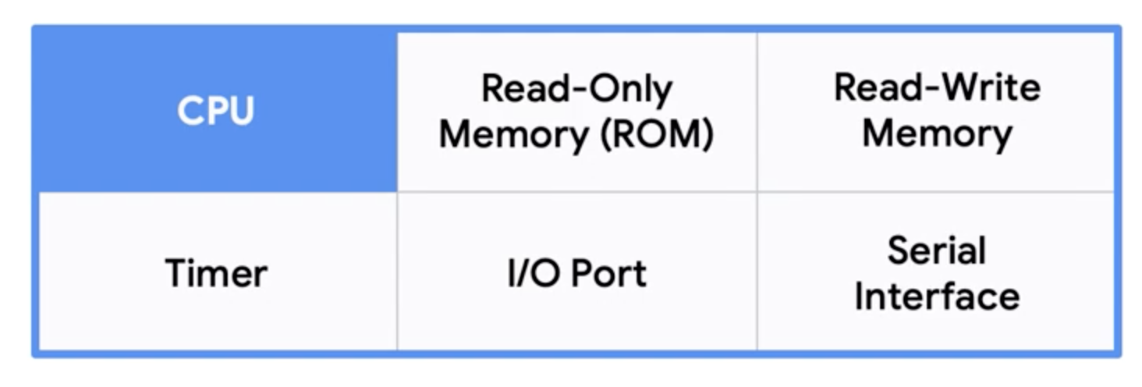
Microprocessor vs Microcontroller
Microcontroller

Slide 16
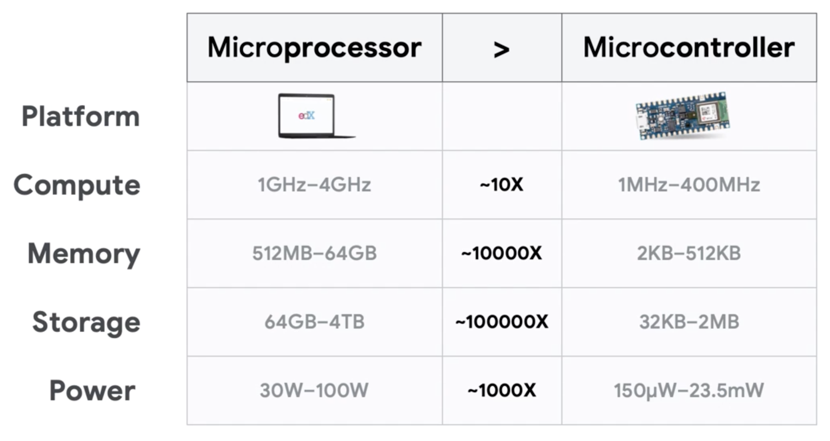
Microprocessor vs Microcontroller
Ref: https://www.edx.org/professional-certificate/harvardx-tiny-machine-learning

Slide 17
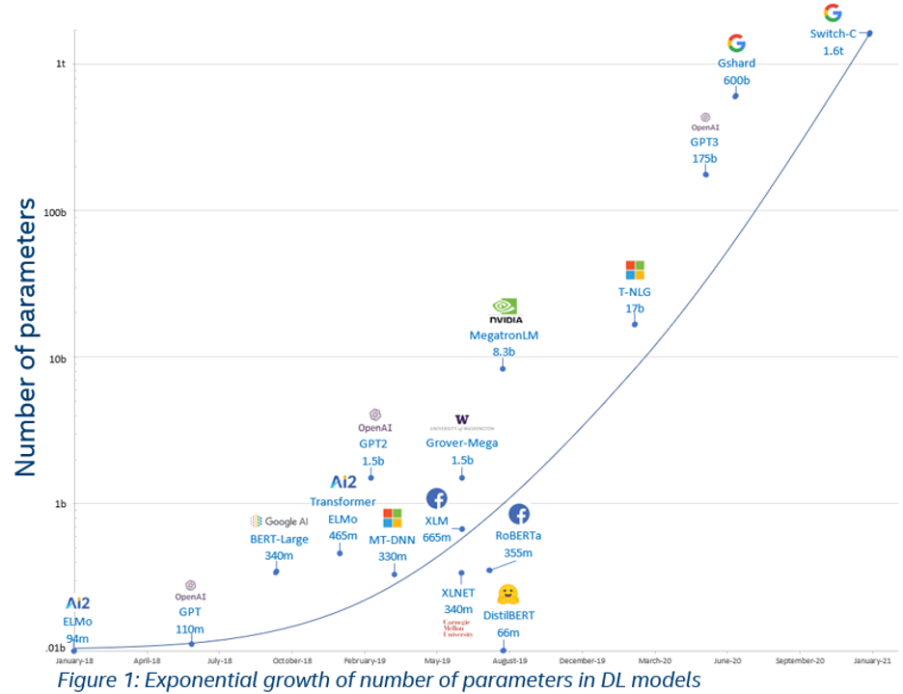

Slide 18
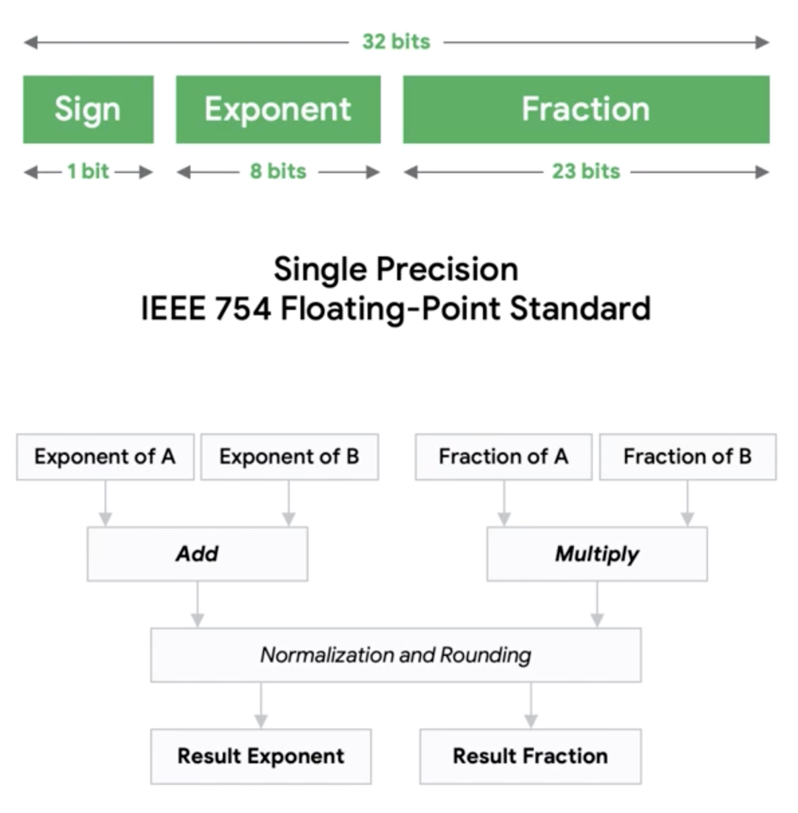
Microprocessor vs Microcontroller
Floating point operation
Ref: https://www.edx.org/professional-certificate/harvardx-tiny-machine-learning

Slide 19
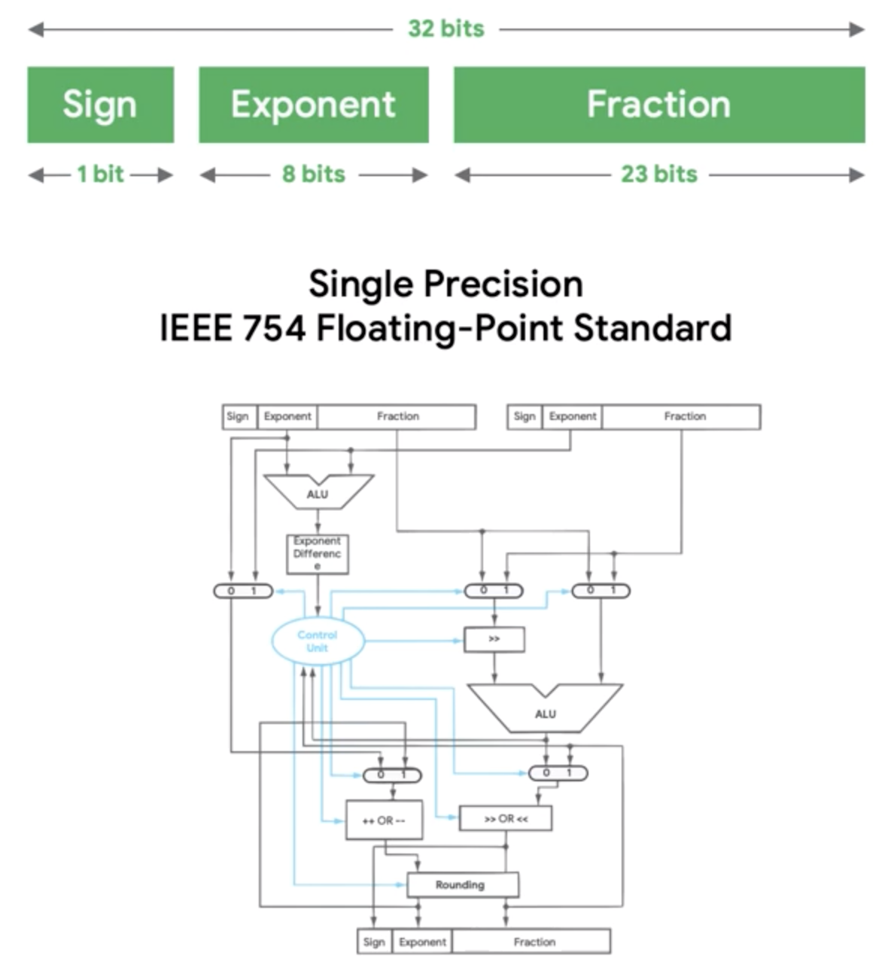
Microprocessor vs Microcontroller
Floating point operation
Ref: https://www.edx.org/professional-certificate/harvardx-tiny-machine-learning

Slide 20
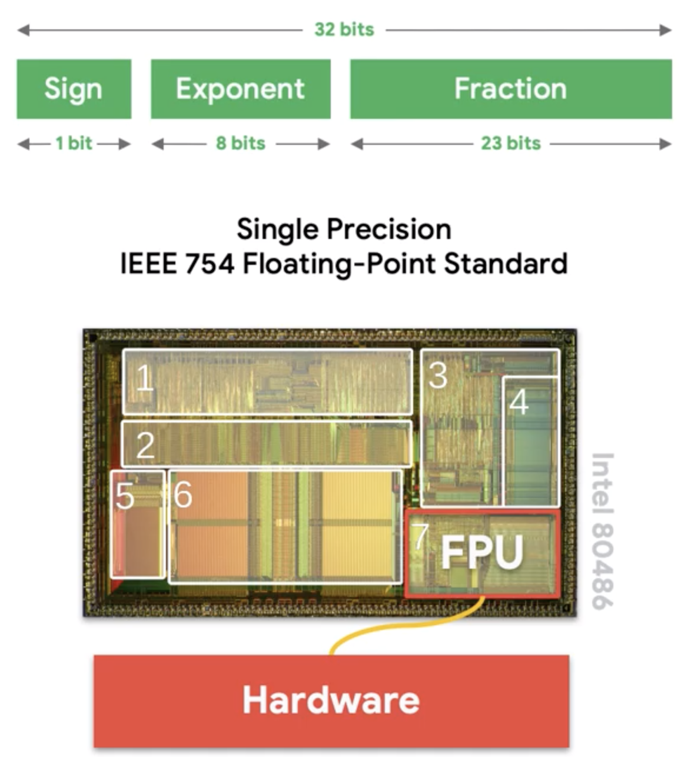
Microprocessor vs Microcontroller
Floating point operation
Ref: https://www.edx.org/professional-certificate/harvardx-tiny-machine-learning

Slide 21
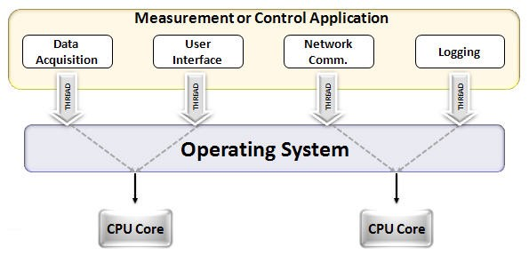
CPU vs GPU
Notes:
https://www.analyticsvidhya.com/blog/2020/09/why-gpus-are-more-suited-for-deep-learning/

Slide 22
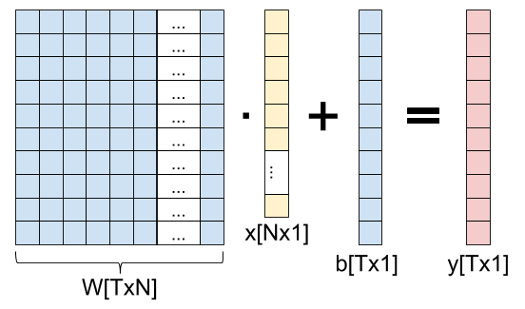
CPU vs GPU for parallel operations
Notes:
https://eli.thegreenplace.net/2018/backpropagation-through-a-fully-connected-layer/

Slide 23
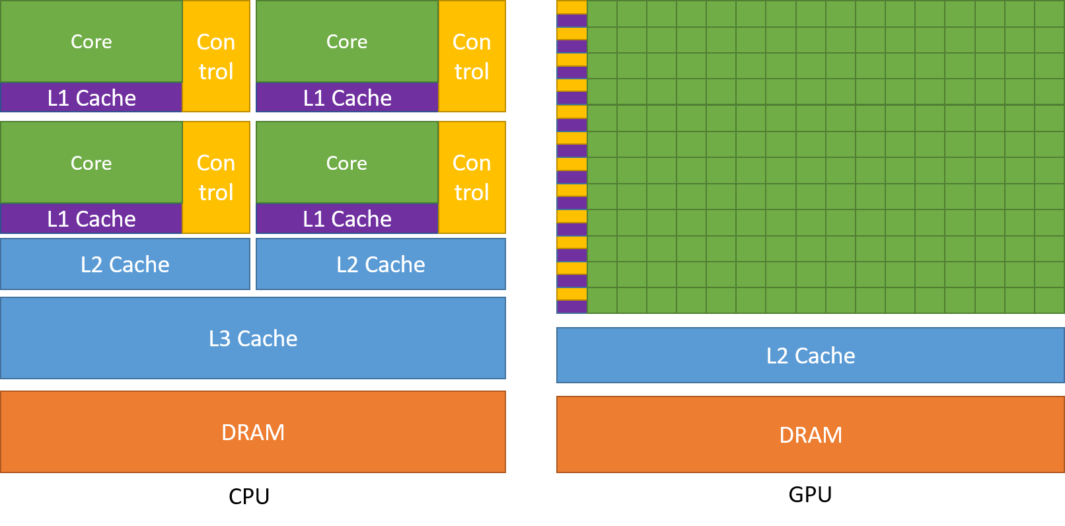
CPU vs GPU
Notes:
https://www.analyticsvidhya.com/blog/2020/09/why-gpus-are-more-suited-for-deep-learning/

Slide 24
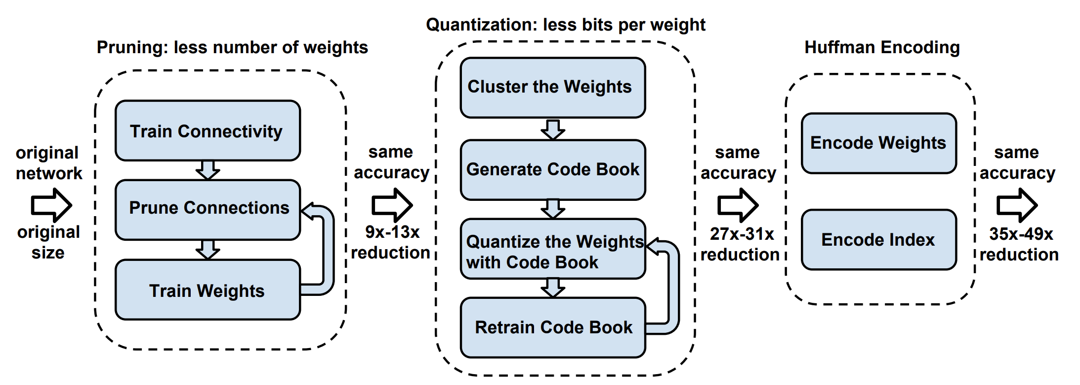
Compression of deep learning models
(TinyML example)
Notes:
https://tutorials.one/tiny-machine-learning/

Slide 25
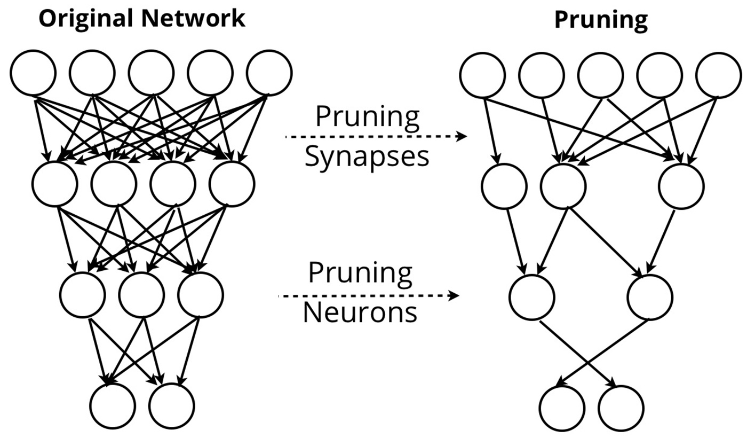
a. Pruning

Slide 26
b. Quantization

Slide 27
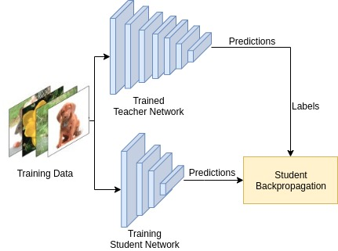
c. Knowledge distillation

Slide 28
Extra slides

Slide 29
Deep Learning refresher

Slide 30
b₁
i₁
w₁
h₁
w₅
w₂
O₁
b₂
w₃
w₆
i₂
w₄
h₂
Input layer
Hidden layer
Output layer
Ref: https://hmkcode.com/ai/backpropagation-step-by-step/

Slide 31
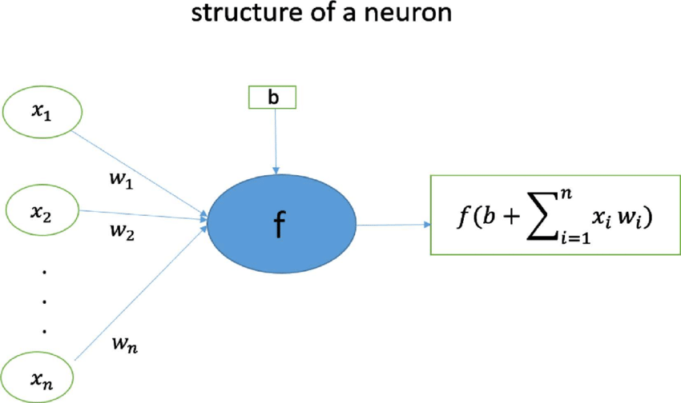
Structure of a neuron

Slide 32
b₁
i₁
w₁
h₁
w₅
w₂
O₁
b₂
w₃
w₆
i₂
w₄
h₂
For simplicity:
Set bias terms to zero.
Activation function: f(z) = z

Slide 33
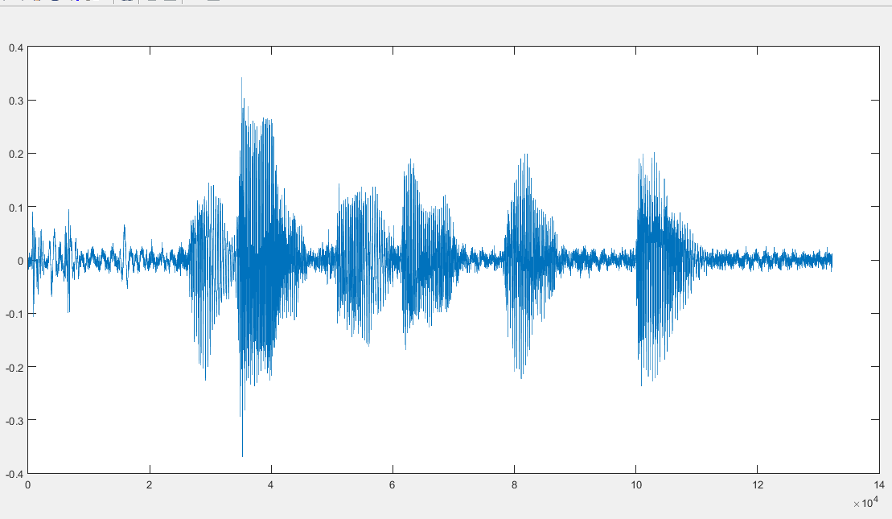
Forward propagation
i₁
w₁
h₁
w₅
w₂
[4.5, 0.8, 2.2, 9.1]
O₁
w₃
w₆
i₂
w₄
h₂
Prediction
Loss = ½(Actual output - prediction)²
Optimization: Adjust parameters to minimize loss

Slide 34
Back propagation
i₁
w₁
h₁
w₅
w₂
O₁
w₃
w₆
i₂
w₄
h₂
Prediction
Loss = ½(Actual output - prediction)²
Optimization: Adjust parameters to minimize loss

Slide 35
i₁
w₁
h₁
w₅
w₂
O₁
w₃
w₆
i₂
w₄
h₂
An example:
Input: i₁=2, i₂=3
Actual output = 1

Slide 36
2
w₁
h₁
w₅
w₂
O₁
w₃
w₆
Actual output = 1
3
w₄
h₂
An example:
Input: i₁=2, i₂=3
Actual output = 1

Slide 37
Start with random parameters
2
w₁
h₁
w₅
w₂
O₁
w₃
w₆
Actual output = 1
3
w₄
h₂

Slide 38
Start with random parameters
2
0.11
h₁
0.21
0.14
O₁
0.12
0.15
Actual output = 1
3
h₂
0.08
Forward propagation:
0.11
0.12
[
2
3
]
=
[
0.85
0.48
]
0.21
0.08

Slide 39
Start with random parameters
2
0.11
0.85
0.21
0.14
O₁
0.12
0.15
Actual output = 1
3
0.48
0.08
Forward propagation:
h₁
h₂
0.14
O₁
0.11
0.12
=
[
]
[
2
3
]
=
[
0.85
0.48
]
0.191
0.21
0.08
0.15

Slide 40
Start with random parameters
2
0.11
0.85
0.21
0.14
O₁
0.12
0.15
Actual output = 1
3
0.48
0.08
Error/Loss calculation:
O₁
Actual output = 1
1/2(
0.191
-
1
)²
=
0.327

Slide 41
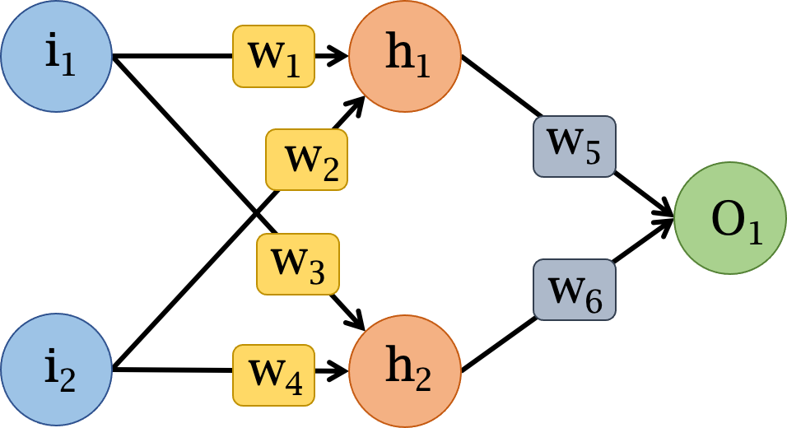

Slide 46
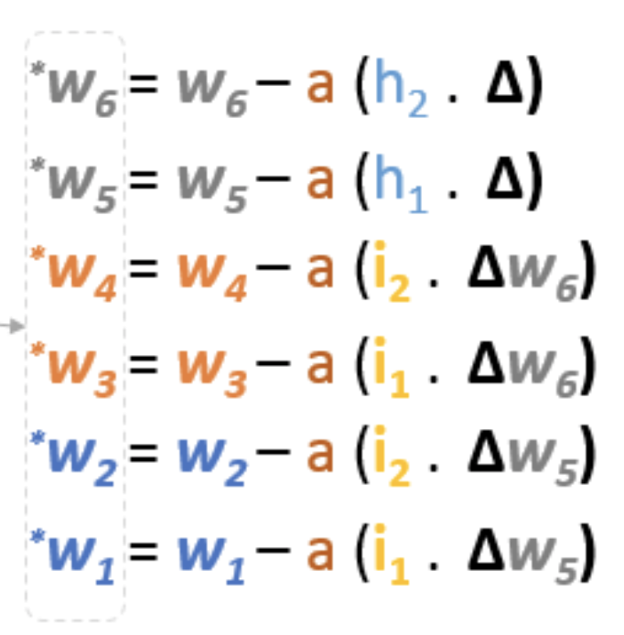
Ref: https://hmkcode.com/ai/backpropagation-step-by-step/

Slide 47
i₁
w₁
h₁
w₅
w₂
O₁
w₃
w₆
i₂
w₄
h₂

Slide 48
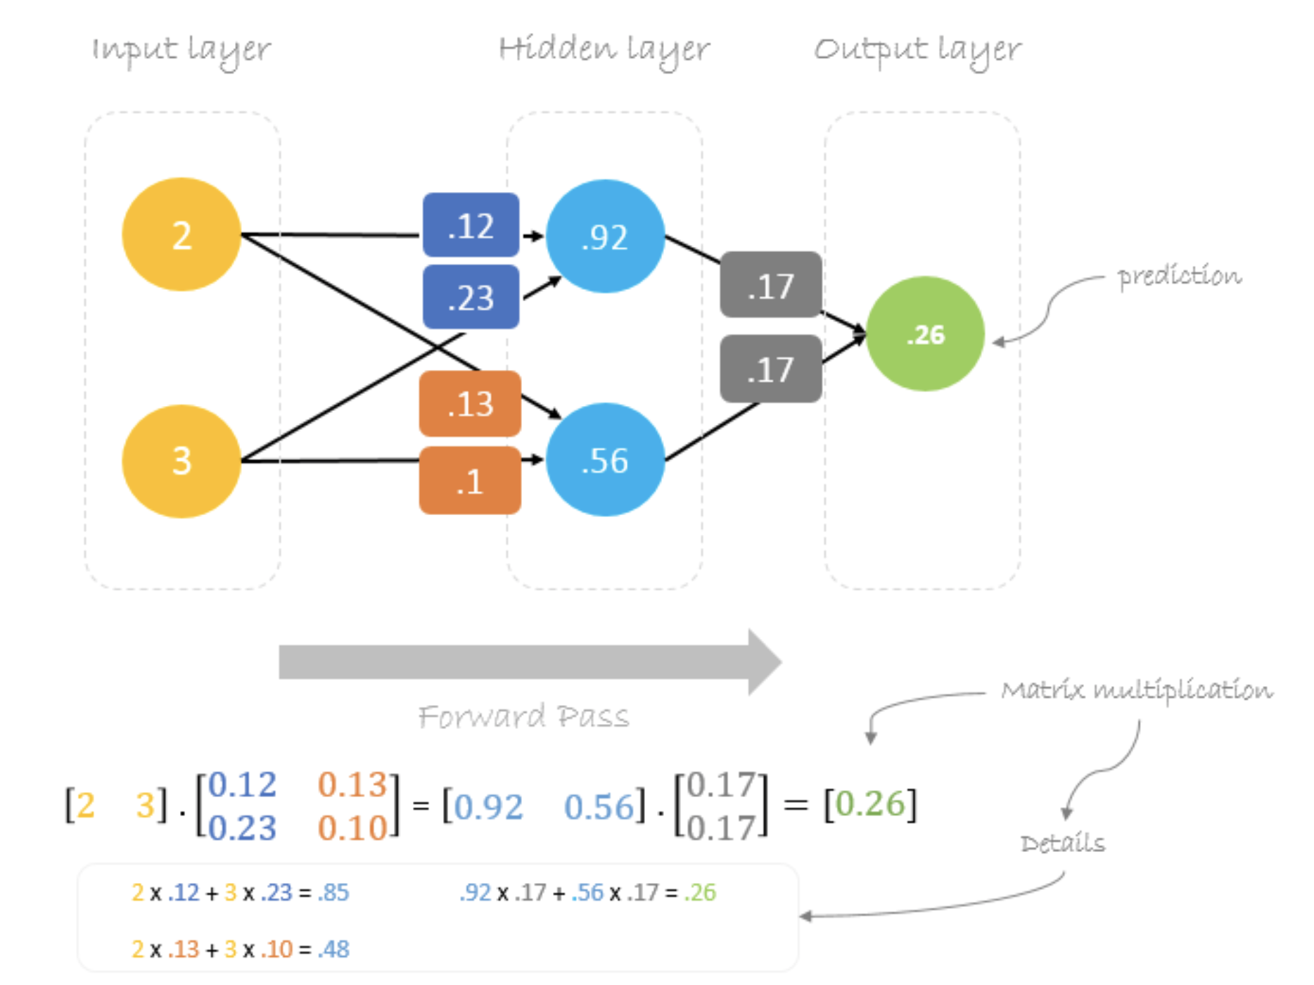

Slide 49
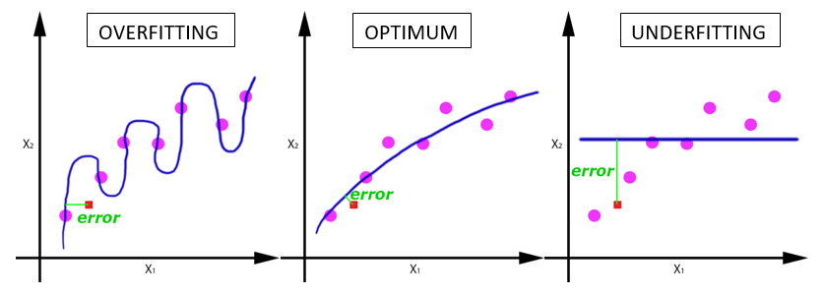
Deep learning terminologies
5. Epoch, Batches, Batch size, Iteration
a. Epoch:
-Entire dataset is passed (forward and backward) through the network.
-Why do we need multiple epochs?
How to find the right number of epochs?
Notes:
Ref: https://www.analyticsvidhya.com/blog/2019/08/detailed-guide-7-loss-functions-machine-learning-python-code/

Slide 50
Deep learning terminologies
5. Epoch, Batches, Batch size, Iteration
a. Epoch:
-Entire dataset is passed (forward and backward) through the network.
b. Batch/Batch size:
-Large data set is divided into smaller chunks or batches of specific size.
Notes:
Ref: https://www.analyticsvidhya.com/blog/2019/08/detailed-guide-7-loss-functions-machine-learning-python-code/

Slide 51
Deep learning terminologies
5. Epoch, Batches, Batch size, Iteration
a. Epoch:
-Entire dataset is passed (forward and backward) through the network.
b. Batch/Batch size:
-Large data set is divided into smaller chunks or batches of specific size.
c. Iteration:
-Number of batches required to complete one epoch.
Notes:
Ref: https://www.analyticsvidhya.com/blog/2019/08/detailed-guide-7-loss-functions-machine-learning-python-code/

Slide 52
Deep learning terminologies
5. Epoch, Batches, Batch size, Iteration
a. Epoch:
-Entire dataset is passed (forward and backward) through the network.
A dataset of 1000 training examples is divided into batches of 200 examples.
It will take 5 iterations to complete 1 epoch.
b. Batch/Batch size:
-Large data set is divided into smaller chunks or batches of specific size.
c. Iteration:
-Number of batches required to complete one epoch.
Notes:
Ref: https://www.analyticsvidhya.com/blog/2019/08/detailed-guide-7-loss-functions-machine-learning-python-code/

Slide 53
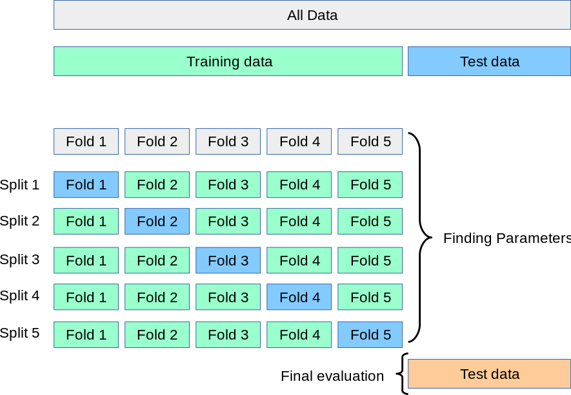
Deep learning terminologies
6. Cross-validation
Notes:
PC: https://en.wikipedia.org/wiki/Cross-validation_(statistics)

Slide 54
Types of learning problems
1. Supervised
a. Classification
b. Regression
2. Unsupervised
a. Clustering
b. Association
3. Reinforcement

Slide 55
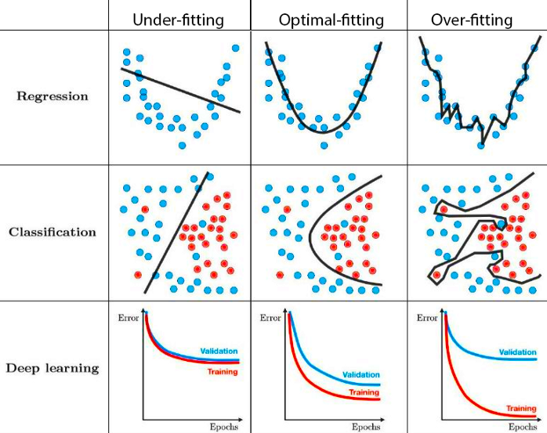
Challenges: Underfitting & Overfitting
Notes:
PC: https://towardsdatascience.com/techniques-for-handling-underfitting-and-overfitting-in-machine-learning-348daa2380b9

Slide 56
Dealing with underfitting
a. Increase model complexity
b. Use more epochs for training
c. Shuffle data per epoch
Notes:
https://towardsdatascience.com/techniques-for-handling-underfitting-and-overfitting-in-machine-learning-348daa2380b9

Slide 57
Dealing with overfitting
a. Increase training dataset
Regularization
a. Dropout
b. Augmentation
c. Early stopping
Notes:
https://towardsdatascience.com/techniques-for-handling-underfitting-and-overfitting-in-machine-learning-348daa2380b9

Slide 58
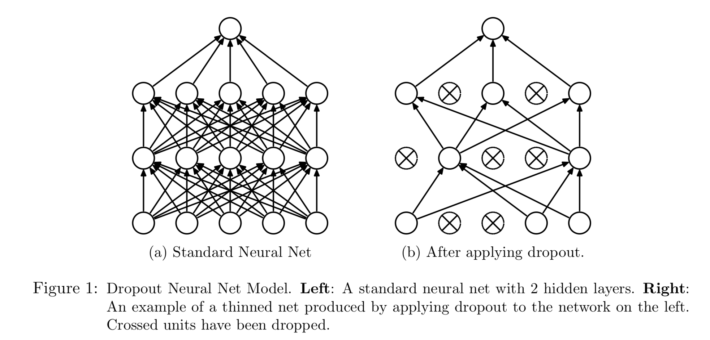
Dealing with overfitting
a. Dropout
Ref: Dropout: A Simple Way to Prevent Neural Networks from Overfitting
https://www.cs.toronto.edu/~hinton/absps/JMLRdropout.pdf
Notes:
DropConnect

Slide 59
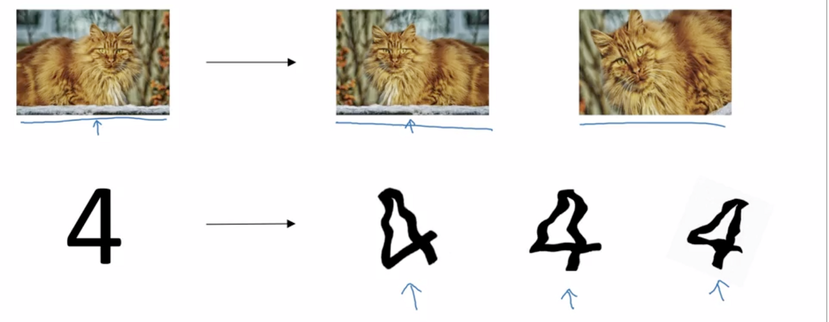
Dealing with overfitting
b. Augmentation
Notes:
https://medium.com/@dhartidhami/regularization-in-deep-learning-2065b7c889e5

Slide 60
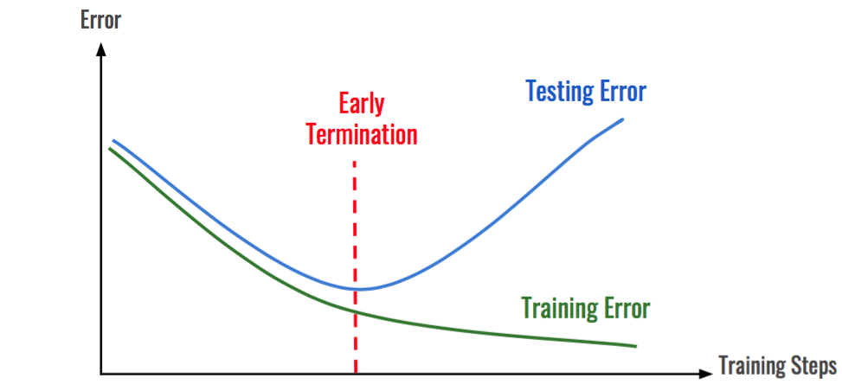
Dealing with overfitting
c. Early stopping

