Slide 1
GLOBAL FUSION

Slide 2
GLOBAL FUSION
A Global Attentional Deep Learning Framework for Multi-sensor Information Fusion
Paper Review
By
Hirad Yazdankhah
Fall 2022 CMSC-715
Paper Authors at University of Illinois at Urbana-Champaign :
SHENGZHONG LIU*, SHUOCHAO YAO*, JINYANG LI, DONGXIN LIU, TIANSHI WANG,HUAJIE SHAO, TAREK ABDELZAHER,

Slide 3
Problem
How can we accurately identify & classify a system state using multiple sensors?

Slide 4
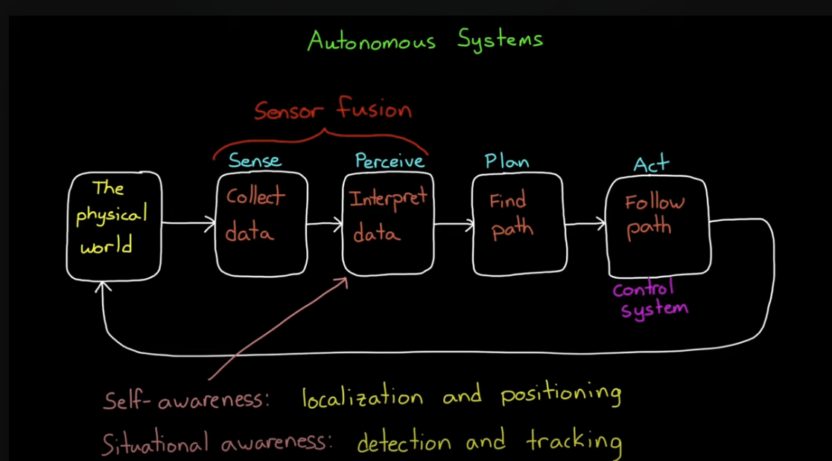
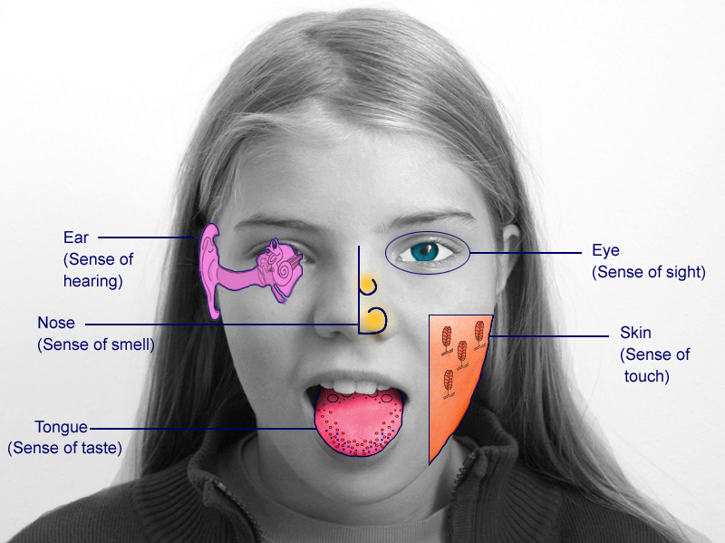
Perception Challenge : Multi-Sensor Fusion
https://www.youtube.com/watch?v=6qV3YjFppuc

Slide 5
Use Case : Human Activity Detection Approach : Using Sensor Fusion & Attention Focus Mechanism
Key Question:
How to effectively and efficiently perform
Multi-sensor information fusion with neural network algorithms
and automatically decide,
where to pay attention to detect a given class of system activity?
Our Answer : Global Fusion

Slide 6
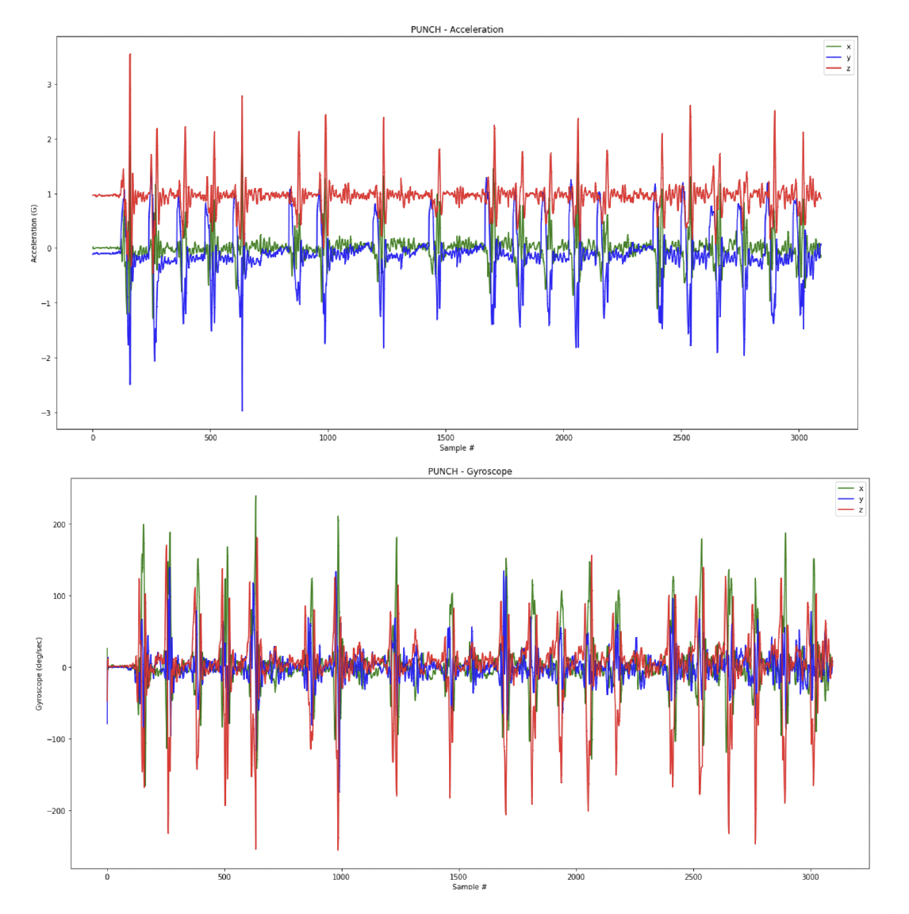
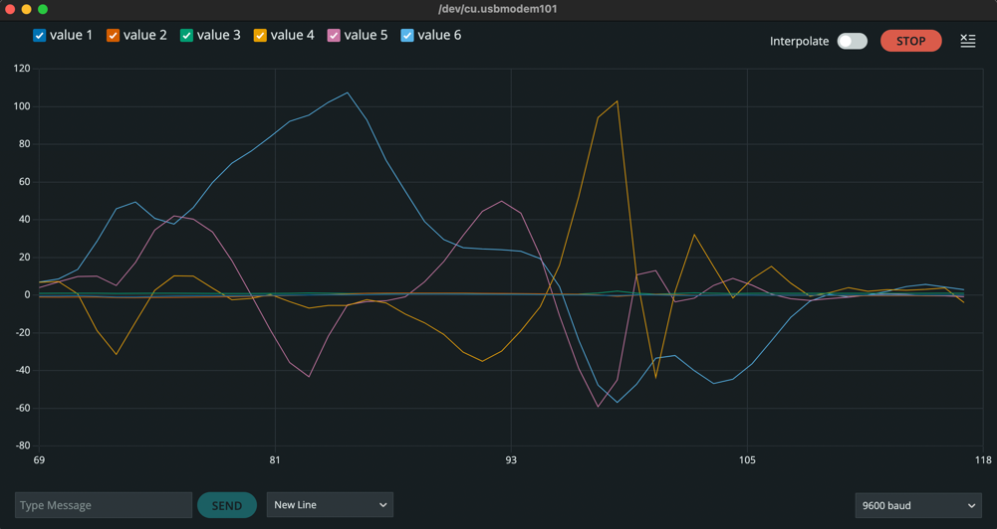
HW#3
Arduino output for a “punch”

Slide 7
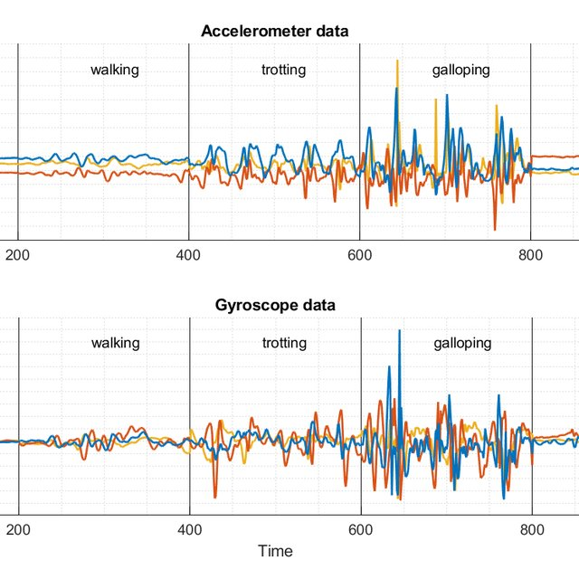
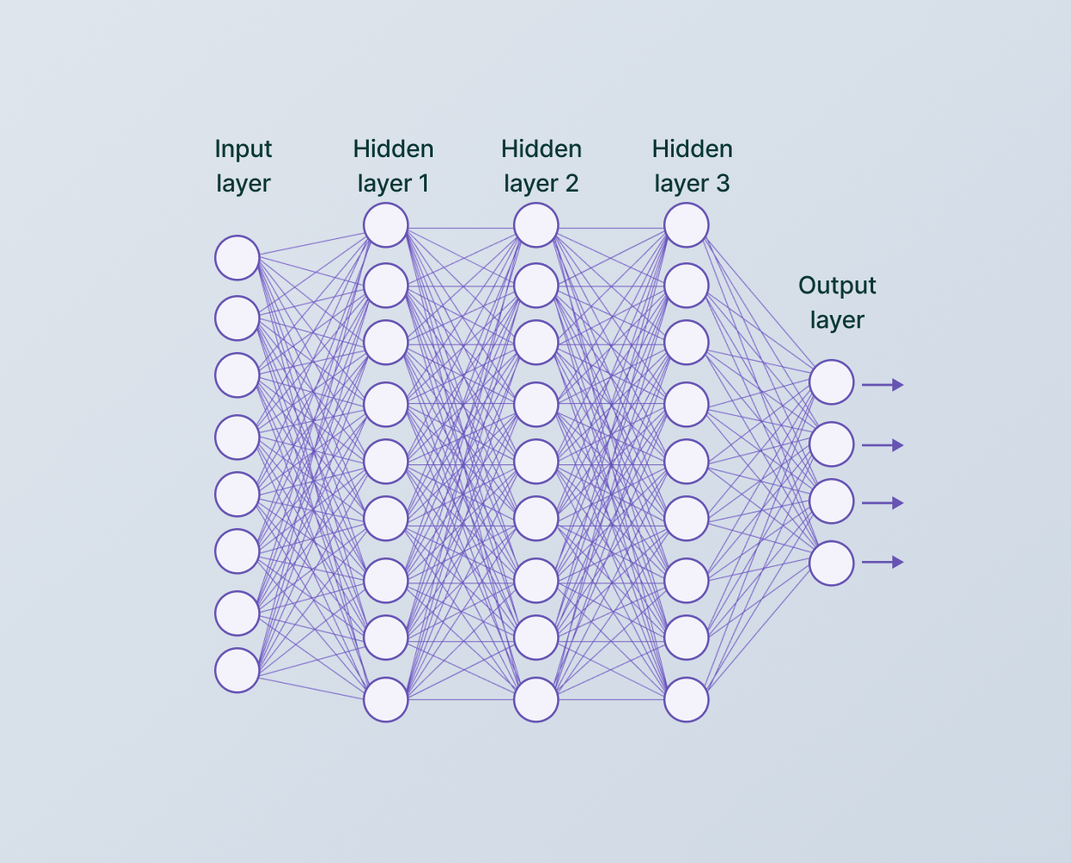
HW#3
1 device

Slide 8
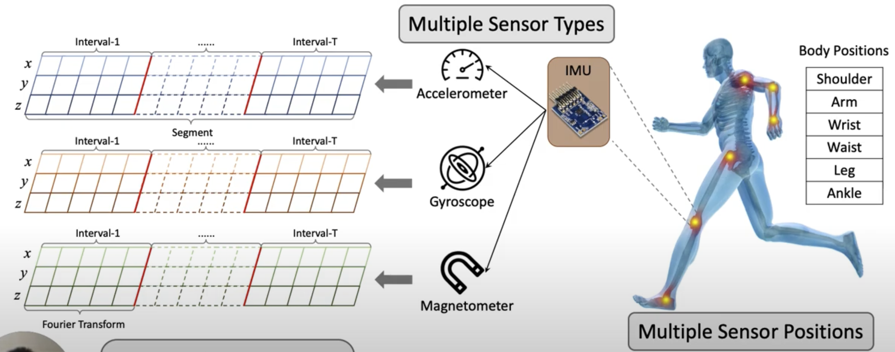
Multi-Device Human Activity Recognition
Moving
Speed
Angular
Orientation in 3D
Spectrogram of Single Sensor Data
Note: By utilizing the time-frequency input, both the time domain order information and frequency domain pattern information are well preserved.

Slide 9
Approach
Fusion + Attention

Slide 10
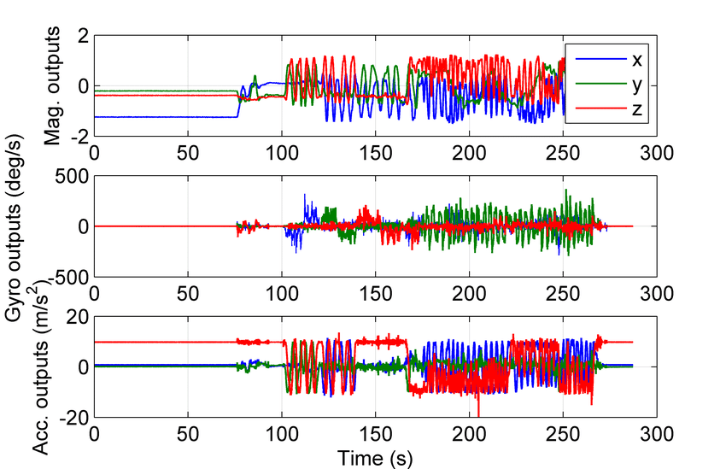
Overview : Fusion + Attention Process
Individual
Convolution
Module
For each device
Many Devices/Sensors
Global Modality Fusion + Attention
Global Position Fusion + Attention
FFT

Slide 11
Global Fusion 4 Modules
Individual sensor convolution module
Spatial fusion module
3 layer convolution module
Global Position Attention module
modality fusion module
time recurrent module.

Slide 12
Fusion

Slide 13
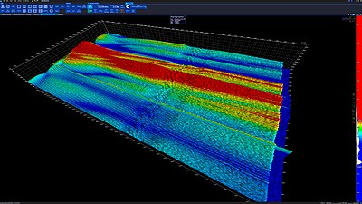
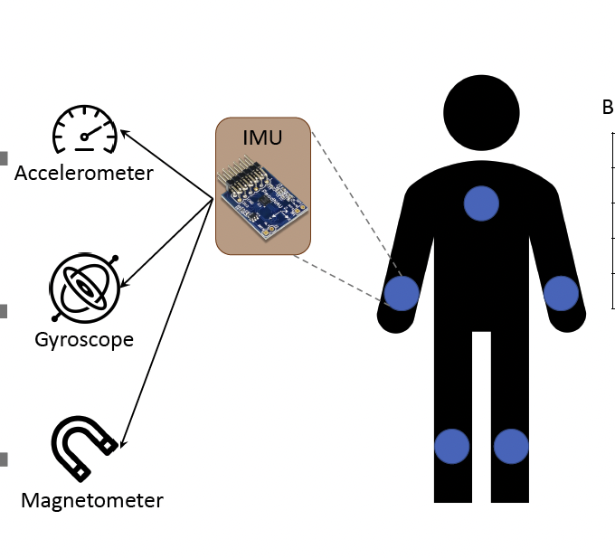
Pre-prosessing
Many Devices/Sensors
Individual sensor convolution module
Segmentation
&
FFT
Sensor,
Position,
Interval ,
Features
The preliminary Global Feature Extration Module refers to a 3 layer CNN
Note : No sensor or body position interaction is considered in this module. convolution layers are used to gradually extract frequency pattern features within the spectrum of each time interval.

Slide 14
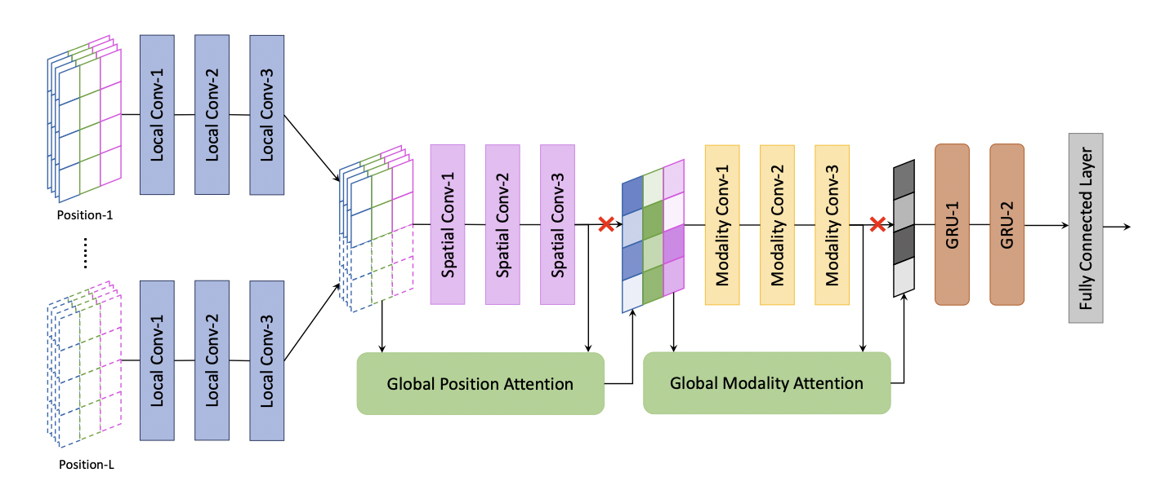
FUSION ARCHITECTURE
Frequency
Location
Modality
Time
Individual Convolution Module
Spatial Fusion Module
Modality Fusion Module
Time Recurrent Module
{Sensor Modality Type ,
Position on Body ,
Time Interval }
Features
{Sensor Modality Type ,
Time Interval }
Features
{Time Interval }
Features
Sequence Classification
Via 2 layer GRU
Represent the information contained in a given sensor across all body positions at specific interval.
Location, Modality & Time Segment
Modality &
Time Segment
Only
Time Segment

Slide 15
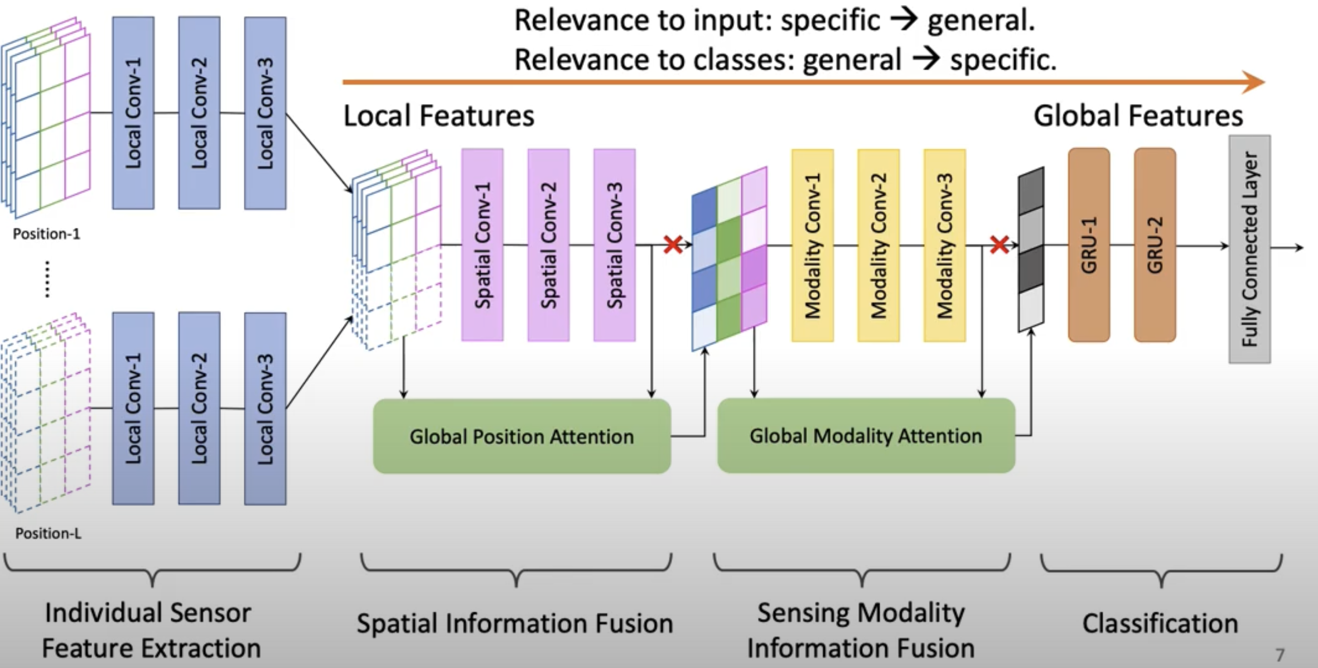
GlobalFusion framework overview.
Arms
Legs
CNN
CNN
CNN
RNN

Slide 16
Attention
Goal:
We want to see features from informative sensor modalities and positions to be amplified while the unrelated noise suppressed.

Slide 17
Fusion+ Attention
NN mechanism is capable of utilizing information collected from higher layers of the neural network to selectively amplify the influence of informative features and suppress unrelated noise at the fusion layer.
Standing
Standing
Self Attention where we create a mask query extracted from the input features. We match the neural network node outputs (at certain layers) against inputs at earlier layers with the idea that inputs that are more correlated with outputs deserve more attention.
Walking

Slide 18
Approach: Self attention
Attention Mechanism is a technique to dynamically adjusting neural network’s focus by scaling the features using corresponding weights computed by a separate attention module.
By design the network can automatically amplify the influence of informative features and suppress unrelated noise. In conventional attention mechanisms for regression problems, the extraction of features weights are often computed from matching features from the input signal and features from the output signal. The features used to estimate input features importance are called the query.

Slide 19
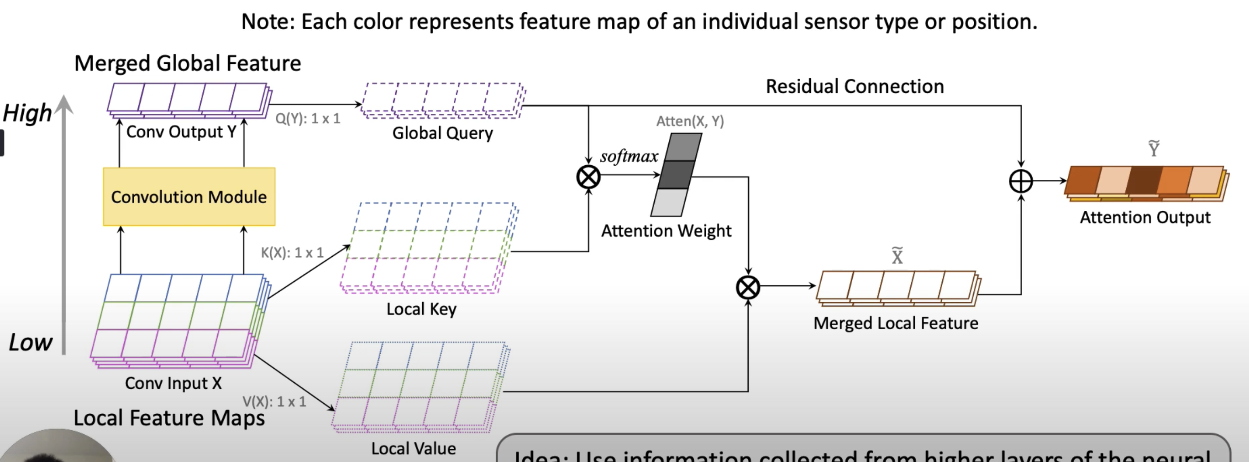
ATTENTION ARCHITECTURE
In global attention module, the complementary information is extracted from input local features and added to global output features before feeding them into next layer. we use the global features as the to estimate the importance, i.e.,global query attention weight, of each sensing modality / body position.
softmax function is used to normalize the outputs, converting them from weighted sum values into probabilities that sum to one. Each value in the output of the softmax function is interpreted as the probability of membership for each class.

Slide 20
Evaluation& Results

Slide 21
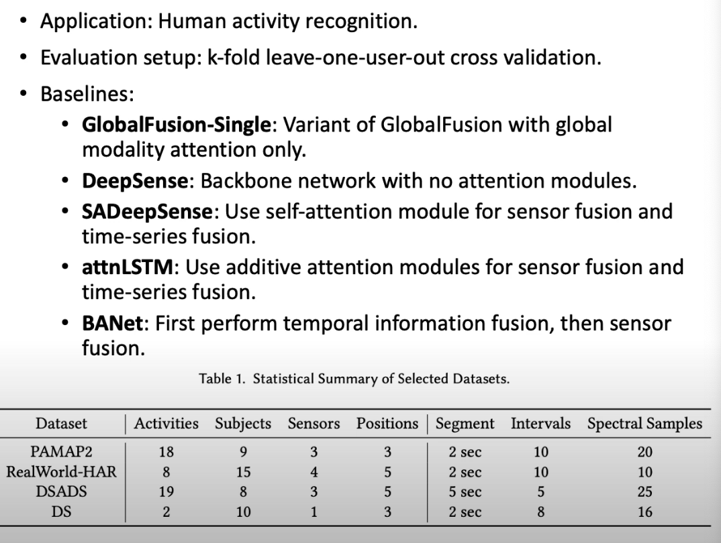
Evaluation : Comparing GlobalFusion to other Algorithms using standard Datasets
Algorithms
5 Attention based sensor fusion Algorithms
Datasets
Multiple datasets, with multiple types of sensor readings collected from several body positions to infer human activities.

Slide 22
Experimental Setup
All the models evaluated in this paper are trained with Tensorflow 1.14 on a workstation equipped with an
Intel i9-9960X processor, 64GB memory, and four NVIDIA RTX 2080 Ti GPU.
For training the model, we adopt a standard cross entropy loss for classification, along with L2 normalization. The normalization factor is set as 5e-4.
The model is optimized by the ADAM algorithm [16] with a learning rate of 1e-4, while β1 = 0.5 and β2 = 0.9.
We add a batch normalization layer and a dropout layer after each convolutional layer to stabilize the training
process and prevent overfitting. Training batch size is set as 64.
Setup
Datasets
We evaluate inference accuracy on human activity recognition tasks that use multiple sensors as input. All models are evaluated under a leave-one-user-out scenario with k-fold cross validation. Specifically, one subject is chosen as the test user each time, while the activity traces of all remaining subjects are used for training. The test user is then rotated until all users have been exhausted.

Slide 23
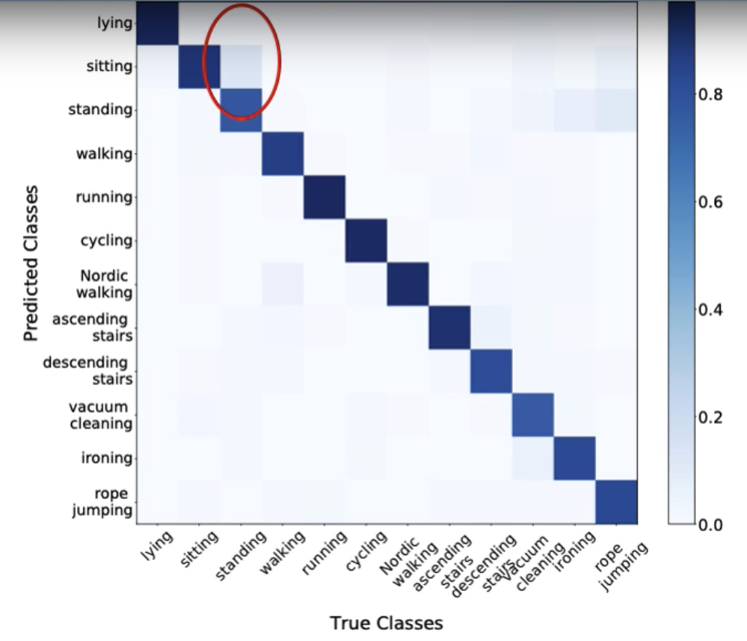
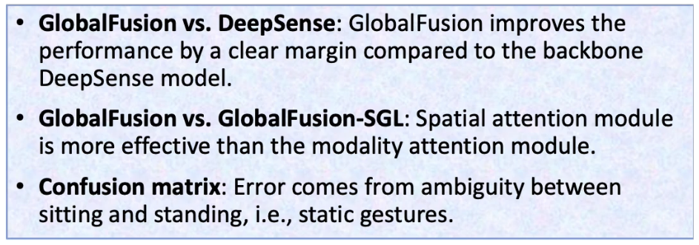
Quantitative Evaluation
PAPMAP2 Classification

Slide 24
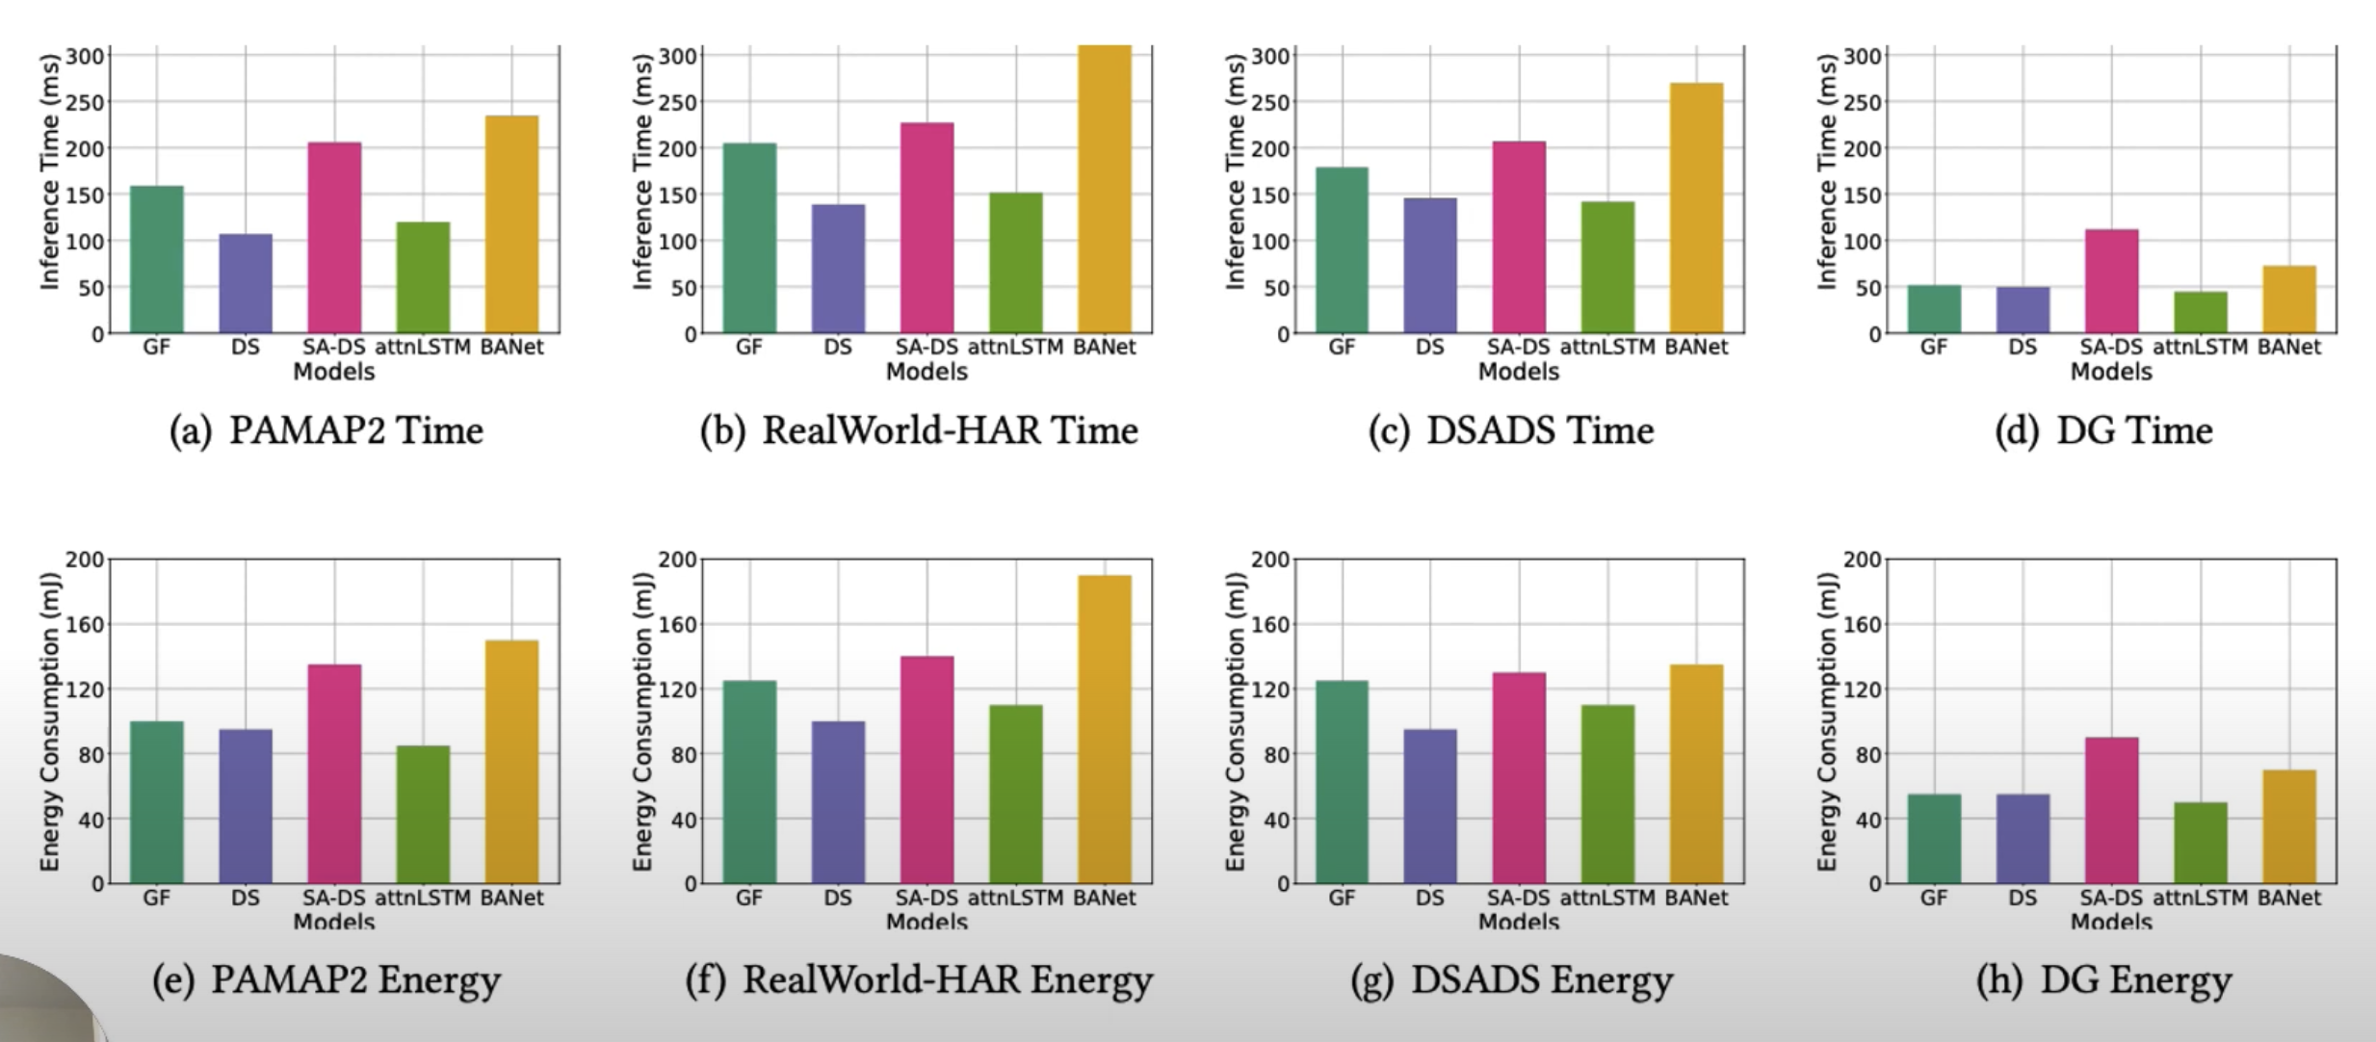
Time and Energy Efficiency
GlobalFusion has higher time and energy efficiencies than SADeepSense

Slide 25
Conclusion

Slide 26
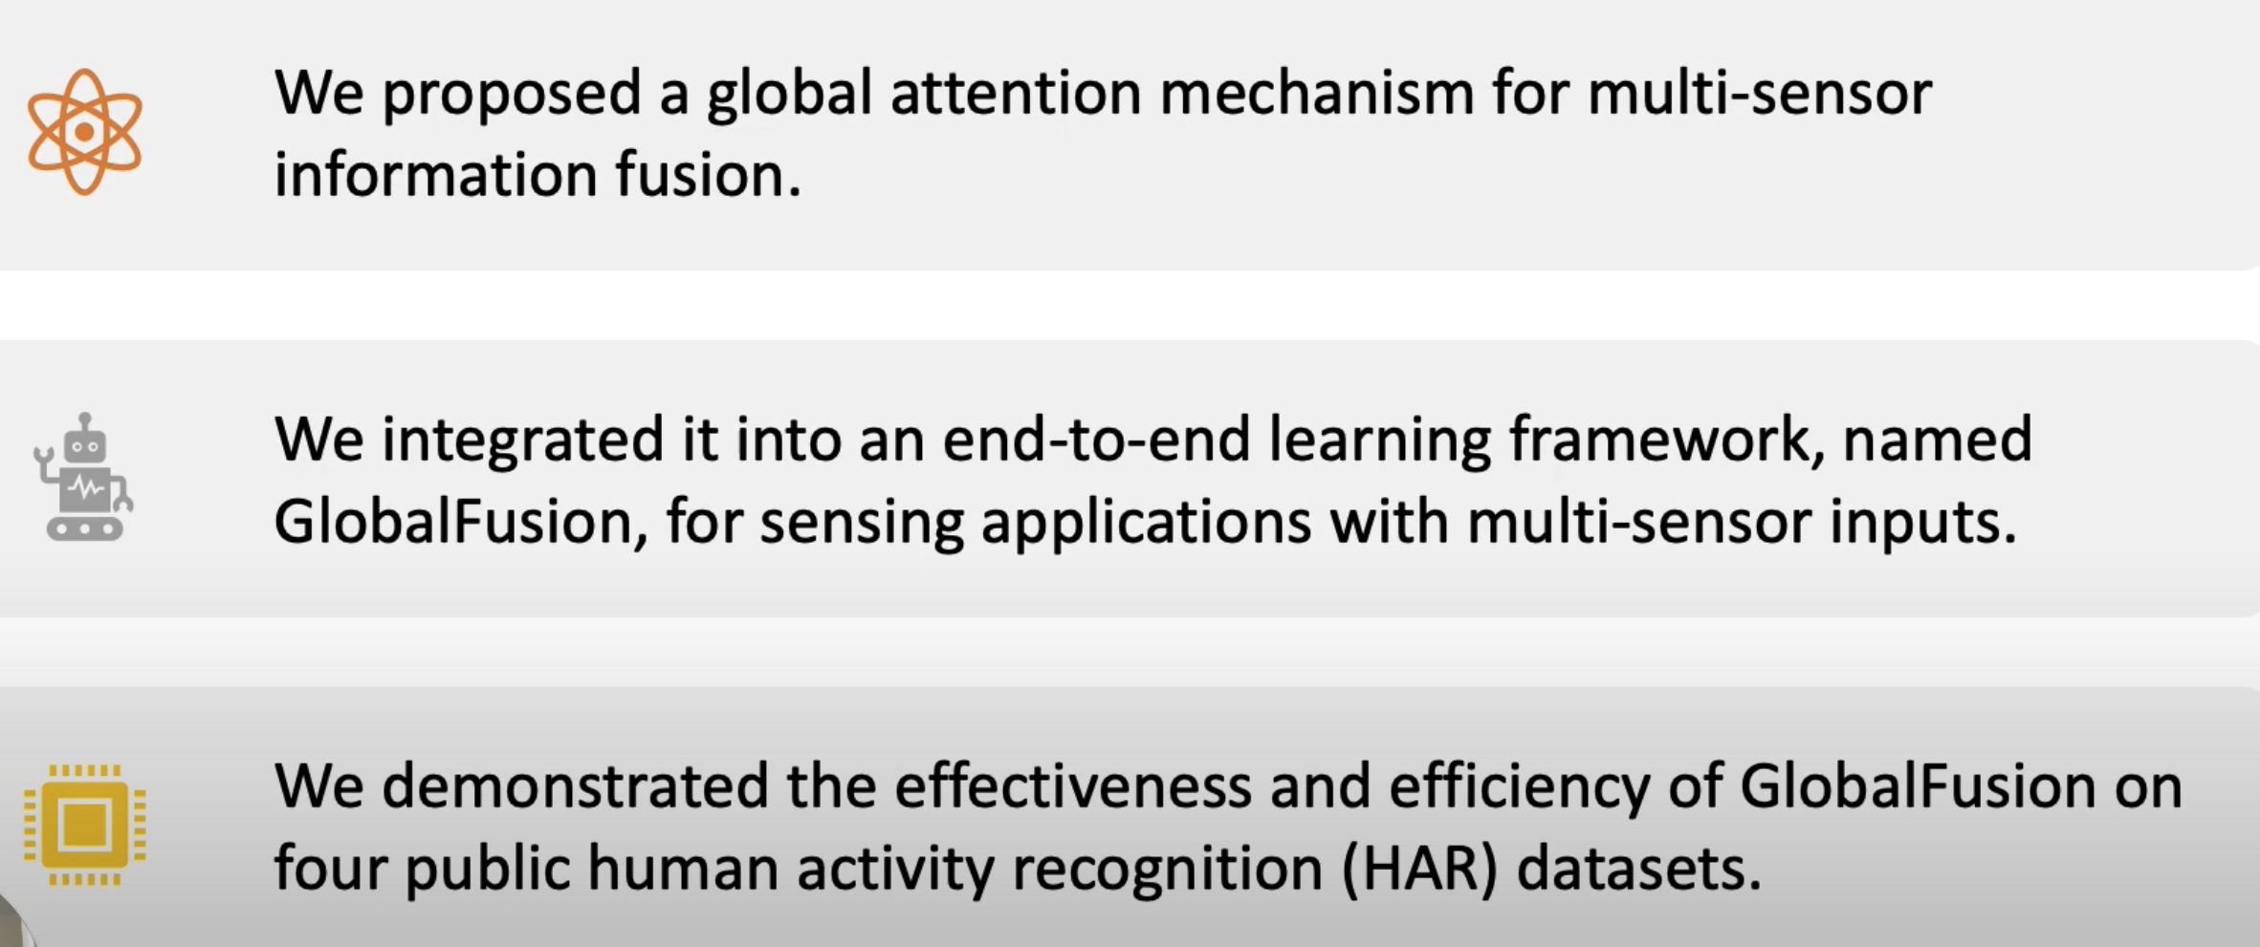
Conclusion

Slide 27
The End !

Slide 28
References
https://medium.com/lansaar/what-is-sensor-fusion-cb596f7cf446
https://semiengineering.com/a-dsp-for-implementing-high-performance-sensor-fusion-on-an-embedded-budget/
https://www.kaggle.com/code/fahadmehfoooz/human-activity-recognition-with-neural-networks
https://www.nature.com/articles/s41467-020-19424-2/figures/1

Slide 29
THANKS!
Please keep this slide for attribution.

Slide 30
Backup

Slide 31
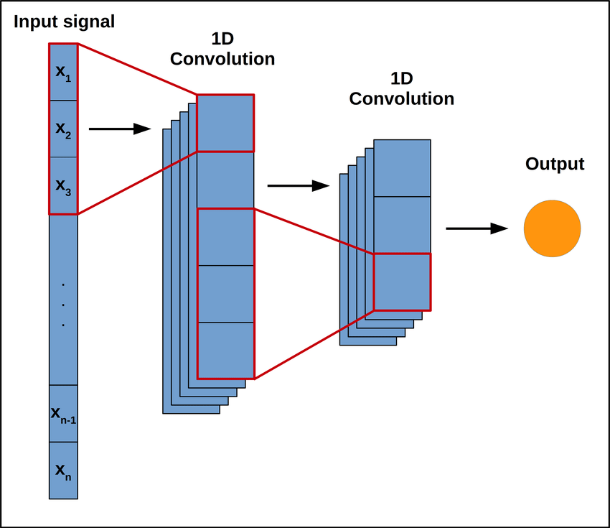
Three Layer Convolutional Neural Network
IDEA: For a deep neural network, the features of lower layers are specific to the input but general to the classes, while the features of higher layers are general to the input but specific to the classes.

Slide 32
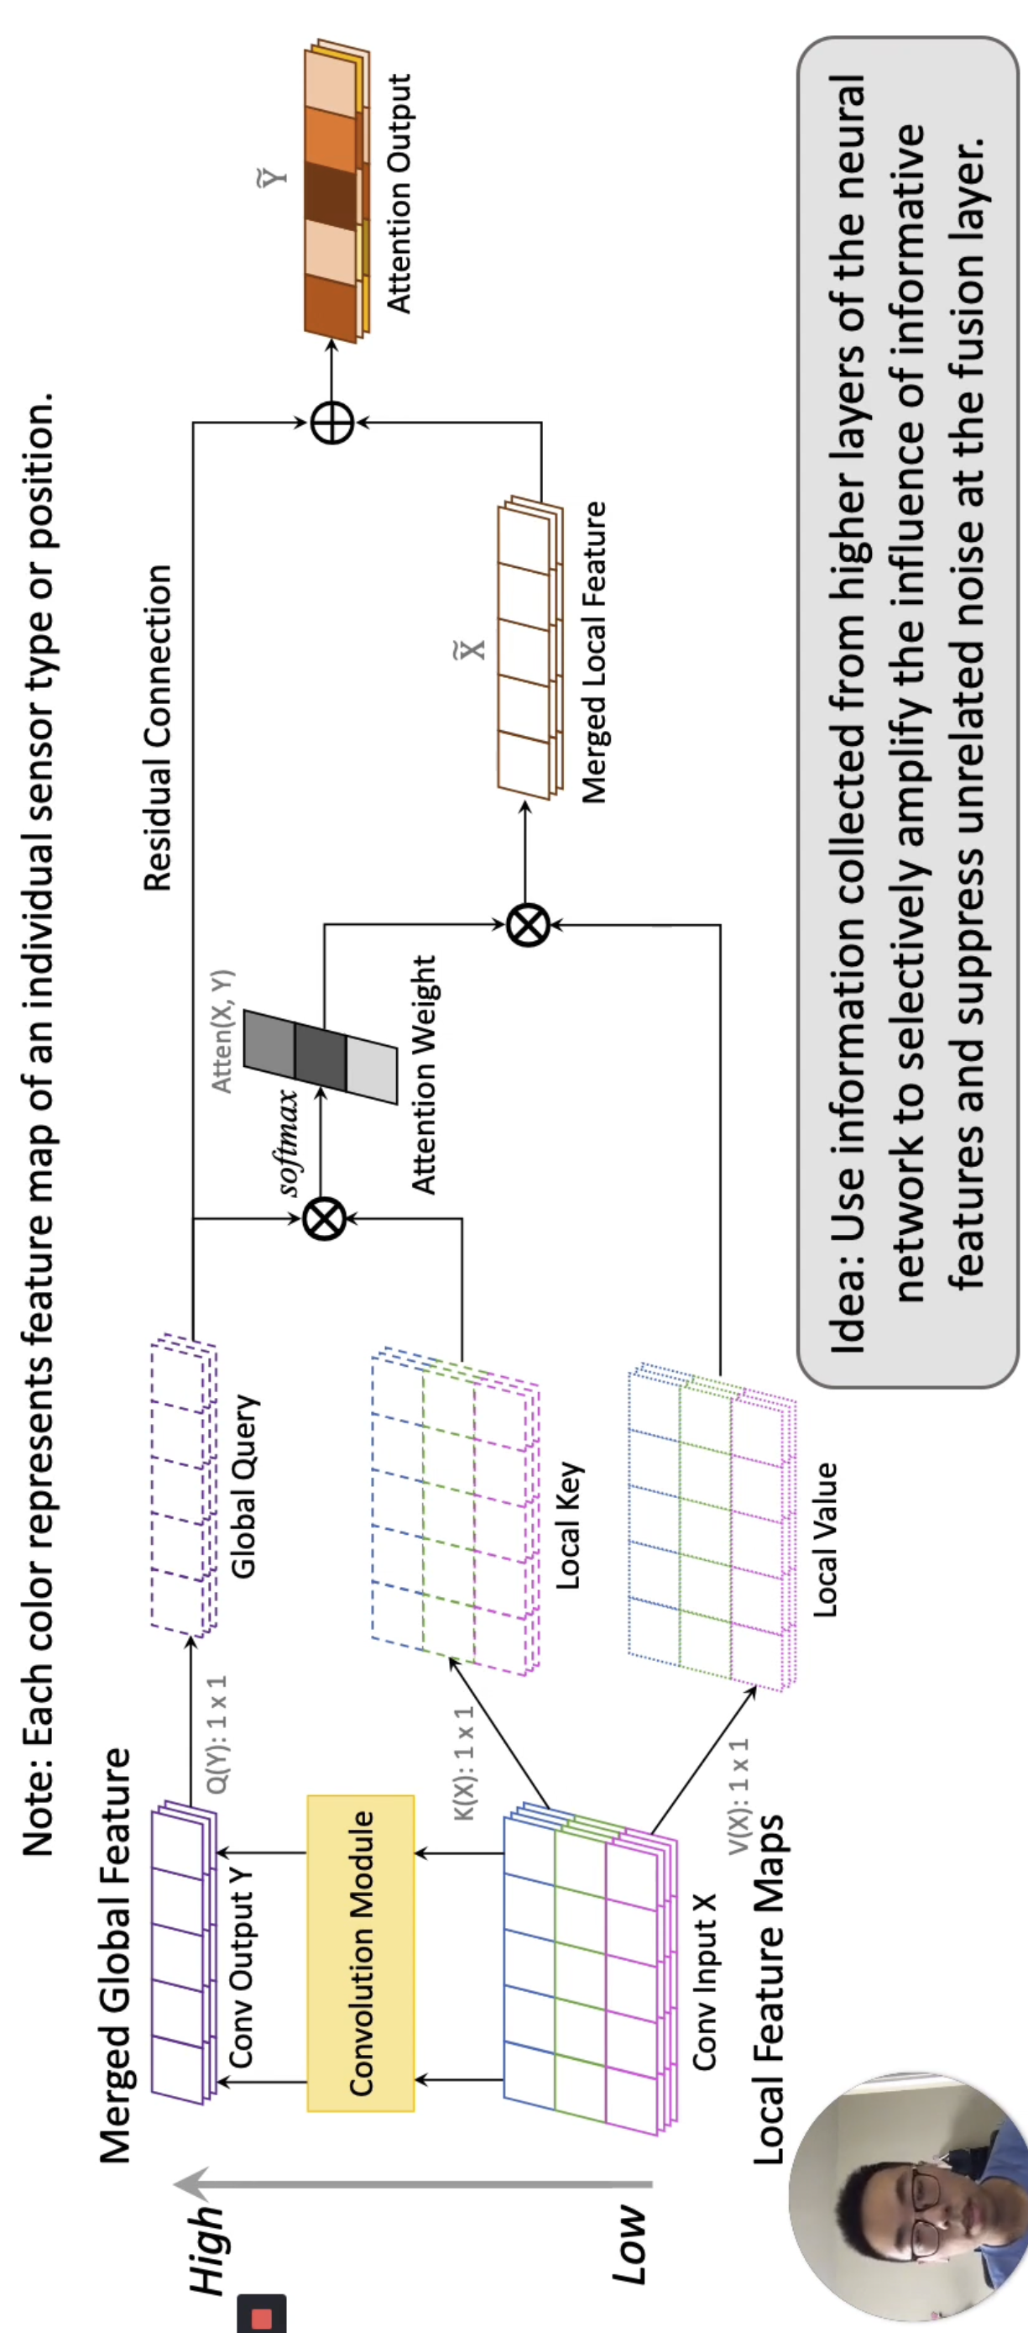
Three Layer Convolutional Neural Network
Our insight is that we try to match the neural network node outputs (at certain layers) against inputs at earlier layers with the idea that inputs that are more correlated with outputs deserve more attention.

Slide 33
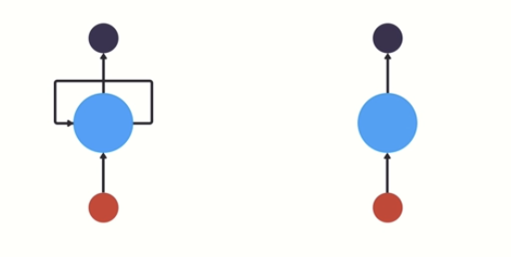
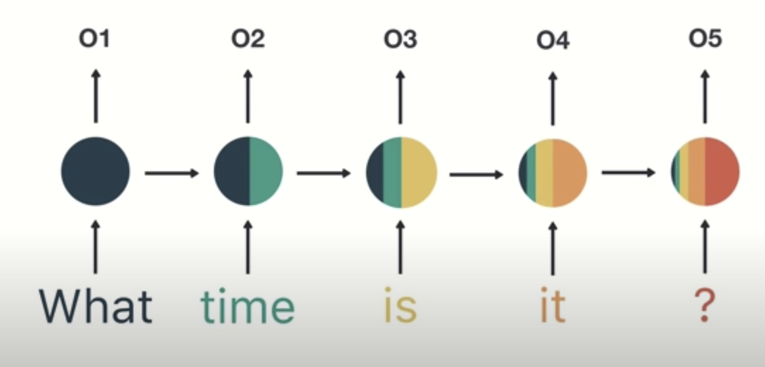
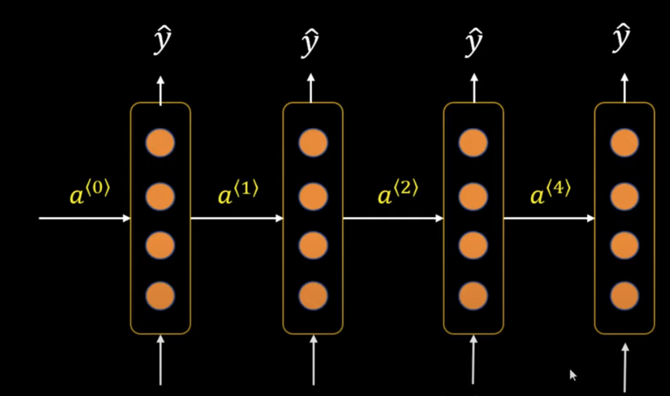
RNN Short Term Memory
Lets say we want to classify user intention from inputted text
https://towardsdatascience.com/illustrated-guide-to-recurrent-neural-networks-79e5eb8049c9

Slide 34
Convolution

