Slide 1
MUTE: Bringing IoT to Noise Cancellation
Sheng Shen, Nirupam Roy, Junfeng Guan, Haitham Hassanieh, Romit Roy Choudhury
University of Illinois at Urbana-Champaign

Slide 2
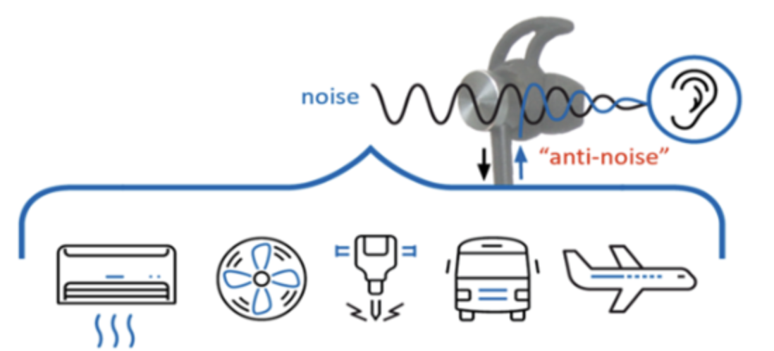
Noise Cancellation
Two main kinds:
Passive Noise Cancellation
Active Noise Cancellation (ANC)

Slide 3
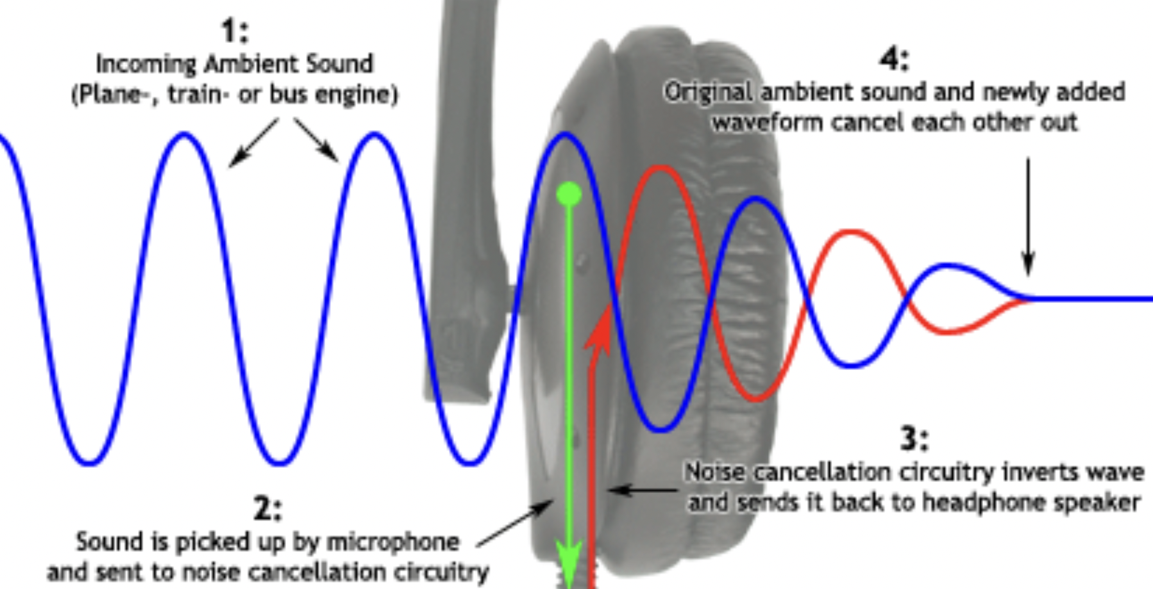
Active Noise Cancellation: An Overview

Slide 4
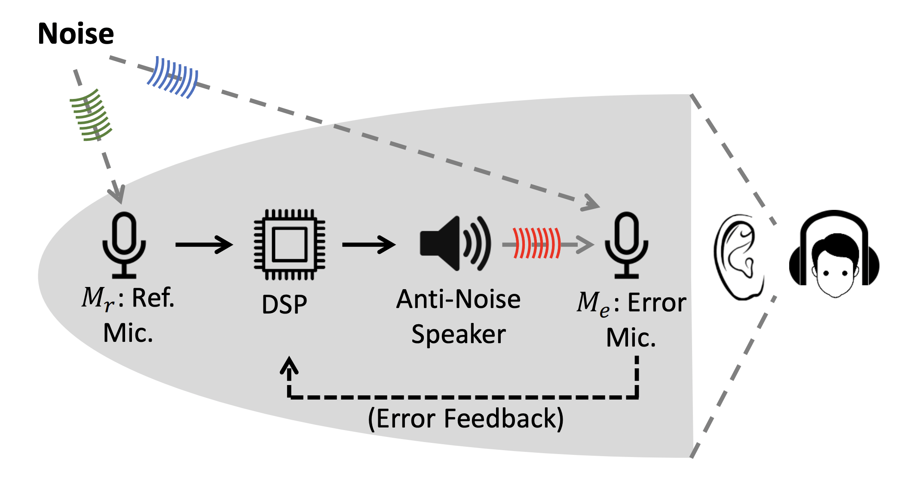
Active Noise Cancellation: An Overview

Slide 5
Key Challenges in ANC
Small distance between the headphone and the ear-drum
ANC system produce anti-noise in ≈ 30 µs?
Smaller phase error for low frequency (< 1 kHz)
Works better for periodic noise, what about people speaking?
Inverse channel estimation for non-causal convolutions

Slide 6
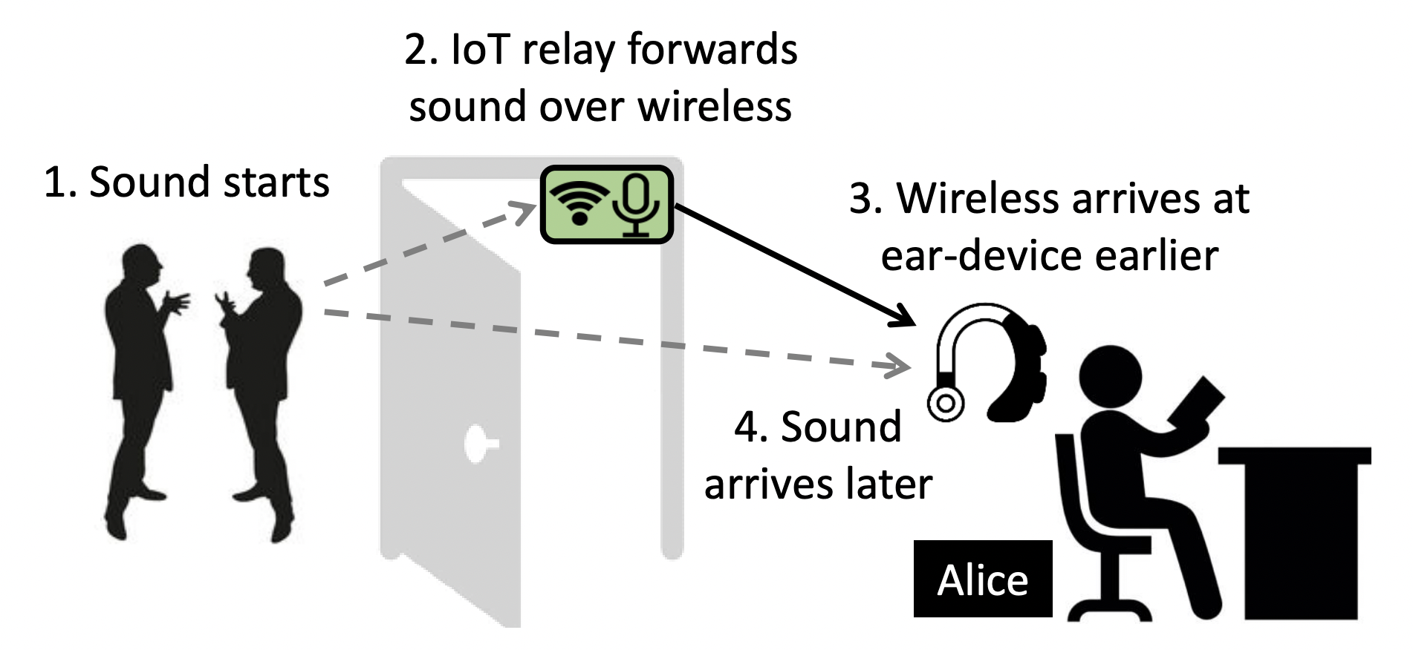
MUTE: Using IoT to Lookahead
Microseconds -> Milliseconds, if microphone is a metre away

Slide 7
MUTE: Using IoT to Lookahead

Slide 8
How does Active Noise Cancellation work?

Slide 9
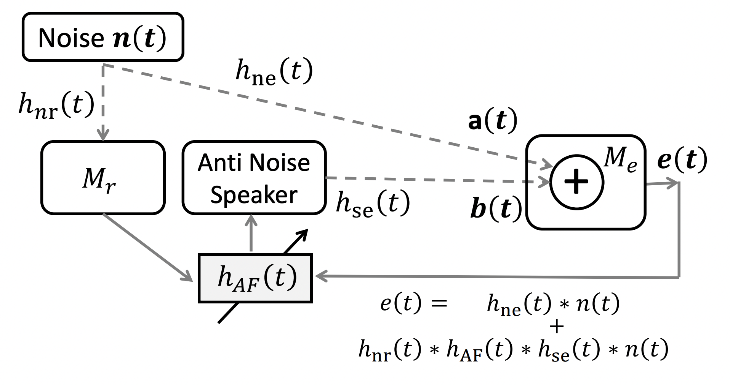
Active Noise Cancellation: Block Diagram

Slide 10
Active Noise Cancellation: Setup
Noise source: a(t)
Headphone’s anti-noise: b(t)
Effective signal at M_{e}: e(t) = a(t) + b(t) (ideally 0)

Slide 11
Active Noise Cancellation: Setup
Noise source: a(t)
Headphone’s anti-noise: b(t)
Effective signal at M_{e}: e(t) = a(t) + b(t) (ideally 0)
a(t) can be modeled as:
b(t) can be modelled as:

Slide 12
Active Noise Cancellation: Block Diagram

Slide 13
Convolutions

Slide 14
Computing the Adaptive Filter
h⁻¹_{se} : estimated using known preamble from anti-noise speaker and measuring the response at the error microphone
h_{ne} and h⁻¹_{nr} cannot be easily estimated:
noise signal n(t) does not exhibit any preamble-like structure
channels are continuously varying over time
inverse channel requires future samples for precise estimation

Slide 15
Fourier transform diagonalizes Convolutions!

Slide 16
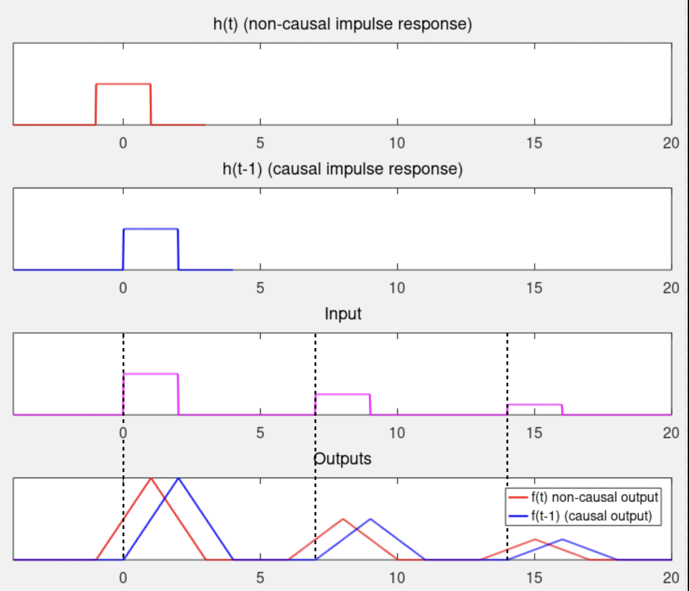
Non-Causal Channel Inversion in ANC
Linear filters can be characterized by their impulse response:
Causal Filters depends only on past and current inputs:
Stability:

Slide 17
ANC Timeline

Slide 18
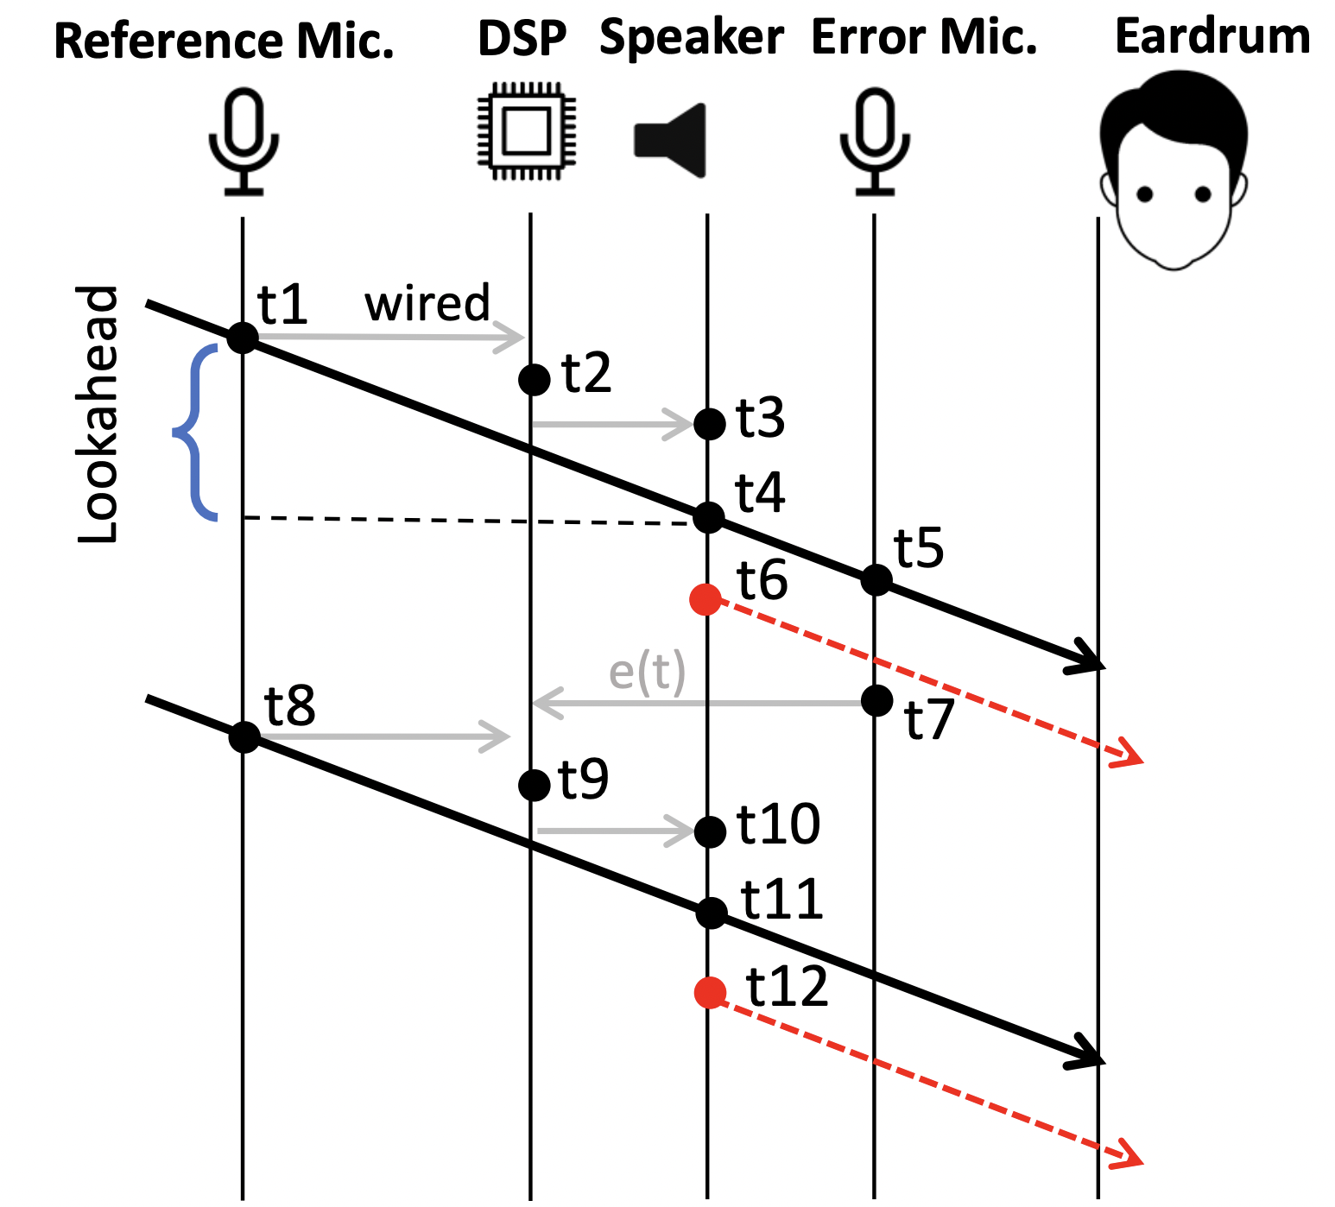
ANC Timeline

Slide 19
ANC Timeline

Slide 20
ANC Timeline

Slide 21
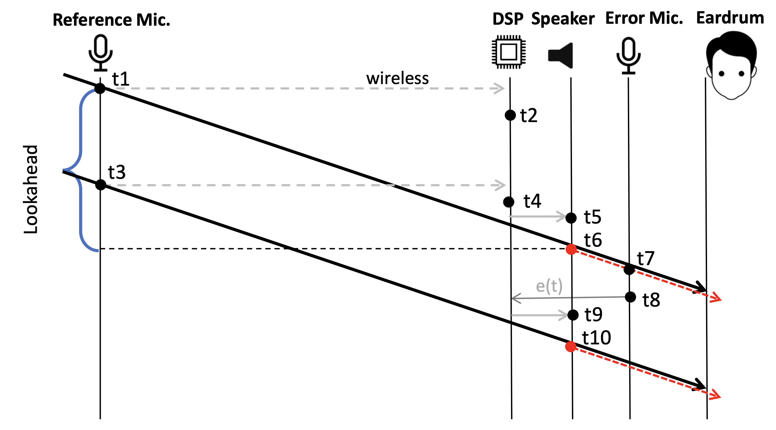
Lookahead
with MUTE

Slide 22
Lookahead Aware Processing
Using this large lookahead:
(1) Address non-causal channel inversion
(2) Foresee macro changes in sound profiles, preload filters

Slide 23
Lookahead Aware ANC (LANC)
Adaptive Filter for noise cancellation:
Find the filter to minimize error:

Slide 24
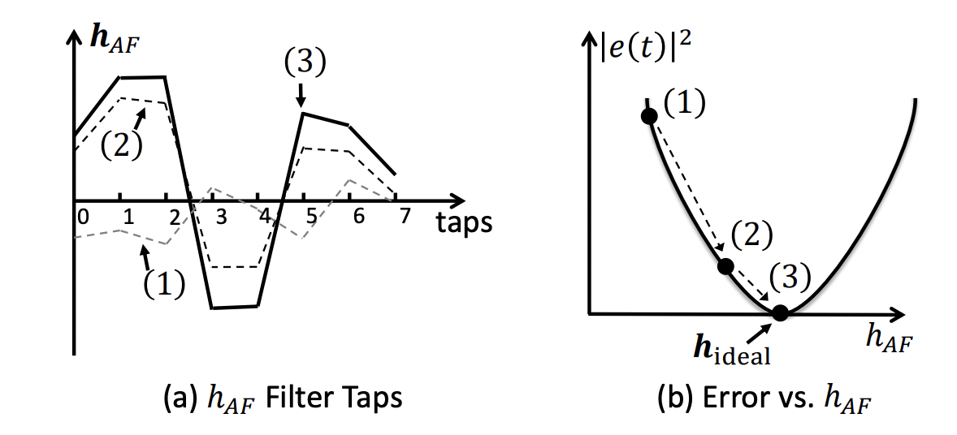
Lookahead Aware ANC (LANC)
Adaptive Filter for noise cancellation:
Find the filter to minimize error:

Slide 25
Lookahead Aware ANC (LANC)
Adaptive Filter for noise cancellation:
Find the filter to minimize error:
Non-causal: Negative “k” -> future samples of x(t) , Peek ahead using LANC:

Slide 26
Lookahead Aware ANC (LANC)

Slide 27
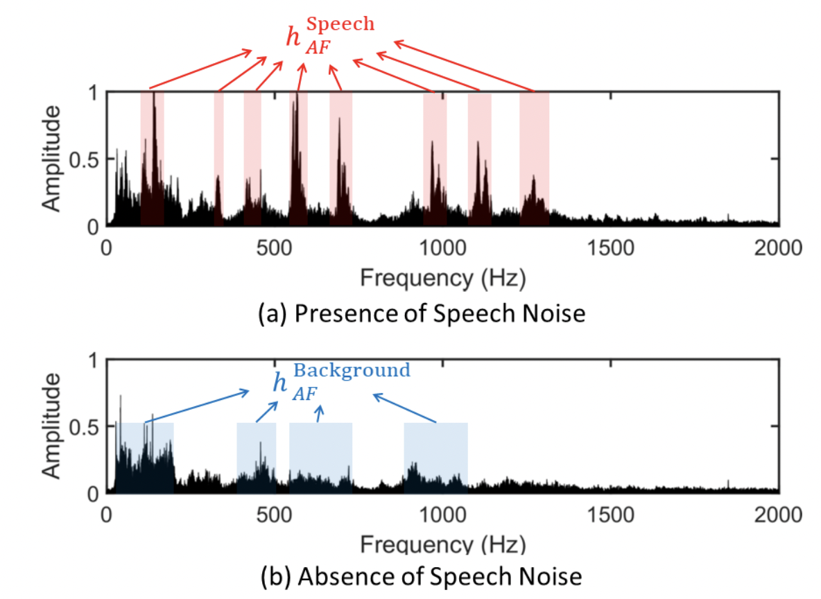
Predictive Sound Profiling

Slide 28
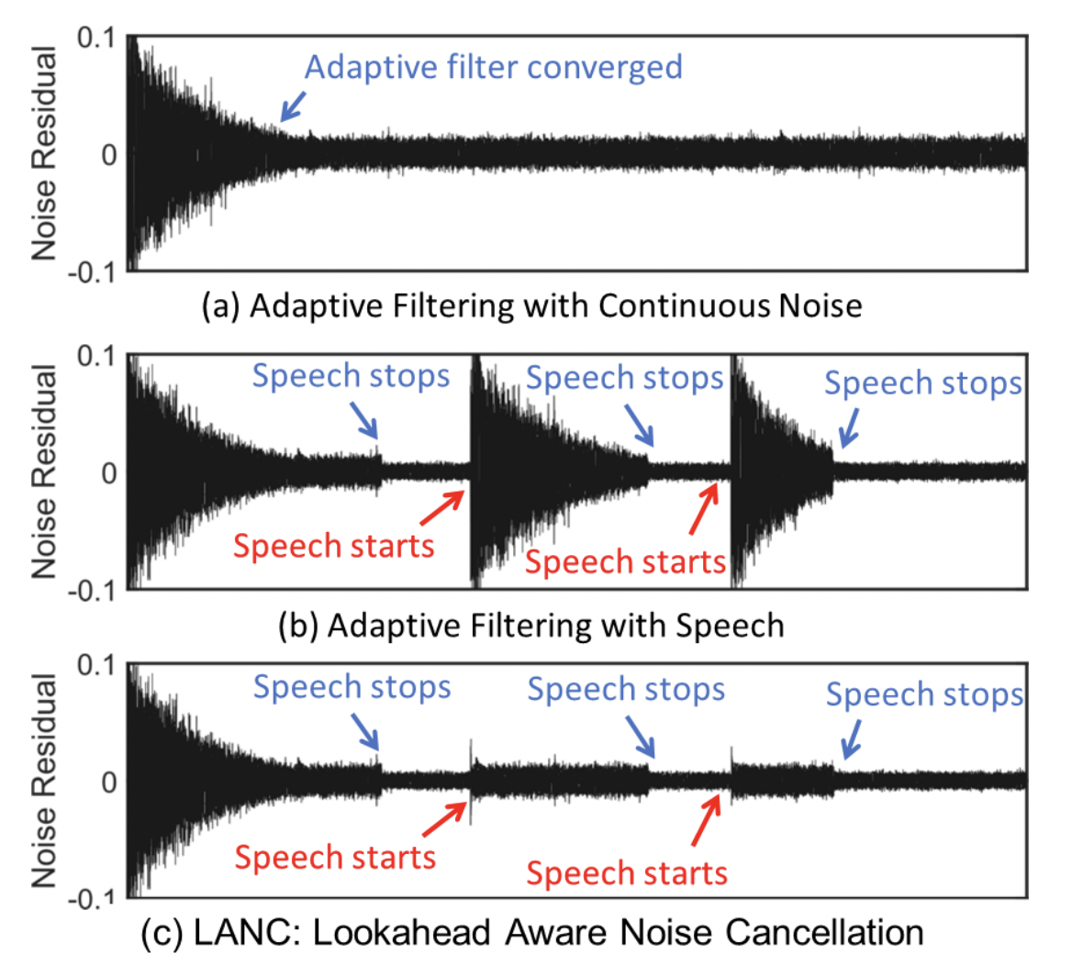
LANC: Anticipate profile transitions

Slide 29
Wireless Relay Design: Frequency Modulation
and similarly, Frequency demodulation occurs at the receiver
Notes:
impedance matching circuit connects the audio signal to an RF VCO (voltage controlled oscillator). The VCO outputs a frequency modulated (FM) signal, which is then mixed with a carrier frequency generated by a phase lock loop (PLL), and up-converted to the 900 MHz ISM band. The RF signal is then band pass filtered and passed to a power amplifier connected to a 900 MHz antenna.

Slide 30
Wireless Relay Design: Frequency Modulation
Some advantages of FM:
(1) Noise mainly affects amplitude, less so for Freq.
(2) Narrow bandwidth: h_{w}(t) flat in frequency, needs single-tap
(3) Carrier frequency offsets appear as DC, can be averaged out

Slide 31
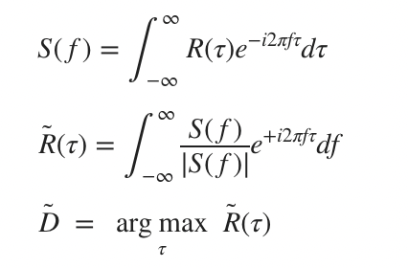
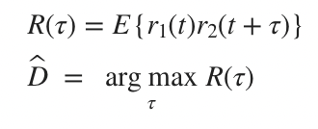
Automatic Relay Selection: Positive vs Negative Lookahead
Wireless relay must be closer to noise source, else negative lookahead
LANC uses Generalized Cross Correlation with PHAse Transform to sharpen the cross-correlation peak:

Slide 32
Architectural Variants

Slide 33
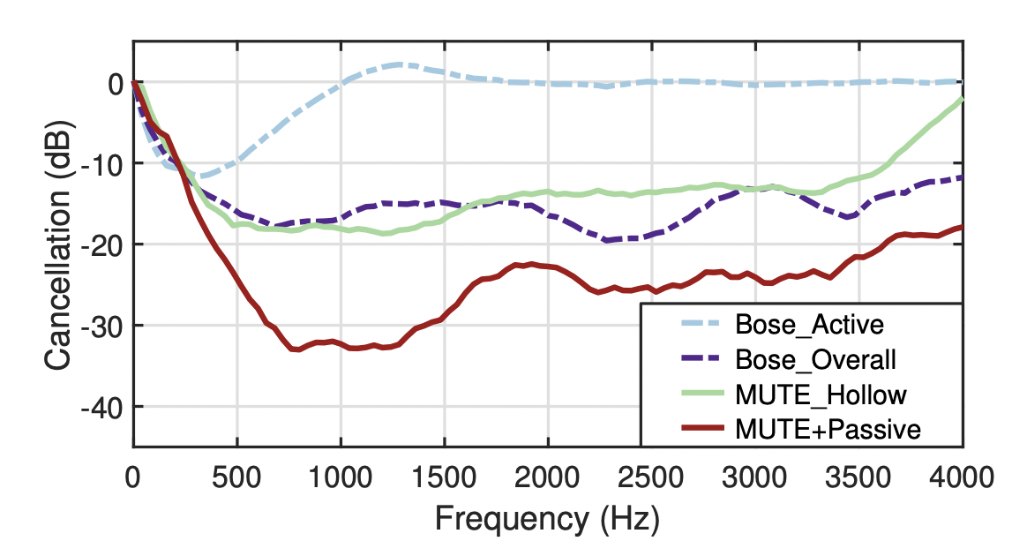
Comparative analysis using MUTE
Notes:
• MUTE achieves cancellation across [0, 4] kHz, while Bose cancels only up to 1 kHz. Within 1 kHz, MUTE outperforms Bose by 6.7 dB on average.
• Compared to Bose’s full headphone (i.e., ANC at [0, 1] kHz + sound-absorbing material for [1, 4] kHz), our cancellation is 0.9 dB worse. We view this as a non ear-blocking device with a slight compromise. With ear-blocking, MUTE outperforms Bose by 8.9 dB.

Slide 34
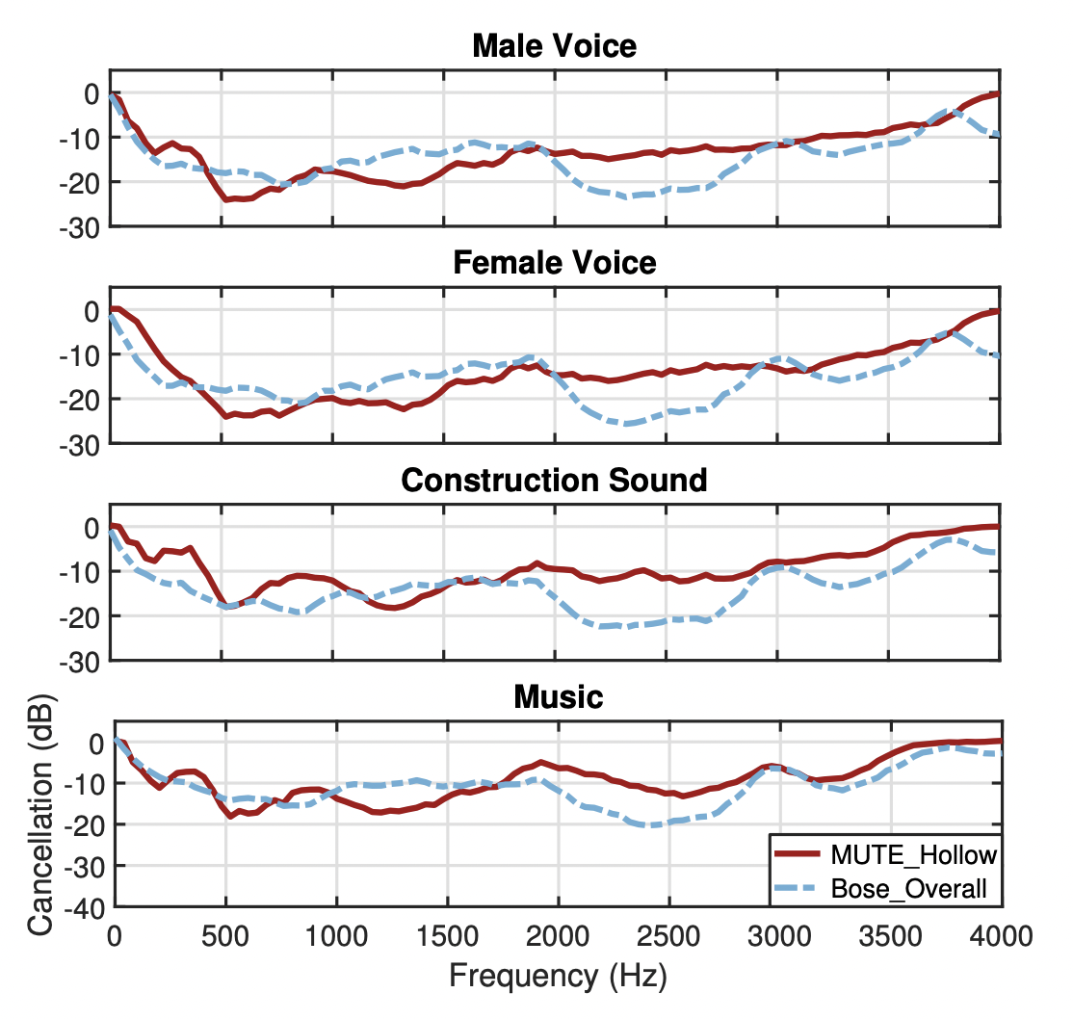
Results with Varying Ambient Noise

Slide 35
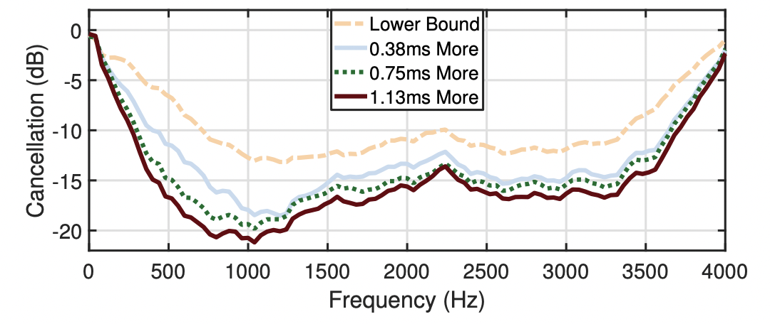
Results with Different Lookahead Periods

Slide 36
Limitations
Multiple Noise Sources – requires multiple mics or source separation algorithms
Cancellation at Human Ear – utilize anatomical ear models (KEMAR head)
Head Mobility
Portability
RF Interference and Channel Contention – uses only 8kHz band

