Slide 1
RFID Tattoo: A Wireless Platform for Speech Recognition
CMSC 715 Presentation
Presenter: Bryan Nousain
Paper Authors: Jingxian Wang, Chengfeng Pan, Haojian Jin, Vaibhav Singh, Yash Jain, Jason I. Hong, Carmel Majidi, Swarun Kumar, Carnegie Mellon University

Slide 2
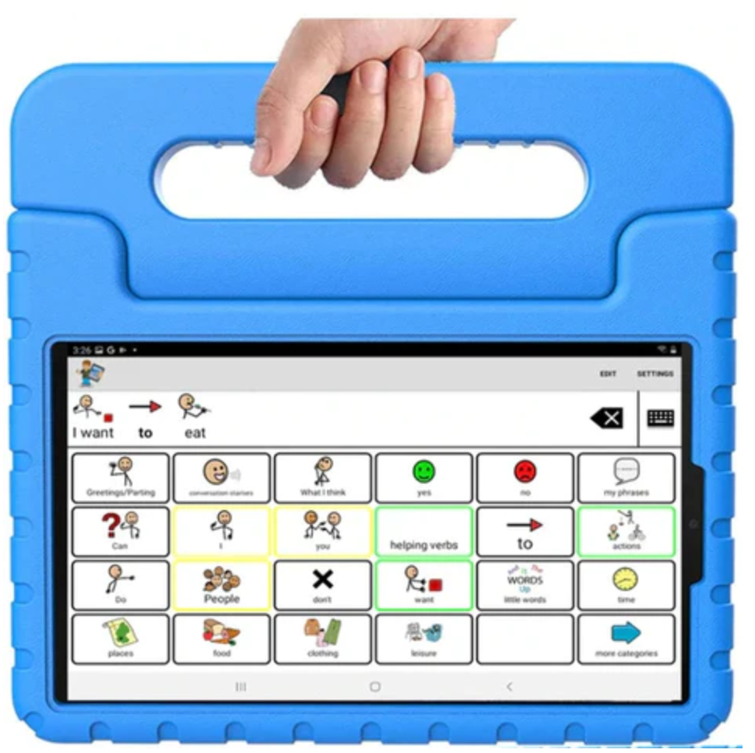
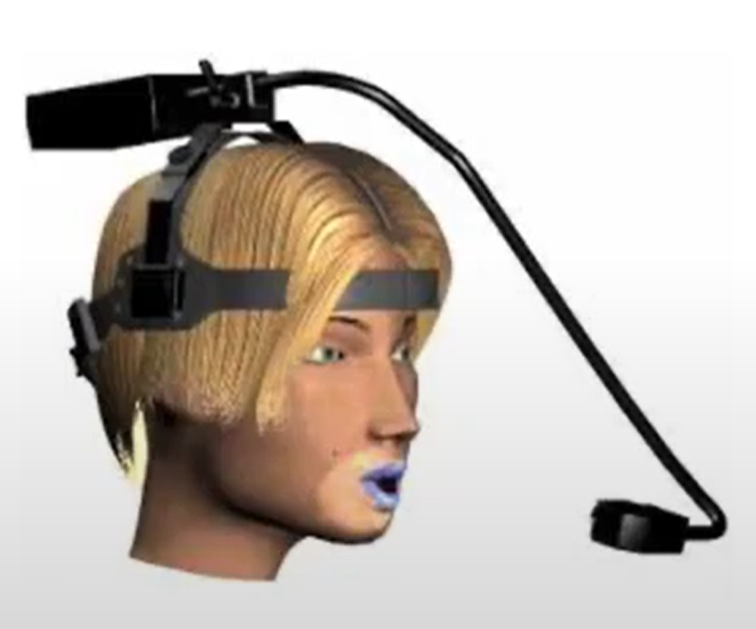
Motivation
About 7.5 million people in the United States have voice disorders
Audio based solutions require users to be able to make a noise
Visual solutions require user to be in front of camera
Text to speech requires users to manually input text into keypads
RFTattoo targets speech impaired users that are able to make facial and lip gestures associated with speech

Slide 3
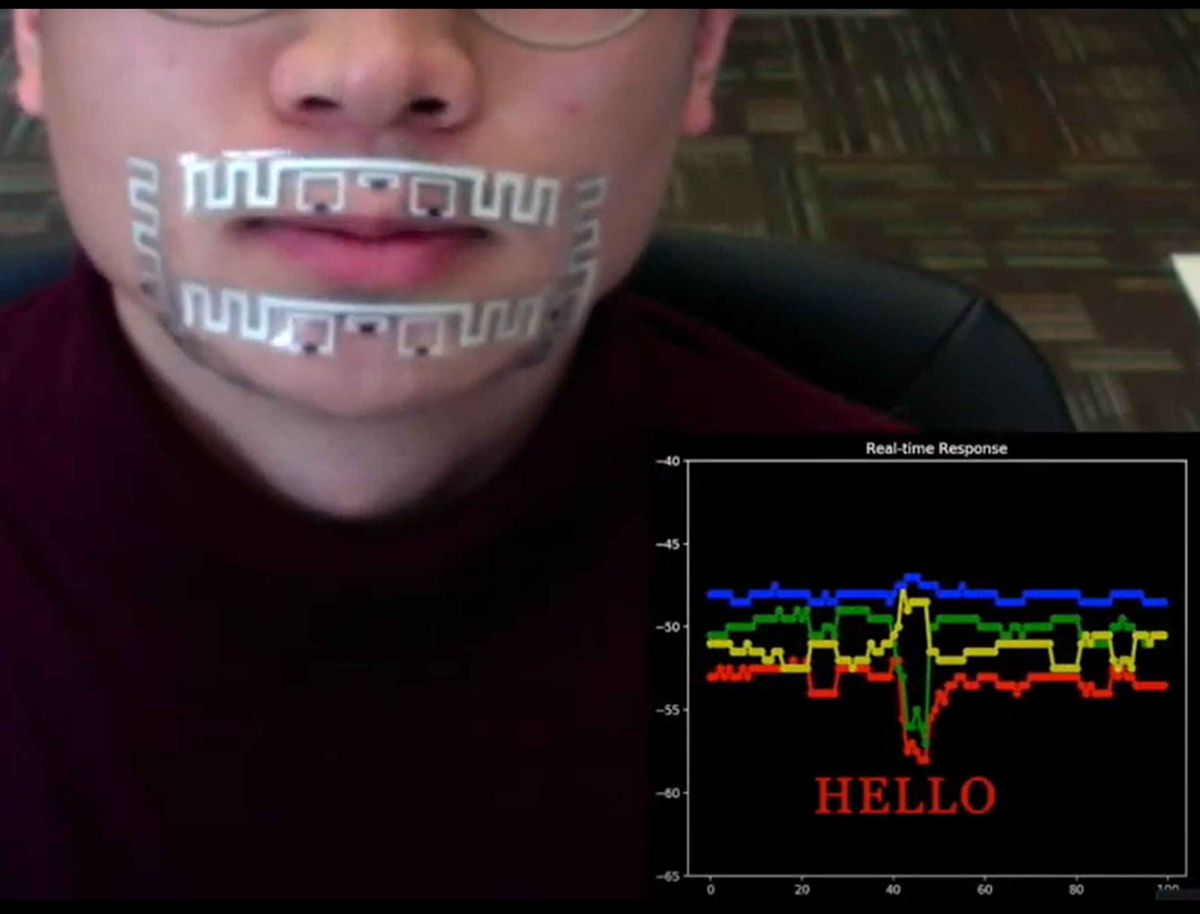
RFTattoo Approach
Recognize facial and lip gestures using flexible RFID tags and synthesize speech in real time
Recognize facial and lip gestures by measuring
Stretch of RFID tag, Tongue position, Mouth shape
Map facial and lip movements to phonemes
RFTattoo*
* https://www.youtube.com/watch?v=mwh_-gzEzRk&t=72s

Slide 4
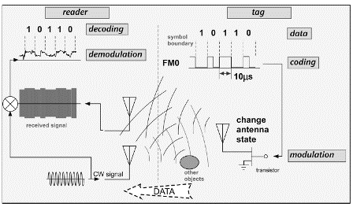
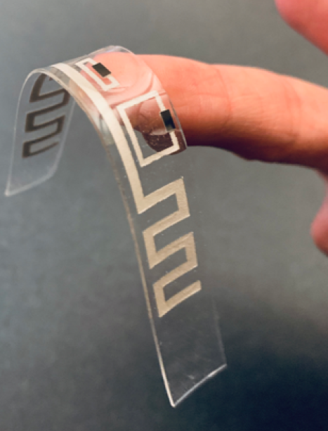
Passive RFID Tutorial
3. Reader receives message from tag
3
RFTattoo
1. Reader transmits CW signal to power up tag
2
1
2. Reader powers up, sends message and powers down
Source: https://www.eetimes.com/rfid-basics-backscatter-radio-links-and-link-budgets/

Slide 5
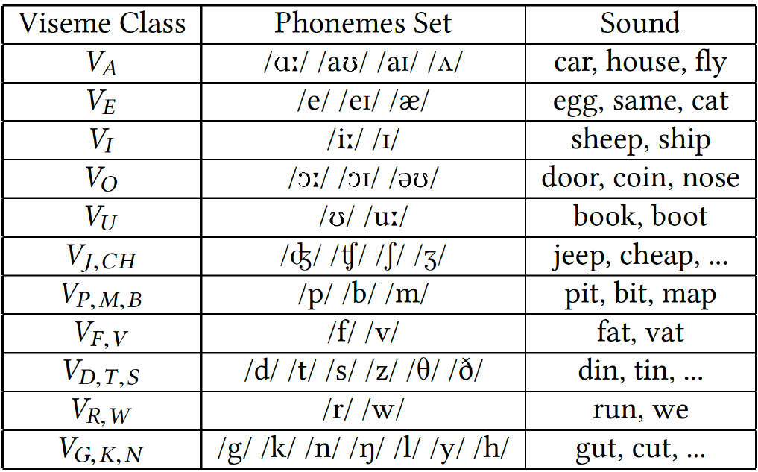
Mapping Facial Gestures to Sounds
Phonemes
Def’n: Speech sounds that we hear
E.g. p/b/m
English has 44 phonemes (24 consonants and 20 vowels) and this paper can distinguish between 38 of the phonemes
Visemes
Def’n: Mouth, facial, and lip gesture made when producing a phoneme
The 44 phonemes only produce 11 different visemes
The Challenge: A single facial gesture is associated with multiple phonemes
Notes:
Example phrase that is ambiguous for lip readers: “elephant juice" looks identical to "I love you”

Slide 6
An ambiguous phrase for lip readers
elephant juice

Slide 7
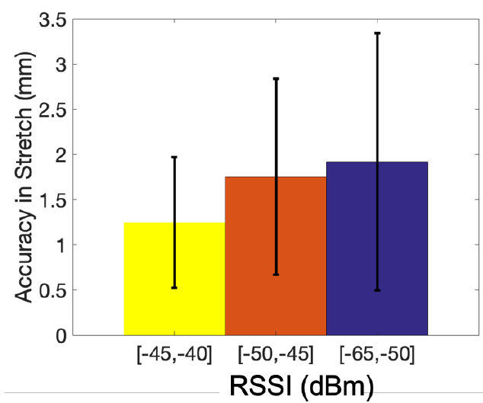
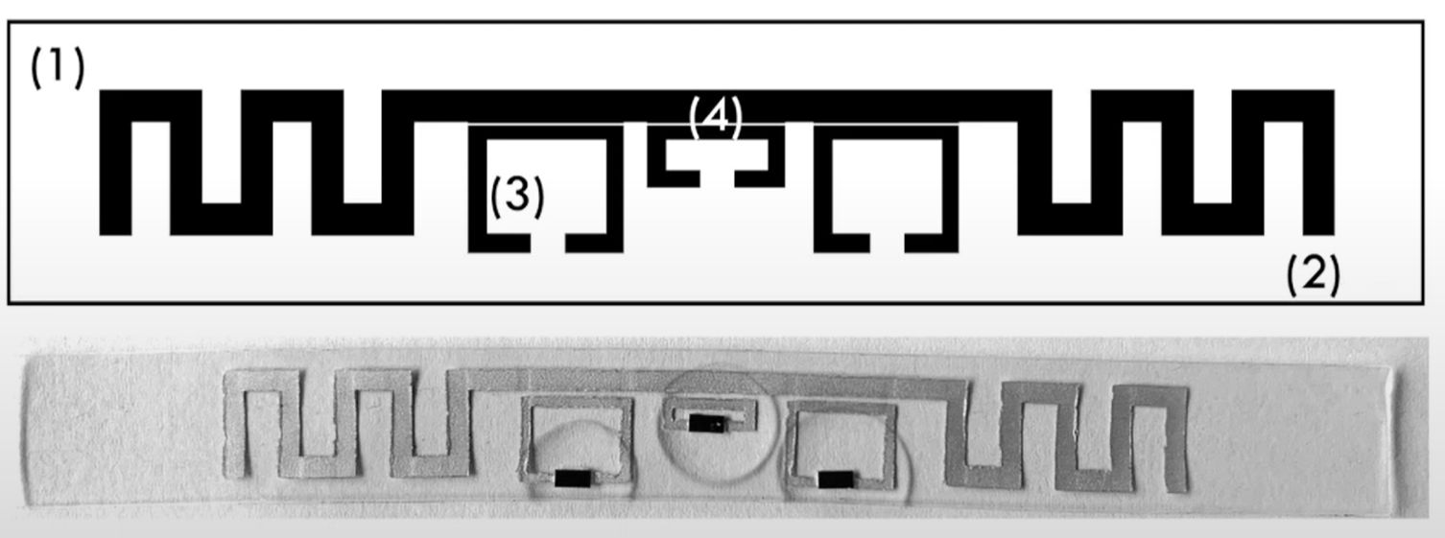
Classify Viseme: Measure Tag Stretch
Challenge: A small stretch in tag stretches significantly changes the resonant frequency of the RFID tag, but FCC mandates RFID tags operate in 902-928 MHz ISM band
$f_{res}=\frac{c}{2\sqrt{ε_{e}}}\frac{1}{L+L_{e}}$, $L_{e}$: effective elongation, $L$: half-wave dipole length
Solution: Each tag only resonates in the 900 MHz ISM band when stretched to a certain length
RFID Tag Antenna
Source: https://www.youtube.com/watch?v=j-1oNPqlQIc
Stretch measurement accuracy vs RSSI
Stretch distance is a function of reflected power within the ISM band

Slide 8
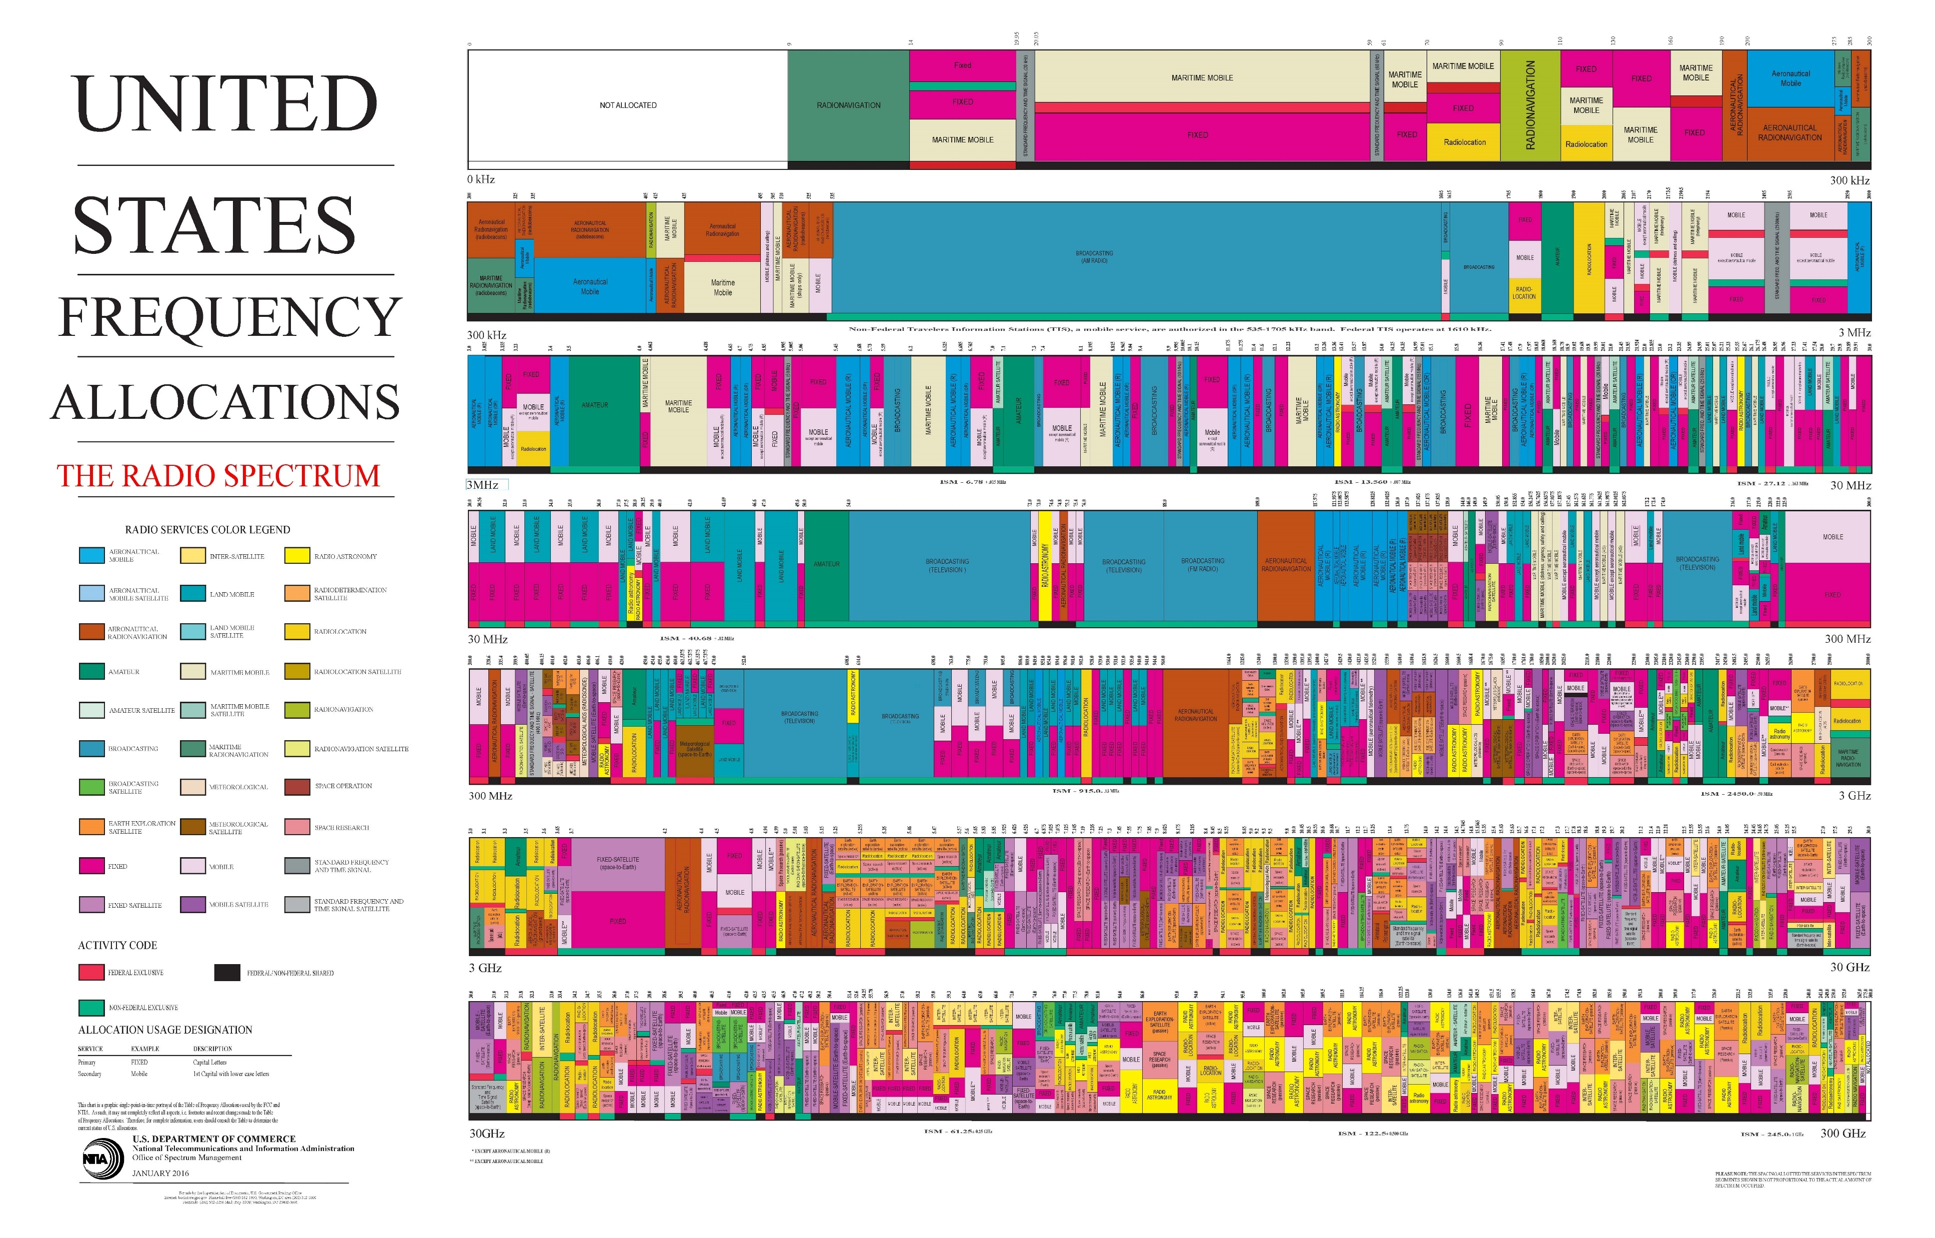
FCC Spectrum Allocation
ISM Band: 902-928 MHz

Slide 9
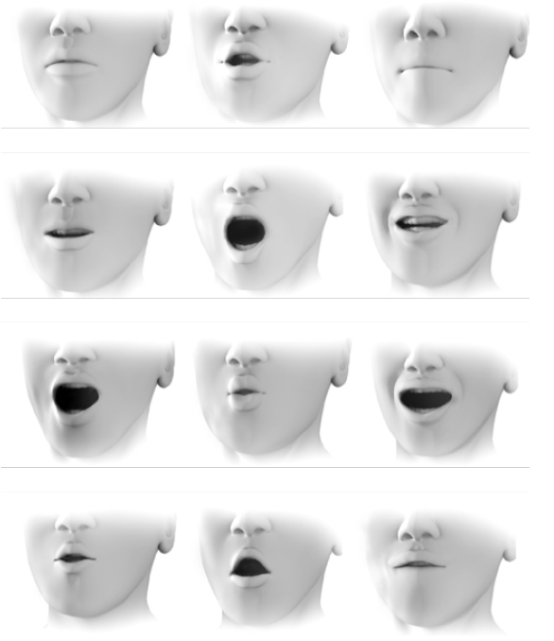
Classify Viseme: Measure Mouth Shape
Uses WiSh* algorithm to shape of mouth
WiSh finds the positions of the RFIDs tags that best match the observed wireless channel response
12 visemes (11 speech visemes + rest position)
* Haojian Jin, Jingxian Wang, Zhijian Yang, Swarun Kumar, and Jason Hong. 2018. WiSh: Towards a Wireless Shape-aware World Using Passive RFIDs. In Proceedings of the 16th Annual International Conference on Mobile Systems, Applications, and Services (MobiSys ’18). ACM, New York, NY, USA, 428–441. https://doi.org/10.1145/3210240.3210328

Slide 10
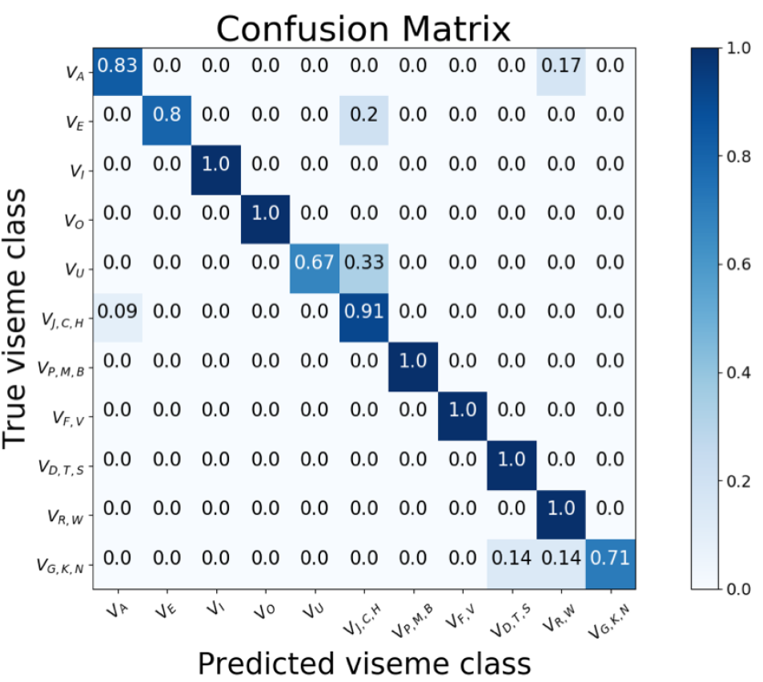
Viseme Inference Accuracy
Can infer viseme with 90% accuracy, but how to map to a phoneme?

Slide 11
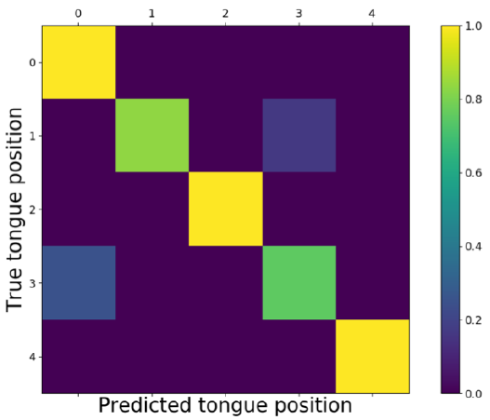
Measure Tongue Position
Tongue position
Tongue position affects impedance on antenna
Use random forest algorithm with 16 features to discriminate between 5 different tongue positions
Resting position
Upper jaw front
Upper jaw back
Lower jaw front
Lower jaw back
Tongue position disambiguates between phonemes with identical visemes

Slide 12
Word Recognition/Synthesis
Organize phonemes into words
Evaluate the “naturalness”, $N$, of a sentence
Use sliding window to count frequency of $m$ consecutive words in Cornell Movie Dialog Corpus, $m=3$ for this paper
$$N\left(w_{k} | w_{1},w_{2},…,w_{k−1}\right)=\prod_{1}^{m}{p\left(w_{k}, w_{k−1}, …,w_{k−m+1}\right)}$$
Choose word $k$ such that naturalness score is maximized
$w_{k}^{∗}=\arg{\max_{w_{k}}{N(w_{k}|w_{1}, w_{2}, …,w_{k−1}}})⋅l\left(w_{k}\right)$
$l\left(w_{k}\right)$ is word likelihood from viseme recognition
Synthesize speech with publicly available speech synthesizer (e.g. Google Text-to-Speech*)
*https://cloud.google.com/text-to-speech/

Slide 13
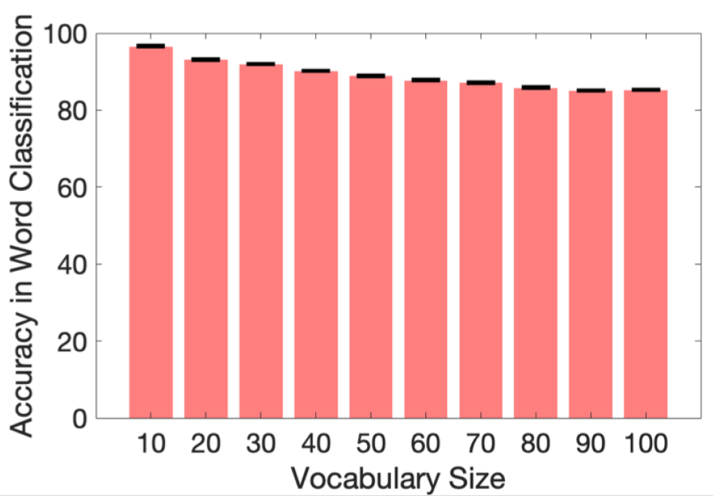
A problem with word recognition
Concatenating visemes into words doesn’t work well, even with a 90% accuracy rate for viseme ID
Probability of error increases exponentially with number of phonemes
Need to take into account that uneven usage of each word to compute likelihood of a word given visemes
Restricting vocabulary to $≤$100 words improves word classification accuracy

Slide 14
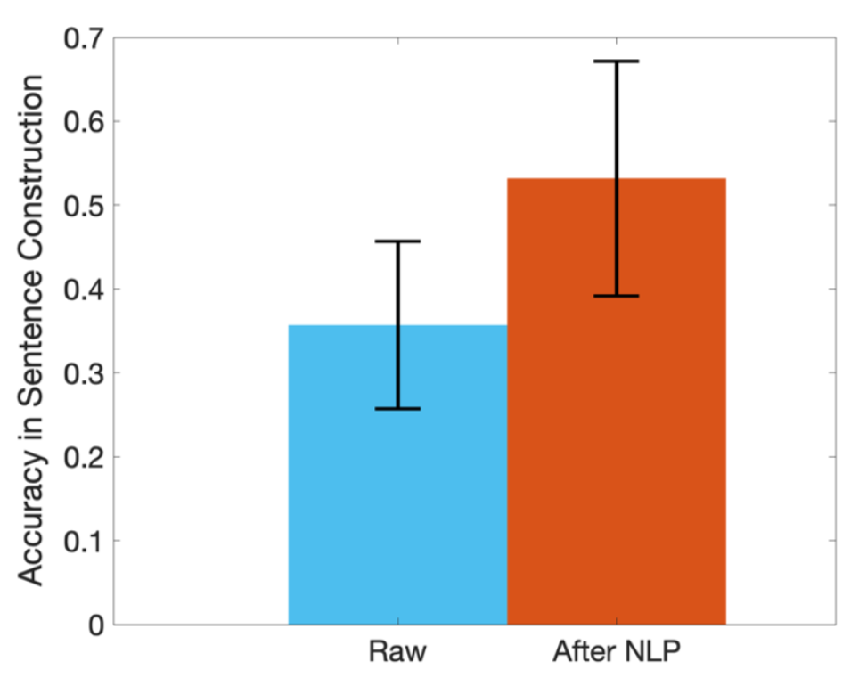
Can we string words into sentences?
Word to sentence conversion was challenging for the same reasons converting visemes to word was challenging
Reducing possible phrases to 20 possible sentences increased accuracy of sentence transcription by 17.5%
This accuracy is comparable to lip reading software using a camera
RFTattoo works as well as a lip reading camera without needing line-of-sight

Slide 15
Conclusion
RFTattoo enables speech impaired users to communicate in a natural way without needing to make any sounds and without being restricted to line-of-sight of a camera
Compounding errors make it difficult to recognize words from a large vocabulary and arbitrary sentences
Reducing word vocabularies less than 100 and possible phrases to 20 sentences allows RFTattoo to recognize
Words with 86% accuracy
Sentences with 53.2% accuracy

