Slide 1
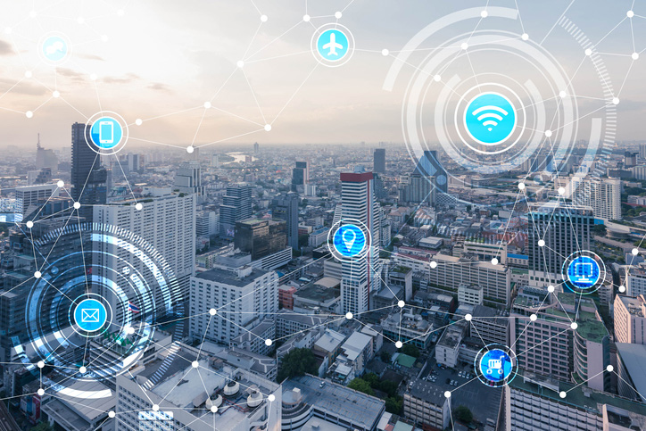
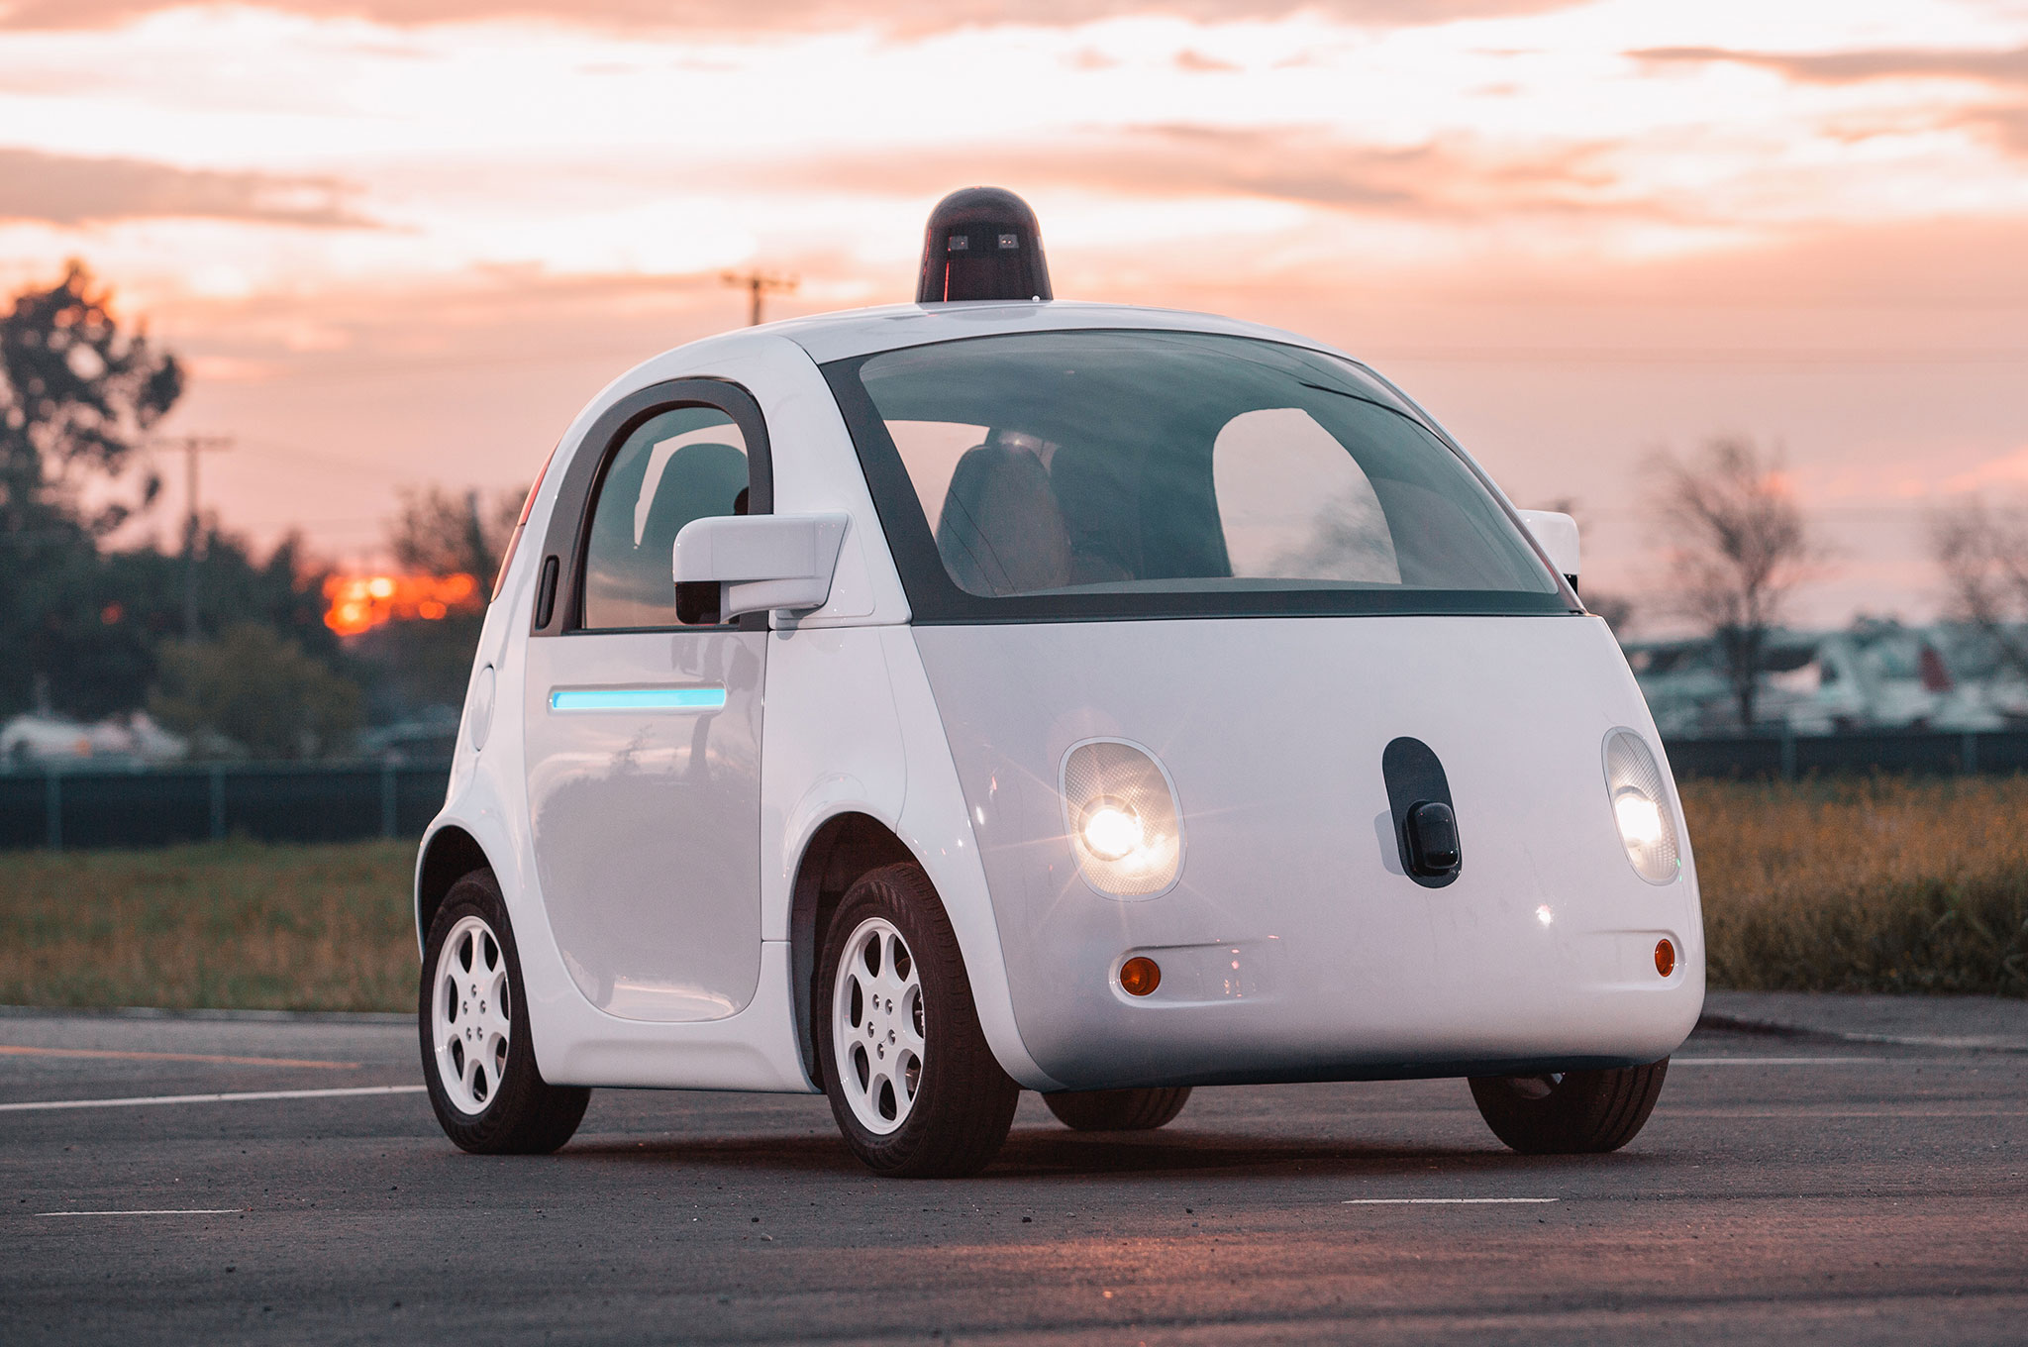
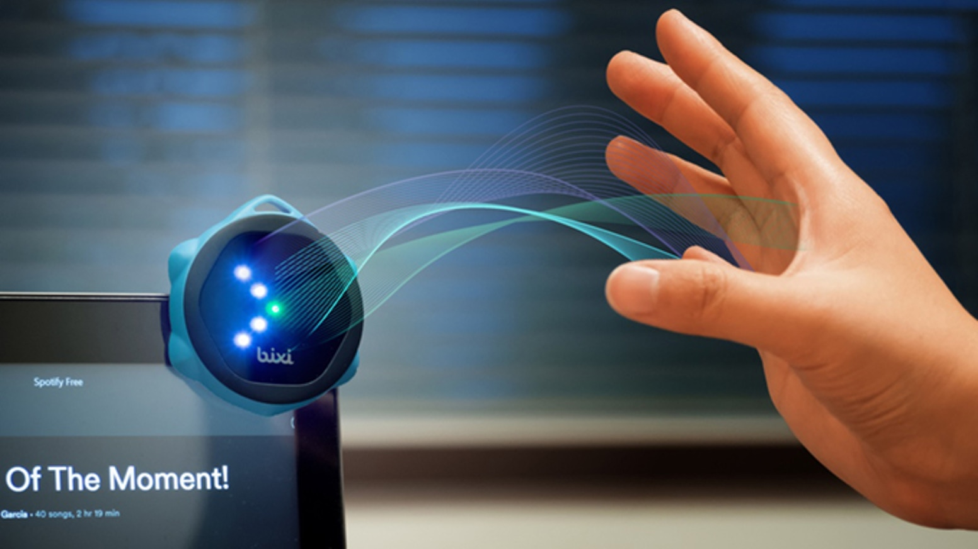


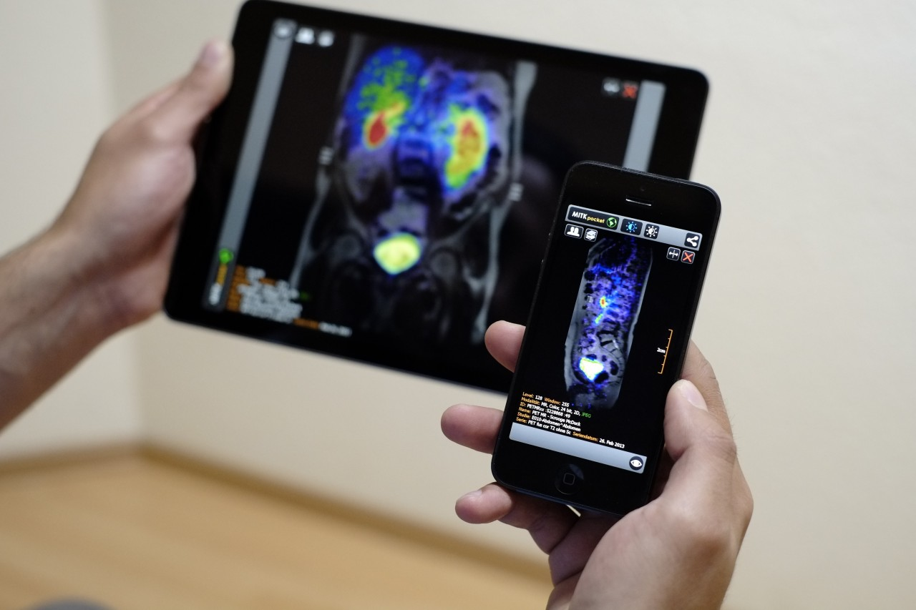
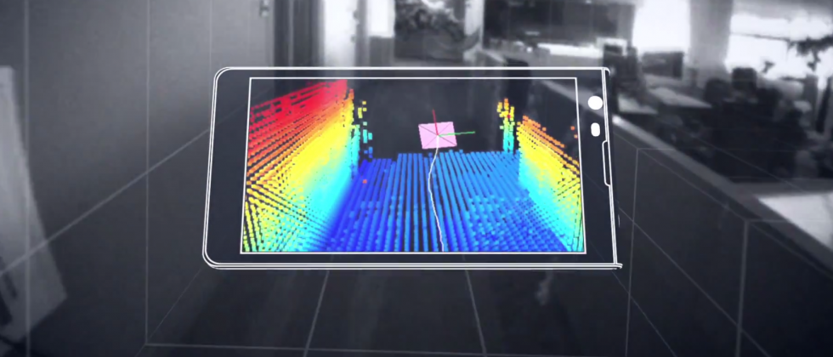
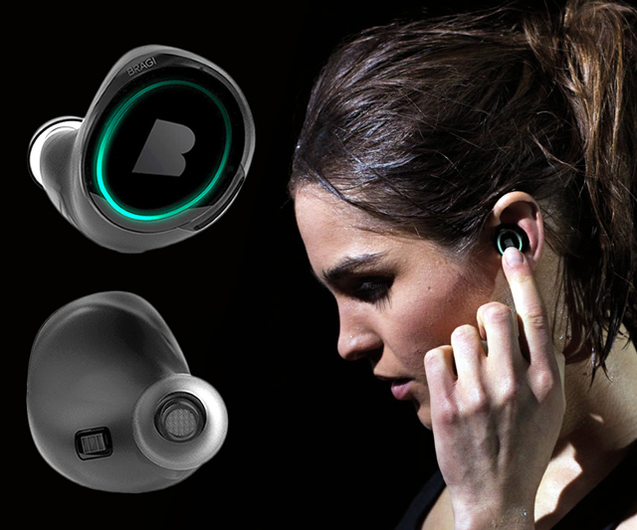
Wireless and Mobile Systems
for the IoT
CMSC 715 : Fall 2022
Lecture: Midterm review
Nirupam Roy
Tu-Th 12:30-1:45pm
CSI 2118

Slide 2
Exam logistics
November 3rd, Thursday, 12:30 PM, Room: 2118
The exam questions will be spread over the topics taught so far (up to lecture 3.5).
Fundamental concepts/theories are important.
No programming.

Slide 3
Midterm syllabus
Lecture 1.1
Sensor fundamentals, Local/global coordinate systems, frequency and phase of a signal.
Lecture 1.2
Time & Frequency domain representation, Analog to Digital conversion, Sampling theorem,
Aliasing
Lecture 1.3
Complex representation of a signal, Positive and negative frequencies, Discrete Fourier Transform (DFT)
Lecture 1.4
Plot DFT spectrum, properties of DFT, Aliasing in different types of signals, Frequency bands, multiplication of frequency.

Slide 4
Lecture 2.1
(continued from lecture 1.4): Antialiasing filter, multiplication of frequencies, frequency bands, Sampling a band of frequencies.
Time-space propagation of signals (waves), reflection and echolocation, using waves for proximity sensing and ranging (distance finding)
Lecture 2.2
An example technique for estimating distance using sound wave (application: contact tracing), reference paper: “BeepBeep: A High-Accuracy Acoustic-Based System for Ranging”
Space-time equation of waves
Lecture 2.3
Phase difference of signal due to location difference, Superposition of waves, Sensing with multiple sensors, Spatial filtering/beamforming in 1-D space
Lecture 2.4
Spatial filtering/beamforming in 2-D space,
Directional sensing with the sensor array, uniform linear array (ULA)
Lecture 2.5
The direction of arrival estimation (Delay sum method, classical FFT method)

Slide 5
Lecture 3.1
Markov model, Hidden Markov Model
Lecture 3.2
Hidden Markov Model (continued from last lecture)
Lecture 3.3
Viterbi decoding
An example project on the application of Bayesian inference: “MoLe: Motion Leaks through Smartwatch Sensors”
Lecture 3.4 & Lecture 3.5
Continued discussion on Bayesian inference and the paper “MoLe: Motion Leaks through Smartwatch Sensors”
Following two papers were discussed in the class and will be included in the syllabus:
1) BeepBeep: A High-Accuracy Acoustic-Based System for Ranging: https://www.cs.purdue.edu/homes/chunyi/pubs/peng-tecs12.pdf
2) MoLe: Motion Leaks through Smartwatch Sensors: https://synrg.csl.illinois.edu/papers/mole.pdf

Slide 6
Question format (tentative)
1. Multiple choice questions (10x2 = 20 points)
Sensor basics, Sampling theory, Aliasing, FFT spectrum, Echolocation,
Wave propagation, Space-time equation of wave, beamforming or spatial filtering, ULA
2. Short answer type (15 points)
Bayesian inference, Markov Model, HMM
Beam-steering
ULA
3. Problem solving (35 points)
Sampling, DFT/FFT, aliasing
Superposition of signal, Wavelength, Space-time equation
HMM and Viterbi

Slide 7
Sensor Basics (Lecture 1.1)

Slide 8
SENSOR
A structure or material
that reacts to the physical phenomenon
A circuit that converts the reaction to measurable electrical signal (e.g. voltage)
A physical phenomenon
We want to measure
Interpretation of the signal, storing the data

Slide 9
Scalar and vector output
Y
X
Global coordinate system

Slide 10
Coordinate system
Local coordinate system
Y
X

Slide 11
Coordinate system
Local coordinate system
Y
V_{y}
V_{x}
X
Z
Output at time t
<V_{x} (t), V_{y}(t), V_{z}(t)>
for a 3-axis sensor

Slide 12
Coordinate system

Slide 13
Coordinate system
North
Y
Local coordinate system
X
Z
Global coordinate system
East

Slide 14
Time Domain and Frequency Domain
Time domain view
Frequency domain view

Slide 15
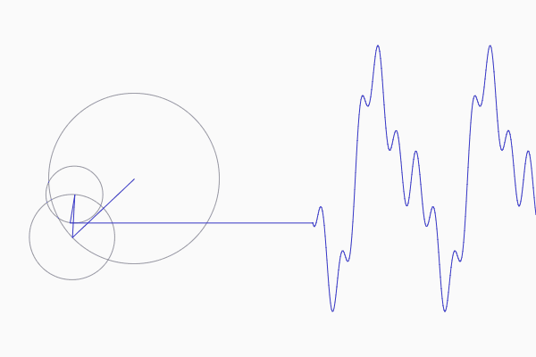
Frequencies of an arbitrary signal

Slide 16
The concept of the Fourier series
Amplitude
Time (sec)
0.00
0.25
0.50
0.75
1.00
1.25
Amplitude
Time (sec)
0.00
0.25
0.50
0.75
1.00
1.25

Slide 17
Sampling, Aliasing, Complex representation of signal (Lecture 1.2)

Slide 18
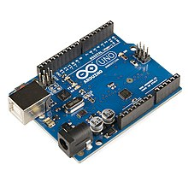
SENSOR
Analog
Analog
A structure or material
That reacts to the physical phenomenon
A circuit that converts the reaction to measurable electrical signal (e.g. voltage)
A physical phenomenon
We want to measure
Interpretation of the signal, storing the data
Digital

Slide 19
Analog
Digital
Physical signal
(voice)
Spectrogram plot
on computer
FFT
Time varying voltage
signal
A collection of numbers
ADC
Analog-to-Digital Converter

Slide 20
Sampling theorem
Amplitude
Time (sec)
0.00
0.25
0.50
0.75
1.00
1.25
Amplitude
Time (sec)
0.00
0.25
0.50
0.75
1.00
1.25
[ 0.34 0.22 0.09 0.21 0.30 0.08 0.09 ]

Slide 21
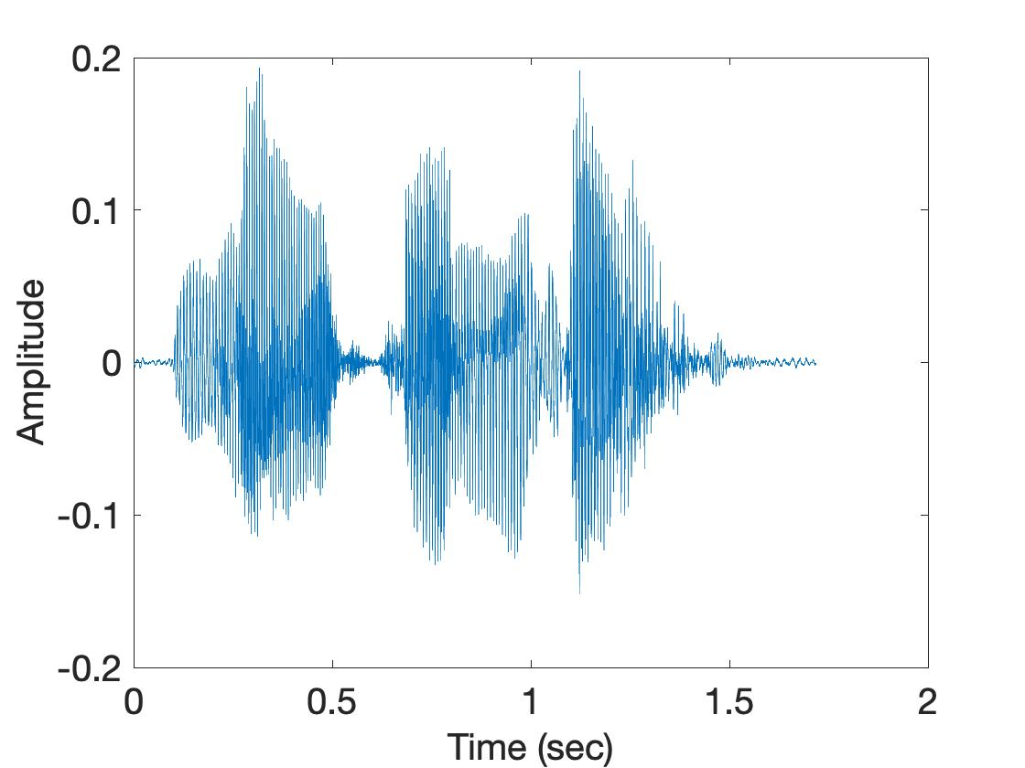
1-dimensional sampling
2-dimensional sampling
3-dimensional sampling

Slide 22

Aliasing

Slide 23
How to find a good sample rate?
Nyquist-Shannon sampling theorem:
In order to uniquely represent a signal F(t) by a set of samples, the sampling rate must be more than twice the highest frequency component present in F(t).
If sample rate is f_{s} and maximum frequency we want to
record is f_{max} , then
f_{s} > 2f_{max}

Slide 24
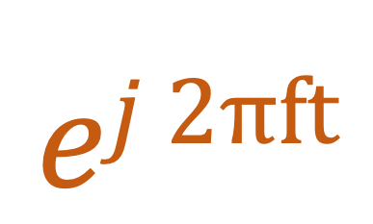
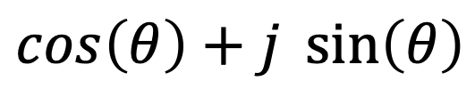


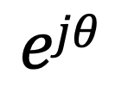
Model for a signal (frequency, amplitude, and phase)
$$ej 2πft$$
$$\cos\left(θ\right)+j \sin\left(θ\right)$$
$$=$$
$$ejθ$$
$$=$$

Slide 25


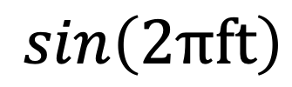
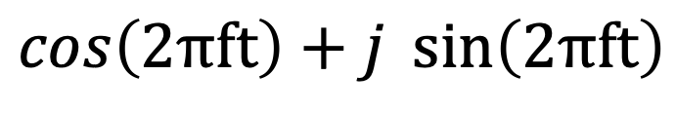




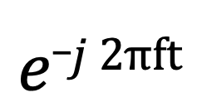
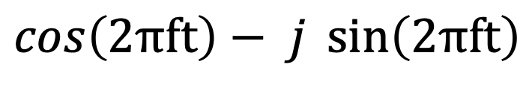
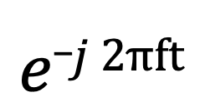
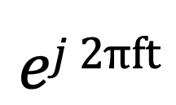
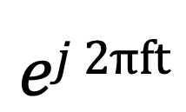
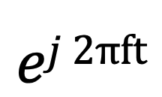
Presenting real signal with the complex model
$$ej 2πft$$
$$=$$
$$\cos\left(2πft\right)+j \sin\left(2πft\right)$$
$$e_j 2πft$$
$$=$$
$$\cos\left(2πft\right)− j \sin\left(2πft\right)$$
$$ej 2πft$$
$$+$$
$$e_j 2πft$$
$$\cos\left(2πft\right)$$
$$=$$
2
$$ej 2πft$$
$$−$$
$$e_j 2πft$$
$$\sin\left(2πft\right)$$
$$=$$
2j

Slide 26
Time-frequency views of signal, DFT/FFT
(Lecture 1.3)

Slide 27
Time Domain and Frequency Domain
Time domain view
Frequency domain view

Slide 28
Frequencies of an arbitrary signal

Slide 29
The concept of the Fourier series
Amplitude
Time (sec)
0.00
0.25
0.50
0.75
1.00
1.25
Amplitude
Time (sec)
0.00
0.25
0.50
0.75
1.00
1.25

Slide 30














Discrete Fourier Transform
Frequency domain coefficients
$$e^{j0}$$
$$e^{j0.\frac{2π}{N}}$$
$$e^{j0.\frac{m.2π}{N}}$$
$$e^{j0.\frac{(N−1).2π}{N}}$$
$$e^{j0}$$
$$e^{j1.\frac{2π}{N}}$$
$$e^{j1.\frac{m.2π}{N}}$$
$$e^{j1.\frac{(N−1).2π}{N}}$$
+
$$e^{j2.\frac{2π}{N}}$$
+
$$e^{j2.\frac{m.2π}{N}}$$
+
$$e^{j2.\frac{(N−1).2π}{N}}$$
Z₀
$$e^{j0}$$
Z₁
…
Z_{m}
…
Z_{N-1}
…
…
…
…
$$e^{j(N−1).\frac{2π}{N}}$$
$$e^{j(N−1).\frac{m.2π}{N}}$$
$$e^{j(N−1).\frac{(N−1).2π}{N}}$$
$$e^{j0}$$
x[0]
x[1]
=
X =
x[2]
Time domain samples
…
x[N-1]

Slide 31
Discrete Fourier Transform
_{F}
…
DFT matrix,
=
f₀
f₁
…
f_{m}
f_{N-1}

Slide 32
Discrete Fourier Transform
_{F}
…
DFT matrix,
=
f₀
f₁
…
f_{m}
f_{N-1}
_{Z}
Z₀
x[0]
X =
Fourier coefficients,
=
Z₁
Time series,
…
x[1]
Z_{m}
x[2]
…
…
Z_{N-1}
x[N-1]

Slide 33
Discrete Fourier Transform
_{X}
_{F}
_{Z}
=
IDFT
_{X}
_{Z}
_{F}⁻¹
=
DFT
_{H}
_{X}
_{Z}
_{F}
=
*
f₀
x[0]
Z₀
*
Z₁
f₁
x[1]
…
=
…
*
x[2]
Z_{m}
f_{m}
…
…
…
Z_{N-1}
*
x[N-1]
f_{N-1}

Slide 34
Properties of DFT
(Lecture 1.4 & continued to 2.1)

Slide 35
Time resolution v/s Frequency resolution

Slide 36
Time resolution v/s Frequency resolution
U
M
D
[
[
DFT
DFT
$$\frac{\text{f}\text{s}}{N}$$
= $\frac{\text{sample} \text{rate}}{\# of FFT points}$
How can we increase the frequency resolution?
How can we increase the time resolution?

Slide 37
The Curious Case of “Negative frequency”
Magnitude
|z_{m}|
-4
-3
-2
-1
m = 0
1
2
3
4
Frequency
Real signal’s magnitude spectrum is symmetric.
Why?

Slide 38
The Curious Case of “Negative frequency”
Magnitude
|z_{m}|
-4
-3
-2
-1
m = 0
1
2
3
4
Frequency
Complex signal’s magnitude spectrum may or may not be symmetric.
Why?

Slide 39
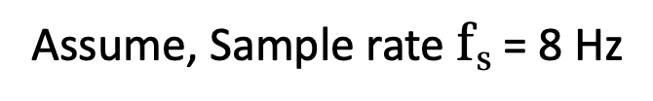
Aliasing: Different frequencies, same name!!
Magnitude/Phase of z_{m}
-4
-3
-2
-1
m = 0
1
2
3
4
Frequency
Assume, Sample rate $\text{f}\text{s}$ = 8 Hz
For a COMPLEX signal, what value will we see if the actual frequency is:
a) 3 Hz
b) -2 Hz
c) 6 Hz
d) -5 Hz
e) 4 Hz and -4Hz

Slide 40
Aliasing: Different frequencies, same name!!
Magnitude/Phase of z_{m}
-4
-3
-2
-1
m = 0
1
2
3
4
Frequency
Assume, Sample rate $\text{f}\text{s}$ = 8 Hz
For a REAL signal, what value will we see if the actual frequency is:
a) 3 Hz
b) -2 Hz
c) 6 Hz
d) -5 Hz
e) 4 Hz and -4Hz

Slide 41
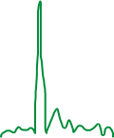

Calculating the aliased frequency value for real signals
Sampling frequency = 10Hz
Nyquist frequency = 5Hz
Amplitude
0
2
4
6
8
Frequency (Hz)

Slide 42

Calculating the aliased frequency value for real signals
Sampling frequency = 10Hz
Nyquist frequency = 5Hz
Amplitude
Received
signal
Amplitude
0
2
4
6
8
0
2
4
6
8
Frequency (Hz)
Frequency (Hz)

Slide 43
Calculating the aliased frequency value for real signals
Sampling frequency = 10Hz
Nyquist frequency = 5Hz
Amplitude
Received
signal
Amplitude
0
2
4
6
8
0
2
4
6
8
Frequency (Hz)
Frequency (Hz)
f_{s} = Sampling frequency
f = Target frequency
f_{a} = Aliased(perceived) frequency
K = Non-negative integer
f_{a} = min(abs(K*f_{s} - f))

Slide 44
Aliasing: A real life scenario
Nyquist frequency
Amplitude
10k
20k
30k
40k
50k
60k
70k
80k
90k
100k
Frequency spectrum
Notes:
to amplify the signal power …
Now, this signal typically contains many more frequencies than the sampling system can handle …

Slide 45
Aliasing: A real life scenario
Nyquist frequency
Amplitude
10k
20k
30k
40k
50k
60k
70k
80k
90k
100k
Frequency spectrum
Notes:
to amplify the signal power …
Now, this signal typically contains many more frequencies than the sampling system can handle …

Slide 46
Aliasing: A real life scenario
Nyquist frequency
Amplitude
10k
20k
30k
40k
50k
60k
70k
80k
90k
100k
Frequency spectrum
We need a “Low-pass filter”
to remove unwanted high frequency signals
Notes:
to amplify the signal power …
Now, this signal typically contains many more frequencies than the sampling system can handle …

Slide 47
Anti-aliasing filter
Nyquist frequency
Amplitude
10k
20k
30k
40k
50k
60k
70k
80k
90k
100k
Frequency spectrum
Sensor
ADC
Anti-aliasing
Filter
Notes:
Hence, a low pass filter…

Slide 48
Anti-aliasing filter
Anti-aliasing
filter
Amplitude
10k
20k
30k
40k
50k
60k
70k
80k
90k
100k
Frequency spectrum
Sensor
ADC
Anti-aliasing
Filter
Notes:
removes the unwanted frequencies above 24 kHz …
And ultimately, this filtered signal is sampled by an ADC to generate digital sound samples

Slide 49
A few more ideas…
1) Filtering frequencies
1) Filtering frequencies
2) Multiplying frequency with frequency
3) Sampling a band of frequencies

Slide 50
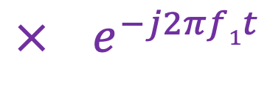
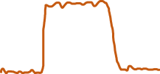



Sample Rate for a Frequency band
$$e^{j2πf1t}$$
$$e^{j2πf2t}$$
Amplitude
$${× e}^{−j2πf1t}$$
0
2
4
6
0
8
Frequency (kHz)
What should be the sample rate?

Slide 51
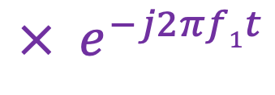
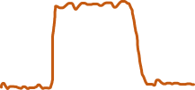

Sample Rate for a Frequency band
$${× e}^{−j2πf1t}$$
Amplitude
Frequency
down-conversion
Amplitude
0
2
4
6
8
0
2
4
6
8
Frequency (kHz)
Frequency (kHz)
What should be the sample rate?
Generally, bandwidth of the signal determines the sample rate.

Slide 52
Waves propagation, echolocation
(Lecture 2.1)

Slide 53
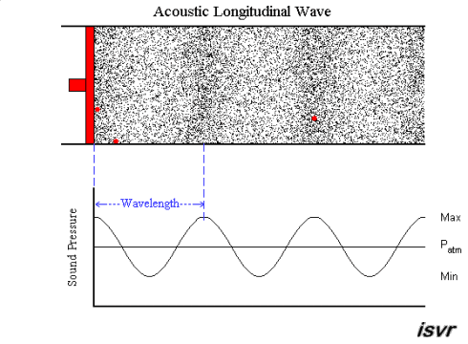
Mechanical Wave
Electromagnetic Wave
Sound
Visible light
Physical vibrations
WiFi signal
Ripples in water
Infrared
…
…

Slide 54
Waves in time and space
Temporal variation of the wave’s amplitude

Slide 55
Waves in time and space

Slide 56
Waves in time and space

Slide 57
Waves in time and space

Slide 58
Waves in time and space

Slide 59
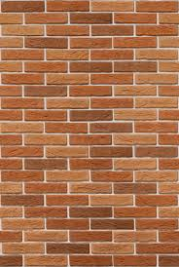
Reflection
Absorption
+
Reflection
echo

Slide 60
Echolocation
Time = t1
Absorption
+
Reflection
d
echo
t2
Sound travelled (2d) distance

Slide 61
Echolocation
Time = t1
Absorption
+
Reflection
d
echo
t2
Sound travelled (2d) distance
C.(t2-t1) = 2d

Slide 62
Distance between devices (Beep-Beep)
(Lecture 2.2)

Slide 63
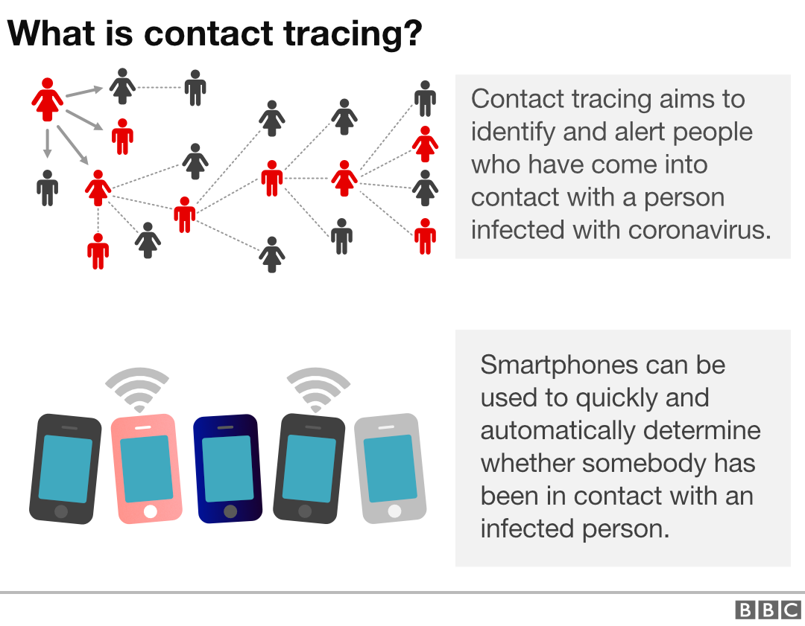
How to find the proximity between two smartphones?

Slide 64
A simple acoustic ranging technique
BeepBeep – SenSys 2007

Slide 65


Timeline
Device A
Device B
1st Beep
t_{A0}
t_{A1}
P
t_{B1}
ETOA_{B}
Q
|ETOA_{A}-ETOA_{B}|
ETOA_{A}
2nd Beep
t_{B2}
= (P+Q+P) – (Q)
t_{B3}
= 2P
P
t_{A3}
= 2 (time of flight)

Slide 66
Time-space equation of waves
(Lecture 2.3)

Slide 67

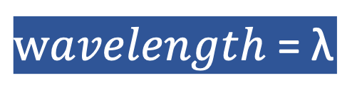

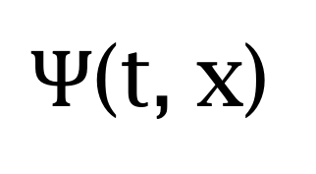
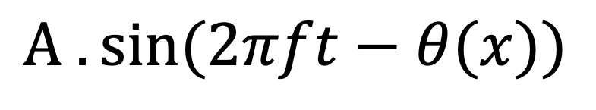
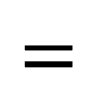
Equation of waves in time and space
$wavelength$ = λ
$$distance from the source (x)$$
$$space$$
$Ψ$(t, x)
$$=$$
$$A . sin⁡(2πft−θ(x))$$

Slide 68

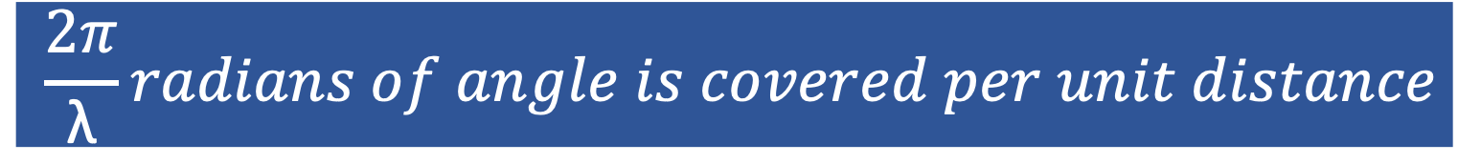


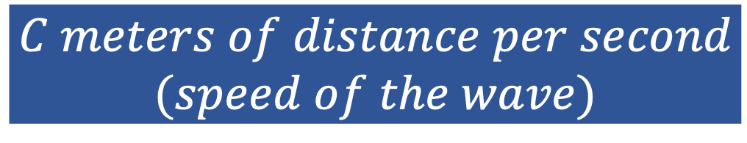
$wavelength$ = λ
Equation of waves in time and space
$$f number of cycles per second$$
$$C meters of distance per second$$
$$(speed of the wave)$$
$distance per cycle=\text{λ}$ = $C$/ $f$
$$2π radians of angle is covered per cycle$$
$$\frac{2π}{\text{λ}}radians of angle is covered per unit distance$$

Slide 69

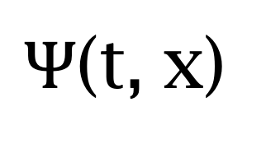
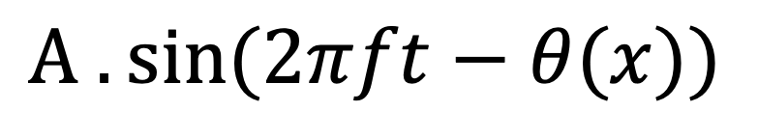

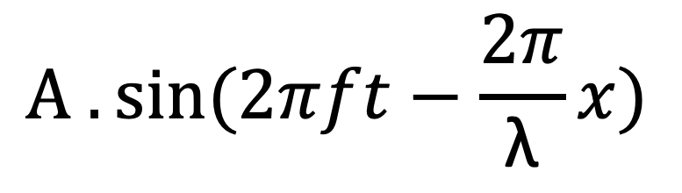
Equation of waves in time and space
$wavelength$ = λ
$$distance from the source (x)$$
$$space$$
$Ψ$(t, x)
$$=$$
$$A . sin⁡(2πft−θ(x))$$
$$A . sin⁡(2πft−\frac{2π}{\text{λ}}x)$$
$$=$$

Slide 70
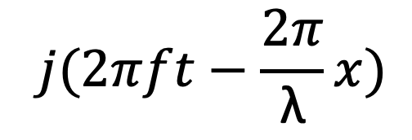
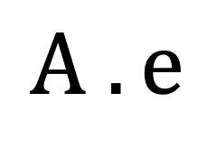
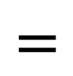
Equation of waves in time and space
$wavelength$ = λ
$$distance from the source (x)$$
$$space$$
$$⁡j(2πft−\frac{2π}{\text{λ}}x)$$
$$A . e$$
$Ψ$(t, x)
$$=$$

Slide 71
Time and space
Cycles per sec = frequency = f Hz
Distance per cycle = wavelength = λ meters
Distance per second = speed = C meters/sec
C = f . λ
Speed of sound in air: 343 m/s
Speed of sound in water: 1493 m/s
Speed of sound in iron: 5130 m/s
Speed of electromagnetic waves: 3*10⁸ m/s
(~ a million times faster than sound)

Slide 72


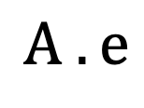
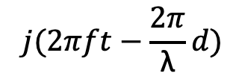
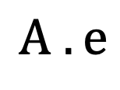
Time and space
$$⁡j(2πft−\frac{2π}{\text{λ}}d)$$
$$A . e$$
Distance = d meter
$$⁡j(2πft)$$
$$A . e$$

Slide 73
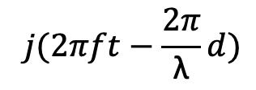
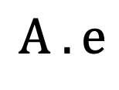
Time and space
$$⁡j(2πft−\frac{2π}{\text{λ}}d)$$
$$A . e$$
d meter
$$⁡j(2πft−\frac{2π}{\text{λ}}d)$$
$$A . e$$
Distance = d meter
$$⁡j(2πft)$$
$$A . e$$

Slide 74

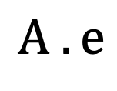

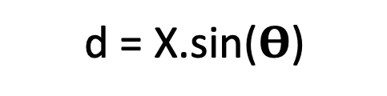
Time and space
d = X.sin($Θ$)
X meters
$$⁡j(2πft)$$
$$Θ$$
$$A . e$$

Slide 75
Spatial filtering (controlling signal gain in space)

Slide 76
Spatial filtering
Alexa!

Slide 77

Spatial filtering

Slide 78
Spatial filtering (controlling signal gain in space)
Superimposition of signals

Slide 79
Spatial filtering (controlling signal gain in space)
Superimposition of signals
(in space)

Slide 80
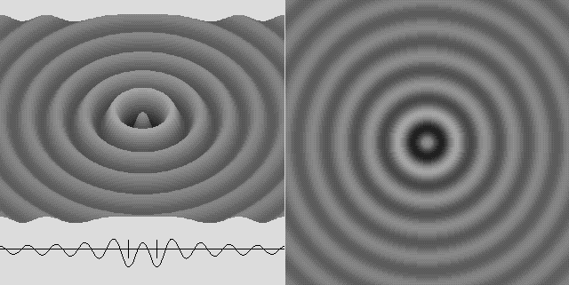
Superimposition of sinusoids

Slide 81

Superimposition of sinusoids
$$sin⁡(2πft)$$

Slide 82


Superimposition of sinusoids
$$sin⁡(2πft)$$
$$d$$
$$sin⁡(2πft+2πd/λ)$$

Slide 83

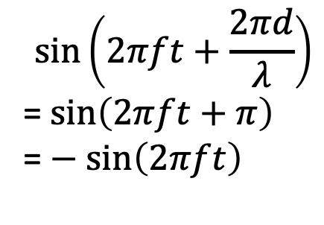
Superimposition of sinusoids
Signal amplified
(perfect constructive interference)
$$sin⁡(2πft)$$
$$d=λ/2$$
$$\sin\left(2πft+\frac{2πd}{λ}\right)$$
= $\sin\left(2πft+π\right)$
= $− sin\left(2πft\right)$
Signal nullified
Signal nullified

Slide 84
Array of sensors, ULA, beamforming
(Lecture 2.4)

Slide 85
Beamforming in 2D space

Slide 86


Beamforming in 2D space
Phase difference between these two paths
$$φ$$
$$d$$

Slide 87
Near vs Far Field
Assume far-field (planar wave model) when the receiver/transmitter are (2L²/ λ) distance apart.

Slide 88



Beamforming in 2D space
Approximation for ‘far field’
$$φ$$
Along this line
$d sin$($φ$)
$$φ$$
$$d$$
Combined signal = $\sin\left(2πft\right) + \sin\left(2πft+ \frac{2π d sin (φ)}{λ}\right)$
= $e^{j\left(2πft\right)}{ }+e^{j\left(2πft+ \frac{2π d sin(φ)}{λ}\right)}{ }$

Slide 89


Beamforming in 2D space
$$φ$$
$$d$$
+
Combined signal
= $e^{j\left(2πft\right)}{ }+e^{j\left(2πft + \frac{2π d sin(φ)}{λ}\right)}{ }$

Slide 90
Beamforming in 2D space
Directional gain of an array

Slide 91
Beamforming in 2D space

Slide 92


Directionality of signals: Physical guiding

Slide 93


Directionality of signals: Array of sensors

Slide 94
Uniform Linear Array (ULA)

Slide 95











Beamforming in 2D space
$3d sin$($φ$)
$2d sin$($φ$)
$d sin$($φ$)
$$E1$$
$$E2$$
$$E3$$
$$E4$$
…
N elements
$$d$$
$$d$$
$$d$$
Interelement distance = d
Path difference with n^{th} element:
$\left(n−1\right)d sin$($φ$)
Phase difference with n^{th} element:
$\left(n−1\right)d sin$($φ$) 2Π/λ

Slide 96














$3d cos$($φ$)
$2d sin$($φ$)
Beamforming in 2D space
$d sin$($φ$)
$$E1$$
$$E2$$
$$E3$$
$$E4$$
…
N elements
$$d$$
$$d$$
$$d$$
Path difference with n^{th} element:
$\left(n−1\right)d sin$($φ$)
Phase difference with n^{th} element:
$\left(n−1\right)d sin$($φ$) 2Π/λ
Signal at 1st sensor:
$e^{j\left(2πft\right)}{ }$
Combined signal:

Slide 97

Beamforming in 2D space
Gain
-90 -60 -30 0 30 60 90
Angle
Notes:
http://www.waves.utoronto.ca/prof/svhum/ece422/notes/15-arrays2.pdf

Slide 98
Beamforming in 2D space

Slide 99
Angle of arrival detection (Lecture 2.5)

Slide 100
Angle-of-Arrival (AoA)
or
Direction-of-Arrival (DoA)

Slide 101

DoA Estimation: Beam-scanning
Scan the region with a steerable beam of the phased array.
DoA of the signal will show maximum received power.

Slide 102

DoA Estimation: Delay-sum

Slide 103





Discrete Fourier Transform for DoA
…
0
1
2
3
4
5
6
N-1
Sample number
$$\frac{kλ}{Nd}$$
$$ϕk$$
$$=$$
asin( )

Slide 104
Statistical inference (Lecture 3.1)

Slide 105

A few basic probability rules
Joint probability: P (A, B) = P (B, A)
Likelihood of multiple events occurring simultaneously
Conditional probability: P (A|B) = P(A,B)/P(B)
Probability of an event, given another event has occurred
Marginal probability: P (B) = $\sum_{Ai}{P(B,Ai)}$
Chain rule: P (A, B, C) = P(A|B,C) P(B,C) = P(A|B,C) P(B|C) P(C)

Slide 106


Bayes rule
Likelihood
Posterior
Prior
Bayes rule: P (A_{i}|B) = $\frac{P\left(B|Ai\right)P(Ai)}{P(B)}$
= $\frac{P\left(B|Ai\right)P(Ai)}{\sum_{i}{P(B, Ai) }}$

Slide 107
Markov Model
Sunny
Sunny
Rainy
Sunny
Rainy
Rainy
t1 t2 t3 t4 t5 t6 (time)
P (sunny after rainy)
P (sunny after sunny)
P (rainy after rainy)
Sunny
day
Rainy
day
P (rainy after sunny)
Mth order Markov assumption: Current state depends on past M states

Slide 108
Hidden Markov Model

Slide 109
Hidden Markov Model
Sunny
Sunny
Rainy
Sunny
Rainy
Rainy
t1 t2 t3 t4 t5 t6 (time)
P (sunny after rainy)
P (sunny after sunny)
P (rainy after rainy)
Sunny
day
Rainy
day
Temp.
P (rainy after sunny)
Temp.
Humidity
Humidity
Wind
Wind

Slide 110
Hidden Markov Model: Definition
S₁
S₁
S₂
M₁
Transition
Emission
1st order Markov assumption:
Transition probability depends on the current state only.
Output independence assumption:
Output/Emission probability depends on the current state only.

Slide 111

Hidden Markov Model: Definition
Observation depends on the current state only
Future state depends on the current state only

Slide 112
Problems solved by HMM
1) Likelihood:
  Determine the likelihood of an observation sequence.
2) Decoding:
  Given an observation sequence, determine the best sequence of hidden states.
[Viterbi algorithm]
[Forward-backward algorithm]
[Baum-Welch algorithm]
3) Learning:
  Given an observation sequence and a sequence of states, learn the HMM parameters:
  i) Transition probabilities
  ii) Emission probabilities

Slide 113
HMM and Viterbi algorithm
(Lecture 3.2 & Lecture 3.3)

Slide 114
Problems solved by HMM
1) Likelihood:
  Determine the likelihood of an observation sequence.
2) Decoding:
  Given an observation sequence, determine the best sequence of hidden states.
[Viterbi algorithm]
[Forward-backward algorithm]
[Baum-Welch algorithm]
3) Learning:
  Given an observation sequence and a sequence of states, learn the HMM parameters:
  i) Transition probabilities
  ii) Emission probabilities

Slide 115

A simple gesture recognition example
States:
Observations:
No
Call
Call
Near
Far
Notes:
http://www.davidsbatista.net/assets/documents/posts/2017-11-11-hmm_viterbi_mini_example.pdf

Slide 116
A simple gesture recognition example
1
Start
End
0.7
0.1
St
0.7
0.3
0.1
No
Call
0.2
Call
0.2
0.7
0.3
0.4
0.7
0.6
Near
Far
Near
Far

Slide 117

A simple gesture recognition example
 | Call | NoCall | End
Start | 0.7 | 0.3 | 0
Call | 0.2 | 0.7 | 0.1
NoCall | 0.7 | 0.2 | 0.1
 | St | Near | Far
Start | 1 | 0 | 0
Call | 0 | 0.7 | 0.3
NoCall | 0 | 0.4 | 0.6
State transition
probabilities
Emission
probabilities

Slide 118
A simple gesture recognition example
Emission states are: Near, Far, Far
What is the hidden state sequence?

Slide 119
A simple gesture recognition example
i = 1 2 3
Call
Call
Call
Start
End
No
Call
No
Call
No
Call
St
Near
Far
Far

Slide 120

Hidden Markov Model: Definition

Slide 121




A simple gesture recognition example
Save two parameters per iteration, per state:
Recursion
$$Initialize, δ0\left(Start\right)=1$$
$$S=\{Start, Call, NoCall, End\}$$
$$ω=\{St, Near, Far\}$$
[Ref] http://www.davidsbatista.net/assets/documents/posts/2017-11-11-hmm_viterbi_mini_example.pdf

Slide 122


A simple gesture recognition example
i = 1 2
Call
Call
No
Call
Near
Far

Slide 123
A simple gesture recognition example
i = 1 2 3
Call
Call
Call
Start
End
No
Call
No
Call
No
Call
St
Near
Far
Far

Slide 124




A simple gesture recognition example
i = 1
 | Call | NoCall | End
Start | 0.7 | 0.3 | 0
Call | 0.2 | 0.7 | 0.1
NoCall | 0.7 | 0.2 | 0.1
Call
State transition probabilities
Start
$$δ0\left(Start\right)=1$$
 | St | Near | Far
Start | 1 | 0 | 0
Call | 0 | 0.7 | 0.3
NoCall | 0 | 0.4 | 0.6
No
Call
St
Near
Emission probabilities

Slide 125


A simple gesture recognition example
i = 1 2
Call
Call
Start
No
Call
No
Call
Near
Far

Slide 126





A simple gesture recognition example
i = 1 2 3
0.14406
Call
Call
Call
0.0043
Start
0.343
0.04116
End
No
Call
No
Call
No
Call
Near
Far
Far

Slide 127
A simple gesture recognition example
i = 1 2 3
Call
Call
Call
The values of delta and psi are not correct on this slide. Please refer to the calculation shown at the following link.
http://www.cs.umd.edu/class/fall2020/cmsc818w/course_materials/slides/Viterbi_solution.pdf
Start
End
No
Call
No
Call
No
Call
Near
Far
Far

Slide 128
A simple gesture recognition example
i = 1 2 3
0.14406
Call
Call
Call
0.0043
Start
0.343
0.04116
End
No
Call
No
Call
No
Call
Near
Far
Far

Slide 129
A simple gesture recognition example
i = 1 2 3
0.14406
Call
Call
Call
0.0043
Start
0.343
0.04116
End
No
Call
No
Call
No
Call
Near
Far
Far

Slide 130
A simple gesture recognition example
i = 1 2 3
0.14406
Call
Call
Call
For complete step by step solution of this example visit:
http://www.cs.umd.edu/class/fall2022/cmsc715/course_materials/slides/Viterbi_solution.pdf
0.0043
Start
0.343
0.04116
End
No
Call
No
Call
No
Call
Viterbi sequence: < Call, NoCall, Call >
P( <Call, NoCall, Call > | <Near, Far, Far>) = 0.0043
Near
Far
Far

Slide 131
Bayesian Inference (Lecture 3.4 & Lecture 3.5)

Slide 132
A sample applications of statistical inference in IoT
Continued from the last lecture

Slide 133

MoLe
Motion Leaks through Smartwatch Sensors
He Wang
Ted Tsung-Te Lai
Romit Roy Choudhury
UIUC
MobiCom’15 Presentation
Continued from the last lecture

Slide 134





MoLe Architecture
Attacker Training Data
Rank of Word_{i}
Attacker Point Cloud
a b c d
Keystroke
Detector
Point
Cloud
Fitting
Bayesian
Inference
P(O|W_{i})
Time
Location
Word W_{i}
Unlabeled Point Cloud
Observation ( O )
User Data
Dictionary

Slide 135
Bayesian Inference
Likelihood function
W_{i}: Candidate word_{i} in dictionary
O: Motion observation

Slide 136



Bayesian Inference
The probability of the observed motion given word_{i}
Number of keystrokes
Number of keystrokes
Location distribution
Location distribution
Time interval distribution
Time interval distribution

