Slide 1
Hybrid Contact Modeling
CMSC828X Student Presentation
Praveen Kumar
11/29/22

Slide 2
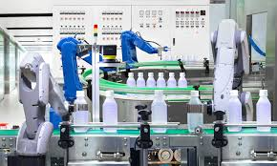
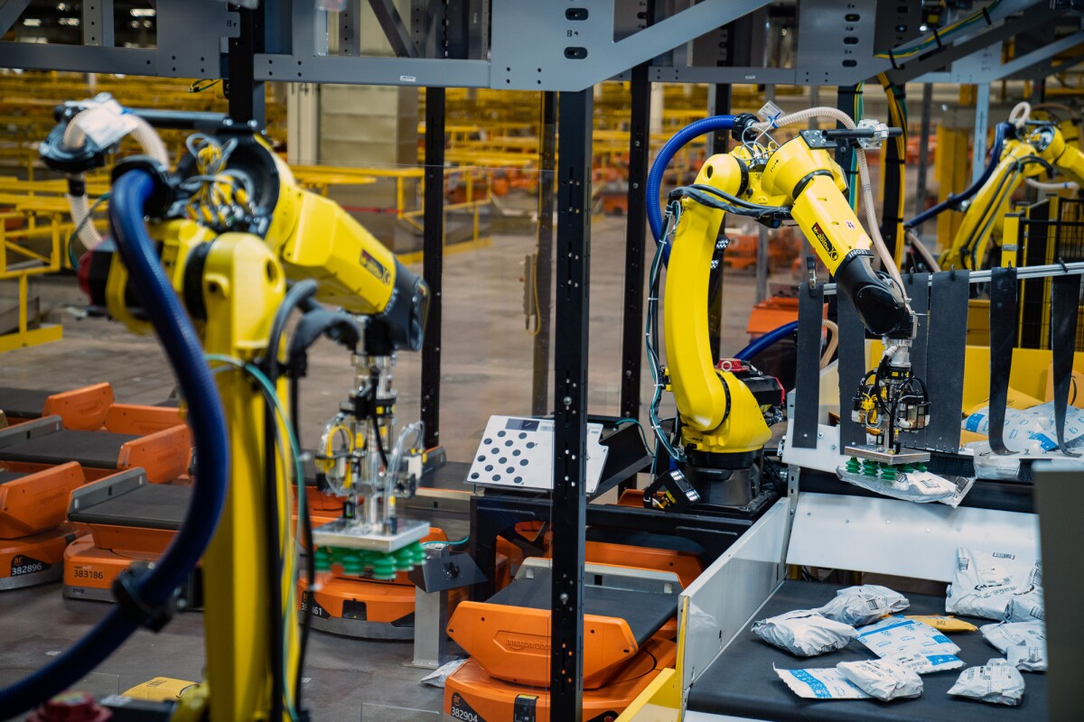
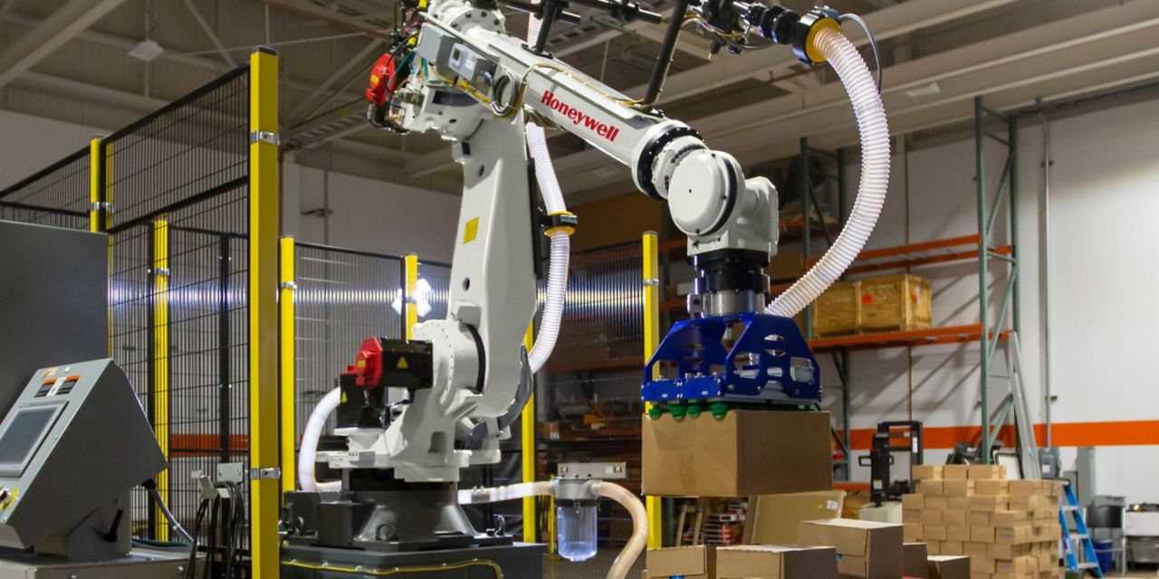
Contact-Rich Manipulation
https://www.newfoodmagazine.com/article/111886/food-manufacture-4-0-automation-and-robotics-at-the-service-of-food-manufacturing/
https://www.amazon.science/latest-news/amazon-robotics-see-robin-robot-arms-in-action
https://blog.robotiq.com/a-brief-history-of-robots-in-manufacturing
https://www.honeywell.com/us/en/news/2022/04/how-robots-are-upgrading-the-supply-chain-industry

Slide 3
Contacts are Unique & Challenging
Contacts ➔ Necessary collisions
Dynamic and non-linear
Discontinuity in system state
Varies with material properties

Slide 4
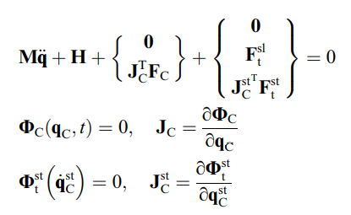
Continuous Contact Dynamics Formulation
Rigid contact
No deformation
No energy dissipation
Requires explicit parameterization of surface & material properties
Numerically stiff differential-algebraic equations – analytical solutions in complex scenarios intractable
M – Inertia matrix in joint space
q – Generalized coordinates
H – Non-impact forces
F_{C} – Normal contact forces
Φ_{C} – Slipping contact constraints
J_{C} – Slipping constraint Jacobian
Φ^{st} – Sticking contact constraints
J^{st} – Sticking constraint Jacobian
F^{sl} – Slipping friction force
F^{st} – Sticking friction force
M – Inertia matrix in joint space
q – Generalized coordinates
H – Non-impact forces
F_{C} – Normal contact forces
Φ_{C} – Slipping contact constraints
J_{C} – Slipping constraint Jacobian
Φ^{st} – Sticking contact constraints
J^{st} – Sticking constraint Jacobian
F^{sl} – Slipping friction force
F^{st} – Sticking friction force

Slide 5
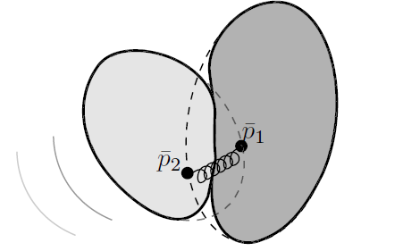
Penalty Approaches
Rigid or deformable body
Captures material properties, topology etc.
Simple and fast
Scalable to multiple contacts
Requires tuning of parameters
Large contact stiffness and damping will cause instabilities
Interpenetration can be violated
F – Contact force
x – Penetration measure
v – Normal velocity
λ – Contact stiffness
µ - Contact damping
Fig. 1 Contact between two bodies represented by spring-damper systems

Slide 6
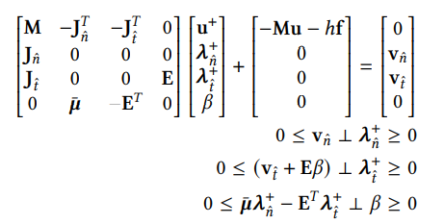
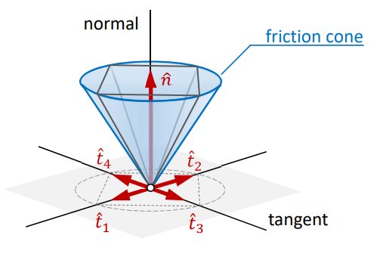
Linear Complementarity Formulation
J_{n} – Non-penetration Jacobian
J_{i} – Friction Jacobian
v_{n} – Normal velocity
v_{i} – Sliding velocity
β – Maximum slipping velocity
λ_{i} – Tangential friction impulse
λ_{n}– Normal friction impulse
Fig. 2 Approximated friction cone

Slide 7
Physics-based Contact Models – Quick Review
Governed by first-principles
Force-Acceleration relationship, Energy conservation
Observable and latent factors
Effect of temperature, lubrication, surface topography [4]
Generalizable & Interpretable [5]
Limited by available knowledge and choice of model parameters [5]
f – True contact dynamics
f_{A} – Physics-based contact dynamics model
ϵ_{A} – Error between reality and model
ϴ_{A} – Physics-based model parameters

Slide 8
Data-Driven Contact Models – Quick Review
Model parameter estimation [2] – Recursive least squares estimation [4][9]
friction model, stiffness matrix, contact Jacobian
Directly learn the entire dynamic mapping [2][5]
Forward, inverse or transition dynamics
No explicit constraint specification
Learning only the latent space of contact dynamics [5]

Slide 9
Data-Driven Contact Models – Quick Review
Parametric (Neural Nets) and Non-Parametric models (Gaussian Process) [4]
Governed by noisy input-output measurements
Not generalizable & interpretable [5]
Limited by experimental setup cost & availability

Slide 10
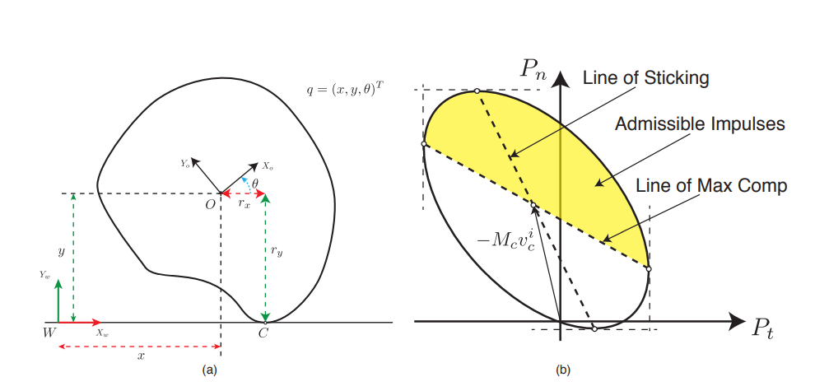
Learning the Entire Dynamic Mapping [2]
Required Contact Model Mapping
Data
Parametric Model
Fig. 3 Planar sliding/pushing; Energy ellipse
Optimization

Slide 11
Hybrid Contact Models
Physics model forms the prior or provides the fundamental structure to be learnt
Data bridges the gap between reality and observed models – simply an error estimator
Influenced by physics simulation-based learning [2][5][7]
Gradient-based optimization algorithms
f – True contact dynamics
f_{A} – Physics-based contact dynamics model
ϵ_{A} – Error between reality and model
ϴ_{A} – Physics-based model parameters
ϴ_{D} – Data-driven model parameters

Slide 12
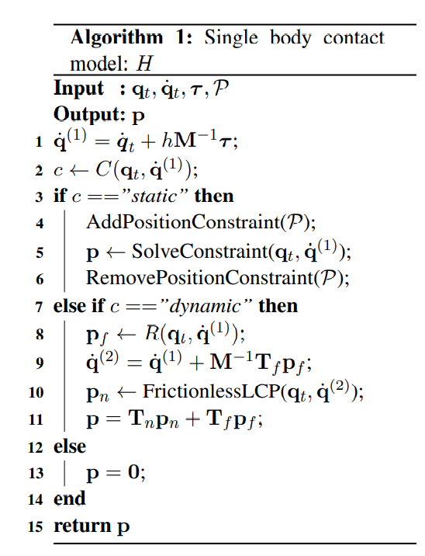
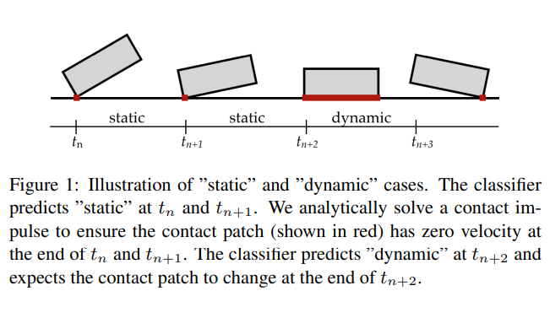
Data Augmented Rigid Body Contact Model [7]

Slide 13
Structured Learning for Rigid Body Dynamics [5]
Fig. 4 Schematic of analytical structured modeling. Data-driven models can approximate the output error of the analytical model (ARM) and/or reduce latent errors inside the analytical model (ALM)

Slide 14
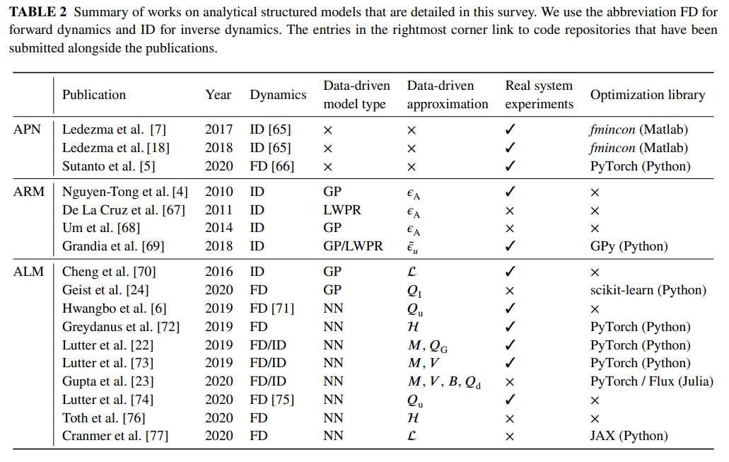
Structured Learning for Rigid Body Dynamics [5]

Slide 15
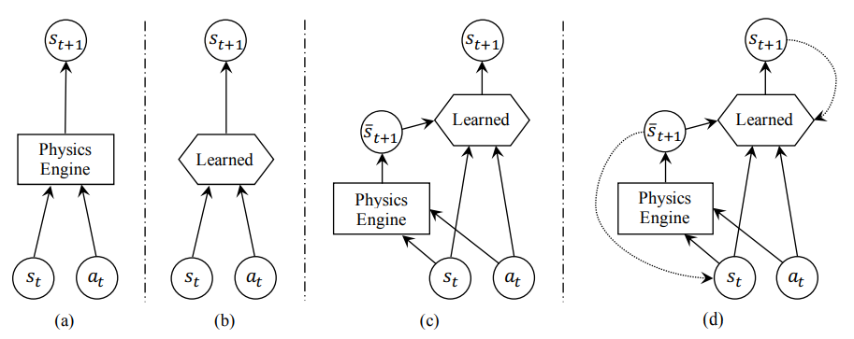
Learning Rigid Body Contact Models with Physics Simulator for Planar Sliding [3]
Fig. 5 (a) physics-based analytical models; (b) data-driven models; (c) simulator-augmented residual models; (d) recurrent simulator-augmented residual models.

Slide 16
Learning Rigid-body Forward Dynamics with Gaussian Process Force Priors[8]
Fig. 6 Robot arm’s forward dynamics model (analytical model) is augmented by a Gaussian Process approximating unknown forces

Slide 17
Reference
[1] Gilardi, Gianni, and Inna Sharf. "Literature survey of contact dynamics modelling." Mechanism and machine theory 37.10 (2002): 1213-1239.
[2] Fazeli, Nima, et al. "Learning data-efficient rigid-body contact models: Case study of planar impact." Conference on Robot Learning. PMLR, 2017.
[3] Ajay, Anurag, et al. "Combining physical simulators and object-based networks for control." 2019 International Conference on Robotics and Automation (ICRA). IEEE, 2019.

Slide 18
Reference
[4] Liu, Qian, Jianxun Liang, and Ou Ma. "A physics-based and data-driven hybrid modeling method for accurately simulating complex contact phenomenon." Multibody System Dynamics 50.1 (2020): 97-117.
[5] Geist, A. René, and Sebastian Trimpe. "Structured learning of rigid‐body dynamics: A survey and unified view from a robotics perspective." GAMM‐Mitteilungen 44.2 (2021): e202100009.

Slide 19
Reference
[6] Ota, Kei, et al. "Data-efficient learning for complex and real-time physical problem solving using augmented simulation." IEEE Robotics and Automation Letters 6.2 (2021): 4241-4248.
[7] Jiang, Yifeng, Jiazheng Sun, and C. Karen Liu. "Data-augmented contact model for rigid body simulation." Learning for Dynamics and Control Conference. PMLR, 2022.

Slide 20
Reference
[8] Rath, Lucas, Andreas René Geist, and Sebastian Trimpe. "Using Physics Knowledge for Learning Rigid-body Forward Dynamics with Gaussian Process Force Priors." Conference on Robot Learning. PMLR, 2022.
[9] Kim, Byungchan, et al. "Learning robot stiffness for contact tasks using the natural actor-critic." 2008 IEEE International Conference on Robotics and Automation. IEEE, 2008.

Slide 21
Thoughts?

