Slide 1
Modeling Hyperelastic Materials
Nathan Hoffman
Notes:
Most of this material is based on the Abaqus user manual

Slide 2
Review of Elastic Materials
Elastic materials follow Hooke’s law:
$F=kx$
This relation is often expressed as:
$σ=Eε$
$σ$, tensile stress, is Force / Area
E is the Young’s Modulus, or modulus of elasticity of a material
$\text{τ}=G\text{γ}$
$\text{τ}$ is shear stress, calculated similarly to tensile stress
G is Shear modulus, equivalent to elastic modulus for shear
$ε$ or γ is strain or engineering strain, ΔL/L

Slide 3
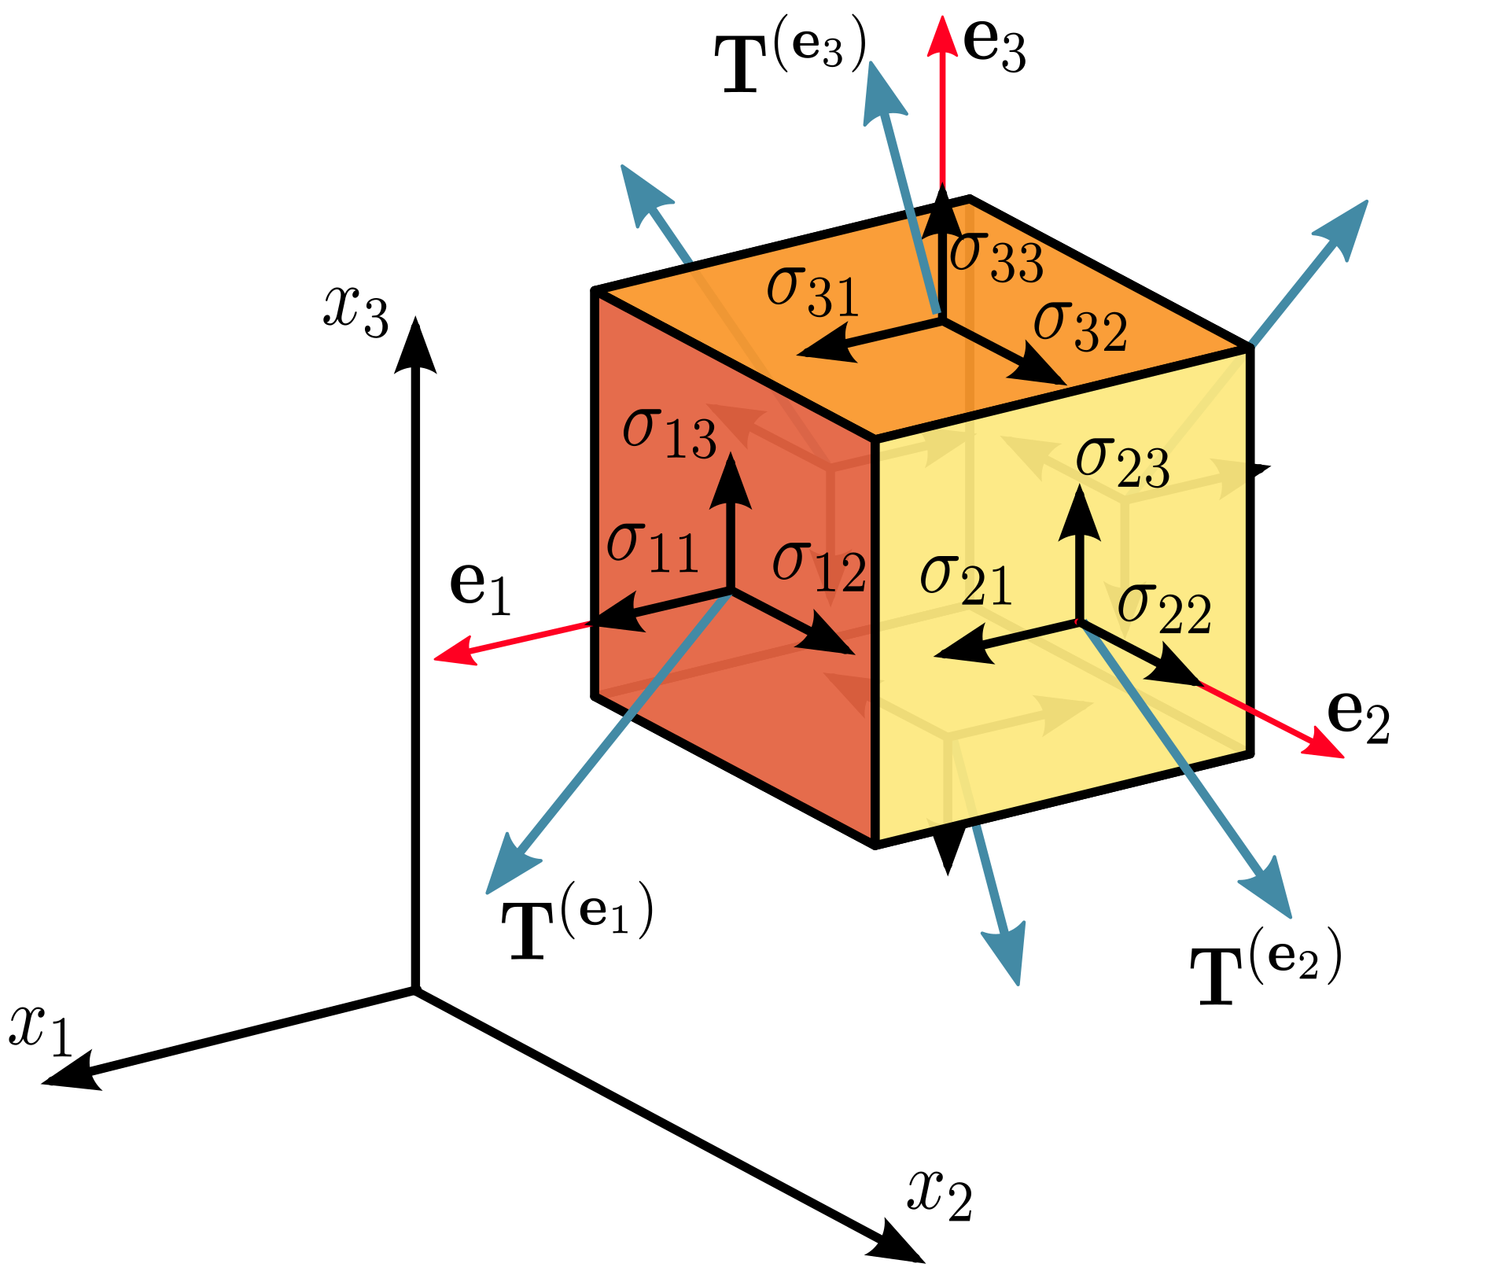
Strain Tensor
$ε=\left[\begin{matrix}ε_{11} & ε_{12} & ε_{13} \\ ε_{21} & ε_{22} & ε_{23} \\ ε_{31} & ε_{32} & ε_{33}\end{matrix}\right]=\left[\begin{matrix}ε_{xx} & ε_{xy} & ε_{xz} \\ ε_{yx} & ε_{yy} & ε_{yz} \\ ε_{zx} & ε_{zy} & ε_{zz}\end{matrix}\right]=\left[\begin{matrix}ε_{xx} & γ_{xy}/2 & γ_{xz}/2 \\ γ_{yx}/2 & ε_{yy} & γ_{yz}/2 \\ γ_{zx}/2 & γ_{zy}/2 & ε_{zz}\end{matrix}\right]$
Note that $ε$ = γ/2 for $ε$ not on diagonal.
Important for converting γ (engineering strain) to strain tensor.
Stretch ratio: λ = $ε$ + 1.
Also called infinitesimal strain
Notes:
Figure from https://commons.wikimedia.org/w/index.php?curid=5668647

Slide 4
Lamé Parameters
Elastic deformation can also be expressed: $σ=2με+λ_{L}tr⁡(ε)I$
$μ$ (second Lamé parameter) is the shear modulus
Shear modulus is often expressed as G
$λ_{L}$ (first Lamé parameter) is related to G and E by $λ_{L}=\frac{G(E−2G)}{3G−E}$

Slide 5
Deformation Gradient
Initial position vector: X
Final position vector: x
Displacement vector: u = X – x
Deformation Gradient: $F=\frac{∂x_{i}}{∂X_{j}}=\left[\begin{aligned}&\frac{∂x_{1}}{∂X_{1}} &&\frac{∂x_{1}}{∂X_{2}} &&\frac{∂x_{1}}{∂X_{3}} \\ &\frac{∂x_{2}}{∂X_{1}} &&\frac{∂x_{2}}{∂X_{2}} &&\frac{∂x_{2}}{∂X_{3}} \\ &\frac{∂x_{3}}{∂X_{1}} &&\frac{∂x_{3}}{∂X_{2}} &&\frac{∂x_{3}}{∂X_{3}}\end{aligned}\right]$
This is a Jacobian matrix

Slide 6
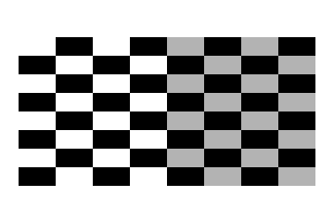
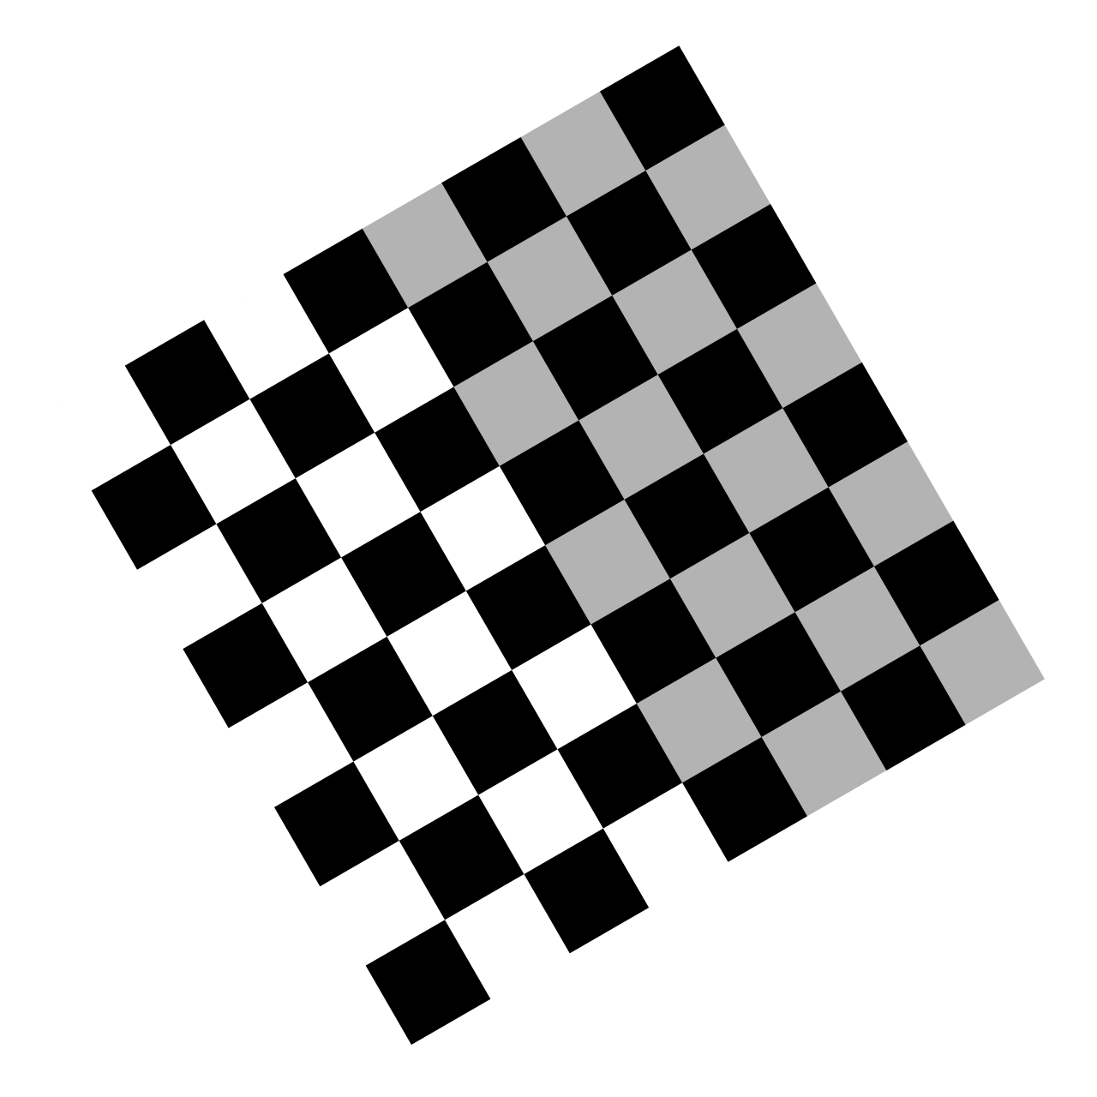
Deformation Gradient Examples
Deformation Gradients are Affine Transformations
Stretch: $F=\left[\begin{aligned}&2 &&0 &&0 \\ &0 &&1 &&0 \\ &0 &&0 &&0\end{aligned}\right]$
Rotation: $F=\left[\begin{aligned}&cos⁡(θ) −&&sin⁡(θ) &&0 \\ &sin⁡(θ) &&cos⁡(θ) &&0 \\ &0 &&0 &&0\end{aligned}\right]$
Shear: $F=\left[\begin{aligned}&1 &&.5 &&0 \\ &0 &&1 &&0 \\ &0 &&0 &&0\end{aligned}\right]$
Notes:
Images:
https://commons.wikimedia.org/wiki/File:Checkerboard_scale.svg
https://commons.wikimedia.org/wiki/File:Checkerboard_rotate.svg
https://commons.wikimedia.org/wiki/File:Checkerboard_shear.svg

Slide 7
Greene Strain Tensor
$E=\frac{1}{2}\left(F^{T}⋅F−I\right)$
Here F is the deformation gradient and I is the identity matrix
The Greene strain tensor takes the following form:
$E=\left[\begin{aligned}&E_{xx} &&E_{xy} &&E_{xz} \\ &E_{xy} &&E_{yy} &&E_{yz} \\ &E_{xz} &&E_{yz} &&E_{zz}\end{aligned}\right]$

Slide 8
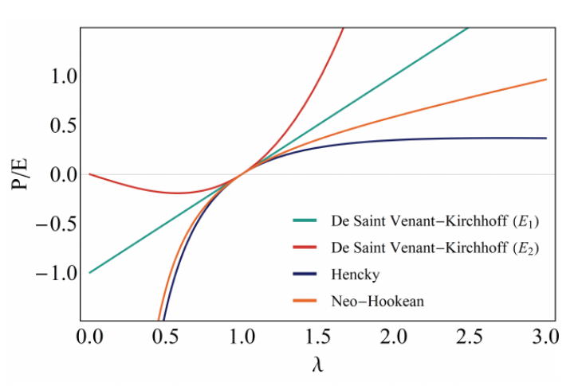
Saint Venant – Kirchoff Model
$U(E)=\frac{λ_{L}}{2}[tr⁡(E)]^{2}+μtr⁡\left(E^{2}\right)$
$μ$ and${ λ}_{L}$are the initial values of first and second Lamé parameter and E is the Greene strain tensor
In the example at right, $E_{1}$is engineering strain (linear elastic model), $E_{2}$ is Greene strain.
Figure from Fraldi et al.
Notes:
Fraldi, Massimiliano & Palumbo, Stefania & Carotenuto, Angelo & Cutolo, Arsenio & Deseri, Luca & Pugno, Nicola. (2018). Buckling Soft Tensegrities: Fickle Elasticity and Configurational Switching in Living Cells. Journal of the Mechanics and Physics of Solids. 124. 10.1016/j.jmps.2018.10.017.

Slide 9
Volume Change & Strain Energy Density Function
Total Volume Change: $J=det⁡(F)$ (This is a Jacobian determinate)
Strain Invariants:
Using principal s$treach ratios \text{λ}=\left[\begin{matrix}λ_{1} & 0 & 0 \\ 0 & λ_{2} & 0 \\ 0 & 0 & λ_{3}\end{matrix}\right]$
$I_{1}=\operatorname{tr}\left(\text{λ}\right)$
$I_{2}=\frac{1}{2}\left(tr⁡\left({\text{λ}}^{2}\right)−(tr⁡(\text{λ}))^{2}\right)$
$I_{3}=det⁡(\text{λ})$
The strain Energy Density Function is defined as: $U(I_{1},I_{2},I_{3})$
Sometimes written as W()

Slide 10
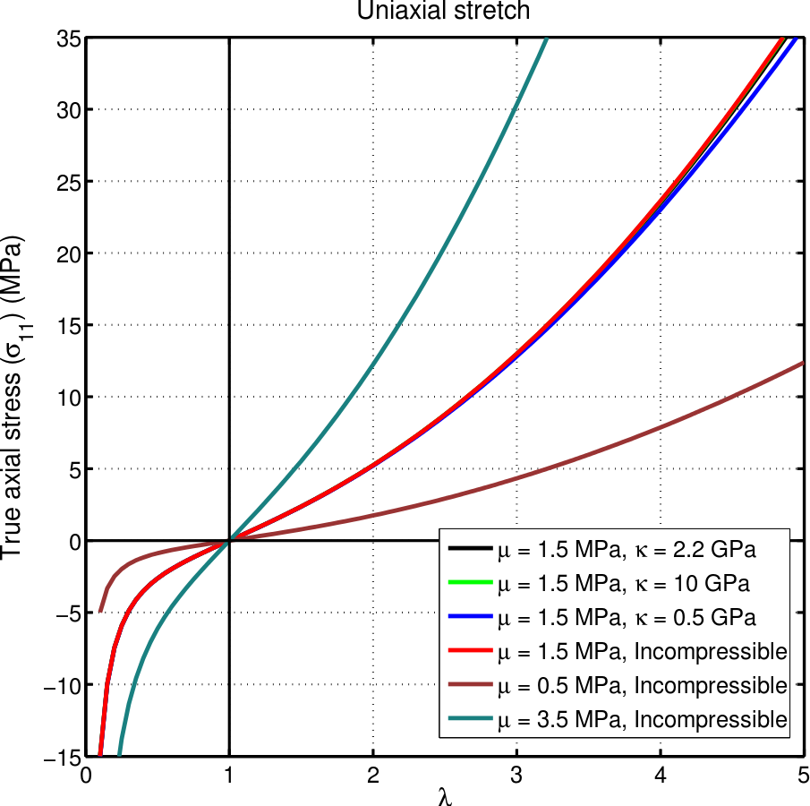
Neo-Hookean Model
Strain Energy Function:
$U=C_{1}\left(I_{1}−3\right)+D_{1}(J−1)^{2}$
$C_{1}=\frac{μ}{2} and D_{1}=\frac{λ_{L}}{2}$
Initial values of shear modulus and the first Lamé parameter
Note that these relations should not necessarily be used – it may be desirable to fit the model to other regions of the curve.
Notes:
Image From https://commons.wikimedia.org/wiki/File:CompNeoHook.svg

Slide 11
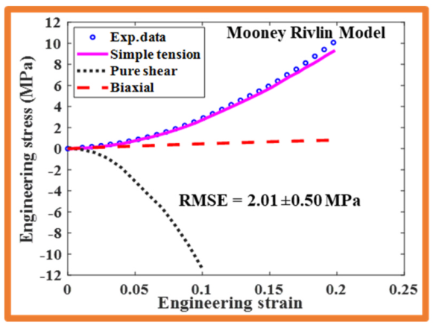
Mooney-Rivlin Model
$\begin{aligned}&{\overline{I}}_{1}=J^{−2/3}I_{1} \\ &{\overline{I}}_{2}=J^{−4/3}I_{2}\end{aligned}$
$U=C_{01}\left({\overline{I}}_{2}−3\right)+C_{10}\left({\overline{I}}_{1}−3\right)+D_{1}(J−1)^{2}$
For Initial Values of $κ and μ$
$λ_{L} =2D_{1};μ=2\left(C_{01}+C_{10}\right)$
If $C_{01}$ = 0, this is the same as the Neo-Hookean model
A Mooney-Rivlin model fitted to data from tested pig skin. Here, $C_{01}=.87 and C_{10}=−.93$ From Dwivedi et al.
Notes:
[1]
K. Kr. Dwivedi, P. Lakhani, S. Kumar, and N. Kumar, “A hyperelastic model to capture the mechanical behaviour and histological aspects of the soft tissues,” Journal of the Mechanical Behavior of Biomedical Materials, vol. 126, p. 105013, Feb. 2022, doi: 10.1016/j.jmbbm.2021.105013.

Slide 12
Polynomial or Generalized Rivlin Model
$U=\sum_{i,j=0}^{n}{ }C_{ij}{\left({\overline{I}}_{1}−3\right)}^{i}{\left({\overline{I}}_{2}−3\right)}^{j}+\sum_{k=1}^{m}{ }D_{k}(J−1)^{2k}$
$C_{00}=0$
Same as Mooney – Rivlin if m and n = 1 and $C_{11}=0$
Rarely used: Mooney – Rivlin model can typically capture enough complexity

Slide 13
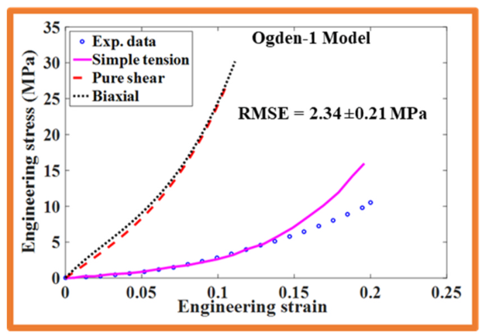
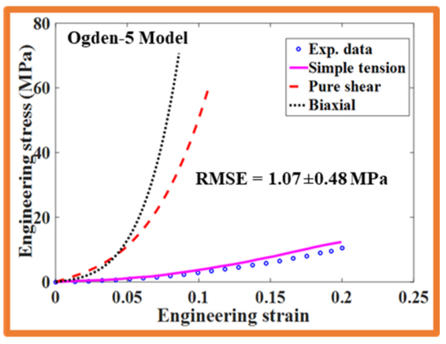
Ogden Model
$U=\sum_{p=1}^{N}{ }\frac{μ_{p}}{α_{p}}\left(λ_{1}^{α_{p}}+λ_{2}^{α_{p}}+λ_{3}^{α_{p}}−3\right)$
Equivalent to Neo-Hookean when N=1 and $α$ = 2
Equivalent to Mooney-Rivlin when N=2, $α_{1}$, and $α_{2}$=-2
1st order example uses $μ_{1}=3.49,α_{1}=21.48$
Ogden model fitted to data from pig skin, From Dwivedi et al.
Notes:
[1]
K. Kr. Dwivedi, P. Lakhani, S. Kumar, and N. Kumar, “A hyperelastic model to capture the mechanical behaviour and histological aspects of the soft tissues,” Journal of the Mechanical Behavior of Biomedical Materials, vol. 126, p. 105013, Feb. 2022, doi: 10.1016/j.jmbbm.2021.105013.

Slide 14
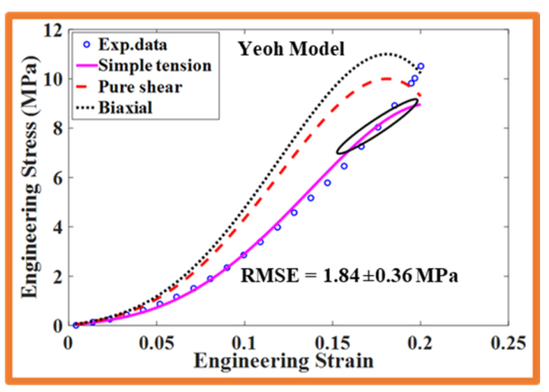
Yeoh Model
$W=\sum_{i=1}^{3}{ }C_{i}{\left(I_{1}−3\right)}^{i}$
$2C_{1}$ = Initial shear modulus
This model was initially created for modeling rubber
A Mooney-Rivlin model fitted to data from tested pig skin. Here, $C_{1}=8.42,C_{2}=8.75,C_{3}=2.35$ From Dwivedi et al.
Notes:
[1]
K. Kr. Dwivedi, P. Lakhani, S. Kumar, and N. Kumar, “A hyperelastic model to capture the mechanical behaviour and histological aspects of the soft tissues,” Journal of the Mechanical Behavior of Biomedical Materials, vol. 126, p. 105013, Feb. 2022, doi: 10.1016/j.jmbbm.2021.105013.

Slide 15
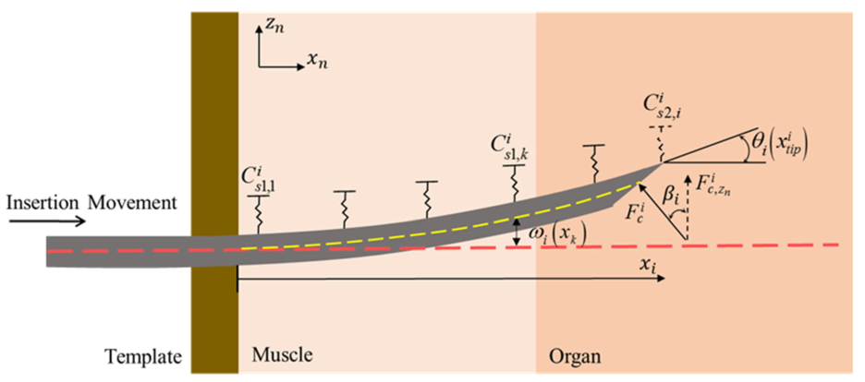
Example of Using the energy density function in a model
Formulate a minimization problem from the potential energy of the system
Example: needle deflection model
Minimize the energy equation:
$Π_{i}=U_{B,i}+U_{T,i}−W_{i}$
Here, $U_{B}$ is energy from the bending of the needle, $U_{T}$ is energy from the compression of the tissue, W is the work done by the needle cutting the tissue ($from F_{c})$

Slide 16
What Model Should You Use?
The Saint Venant – Kirchoff model is simple, computationally cheap, but not as accurate
Less work to fit
The Generalized Rivlin Model is generally more complex than necessary
Other models must be fitted to data. For modeling rubber different strain ranges are best fitted by different models:
Up to 100%: Neo-Hookean (simplest model)
150-200%: Mooney-Rivlin (not as simple)
0-Failure: Ogden (most complex)
specific range: Yeoh
Notes:
Source: https://www.simscale.com/blog/how-to-choose-hyperelastic-material/

