Slide 1
CSMC 412
Operating Systems
Prof. Ashok K Agrawala
Synchronization
Set 9

Slide 2
Semaphore
Invented by Edsger Dijkstra in 1962
When working on and operating system for Electrologica X which became THE.
A non-negative, integer, Global variable (S)
Initialized at set up time, and
Two operations are allowed
P(S) ----- Wait(S)
Decrement S
Wait until this operation can be carried out.
V(S) ------Signal(S)
Increment S
Both operations are considered Atomic

Slide 3
Semaphore
Synchronization tool that provides more sophisticated ways (than Mutex locks) for process to synchronize their activities.
Semaphore S – integer variable
Can only be accessed via two indivisible (atomic) operations
wait() and signal()
Originally called P() and V()
Definition of the wait() operation
wait(S) {
while (S <= 0)
; // busy wait
S--;
}
Definition of the signal() operation
signal(S) {
S++;
}

Slide 4
Information Implications of Semaphore
A process has synch points
To go past a synch point certain conditions must be true
Conditions depend not only on ME but other processes also
Must confirm that the conditions are true before proceeding, else have to wait.
P(S) – Wait (S)
If can complete this operation
Inform others through changed value of S
Proceed past the synch point
If can not complete
Wait for the event when S becomes >0
V(S) – Signal (S)
Inform others that I have gone past a synch point.

Slide 5
Semaphore Usage
Counting semaphore – integer value can range over an unrestricted domain
Binary semaphore – integer value can range only between 0 and 1
Same as a mutex lock
Can solve various synchronization problems
Consider P₁ and P₂ that require S₁ to happen before S₂
Create a semaphore “synch” initialized to 0
P1:
S₁;
signal(synch);
P2:
wait(synch);
S₂;
Can implement a counting semaphore S as a binary semaphore

Slide 6
Semaphore as General Synchronization Tool
Counting semaphore – integer value can range over an unrestricted domain
Binary semaphore – integer value can range only between 0 and 1; can be simpler to implement
Also known as mutex locks
Can implement a counting semaphore S as a binary semaphore
Provides mutual exclusion
Semaphore S; // initialized to 1
P(S);
CriticalSection();
V(S);

Slide 7
Implementing Counting Semaphore using Binary Semaphore
Data structures:
binary-semaphore S1, S2;
int C:
Initialization:
S1 = 1
S2 = 0
C = initial value of semaphore S

Slide 8
Implementing Counting Semaphore
wait operation
wait(S1);
C--;
if (C < 0) {
signal(S1);
wait(S2);
}
signal(S1);
signal operation
wait(S1);
C ++;
if (C <= 0)
signal(S2);
else
signal(S1);

Slide 9
Semaphore Implementation
Must guarantee that no two processes can execute the wait() and signal() on the same semaphore at the same time
Thus, the implementation becomes the critical section problem where the wait and signal code are placed in the critical section
Could now have busy waiting in critical section implementation
But implementation code is short
Little busy waiting if critical section rarely occupied
Note that applications may spend lots of time in critical sections and therefore this is not a good solution

Slide 10
Semaphore Implementation with no Busy waiting
With each semaphore there is an associated waiting queue
Each entry in a waiting queue has two data items:
value (of type integer)
pointer to next record in the list
Two operations:
block – place the process invoking the operation on the appropriate waiting queue
wakeup – remove one of processes in the waiting queue and place it in the ready queue
typedef struct{
int value;
struct process *list;
} semaphore;

Slide 11
Implementation with no Busy waiting (Cont.)
wait(semaphore *S) {
S->value--;
if (S->value < 0) { add this process to S->list;
block();
}
}
signal(semaphore *S) {
S->value++;
if (S->value <= 0) { remove a process P from S->list;
wakeup(P);
}
}

Slide 12
Deadlock and Starvation
Deadlock – two or more processes are waiting indefinitely for an event that can be caused by only one of the waiting processes
Let S and Q be two semaphores initialized to 1
P₀ P₁
wait(S); wait(Q);
wait(Q); wait(S);
... ...
signal(S); signal(Q);
signal(Q); signal(S);
Starvation – indefinite blocking
A process may never be removed from the semaphore queue in which it is suspended
Priority Inversion – Scheduling problem when lower-priority process holds a lock needed by higher-priority process
Solved via priority-inheritance protocol

Slide 13
Problems with Semaphores
Incorrect use of semaphore operations:
signal (mutex) …. wait (mutex)
wait (mutex) … wait (mutex)
Omitting of wait (mutex) or signal (mutex) (or both)
Deadlock and starvation are possible.

Slide 14
Monitors
A high-level abstraction that provides a convenient and effective mechanism for process synchronization
Abstract data type, internal variables only accessible by code within the procedure
Only one process may be active within the monitor at a time
But not powerful enough to model some synchronization schemes
monitor monitor-name
{
// shared variable declarations
procedure P1 (…) { …. }
procedure Pn (…) {……}
Initialization code (…) { … }
}
}

Slide 15
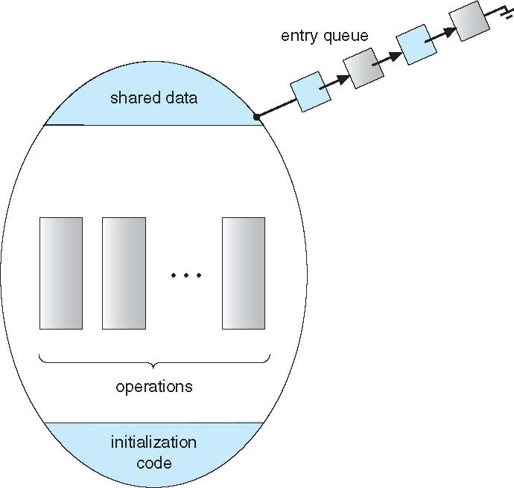
Schematic view of a Monitor

Slide 16
Condition Variables
condition x, y;
Two operations are allowed on a condition variable:
x.wait() – a process that invokes the operation is suspended until x.signal()
x.signal() – resumes one of processes (if any) that invoked x.wait()
If no x.wait() on the variable, then it has no effect on the variable

Slide 17
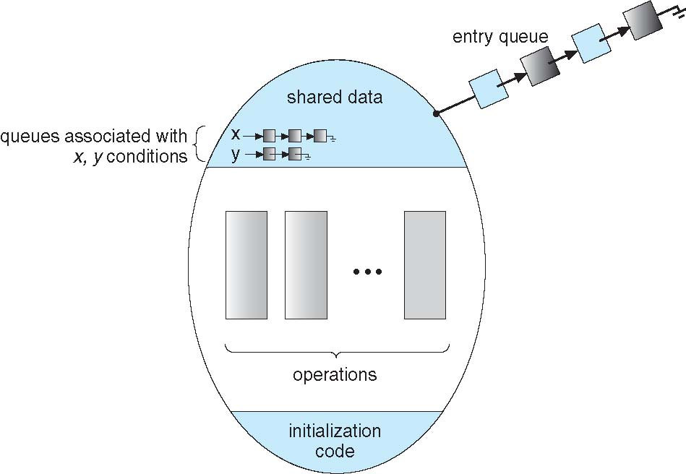
Monitor with Condition Variables

Slide 18
Condition Variables Choices
If process P invokes x.signal(), and process Q is suspended in x.wait(), what should happen next?
Both Q and P cannot execute in parallel. If Q is resumed, then P must wait
Options include
Signal and wait – P waits until Q either leaves the monitor or it waits for another condition
Signal and continue – Q waits until P either leaves the monitor or it waits for another condition
Both have pros and cons – language implementer can decide
Monitors implemented in Concurrent Pascal compromise
P executing signal immediately leaves the monitor, Q is resumed
Implemented in other languages including Mesa, C#, Java

Slide 19
Monitor Implementation Using Semaphores
Variables
semaphore mutex; // (initially = 1)
semaphore next; // (initially = 0)
int next_count = 0;
Each procedure F will be replaced by
wait(mutex);
…
body of F;
…
if (next_count > 0)
signal(next)
else
signal(mutex);
Mutual exclusion within a monitor is ensured

Slide 20
Monitor Implementation – Condition Variables
For each condition variable x, we have:
semaphore x_sem; // (initially = 0)
int x_count = 0;
The operation x.wait can be implemented as:
x_count++;
if (next_count > 0)
signal(next);
else
signal(mutex);
wait(x_sem);
x_count--;

Slide 21
Monitor Implementation (Cont.)
The operation x.signal can be implemented as:
if (x_count > 0) {
next_count++;
signal(x_sem);
wait(next);
next_count--;
}

Slide 22
Resuming Processes within a Monitor
If several processes queued on condition x, and x.signal() executed, which should be resumed?
FCFS frequently not adequate
conditional-wait construct of the form x.wait(c)
Where c is priority number
Process with lowest number (highest priority) is scheduled next

Slide 23
Single Resource allocation
Allocate a single resource among competing processes using priority numbers that specify the maximum time a process plans to use the resource
R.acquire(t);
...
access the resurce;
...
R.release;
Where R is an instance of type ResourceAllocator

Slide 24
A Monitor to Allocate Single Resource
monitor ResourceAllocator
{
boolean busy;
condition x;
void acquire(int time) {
if (busy)
x.wait(time);
busy = TRUE;
}
void release() {
busy = FALSE;
x.signal();
}
initialization code() {
busy = FALSE;
}
}

