Slide 1

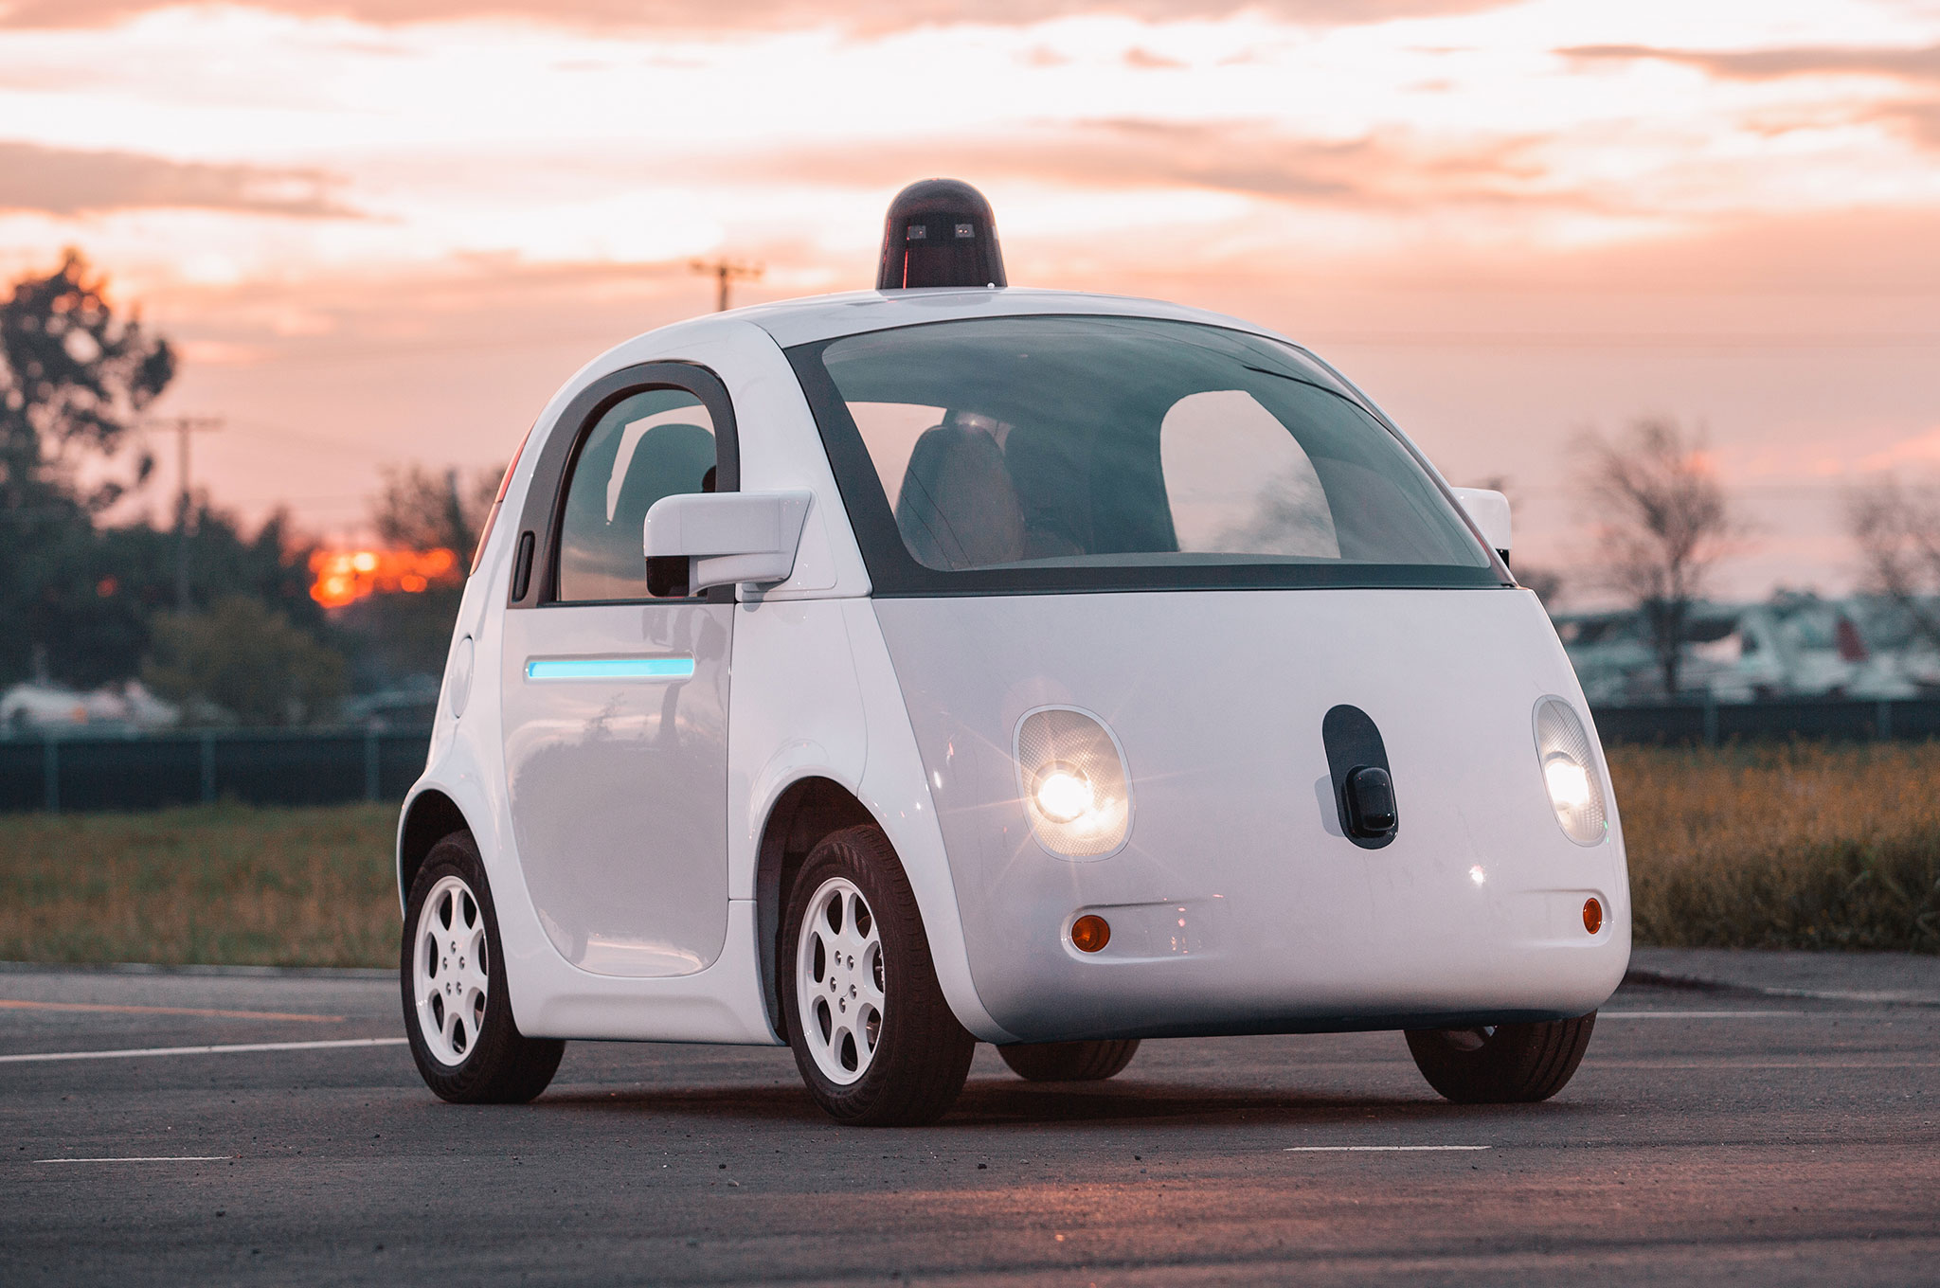



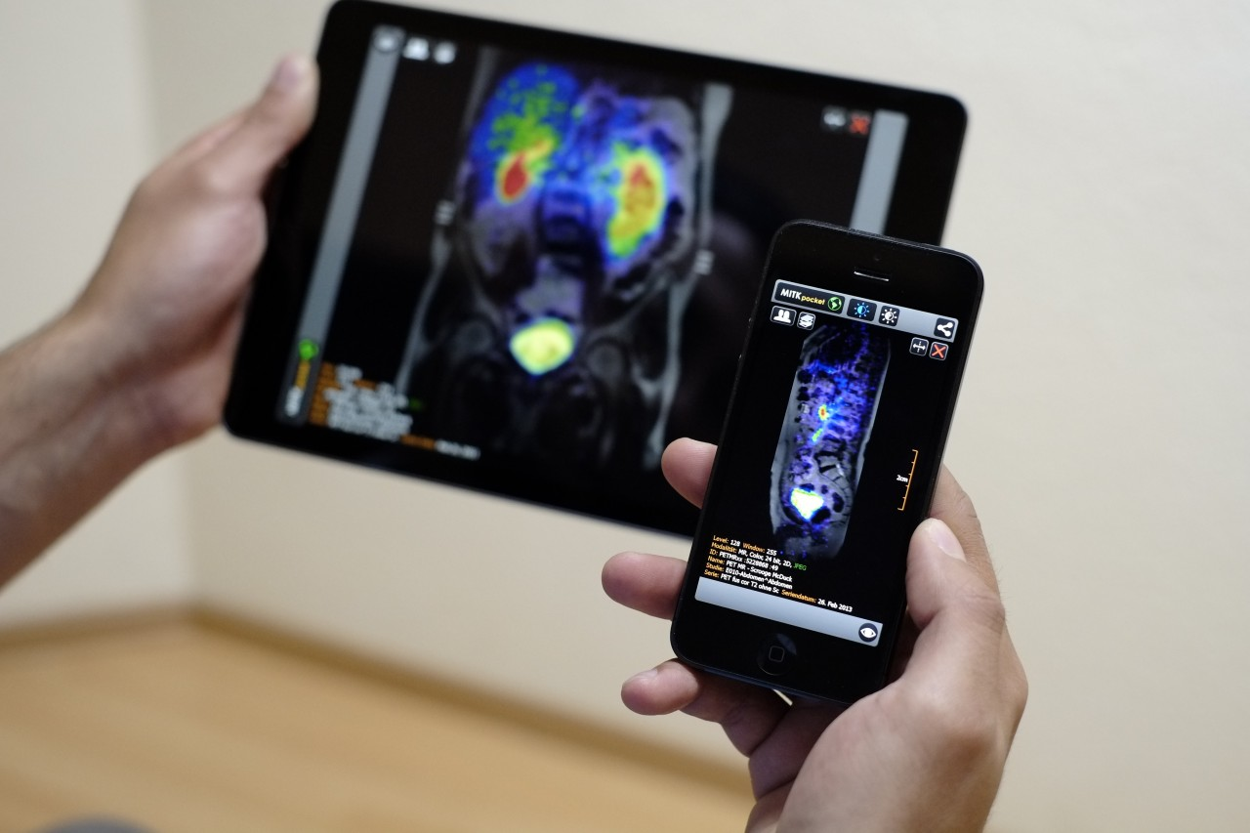
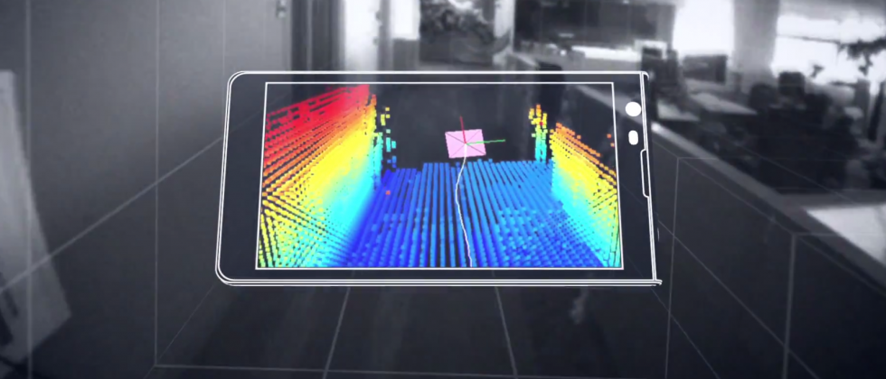
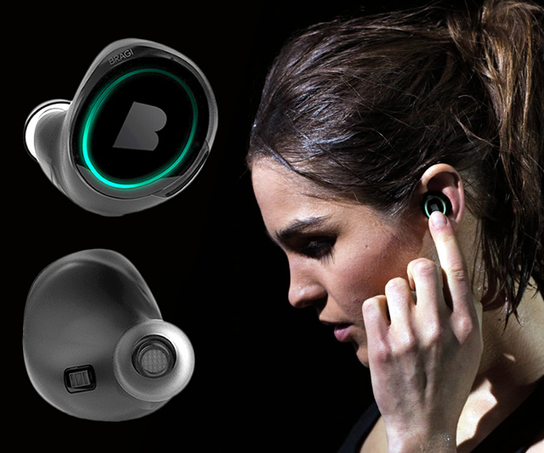
Wireless and Mobile Systems
for the IoT
CMSC 715 : Fall 2022
Lecture 1.3: Mathematical Foundations
for Signal Analysis (Part 2)
Nirupam Roy
Tu-Th 12:30-1:45pm
CSI 3120

Slide 2
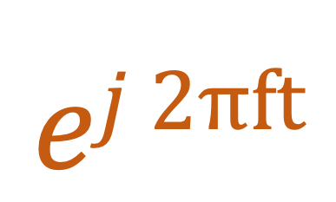
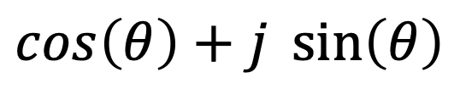


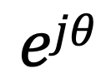
Model for a signal (frequency, amplitude, and phase)
$$ej 2πft$$
$$\cos\left(θ\right)+j \sin\left(θ\right)$$
$$=$$
$$ejθ$$
$$=$$

Slide 3
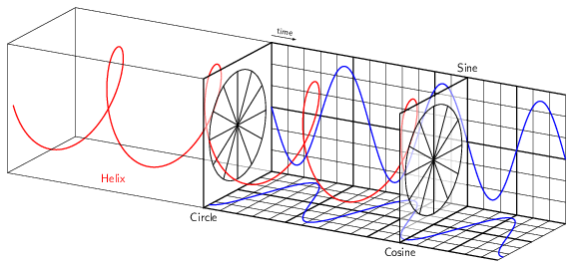
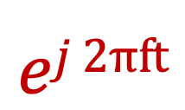
Model for a signal (frequency, amplitude, and phase)
$$ej 2πft$$

Slide 4
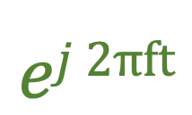
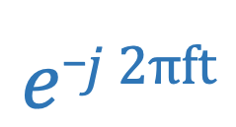
Model for a signal (frequency, amplitude, and phase)
$$ej 2πft$$
$$e_j 2πft$$

Slide 5
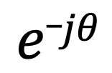

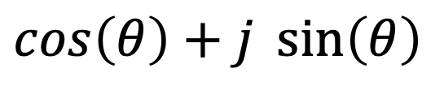
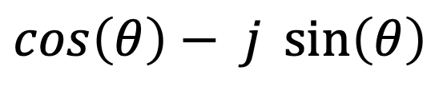
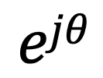
Model for a signal (frequency, amplitude, and phase)
$$ejθ$$
$$=$$
$$\cos\left(θ\right)+j \sin\left(θ\right)$$
$$e_jθ$$
$$=$$
$$\cos\left(θ\right)− j \sin\left(θ\right)$$

Slide 6




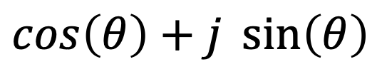

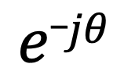
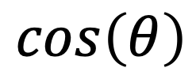

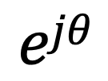
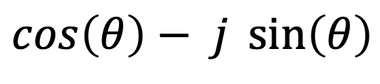
Presenting real signal with the complex model
$$ejθ$$
$$=$$
$$\cos\left(θ\right)+j \sin\left(θ\right)$$
$$e_jθ$$
$$=$$
$$\cos\left(θ\right)− j \sin\left(θ\right)$$
How about real sinusoids?
$$\cos\left(θ\right)$$
$$=$$
$$?$$
$$\sin\left(θ\right)$$
$$=$$
$$?$$

Slide 7

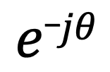
Presenting real signal with the complex model
$$ejθ$$
$$=$$
$$\cos\left(θ\right)+j \sin\left(θ\right)$$
$$e_jθ$$
$$=$$
$$\cos\left(θ\right)− j \sin\left(θ\right)$$
How about real sinusoids?
$$ejθ$$
$$+$$
$$e_jθ$$
$$\cos\left(θ\right)$$
$$=$$
2
$$\sin\left(θ\right)$$
$$=$$
$$?$$

Slide 8
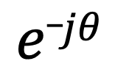
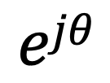

Presenting real signal with the complex model
$$ejθ$$
$$=$$
$$\cos\left(θ\right)+j \sin\left(θ\right)$$
$$e_jθ$$
$$=$$
$$\cos\left(θ\right)− j \sin\left(θ\right)$$
How about real sinusoids?
$$ejθ$$
$$+$$
$$e_jθ$$
$$\cos\left(θ\right)$$
$$=$$
2
$$ejθ$$
$$−$$
$$e_jθ$$
$$\sin\left(θ\right)$$
$$=$$
2j

Slide 9
Presenting real signal with the complex model

Slide 10


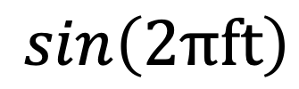
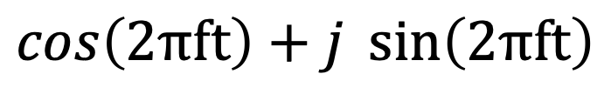




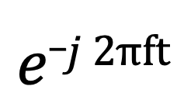
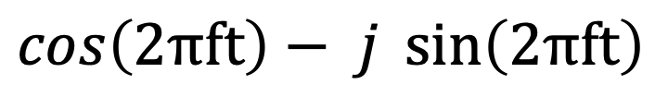
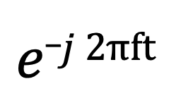
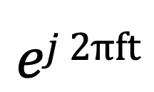
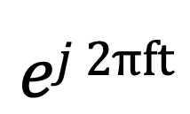
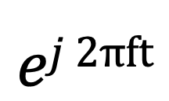
Presenting real signal with the complex model
$$ej 2πft$$
$$=$$
$$\cos\left(2πft\right)+j \sin\left(2πft\right)$$
$$e_j 2πft$$
$$=$$
$$\cos\left(2πft\right)− j \sin\left(2πft\right)$$
$$ej 2πft$$
$$+$$
$$e_j 2πft$$
$$\cos\left(2πft\right)$$
$$=$$
2
$$ej 2πft$$
$$−$$
$$e_j 2πft$$
$$\sin\left(2πft\right)$$
$$=$$
2j

Slide 11
Time Domain and Frequency Domain
Fourier Transform
FFT
Amplitude
Amplitude
IFFT
0.00
0.25
0.50
0
2
4
6
8
Time
Frequency (Hz)
Time domain
Frequency domain
FFT = Fast Fourier Transform
IFFT = Inverse Fast Fourier Transform

Slide 12
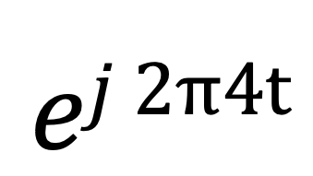
Time Domain and Frequency Domain
Fourier Transform
$$ej 2π4t$$
FFT
Amplitude
0
2
4
6
8
Frequency (Hz)
Time domain
Frequency domain
FFT = Fast Fourier Transform
IFFT = Inverse Fast Fourier Transform

Slide 13

Time Domain and Frequency Domain
Fourier Transform
FFT
?
$$\cos\left(2π4t\right)$$
Amplitude
0
2
4
6
8
Frequency (Hz)
Time domain
Frequency domain
FFT = Fast Fourier Transform
IFFT = Inverse Fast Fourier Transform

Slide 14




Time Domain and Frequency Domain
Fourier Transform
FFT
?
$$\cos\left(2π4t\right)$$
Amplitude
$$ej 2π4t$$
$$+$$
$$e_j 2π4t$$
$$=$$
2
0
2
4
6
8
Frequency (Hz)
Time domain
Frequency domain
FFT = Fast Fourier Transform
IFFT = Inverse Fast Fourier Transform

Slide 15
Time Domain and Frequency Domain
Fourier Transform
FFT
$$\cos\left(2π4t\right)$$
Amplitude
$$ej 2π4t$$
$$+$$
$$e_j 2π4t$$
$$=$$
2
-6
-4
-2
0
2
4
6
8
Frequency (Hz)
Time domain
Frequency domain
FFT = Fast Fourier Transform
IFFT = Inverse Fast Fourier Transform

Slide 16

Time Domain and Frequency Domain
Fourier Transform
FFT
$$\cos\left(2π4t\right)$$
Amplitude
$$ej 2π4t$$
$$+$$
$$e_j 2π4t$$
$$=$$
2
-6
-4
-2
0
2
4
6
8
Frequency (Hz)
Time domain
Frequency domain
FFT = Fast Fourier Transform
IFFT = Inverse Fast Fourier Transform

Slide 17
Matlab demo
function fft_test()
freq = 200;
sampleRate = 1000;
time_ticks = 0:1/sampleRate:1;
realSignal = sin(2*pi*freq*time_ticks);
plot_fft(realSignal, sampleRate);
complexSignal = exp(j*2*pi*freq*time_ticks);
plot_fft(complexSignal, sampleRate);
end

Slide 18
Calculating
Discrete Fourier Transform (DFT)

Slide 19
Discrete Fourier Transform
…
0
1
2
3
4
5
6
N-1
Sample number
X = [ ]
x[0], x[1], x[2], x[3], x[4], … x[N-1]

Slide 20
Discrete Fourier Transform
…
0
1
2
3
4
5
6
N-1
Sample number
X = [ ]
x[0], x[1], x[2], x[3], x[4], … x[N-1]

Slide 21





Discrete Fourier Transform
…
0
1
2
3
4
5
6
N-1
Sample number
$$e^{j2.\frac{2π}{N}}$$
$$e^{j1.\frac{2π}{N}}$$
$$\frac{2π}{N}$$
$$e^{j0.\frac{2π}{N}}$$
$$e^{j(N−1).\frac{2π}{N}}$$

Slide 22



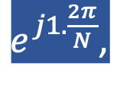
Discrete Fourier Transform
…
0
1
2
3
4
5
6
N-1
Sample number
= [ ]
Freq f₁
$$e^{j0.\frac{2π}{N}},$$
$e^{j1.\frac{2π}{N}}$,
$$e^{j2.\frac{2π}{N}},$$
…
$${,e}^{j(N−1).\frac{2π}{N}}$$
$$e^{j2.\frac{2π}{N}}$$
$$e^{j1.\frac{2π}{N}}$$
$$\frac{2π}{N}$$
$$e^{j0.\frac{2π}{N}}$$
$$e^{j(N−1).\frac{2π}{N}}$$

Slide 23

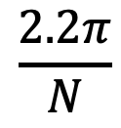


Discrete Fourier Transform
…
0
1
2
3
4
5
6
N-1
Sample number
$$e^{j1.\frac{2.2π}{N}}$$
$$\frac{2.2π}{N}$$
$$e^{j0.\frac{2.2π}{N}}$$
$$e^{j(N−1).\frac{2.2π}{N}}$$

Slide 24

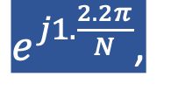


Discrete Fourier Transform
…
0
1
2
3
4
5
6
N-1
Sample number
= [ ]
Freq f₂
$$e^{j0.\frac{2.2π}{N}},$$
$e^{j1.\frac{2.2π}{N}}$,
$$e^{j2.\frac{2.2π}{N}},$$
…
$${,e}^{j(N−1).\frac{2.2π}{N}}$$
$$e^{j1.\frac{2.2π}{N}}$$
$$\frac{2.2π}{N}$$
$$e^{j0.\frac{2.2π}{N}}$$
$$e^{j(N−1).\frac{2.2π}{N}}$$

Slide 25
Discrete Fourier Transform
…
0
1
2
3
4
5
6
N-1
Sample number
What is the MINIMUM number of cycles
observable in this model?

Slide 26

Discrete Fourier Transform
…
0
1
2
3
4
5
6
N-1
Sample number
$$0$$

Slide 27



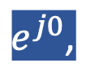
Discrete Fourier Transform
…
0
1
2
3
4
5
6
N-1
Sample number
= [ ]
Freq f₀
$$e^{j0},$$
$e^{j0}$,
$$e^{j0},$$
…
$${,e}^{j0}$$
$$0$$

Slide 28





Discrete Fourier Transform
…
0
1
2
3
4
5
6
N-1
Sample number
= [ ]
Freq f₀
$$e^{j0.\frac{2π}{N}},$$
$e^{j1.\frac{2π}{N}}$,
$$e^{j2.\frac{2π}{N}},$$
…
$${,e}^{j(N−1).\frac{2π}{N}}$$
$$e^{j2.\frac{2π}{N}}$$
$$e^{j1.\frac{2π}{N}}$$
$$\frac{2π}{N}$$
$$e^{j0.\frac{2π}{N}}$$
$$e^{j(N−1).\frac{2π}{N}}$$

Slide 29
Discrete Fourier Transform
…
0
1
2
3
4
5
6
N-1
Sample number
What is the MAXIMUM number of cycles
observable in this model?

Slide 30
Discrete Fourier Transform
…
0
1
2
3
4
5
6
N-1
Sample number
What happens when the ball rotates exactly N times?
$$0$$
We can uniquely observe up to (N-1) number of cycles.

Slide 31


Discrete Fourier Transform
Freq f₀
n=0
$$e^{j0}$$
n=1
$$e^{j0}$$
n=2
$$e^{j0}$$
…
…
n=N-1
$$e^{j0}$$

Slide 32
Discrete Fourier Transform
Number of cycles
…
…
Freq f₀
Freq f₁
Freq f_{m}
Freq f_{N-1}
n=0
$$e^{j0}$$
n=1
$$e^{j0}$$
Sample number
n=2
$$e^{j0}$$
…
…
n=N-1
$$e^{j0}$$

Slide 33












Discrete Fourier Transform
Number of cycles
…
…
Freq f₀
Freq f₁
Freq f_{m}
Freq f_{N-1}
n=0
$$e^{j0}$$
$$e^{j0.\frac{2π}{N}}$$
$$e^{j0.\frac{m.2π}{N}}$$
$$e^{j0.\frac{(N−1).2π}{N}}$$
n=1
$$e^{j0}$$
$$e^{j1.\frac{2π}{N}}$$
$$e^{j1.\frac{m.2π}{N}}$$
$$e^{j1.\frac{(N−1).2π}{N}}$$
Sample number
…
…
$$e^{j2.\frac{(N−1).2π}{N}}$$
$$e^{j2.\frac{2π}{N}}$$
$$e^{j2.\frac{m.2π}{N}}$$
n=2
$$e^{j0}$$
…
…
…
…
…
$$e^{j(N−1).\frac{2π}{N}}$$
$$e^{j(N−1).\frac{m.2π}{N}}$$
$$e^{j(N−1).\frac{(N−1).2π}{N}}$$
n=N-1
$$e^{j0}$$

Slide 34














Discrete Fourier Transform
$$e^{j0}$$
$$e^{j0.\frac{2π}{N}}$$
$$e^{j0.\frac{m.2π}{N}}$$
$$e^{j0.\frac{(N−1).2π}{N}}$$
$$e^{j0}$$
$$e^{j1.\frac{2π}{N}}$$
$$e^{j1.\frac{m.2π}{N}}$$
$$e^{j1.\frac{(N−1).2π}{N}}$$
+
$$e^{j2.\frac{2π}{N}}$$
+
$$e^{j2.\frac{m.2π}{N}}$$
+
$$e^{j2.\frac{(N−1).2π}{N}}$$
Z₀
$$e^{j0}$$
Z₁
…
Z_{m}
…
Z_{N-1}
…
…
…
…
$$e^{j(N−1).\frac{2π}{N}}$$
$$e^{j(N−1).\frac{m.2π}{N}}$$
$$e^{j(N−1).\frac{(N−1).2π}{N}}$$
$$e^{j0}$$

Slide 35














Discrete Fourier Transform
$$e^{j0}$$
$$e^{j0.\frac{2π}{N}}$$
$$e^{j0.\frac{m.2π}{N}}$$
$$e^{j0.\frac{(N−1).2π}{N}}$$
$$e^{j0}$$
$$e^{j1.\frac{2π}{N}}$$
$$e^{j1.\frac{m.2π}{N}}$$
$$e^{j1.\frac{(N−1).2π}{N}}$$
+
$$e^{j2.\frac{2π}{N}}$$
+
$$e^{j2.\frac{m.2π}{N}}$$
+
$$e^{j2.\frac{(N−1).2π}{N}}$$
Z₀
$$e^{j0}$$
Z₁
…
Z_{m}
…
Z_{N-1}
…
…
…
…
$$e^{j(N−1).\frac{2π}{N}}$$
$$e^{j(N−1).\frac{m.2π}{N}}$$
$$e^{j(N−1).\frac{(N−1).2π}{N}}$$
$$e^{j0}$$

Slide 36
Discrete Fourier Transform
$$e^{j0}$$
$$e^{j0.\frac{2π}{N}}$$
$$e^{j0.\frac{m.2π}{N}}$$
$$e^{j0.\frac{(N−1).2π}{N}}$$
$$e^{j0}$$
$$e^{j1.\frac{2π}{N}}$$
$$e^{j1.\frac{m.2π}{N}}$$
$$e^{j1.\frac{(N−1).2π}{N}}$$
+
$$e^{j2.\frac{2π}{N}}$$
+
$$e^{j2.\frac{m.2π}{N}}$$
+
$$e^{j2.\frac{(N−1).2π}{N}}$$
Z₀
$$e^{j0}$$
Z₁
…
Z_{m}
…
Z_{N-1}
…
…
…
…
$$e^{j(N−1).\frac{2π}{N}}$$
$$e^{j(N−1).\frac{m.2π}{N}}$$
$$e^{j(N−1).\frac{(N−1).2π}{N}}$$
$$e^{j0}$$
=
…
0
1
2
3
4
5
6
N-1
Sample number

Slide 37
Discrete Fourier Transform
Frequency domain coefficients
$$e^{j0}$$
$$e^{j0.\frac{2π}{N}}$$
$$e^{j0.\frac{m.2π}{N}}$$
$$e^{j0.\frac{(N−1).2π}{N}}$$
$$e^{j0}$$
$$e^{j1.\frac{2π}{N}}$$
$$e^{j1.\frac{m.2π}{N}}$$
$$e^{j1.\frac{(N−1).2π}{N}}$$
+
$$e^{j2.\frac{2π}{N}}$$
+
$$e^{j2.\frac{m.2π}{N}}$$
+
$$e^{j2.\frac{(N−1).2π}{N}}$$
Z₀
$$e^{j0}$$
Z₁
…
Z_{m}
…
Z_{N-1}
…
…
…
…
$$e^{j(N−1).\frac{2π}{N}}$$
$$e^{j(N−1).\frac{m.2π}{N}}$$
$$e^{j(N−1).\frac{(N−1).2π}{N}}$$
$$e^{j0}$$
x[0]
x[1]
=
X =
x[2]
Time domain samples
…
x[N-1]

Slide 38
Discrete Fourier Transform
_{F}
…
DFT matrix,
=
f₀
f₁
…
f_{m}
f_{N-1}

Slide 39
Discrete Fourier Transform
_{F}
…
DFT matrix,
=
f₀
f₁
…
f_{m}
f_{N-1}
_{Z}
Z₀
Fourier coefficients,
=
Z₁
…
Z_{m}
…
Z_{N-1}

Slide 40
Discrete Fourier Transform
_{F}
…
DFT matrix,
=
f₀
f₁
…
f_{m}
f_{N-1}
_{Z}
Z₀
x[0]
X =
Fourier coefficients,
=
Z₁
Time series,
…
x[1]
Z_{m}
x[2]
…
…
Z_{N-1}
x[N-1]

Slide 41
Discrete Fourier Transform
_{X}
_{F}
_{Z}
=
_{X}
_{Z}
_{F}⁻¹
=
_{H}
_{X}
_{Z}
_{F}
=

Slide 42
Discrete Fourier Transform
_{X}
_{F}
_{Z}
=
_{X}
_{Z}
_{F}⁻¹
=
_{H}
_{X}
_{Z}
_{F}
=
*
f₀
*
f₁
…
*
f_{m}
…
*
f_{N-1}

Slide 43
Discrete Fourier Transform
_{X}
_{F}
_{Z}
=
IDFT
_{X}
_{Z}
_{F}⁻¹
=
DFT
_{H}
_{X}
_{Z}
_{F}
=
*
f₀
x[0]
Z₀
*
Z₁
f₁
x[1]
…
=
…
*
x[2]
Z_{m}
f_{m}
…
…
…
Z_{N-1}
*
x[N-1]
f_{N-1}

Slide 44
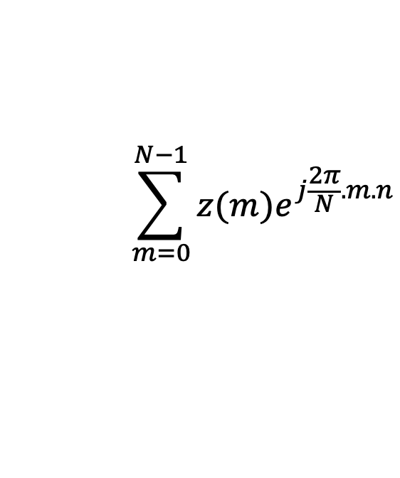
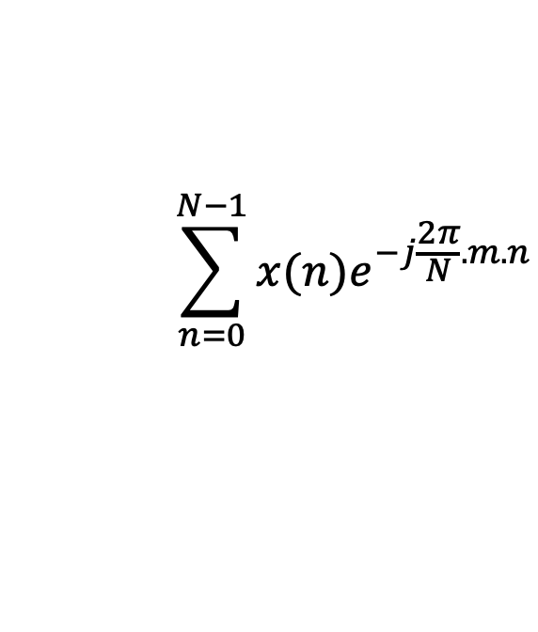
Discrete Fourier Transform
$$\sum_{n=0}^{N−1}{x(n)e^{−j\frac{2π}{N}.m.n}}$$
DFT:
z(m) =
$$\sum_{m=0}^{N−1}{z(m)e^{j\frac{2π}{N}.m.n}}$$
IDFT:
x(n) =

Slide 45
Preserving energy in time and frequency domain

Slide 46
Preserving energy in time and frequency domain
Is IDFT( DFT(x) ) = x ?

Slide 47

Preserving energy in time and frequency domain
Is IDFT( DFT(x) ) = x ?
*
_{X ?}
_{X}
_{F F}
=
*
_{N.X}
_{X}
_{F F}
=
_{F}
$$\frac{1}{\sqrt{N}}$$
…
DFT matrix,
=
f₀
f₁
…
f_{m}
f_{N-1}

Slide 48
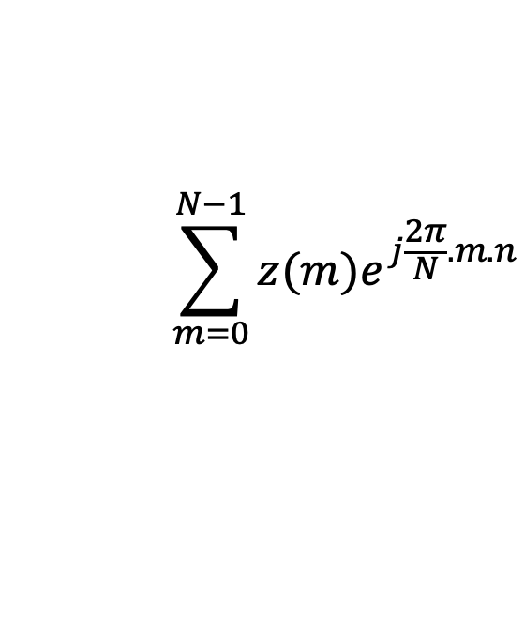
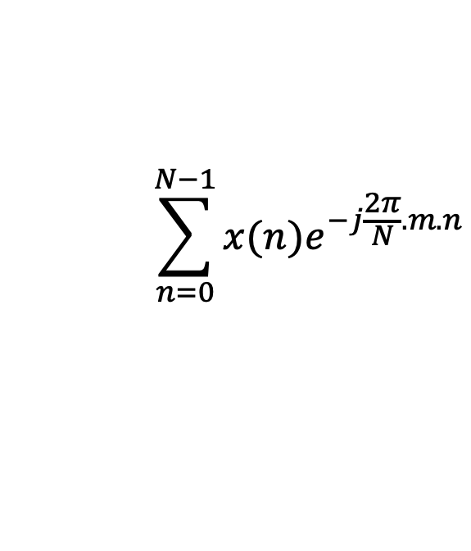


Discrete Fourier Transform
$$\sum_{n=0}^{N−1}{x(n)e^{−j\frac{2π}{N}.m.n}}$$
z(m) =
$$\frac{1}{\sqrt{N}}$$
DFT:
$$\sum_{m=0}^{N−1}{z(m)e^{j\frac{2π}{N}.m.n}}$$
x(n) =
$$\frac{1}{\sqrt{N}}$$
IDFT:

Slide 49
Plotting
DFT spectrum

Slide 50
Plotting the DFT spectrum
Magnitude
|z_{m}|
m = 0
1
2
3
4
…
Frequency
N-2
N-1

Slide 51
Plotting the DFT spectrum
Magnitude
|z_{m}|
m = 0
1
2
3
4
…
Frequency
N-2
N-1
Phase
⦨ z_{m}
m = 0
1
2
3
4
…
Frequency
N-2
N-1

Slide 52

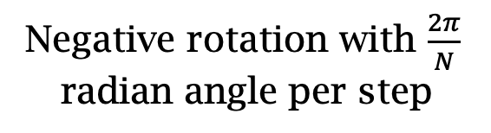

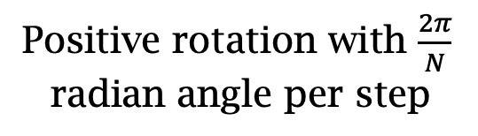
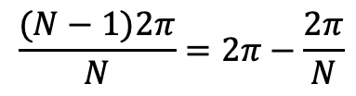
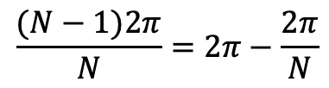
The Curious Case of “Negative frequency”
$$\frac{(N−1)2π}{N}=2π−\frac{2π}{N}$$
$$\frac{2π}{N}$$
$$\frac{2π}{N}$$
$$\frac{(N−1)2π}{N}=2π−\frac{2π}{N}$$
Positive rotation with $\frac{2π}{N}$ radian angle per step
Negative rotation with $\frac{2π}{N}$ radian angle per step

Slide 53
The Curious Case of “Negative frequency”
m = 0
1
2
3
4
…
Frequency
N-2
N-1
+
+
+
-
-
-

Slide 54
The Curious Case of “Negative frequency”
-4
-3
-2
-1
m = 0
1
2
3
4
Frequency

Slide 55
The Curious Case of “Negative frequency”
Magnitude
|z_{m}|
-4
-3
-2
-1
m = 0
1
2
3
4
Frequency
Real signal’s magnitude spectrum is symmetric.
Why?

Slide 56
The Curious Case of “Negative frequency”
Magnitude
|z_{m}|
-4
-3
-2
-1
m = 0
1
2
3
4
Frequency
Complex signal’s magnitude spectrum may or may not be symmetric.
Why?

Slide 57
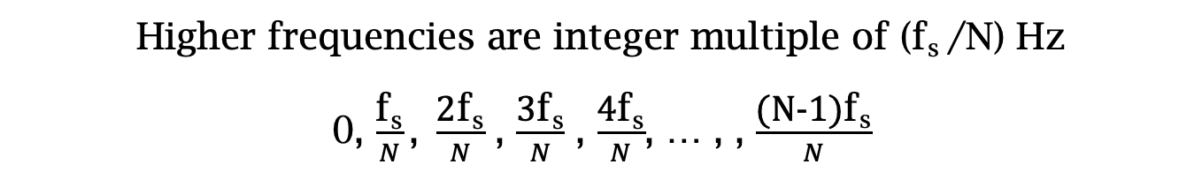
Estimating the real-world frequencies
Sampling frequency = f_{s} (i.e., f_{s} samples per second)
Slowest frequency ($\frac{2π}{N}$ radians per step) = N samples per rotation
= (N/ f_{s}) seconds per rotation
Therefore, the slowest frequency = (f_{s} /N) Hz
Higher frequencies are integer multiple of (f_{s} /N) Hz
0, $\frac{\text{f}\text{s}}{N}\text{, }\frac{\text{2}\text{f}\text{s}}{N}$ , $\frac{\text{3}\text{f}\text{s}}{N}$ , $\frac{\text{4}\text{f}\text{s}}{N}$, … , , $\frac{\text{(}\text{N}\text{−1)}\text{f}\text{s}}{N}$

Slide 58

The resolution and the highest frequency
Magnitude/Phase of z_{m}
-4
-3
-2
-1
m = 0
1
2
3
4
Frequency
Resolution
= minimum observable frequency difference =
$\frac{\text{f}\text{s}}{N}$
What if the actual frequency falls in between two frequency bins?

Slide 59
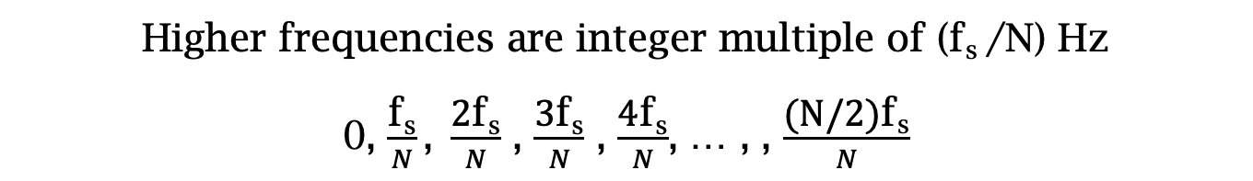
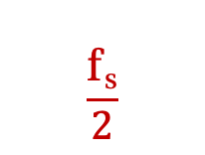

Estimating the real-world frequencies
Sampling frequency = f_{s} (i.e., f_{s} samples per second)
Slowest frequency ($\frac{2π}{N}$ radians per step) = N samples per rotation
= (N/ f_{s}) seconds per rotation
Therefore, the slowest frequency = (f_{s} /N) Hz
Higher frequencies are integer multiple of (f_{s} /N) Hz
0, $\frac{\text{f}\text{s}}{N}\text{, }\frac{\text{2}\text{f}\text{s}}{N}$ , $\frac{\text{3}\text{f}\text{s}}{N}$ , $\frac{\text{4}\text{f}\text{s}}{N}$, … , , $\frac{\text{(}\text{N}\text{/2)}\text{f}\text{s}}{N}$
$$\frac{\text{f}\text{s}}{2}$$
- $\frac{\text{f}\text{s}}{N}\text{, }\text{−}\frac{\text{2}\text{f}\text{s}}{N}$ , - $\frac{\text{3}\text{f}\text{s}}{N}$ , - $\frac{\text{4}\text{f}\text{s}}{N}$, … , , - $\frac{\text{(}\text{N}\text{/2)}\text{f}\text{s}}{N}$

Slide 60
The resolution and the highest frequency
Magnitude/Phase of z_{m}
-4
-3
-2
-1
m = 0
1
2
3
4
Frequency
Resolution
= minimum observable frequency difference =
$\frac{\text{f}\text{s}}{N}$
What if the actual frequency falls in between two frequency bins?

Slide 61
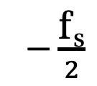
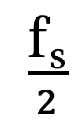
The resolution and the highest frequency
Magnitude/Phase of z_{m}
-4
-3
-2
-1
m = 0
1
2
3
4
Frequency
$−\frac{\text{f}\text{s}}{2}$
$\frac{\text{f}\text{s}}{2}$
Highest frequency =

Slide 62
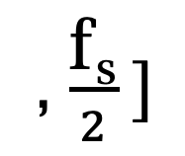



The resolution and the highest frequency
How can we increase the resolution?
$$\frac{\text{f}\text{s}}{N}$$
= $\frac{\text{sample} \text{rate}}{\# of FFT points}$
How can we increase the range of the spectrum?
$[−\frac{\text{f}\text{s}}{2}$
, $\frac{\text{f}\text{s}}{2} ]$

Slide 63
Time resolution v/s Frequency resolution

Slide 64



Time resolution v/s Frequency resolution
U
M
D
[
[
DFT
DFT
$$\frac{\text{f}\text{s}}{N}$$
= $\frac{\text{sample} \text{rate}}{\# of FFT points}$
How can we increase the frequency resolution?
How can we increase the time resolution?

Slide 65
Aliasing

Slide 66
Sampling theorem
Amplitude
Time (sec)
0.00
0.25
0.50
0.75
1.00
1.25
Amplitude
Time (sec)
0.00
0.25
0.50
0.75
1.00
1.25
Aliasing: Two signals become indistinguishable after sampling

Slide 67
Time domain samples
Amplitude
Time (sec)
0.00
0.25
0.50
0.75
1.00
1.25
FFT
Amplitude
-6
-4
-2
0
2
4
6
8
Frequency (Hz)
Frequency domain

Slide 68

Aliasing: Different frequencies, same name!!
Magnitude/Phase of z_{m}
-4
-3
-2
-1
m = 0
1
2
3
4
Frequency
Assume, Sample rate $\text{f}\text{s}$ = 8 Hz
For a COMPLEX signal, what value will we see if the actual frequency is:
a) 3 Hz
b) -2 Hz
c) 6 Hz
d) -5 Hz
e) 4 Hz and -4Hz

Slide 69
Magnitude/Phase of z_{m}
-4
-3
-2
-1
m = 0
1
2
3
4
Frequency
5
6
7
8

Slide 70
Magnitude/Phase of z_{m}
-4
-3
-2
-1
m = 0
1
2
3
4
Frequency
5
6
7
8

Slide 71
Magnitude/Phase of z_{m}
-4
-3
-2
-1
m = 0
1
2
3
4
Frequency
0
- F_{s}/4
F_{s}/4
F_{s}/2

Slide 72
Magnitude/Phase of z_{m}
-4
-3
-2
-1
m = 0
1
2
3
4
Frequency
0
-1
1
- 2
2
-3
3
4
-4

Slide 73
Aliasing: Different frequencies, same name!!
Magnitude/Phase of z_{m}
-4
-3
-2
-1
m = 0
1
2
3
4
Frequency
Assume, Sample rate $\text{f}\text{s}$ = 8 Hz
For a COMPLEX signal, what value will we see if the actual frequency is:
a) 3 Hz
b) -2 Hz
c) 6 Hz
d) -5 Hz
e) 4 Hz and -4Hz

Slide 74
Aliasing: Different frequencies, same name!!
Magnitude/Phase of z_{m}
-4
-3
-2
-1
m = 0
1
2
3
4
Frequency
Assume, Sample rate $\text{f}\text{s}$ = 8 Hz
For a REAL signal, what value will we see if the actual frequency is:
a) 3 Hz
b) -2 Hz
c) 6 Hz
d) -5 Hz
e) 4 Hz and -4Hz

Slide 75

Aliasing: Spectrogram of increasing frequency

Slide 76


Calculating the aliased frequency value for real signals
Sampling frequency = 10Hz
Nyquist frequency = 5Hz
Amplitude
0
2
4
6
8
Frequency (Hz)

Slide 77

Calculating the aliased frequency value for real signals
Sampling frequency = 10Hz
Nyquist frequency = 5Hz
Amplitude
Received
signal
Amplitude
0
2
4
6
8
0
2
4
6
8
Frequency (Hz)
Frequency (Hz)

Slide 78
Calculating the aliased frequency value for real signals
Sampling frequency = 10Hz
Nyquist frequency = 5Hz
Amplitude
Received
signal
Amplitude
0
2
4
6
8
0
2
4
6
8
Frequency (Hz)
Frequency (Hz)
f_{s} = Sampling frequency
f = Target frequency
f_{a} = Aliased(perceived) frequency
K = Non-negative integer
f_{a} = min(abs(K*f_{s} - f))

Slide 79
Aliasing: A real life scenario
Nyquist frequency
Amplitude
10k
20k
30k
40k
50k
60k
70k
80k
90k
100k
Frequency spectrum
Notes:
to amplify the signal power …
Now, this signal typically contains many more frequencies than the sampling system can handle …

Slide 80
Aliasing: A real life scenario
Nyquist frequency
Amplitude
10k
20k
30k
40k
50k
60k
70k
80k
90k
100k
Frequency spectrum
Notes:
to amplify the signal power …
Now, this signal typically contains many more frequencies than the sampling system can handle …

Slide 81
Aliasing: A real life scenario
Nyquist frequency
Amplitude
10k
20k
30k
40k
50k
60k
70k
80k
90k
100k
Frequency spectrum
We need a “Low-pass filter”
to remove unwanted high frequency signals
Notes:
to amplify the signal power …
Now, this signal typically contains many more frequencies than the sampling system can handle …

Slide 82
Anti-aliasing filter
Nyquist frequency
Amplitude
10k
20k
30k
40k
50k
60k
70k
80k
90k
100k
Frequency spectrum
Sensor
ADC
Anti-aliasing
Filter
Notes:
to amplify the signal power …
Now, this signal typically contains many more frequencies than the sampling system can handle …

Slide 83
Anti-aliasing filter
Nyquist frequency
Amplitude
10k
20k
30k
40k
50k
60k
70k
80k
90k
100k
Frequency spectrum
Sensor
ADC
Anti-aliasing
Filter
Notes:
Hence, a low pass filter…

Slide 84
Anti-aliasing filter
Anti-aliasing
filter
Amplitude
10k
20k
30k
40k
50k
60k
70k
80k
90k
100k
Frequency spectrum
Sensor
ADC
Anti-aliasing
Filter
Notes:
removes the unwanted frequencies above 24 kHz …
And ultimately, this filtered signal is sampled by an ADC to generate digital sound samples

