Slide 1
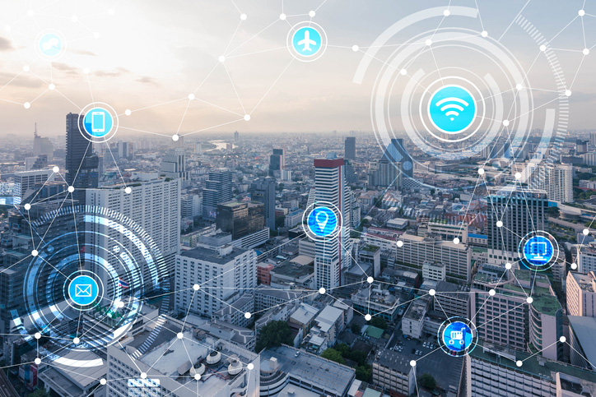
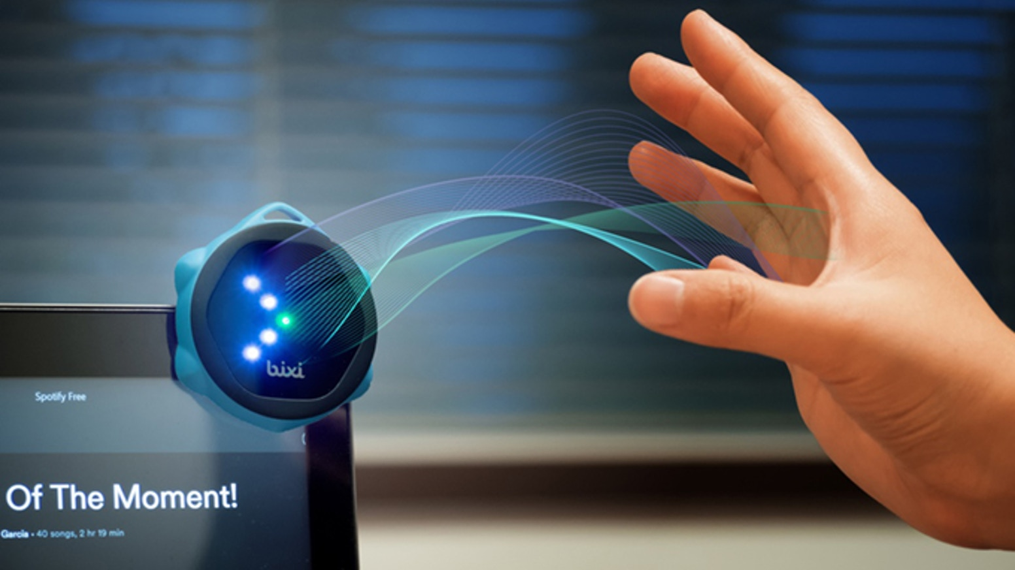
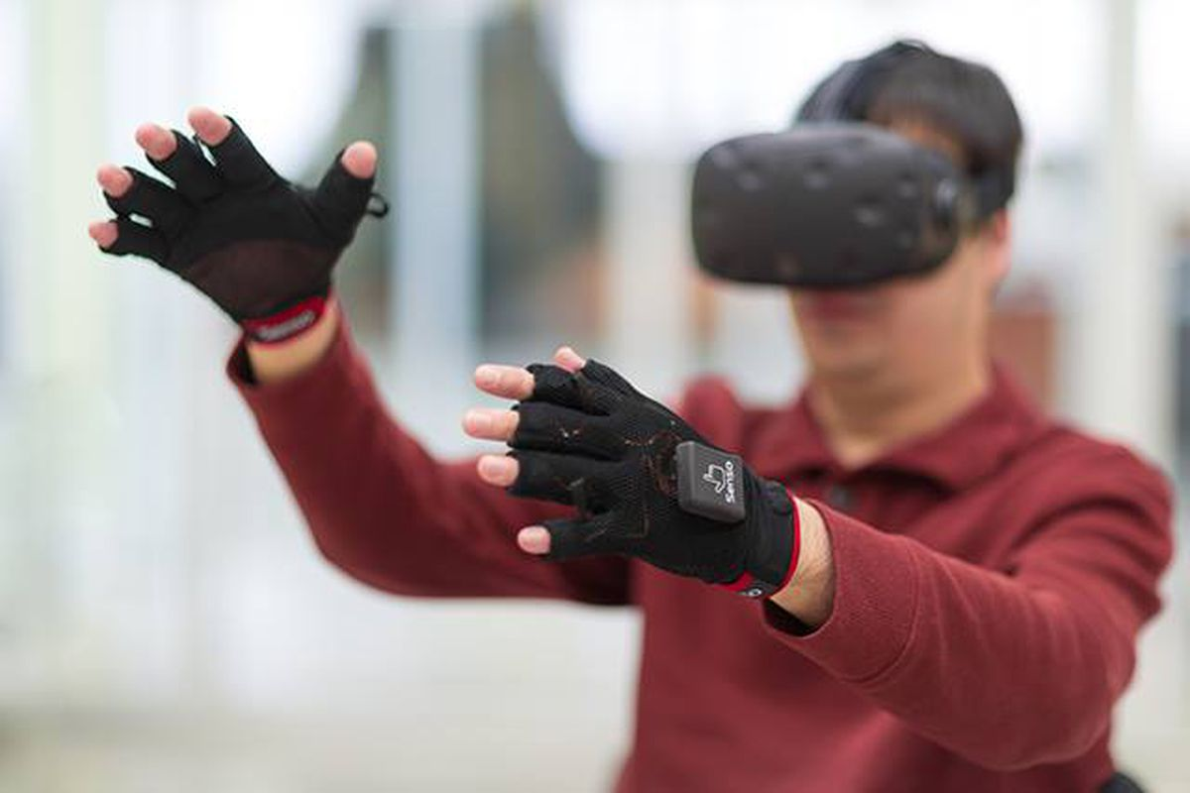
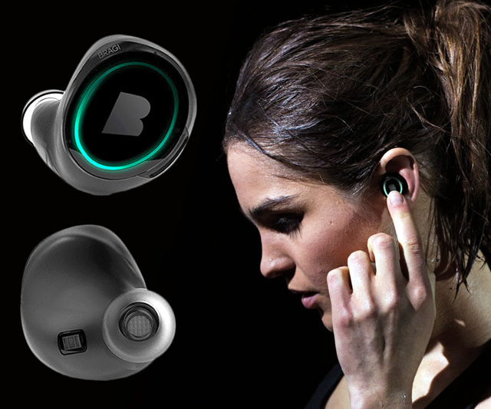
Wireless and Mobile Systems
for the IoT
CMSC 715 : Fall 2023
Lecture 2.1: Wave basics
Nirupam Roy
Tu-Th 12:30-1:45pm
CSI 2107

Slide 2
A few more ideas…
1) Filtering frequencies
1) Filtering frequencies
2) Multiplying frequency with frequency
3) Sampling a band of frequencies

Slide 3
Matlab demo code

Slide 4
A few more ideas…
1) Filtering frequencies
2) Multiplying frequency with frequency
3) Sampling a band of frequencies

Slide 5
Multiplying two frequencies
Magnitude/Phase of z_{m}
-4
-3
-2
-1
m = 0
1
2
3
4
Frequency
Two signals with frequencies f1 and f2 are multiplied:
$$ej 2π f1 t$$
$$ej 2π f2 t$$
$$ej 2πf1 t$$
$$+$$
$$e_j 2πf1t$$
$$ej 2πf2 t$$
$$+$$
$$e_j 2πf2t$$
2
2

Slide 6
Matlab demo code

Slide 7
A few more ideas…
1) Filtering frequencies
2) Multiplying frequency with frequency
3) Sampling a band of frequencies

Slide 8
Sample Rate for a Frequency band
$$e^{j2πf1t}$$
$$e^{j2πf2t}$$
Amplitude
$${× e}^{−j2πf1t}$$
0
2
4
6
0
8
Frequency (kHz)
What should be the sample rate?

Slide 9
Sample Rate for a Frequency band
$${× e}^{−j2πf1t}$$
Amplitude
Frequency
down-conversion
Amplitude
0
2
4
6
8
0
2
4
6
8
Frequency (kHz)
Frequency (kHz)
What should be the sample rate?
Generally, bandwidth of the signal determines the sample rate.

Slide 10
Waves

Slide 11
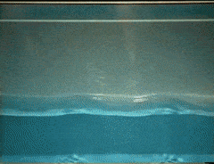
Waves: Transfer of energy, not mass

Slide 12
Sound
Visible light
Physical vibrations
WiFi signal
Ripples in water
Infrared
…
…

Slide 13
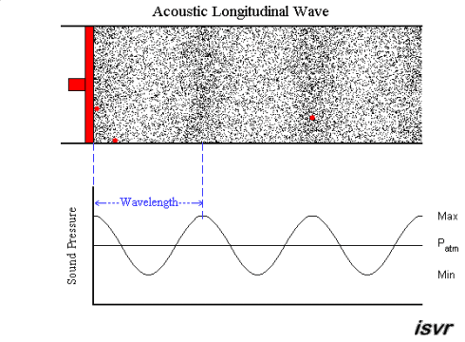
Mechanical Wave
Electromagnetic Wave
Sound
Visible light
Physical vibrations
WiFi signal
Ripples in water
Infrared
…
…

Slide 16
Waves made this possible

Slide 17
Waves made this possible

Slide 18
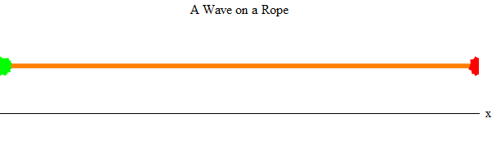
Waves properties:
frequency, amplitude, phase + speed

Slide 19
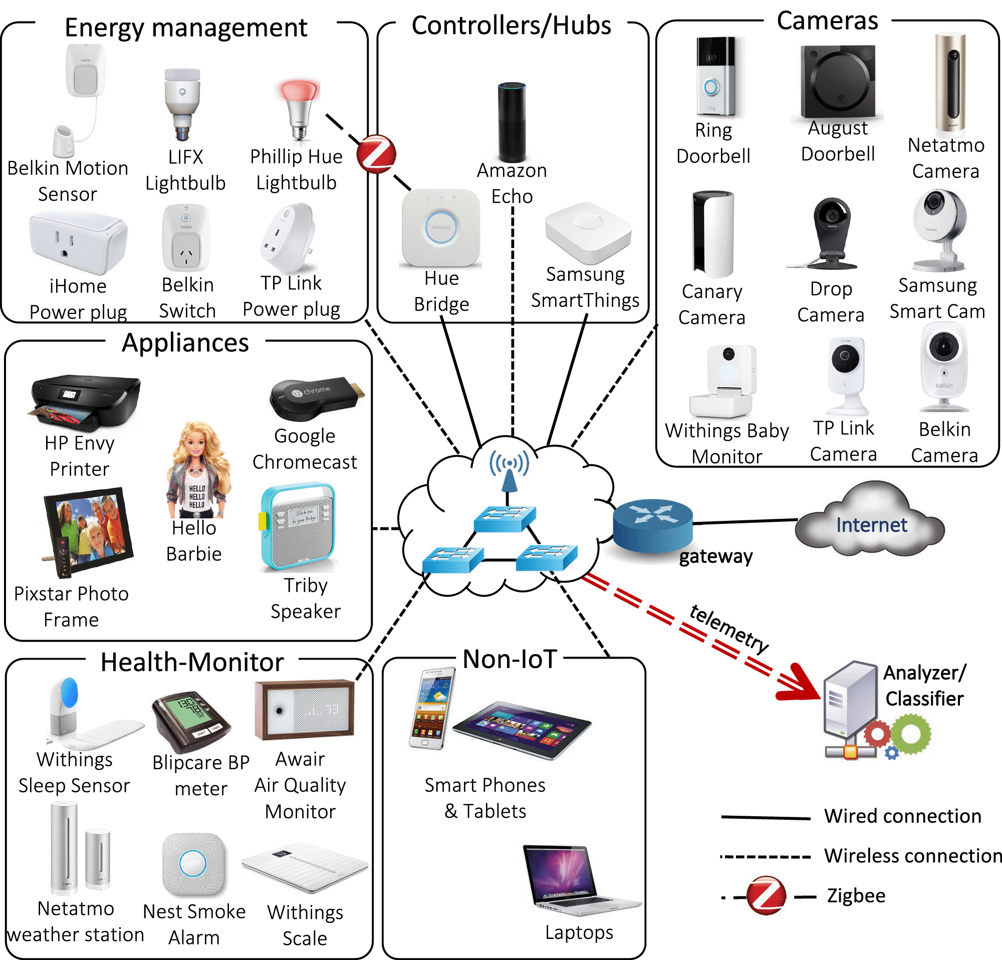
Waves made this possible

Slide 20
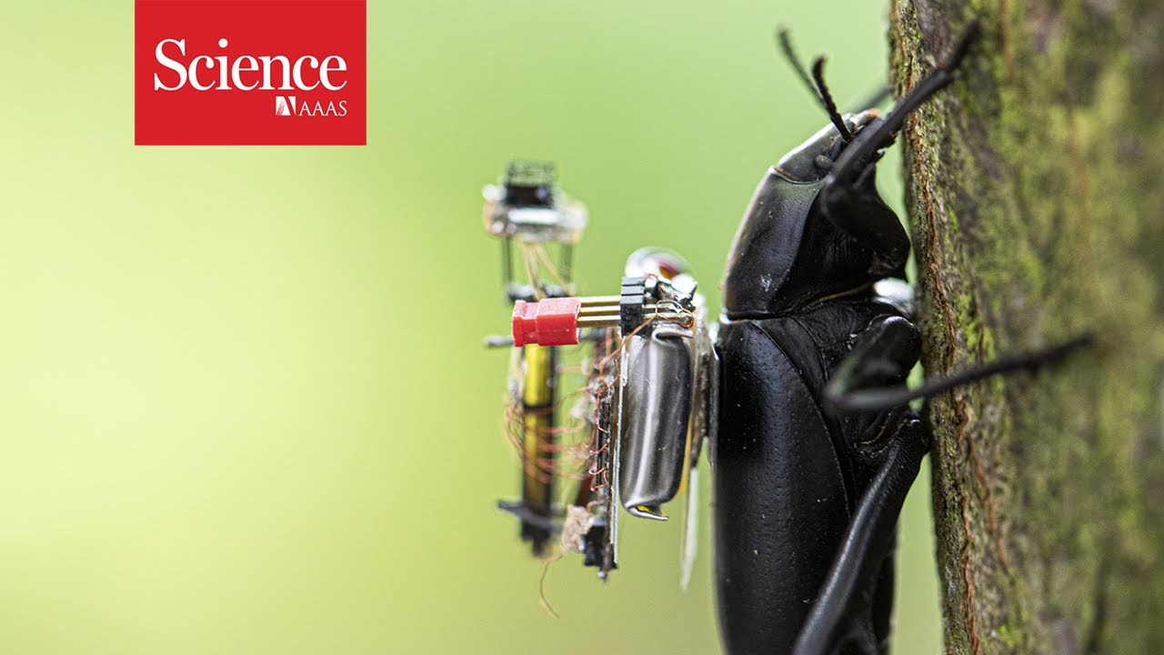
Waves made this possible

Slide 21
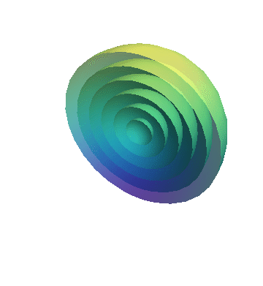
Waves in time and space

Slide 22
Waves in time and space
Temporal variation of the wave’s amplitude

Slide 23
Waves in time and space

Slide 24
Waves in time and space

Slide 25
Waves in time and space

Slide 26
Waves in time and space

Slide 27
Waves in time and space

Slide 28
Waves in time and space

Slide 29
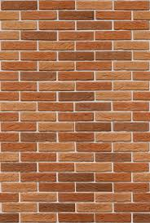
Reflection
Absorption
+
Reflection
echo

Slide 30
Reflection
Time = t1

Slide 31
Reflection
Time = t1
Absorption
+
Reflection

Slide 32
Reflection
Time = t1
Absorption
+
Reflection
echo
t2

Slide 33
Reflection
Time = t1
Absorption
+
Reflection
d
echo
t2
Sound travelled (2d) distance

Slide 34
The speed of the wave is known

Slide 35
Reflection
Time = t1
Absorption
+
Reflection
d
echo
t2
Sound travelled (2d) distance
C.(t2-t1) = 2d

Slide 36
Reflection
Time = t1
Absorption
+
Reflection
d
Echolocation
echo
t2
Sound travelled (2d) distance
C.(t2-t1) = 2d

Slide 37
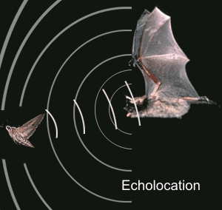
Echolocation in nature
Bat

Slide 38
Estimating distance using waves
Application: Contact tracing

Slide 40
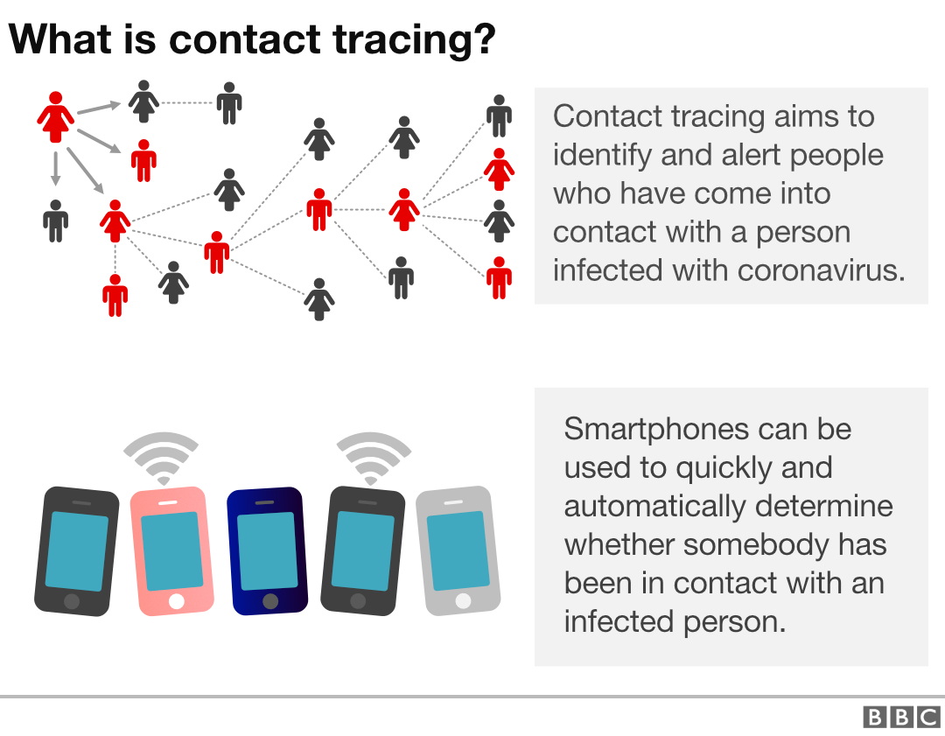
How to find the proximity between two smartphones?

Slide 41
A simple acoustic ranging technique
BeepBeep – SenSys 2007

Slide 42
Distance = d
Device A
Device B

Slide 43
Time = t1
Distance = d
Device A
Device B

Slide 44
Time = t1
Time = t2
Distance = d
Device A
Device B

Slide 45
Bluetooth/WiFi
Time = t1
Time = t1
Time = t2
Distance = d
Device A
Device B

Slide 46
Bluetooth/WiFi
Time = t1
Time = t1
Time = t2
Distance = d
Device A
Device B
d = C . (t2-t1)
C = speed of the wave
= ~340m/s for sound

Slide 47
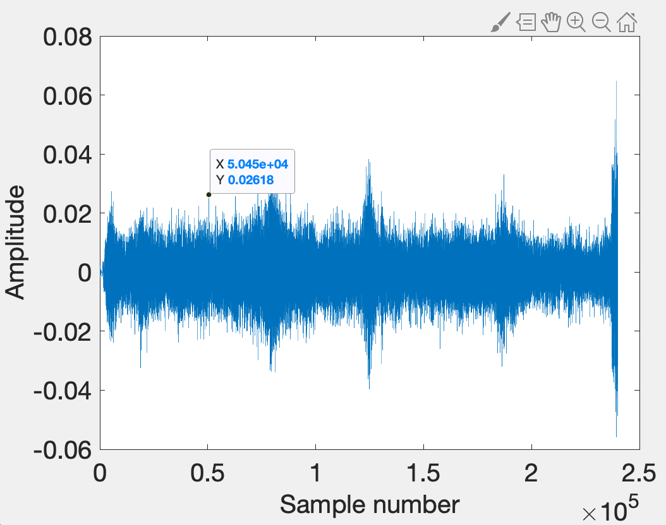
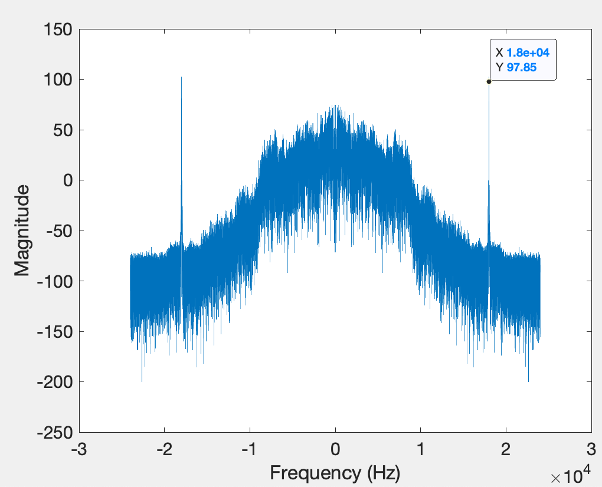
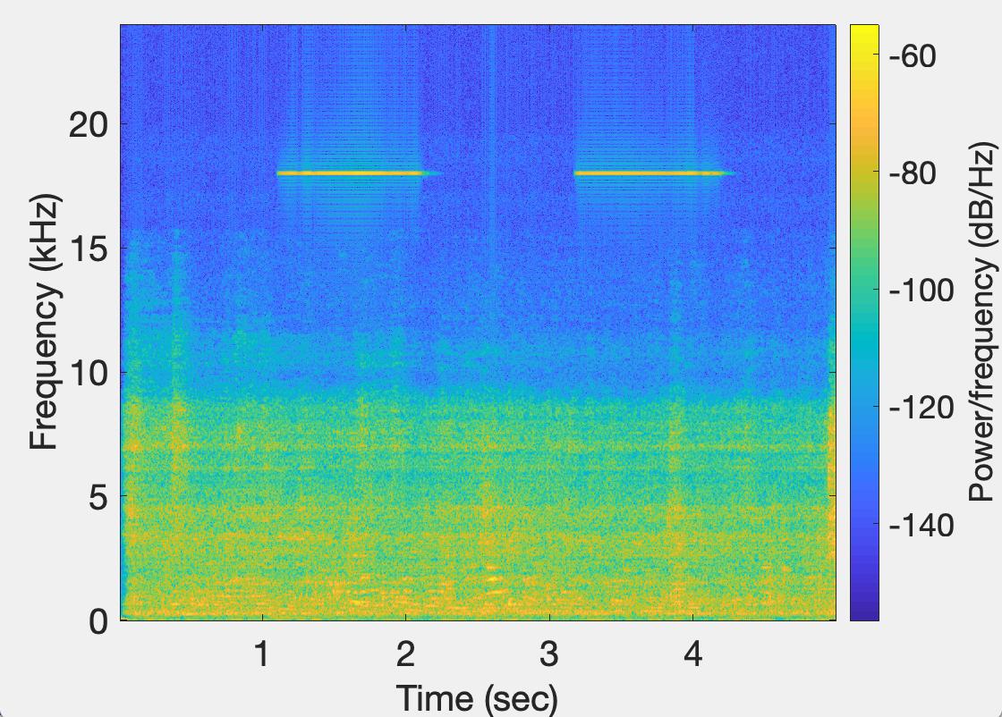
Time domain
signal
FFT Plot
Device A
STFT Plot

Slide 48
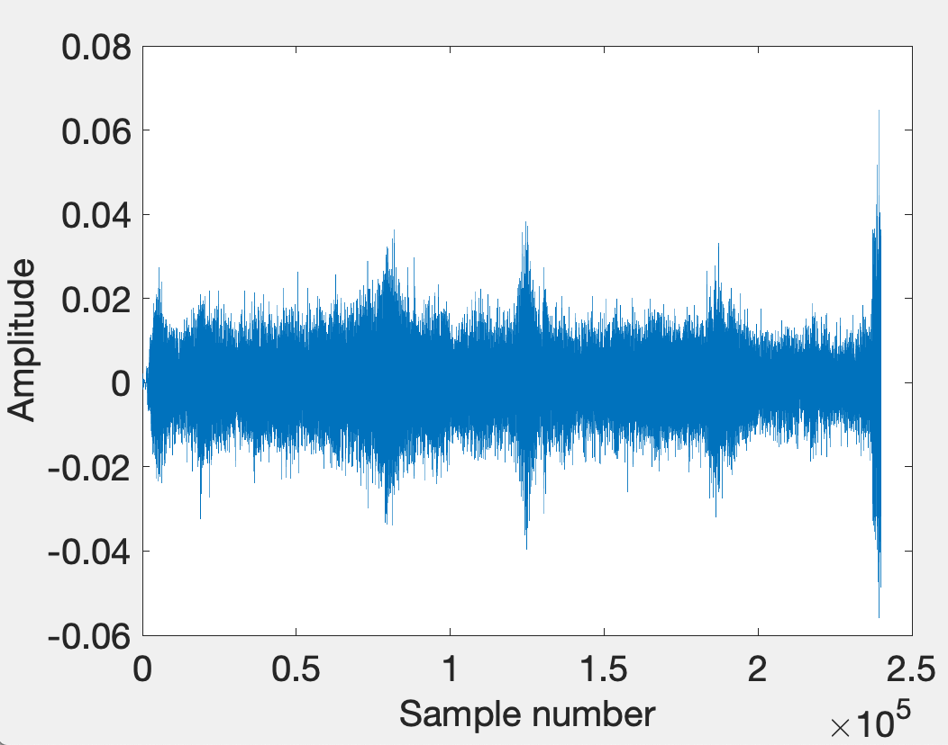
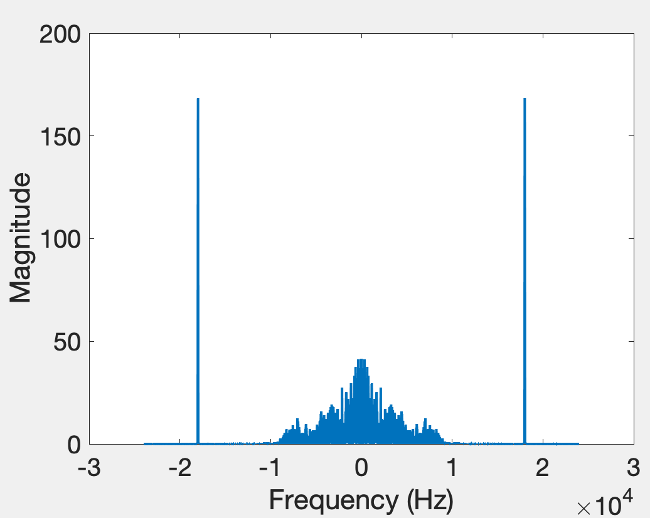
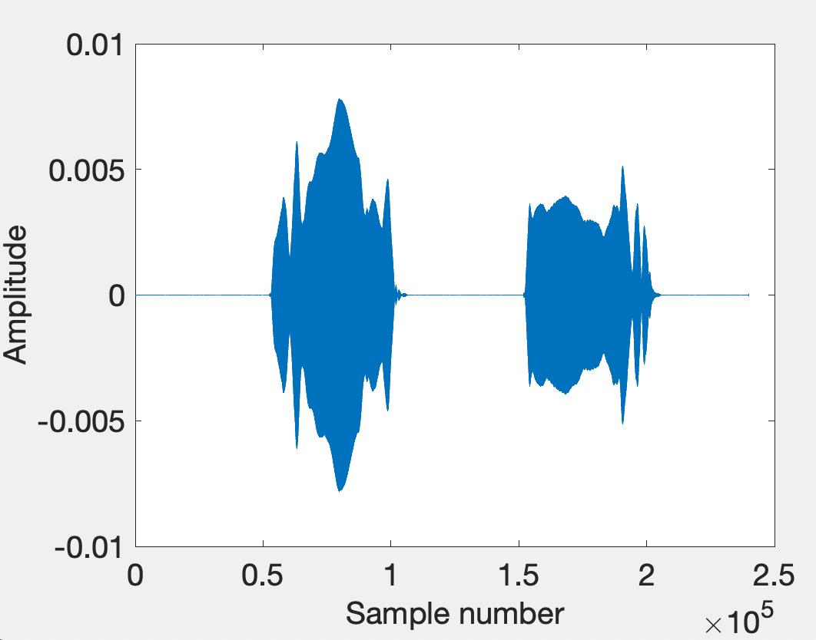
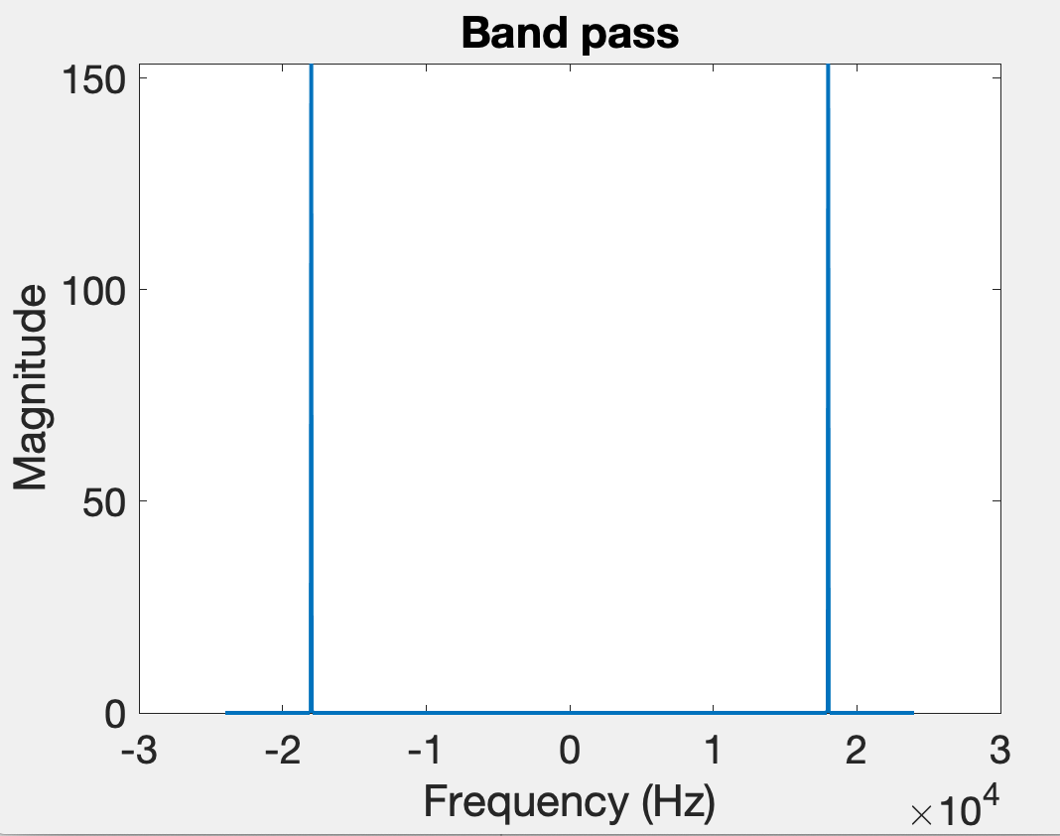
Time domain
Freq. domain
After bandpass filter

Slide 49
Bluetooth/WiFi
Time = t1
Time = t1
Time = t2
Distance = d
Problem: Synchronization
Device A
Device B
d = C . (t2-t1)

Slide 50
The root cause of inaccuracy – three uncertainties
Clock synchronization uncertainty
time

Slide 51
The root cause of inaccuracy – three uncertainties
Clock synchronization uncertainty
Sending uncertainty
time

Slide 52
The root cause of inaccuracy – three uncertainties
Clock synchronization uncertainty
Sending uncertainty
Receiving uncertainty
time

Slide 53
Sound production and recording

Slide 54
Sound recording with microphone
Sound

Slide 55
Sound recording with microphone
Analog signal (voltage)
Sound
ADC
ADC = Analog-to-Digital Converter

Slide 56
Sound recording with microphone
Analog signal (voltage)
Sound
ADC
S6 S5 S4 S3 S2 S1 S0
Audio Sample Buffer
ADC = Analog-to-Digital Converter

Slide 57
Sound production with speaker
S6 S5 S4 S3 S2 S1 S0
Audio Sample Buffer

Slide 58
Sound production with speaker
S6 S5 S4 S3 S2 S1 S0
Analog signal (voltage)
Audio Sample Buffer
DAC
DAC = Digital-to-Analog Converter

Slide 59
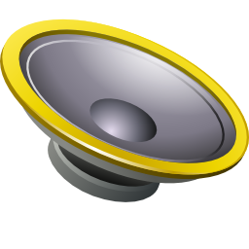
Sound production with speaker
S6 S5 S4 S3 S2 S1 S0
Analog signal (voltage)
Audio Sample Buffer
DAC
Sound
DAC = Digital-to-Analog Converter

Slide 60
The root cause of inaccuracy – three uncertainties
Clock synchronization uncertainty
Sending uncertainty
software issuing command
...
t0 = wall_clock();
write(sound_dev, signal);
...
time

Slide 61
The root cause of inaccuracy – three uncertainties
Clock synchronization uncertainty
Sending uncertainty
software issuing command
...
t0 = wall_clock();
write(sound_dev, signal);
...
unknown delays (software, system, driver, hardware, …) ?
sound leaves
speaker
time

Slide 62
The root cause of inaccuracy – three uncertainties
Clock synchronization uncertainty
Sending uncertainty
Receiving uncertainty
software issuing command
...
t0 = wall_clock();
write(sound_dev, signal);
...
unknown delays (software, system, driver, hardware, …) ?
sound leaves
speaker
time

Slide 63
The root cause of inaccuracy – three uncertainties
Clock synchronization uncertainty
Sending uncertainty
Receiving uncertainty
software issuing command
...
t0 = wall_clock();
write(sound_dev, signal);
...
unknown delays (software, system, driver, hardware, …) ?
sound leaves
speaker
sound
reaches mic
time

Slide 64
The root cause of inaccuracy – three uncertainties
Clock synchronization uncertainty
Sending uncertainty
Receiving uncertainty
software issuing command
...
t0 = wall_clock();
write(sound_dev, signal);
...
unknown delays (software, system, driver, hardware, …) ?
sound leaves
speaker
sound
reaches mic
unknown delays (hardware, interrupt, driver, scheduling, …) ?
time

Slide 65
The root cause of inaccuracy – three uncertainties
Clock synchronization uncertainty
Sending uncertainty
Receiving uncertainty
software issuing command
software aware of arrival
...
t0 = wall_clock();
write(sound_dev, signal);
...
...
read(sound_dev, signal);
t1 = wall_clock();
...
unknown delays (software, system, driver, hardware, …) ?
sound leaves
speaker
sound
reaches mic
unknown delays (hardware, interrupt, driver, scheduling, …) ?
time

Slide 66
Beepbeep’s basic procedure
Device A emits a beep while both recording
Device B emits another beep while both continue recording
Both devices detect TOA of the two beeps and obtain respective ETOAs
Exchange ETOAs and calculate the distance
Device A
Device B
A’s recording
B’s recording
ETOA_{A}
ETOA_{B}
D_{AB}=|ETOA_{A}-ETOA_{B}|/2

Slide 67
Timeline
Device A
Device B

Slide 68
Timeline
Device A
Device B
1st Beep
t_{A0}

Slide 69
Timeline
Device A
Device B
1st Beep
t_{A0}
t_{A1}
t_{B1}

Slide 70
Timeline
Device A
Device B
1st Beep
t_{A0}
t_{A1}
t_{B1}
2nd Beep
t_{B2}

Slide 71
Timeline
Device A
Device B
1st Beep
t_{A0}
t_{A1}
t_{B1}
2nd Beep
t_{B2}
t_{B3}
t_{A3}

Slide 72
Timeline
Device A
Device B
1st Beep
t_{A0}
t_{A1}
t_{B1}
ETOA_{A}
2nd Beep
t_{B2}
t_{B3}
t_{A3}

Slide 73
Timeline
Device A
Device B
1st Beep
t_{A0}
t_{A1}
t_{B1}
ETOA_{B}
ETOA_{A}
2nd Beep
t_{B2}
t_{B3}
t_{A3}

Slide 74
Timeline
Device A
Device B
1st Beep
t_{A0}
t_{A1}
P
t_{B1}
ETOA_{B}
ETOA_{A}
2nd Beep
t_{B2}
t_{B3}
t_{A3}

Slide 75
Timeline
Device A
Device B
1st Beep
t_{A0}
t_{A1}
P
t_{B1}
ETOA_{B}
ETOA_{A}
2nd Beep
t_{B2}
t_{B3}
P
t_{A3}

Slide 76
Timeline
Device A
Device B
1st Beep
t_{A0}
t_{A1}
P
t_{B1}
ETOA_{B}
Q
ETOA_{A}
2nd Beep
t_{B2}
t_{B3}
P
t_{A3}

Slide 77
Timeline
Device A
Device B
1st Beep
t_{A0}
t_{A1}
P
t_{B1}
ETOA_{B}
Q
|ETOA_{A}-ETOA_{B}|
ETOA_{A}
2nd Beep
t_{B2}
= (P+Q+P) – (Q)
t_{B3}
P
t_{A3}

Slide 78
Timeline
Device A
Device B
1st Beep
t_{A0}
t_{A1}
P
Did you notice a small scope for error?
t_{B1}
ETOA_{B}
Q
|ETOA_{A}-ETOA_{B}|
ETOA_{A}
2nd Beep
t_{B2}
= (P+Q+P) – (Q)
t_{B3}
= 2P
P
t_{A3}
= 2 (time of flight)

Slide 79
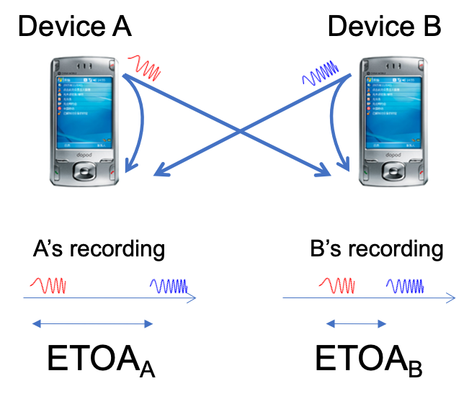
Timeline
Device A
Device B
1st Beep
t_{A0}
t_{A1}
P
t_{B1}
ETOA_{B}
Q
|ETOA_{A}-ETOA_{B}|
ETOA_{A}
2nd Beep
t_{B2}
= (P+Q+P) – (Q)
t_{B3}
= 2P
P
t_{A3}
= 2 (time of flight)

