Slide 1

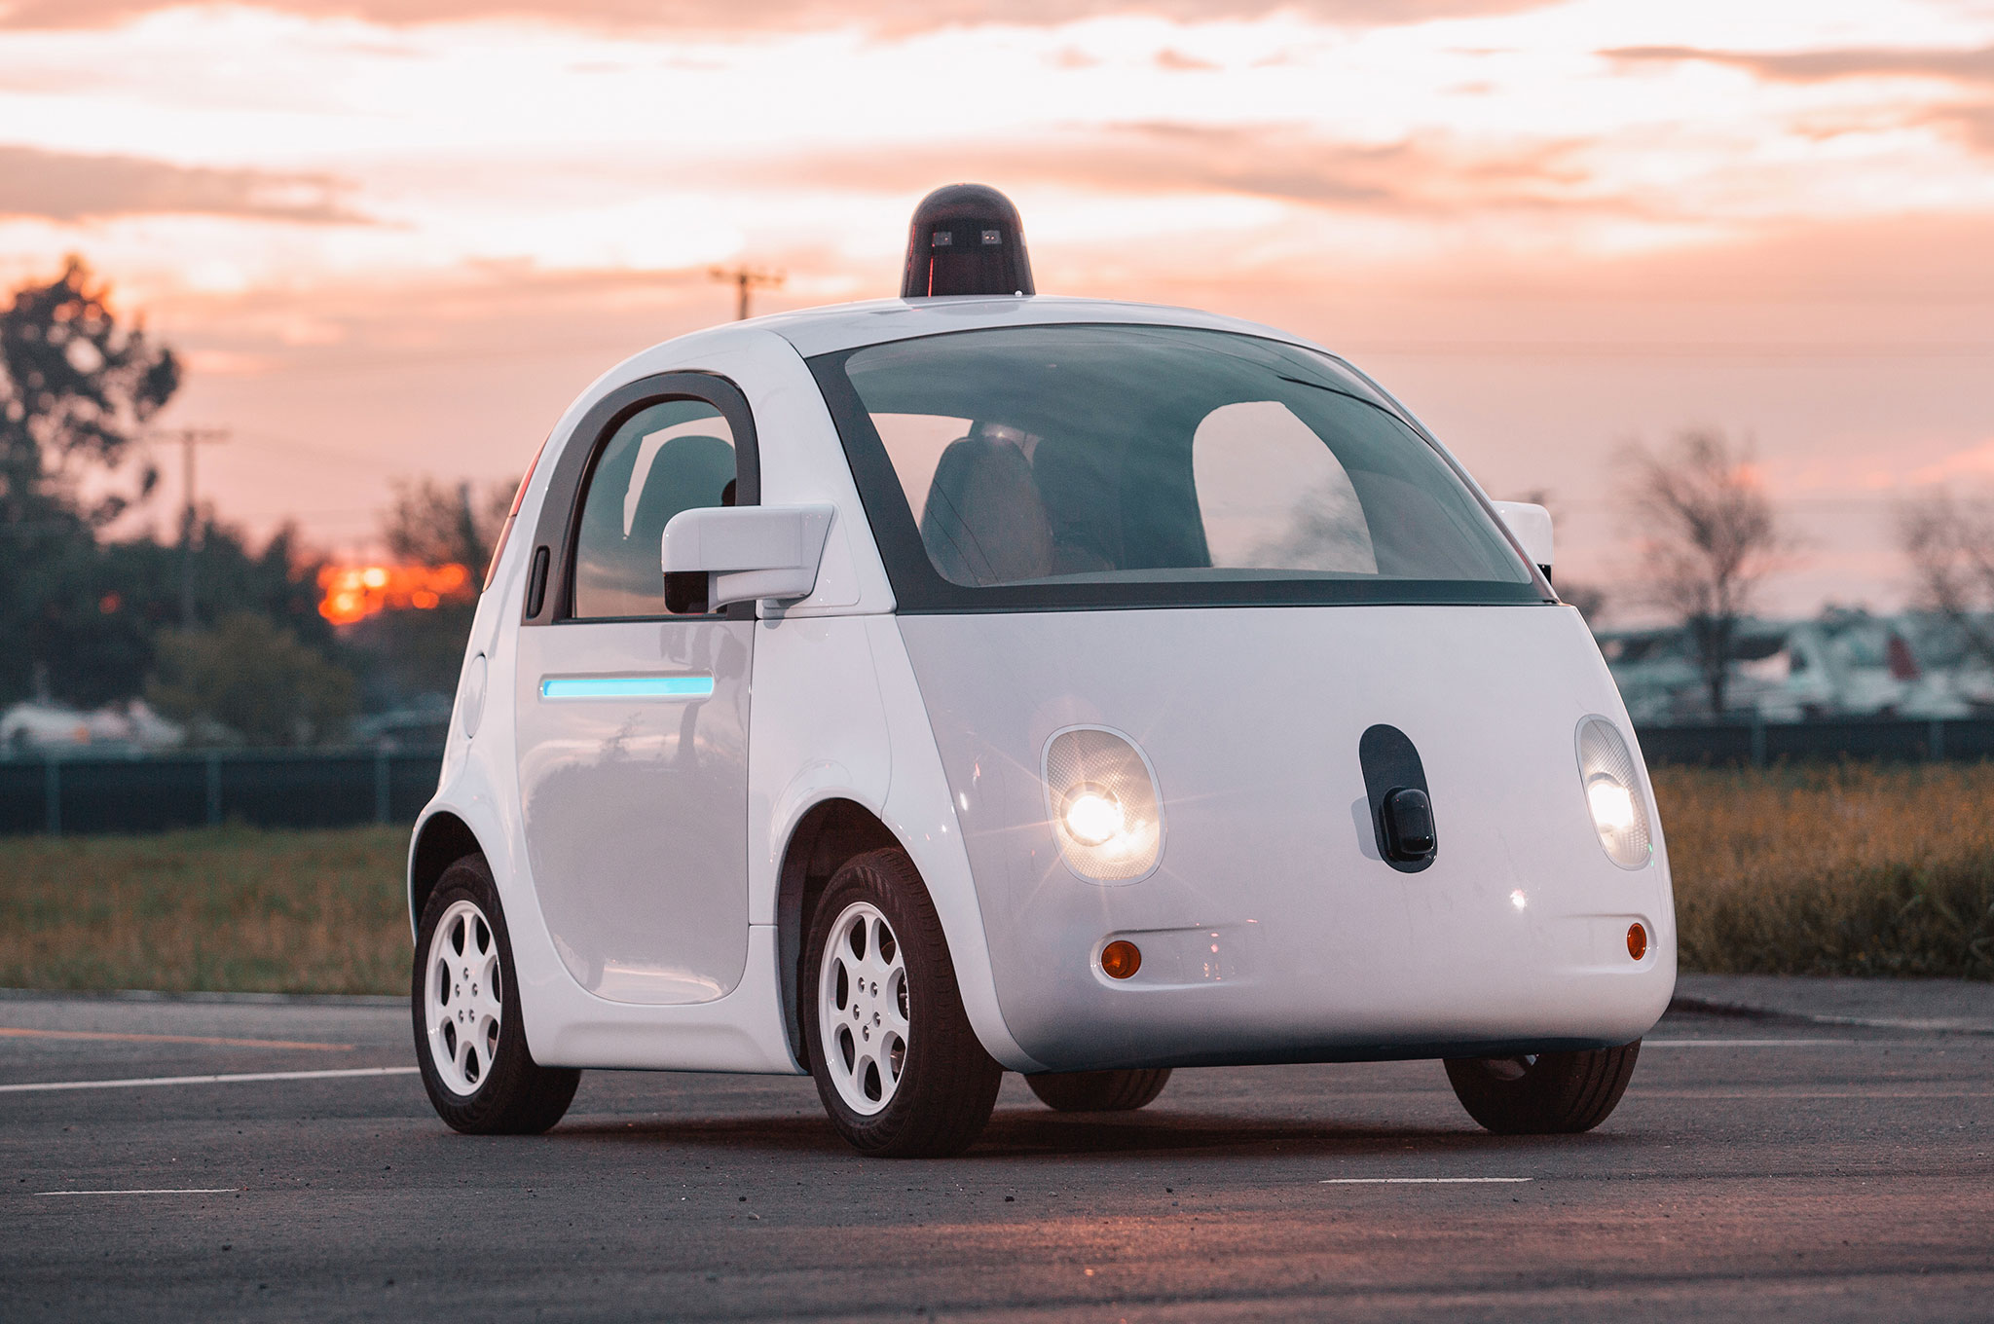



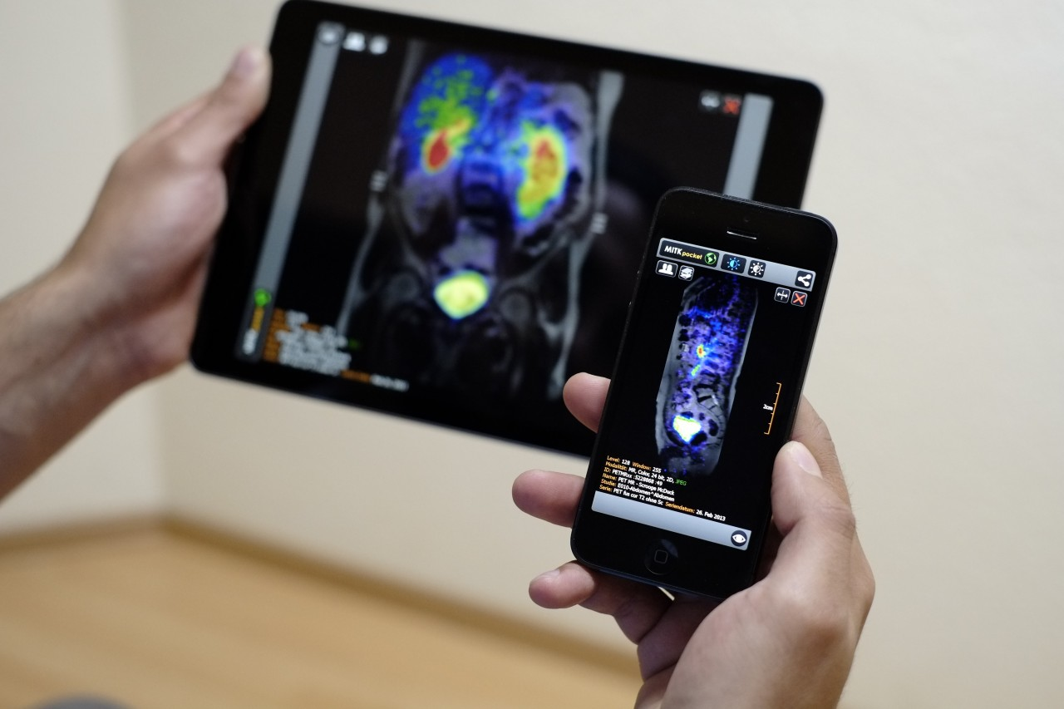
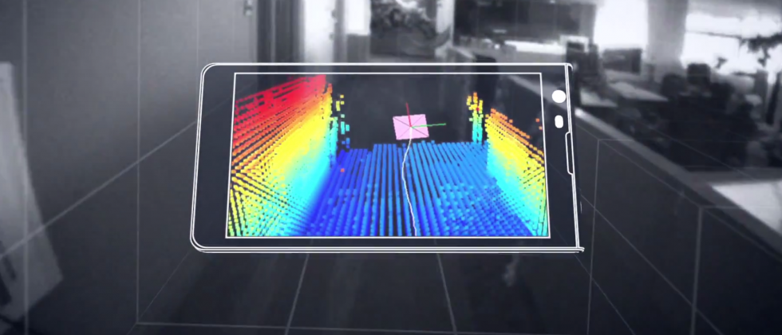

Wireless and Mobile Systems
for the IoT
CMSC 715 : Fall 2023
Lecture 2.3: Sensing in Time and Space – Part 2
Nirupam Roy
Tu-Th 12:30-1:45pm
IRB 2107

Slide 2
Spatial filtering (controlling signal gain in space)

Slide 3
Spatial filtering
Alexa!

Slide 4

Spatial filtering
Omni-directional

Slide 5
Spatial filtering

Slide 6
Spatial filtering

Slide 7
Spatial filtering

Slide 8
Applications of spatial filtering

Slide 9
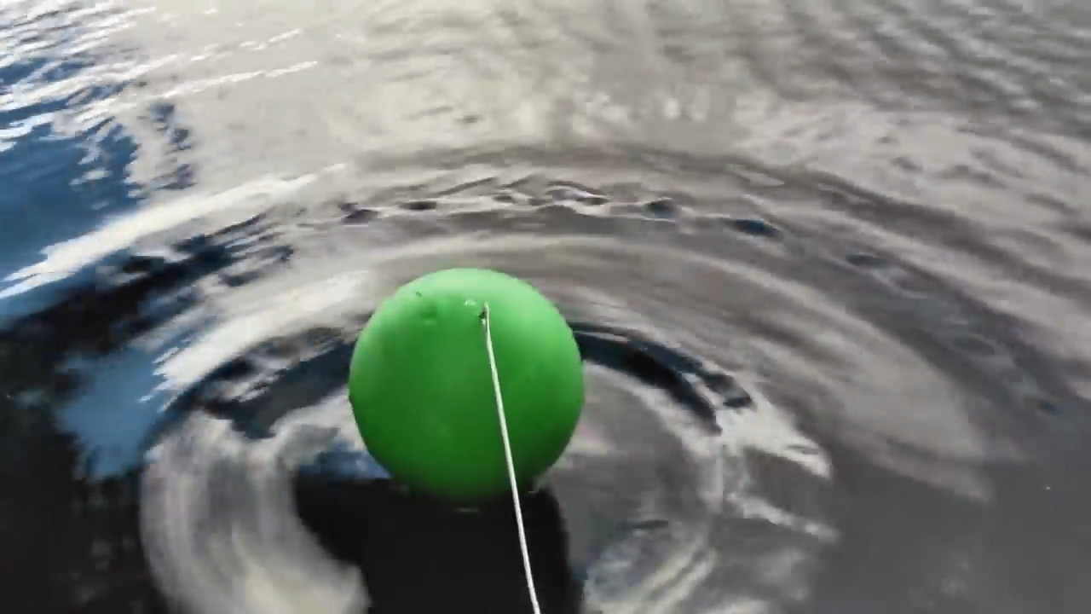
Interference of Waves
[Reference] https://www.youtube.com/watch?v=Iuv6hY6zsd0

Slide 10
Spatial filtering (controlling signal gain in space)
Superimposition of signals

Slide 11
Spatial filtering (controlling signal gain in space)
Superimposition of signals
(in time)

Slide 12


Superimposition of sinusoids
$$A1 . sin⁡(2πf1t+Θ1)$$
Amplitude
Amplitude
$$A2 . sin⁡(2πf2t+Θ2)$$

Slide 13
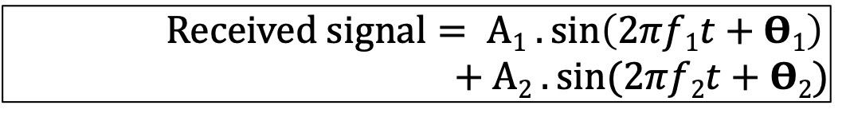
Superimposition of sinusoids
$$A1 . sin⁡(2πf1t+Θ1)$$
Amplitude
Amplitude
$$A2 . sin⁡(2πf2t+Θ2)$$
$Received signal= A1 .\sin\left(2πf1t+Θ1\right)$ $+A2 . sin⁡(2πf2t+Θ2)$

Slide 14
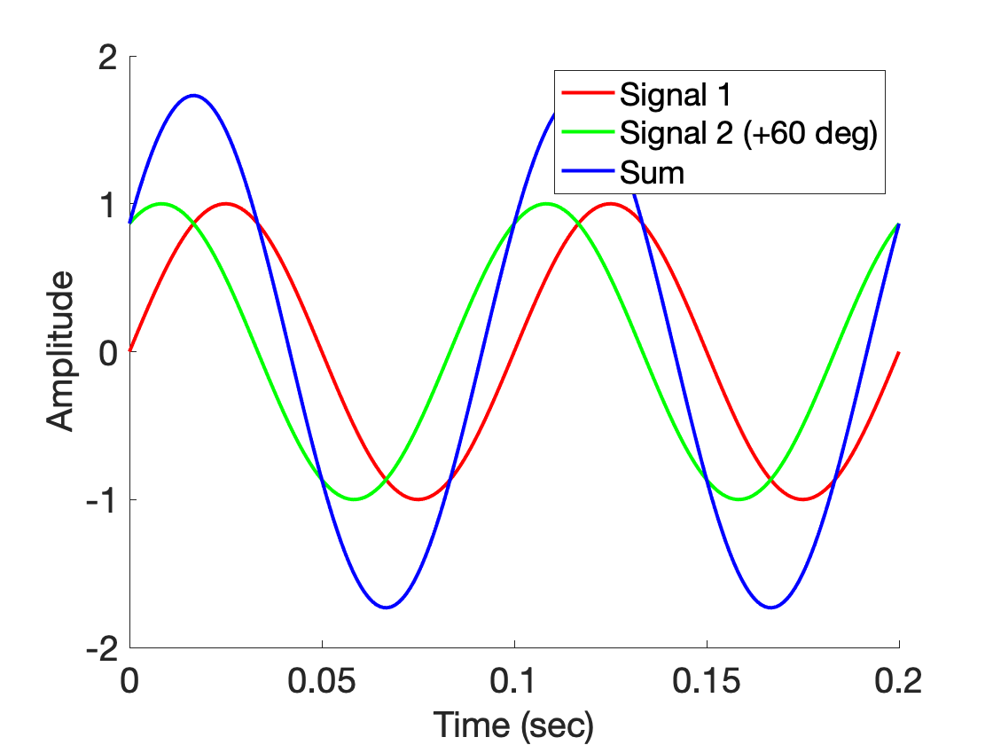
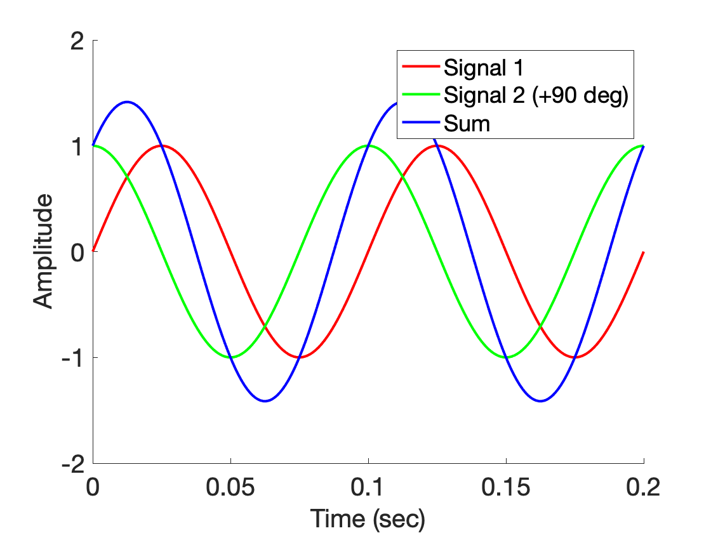
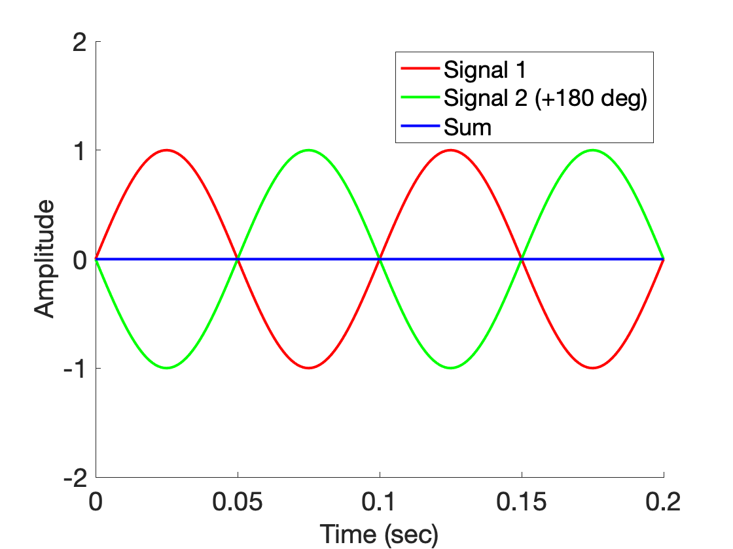
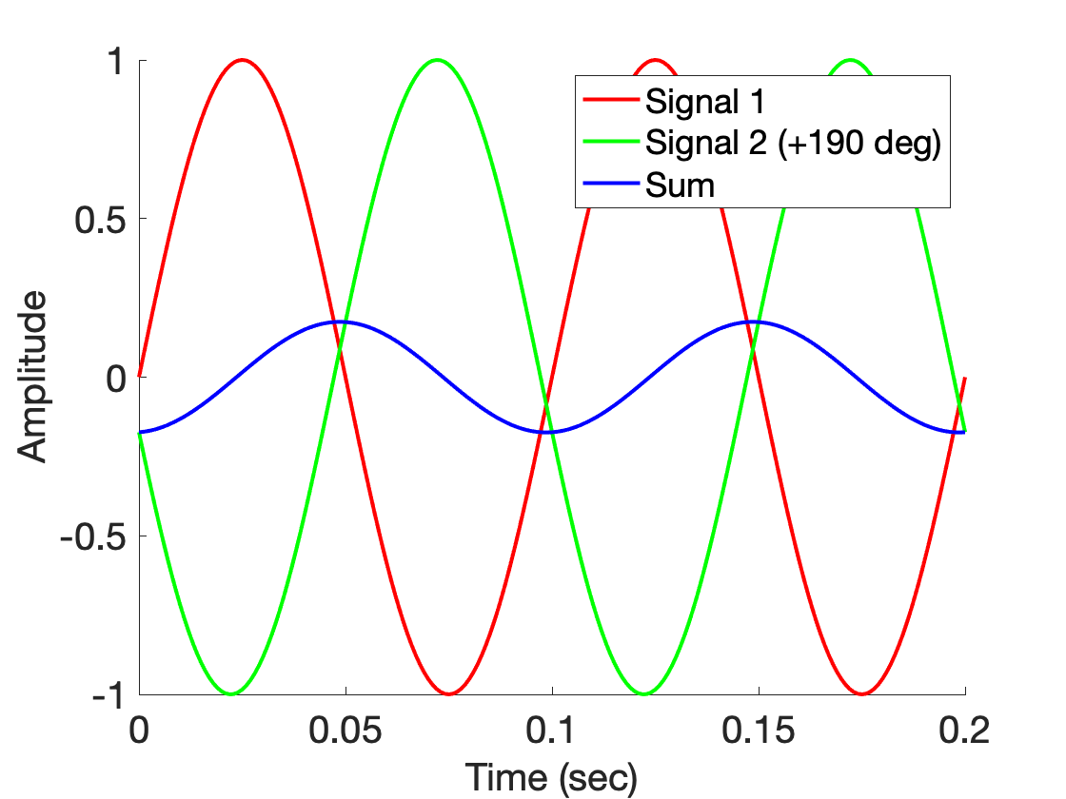
Superimposition of sinusoids

Slide 15
Spatial filtering (controlling signal gain in space)
Superimposition of signals
(in space)

Slide 16
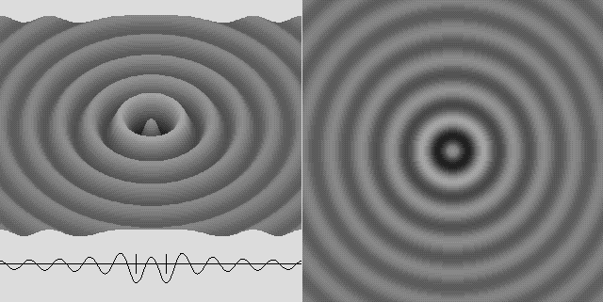
Superimposition of sinusoids

Slide 17

Superimposition of sinusoids
$$sin⁡(2πft)$$

Slide 18

Superimposition of sinusoids
>
$$sin⁡(2πft)$$

Slide 19
Superimposition of sinusoids
$$sin⁡(2πft)$$

Slide 20


Superimposition of sinusoids
$$sin⁡(2πft)$$
$$d$$
$$sin⁡(2πft+2πd/λ)$$

Slide 21

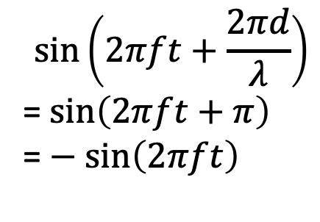
Superimposition of sinusoids
Signal amplified
(perfect constructive interference)
$$sin⁡(2πft)$$
$$d=λ/2$$
$$\sin\left(2πft+\frac{2πd}{λ}\right)$$
= $\sin\left(2πft+π\right)$
= $− sin\left(2πft\right)$
Signal nullified
Signal nullified

Slide 22
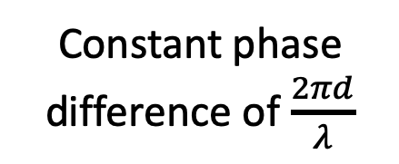



Superimposition of sinusoids: Gain
Power gain due to the array structure
Distance from the center of the array
$$−λ/4$$
$$0$$
$$λ/4$$
$$d=λ/2$$
Constant phase difference of $\frac{2πd}{λ}$

Slide 23
Superimposition of sinusoids: Gain
Beamforming in 1D space
Power gain due to the array structure
Distance from the center of the array
Controlling spatial signal gain using multiple signal sources or receivers.
$$−λ/4$$
$$0$$
$$λ/4$$
The gain depends on distance between the elements and signal wavelength.
$$d=λ/2$$
Constant phase difference of $\frac{2πd}{λ}$

Slide 24
Beamforming in 2D space

Slide 25
Beamforming in 2D space
Approximation for ‘far field’
$$φ$$
$$?$$
$$d$$

Slide 26
Beamforming in 2D space
Approximation for ‘far field’
$$φ$$
$d sin$($φ$)
$$?$$
$$φ$$
$$d$$

Slide 27
Beamforming in 2D space
Approximation for ‘far field’
$$φ$$
Along this line
$d sin$($φ$)
$$φ$$
$$d$$
Combined signal = $\sin\left(2πft\right) + \sin\left(2πft+ \frac{2π d sin (φ)}{λ}\right)$
= $e^{j\left(2πft\right)}{ }+e^{j\left(2πft+ \frac{2π d sin(φ)}{λ}\right)}{ }$

Slide 28
Beamforming in 2D space
Approximation for ‘far field’
Parameters: d, $φ$, $λ$ (or f)
Does the gain depend on the distance from the array?
$$φ$$
Along this line
$d sin$($φ$)
$$φ$$
$$d$$
Combined signal = $\sin\left(2πft\right) + \sin\left(2πft+ \frac{2π d sin (φ)}{λ}\right)$
= $e^{j\left(2πft\right)}{ }+e^{j\left(2πft+ \frac{2π d sin(φ)}{λ}\right)}{ }$

Slide 29
Beamforming in 2D space
Directional gain of an array

Slide 30
Beamforming in 2D space

Slide 31
Beamforming in 2D space
$$φ$$
$$d$$

Slide 32
Beamforming in 2D space
$$φ$$
$$d$$
+
Combined signal
= $e^{j\left(2πft\right)}{ }+e^{j\left(2πft + \frac{2π d sin(φ)}{λ}\right)}{ }$

Slide 33
Sensing with an Array

Slide 34
Sensing with an Array

Slide 35
Sensing with an Array

Slide 36
Sensing with an Array
Extra path delay
== additional phase

Slide 37
Sensing with an Array
Extra path delay
== additional phase
+
Received combined signal

Slide 38
Sensing with an Array
Extra path delay
== additional phase
+
Received combined signal

Slide 39
Sensing with an Array
Extra path delay
== additional phase
+
Received combined signal

Slide 40
Sensing with an Array
$$φ$$
Extra path delay
== additional phase
+
Received combined signal

Slide 41
Sensing with an Array
Approximation for ‘far field’

Slide 42
Sensing with an Array
Approximation for ‘far field’
Extra path delay
== additional phase

Slide 43
Sensing with an Array
Approximation for ‘far field’
$$φ$$
$d sin$($φ$)
$$d$$
+
Received combined signal

Slide 44
Sensing with an Array
Approximation for ‘far field’
$$φ$$
Along this line
$d sin$($φ$)
$$d$$
= $e^{j\left(2πft\right)}{ }+e^{j\left(2πft+ \frac{2π d sin(φ)}{λ}\right)}{ }$
Combined signal

Slide 45
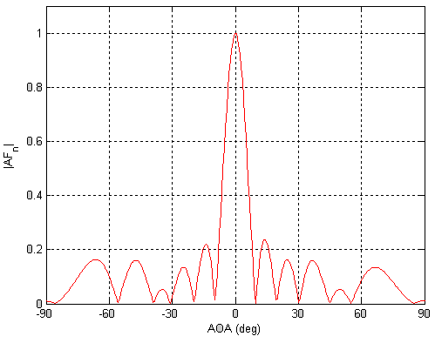
Sensing with an Array: Spatial gain
$$φ$$

Slide 46
Sensing with an Array
$$φ$$
$$d$$
+
Combined signal
= $e^{j\left(2πft\right)}{ }+e^{j\left(2πft + \frac{2π d sin(φ)}{λ}\right)}{ }$

Slide 47
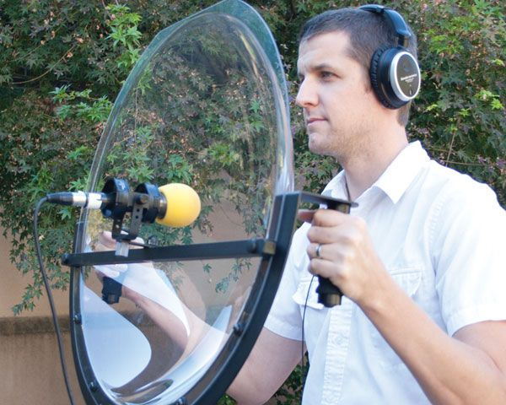
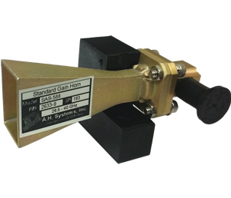
Directionality of signals: Physical guiding

Slide 48
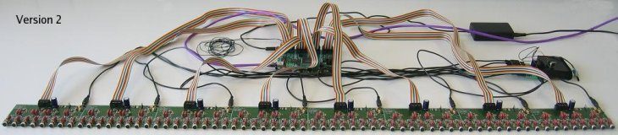
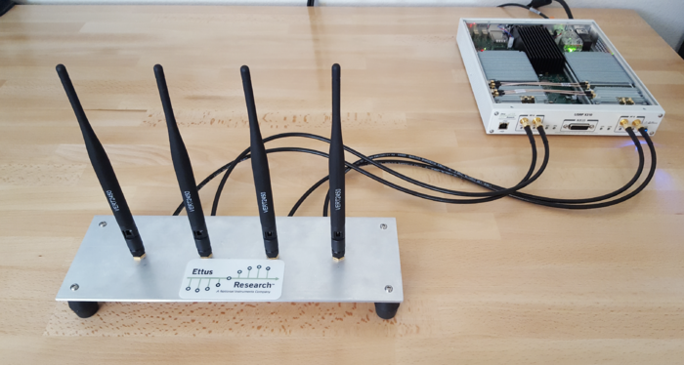
Directionality of signals: Array of sensors

Slide 49
Uniform Linear Array (ULA)

Slide 50
Beamforming in 2D space
$d sin$($φ$)
$$E1$$
$$E2$$
$$E3$$
$$E4$$
…
N elements
$$d$$
$$d$$
$$d$$
Interelement distance = d

Slide 51
Beamforming in 2D space
$3d sin$($φ$)
$2d sin$($φ$)
$d sin$($φ$)
$$E1$$
$$E2$$
$$E3$$
$$E4$$
…
N elements
$$d$$
$$d$$
$$d$$
Interelement distance = d

Slide 52
Beamforming in 2D space
$3d sin$($φ$)
$2d sin$($φ$)
$d sin$($φ$)
$$E1$$
$$E2$$
$$E3$$
$$E4$$
…
N elements
$$d$$
$$d$$
$$d$$
Path difference with n^{th} element:
$\left(n−1\right)d sin$($φ$)
Phase difference with n^{th} element:
$\left(n−1\right)d sin$($φ$) 2Π/λ

Slide 53
Beamforming in 2D space
$3d sin$($φ$)
$2d sin$($φ$)
$d sin$($φ$)
$$E1$$
$$E2$$
$$E3$$
$$E4$$
…
N elements
$$d$$
$$d$$
$$d$$
Interelement distance = d
Path difference with n^{th} element:
$\left(n−1\right)d sin$($φ$)
Phase difference with n^{th} element:
$\left(n−1\right)d sin$($φ$) 2Π/λ

Slide 54
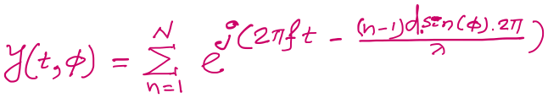

$3d cos$($φ$)
$2d sin$($φ$)
Beamforming in 2D space
$d sin$($φ$)
$$E1$$
$$E2$$
$$E3$$
$$E4$$
…
N elements
$$d$$
$$d$$
$$d$$
Path difference with n^{th} element:
$\left(n−1\right)d sin$($φ$)
Phase difference with n^{th} element:
$\left(n−1\right)d sin$($φ$) 2Π/λ
Signal at 1st sensor:
$e^{j\left(2πft\right)}{ }$
Combined signal:

Slide 55
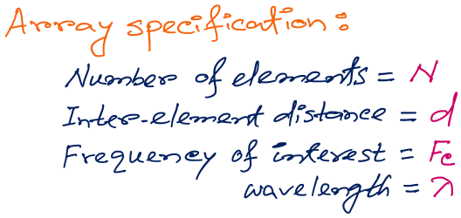
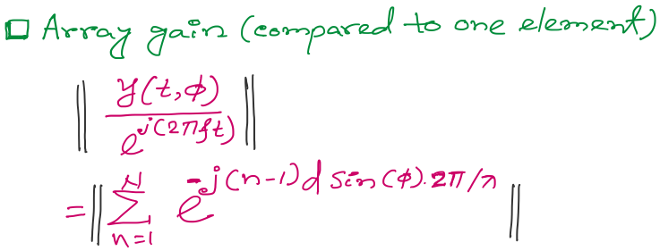
Beamforming in 2D space
f
Notes:
http://www.waves.utoronto.ca/prof/svhum/ece422/notes/15-arrays2.pdf

Slide 56

Beamforming in 2D space
Notes:
http://www.waves.utoronto.ca/prof/svhum/ece422/notes/15-arrays2.pdf

Slide 57
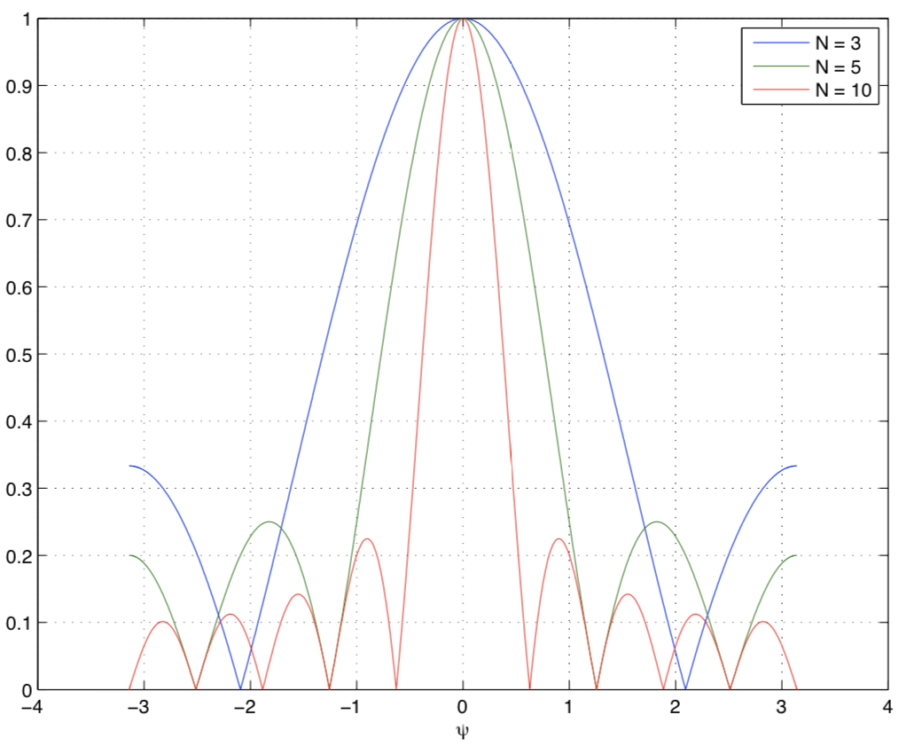
Beamforming in 2D space
Gain
-90 -60 -30 0 30 60 90
Angle
Notes:
http://www.waves.utoronto.ca/prof/svhum/ece422/notes/15-arrays2.pdf

Slide 58
Beamforming in 2D space
Notes:
http://www.waves.utoronto.ca/prof/svhum/ece422/notes/15-arrays2.pdf

Slide 59
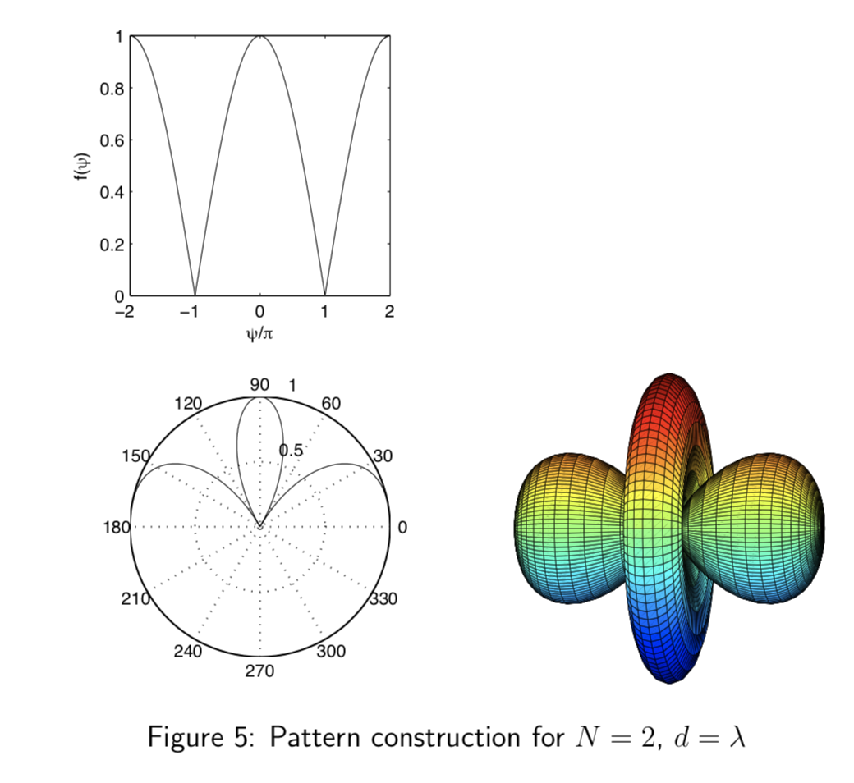
Beamforming in 2D space
Notes:
http://www.waves.utoronto.ca/prof/svhum/ece422/notes/15-arrays2.pdf

Slide 60
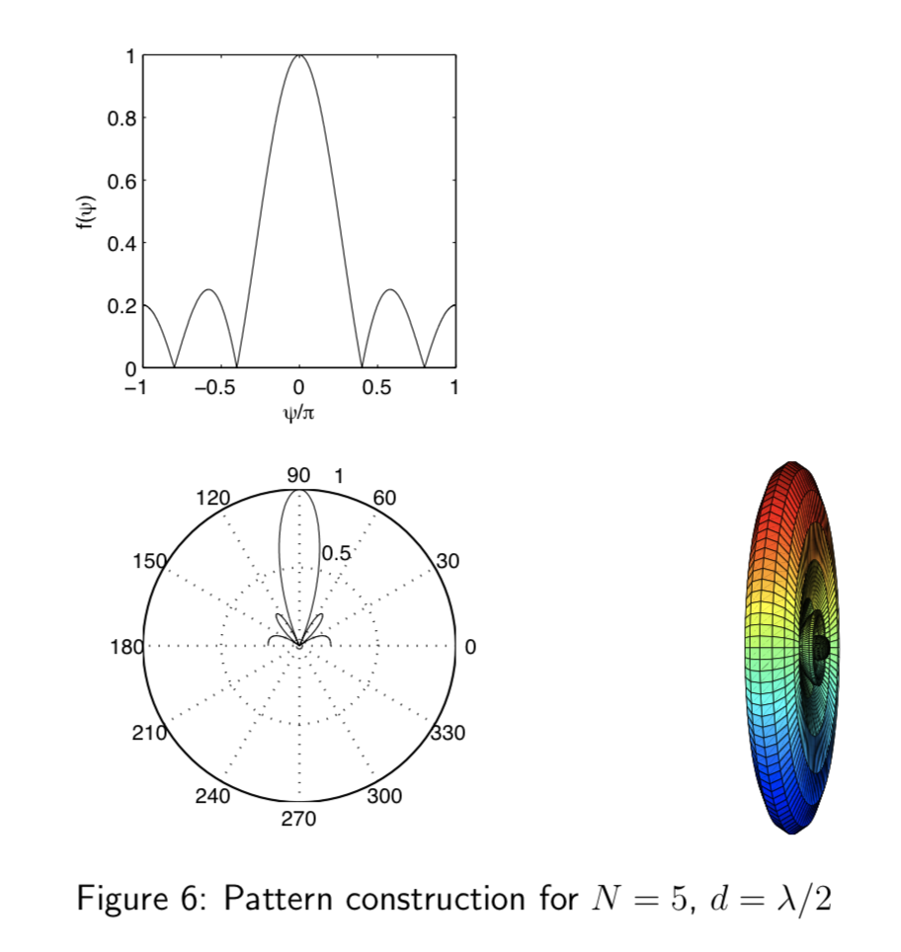
Beamforming in 2D space
Notes:
http://www.waves.utoronto.ca/prof/svhum/ece422/notes/15-arrays2.pdf

Slide 61
Beamforming in 2D space

Slide 62
Sensing with an Array
$$φ$$
$$d$$
Extra phase-1
Extra phase-2
+
Combined signal

Slide 63
Sensing with an Array
$$φ$$
$$d$$
Extra phase-1
Extra phase-2
= $e^{jΘ2}{ }$
= $e^{jΘ1}{ }$
+
= $e^{j\left(2πft\right)}{ }+e^{j\left(2πft + \frac{2π d sin(φ)}{λ}\right)}{ }$

Slide 64
Sensing with an Array
$$φ$$
$$d$$
Extra phase-1
Extra phase-2
= $e^{jΘ2}{ }$
= $e^{jΘ1}{ }$
+
= $e^{j\left(2πft+Θ1\right)}{ }+e^{j\left(2πft + \frac{2π d sin(φ)}{λ}+Θ2\right)}{ }$

Slide 65
Beam-steering
Delay-sum beamformer or Phased array
Notes:
http://www.waves.utoronto.ca/prof/svhum/ece422/notes/15-arrays2.pdf

Slide 66
Beam-steering
Phased array
Add additional phase:
$−\left(n−1\right)d sin$(𝚹_{s}) 2Π/λ
Notes:
http://www.waves.utoronto.ca/prof/svhum/ece422/notes/15-arrays2.pdf

Slide 67
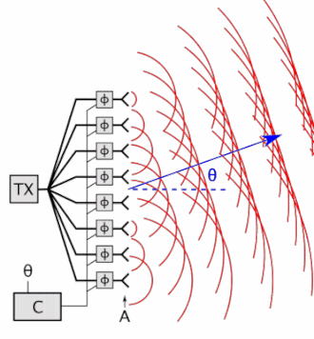

Beam-steering
Delay-sum beamformer or Phased array
Notes:
http://www.waves.utoronto.ca/prof/svhum/ece422/notes/15-arrays2.pdf

Slide 68
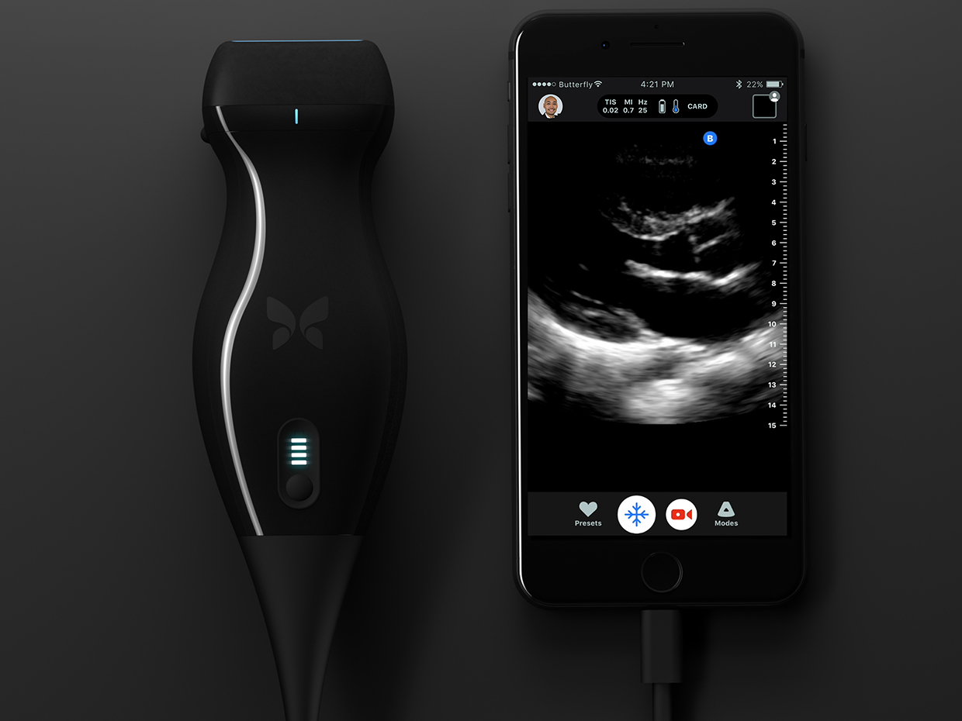
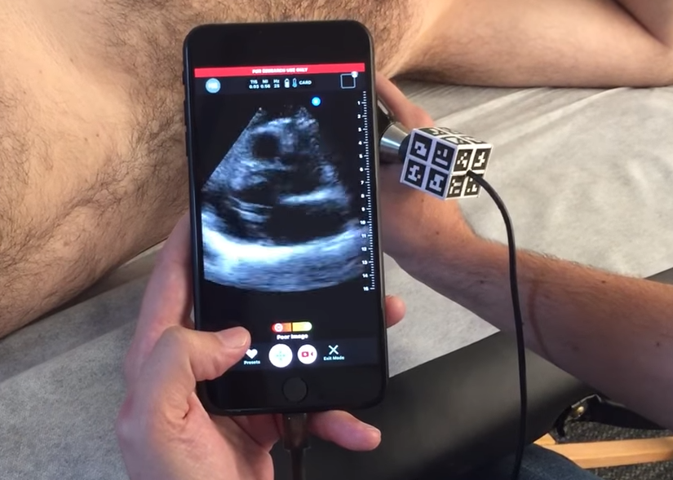

Slide 69
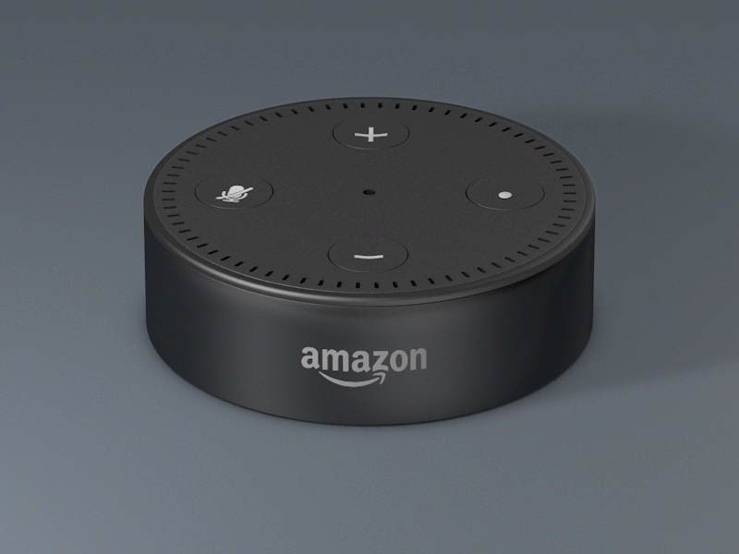

Slide 70
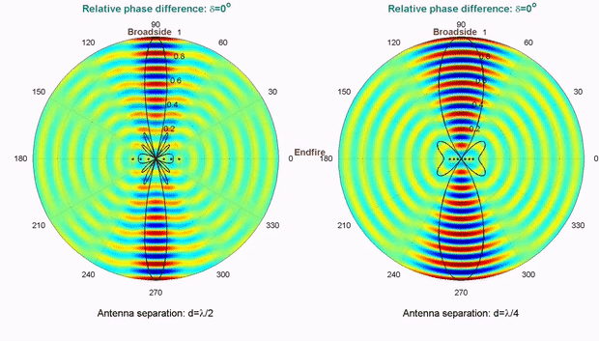
Computationally controlling beam direction

