Slide 1

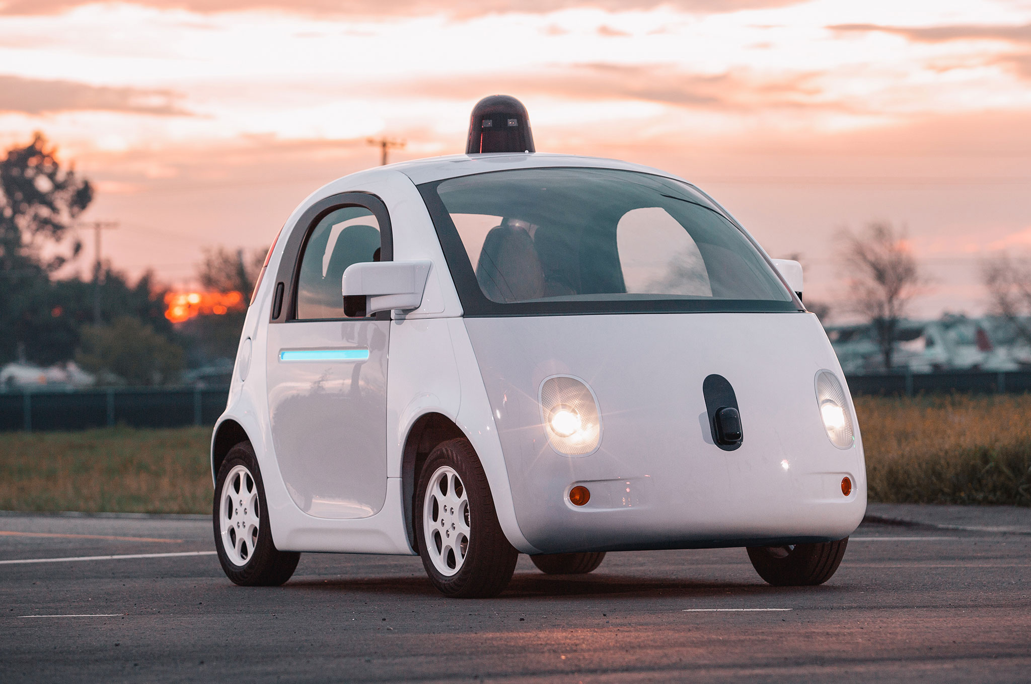

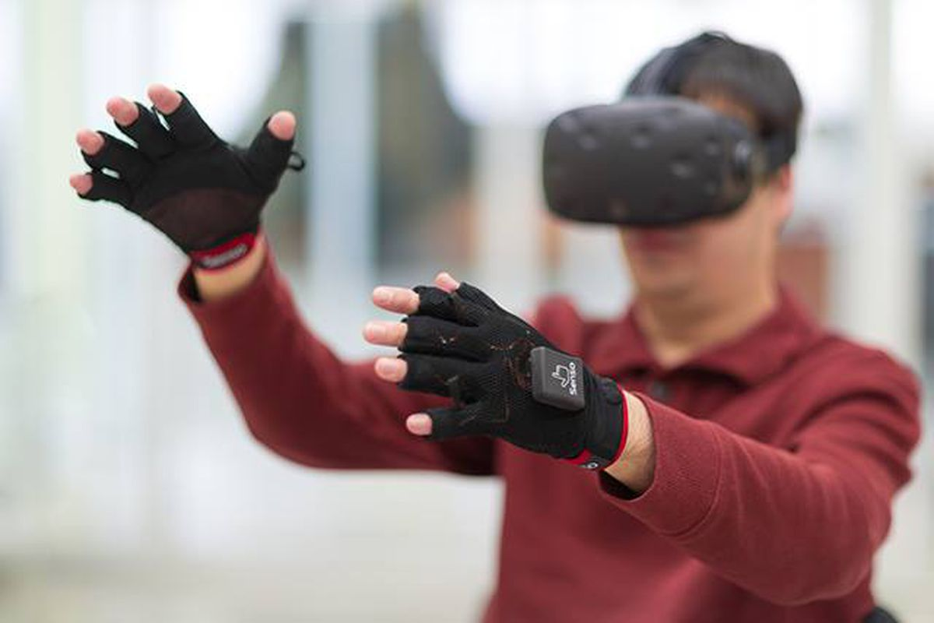


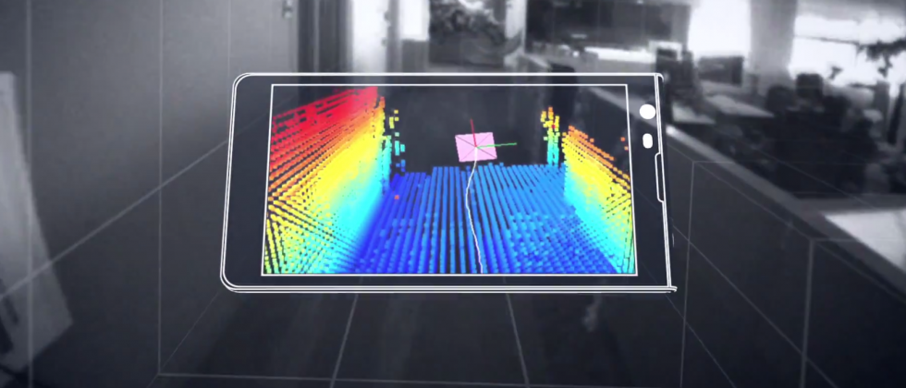

Wireless and Mobile Systems
for the IoT
CMSC 715 : Fall 2023
Lecture 3.1: Inference for IoT
Nirupam Roy
Tu-Th 12:30-1:45pm
IRB 2107

Slide 2
Happy or sad?

Slide 3
Happy or sad?

Slide 4
Happy or sad?

Slide 5
Happy or sad?
Past experience
P (The dolphin is happy | Experience)

Slide 6
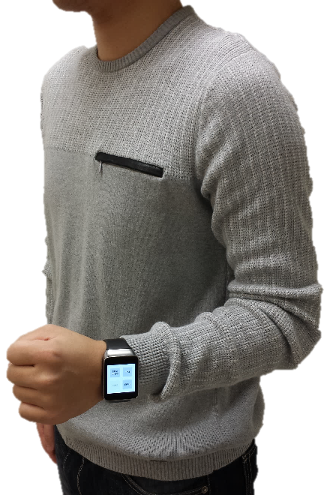
Inference from sensor data
Tracking arm motion

Slide 7
Inference from sensor data
Tracking arm motion
Partial information from sensors

Slide 8
Inference from sensor data
Tracking arm motion
Knowledge about the arm’s motion
(probabilistic models)
+
Partial information from sensors

Slide 9
Inference from sensor data
Tracking arm motion
Knowledge about the arm’s motion
(probabilistic models)
Arm’s gesture
and movement
tracking
+
Partial information from sensors

Slide 10


Slide 11
Sensors are not perfect

Slide 12

The physical world
Statistical models, learning, perception
Meaningful information

Slide 13
The physical world
Neither perfect nor adequate
Statistical models, learning, perception
Inherently probabilistic
in nature
Meaningful information

Slide 14
Probability refresher

Slide 15
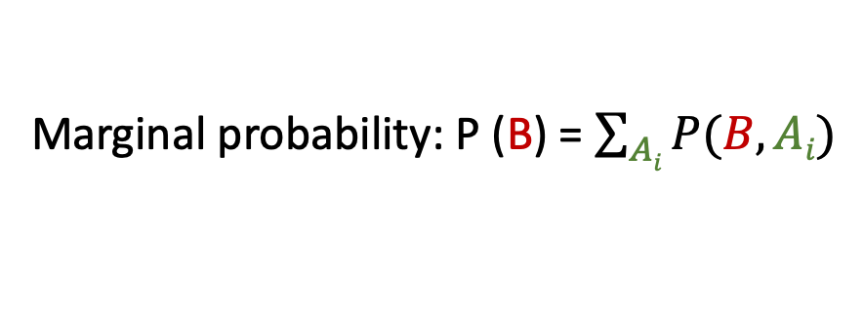
A few basic probability rules
Joint probability: P (A, B) = P (B, A)
Likelihood of multiple events occurring simultaneously
Conditional probability: P (A|B) = P(A,B)/P(B)
Probability of an event, given another event has occurred
Marginal probability: P (B) = $\sum_{Ai}{P(B,Ai)}$

Slide 16
A few basic probability rules
Joint probability: P (A, B) = P (B, A)
Likelihood of multiple events occurring simultaneously
Conditional probability: P (A|B) = P(A,B)/P(B)
Probability of an event, given another event has occurred
Marginal probability: P (B) = $\sum_{Ai}{P(B,Ai)}$
A1
A2
A3
B

Slide 17
A few basic probability rules
Joint probability: P (A, B) = P (B, A)
Likelihood of multiple events occurring simultaneously
Conditional probability: P (A|B) = P(A,B)/P(B)
Probability of an event, given another event has occurred
Marginal probability: P (B) = $\sum_{Ai}{P(B,Ai)}$
Chain rule: P (A, B, C) = P(A|B,C) P(B,C) = P(A|B,C) P(B|C) P(C)

Slide 18
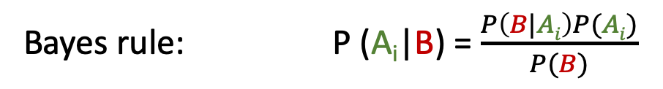
Bayes rule
Bayes rule: P (A_{i}|B) = $\frac{P\left(B|Ai\right)P(Ai)}{P(B)}$

Slide 19
Bayes rule
Likelihood
Posterior
Prior
Bayes rule: P (A_{i}|B) = $\frac{P\left(B|Ai\right)P(Ai)}{P(B)}$

Slide 20
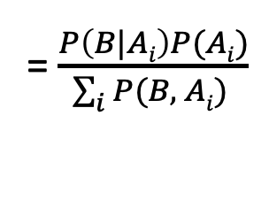
Bayes rule
Likelihood
Posterior
Prior
Bayes rule: P (A_{i}|B) = $\frac{P\left(B|Ai\right)P(Ai)}{P(B)}$
= $\frac{P\left(B|Ai\right)P(Ai)}{\sum_{i}{P(B, Ai) }}$

Slide 21
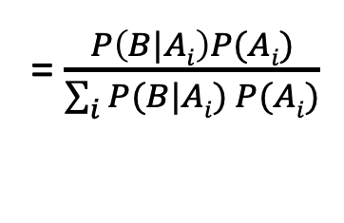
Bayes rule
Likelihood
Posterior
Prior
Bayes rule: P (A_{i}|B) = $\frac{P\left(B|Ai\right)P(Ai)}{P(B)}$
= $\frac{P\left(B|Ai\right)P(Ai)}{\sum_{i}{P(B, Ai) }}$
= $\frac{P\left(B|Ai\right)P(Ai)}{\sum_{i}{P(B|Ai) P(Ai)}}$

Slide 22
Bayes rule
Likelihood
Posterior
Prior
Bayes rule: P (A_{i}|B) = $\frac{P\left(B|Ai\right)P(Ai)}{P(B)}$
= $\frac{P\left(B|Ai\right)P(Ai)}{\sum_{i}{P(B, Ai) }}$
= $\frac{P\left(B|Ai\right)P(Ai)}{\sum_{i}{P(B|Ai) P(Ai)}}$
Relates inverse representations of the probabilities concerning two events

Slide 23
Bayes rule: View 1
Healthy: A1
Diabetes: A2
Cancer: A3
Smoker: B

Slide 24
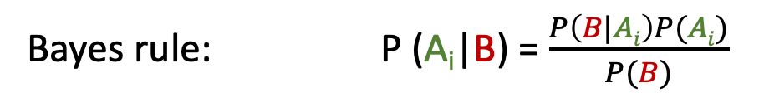
Bayes rule: View 1
Healthy: A1
Diabetes: A2
Cancer: A3
Smoker: B
Likelihood
Posterior
Prior
Bayes rule: P (A_{i}|B) = $\frac{P\left(B|Ai\right)P(Ai)}{P(B)}$

Slide 25
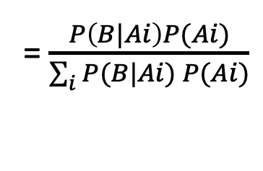
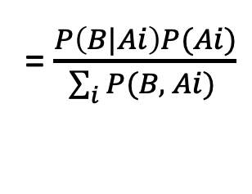
Bayes rule: View 1
Healthy: A1
Diabetes: A2
Cancer: A3
Smoker: B
Likelihood
Posterior
Prior
Bayes rule: P (A_{i}|B) = $\frac{P\left(B|Ai\right)P(Ai)}{P(B)}$
= $\frac{P\left(B|Ai\right)P(Ai)}{\sum_{i}{P(B, Ai) }}$
= $\frac{P\left(B|Ai\right)P(Ai)}{\sum_{i}{P(B|Ai) P(Ai)}}$
Relates inverse representations of the probabilities concerning two events

Slide 26
Bayes rule: View 2
Not cancer: ~A
Cancer: A
Smoker: B

Slide 27
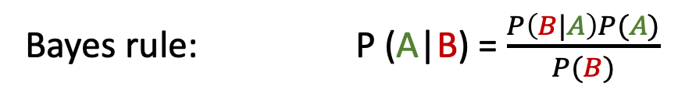
Bayes rule: View 2
Not cancer: ~A
Cancer: A
Smoker: B
Likelihood
Posterior
Prior
Bayes rule: P (A|B) = $\frac{P\left(B|A\right)P(A)}{P(B)}$

Slide 28
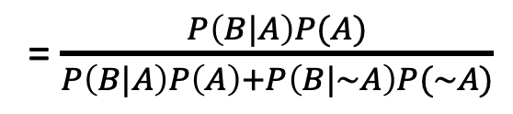
Bayes rule: View 2
Not cancer: ~A
Cancer: A
Smoker: B
Likelihood
Posterior
Prior
Bayes rule: P (A|B) = $\frac{P\left(B|A\right)P(A)}{P(B)}$
= $\frac{P\left(B|A\right)P(A)}{P\left(B|A\right)P\left(A\right)+P\left(B|\sim A\right)P(\sim A)}$
Updates the believes, based on evidences

Slide 29

Happy or sad?

Slide 30
Happy or sad?
Given the “sequence” of tricky questions asked today, what should be the answer?

Slide 31
Markov Model

Slide 32
Markov Model
Sunny
Sunny
Rainy
Sunny
Rainy
Rainy
t1 t2 t3 t4 t5 t6 (time)

Slide 33
Markov Model
Sunny
Sunny
Rainy
Sunny
Rainy
Rainy
t1 t2 t3 t4 t5 t6 (time)
Sunny
day
Rainy
day

Slide 34
Markov Model
Sunny
Sunny
Rainy
Sunny
Rainy
Rainy
t1 t2 t3 t4 t5 t6 (time)
P (sunny after rainy)
P (sunny after sunny)
P (rainy after rainy)
Sunny
day
Rainy
day
P (rainy after sunny)
Mth order Markov assumption: Current state depends on past M states

Slide 35
Markov Model
Sunny
Sunny
Rainy
Sunny
Rainy
Rainy
t1 t2 t3 t4 t5 t6 (time)
P (sunny after rainy)
P (sunny after sunny)
P (rainy after rainy)
1st Order Markov assumption: The future depends on the present only, not on the past
Sunny
day
Rainy
day
P (rainy after sunny)

Slide 36
Markov Model
Sunny
Sunny
Rainy
Sunny
Rainy
Rainy
t1 t2 t3 t4 t5 t6 (time)
P (sunny after rainy)
P (sunny after sunny)
P (rainy after rainy)
Sunny
day
Rainy
day
P (rainy after sunny)

Slide 37
Markov Model
Sunny
Sunny
Rainy
Sunny
Rainy
Rainy
t1 t2 t3 t4 t5 t6 (time)
P (sunny after rainy)
P (sunny after sunny)
P (rainy after rainy)
Sunny
day
Rainy
day
Temp.
P (rainy after sunny)
Temp.
Humidity
Humidity
Wind
Wind

Slide 38
Hidden Markov Model

Slide 39
Hidden Markov Model: Toy robot localization example
Find location of the robot
(Hidden information)
Observations =
sensor measurement
S₁
S₂
S₃
…

Slide 40
Hidden Markov Model: Toy robot localization example
Starting from an arbitrary location
(All locations are equally likely)
Prob
0
1
t=0

Slide 41
Hidden Markov Model: Toy robot localization example
Sensing changes the probabilities
Prob
0
1
t=1

Slide 42
Hidden Markov Model: Toy robot localization example
Prob
0
1
t=1

Slide 43
Hidden Markov Model: Toy robot localization example
Prob
0
1
t=2

Slide 44
Hidden Markov Model: Toy robot localization example
Prob
0
1
t=3

Slide 45
Hidden Markov Model: Toy robot localization example
Prob
0
1
t=4

Slide 46
Hidden Markov Model: Toy robot localization example
Prob
0
1
t=5

Slide 47
Hidden Markov Model: Toy robot localization example
State = location on the grid = S_{i}
S₁
S₂
S₃
…

Slide 48
Hidden Markov Model: Toy robot localization example
Observations =
sensor measurement = M_{i}
State = location on the grid = S_{i}
S₁
S₂
S₃
…

Slide 49
Hidden Markov Model: Toy robot localization example
Observations =
sensor measurement = M_{i}
State = location on the grid = S_{i}
S₁
S₂
S₃
…
Depends on the current state
only
(Emission)
S_{i}

Slide 50
Hidden Markov Model: Toy robot localization example
Observations =
sensor measurement = M_{i}
State = location on the grid = S_{i}
S₁
S₂
S₃
…
Depends on the current state
only
(Emission)
S_{i}
S_{i+1}
S_{i+2}
…
S_{i}
States change over time (Transition)

