Slide 1

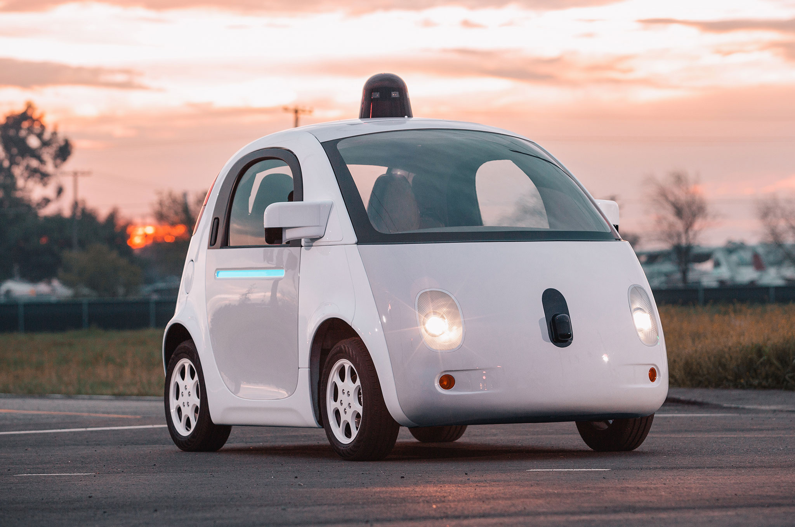

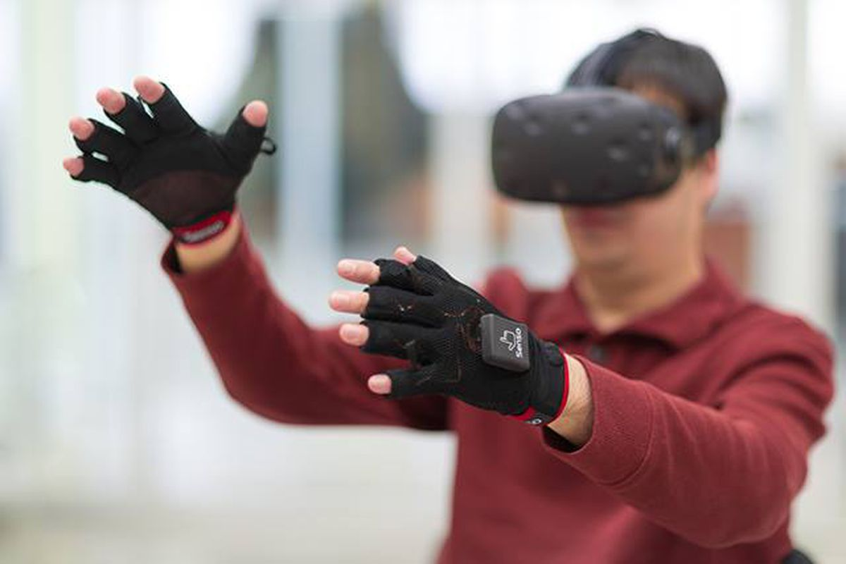


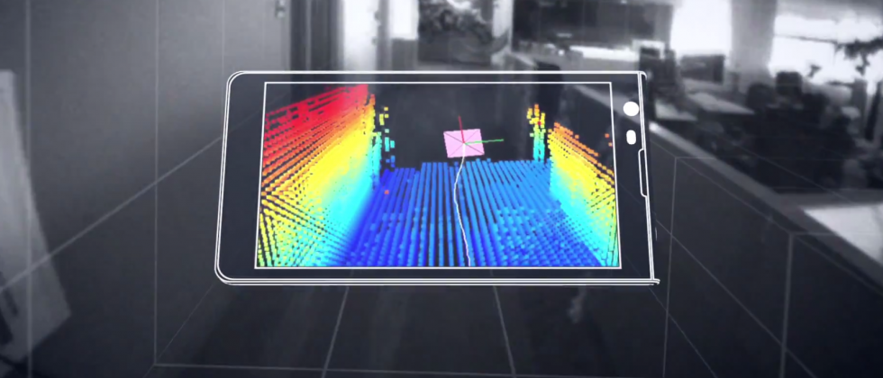
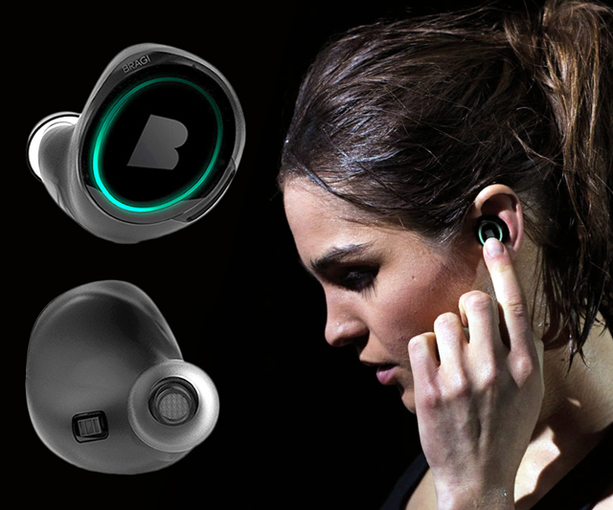
Wireless and Mobile Systems
for the IoT
CMSC 715 : Fall 2023
Lecture 3.2: Inference for IoT
Nirupam Roy
Tu-Th 12:30-1:45pm
IRB 2107

Slide 2
Class project: Rules
The class project == 30% of the total grade.
Demonstrate your understanding of the core theories and capability to transform them into real-world solutions.
You can pick a project idea from the following list, or may improvise an idea from the list, or may work on your own idea.
Project must conform to the philosophy of this course, "wireless and mobile systems for the IoT." (Recommend in-person discussions with the instructor to ensure that your project qualifies.)

Slide 3
Class project: Rules
Team of two. Need the instructor's permission for any other team sizes.
More than one team may pick the same project idea, must work independently.
Your final project report should contain no more than six (6) pages, including all figures and references.

Slide 4
Class project: Rules
Final project report must contain the following sections:
  Introduction (includes an overview of the project and the motivation)
  System Design (describes the methods and implementation details)
  Evaluation (evaluates the developed system with experimental results and plots)
  -- A template is provided.
5% of the project grades as a bonus for submitting a working demo of the project.
Each student will be graded separately.
We can help.

Slide 5
Class project: Ideas
A list of project ideas is given here:
http://www.cs.umd.edu/class/fall2023/cmsc715/projectIdeas.html

Slide 6
Hidden Markov Model

Slide 7
Hidden Markov Model: Toy robot localization example
Find location of the robot
(Hidden information)
Observations =
sensor measurement
S₁
S₂
S₃
…

Slide 8
Hidden Markov Model: Toy robot localization example
Starting from an arbitrary location
(All locations are equally likely)
Prob
0
1
t=0

Slide 9
Hidden Markov Model: Toy robot localization example
Sensing changes the probabilities
Prob
0
1
t=1

Slide 10
Hidden Markov Model: Toy robot localization example
Prob
0
1
t=1

Slide 11
Hidden Markov Model: Toy robot localization example
Prob
0
1
t=2

Slide 12
Hidden Markov Model: Toy robot localization example
Prob
0
1
t=3

Slide 13
Hidden Markov Model: Toy robot localization example
Prob
0
1
t=4

Slide 14
Hidden Markov Model: Toy robot localization example
Prob
0
1
t=5

Slide 15
Hidden Markov Model: Toy robot localization example
State = location on the grid = S_{i}
S₁
S₂
S₃
…

Slide 16
Hidden Markov Model: Toy robot localization example
Observations =
sensor measurement = M_{i}
State = location on the grid = S_{i}
S₁
S₂
S₃
…

Slide 17
Hidden Markov Model: Toy robot localization example
Observations =
sensor measurement = M_{i}
State = location on the grid = S_{i}
S₁
S₂
S₃
…
Depends on the current state
only
(Emission)
S_{i}

Slide 18
Hidden Markov Model: Toy robot localization example
Observations =
sensor measurement = M_{i}
State = location on the grid = S_{i}
S₁
S₂
S₃
…
Depends on the current state
only
(Emission)
S_{i}
S_{i+1}
S_{i+2}
…
S_{i}
States change over time (Transition)

Slide 19
Hidden Markov Model: Definition
S₁
S₂
S₃
S₄
M₁
M₂
M₃
M₄

Slide 20
Hidden Markov Model: Definition
Hidden states
S₁
S₂
S₃
S₄
M₁
M₂
M₃
M₄

Slide 21
Hidden Markov Model: Definition
Hidden states
S₁
S₂
S₃
S₄
M₁
M₂
M₃
M₄
Observations

Slide 22
Hidden Markov Model: Definition
S₁
S₁
S₂
M₁
Transition
Emission

Slide 23
Hidden Markov Model: Definition
S₁
S₁
S₂
M₁
Transition
Emission
1st order Markov assumption:
Transition probability depends on the current state only.
Output independence assumption:
Output/Emission probability depends on the current state only.

Slide 24
Hidden Markov Model: Definition
Hidden states
S₁
S₁
S₂
S₃
S₄
S₁
S₂
M₁
M₁
M₂
M₃
M₄
Transition
Emission
Observations
1st order Markov assumption:
Transition probability depends on the current state only.
Output independence assumption:
Output/Emission probability depends on the current state only.

Slide 25
Hidden Markov Model: Definition
Probability of a sequence of hidden states, given a sequence of observations

Slide 26
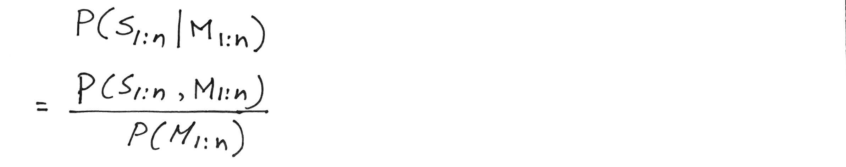
Hidden Markov Model: Definition
Probability of a sequence of hidden states, given a sequence of observations

Slide 27
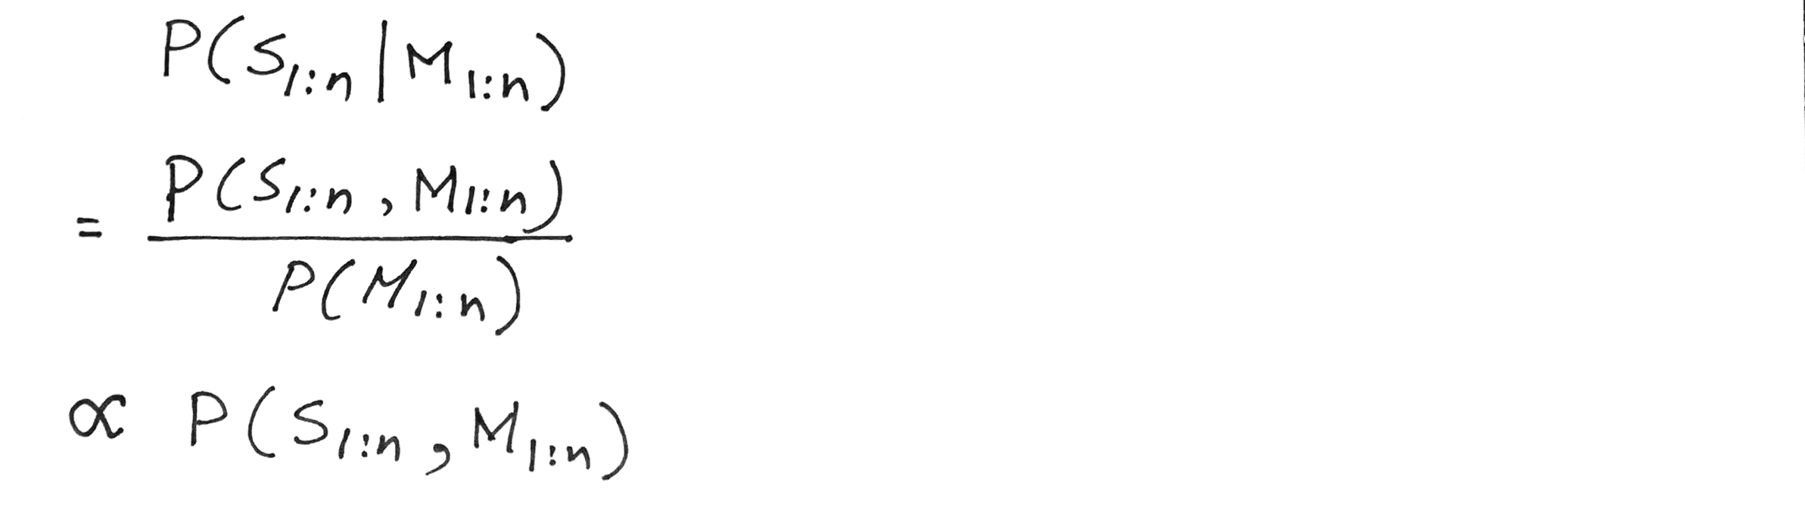
Hidden Markov Model: Definition
Probability of a sequence of hidden states, given a sequence of observations

Slide 28
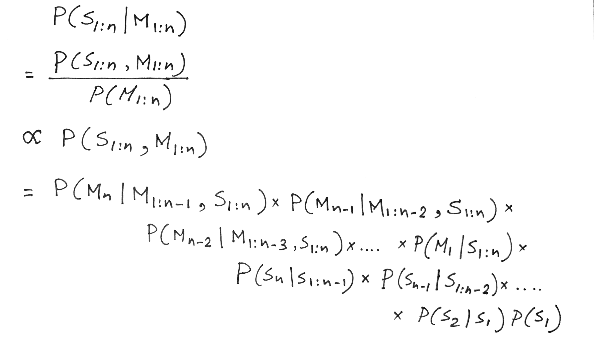
Hidden Markov Model: Definition
Chain rule

Slide 29
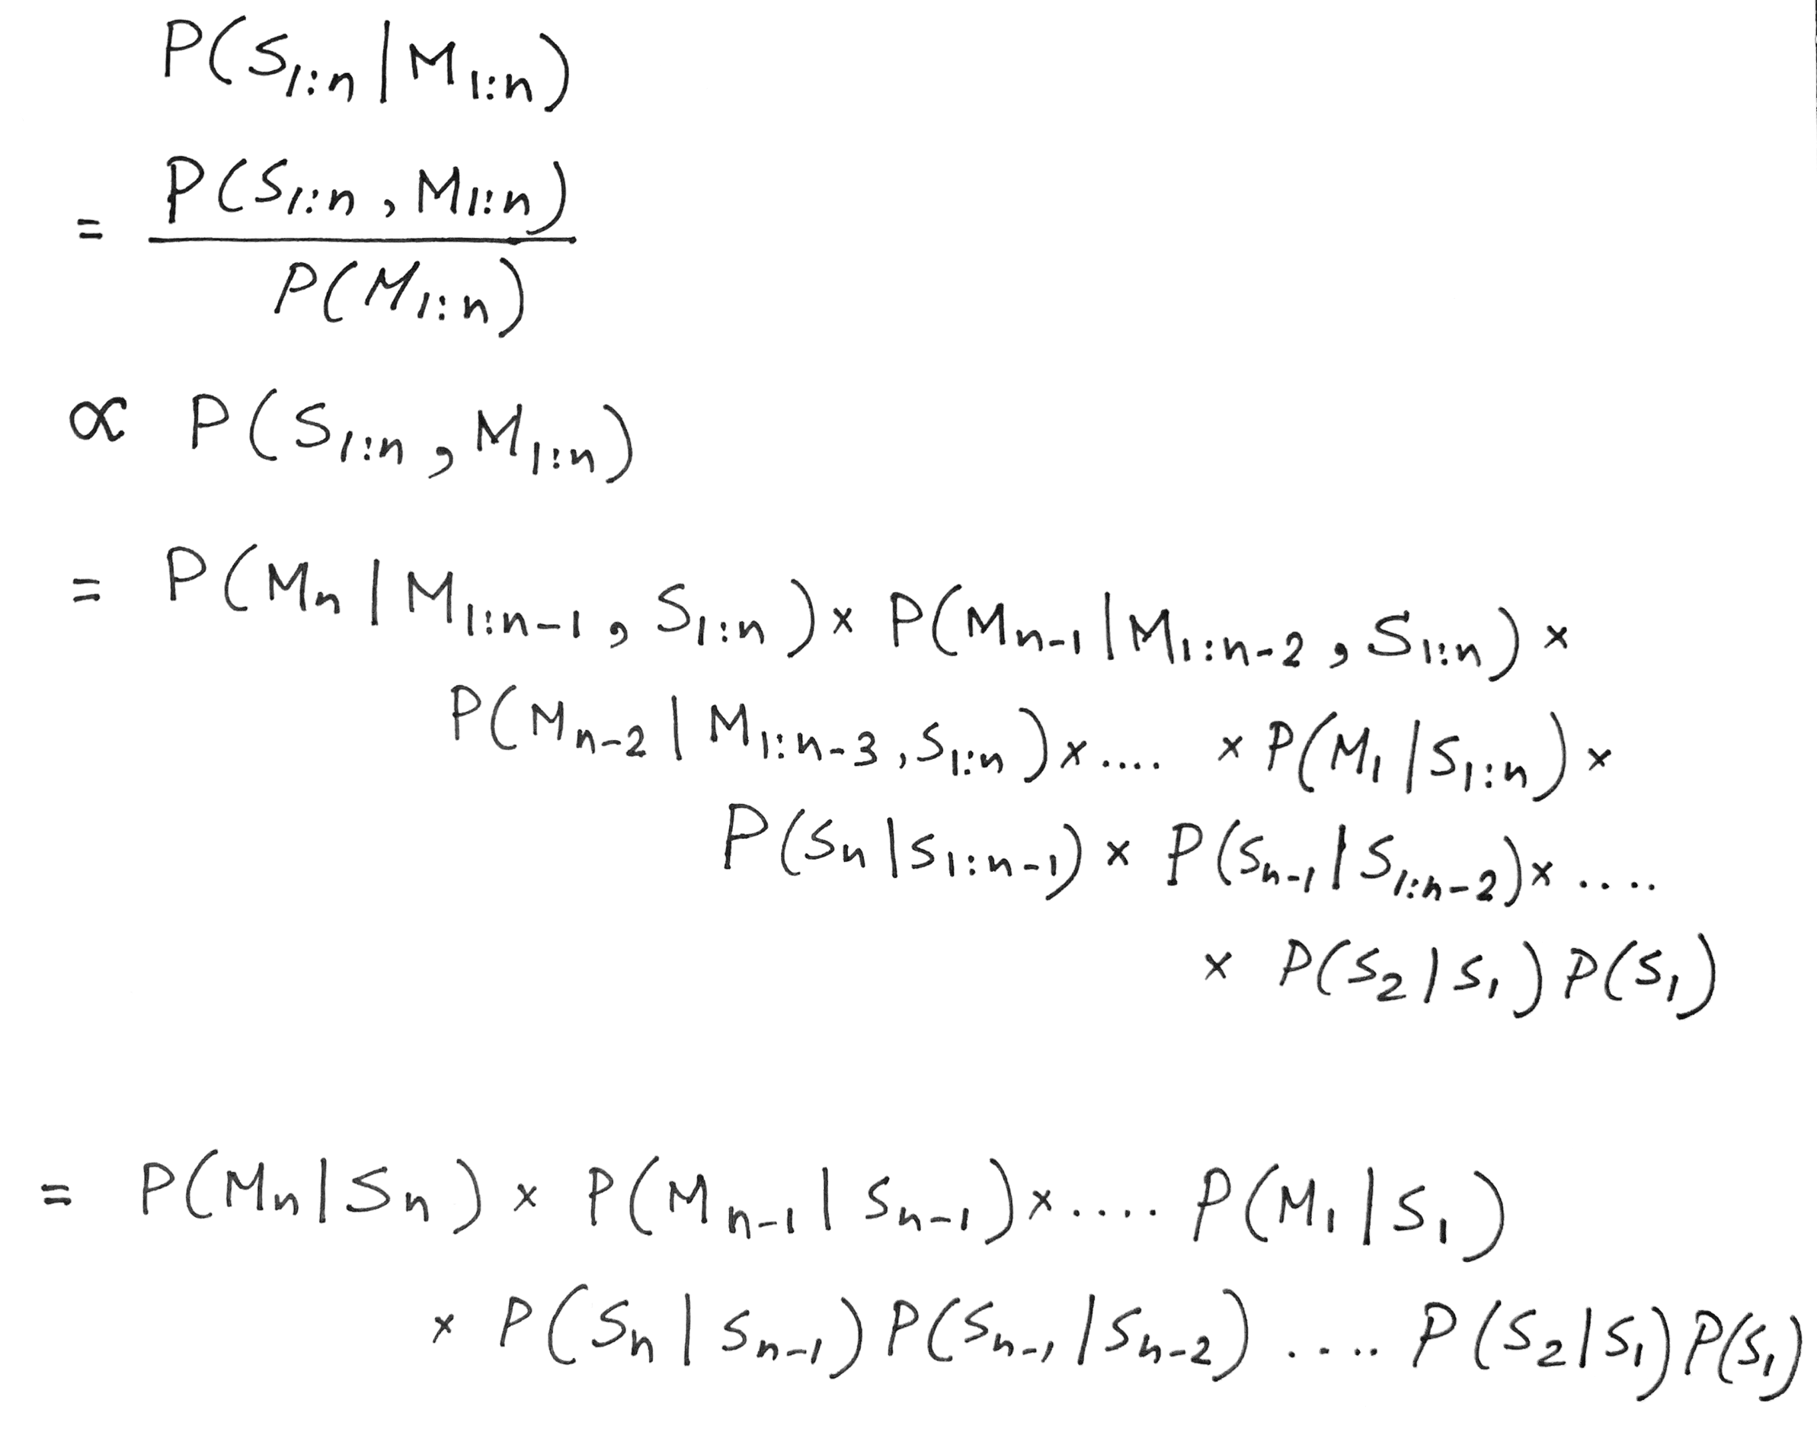
Hidden Markov Model: Definition
Observation depends on the current state only

Slide 30
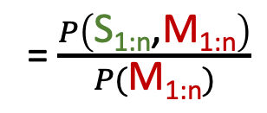
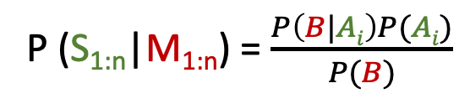
Hidden Markov Model: Definition
P (S_{1:n}|M_{1:n}) = $\frac{P\left(B|Ai\right)P(Ai)}{P(B)}$
= $\frac{P\left(\text{S}\text{1:}\text{n}\text{,}\text{M}\text{1:}\text{n}\right)}{P(\text{M}\text{1:}\text{n})}$
Observation depends on the current state only
Future state depends on the current state only

Slide 31
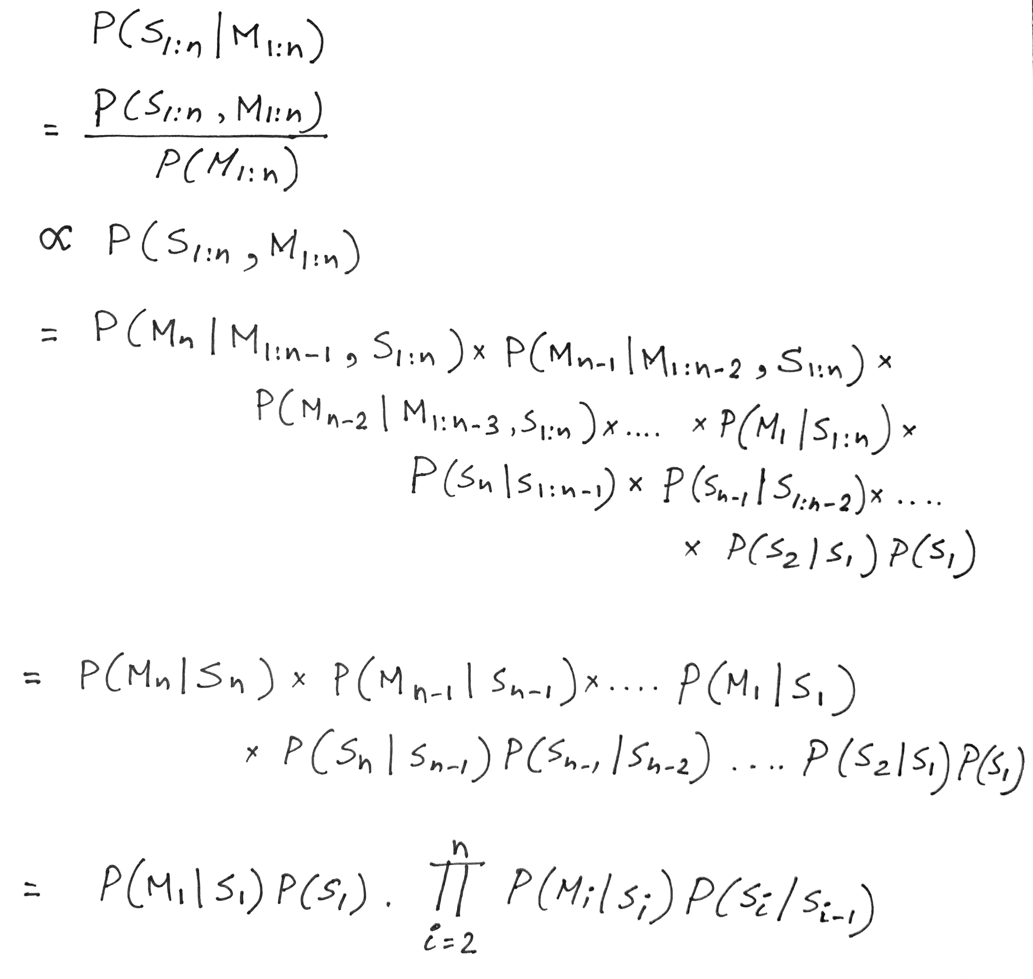
Hidden Markov Model: Definition
For N hidden states and a sequence of T observations, N^{T} different combinations

Slide 32
Problems solved by HMM
1) Likelihood:
  Determine the likelihood of an observation sequence.
2) Decoding:
  Given an observation sequence, determine the best sequence of hidden states.
[Viterbi algorithm]
[Forward-backward algorithm]
[Baum-Welch algorithm]
3) Learning:
  Given an observation sequence and a sequence of states, learn the HMM parameters:
  i) Transition probabilities
  ii) Emission probabilities

Slide 33
Problems solved by HMM
1) Likelihood:
  Determine the likelihood of an observation sequence.
2) Decoding:
  Given an observation sequence, determine the best sequence of hidden states.
[Viterbi algorithm]
[Forward-backward algorithm]
[Baum-Welch algorithm]
3) Learning:
  Given an observation sequence and a sequence of states, learn the HMM parameters:
  i) Transition probabilities
  ii) Emission probabilities

Slide 34
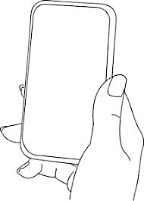
A simple gesture recognition example
States:
Observations:
No
Call
Call
Near
Far
Notes:
http://www.davidsbatista.net/assets/documents/posts/2017-11-11-hmm_viterbi_mini_example.pdf

Slide 35
A simple gesture recognition example
Start
End
St
No
Call
Call
Near
Far
Near
Far

Slide 36
A simple gesture recognition example
 | Call | NoCall | End
Start | 0.7 | 0.3 | 0
Call | 0.2 | 0.7 | 0.1
NoCall | 0.7 | 0.2 | 0.1
 | St | Near | Far
Start | 1 | 0 | 0
Call | 0 | 0.7 | 0.3
NoCall | 0 | 0.4 | 0.6
State transition
probabilities
Emission
probabilities

Slide 37
A simple gesture recognition example
Emission states are: Near, Far, Far
What is the hidden state sequence?

Slide 38
A simple gesture recognition example
i = 1 2 3
Call
Call
Call
Start
End
No
Call
No
Call
No
Call
St
Near
Far
Far

Slide 39
Hidden Markov Model: Definition

Slide 40
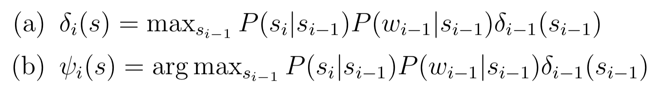

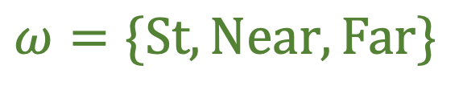

A simple gesture recognition example
Save two parameters per iteration, per state:
Recursion
$$Initialize, δ0\left(Start\right)=1$$
$$S=\{Start, Call, NoCall, End\}$$
$$ω=\{St, Near, Far\}$$
[Ref] http://www.davidsbatista.net/assets/documents/posts/2017-11-11-hmm_viterbi_mini_example.pdf

Slide 41


A simple gesture recognition example
i = 1 2
Call
Call
No
Call
Near
Far

Slide 42
A simple gesture recognition example
i = 1 2 3
Call
Call
Call
Start
End
No
Call
No
Call
No
Call
St
Near
Far
Far

Slide 43




A simple gesture recognition example
i = 1
 | Call | NoCall | End
Start | 0.7 | 0.3 | 0
Call | 0.2 | 0.7 | 0.1
NoCall | 0.7 | 0.2 | 0.1
Call
State transition probabilities
Start
$$δ0\left(Start\right)=1$$
 | St | Near | Far
Start | 1 | 0 | 0
Call | 0 | 0.7 | 0.3
NoCall | 0 | 0.4 | 0.6
No
Call
St
Near
Emission probabilities

Slide 44


A simple gesture recognition example
i = 1 2
Call
Call
Start
No
Call
No
Call
Near
Far

Slide 45





A simple gesture recognition example
i = 1 2 3
0.14406
Call
Call
Call
0.0043
Start
0.343
0.04116
End
No
Call
No
Call
No
Call
Near
Far
Far

Slide 46
A simple gesture recognition example
i = 1 2 3
Call
Call
Call
The values of delta and psi are not correct on this slide. Please refer to the calculation shown at the following link.
http://www.cs.umd.edu/class/fall2020/cmsc818w/course_materials/slides/Viterbi_solution.pdf
Start
End
No
Call
No
Call
No
Call
Near
Far
Far

Slide 47
A simple gesture recognition example
i = 1 2 3
0.14406
Call
Call
Call
0.0043
Start
0.343
0.04116
End
No
Call
No
Call
No
Call
Near
Far
Far

Slide 48
A simple gesture recognition example
i = 1 2 3
0.14406
Call
Call
Call
0.0043
Start
0.343
0.04116
End
No
Call
No
Call
No
Call
Near
Far
Far

Slide 49
A simple gesture recognition example
i = 1 2 3
0.14406
Call
Call
Call
For complete step by step solution of this example visit:
http://www.cs.umd.edu/class/fall2022/cmsc715/course_materials/slides/Viterbi_solution.pdf
0.0043
Start
0.343
0.04116
End
No
Call
No
Call
No
Call
Viterbi sequence: < Call, NoCall, Call >
P( <Call, NoCall, Call > | <Near, Far, Far>) = 0.0043
Near
Far
Far

Slide 50
Extra slides
(Not taught in class)

Slide 51
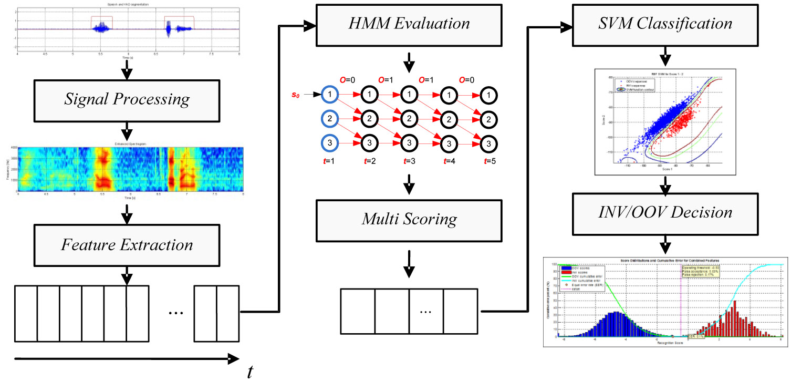

Slide 52
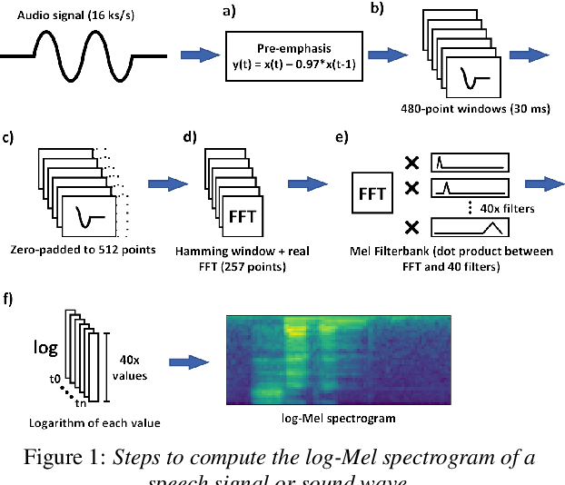

Slide 53
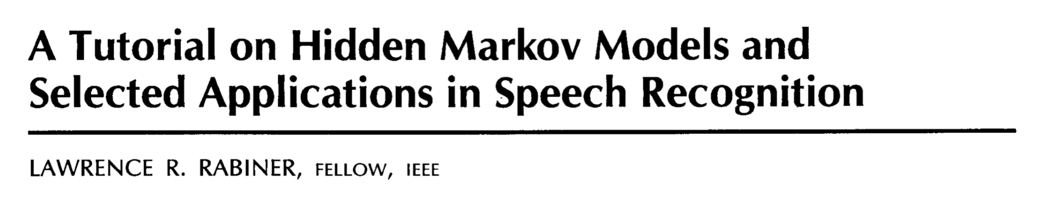

Slide 54
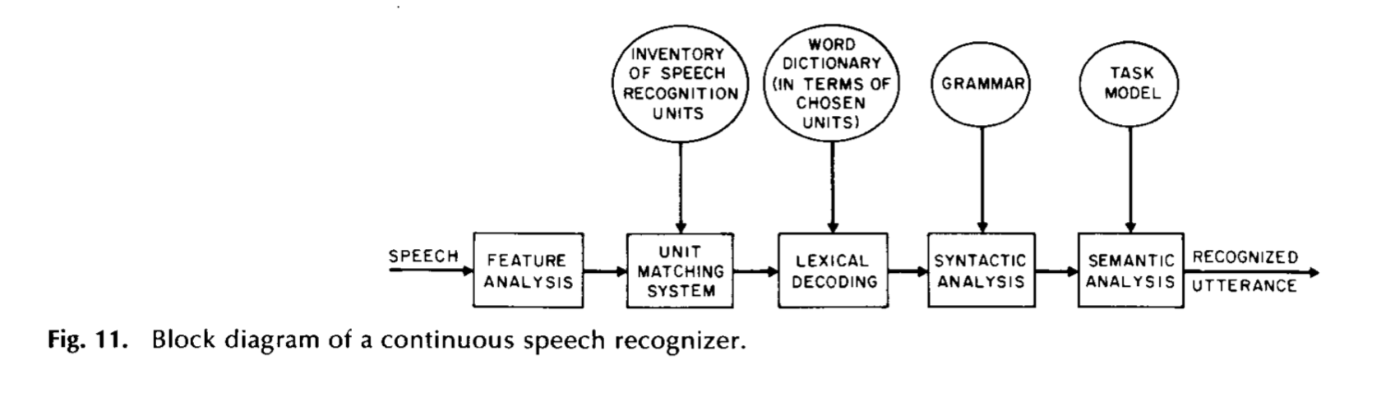

Slide 55
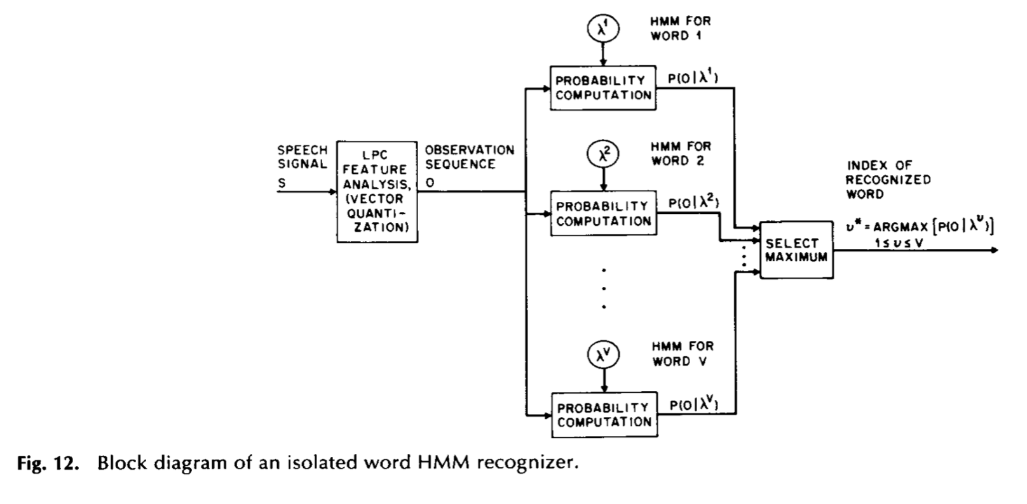

Slide 56
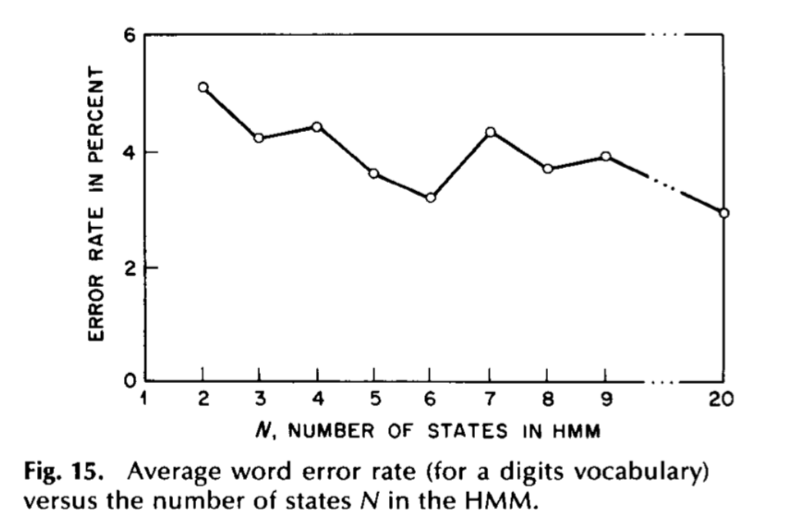

Slide 57
An Application of HMM and Viterbi Algorithm
Ref: https://www.ri.cmu.edu/pub_files/pub3/yang_jie_1994_1/yang_jie_1994_1.pdf

Slide 58
An Application of HMM and Viterbi Algorithm
Approach:
1) Define meaningful gestures
2) Describe each gesture in terms of an HMM
3) Collect base data
4) Find parameters of the HMM through base data
5) Estimate gestures with the HMM model

Slide 59
https://jonathan-hui.medium.com/speech-recognition-gmm-hmm-8bb5eff8b196

