Slide 1
Differentiable Navigation & Path Planning
CMSC 838B / 498Z (Fall 2023): Differentiable Programming
Paul Zaidins

Slide 2
Overview of Material
Discrete Path Planning: Search, Algorithms, and Heuristics
Path Planning using Neural A* Search [1]
Differentiable Spatial Planning using Transformers [2]
Boustrophedon Path Plans
Differentiable Boustrophedon Path Plans [4]
Navigation
Differentiable SLAM-net: Learning Particle SLAM for Visual Navigation [3]

Slide 3
Path Planning [5]
Problem: Find a traversable continuous path through a space from an initial state to a goal state
The space in question need not be a physical space, but most of this presentation will focus on such spaces
NP-Hard
Global vs local
We will focus on discrete planning, particularly graph-based methods

Slide 4
Graph-Based Path Planning
Represent the world as a graph $G=\left(V,E,W\right)$
Every node $vεV$ is a state/location
Every edge $e=\left(u,v\right)εE$, represents an action allowing a transition from u to v
The weight $wεW$ of an edge is generally interpreted as the cost of transitioning from u to v

Slide 5
Algorithm Basics [5]
Common ideas
Selected: the current node whose edges will be examined
Visited: all the nodes that have been selected
Frontier: all the nodes that have had an edge incoming from a selected node
We initialize selected as the initial node
We check all the edges outgoing from the selected node and add them to the frontier if the terminal nodes are unvisited
We add the selected node to visited and we take a node from the frontier as the new selected, if the selected node is a goal we terminate
The process by which we select nodes from the frontier is the heart of these algorithms
Additionally, we will need to track and potentially update the paths to the frontier nodes

Slide 6
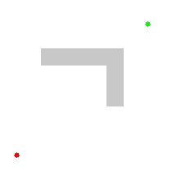
Simple Algorithms [5]
Breadth-First-Search: select nodes in the order they are added to the frontier (FIFO)
Depth-First-Search: select from the most recently added frontier nodes first (LIFO)
Dijkstra’s: select nodes to favor the shortest path
Additionally update nodes for which the new path is shorter
Visual representation of Dijkstra’s algorithm [6]

Slide 7
Heuristics [7]
Heuristic function: a function that estimates the cost of going from a node to a goal node
Let $h(n)$ be a heuristic function and $h^{∗}(n)$ be the true cost function
If$∀n,h\left(n\right)≤h^{∗}\left(n\right); h$ is admissible
Guarantees least cost path
If $h$ is monotonic nonincreasing; $h$ is consistent
Prevents node reopening
$g\left(n\right)=c\left(n\right)+h(n)$
c is the true cost of arriving at a node and g is the predicted total cost of reaching the goal

Slide 8
Heuristic Based Algorithms [5]
Best-First: select nodes from the frontier in order of least h value
A*: select nodes from the frontier in order of least g value
WA*: selects nodes in an order between BF and A* with the weight tunable
D*: A* variant for dynamic obstacles
Visual representation of A* algorithm [6]

Slide 9
Overview of Material
Discrete Path Planning: Search, Algorithms, and Heuristics
Path Planning using Neural A* Search [1]
Differentiable Spatial Planning using Transformers [2]
Boustrophedon Path Plans
Differentiable Boustrophedon Path Plans [4]
Navigation
Differentiable SLAM-net: Learning Particle SLAM for Visual Navigation [3]

Slide 10
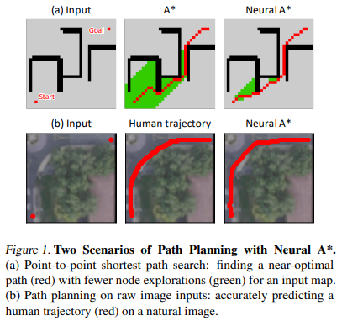
Path Planning using Neural A* Search [1]
Data-driven search-based planner: Neural A*
Reformulation of A* search algorithm to be differentiable
Empirical evaluation on
Near optimal point-to-point shortest path planning
Path planning on raw images without given movement costs

Slide 11
Data Driven Planning [1]
Each problem instance is an indexed tuple: $Q^{(i)}=\left(X^{(i)},v_{s}^{(i)},v_{g}^{(i)} \right)$
$X$ is either
A binary map of the original graph where 1 represents a location being passable – near optimal shortest path
A raw colored image – path planning on raw colored images
$v_{s}$ is the starting location
$v_{g}$ is the goal location
Each instance has a provided desired path ${\overline{P}}^{(i)}$ as a binary map where 1 indicates that the path passes through a location
Given by optimal planner for first case
Human annotation for second

Slide 12
Differentiable A* Math Part 1 [1]
$V^{∗}=I_{max}\left(\frac{e^{−(G+H)/τ}⨀O}{\left\langle e^{−(G+H)/τ},O\right\rangle }\right)$; selected node
$I_{max}$ is the argmax of A as a one-hot matrix for the forward pass and the identity function for the backward pass
O is a mask for open nodes
C is a mask for closed nodes
$⨀$ is elementwise multiplication
H is the matrix form of h(n)
$τ$ is a temperature parameter empirically set
$V_{nbr}=Conv\left(V^{∗},K\right)⨀X⨀\left(1−O\right)⨀\left(1−C\right)$; unvisited neighbors
$K=\left(\begin{matrix}1 & 1 & 1 \\ 1 & 0 & 1 \\ 1 & 1 & 1\end{matrix}\right)$
${\overline{V}}_{nbr}=\left(V^{∗}∗K\right)⨀O⨀\left(1−C\right)$; neighboring nodes in open list

Slide 13
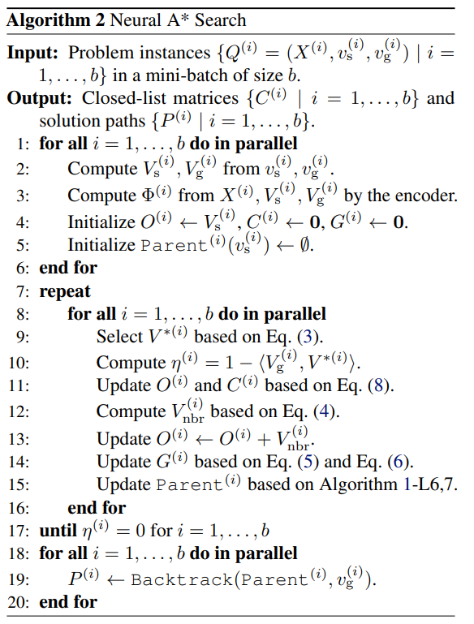
Differentiable A* Math Part 2 [1]
$G←G^{′}⨀V_{nbr}+\min\left(G^{′},G\right)⨀{\overline{V}}_{nbr}+G⨀\left(1−V_{nbr}−{\overline{V}}_{nbr}\right)$
$G^{′}=\left\langle G,V^{∗}\right\rangle ∙1+Φ$
$Φ$ is matrix of guidance costs
G is the sum of guidance costs
$L={\left\|C−\overline{P}\right\|}_{1}/\left|𝒱\right|$
To allow for minibatch training with searches of variable lengths, C and O are held constant after goal is found
A batch ends when every member has reached this state

Slide 14
Neural A*[1]
Encoder: U-Net with VGG-16 backbone
H: Chebyshev distance with Euclidean distance-based addition for tie-breaking
$τ=\sqrt{M}$

Slide 15
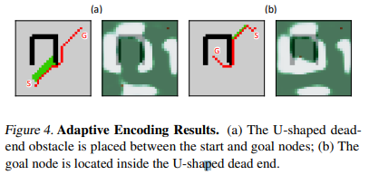
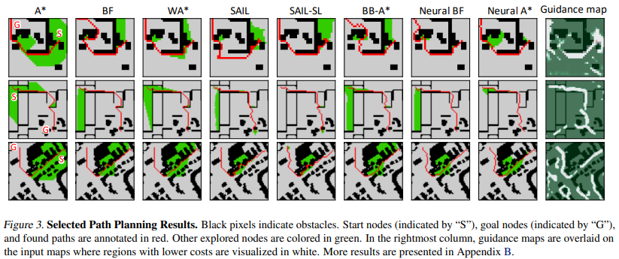
Qualitative Results [1]
Encoder successfully captures visual cues
Dead-end regions have high cost throughout
Shortcuts and bypasses have low cost

Slide 16
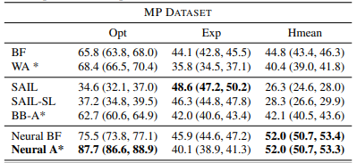
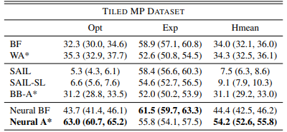
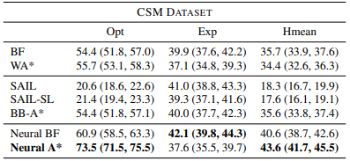
Quantitative Results [1]
Opt: path optimality ratio
Exp: Reduction ratio of node explorations
Hmean: Harmonic mean of Opt and Exp
Classical methods: Best-First (BF), Weighted A* (WA*)
Previous data-driven methods Search as Imitation Learning (SAIL for learned heuristic function, SAIL-SL for oracle planner), Blackbox-Differentiation A* (BB-A*)
Neural Best-First (Neural BF), Neural A* where $G=Φ$

Slide 17
Overview of Material
Discrete Path Planning: Search, Algorithms, and Heuristics
Path Planning using Neural A* Search [1]
Differentiable Spatial Planning using Transformers [2]
Boustrophedon Path Plans
Differentiable Boustrophedon Path Plans [4]
Navigation
Differentiable SLAM-net: Learning Particle SLAM for Visual Navigation [3]

Slide 18
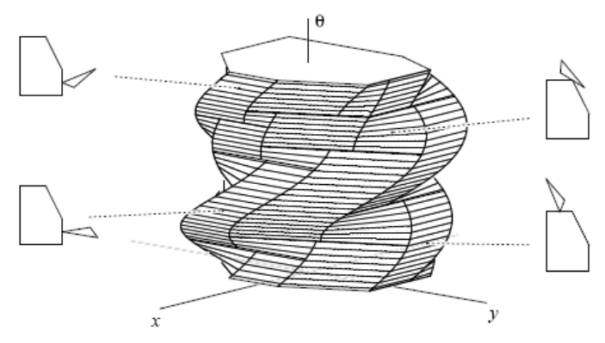
An Aside on Configuration Spaces [8]
Many path planning techniques assume that the agent is point-mass
Configuration space (or c-space) defines all possible agent parameters (think joint angles, location, etc)
We can treat an agent in this space a point-mass for path planning
Polygonal robot with c-space consisting of 2 positional and 1
Angular DOF [8]

Slide 19
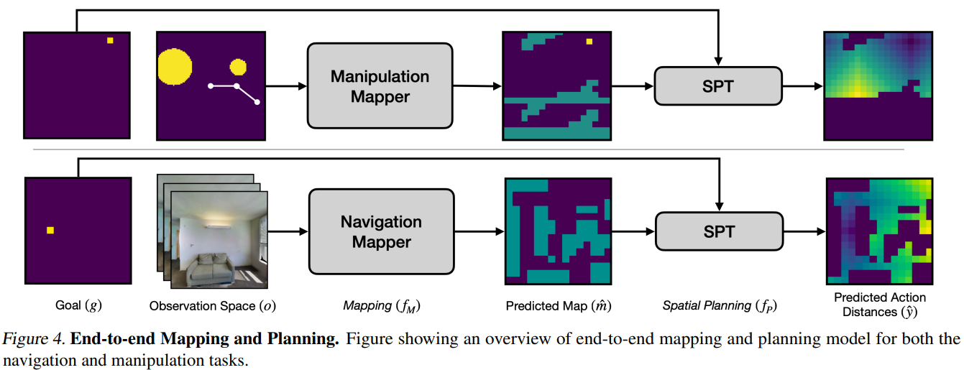
Differentiable Spatial Planning using Transformers [2]
Long-range value propagation using Spatial Planning Transformers (SPT)
Comparison of SPT vs other learned planning approaches
Differentiable framework for mapping and planning without a priori map

Slide 20
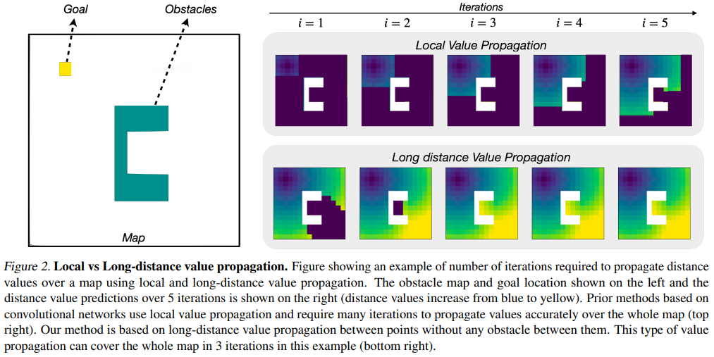
Local vs Long Distance Value Propagation [2]
Local
Distance values are “spread” across local neighborhood using CNN
$O\left(D\right);M≤D≤M^{2}$; $D$ is shortest-path length, $M$ is map length
Long-Distance
Uses transformer to avoid wasting computation on empty space
$O\left(n_{O}\right)$; $n_{O}$ is number of obstacles

Slide 21
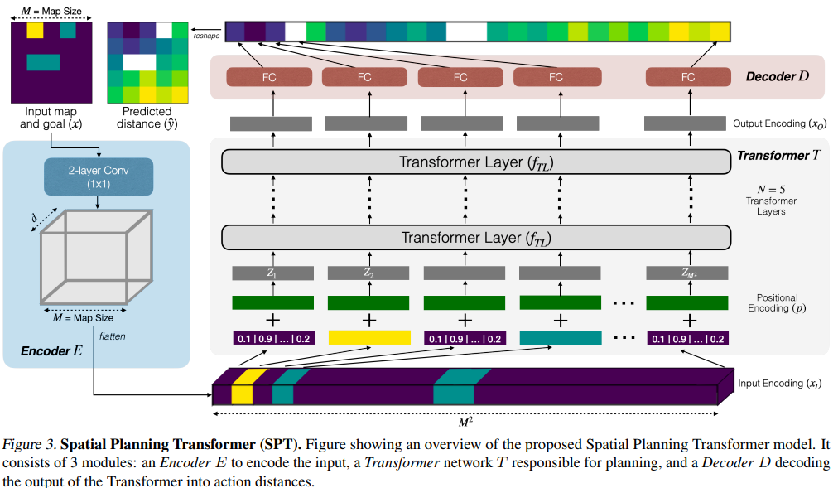
Spatial Planning Transformers [2]
Encoder E: creates embedding for goal and obstacles
Transformer: long-range distance propagation
Decoder: restores distance values to original space

Slide 22
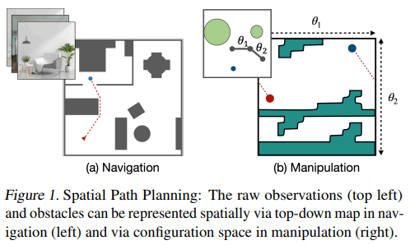
Planning with Unknown Maps [2]
$\hat{y}=f_{P}\left(\hat{m}\right)=f_{P}\left(f_{M}\left(o\right)\right)$; predict action distance $\hat{y}$ using the Planner $f_{P}$ on the predicted map $\hat{m}$, derived from the Mapper $f_{M}$ input with $o$ the sensor data
Sensor Data
Navigation: cardinal direction images for all valid locations
Manipulation: binary map of physical operational space
Planner will be the SPT model and is pretrained for end-to-end training with Mapper

Slide 23
Mapper [2]
Navigation
Predicts whether the central viewed cell is an obstacle for every image
Architecture: ResNet18 convolution layers followed by 3 fully connected layers (ReLU, ReLU, Sigmoid)
Final prediction for each cell is max pool of all predictions for that cell
Manipulation
Predicts whether a collision would occur for each configuration
Architecture: modified SPT with encoder using 3 x 3 convolution kernel

Slide 24
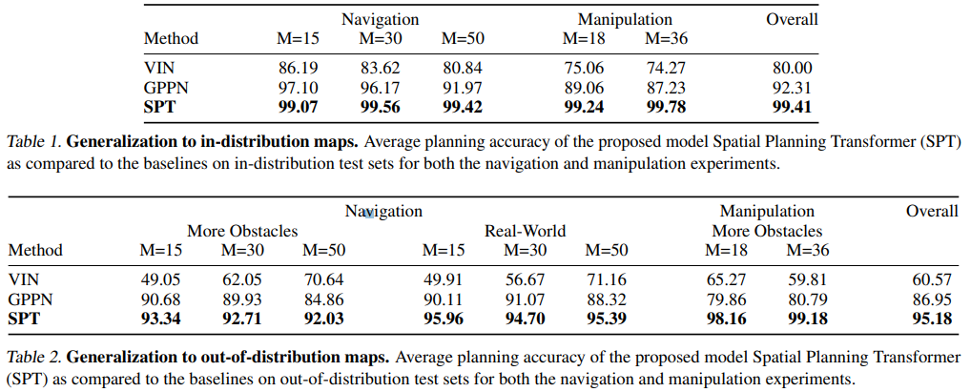
Known Map Comparison [2]
100K/5K/5K training/validation/test split
Accuracy is action prediction accuracy for all free cells on a map
A prediction is correct if one of the cells closest to the goal is selected
Really only care about relative distance between cells
Compared against Value Iteration Networks (VIN) and Gated Path-Planning Networks (GPPN)
Training modified so that comparison is against best model performance with inference time no more than 1.1 times SPT

Slide 25
Mapping and Planning Results [2]
Classical: monocular depth estimation model mapper with Dijkstra planner
100K/5K training/test split for manipulation
36K/7K training/test split for navigation (Habitat simulator)

Slide 26
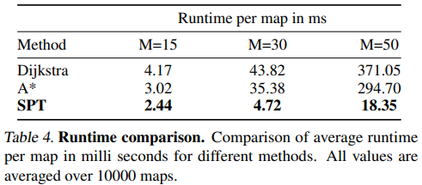
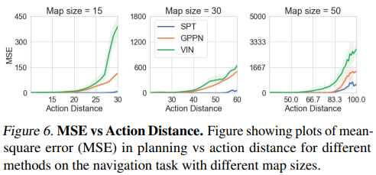
Analysis [2]
SPT is 1.24x - 20.22x faster than classical algorithms and scales better with map size
SPT performance scales much better with map size than other data-based methods

Slide 27
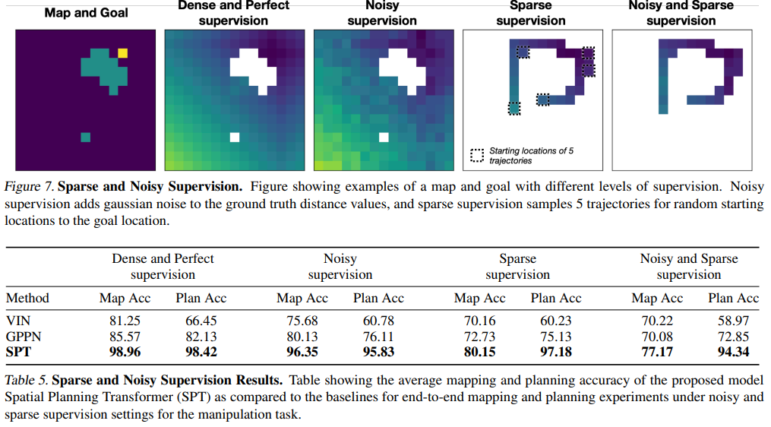
Noisy and Sparse Observations [2]
Noise: $N\left(μ=0,σ=1\right)$
Sparse: Only 5 trajectories provided

Slide 28
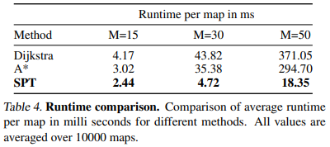
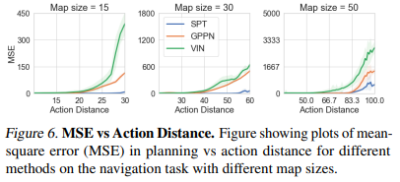
Scalability [2]
SPT runs faster than standard A* and Dijkstra and scales with map size better in terms of speed
SPT generates more accurate distance values than other data-driven methods and scales better with map size in terms of accuracy

Slide 29
Overview of Material
Discrete Path Planning: Search, Algorithms, and Heuristics
Path Planning using Neural A* Search [1]
Differentiable Spatial Planning using Transformers [2]
Boustrophedon Path Plans
Differentiable Boustrophedon Path Plans [4]
Navigation
Differentiable SLAM-net: Learning Particle SLAM for Visual Navigation [3]

Slide 30
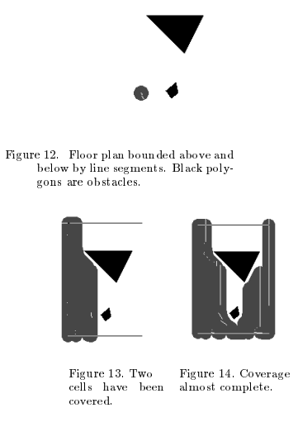
Boustrophedon Path Plans [9]
Boustrophedon: “way of the ox”
Goal: make a path such that every point in the map is within coverage range at some point during the path
Generally, a lawnmower-pattern emerges
In practice, breaks the world into convex polygons of free space, sweeps each polygon, and then repeats for every polygon
Coverage planning by Boustrophedon Cellular Decomposition [9]

Slide 31
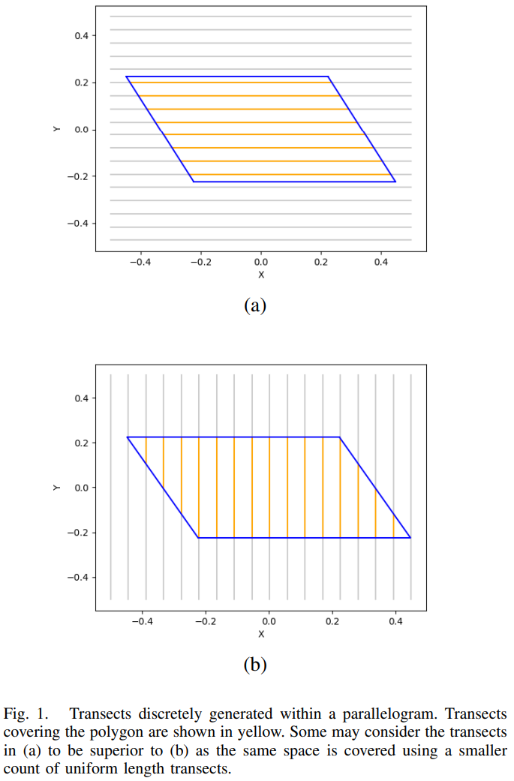
Differentiable Boustrophedon Path Plans [4]
Differentiability allows for a much finer optimization than under current methdos
Numerically stable and differentiable representation for boustrophedon paths over convex polygons
Comparison with classical discrete methods
Examination of complexity of optimization space

Slide 32
Discrete Formulation [4]
$f\left(θ\right)=a∙{m^{′}}_{θ}+b∙\left(1−{COV}_{θ}\right)$
Discrete objective function for maximizing mean transect length and standard deviation in transect length
Potential application: marine vehicle sonar
Long transects improve platform stability
Transects of similar length improves ease of sensor interpretation

Slide 33
Differentiable Polygons Part 1 [4]
Approximate each polygon face with $W^{T}X+B$
Resize polygon’s maximal dimension to 1
Given edge defined by $\left(x_{1},y_{1}\right),\left(x_{2},y_{2}\right)$
$X_{e}=\left(\begin{matrix}x_{1} & 1 \\ x_{2} & 1\end{matrix}\right)$, $Y_{e}=\left(\begin{matrix}y_{1} & 1 \\ y_{2} & 1\end{matrix}\right)$, $C_{e}=\left(\begin{matrix}x_{1} & y_{1} \\ x_{2} & y_{2}\end{matrix}\right)$
$W=\left[\begin{matrix}Det\left(X_{e}\right) & Det\left(Y_{e}\right)\end{matrix}\right]$
$B=Det\left(C_{e}\right)$

Slide 34
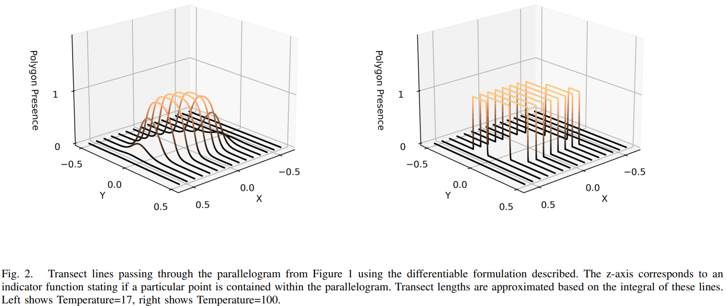
Differentiable Polygons Part 2 [4]
$v=W^{T}X+B$
$P\left(X,F,Temp\right)=\prod_{\left(W,B\right)∈F}{σ\left(W^{T}X+B ,Temp\right)}$
Indicator function for whether point falls in polygon
$P_{σ}\left(X,F,Temp\right)=σ\left(P\left(X,F,Temp\right)−0.5,Temp\right)$
Modification for numeric stability

Slide 35
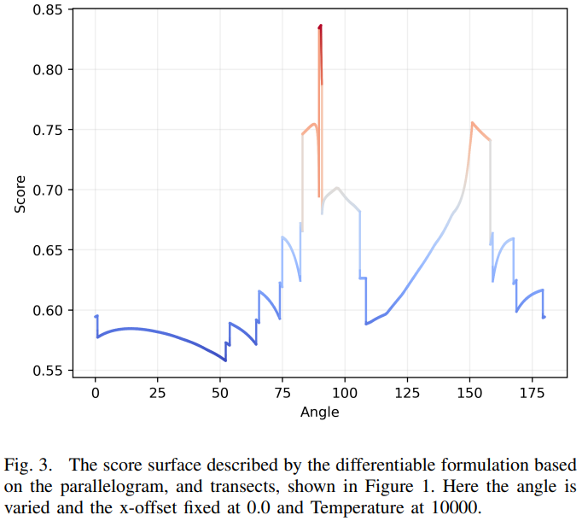
Differentiable Transects and Scoring Function [4]
Single transect length: $\int_{−0.5}^{0.5}{P_{σ}\left(\left[\begin{matrix}x & y\end{matrix}\right],F,Temp\right)}dy$
$S\left(x,F,Temp\right)=\frac{\int_{−0.5}^{0.5}{P_{σ}\left(\left[\begin{matrix}x & y\end{matrix}\right],F,Temp\right)}dy−0.5}{0.5}$
Differentiating for optimal $θ$ and x-offset
Spacing is fixed we are moving along x-axis and rotating polygon

Slide 36
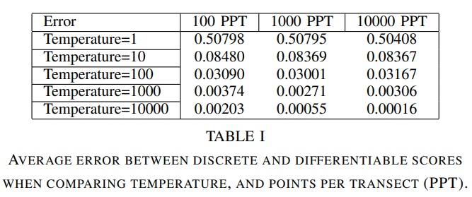
Comparison with Discrete Formulation [4]
Assumption that discrete is optimal, examining tradeoff for differentiability
Temperature increases fidelity, but costs computation time
Eventually high temperatures will cause numeric instability from floating point overflow

Slide 37
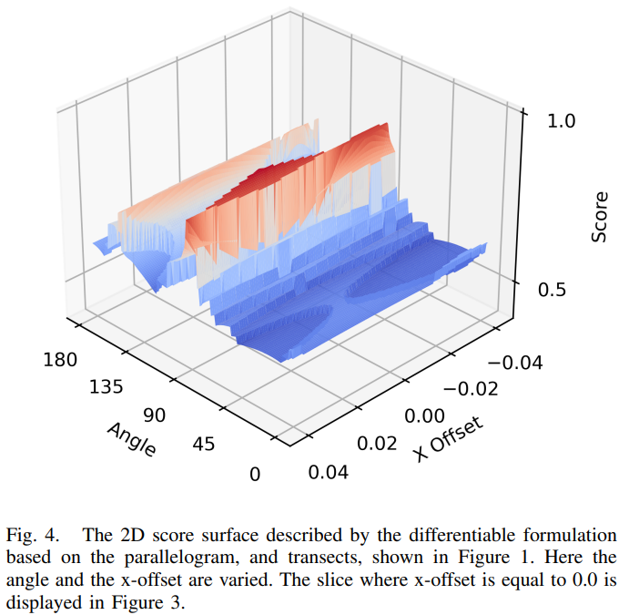
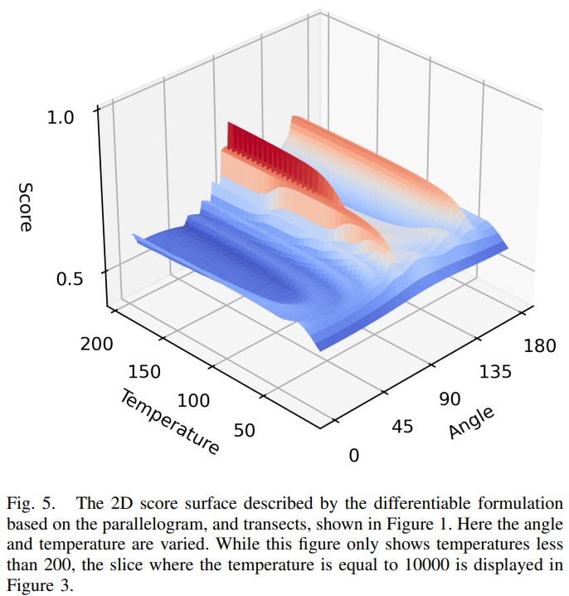
Optimization Space and Ramifications [4]
Extreme nonconvexity due to transects entering and leaving polygon with parameter variation
Gradient descent insufficient for optimization
Given 1000 randomly generated polygons, method found optima roughly 0.13633 higher than truth

Slide 38
Overview of Material
Discrete Path Planning: Search, Algorithms, and Heuristics
Path Planning using Neural A* Search [1]
Differentiable Spatial Planning using Transformers [2]
Boustrophedon Path Plans
Differentiable Boustrophedon Path Plans [4]
Navigation
Differentiable SLAM-net: Learning Particle SLAM for Visual Navigation [3]

Slide 39
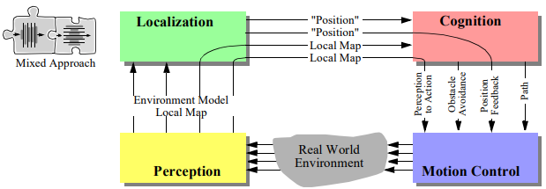
Navigation [10]
Navigation requires path planning, but it also requires a way to sense and understand an environment
Basic architectural diagram of an agent that must
perform navigation [10]

Slide 40
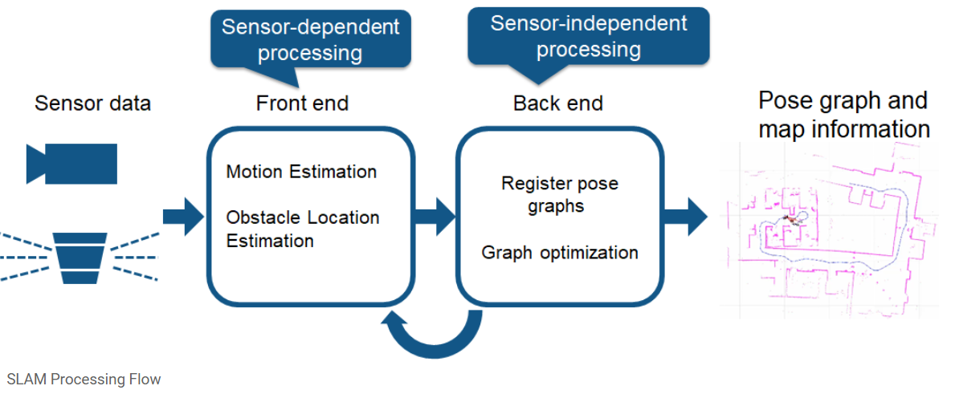
Simultaneous Localization and Mapping (SLAM) [11]
Localization: understanding your position and orientation within a map
Mapping: building a model and representation of the world
Task: build a map of the area and localize yourself within it given only sensor measurements
Example next slide [12]
[11]

Slide 42
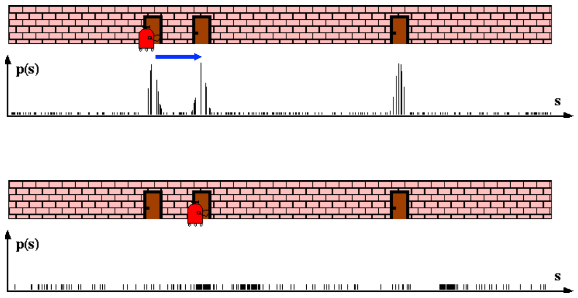
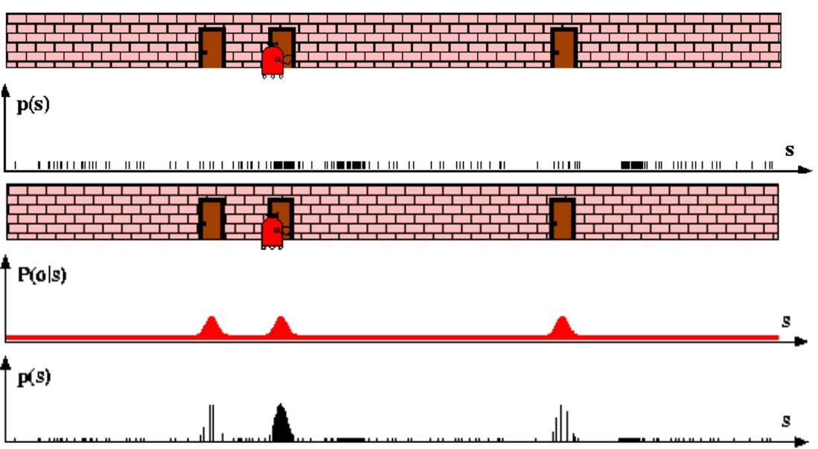
Particle Filters [13]
Idea: create a bunch of random potential states, take a measurement, replace improbable states, keep doing this until states converge
Dynamics/Transition Model: given the state at time t, what is the state at time t+1
Observation Model: Given a measurement at t, what is the probability that a state is correct
1D example of a particle filter. The conditional probability is used to guide sampling. [13]

Slide 43
Overview of Material
Discrete Path Planning: Search, Algorithms, and Heuristics
Path Planning using Neural A* Search [1]
Differentiable Spatial Planning using Transformers [2]
Boustrophedon Path Plans
Differentiable Boustrophedon Path Plans [4]
Navigation
Differentiable SLAM-net: Learning Particle SLAM for Visual Navigation [3]

Slide 44
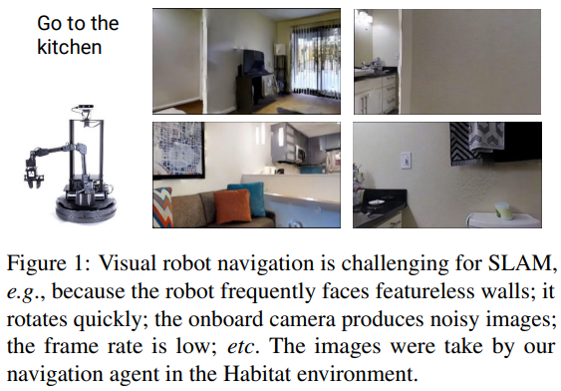
Differentiable SLAM-net: Learning Particle SLAM for Visual Navigation [3]
SLAM-net, SLAM algorithm as a differentiable module
Navigation architecture that uses SLAM-net
Experiments on Habitat simulator and self-driving odometry data

Slide 45
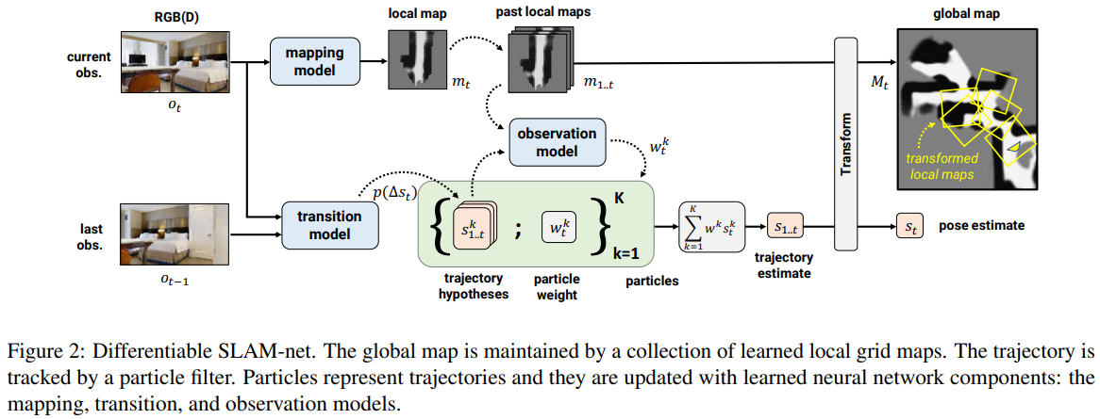
SLAM-Net [3]
3 DOF: 2 positional, one angular

Slide 46
SLAM-Net Models [3]
Transition
takes current and previous observations and ouputs Gaussian mixture model parameters
Pre-trained to maximize the log-likelihood of true relative poses along training trajectories
Mapping
CNN with transformer pre-input layer
Takes observation and outputs local map
Observation
CNN takes in pairs of local maps and output compatibility value
Overall compaitiblity is the sum of pairwaise compatibility values along particle trajectory
Done for only “most relevant” pairs as determined by geometric constraints

Slide 47
Training [3]
Pretrain the transition model
Pretrain the observation and mapping models together with ground truth values and added noise
Finetune models together for end objective
Convolution layers are frozen along the mixture head of the transition model
Training trajectories are much shorter and particles much fewer for computational reasons than during inference

Slide 48
Navigation Implementation [3]
Path planner: weighted D* that penalizes being near obstacles
Path is replanned every map and pose update
Collision recovery initiated when estimated pose remains within 3 cm during forward actions
Does a full rotation at episode start

Slide 49
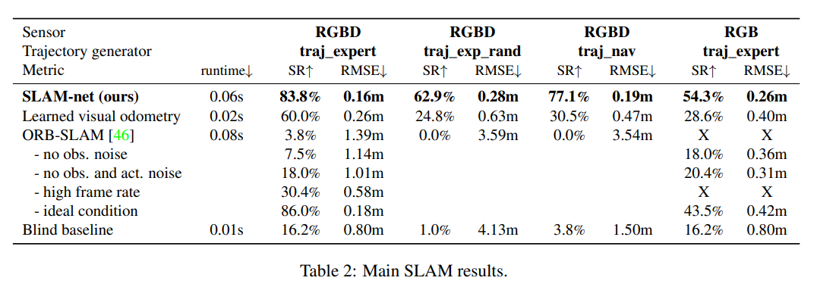
Experiments [3]
Robot navigates unseen apartment with noisy RGB input
Only a priori information is goal’s location relative to start
Task ends when robot decides to stop within 0.36 m of goal

Slide 50
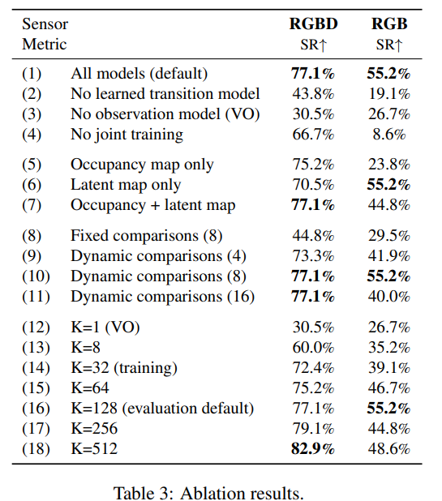
Ablation Study [3]
All the models are useful
Dynamic comparison are useful
Model may be overfitting to 8 comparison condition
More particles help, but benefits tapper off at 128 particles

Slide 51
Concluding Thoughts
Differentiable programming has many promising applications in navigation and path planning
Memory cost and training time might limit widespread adoption
Neural A*: might be generalizable to more graph-based search problems
Spatial Planning Transformers: can it be dynamic?
Boustrophedon Paths: needs to be able to handle more beyond convex polygons
SLAM-Net: Gaussian filter?

Slide 52
Citations
Abbeel, P. (n.d.). Particle Filters. Robotics. https://homes.cs.washington.edu/~todorov/courses/cseP590/16_ParticleFilter.pdf [13]
Choset, H., & Pignon, P. (1998). Coverage Path Planning: The Boustrophedon Cellular Decomposition. [9]
Choset, H. (n.d.). Robotic Motion Planning: Configuration Space - Carnegie Mellon University. Robotic Motion Planning. https://www.cs.cmu.edu/~motionplanning/lecture/Chap3-Config-Space_howie.pdf [8]
Devendra Singh Chaplot, Deepak Pathak, Jitendra Malik: Differentiable Spatial Planning using Transformers. CoRR abs/2112.01010 (2021)[2]
DROID-SLAM: Deep Visual SLAM for Monocular, Stereo and RGB-D Cameras. (2021). YouTube. Retrieved October 23, 2023, from https://www.youtube.com/watch?v=GG78CSlSHSA. [12]
Gershenfeld, N. (n.d.). Robotic Path Planning. Path Planning. https://fab.cba.mit.edu/classes/865.21/topics/path_planning/robotic.html [6]
Karur, K., Sharma, N., Dharmatti, C., & Siegel, J.E. (2021). A Survey of Path Planning Algorithms for Mobile Robots. Vehicles. [5]
Kask, K. (n.d.). Set 3: Informed heuristic search - donald bren school of information ... CompSci 271: Introduction to Artificial Intelligence, Fall 2016. https://ics.uci.edu/~kkask/Fall-2016%20CS271/slides/03-InformedHeuristicSearch.pdf [7]
Manzini, T., & Murphy, R. (2023). Differentiable Boustrophedon Path Plans. arXiv preprint arXiv:2309.09882. [4]
MathWorks. (n.d.). What is SLAM (simultaneous localization and mapping) – matlab & simulink. What Is SLAM (Simultaneous Localization and Mapping) – MATLAB & Simulink - MATLAB & Simulink. https://www.mathworks.com/discovery/slam.html [11]
Péter Karkus, Shaojun Cai, David Hsu: Differentiable SLAM-net: Learning Particle SLAM for Visual Navigation. CoRR abs/2105.07593 (2021) [3]
Planning and Navigation. CMU School of Computer Science. (n.d.). https://www.cs.cmu.edu/~rasc/Download/AMRobots6.pdf [10]
Ryo Yonetani, Tatsunori Taniai, Mohammadamin Barekatain, Mai Nishimura, Asako Kanezaki: Path Planning using Neural A* Search. CoRR abs/2009.07476 (2020) [1]

Slide 53
Questions?

