Slide 1
CSMC 412
Operating Systems
Prof. Ashok K Agrawala
Set 15

Slide 2
Mass-Storage Systems
Overview of Mass Storage Structure
Disk Structure
Disk Attachment
Disk Scheduling
Disk Management
Swap-Space Management
RAID Structure
Stable-Storage Implementation

Slide 3
Objectives
To describe the physical structure of secondary storage devices and its effects on the uses of the devices
To explain the performance characteristics of mass-storage devices
To evaluate disk scheduling algorithms
To discuss operating-system services provided for mass storage, including RAID

Slide 4
Overview of Mass Storage Structure
Magnetic disks provide bulk of secondary storage of modern computers
  Drives rotate at 60 to 250 times per second
  Transfer rate is rate at which data flow between drive and computer
  Positioning time (random-access time) is time to move disk arm to desired cylinder (seek time) and time for desired sector to rotate under the disk head (rotational latency)
  Head crash results from disk head making contact with the disk surface -- That’s bad
Disks can be removable
Drive attached to computer via I/O bus
  Busses vary, including EIDE, ATA, SATA, USB, Fibre Channel, SCSI, SAS, Firewire
  Host controller in computer uses bus to talk to disk controller built into drive or storage array

Slide 5
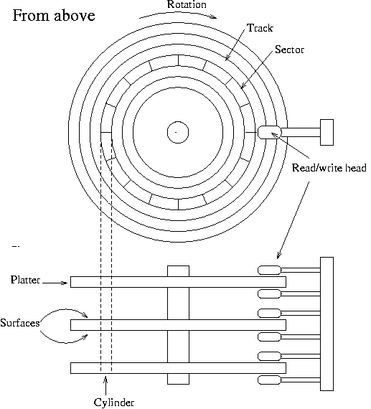
Disk Organization

Slide 6
Moving-head Disk Mechanism

Slide 7
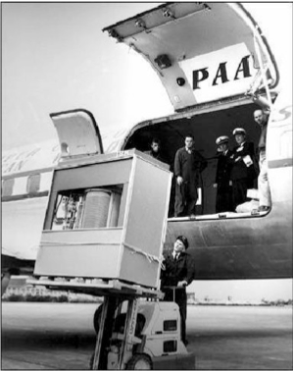
The First Commercial Disk Drive
1956
IBM RAMDAC computer included the IBM Model 350 disk storage system
5M (7 bit) characters
50 x 24” platters
Access time = < 1 second

Slide 8
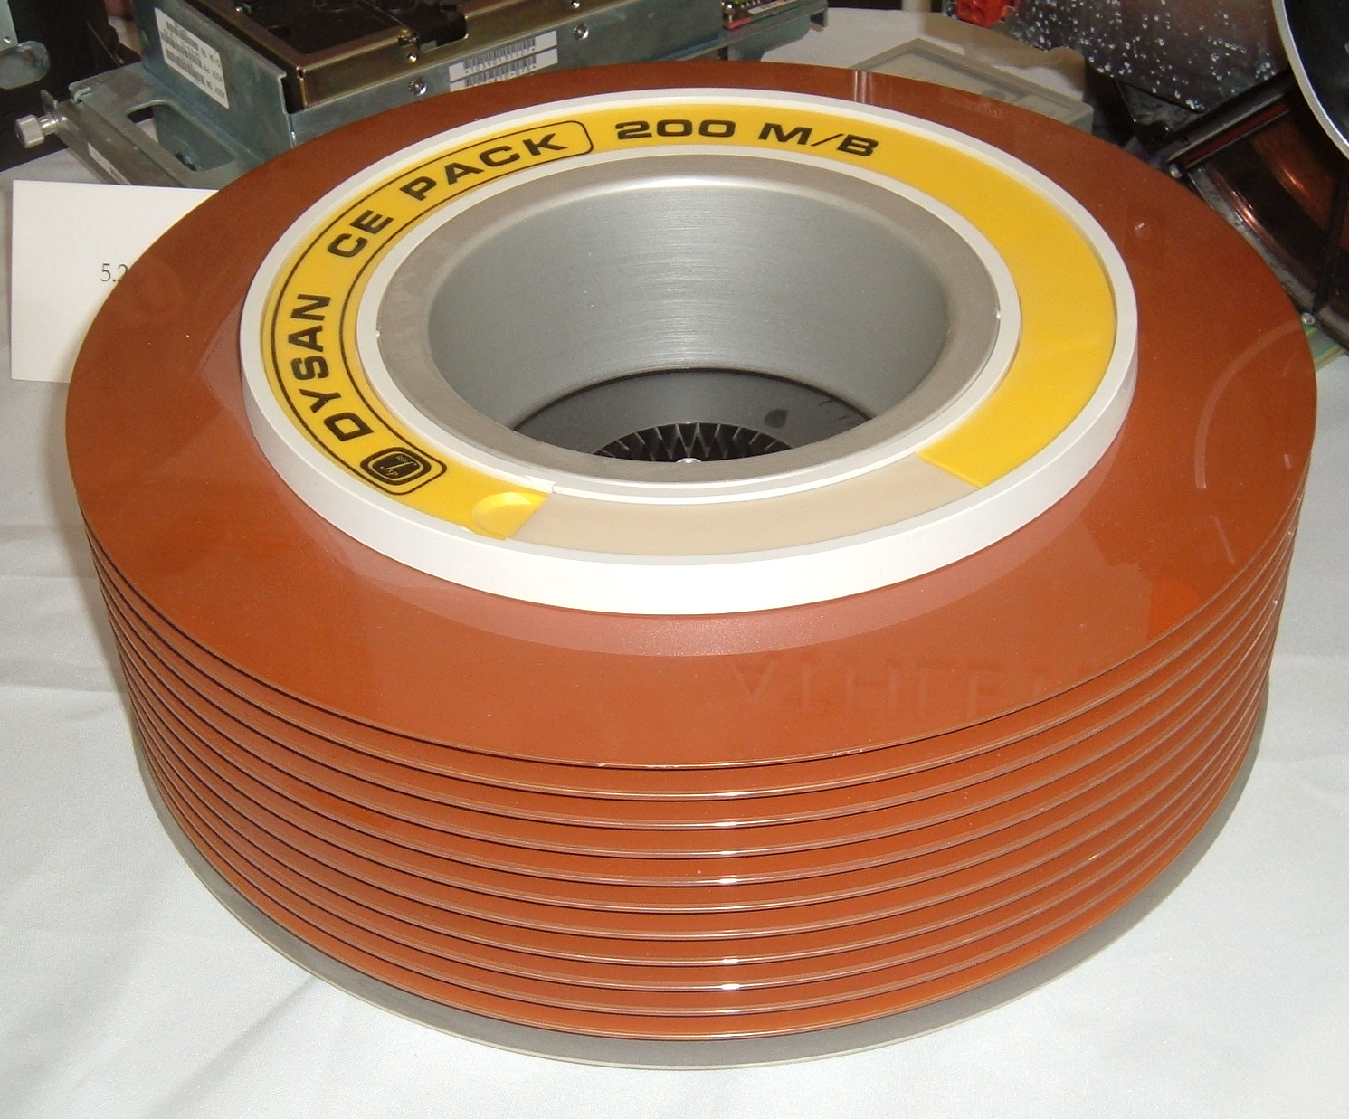
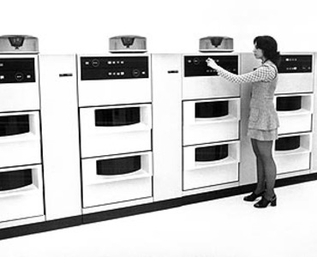
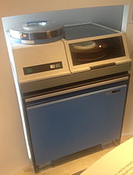
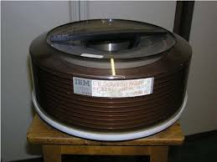
IBM 3330 Disk Drives

Slide 9
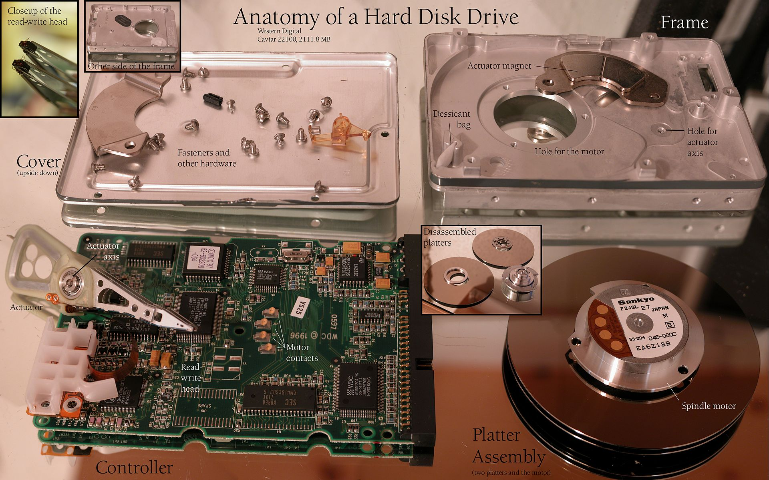
Vintage 1997 Disk Drive

Slide 10
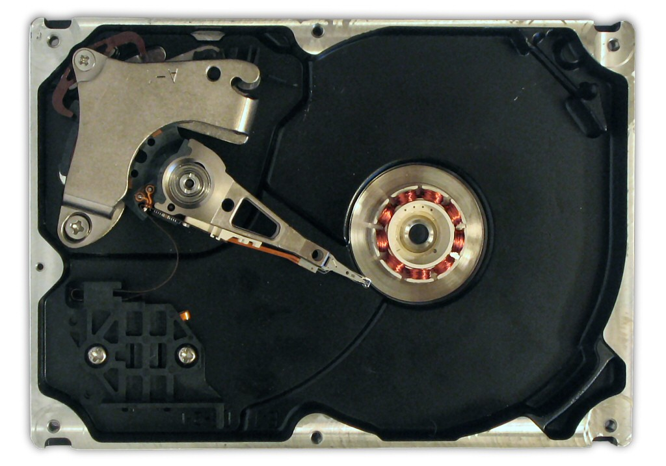

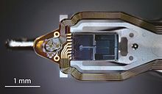

Slide 11
HDD Improvements
Parameter | Started with (1957) | Developed to (2018) | Improvement
Capacity (formatted) | 3.75 megabytes | 15 terabytes | 4-million-to-one
Physical volume | 68 cubic feet(1.9 m³) | 2.1 cubic inches(34 cm³) | 56,000-to-one
Weight | 2,000 pounds(910 kg) | 2.2 ounces (62 g) | 15,000-to-one
Average access time | approx. 600 milliseconds | 2.5 ms to 10 ms; RW RAM dependent | About 200-to-one
Price | US$9,200 per megabyte (1961) | US$0.032 per gigabyteby 2015 | 300-million-to-one
Data density | 2,000 bits per square inch | 1.3 terabits per square inch in 2015 | 650-million-to-one
Average lifespan | c. 2000 hrs MTBF | c. 2,500,000 hrs (~285 years) MTBF | 1250-to-one

Slide 12
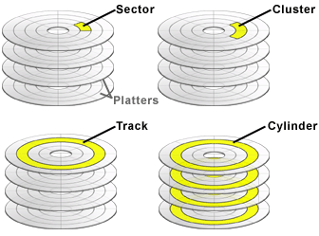
Sector, Track, Cluster, Cylinder

Slide 13
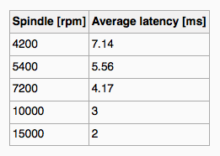
Hard Disks
Platters range from .85” to 14” (historically)
  Commonly 3.5”, 2.5”, and 1.8”
Range from 30GB to 16TB per drive
Performance
  Transfer Rate – theoretical – 6 Gb/sec
  Effective Transfer Rate – real – 1Gb/sec
  Seek time from 3ms to 12ms – 9ms common for desktop drives
  Average seek time measured or calculated based on 1/3 of tracks
  Latency based on spindle speed
    1 / (RPM / 60) = 60 / RPM
  Average latency = ½ latency
(From Wikipedia)

Slide 14
Hard Disk Performance
Access Latency = Average access time = average seek time + average latency
  For fastest disk 3ms + 2ms = 5ms
  For slow disk 9ms + 5.56ms = 14.56ms
Average I/O time = average access time + (amount to transfer / transfer rate) + controller overhead
For example, to transfer a 4KB block on a 7200 RPM disk with a 5ms average seek time, 1Gb/sec transfer rate with a .1ms controller overhead =
  5ms + 4.17ms + 0.1ms + transfer time =
  Transfer time = 4KB / 1Gb/s * 8Gb / GB * 1GB / 1024²KB = 32 / (1024²) = 0.031 ms
  Average I/O time for 4KB block = 9.27ms + .031ms = 9.301ms

Slide 15
Solid State Drives
Original concept by Storage Technology Corp in 1978
Introduced by SanDisk in 1991
  Capacity 20MB in 2.5 inch form factor.
Current capacities up to 100 TB

Slide 16
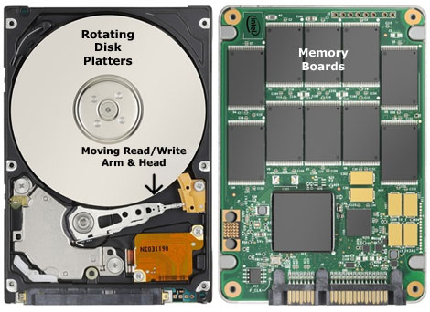

mSATA SSD with external enclosure

Slide 17
SSD Improvements over time
Parameter | Started with (1991) | Developed to (2018) | Improvement
Capacity | 20 megabytes | 100 terabytes (Nimbus Data DC100) | 5-million-to-one
Price | US$50 per megabyte | US$0.372 per gigabyte (Samsung PM1643) | 134,408-to-one

Slide 18
Solid-State Disks
Nonvolatile memory used like a hard drive
  Many technology variations
Can be more reliable than HDDs
More expensive per MB
Maybe have shorter life span
Less capacity
But much faster
Busses can be too slow -> connect directly to PCI for example
No moving parts, so no seek time or rotational latency

Slide 19
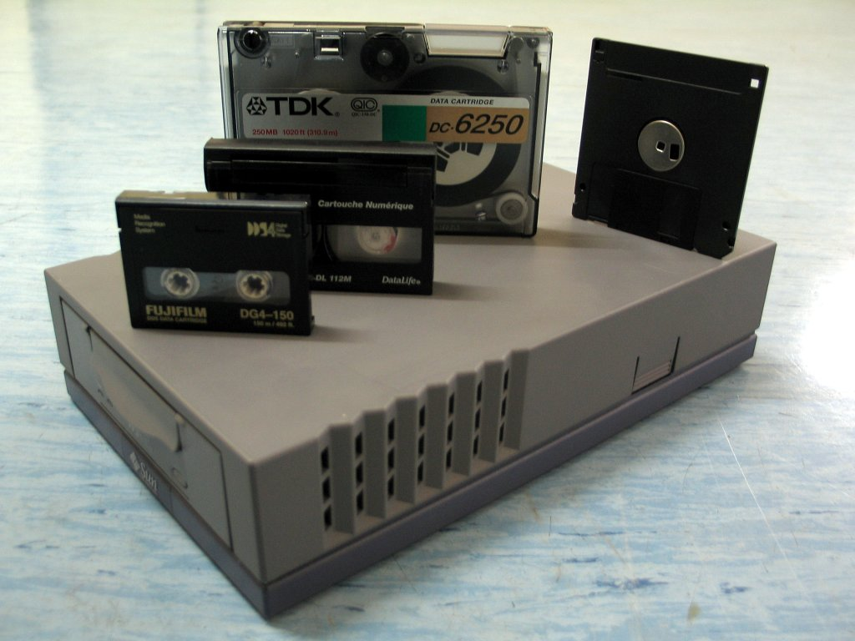
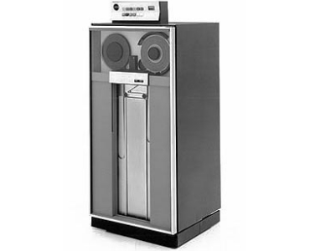
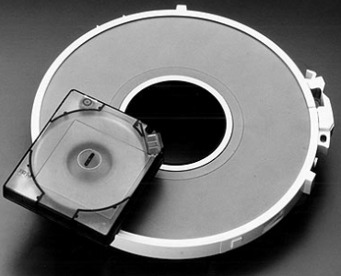
Magnetic Tapes

Slide 20


Slide 21
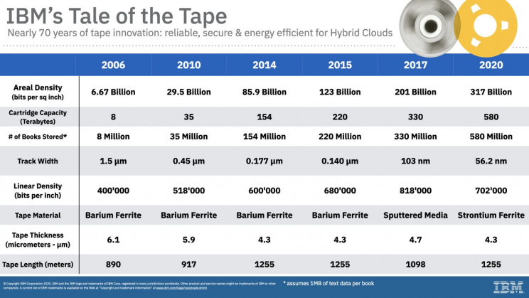

Slide 22
Magnetic Tape
Was early secondary-storage medium
  Evolved from open spools to cartridges
Relatively permanent and holds large quantities of data
Access time slow
Random access ~1000 times slower than disk
Mainly used for backup, storage of infrequently-used data, transfer medium between systems
Kept in spool and wound or rewound past read-write head
Once data under head, transfer rates comparable to disk
  140MB/sec and greater

Slide 23
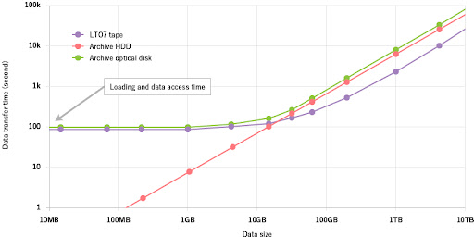
Disk Vs Tape Storage

Slide 24
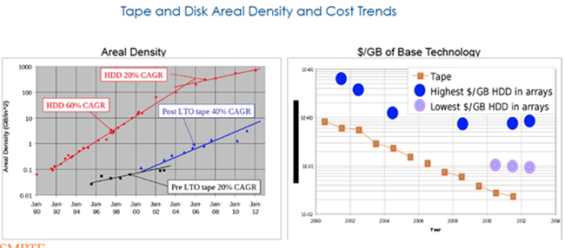

Slide 25
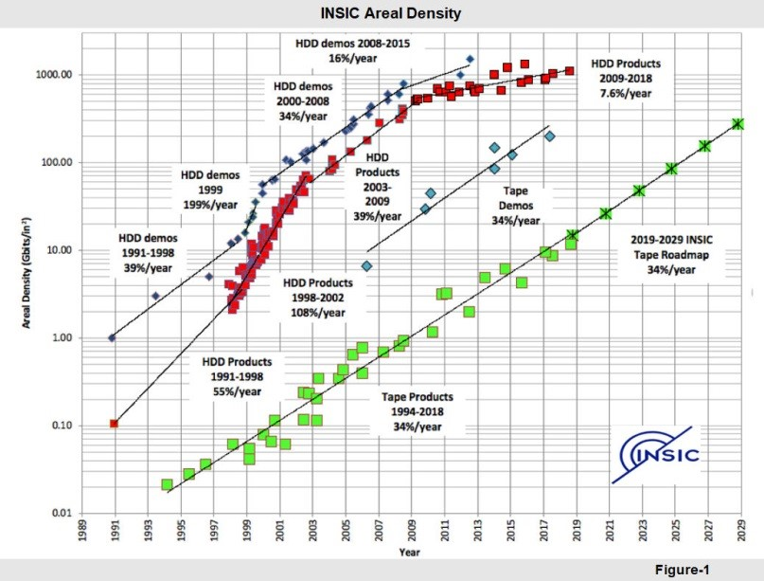

Slide 26
Disk Structure - Logical
Disk drives are addressed as large 1-dimensional arrays of logical blocks, where the logical block is the smallest unit of transfer
  Low-level formatting creates logical blocks on physical media
The 1-dimensional array of logical blocks is mapped into the sectors of the disk sequentially
  Sector 0 is the first sector of the first track on the outermost cylinder
  Mapping proceeds in order through that track, then the rest of the tracks in that cylinder, and then through the rest of the cylinders from outermost to innermost
  Logical to physical address should be easy
    Except for bad sectors
    Non-constant # of sectors per track via constant angular velocity

Slide 27
Disk Attachment
Host-attached storage accessed through I/O ports talking to I/O busses
SCSI itself is a bus, up to 16 devices on one cable, SCSI initiator requests operation and SCSI targets perform tasks
  Each target can have up to 8 logical units (disks attached to device controller)
FC is high-speed serial architecture
  Can have a switched fabric with 24-bit address space – the basis of storage area networks (SANs) in which many hosts attach to many storage units
I/O directed to bus ID, device ID, logical unit (LUN)

Slide 28
Storage Array
Can just attach disks, or arrays of disks
Storage Array has controller(s), provides features to attached host(s)
  Ports to connect hosts to array
  Memory, controlling software (sometimes NVRAM, etc)
  A few to thousands of disks
  RAID, hot spares, hot swap (discussed later)
  Shared storage -> more efficiency
  Features found in some file systems
    Snaphots, clones, thin provisioning, replication, deduplication, etc

Slide 29
Storage Area Network
Common in large storage environments
Multiple hosts attached to multiple storage arrays - flexible

Slide 30
Storage Area Network (Cont.)
SAN is one or more storage arrays
  Connected to one or more Fibre Channel switches
Hosts also attach to the switches
Storage made available via LUN Masking from specific arrays to specific servers
Easy to add or remove storage, add new host and allocate it storage
  Over low-latency Fibre Channel fabric
Why have separate storage networks and communications networks?
  Consider iSCSI, FCOE

Slide 31
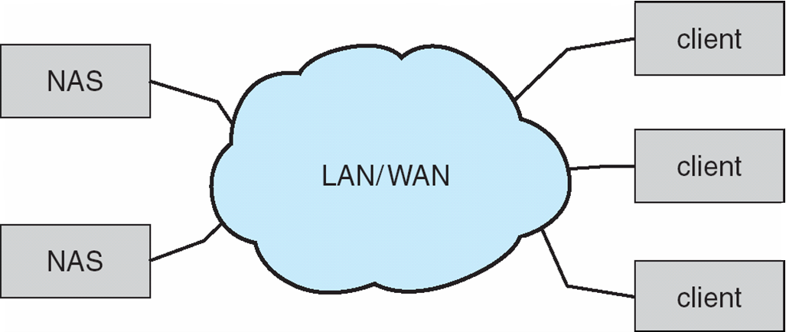
Network-Attached Storage
Network-attached storage (NAS) is storage made available over a network rather than over a local connection (such as a bus)
  Remotely attaching to file systems
NFS and CIFS are common protocols
Implemented via remote procedure calls (RPCs) between host and storage over typically TCP or UDP on IP network
iSCSI protocol uses IP network to carry the SCSI protocol
  Remotely attaching to devices (blocks)

Slide 32
Disk Scheduling
The operating system is responsible for using hardware efficiently — for the disk drives, this means having a fast access time and disk bandwidth
Minimize seek time
Seek time ≈ seek distance
Disk bandwidth is the total number of bytes transferred, divided by the total time between the first request for service and the completion of the last transfer

Slide 33
Disk Scheduling (Cont.)
There are many sources of disk I/O request
  OS
  System processes
  User processes
I/O request includes input or output mode, disk address, memory address, number of sectors to transfer
OS maintains queue of requests, per disk or device
Idle disk can immediately work on I/O request, busy disk means work must queue
  Optimization algorithms only make sense when a queue exists

Slide 34
Disk Scheduling (Cont.)
Note that drive controllers have small buffers and can manage a queue of I/O requests (of varying “depth”)
Several algorithms exist to schedule the servicing of disk I/O requests
The analysis is true for one or many platters
We illustrate scheduling algorithms with a request queue (0-199)
98, 183, 37, 122, 14, 124, 65, 67
Head pointer 53

Slide 35
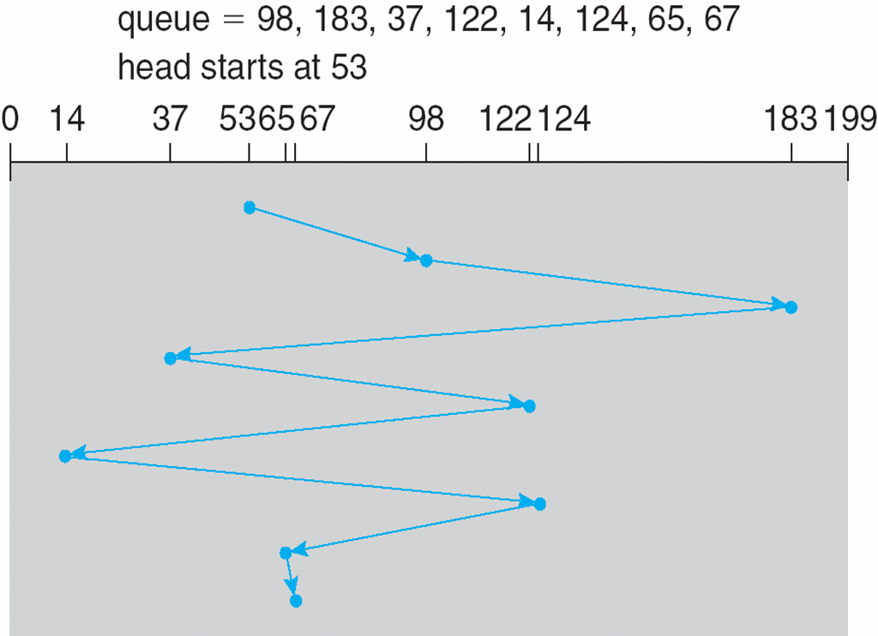
FCFS
Illustration shows total head movement of 640 cylinders

Slide 36
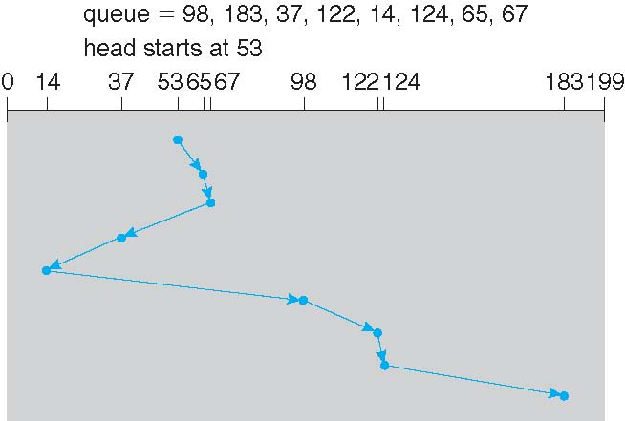
SSTF
Shortest Seek Time First selects the request with the minimum seek time from the current head position
SSTF scheduling is a form of SJF scheduling; may cause starvation of some requests
Illustration shows total head movement of 236 cylinders

Slide 37
SCAN
The disk arm starts at one end of the disk, and moves toward the other end, servicing requests until it gets to the other end of the disk, where the head movement is reversed and servicing continues.
SCAN algorithm Sometimes called the elevator algorithm
Illustration shows total head movement of 236 cylinders
But note that if requests are uniformly dense, largest density at other end of disk and those wait the longest

Slide 38
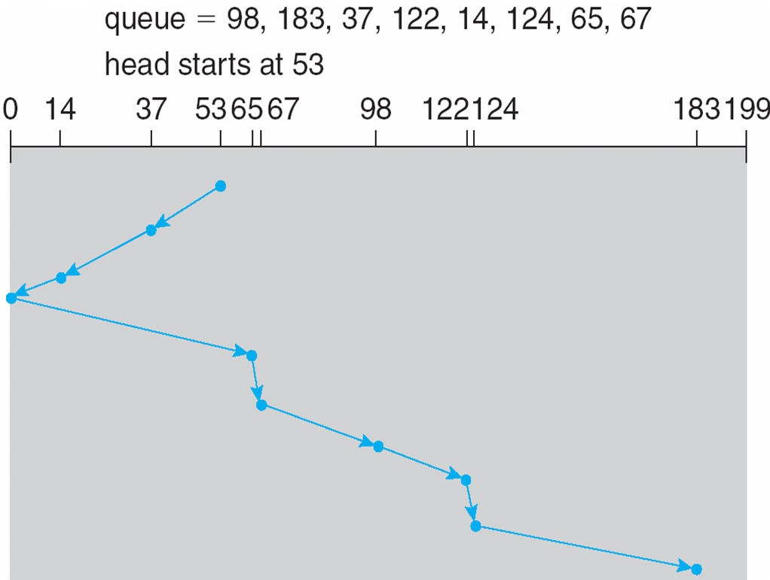
SCAN (Cont.)

Slide 39
C-SCAN
Provides a more uniform wait time than SCAN
The head moves from one end of the disk to the other, servicing requests as it goes
  When it reaches the other end, however, it immediately returns to the beginning of the disk, without servicing any requests on the return trip
Treats the cylinders as a circular list that wraps around from the last cylinder to the first one
Total number of cylinders?

Slide 40
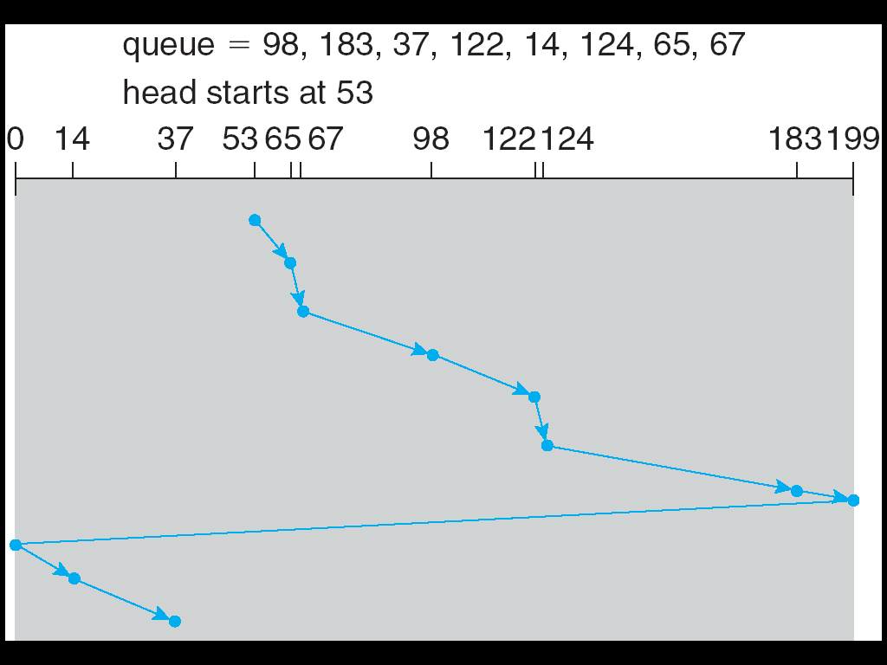
C-SCAN (Cont.)

Slide 41
C-LOOK
LOOK a version of SCAN, C-LOOK a version of C-SCAN
Arm only goes as far as the last request in each direction, then reverses direction immediately, without first going all the way to the end of the disk
Total number of cylinders?

Slide 42
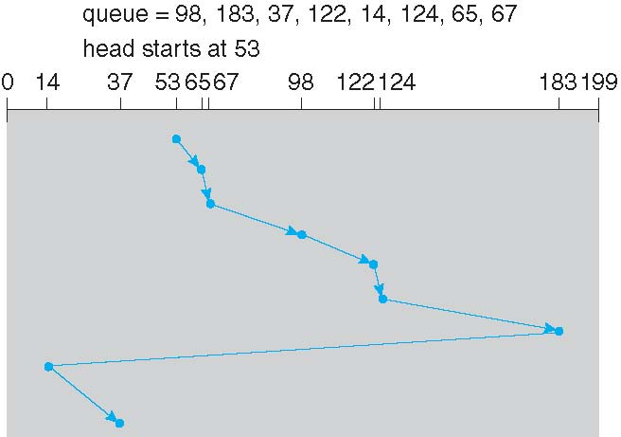
C-LOOK (Cont.)

Slide 43
Selecting a Disk-Scheduling Algorithm
SSTF is common and has a natural appeal
SCAN and C-SCAN perform better for systems that place a heavy load on the disk
  Less starvation
Performance depends on the number and types of requests
Requests for disk service can be influenced by the file-allocation method
  And metadata layout
The disk-scheduling algorithm should be written as a separate module of the operating system, allowing it to be replaced with a different algorithm if necessary
Either SSTF or LOOK is a reasonable choice for the default algorithm
What about rotational latency?
  Difficult for OS to calculate
How does disk-based queueing effect OS queue ordering efforts?

Slide 44
Disk Management
Low-level formatting, or physical formatting — Dividing a disk into sectors that the disk controller can read and write
  Each sector can hold header information, plus data, plus error correction code (ECC)
  Usually 512 bytes of data but can be selectable
To use a disk to hold files, the operating system still needs to record its own data structures on the disk
  Partition the disk into one or more groups of cylinders, each treated as a logical disk
  Logical formatting or “making a file system”
  To increase efficiency most file systems group blocks into clusters
    Disk I/O done in blocks
    File I/O done in clusters

Slide 45
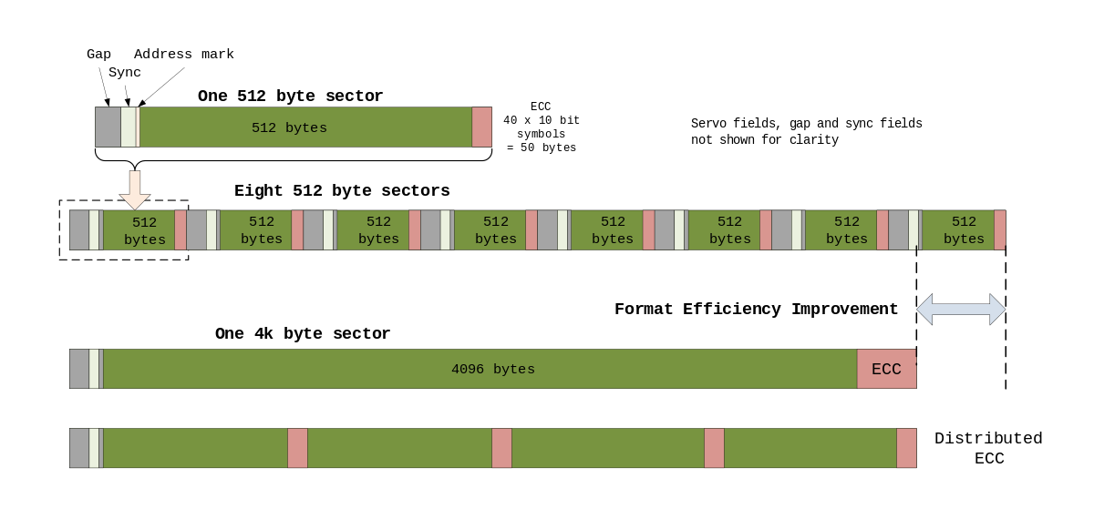
Sector Format

Slide 46
Disk Management (Cont.)
Raw disk access for apps that want to do their own block management, keep OS out of the way (databases for example)
Boot block initializes system
  The bootstrap is stored in ROM
  Bootstrap loader program stored in boot blocks of boot partition
Methods such as sector sparing used to handle bad blocks

Slide 47
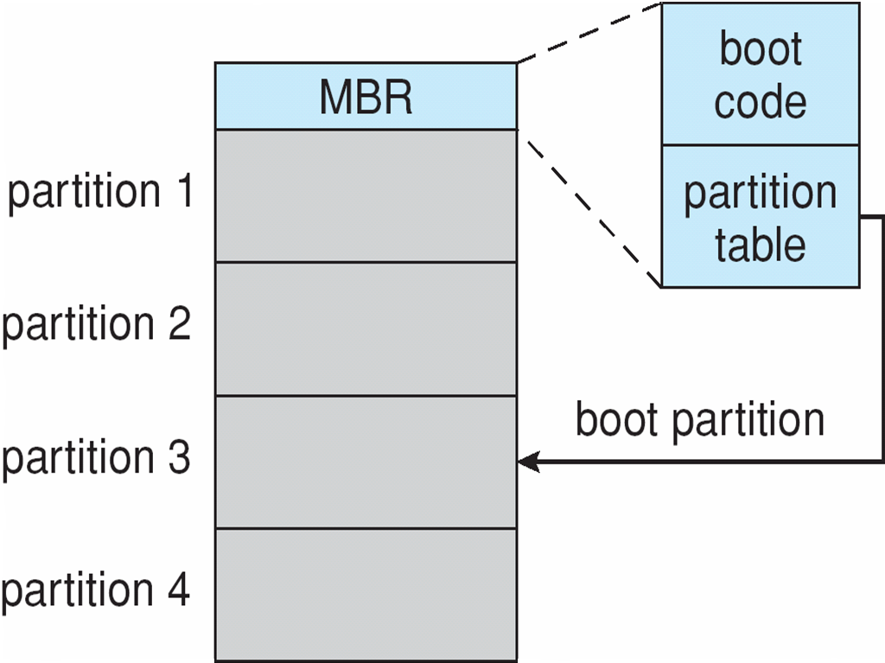
Booting from a Disk in Windows

Slide 48
Swap-Space Management
Swap-space — Virtual memory uses disk space as an extension of main memory
  Less common now due to memory capacity increases
Swap-space can be carved out of the normal file system, or, more commonly, it can be in a separate disk partition (raw)
Swap-space management
  4.3BSD allocates swap space when process starts; holds text segment (the program) and data segment
  Kernel uses swap maps to track swap-space use
  Solaris 2 allocates swap space only when a dirty page is forced out of physical memory, not when the virtual memory page is first created
    File data written to swap space until write to file system requested
    Other dirty pages go to swap space due to no other home
    Text segment pages thrown out and reread from the file system as needed
What if a system runs out of swap space?
Some systems allow multiple swap spaces

Slide 49
RAID Structure
RAID – redundant array of inexpensive disks
  multiple disk drives provides reliability via redundancy
Increases the mean time to failure
Mean time to repair – exposure time when another failure could cause data loss
Mean time to data loss based on above factors
If mirrored disks fail independently, consider disk with 100,000 mean time to failure and 10 hour mean time to repair
  Mean time to data loss is 100, 000² / (2 ∗ 10) = 500 ∗ 10⁶ hours, or 57,000 years!
Frequently combined with NVRAM to improve write performance
Several improvements in disk-use techniques involve the use of multiple disks working cooperatively

Slide 50
RAID (Cont.)
Disk striping uses a group of disks as one storage unit
RAID is arranged into six different levels
RAID schemes improve performance and improve the reliability of the storage system by storing redundant data
  Mirroring or shadowing (RAID 1) keeps duplicate of each disk
  Striped mirrors (RAID 1+0) or mirrored stripes (RAID 0+1) provides high performance and high reliability
  Block interleaved parity (RAID 4, 5, 6) uses much less redundancy
RAID within a storage array can still fail if the array fails, so automatic replication of the data between arrays is common
Frequently, a small number of hot-spare disks are left unallocated, automatically replacing a failed disk and having data rebuilt onto them

Slide 51
RAID Levels

Slide 52
RAID (0 + 1) and (1 + 0)

Slide 53
Other Features
Regardless of where RAID implemented, other useful features can be added
Snapshot is a view of file system before a set of changes take place (i.e. at a point in time)
  More in Ch 12
Replication is automatic duplication of writes between separate sites
  For redundancy and disaster recovery
  Can be synchronous or asynchronous
Hot spare disk is unused, automatically used by RAID production if a disk fails to replace the failed disk and rebuild the RAID set if possible
  Decreases mean time to repair

Slide 54
Extensions
RAID alone does not prevent or detect data corruption or other errors, just disk failures
Solaris ZFS adds checksums of all data and metadata
Checksums kept with pointer to object, to detect if object is the right one and whether it changed
Can detect and correct data and metadata corruption
ZFS also removes volumes, partitions
  Disks allocated in pools
  Filesystems with a pool share that pool, use and release space like malloc() and free() memory allocate / release calls

Slide 55
ZFS Checksums All Metadata and Data

Slide 56
Traditional and Pooled Storage

Slide 57
Stable-Storage Implementation
Write-ahead log scheme requires stable storage
Stable storage means data is never lost (due to failure, etc.)
To implement stable storage:
  Replicate information on more than one nonvolatile storage media with independent failure modes
  Update information in a controlled manner to ensure that we can recover the stable data after any failure during data transfer or recovery
Disk write has 1 of 3 outcomes
  Successful completion - The data were written correctly on disk
  Partial failure - A failure occurred in the midst of transfer, so only some of the sectors were written with the new data, and the sector being written during the failure may have been corrupted
  Total failure - The failure occurred before the disk write started, so the previous data values on the disk remain intact

Slide 58
Stable-Storage Implementation (Cont.)
If failure occurs during block write, recovery procedure restores block to consistent state
  System maintains 2 physical blocks per logical block and does the following:
    Write to 1st physical
    When successful, write to 2nd physical
    Declare complete only after second write completes successfully
  Systems frequently use NVRAM as one physical to accelerate

